Slide 1
Secure PV Access Project Overview
Greg White
EPICS Collaboration Meeting
September 2024.

Slide 2
How Beam Tuning by Machine Learning, Multi-particle modeling, and Big Data are Driving Accelerator Network Architecture and Cyber Security
Greg White, Auralee Edelen, SLAC
Prepared for EPICS Collaboration Meeting
September 2024.
Work of A. Edelen, R. Roussel, C. Mayes, D. Ratner, C. Emma, S. Miskovich, J. Garrahan, C. Xu, W. Neiswanger, H. Slepicka, J. Duris, A. Hanuka, N. Neveu, L. Gupta, E. Cropp, P. Musumeci, A. Mishra, Z. Zhang, J.P. Gonzalez-Aguilera, S. Kim, J. Power, E.Wisniewski, A. Lutman;
J. Garrahan, J. Bellister;
Amedeo Perazzo, Ken Brobeck, Daron Chabot, Mike Zelazny, Debbie Rogind, Lance Nakata;
Erwin Lopez, Mark McCullough (SLAC IT Cyber)
B. Dalesio, M. Davidsaver, G. McIntyre, Bruno Martins, (Osprey DCS), K. Kasemir (ORNL), M. Sekoranja (CosyLab).
Many Thanks to Dale Dale Hugo Leschnitzer, Mark Hahnert (US Dept of Energy, Office of Science)
David Manz (PNNL), Jozsef Gacsal (SecurityLit), Jason Carter (ORNL), Ralph Lange (ITER),
EPICS 7 Development Team, and many others.

Slide 3
Talk Outline. Accelerator Computing and Controls Revolution
Premise: Online Beam Tuning is revolutionizing: Linear numerical methods, precomputed linear or 2nd order model → non-linear, multi-particle model based, ML and multiparametric methods.
⇒ 𝚫 Scope: Controls += Accelerator Optimization + Big Data
⇒ 𝚫 Network: Controls += High-Performance Computing
⇒ 𝚫 Security: EPICS += Transport Layer Security. Secure High-Performance Computing
Experiences of Cyber Review. Cyber Penetration Testing. Cyber Regulatory Framework

Slide 4
Talk Outline. Accelerator Computing and Controls Revolution
Premise: Online Beam Tuning is revolutionizing: Linear numerical methods, precomputed linear or 2nd order model → non-linear, multi-particle model based, ML and multiparametric methods.
⇒ 𝚫 Scope: Controls += Accelerator Optimization + Big Data
⇒ 𝚫 Network: Controls += High-Performance Computing
⇒ 𝚫 Security: EPICS += Transport Layer Security. Secure High-Performance Computing
Experiences of Cyber Review. Cyber Penetration Testing. Cyber Regulatory Framework

Slide 5
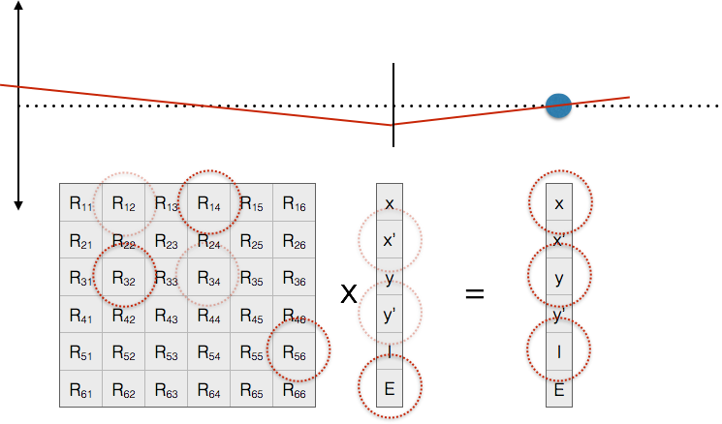
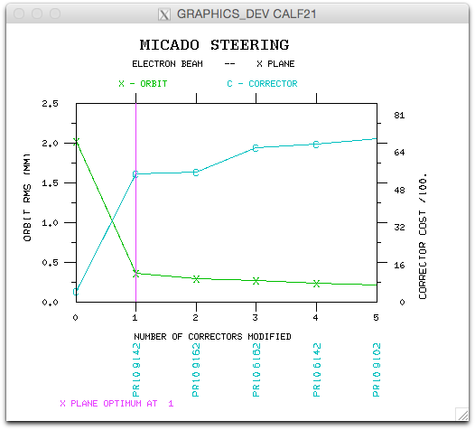
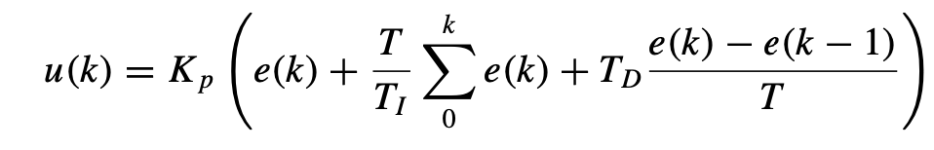

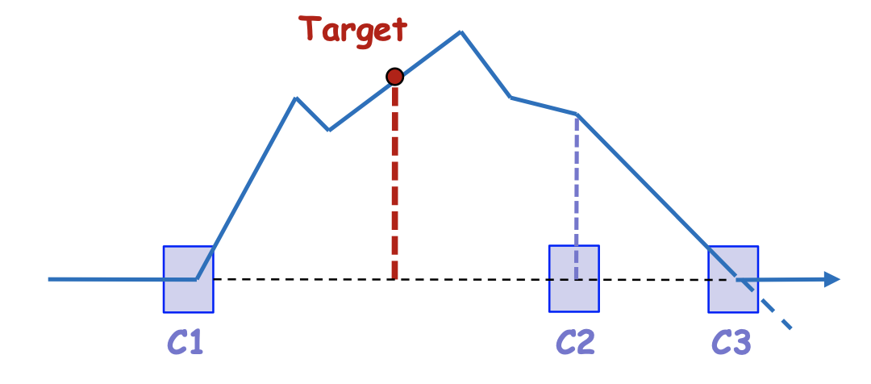
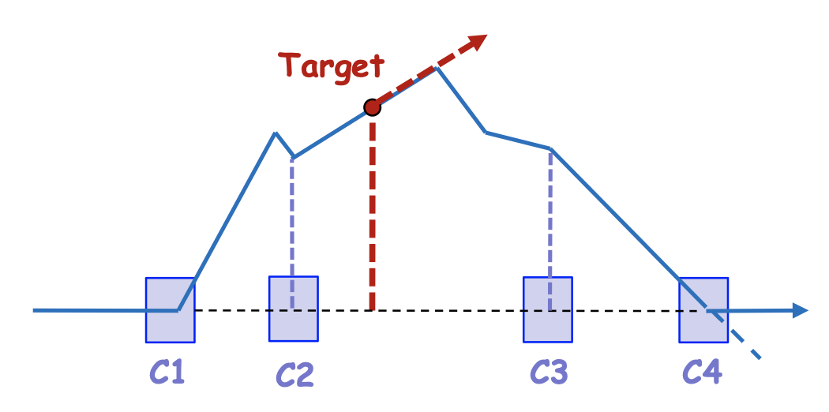
Classical Beam Tuning
“The orbit correction problem”
MICADO (90’s)
Feedbacks. PID Control
A corrector
x
b
A BPM
Transverse
beam offset
(x or y)
“Modern Control Theory”
Bumps (eg “3” and “4” bumps)
Micado, B. Autin and Y. Marti (CERN)
Singular Value Decomposition
SVD. E. Beltrami, C. Jordan. G. Gobub (computation)
Thank you J. Wenninger, CERN
Methods largely based on 3 assumptions 1) that you know a priori basically the relation between actuators and sensors – the linear (plus some 2nd order) online “model”, 2) That optimizing the orbit RMS, or timing, will optimize the true objective – minimize emittance or maximize luminosity, 3) Direct tuning 6D phase space was out of reach.
Notes:
All methods based on the assumption that you know a priori basically the relation between actuators and sensors – at least roughly. And that has been computed or verified by some model. The model may have been, occasionally, empirically verified- but not often because that’s usually invasive – done as a machine development rather than continuously, and by scanning actuators and taking measurements. Model computation (lattice design) is offline. Model use (B->K) is online. Model verification is online and invasive.
Bumps can be used for local region orbit correction, small energy tunes (via dispersion), fix gradient errors, cancelling dispersion in wakefiled, even tuning for polarization.

Slide 6
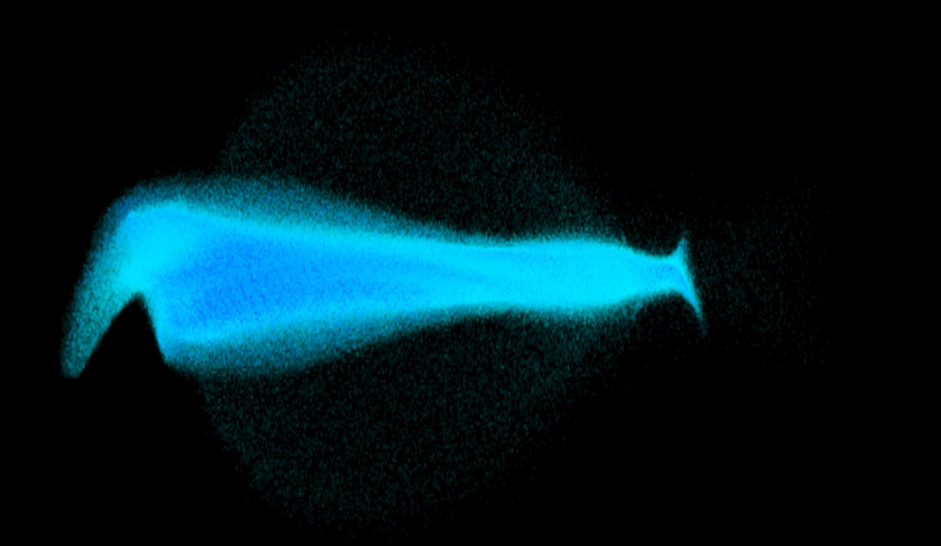
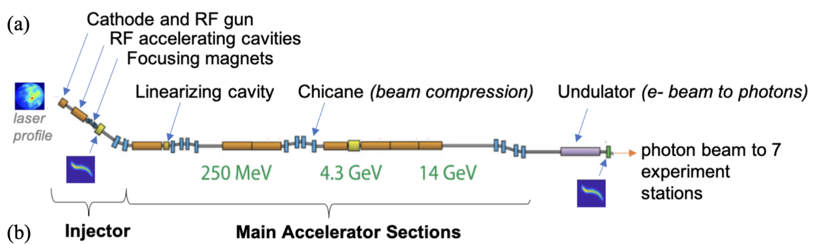
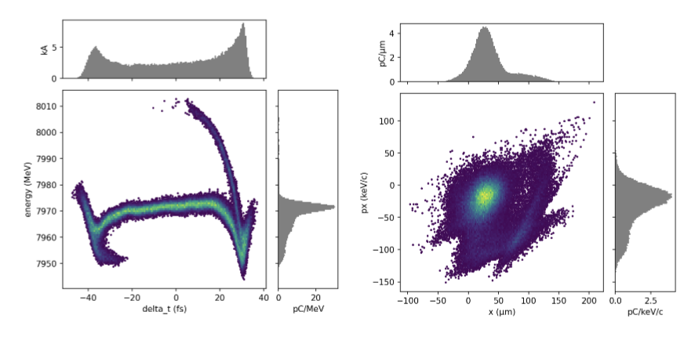
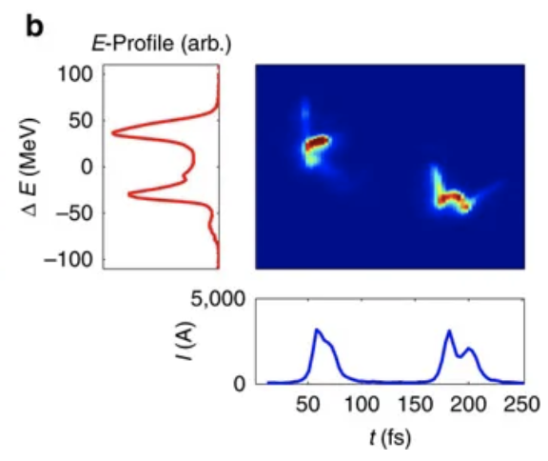
Tuning problems now at accelerators require detailed phase space customization for different experiments
Increasingly this requirement is for immediate beam diagnostics and optimization
Beam exists in 6-D position-momentum phase space
Have incomplete information: measure 2-D projections or reconstruct based on perturbations of upstream controls (e.g. tomography, quad scans)
Have dozens-to-hundreds of controllable variables and hundreds-of-thousands (up to millions for LCLS-II) to monitor
Energy (MeV)
Nonlinear, high-dimensional optimization problem
Time (fs)
Auralee Edelen, et al
A. Marinelli, et al., Nat. Commun. 6, 6369 (2015)
A. Marinelli, IPAC’18
Notes:
But now, many problems need real phase space understanding.
Time – energy spectrograph of beam at target
Two bunch from one pulse
Beam Customization = invertible.

Slide 7
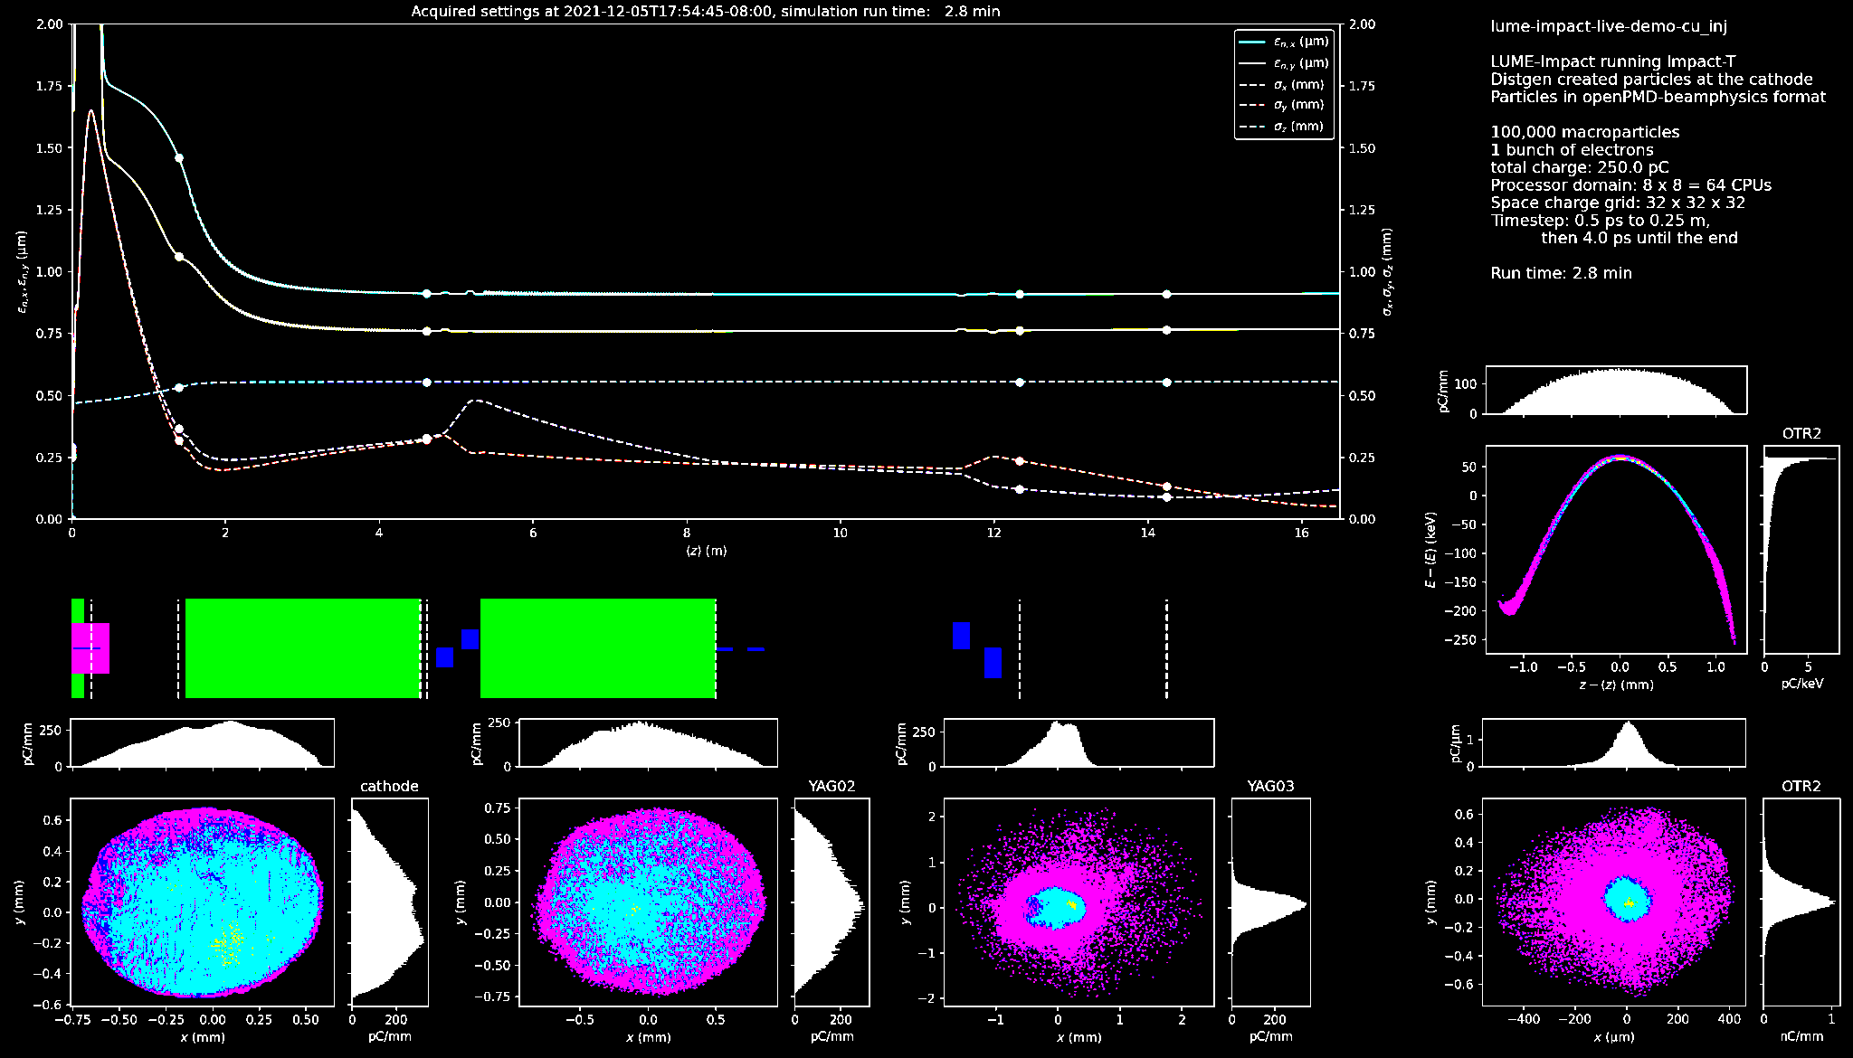
Spectrum of Tuning approaches leverage different amounts of data / previous knowledge
→ suitable under different circumstances
less
assumed knowledge of machine
more
Model-Free
Optimization
Model-guided Optimization
Global Modeling +
Feed-forward Corrections
J. Kirschner
Observe performance change after a setting adjustment
→ estimate direction or apply heuristics toward improvement
Update a model at each step
→ use model to help select the next point
Make fast system model
→ provide initial guess (i.e. warm start) for settings or fast compensation
gradient descent
simplex
ES
Bayesian optimization
reinforcement learning
ML system models +
inverse models
General strategy: start with sample-efficient methods that do well on new systems, then build up to more data-intensive and heavily model-informed approaches.
Auralee Edelen, et al

Slide 8
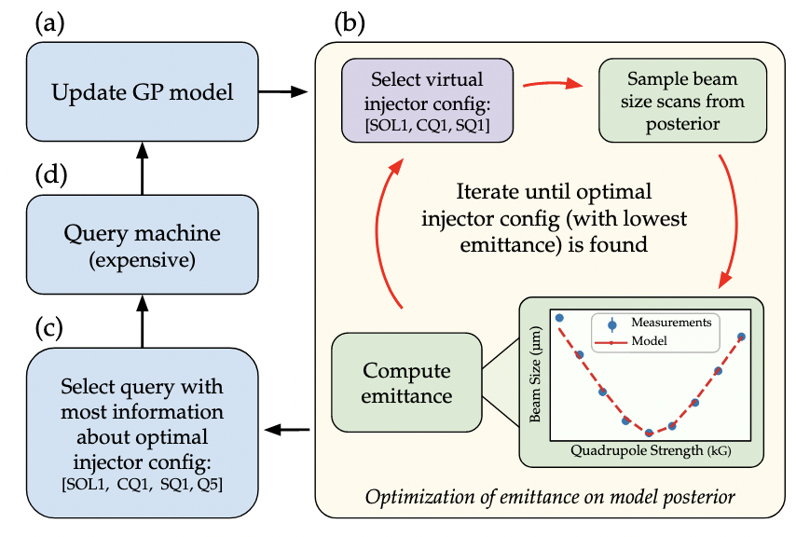
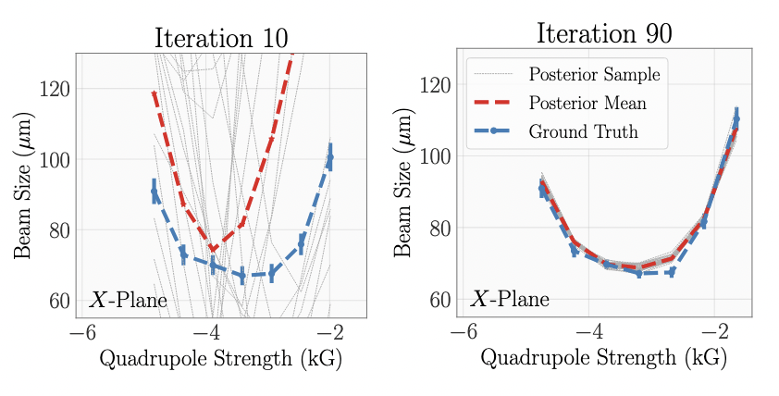
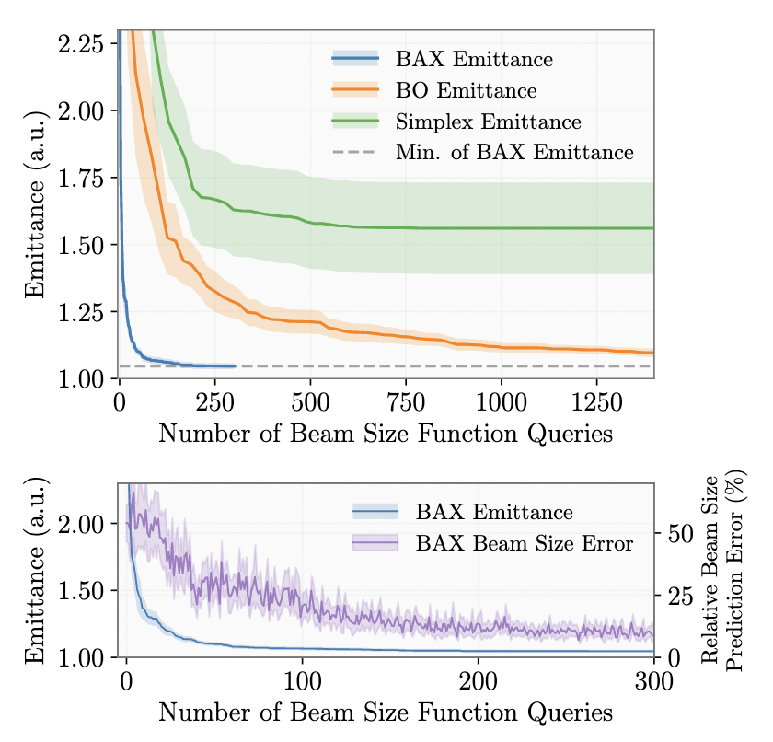
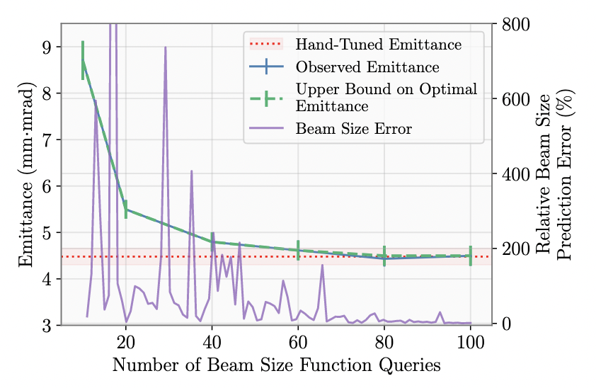
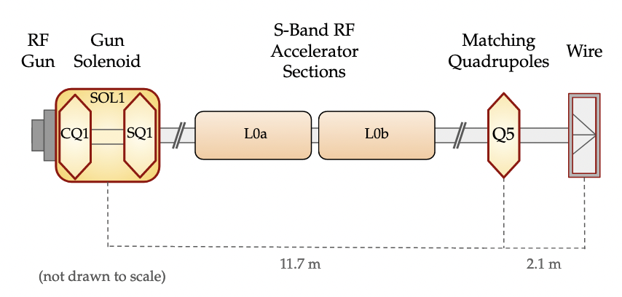
Efficient Emittance Optimization with Partial Measurements
Instead of tuning on costly emittance measurements directly, learn a fast-executing model online for beam size while optimizing → learn on direct observables (e.g. beam size); do inferred “measurements” (e.g. emittance)
New algorithmic paradigm leveraging “Bayesian Algorithm Execution” (BAX) for 20x speedup in tuning
simulation
Convergence of beam size prediction error gives practical indicator of optimization convergence (no need to do direct emittance measurement until the end)
model is learned
on-the-fly
Found equivalent quality to hand-tuning in about 70 iterations (estimate this would take a few minutes with computationally optimized routine)
experiment
https://arxiv.org/abs/2209.04587
Paradigm shift in how tuning on indirectly computed beam measurements (such as emittance) is done, with 20x improvement over standard method for emittance tuning. → Now working to integrate into operations.
Also now working to incorporate more informative global models /priors rather than learning the model from scratch each time.
Notes:
Iteratively refine your understanding of quad settings on emittance.

Slide 9
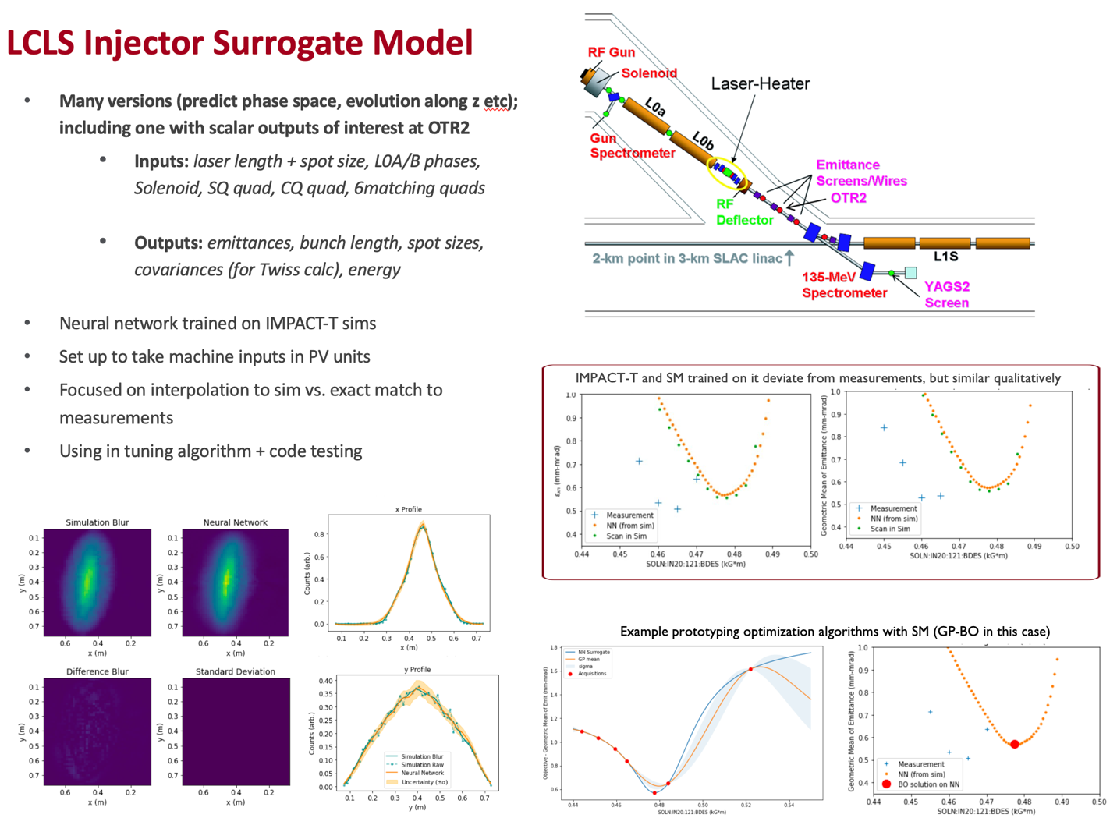
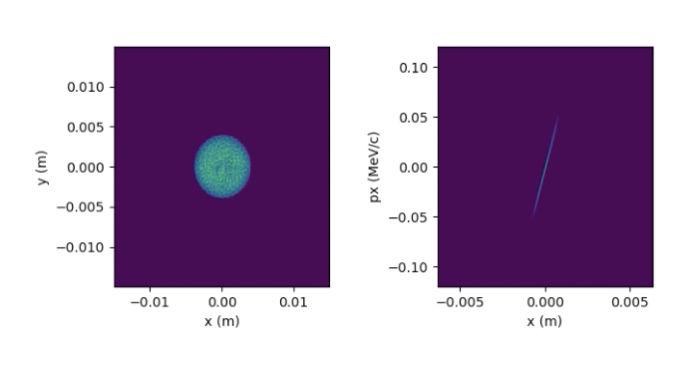
In Regular Use: Injector Surrogate Model at LCLS
ML models trained on detailed physics simulations with nonlinear collective effects
Accurate over a wide range of settings → calibrate to match machine measurements
Used to develop/prototype new algorithms before testing online
(e.g. BAX w/ 20x speedup in emittance tuning https://arxiv.org/abs/2209.04587)
Will provide initial Twiss parameters for downstream online model for optics matching
Working on integrating model information to further speed up optimization algorithms
prototyping optimization
algorithms
ML model matches simulation under interpolation
Simulation and ML model trained on it are qualitatively similar to measurements under interpolation (setting combinations reasonable distance from training set)
interactive model widget and visualization tools
  Automatic adaptation of models and identification of sources of deviation between simulations and as-built machine
ML models trained on simulations and measurements have enabled fast prototyping of new optimization algorithms, facilitated rapid model adaptation under new conditions, and can directly aid online tuning and operator decision making

Slide 10
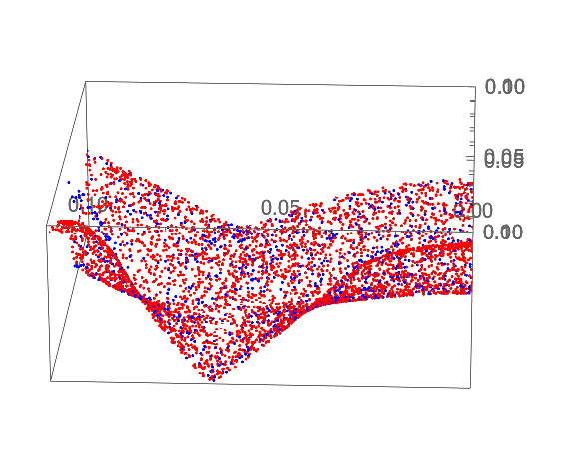
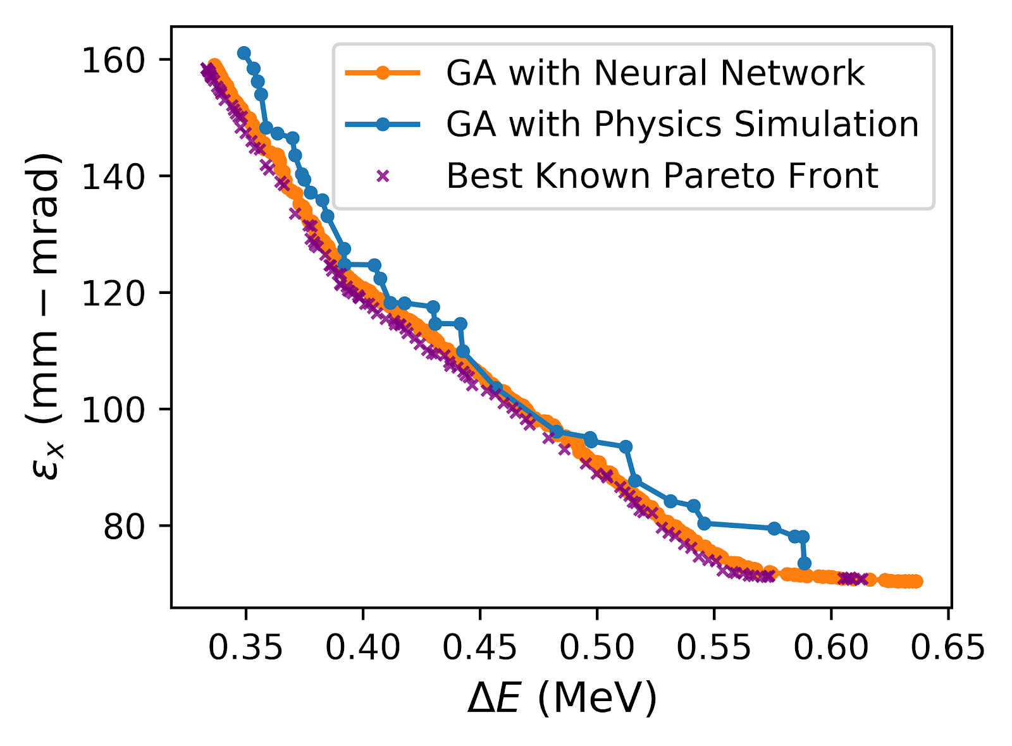
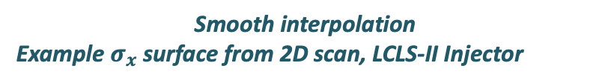
Smooth interpolation
Example $σ_{x}$ surface from 2D scan, LCLS-II Injector
Warm starts for optimization
A. Scheinker, A. Edelen,
et al, PRL, 2018
A. Edelen et al., NeurIPS 2019
Physics Sim:
~95k core hrs, 131k sims
2246 cores, 36 hours
Neural Network:
~2 mins on a laptop
(500 sims for training)
A. Edelen
et al., PRAB, 2020
Surrogate-boosted design optimization
Auralee Edelen, et al

Slide 11
Talk Outline. Accelerator Computing and Controls Revolution
Premise: Online Beam Tuning is revolutionizing: Linear numerical methods, precomputed linear or 2nd order model → non-linear, multi-particle model based, ML and multiparametric methods.
⇒ 𝚫 Scope: Controls += Accelerator Optimization + Big Data
⇒ 𝚫 Network: Controls += High-Performance Computing
⇒ 𝚫 Security: EPICS += Transport Layer Security. Secure High-Performance Computing
Experiences of Cyber Review. Cyber Penetration Testing. Cyber Regulatory Framework

Slide 12
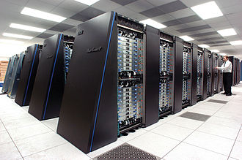

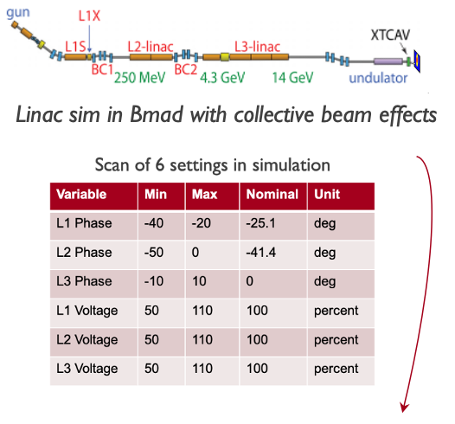
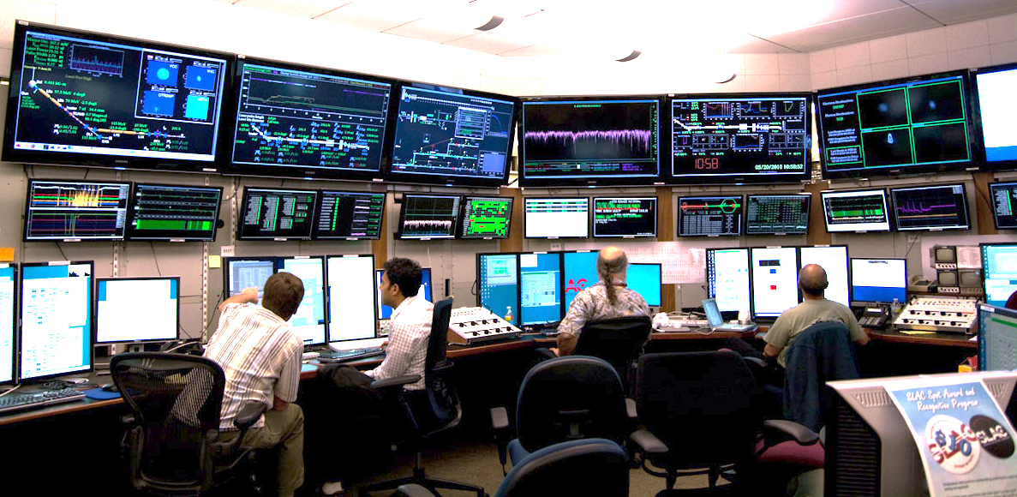
Very Fast, Accurate System Models, from HPC, drive beam control
Simulation on High Performance Computing used in online control system
Machine Learning
Multi-particle simulation
Control prototyping
Experiment planning
Online prediction
Model-based control
Online modeling in High Performace Computing, enables accurate predictions of system responses with unprecedented speeds, opening up new avenues for high-fidelity online prediction, tracking of machine behavior, and model-based control
Notes:
NOTE the direction of inputs and outputs is two-way from HPC to control system

Slide 13
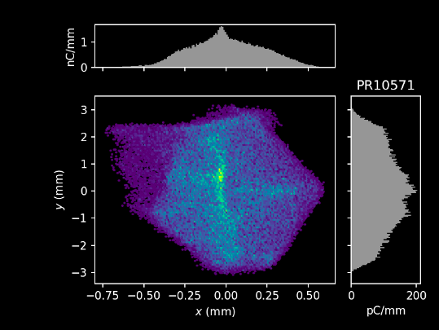
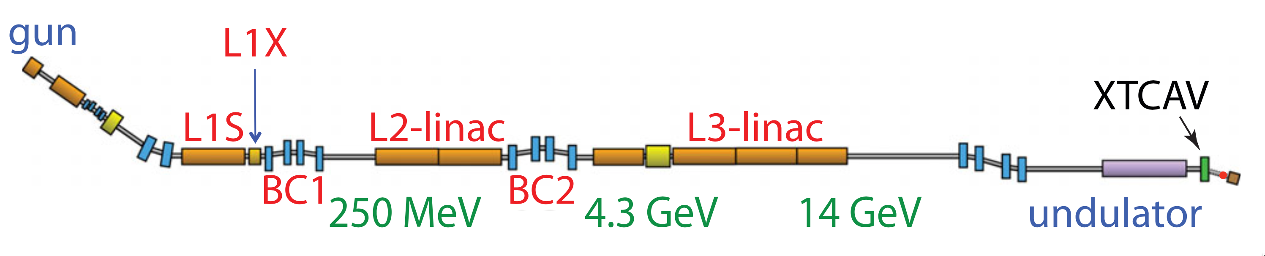

Goal: Multi-modal HPC Modeling Facility. Full Integration of AI/ML Optimization, Data-Driven Modeling, and Physics Simulations, working in a machine-agnostic ecosystem for online simulation, but delivering fast model RESULTS - PV settings - to running accelerators (!)
Cluster Compute
(CPU,GPU)
C. Mayes
Making good progress toward this vision with open-source, modular software tools

Slide 14
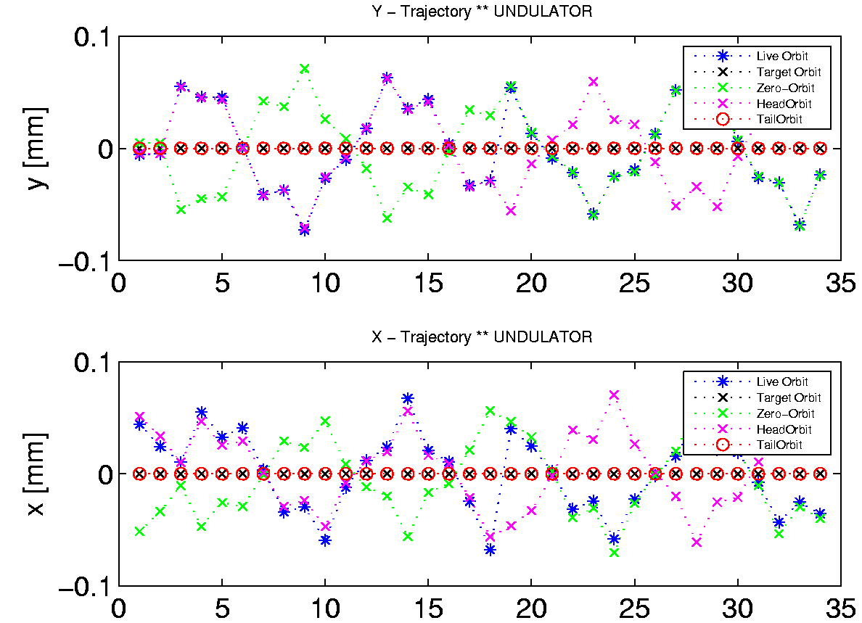
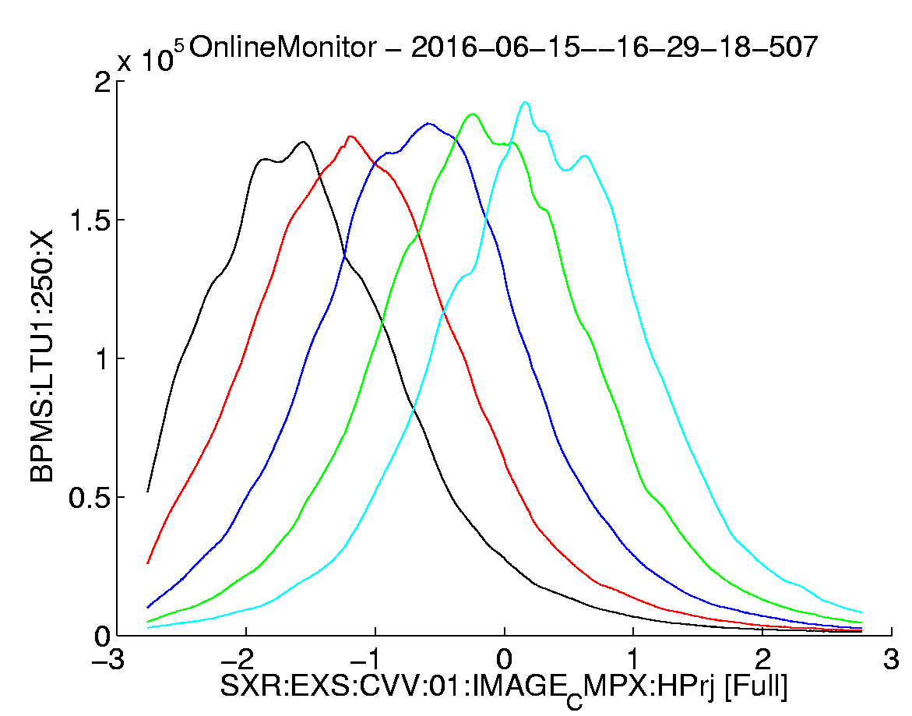
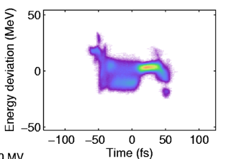
Beam Synchronous Data – and Event building
Alberto Lutman, SLAC
Objective: Build a model and inverse problem for energy spectra tuning. Support Regression Analysis and ML, and event build for FEL tuning
Problem: Assemble pulse synchronous data & machine meta data. Complex, incomplete.
  In Accelerator – Beam Synchronous Acquisition system (BSA).
  In Experimental support controls, Beam Line Data System (BLD).
Requirement: Save all Beam Synchronous Data (eg monitors), on every pulse, continuously!
Controls and Data Systems Requirement: Fast transfer ALL pulse identified data, as atomic structures of the measured data and their “meta-data” for analysis, experiment tuning, and ML , accessible both immediately, and from archive (!)

Slide 15
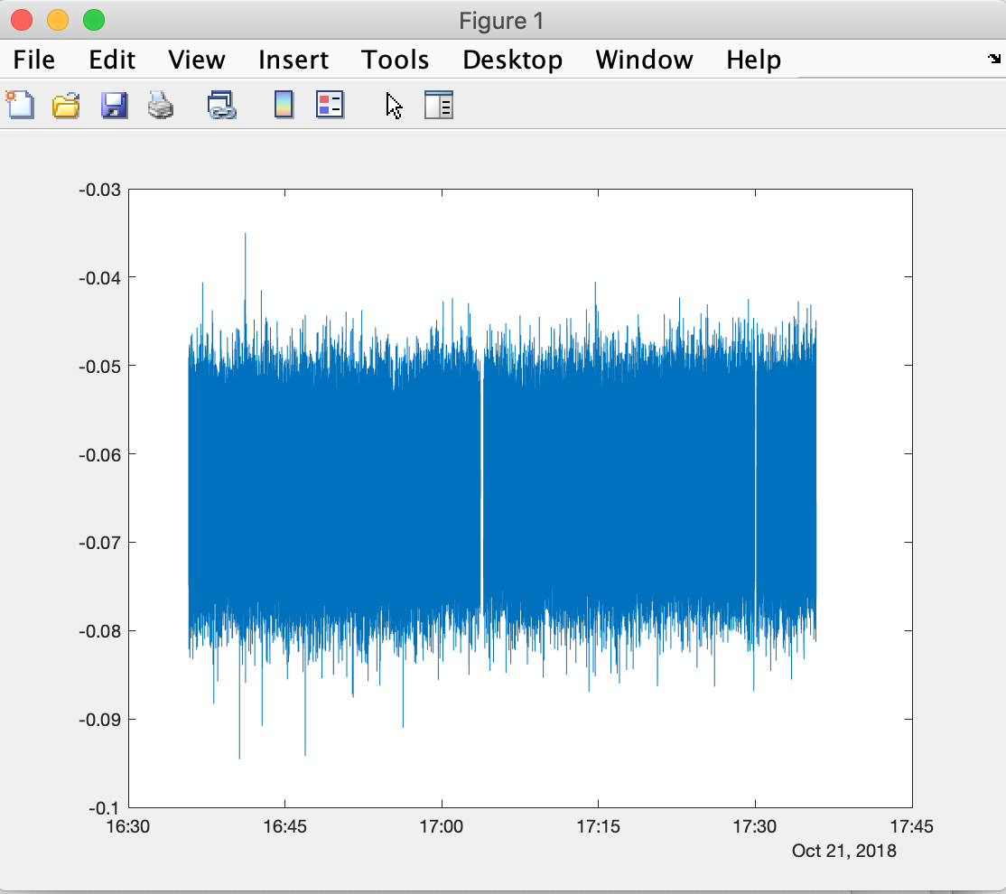
“All the [beam] data, all the time” at SLAC’s LCLS
Figure: Accelerator Event Building Service collects all bunch-by-bunch data, lines up by bunch ID, tags with accelerator meta data, stream to clients, and archives for Machine Learning and diagnostics. ~800 TB/yr
Physics Software Apps (HLAs)
Displays (pyDM)
SRF diagnostics
Regression Analysis & ML
1 EPICS 7 NTTable PV of all Beam Synchronous BSA PVs in beampath, for every pulse <= 1 kHz. Statistics for pulse rates > 1 kHz.
BSA Service listens to ALL Beam Synchronous PVs collates and publishes. Impl in p4p.
PVA
EPICS 7 p4p
EPICS 7 p4p
PVA
Pulse Synchronous Data Archive
BSA Event Building Service Collector
BSA Service PVA Writer
PVA
CA
All ~3000 PVs 1 kHz
single pulse data
1 MHz aggregate
LCLS-II SC
Beam Synchronous Acquisition
LCLS-I Cu
Beam Synchronous Acquisition (BSA)
(Complete)
All ~3000 PVs 120 Hz
single pulse data
EPICS 7 IOCs
EPICS 3 IOCs
>> load('~/Development/bsd/CU_HXR_20181022_003549.h5','-mat’);
>> % Make a single vector of real seconds POSIX time, and convert to local time
>> ts=double(secondsPastEpoch)+double(nanoseconds)*1e-9;
>> t=datetime(ts,'ConvertFrom','posixtime','TimeZone','America/Los_Angeles’);
>> % E.g. Plot every pulse at one BPM PV over the hour
>> plot(t,BPMS_IN20_525_X);
15
https://www.slac.stanford.edu/grp/ad/docs/model/matlab/bsd.html, M. Davidsaver, B. Martins, D. Murray, G. White

Slide 16
EPICS 7 network performance (pvAccess)
Performance and Reliability
Comparison of new data protocol included in EPICS 7 compared to EPICS 3
pvAccess is significantly faster than EPICS 3 at big data. CA is faster at many small ops in parallel.
Use Cases Indication: Use pvAccess for machine beam synchronous accelerator data, experimental data, camera data, structured data or data & metadata. Maybe use CA for very full synoptic displays and compatibility with legacy display mgr.
Matej Sekoranja, Cosylab
Notes:
So, as you can see, for many parallel gets, of small data object sizes (like scalar), CA is faster than PvAccess.
But for larger datasizes, like images, and modern beam data, PvAccess is faster. Much faster in the sequential case – eg camera acq, RPC.

Slide 17
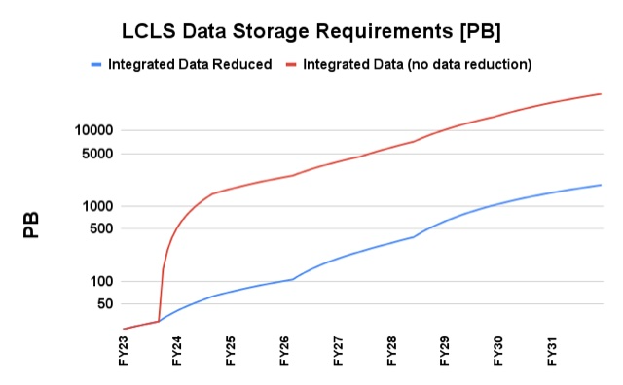
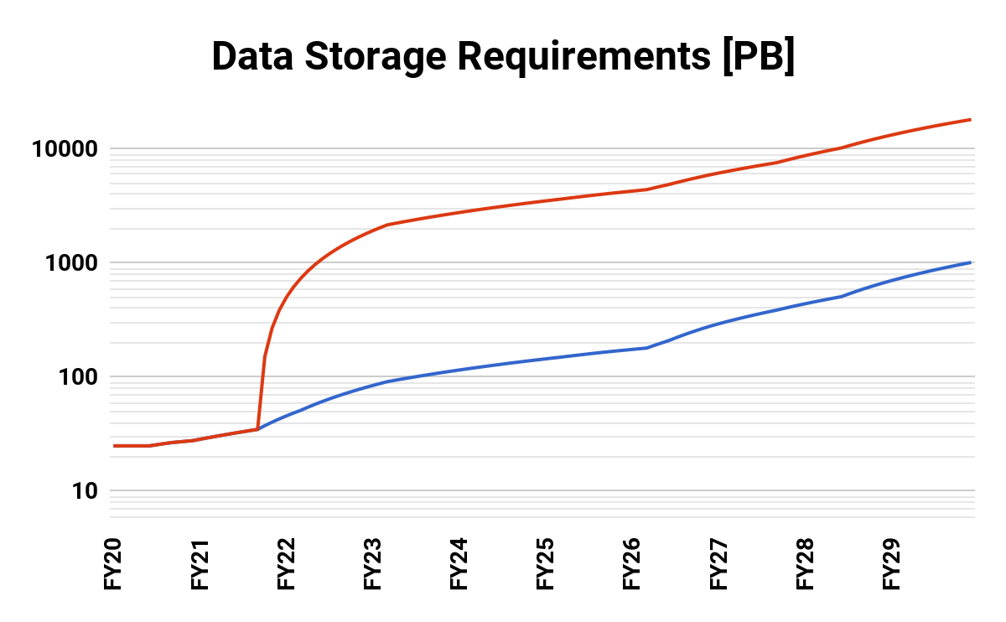
Data will drive analytics. Both data generated and storage requirement are set to grow enormously
1 TB/s
Detector Output
250 GB/s
Processed Data
LCLS Accelerator Data
LCLS Experiment Data
G. White, D. Murray
Jana Thayer, LCLS
Optimistic: Assumes continuous 24/7 data recording and file format does include data summary tuple for characterizing data >1 kHz. At end of years.
Data roll-up DOES NOT Include LCLS-HE assumed coming after 2026
Data roll-up DOES NOT include Camera image data
Accelerator data storage size will be large for us, but small compared to LCLS experiment (1 PB << 1000 PB)
Notes:
BSAS 800 TB per year.

Slide 18
Talk Outline. Accelerator Computing and Controls Revolution
Premise: Online Beam Tuning is revolutionizing: Linear numerical methods, precomputed linear or 2nd order model → non-linear, multi-particle model based, ML and multiparametric methods.
⇒ 𝚫 Scope: Controls += Accelerator Optimization + Big Data
⇒ 𝚫 Network: Controls += High-Performance Computing
⇒ 𝚫 Security: EPICS += Transport Layer Security. Secure High-Performance Computing
Experiences of Cyber Review. Cyber Penetration Testing. Cyber Regulatory Framework

Slide 19
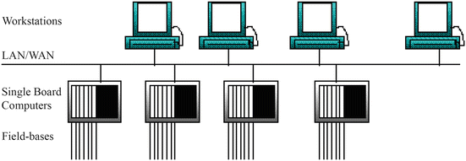
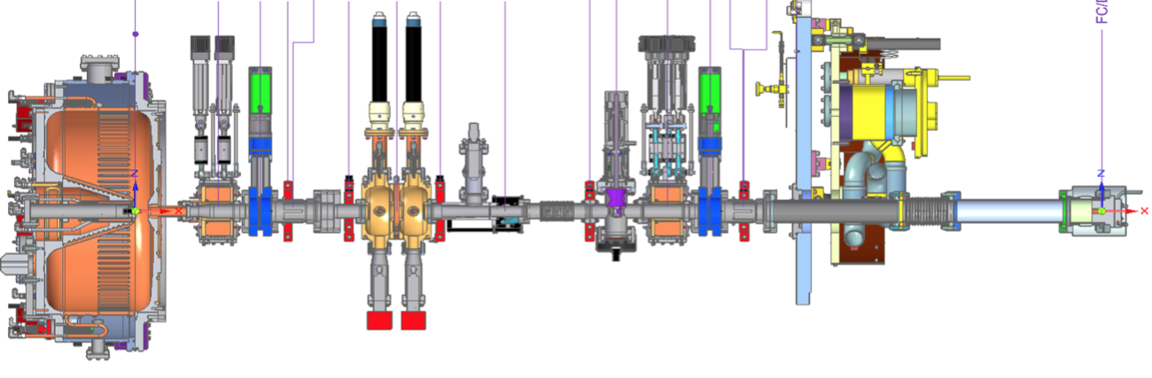
A Distributed Control System + EPICS Cyber Schematic
Classically, usual Policy = ALL machine settable process variables MUST ONLY be set from the production network – as an implementation of the cyber policy that only authorized personnel or authorized machines may write PVs. That is, accelerator cyber sec is implemented as a sequestered network.
Control Network. EPICS (CA and/or PVA) in most DOE labs. Others include ACNET, TANGO, SLCMSG etc. EPICS has Authorization but no intrinsic Authentication.
⇒ Server can’t be sure who made a control request. Client can’t be sure data came from a given device.
Field Buses;
Allen-Bradley, VME, CAMAC
Input Output Controllers (IOCs). Pseudo real-time dataflow databases and device drivers, maybe also real-time PLC or FPGA. Essentially no authentication nor authorization. No software signing.
⇒ Can’t be sure the computer code you think is running your accelerator is in fact running your accelerator.
Glossary. “AAA”:
Authentication: Establish you are who you say you are
Authorization: What set of things are you allowed to do once authenticated
Audit: Keeping track of what you did.
Borrowing from M. Thuot 1996.

Slide 20


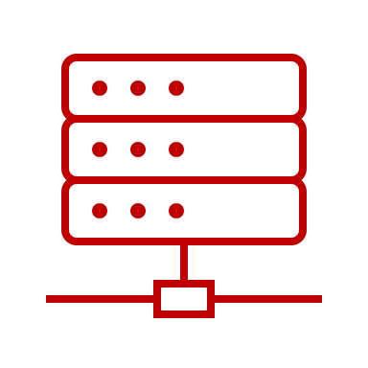
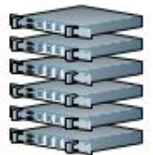


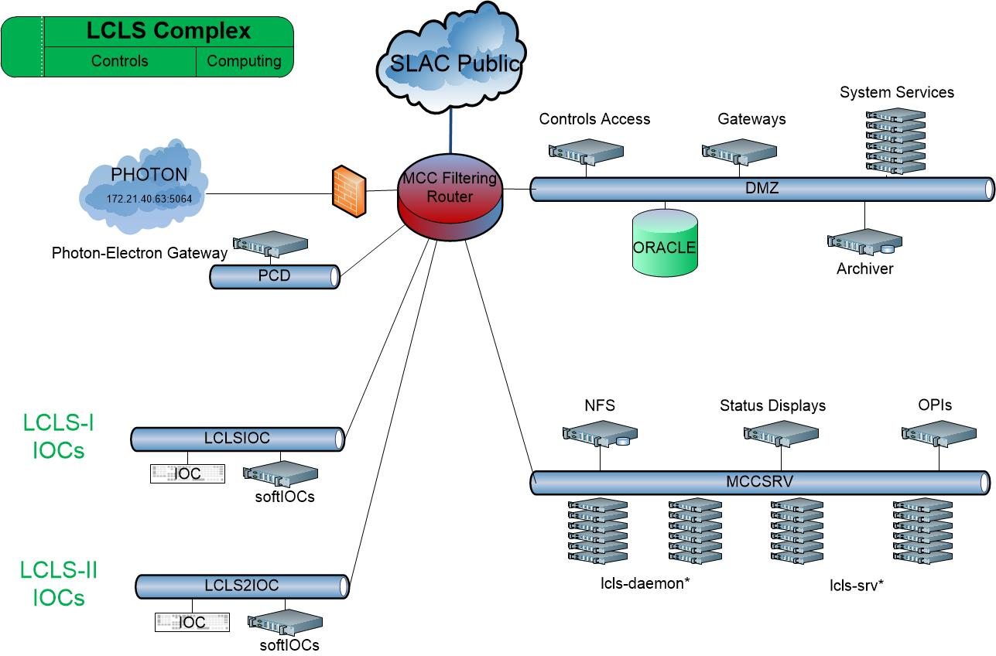
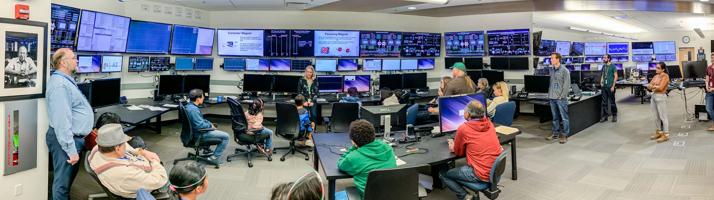
Present Typical Accelerator Computing Architecture
(LCLS complex at SLAC)
Big Data stores
High Performance Computing Network
Experiment Data Analysis
Office Network
Science Data Facility
SLAC Network
SDF Disk
SDF Disk
Accelerator Physics Analysis
Documents, Engineering Drawings
Oracle, People-soft etc
Multi-particle Tracking (s-2-e)
Machine Learning Training
Data Systems Analysis Network
Experiment Network
Non-critical Data Services
Simulation
Software development
Controls Network
Production Services and Control Room Network
Control room displays
High Level Apps execution
Online modeling
Critical Data Services
Optimization, ML and slow feedback
EPICS Input Output Controllers (IOCs) - 100s
Accelerator devices - 1000s. Producing control and diagnostics signals (Process Variables) - > 8 million at LCLS

Slide 21
Present Typical Accelerator Computing Architecture
(LCLS complex at SLAC)
Big Data stores
High Performance Computing Network
Experiment Data Analysis
Office Network
Science Data Facility
SLAC Network
SDF Disk
SDF Disk
Accelerator Physics Analysis
Documents, Engineering Drawings
Oracle, People-soft etc
Multi-particle Tracking (s-2-e)
Machine Learning Training
Data Systems Analysis Network
Experiment Network
Non-critical Data Services
Simulation
Software development
Controls Network
Production Services and Control Room Network
Control room displays
High Level Apps execution
Online modeling
Critical Data Services
Optimization, ML and slow feedback
EPICS Input Output Controllers (IOCs) - 100s
Accelerator devices - 1000s. Producing control and diagnostics signals (Process Variables) - > 8 million at LCLS

Slide 22
In progress Accelerator Computing Architecture
Multi-modal modelling systems added to High Performance Computing
Big Data stores
Experiment Data Analysis
Accelerator Physics Analysis
Multi-particle Tracking (s-2-e)
Machine Learning Training
Acting on Multi-particle results -> PV write
Machine Learning Inference -> PV write (Hmmm, problematic!)
High Performance Computing Network
Office Network
Science Data Facility
SLAC Network
SDF Disk
SDF Disk
Documents, Engineering Drawings
Oracle, People-soft etc
Data Systems Analysis Network
Experiment Network
Non-critical Data Services
Software development
Controls Network
Production Services and Control Room Network
Control room displays
High Level Apps execution
Online modeling
Critical Data Services
Optimization, ML and slow feedback
EPICS Input Output Controllers (IOCs) - 100s
Accelerator devices - 1000s. Producing control and diagnostics signals (Process Variables) - > 8 million at LCLS

Slide 23
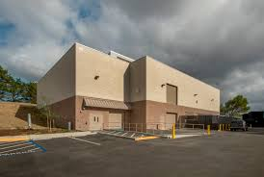
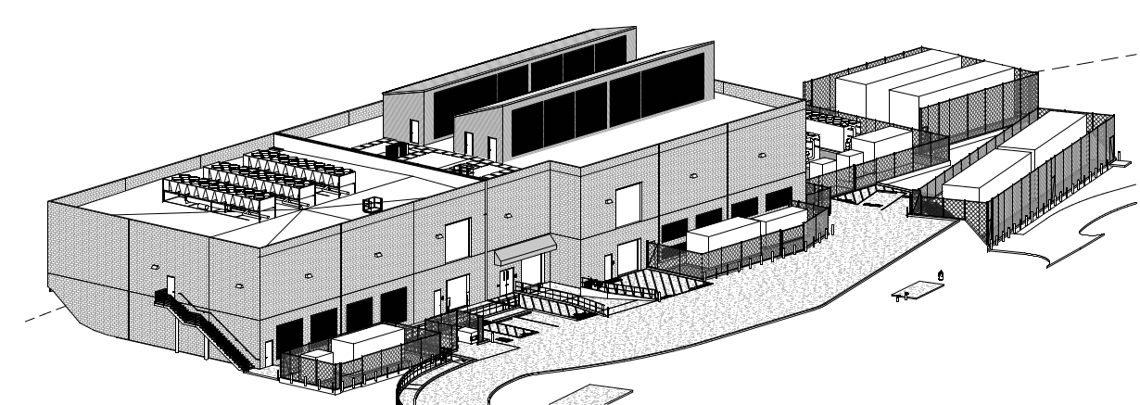
SLAC Shared Science Data Facility (S3DF) and
Stanford Research Computing Facility (SRCF)
S3DF is key for Accelerator Computing in:
  AI/ML + Multi-particle computing
  ”Big Data” – storing Beam Synchronous Archive – “Datastore”
  S3DF’s filesystem “Weka” replaces AFS
  Radiation Physics
S3DF is a compute, storage and network architecture designed to support massive scale analytics
Over the next decade will deploy 2+ and 20+ PFLOPS of CPU and GPU compute, 50 PB of flash-based storage, 500 PB of spindle-based storage and 2.5 exabytes of archiving capabilities
Beneficial occupancy of the second module of the Stanford Research Computing Facility (SRCF-II) expected for late-Oct
Combined facility to offer 6 megawatts of power and host 360 racks
S3DF will eventually occupy roughly ⅓ of SRCF I + II
A. Perazzo*, A. (Yemi) Adesanya, L. Nakata, Y. L. Ting, https://s3df.slac.stanford.edu

Slide 24
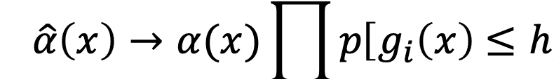
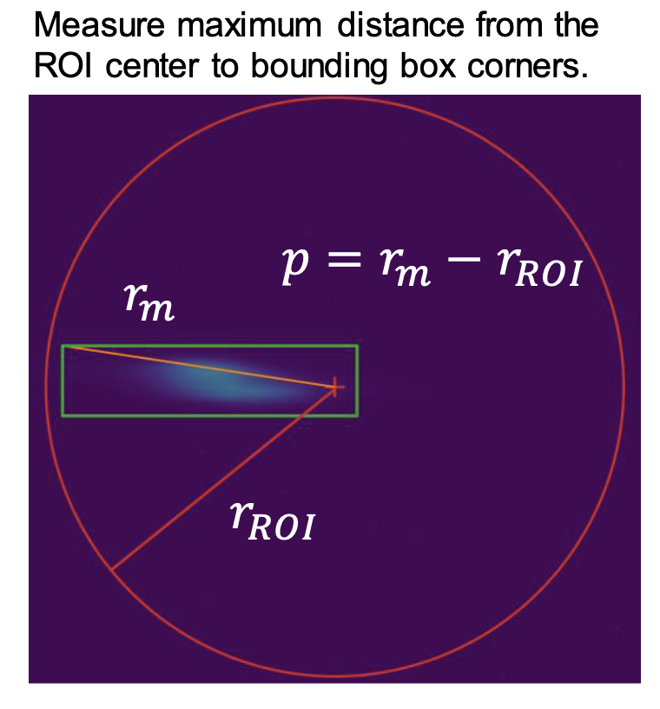
Requirement: ML / AI solution must include Machine Safety and Beam Operational Requirements!
SVD/LLS methods incorporate parameter constraints.
E.g. “Constrained SVD”
Emerging ML methods.
Set input bounds for settings that can't be violated
Use learned output constraints
Set a max step size if desired to avoid making large jumps
SVD. E. Beltrami, C. Jordan. G. Gobub (computation)
Weigh the acquisition function by the probability the constraint
Is satisfied.
R. Roussel
Bayesian optimization (e.g. GPs, but any with an uncertainty estimate) we can also model the probability of a constraint violation (such as losing the beam off a screen).
Constrained SVD, G. White, T. Himel, G. Golub
Notes:
set input bounds usually informed by ops or a reasonable historical range, rather than the EPICS max/mins.
(more detail below), learned output constraints so that the algorithm learns to avoid settings that lead to constraint violations
large jumps in settings; this can interfere with finding an optimum as efficiently, but it is a tradeoff

Slide 25
Secure Model Tuning Solution (PVs values)
Implementation(*) Requirements
A secure online Optimal Control process (i.e. model) in a super-compute cluster:
MUST guarantee that the PV(s) settings not dangerous to the machine. E.g. large machine model making recommendation on large set of heterogenous PVs. At least minimize subject to constraints. Ideally, something like LCLS Guardian or SLC Paranoia also.
MUST be protocol secure. Computed recommendation for a machine PV value deployed into the accelerator without risk that PV’s value has been trivially hacked - compromised by a malign actor. E.g. someone on HPC just writes to an objective PV, that then is reflected into the accelerator
MUST/SHOULD guarantee code secure. That the PV processing itself has not been hacked (Model itself, hosted in HPC, maybe an EPICS IOC in HPC).
(*) By “value implementation” is meant, computed objective solution (recommended PV values) to be deployed into the running accelerator.

Slide 26
Talk Outline. Accelerator Computing and Controls Revolution
Premise: Online Beam Tuning is revolutionizing: Linear numerical methods, precomputed linear or 2nd order model → non-linear, multi-particle model based, ML and multiparametric methods.
⇒ 𝚫 Scope: Controls += Accelerator Optimization + Big Data
⇒ 𝚫 Network: Controls += High-Performance Computing
⇒ 𝚫 Security: EPICS += Transport Layer Security. Secure High-Performance Computing
Experiences of Cyber Review. Cyber Penetration Testing. Cyber Regulatory Framework

Slide 27
Cyber Threat Statistics and Context
SLAC CYBER EVENT DATA | Q4 2022 | Q2 2023 | Q2 2024
Perimeter defenses stopped attempts. Scanning for known vulnerabilities. Like ssh user brute force attack, Apache path traversal, ZeroShell command execution, etc. Or actual exploits. Like Remote Code Execution (RCE), SQL injection, etc. | 33,149,555 | 509,750,086 (Yes, 509 M) | Outer: Not known*
 |  |  | Inner: ~25 M
Endpoint protection events stopped: Crowdstrike. Malicious software detected. Successfully mitigated by Endpoint protection and response | 130 | 490 | 63
Control system intrusions known | 0 | 0 | 0
Front-end intrusions known | 0 | 0 | 0
(*) Aggressive blocking: blocks added to edge routers (not in statistics). Now block whole subnets, so expensive to evade.
  Context and thinking
  Historically, accelerator control systems have not included strong cyber security within the network
  We have relied on “secure–perimeter” (sometimes called sequestered network, or “walled garden”)
  The world is a different place
  Is secure-perimeter still advisable? Cf Executive Order (EO) 14028, Improving the Nation’s Cybersecurity and Zero Trust Architecture (ZTA) and DOE SC orders
  Is EPICS secure? See later in talk.

Slide 28
Experience of SLAC Accelerator Cyber Assessment
1. Scope and Objective
System Experts charged with assessment of resilience to cyber attack on:
Operations (for instance deletion of required software)
Physical accelerator controls (e.g. malicious write to PVs of cryo facility)
Accelerator configuration basis (e.g. magnet polynomials in Oracle)
Data, analysis or diagnostics (e.g. deletion or change of archived values).
PPS cyber security was not investigated. We did NOT consider physical security such as vacuum of cryomodule, cavity tune, etc.
Results used to plan immediate improvements and further analysis. Experts directed to highlight items that worried them. And to use the systems analysis to investigate and propose fixes.

Slide 29
Experience of SLAC Accelerator Cyber Assessment cont’d
2. Systems in Scope
SLAC IT Network; routers, gateways, Domain Name Services.
Control System Access mechanism:
Enterprise (SLAC) Identity Access Management -> DMZ bastion -> ssh public key
Accelerator Control System Hosts
Control System Software security
  PV write authorization security (EPICS Channel Access - “ACLs” for PVs)
  Control Protocol security (EPICS Channel Access, PvAccess)
  Front end computer security (EPICS IOC software, FPGA, field busses etc)
  Beam diagnostics, tuning and optimization security (Matlab, Python)
Data Stores: EPICS Archiver, High Performance timeseries data stores
Intellectual Property Stores: Physics Log, Operations Log
Databases: Oracle (Device Infrastructure, Magnet, Cabling, Issue management, etc)
High Performance Computing Systems
Controlled Document store (Sharepoint)
Engineering Drawings (Windchill, Solid Edge, AutoCAD, SODA)

Slide 30
Experience of SLAC Accelerator Cyber Assessment cont’d
3. Systems Specialists Briefing & Response Template
For each system assignment:
Describe the use of the system in brief
Describe existing security measures, assess any weaknesses, and highlight missing coverage
Tabulate the system with respect to the following. For each defense type, if the system includes it, describe the defense’s implementation in the system. If the defense is not pertinent to the system, enter “N/A”. If the defense would be pertinent to the system, but is not in fact employed, enter “Not implemented” and, if possible, details of what you would recommend.
Security or Cyber Defense Type | Describe
Authentication, Authorization, Audit. Kerberos, SSL public/private key | How is a user authenticated to the system. Is Authentication for instance by Kerberos? How are communications encrypted (if at all)
Known Vulnerability scanning | Is the system scanned for known ways to hack?
Backups | Verify backups exist and are being updated. Document the backup schedule and where backups are located. Are backups secure against system failure, power, fire.
Malware Detection | Is the system included in Crowdstrike?
Accelerator self-defense – EPICS LO/HI limits, MPS, BCS | For accelerator controls, what mechanisms exist to ensure proper operating range?
Air-gapped processor-observer pattern (as in PPS) | Does any part of the system include air-gapped or one-way only communications (data diode) security?
Network segmentation | Is the system hosted in a controlled or otherwise confined network?

Slide 31
Penetration Test Experience
Method:
Used Taxonomy of subnets: “Open”, ”Coordinate”, ”Light Touch” (ICS), “Exclude”
Other production included (while machine was down)
Pen testers change attacks for Light Touch. No port scan. If they got any host, stop test for subnet
For Exclusion, they had a tool which monitored and stopped “accidental” attacks.
Conclusions:
Training issue of operators / System administrators. Lessons:
  Prepare ops and sys admins for what they’re likely to see
  Have a senior linux sysadmin on deck to help them understand likely error
    E.gs. SSHD incomplete connection. Repeated failed log-in attempt (system doing exactly what it’s supposed to).
Wire scanners. Port scans caused system control errors. Port scans should be coordinated as a test with safety implications. Integrate into Work Planning and Control – which is difficult because it crosses organizations (enterprise IT and science).
Need dedicated subnet for setting up new systems. Not public (not DMZ) and functionally identical to prod.
Minimize Administrative controls (of course). Prefer firewall rules / network ACLs / “gateways.” Negotiated authentication controls to external bridge. -> EPICS PVA+TLS.

Slide 32
Findings of SLAC Accelerator Cyber Review
System | Authentication Authorization and Audit | Vulnerability Scanning | Malware Det. (Crowdstrike) | Backups | Accelerator Protection system | Air-gap / process-observer | Network Segmentation
MCC. Accelerator Controls Networks - ~ OSI 7 Layer Model levels 1-5 | ssh rsa/dsa public-private key using SLAC User ID and mcclogin as a bastion host. VMS password. | No vulnerability scanning on accelerator networks, for fear of interference with ops. Yes, at DMZ level. | No malware scanning on accelerator networks, for fear of interference with ops. Yes, at DMZ level. | Yes. All NFS data and systems are backed up by coordination with OCIO. Operational to MCC (bldg. 5). Disaster recovery to ANR (B52). Large data to AFS. | N/A | No. Direct authenticated login is supported. | Yes. Filtering Router enforces DMZ intermediates SLAC to prod. Each accelerator network is segmented into a few functional VLANs.
EPICS. Accelerator Controls Networks ~ OSI 7 Layer Model levels 6-7 | No control network user Authentication. EPICS PV change Authorization being added. | No. IOC processes and client servers are not scanned for vulnerabilities. | No. No malware detection of EPICS processes on Production . No front end executable certification | Access Control Files backed up by virtue of AFS. | Yes, extensive but may be incomplete. Facilitated by EPICS DRV-L/H, MPS, BCS. | Not as such, but separation mediated by router is sometimes used. | Yes. Production networks are isolated via DMZ.
SLAC Science Data Facility (aka S3DF) | Kerberos (until SLAC standard federated is available) | Yes. S3DF DMZ daily. Others biannual. | Yes - DMZ & Workstations. No - HPC and core. | Yes (as of Aug 22). | N/A | Not employed. S3DF is intended for access internally and externally. | Yes.
SLAC Enterprise Networks (SLAC IT) | Networking device management requires authentication by Kerberos + DOE PIV card. | Yes, admin. by SLAC cyber. | Yes. Networking management hosts have CrowdStrike. Devices (routers etc) do not. | Yes. Backups daily to SLAC AFS and Stanford AFS. | N/A | No. SLAC IT does not operate any air-gapped enterprise networking | Yes. SLAC Networks are segmented; access and firewall implemented individually for each.
Oracle & APEX. | UserID + Oracle db pwd or Oracle wallet. LDAP & WebAuth for APEX. | Yes, admin. by SLAC cyber. | Yes on main SLACPROD dbs. No on MCCO dbs. | Yes. Full and incremental backups daily. 30 day retention. | N/A | No. | DBs segmented by content. Diff. pwd/wallet required for each. MCCO is in DMZ.
Controlled Document Management System (CDMS) | SLAC Active Directory & MFA. MS has no access to SLAC cloud data. | Yes, admin. by MS. | Yes, administered by MS. | Yes, redundancy and resiliency by MS. We assume their diligence | Content describes Accelerator Protection Systems. | No. | Yes [2]
Engineering Drawings and Data (TC / SEDA) | TC req SLAC ID of named license holder. SEDA req SLAC ID/ MFA | Yes, admin. by SLAC cyber. | Yes, admin by SLAC cyber. | TC: Yes, admin by SLAC IT. SEDA: Yes, admin by MS. | N/A | No. | Per TC system.
High Level Applications (HLA) | Presently, all HLAs are on prod, so AAA is per MCC and EPICS above. | No, not in production. | No, not in production. | Yes, per MCC. | Partly. Mostly rely on EPICS limits. | No. However do have read-only gateway. | Yes, per MCC.
SLAC
SLAC Summary: Positive Overall. Our cyber security was found complete with respect to common practice.
Login security is comparable to most facilities. Will soon be leading
Backups are complete
Malware Detection & Vulnerability Detection are complete (subject to the norm that malware detection is not run in production)
CA Security (authorization to change PV) is designed, in cryo IOCS, and ready for broad implementation
Pen tests are useful but must be coordinated, possibly with safety WPC
Have a controls intrusion “emergency plan”. See 3.3.2 & 3.3.3 of NIST SP800.
All EPICS Labs
However, EPICS itself is insecure. Its use is based on aging assumption of secure perimeter. Lacks strong authentication and software signing.
Figure: Example table of cyber review findings, showing each of 8 system’s cyber situation on 7 metrics

Slide 33
Requirement: Secure EPICS.
Present EPICS Security Vulnerabilities:
Passive Traffic Inspection
Passive attacker can observe and learn Process Variable and server names. Not considered serious.
⇒ Could Mitigate by TCP+TLS(*)
PV Denial of Service by search spam
Active attacker responds to PV search requests, directing to null server
PV Search Hijacking / Man in the Middle Attack
Active attacker responds quickly to all observed searches, redirect clients to rogue EPICS server. Returns fake data, or proxy forwards bad control data to a legitimate control system EPICS server. Very bad things.
⇒ Mitigate by adding Transport Layer Security (as long as attacker does not hold certificate)
Server impersonation / credential theft
Theft of server certificate used to maliciously impersonate PVs provided a legitimate server.
⇒ Mitigate by something like certificate “pinning.”
(*) Transport Layer Security (TLS); Encryption, certificate-based authentication, compression.
Work of Michael Davidsaver, Osprey DCS, under SLAC contract, 2021

Slide 34
EPICS Authorization Exists. Access Control File (ACF)
[physics@lcls-srv01 .../epics/iocCommon/facility]$ more access_security_cryo.acf
UAG(CRYO) { dianek, smcqueen, rredford, vivienl, eidle, kdouglas, gclooney, cryoegr }
UAG(SYSMAN) { sysman }
HAG(CRYOMCR) { cryo-opi01, cryo-opi02, cryo-opi03, cryo-opi04, cryo-opi05 }
HAG(ACR) { opi10, opi11, opi12, opi13, opi14, opi15, opi16, opi17, opi20, opi21, opi22, opi23, opi24, opi25, opi26, opi30, opi31, op
i32, opi33, opi34, opi35, opi40, opi41, opi42, opi43, opi44, opi45, opi46, opi47 }
ASG(CRYO) {
INPA(ZIOC:CP00:CR01:CRYO_ACCESS) # Subsystem-specific permissions bit
RULE(1, READ)
RULE(1, WRITE) { UAG(SYSMAN) }
# Global permissions ("CRYO only")
RULE(1, WRITE, TRAPWRITE) {
HAG(CRYOMCR)
}
# Subsystem Specialist access
RULE(1, WRITE, TRAPWRITE) {
CALC("A=1")
UAG(CRYO)
HAG(SRV)
}
}
Example: Access Control File for LCLS Cryogenic Systems,
showing individual user names, computer names, that the cryo control
room can write a cryo PV at any time, and that cryo specialists can write
to a cryo PV only if they have been enabled to do so by operations.

Slide 35
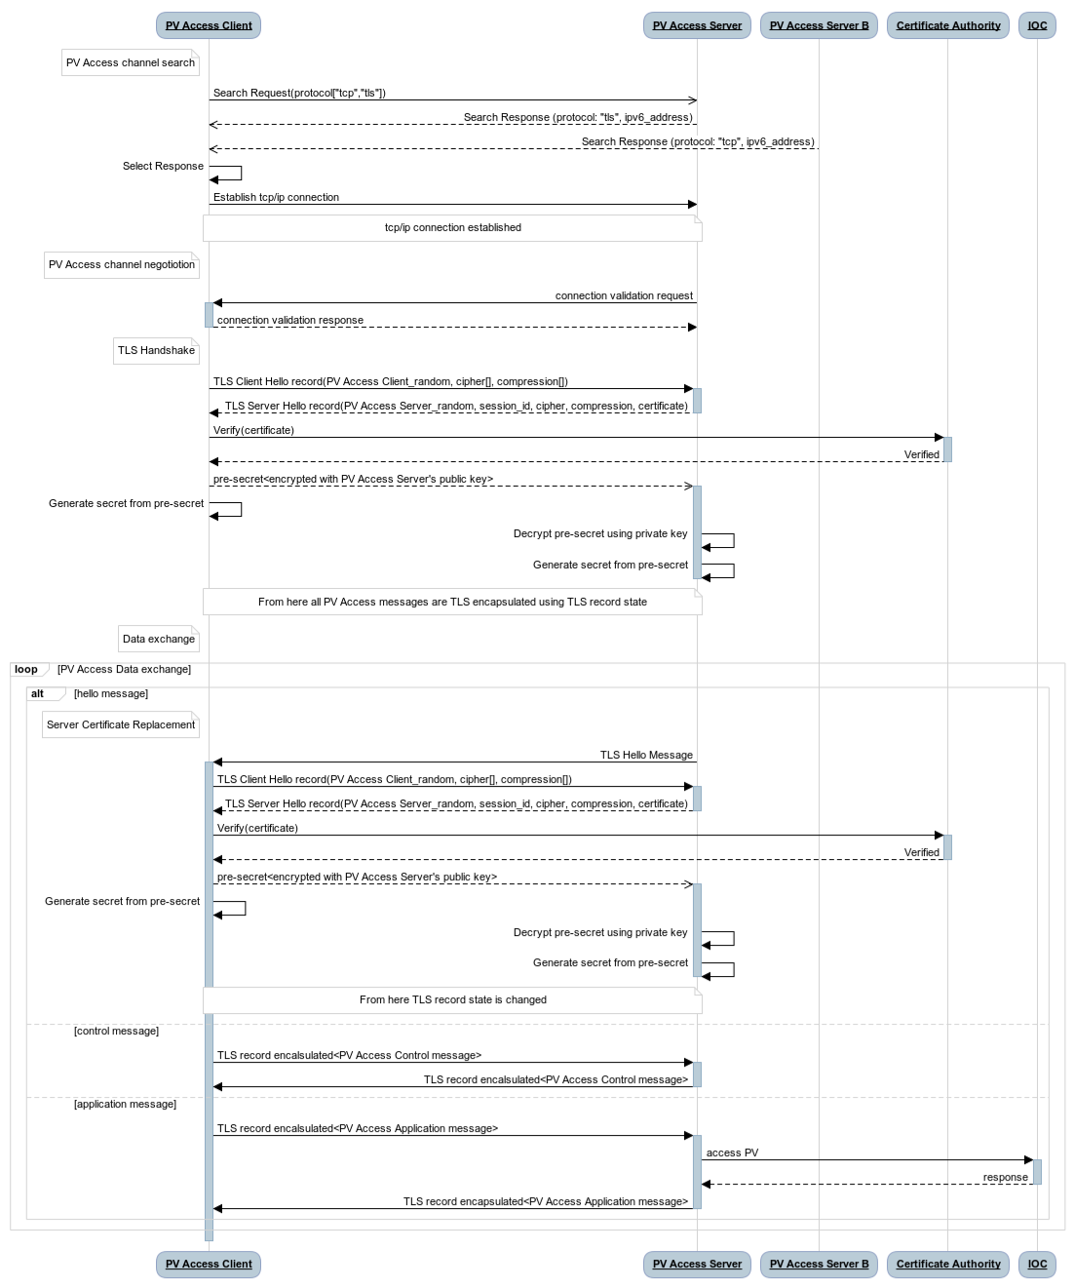
EPICS Security Improvement:
PvAccess and Transport Layer Security (TLS)
PvAccess += Transport Layer Security.
First step to Zero Trust Architecture in EPICS Accelerator controls
Multi-phase project:
  Server side authentication
  Client side
  Yr 2 / 3. Certificate server? Name Server? Pinning?
Transition phase: EPICS pvAaccess TLS fully backward compatible. TLS endpoints co-exist with non TLS.
GOAL: All endpoints use PvAccess + TLS.
NOTE security implies removal of Channel Access protocol from EPICS systems (!)
Prototypes now available
Integration with diverse lab authentication infrastructure, authentication - certificate management, and testing edge cases, will dominate next years.
Figure: EPICS PVA negotiation with TLS proposal, showing:
TLS handshake after message validation, ”tls” message, cipher handshake, and certificate verification additions to EPICS PvAccess protocol.
Modification uses the “magic” byte in the pvAccess header, and existing protocols field in the search response.
Work of George McIntyre, Level-N Ltd, + Michael Davidsaver, Bob Dalesio, Osprey DCS, for SLAC. Kay Kasemir for ORNL.

Slide 36
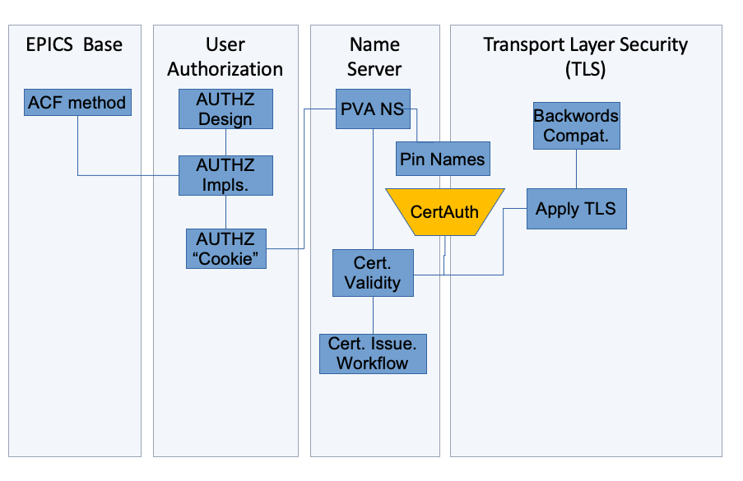
EPICS Security Improvement 2:
US Dept of Energy sponsored project to add TLS to PvAccess for the EPICS community
$ 1.4 M over 2 years. SLAC leading, Osprey primary contractor (M. Davidsaver, G. McIntyre). Kay Kasemir (ORNL) adding for core-PVA. Many, many thanks to Dale Dale Hugo Leschnitzer & Mark Hahnert (US Dept of Energy, Office of Science).
Year One
Technology analysis and selection
Implement a simple prototype containing TLS additions to the EPICS PV Access protocol
Design changes to EPICS
Implement prototype for client authorization via certificate
Integrate with authentication protocols
PVA Protocol Performance tests
Functional Verification Testing and Combined Report
Year Two
Test at SLAC and monitor (done for HPC Modeling)
Integrate with site specific authentication systems.
Implement Beta version of PVA TLS
Update Beta with performance and usability improvements
Collaboration for testing and feedback
Update Beta with certificate management improvements
Figure: The basic architecture of PVA+TLS in context of an EPICS installation, showing integration with enterprise authentication, certificate validation and management, and integration with EPICS Access Control.

Slide 37
U.S. Cyber Security Regulatory Framework
Executive Order (EO) 14028, Improving the Nation’s Cybersecurity.
Calls for a “Zero Trust” posture
  OMB Memorandum M-22-09, Moving the U.S. Government Toward Zero Trust Cybersecurity Principles
    DOE Plan to Implement Zero Trust Architecture (ZTA), July 11, 2021
    DOE Improving Cybersecurity: Guide to Implement Zero Trust Architecture, DOE OCIO, March 2022
    DOE Moving the U.S. Government Toward Zero Trust Cybersecurity Principles Zero Trust Strategy Document. M-22-09, Gina Fisk, DOE-SC CISO, July 2022

Slide 38
U.S. government Dept of Energy Zero Trust Order Compliance Gap Analysis
    Zero Trust Architecture order [2] Principle; authenticate individuals for each action they take; and make authentication so ubiquitous that the secure perimeter can and should be dismantled.
DOE Zero Trust Guidance (from [6]) | Norms in Accelerator Distributed Controls network
Assume no implicit trust is granted to users, … or resources. | A lot of implicit trust granted to accelerator users
Foundational tenet… no resource is inherently trusted | Resources frequently trusted. No way to verify identity nor true operation of resource. EPICS+TLS would enable resource certification.
… and must be continuously authenticated | Rarely re-authenticate. Could add. Implies work disruption
Encrypt data-at-rest and data-in-transit | Control data-in-transit not encrypted. EPICS+TLS would enable encryption. Data-at-rest (stored, archived) not encrypted. Could add, though won’t be popular.
Multi-factor authentication | MFA rare inside controls. Possible to add MFA to ssh. Must consider MFA for operations.
Malware Detection everywhere | Uncommon for malware detection in high performance, high availability control systems. Rare for malware in front end computing.
Update 2023-2024: DOE SC Office of CISO know this, and want to work with us to create pertinent guidance
      Sequestered network rather than strong internal authentication
      So some places we can continue to use MFA. But most can’t.
      Where can we put crowdstrike? Where is it not technically feasible: FPGA, firmware front end systems.
      Where could we but so far has been resisted. HPC? Control system?
      Write exceptions, but balance and mitigate the exceptions.
    OMB and EO hit DOE
    But: V low MFA usage
    Partnership between control, physics, and cyber security.

Slide 39

Ultimately- the Control System Network will be Defined As the network of endpoints that communicate over secure (TLS) PVA.
No more slow and clunky display over X11. Transport the control protocol, not the display protocol as now.
High Performance Computing Network
Office Network
Science Data Facility
SLAC Network
k8 LUME process’ EPICS server
SDF Disk
SDF Disk
Documents, Engineering Drawings
Oracle, People-soft etc
Data Systems Analysis Network
Experiment Network
PVA+TLS R/W
PVA+TLS R/W
Pros | Cons
Simple | No obvious location for a guardian process. But we can add that at the CS level.
Secure control system I/O R & W
Pattern for long term production network
Fast remote native displays. No more X11
Controls Network
Production Services and Control Room Network
EPICS Input Output Controllers (IOCs) - 100s

Slide 40
Summary
AI/ML/Multi-particle simulation will change how we do beam tuning, and in turn change computing infrastructure and Cyber Security design.
Cyber attacks going up. Cyber attacks on accelerator in sight
Regulations and impacts are coming. We can work with DOE
EPICS Cyber Security (PVA+TLS) will help. It’s going to a long road to implement in lab environments
But EPICS Cyber Security will enable new architectures for emergent accelerator physics too

Slide 41
Backups

Slide 42
Wide spectrum of tuning needs
laser
profile
photon beam to 7 experiment stations
A. Marinelli, et al., Nat. Commun. 6, 6369 (2015)
A. Marinelli, IPAC’18
J. Qiang et al, PRAB (2017)
Energy (MeV)
Energy (MeV)
Time (fs)
Time (fs)
Achieve new configurations + unprecedented beam parameters
Fine control to maintain
stability within tolerances
Rapid FEL beam customization
Auralee Edelen, et al

Slide 43
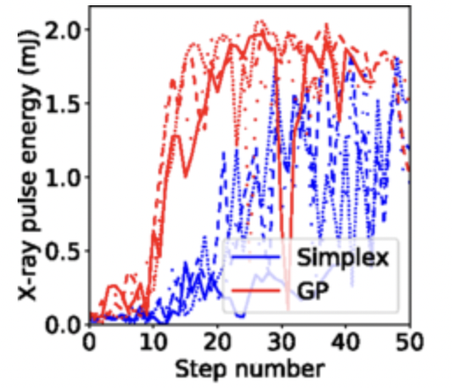
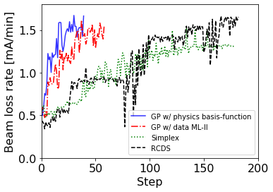
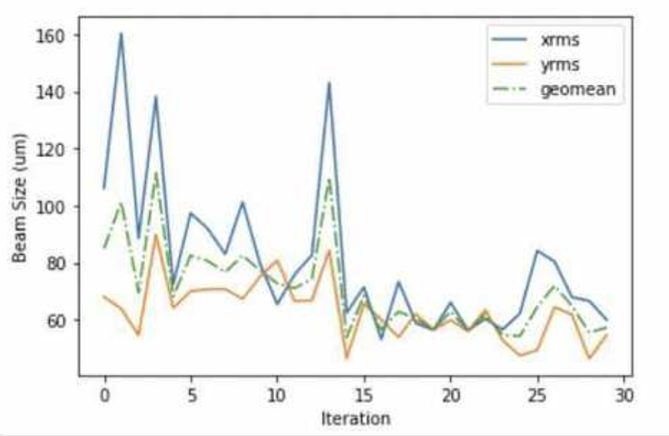
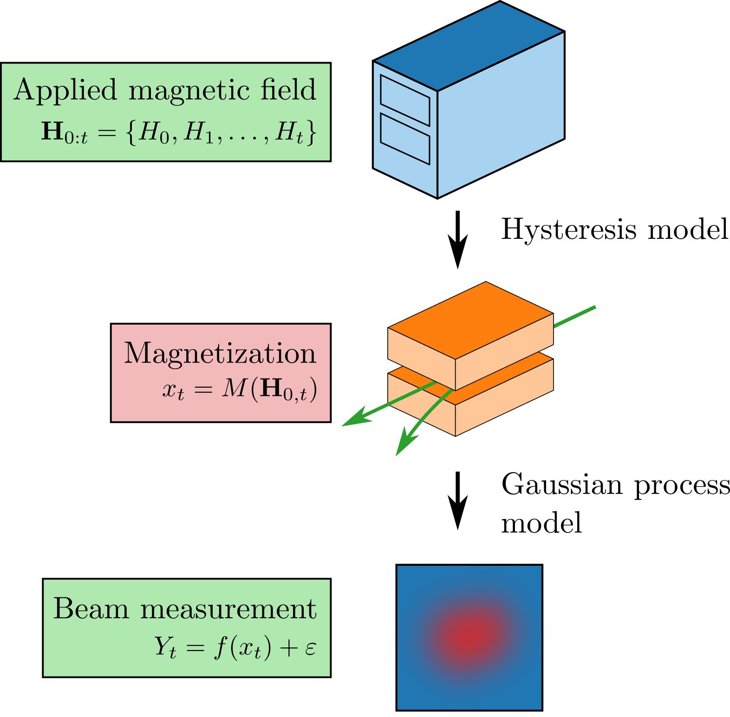
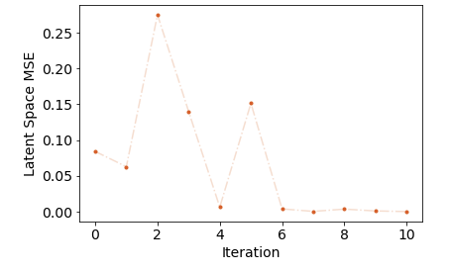
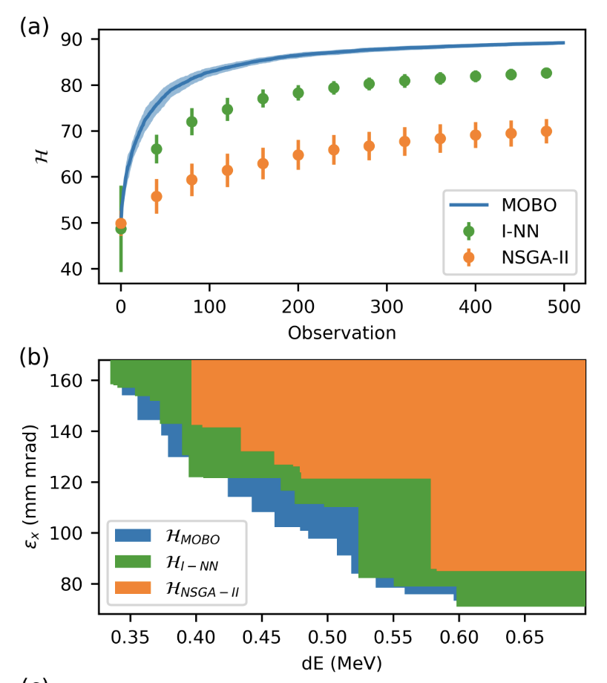
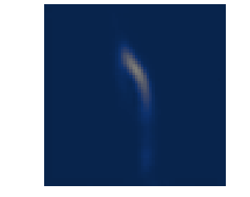




FEL pulse energy tuning at LCLS
Loss rate tuning at SPEAR3
Sextupole tuning for IP at FACET-II
SLAC - Many successes with Bayesian Optimization
(+ improvements)
Duris et. al. PRL , 2020
Hanuka et. al. PRAB , 2021
Multi-objective
Bayesian Optimization
Longitudinal phase space tuning on LCLS
Higher-precision optimization possible when including hysteresis effects in model
BO on sys. with hysteresis
target
Hybrid BO on sys. with hysteresis
Roussel et. al. PRL , 2022
Roussel et. al. PRAB , 2021
Algorithms being implemented/distributed in Xopt: https://github.com/ChristopherMayes/Xopt

Slide 44


Controls Evolution: Fast-Executing & Accurate System Models
Accelerator simulations that include nonlinear and collective effects are powerful tools, but they can be computationally expensive
ML models are able to provide fast approximations to simulations
(“surrogate models”)
< ms execution speed
10⁶ times speedup
10 hours on thousands of cores at NERSC!
Edelen et al., NeurIPS 2019
ML modeling enables accurate predictions of system responses with unprecedented speeds, opening up new avenues for high-fidelity online prediction, tracking of machine behavior, and model-based control

Slide 45
Review - Physics Requirements of the Future Controls
Online Beam Optimization no longer just known a priori model. Not only ad-hoc “correlation plots”, Singular Value Decomposition, bumps, PID or Kalman – based. Rather continuous multi-parametric and NN online, and big-data offline, informing online in real time
Online Models no longer linear only. Space charge, RF kicks, magnet errors, dynamic initial conditions, must be included. That implies large HPC and ML, reading and writing to online PVs!
Tuning on Pulse identified data. Pulse Synchronous Archiving All pulses, (soft) Real time pulse synch accelerator-detector optimization, Continuous image acq/store, Pulse based Modeling
Control system Requirements (EPICS). High Speed Data Services (PVA). Semi-structured science data (PVA)
  Big Data Storage – typically outside the control network (!)
  High Performance Computing – typically outside the control network (!)
CONCLUSION: Controls Architecture must adapt to support physics analysis on fast networks off production;
Control system moves into High Performance Compting (formery entirely offline, and outside the production secure network)
Controls can no longer rely on a secure perimeter cyber model.

Slide 46
Experience of SLAC Accelerator Cyber Assessment
1. Scope and Objective
System Experts charged with assessment of resilience to cyber attack on:
Operations (for instance deletion of required software)
Physical accelerator controls (e.g. malicious write to PVs of cryo facility)
Accelerator configuration basis (e.g. magnet polynomials in Oracle)
Data, analysis or diagnostics (e.g. deletion or change of archived values).
PPS cyber security was not investigated. We did NOT consider physical security such as vacuum of cryomodule, cavity tune, etc.
Results used to plan immediate improvements and further analysis. Experts directed to highlight items that worried them. And to use the systems analysis to investigate and propose fixes.

Slide 47
Experience of SLAC Accelerator Cyber Assessment cont’d
2. Systems in Scope
SLAC IT Network; routers, gateways, Domain Name Services.
Control System Access mechanism:
Enterprise (SLAC) Identity Access Management -> DMZ bastion -> ssh public key
Accelerator Control System Hosts
Control System Software security
  PV write authorization security (EPICS Channel Access - “ACLs” for PVs)
  Control Protocol security (EPICS Channel Access, PvAccess)
  Front end computer security (EPICS IOC software, FPGA, field busses etc)
  Beam diagnostics, tuning and optimization security (Matlab, Python)
Data Stores: EPICS Archiver, High Performance timeseries data stores
Intellectual Property Stores: Physics Log, Operations Log
Databases: Oracle (Device Infrastructure, Magnet, Cabling, Issue management, etc)
High Performance Computing Systems
Controlled Document store (Sharepoint)
Engineering Drawings (Windchill, Solid Edge, AutoCAD, SODA)

Slide 48
Experience of SLAC Accelerator Cyber Assessment cont’d
3. Systems Specialists Briefing & Response Template
For each system assignment:
Describe the use of the system in brief
Describe existing security measures, assess any weaknesses, and highlight missing coverage
Tabulate the system with respect to the following. For each defense type, if the system includes it, describe the defense’s implementation in the system. If the defense is not pertinent to the system, enter “N/A”. If the defense would be pertinent to the system, but is not in fact employed, enter “Not implemented” and, if possible, details of what you would recommend.
Security or Cyber Defense Type | Describe
Authentication, Authorization, Audit. Kerberos, SSL public/private key | How is a user authenticated to the system. Is Authentication for instance by Kerberos? How are communications encrypted (if at all)
Known Vulnerability scanning | Is the system scanned for known ways to hack?
Backups | Verify backups exist and are being updated. Document the backup schedule and where backups are located. Are backups secure against system failure, power, fire.
Malware Detection | Is the system included in Crowdstrike?
Accelerator self-defense – EPICS LO/HI limits, MPS, BCS | For accelerator controls, what mechanisms exist to ensure proper operating range?
Air-gapped processor-observer pattern (as in PPS) | Does any part of the system include air-gapped or one-way only communications (data diode) security?
Network segmentation | Is the system hosted in a controlled or otherwise confined network?

Slide 49
Findings of SLAC Accelerator Cyber Review
System | Authentication Authorization and Audit | Vulnerability Scanning | Malware Det. (Crowdstrike) | Backups | Accelerator Protection system | Air-gap / process-observer | Network Segmentation
MCC. Accelerator Controls Networks - ~ OSI 7 Layer Model levels 1-5 | ssh rsa/dsa public-private key using SLAC User ID and mcclogin as a bastion host. VMS password. | No vulnerability scanning on accelerator networks, for fear of interference with ops. Yes, at DMZ level. | No malware scanning on accelerator networks, for fear of interference with ops. Yes, at DMZ level. | Yes. All NFS data and systems are backed up by coordination with OCIO. Operational to MCC (bldg. 5). Disaster recovery to ANR (B52). Large data to AFS. | N/A | No. Direct authenticated login is supported. | Yes. Filtering Router enforces DMZ intermediates SLAC to prod. Each accelerator network is segmented into a few functional VLANs.
EPICS. Accelerator Controls Networks ~ OSI 7 Layer Model levels 6-7 | No control network user Authentication. EPICS PV change Authorization being added. | No. IOC processes and client servers are not scanned for vulnerabilities. | No. No malware detection of EPICS processes on Production . No front end executable certification | Access Control Files backed up by virtue of AFS. | Yes, extensive but may be incomplete. Facilitated by EPICS DRV-L/H, MPS, BCS. | Not as such, but separation mediated by router is sometimes used. | Yes. Production networks are isolated via DMZ.
SLAC Science Data Facility (aka S3DF) | Kerberos (until SLAC standard federated is available) | Yes. S3DF DMZ daily. Others biannual. | Yes - DMZ & Workstations. No - HPC and core. | Yes (as of Aug 22). | N/A | Not employed. S3DF is intended for access internally and externally. | Yes.
SLAC Enterprise Networks (SLAC IT) | Networking device management requires authentication by Kerberos + DOE PIV card. | Yes, admin. by SLAC cyber. | Yes. Networking management hosts have CrowdStrike. Devices (routers etc) do not. | Yes. Backups daily to SLAC AFS and Stanford AFS. | N/A | No. SLAC IT does not operate any air-gapped enterprise networking | Yes. SLAC Networks are segmented; access and firewall implemented individually for each.
Oracle & APEX. | UserID + Oracle db pwd or Oracle wallet. LDAP & WebAuth for APEX. | Yes, admin. by SLAC cyber. | Yes on main SLACPROD dbs. No on MCCO dbs. | Yes. Full and incremental backups daily. 30 day retention. | N/A | No. | DBs segmented by content. Diff. pwd/wallet required for each. MCCO is in DMZ.
Controlled Document Management System (CDMS) | SLAC Active Directory & MFA. MS has no access to SLAC cloud data. | Yes, admin. by MS. | Yes, administered by MS. | Yes, redundancy and resiliency by MS. We assume their diligence | Content describes Accelerator Protection Systems. | No. | Yes [2]
Engineering Drawings and Data (TC / SEDA) | TC req SLAC ID of named license holder. SEDA req SLAC ID/ MFA | Yes, admin. by SLAC cyber. | Yes, admin by SLAC cyber. | TC: Yes, admin by SLAC IT. SEDA: Yes, admin by MS. | N/A | No. | Per TC system.
High Level Applications (HLA) | Presently, all HLAs are on prod, so AAA is per MCC and EPICS above. | No, not in production. | No, not in production. | Yes, per MCC. | Partly. Mostly rely on EPICS limits. | No. However do have read-only gateway. | Yes, per MCC.
SLAC
SLAC Summary: Positive Overall. Our cyber security was found complete with respect to common practice.
Login security is comparable to most facilities. Will soon be leading
Backups are complete
Malware Detection & Vulnerability Detection are complete (subject to the norm that malware detection is not run in production)
CA Security (authorization to change PV) is designed, in cryo IOCS, and ready for broad implementation
All EPICS Labs
However, EPICS itself is insecure. Its use is based on aging assumption of secure perimeter. Lacks strong authentication and software signing.
Figure: Example table of cyber review findings, showing each of 8 system’s cyber situation on 7 metrics

Slide 50
EPICS Version 7 in a Nutshell
New Fast Protocol, “pvAccess” replaces CA
Structured data
Python and MATLAB APIs (and C++ and Java)
Data Services (Process variables with arguments)
Standardized Scientific Types
Dynamic typing
Introspection interface
New smart process database
$ pvget XCOR:LI24:900:TWISS
structure
double energy 5.00512
double psix 37.7625
double alphax 13.6562
double betax -2.78671
double etax -0.00698294
double etaxp 0.00107115
double psiy 31.9488
double alphay 116.762
double betay 5.2592
double etay 0
double etayp 0
Figure: pvAccess getting PV of a structure of
optics parameters. In this case a standard
“Normative Type” type was not used, so the raw
structure is displayed
Faster. Structured data. Metadata. RPC. Easier.

Slide 51


EPICS 7 Image Type (NTNDArray) Example
Helping ML answer e.g. – What does the cathode look like when the photon flux intensity is high
Command line request for a given image PV by name.
Data Type Identifier
A lot of data snipped
Raw image data.
Widget learns how to display image from metadata
The image meta data; giving parameters to interpret data in the value field, and other information.
Figure: A screenshot of the output of the EPICS 7 “pvget” command, for an image.
Figure: A screenshot of PyDM displaying a beam profile image.
B. Martins (now MS), M. Gibbs SLAC

Slide 52




Emerging Control Ecosystem Roles in AI/ML & Physics Applications
Device Abstraction, Data Measurement & Transport | Online non-linear optimization | Collection & Event Building / Big Data | Online Linear Modeling | Big simulation, ML, LLM
 |  |  |  | Online Multi-particle simulation (Impact-T). ML real time optimization.
 |  |  | Online linear model of whole machine, from pulse sync data
 |  | Beamline - Accelerator Synchronous tuning
 |  | Bunch resolved mass data archived w/ meta data
 |  | Sync Camera data
 | Ad-hoc Bunch sync ML regression analysis / ML. Non-linear Model. Gaussian Process. Gradient decent
EPICS 7 Structured data. EPICS Security
EPICS 7 gateway. New network protocol. Process Variables of Structured data. EPICS Security
PV carries many signals/records. E.g. NTNDArray image | PVs carry physics measurements & tuning results | 1 PV carries whole synchronous orbit data etc. | 1 PV carries whole lattice, all Twiss etc. | PVs from High Performance Cluster carry tuning for immediate use online. Cyber?

