Slide 1
TDM, a display manager based on web technologies
Hao Hao
Oak Ridge National Laboratory
September 18, 2024

Slide 2
Why web technologies?
Web technologies have been developed for more than 3 decades
One of the most widely used technical stack
Realize protocols, data transmission, user interface, database, security ...
Provide solutions for servers and clients
A variety of development frameworks
Frontend: React, Vue, Angular, Svelte, ...
Backend: Express, Django, Ruy on Rails, ...
Full stack: Next, ASP.net, Spring, ...
It’s also used on desktop software
webview, tauri, NW.js, electron.js, Flutter, React Native, ...

Slide 3
Technical choices of TDM
It is primarily a desktop software, not simply a webpage or website
Programming language: Node.js. Cross-platform, high efficiency, widely supported, asynchronous, support for web technologies, transpiled to webpage JavaScript.
GUI framework: electron.js. Based on Chromium, cross-platform, works well with Node.js, HTML, and CSS, mutli-thread, server-client model.
GUI interface: React.js. High efficiency to control element lifecycle, JSX syntax to handle layout.

Slide 4
TDM architecture
IOC
IOC
Main process: communication with IOCs,
managing windows and PVs, read/write files, ...
CA client: epics-tca
electron.js natively has a good IPC library, Why websocket? Realtime and two-way communication, expansion for future use.
Why not run epics-tca on renderer process? For efficient PV management, future expansion.
network
electron.js
CA client
Main process
WebSocket server
WebSocket
Renderer process
(html page)
Renderer process
(html page)
Renderer process
(html page)

Slide 5
Install and start
Technically any platform that can install Chromium would run TDM: Linux, MacOS, Windows; x86_64, arm.
Download from https://github.com/diverhao/tdm/releases/tag/v2408
Packaged with a modified node.js executable.
Double click to open the application.

Slide 6
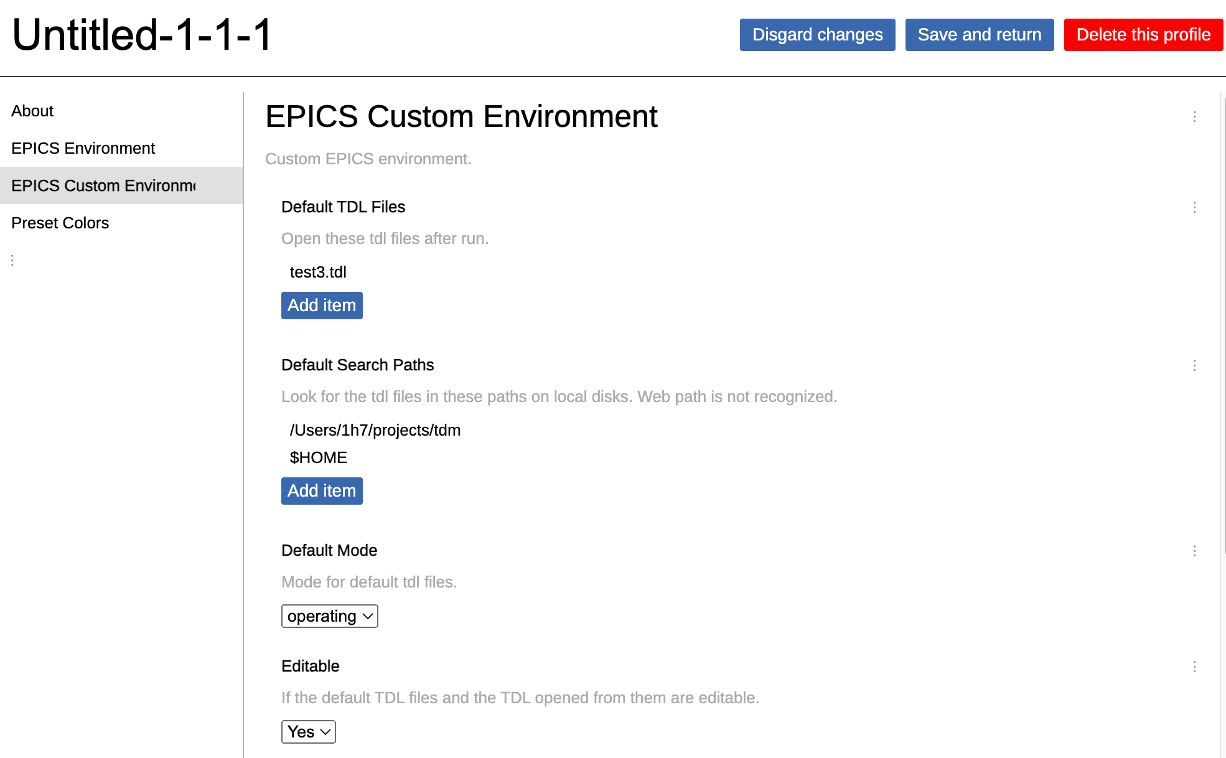
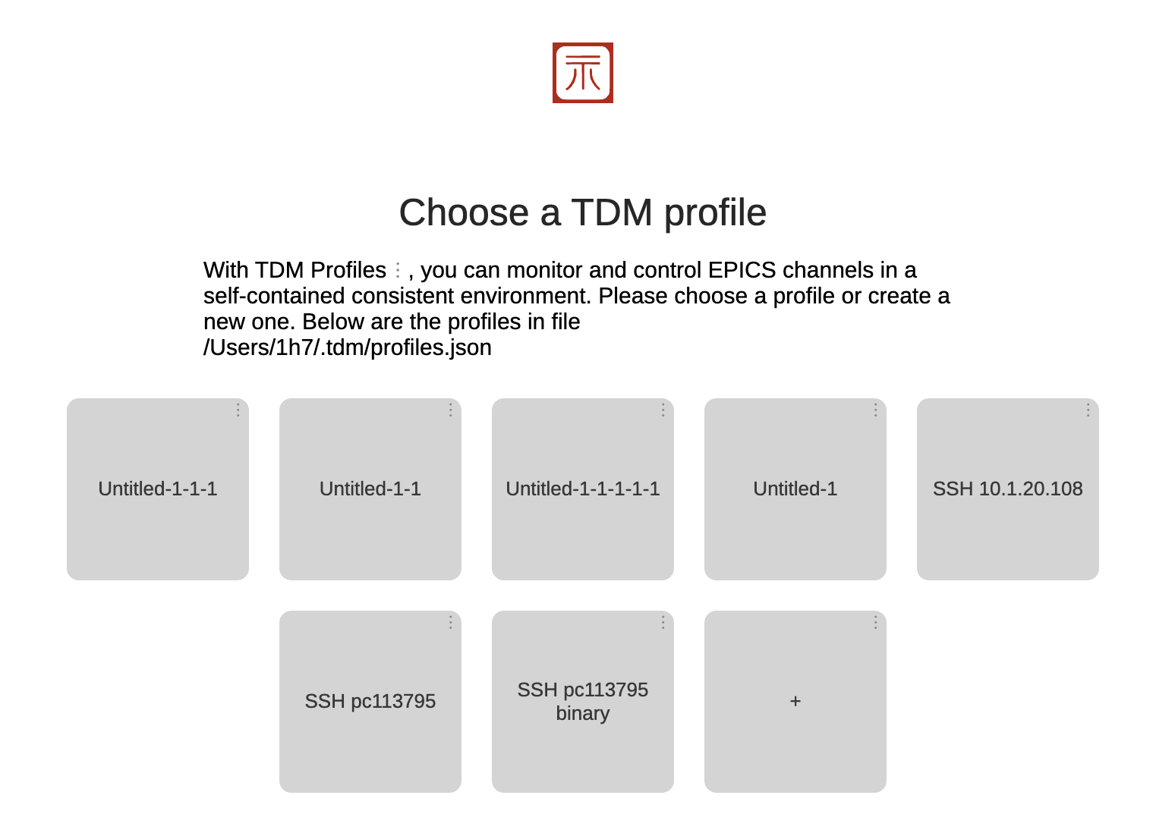
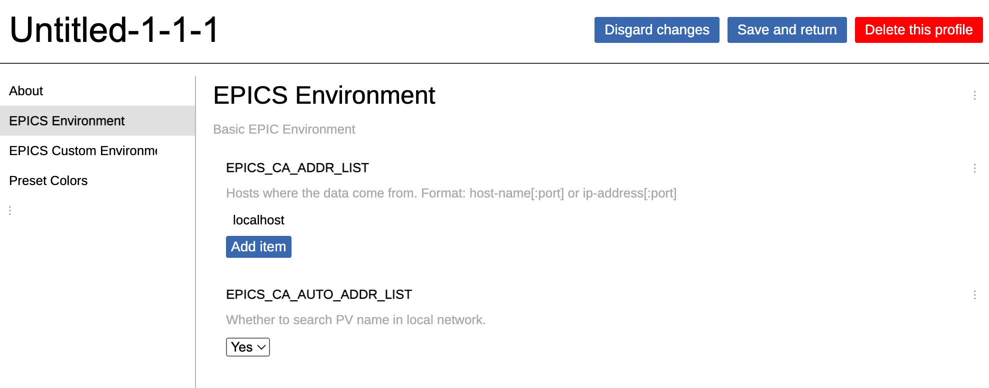
Main window and profile
Profile: a collection of information
EPICS environment variables (EPICS_CA_ADDR_LIST, TMO, ...)
Default search paths, opened files, ...
Other developer-defined variables
User can define multiple profiles. Each profile is independent to each other.
Save the effort of manually providing configuration file to TDM instance.
Profile editor: GUI interface that can fully edit the profile
All profiles are stored in one file $(HOME)/.tdm/profiles.json

Slide 7
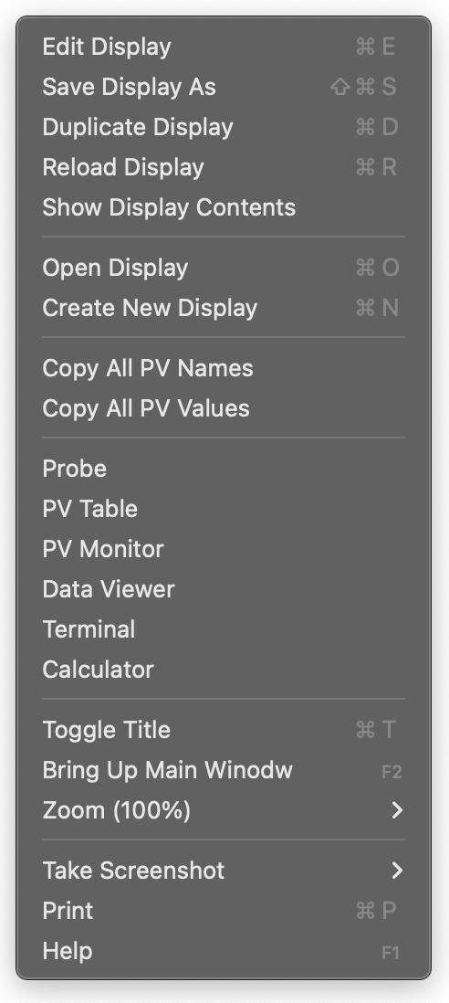
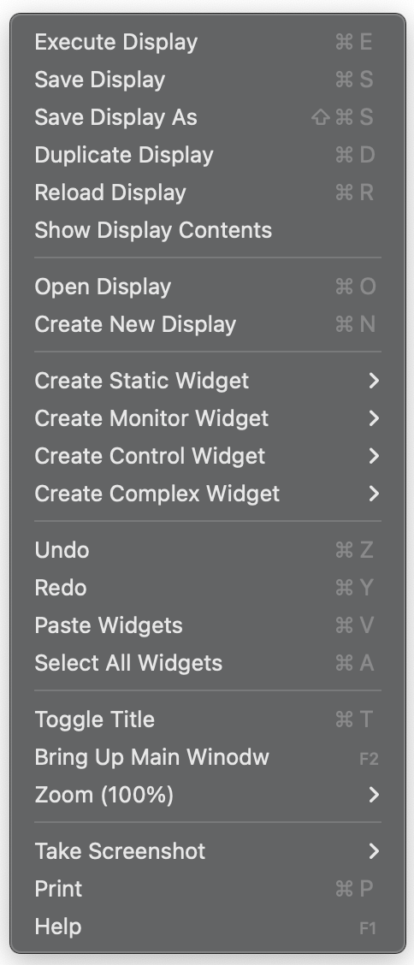
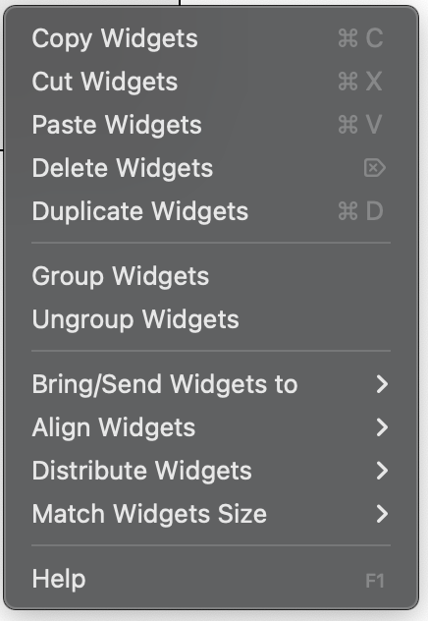
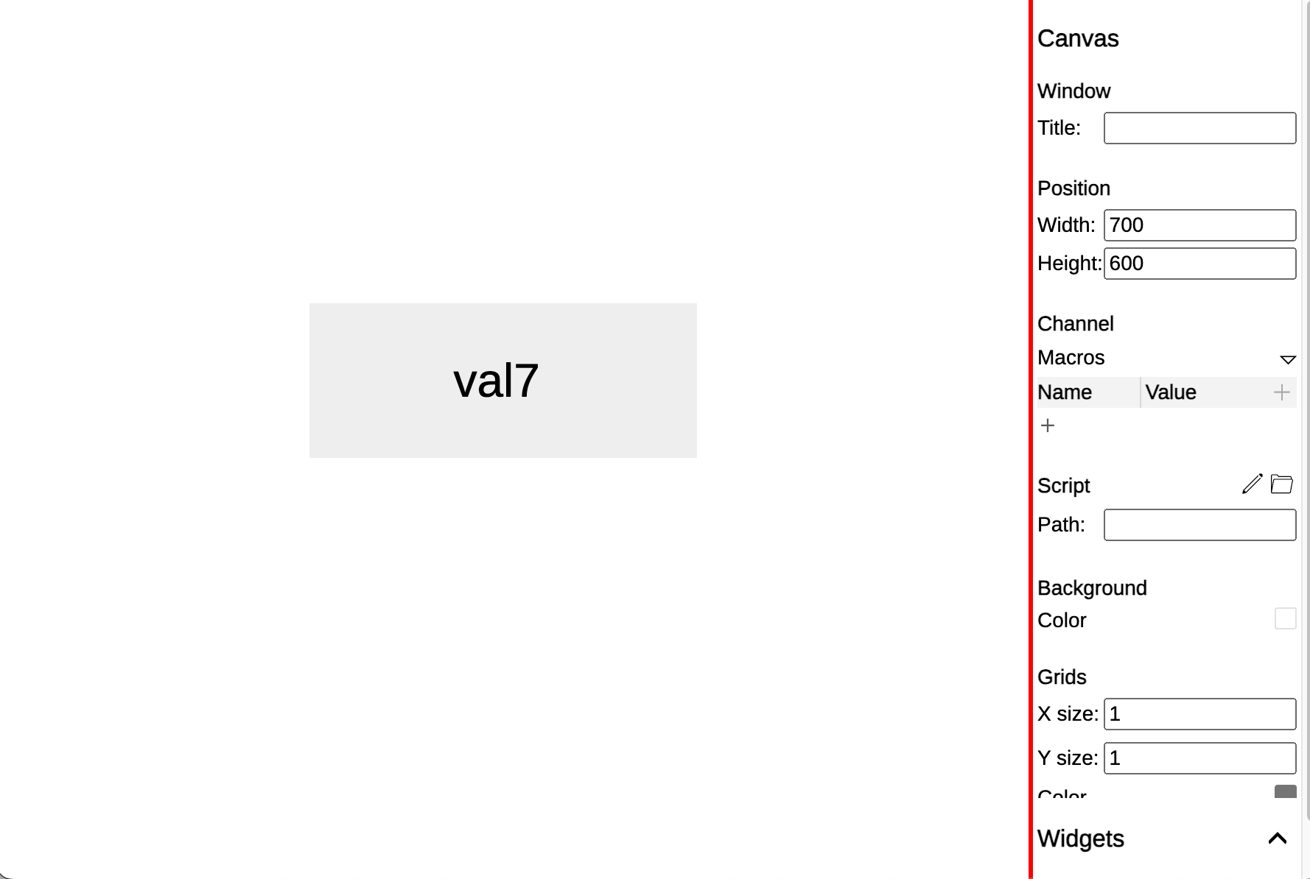
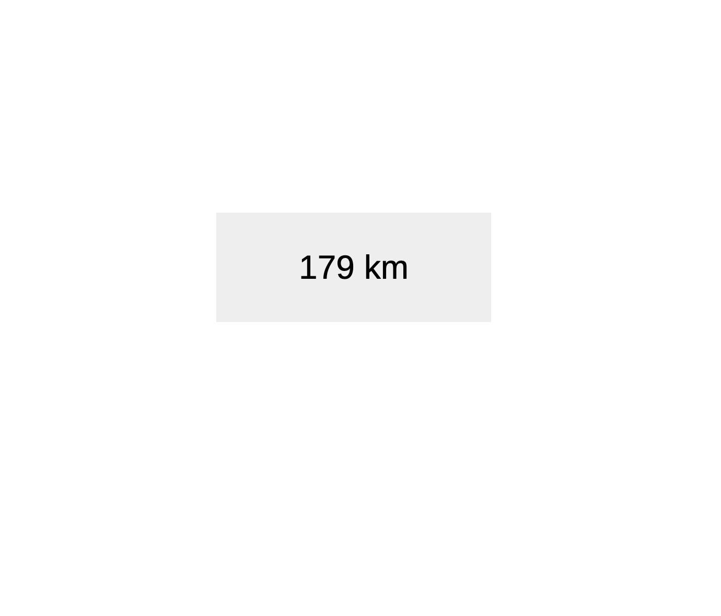
Display interface
Editing mode vs operating mode
All operations on a display window are integrated in the right click context menu

Slide 8
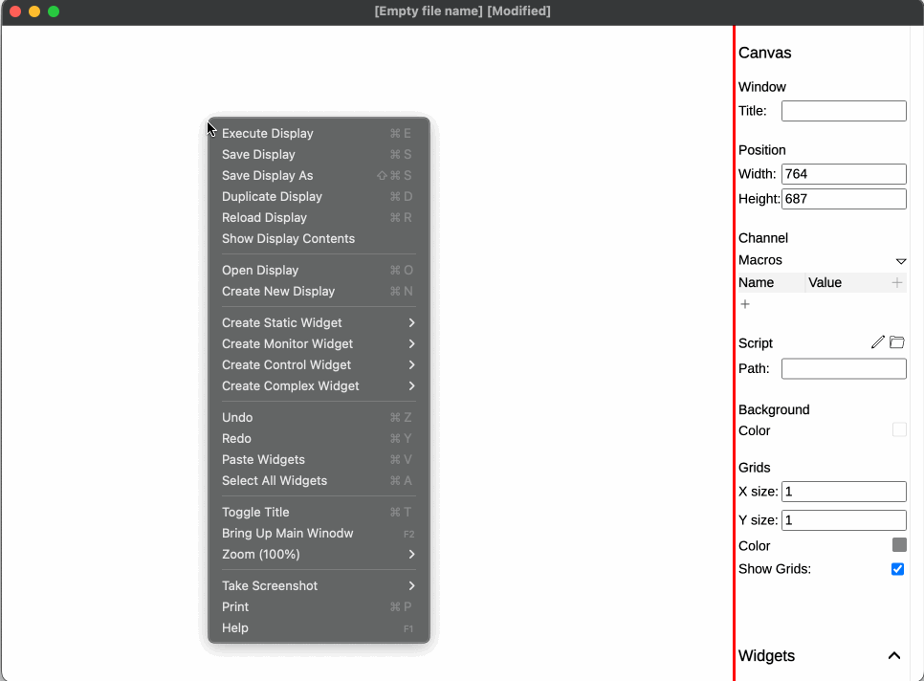
Create a widget (Text Update)

Slide 9
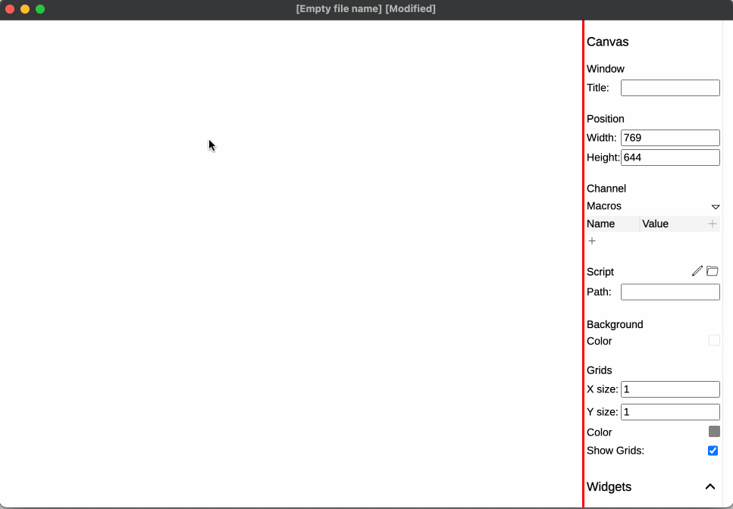
Create a widget (XY Plot)

Slide 10
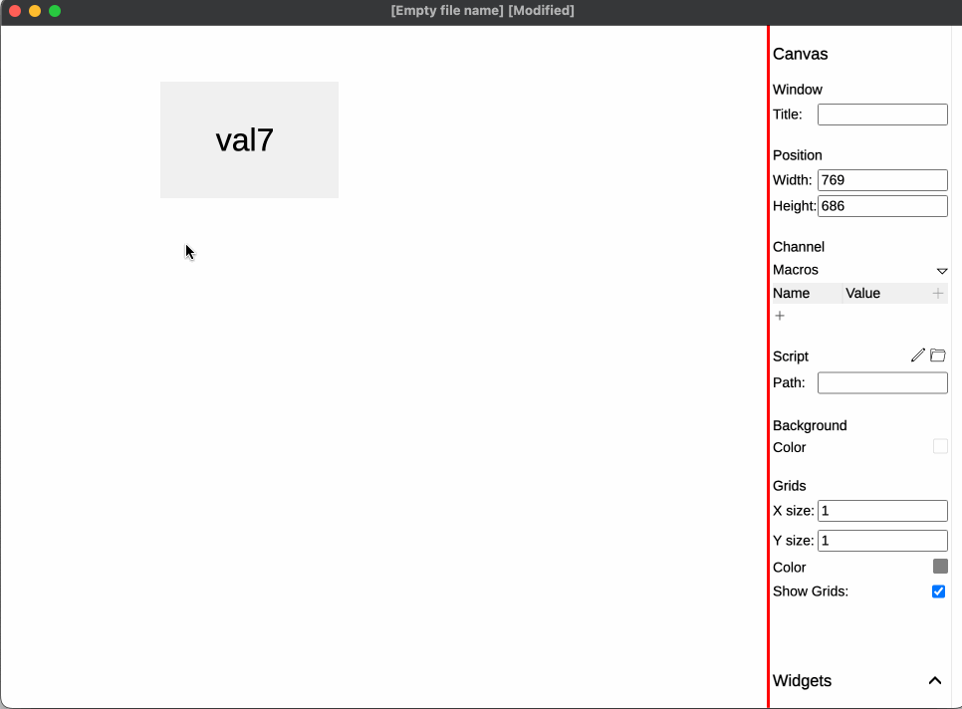
Control a PV (Text Entry)

Slide 11
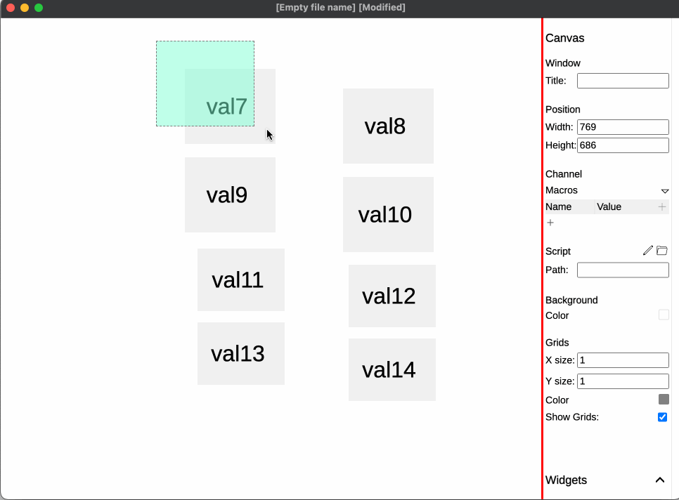
Responsive editing

Slide 12
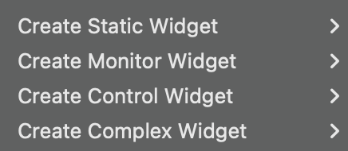
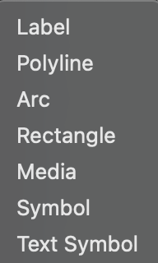
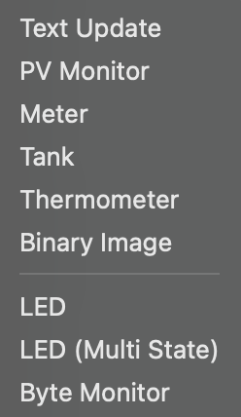
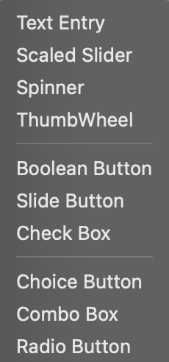
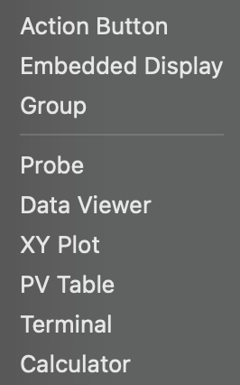
Widgets
A variety of widgets are provided for monitor and controlling.

Slide 13
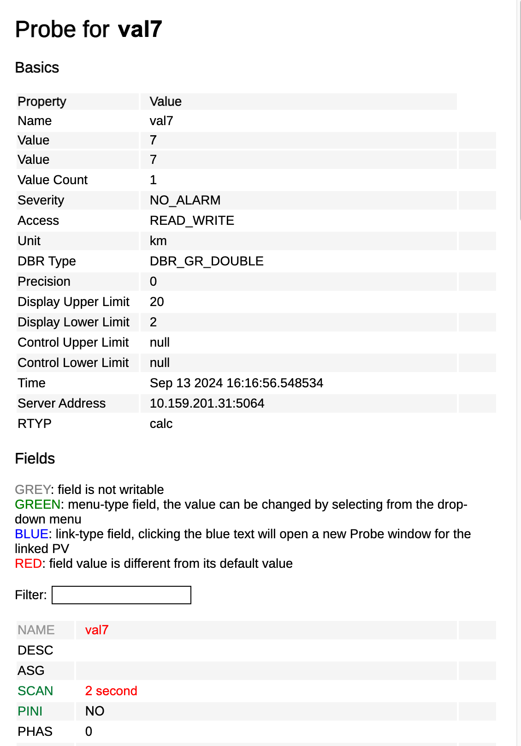
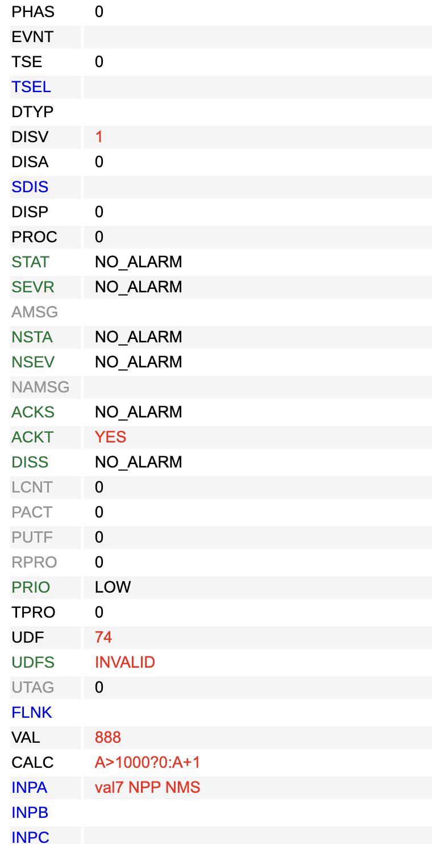
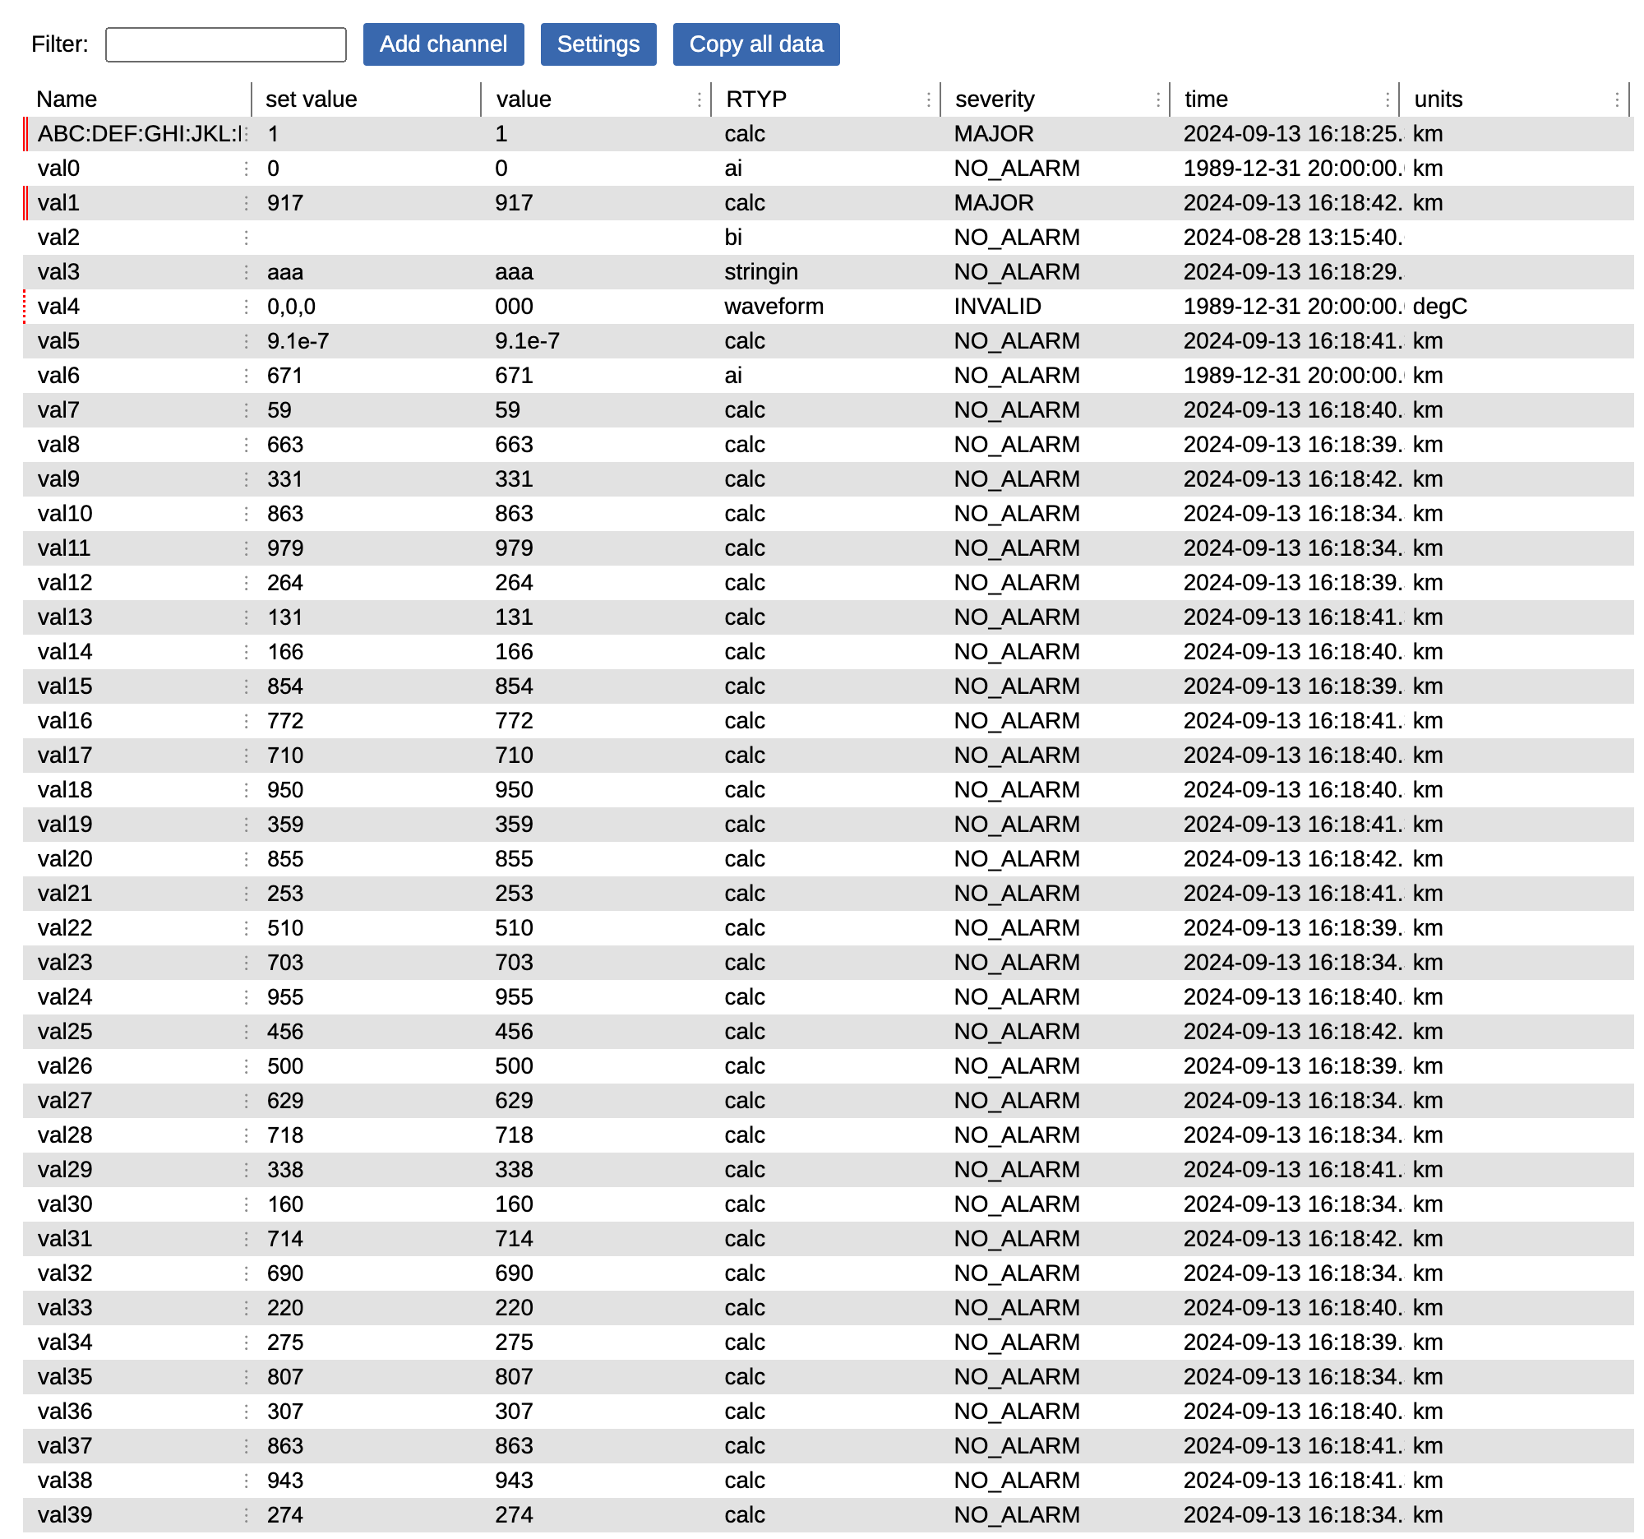
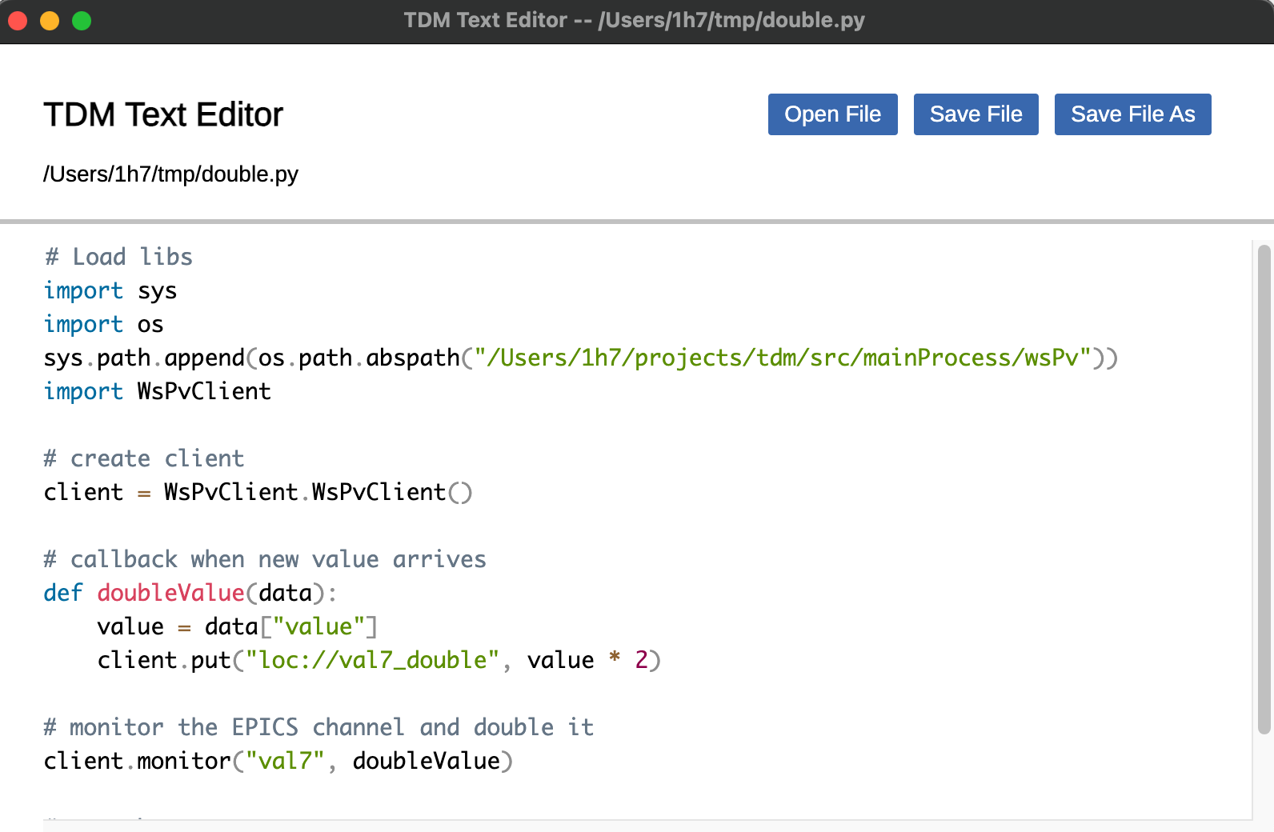
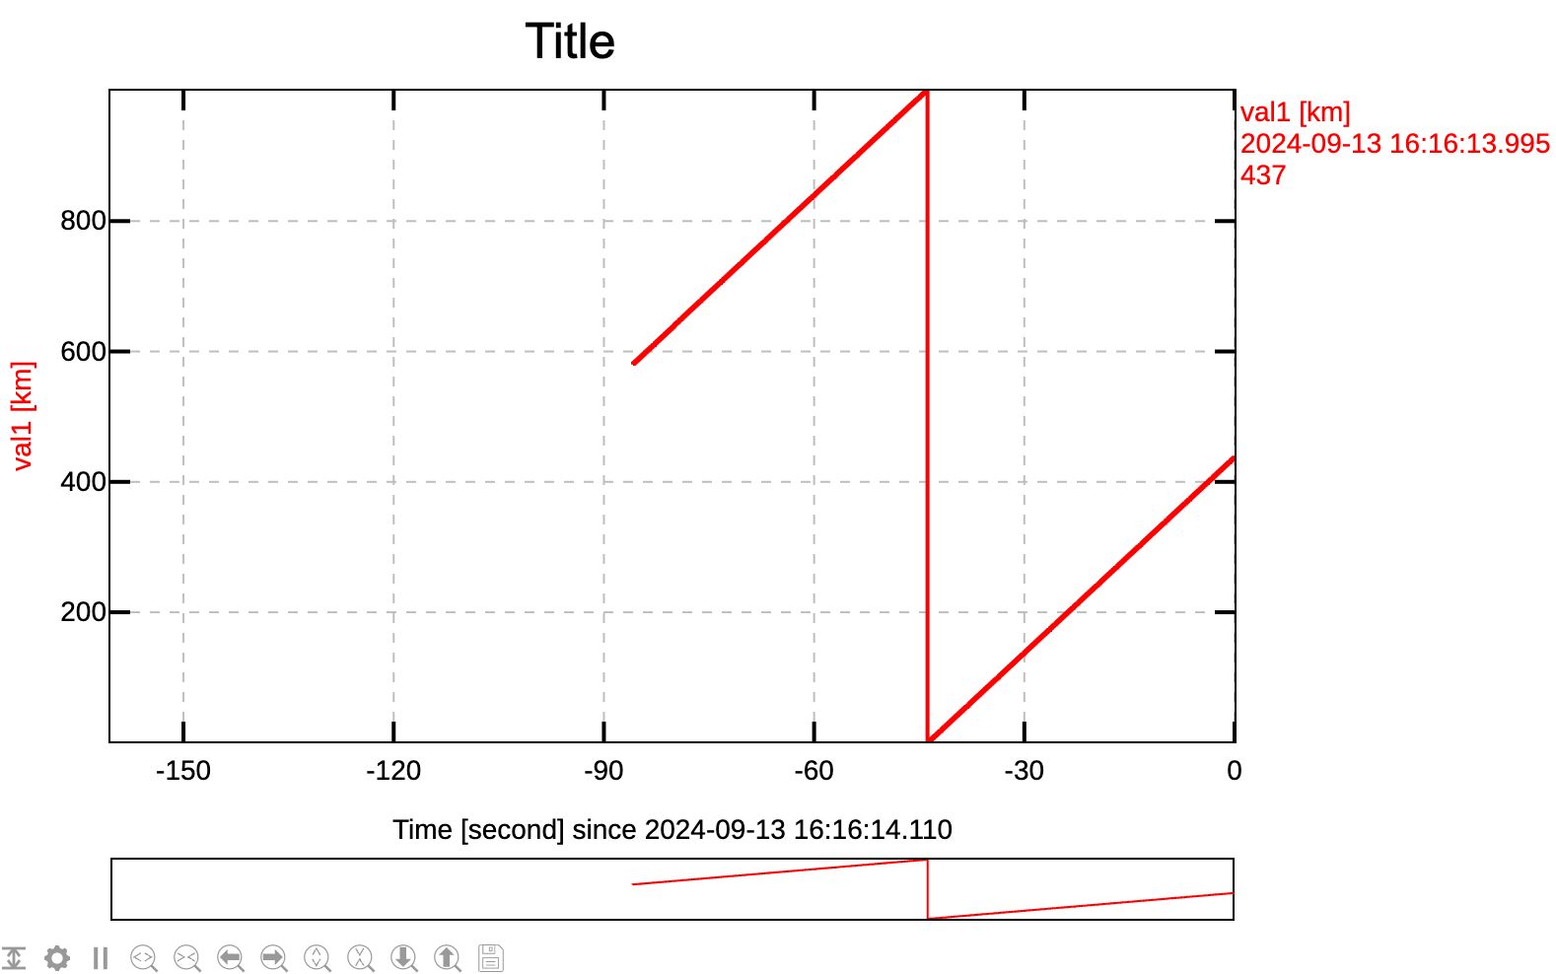
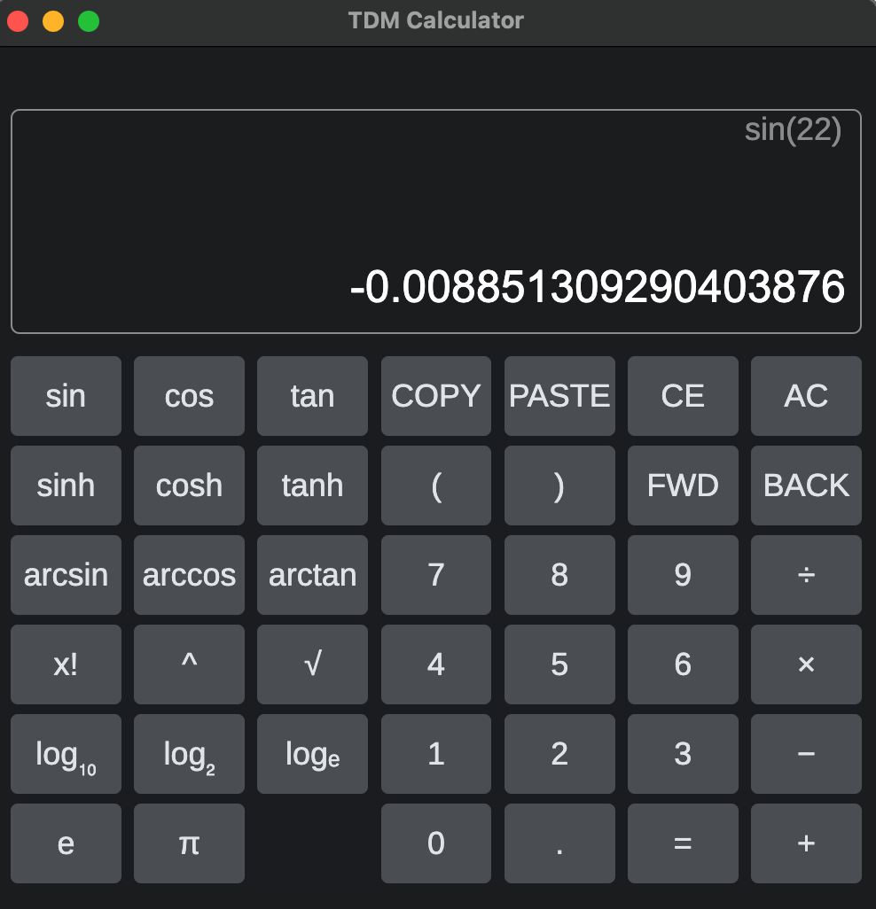
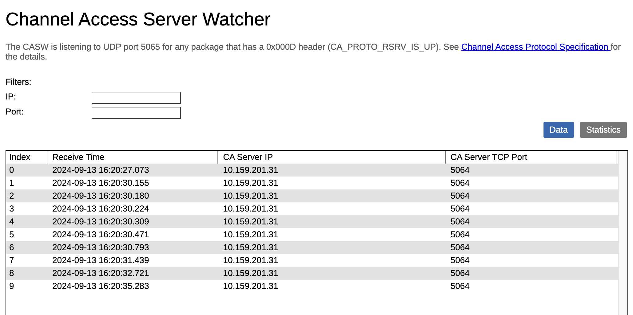
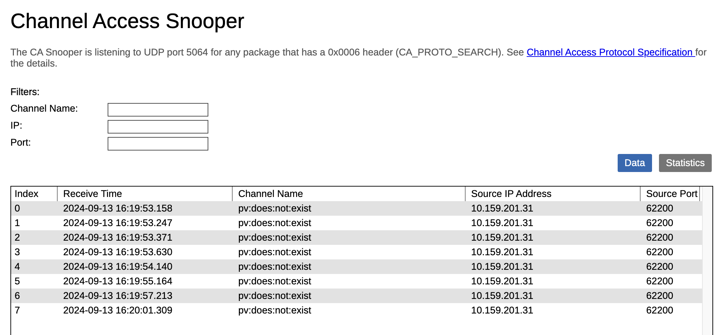
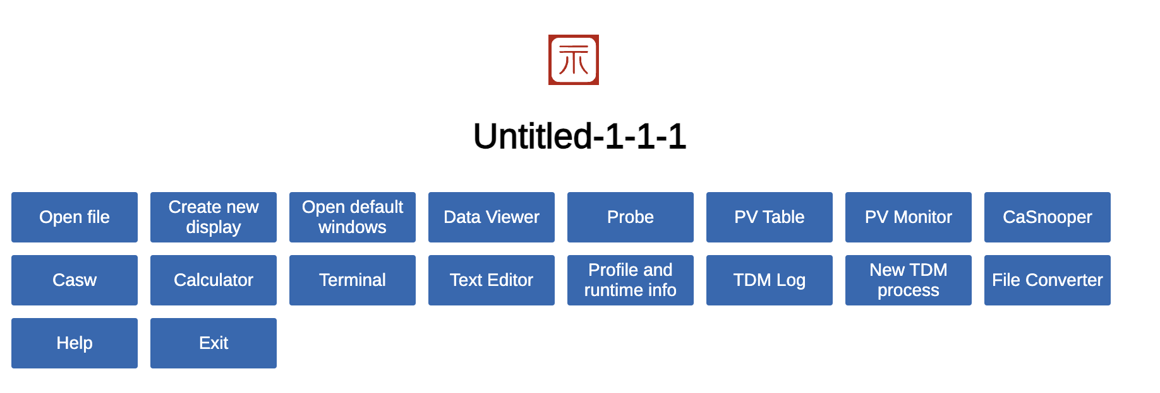
Tools

Slide 14
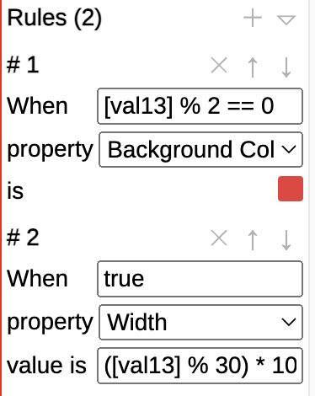
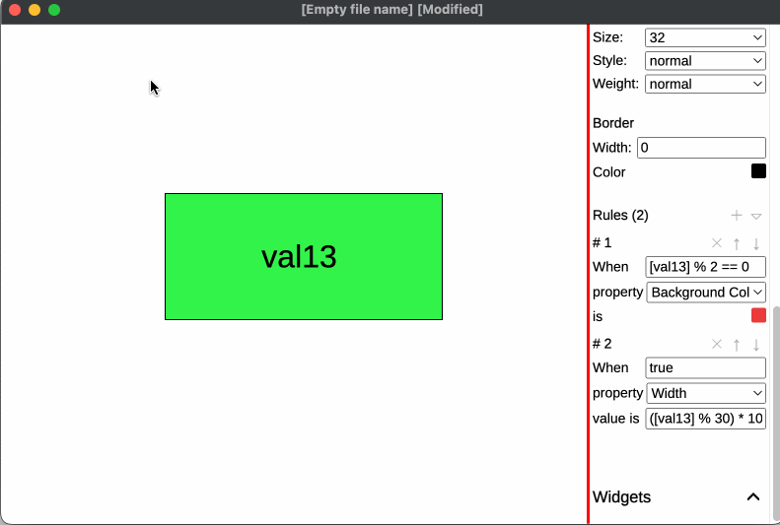
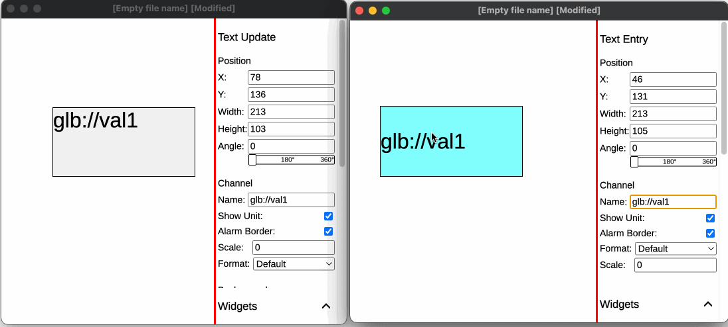
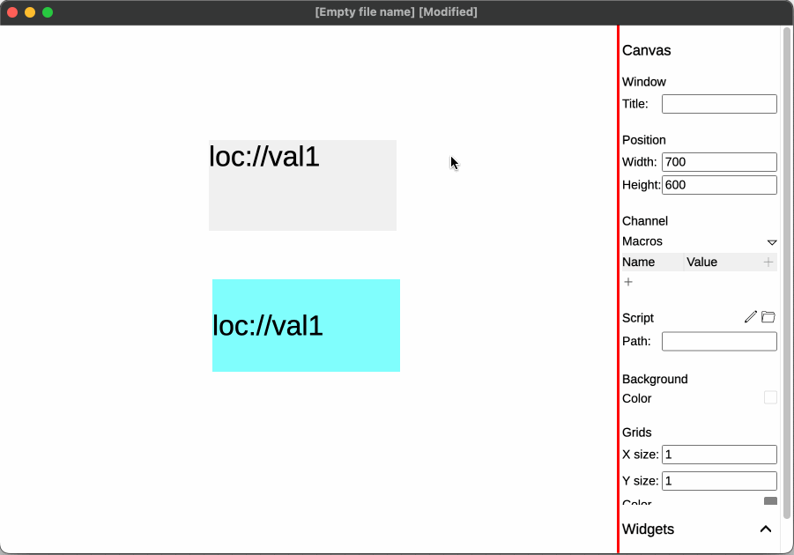
Advanced features
Rules
when a condition is true, the widget’s appearance becomes something
when the PV is an even number, the widget’s background becomes red
Virtual PV
loc://
glb://

Slide 15
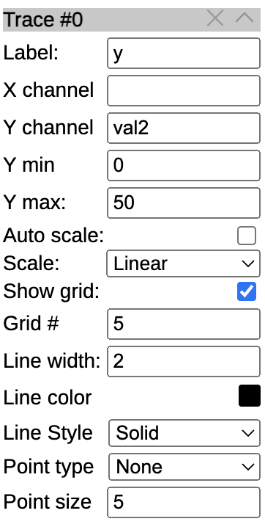
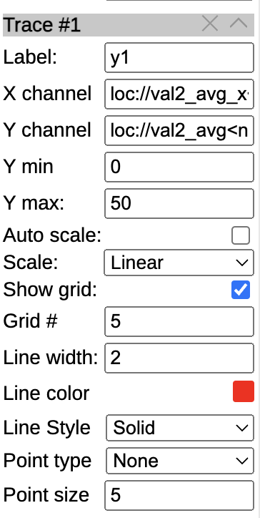
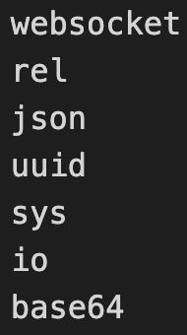
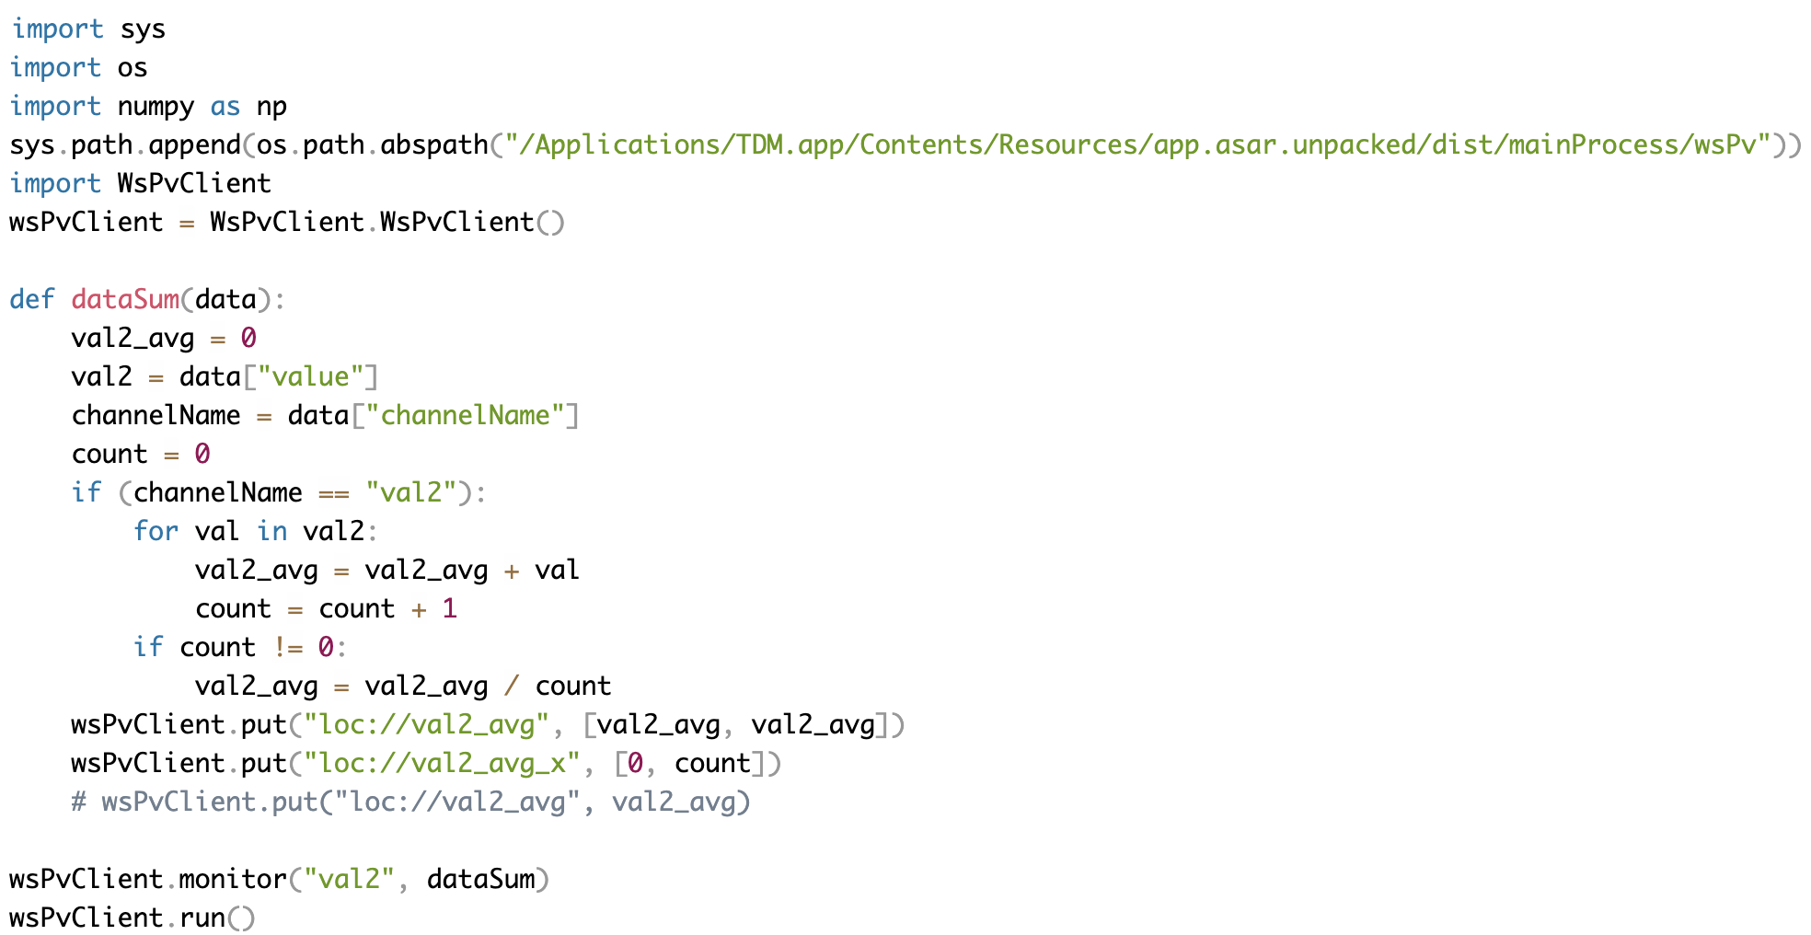
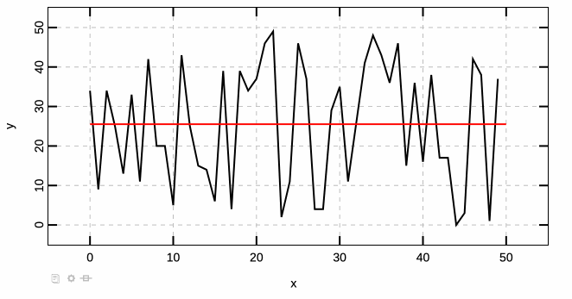
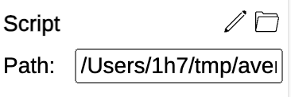
Advanced features
Scripts
Attached to the display
Python or node.js (JavaScript)
Runs in separate thread
Python requres:
Post-process data in frontend

Slide 16
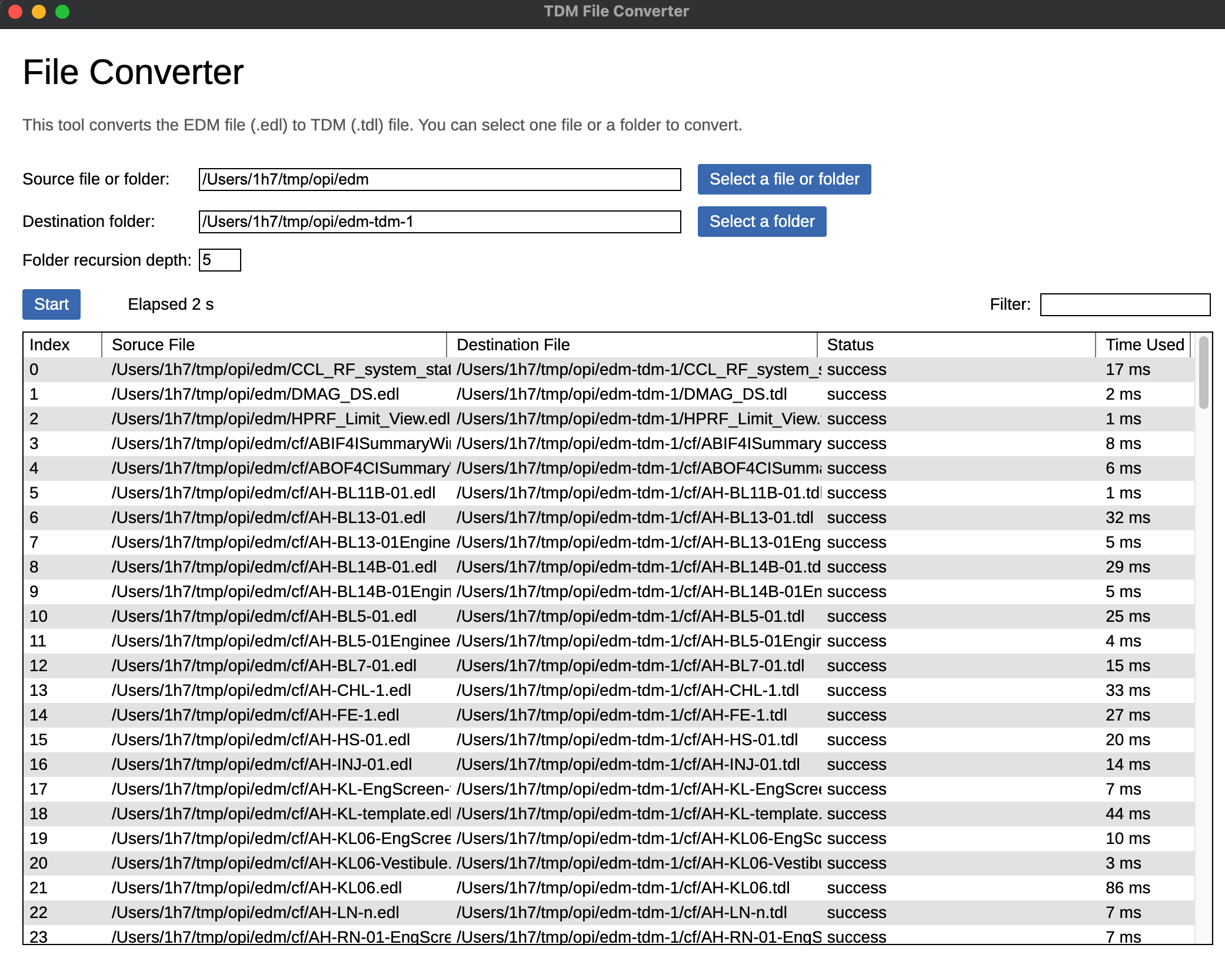
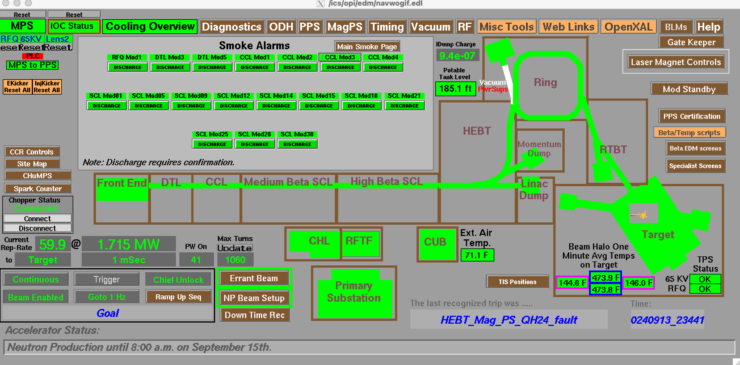
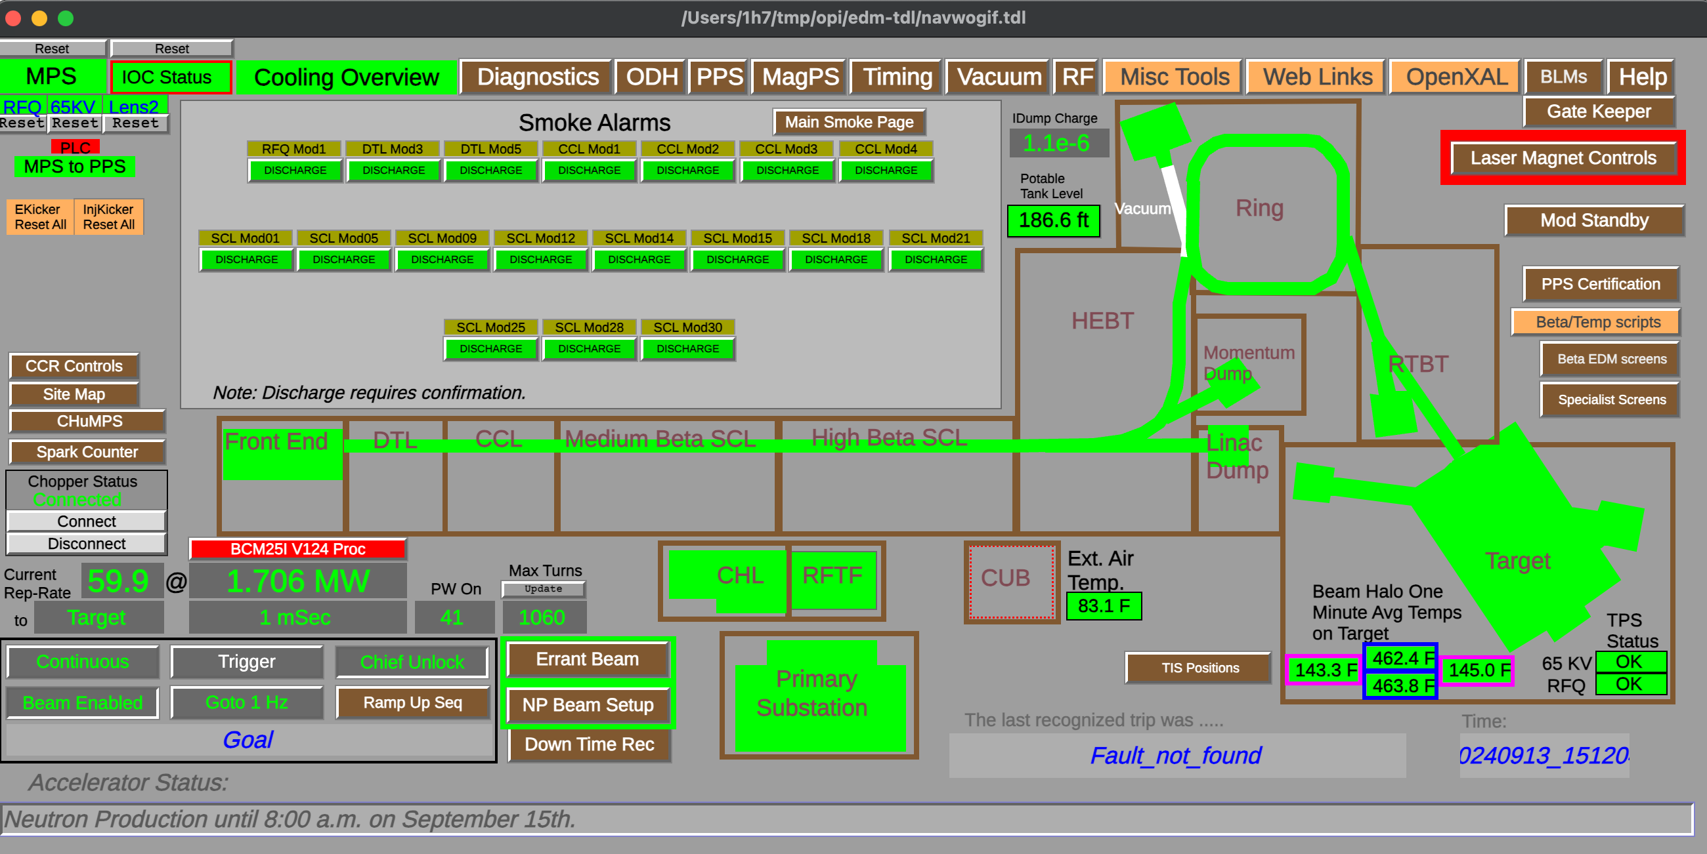
EDM compatibility
TDM can directly open .edl files (with an on-the-fly conversion)
TDM provides a converter that converts multiple .edl files to .tdl
Converting 3800 edl files takes about 20 minutes
EDM
TDM

Slide 17
Revisit TDM architecture
IOC
IOC
network
electron.js
CA client
Main process
Web Socket server
WebSocket
Renderer process
(html page)
Renderer process
(html page)
Renderer process
(html page)

Slide 18
SSH mode
IOC
IOC
network
network
SSH tunnel
SSH server
SSH client
CA client
TCP server
Main process
TCP client
Main process
computer B
Web Socket server
computer A
WebSocket
Renderer process
(html page)
computer B
Renderer process
(html page)
Renderer process
(html page)

Slide 19
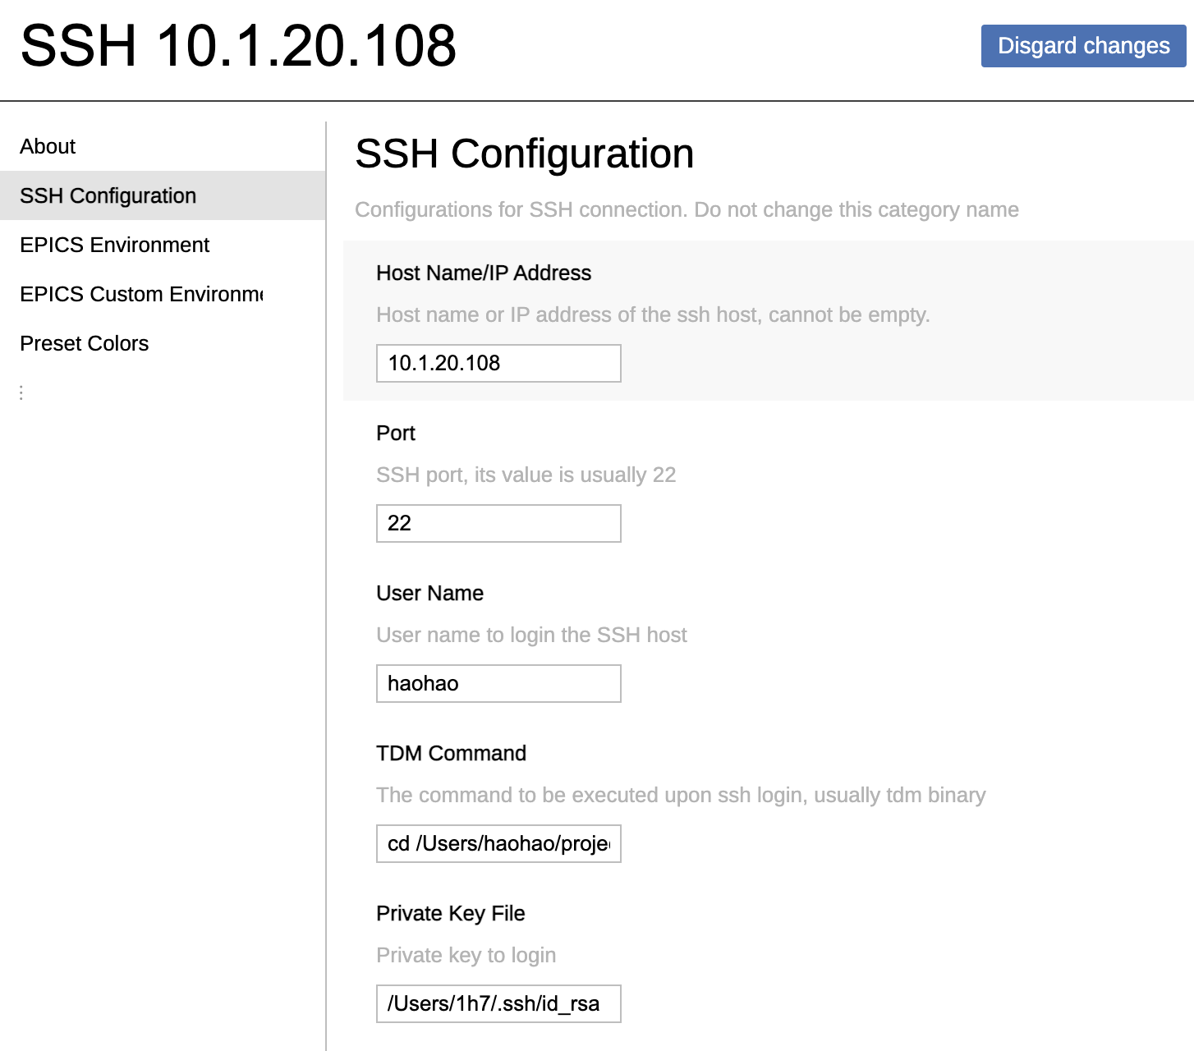
SSH mode
Configure the server
Install TDM, e.g. to /Applications/TDM.app
Configure the client
password-less ssh login
install TDM
/Applications/TDM.app/Contents/MacOS/TDM --main-process-mode ssh-server
The server runs the above command automatically

Slide 20
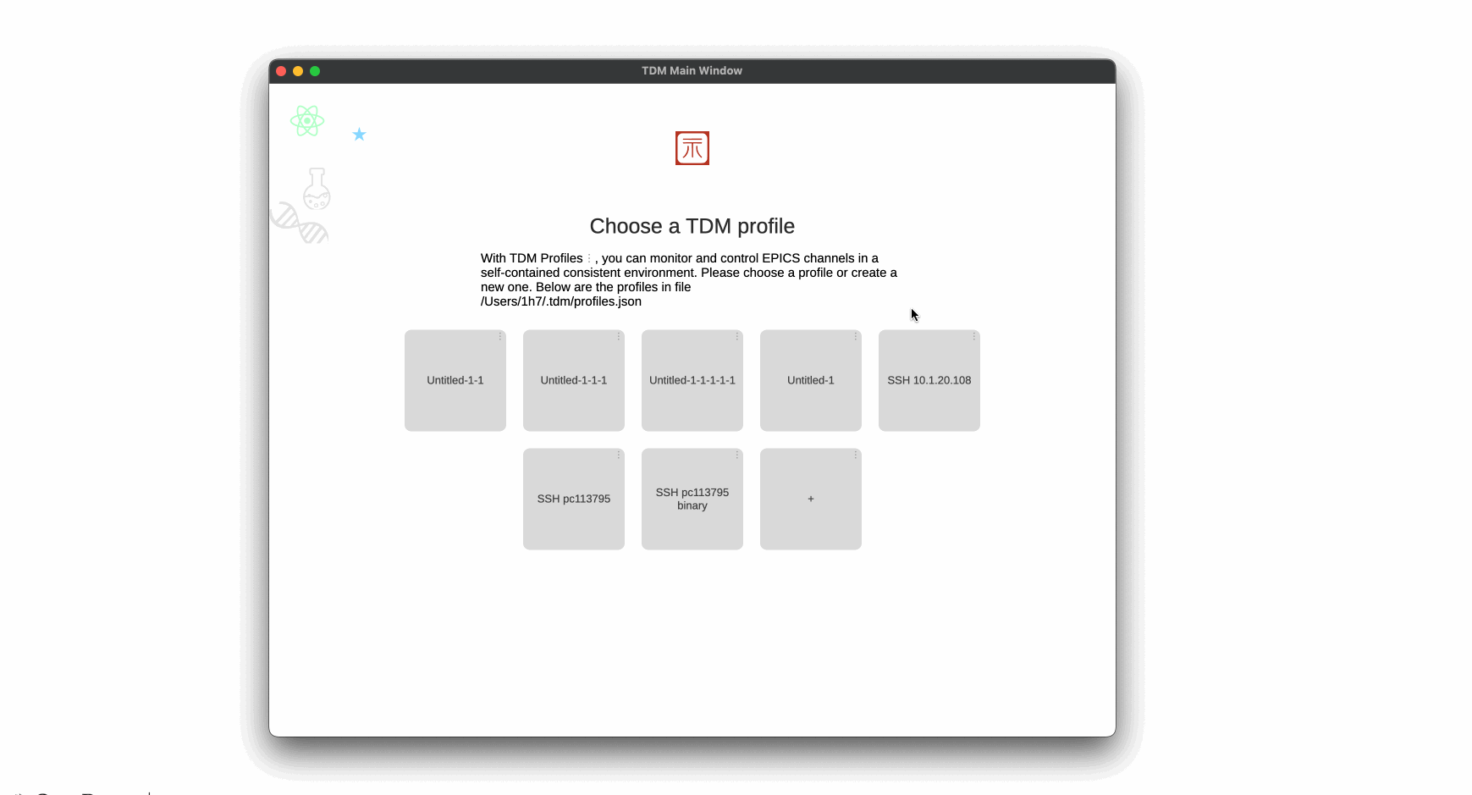
SSH mode – new animation

Slide 21
Revisit SSH mode architecture
IOC
IOC
network
network
SSH tunnel
SSH server
SSH client
CA client
TCP server
Main process
TCP client
Main process
computer B
Web Socket server
computer A
WebSocket
Renderer process
(html page)
computer B
Renderer process
(html page)
Renderer process
(html page)

Slide 22
A website
IOC
IOC
network
network
CA client
Web Socket server
WebSocket
Main process
Renderer process
(html page)
Renderer process
(html page)
Renderer process
(html page)
Web server
electron.js
Web Browser
Start the server
/Applications/TDM.app/Contents/MacOS/TDM --main-process-mode web

Slide 23
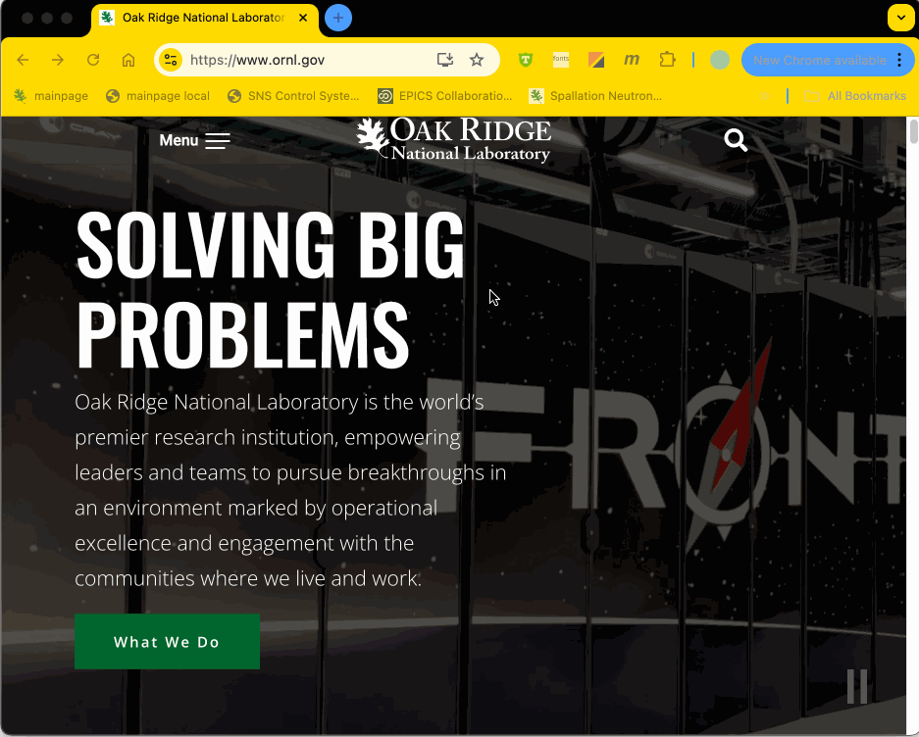
A webpage

Slide 24
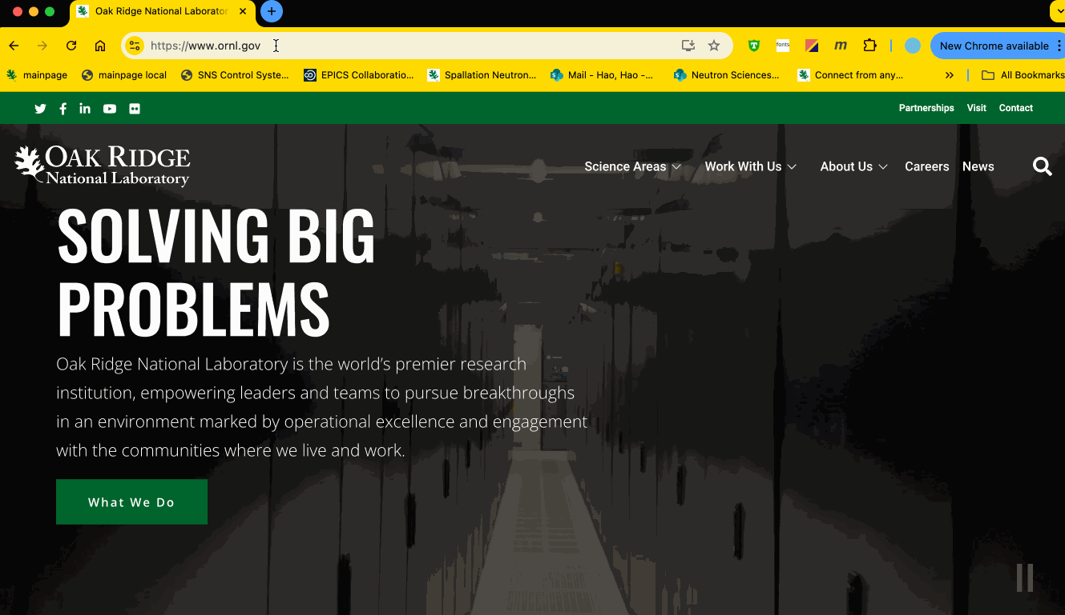
A webpage

Slide 25
Optimization
Speed up the startup
Create a blank electron.js renderer process takes about 300 ms. Create a hidden standby window.
WebPack packages all node.js files into one file, saves 200 ms.
Reduce runtime CPU usage
In most situations, EPICS itself is not a CPU, memory, or network intensive application.
Rendering an element on webpage is expensive. React.js minimizes the rendering cost.
Chromium has a great tool to profile, analyze, and improve efficiency.

Slide 26
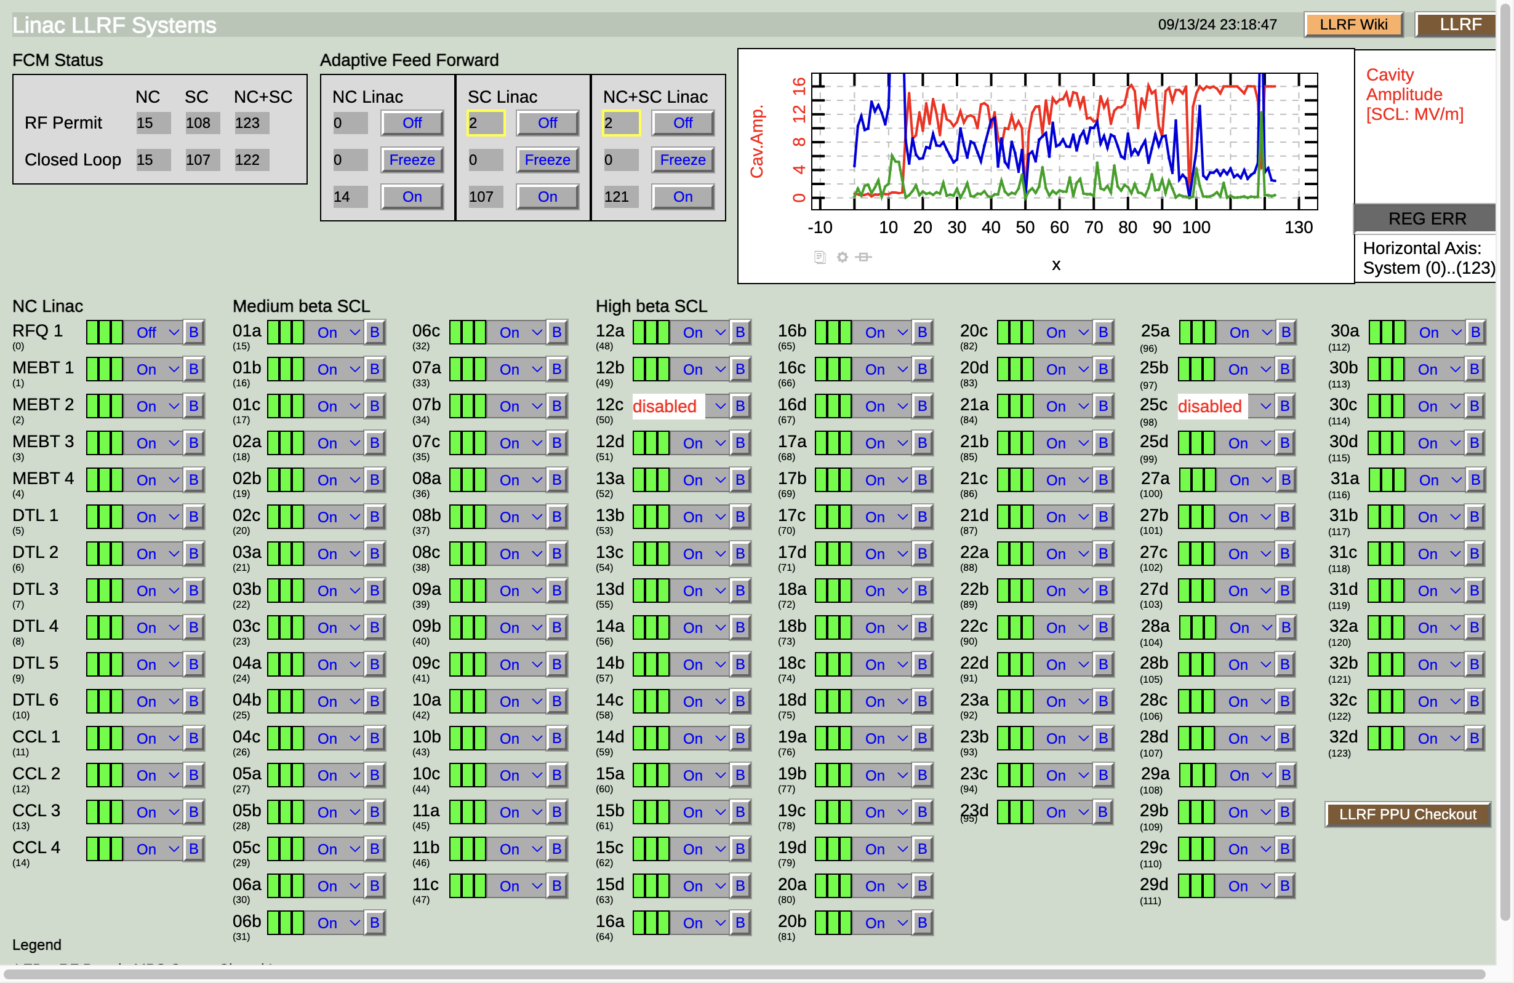
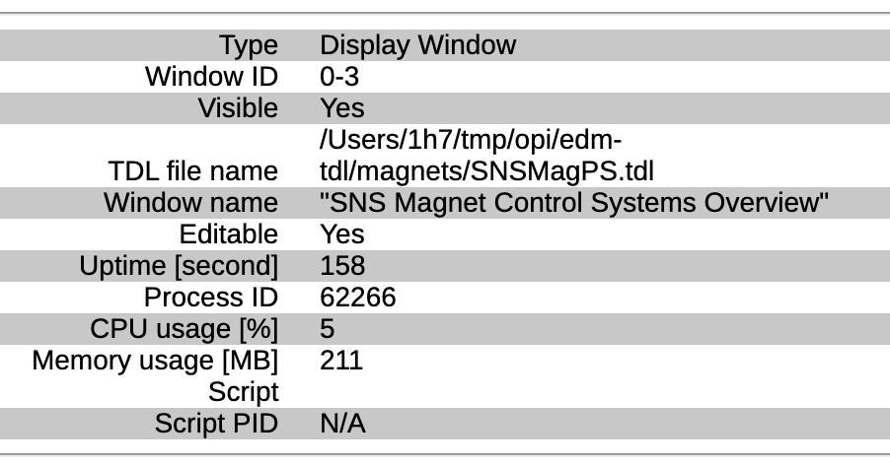
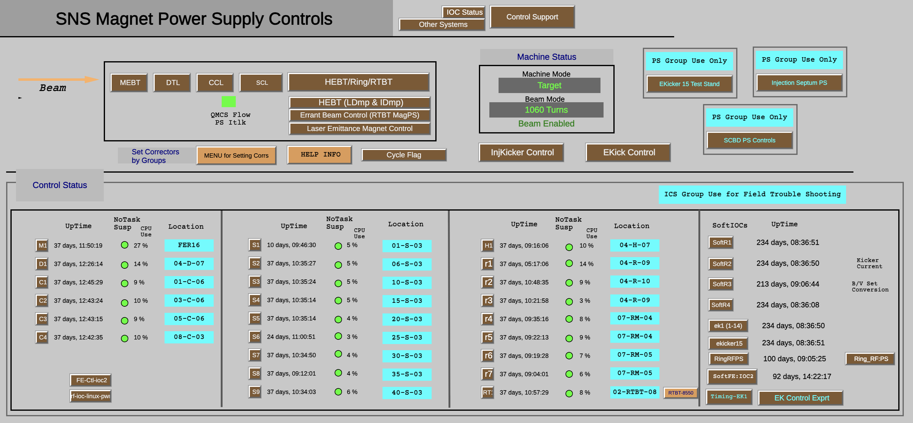
Performance
Open a display that has 1579 widgets costs about 1 s on Macbook pro M1.
A window with 223 widgets costs about 0.5 s.
uncompressed memory

Slide 27
Summary
TDM demonstrates that it is feasible to use web technologies for an EPICS display manager.
Loads of bugs need to be fixed, not ready for production.
New features need to be implemented.
Future technologies?

Slide 28
Thanks!

Slide 29
