Slide 1
Utilizing Python to Support Operational Functions
September 17th, 2024
Notes:
Good afternoon, my name is David Brown and I am one of the Machine Specialists at the Spallation Neutron Source. I am in my 22nd year here and in that time I have been involved in many software projects involving EPICS. Today, however, I wanted to talk about Python and how we are coding to support Operational Functions that aren’t natively handled by EPICs.

Slide 2
Historical Mess
Since the project’s beginning, we have been committed to EPICs
Stability and reliability ruled the day and version control was static, mostly.
There were limitations that needed to be overcome using EPICS 3.14.7, initially.
Creating a line given only points
Copying one waveform to a compress record
Making automated e-log entries
Batch scripting (shell, php, perl)
Perl scripts called from sequencers or c code called from a subroutine record were used to bridge the gap.
Notes:
First I need to say where we came from

Slide 3
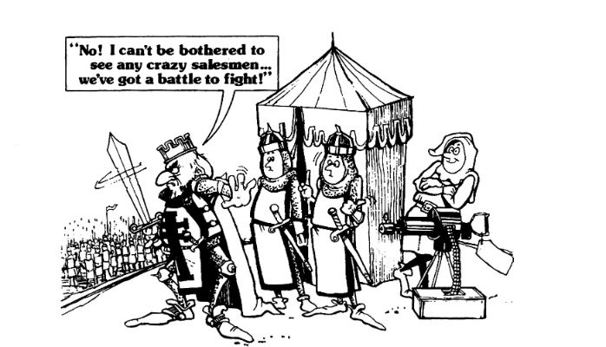
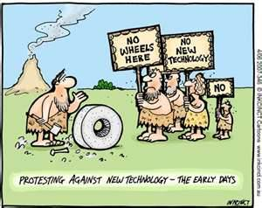
History Doesn’t Have to Define the Future
Notes:
Up until about 5 years ago, this was the norm. The ability to maintain, adapt, or even read in some cases was daunting as many of the originators had left to chase other dreams. Despite mild resistance, Python was declared the path forward specifically for its modern, more readable language, but future proofing and standardization were important, as well. We have since invested a heavy effort into converting perl or php scripts to python or creating new programs out of python.

Slide 4
Python is Easy
Notes:
Python is like the classic game Othello. If this is a game you’ve never heard of, it is a take on the ancient game Go. It had the tagline, “A minute to learn, a lifetime to master”. What we found was that it is easy to get started getting something going in Python, but if you are not methodical in your programming approach, you can easily produce spaghetti code that will cause hate and discontent in the future.

Slide 5
From Modest Beginnings
#!/bin/env python3
# Send value to PVs contained in a file
# Python version of SET_PV.pl Perl script
#
# Author: Klemen Vodopivec
# Created: Oct 1, 2021
import argparse
import sys
from epics import caget_many
parser = argparse.ArgumentParser(description='Retrieve and print value for each PV from a file')
parser.add_argument('PV_file', type=argparse.FileType('r'), help='file of PVs one per line')
parser.add_argument('--suffix', '-s', help='Optional PV suffix', default='')
args = parser.parse_args()
pvs = []
for line in args.PV_file.readlines():
pvs.append( line.strip().split(' ')[0] + args.suffix )
succeeded = True
for i,retval in enumerate(caget_many(pvs, as_string=True)):
if retval is not None:
print('%s\t%s' % (pvs[i], retval))
else:
print('ERROR: Channel failed to connect to %s' % pvs[i])
succeeded = False
if not succeeded:
sys.exit(1)
In addition to using Python, exclusively for scripting, there was a parallel effort to migrate to EPICs 7 directly from EPICs 3.14.12 (very big effort)
Part of that migration included making sure that Python 3.6 and then 3.9 worked with a generic set of libraries in the new 64-bit, Red Hat environments.
Started by migrating screens and converting scripts.
We started with simple generic scripts
GET/SET PV scripts one of which is shown in its entirety
Notes:
Started simple

Slide 6
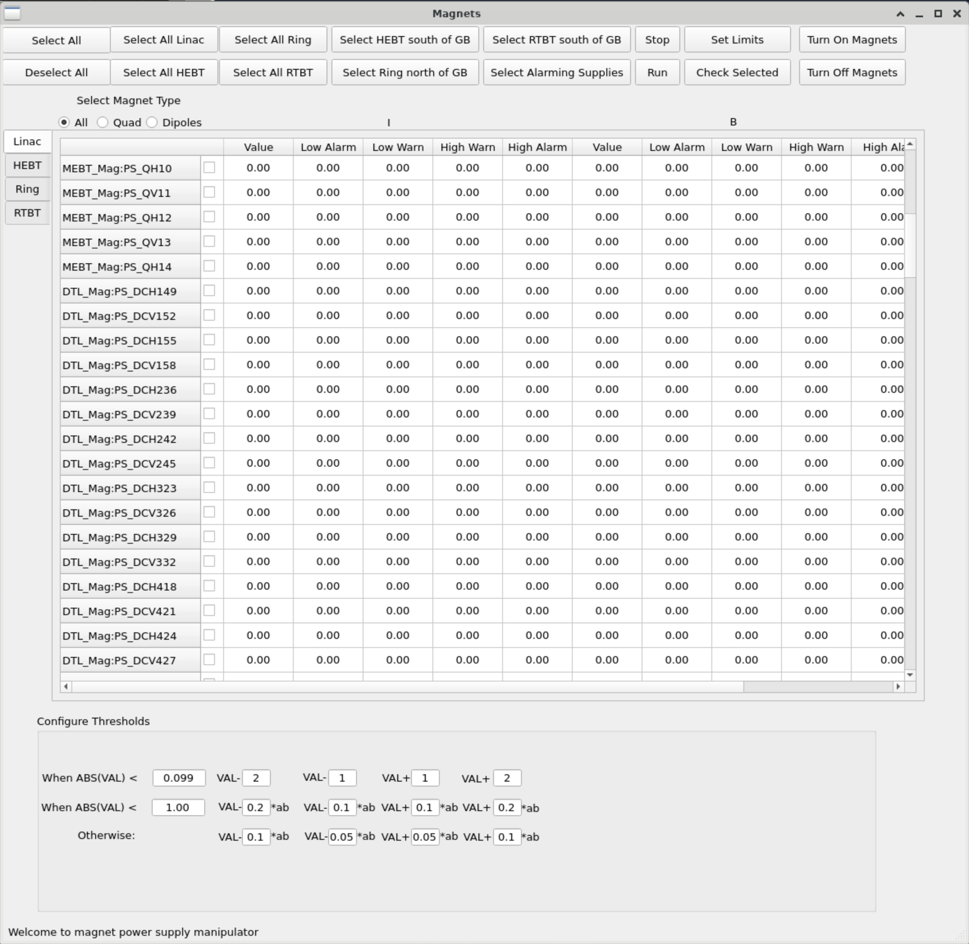
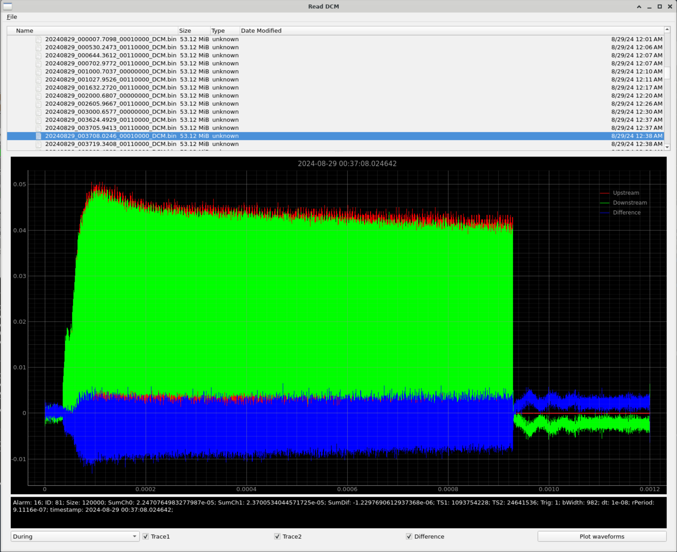
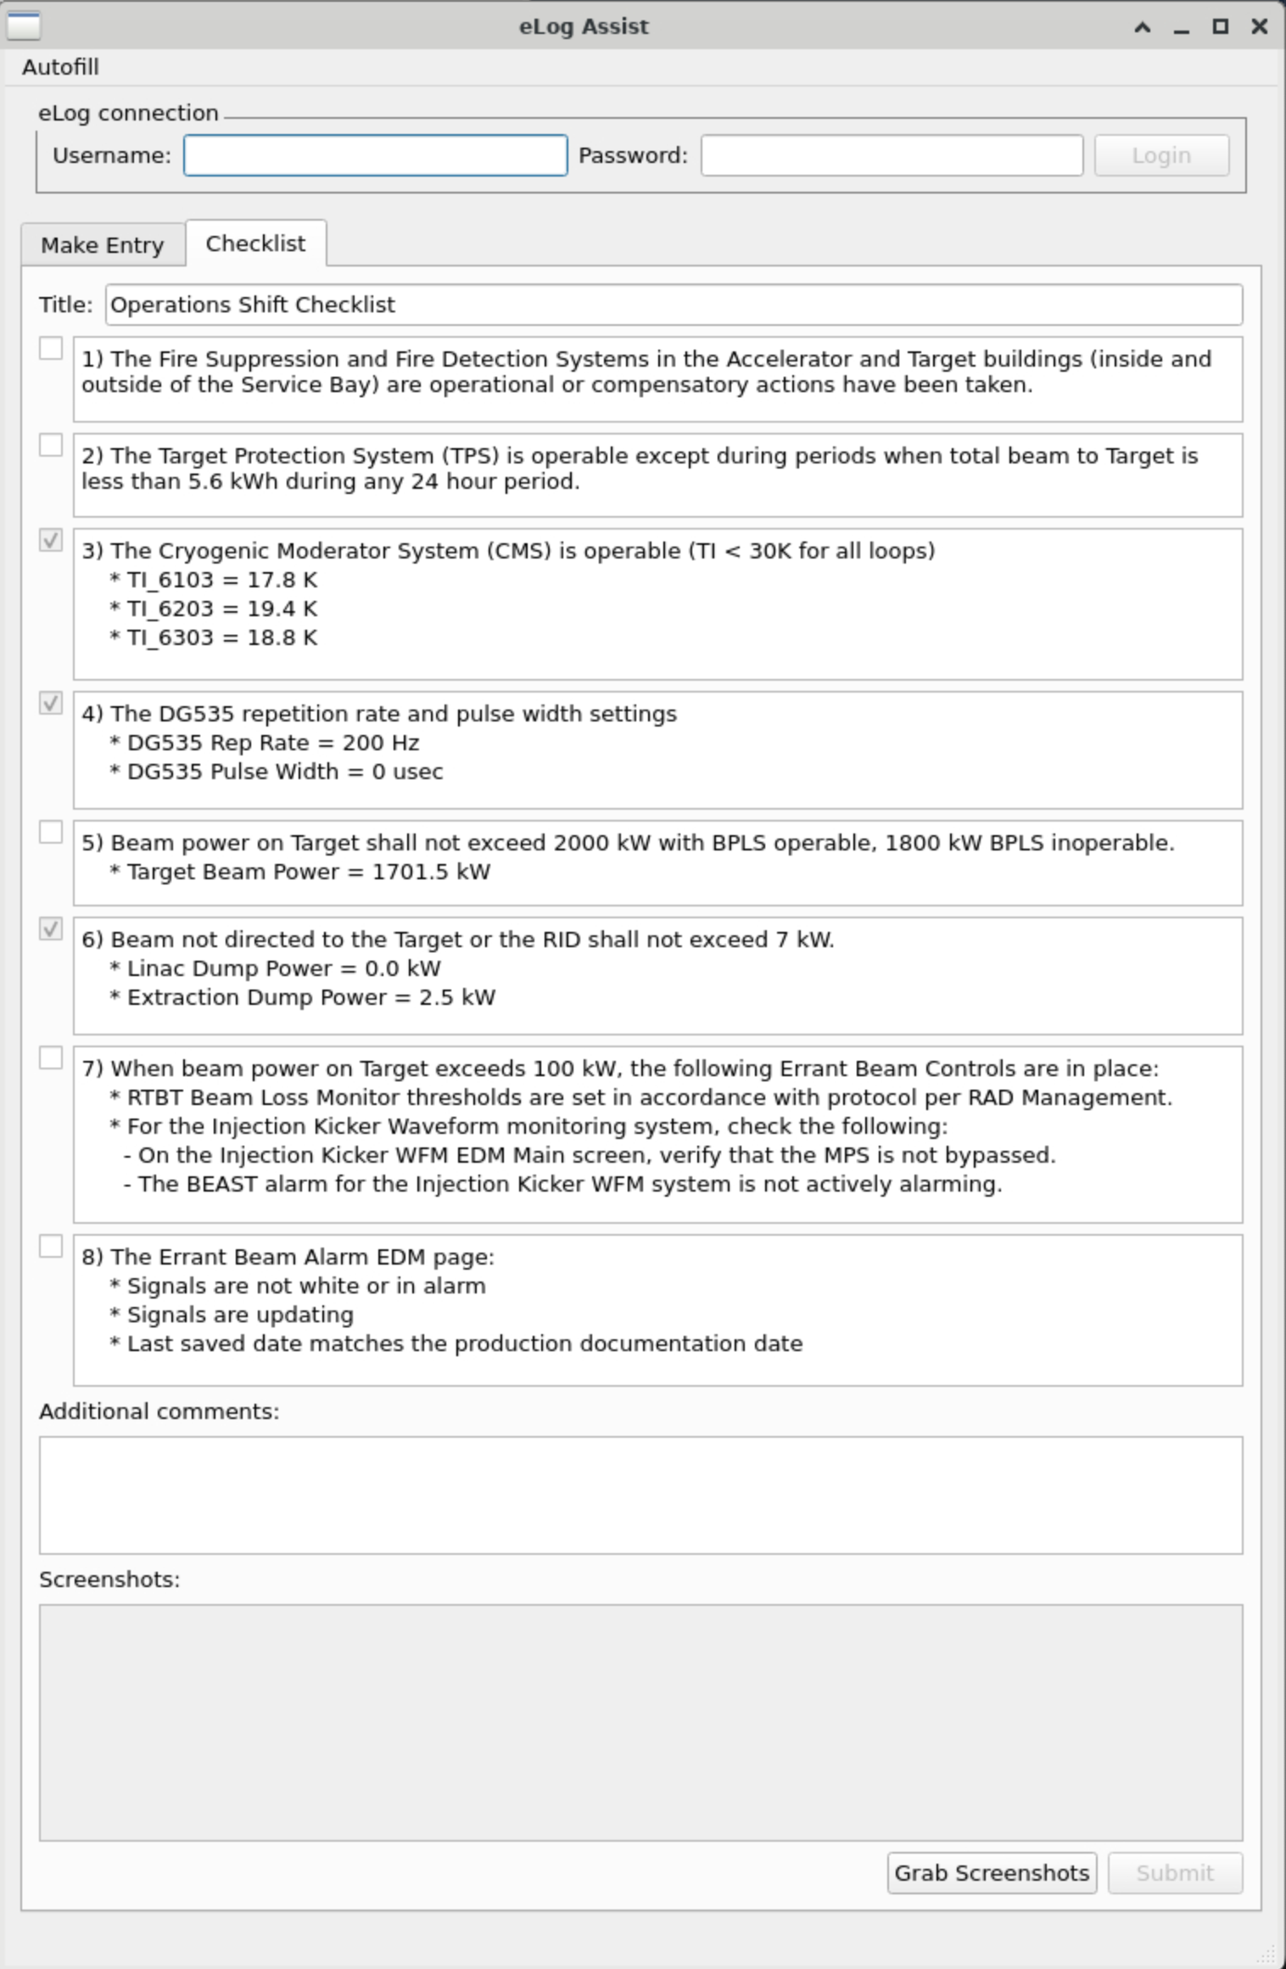
Very Steep Learning Curve
Notes:
We started converting old perl tkinter programs and php scripts into full blown python applications using PyQt based GUIs. It is a much more modern look than the old programs, are more secure, and more robust. It is much more readable, as well, from a programming perspective. We went from no (or very little) institutional Python experience to having full blown programs in a very short period thanks in large part to two or three influential people we have on staff. Operations made most of what you will see in this talk, but we had help from those handful of staff in troubleshooting and guiding us with best practices. Seen here are tools that we use to make e-log entries with pictures and text in addition to making a shift checklist the operators are required to do every shift we are running beam. The next image is a magnet power supply manipulator that turns batches of power supplies on and off and sets alarm limits around the readbacks based on the setpoint. This third program actually displays captured fault data from two devices measuring beam current upstream and downstream and subtracts the difference. Along the way, we had to learn things like how to automatically build nested dictionaries, lists can be keys, and threading is nice to be able to use GUIs. If any of what I just said bores you, its over, but if you understood it, welcome home.

Slide 7
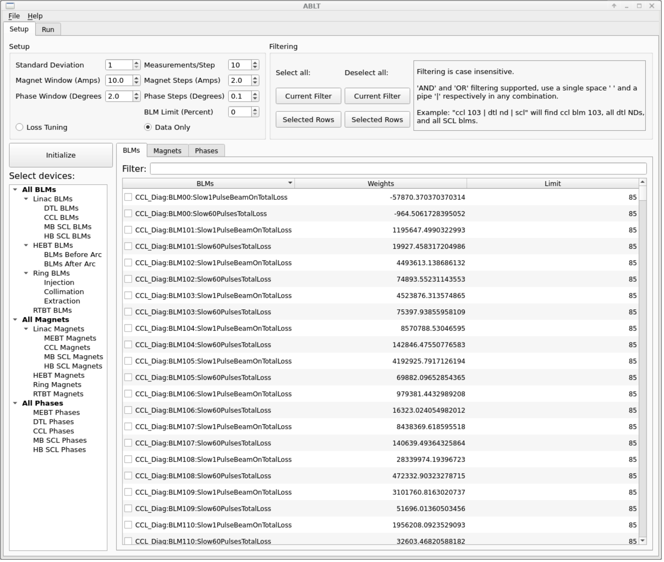
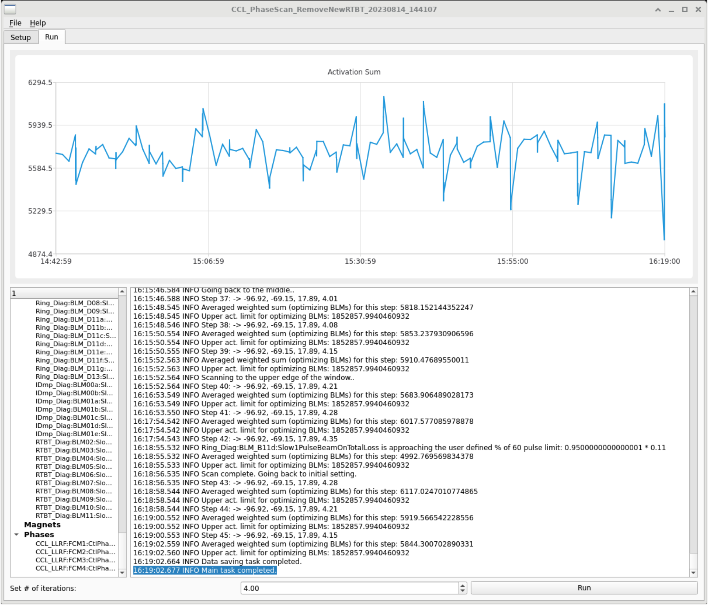
Automated Beam Loss Tuning App (ABLT)
Notes:
This project is easily the most challenging one that we have undertaken under direction of one of our physicists. It is designed to take in loss pattern data and make small adjustments upstream to lower losses. This is still in development, but we were actually able to run a small test on the production machine with huge success. Shown here is one of the readbacks called activation sum that we developed to match our loss monitor readbacks to activation levels. The next step is to use it on our test stand for long term testing, and, when completed, will replace the need for hand tuning by experts.

Slide 8
Python Generates EPICs/EDM Files
Notes:
Alarms are a central indication for Operations and we have developed alarm handlers for all of our usual alarms with the ability to easily adjust alarm limits and and mask them, if necessary. These summaries are then entered into the BEAST for annunciation. This is one example of a set of database files and EDM screens that are completely generated with python scripts and config files, which makes maintenance much easier when PVs change or additions or subtractions are necessary.

Slide 9
Mimir
Notes:
Using Pcaspy, we are able to use Python to launch a channel access server that generates process variables. An example of such an instance is our virtual accelerator running on a virtual machine named Mimir. In full transparency, this was not an operations developed program. It was developed by our Physics group, and they developed a new pyorbit model to determine the behavior of the virtual accelerator bunch precession. We use this setup for software development and for training operators how to use XAL Apps.

Slide 10
MKS RGA Driver
Notes:
This is our Pydev portion of the talk. Pydev is a project that allows existing record types to execute python code directly from the record. In introducing the shown program, I have to start off by saying that this is a program using an MKS driver controlling a residual gas analyzer developed many years ago by people at SLAC who were nice enough to share with us, and we were able to adapt it and get it running on one of our accelerating cavities to troubleshoot why it was faulting. Recently, we tried it on a different residual gas analyzer, but it didn’t work when migrated to the new system. It was discovered that the subArray calling C-code wasn’t working on EPICs 7. We fixed it by replacing four records dependent on the C-code with four records, three of which were pycalc records completely replacing over 300 lines of C-code.

Slide 11
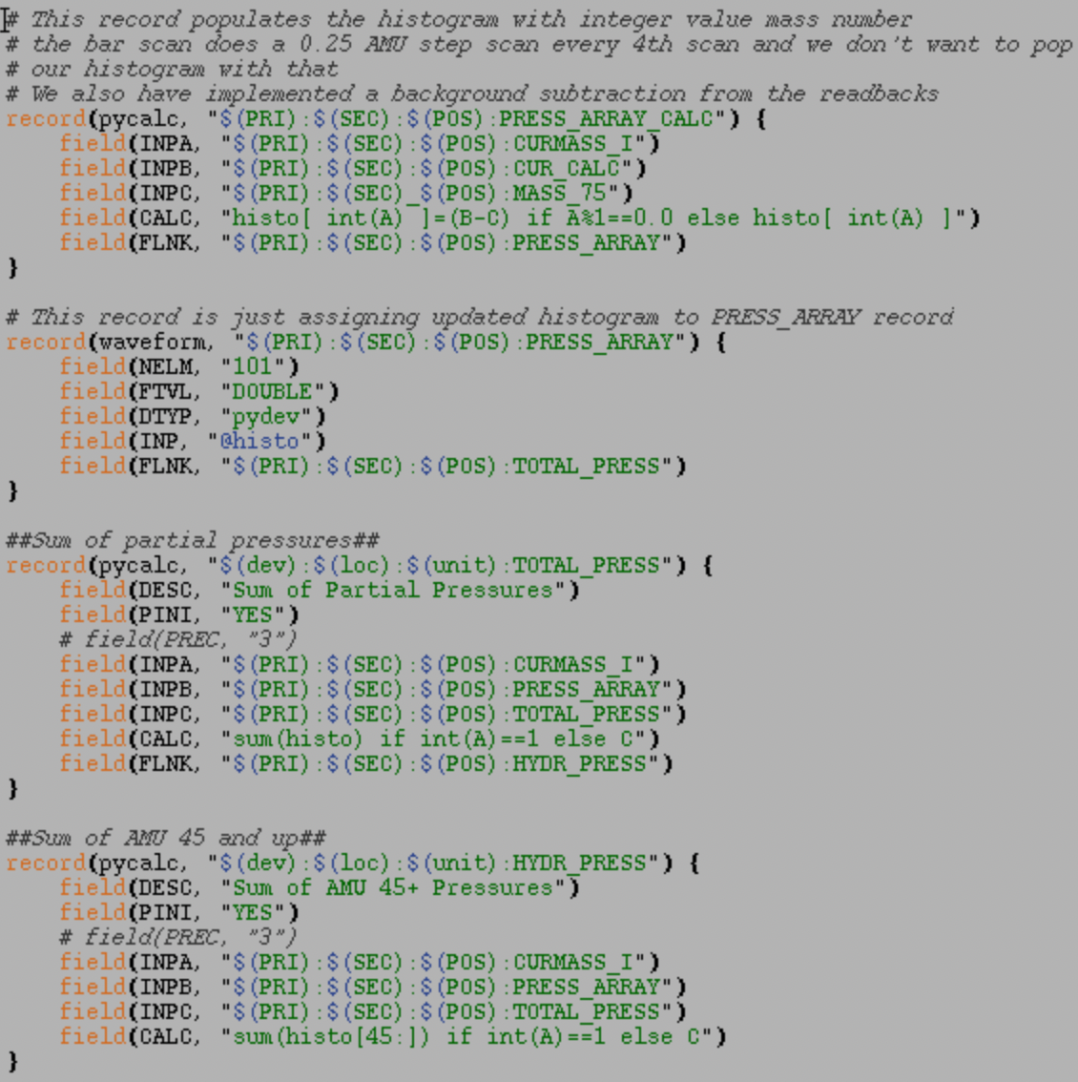
Code replacing the subArrays with Pydev
Notes:
Pycalc is a new record type dependent on PyDev that calls Python code in the CALC field using inputs imported through INPA-INPL fields of the record. This was a natural transition to pydev/pycalc after our journey becoming more and more familiar with Python.

Slide 12
AFF Save/Restore
Notes:
Adaptive Feed Forward is a LLRF feedback to compensate for beam loading and constantly learns on beam pulses. After about 10 minutes of beam off, however, LLRF clears the registry and has to re-learn, but the losses in the Linac suffer until it resolves the solution. We have a program that allows us to save a state and push a good state to the LLRF AFF registers to give it a head start. This is another example of a program that utilizes C-code to copy an array from one record to another, which we have rewritten with pycalc to completely abandon the external C-code, make it more readable, and make it much more maintainable.

Slide 13
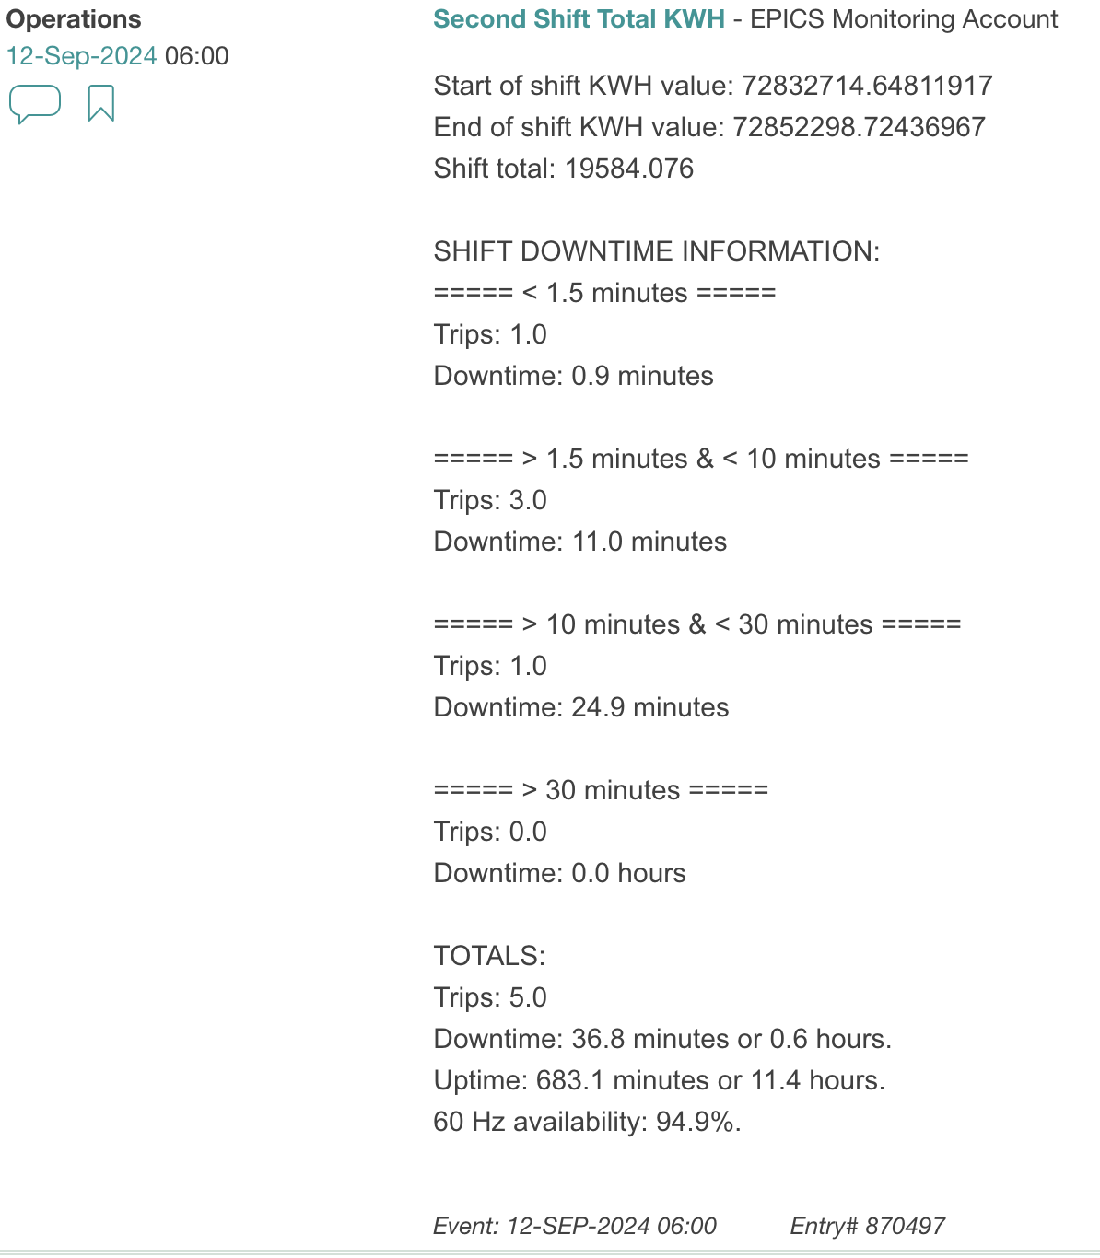
Automatic Logbook Entries
Script to automatically make entries every 12 hours showing how many KWH were delivered and show availability/downtime trips.
In the process of converting a perl script to python that automatically makes elog entries about trips that happen within seconds of the trip happening making the entries more consistent with the same information.

Slide 14
Conclusions
Python is decidedly our path forward
We are developing a team of python programmers for robustness and redundancy.
PyDev/PyCalc will be replacing all C-code calls from subarray
Makes code more readable and more compact
Not all of those python programmers know PyDev/PyCalc, or even EPICs database programming
We can still launch a channel access server using pcaspy without a softioc.

