Slide 1
EPICS Collaboration Meeting Closeout Karen S. White
September 19, 2024

Slide 2
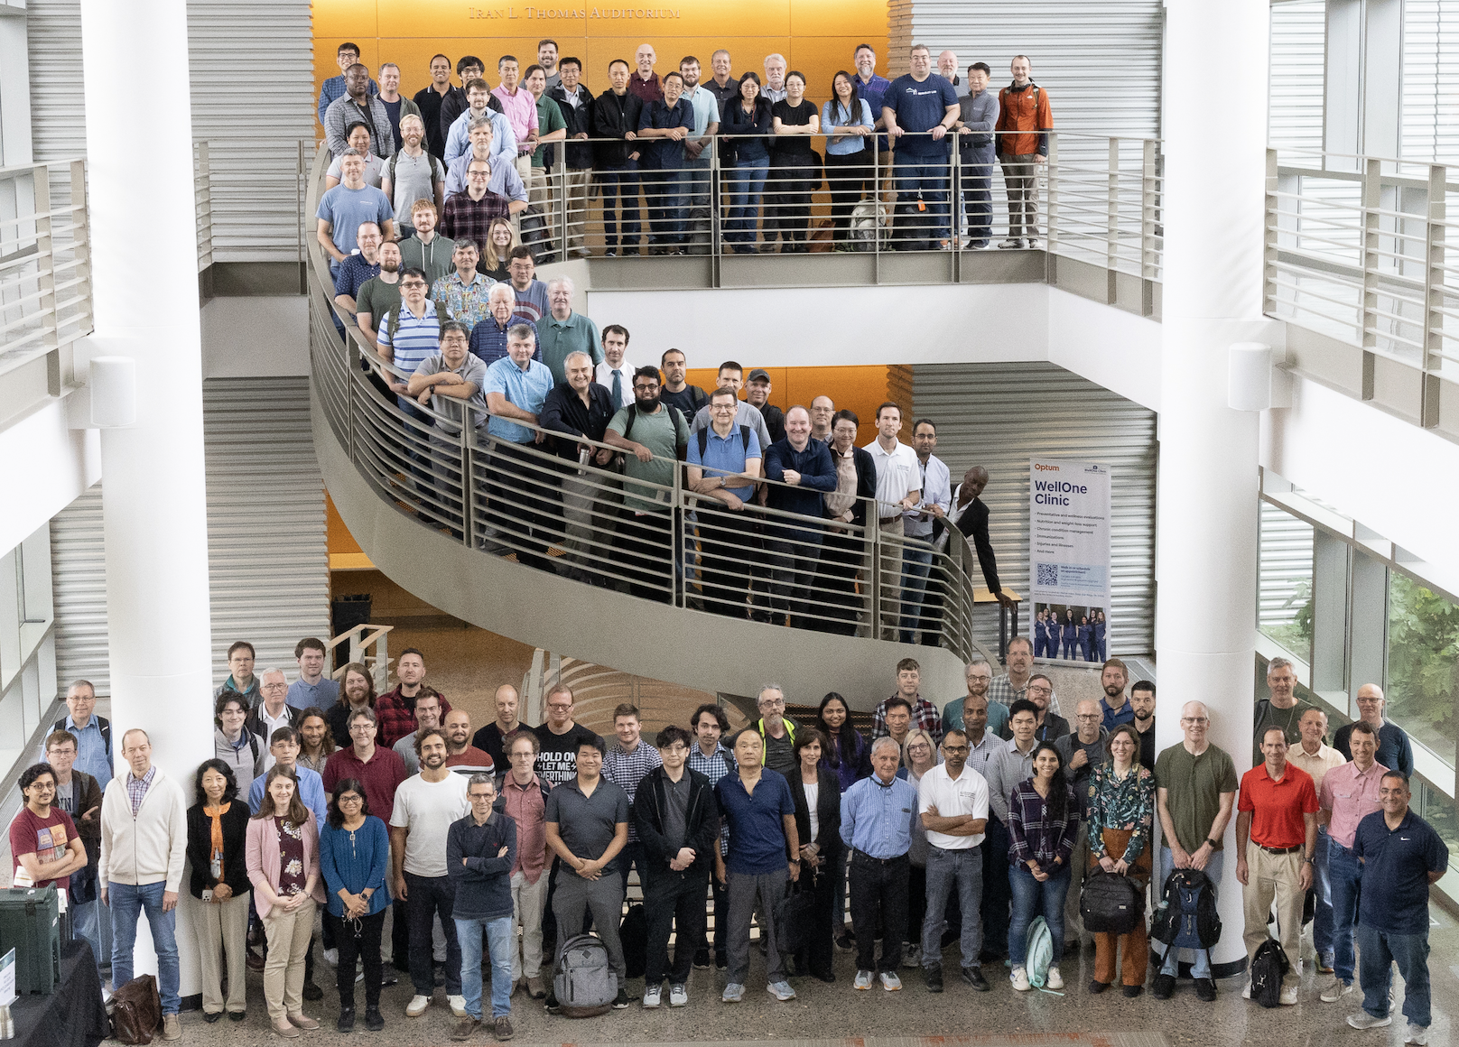
Thank You!
Organizing committee
Kay Kasemir
Steven Hartman
Klemen Vodopivec
Karen White
Kristin Massengill
Others who
Chaired sessions
Handled microphones
Uploaded talks
And more
Attendees (158)
Chaired sessions
Handled microphones
Uploaded talks
EPICS is only as good as its collaborators

Slide 3
By the numbers
1 great EPICS Collaboration Meeting
5 days
158 attendees
8 satellite meetings
54 Talks
Endless networking
Notes:
In case of emergency follow instructions from an ORNL employee or PA announcements
Assembly points – Exit through the emergency exits near the stage or lobby front doors, assemble just past the flagpole
Your visitor badge allows you to be unescorted in this building (8600)
Please obey all safety postings – most relevant for the tours on Friday
While you are at ORNL, please do not take photographs of areas that indicate photography is forbidden
Our planned tour route allows photos at all locations

Slide 4
Collaboration Meetings
EPICS Collaboration Meetings
2024-1 Pohang South Korea
hosted by Pohang Accelerator Laboratory
2024-2 Oak Ridge, Tennessee September 2024
Hosted by Oak Ridge National Laboratory
2025-1 (Spring)
TBD – looking for a European host
2025-2 Chicago, Illinois
Hosted by Argonne National Laboratory in conjunction with ICALEPCS 2025
Code-a-thon, Document-a-thon
June 2024 Long Island, New York
Hosted by Brookhaven National Laboratory
February 2025
Hosted by Diamond Light Source
Notes:
In case of emergency follow instructions from an ORNL employee or PA announcements
Assembly points – Exit through the emergency exits near the stage or lobby front doors, assemble just past the flagpole
Your visitor badge allows you to be unescorted in this building (8600)
Please obey all safety postings – most relevant for the tours on Friday
While you are at ORNL, please do not take photographs of areas that indicate photography is forbidden
Our planned tour route allows photos at all locations

Slide 5
You might also like…ICALEPCS
International Conference on Accelerator and Large Experimental Control Systems
September 20-27, 2025
Chicago, Illinois
Hosted by Argonne National Laboratory
October 2027
Japan
Hosted by KEK
Notes:
In case of emergency follow instructions from an ORNL employee or PA announcements
Assembly points – Exit through the emergency exits near the stage or lobby front doors, assemble just past the flagpole
Your visitor badge allows you to be unescorted in this building (8600)
Please obey all safety postings – most relevant for the tours on Friday
While you are at ORNL, please do not take photographs of areas that indicate photography is forbidden
Our planned tour route allows photos at all locations

Slide 6
How do we pay for EPICS?
EPICS is open source but not free, but also not funded
The EPICS Collaboration does not receive any specific funding to maintain and improve the software, but this work is essential to ensure future viability
The collaboration relies on donated labor from organizations using EPICS software
The collaboration provides an incredible community of support (free)

Slide 7
You and your organization can should help
If your organization benefits from EPICS, consider how you can help
New projects are well positioned to fund new capabilities
Tell your boss EPICS needs your organization to donate time/money to help with maintenance, testing, support, development or documentation
You can donate labor or fund a contract developer
What would you use if you did not have EPICS?

Slide 8
How can you get involved?
Opportunities to join working groups such as EPICS core, CS-Studio, more
Send someone to a code-a-thon or document-a-thon
You can work with international experts => develop more advanced skills that benefit your professional development and your effectiveness for your home organization
Leadership, host an EPICS Collaboration Meeting, code-a-thon, document-a-thon or developer’s meeting
“Win-win-win: Good for you, good for your lab, good for EPICS”
– Ralph Lange

Slide 9
Workshops on Friday
9:00 am
Cyber Security 8610, L-183, overflow L-182 these rooms are in the adjacent building
Bluesky C-464
Motors J-337, overflow AG-05
10:50 am
Timing AG-07
Tour 1:40 pm – meet in the front of the building by the flagpole
Food - Located in C-150 on Friday
We won’t have the tables in the lobby or hallway Friday
Please get your food in C-150 and eat in your workshop rooms or the patio on the ground level (go down the spiral staircase)
Notes:
In case of emergency follow instructions from an ORNL employee or PA announcements
Assembly points – Exit through the emergency exits near the stage or lobby front doors, assemble just past the flagpole
Your visitor badge allows you to be unescorted in this building (8600)
Please obey all safety postings – most relevant for the tours on Friday
While you are at ORNL, please do not take photographs of areas that indicate photography is forbidden
Our planned tour route allows photos at all locations

