Slide 1

EPICS Collaboration Meeting
Welcome
September 17, 2024

Slide 2
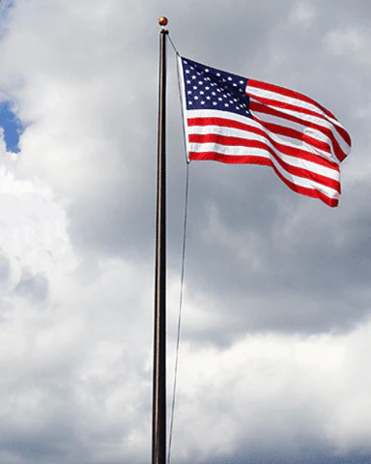


Safety first
Notes:
In case of emergency follow instructions from an ORNL employee or PA announcements
Assembly points – Exit through the emergency exits near the stage or lobby front doors, assemble just past the flagpole
Your visitor badge allows you to be unescorted in this building (8600)
Please obey all safety postings – most relevant for the tours on Friday
While you are at ORNL, please do not take photographs of areas that indicate photography is forbidden
Our planned tour route allows photos at all locations

Slide 3


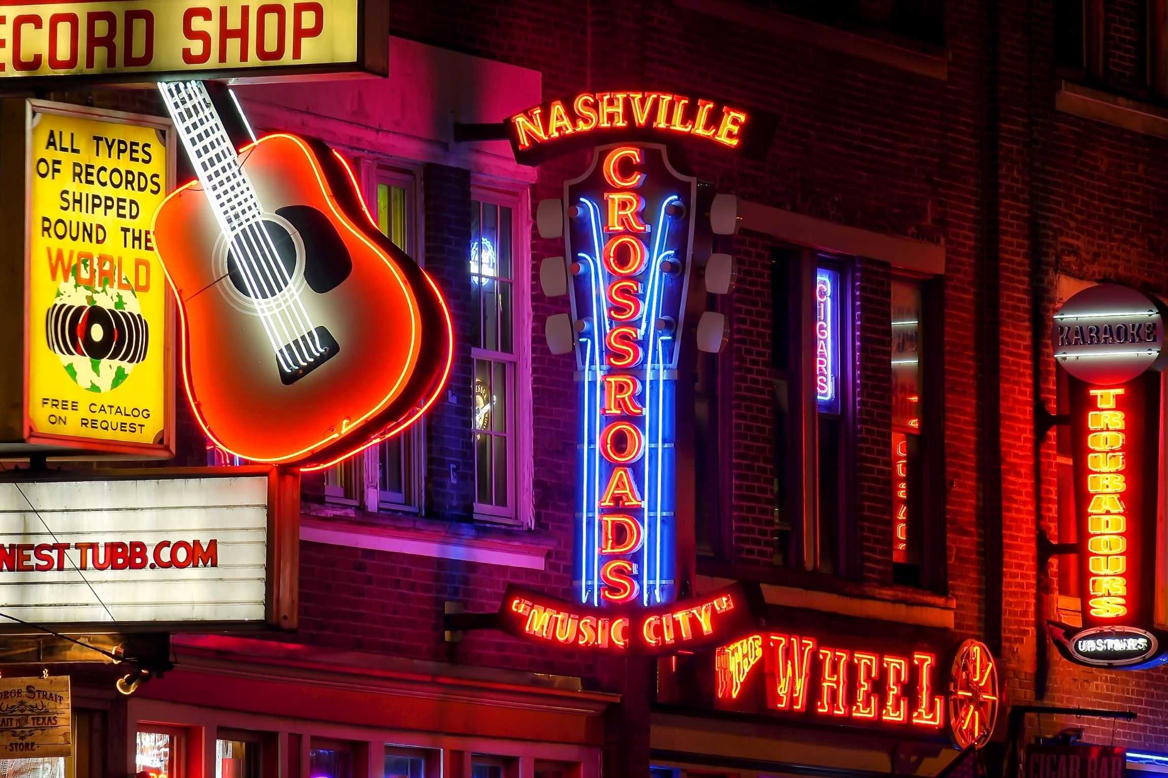


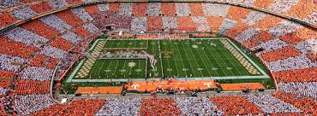








Welcome to Tennessee
Notes:
148 Participants including 12 remote

Slide 4

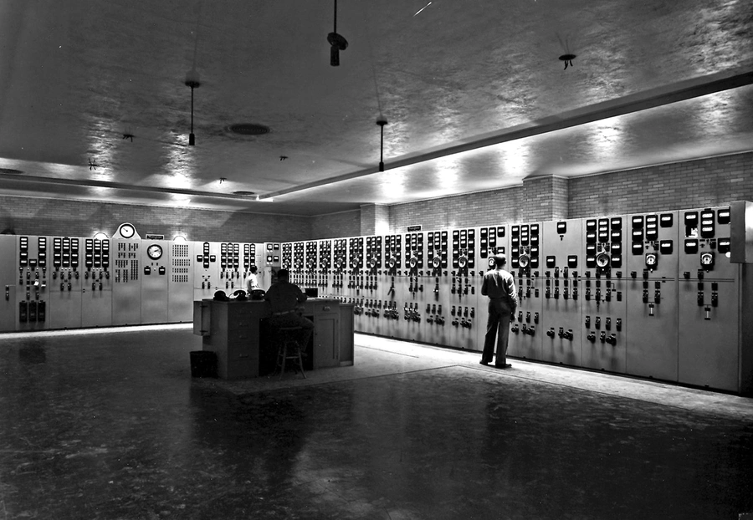
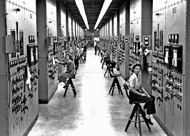
Welcome to ORNL

Slide 5
Logistics
Coffee, tea and light refreshments will be available for the morning and afternoon breaks
Lunch will be provided in the lobby area, different location Friday
We will have a group photo at the start of our morning break today
Please gather on the circular staircase

Slide 6
About this meeting
~150 registered participants
12 remote

Slide 7
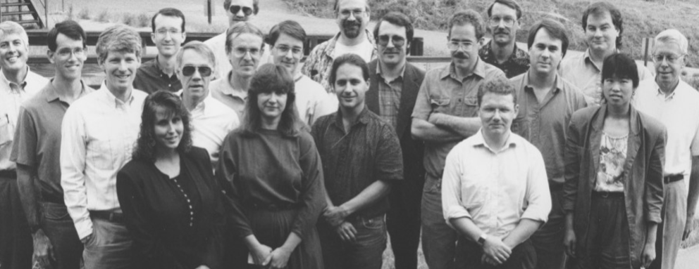

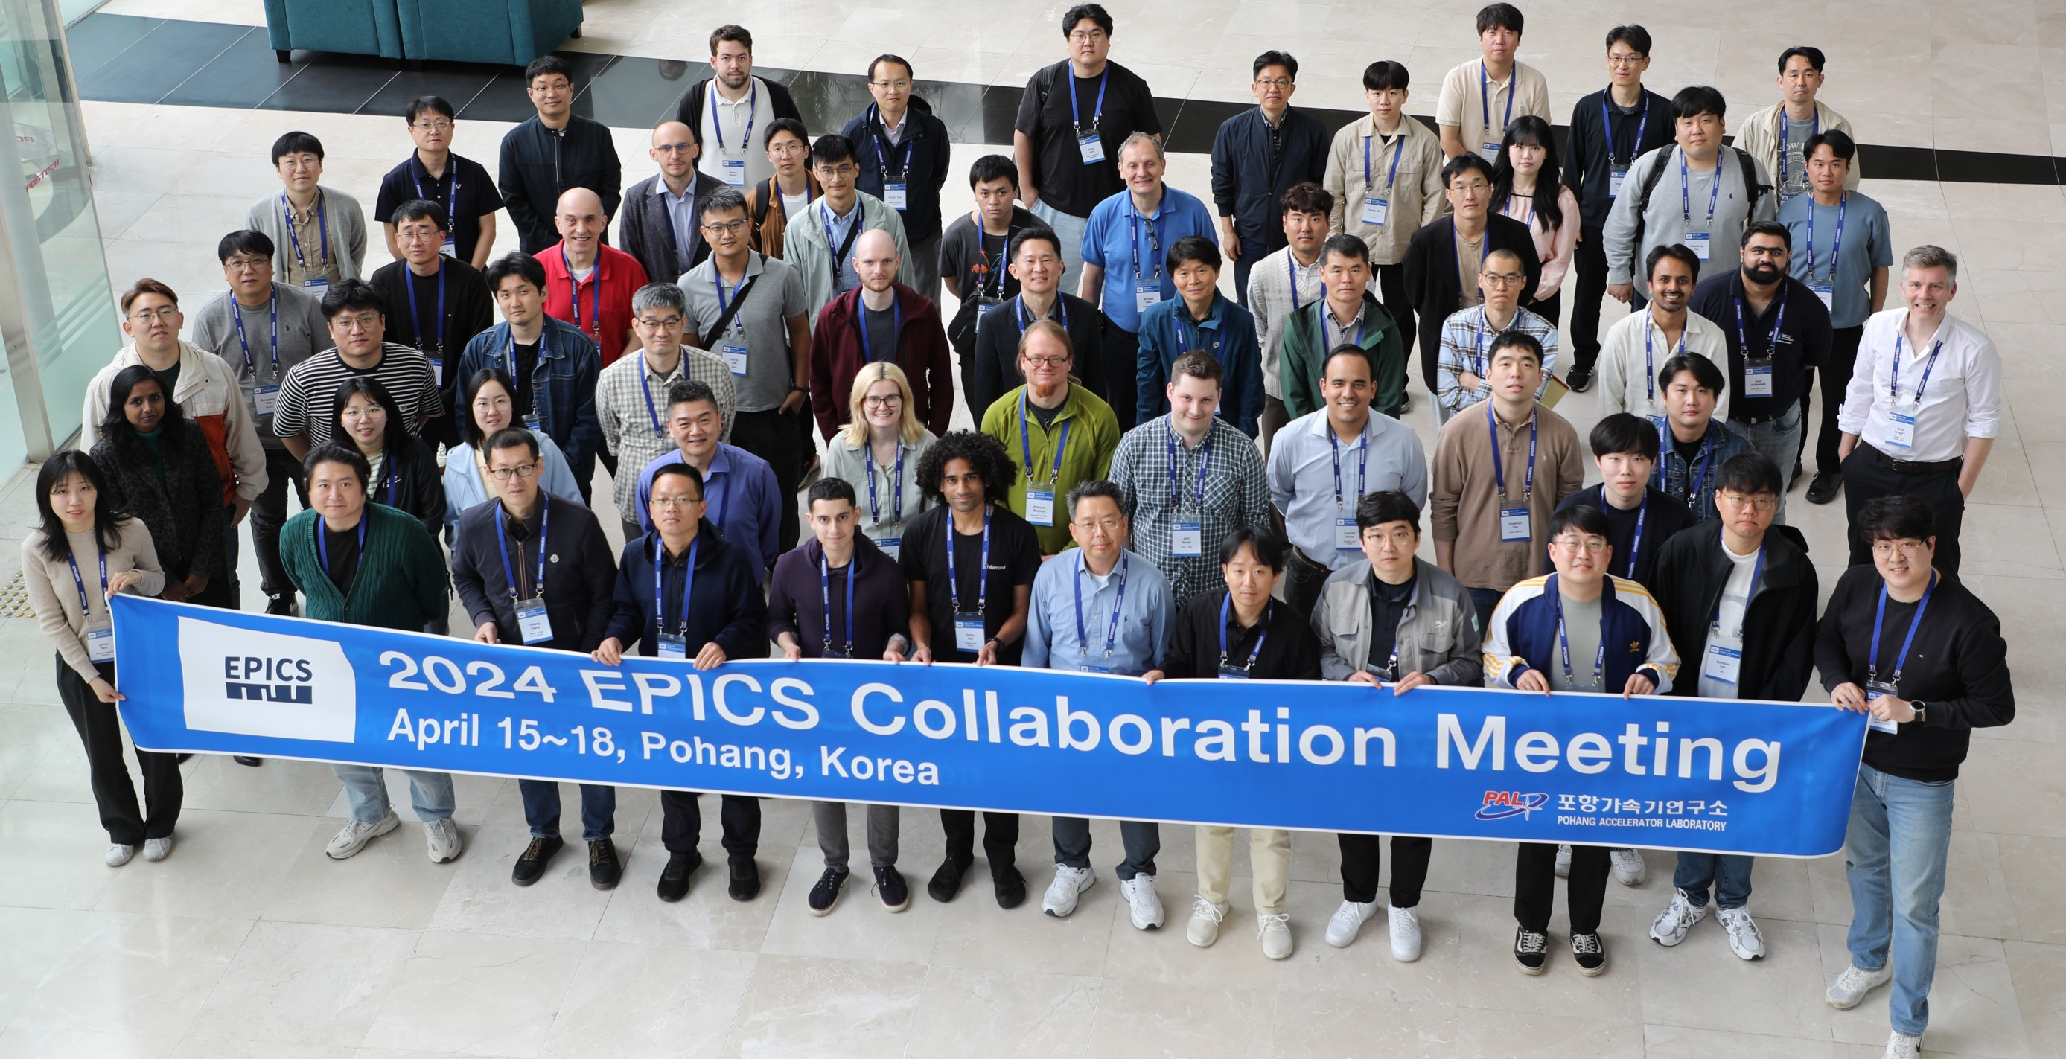

EPICS is 35

