Slide 1
Overview of Reflectometry Detector Technologies
Anton Khaplanov
Neutron Detectors Lead
QIKR Detector PDR
2024-12-16

Slide 2
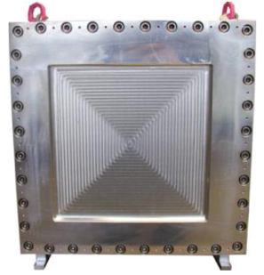
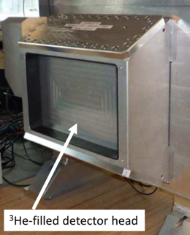
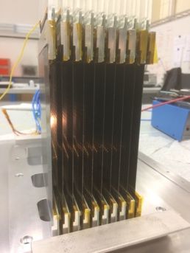
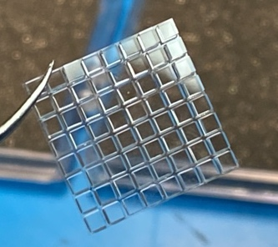
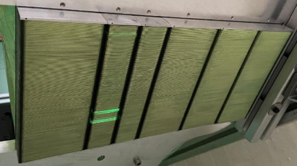
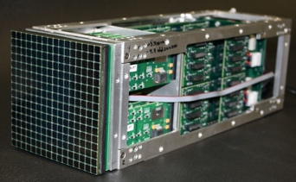
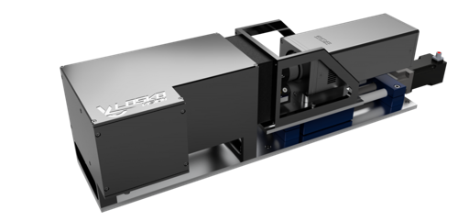
Reflectometer Detector Options
MWPC
Multi-Tube
WLSF
Multi-Blade
Anger Camera
Pixel Camera
LumaCam
Ex. instruments:
LiqRef, MagRef, SupeADAM
(also on SANS, diff.)
Built by:
(BNL), Denex, ILL
Advantages:
High efficiency
Low gamma
Limitations:
Disadvantages:
(Very) low rate
Thick window
Ex. instruments:
FIGARO, D17, PLATYPUS
(also on SANS, diff.)
Built by:
ILL
Advantages:
High efficiency
Low gamma
Limitations:
Asymmetric pixels
Disadvantages:
Medium rate
Ex. instruments:
INTER
(also on diffraction)
Built by:
ISIS, SNS
Advantages:
High efficiency
Low gamma
Limitations:
Asymmetric pixels
Disadvantages:
Medium rate
Ex. instruments:
None
Planned: ESTIA, FREIA
Built by:
ESS
Advantages:
Medium-high rate
Low gamma
Limitations:
Asymmetric pixels
~40% efficiency
ASIC readout
Disadvantages:
Uniformity
Ex. instruments:
None
(several diffractometers)
Built by:
SNS
Advantages:
Medium-high rate
Sufficient resolution
Limitations:
Gamma sensitivity
Rate currently not enough
Disadvantages:
Low radiation hardness
Ex. instruments:
None
Built by:
SNS (pending R&D)
Advantages:
Very high rate
Limitations:
Large Pixels
Disadvantages:
High gamma sensitivity
Pixel gaps
Ex. instruments:
Imaging at LANL, PSI
(Tested in many instruments)
Built by:
LoscoVision / ASI
Advantages:
High rate
Very high resolution
Flexible configuration
Likely several instruments
Limitations:
Improvements pending
Disadvantages:

Slide 3
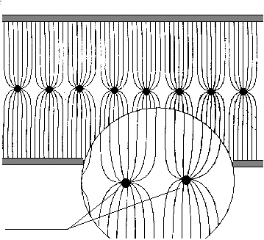
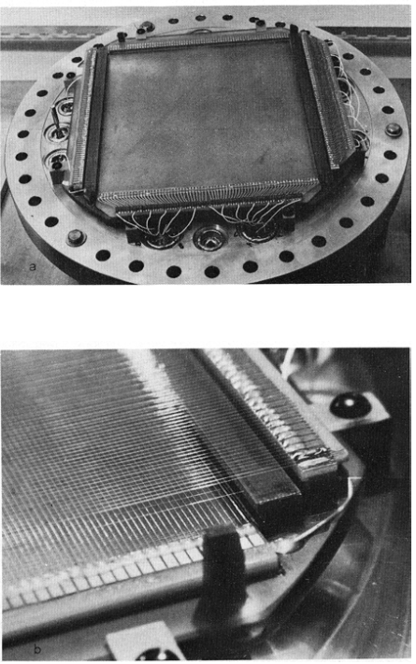
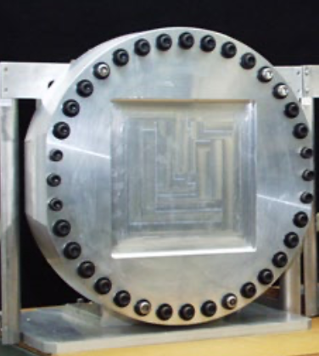
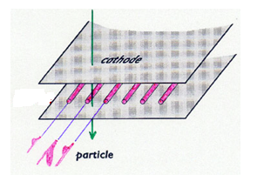
Multi-Wire Proportional Counter – SNS (BNL), ILL, Denex
Cathode
Cathode
Anodes
- wires
Electric field
R.B. Boie et al. 1982 “Thermal neutron detector”

Slide 4
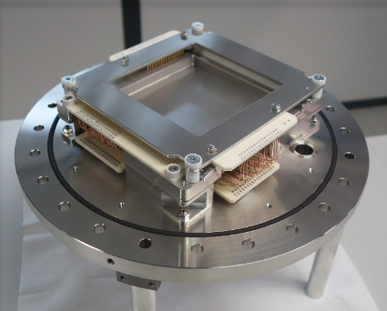
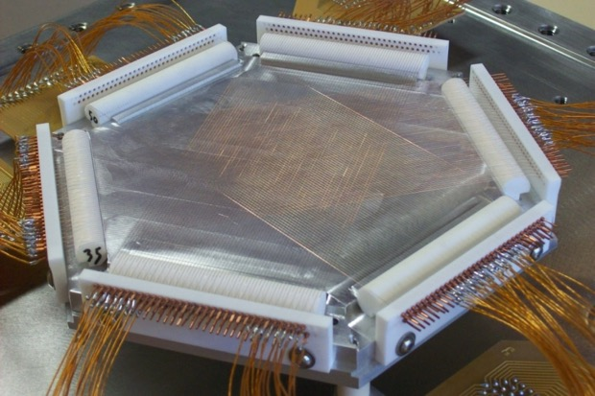
Multi-Wire Proportional Counter – SNS (BNL), ILL, Denex
Some ILL MWPCs
Classical x-y MWPC
Hexagonal MWPC – avoids coincidence ambiguity… but not very practical.

Slide 5
Multi-Tube Detector – ILL, ANSTO
³He tubes of various dimensions
Not limited to cylinders
Charge division readout
Aluminium body
Up to 40kHz per cm² (continuous)
Straight Multi-Tube
SANS: D11,
Reflectometer: FIGARO, D17, PLATYPUS (ANSTO)

Slide 6
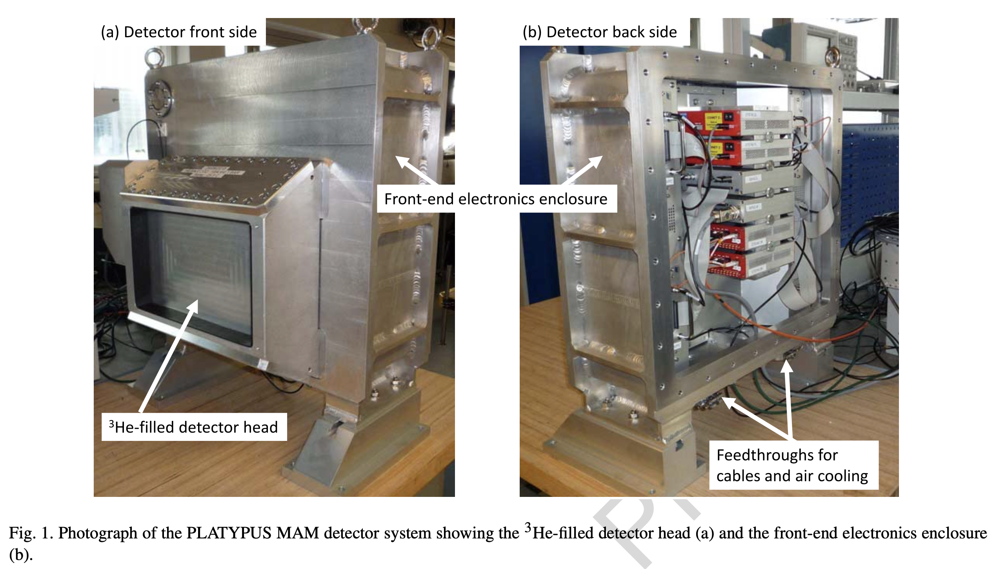
Multi-Tube Detector – ILL, ANSTO
J. Marchal et al., JINST 23 53-67 (2021)

Slide 7
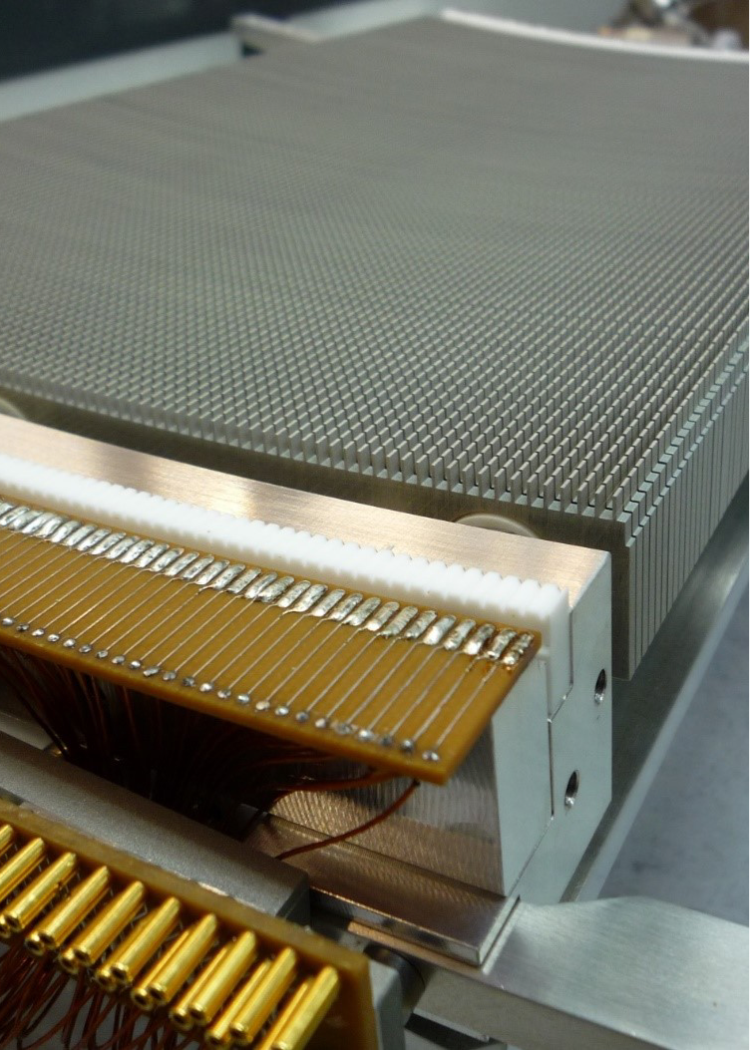
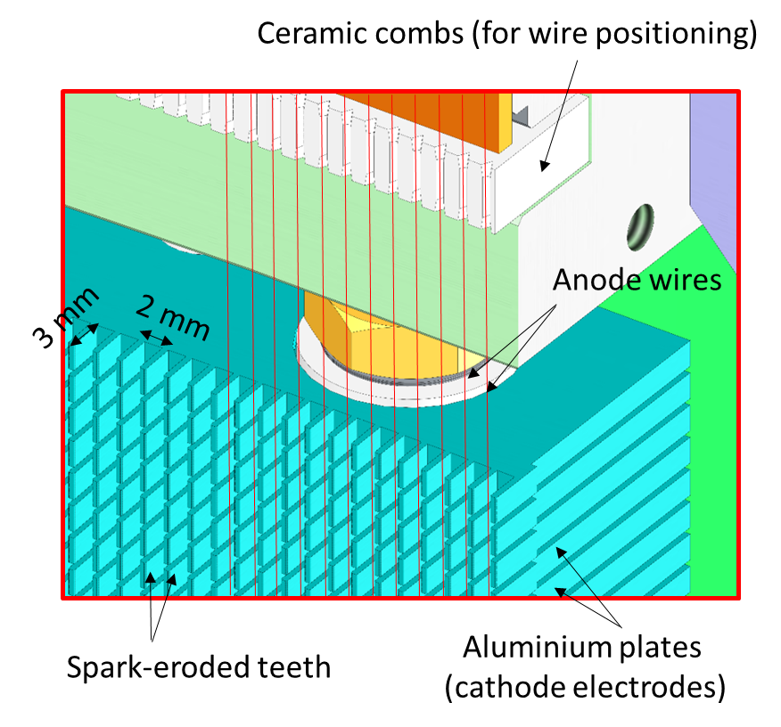
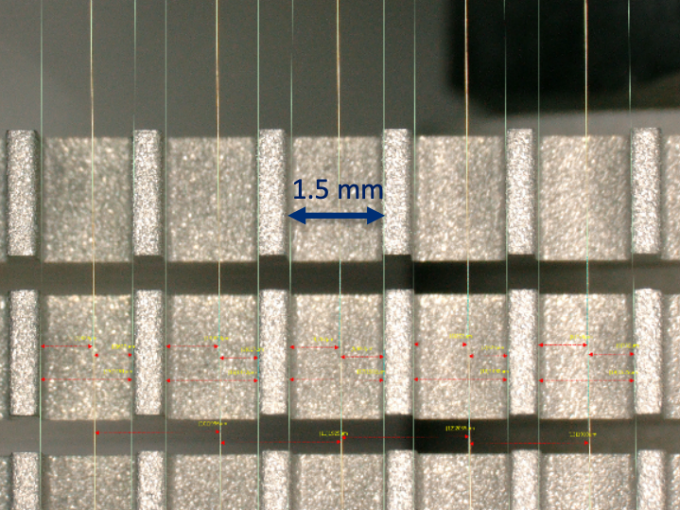
ILL Trench ³He Detector
A hybrid between tubes and MWPC.
J. Marchal et al., JINST C12009 (2017)

Slide 8
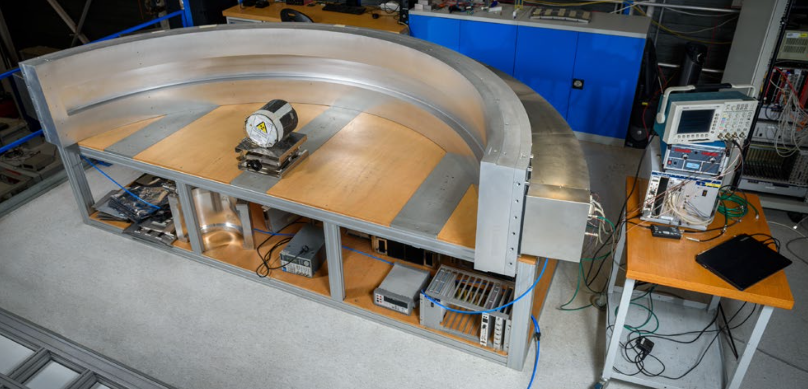
Trench Detector for D20 at ILL
Trench detectors installed on D20, D16 and XtremeD
Designed and used as a curved detector but can be flat too.

Slide 9
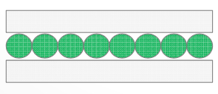
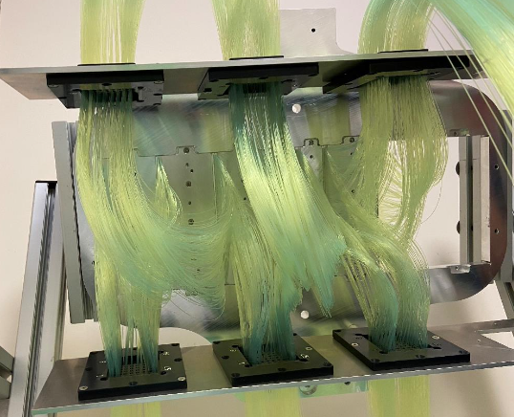
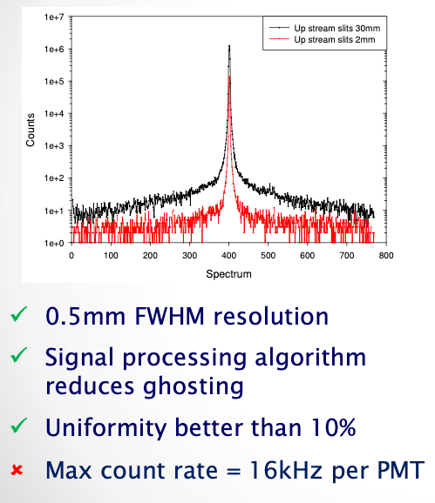
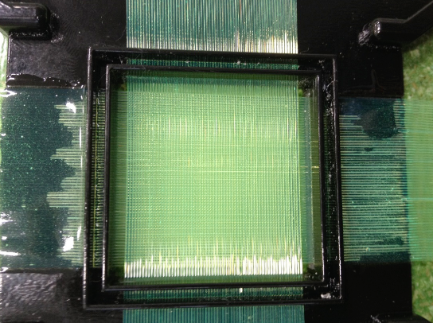
ZnS with Wavelength-Shifting Fibres – ISIS
Also at J-PARC, SNS, JCNS
G. Mauri et al. Eur. Phys. J. Plus (2021) 136:286

Slide 10
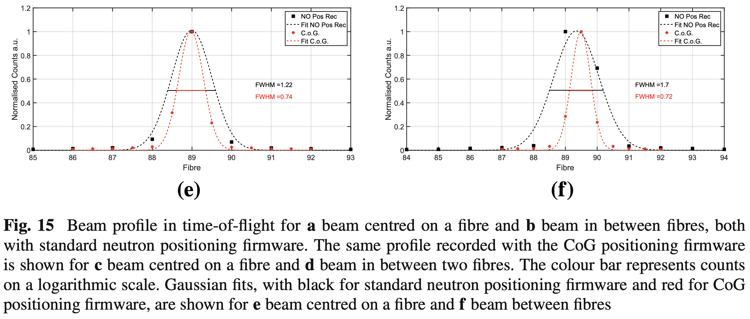
ZnS with Wavelength-Shifting Fibres – ISIS
G. Mauri et al. Eur. Phys. J. Plus (2021) 136:286

Slide 11
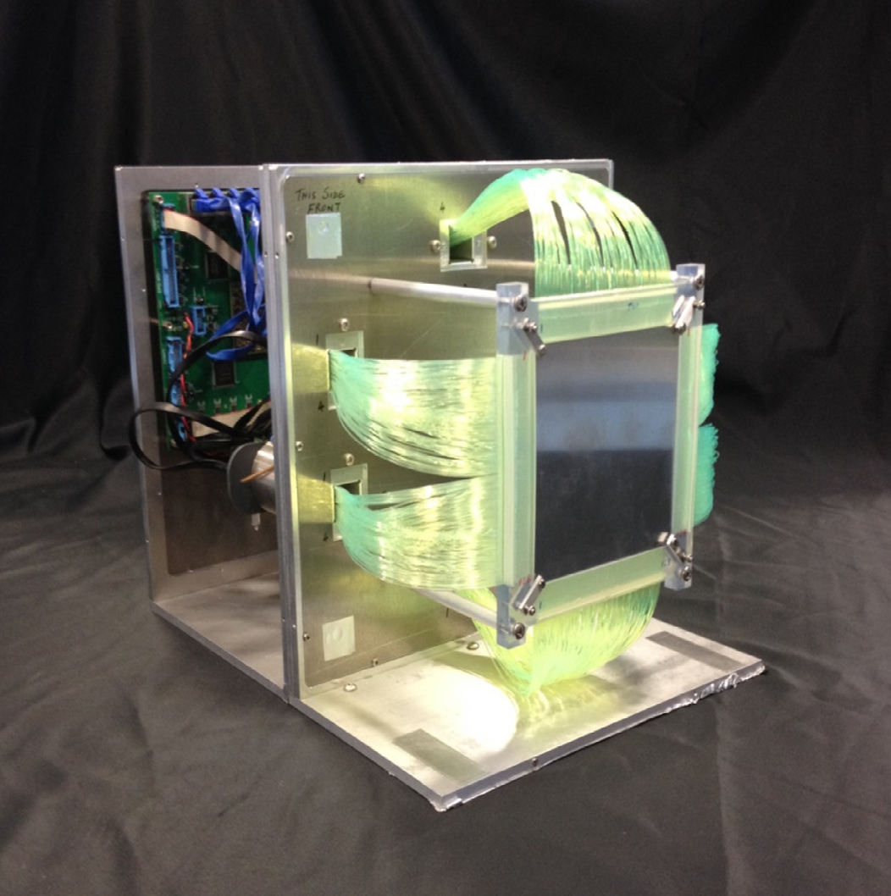
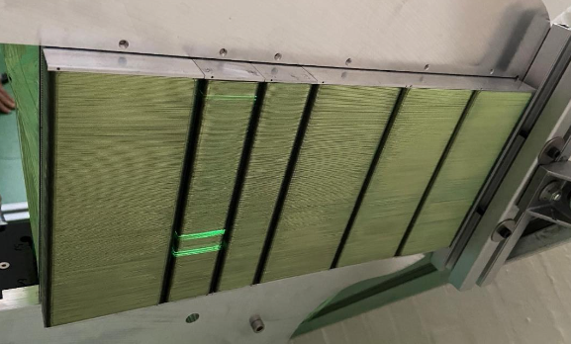
ZnS with Wavelength-Shifting Fibres – ISIS

Slide 12
Detection in ¹⁰B Layers
few um
gas ¹⁰B₄C
detection
conversion
⁴He
neutron
⁷Li
⁴He
⁴He
⁴He
⁷Li
⁷Li
⁷Li

Slide 13
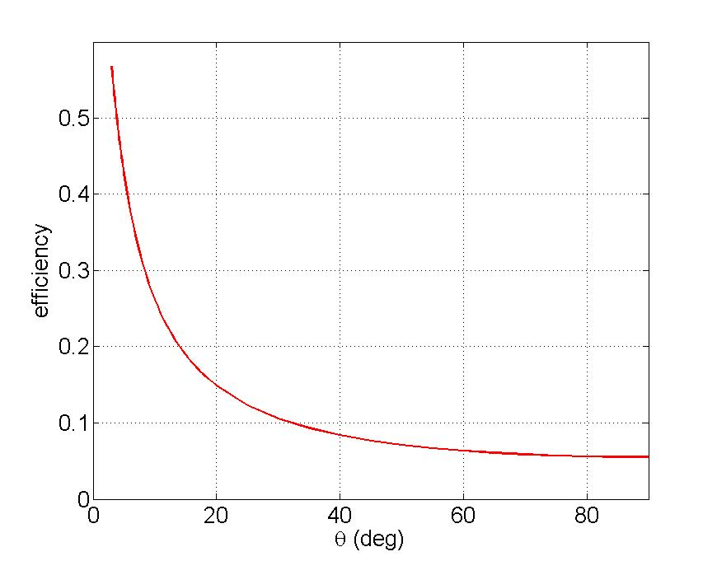
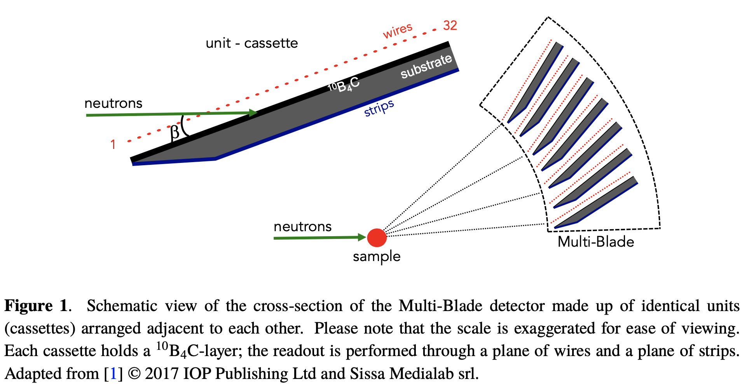
Multi-Blade – Blade Angles
Efficiency at small angles
Single back-scattering layer.
~43% @ 5˚
(@ 2.5Å)
~28% @ 10˚
~5% @ 90˚
neutron
G. Mauri et al 2020 JINST 15 P03010
F. Piscitelli et al 2018 JINST 13 P05009

Slide 14
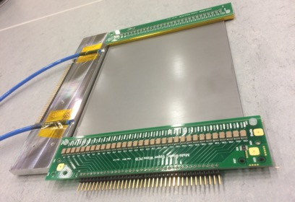
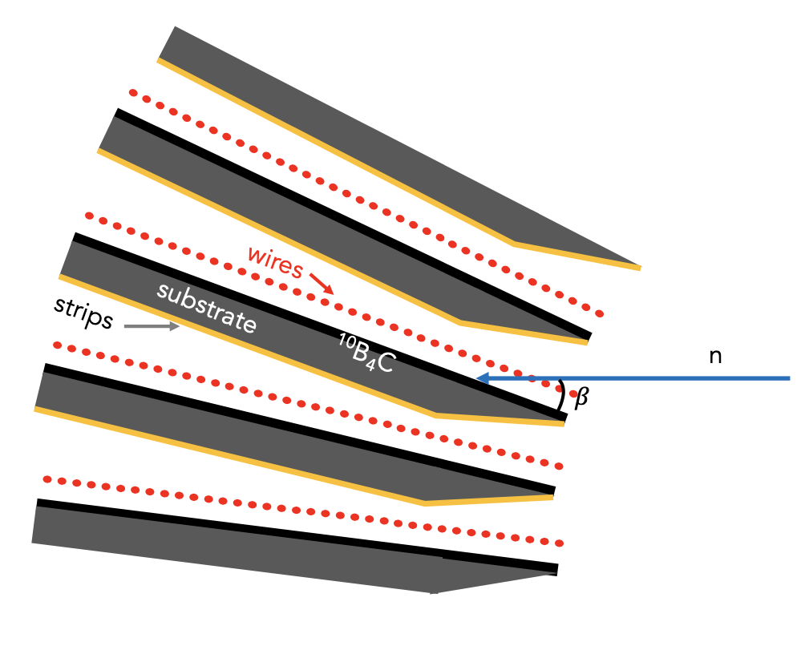
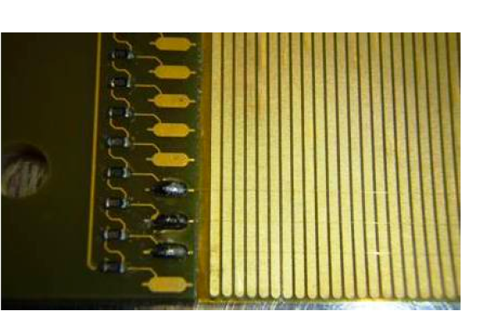
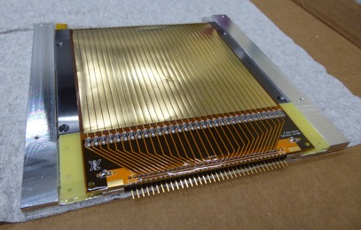
¹⁰B Multi-Blade– ESS (PSI)
A cassette
front
Each cassette individually oriented at 5deg to beam.
A cassette
back
G. Mauri et al 2020 JINST 15 P03010
F. Piscitelli et al 2018 JINST 13 P05009

Slide 15
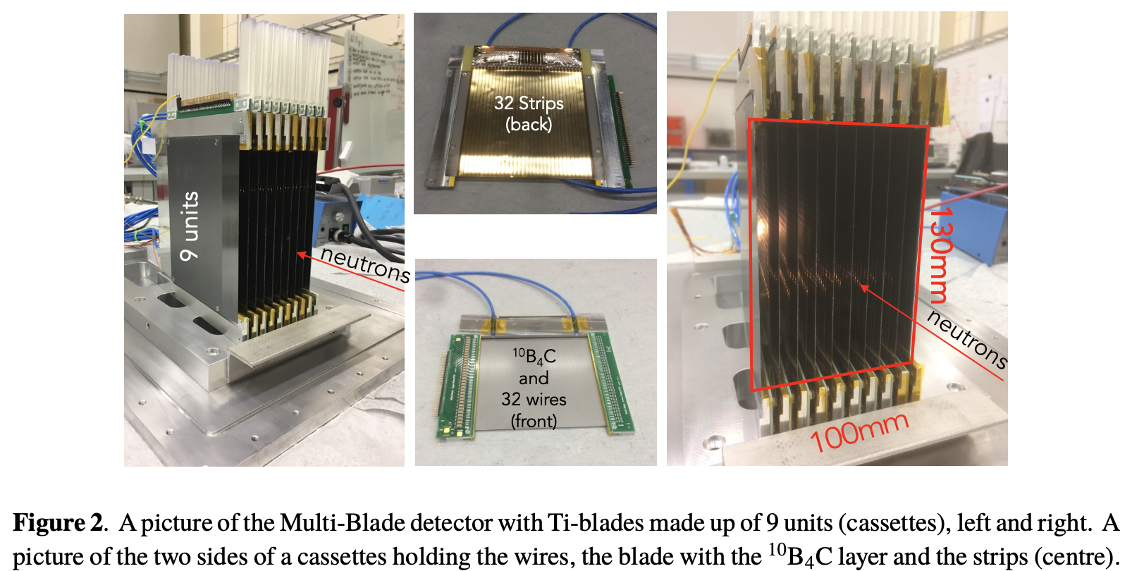
Multi-Blade Boron 10 – ESS (PSI)
G. Mauri et al 2020 JINST 15 P03010
F. Piscitelli et al 2018 JINST 13 P05009

Slide 16
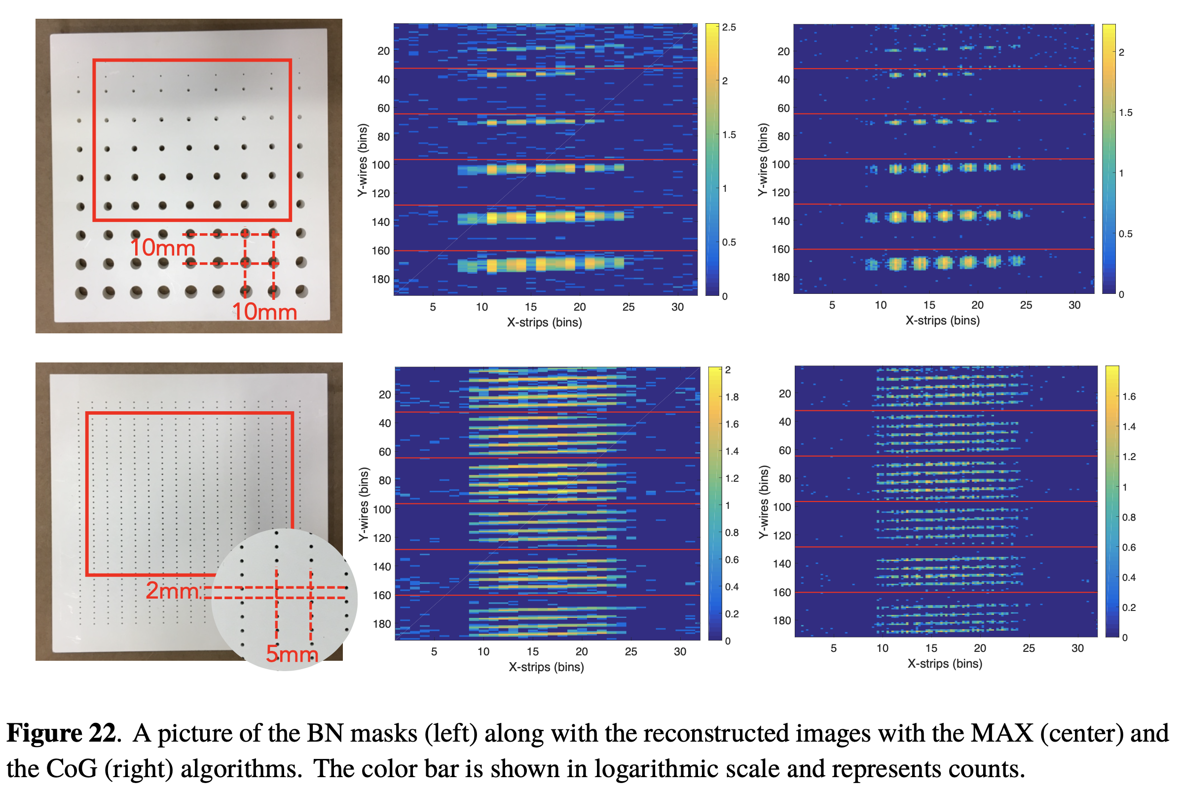
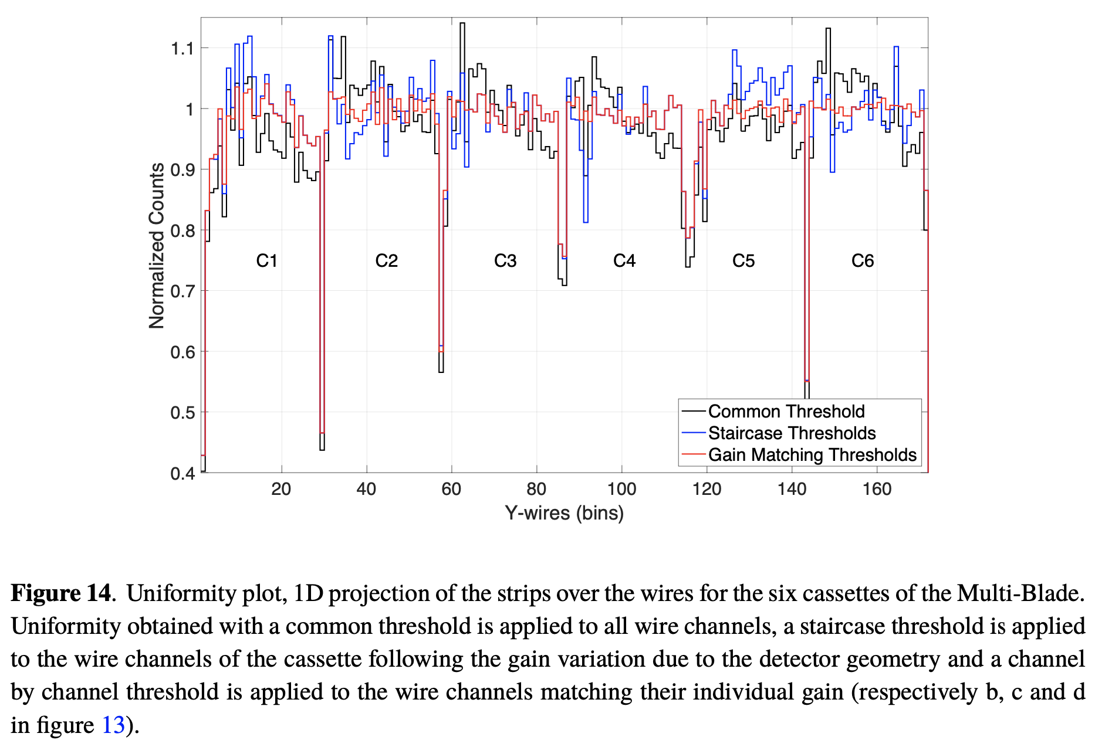
Multi-Blade Boron 10 – ESS (PSI)
G. Mauri et al 2020 JINST 15 P03010
F. Piscitelli et al 2018 JINST 13 P05009

Slide 17
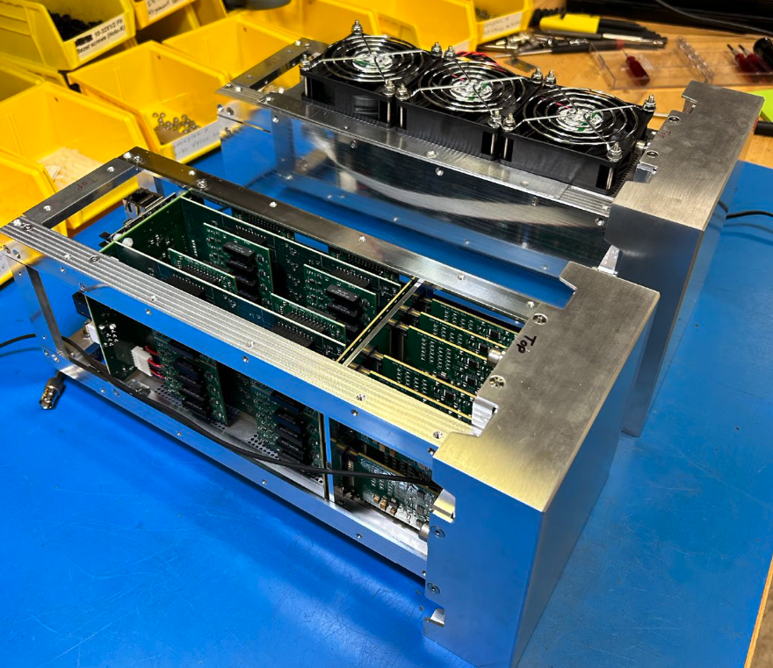
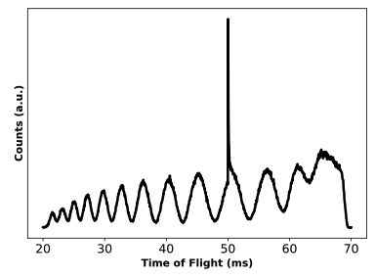
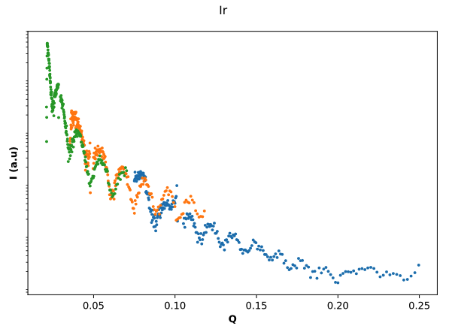
Anger Camera – Potentially at SNS
Anger Camera was also tested at ASTERIX.
In reflection only – due to direct beam damage of SiPMs

Slide 18
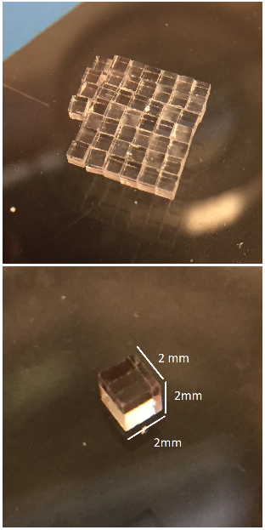
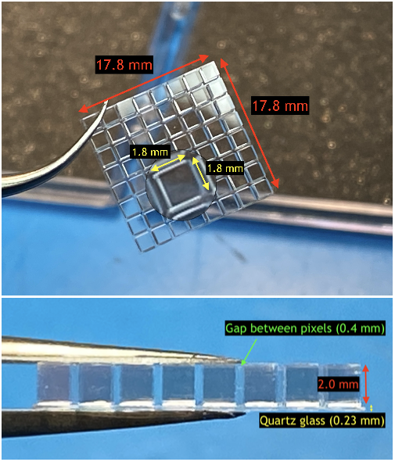
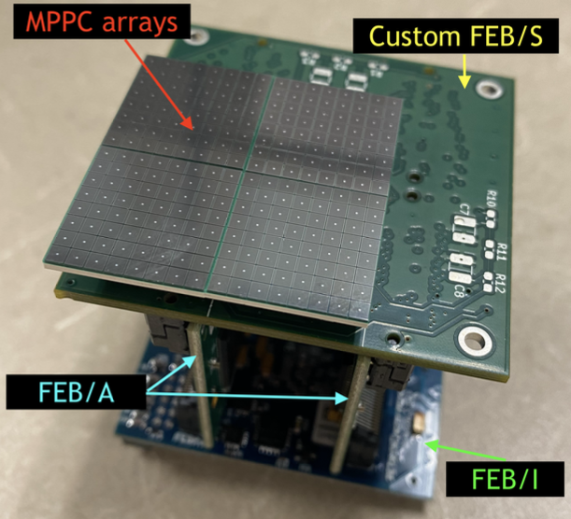
SiPM Pixel Detector – SNS / UTK R&D Project (inactive)
SiPM array with ASIC readout
Scintillator pixel arrays

Slide 19
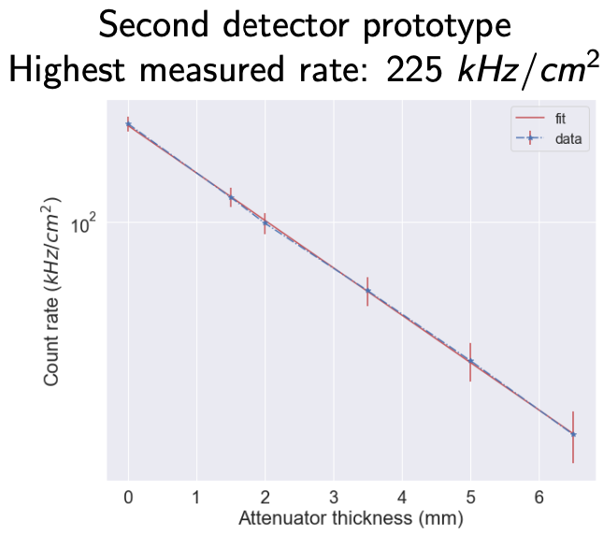
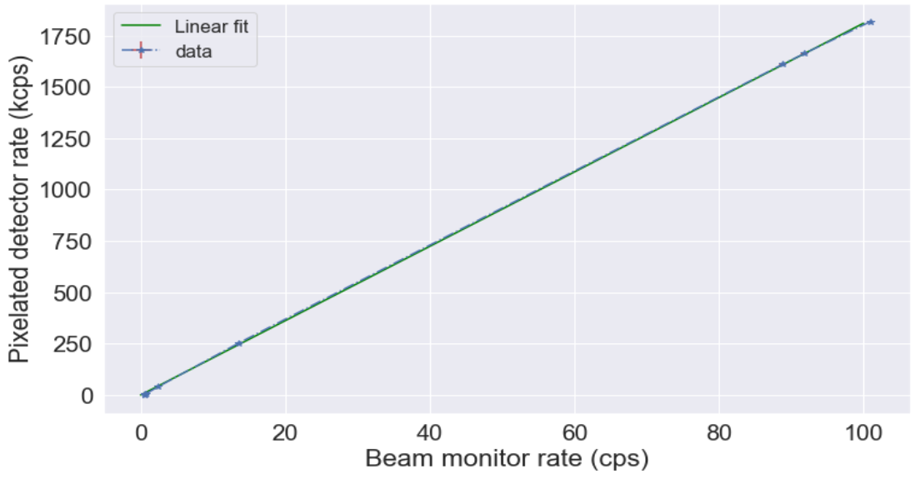
SiPM Pixel Detector – Rate Performance
Rate up to 1.8 MHz has been measured with no saturation.

Slide 20
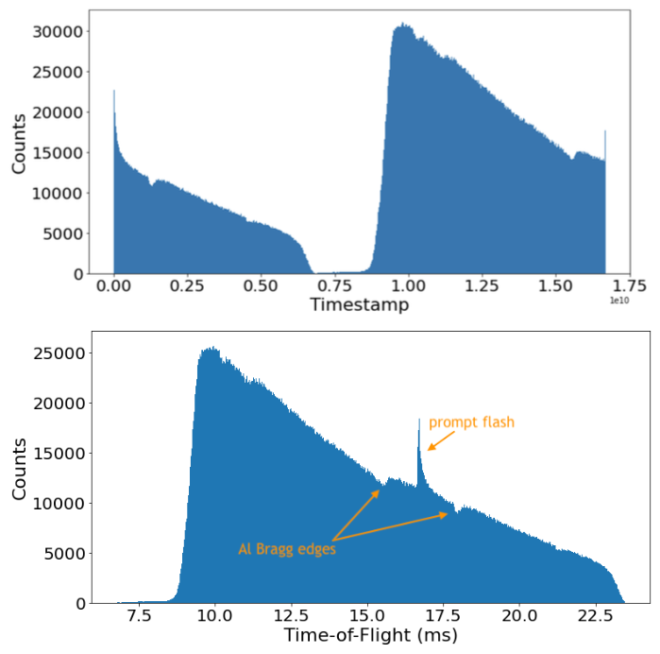
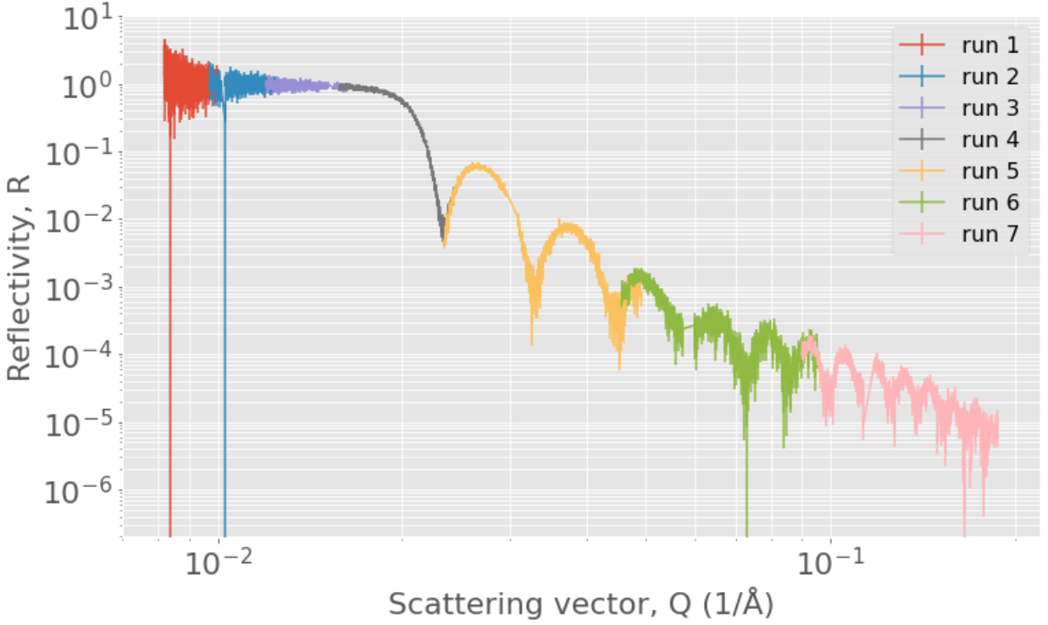
SiPM Pixel Detector – Reflectometry Performance

Slide 21
Reflectometer Detector Options
MWPC
Multi-Tube
WLSF
Multi-Blade
Anger Camera
Pixel Camera
LumaCam
Ex. instruments:
LiqRef, MagRef, SupeADAM
(also on SANS, diff.)
Built by:
(BNL), Denex, ILL
Advantages:
High efficiency
Low gamma
Limitations:
Disadvantages:
(Very) low rate
Thick window
Ex. instruments:
FIGARO, D17, PLATYPUS
(also on SANS, diff.)
Built by:
ILL
Advantages:
High efficiency
Low gamma
Limitations:
Asymmetric pixels
Disadvantages:
Medium rate
Ex. instruments:
INTER
(also on diffraction)
Built by:
ISIS, SNS
Advantages:
High efficiency
Low gamma
Limitations:
Asymmetric pixels
Disadvantages:
Medium rate
Ex. instruments:
None
Planned: ESTIA, FREIA
Built by:
ESS
Advantages:
Medium-high rate
Low gamma
Limitations:
Asymmetric pixels
~40% efficiency
ASIC readout
Disadvantages:
Uniformity
Ex. instruments:
None
(several diffractometers)
Built by:
SNS
Advantages:
Medium-high rate
Sufficient resolution
Limitations:
Gamma sensitivity
Rate currently not enough
Disadvantages:
Low radiation hardness
Ex. instruments:
None
Built by:
SNS (pending R&D)
Advantages:
Very high rate
Limitations:
Large Pixels
Disadvantages:
High gamma sensitivity
Pixel gaps
Ex. instruments:
Imaging at LANL, PSI
(Tested in many instruments)
Built by:
LoscoVision / ASI
Advantages:
High rate
Very high resolution
Flexible configuration
Likely several instruments
Limitations:
Improvements pending
Disadvantages:

Slide 22
Why LumaCam?
 | MWPC | Multi-Tube, Trench | WLSF | Multi-Blade | Anger camera | SiPM pixel | LumaCam
Survive direct beam | No (ageing) | No (ageing) | Yes | Yes | No | No | Yes
Measure direct beam | No | No | No | No | No | No | Yes (at low efficiency)
Efficiency | Good (~90%) | Good (~90%) | Fine (~60%) | Ok (~45%) | Fine (~70%) | Fine (~60%) | Fine (~60%)
Gamma rejection | Good | Good | Good | Good | Ok | Poor | Good
Bespoke components | Lab-made | Lab-made | Lab-made | Lab-made | Lab-made | Lab/small company | Small company
Replaceable components | No | No | No | No | No | No | Yes
Specific issues |  | Asymmetric pixels |  | Asymmetric pixels |  | Inter-pixel gaps
Potential for x10+ gain | No | No | No | No | No | No | Yes

