Slide 1
QIKR Neutron Detection
John F. Ankner
QIKR Instrument Scientist
QIKR Motion Preliminary Design Review
December 16, 2024

Slide 2
Detecting QIKR
Overview
Measuring reflectivity
  Bring source to sample
  Define beam
  Position sample and detector
  Normalize to direct beam
    Expected count rates
    Revisit requirements
    Mitigation strategies
Summary

Slide 3
Detecting QIKR
Overview
Measuring reflectivity
  Bring source to sample
  Define beam
  Position sample and detector
  Normalize to direct beam
    Expected count rates
    Revisit requirements
    Mitigation strategies
Summary

Slide 4
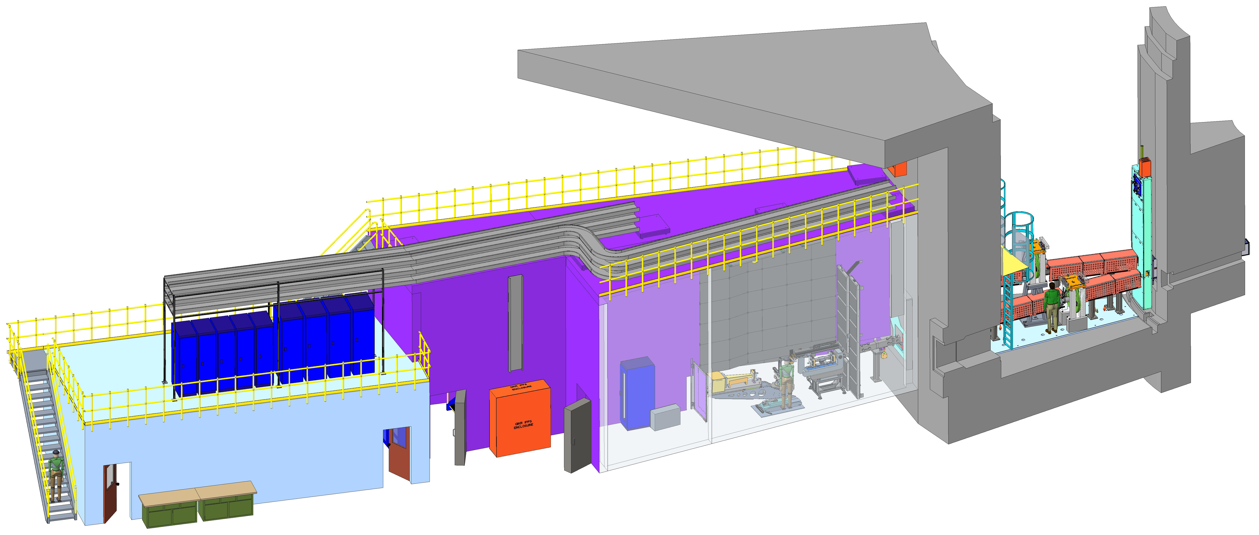

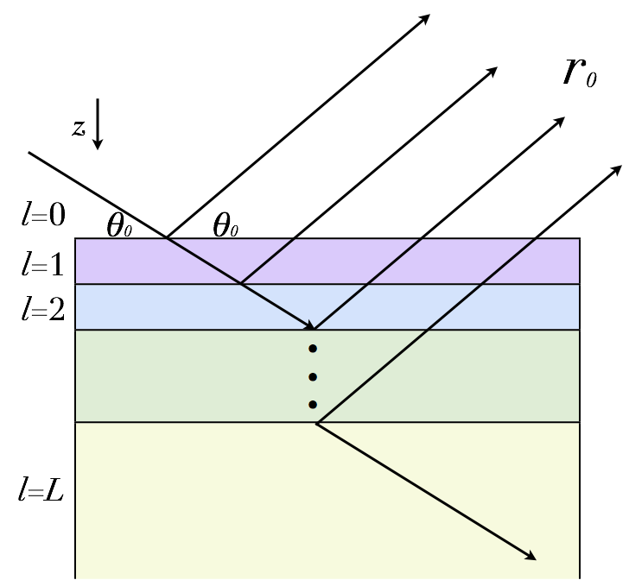
QIKR will make time-resolved reflectometry routine
STS flux and wavelength bandwidth will enable routine single-setting measurement of specular reflectivity in seconds to minutes, depending on the sample
Source
Monolith
Cave
Bunker
Control
Hutch
“Cinematic” data collection at one instrument setting and event-based data reduction will enable post-experiment tracking of structural evolution in time over a broad scientific landscape
[Density × Avogadro’s number /
Molecular mass]
Notes:
The picture on the left shows how neutron waves reflect from layers of different refractive index n_{l} below the sample surface
Refractive index depends on the density of scatterers within a molar volume, e.g., monomer or crystal unit cell
The picture on the upper right shows the upper and lower QIKR end stations with cartoon men for scale

Slide 5
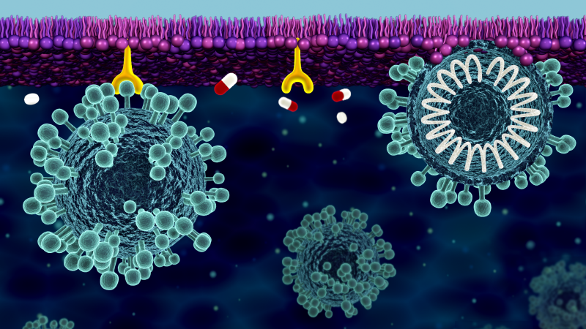
A sampling of scientific communities served by QIKR
Energy Materials
Solid-electrolyte interphase
Organic photovoltaics
Ionic liquids
Corrosion
Mesoporous films
Conjugated polymer films
Metal-harvesting polymers
Soft Matter
Polymer diffusion
Chemical transformation of reactive films
Hydrogels
Fouling
Structure-properties of films under shear
Synthetic membranes
Responsive films
Polymer brushes under shear
Surface modification
Reactions at oil/water interfaces
Biomaterials
Model membranes
Lipid flip-flop
Structure of transmembrane peptides
Biocompatible coatings
Surfactant and phospholipid monolayers
Drug delivery
Protein conformation to membranes
Influence of synthetic nanoparticles on membrane structure
[Courtesy R. Ashkar]
Notes:
To be updated with TOCs

Slide 6
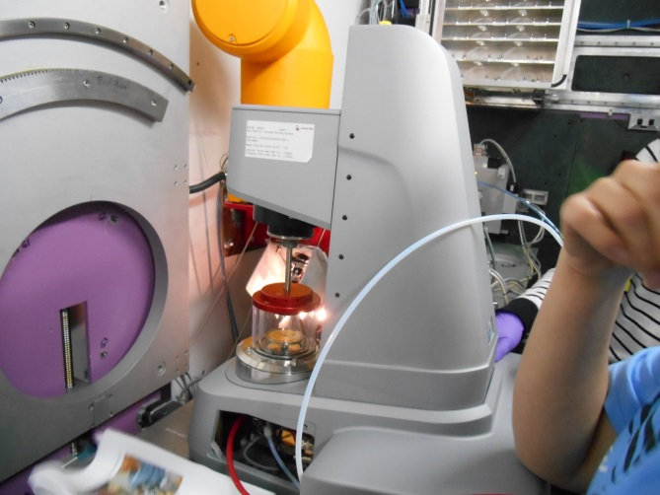
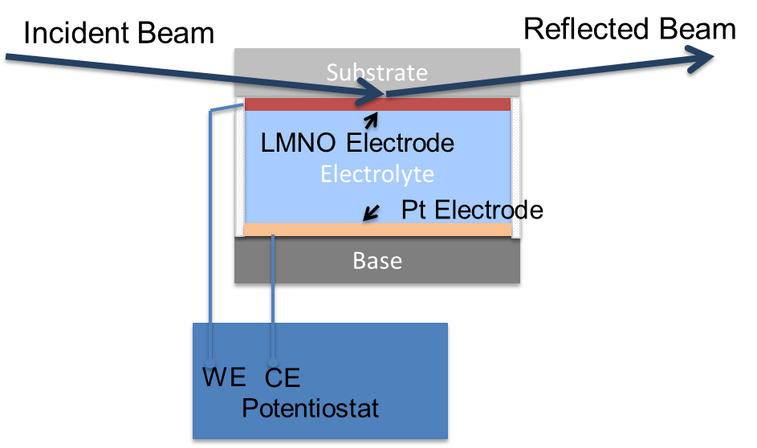
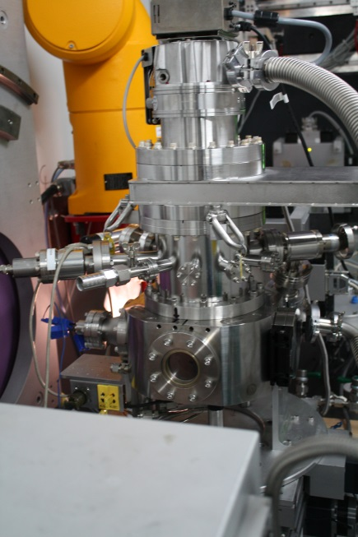
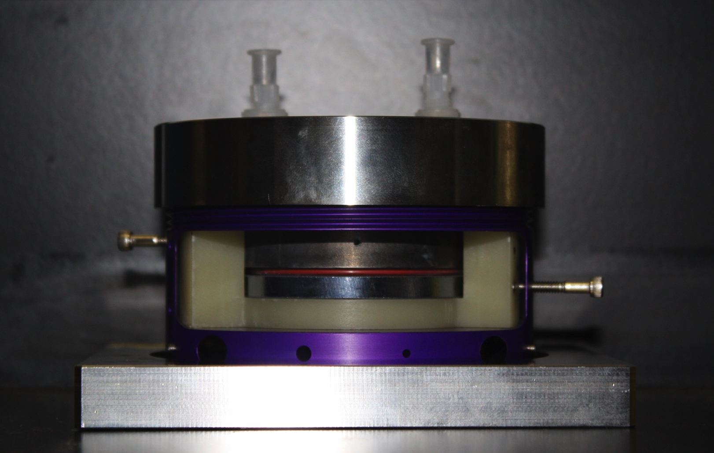
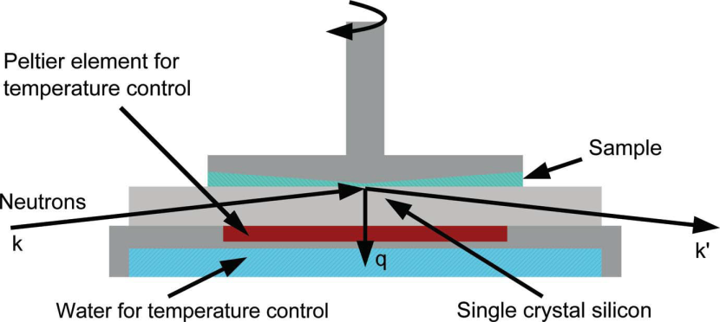
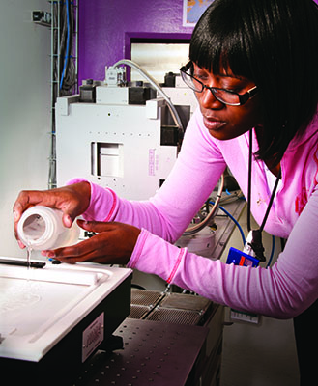
Diverse environments
θ_{s} = 0, fixed
θ_{i}
θ_{d}
θ-θ geometry
θ_{d} = -θ_{i}
θ_{i}
θ_{d}
θ_{s} = 0, fixed
θ-2θ geometry
θ_{d} = 2θ_{s}
θ_{i} fixed
θ_{s}
θ_{d}
Two end stations

Slide 7
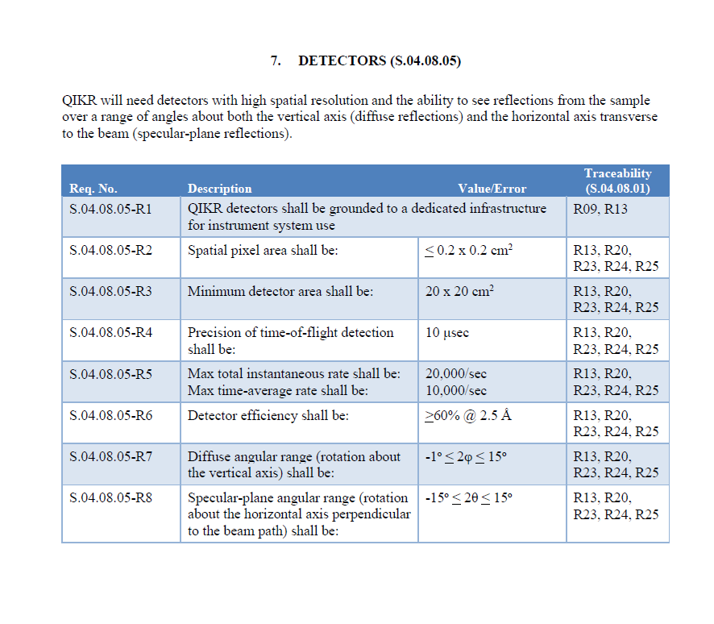
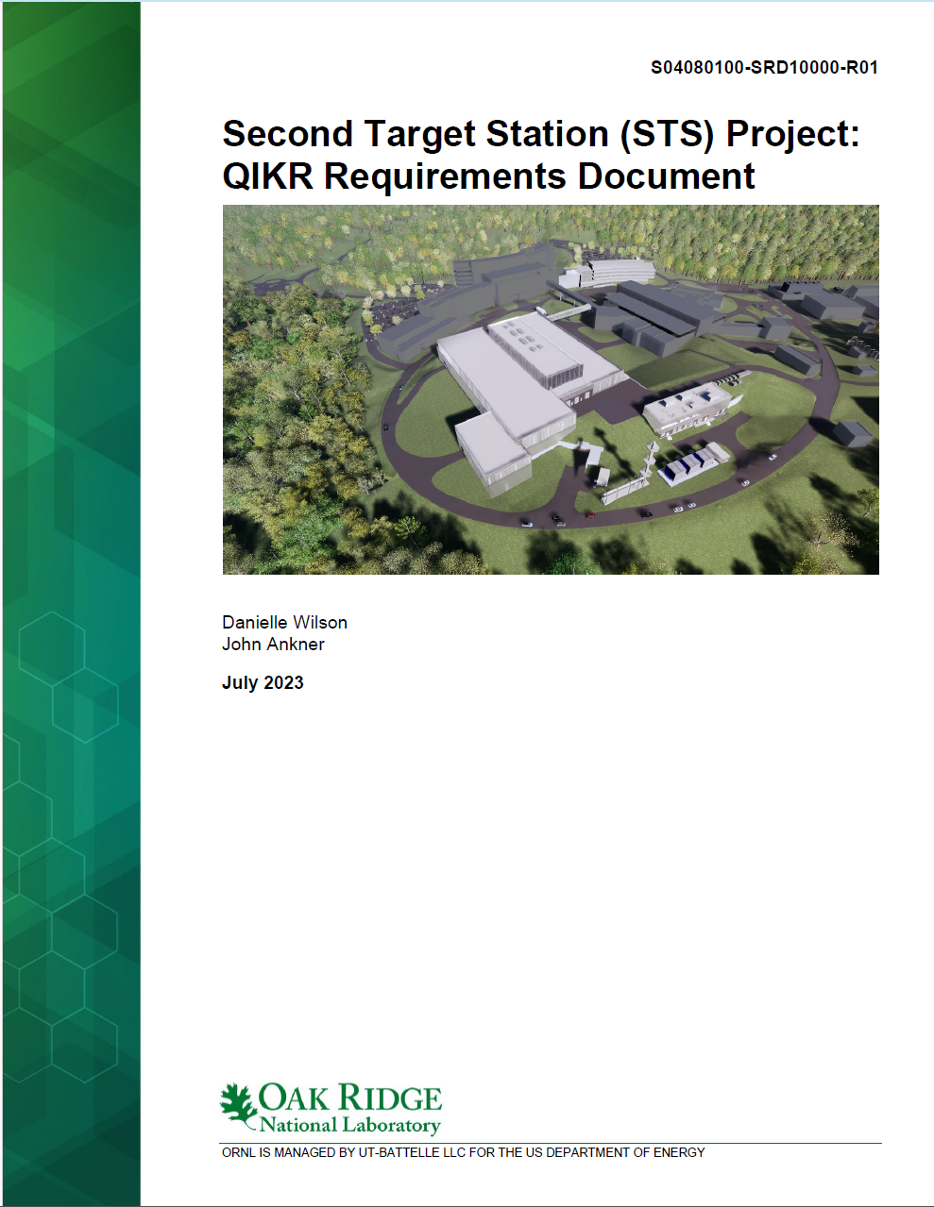
QIKR detector requirements
Charge 1

Slide 8
Detecting QIKR
Overview
Measuring reflectivity
  Bring source to sample
  Define beam
  Position sample and detector
  Normalize to direct beam
    Expected count rates
    Revisit requirements
    Mitigation strategies
Summary

Slide 9
Neutron reflectivity from Ir/Si standard
Fit
r
θ
θ
Q = 4π sinθ / λ
t
NR characterized by wavevector Q, a function of incident angle θ and wavelength λ
No useful information below Q_{min}
Q_{max} background limited
=> 0.005 Å⁻¹ < Q < 0.5 Å⁻¹
Notes:
Decibumps?

Slide 10
Single setting Q range
Equivalent fit quality
to full Q range
Wavevector transfer
Q = 4π sinθ / λ
and wave-particle duality
h² / 2mλ² = mv² / 2
determine Q dynamic range
where
h/m = 3956.0 m-Hz-Å
L = instrument length (m)
f = repetition rate (Hz)
λ_{min} = minimum wavelength (Å)
STS QIKR-L
L = 20.0 m
f = 7.5 Hz
λ_{min} = 2.5 Å
D = 11.5

Slide 11
Detecting QIKR
Overview
Measuring reflectivity
  Bring source to sample
  Define beam
  Position sample and detector
  Normalize to direct beam
    Expected count rates
    Revisit requirements
    Mitigation strategies
Summary

Slide 12
Transport source to sample (QIKR-L)
Diverging tapered
from 2.65 to 10 cm high over 11.13 m
Converging tapered
from 10 to 2 cm high over 2.87 m
Vertical:
Guide
begins
(2.0 m)
Source
Double disk
chopper
(8.0 m)
Guide
ends
(16.0 m)
Slits
Sample
Table
(18.0 m)
Detector
(20.0 m)
Horizontal:
Curved bender
3 channels, 3 cm wide
Straight 3 cm wide
Neutron guide filters out unwanted neutrons,
delivering wanted neutrons (3×2 cm²) to the sample

Slide 13
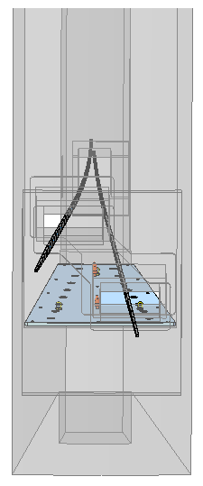
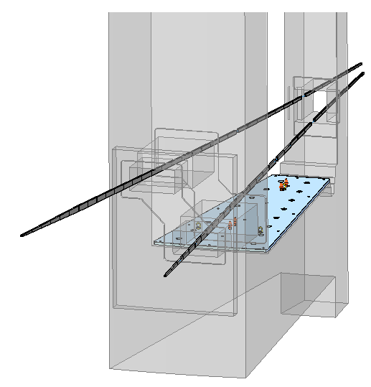
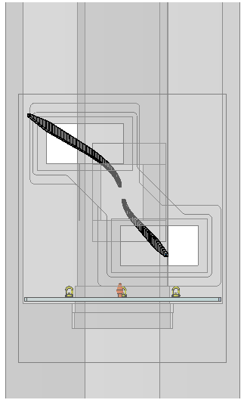
Guide views – looking upstream
QIKR-U
QIKR-L
Monolith
Bunker
Caves

Slide 14
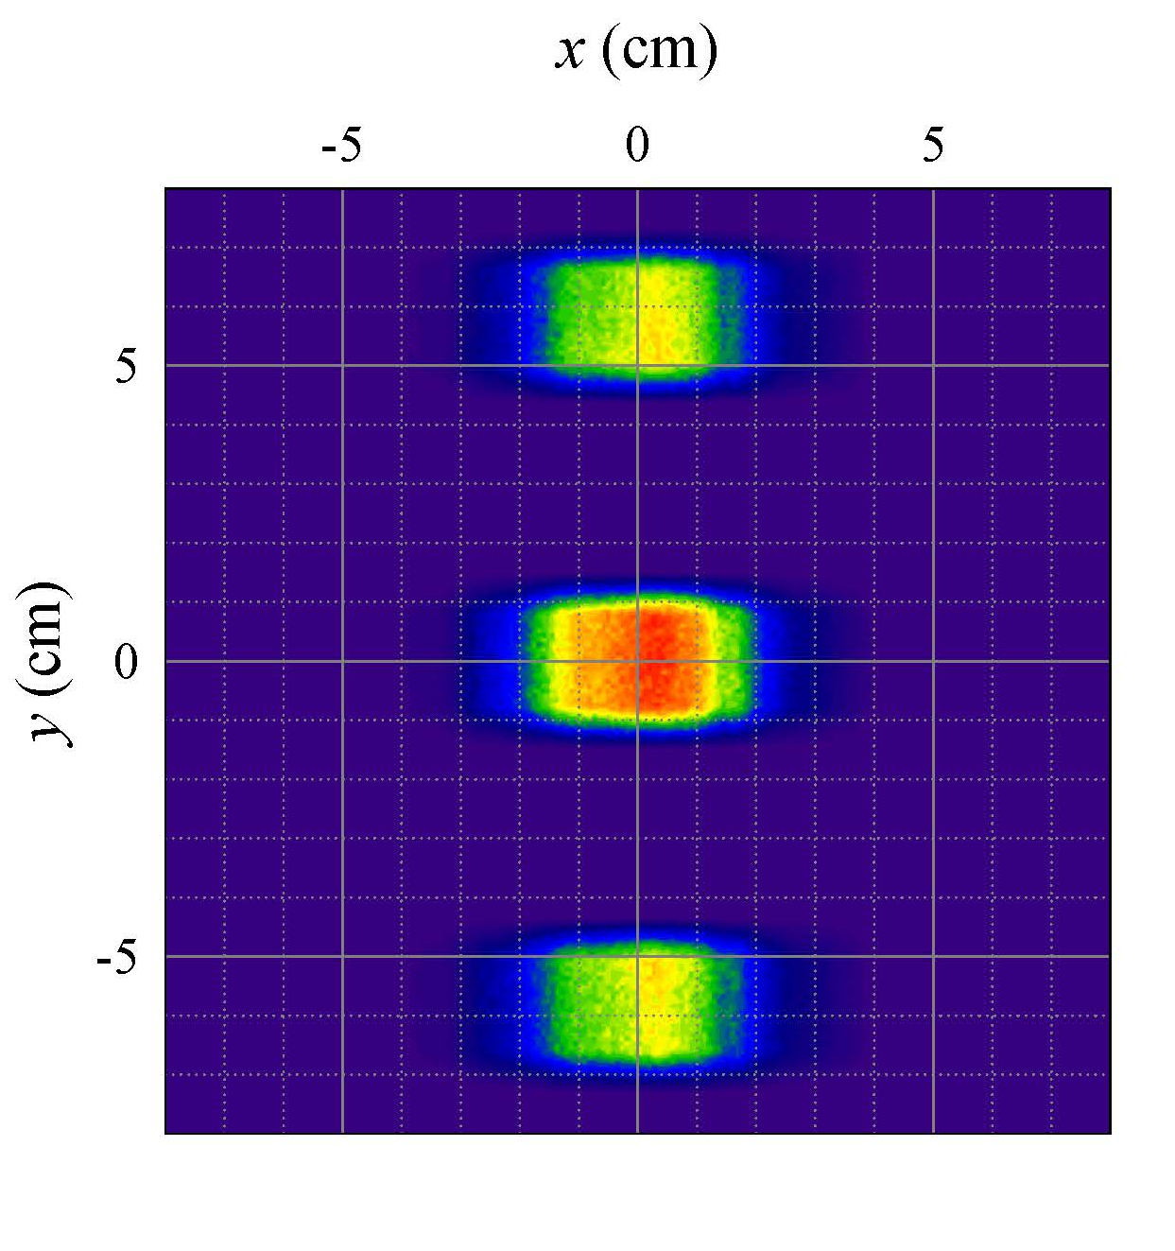
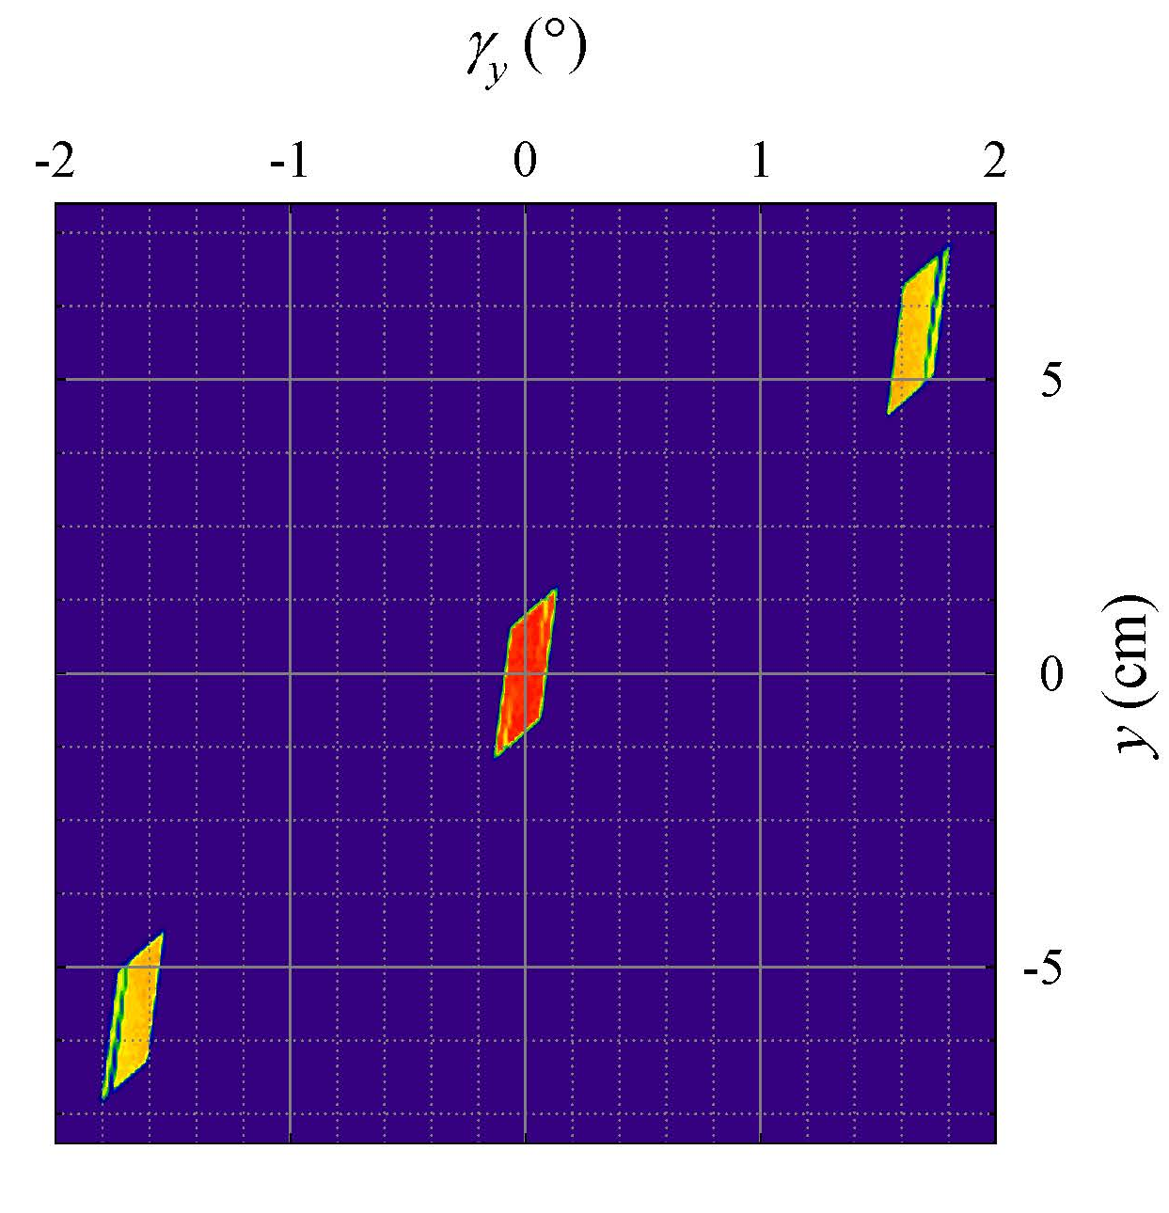
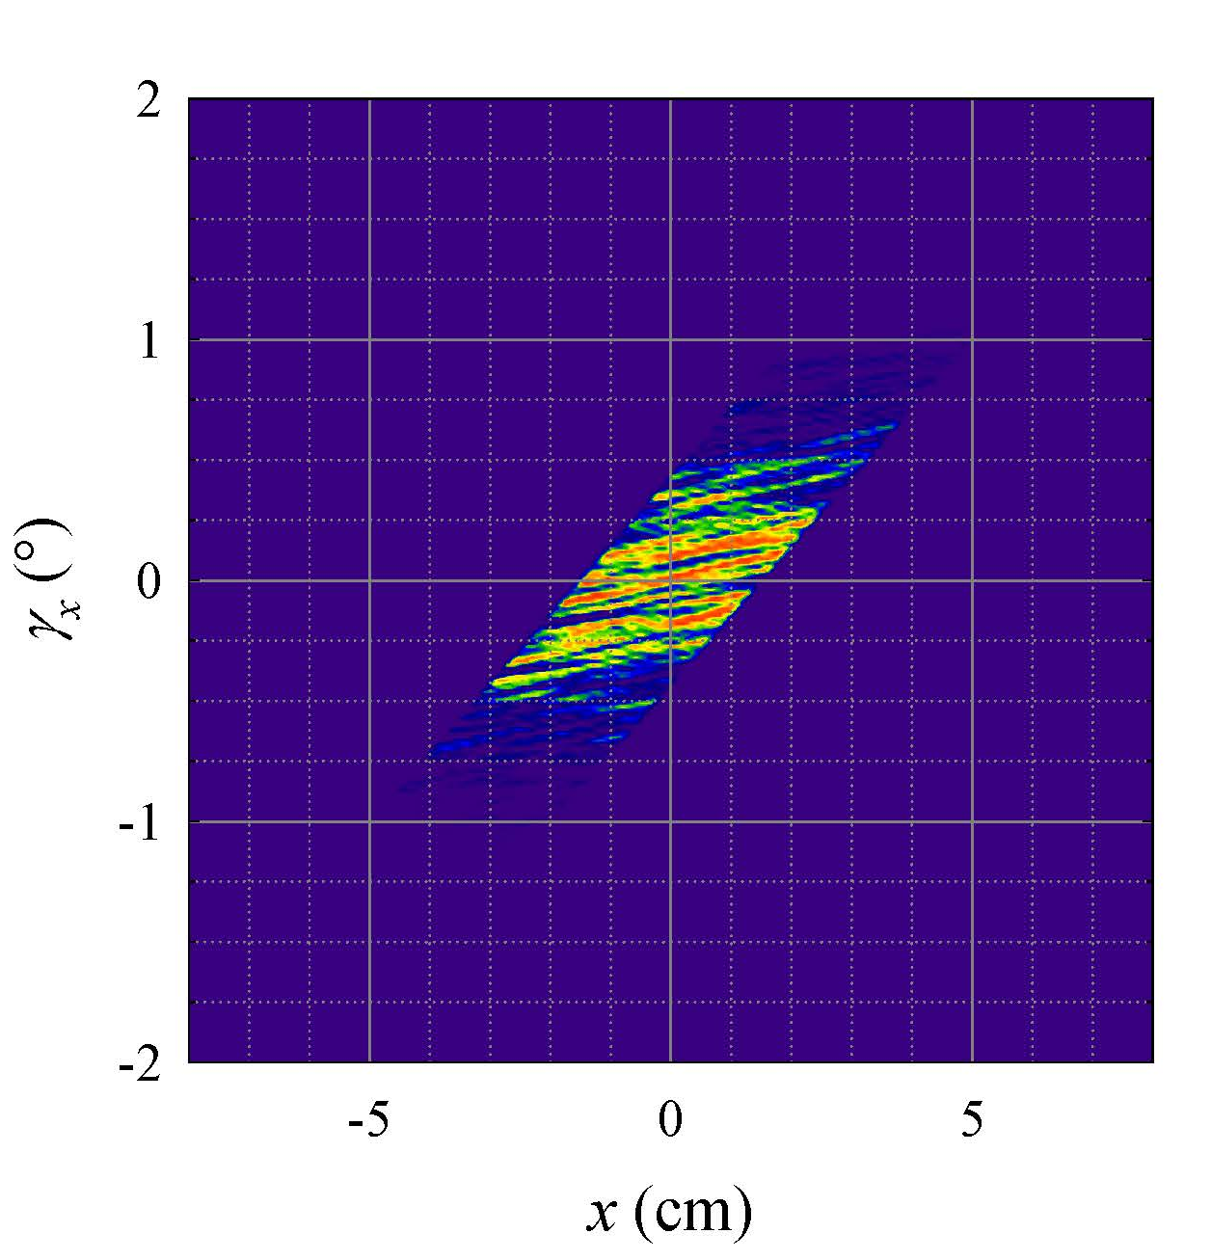
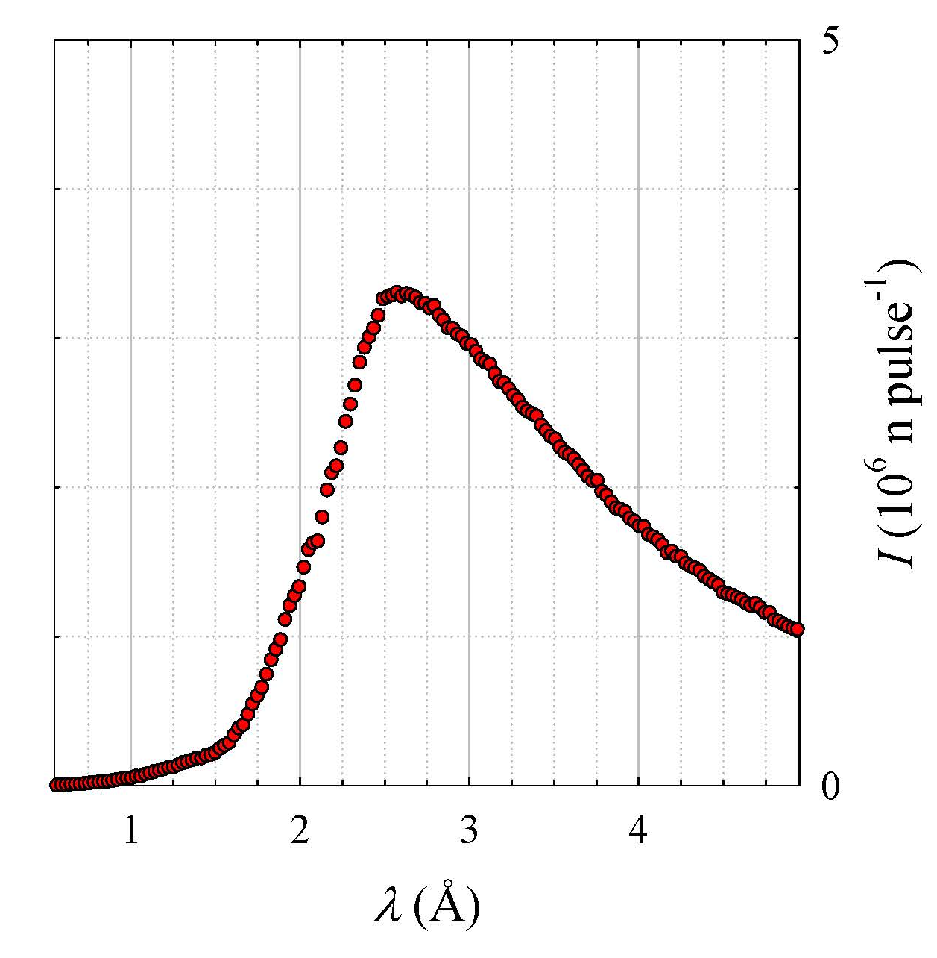
Guide system provides multiple beams
Characteristics
Three beams
…separated in space (y)
…and angle γ_{y}
Select which to use in θ-θ geometry
to span needed Q range
(QIKR-L McStas simulation)

Slide 15
Detecting QIKR
Overview
Measuring reflectivity
  Bring source to sample
  Define beam
  Position sample and detector
  Normalize to direct beam
    Expected count rates
    Revisit requirements
    Mitigation strategies
Summary

Slide 16
Slits define resolution and footprint
s_{u}
s_{d}
(not to scale)
l_{ud}
s_{s} = F sinθ_{i}
θ_{i}
F
l_{ds}
Which slit settings s_{u} and s_{d} will
confine beam within footprint F
at incident angle θ with angular
divergence (δθ/θ)?
What is the integrated acceptance?
=>

Slide 17
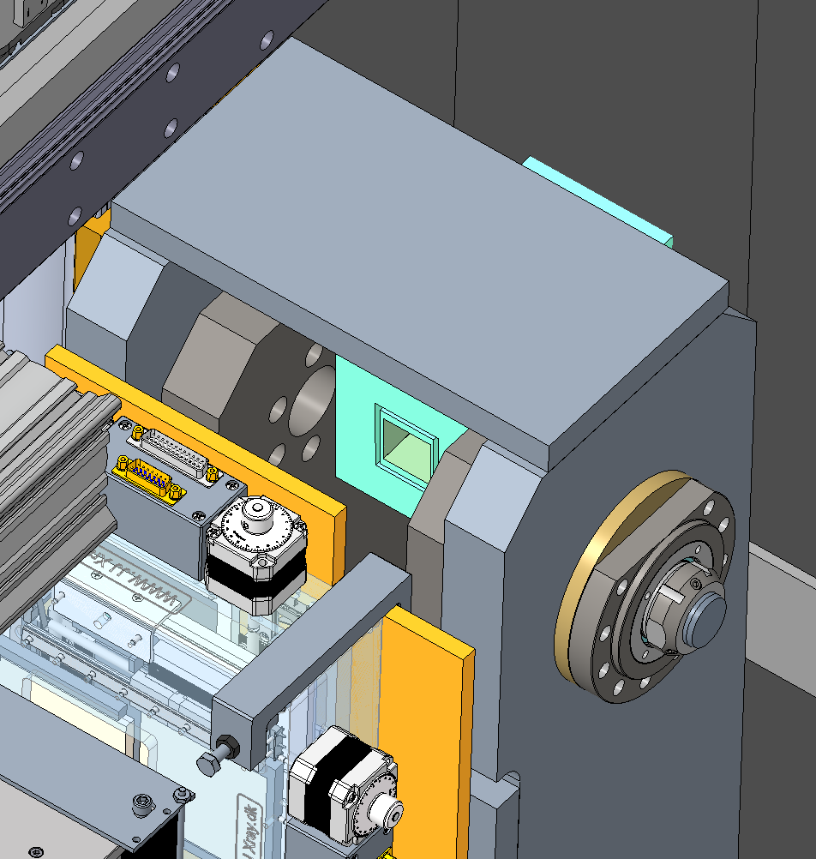
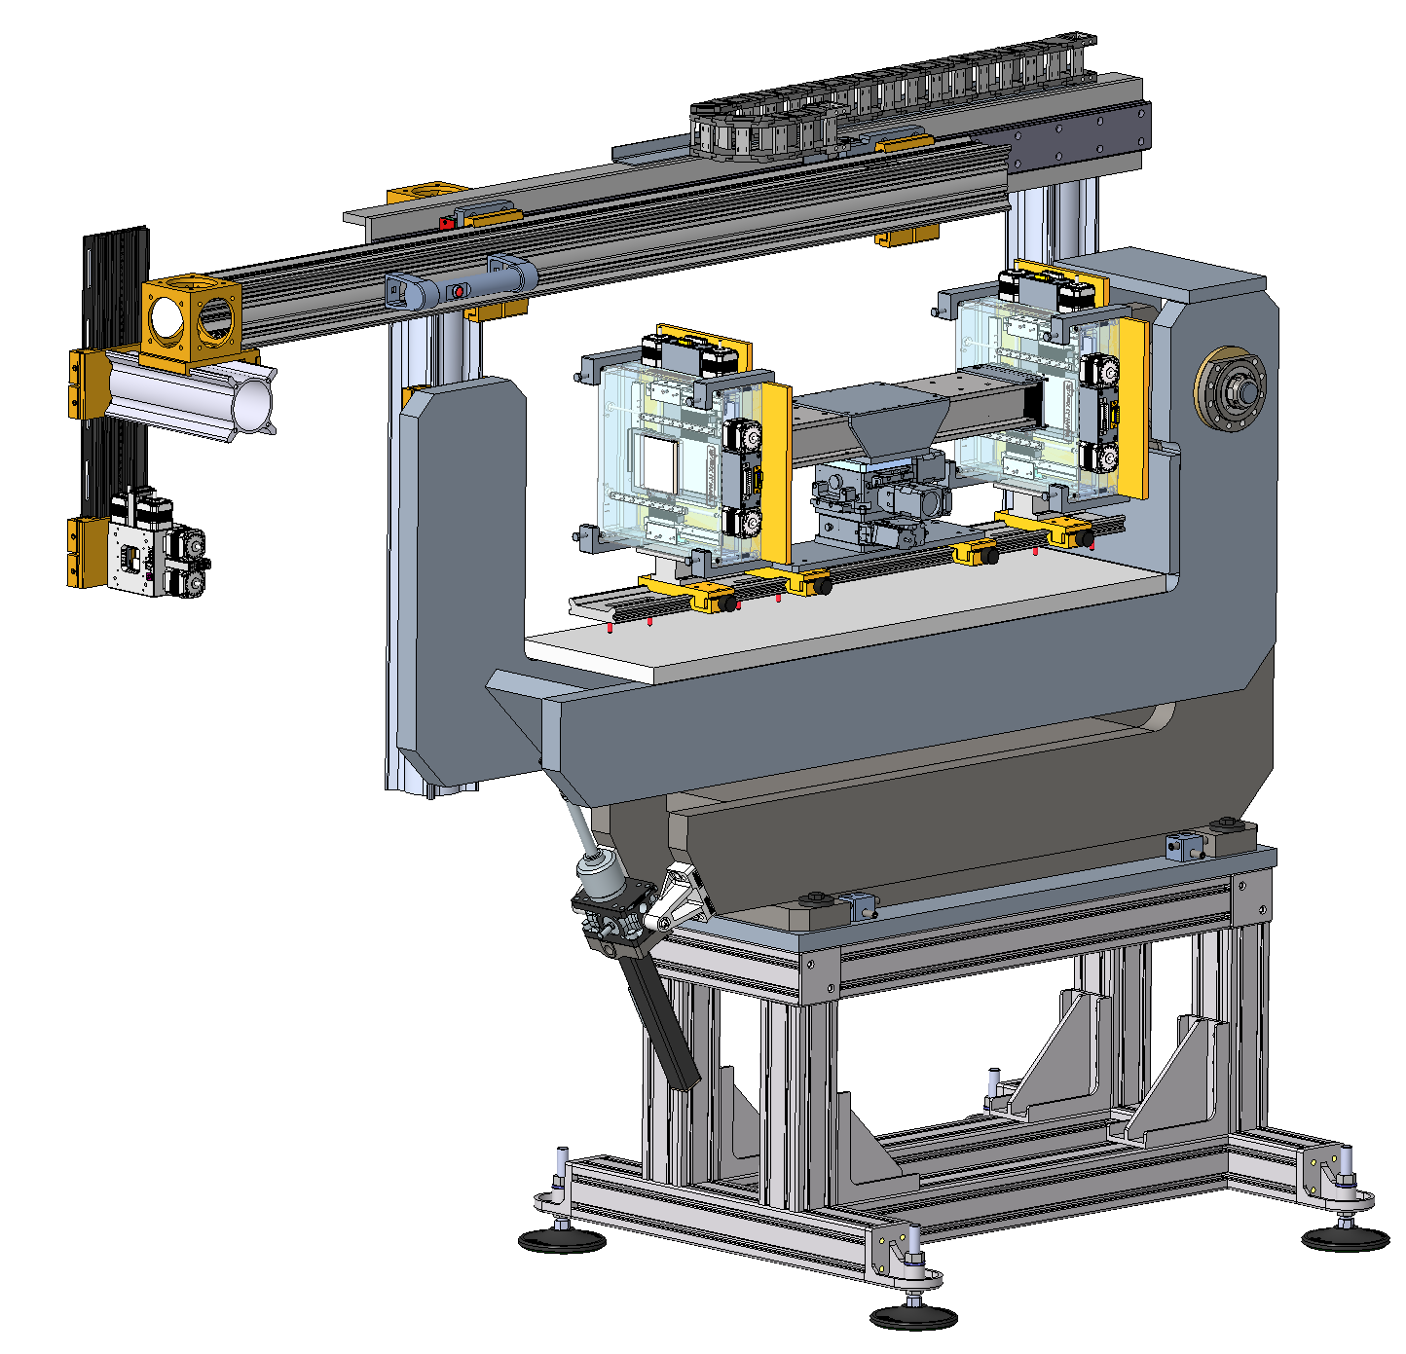
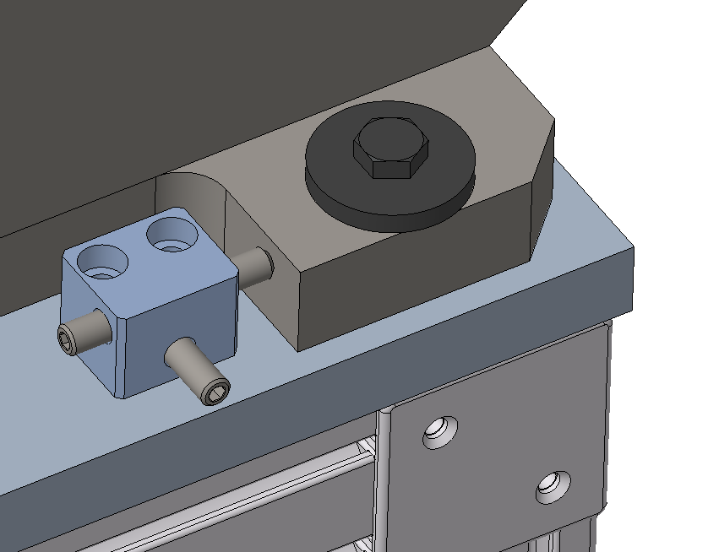
Incident Table – holds slits and optics
Preliminary design of an incident table for QIKR
The axis of rotation ideally lies on the face and the symmetry
plane of the neutron guide.
Hollow profiles together with energy
chain enable protected cable
installation.
A rigid bearing ensures
precise alignment of the slits.
A platform open to the sides, with
sufficient distance to the beam
line, offers flexible installation space
for future installations.
Manually adjustable slit
position with safety brake
in z-direction.
Adjustability in
the xz plane.
Translating ball screw
enables an accurate
pivoting in the range ± 5°.
Short support for more
stability.
Adjustable machine feet
with vibration absorbing pads.
[courtesy Rudy Thermer]

Slide 18
Footprint calculator – maximum slits
Resolution
0.02 < δθ/θ < 0.07
implies
0.1 mm < s < 10 mm

Slide 19
Footprint calculator – minimum slits
Beam Size
and Footprint
Smallest: 0.1 mm
δθ/θ = 0.02 @ θ = 0.5°
=> δθ = 0.01°
[Req. S.04.08.04-R2]

Slide 20
Detecting QIKR
Overview
Measuring reflectivity
  Bring source to sample
  Define beam
  Position sample and detector
  Normalize to direct beam
    Expected count rates
    Revisit requirements
    Mitigation strategies
Summary

Slide 21
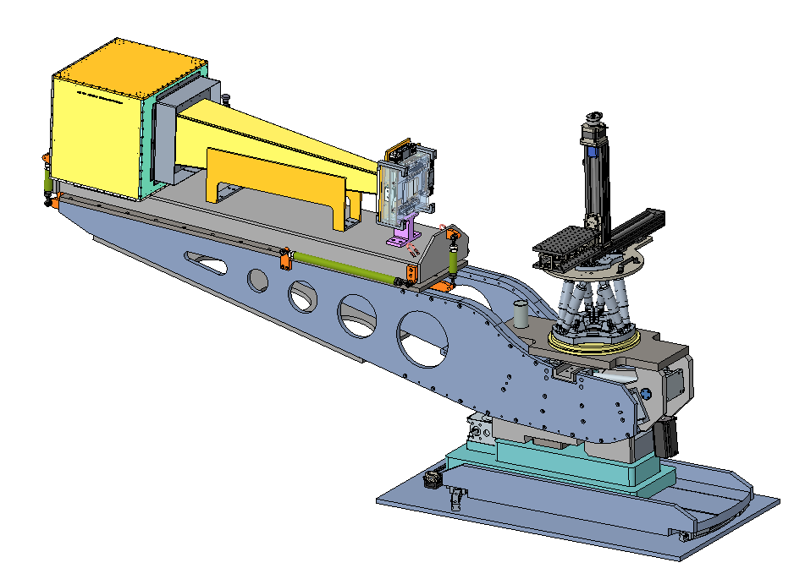
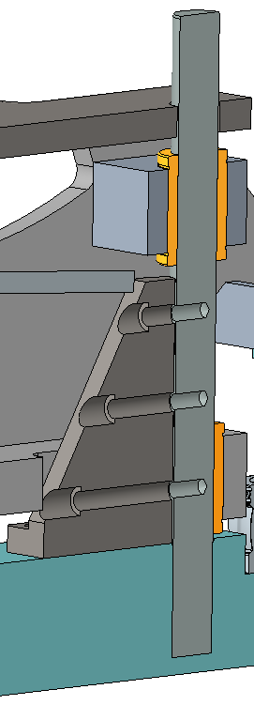
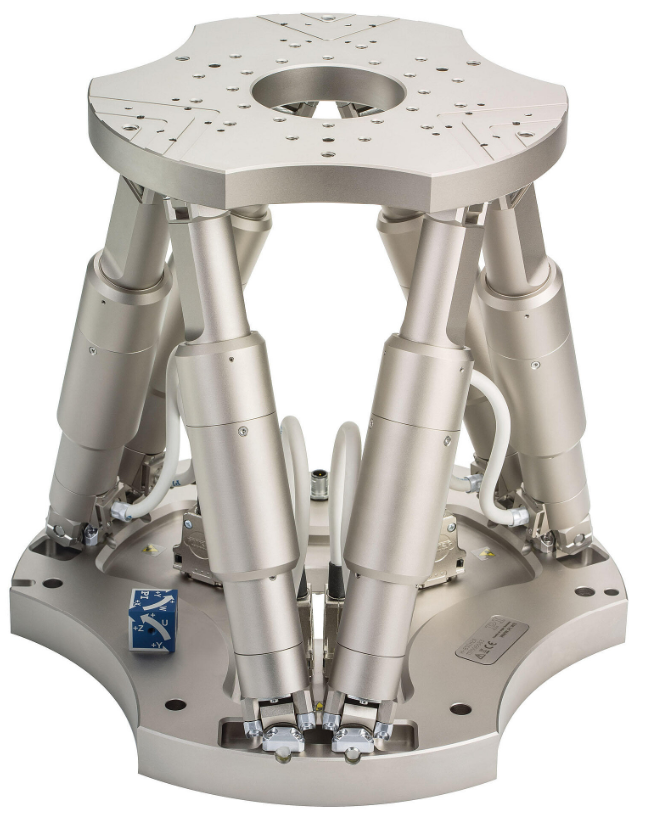
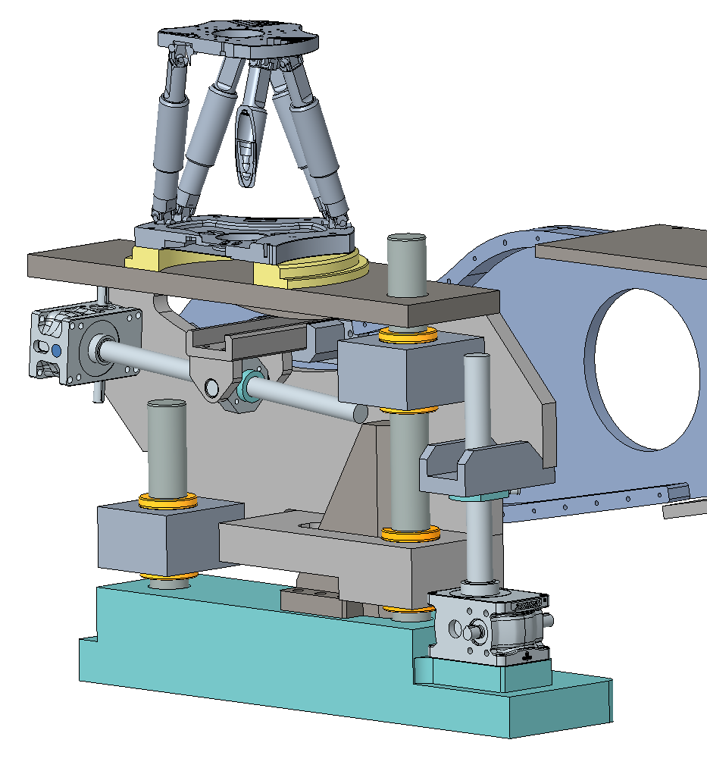
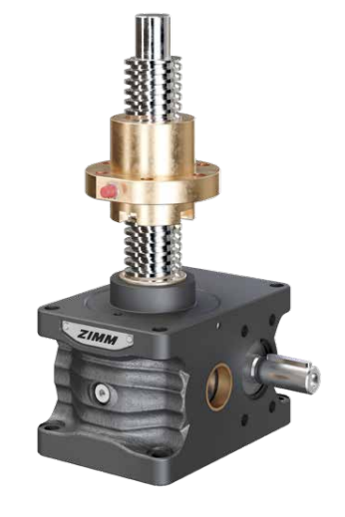
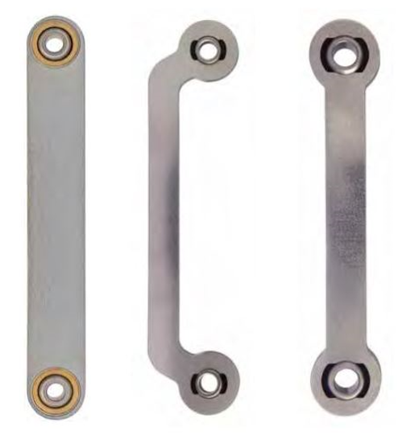
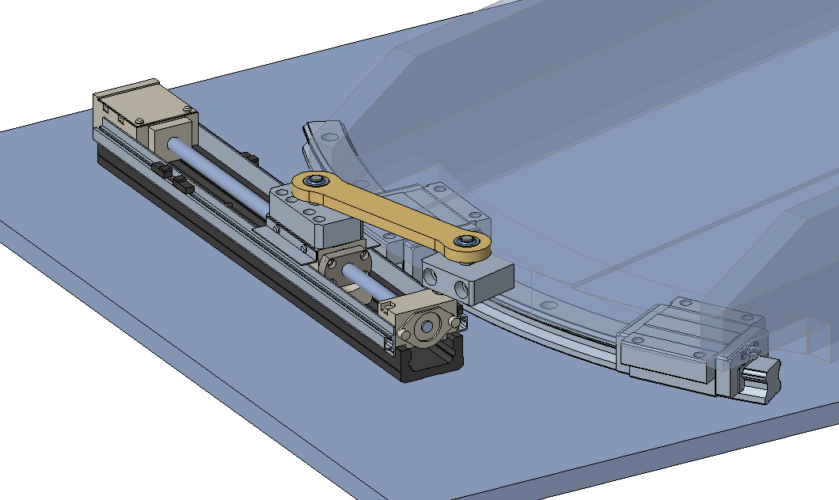
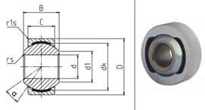
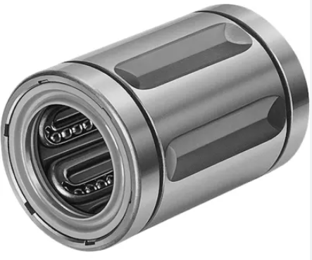
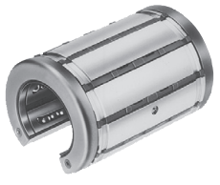
Sample Table and Detector Arm unit
The design employs well-developed standard components (increased reliability, reduced costs).
PI H-850 Hexapod
Payload: 250 kg
Robust guide
system
∅ 60 mm
Hexapods offer six degrees of freedom of movement in the most compact space.
Increased stiffness
due to a free length
Reduction of 50%.
ZIMM Screw
Jack
Yaw swivel unit
THK-TU-Series Slide table
providing high load capacity
and accuracy in a single
Structure.
F_{Lift}
Compensatory
force transmitting
link.
F_{Det}
Available with different load capacities i.e., various spindle sizes, gear ratios and accuracies.
Spindle
nut
THK Curved
linear guides
15°
Preloaded
linear ball
bushings
With an ideal load-bearing arrangement in relation to the spindle lifting nut.
Nadella GLK (NIRO)
Spherical-plain bearing
Radial clearance: 0 -10 µm!
[courtesy Rudy Thermer]

Slide 22
Sample Table and Detector Arm unit
Positioning
Axes of ST and DA
must coincide in beam
DA rotates about
sample
The design employs well-developed standard components (increased reliability, reduced costs).
PI H-850 Hexapod
Payload: 250 kg
Robust guide
system
∅ 60 mm
Hexapods offer six degrees of freedom of movement in the most compact space.
Increased stiffness
due to a free length
Reduction of 50%.
ZIMM Screw
Jack
Yaw swivel unit
THK-TU-Series Slide table
providing high load capacity
and accuracy in a single
Structure.
F_{Lift}
Compensatory
force transmitting
link.
F_{Det}
Available with different load capacities i.e., various spindle sizes, gear ratios and accuracies.
Spindle
nut
THK Curved
linear guides
15°
Preloaded
linear ball
bushings
With an ideal load-bearing arrangement in relation to the spindle lifting nut.
Nadella GLK (NIRO)
Spherical-plain bearing
Radial clearance: 0 -10 µm!
[courtesy Rudy Thermer]

Slide 23
Detecting QIKR
Overview
Measuring reflectivity
  Bring source to sample
  Define beam
  Position sample and detector
  Normalize to direct beam
    Expected count rates
    Revisit requirements
    Mitigation strategies
Summary

Slide 24
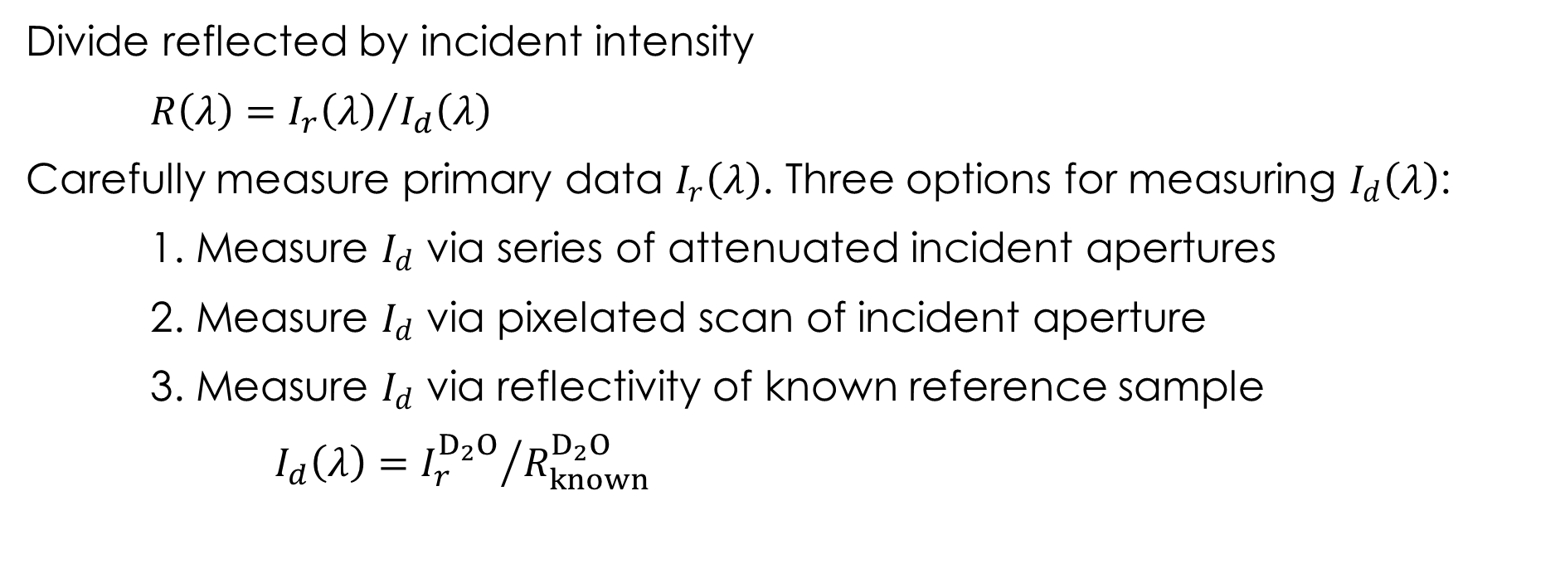
Measuring specular reflectivity
Divide reflected by incident intensity
$R\left(λ\right)={I_{r}\left(λ\right)}/{I_{d}\left(λ\right)}$
Carefully measure primary data $I_{r}\left(λ\right)$. Three options for measuring $I_{d}\left(λ\right)$:
1. Measure $I_{d}$ via series of attenuated incident apertures
2. Measure $I_{d}$ via pixelated scan of incident aperture
3. Measure $I_{d}$ via reflectivity of known reference sample
$I_{d}\left(λ\right)={I_{r}^{D_{2}O}}/{R_{known}^{D_{2}O}}$

Slide 25
Simulate QIKR direct-beam rates (I_{d})
Maximal and typical beams were simulated using McStas
Large I_{d} at short λ
Three-decade I_{d} dynamic range
To measure and use I_{d}
Create tractable count rate
Even out counting statistics in λ

Slide 26
Solution: normalize to reflectivity standard
Charge 1
Reflect from D₂O and measure
Typical configuration’s rate reduced to ~20 kHz
Dynamic range flattened

Slide 27
Solution: normalize to reflectivity standard
Charge 1
Reflect from D₂O and measure
Maximal configuration’s rate also reduced to <~20 kHz – steeper incident angle lowers D₂O reflectivity
Dynamic range flattened

Slide 28
Challenge: poor short-wavelength performance
Reflect from D₂O and measure
Maximal configuration’s rate also reduced to <~20 kHz – steeper incident angle lowers D₂O reflectivity
Dynamic range flattened
Issue: D₂O reflectivity too low at short λ
For λ < 4 Å, R_{D2O} small and difficult to measure, yielding low rate
  Develop a different standard e.g., 20 Å Ni / SiO₂
  Or measure short λ via attenuation and/or pixelation

Slide 29
What about reflected beam (I_{R})?
Reflect from Ni / SiO₂
Maximal configuration
  θ = 0.83°; δθ/θ = 0.07
  I_{R} > 10⁶ n sec⁻¹
What to do?

Slide 30
What about reflected beam (I_{R})?
Charge 1
Reflect from Ni / SiO₂
Maximal configuration
  θ = 0.83°; δθ/θ = 0.07
  I_{R} > 10⁶ n sec⁻¹
What to do
Use a steeper angle
  θ = 2.5°; δθ/θ = 0.07
  I_{R} < 10⁵ n sec⁻¹

Slide 31
What about reflected beam (I_{R})?
Charge 1
Reflect from Ni / SiO₂
Maximal configuration
  θ = 0.83°; δθ/θ = 0.07
  I_{R} > 10⁶ n sec⁻¹
What to do if you must see R=1
Use a steeper angle
  θ = 1.5°; δθ/θ = 0.07
  I_{R} > 10⁵ n sec⁻¹
  Dead-time correct?
  Attenuate?

Slide 32
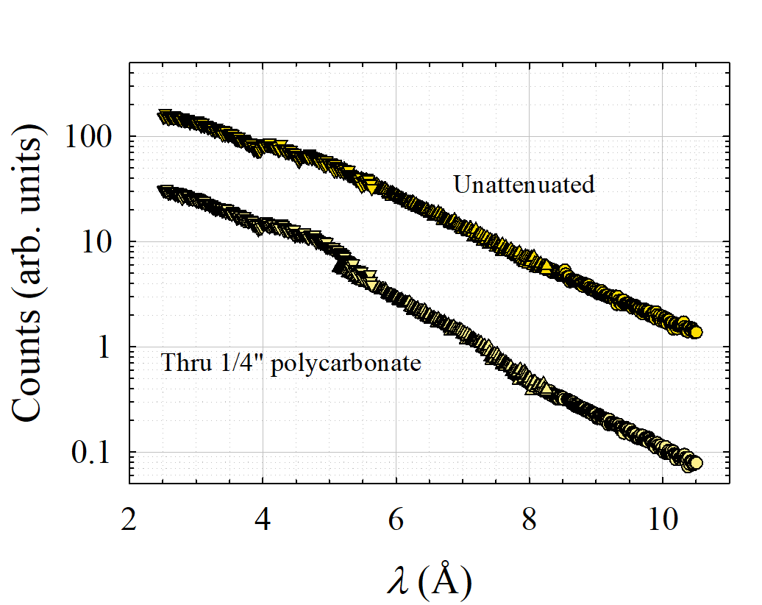
Effect of attenuator
“Achromatic” attenuators
Use e.g., polycarbonate
(PC) or Plexiglas (PMMA)
Weakly λ dependent – alters spectrum
Multiple measurements needed to correct spectral distortion
Thick attenuator behaves like a moderator

Slide 33
Detecting QIKR
Overview
Measuring reflectivity
  Bring source to sample
  Define beam
  Position sample and detector
  Normalize to direct beam
    Expected count rates
    Revisit requirements
    Mitigation strategies
Summary

Slide 34
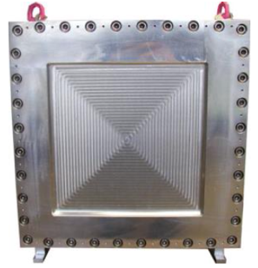
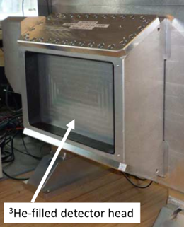
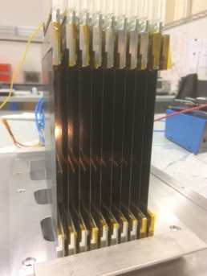
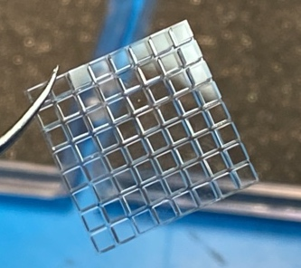
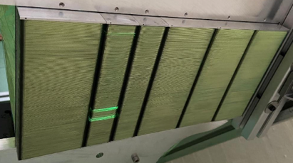
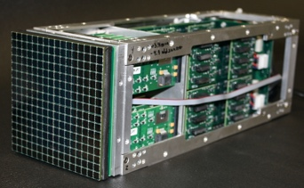
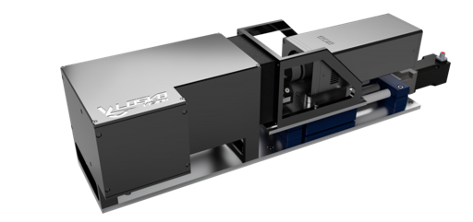
Reflectometer detector options
MWPC
Multi-Tube
WLSF
Multi-Blade
Anger Camera
Pixel Camera
LumaCam
Ex. instruments:
LiqRef, MagRef, SupeADAM
(also on SANS, diff.)
Built by:
(BNL), Denex, ILL
Advantages:
High efficiency
Low gamma
Limitations:
Disadvantages:
(Very) low rate
Thick window
Ex. instruments:
FIGARO, D17, PLATYPUS
(also on SANS, diff.)
Built by:
ILL
Advantages:
High efficiency
Low gamma
Limitations:
Asymmetric pixels
Disadvantages:
Medium rate
Ex. instruments:
INTER
(also on diffraction)
Built by:
ISIS, SNS
Advantages:
High efficiency
Low gamma
Limitations:
Asymmetric pixels
Disadvantages:
Medium rate
Ex. instruments:
None
Planned: ESTIA, FREIA
Built by:
ESS
Advantages:
Medium-high rate
Low gamma
Limitations:
Asymmetric pixels
~40% efficiency
ASIC readout
Disadvantages:
Uniformity
Ex. instruments:
None
(several diffractometers)
Built by:
SNS
Advantages:
Medium-high rate
Sufficient resolution
Limitations:
Gamma sensitivity
Rate currently not enough
Disadvantages:
Low radiation hardness
Ex. instruments:
None
Built by:
SNS (pending R&D)
Advantages:
Very high rate
Limitations:
Large Pixels
Disadvantages:
High gamma sensitivity
Pixel gaps
Ex. instruments:
Imaging at LANL, PSI
(Tested in many instruments)
Built by:
LoscoVision / ASI
Advantages:
High rate
Very high resolution
Flexible configuration
Likely several instruments
Limitations:
Improvements pending
Disadvantages:

Slide 35
Summary
Charge 1
The specifications for the QIKR detector have been derived from extrapolation of existing FTS-LR capabilities
No detector will be able to measure the anticipated direct beams directly
The expected instantaneous rate for reflectivity measurements suggests increasing specification S.04.08.05-R2 from 2×10⁴ to 10⁵
QIKR has been designed to enable three different mitigation strategies
  Attenuated direct beams
  Pixelated direct beams
  Normalization to reflectivity
Dead-time correction will be applied as needed
The appropriate strategy/strategies will be chosen based on detector capability
The better the detector, the easier the mitigation

Slide 36
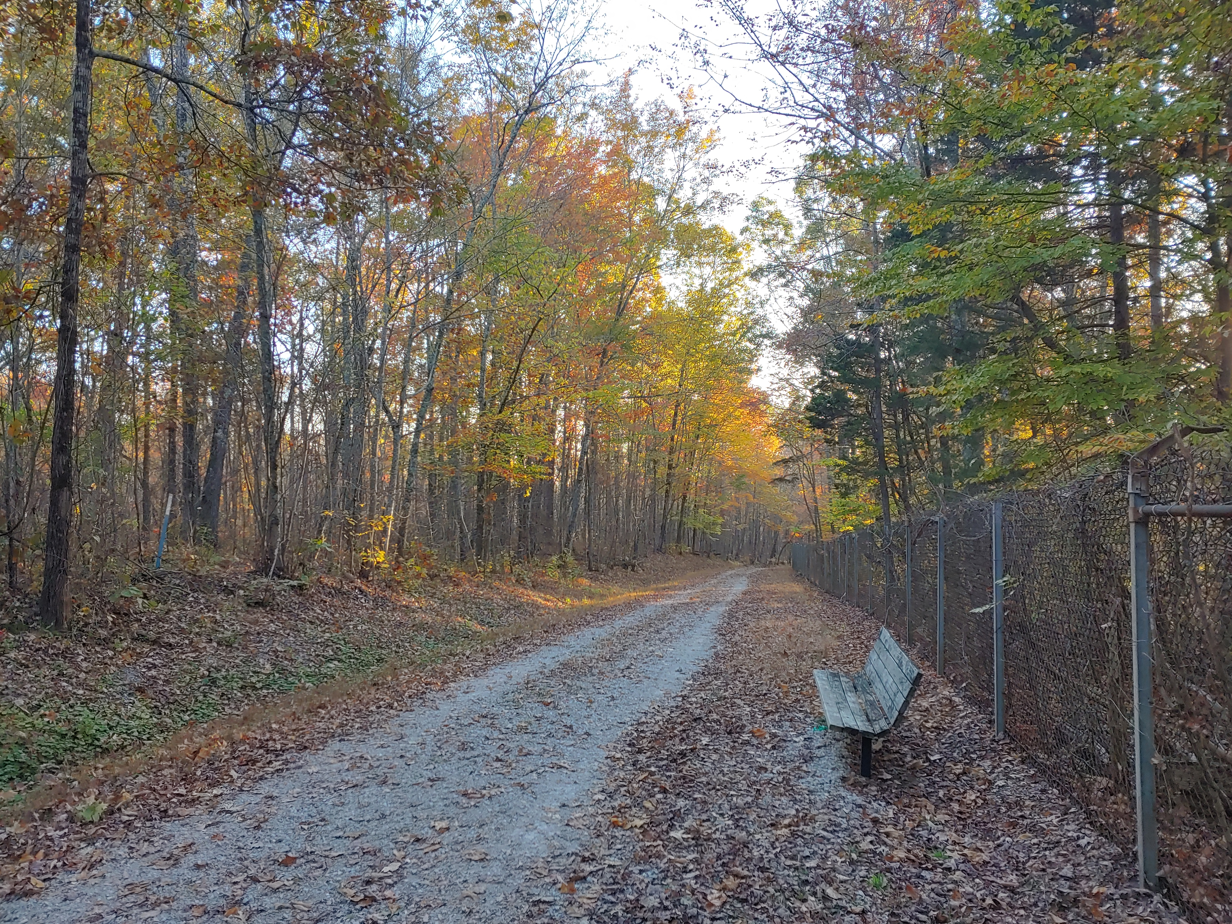
Thanks
Anton Khaplanov
Danielle Wilson
Ryan Butz

Slide 37
Compile into table of direct beam “runs”
Direct beams in counts/mC – no scale factors required

Slide 38
Et voilà: specular reflectivity normalized to $R_{known}^{D_{2}O}$

Slide 39
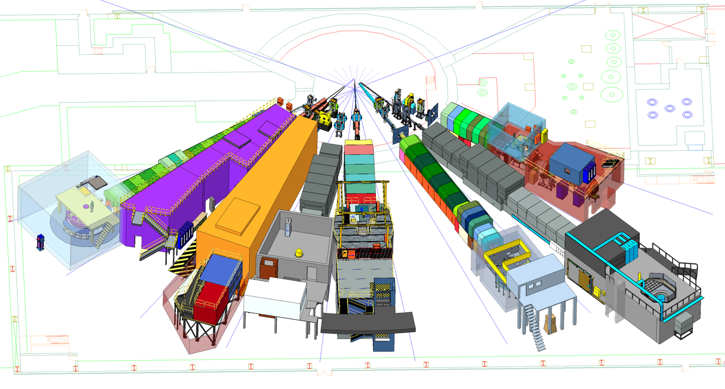
Location of QIKR
QIKR will sit at port ST02 and view the cylinder moderator
QIKR
Beamline
ST02
STS Beamlines in the South Instrument Hall

Slide 40
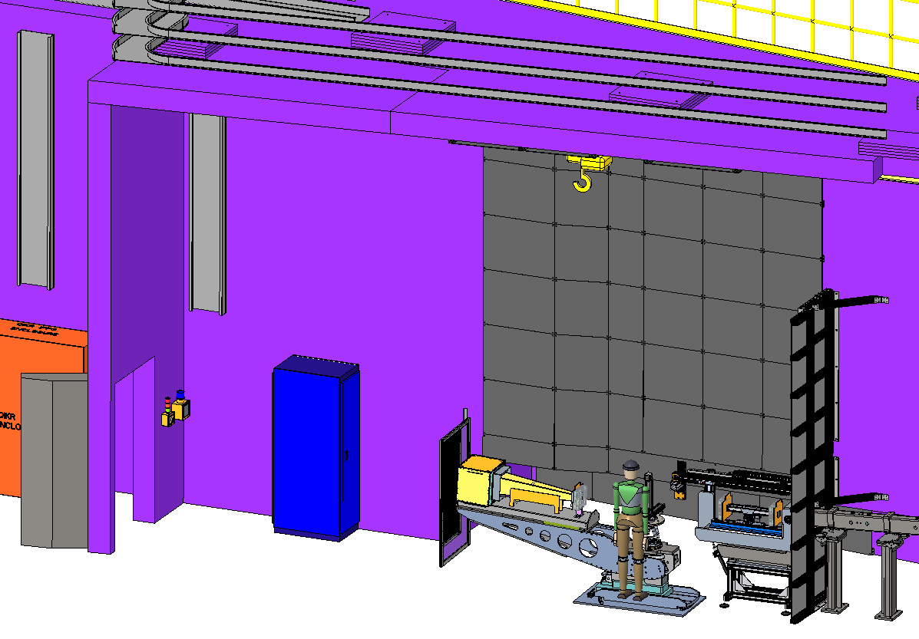
QIKR-L instrument cave
Shield
Walls
Guide
Cave Entrance
Detector Arm
Sample Table
Incident Table
[Requirements A,B,F]

Slide 41
Attenuated apertures
Start with measurable spectrum
Place attenuator, re-measure
Repeat as needed

Slide 42
In practice – constant θ = 0.6°
Measure at reduced apertures
(<1 kHz for Brookhaven ³He)
Determine scale factors by a series
of attenuated measurements
F_{j} = A_{j} + B_{j} λ
Apply factors to determine
actual spectrum

Slide 43
In practice – constant 2.5 < λ < 6 Å
Measure at reduced apertures
(<1 kHz for Brookhaven ³He)
Determine scale factors by a series
of attenuated measurements
F_{j} = A_{j} + B_{j} λ
Apply factors to determine
actual spectrum – gets
softer as slits open wider

