Slide 1
QIKR Detector PDR: Mechanical Overview
D. Wilson, Lead Engineer
December 16, 2024

Slide 2
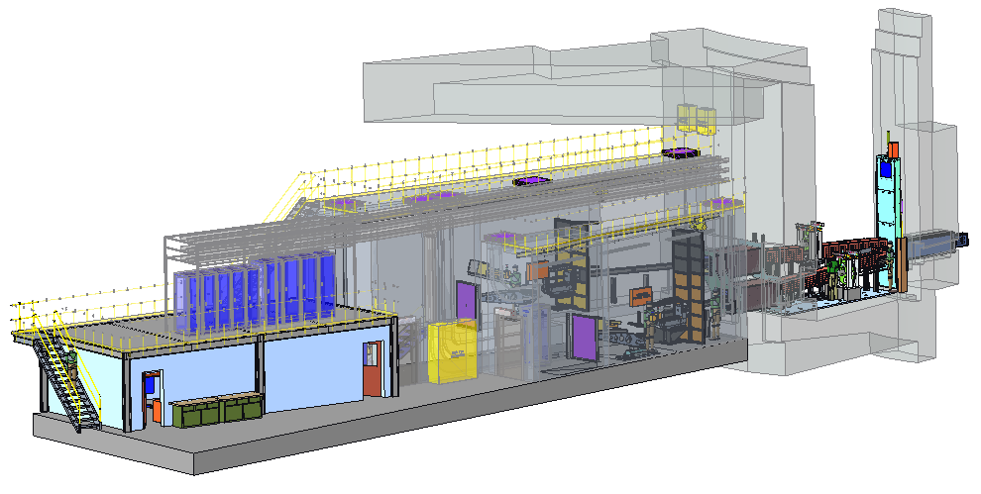
Outline
QIKR Overview
Review Scope
Documentation
High level QIKR description
Detector & Beam Monitor
Beam Monitor locations
Detector details

Slide 3
QIKR Overview

Slide 4
Review Scope
Included
Not Included
QIKR Detector
QIKR Beam Monitor (Overview)
Details of QIKR Beam Monitor design… this is a design that is copied from ILL

Slide 5
Requirements, CQLD, Interface, FMEA Documents
Requirements Documents:
QIKR Instrument Requirements: S04080100-SRD10000-R02 (not released)
The latest revision (R02) has not been released yet, awaiting optics alignment updates
CQLD Detector:
Quality Level 2, Configuration Level 3: S04080500-QAI10000-R00 (released)
Quality Level 2 is primarily because of the impact to the user of a detector failure on QIKR (there is only one detector per beamline)
CQLD Beam Monitor:
Quality Level 3, Configuration Level 3: S04080500-QAI10001-R00 (released)
Interface Documents:
Interface to ICS (detectors): S01020500-IST10117-R00 (released)
FMEA for Detector: S04080500-FMA10000-R00 (not released)
Created by D.Wilson, J.Ankner, A.Khaplanov
One item of concern (discussed in later slides)

Slide 6
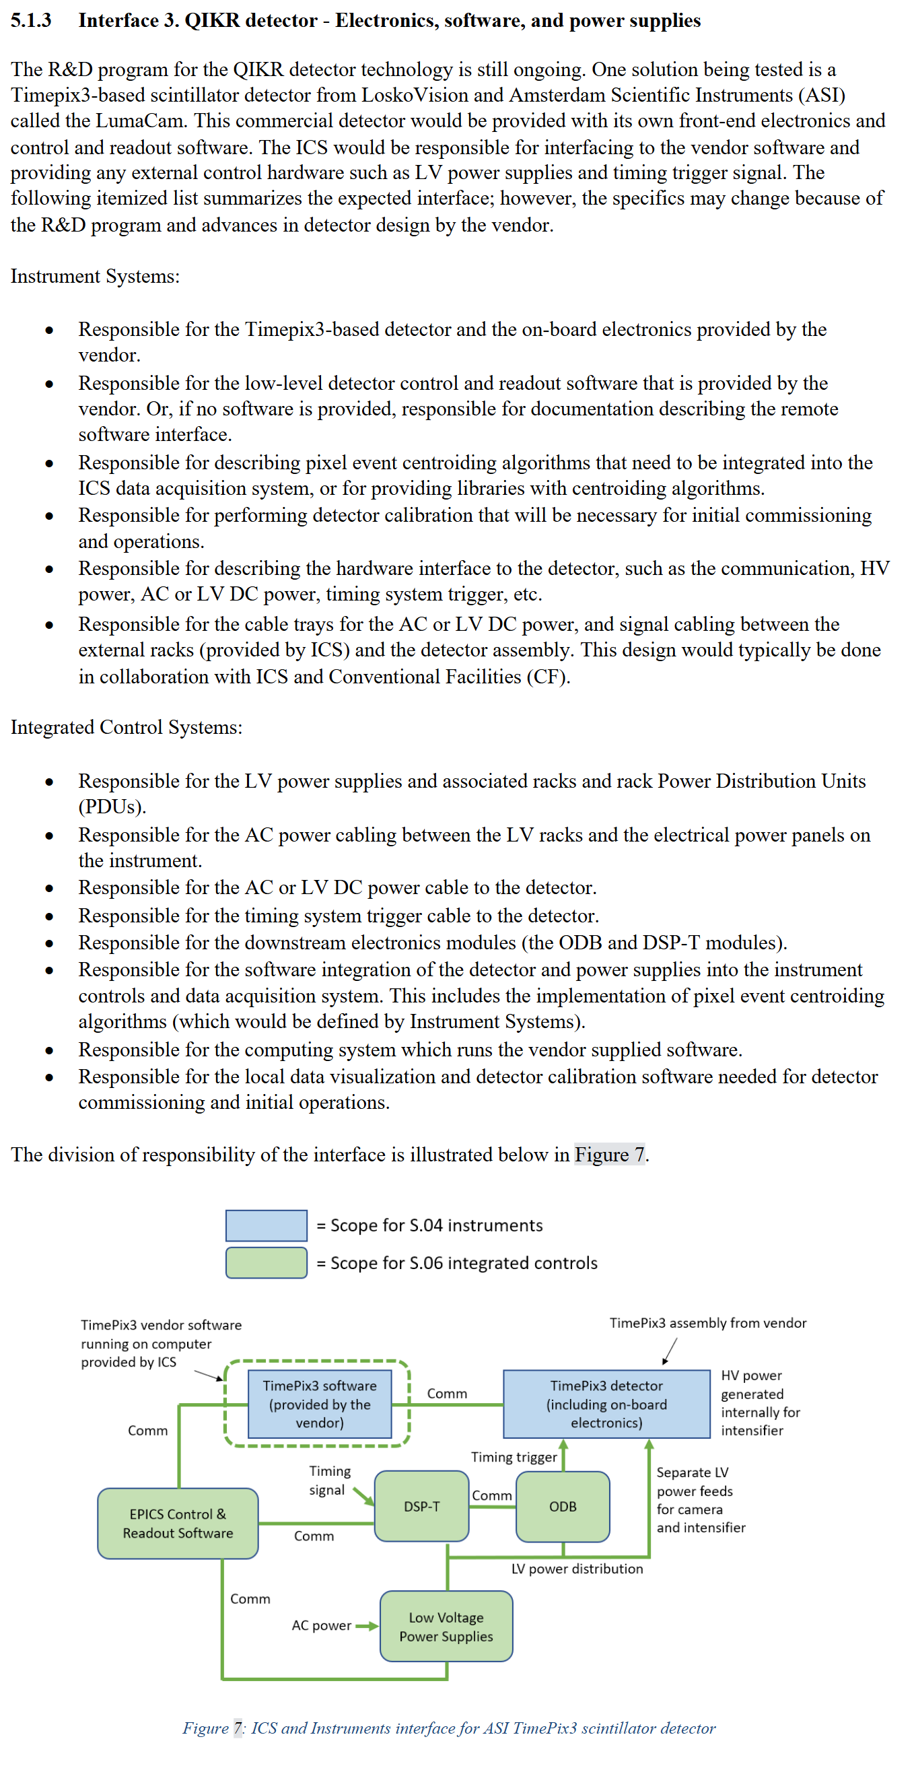
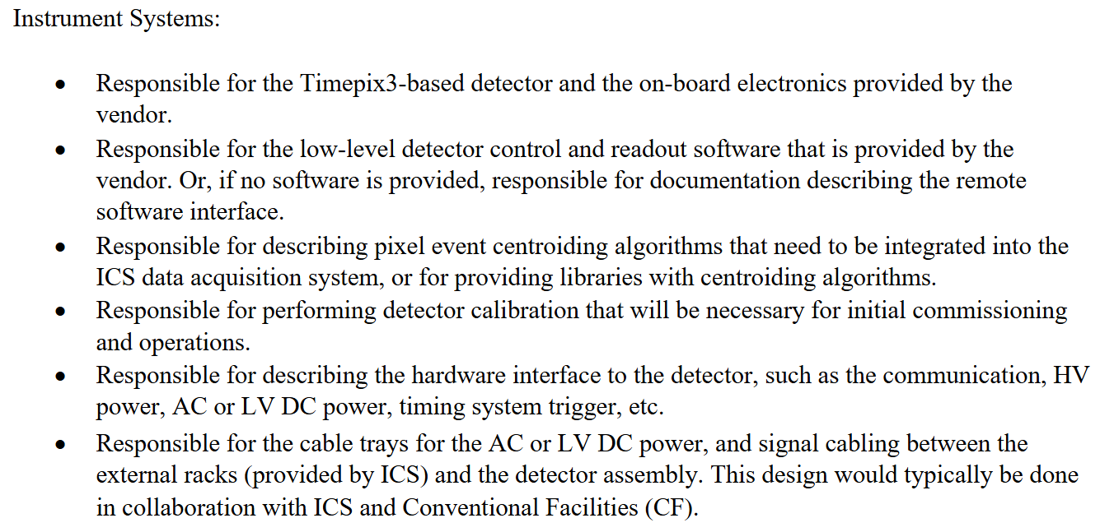
Interface Details, ICS to QIKR Instrument Detector

Slide 7
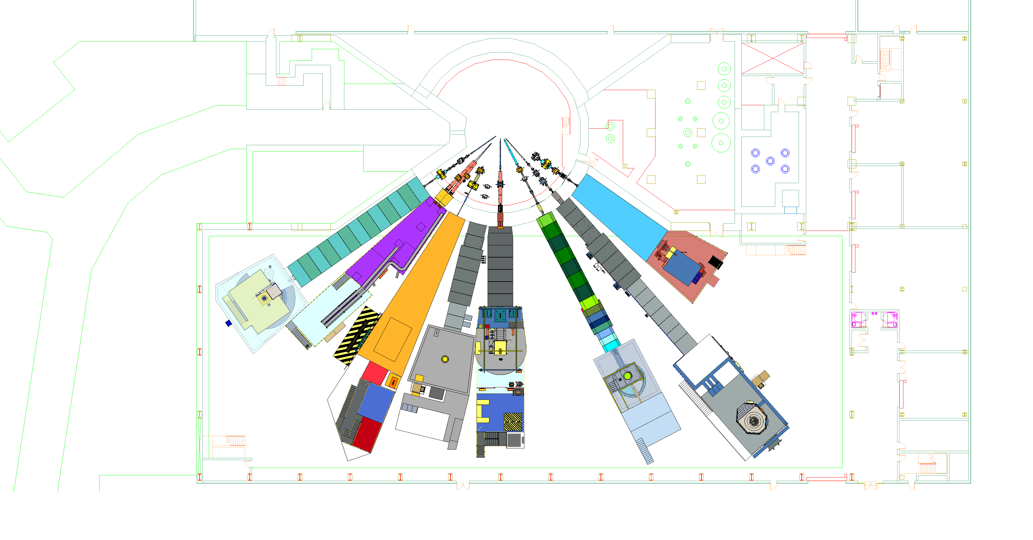
STS Instrument Suite
North Hall
(ST10-ST18)
Monolith Region
Proton Beam
Target Bay
South Hall
(ST01-ST09)
ST01
EXPANSE
ST02
QIKR
ST03
CUPI2D
ST04
BWAVES
ST05
CHESS
ST06
Future
ST07
VERDI
ST08
PIONEER
ST09
CENTAUR

Slide 8
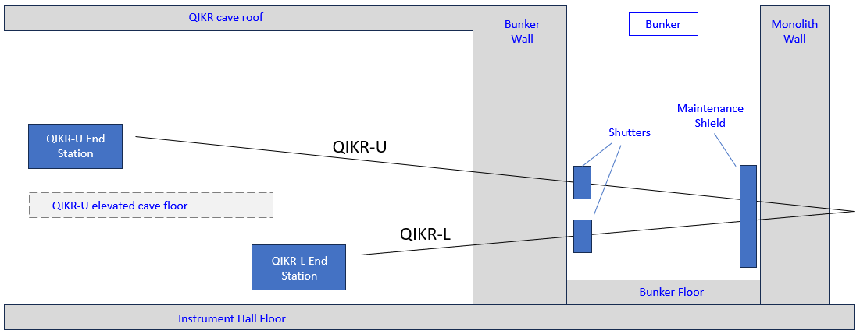
QIKR – Schematic View
As oriented in this view, QIKR-A occupies the back half of the instrument wedge & cave, and QIKR-B occupies the front half
24m moderator-to-detector distance
QIKR-A End Station
QIKR-A
QIKR-A
QIKR-B
20m moderator-to-detector distance
QIKR-B End Station
The shutters also contain the beam monitors
The End Station consists of the Incident Table with Slits and Frame Overlap Mirror, the Sample Table, the Detector Table, and the Sample Changer

Slide 9
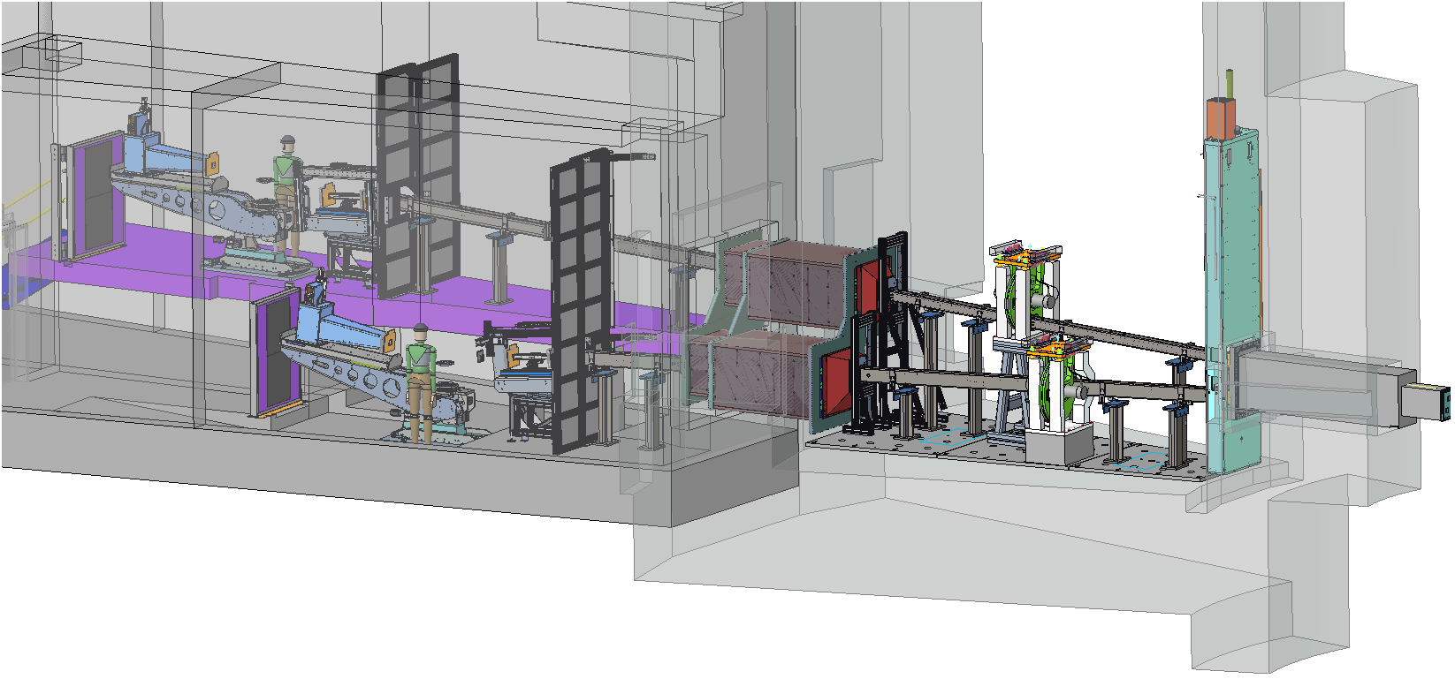
QIKR –3D Model View
User stands on opposite sides of the end station, upper vs. lower
Maintenance Shield
QIKR-A
Shutters, Beam Monitors
Neutrons
QIKR-B
Sample and Detector Tables, Sample Changer
Incident Table with Slits & Frame Overlap Mirror
End Station

Slide 10
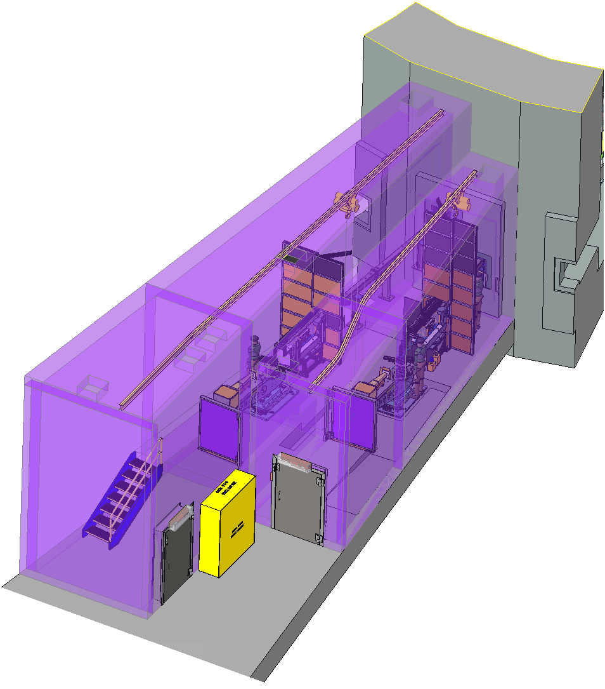
Installation of Components
All QIKR in-bunker components will be installed by removing the bunker roof panels and using the 50-ton high bay gantry crane unless they are light enough to be hand-carried
Most QIKR in-cave components will be installed by bringing the components into each cave on a cart, then carrying them to their final location with a 2-ton monorail hoist
The monorail will also be used during operations to swap sample environments and to service end station components
Note: The detector and its associated components have a low enough weight to allow manual assembly without the monorail
2-ton monorail in each cave for component installation, & sample environment changes
Beam stops are hinged and swing out of the way to allow user or component access when needed

Slide 11
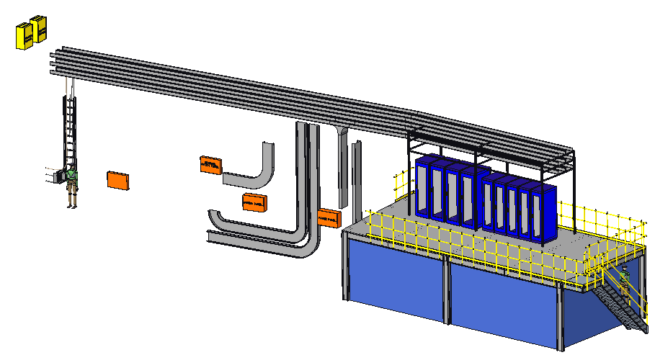
Cable Routing
QIKR-B’s motion and detector cables are routed through QIKR-A’s cave, which allows the cables to be under 30m in length
QIKR-A’s motion and detector cables are under 30m in length as well (routed directly up through the roof)
IPPS boxes for Shutters (on exterior bunker wall)
QIKR-B routing through bunker wall pass-thru & roof for in-bunker components
QIKR-B patch panel (on inner wall)
QIKR-B power panel (on outer wall)
Cable routing to cave both QIKR-A and QIKR-B
QIKR-B additional routing to the roof
Control racks for both QIKR-A and QIKR-B
All IPPS cables
QIKR-B motion & detector cable routing to the roof & control racks
QIKR-A motion & detector cable routing to the roof & control racks
QIKR-A patch panel (on inner wall)
QIKR-A power panel (on inner wall)
QIKR-A additional routing to the roof

Slide 12
Beam Monitor

Slide 13
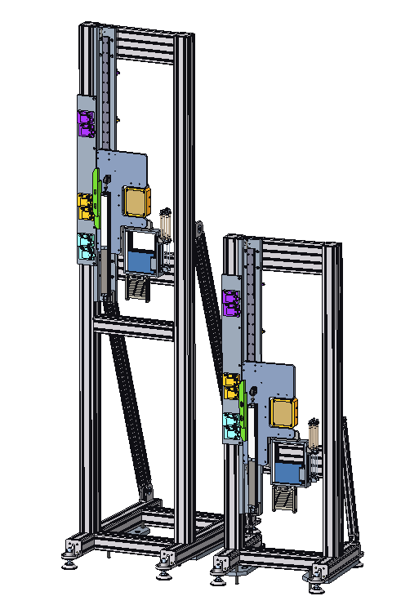
Shutter
Upper beamline (QIKR-A) Shutter
Downstream side (looking upstream)
The Shutter blocks the neutron beam to allow personnel access to the cave… there is one shutter per beamline (two total)
The QIKR Shutter operation is different from standard in two ways:
The “open” position also contains the attenuators
There is a third position for a beam monitor
The need to minimize guide gaps and windows drives the multi-functionality of the shutter
Blocked position
Lower beamline (QIKR-B) Shutter
Open position (with optional attenuation)
Beam Monitor position
Design credit: Rudy Thermer

Slide 14
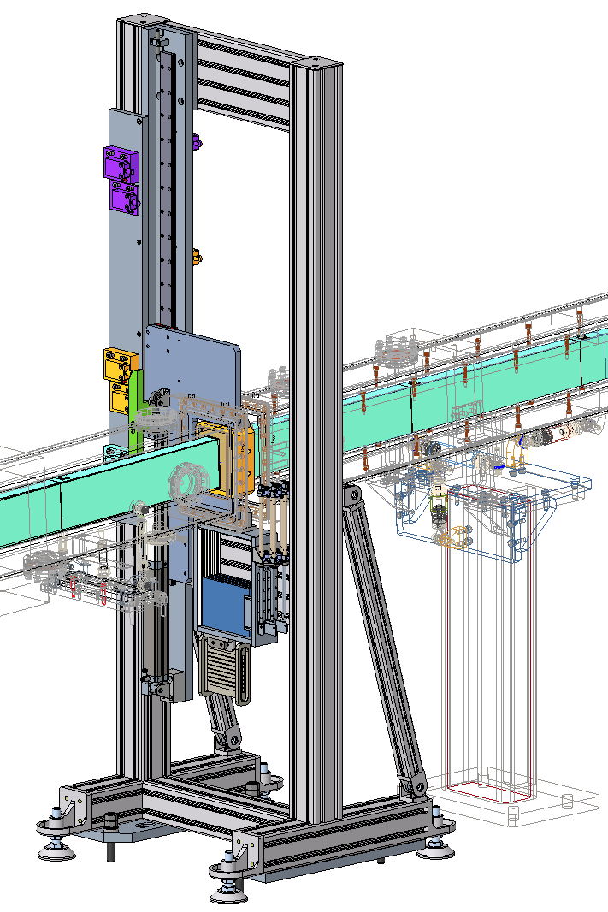
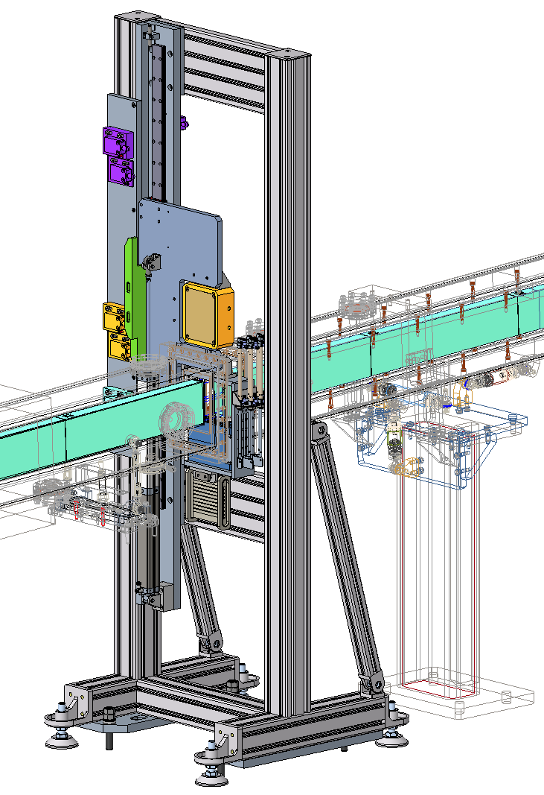
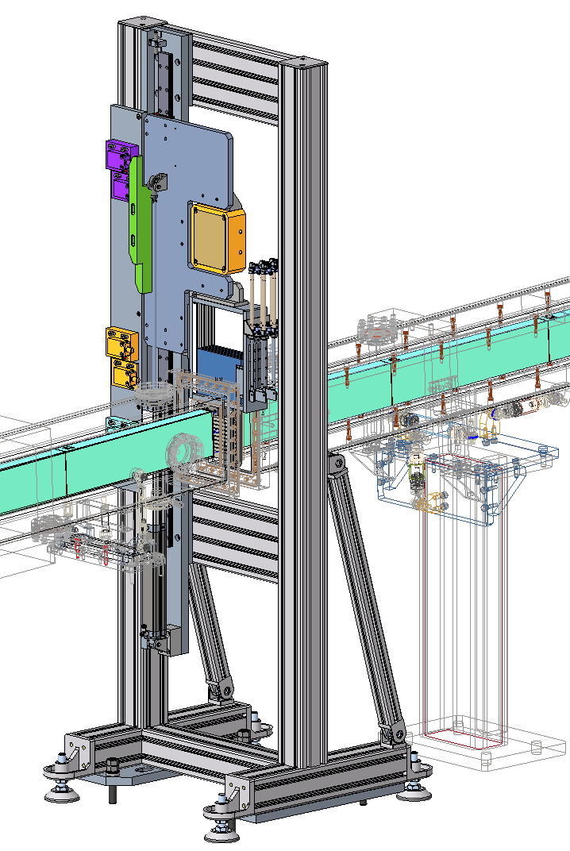
Shutter Positions
Neutrons
Neutrons
Neutrons
A) Beam blocker in position
B) Open position with attenuator
C) Multitube beam monitor in position
Design credit: Rudy Thermer

Slide 15
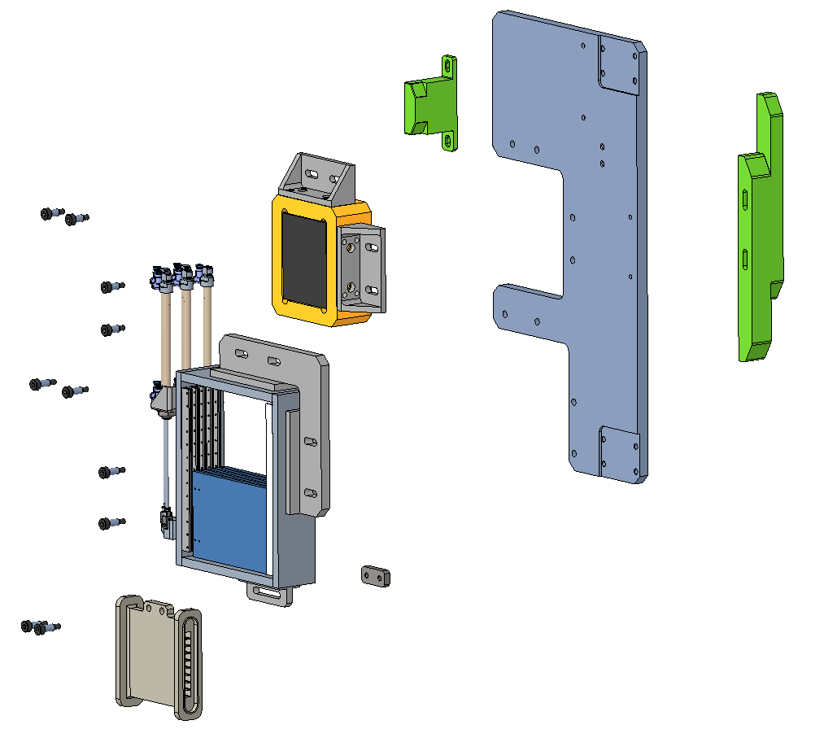
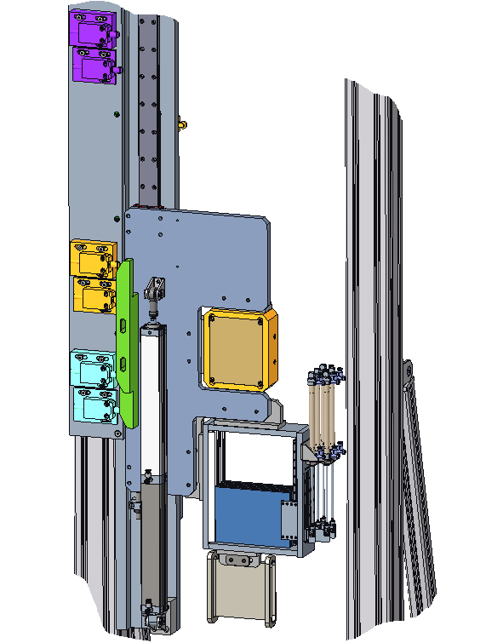
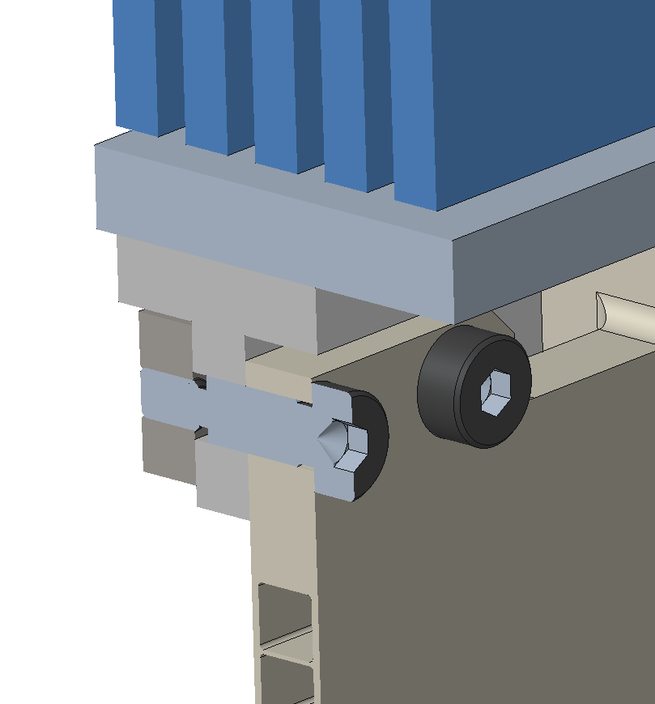
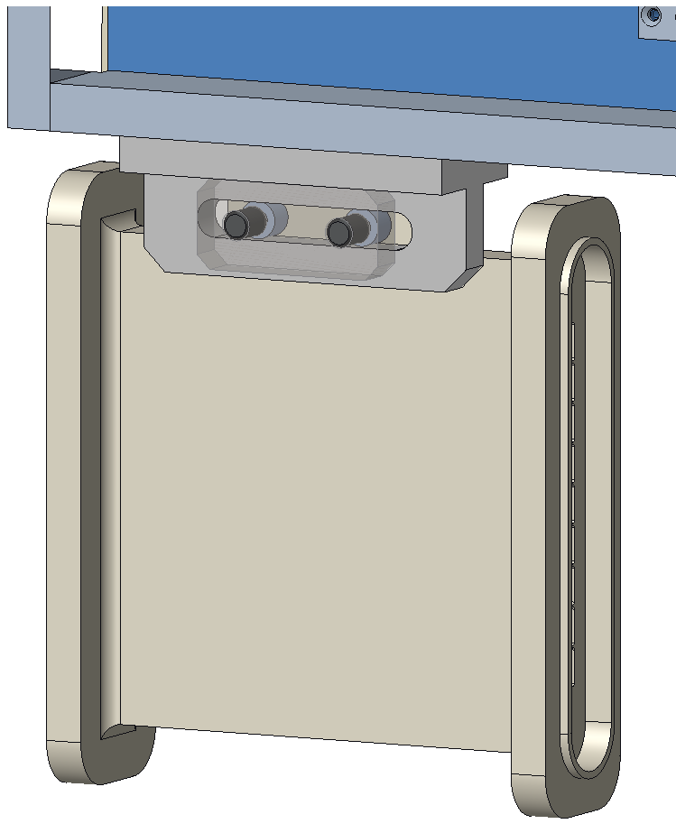
Shutter Components
Downstream side (looking upstream)
Beam Monitor Attachment
PPS “Beam Monitor”
Fabricated aluminum plates
Aluminum extrusion frame (similar to standard design)
Bearing rail (stainless steel)
PPS flag
Beam Blocker
10cm tungsten +
1cm B₄C
PPS “Beam Open”
Fabricated carrier for the beam blocker
PPS “Beam Blocked”
Attenuator assembly
Elongated bracket holes allow adjustment in x-direction
2-stage air cylinder, fail-safe for electrical failure
Nested shoulder screw acts as a guide pin
Design credit: Rudy Thermer
Beam Monitor

Slide 16
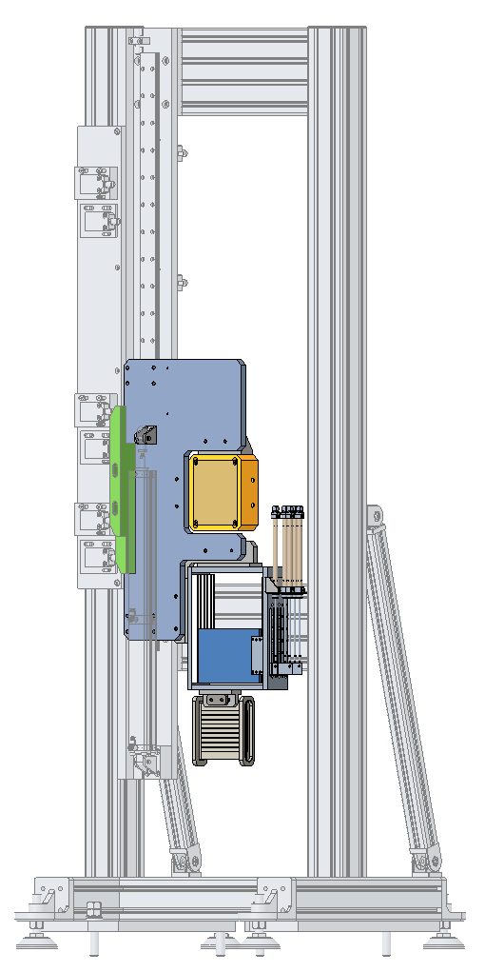
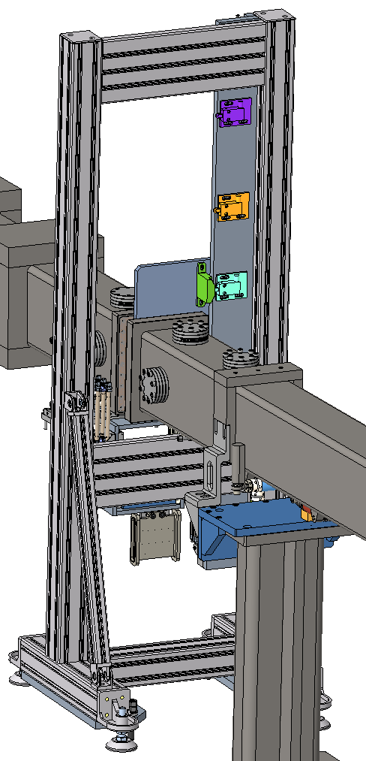
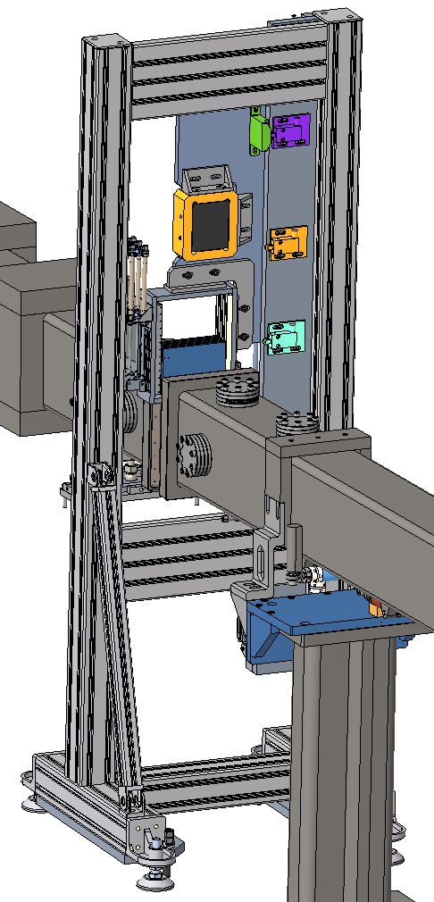
Component Accessibility for Assembly & Disassembly
Multitube monitor & Attenuator: accessible from above the guide
Multitube monitor: accessible from below.
Design credit: Rudy Thermer

Slide 17
Beam Monitor Requirements
There are no specific beam monitor requirements for QIKR

Slide 18
Acquisition strategy
The parts will be effectively COTS, ordered from ILL
Competitive bid not possible… ILL will supply the monitors
Monitor is not available from a US distributor
No expected supplier constraints (unless ILL closes before STS orders parts)
No exotic or hard-to-obtain materials

Slide 19
Manufacturing strategy
There are no fabricated parts
Assembly of the beam monitor into the beamline will be done in-house
No assembly needed at the monitor level itself

Slide 20
Installation Plan
Beam Monitor will be placed manually onto the shutter & tested for basic functionality prior to being installed in the beamline
Riggers to place the shutter assembly into the bunker with the 50-ton overhead high bay crane (through the bunker roof)
Installation should occur after the bunker wall and monolith guide sections are installed, but before the remaining in-bunker guide sections are installed
SNS technicians & engineers to do final adjustments, connect cabling, test component function while connected to bunker air & instrument power, PPS, ICS

Slide 21
Beam Monitor Costs & Labor Hours
Material & Labor Costs
Beam Monitor | Mat’l Cost | Labor Cost | Labor Hours
Procure (P6) | $46,489 | $5,836 | 28
Install (P6) | $1,954 | $8,570 | 50
Only the QIKR-B monitor will be purchased and installed
Labor Hours
P6 vs. Current | Labor Type | Procure/Asm | Install
Source = P6 | scientist | 20 | 20
 | engineer |  | 6
 | designer
 | technician | 8 | 24
 | Davis-Bacon
ICS has additional hours for install, not funded from the Instrument budget

Slide 22
Detector

Slide 23
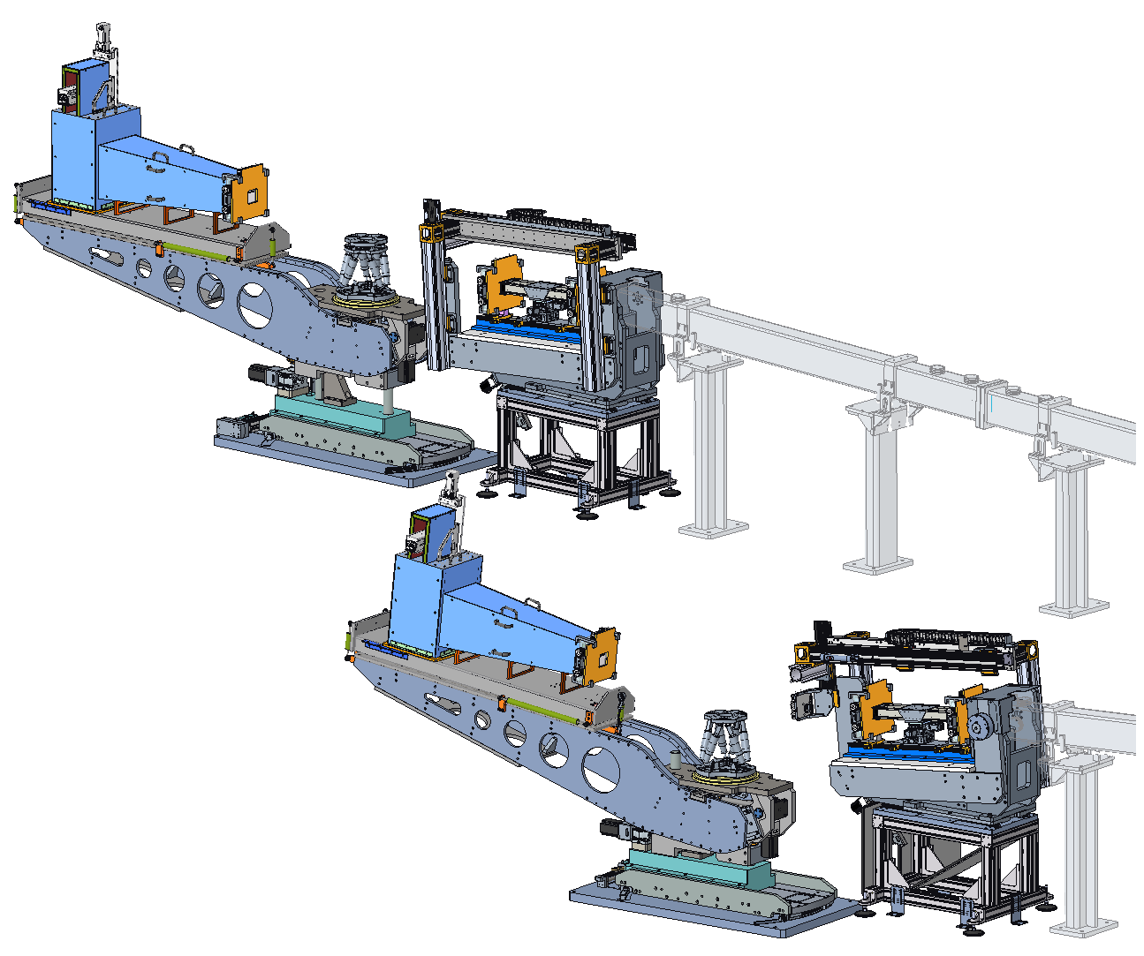
End Station – Overview
Design credit: Rudy Thermer
Upper beamline (QIKR-A)
End station components:
Incident Table
Sample/Detector Table
Beam Conditioning Slits
Frame overlap mirror (FOM)
Hexapod
Sample Changer
Detector & Shielding
The user stands on the opposite side of the upper end station vs. the lower one
Some features on the detector may be mirrored
Incident Table Assembly (upper and lower versions)
Sample and
Detector Table Assembly
Lower beamline (QIKR-B)
User stands here

Slide 24
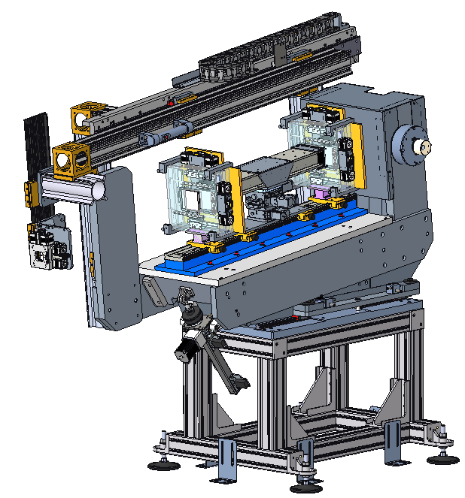
Incident Table – Operation Overview
Design credit: Rudy Thermer
At the guide exit, the neutron beam splits into 3 main components separated by 1.5°
Neutrons
Guide
The incident table’s purpose is to select one of the 3 main neutron beams exiting the guide
A beam is selected by moving the slits and Frame Overlap Mirror (FOM) as a unit to be in line with the desired beam
The slits allowed the selected beam to pass through while blocking the others
This detector must look at one of three possible sample locations each separated vertically by ~60mm
Frame Overlap Mirror (FOM)
Incident Table pivot point
Tie-downs to the cave floor (on all 4 sides)
Slits

Slide 25
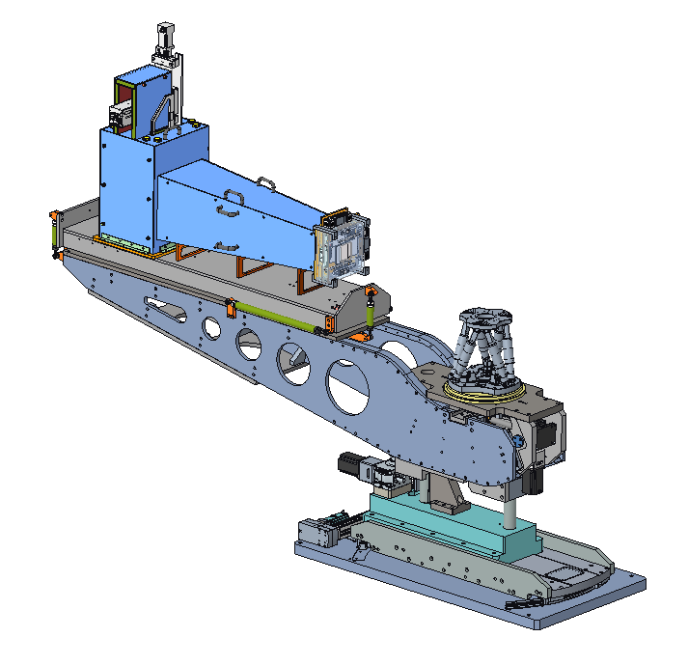
Sample/Detector Table
Detector & shielding will change slightly as the detector geometry is finalized, but will be very similar to what is shown
Design credit: Rudy Thermer
The detector and sample table move vertically together (motorized)… there is no separate vertical motion for those components
Reduces axes & cost
The detector and sample table also rotate together (motorized) about a vertical axis through the sample nominal center
Fine sample positioning is handled by an electric motor hexapod sitting on a stack of shims
The shims provide larger height adjustments for tall vs. short sample environments
The detector rotates about an x-axis (motorized) through the sample center using curved guide rails
The detector is always looking at the sample center, even if the sample table changes height
Detector, downstream slit, and detector snout (shields the detector from background) all sit on a table mounted to the detector arms via six-strut linkages to allow initial alignment (manual)
Hexapod (electric motors) with spacers for fine positioning of the sample
This sample table moves up/down to place the sample in the path of one of the three beams
The detector arms rotate about the sample center location (+15°) and are carried up/down vertically with the sample table
Base plate is bolted to a levelled grout plate (not shown) in the cave floor
Curved wire-race bearings (on both sides) for the detector arm rotation
Sample table and detector arms can rotate 15° about a vertical axis through the sample center

Slide 26
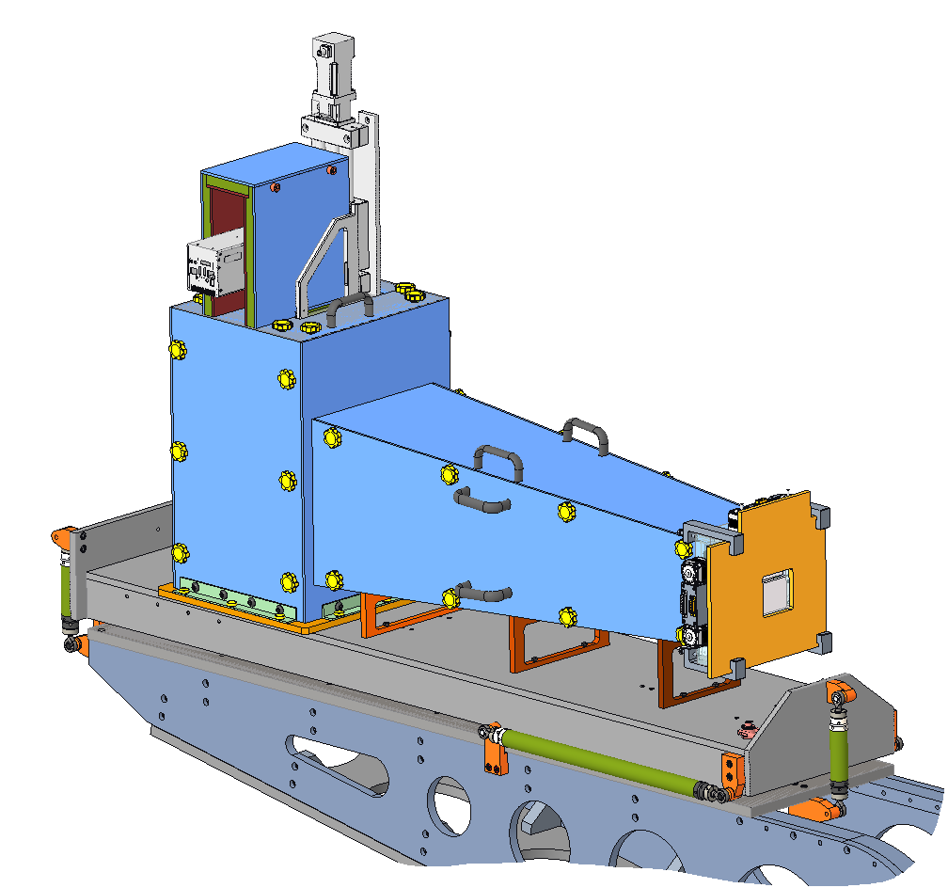
Detector Platform
Lift features for installation
Fabricated aluminum or steel brackets to attach the 6-struts
Design credit: Art Diaz
The detector platform is attached to the detector arm via 6-strut linkages… 6 turnbuckles that fully constrain and allow position adjustment of all DOF’s
Struts allow ~25mm (1”) of linear adjustment
The detector platform has lift features for installation via the overhead monorail crane
Design is a placeholder at the moment… will be completed when the detector and snout design is finished (final detector geometry TBD)
There will be mounting features for the detector, the snout, and the slit that allow some relative position adjustment between the 3 components
Fabricated aluminum plates, screwed together (screws not shown)
Attach points for the detector, snout, & slit… final design TBD pending detector design finalization
The components will be mounted to an optical rail (not shown) once the detector design is finalized
Slit and shield plate (orange)
6-strut linkages… allow linear and angular adjustment of the detector, snout, and slit as a unit (adjustment range ~25mm)

Slide 27
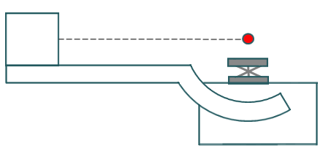
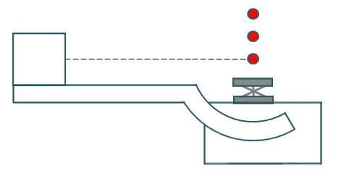
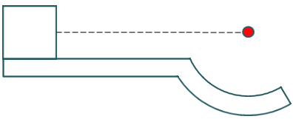
Motions of Detector Arm and Sample Table
Vertical ‘Y’ axis through nominal sample center
Sample positions needed for each beam
The 3 neutron beams for QIKR-B
Detector
Hexapod
Sample Table Vertical Travel
Detector Arm
Sample Table
Sample/ Detector Table Base
Detector Arm rotates about a horizontal ‘X’ axis drawn through the nominal sample center
Each sample position separated by ~60mm
Sample Table moves vertically to place the Detector Arm’s center of rotation on the desired sample position
Sample Table also rotates toward the user about a vertical ‘Y’ axis drawn through the nominal sample center

Slide 28
Detector Description
Mechanical Details of Detector
The detector consist of:
a light-tight box that has a scintillator coating on the interior of the surface that faces incoming neutrons
a 45° mirror that reflects visible light into a camera lens
a camera lens that focuses the incoming light (lenses can be changed as needed for different fields of view)
an intensifier that multiplies the incoming photons
a camera that captures the visible light and relays an image
a motor with encoder that moves the camera, lens, and intensifier in order to adjust the focus
Detector geometry not final yet
Needs to be up-sized to give QIKR’s required 20cm x 20cm detection area… details of that have not been finalized (must work with Losko Vision)
Perhaps use a two-camera design instead of only one?

Slide 29
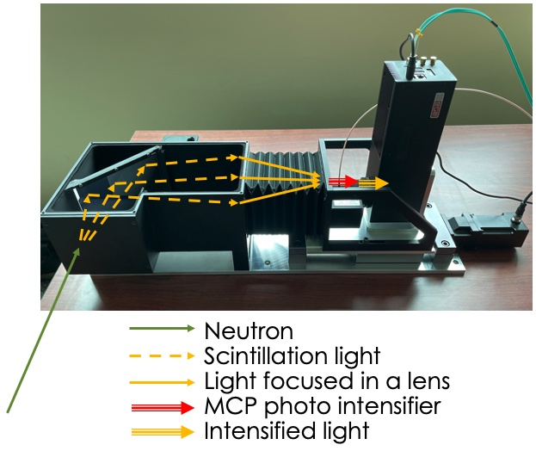
LumaCam Detector
Bellows to allow focusing motion while maintaining light-tightness (camera lens moves inside the bellows)
Light-sensing camera
45° mirror to reflect the scintillation light into the camera lens
Light-tight box (lid not shown)
Motor + encoder cable
Scintillator coats the interior of this aluminum housing surface
Focusing motor
Light intensifier

Slide 30
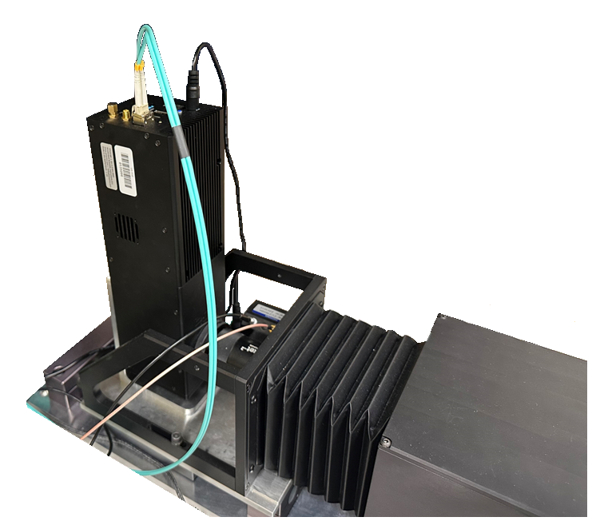
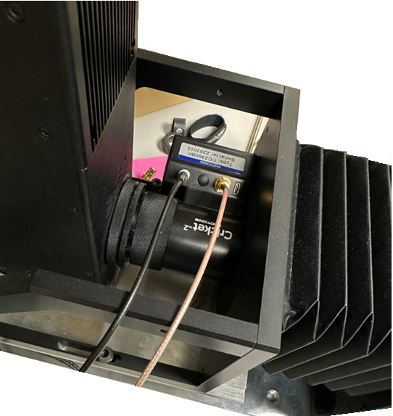
LumaCam Detector
Camera output data cable (fiber-optic)
Camera power cable
Image intensifier
5V TTL signal cable
Low voltage cable to control amount of signal intensification (volume control)
Camera timing signal cable (not shown)
Movable camera-focusing portion of detector (camera, lens, intensifier, one end of the bellows)
Low voltage intensifier power cable (not shown)
Fixed neutron-sensing portion of detector

Slide 31
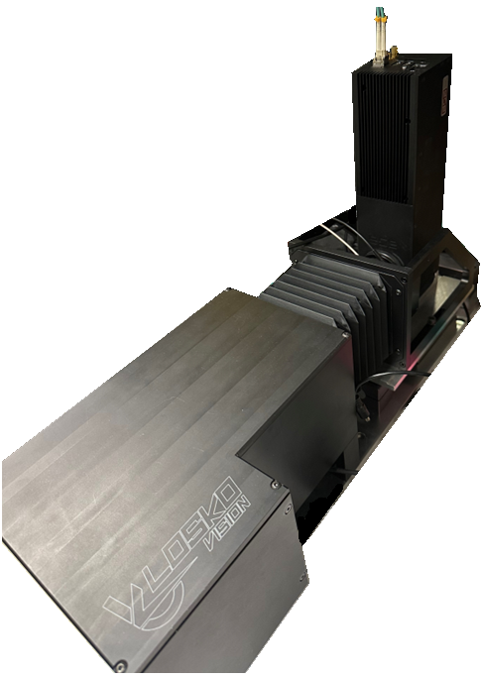
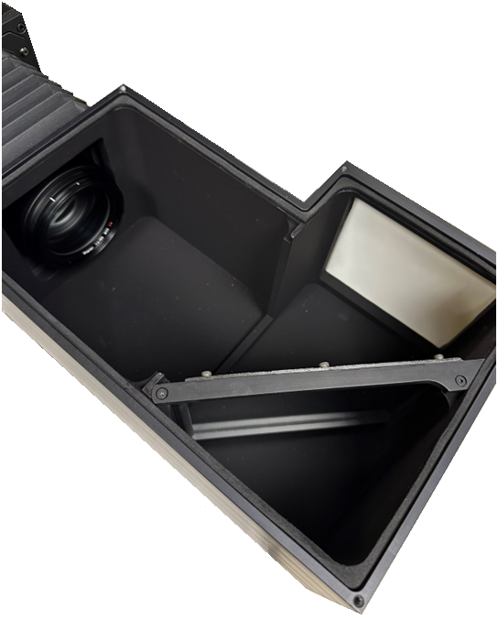
LumaCam Detector
Camera lens
Neutrons
Light
Neutrons

Slide 32
Detector Shielding Description
There is shielding around the detector to prevent unwanted neutrons from getting to the scintillator
A rectangular pyramid “snout” extends between the detector and the slit downstream of the sample
A shield box encloses the scintillator housing on all sides
A shield plate is assembled on the upstream side of the slit
The camera is not expected to need full shielding & should remain un-enclosed to avoid potential overheating issues

Slide 33
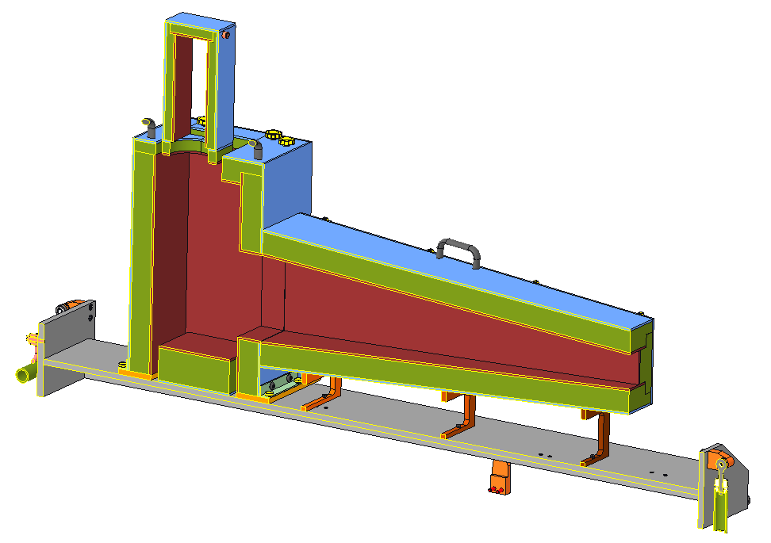
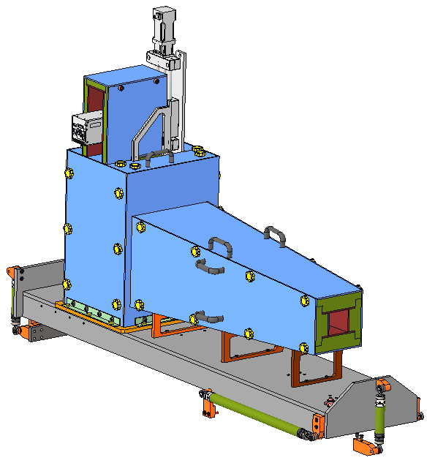
Detector Shielding Details
Design credit: Ryan Butz
Shielding is comprised of multi-layer panels
The thickest layer is borated polyethylene (PE)
The interior layer is B₄C (glued on)
The exterior layer is aluminum sheet (glued on)… the PE must be covered per fire protection rules
The PE layer contains threaded inserts that are used to screw the panels together
Most screws have thumb-screw caps attached for easy installation/ removal
Allows for easy access to the interior of the scintillator housing if lens changes are needed
Larger panels have handles, also for easy installation/ removal
Weight of assembly shown = 195kg Weight allowed = 306kg
Camera shielding
Aluminum
(blue)
Borated polyethylene (PE)
(green)
Scintillator housing shielding
B₄C (red)
Handles
Screws with thumb-screw caps
“Snout”
Attachment to the detector platform
Detector platform
Snout supports… will likely attach these to an optical rail

Slide 34
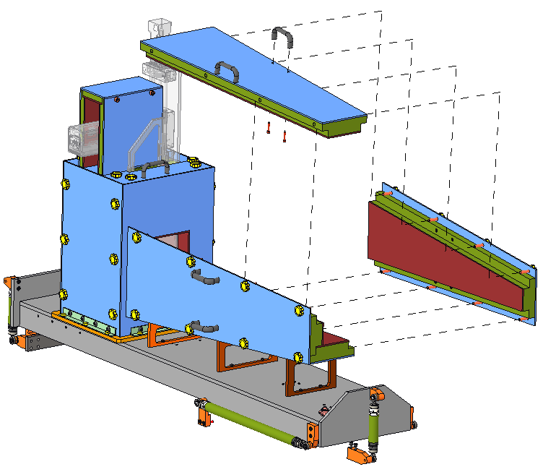
Detector Shielding – “Snout”
Camera shielding
Bottom snout panel is placed first
Side panels are screw-attached to the bottom panel
Top panel is placed and screw-attached to the sides
Weight of each panel is ~33lbs
Snout will eventually be placed on an optical rail that will allow it slide toward and away from the detector to close any gaps in shielding
Snout is not screw-attached to the scintillator housing shielding, only to the detector platform
Scintillator housing shielding

Slide 35
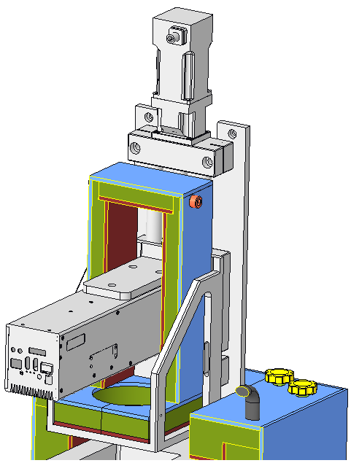
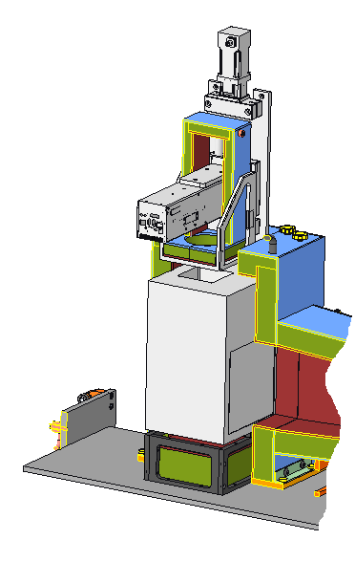
Detector Shielding – Camera & Scintillator
Camera shielding,3 pieces, sits on shielding below… free-floating (shown as a cross-section)
Detector frame screw-attaches to the detector platform
An 8.6lb rectangular piece of shielding fits beneath… free-floating, not screw-attached… held in place by the detector frame
Two Free-floating panels fit around intensifier tube
Each panel weighs ~0.6lbs
Free-floating camera shielding sits on top of the panels around the intensifier tube… can attach this to neighboring shielding if needed
Side panels are each ~6lbs, the top panel is ~2.6lbs
Shield panels for the scintillator housing screw-attach to each other and to the detector platform
Total weight ~86lbs, heaviest single component weight ~22lbs
Assembled around intensifier tube… free-floating (intensifier not shown)
Detector frame with shielding tucked beneath
Shielding fully encloses scintillator housing (shown as a cross-section here). Panels are screw-attached to each other

Slide 36
Detector Cable Routing – Description
There are six cables plus a motor power & encoder cable
Three cables for the camera (signal, power, timing), and three for the intensifier (5V TTL, power, amplification)
These will all be routed along the detector arm on the side farthest from the user, then drop down to the floor and route to the control racks from there
Motor power will be kept separate from the remaining cables
No intermediate junction boxes (power supplies, signal conditioners, etc.) are needed
Detector is not expected to need separate grounding, but should have the capability to be connected to ground within the beamline

Slide 37
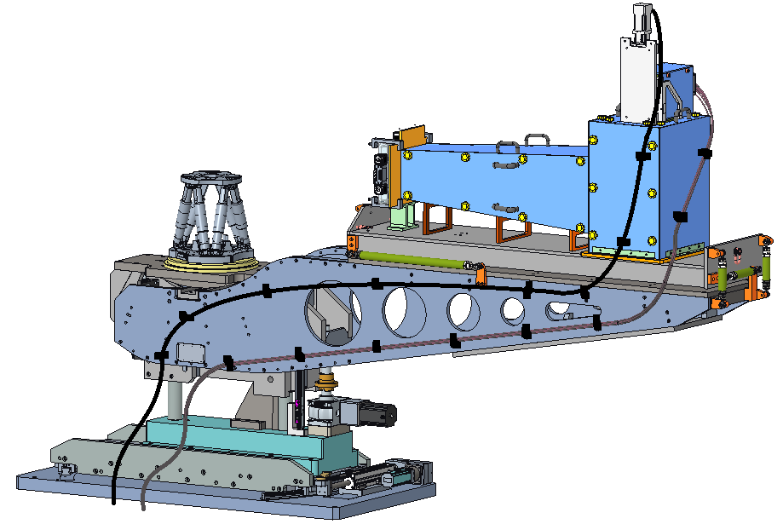
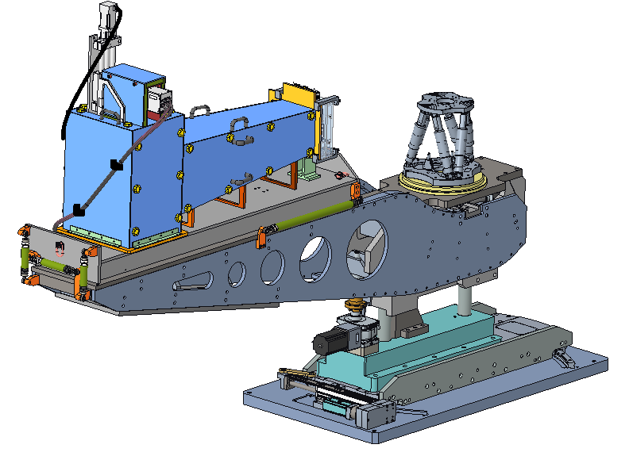
Detector Cable Routing – Details
Motor and encoder cable routes separately from the camera & intensifier cables
Motor & encoder cable
This side of the arm is opposite the user. Cables are routed to the sample location, then run down into the cable channel in the floor.
Camera & intensifier cables
Sufficient cable slack will be provided here to accommodate the detector arm and sample table table rotations

Slide 38
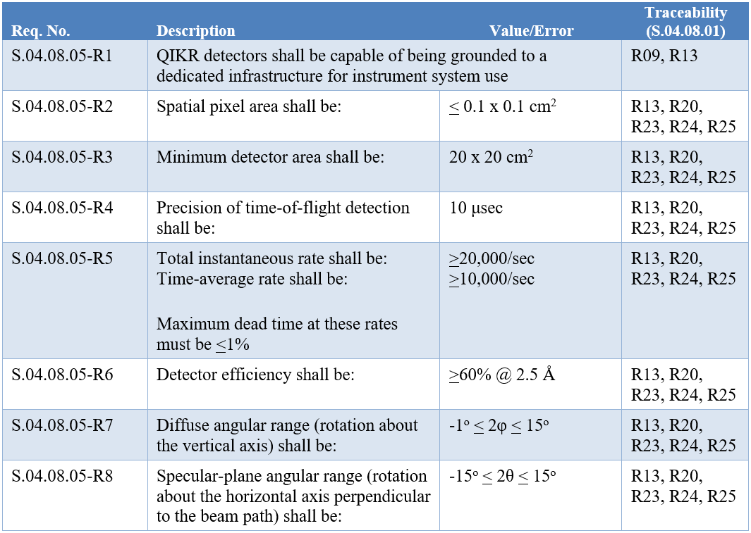
Detector Requirements
These have been achieved by the motion systems

Slide 39
Detector Concerns from FMEA
Camera lens
User may want to open the light-tight box to change the lens
Neutrons
Light
A reasonable use-case is for the lens to be swapped out for one with a different focal length
Opening the lid of the light-tight scintillator housing to access the lens can cause damage to the intensifier if the intensifier is not powered off first
there are no controls in place to prevent this & it will be easy to forget the power off step
Recommendation from the FMEA is to design the lid and intensifier power cable routing such that the lid cannot be removed without unplugging the intensifier power
Low voltage intensifier power cable (not shown)

Slide 40
Acquisition strategy
Detector is effectively a COTS part, customized as needed by LoskoVision
Shielding is fabricated
Competitive bid not possible on the detector, is possible with the shielding
Shielding components are available from US distributors
No expected supplier constraints (unless LoskoVision closes before STS orders parts)
No exotic or hard-to-obtain materials

Slide 41
Manufacturing strategy
The fabricated parts will be build-to-print
Detector will be built to a specification
Assembly of shielding will be done in-house, as will some small amount of assembly for the detector

Slide 42
Installation Plan
The detector platform will be installed using the cave overhead monorail hoist
The detector and shielding will be placed on the platform manually, then will be aligned to the sample location using the six-strut linkages
SNS technicians & engineers will do final adjustments, connect cabling, test component function while connected to bunker air & instrument power, PPS, ICS

Slide 43
Detector Costs & Labor Hours
Current Design labor hours include an additional 16 technician hours for detector shielding assembly
Costs
Shutter | COTS Mat’l Cost | Labor Cost | Labor Hours
P6 | $1,134,522 | $166,638 | 1215
Current Design | $544,236 | $168,462 | 1231
Delta | -$590,286 | +$1,824 | +16
Includes detector and shielding costs for a single camera design
For a 2-camera design, this cost would go to $864,663 for the camera asm plus ~$30,000 additional for the shielding
Labor Hours
P6 vs. Current | Labor Type | Procure/Asm | Install
P6 | scientist | 200 | 40
 | engineer | 100 | 15
 | designer
 | technician | 820 | 40
 | Davis-Bacon
Current Design | scientist | 200 | 40
 | engineer | 100 | 15
 | technician | 820 | 56
 | Davis-Bacon
ICS has additional hours for install, not funded from the Instrument budget
*details of the shielding and detector costs for the current design are shown on slides 46-47

Slide 44
Summary
Component weights are within the capacity of the motion components to support them
Cost is within the P6 budget, even if a 2-camera solution is used
Detector and beam monitor both fit well in the space allotted to them
There is room to grow the detector should the decision be to go with dual cameras in the detector
There is some concern with acquiring the beam monitor, but this is not a critical component for QIKR
The detector is single-sourced with LoskoVision, but ORNL is allowed to produce cameras on its own (if needed) once the contract with LoskoVision is established

Slide 45
Backup Slides

Slide 46
Detector Cost Details
Cost estimates in 2024 dollars:
$133,000 TimePix3 camera double this for 2-camera design
$50,000 Intensifier double this for 2-camera design
$45,000 Enclosure + motor + controller + cables + mirror
$4,000 Scintillator double this for 2-camera design
$2,000 Lens double this for 2-camera design
$50,000 Design Costs for Enclosure (NRE)
$284,000 TOTAL (2024) $473,000 for 2-camera design
Cost estimates in 2031 dollars (last year of procurement)
$519,163 Total 1-camera design costs
$26,897 Shielding including additional labor (see next slide)
$546,060 TOTAL (2031)

Slide 47
Shielding Cost Details
Aluminum plates are priced at $6.50/lb in 2024 dollars, $8/lb in 2031 using 3% escalation per year
Assume a $500 charge per plate for machining
Total costs = $7,454
5% Borated Polyethylene blocks cost $6,945 (tax and delivery included) in 2024 dollars, $8540 in 2031. Converted that into cost/volume to calculate PE shielding cost for each piece
Assume $500 charge per piece for machining
Total costs = $15,354
5mm thick Mirrobor, 0.5m x 1m was quoted at $1,060/m² in 2022, estimated to cost $1,510/m² in 2031
Assume 2 man-days of technician hours to cut and assemble the Mirrobor (16hrs @ $114/hr = $1,824)
Total area of Mirrobor needed = 1,292,960mm² = 3 panels of 0.5m x 1m Mirrobor needed ($2,265)
Total costs $4,089

