Slide 1
QIKR Instrument Overview
John F. Ankner
QIKR Instrument Scientist
QIKR Shielding Preliminary Design Review
March 3, 2025

Slide 2
Outline
QIKR, Briefly
Unwanted Neutrons
  Lost in monolith and bunker
  Lost in instrument cave
Summary

Slide 3
Outline
QIKR, Briefly
Unwanted Neutrons
  Lost in monolith and bunker
  Lost in instrument cave
Summary

Slide 4
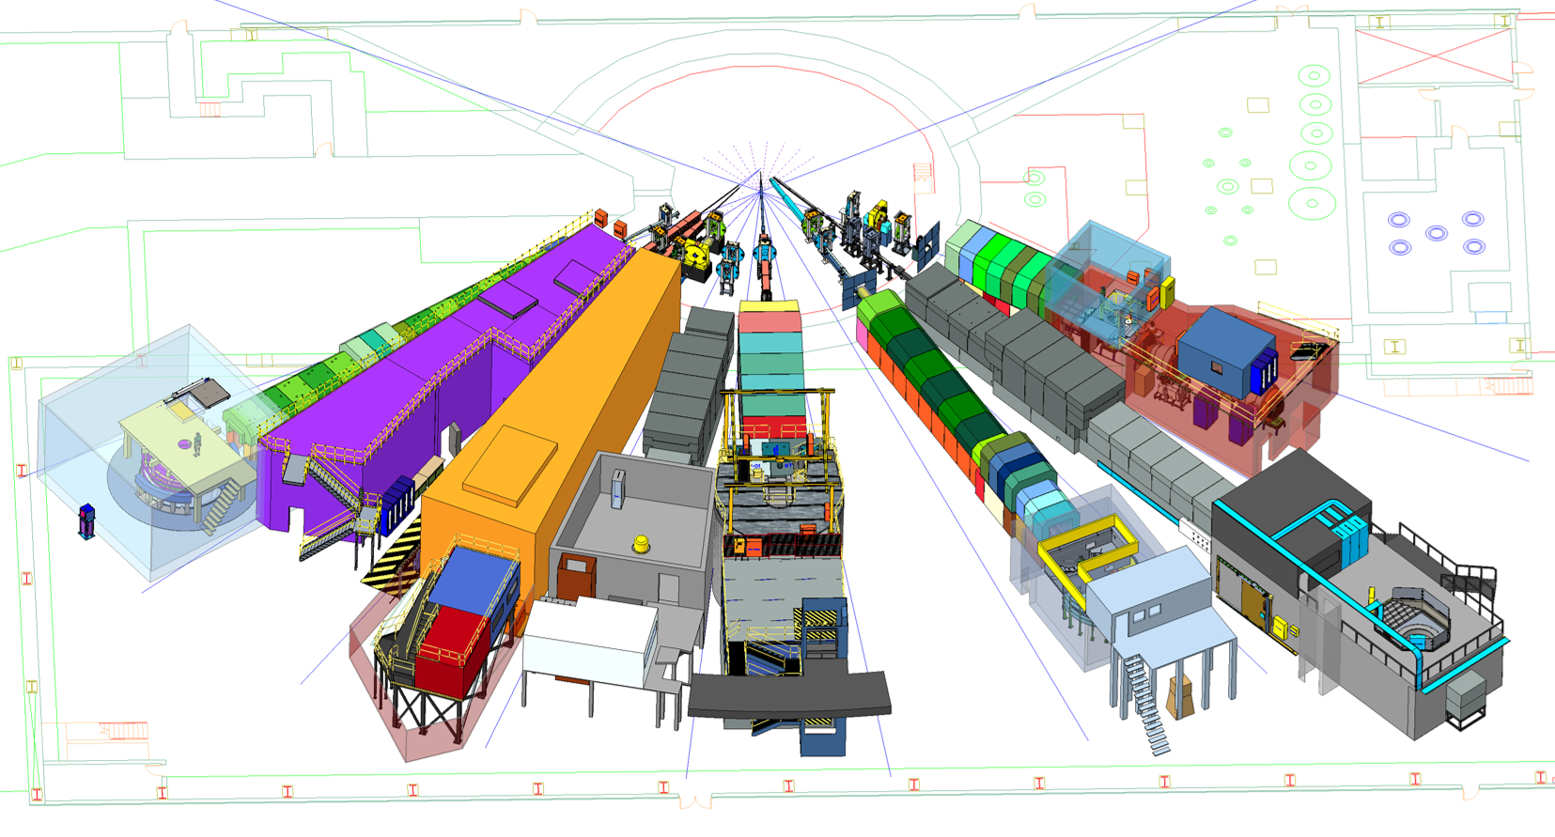
Location of QIKR
QIKR will sit at port ST02 and view the cylinder moderator
QIKR
Beamline
ST02
STS Beamlines in the South Instrument Hall

Slide 5
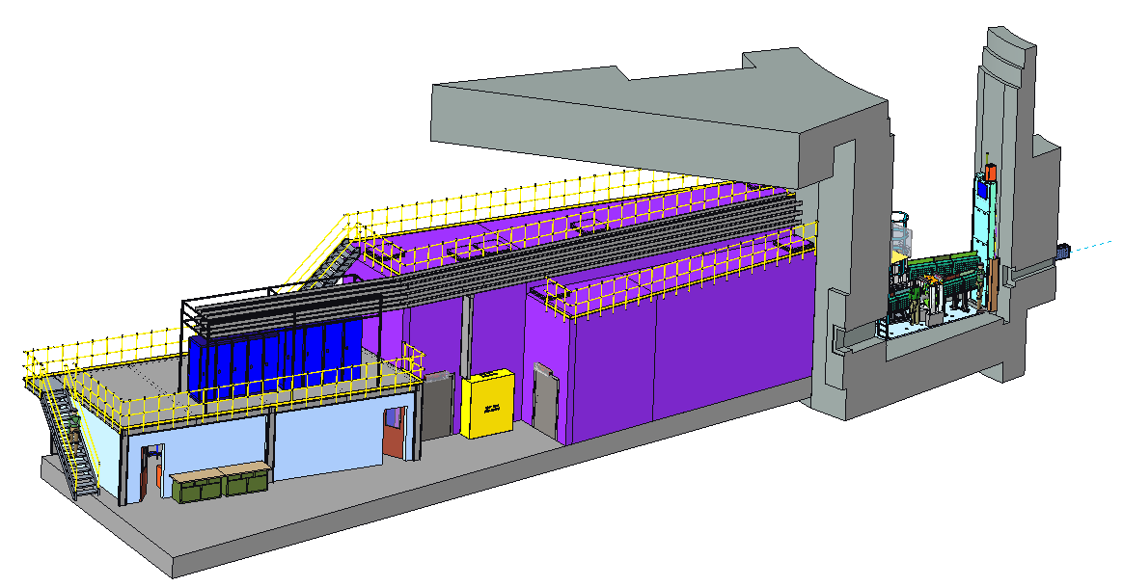

QIKR Instrument Sections
Lintel
QIKR-L
QIKR-U
ST02
Bunker
Cave
Hutch

Slide 6
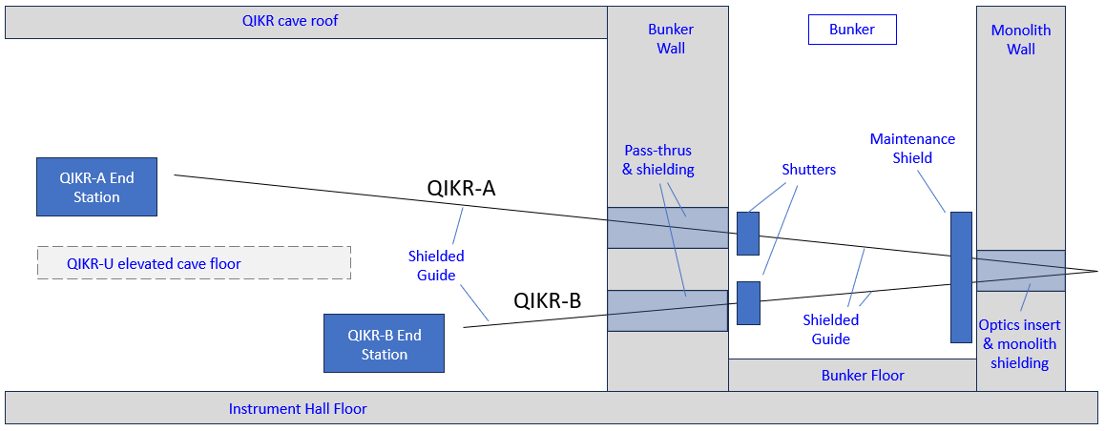
QIKR features two independent beamlines (schematic)
As oriented in this view, QIKR-U occupies the back portion of the instrument wedge & cave, and QIKR-L occupies the front portion
QIKR-U End Station
QIKR-U
ST02
QIKR-U
QIKR-L
QIKR-L End Station
The maintenance shield does not perform a beam blocking function
The End Stations consist of an Incident Table with Slits, a Sample Table, and a Detector Arm

Slide 7
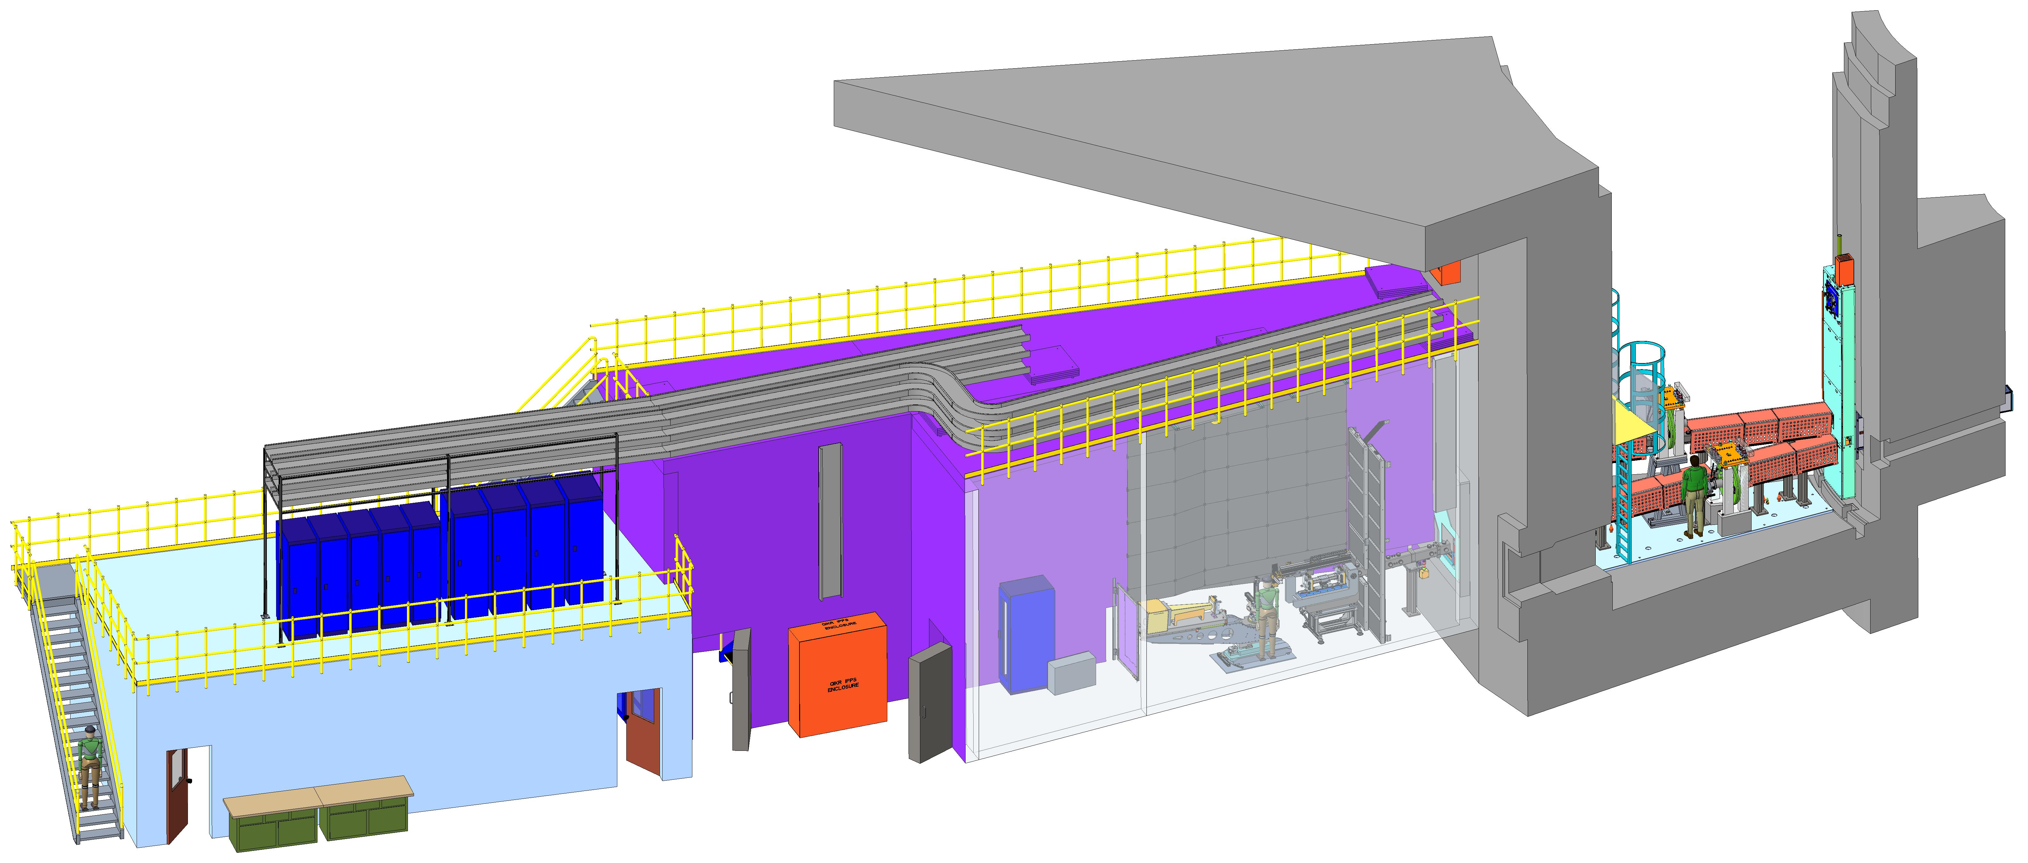
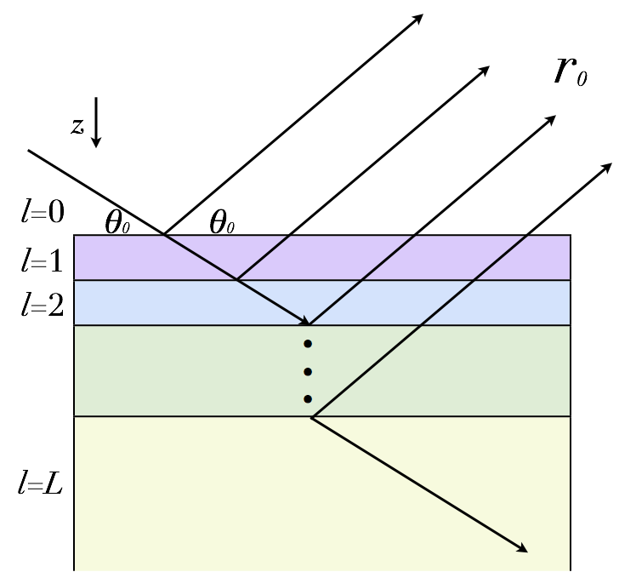
QIKR will make time-resolved reflectometry routine
STS flux and wavelength bandwidth will enable routine single-setting measurement of specular reflectivity in seconds to minutes, depending on the sample
Source
Reflected
beam
Incident
beam
Monolith
Cave
Bunker
Control
Hutch
“Cinematic” data collection at one instrument setting and event-based data reduction will enable post-experiment tracking of structural evolution in time over a broad scientific landscape
[Density × Avogadro’s number /
Molecular mass]
Notes:
The picture on the left shows how neutron waves reflect from layers of different refractive index n_{l} below the sample surface
Refractive index depends on the density of scatterers within a molar volume, e.g., monomer or crystal unit cell
The picture on the upper right shows the upper and lower QIKR end stations with cartoon men for scale

Slide 8
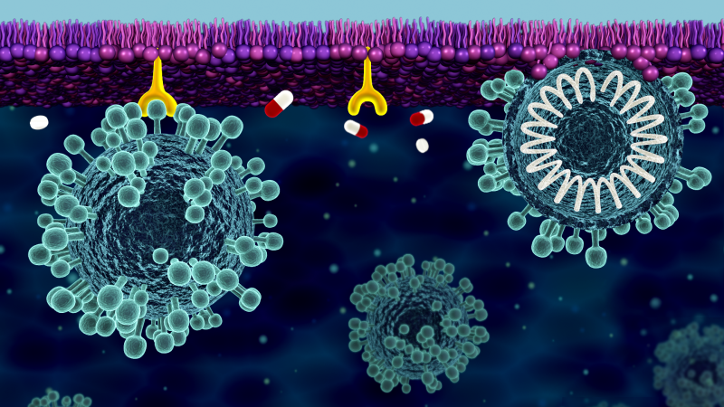
A sampling of scientific communities served by QIKR
Energy Materials
Solid-electrolyte interphase
Organic photovoltaics
Ionic liquids
Corrosion
Mesoporous films
Conjugated polymer films
Metal-harvesting polymers
Soft Matter
Polymer diffusion
Chemical transformation of reactive films
Hydrogels
Fouling
Structure-properties of films under shear
Synthetic membranes
Responsive films
Polymer brushes under shear
Surface modification
Reactions at oil/water interfaces
Biomaterials
Model membranes
Lipid flip-flop
Structure of transmembrane peptides
Biocompatible coatings
Surfactant and phospholipid monolayers
Drug delivery
Protein conformation to membranes
Influence of synthetic nanoparticles on membrane structure
[Courtesy R. Ashkar]
Notes:
To be updated with TOCs

Slide 9
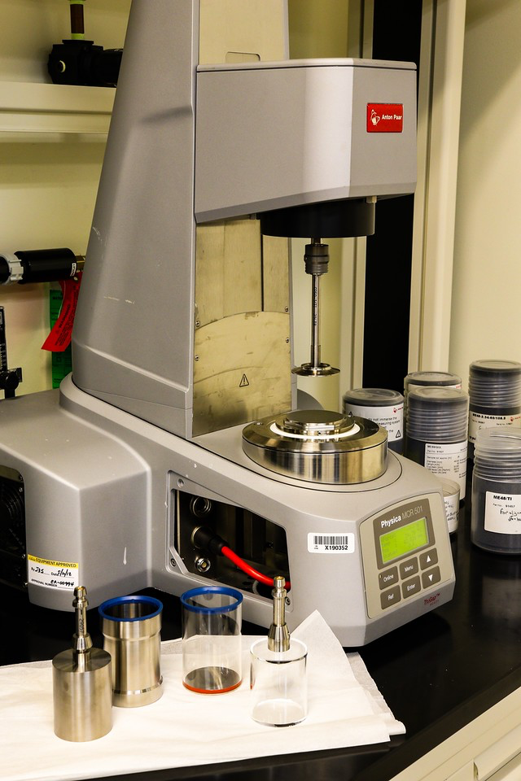
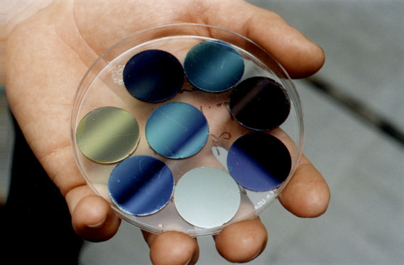
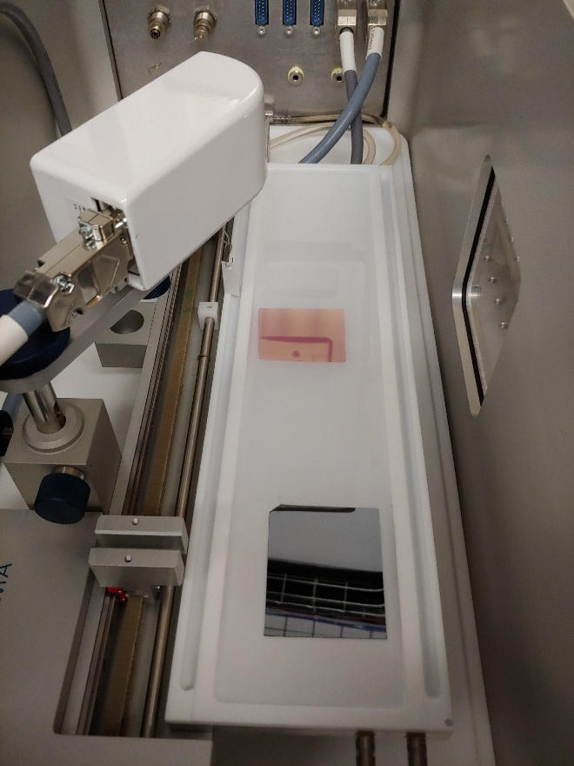
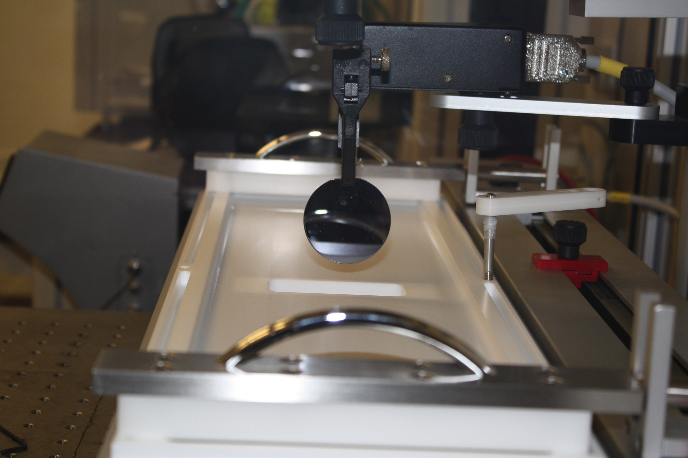
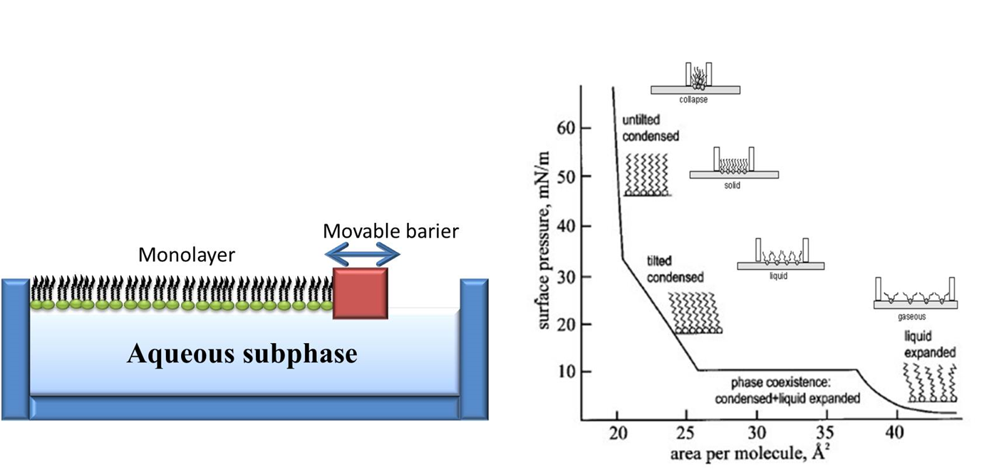
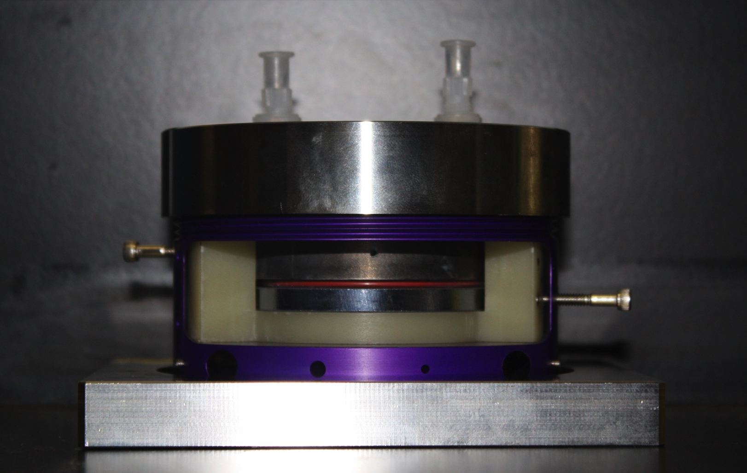
Nano-scale layers deposited on flat substrates
Langmuir Films
Rheometry
Layer-by-Layer Growth
Electrochemistry
Spin Coating
Langmuir-Blodgett
deposition

Slide 10
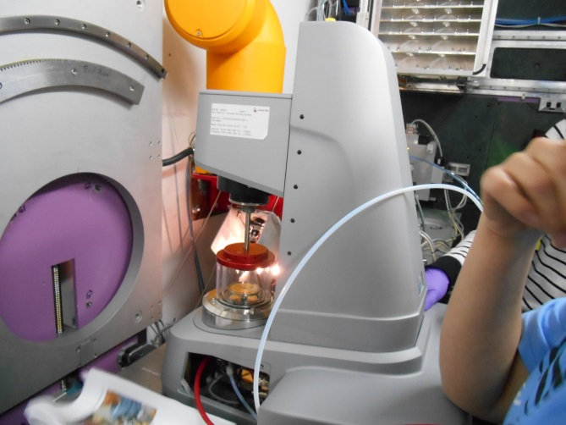
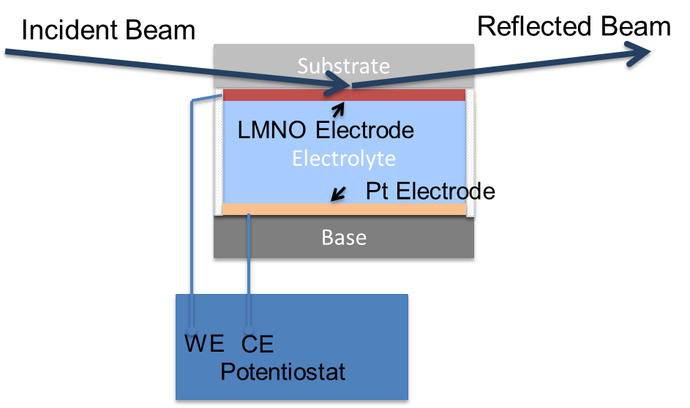
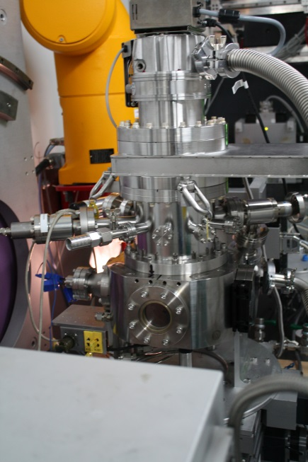
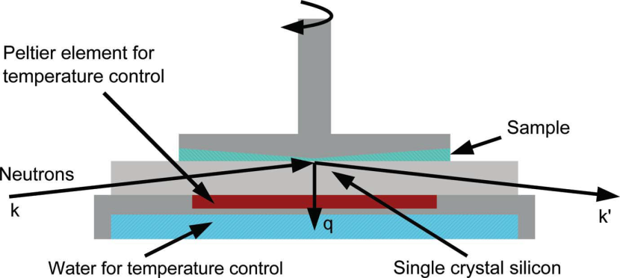
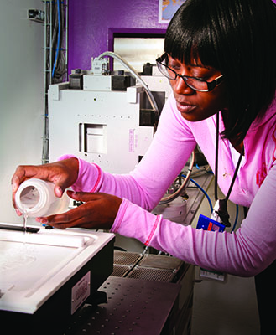
Diverse geometries
θ_{s} = 0, fixed
θ_{i}
θ_{d}
θ-θ geometry
θ_{d} = -θ_{i}
θ_{i}
θ_{d}
θ_{s} = 0, fixed
θ-2θ geometry
θ_{d} = 2θ_{s}
θ_{i} fixed
θ_{s}
θ_{d}
Two end stations

Slide 11
Outline
QIKR, Briefly
Unwanted Neutrons
  Lost in monolith and bunker
  Lost in instrument cave
Summary

Slide 12
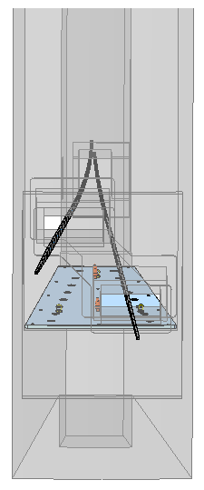
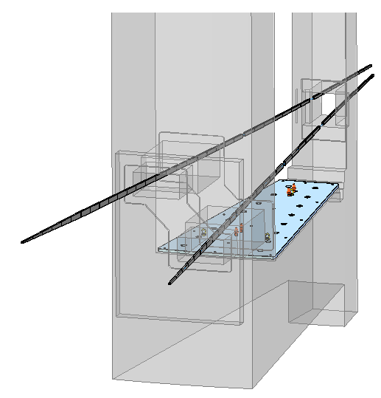
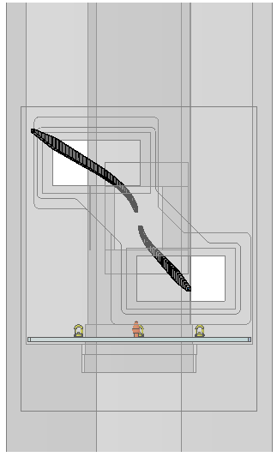
Guide views – looking upstream
End
L = 16 m
Begin
L = 2 m
QIKR-U
QIKR-L
End
L = 20 m
Monolith
Bunker
Guides taper, curve, and are angled up/down, left/right
Caves

Slide 13
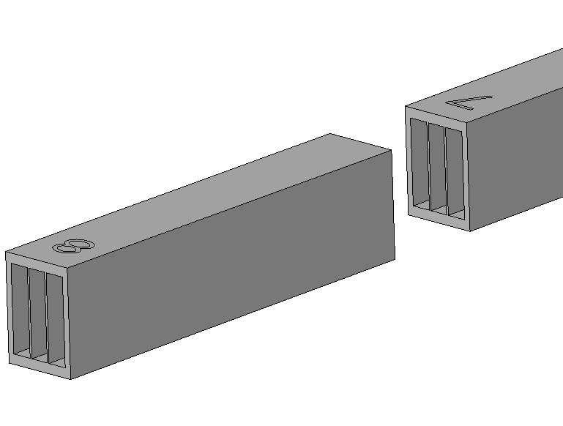
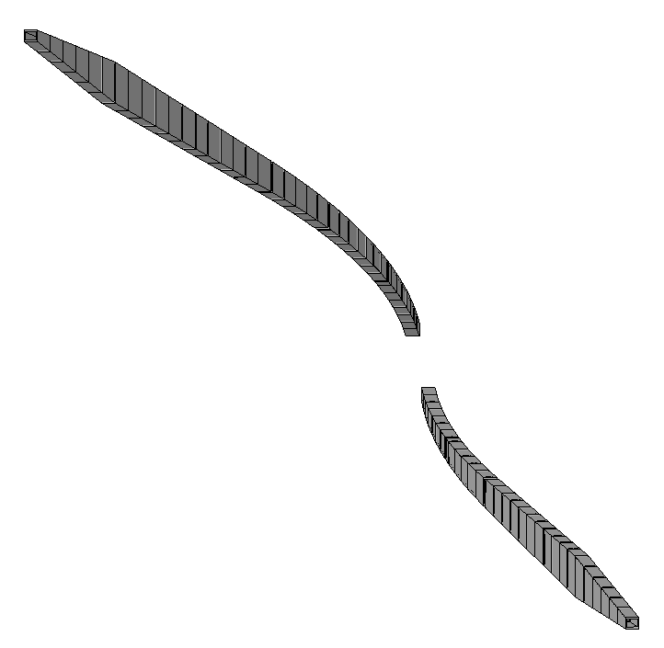
QIKR Overview – Guide Path
Gaps between Elements
Guide Element
Tapered Guide (TG)
Ballistic Guide (BG)
Ballistic Bender blades
3-channel Ballistic Bender (BB)
QIKR-U guide
Three sections in each guide path: Ballistic Bender (BB), Ballistic Guide (BG), and Tapered Guide (TG)
Each guide Element is straight, even in the BB section
In the BB section, each guide element is angled relative to its neighbor to approximate a 156-m radius circle
  The initial 12 elements in each bender section are multichannel, the number of channels = 3
The upper guide initially angles up by 2.5° and rotated by 0.7° toward ST01
The lower guide angles down by 2.5° and rotated by 0.5° toward ST03
View toward the moderator along the z-axis
QIKR-L guide
3-channel Ballistic Bender (BB)
Ballistic Guide (BG)
Tapered Guide (TG)

Slide 14
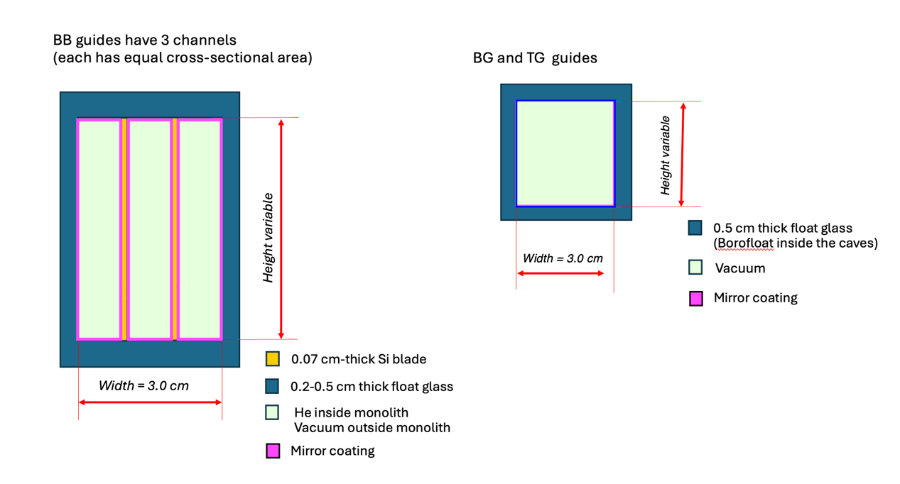
Guide representation in MCNP
Neutron guide transport calculated using a common STS source and dimensions and coordinates transferred from the engineering model (Creo->IGES) to both McStas and MCNP agreed within 15%

Slide 15
QIKR-L guide cartoon
Diverging tapered
from 2.65 to 10 cm high over 11.13 m
Converging tapered
from 10 to 2 cm high over 2.87 m
Vertical:
Guide
begins
(2.0 m)
Source
Double disk
chopper
(8.0 m)
Guide
ends
(16.0 m)
Slits
Sample
Table
(18.0 m)
Detector
(20.0 m)
Horizontal:
Curved bender
3 channels, 3 cm wide
Straight 3 cm wide
The QIKR-L and QIKR-U guides have been optimized
to fulfill requirements at minimal cost in supermirror coating

Slide 16
Neutrons lost in monolith and bunker
Segment
0 (entrance)
1,2 (shield)
3 (chopper)
4 (shutter)
5 (ballistic end)
6 (exit)
A Tale of Loss
Bulk of fast neutrons shed in Ballistic Bender (BB – Segments 1-2)
Little loss in Ballistic Guide (BG – Segments 3-5)
Tapered Guide (TG) trims unwanted thermal and cold neutrons (Segment 6)
→ Shielding must mop up unused neutrons

Slide 17
Outline
QIKR, Briefly
Unwanted Neutrons
  Lost in monolith and bunker
  Lost in instrument cave
Summary

Slide 18
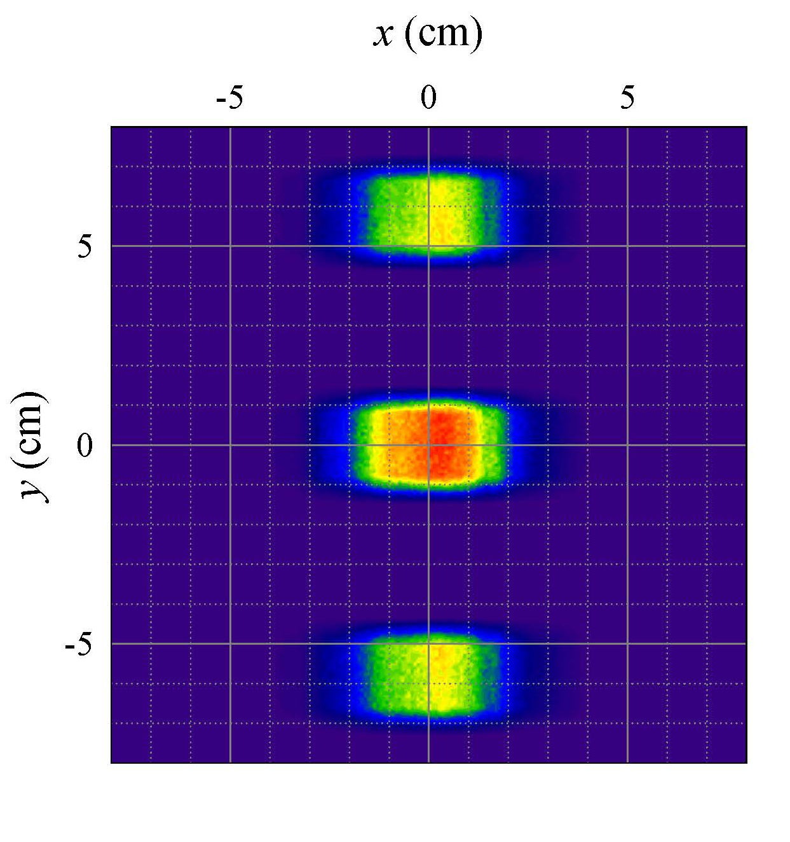
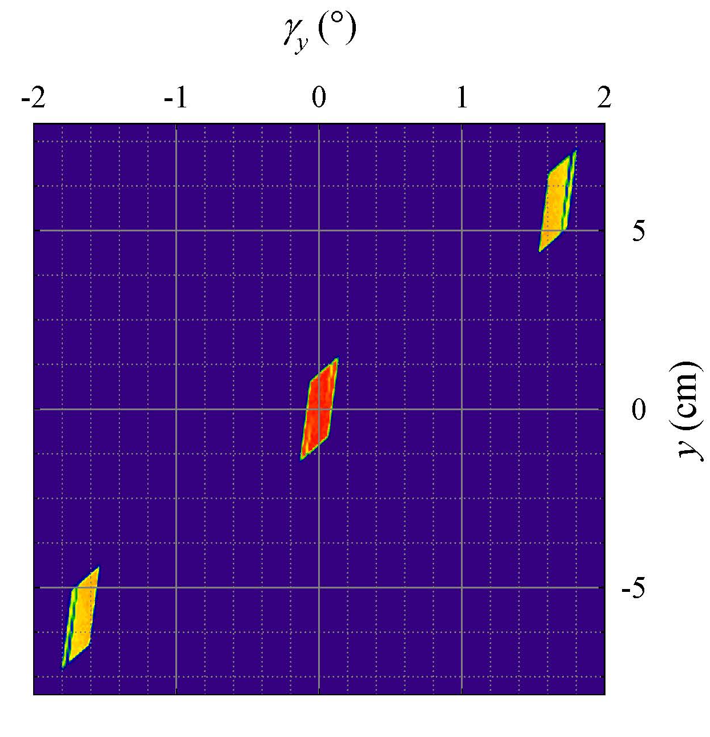
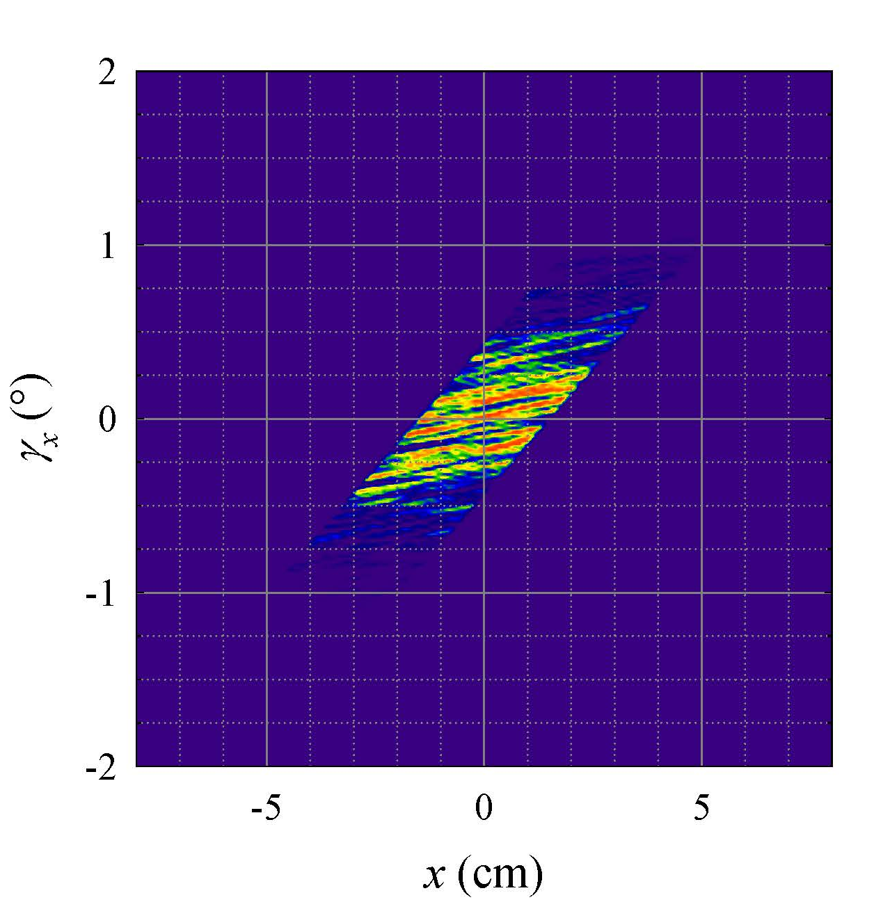
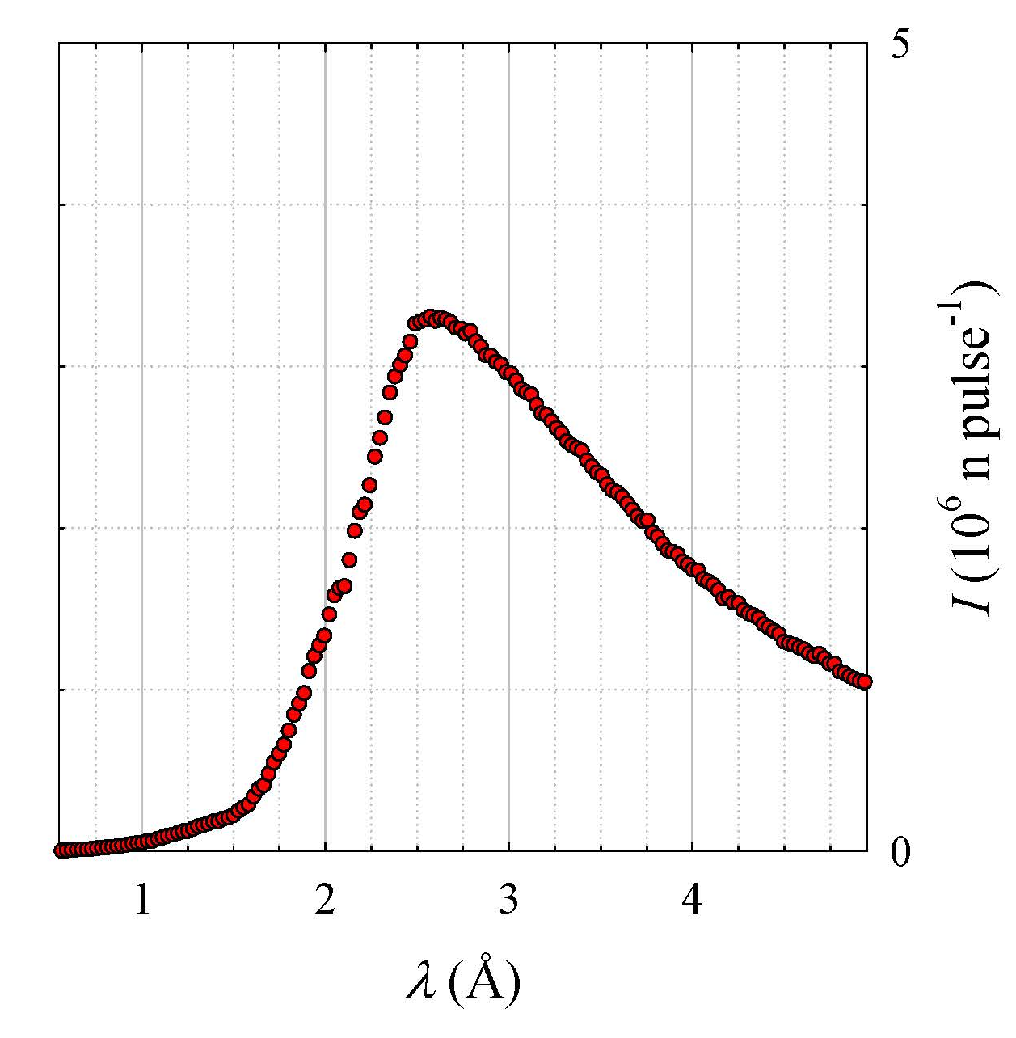
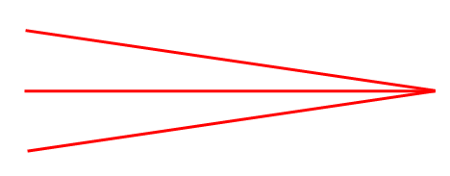
Guide system provides multiple beams
Characteristics
Three beams
…separated in space (y)
…and angle γ_{y}
Select which to use in θ-θ geometry
to span needed Q range
slits
QIKR-L
Guide
Incident Table rotates to align with chosen beam exiting the guide. Slits absorb the unused beams and shape the chosen beam.
(QIKR-L McStas simulation)

Slide 19
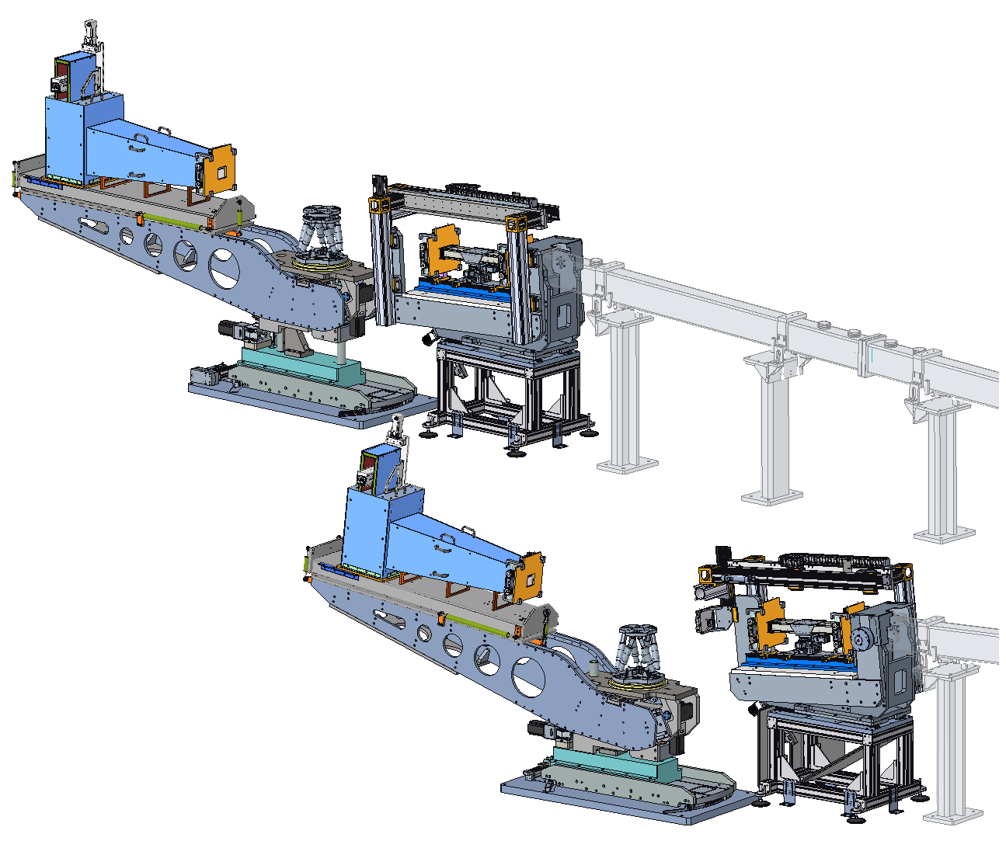
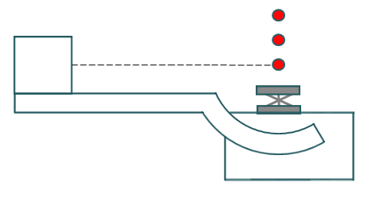
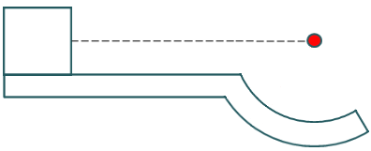
QIKR end stations: beam selection and detector motion
Upper station (QIKR-U)
Sample positions needed for each beam
The 3 available beams for QIKR-L
Hexapod for tilting the sample
Incident Table Assembly (upper and lower versions)
Detector
Hexapod
Detector Arm
Sample Table and
Detector Arm Assembly
Sample Table
Sample/ Detector Table Base
Detector Arm rotates about a horizontal x axis (out of the screen) passing through the sample center
Lower station (QIKR-L)

Slide 20
Slits define angular resolution and beam footprint
s_{u}
s_{d}
(not to scale)
l_{ud}
s_{s} = F sinθ_{i}
θ_{i}
F
l_{ds}
Slits s_{u} and s_{d} confine beam within footprint F at incident angle θ with angular divergence (δθ/θ)
→ All unwanted neutrons must be absorbed by shielding (slit blades and housings)
=>
Useful data cannot be collected in the absence of collimating slits, so after commissioning they will remain in place

Slide 21
Operate in θ-2θ and θ-θ geometries
θ-2θ geometry
Incident beam fixed
Sample moves
Detector moves
θ-θ geometry
Incident beam varies
Sample fixed
Detector moves
θ_{s} = 0, fixed
θ_{i}
θ_{d}
θ-2θ geometry
θ_{d} = 2θ_{s}
θ_{i} fixed
θ-θ geometry
θ_{d} = -θ_{i}
θ_{s}
θ_{d}
θ_{i}
θ_{d}
θ_{s} = 0, fixed

Slide 22
Footprint calculator – maximum slits
Resolution
0.02 < δθ/θ < 0.07
implies
0.1 mm < s < 10 mm
→ Maximum usable slit aperture is smaller than the fully open setting

Slide 23
Detector sensitivity to unwanted neutrons (background)
Personnel safety is a necessary but not sufficient function of the shielding (the one investigated by neutronics analysis)
Detector sensitivity to unwanted neutrons is the other function (not investigated by current neutronics analysis)
Experience with the BL4B detector at SNS shows that using B₄C to block the detector’s view of concrete surfaces is effective at reducing detector background

Slide 24
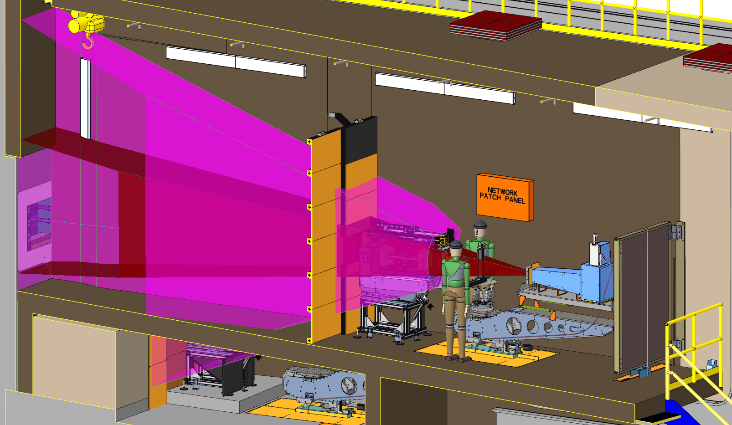
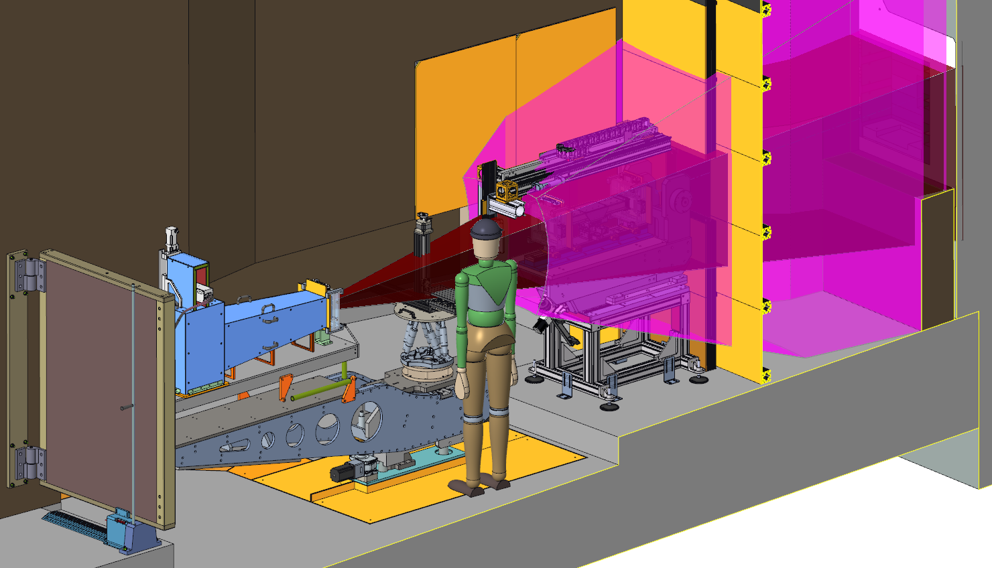
Backdrop must be dark
Every surface painted by the magenta cones is visible to the detector and should be shielded from view using B₄C (gold panels)
QIKR-U
QIKR-L
The backdrop of the sample, viewed by the detector, needs to be as dark as possible. The placement of B₄C shielding panels and additional wall-mounted shielding is dictated by this requirement.

Slide 25
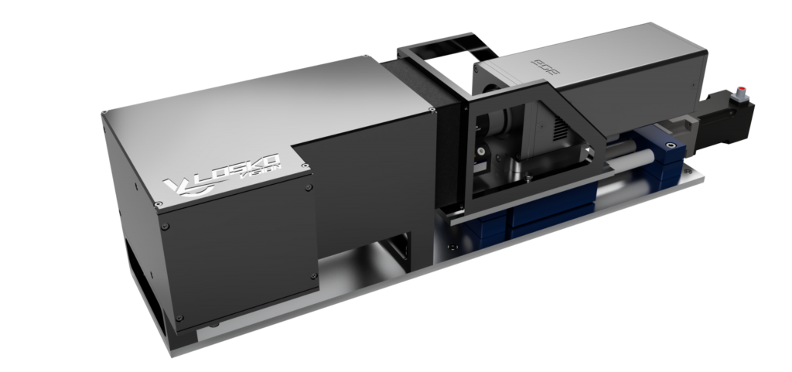
Detector assessment
Detector: Timepix3-based scintillator
  Equivalent performance to conventional ³He detector
  Greater (>20×) count-rate capability
  Modular design – replaceable components
  Upgrade path to Timepix4
  → Measuring R down to 10⁻⁷ requires low background
Ankner and Khaplanov (STS),
Watkins and Loyd (NScD), and
Long (LANL) data collected at
Lujan Center Asterix reflectometer

Slide 26
Define beam – reject even more neutrons
Beam-defining slits
Select a satellite beam
Collimate to define resolution and footprint
Reduce intensity >67%
Sample reflectivity
Further reduction of intensity by factor of 10⁻⁷-1 depending on λ
→ Shielding in cave must mop up unused thermal and cold neutrons

Slide 27
There are a lot of neutrons to absorb
Fast neutrons in the monolith and bunker
Thermal and cold neutrons in the instrument cave

Slide 28
Outline
QIKR, Briefly
Unwanted Neutrons
  Lost in monolith and bunker
  Lost in instrument cave
Summary

Slide 29
Summary
The curvature of the QIKR guides causes high energy neutrons to depart the guide and enter the bunker→shielding is needed for biological safety and to prevent those neutrons from entering the cave & creating excessive background
The tapering at the end of the QIKR guide causes large neutron loss inside the cave→shielding needs to absorb those neutrons
The tapered guide creates multiple beams exiting the guide→slits select the desired beam and shield (block) the rest
  There is not a reasonable scenario where the slits would be removed before turning on the beam→no useful data can be collected in that state
Additional shielding is needed to minimize unwanted neutrons entering the detector
  An effective solution on BL4B was to have the detector view panels of ZHIP mix (B₄C) rather than concrete surfaces→the same will be done on QIKR, though neutronic analysis to confirm its effectiveness has not yet been done

Slide 30
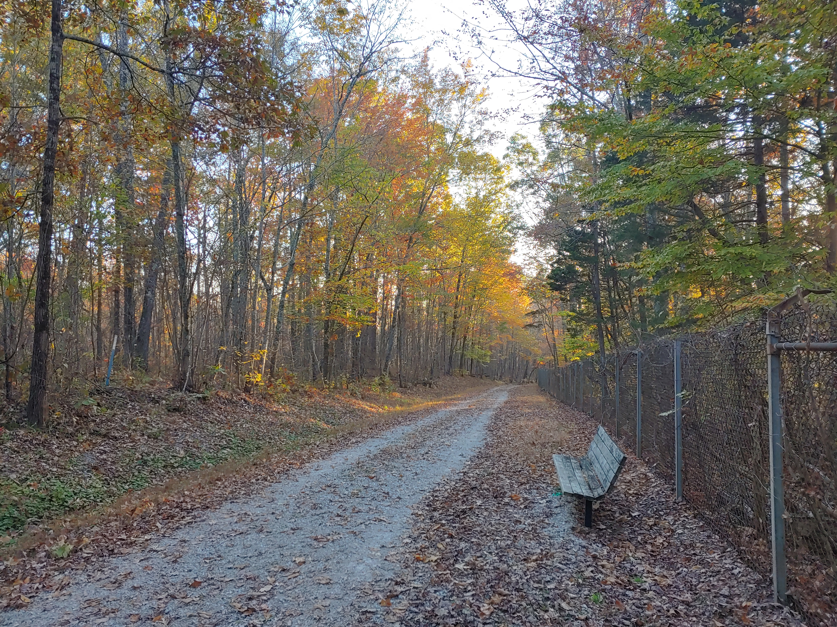
Thanks
ORNL STS Design Team
John Ankner
Danielle Wilson
Kursat Bekar
Ryan Butz
Joe Griffith
Rudy Thermer
Anton Khaplanov

Slide 31
Footprint calculator – maximum slits
Resolution
0.02 < δθ/θ < 0.07
implies
0.1 mm < s < 10 mm

Slide 32
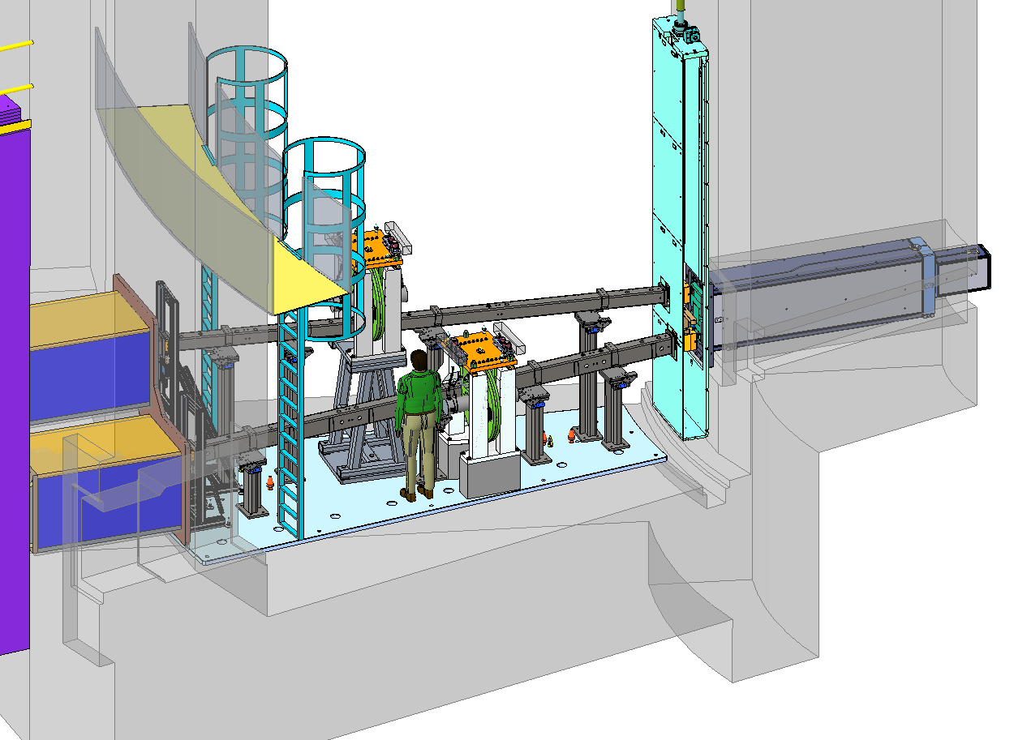
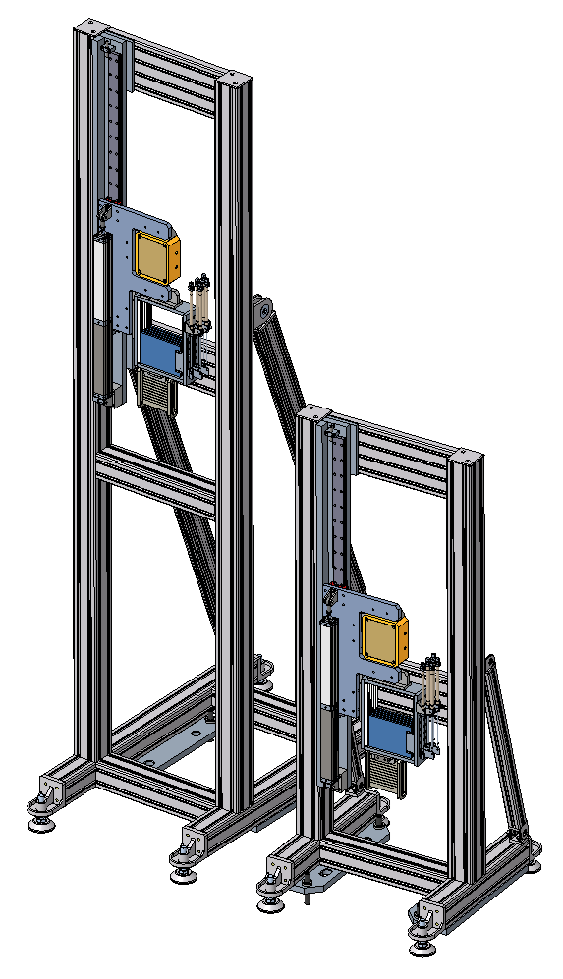
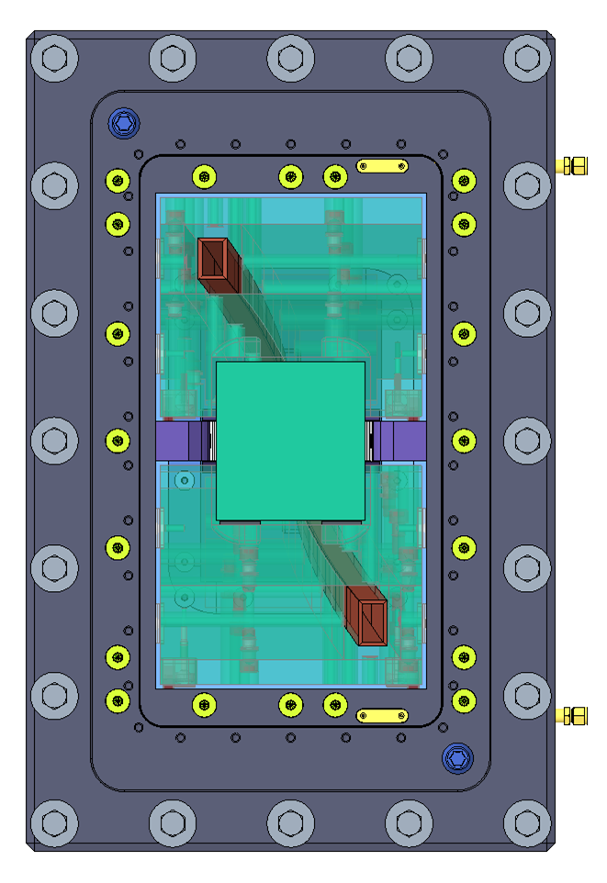
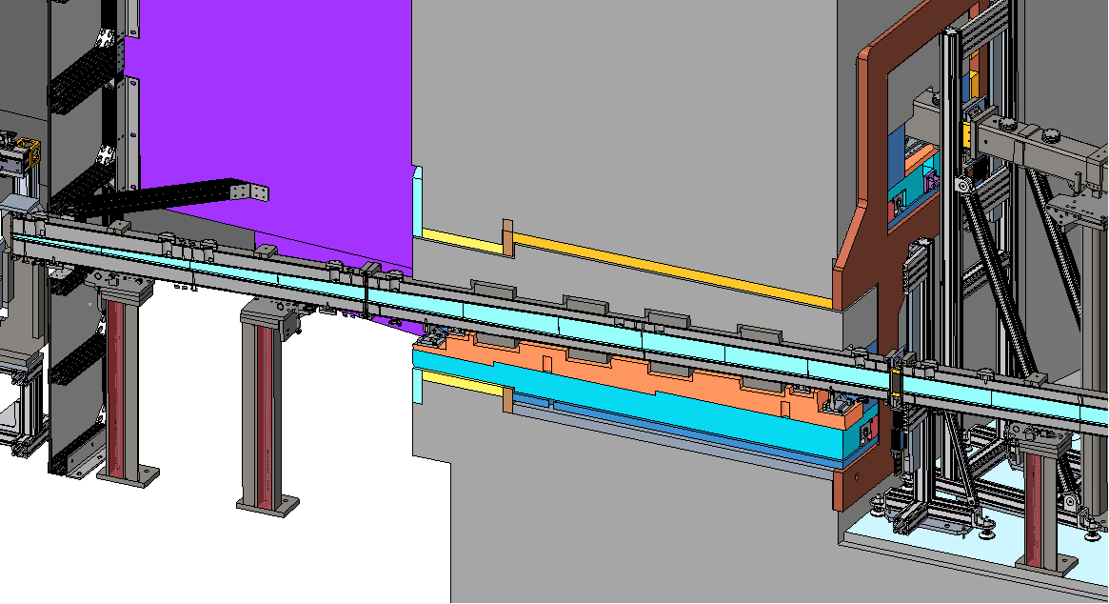
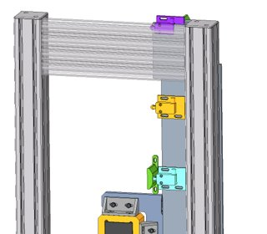
In-bunker components
Shutter assemblies
B₄C / W shutter
Attenuator deck
Beam monitor
QIKR-U
QIKR-L
Monolith insert
Bunker inserts
Bandwidth
choppers
ICS Switches
×
Tapered guide

Slide 33
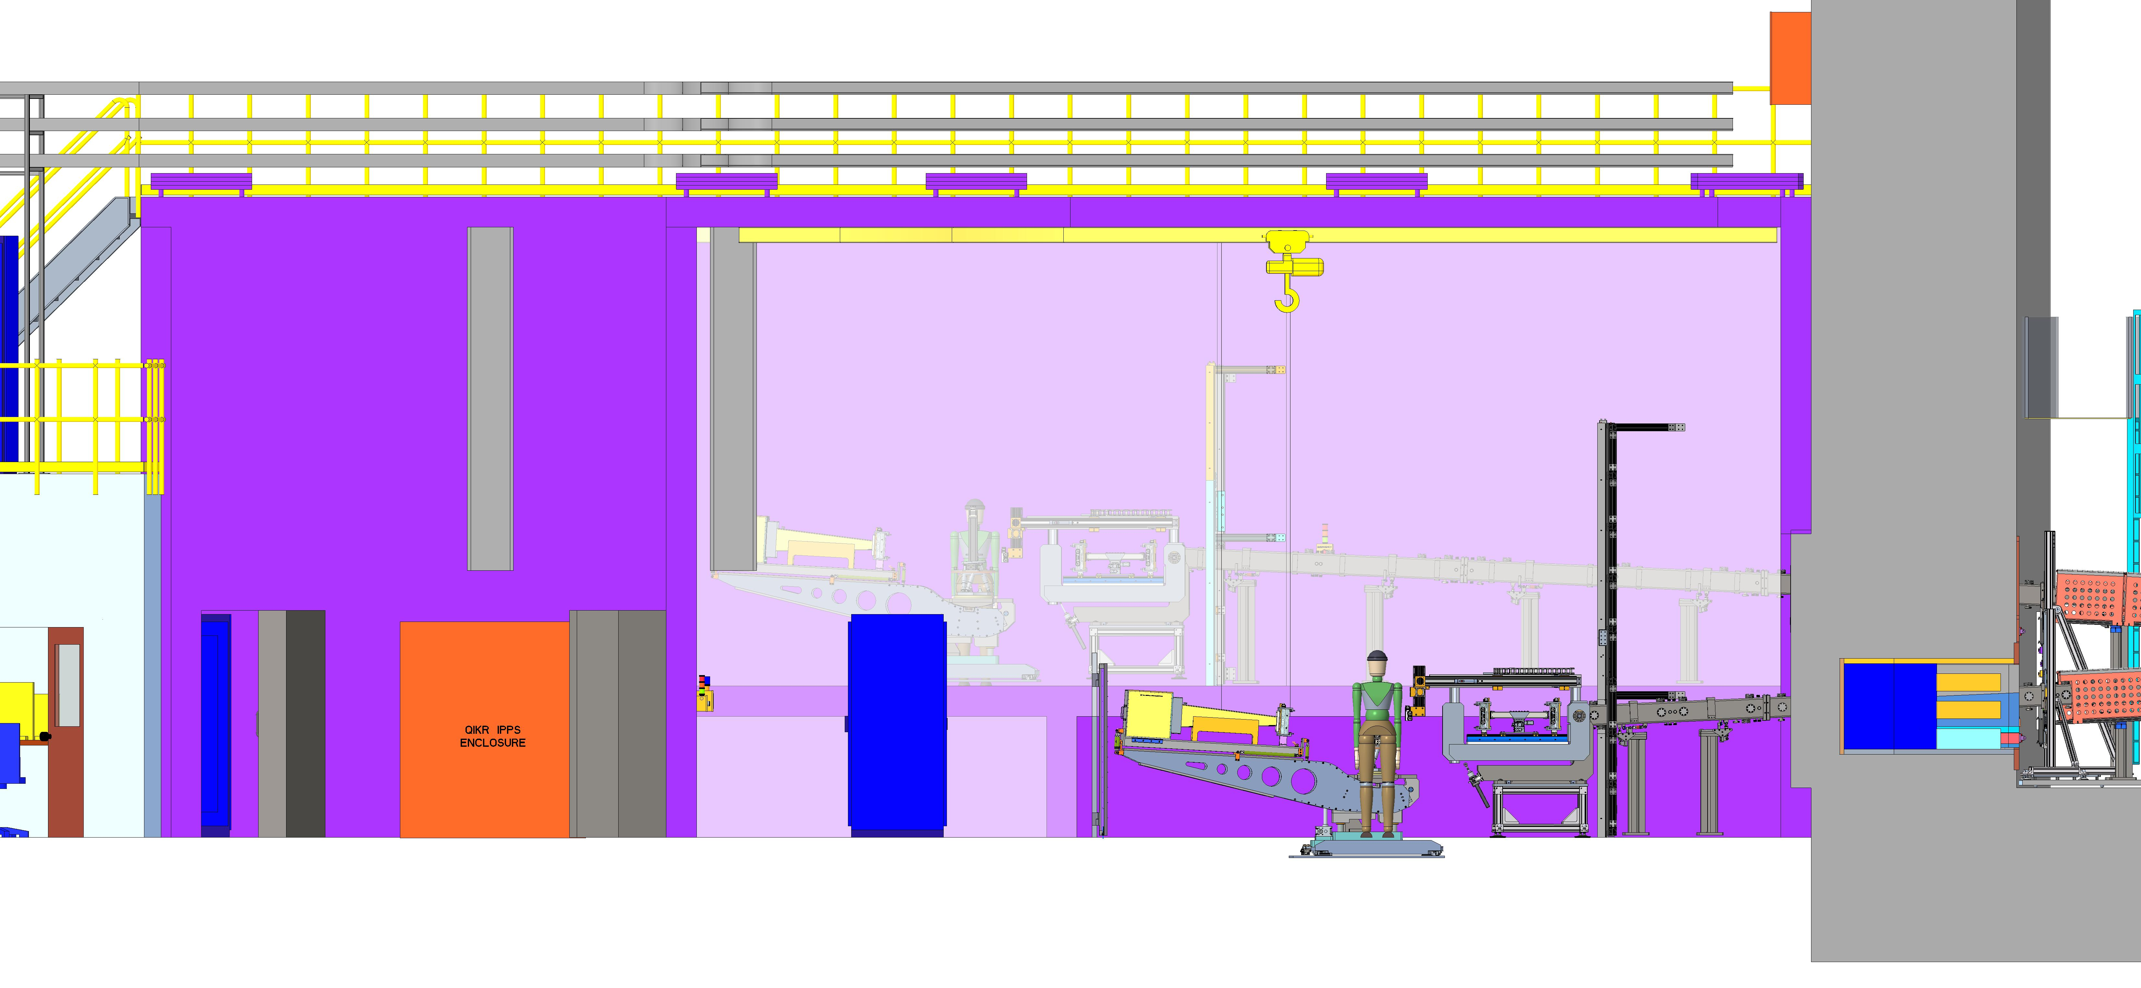
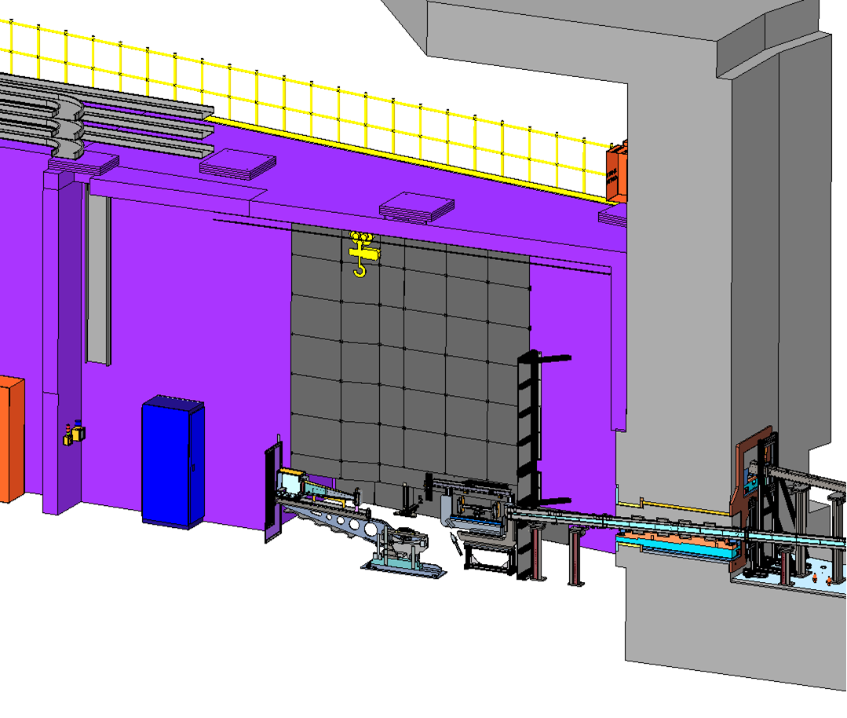
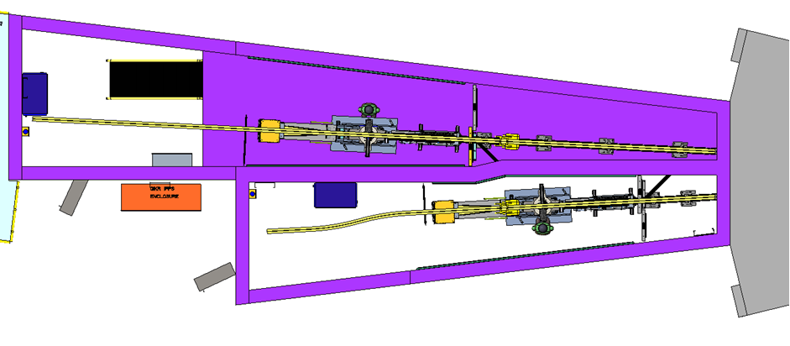
End-station caves
Charge 1
Elevation
Isometric
QIKR-L
20 m
QIKR-U
24 m
Bunker
Plan

Slide 34
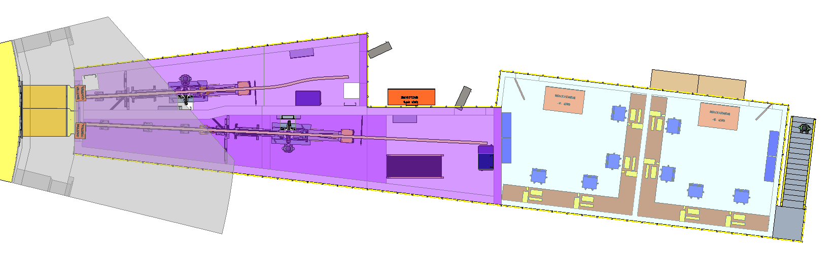
QIKR Caves & User Hutches – plan view
Bunker Wall
Lower Cave Monorail
IPPS Enclosure
Lower Cave
End Station
Lower Cave Sample Rack
QIKR L
Workstation
QIKR U
Workstation
Upper Cave Monorail
Upper Cave Sample Rack
Upper Cave End Station

Slide 35
McStas Analysis
McStas can tell the neutrons leave the guide, but can’t tell where they go afterward… the shielding has to mop up those neutrons
MCNP analysis agrees with McStas to within 10% if the same source is used in each
  Therefore MCNP reflects low-energy neutrons correctly
McStas also matches Creo geometry

Slide 36
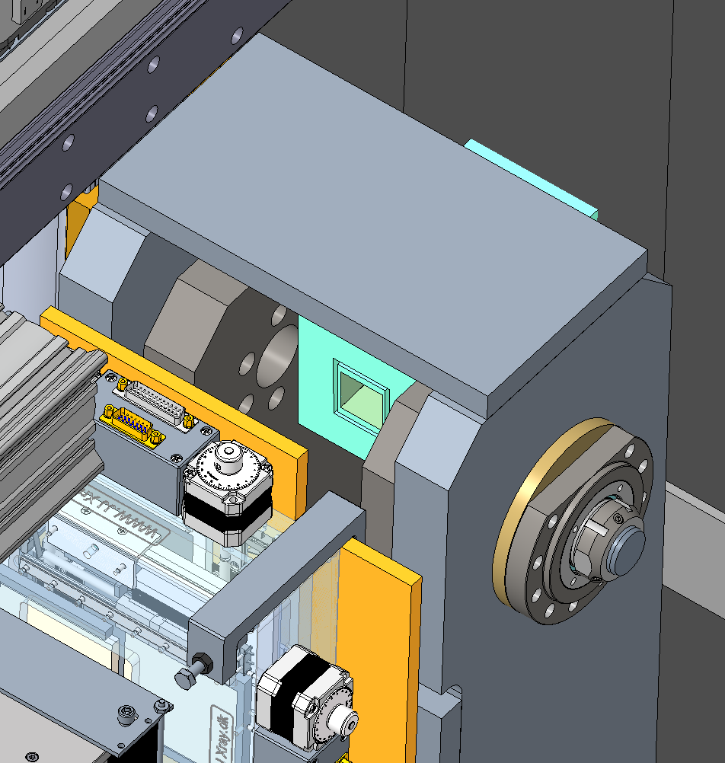
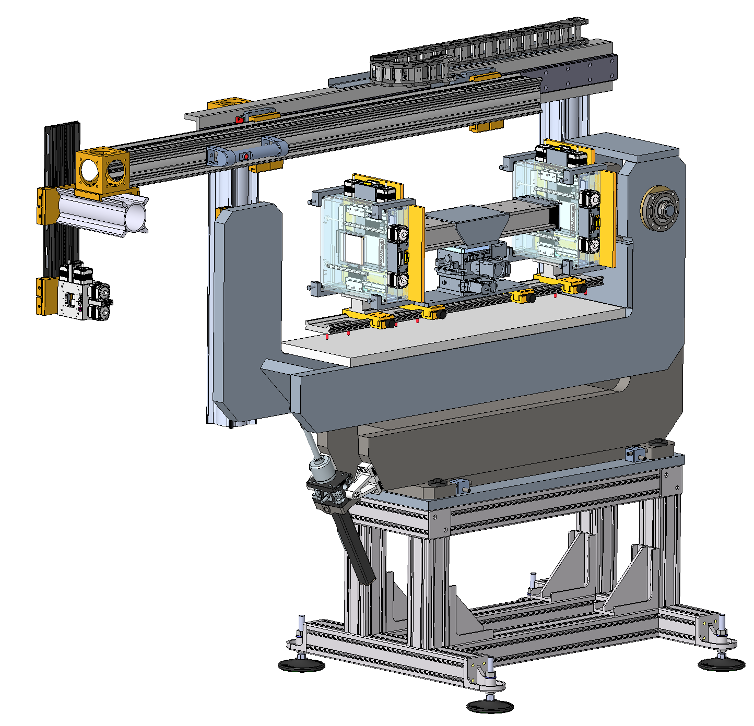
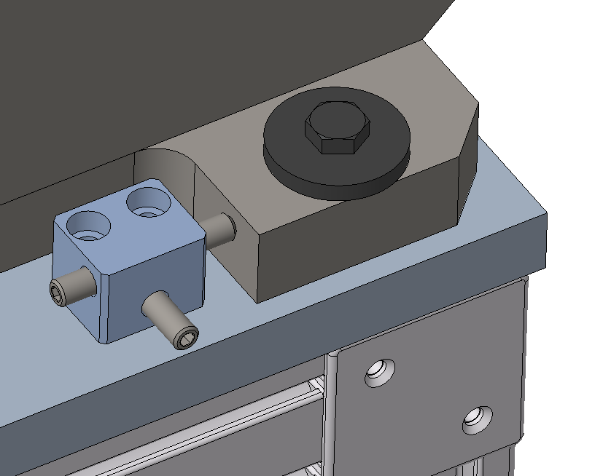
Incident Table – holds slits and optics
Preliminary design of an incident table for QIKR
The axis of rotation ideally lies on the face and the symmetry
plane of the neutron guide.
Hollow profiles together with energy
chain enable protected cable
installation.
A rigid bearing ensures
precise alignment of the slits.
A platform open to the sides, with
sufficient distance to the beam
line, offers flexible installation space
for future installations.
Manually adjustable slit
position with safety brake
in z-direction.
Adjustability in
the xz plane.
Translating ball screw
enables an accurate
pivoting in the range ± 5°.
Short support for more
stability.
Adjustable machine feet
with vibration absorbing pads.
[courtesy Rudy Thermer]

Slide 37
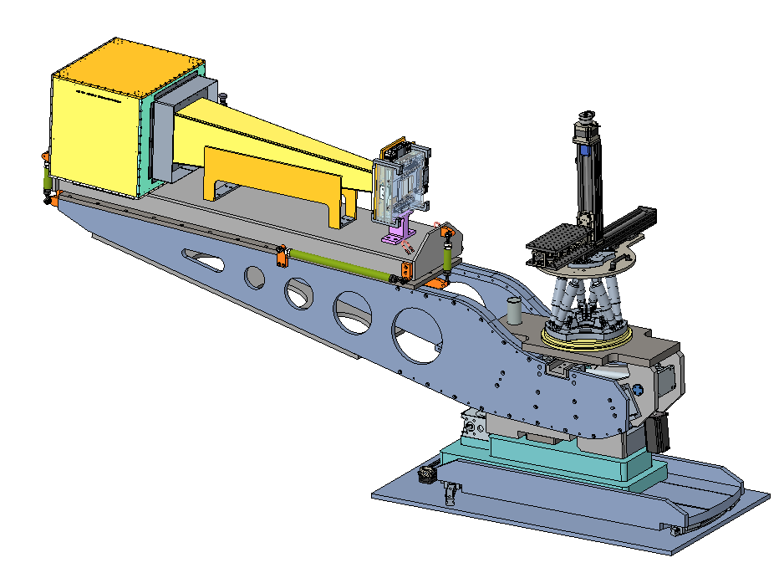
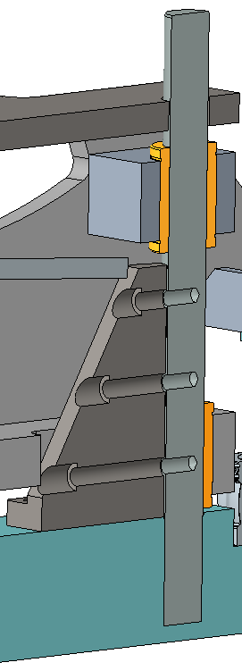
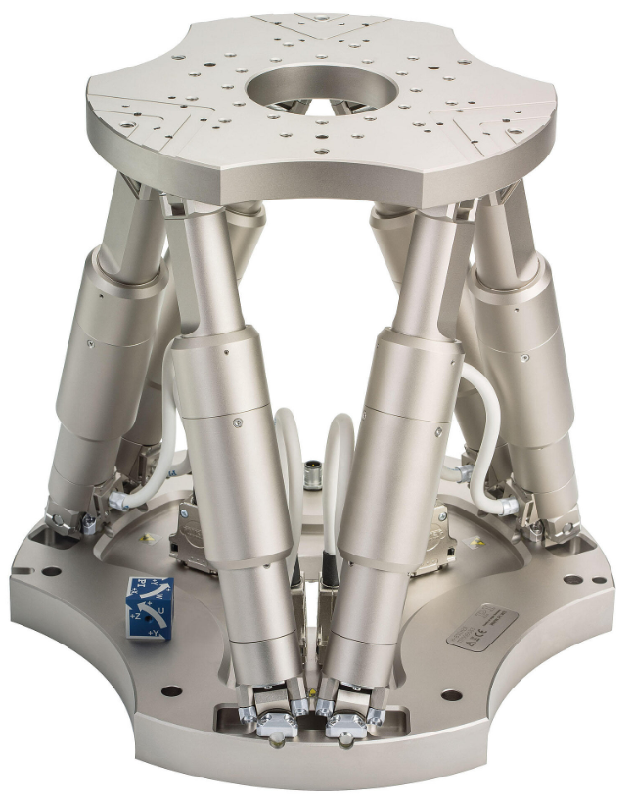







Sample Table and Detector Arm unit
Charge 1
The design employs well-developed standard components (increased reliability, reduced costs).
PI H-850 Hexapod
Payload: 250 kg
Robust guide
system
∅ 60 mm
Hexapods offer six degrees of freedom of movement in the most compact space.
Increased stiffness
due to a free length
Reduction of 50%.
ZIMM Screw
Jack
Yaw swivel unit
THK-TU-Series Slide table
providing high load capacity
and accuracy in a single
Structure.
F_{Lift}
Compensatory
force transmitting
link.
F_{Det}
Available with different load capacities i.e., various spindle sizes, gear ratios and accuracies.
Spindle
nut
THK Curved
linear guides
15°
Preloaded
linear ball
bushings
With an ideal load-bearing arrangement in relation to the spindle lifting nut.
Nadella GLK (NIRO)
Spherical-plain bearing
Radial clearance: 0 -10 µm!
[courtesy Rudy Thermer]

Slide 38

Create a layer:
Langmuir trough

Slide 39


Biological Membrane Studies Conducted at Liquids Reflectometer
Lipid membranes form the boundary between cells and the outside world
Membranes (e.g. analogues of lung cells) are spread on a water surface or a solid (e.g. silicon) support
Viral proteins and potential drugs are introduced into the water below the film
Neutrons see the nano-scale rearrangements of the protein relative to the membrane under different conditions
These rearrangements reveal protein function

Slide 40

Prepare DPPC film and measure NR
Dual barrier KSV NIMA frame assembly
Three trough sizes
Trough | Surface Area (cm²) | Subphase Volume (mL) | Compression Ratio
Extra Small | 150 | 18 | 8.7
Small | 98 | 57 | 5.2
Medium | 273 | 176 | 10.8
Hermetically sealed enclosure
  Sapphire windows for beam transport
  Large viewing area
Active vibration isolation
[Galuska L., Muckley E.S., Cao Z., Ehlenberg D., Qian Z., Zhang S., Rondeau-Gagne S., Phan M.D., Ankner J.F., Ivanov I., Gu X., "SMART transfer method to directly compare the mechanical response of water-supported and free-standing ultrathin polymeric films", Nature Communications 12, 2347 (2021)]

Slide 41





Langmuir film deposition
KSV NIMA micro BAM
  Fixed angle-of-incidence – 53º
  Large fields of view – 3600μm x 4000μm
  12 μm resolution
  Still images as well as real-time video
KSV 2000 Dual-Barrier Trough
  Large dipping well: 100 x 100 x 35 mm³
  Subphase temperature control
  Total subphase volume: 1.2 L
  Active vibration isolation
μ-BAM image of P3HT-b-PEOT on water subphase
KSV NIMA Surface Potential Meter (SPOT)
  μ_{n} = ΔV•ε•ε₀•A
  Determine effective dipole moment
  Determine molecular orientation
  Monitor complex formation between monolayers, subphase species and adsorbates

Slide 42
Rheology
Anton Paar MCR 501
  Measuring geometries
    Cone-plate (Ti cone w/ single crystal Si base plate)
    Plate-plate (Ti plate w/ single crystal Si base plate)
    Cup and bob ( quartz for RheoSANS and quartz and Al for bench top measurements)
  Temperature control
    Convection (-50 ºC to 200 ºC)
    Peltier (15 ºC to 80 ºC)
  RheoSANS
    Bin Wu from BSMD is actively developing a focus area in in situ rheological measurements in SANS
      GP-SANS (HFIR) and EQ-SANS (SNS)

Slide 43


Multi-Environment Chamber
Radiant resistive heater
  Sample temperatures to 600 ºC
Chamber base pressure ≤ 10⁻⁹ Torr
For surface adsorption studies, absolute gas pressures in the range 0.001 Torr to 1000 Torr.

Slide 44

Layer-by-Layer (LbL) growth
Simple
Versatile – vast inventory of polyelectrolytes
Environmentally friendly – aqueous, room temperature
No limitation on substrate shape or size

