Slide 1
QIKR Shielding PDR: Neutronics Analysis
March 03, 2025
Kursat Bekar, Neutronics Scientist

Slide 2
Outline
QIKR MCNP Model
QIKR MCNP Source Model
QIKR Analysis for Monolith and Bunker
QIKR Downstream Sources
QIKR Shutter Design and Analysis
QIKR Beam Stop Design and Analysis
QIKR Cave Shielding Design Analysis

Slide 3
QIKR Model – Creo
Guide Shielding not shown here
Monolith Wall
Bunker (roof panels not shown)
Elevation View
Upper Guide
Lower Guide
Target Vessel & Shielding
Monolith & Optics Inserts
Chopper locations
Shutter locations
Bunker Wall
Cave
QIKR-L
QIKR-U
Monolith Wall
Plan View
Proton Beam

Slide 4
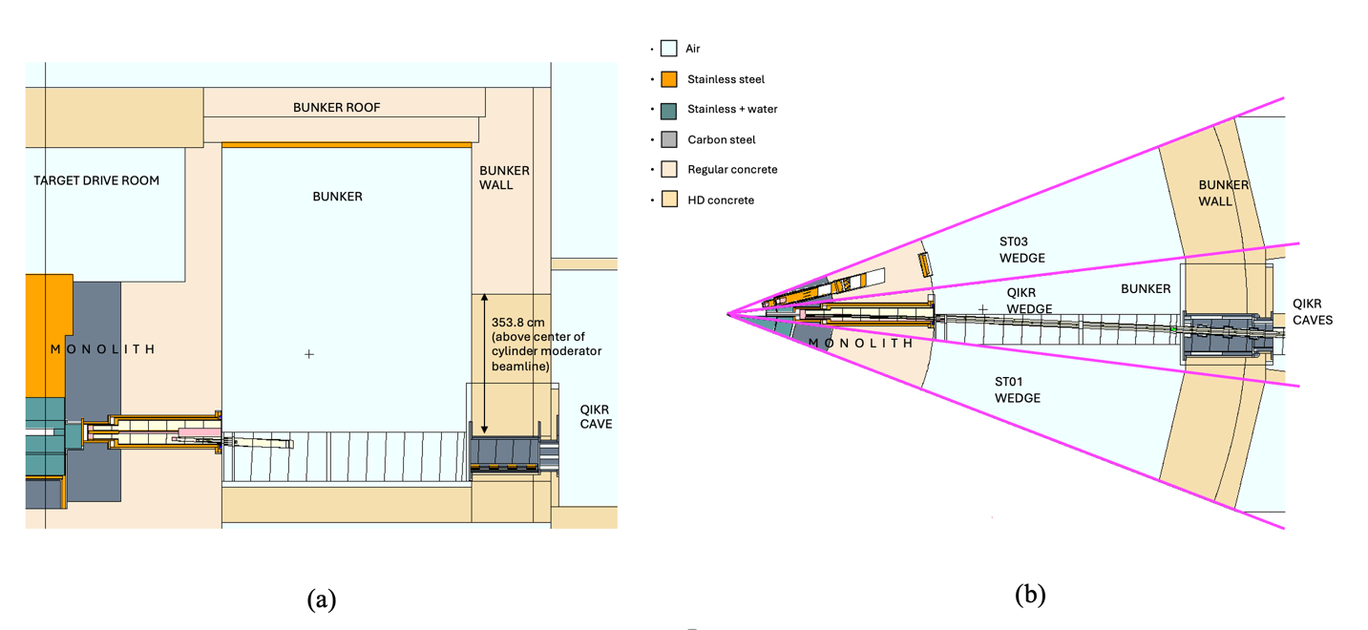
QIKR MCNP Model
A portion of QIKR MCNP model including monolith/bunker up to the QIKR instrument caves
Matches Creo models
(a) Elevation view, cut at the center of the QIKR wedge
(b) Plan view along the QIKR-U elevation
A portion of QIKR MCNP model including monolith/bunker up to QIKR instrument caves

Slide 5
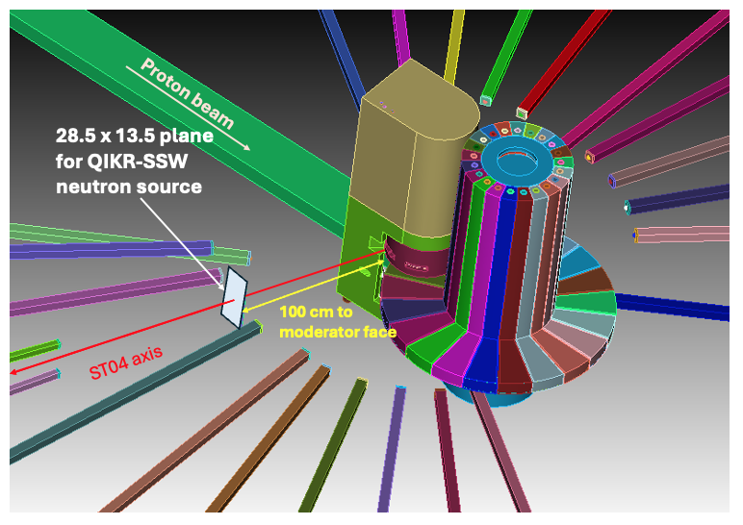
QIKR MCNP Source Model
QIKR-SSW source
It utilizes the direct particle information for source neutron on the source plane (neutrons are stored with their exact position, direction and energy information while crossing the source plane)
It was generated by using MCNP’s surface crossing source capability:
MCNP full model was simulated with a proton source (700 kW, 1.3 GeV proton beam, corresponds ~ 3.37 x 10¹⁵ p/s)
A rectangular source plane (28.5 x 13.5 cm²) was located 100 cm away from the moderator surface
Only forward-directed neutron tracks passing through the predefined rectangular surface area were stored
~ 54 million neutron tracks stored for 1 million proton, resulting in total 0.04315 n/s per source proton
0.002384 n/s per source proton within 0° - 3° degree
ST11
Illustration of the location of the source plane for QIKR-
SSW source generation (no shielding is shown, only
target moderator assembly and beamlines)
QIKR-SSW source was developed when QIKR was on ST04. Since then, QIKR location has been changed twice; first moved to ST03, and now located on ST02

Slide 6
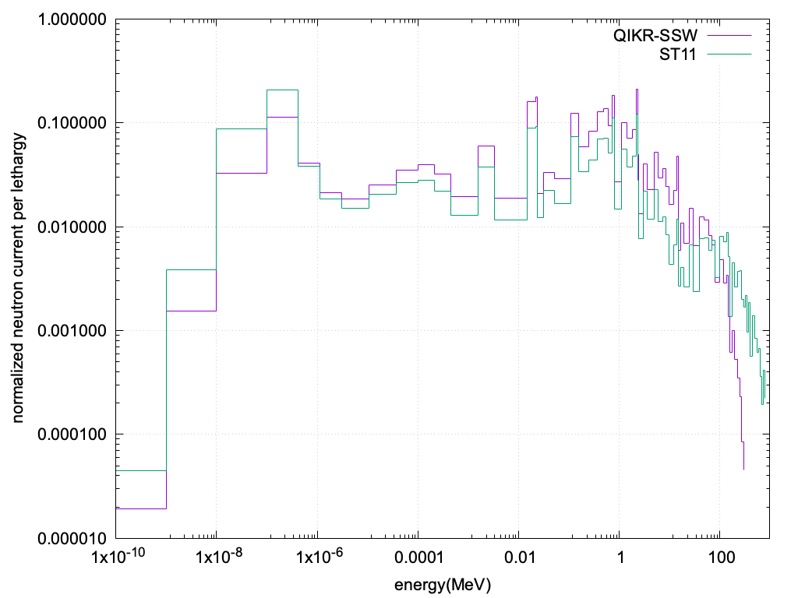
QIKR MCNP Source Model
Normalized energy spectra of QIKR-SSW source vs generic neutron plane source
QIKR-SSW
Generic
The generic neutron plane source was developed for STS shielding studies (documented in: STS Project Generation of Beamline Sources – Preliminary Design, S04030200-TRT10002 )
Used in most STS shielding studies
Limited angular resolution
Limited energy resolution at low energy
QIKR-SSW better represents the space- dependent energy and angular distributions of neutrons
Differences in spectra at very high-energy range is mainly due to the locations of the source planes (QIKR-SSW at ST04-Generic source at ST11 locations)
Comparison of neutron energy spectra for QIKR-SSW and generic neutron source
Generic neutron plane source generated for STS shielding studies

Slide 7
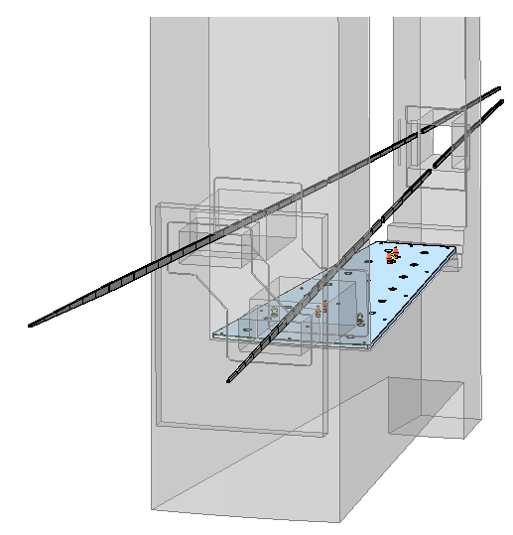
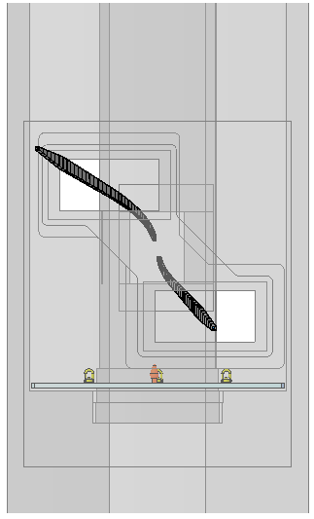
QIKR Guides – Creo
Guide start: 2m from moderator
View looking straight toward moderator
QIKR-U
QIKR-L

Slide 8
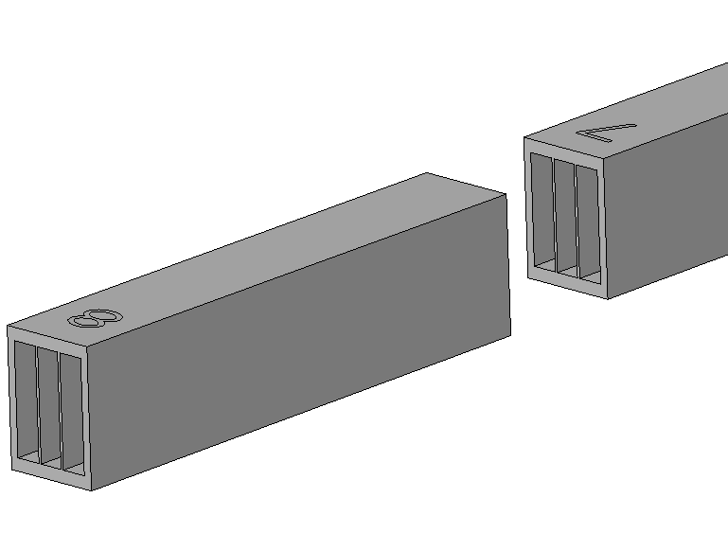
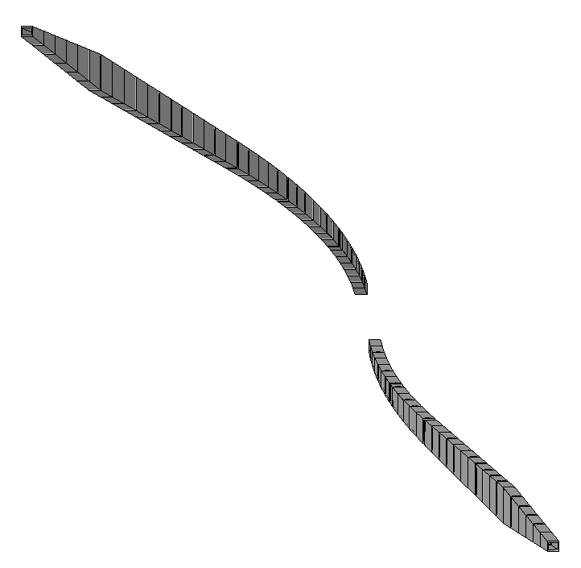
QIKR Guides – Creo
Gaps to accommodate components
Guide Element
Tapered guide (TG)
Multichannel bender blades
Ballistic guide (BG)
Upper guide
3-channel ballistic bender (BB)
There are three main sections in each guide path: multi-channel ballistic bender (BB), ballistic guide (BG, and tapered guide (TG). Guide height continually increases until the TG section when it decreases quickly.
Each guide element is straight, even in the bender section
In the bender section, each guide element is angled relative to its neighbor to approximate a 156m radius curve. The guide elements are parallel to each other in the remaining sections
The elements in each bender section are multichannel (3 channels)
The upper guide angles up by 2.5° and is then rotated by 0.7° toward ST02
The lower guide angles down by 2.5° and is then rotated by 0.75° toward ST04
View looking straight toward moderator along the z-axis
ST02
Lower guide
3-channel ballistic bender (BB)
Ballistic guide (BG)
Tapered guide (TG)

Slide 9
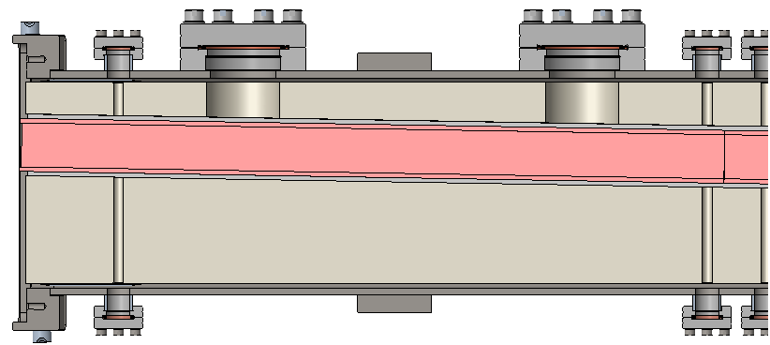
Guide Shielding
Vacuum Housing
Guide Shielding:
Exterior surfaces conform to the interior of the vacuum housing (3mm clearance)
Interior surfaces conform to the contour of the guide elements (3mm clearance)
Plan View (Top), Cross-Section
Shielding thickness varies along the length of the guide for two reasons:
The guide curves within each ~3m long straight section of housing
The guide tapers (continually changes height) within each straight section of housing

Slide 10
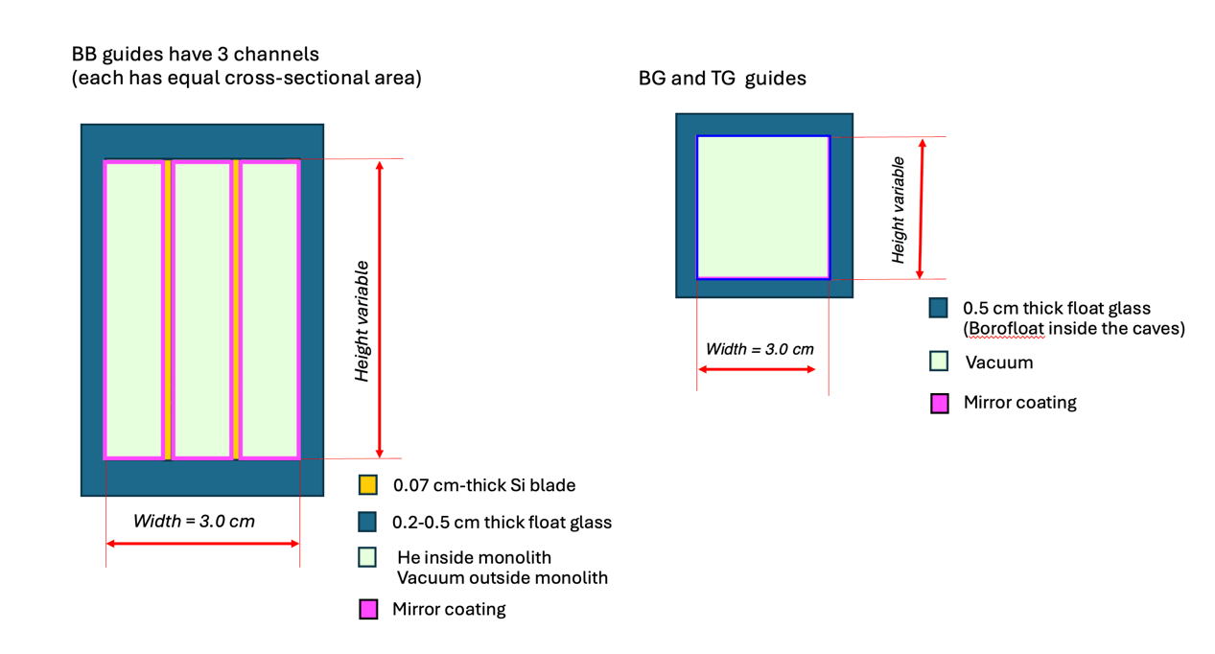
QIKR Guide Design in MCNP model
Guide version: 5.0, provided by Ankner in May 2024
Guide segment | QIKR-L | QIKR-U
BB (ballistic bender) | 13 | 12
BG (ballistic guides) Float glass | 11 | 20
TG (tapered guides) | 6 | 6
# of elements
QIKR-L and QIKR-U are curved beamline
QIKR-L (lower guide): angled 2.5° downward from the horizontal and total 2.95 ° rotation from the QIKR-Z axis in the horizontal plane (only BB guide section)
QIKR-U (upper guide): angled 2.5° upward from the horizontal and total -2.773 ° rotation from the QIKR-Z axis in the horizontal plane (only BB guide section)
Matches Creo and McStas models
A steel vacuum housing (cross-sectional area of 15.24 cm by 20.339 cm) encloses each guide section
The space between the vacuum housing and the guide substrate is filled with a steel shield of varying thickness, leaving a 0.3 cm gap on each side
Projection of the QIKR beam paths in the horizontal plane

Slide 11
QIKR Guide Design for MCNP model
Guide version: 5.0, provided by Ankner in May 2024
QIKR-L mirror coatings
QIKR-U mirror coatings
Guide section | Top | Bottom | Left | Right
BB1 - BB7 | 2.5 | 2.5 | 2.0 | 4.0
BB8 - BB13 | 2.5 | 2.5 | 2.0 | 4.0
BG1 - BG11 | 0.45 | 0.45 | 3.5 | 3.5
TG1 - TG6 | 5.0 | 5.0 | 3.5 | 3.5
Guide section | Top | Bottom | Left | Right
BB1 - BB7 | 3.0 | 3.0 | 4.0 | 2.0
BB8 - BB13 | 3.0 | 3.0 | 4.0 | 2.0
BG1 - BG3 | 2.0 | 2.0 | 3.5 | 3.5
BG4 - BG8 | 1.5 | 1.5 | 3.5 | 3.5
BG9 - BG20 | 0.45 | 0.45 | 3.5 | 3.5
TG1– TG6 | 5.0 | 5.0 | 3.5 | 3.5
These mirror configurations used in McStas model were also used in MCNP guide model (MCNP neutron mirror physics capability) to simulate the low-energetic neutron motion more realistically inside the guide
McStas is a neutron ray-trace simulation package used for guide design

Slide 12
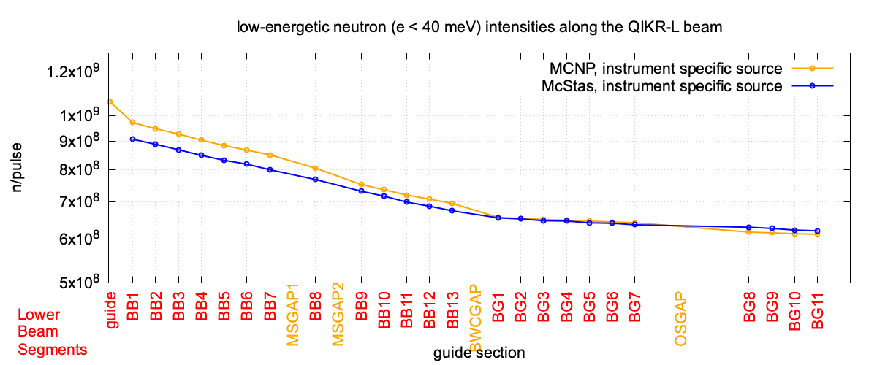
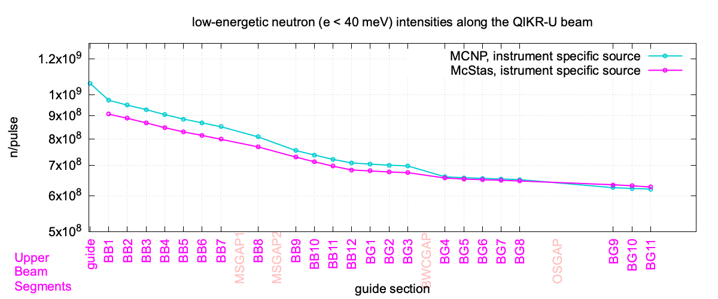
Agreement Between MCNP and McStas
MCNP and McStas agree within 10% for reflected (ie, low energy) neutrons. Therefore, the MCNP model is correctly capturing the intended mirror surface performance.
The same low-energetic instrument-specific source were used in both MCNP and McStas.

Slide 13
Analysis for Monolith/Bunker
March 03, 2025
Kursat Bekar, Neutronics Scientist

Slide 14
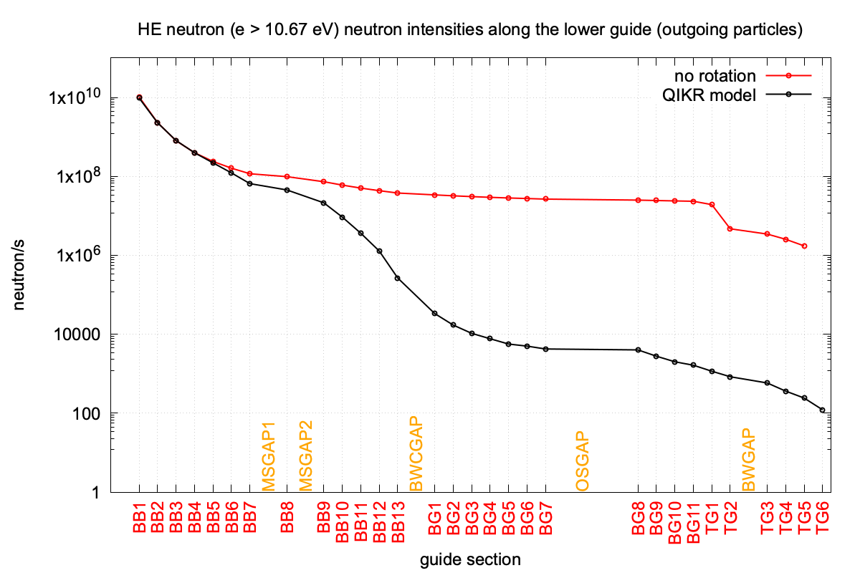
How well QIKR curved guides reduce the high-energetic neutrons?
Straight guides
QIKR guide design (curved guide) helps to reduce the high-energetic neutrons in the beam by ~ 4 orders of magnitude at the shutter location
no rotation
with rotation
Curved guides
Gap at Shutter location
NOTE: There are still some high energy neutrons entering the cave through the guide. This is important for the beam stop design.
High energetic neutron intensities at the end of guide sections for the cases with and without rotation
QIKR MCNP model was used with QIKR-SSW source for these simulations

Slide 15
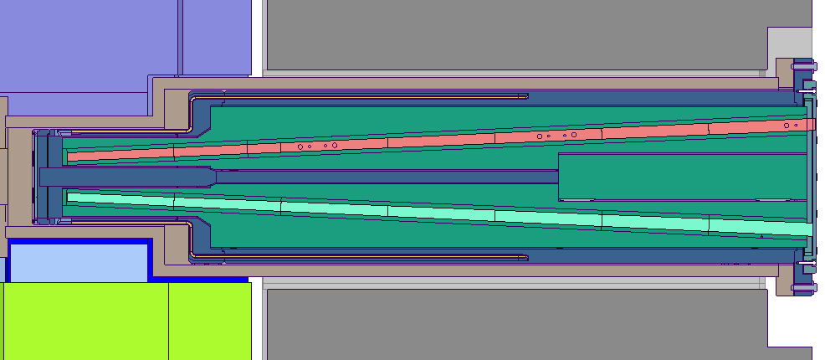
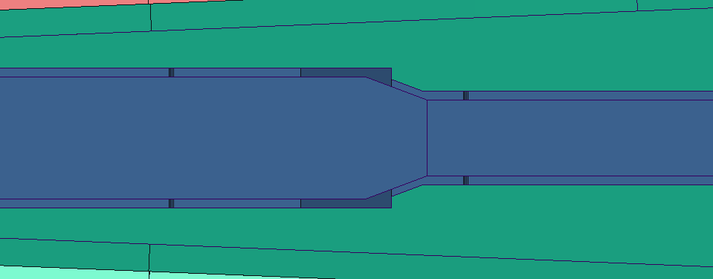
Potential Streaming Paths: QIKR Monolith & Optics Insert Gaps – Creo Models
Long straight gaps, top/ bottom
Elevation (Side) View
Neutrons
Monolith insert
anti-streaming block
6mm
0.04315
Long straight gaps, top/ bottom
6mm
6mm
6mm
Optics insert (QIKR-U)
Optics insert
Chicane anti-streaming block
Monolith insert
Optics insert, steel
Monolith insert, steel
Optics insert (QIKR-L)
Monolith nozzle, steel
6mm
6mm
Gap filled with He

Slide 16
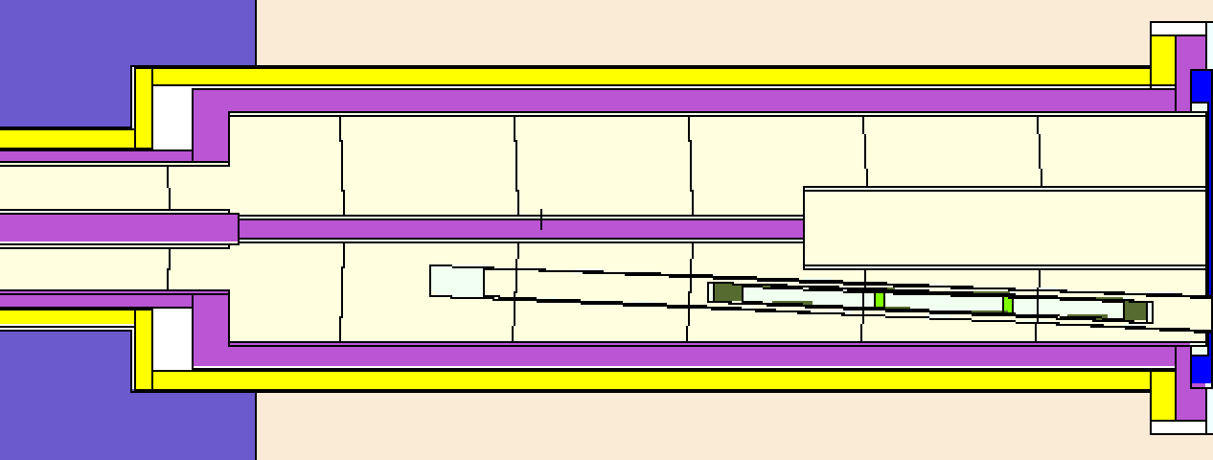
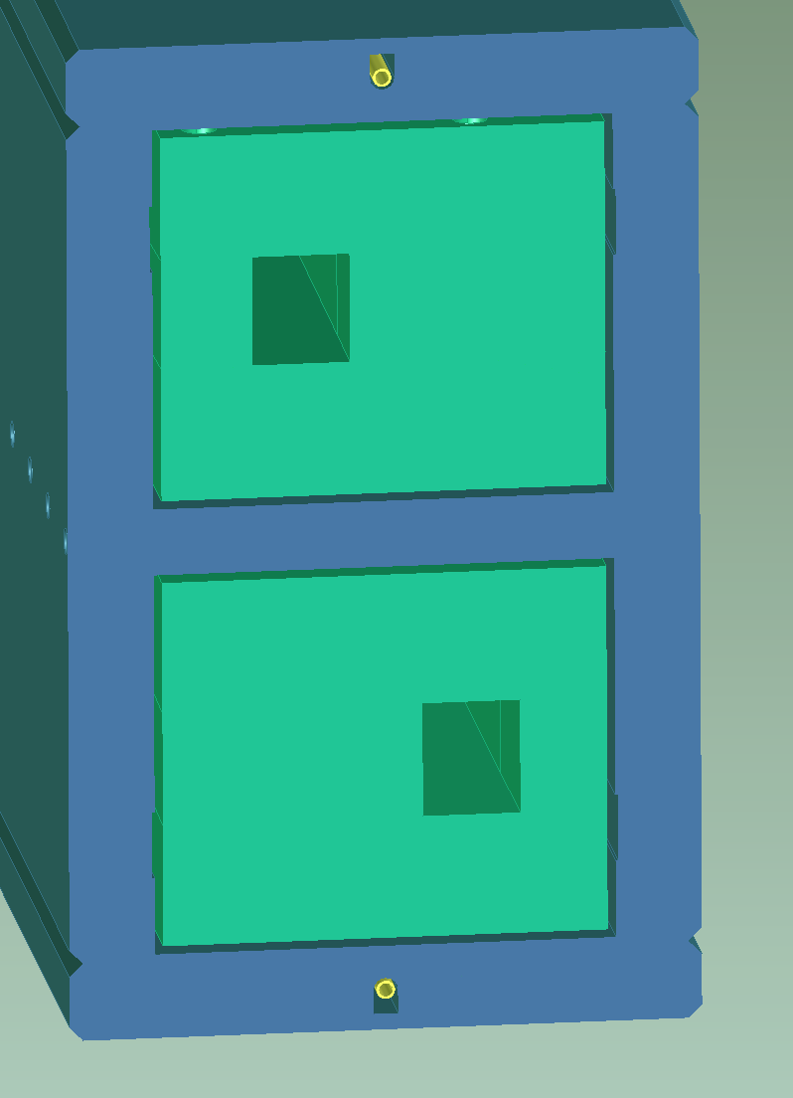
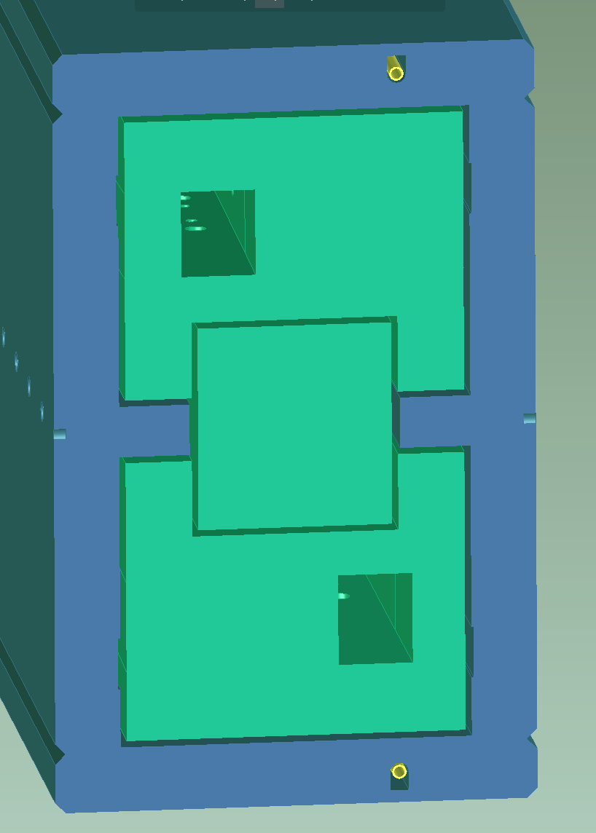
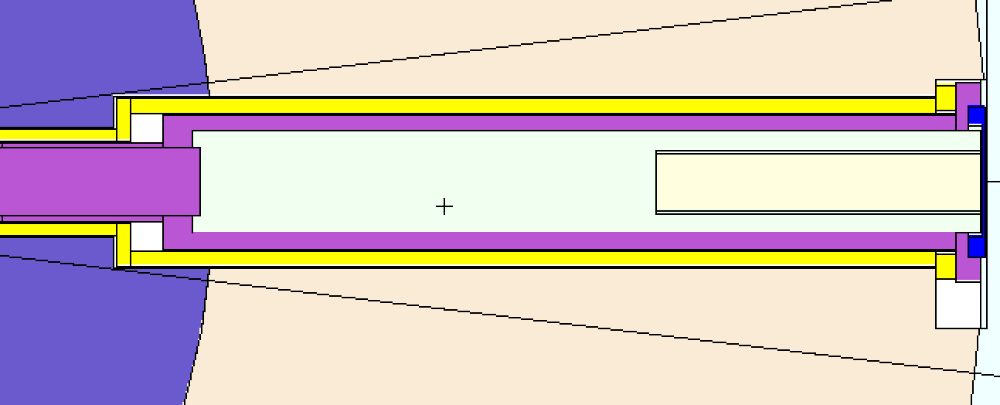
Potential Streaming Paths: QIKR Monolith & Optics Insert Gaps – Creo Models
Creo Model, elevation (side view)
Long straight gaps between shelf and optical inserts
MCNP Model Elevation (Side) View
monolith insert
(shelf)
Cut Views at the dashed lines
MCNP Model plan view
(cut-view at a location 2.5 cm above the moderator center)
6mm
6mm
6mm
6mm
6mm
Optics insert, steel
Monolith insert, steel
He filled straight gap
Monolith nozzle, steel
Gap filled with He

Slide 17
Potential Streaming Paths: QIKR Monolith & Optics Insert Gaps – Creo Models
Long straight gaps on insert sides
Optics insert, steel
Monolith insert, steel
Monolith nozzle, steel
Gap filled with He
Neutrons
Plan (Top) View
6mm
6mm
6mm
6mm

Slide 18
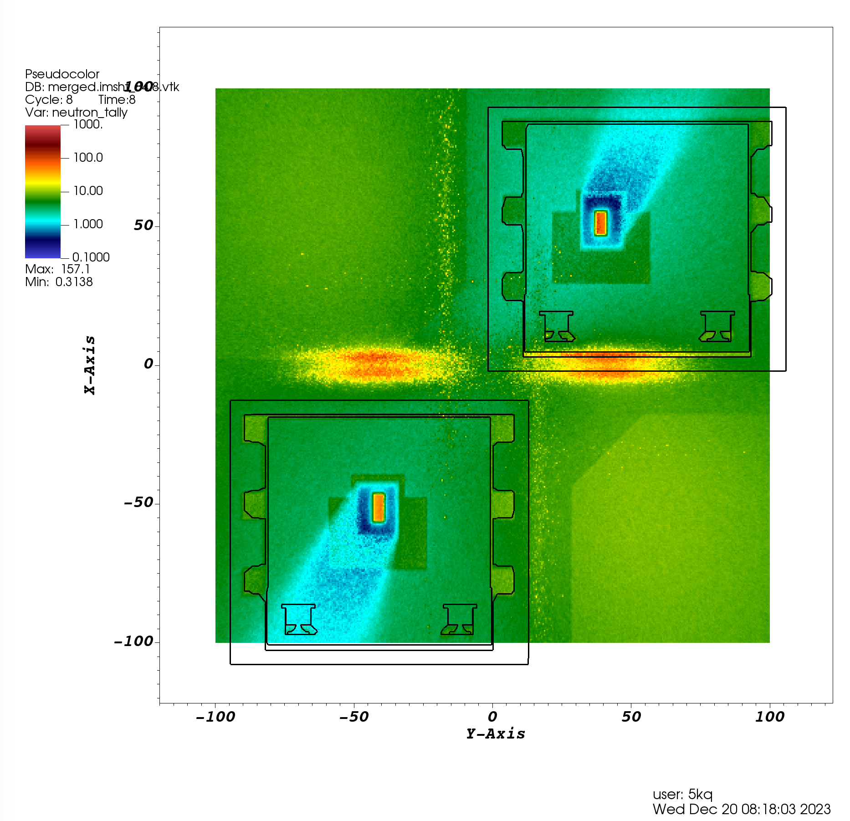
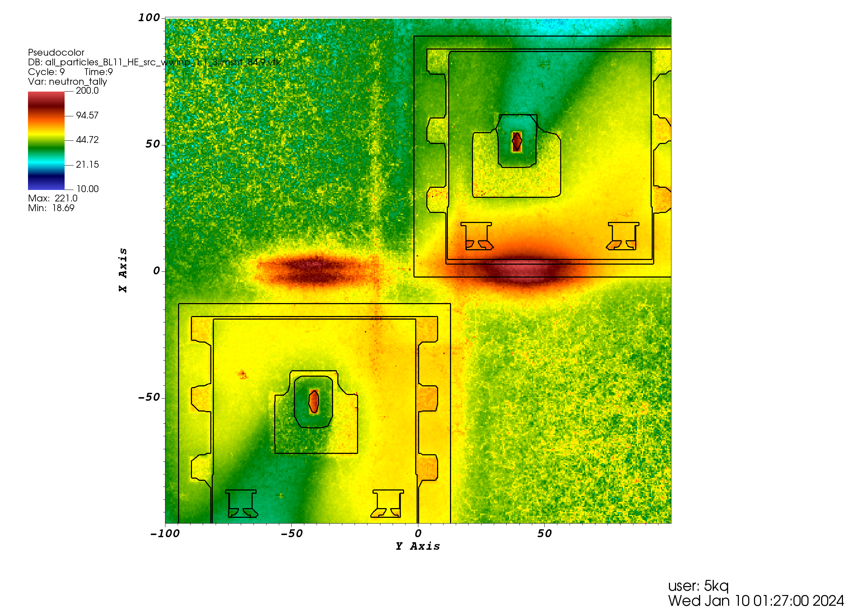
Effects of Gaps in/around QIKR Monolith/Optic inserts on Bunker Wall
neutron dose rates (mrem/hr)
No line-of-sight neutrons are shown on bunker wall??
Thick steel shield around guide reduces high-energetic neutrons
(line-of-sight neutrons) impact on bunker wall significantly
These are the HE neutrons which stream through gaps around/in monolith/optic inserts
Only very high energetic neutrons ( E > 10 MeV)
neutrons ( E > 10.67 eV)
Cable channels
We should consider removing the inner cable channels
Neutron dose profiles at the bunker wall (view from the bunker area)

Slide 19
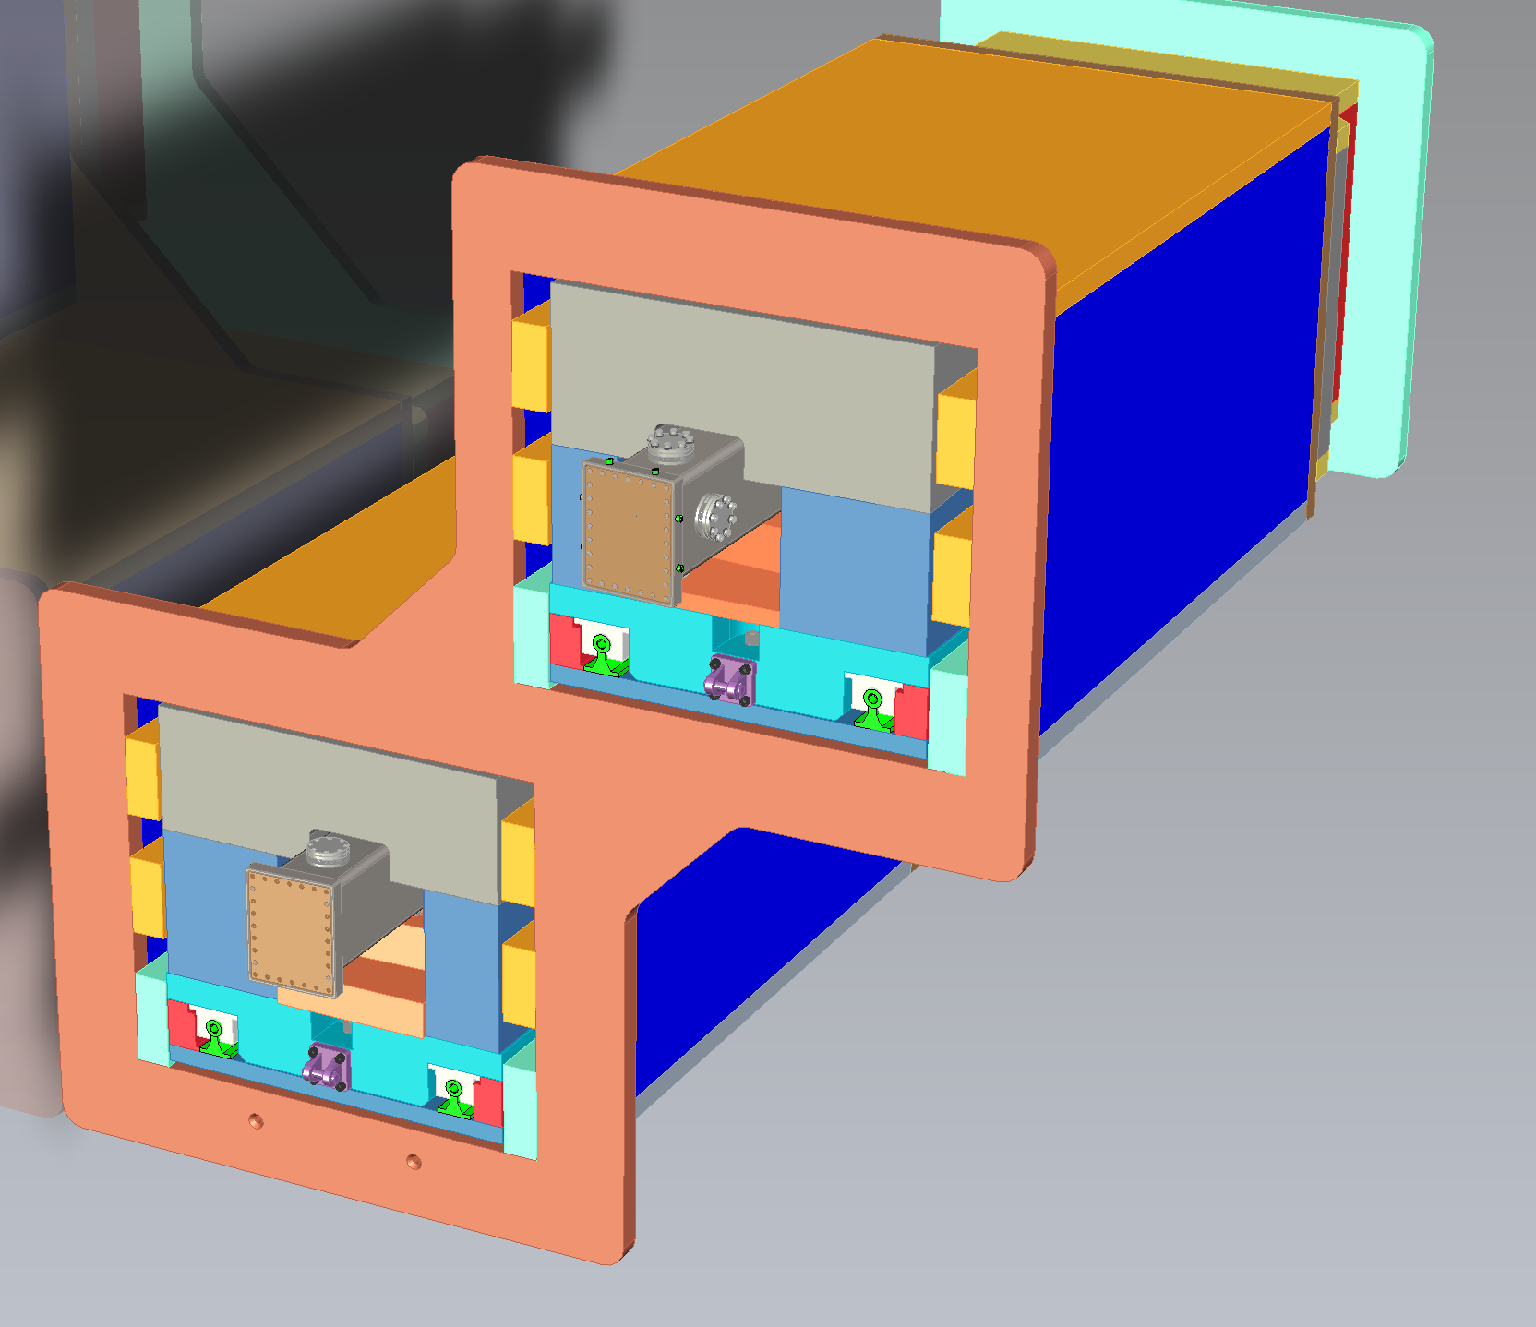
Analysis for Bunker pass-thru
Cable channels line up with the gaps in/around monolith/optic inserts (potential streaming paths)

Slide 20
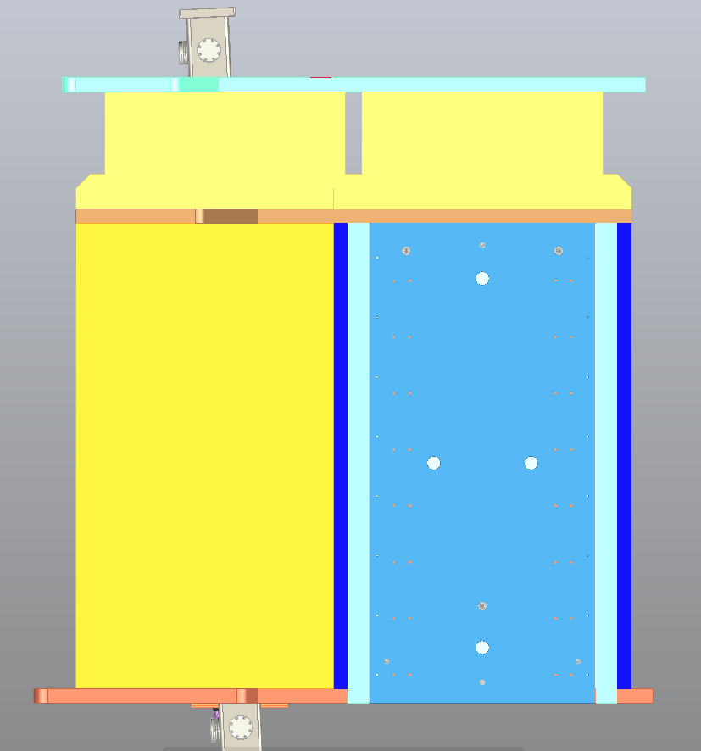
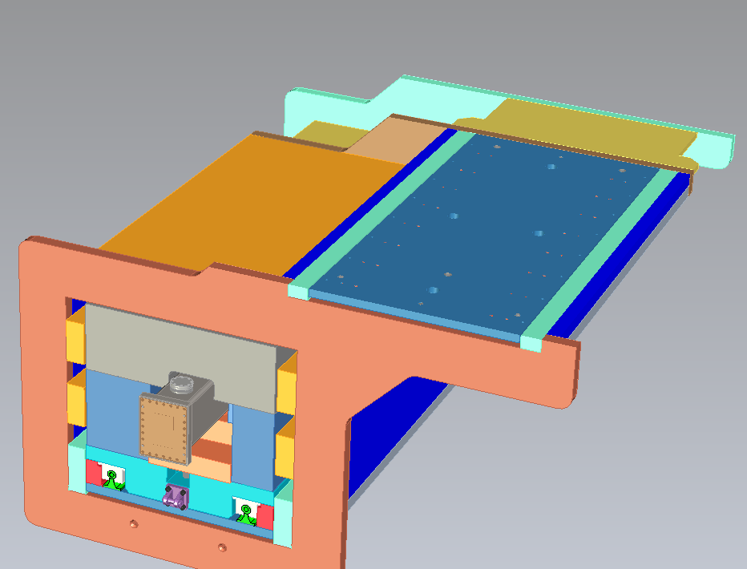
Analysis for Bunker pass-thru
Potential streaming path for the neutrons/photons from the bunker area to the cave
could elevate dose rates inside the cave
Gap under this plate extends almost all the way
Cut-view through bunker pass-thru close just above the
bottom gap (plan view)
In the actual design, this gap will be filled with regular density concrete (RDC). The MCNP model includes this as well, though the effect of removing it was investigated.
Cut-view through bunker pass-thru close just above the bottom gap

Slide 21
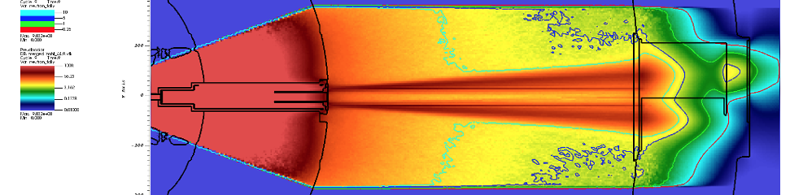
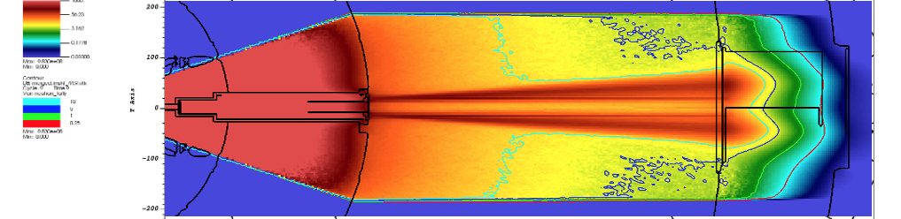
Analysis for Bunker pass-thru
elevated dose
rates inside the cave
neutron dose rates(mrem/h)
horizontal cut-view at the moderator elevation (plan view)
bottom gap
without grout
This matches reality and shows the pass-thru is not allowing significant radiation into the cave
bottom gap
with grout
problem resolved

Slide 22
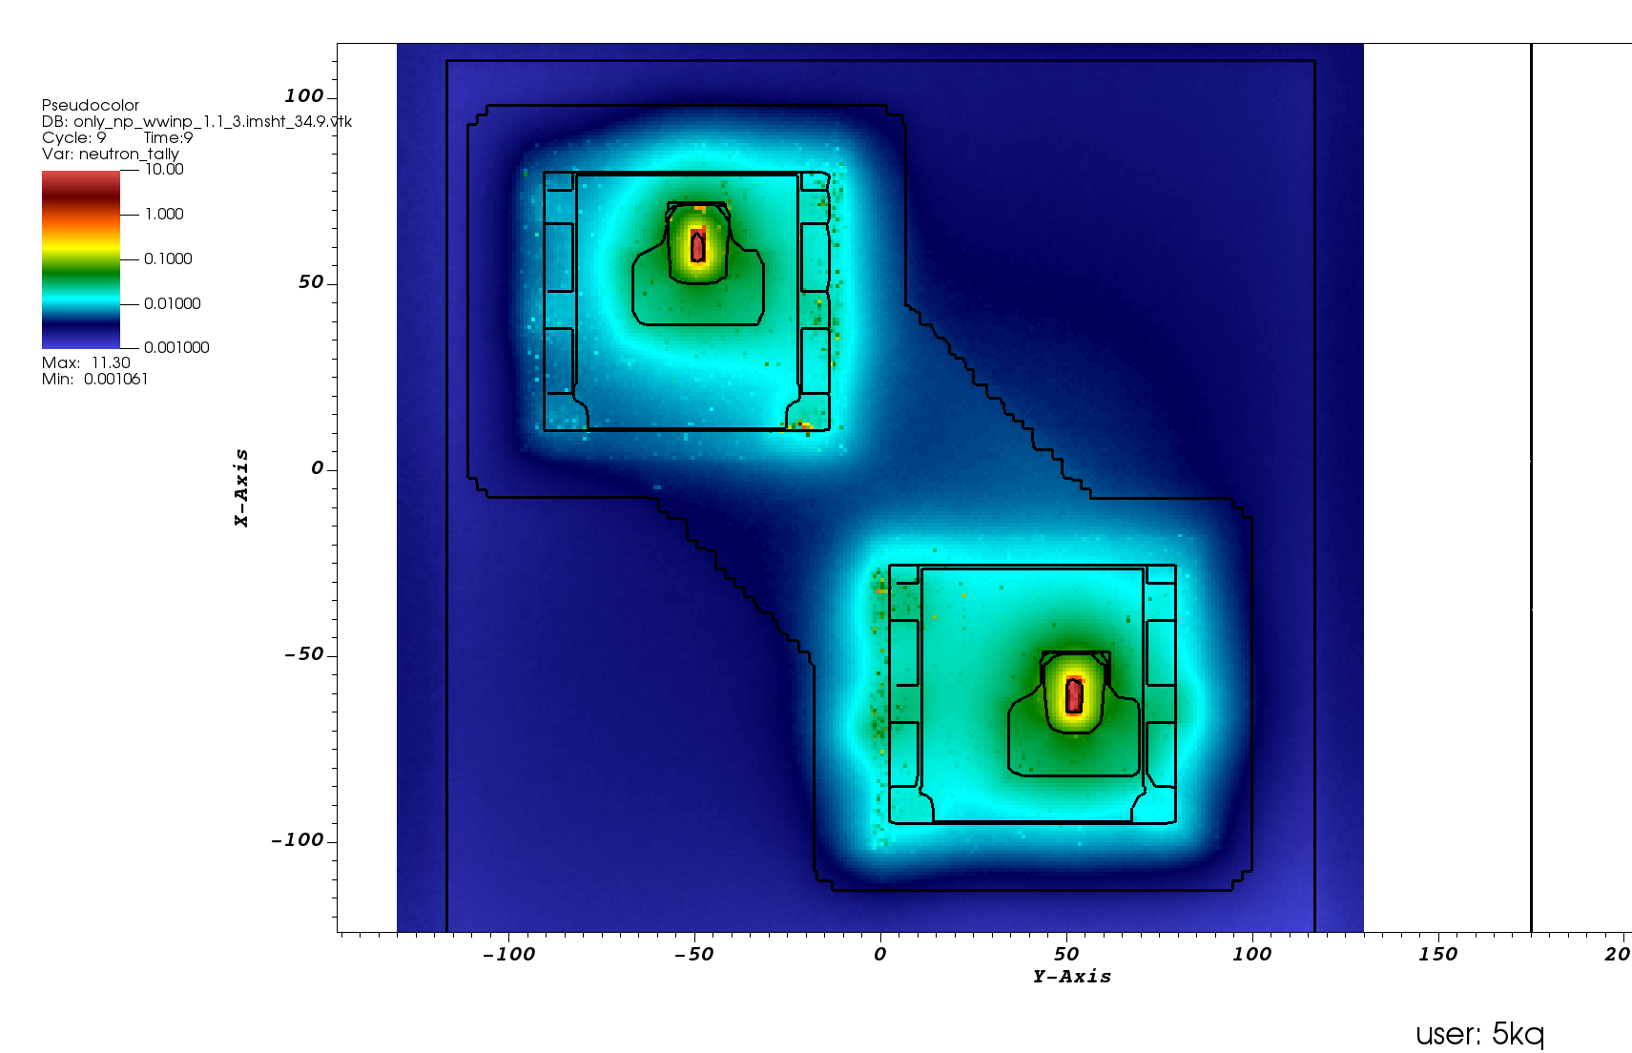
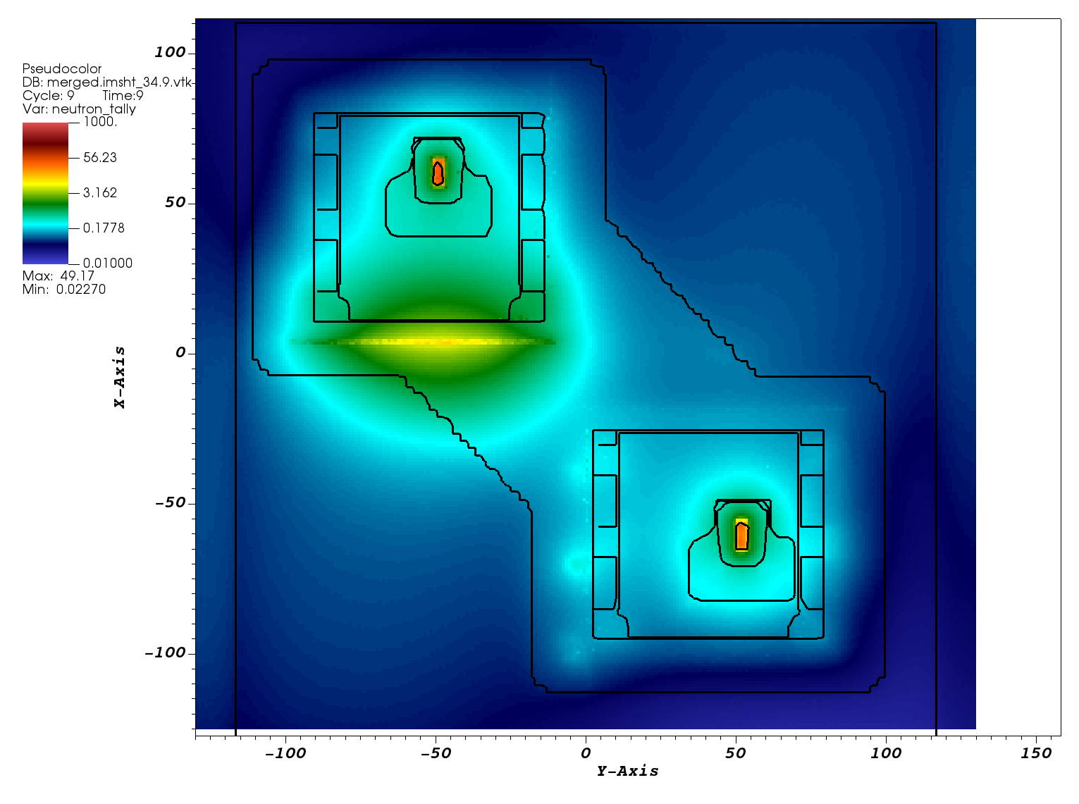
Analysis for Bunker Passthrough
Neutron streaming through bottom gap elevates the neutron dose rate above 5 mrem/h at the upstream cave locations (QIKR-U cave)
neutron dose rates (mrem/h)
This matches reality and shows the only significant radiation entering the cave is through the guides themselves, not through the bunker wall or pass-thru
With grout
Without grout
Vertical cut-view at the exit face of the bunker pass-thru (view from inside the cave)

Slide 23
QIKR Downstream Neutron Sources
March 03, 2025
Kursat Bekar, Neutronics Scientist

Slide 24
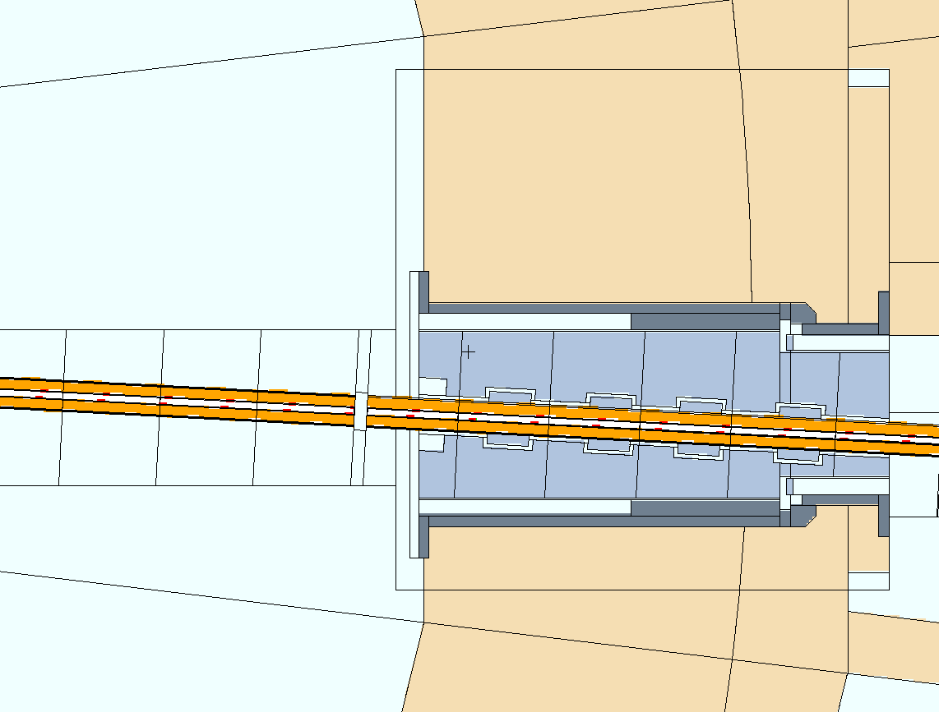
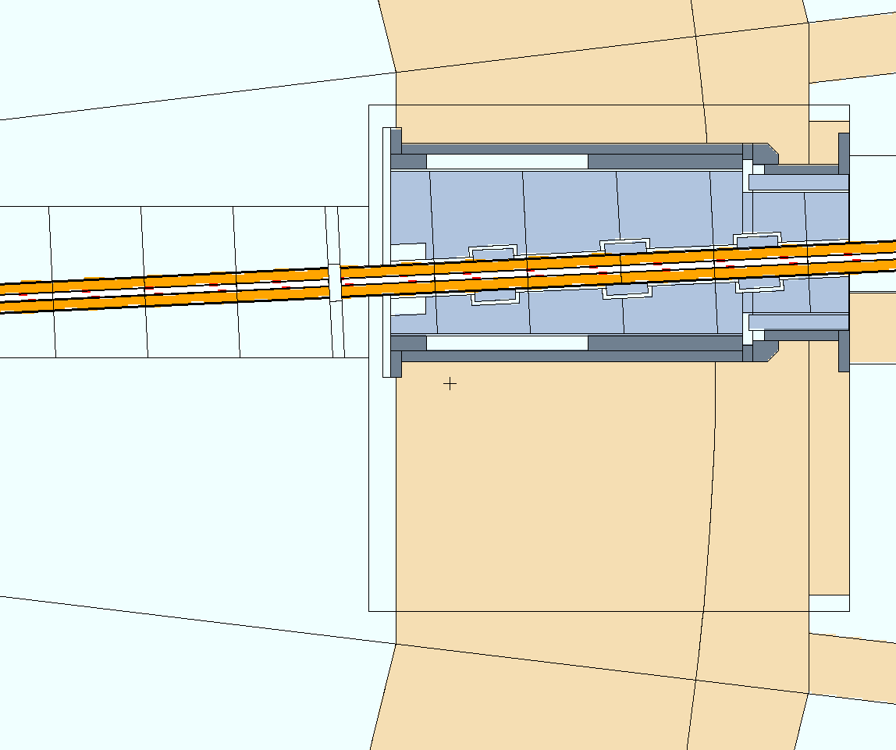
QIKR-L and QIKR-U Downstream Neutron Sources
Simulations with QIKR-SSW are timely calculations especially for downstream calculations
Require QIKR MCNP full model even a calculation at the very downstream locations (e.g. beam stop design)
→ longer simulation time
Require detail optimization for variance reduction to improve the statistics in MCNP results → longer analyst time
Two new sources were developed for downstream calculations to speed up the downstream calculations
beamline specific source for QIKR-U
beamline specific source for QIKR-L
Downstream sources were obtained by performing MCNP simulations with QIKR MCNP Full model with QIKR-SSW neutron source
Location where source plane located
Location where source plane located
QIKR-L beam
Distance to moderator surface ~ 1130 cm
QIKR-U beam
Distance to moderator surface ~ 1130 cm
QIKR-L source plane location
View along the QIKR-L beam elevation
QIKR-U source plane location
View along the QIKR-U beam elevation

Slide 25
QIKR-L and QIKR-U Downstream Neutron Sources
 | QIKR-U downstream source | QIKR-L downstream source
Distance to moderator surface | ~ 1080 cm | ~ 1080 cm
Source surface area | 6.957 x 3 cm² | 8.496 x 3 cm²
Spatial distribution | Uniform | Uniform
Angular distribution | 6 angular bins (0-0.25, 0.25-0.50, 0.50-1.0, 1.0-1.5, 1.5-2.0, > 2.0) | 6 angular bins (0-0.25, 0.25-0.50, 0.50-1.0, 1.0-1.5, 1.5-2.0, > 2.0)
Energy distribution | Each angular bin has its spectrum | Each angular bin has its spectrum
Low-energetic portion (E < 10.67 eV) Neutron intensity | 1.368 x 10¹⁰ n/s | 1.367 x 10¹⁰ n/s
High-energetic portion (E > 10.57 eV) Neutron intensity | ~ 8.93 x 10³ n/s | ~ 10.87 x 10³ n/s
These new sources were used in the analysis for QIKR shutters, beam stops and cave shielding.

Slide 26
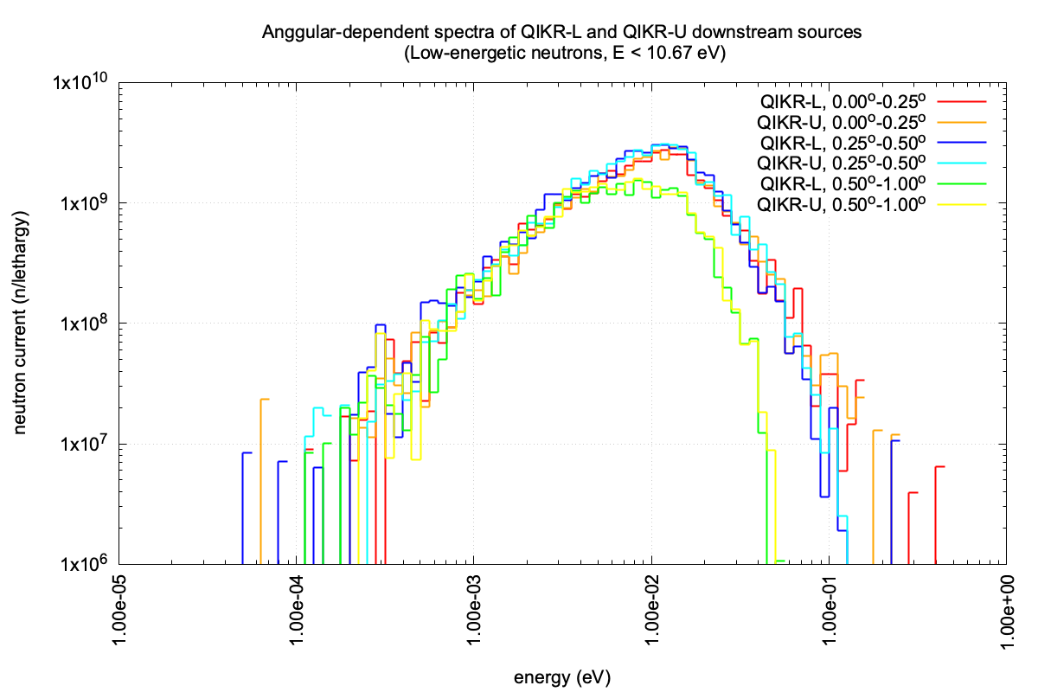
QIKR-L and QIKR-U Downstream Neutron Sources
Majority of low-energetic neutrons are in the first three angular bins:
0.0—0.25, 0.25-0.50, and 0.5-1.0 degree bins
 | QIKR-L | QIKR-U
Angular bins (degrees) | fraction | fraction
0 – 0.25 | 0.354 | 0.356
0.25-0.50 | 0.413 | 0.408
0.50-1.00 | 0.223 | 0.229
> 1.0 | 0.010 | 0.007

Slide 27
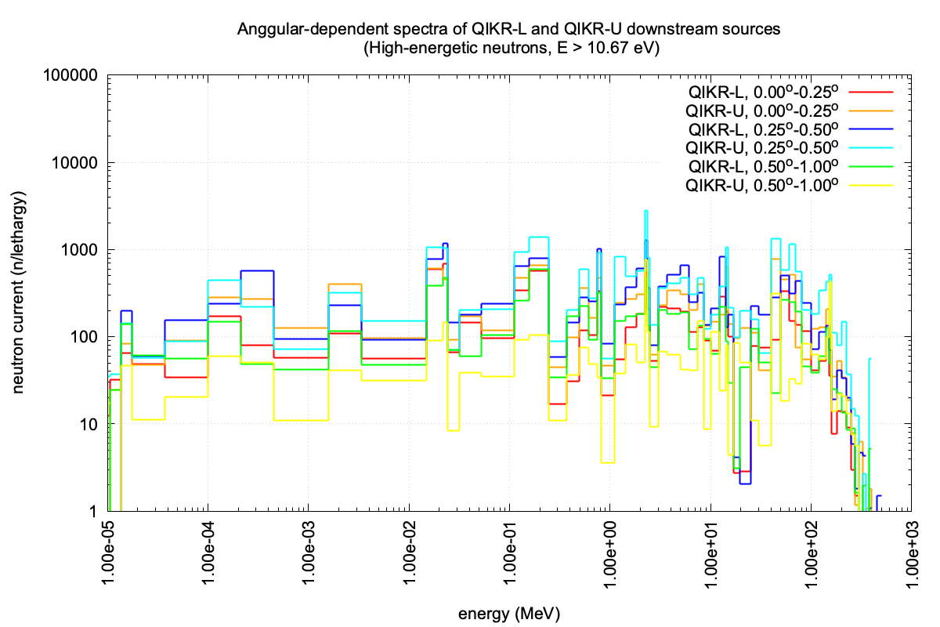
QIKR-L and QIKR-U Downstream Neutron Sources
Majority of high-energetic neutrons are in the first three angular bins:
0.0—0.25, 0.25-0.50, and 0.5-1.0 degree bins
 | QIKR-L | QIKR-U
Angular bins (degrees) | fraction | fraction
0 – 0.25 | 0.195 | 0.340
0.25-0.50 | 0.456 | 0.464
0.50-1.00 | 0.192 | 0.068
> 1.0 | 0.157 | 0.128

Slide 28
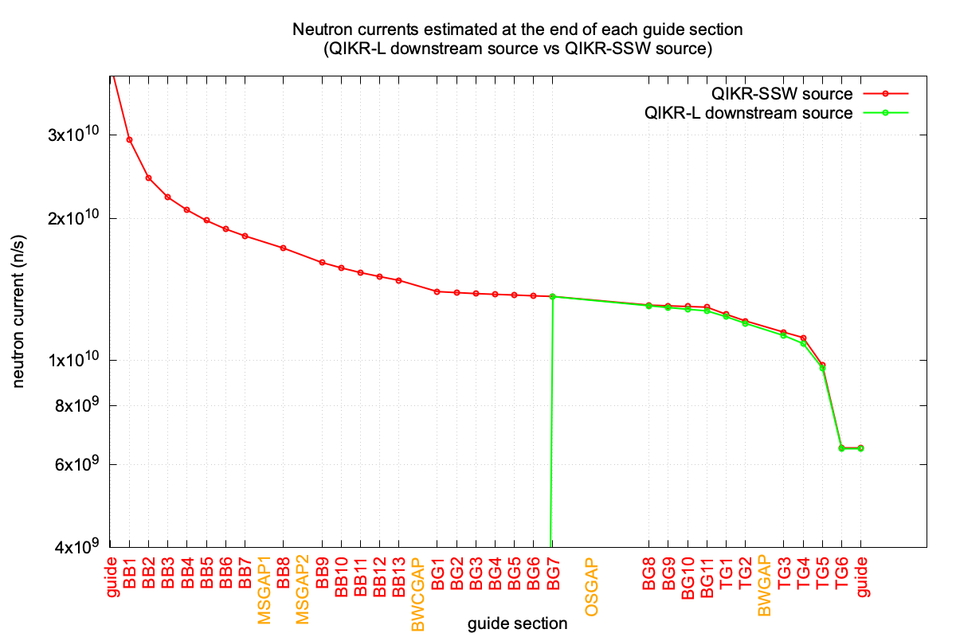
Downstream Neutron Source Verification
QIKR MCNP model were simulated for QIKR-L with both QIKR-SSW and QIKR-L downstream source
the difference is less than 1% at each guide section end and the sample location
QIKR downstream source reduce the overall simulation time by a –7 factors while providing the accuracy with the same level of uncertainties

Slide 29
QIKR Preliminary Shutter Designs
March 03, 2025
Kursat Bekar, Neutronics Scientist

Slide 30
QIKR Preliminary Shutter Designs
Shutter gap
Shutter gap
QIKR-L beam
QIKR-U beam
Distance to moderator
surface ~ 1130 cm
Distance to moderator
surface ~ 1130 cm
QIKR-L shutter location
View along the QIKR-L beam elevation
QIKR-U shutter location
View along the QIKR-U beam elevation

Slide 31
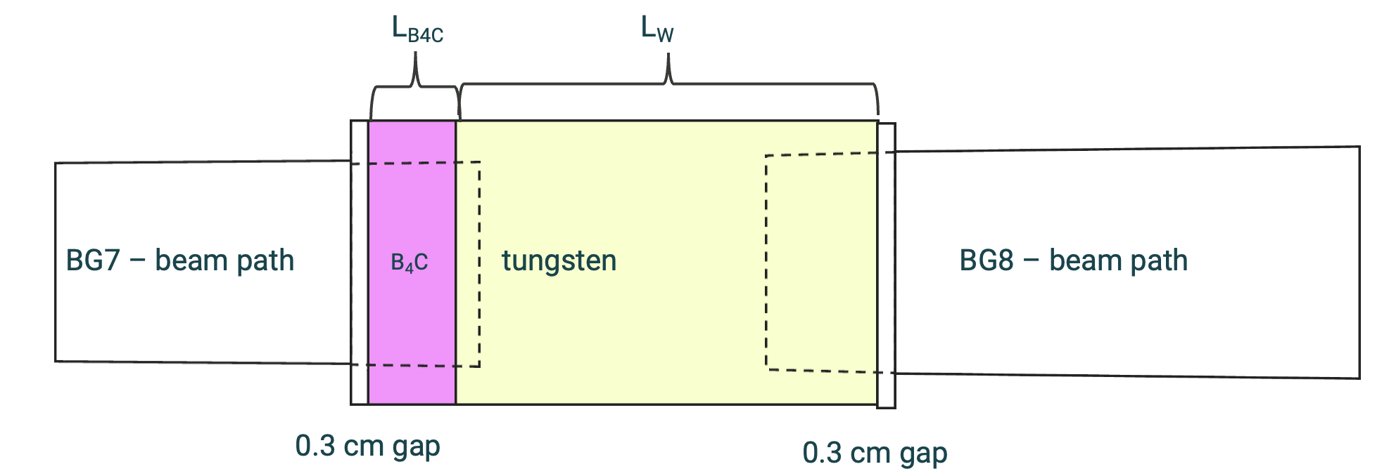
QIKR Preliminary Shutter Designs
Design criterion: Shutter beam blocker should reduce the total dose rates to 0.25 mrem/h at the sample location
Shutter beam blocker consists of a B4C front plate followed by a thick tungsten block (Note that shutter cross-sectional area is slightly larger than the beam path)
B4C plate → block low-energetic neutrons in the beam
W plate → block photons as well as high-energetic neutrons in the beam
In the optimization calculations:
Dynamic shutter gap (0.3 x 2 + L_{B4c} + L_{W}) ➔ The lengths of the BG7 and BG8 guide sections are shortened depending on the increase in the shutter gap
Parameter space: L_{B4c} = [ 0.0, 2.0] and L_{W} = [ 0.0, 10.0]
Objective : Total dose rate = 0.25 mrem/h at sample location
.
neutron beam
sample
location
A schematic view of shutter beam blocker placed in the shutter gap

Slide 32
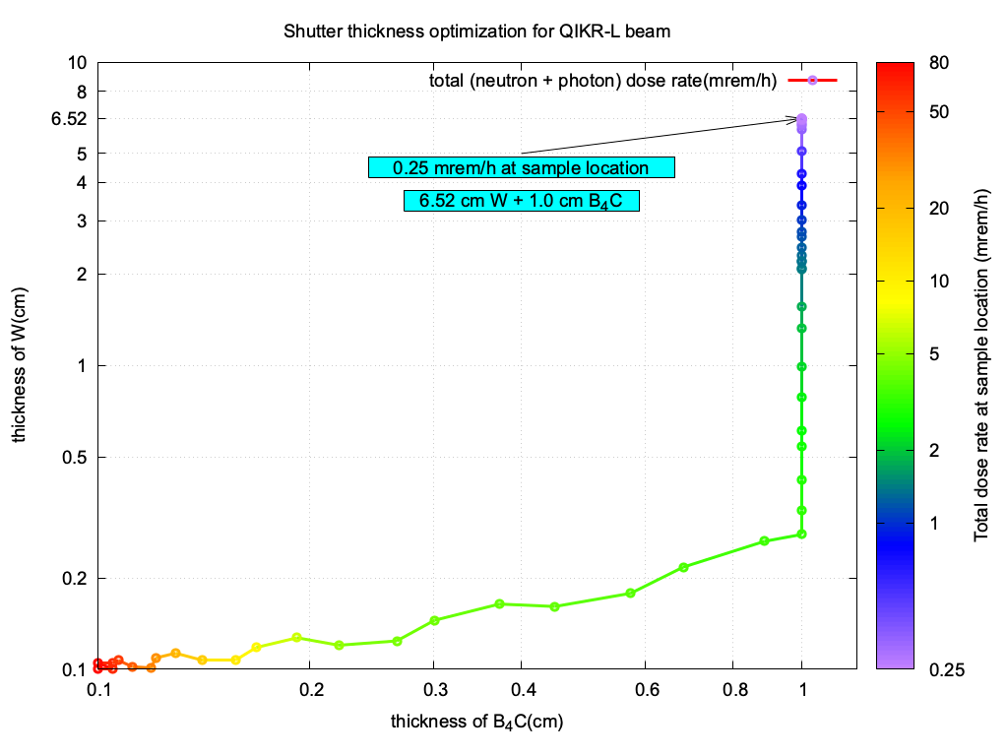
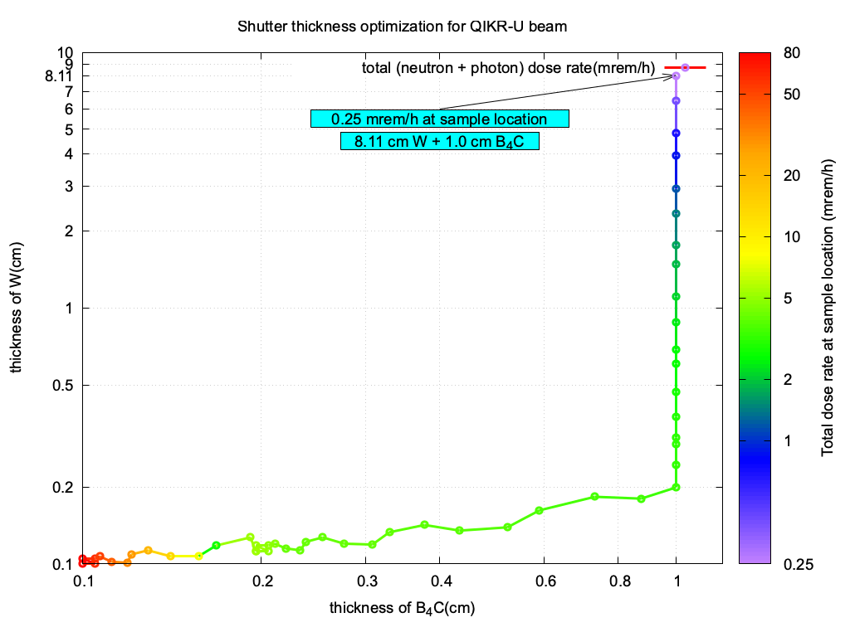
QIKR Preliminary Shutter Design
Design criterion: Shutter beam blocker should reduce the total dose rates to 0.25 mrem/h at the sample location
Total dose rates refer to neutron + photon, over entire range (0-1.3 GeV)
QIKR-L → L_{B4c} = 1.0 cm and L_{W} = 6.52 cm
QIKR-U → L_{B4c} = 1.0 cm and L_{W} = 8.11 cm
Low-energetic neutron ratio (QIKR-U/QIKR-L) ~ 1
High-energetic neutron ratio (QIKR-U/QIKR-L) ~ 1.22
➔ Longer W blocker in QIKR-U compared to QIKR-L one
In Creo, 10cm of tungsten was used for both beamlines to be conservative

Slide 33
QIKR Preliminary Shutter Design
Why QIKR-U has larger high-energetic neutron intensity compared to QIKR-L:
The different initial rotations of the beamlines with respect to the moderator (0.75° for QIKR-L and 0.70° for QIKR-U)
The total curvature of the beamlines, which is 2.95° for QIKR-L and 2.733° for QIKR-U
Therefore, QIKR-U beam blocker is longer than the QIKR-L beam blocker

Slide 34
QIKR Preliminary Beam Stop Designs
March 03, 2025
Kursat Bekar, Neutronics Scientist

Slide 35
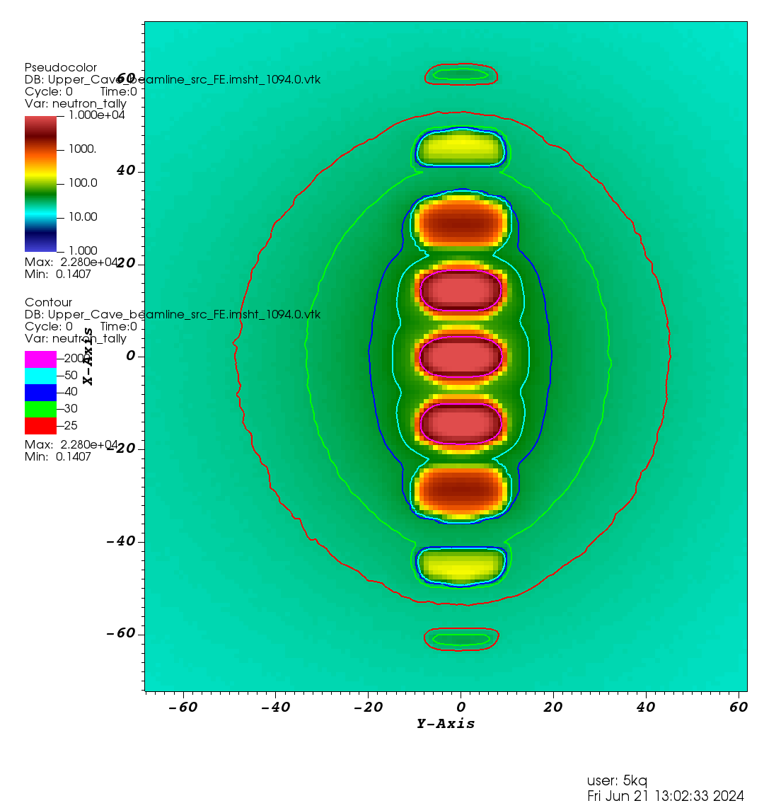
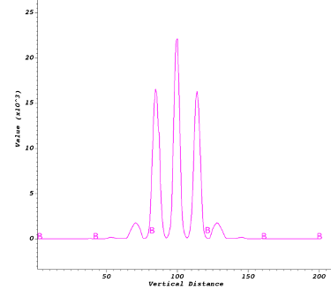
QIKR Preliminary Beam Stop Designs: What drives the beam stop designs?
QIKR guide design splits the neutron beam in the central beam inclined by 2.5° from horizontal direction and two or more additional weaker beams diverging from the central beam in vertical direction as depicted below figures.
Dose contour maps obtained with white beam (no obstruction between guide exit and beam stop location) at the beam stop locations are used to estimate the height and width of the beam stop.
Vertical cut-view perpendicular
to the center beam
QIKR-U cave
Neutron dose rate profiles
Vertical cut-view along the QIKR-U beam
Intensities of each beam components
at the specified location

Slide 36
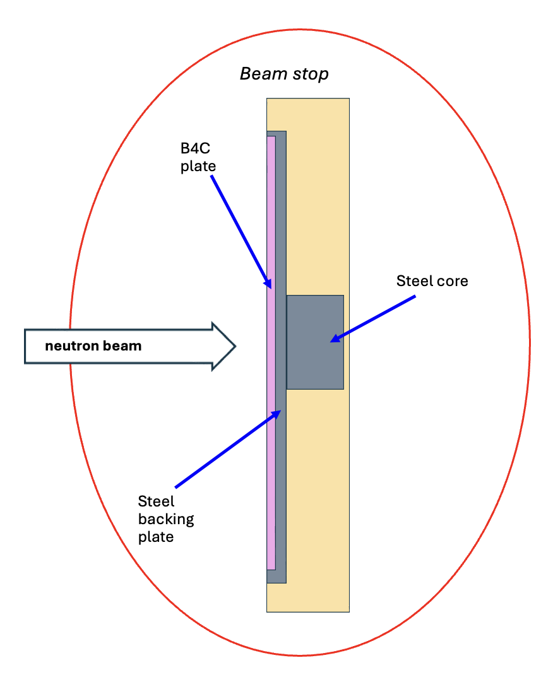
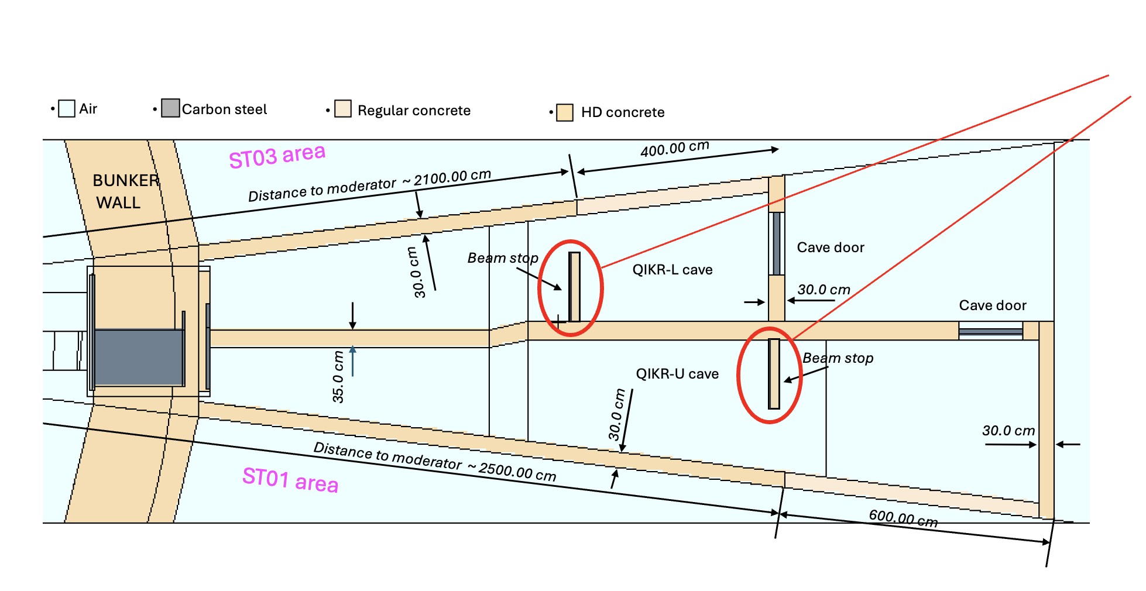
QIKR Preliminary Beam Stop Designs
Beam stops are placed 500 cm away from the guide exits
The same preliminary beam stop design was used for cave shielding
analysis for both QIKR-L and QIKR-U.
QIKR-L and QIKR-U downstream sources were used in the beam stop analysis
NO SLITS in the beam stop calculations
(white beam, no obstruction in the beam)
Vertical cut-view at beam stop
centerline
QIKR MCNP cave model
Horizontal cut-view at the moderator elevation

Slide 37
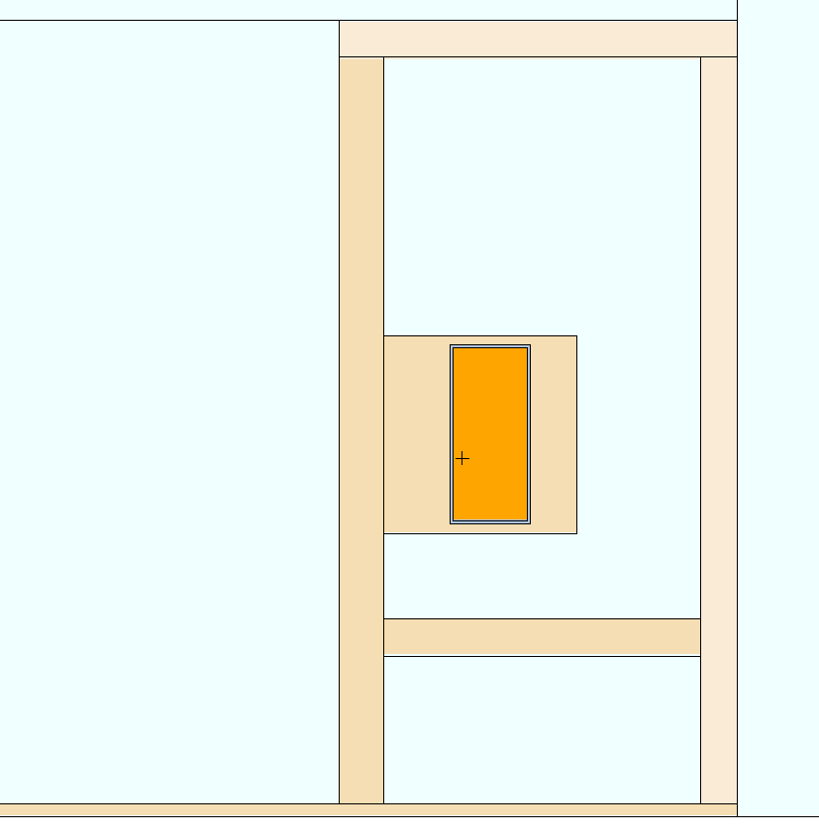
QIKR Preliminary Beam Stop Designs
Beam stop dimensions:
0.5 cm thick B4C front-plate (H=140cm, W=60 cm)
0.5 cm thick steel backing plate (H=145cm, W=65cm)
5 cm thick center steel core for HE neutrons (H=20cm, W=20cm)
10 cm thick HDC enclosing above components (H=160 cm, W=125 cm)
neutron beam
Vertical cut-view at the
beam stop centerline
Front view of QIKR-U beam stop
(view from cave upstream)
Wide B4C front-plate → for low-energetic neutrons
Center steel core → for photons and high-energetic neutrons in the center beam component
HDC → for photons
Larger beam stop cross-sectional area also helps limit the dose rates under normal operation and accident conditions

Slide 38
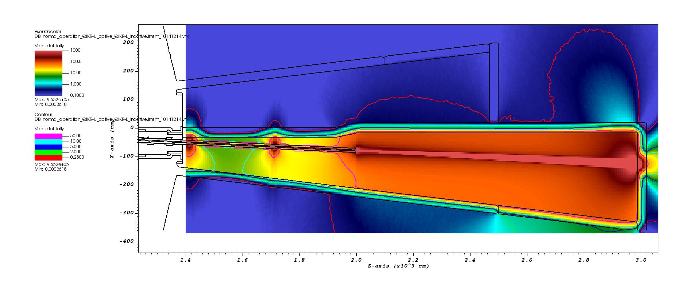
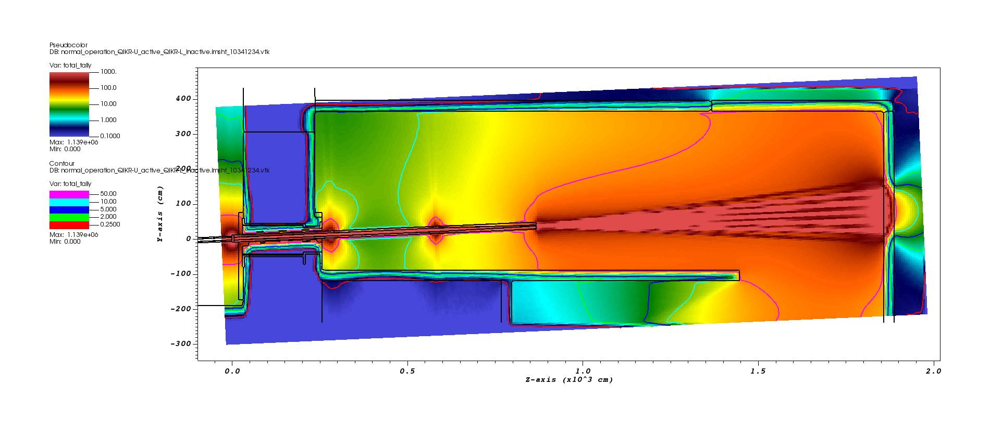
QIKR Preliminary Beam Stop Designs: QIKR-U
Total (neutron + photon)
dose rates outside the enclosure
when beam stop is not in the cave
18.7 mrem/h
Outside the cave backwall
(30 cm from the wall)
18.7 mrem/h
Outside the enclosure
(30 cm from the wall)
Cut-view along the QIKR-U beam elevation
Note: Dose profiles obtained when only QIKR-U is active (shutter open)
Vertical cut-view along the QIKR-U beam

Slide 39
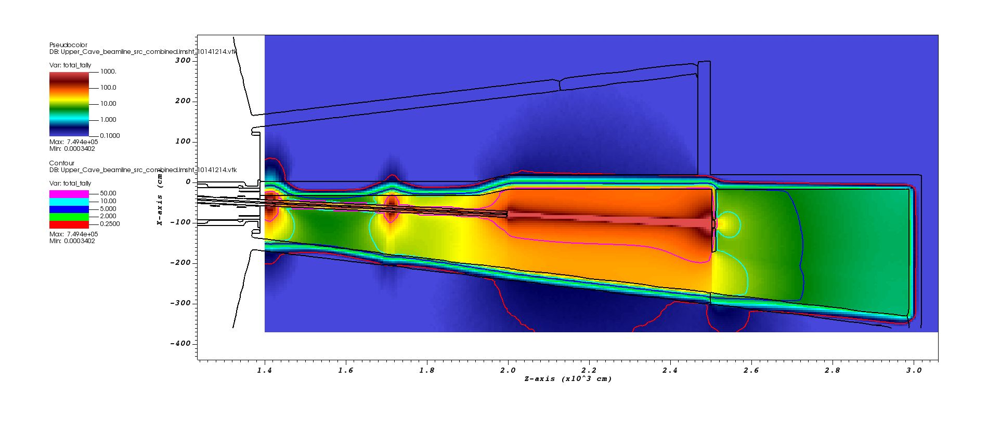
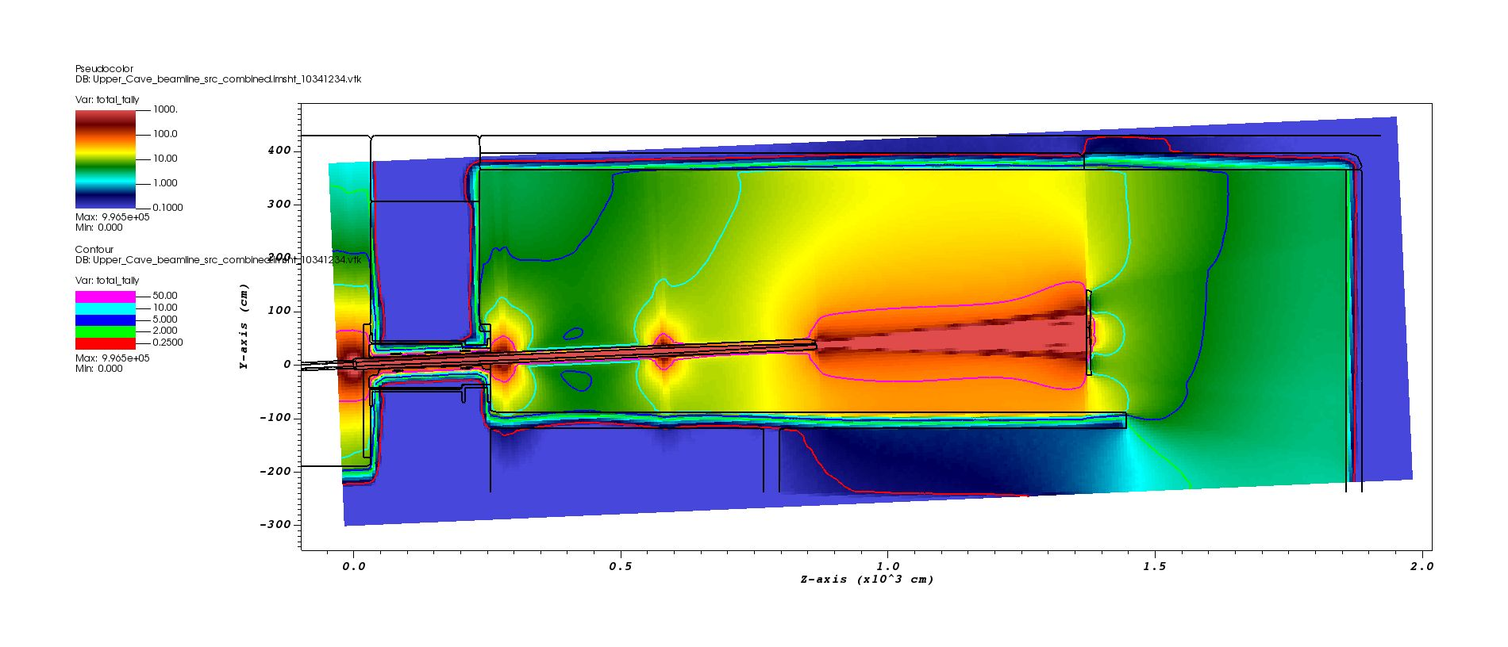
QIKR Preliminary Beam Stop Designs: QIKR-U
Total (neutron + photon)
dose rates outside the enclosure
when beam stop is in the cave
Dose rates are within the limit outside the enclosure
(30 cm from the wall)
Cut-view along the QIKR-U beam elevation
Details will be discussed in QIKR Cave Shielding Analysis
Vertical cut-view along the QIKR-U beam

Slide 40
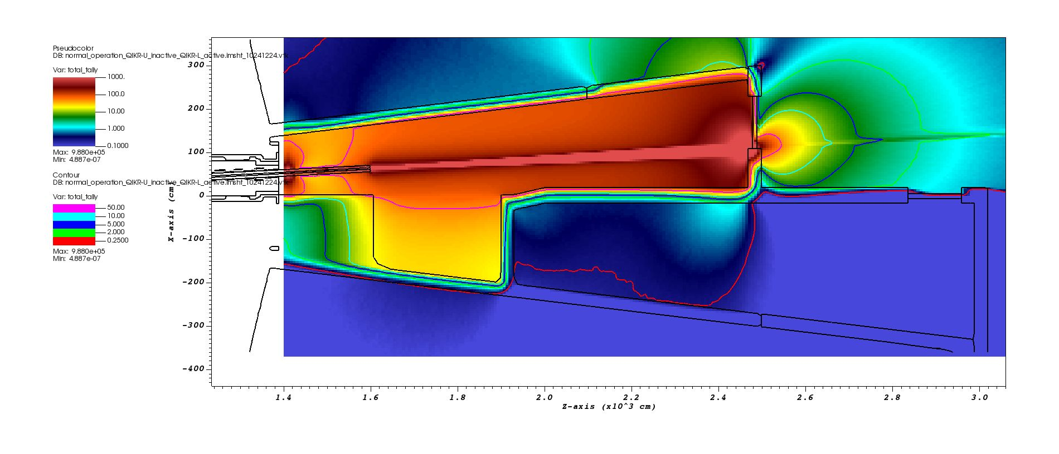
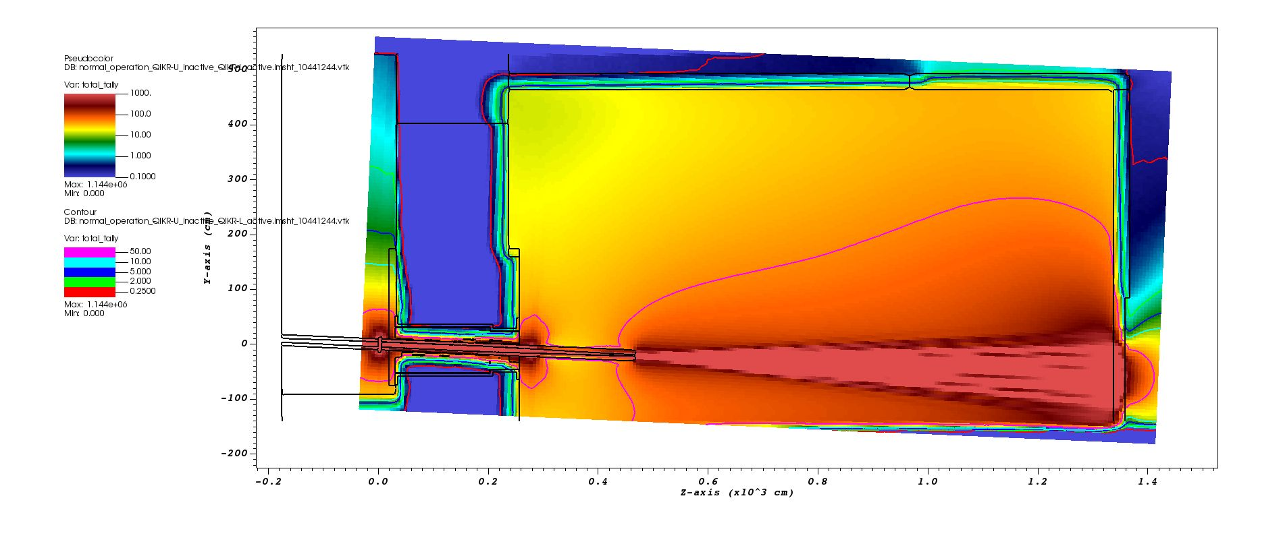
QIKR Preliminary Beam Stop Designs: QIKR-L
Total (neutron + photon)
dose rates outside the enclosure
when beam stop is not in the cave
18.7 mrem/h
Outside the cave backwall
(30 cm from the wall)
176.1 mrem/h
Outside the enclosure
(30 cm from the wall)
Cut-view along the QIKR-L beam elevation
The back door of the QIKR-L cave is in the QIKR-L beam path, resulting in higher dose rates outside the enclosure
Note: Dose profiles obtained when only QIKR-L is active (shutter open)
Vertical cut-view along the QIKR-L beam

Slide 41
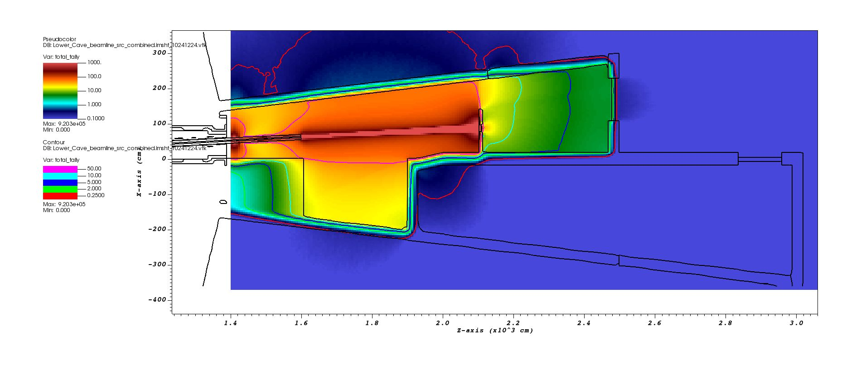
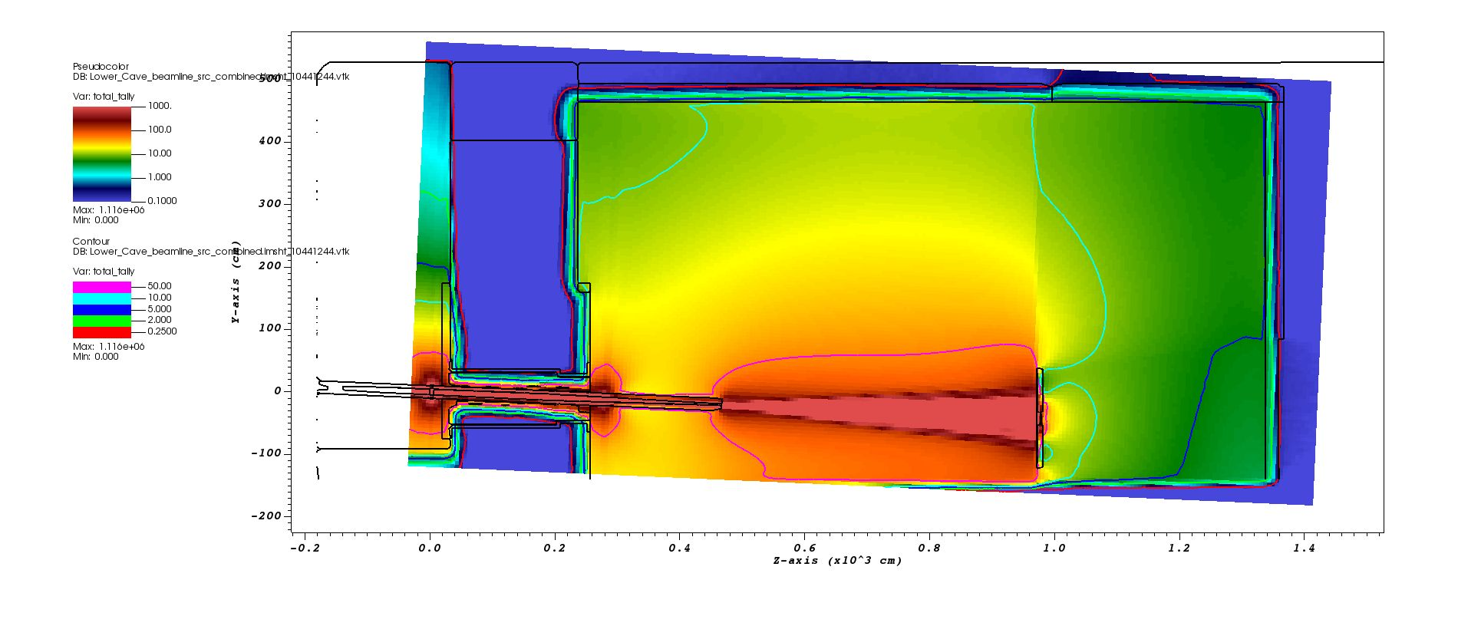
QIKR Preliminary Beam Stop Designs: QIKR-L
Total (neutron + photon)
dose rates outside the enclosure
when beam stop is in the cave
Dose rates are within the limit outside the enclosure
(30 cm from the wall)
Dose rates are within the limit outside the enclosure
(30 cm from the wall)
Cut-view along the QIKR-L beam elevation
Details will be discussed in QIKR Cave Shielding Analysis
Vertical cut-view along the QIKR-L beam

Slide 42
QIKR Cave Shielding Analysis
March 03, 2025
Kursat Bekar, Neutronics Scientist

Slide 43
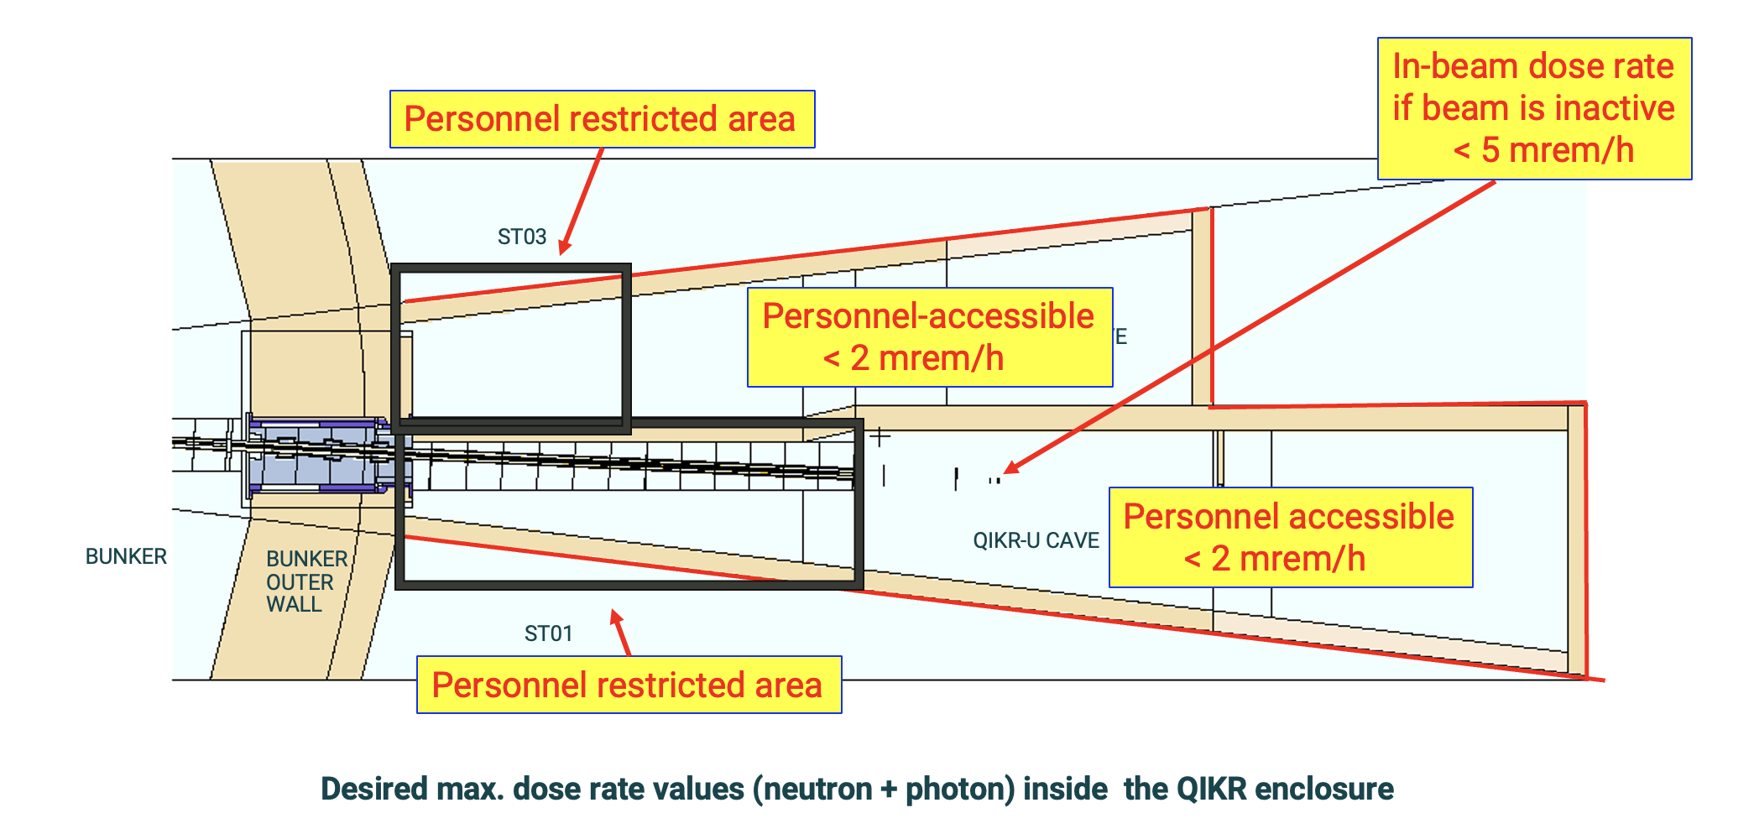
QIKR Instrument Cave Shielding Analysis– Preliminary Design
Acceptance Criteria for QIKR Shielding Design
(QIKR Cave Acceptable Dose Rates Design Criteria Document)
Normal operation:
0.25 mrem/h at generally accessible areas outside the QIKR Instrument Caves
2 mrem/h allowed in the areas between the outer wall of the QIKR instrument cave and the shielding of the adjacent beamlines
2 mrem/h in the user-accessible areas within the cave and 5 mrem/h at the sample location when the beam is inactive
Accident condition:
Dose rates will be documented to provide information for implementation of Instrument Personal Protection System
General accessible area
< 0.25 mrem/h
General accessible area
< 0.25 mrem/h
Above roof < 2mrem/h

Slide 44
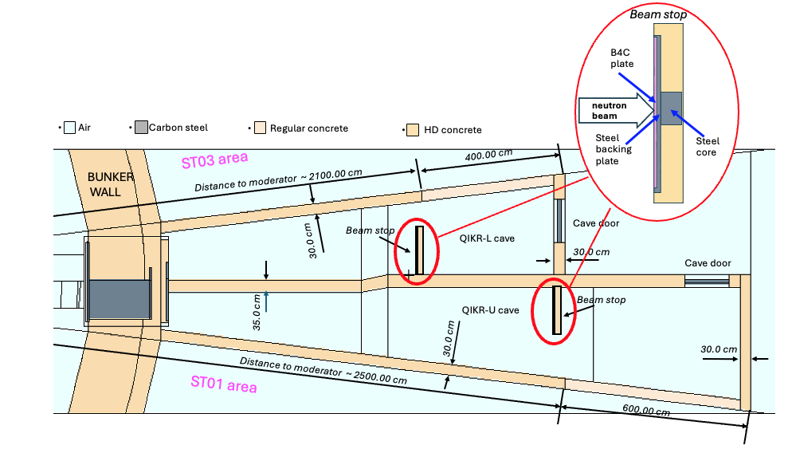
QIKR Cave Shielding Analysis
All outside walls (side walls and back wall) of QIKR instrument cave enclosure are
30 cm-thick high-density concrete(HDC) except the below wall sections:
Regular density concrete (RDC) wall section between ST03 and QIKR-L cave: starting from ~21 m ending about ~25 m (distances are measured from the moderator face)
RDC wall section between ST01 and QIKR-U cave: starting from ~25 m ending about ~ 30 m (distances are measured from the moderator face)
The wall separating QIKR-U and
QIKR-L caves is 35 cm-thick HDC
Beam stops are always present in the MCNP model
QIKR MCNP cave model
Horizontal cut-view at the moderator elevation
QIKR-L and QIKR-U downstream sources were used in cave shielding analysis

Slide 45
QIKR Cave Shielding Analysis
Same geometry and concrete types as is used in the Creo model
30 cm-thick HDC and RDC sections are used for each QIKR roof:
QIKR-U cave HDC-RDC transition line is ~ 25 m
away from the moderator
surface
QIKR-L cave HDC-RDC transition line is ~ 21 m
away from the moderator
surface
QIKR-L and QIKR-U downstream sources were used in cave shielding analysis
QIKR MCNP cave model
View from above the roof

Slide 46
QIKR Cave Shielding Analysis: SLITS in the model
Dimensions
Slit1: 16 x 21 x 0.5 cm³
Slit2: 31 x 31 x 0.5 cm³
Slit3: 31 x 31 x 0.5 cm³
Max. apertures
Slit1: 3 x 3 cm²
Slit2: 8 x 8 cm²
Slit3: 8 x 8 cm²
Slit geometries and locations provided by John Ankner
0.5 cm thick B4C plates with center opening were used for SLITs
Accident condition, normal operation → full apertures were set (3 x 3, 8 x 8 and 8 x 8 cm²⁾
For normal operation scenario, performing calculations with full aperture rather than using maximum opening is a conservative approach (max. opening in slits when operation normally is 0.9 x 2.5, 0.5 x 2.5, 0.2 x 2.5 cm²)

Slide 47
QIKR Cave Shielding Analysis
No significant radiation coming through bunker pass-thru; therefore, cave analysis are carried out only with beam sources(see slide 23)
Assumption: Negligible radiation into the cave from adjacent beamlines and shields
The analysis simulated different normal operating modes and potential accident conditions by performing a series of QIKR-L and QIKR-U calculations:
Normal operation (white beam, water sample at the sample location)
Both QIKR-L and QIKR-U are active → dose rates outside the cave enclosure
QIKR-L is active, QIKR-U is inactive → dose rates inside the QIKR-U cave
QIKR-U is active, QIKR-L is inactive → dose rates inside the QIKR-L cave
Accident condition (white beam, steel sample at the sample location)
Accident in QIKR-L cave while QIKR-U is active → dose rates outside the cave enclosure
Accident in QIKR-U cave while QIKR-L is active → dose rates outside the cave enclosure
Accident in QIKR-L cave while QIKR-U inactive → dose rates inside the QIKR-U cave
Accident in QIKR-U cave while QIKR-L inactive → dose rates inside the QIKR-L cave
Active = shutter open
Inactive = shutter closed

Slide 48
QIKR Cave Shielding Analysis: Normal Operation
Normal operation, QIKR-L and QIKR-U operate normally
- White beam - Water sample - With Slits (full aperture)
Red contour lines show the
0.25 mrem/h total dose boundary
Dose profiles calculated at 30 cm away from the cave outer walls when both beamlines are operating normally.

Slide 49
QIKR Cave Shielding Analysis: Normal Operation
Normal operation, QIKR-L and QIKR-U operate normally
- White beam - Water sample - With Slits (full aperture)
Red contour lines show the
0.25 mrem/h total dose boundary
Dose profiles at 30 cm above the instrument caves roof (plan-view) when both beamlines are operating normally.

Slide 50
QIKR Cave Shielding Analysis: Normal Operation
Normal operation, One beamline is active, the other is inactive (used to estimate the dose rates inside the caves)
- White beam - Water sample - With Slits (full aperture)
Red contour lines show the
0.25 mrem/h total dose boundary
Dose profiles when one beam is operating normally, and the other is inactive.

Slide 51
QIKR Cave Shielding Analysis: Normal Operation
Normal operation, One beamline is active, the other is inactive (used to estimate the dose rates inside the caves)
- White beam - Water sample - With Slits (full aperture)
Red contour lines show the
0.25 mrem/h total dose boundary
Dose profiles when one beam is operating normally, and the other is inactive.

Slide 52
Summary: Normal Operation
No significant elevated dose rates inside/outside the QIKR instrument cave enclosure
normal operation (QIKR-L active and QIKR-U active)
Cave | Location |  | maximum total dose rate (mrem/h)
QIKR-L | Outer wall, ST03 side | Upstream (HDC) | 0.72
 |  | Downstream (RDC) | 0.28
 | Back Wall |  | < 0.25
 | Roof | Upstream (HDC) | < 0.25
 |  | Downstream (RDC) | 0.43
QIKR-U | Outer wall, ST01 side | Upstream (HDC) | 0.64
 |  | Downstream (RDC) | 0.34
 | Back Wall |  | < 0.25
 | Roof | Upstream (HDC) | 0.31
 |  | Downstream (RDC) | 0.51
normal operation (only QIKR-U active)
QIKR-L | in-beam |  | 0.27
 | bisector wall (inside cave) | Upstream (HDC) | 1.02
 |  | Downstream (RDC) | 0.49
normal operation (only QIKR-L active)
QIKR-U | in-beam |  | 0.28
 | bisector wall (inside cave) | Upstream (HDC) | 0.71
 |  | Downstream (RDC) | 0.29

Slide 53
QIKR Cave Shielding Analysis: Accident Conditions
Accident condition
White beam, Steel sample, With Slits (full aperture)
QIKR-U is in accident
QIKR-L is operating normally
Red contour lines show the
0.25 mrem/h total dose boundary
Dose profiles calculated at 30 cm away from the cave outer walls when QIKR-U is in accident and QIKR-L is operating normally.

Slide 54
QIKR Cave Shielding Analysis: Accident Conditions
Accident condition
White beam, Steel sample, With Slits (full aperture)
QIKR-U is in accident
QIKR-L is operating normally
Red contour lines show the
0.25 mrem/h total dose boundary
Dose profiles at 30 cm above the QIKR instrument caves' roof (plan-view) when QIKR-U is in accident and QIKR-L is operating normally.

Slide 55
QIKR Cave Shielding Analysis: Accident Conditions
Accident condition
White beam, Steel sample, With Slits (full aperture)
QIKR-U is operating normally
QIKR-L is in accident
Red contour lines show the
0.25 mrem/h total dose boundary
Dose profiles calculated at 30 cm away from the cave outer walls when QIKR-L is in accident and QIKR-U is operating normally.

Slide 56
QIKR Cave Shielding Analysis: Accident Conditions
Accident condition
White beam, Steel sample, With Slits (full aperture)
QIKR-U is operating normally
QIKR-L is in accident
Red contour lines show the
0.25 mrem/h total dose boundary
Dose profiles at 30 cm above the QIKR instrument caves' roof (plan-view) when QIKR-L is in accident and QIKR-U is operating normally.

Slide 57
QIKR Cave Shielding Analysis: Accident Conditions
Accident condition
White beam, Steel sample, With Slits (full aperture)
One beamline is in accident,
the other is inactive
Red contour lines show the
0.25 mrem/h total dose boundary
Dose profiles in the inactive beam cave when the other beamline is in accident.

Slide 58
Summary: Accident Conditions
Some elevated dose rates above 2mrem/h inside/outside the QIKR instrument cave enclosure when one QIKR beam line is in accident… something to address?
accident condition (QIKR-L normal operating and QIKR-U accident)
Cave | Location |  | maximum total dose
 |  |  | rate (mrem/h)
QIKR-L | Outer wall, ST03 side | Upstream (HDC) | 0.72
 |  | Downstream (RDC) | 0.31
 | Back Wall |  | < 0.25
 | Roof | Upstream (HDC) | < 0.25
 |  | Downstream (RDC) | 0.43
QIKR-U | Outer wall, ST01 side | Upstream (HDC) | 1.79
 |  | Downstream (RDC) | 0.30
 | Back Wall |  | < 0.25
 | Roof | Upstream (HDC) | 0.65
 |  | Downstream (RDC) | 0.88
accident condition (QIKR-L accident and QIKR-U normal operating)
QIKR-L | Outer wall, ST03 side | Upstream (HDC) | 2.70
 |  | Downstream (RDC) | < 0.25
 | Back Wall |  | 0.31
 | Roof | Upstream (HDC) | 0.38
 |  | Downstream (RDC) | 0.71
QIKR-U | Outer wall, ST01 side | Upstream (HDC) | 0.94
 |  | Downstream (RDC) | 0.34
 | Back Wall |  | < 0.25
 | Roof | Upstream (HDC) | 0.31
 |  | Downstream (RDC) | 0.51
accident condition (QIKR-L inactive and QIKR-U accident)
QIKR-L | in beam |  | 0.28
 | bisector wall | Upstream (HDC) | 1.01
 |  | Downstream (HDC) | 2.76
accident condition (QIKR-L accident and QIKR-U inactive)
QIKR-U | in beam |  | 0.27
 | bisector wall | Upstream (HDC) | 2.35
 |  | Downstream (HDC) | 0.35

Slide 59
Questions??

