Slide 1
Lunch Talk: What-Ifs …
March 03, 2025
Kursat Bekar, Senior R&D Staff

Slide 2
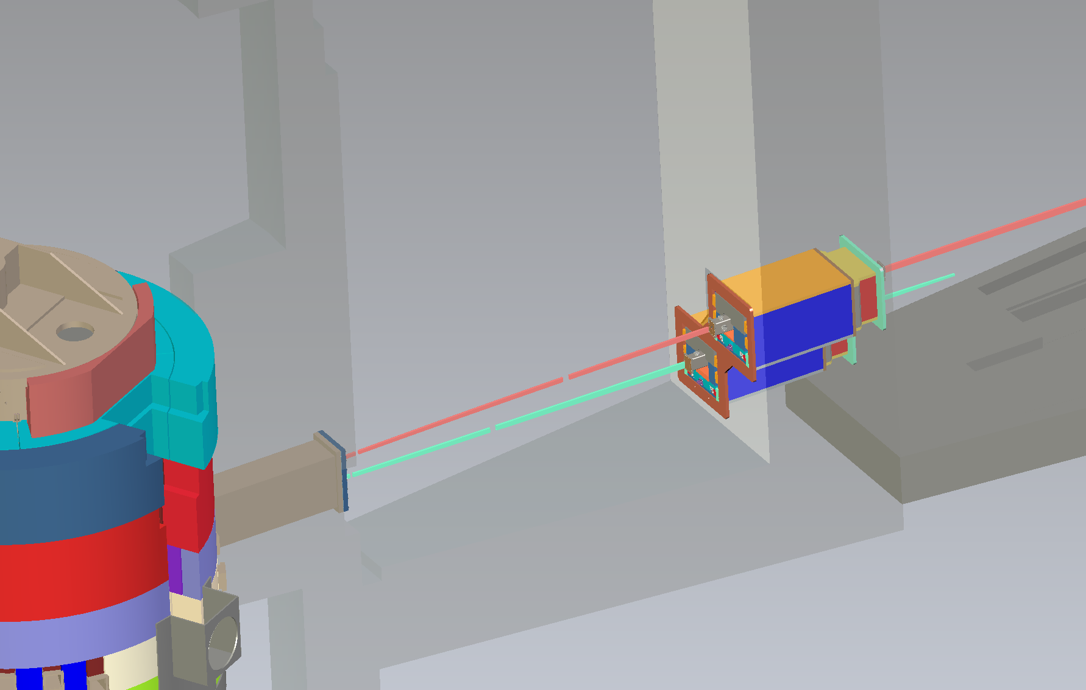
Neutronic analysis to support QIKR needs
A snapshot of dose profiles on bunker wall
Where are the high-energetic neutrons (line-of-sight neutrons)?
Identify the potential streaming paths in monolith area
What-if anti-streaming block is removed
What-if the height taper in the optics inserts is removed
What-if upstream steel insert placed into upstream cavity and chicane removed
Bunker wall
Monolith
shielding
Bunker pass-thru
and shielding
Monolith
insert
The gaps in/around the monolith and optical inserts are potential neutron streaming paths (especially high energetic neutrons)

Slide 3
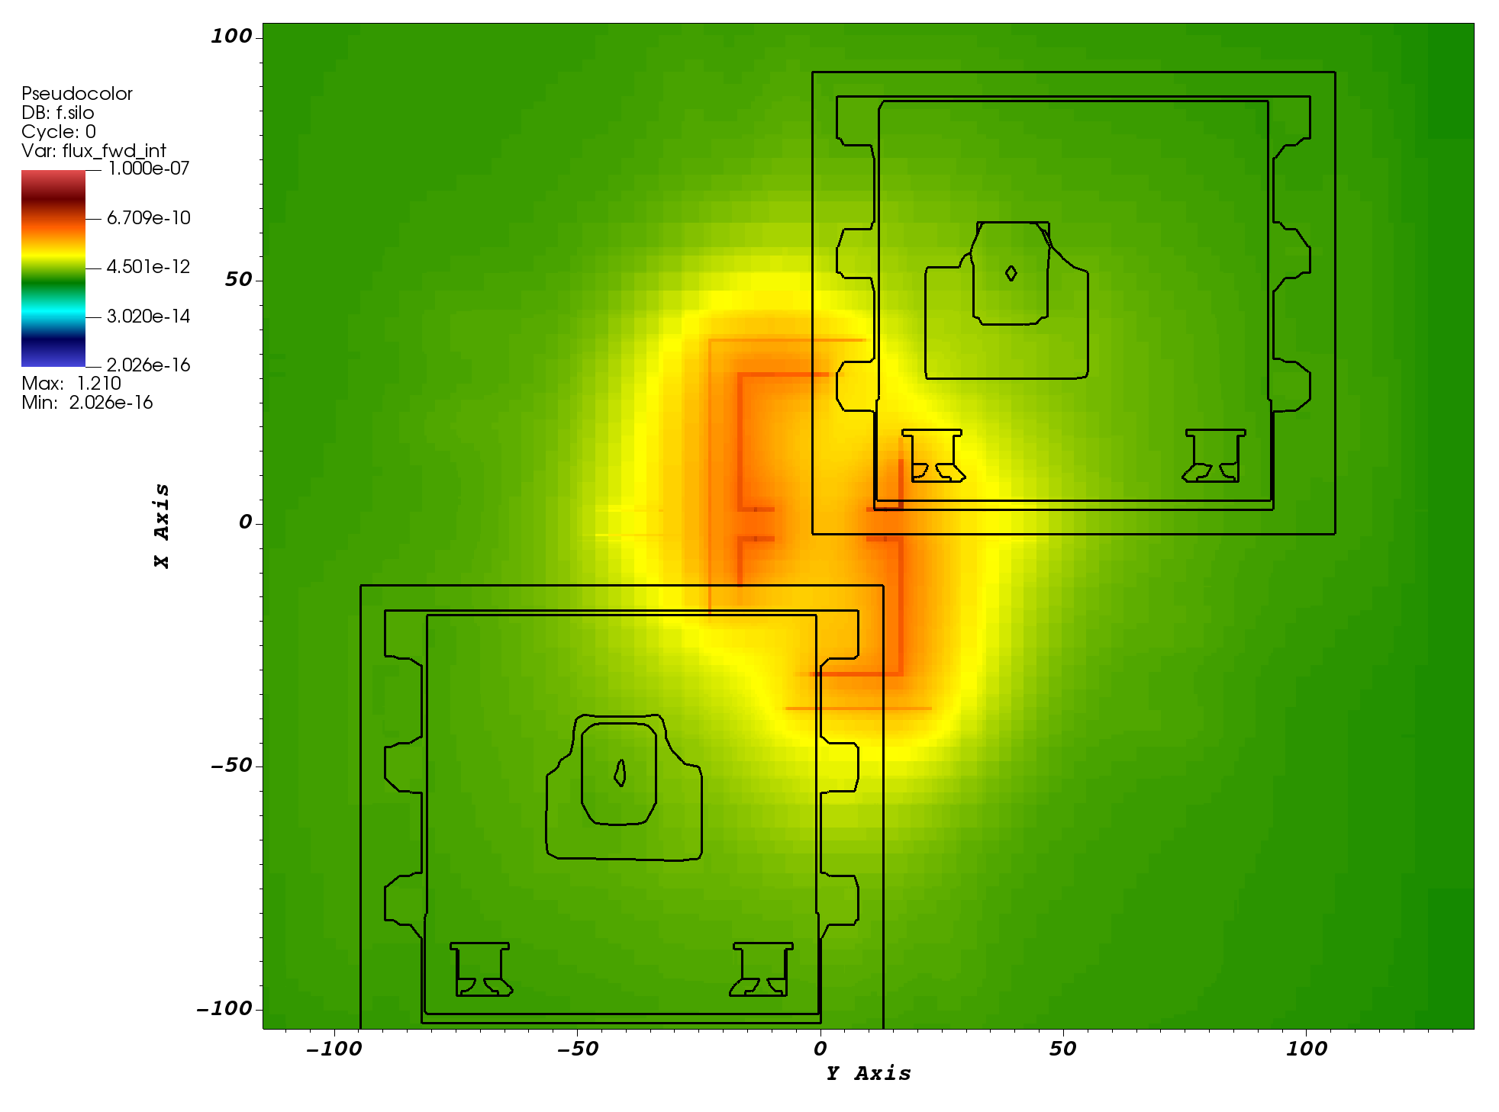
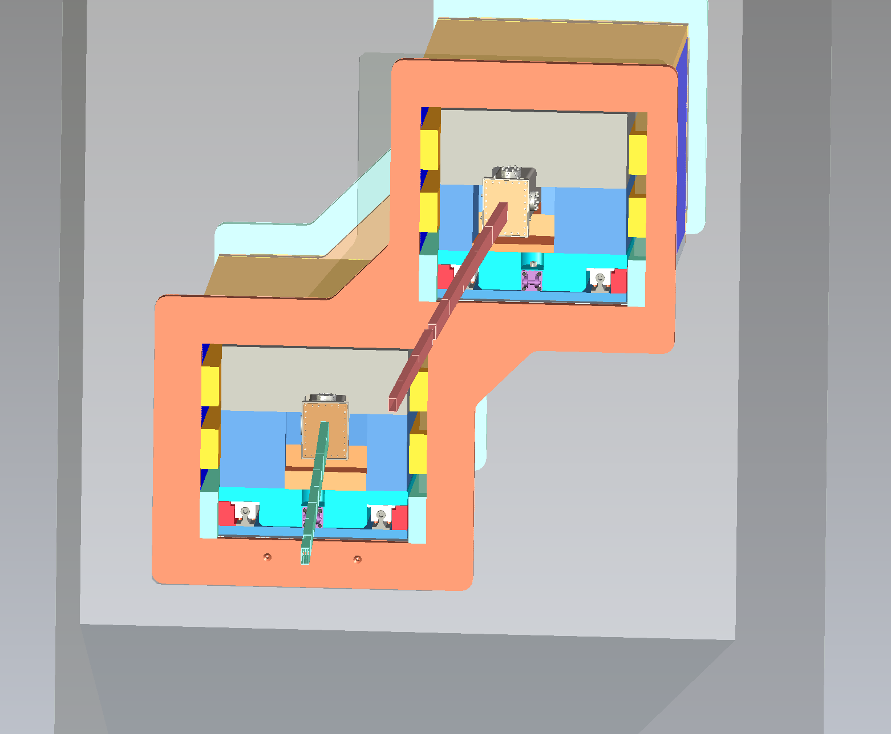
A snapshot of dose profiles on bunker wall
A simple deterministic calculation provides an insight about the potential streaming paths for HE neutrons
Denovo calculation
(deterministic solution)
Neutrons passing through gaps glow on the bunker wall surface
No mirror physics in Denovo →
no reflected neutrons in guide
Bunker pass-thru and its shielding
(view from bunker area)
Neutron dose profiles on bunker wall
(view from bunker area)
No line-of-sight neutrons are shown on bunker wall??

Slide 4
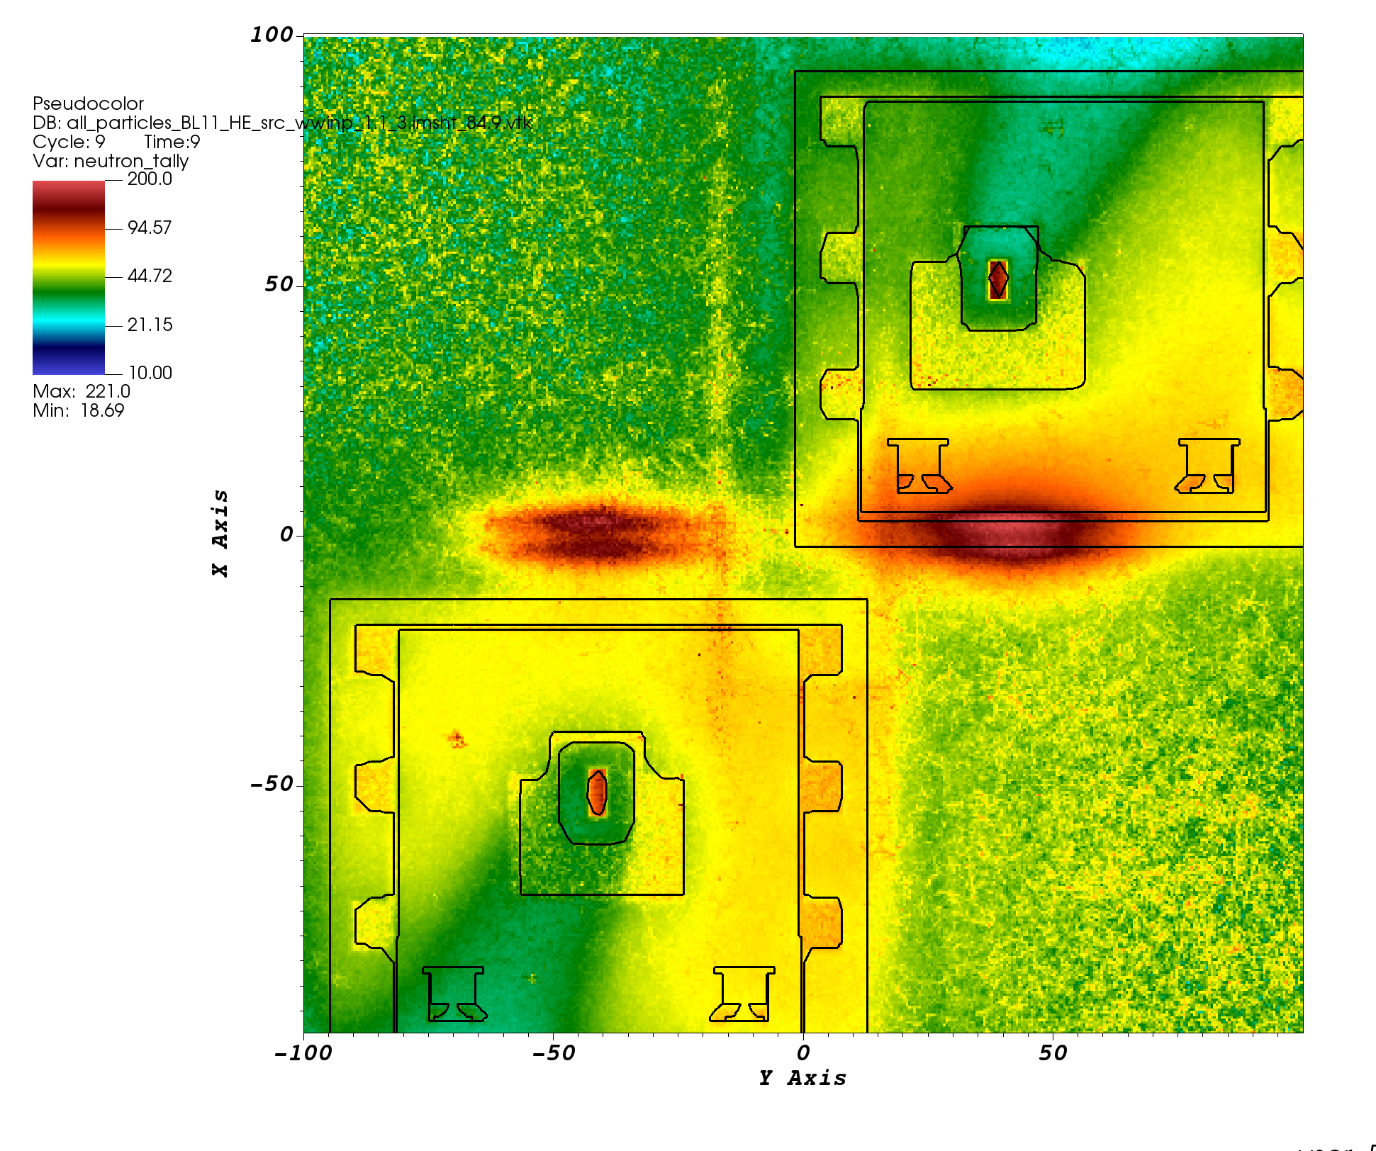
A snapshot of dose profiles on bunker wall
MCNP simulation -- only high-energetic (HE) neutrons (E > 10.67 eV)
neutron dose rates (mrem/h)
These are the HE neutrons which stream
through gaps around/in monolith/optic inserts
No line-of-sight neutrons are shown on bunker wall??
Guide steel shield eliminates the line-of-sight
neutrons ➔
Neutron dose profiles on bunker wall
(view from bunker area)

Slide 5
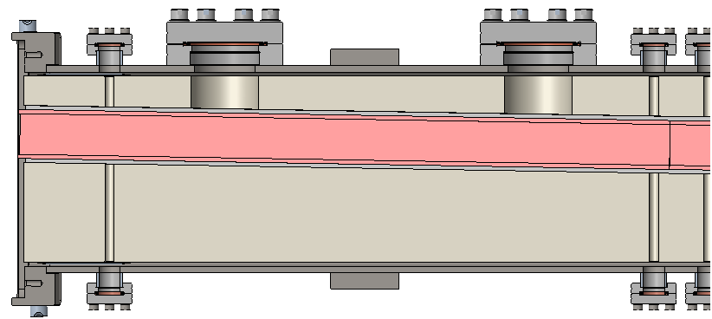
Steel Shielding Around In-Bunker Guides… Needed to Eliminate High Energy Line-of-Sight Neutrons?
Vacuum Housing
Guide Shielding (Steel)
Guide Shielding certainly helps block line-of-sight neutrons, but it would save cost to eliminate that quantity of steel…
Would the bunker wall alone be sufficient to stop the line-of-sight neutrons?
Creo Model
Reflected Neutrons
Guide Shielding (Steel)
Curved Guide
Line-of-Sight Neutrons
Neutrons
Schematic
Vacuum Housing

Slide 6
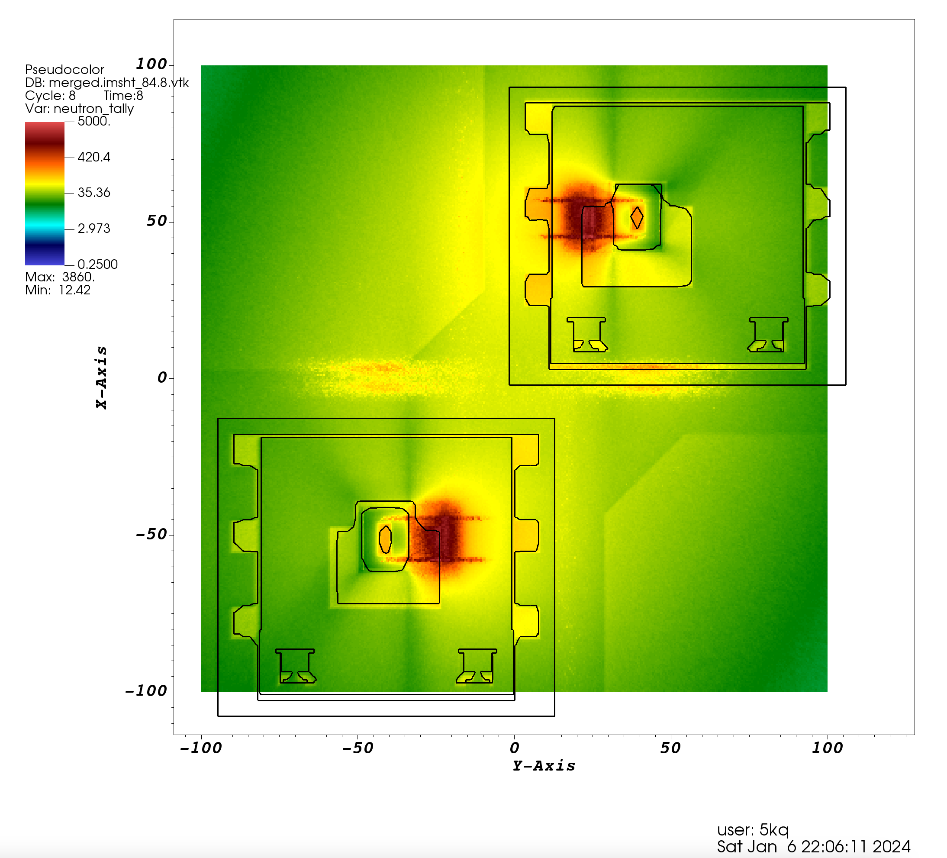
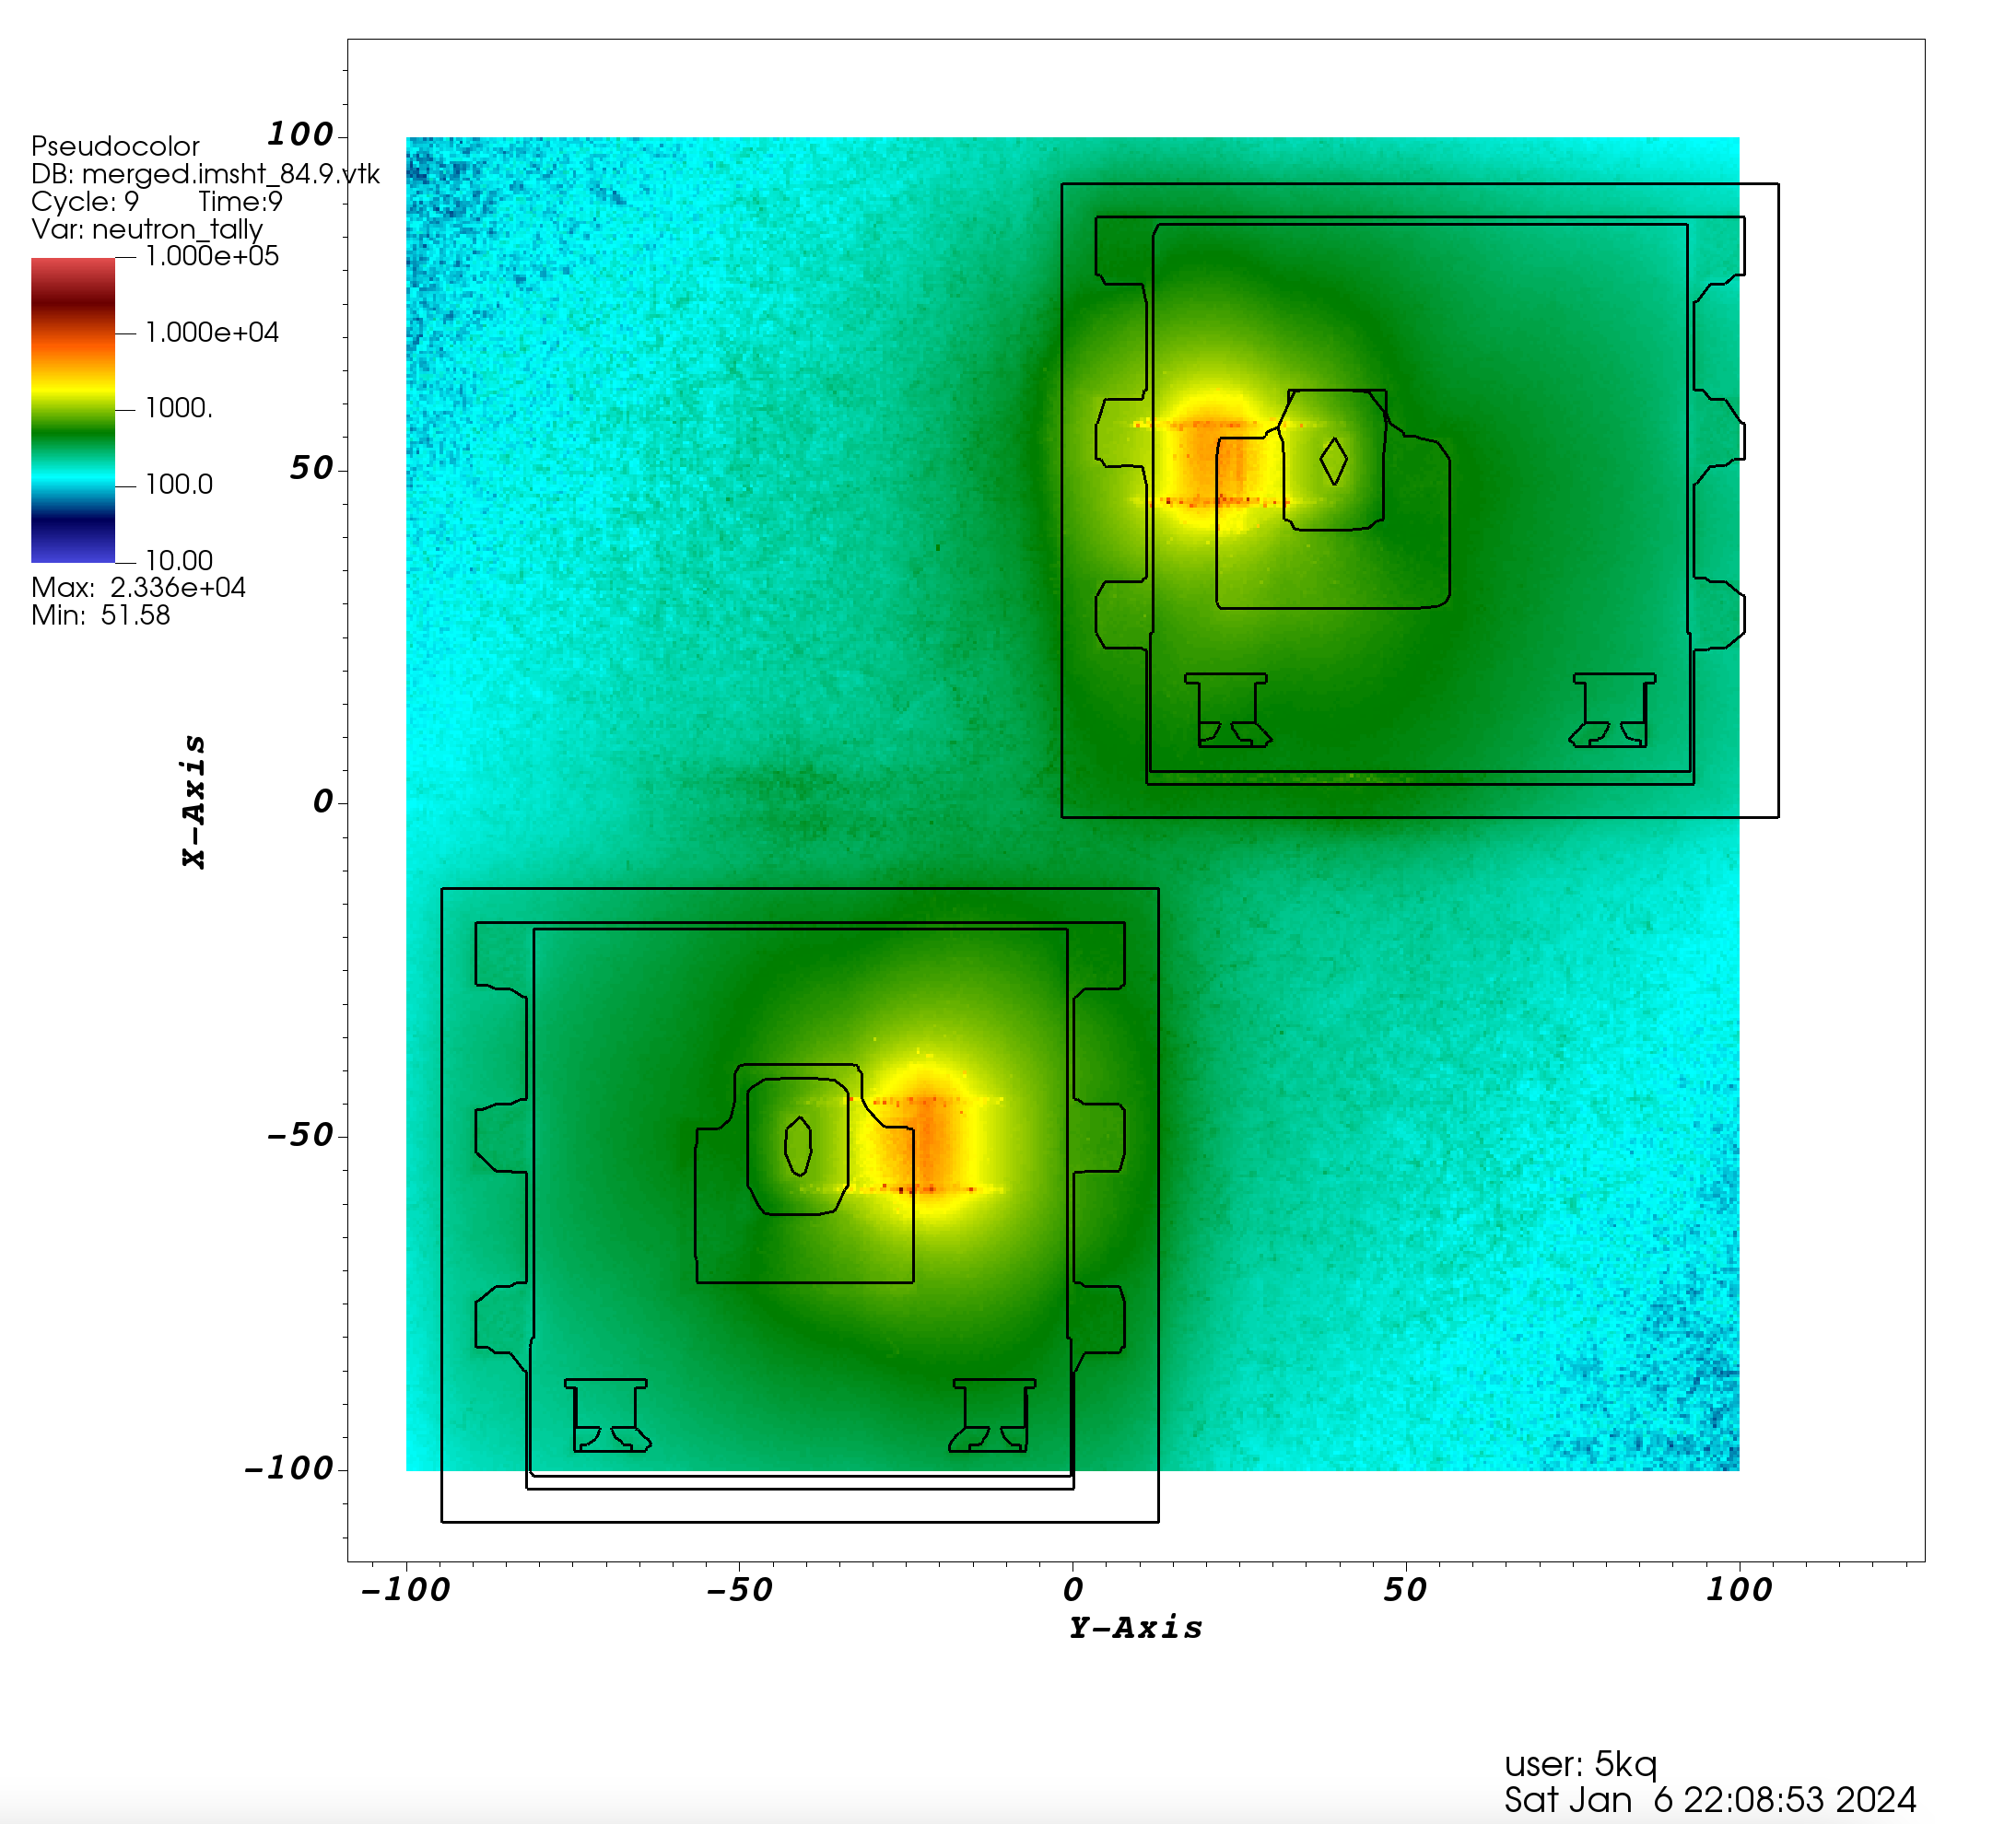
Line-of-sight neutrons appear when we remove the guide steel shield
Repeat calculation by removing steel shield from each guide section (filled with air)
neutron dose rates (mrem/h)
Guide steel removed
Very high energetic neutrons ( > 100 MeV)
All neutrons ( > 10.67 eV)
Bunker wall
Line-of-sight neutrons
Bunker wall

Slide 7
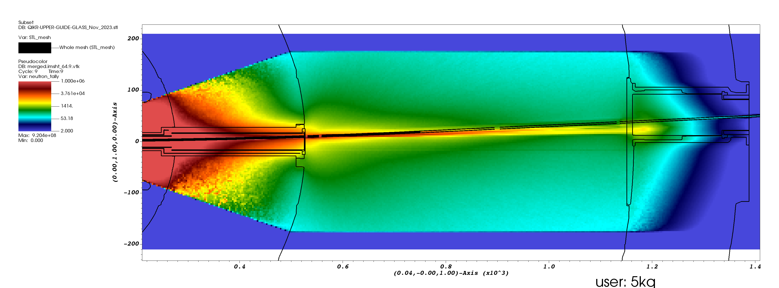
Line-of-sight neutrons appear when we remove the guide steel shield
Line-of-sight neutrons, QIKR-L guide without steel shield
neutron dose rates (mrem/h)
Guide steel removed
Monolith insert
HE neutrons (line-of-sight neutrons)
departing from the beam
Bunker wall
Horizontal cut-view along the QIKR-L guide elevation (plan-view)

Slide 8
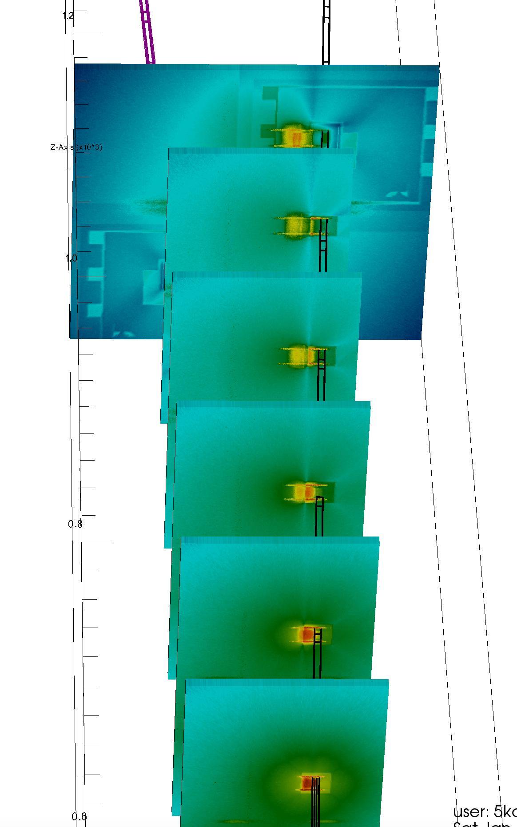
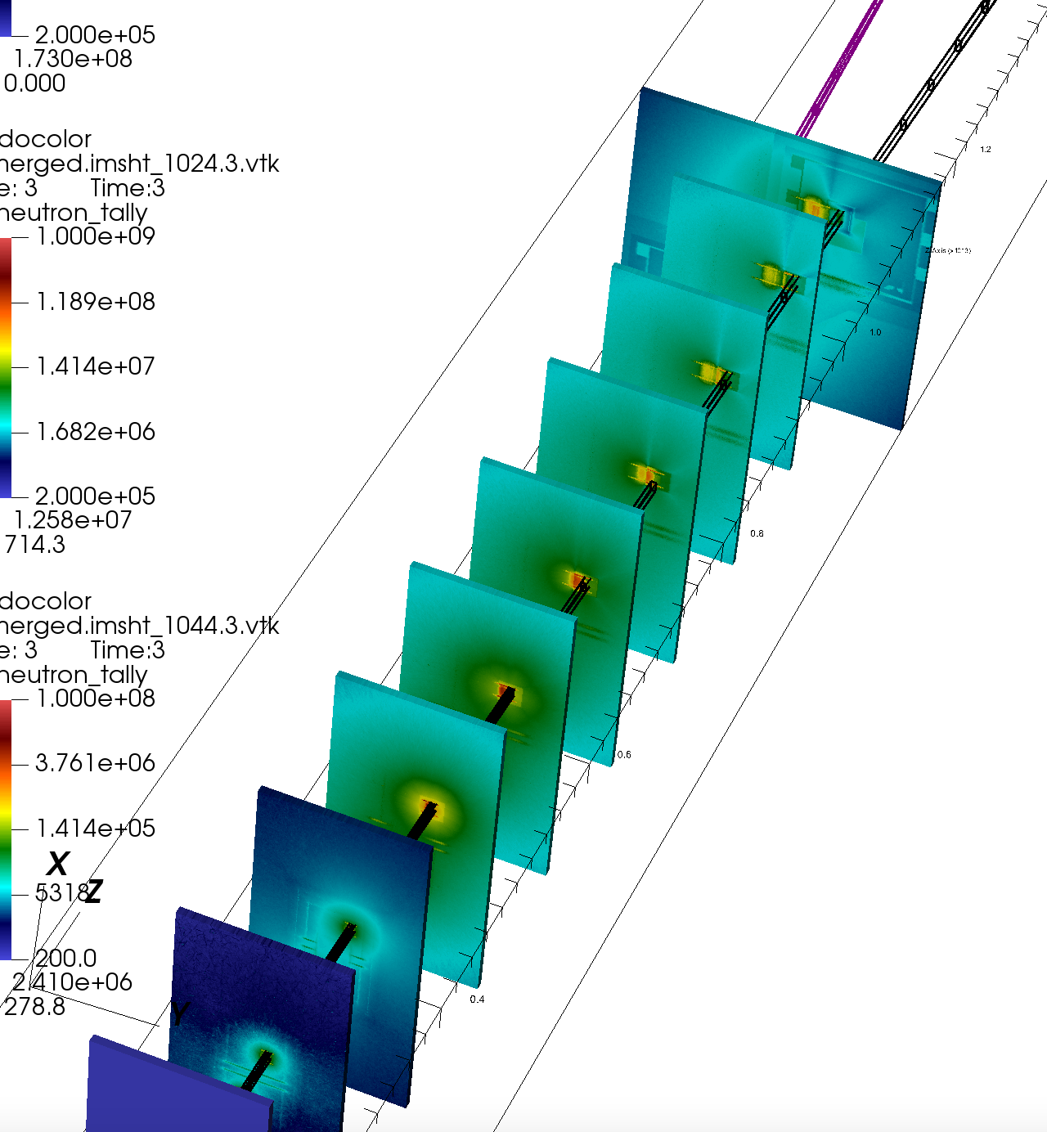
Line-of-sight neutrons appear when we remove the guide steel shield
Bunker wall
neutron dose rates (mrem/h)
Bunker wall
Guide steel removed
Another view of line-of-sight neutrons shown for QIKR-U
Neutron dose profiles at the end of each guide section
(vertical cut-views perpendicular to the beam)

Slide 9
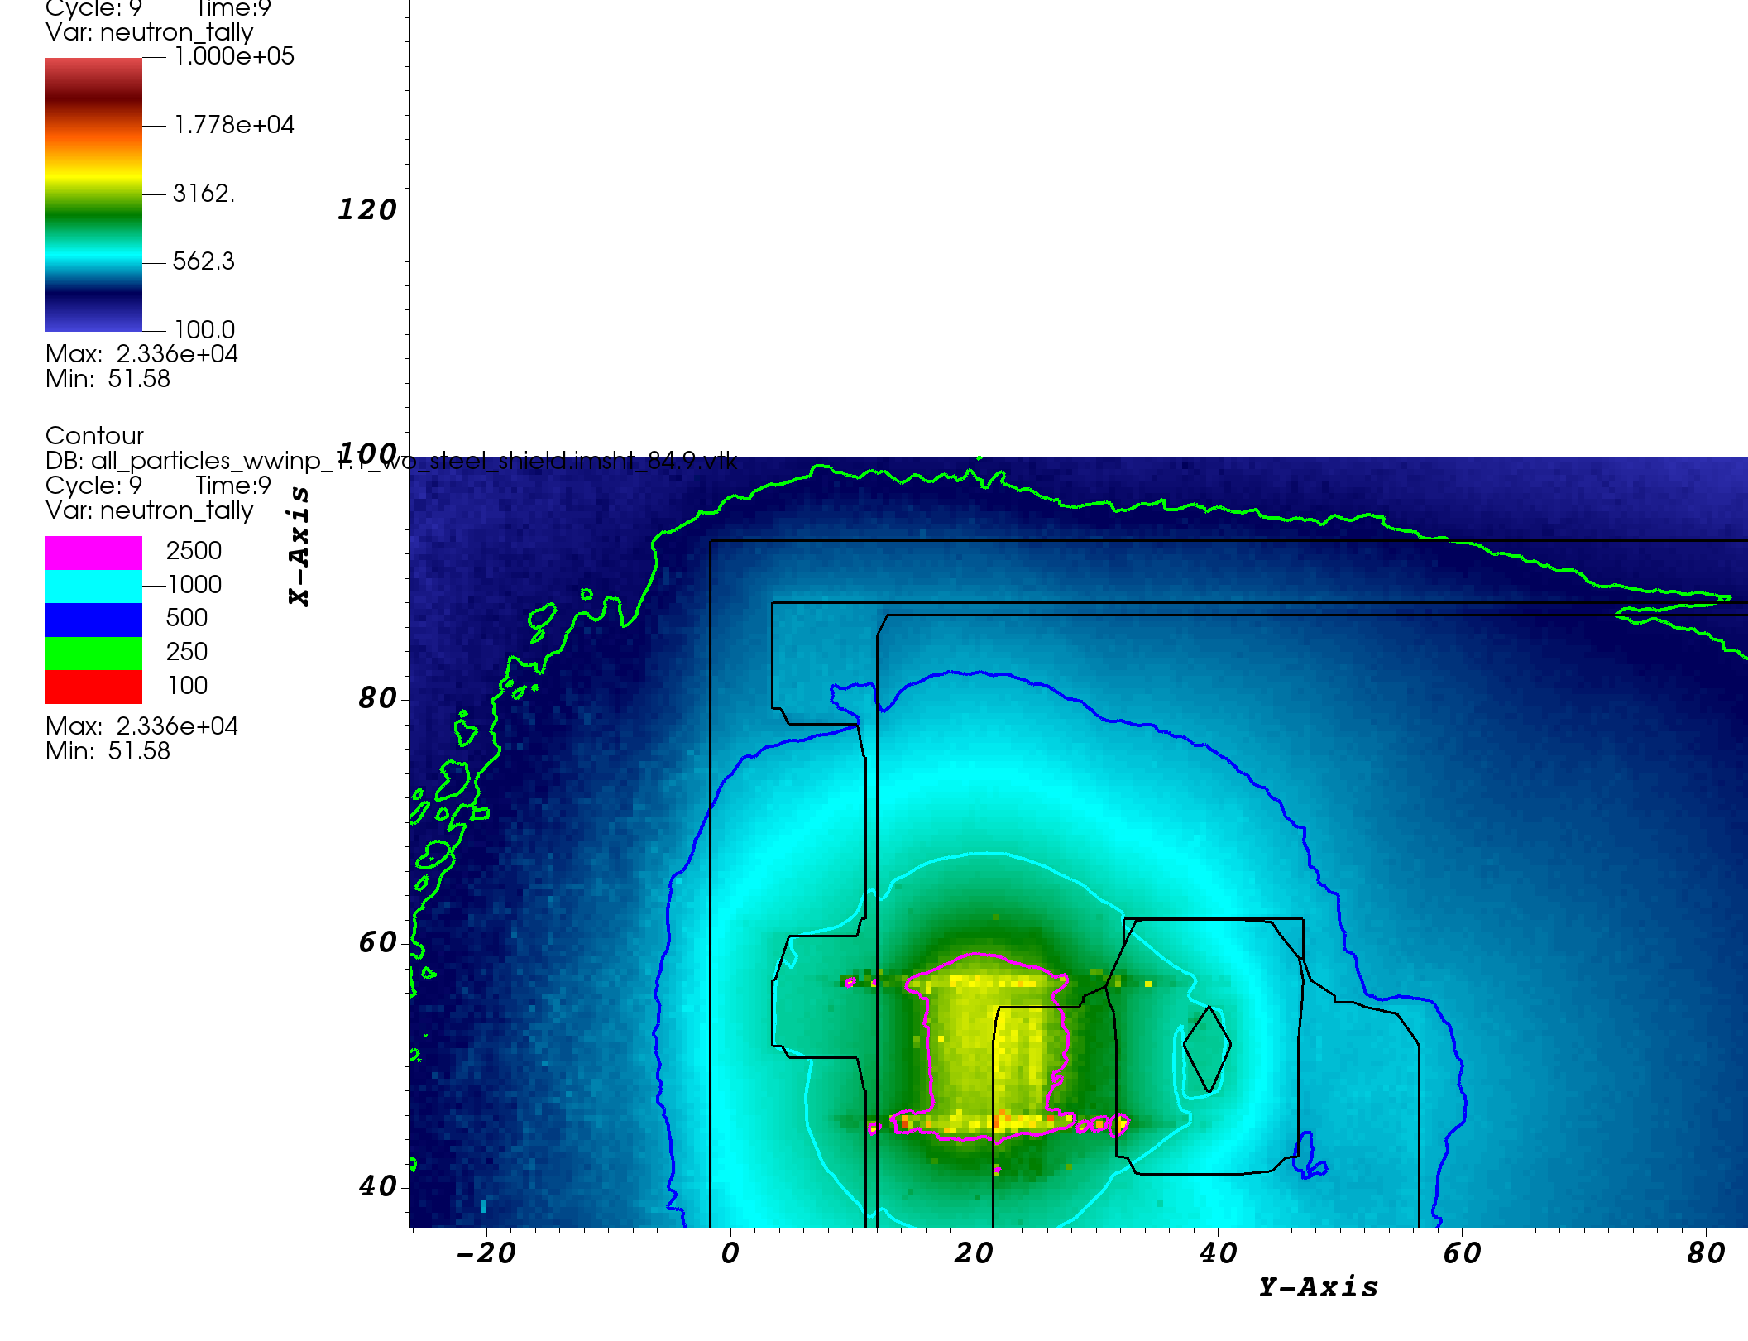
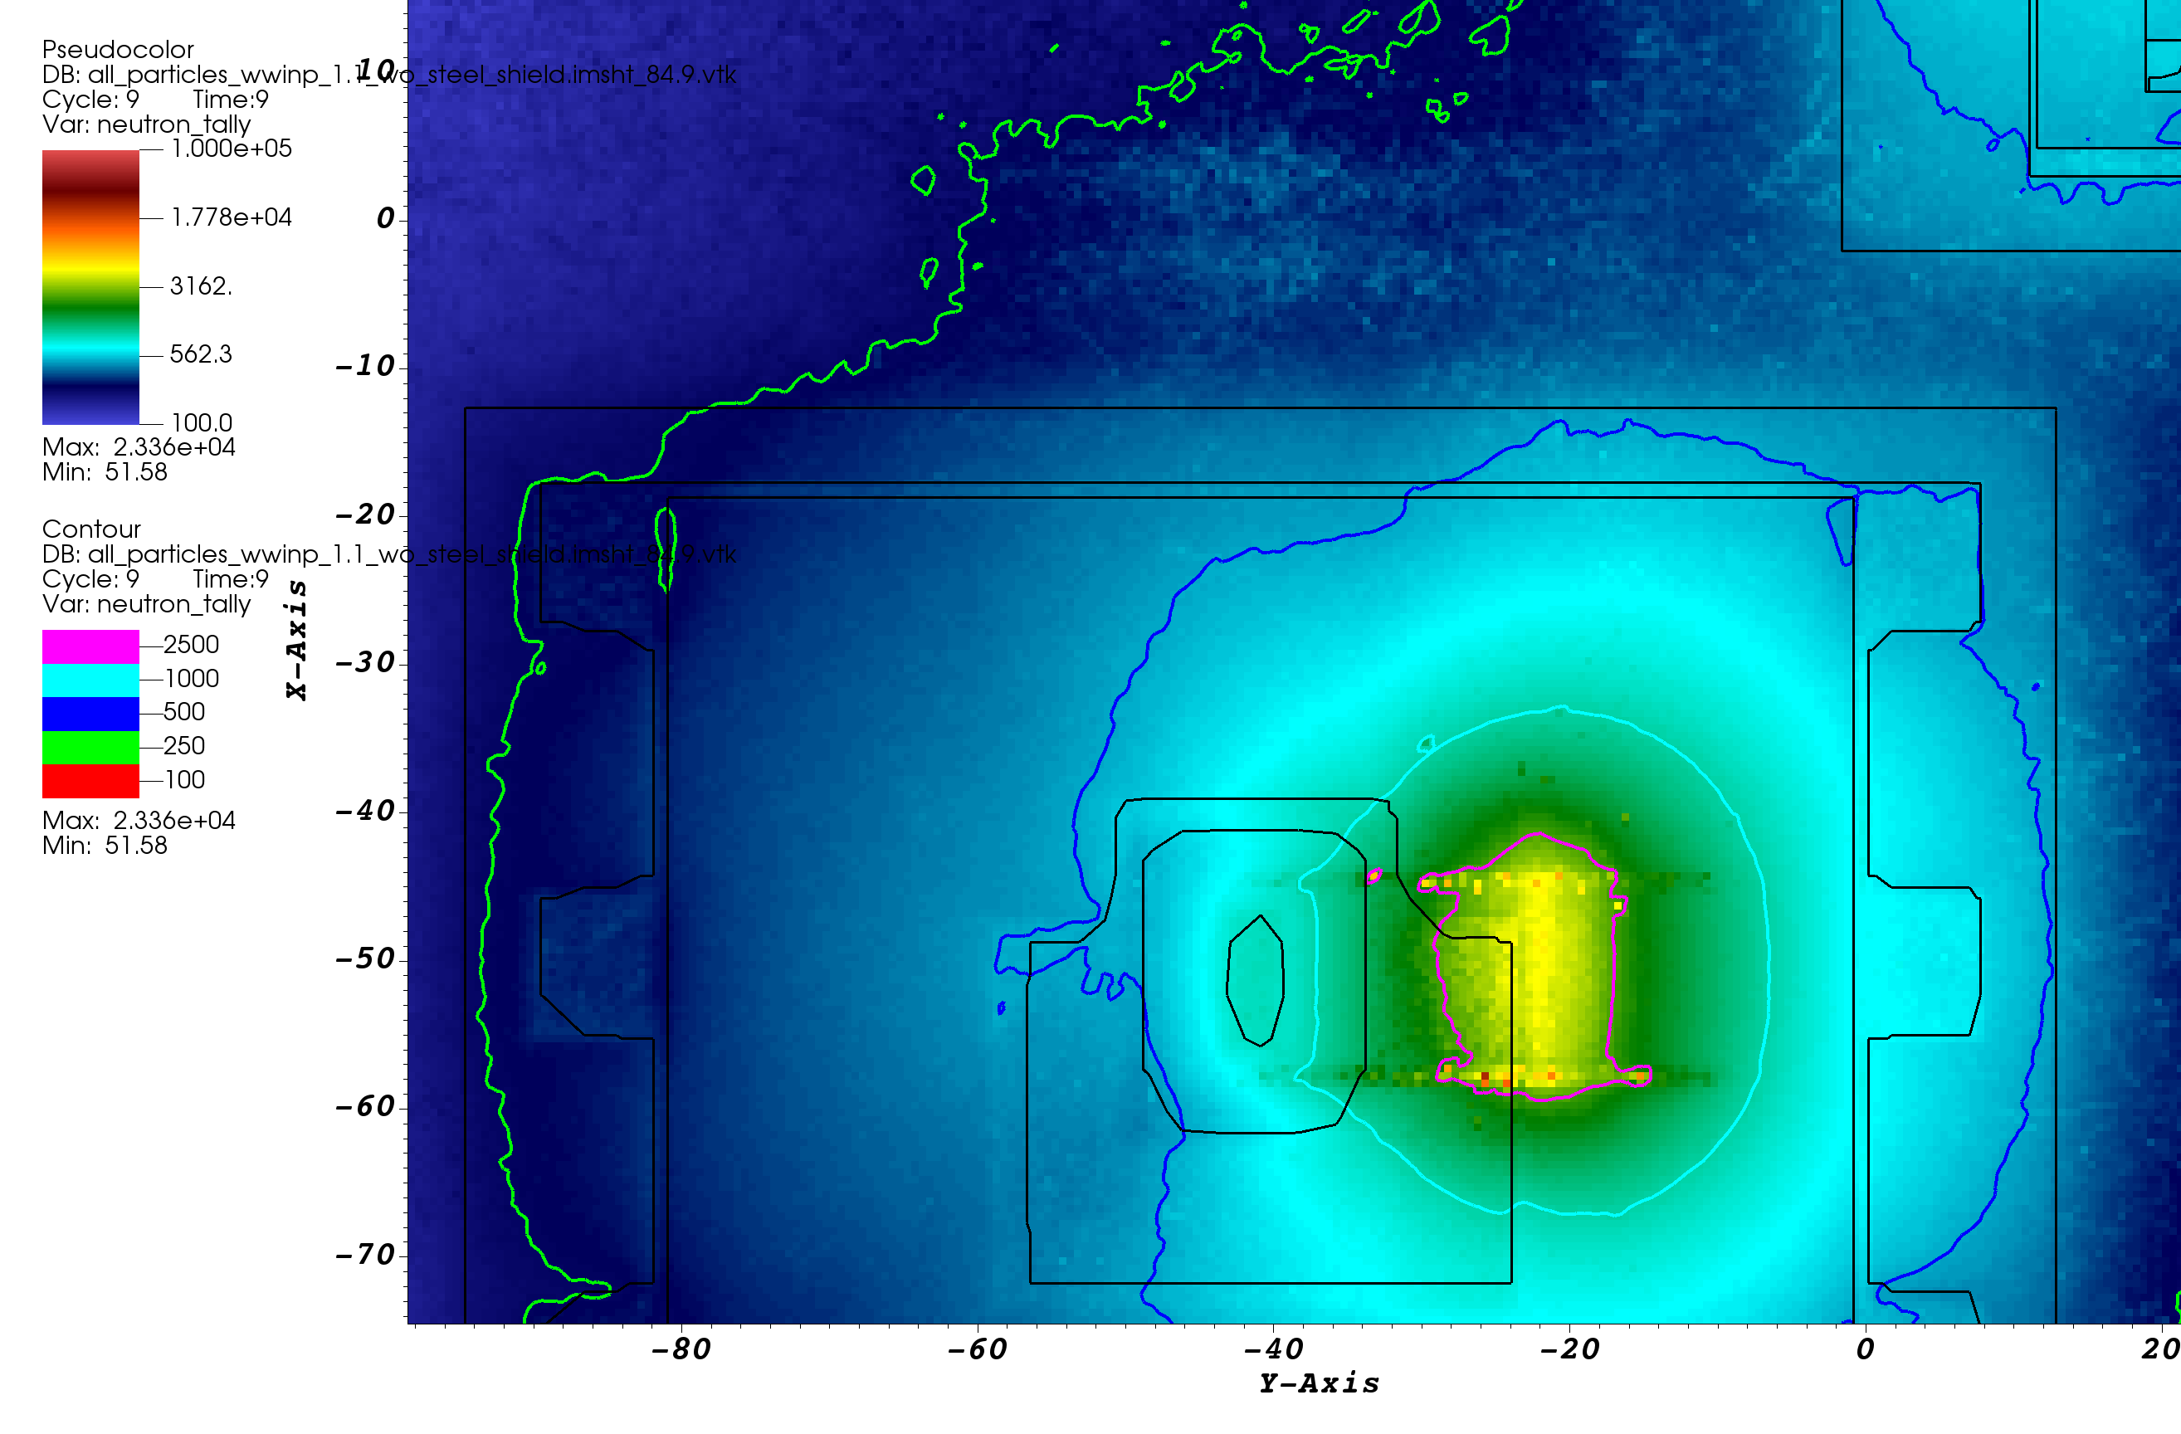
Line-of-sight neutrons appear when we remove the guide steel shield
Guide steel removed
neutron dose rates (mrem/hr)
neutron dose rates (mrem/h)
vertical cut-view at bunker wall (QIKR-U)
(view from bunker area)
vertical cut-view at bunker wall (QIKR-L)
(view from bunker area)
Hot spots are ~ 15-20 cm away from the beam openings
Very high dose rates on bunker wall → how about inside the cave?

Slide 10
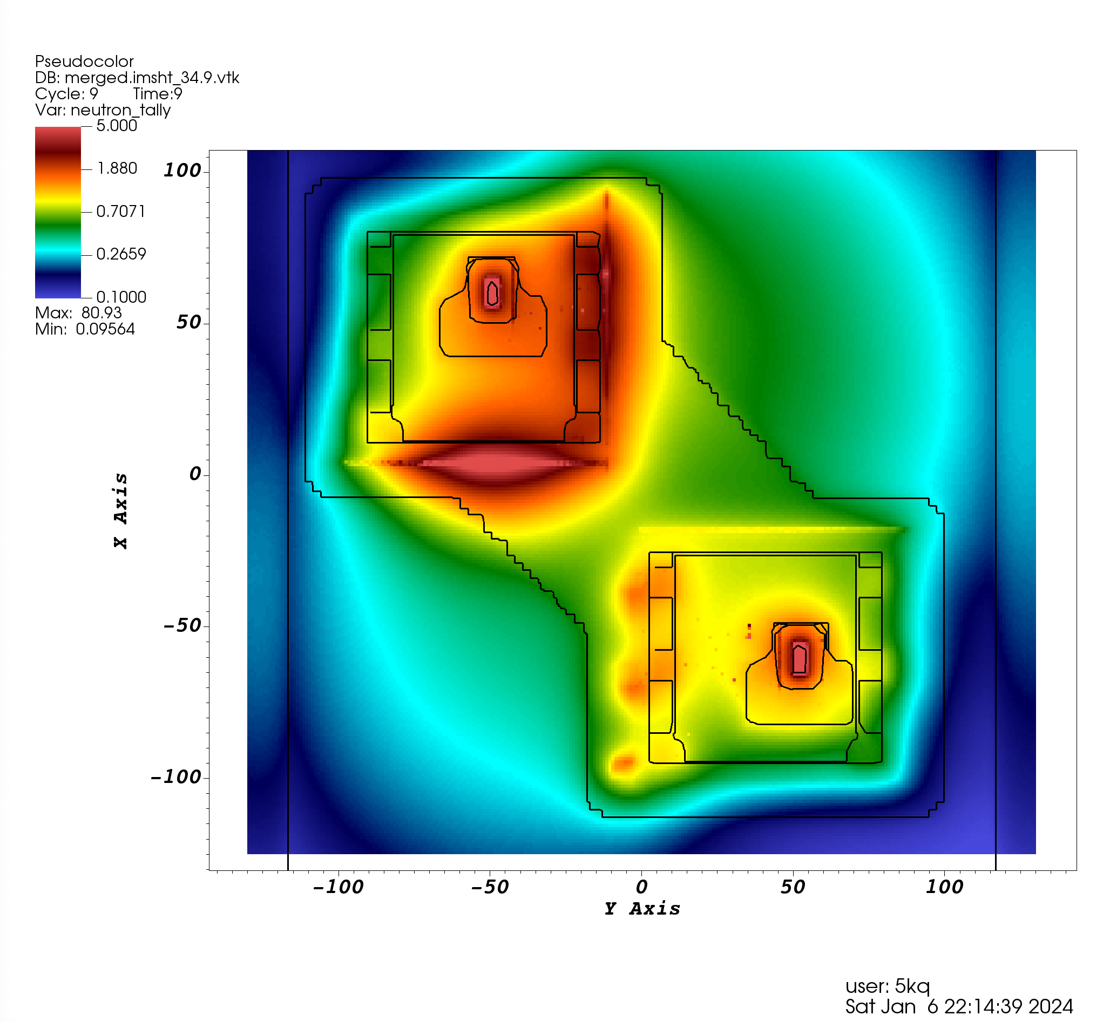
Elevated dose rates inside the cave if there is no guide steel
neutron dose rates (mrem/h)
Very high dose rates inside the cave → no way to remove guide steel shield
QIKR-U
Maximum neutron dose rate at the upstream cave location ~ 80 mrem/h
Guide steel removed
This hot spot is caused by missing grout
under steel
base plate
QIKR-L
vertical cut-view at the exit face of bunker pass-thru
(view from inside the cave)

Slide 11
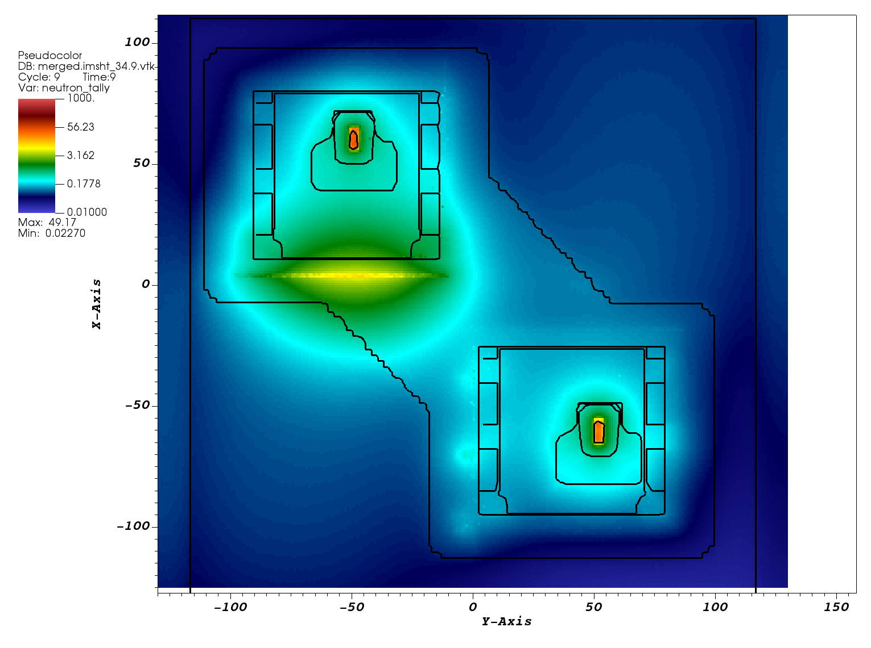
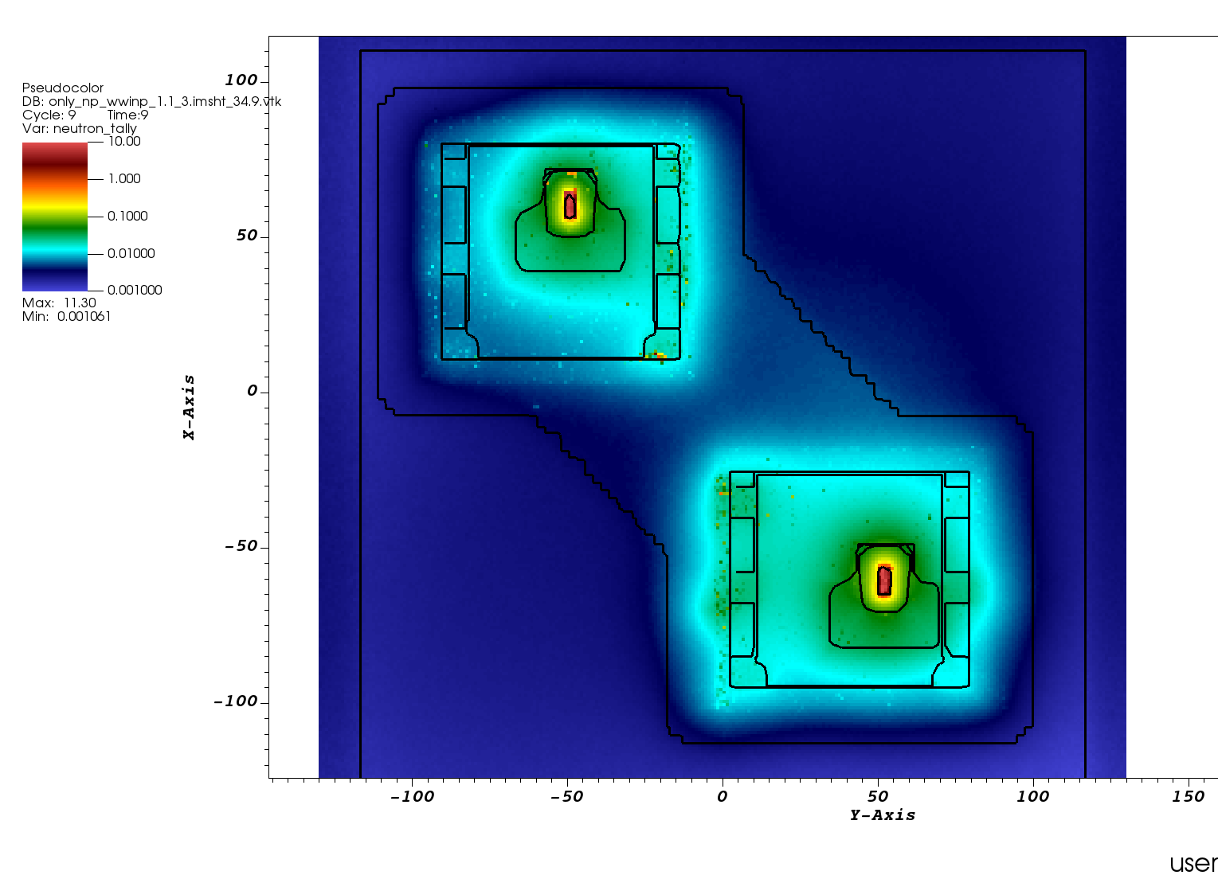
Dose rates reduced significantly when we added back the guide shield
neutron dose rates (mrem/h)
Guides with steel shield
QIKR-U
This hot spot is caused by missing grout
under steel
base plate
After adding grout ➔ the only significant radiation entering the cave is through the guides themselves, not through the bunker wall or pass-thru
Without grout
With grout
vertical cut-view at the exit face of bunker pass-thru (view from inside the cave)

Slide 12
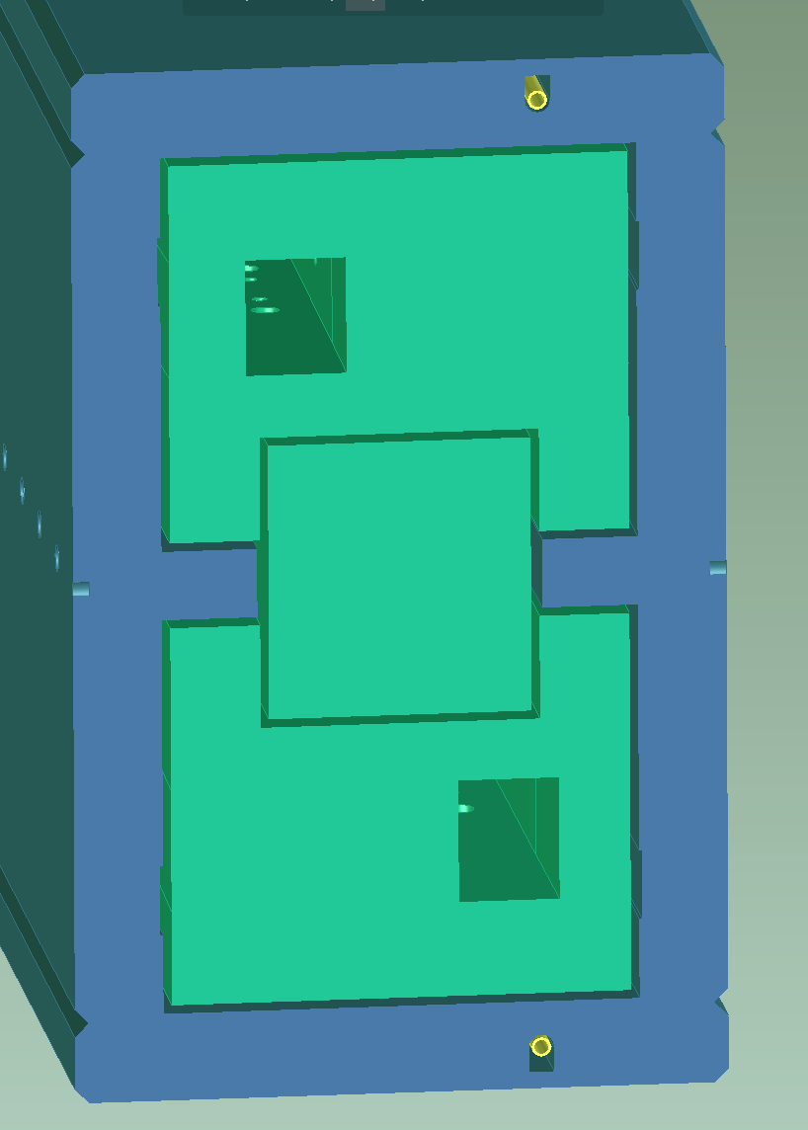
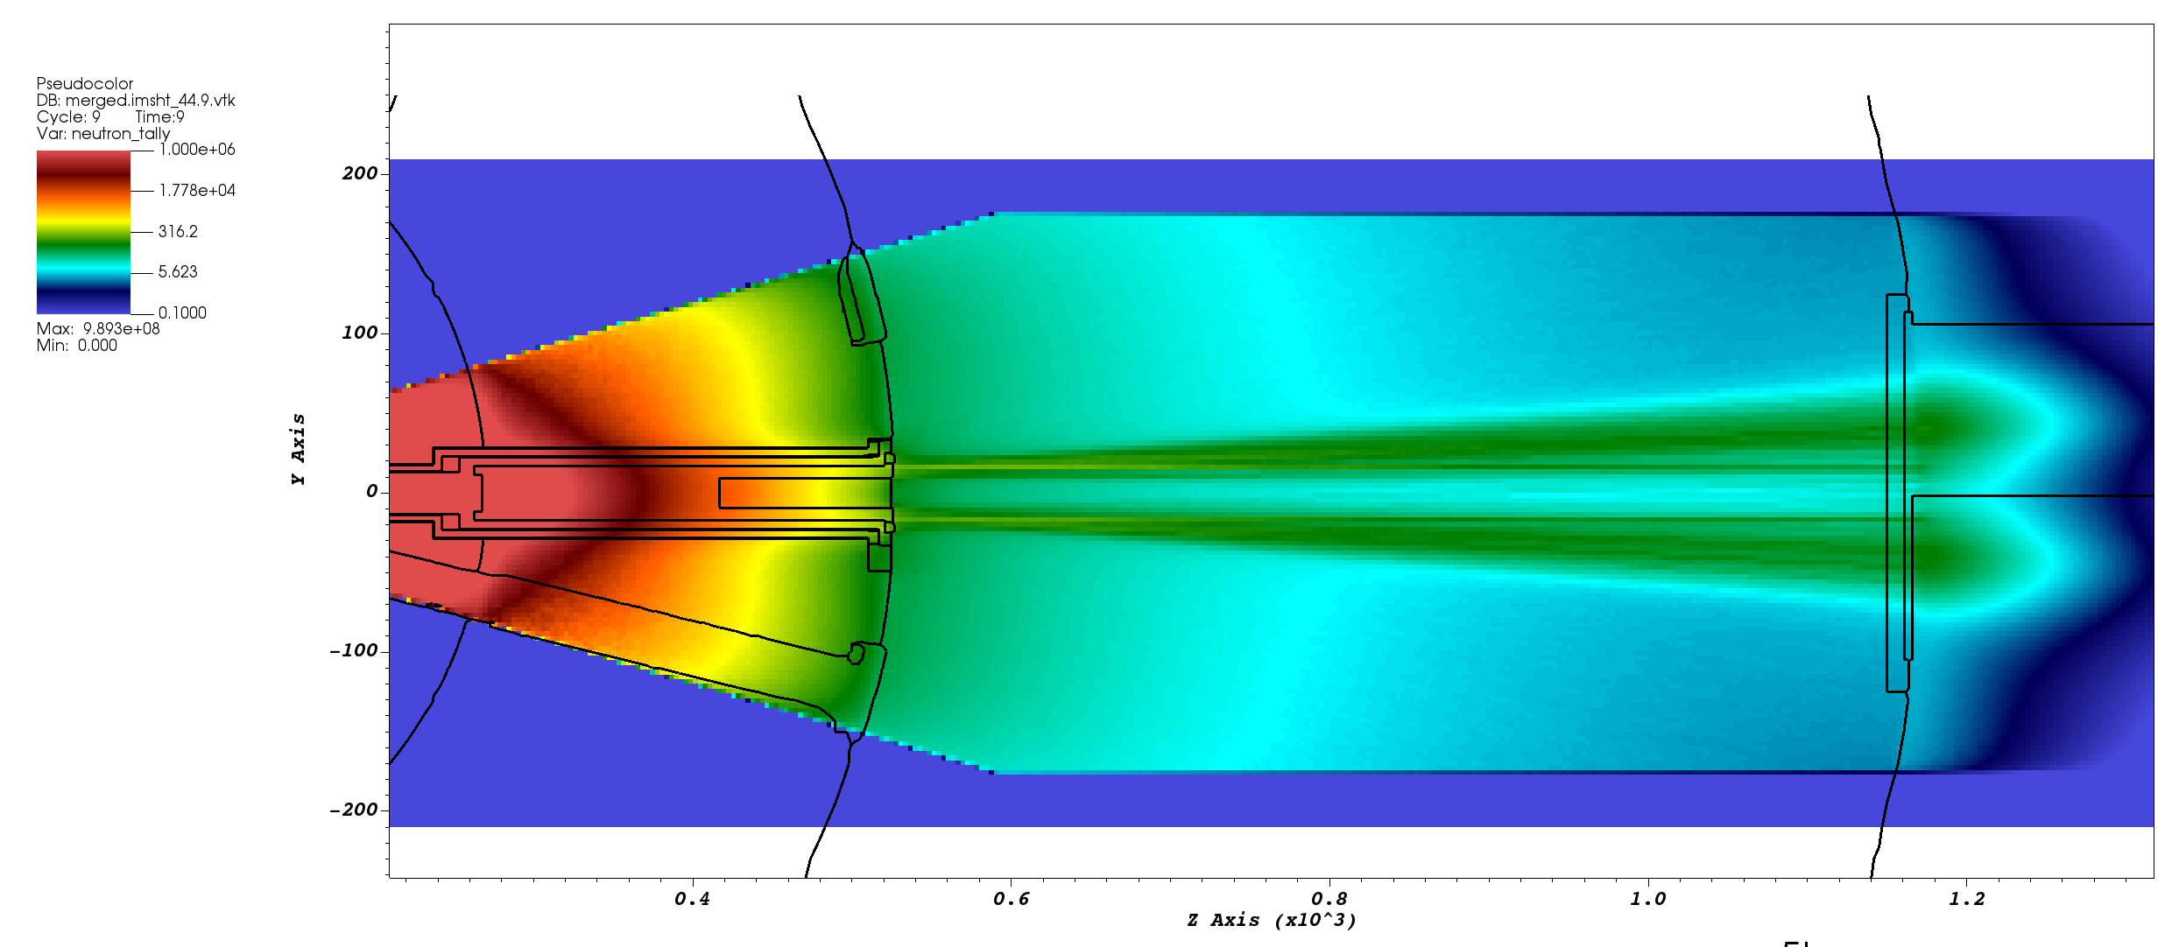
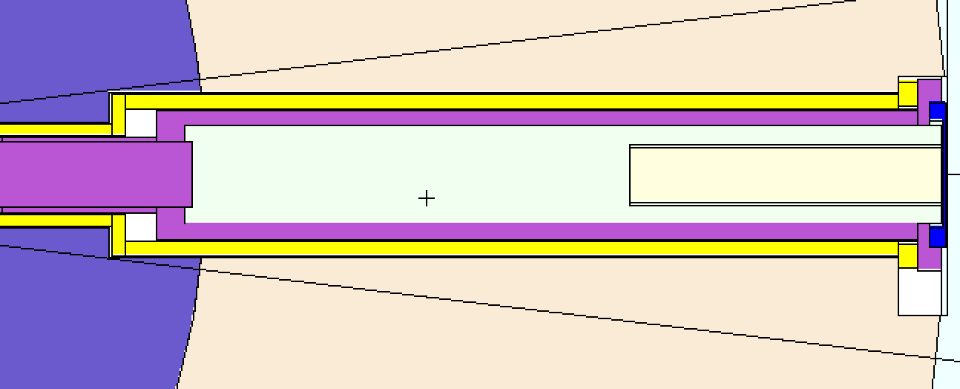
Identify streaming paths in/around the monolith and optic inserts
Guides were removed from the MCNP model when identifying streaming paths and their impact
Upper optic insert
This is the largest gap, neutrons streaming through this gap glow on the bunker wall
Gap between upper
optic insert and shelf
high-energetic (HE) neutrons (E > 10 MeV)
shelf
Anti streaming block
Bunker
wall
Lower optic insert
monolith
Gap filled with He
horizontal cut-view 2.5 cm above from the moderator elevation
Plan-view, monolith and optic inserts
horizontal cut-view 2.5 cm above from the moderator elevation

Slide 13
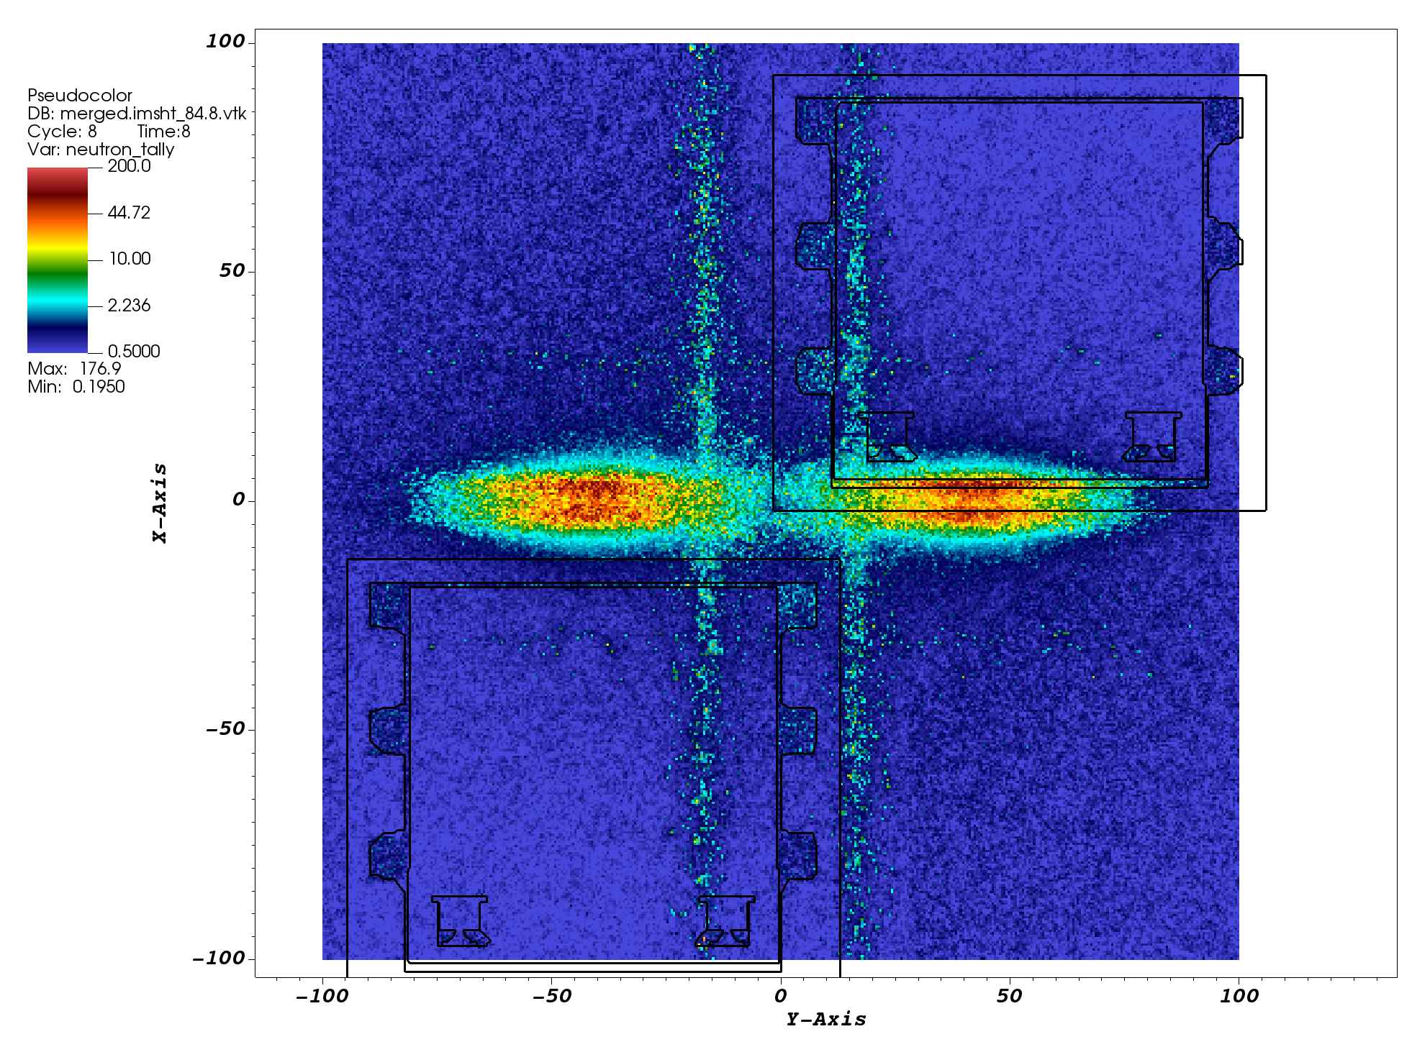
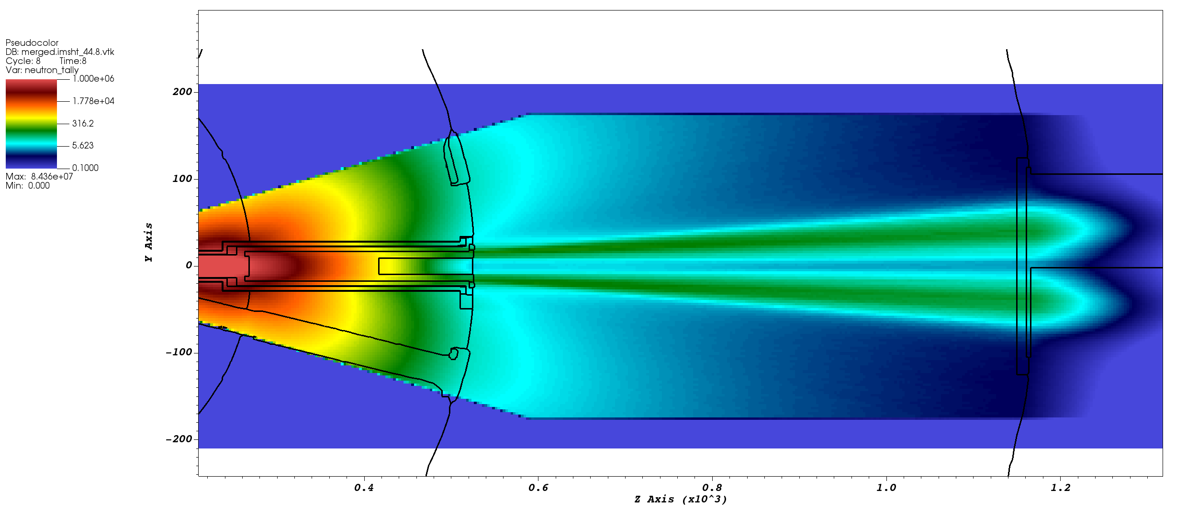
Identify streaming paths in/around the monolith and optic inserts
Guides were removed from the MCNP model when identifying streaming paths and their impact
neutron dose rates (mrem/h)
Problem:
Inner cable cavities line up with one of the gap in/around optic insert ➔ remove the cavities/reduce their size
high-energetic (HE) neutrons (E > 10 MeV)
high-energetic (HE) neutrons (E > 10 MeV)
Bunker
wall
monolith
Problem: Hot spot coincides with a gap under steel base plate of QIKR-U bunker pass—thru ➔
Filling this gap with grout
mitigate the potential issue in the cave area (see slide 11)
horizontal cut-view 2.5 cm above from the moderator elevation
Neutron dose profiles on bunker wall
(view from bunker area)

Slide 14
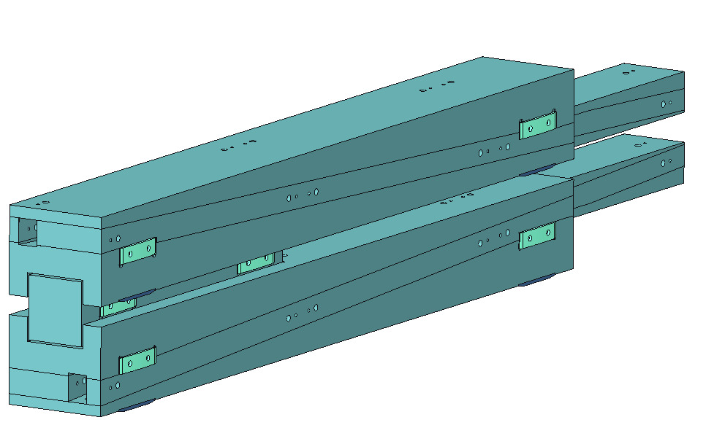
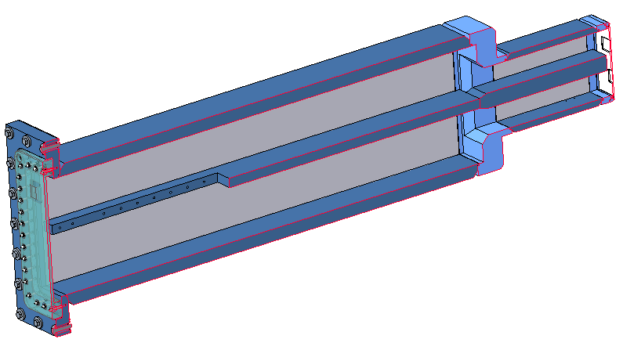
Optics Insert Anti-Streaming Block… Needed?
Monolith Insert
Lower optics insert
Upper optics insert
Very small chicane (9mm)
Shelf to separate upper and lower optics inserts
Cutout for anti-streaming block
Anti-streaming block
The monolith insert has a center shelf to allow the lower and upper optics inserts to be separate from each other (the shelf provides a surface for the upper optics insert to roll along when being installed)
Combined optics inserts was originally thought to be too heavy for the bunker’s optics insert handler to manage (it has since been determined that the handler can lift a combined optics insert)
There is only room for a very small chicane between the monolith shelf and optics insert… may not be enough to prevent streaming between the shelf and optics inserts?
The center shelf has a downstream cutout to allow for an anti-streaming block, but must leave some shelf material on the sides for the upper optics insert to roll on when being installed

Slide 15
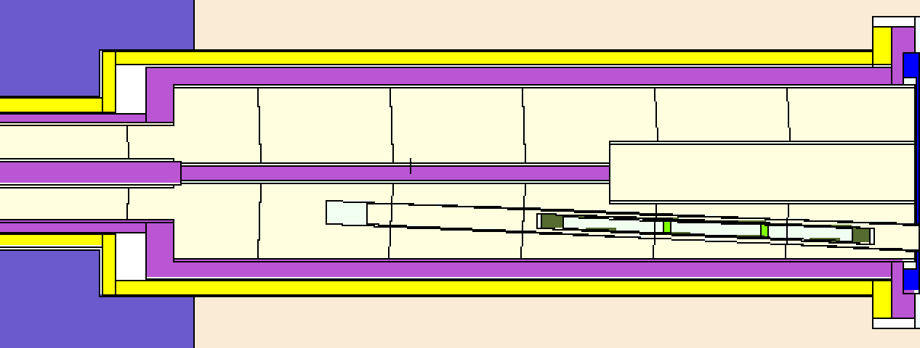
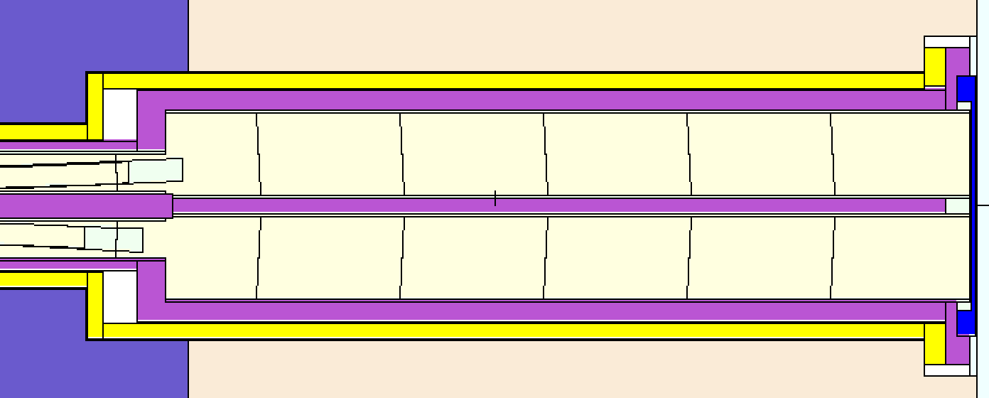
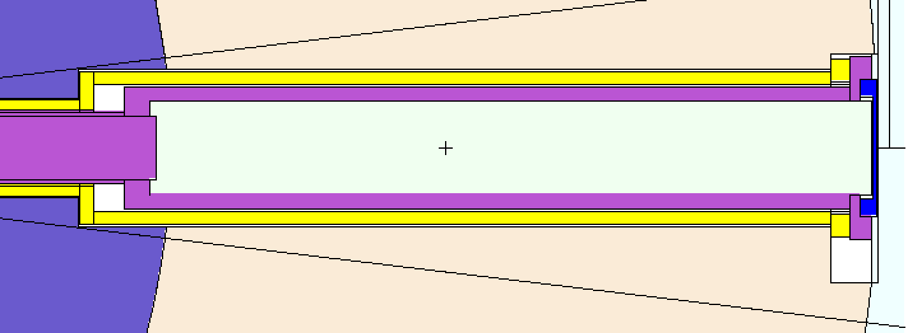
What-if the anti-streaming block is removed?
Removing anti-streaming block enlarge the gap width at the monolith insert exit face…
vertical cut-view along QIKR Z-axis
Anti-streaming block
NO anti-streaming block
Gap filled with He
Gap filled with He
horizontal cut-view 2.5 cm above from the moderator elevation
Enlarged gap

Slide 16
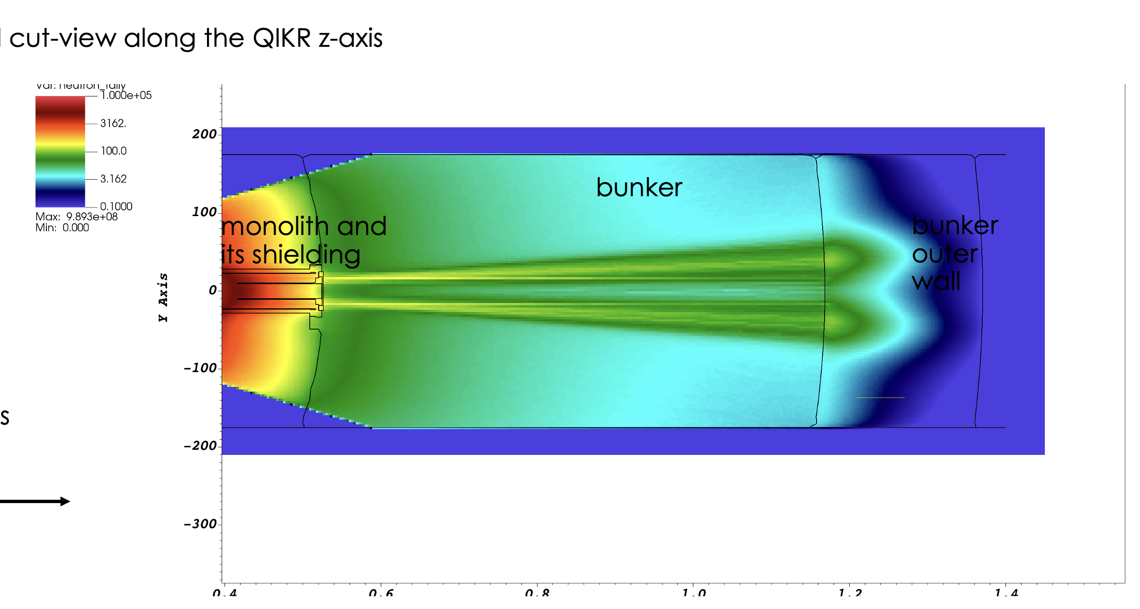
What-if anti-streaming block is removed
no anti-streaming block
with anti-streaming block
Horizontal cut-view at moderator elevation
Horizontal cut-view at moderator elevation
no anti-streaming block
No anti-streaming block → strong streaming
through the gaps between shelf and optic inserts
anti-streaming block is needed, keep it in the design
Vertical cut-view along QIKR-Z axis

Slide 17
Guide Taper Within the Optics Insert… Insert Should Follow?
72.4mm upper & lower, entrance height
88.2mm upper exit, 93.9mm lower exit heights
The height of each QIKR guide continually increases as it progresses through the optics inserts
Is the height change large enough to need the optics insert channels to taper along with the guides, or can the channels be machined with uniform height (still would maintain the 2.5 incline)
Removing the height taper in the optics inserts could simplify machining

Slide 18
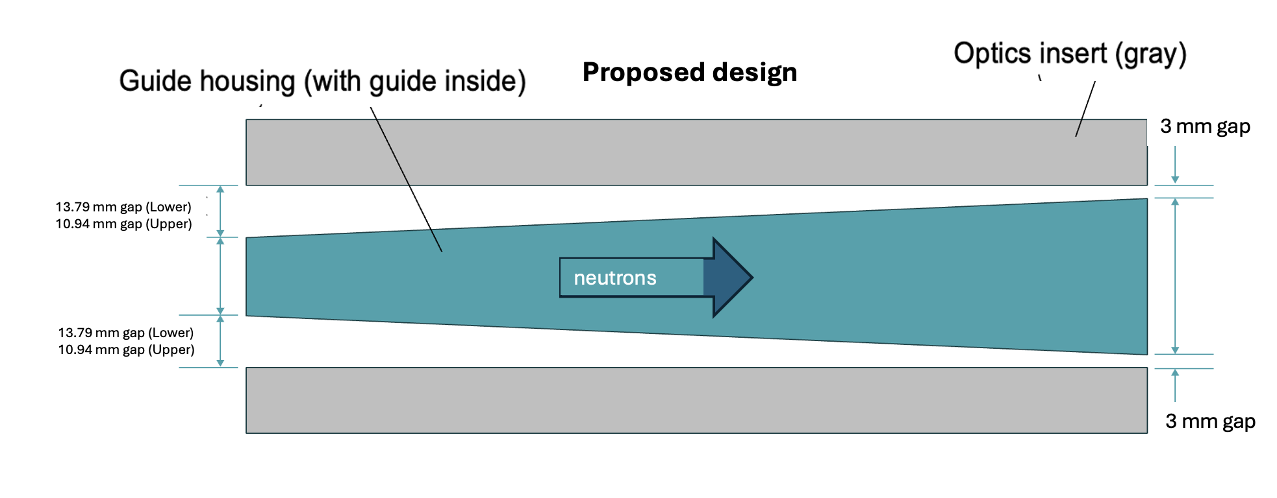
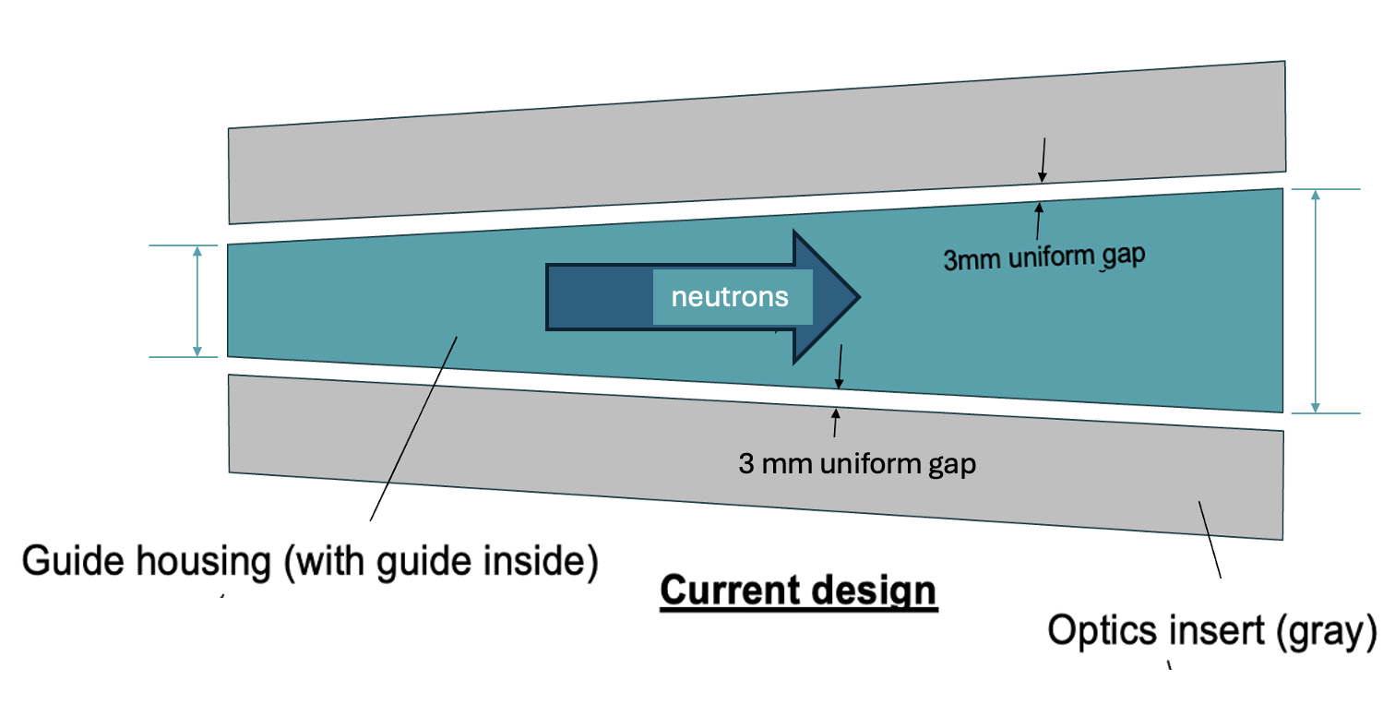
What-if the height taper in the optics inserts is removed
Question: Can we use variable gap between optic inserts and guide?
Evaluate the impact of variable gap between guide housing and optic inserts

Slide 19
What-if the height taper in the optics inserts is removed
Uniform 3mm-thick gap
Variable gap
Slightly elevated dose rates in cave (through inner cable cavities)
Horizontal cut-view at the moderator elevation
Horizontal cut-view at the moderator elevation
Vertical cut-view at the QIKR-Z axis
Vertical cut-view at the QIKR-Z axis

Slide 20
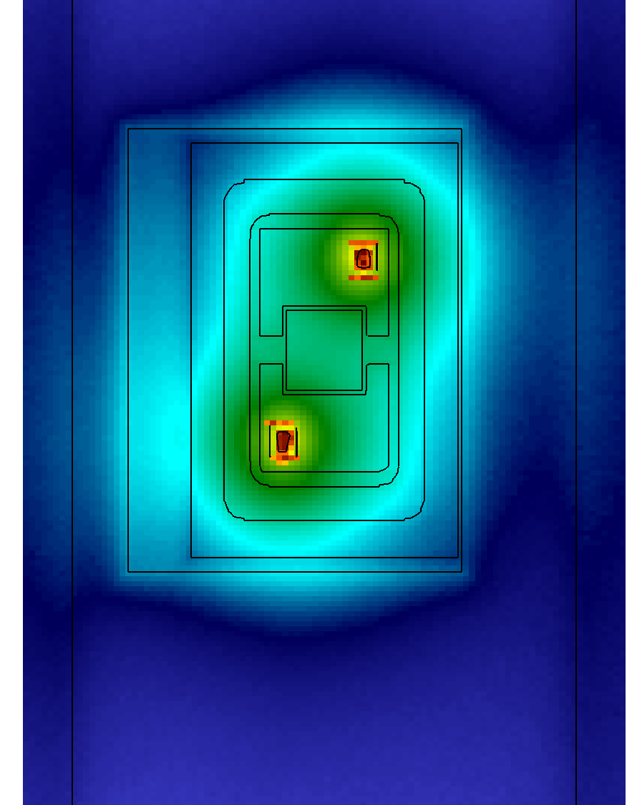
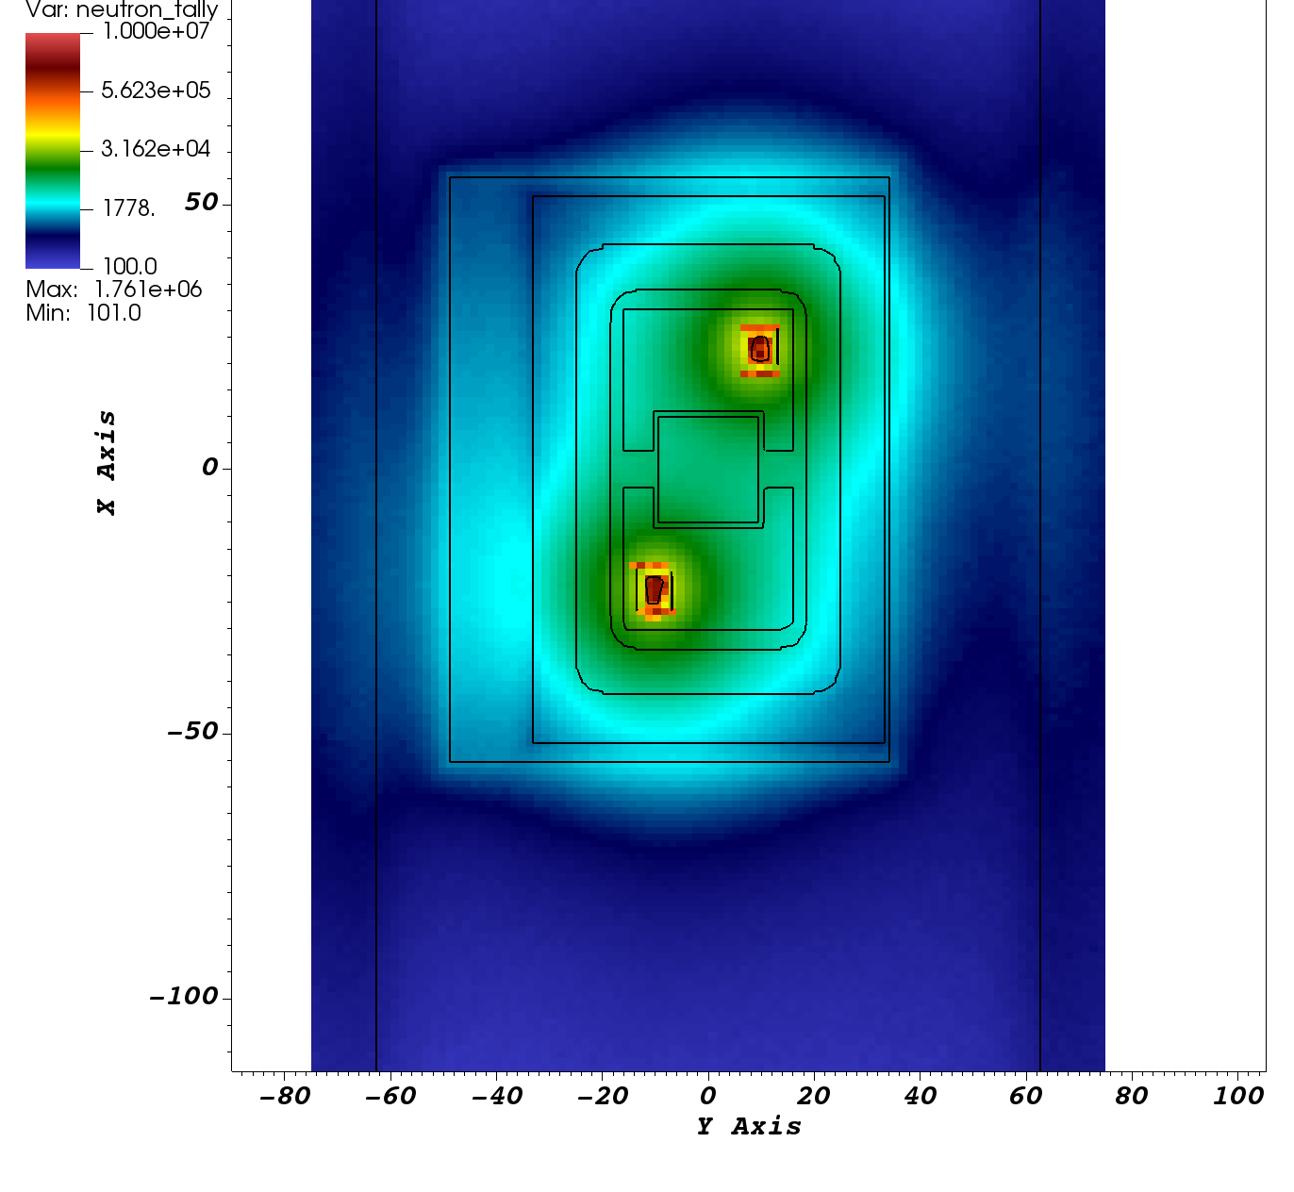
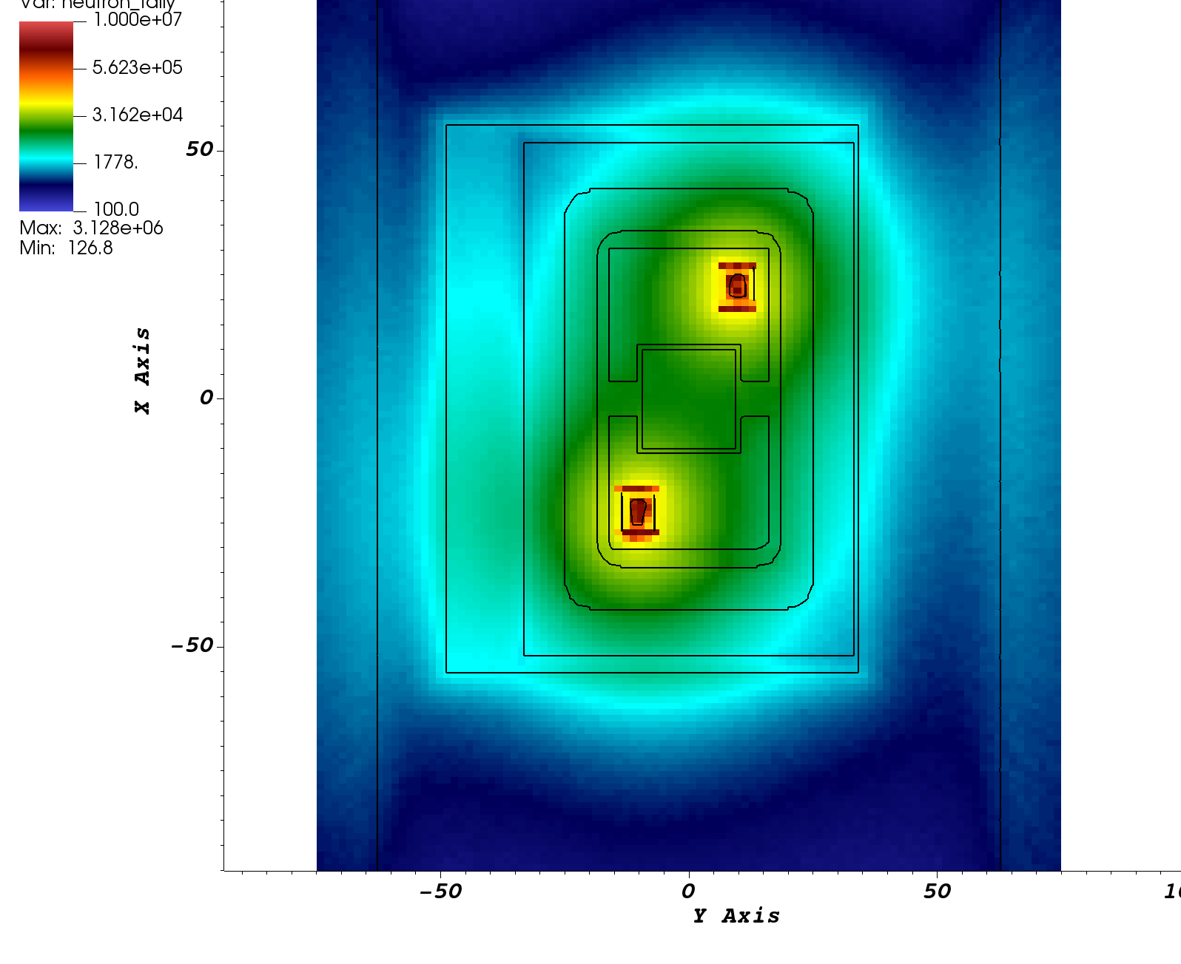
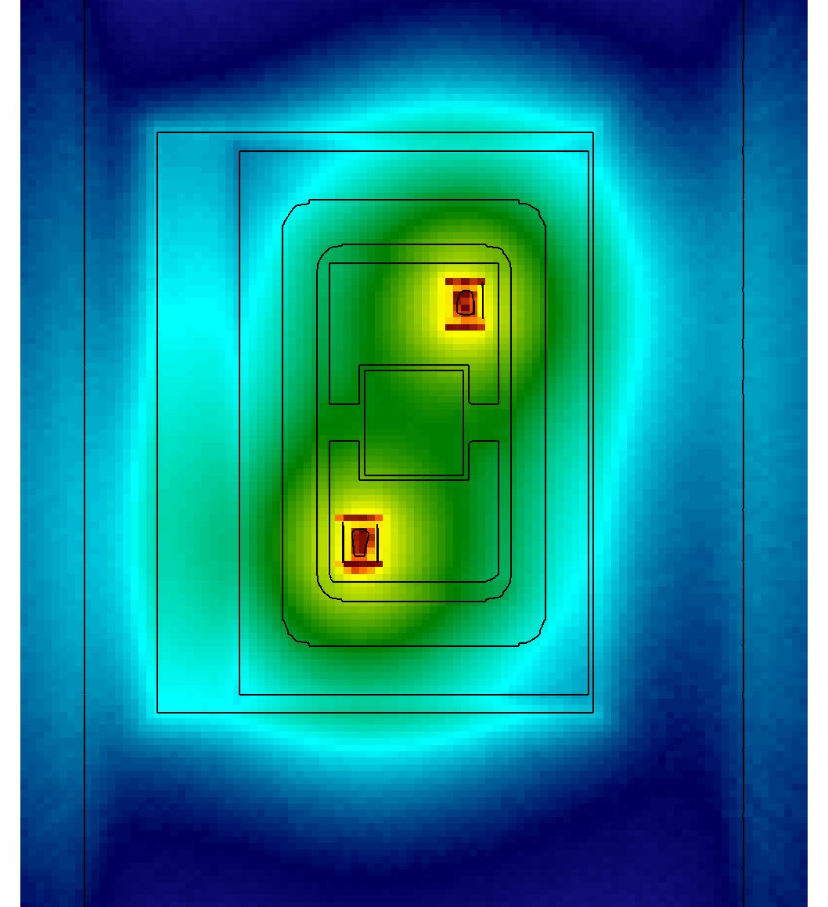
What-if the height taper in the optics inserts is removed
Neutron dose rate
(mrem/hr)
HE neutrons ( > 1 MeV)
HE neutrons ( > 1 MeV)
3mm uniform gap
variable gap
Vertical cut-view at monolith exit face (view from bunker area)

Slide 21
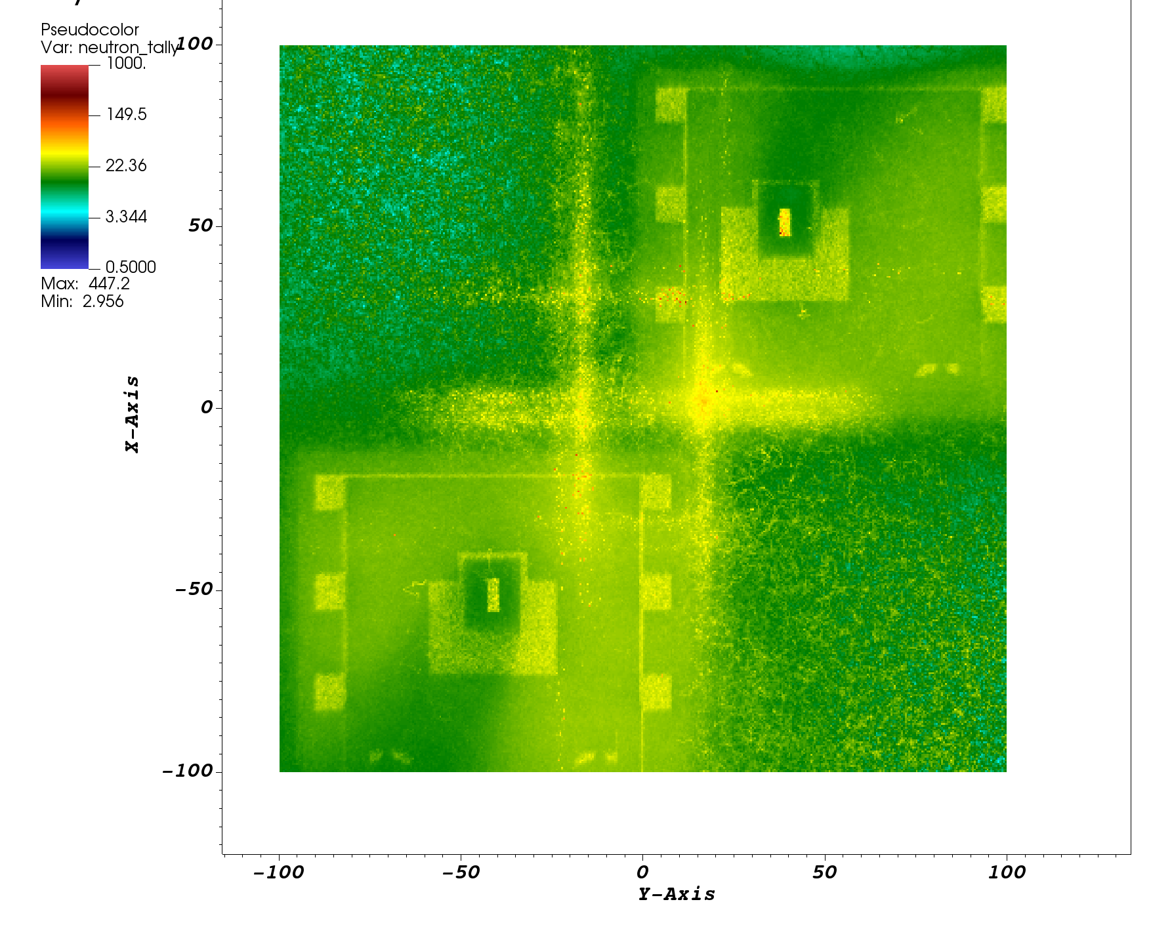
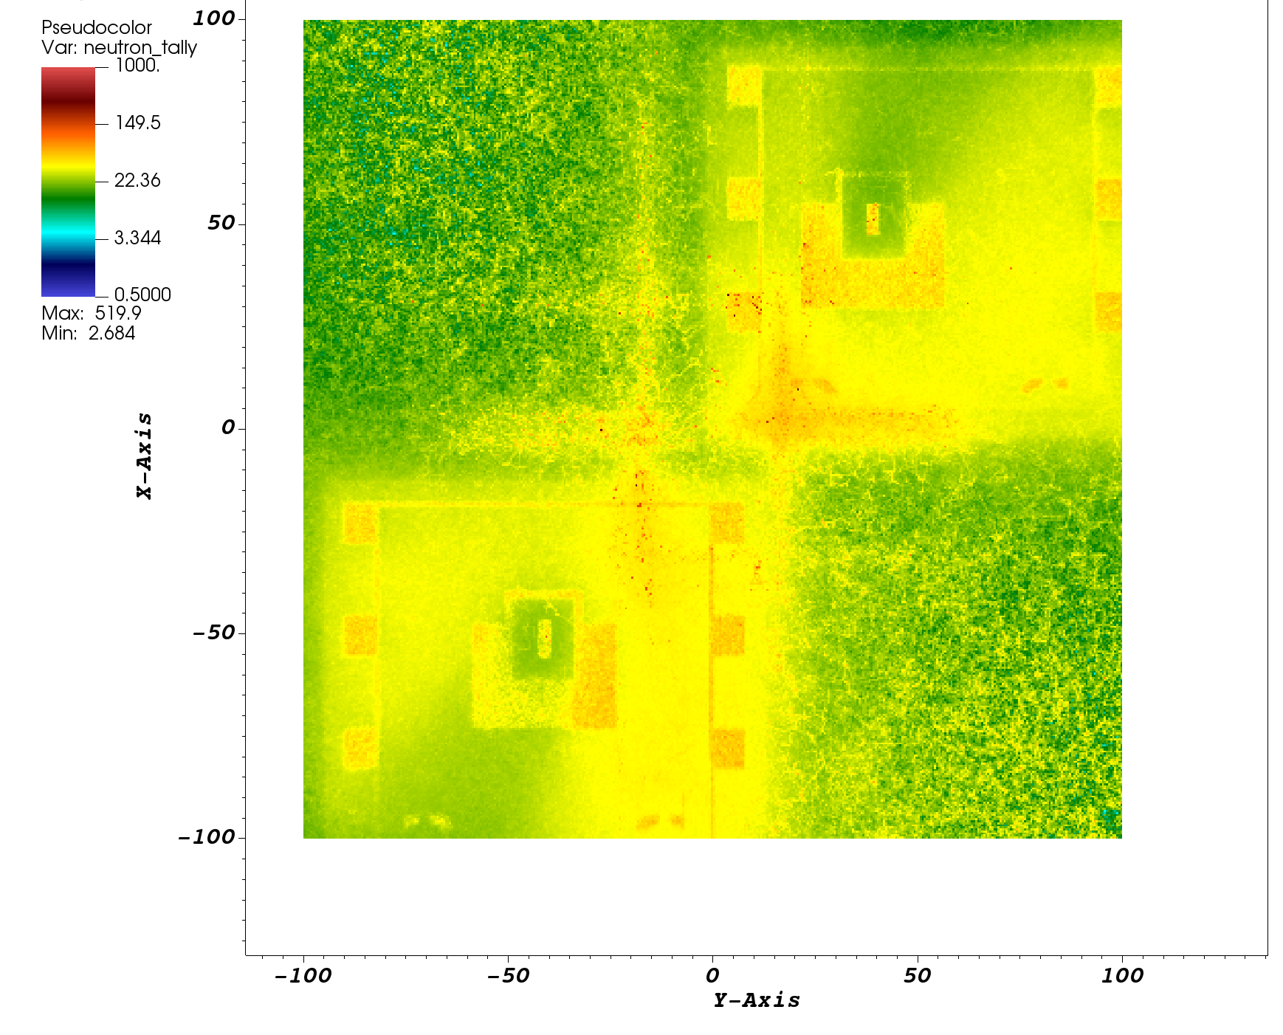
What-if the height taper in the optics inserts is removed
Neutron dose rate
(mrem/hr)
Variable gap inside monolith increases the dose rates
on bunker wall surface (bunker pass-thru upstream face)
HE neutrons ( > 1 MeV)
HE neutrons ( > 1 MeV)
variable gap
3mm uniform gap
Vertical cut-view at the bunker wall (view from the monolith)

Slide 22
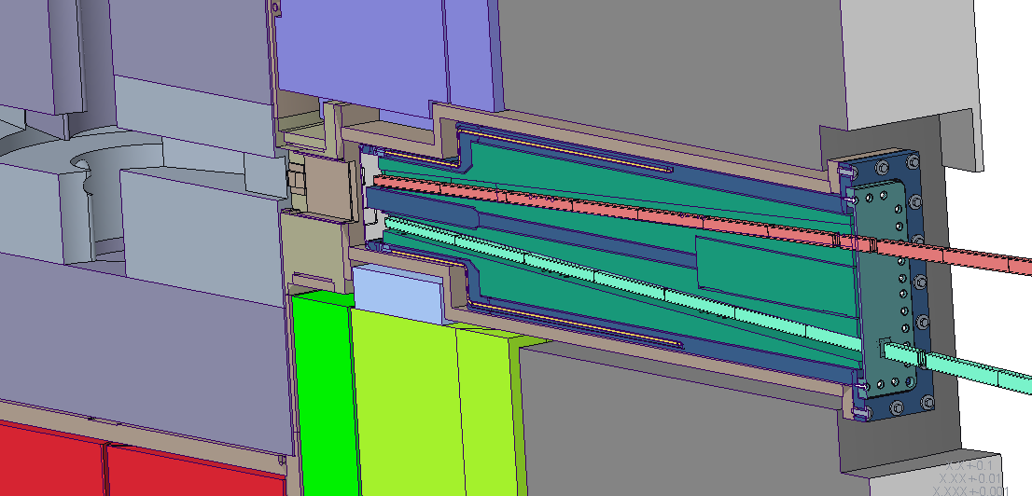
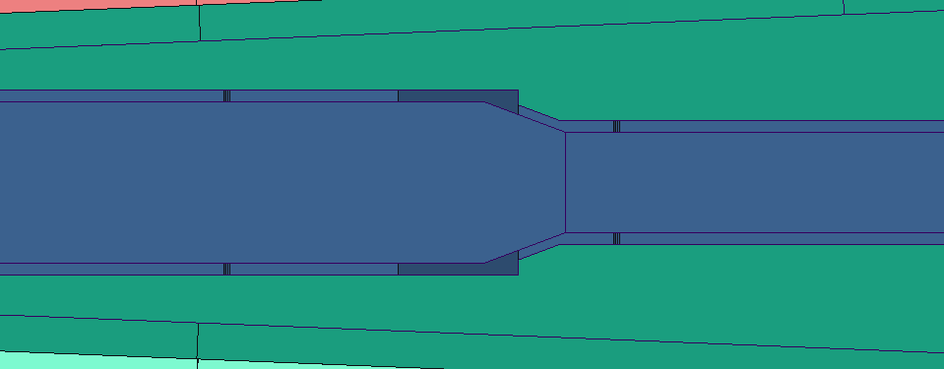
Removing Monolith Insert Chicane, Adding Steel Upstream
There is empty space between the monolith insert upstream window and the moderator… would filling this space with steel be more effective than the small monolith insert chicane at preventing neutron streaming?
9mm chicane

Slide 23
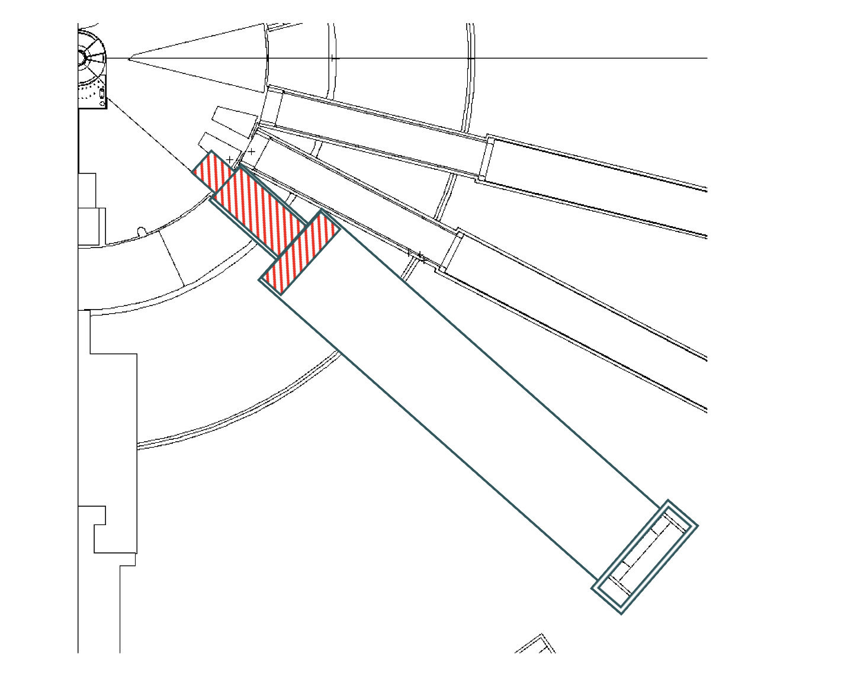
What-if upstream steel insert placed into upstream cavity
ST-04
In QIKR monolith design, shaded area depicted in the figure was empty space
Filling this gap with steel (named upstream steel insert, USI) will reduce the high-energetic neutrons streaming through gaps around/in monolith/optic inserts
ST-03
QIKR
ST-01

Slide 24
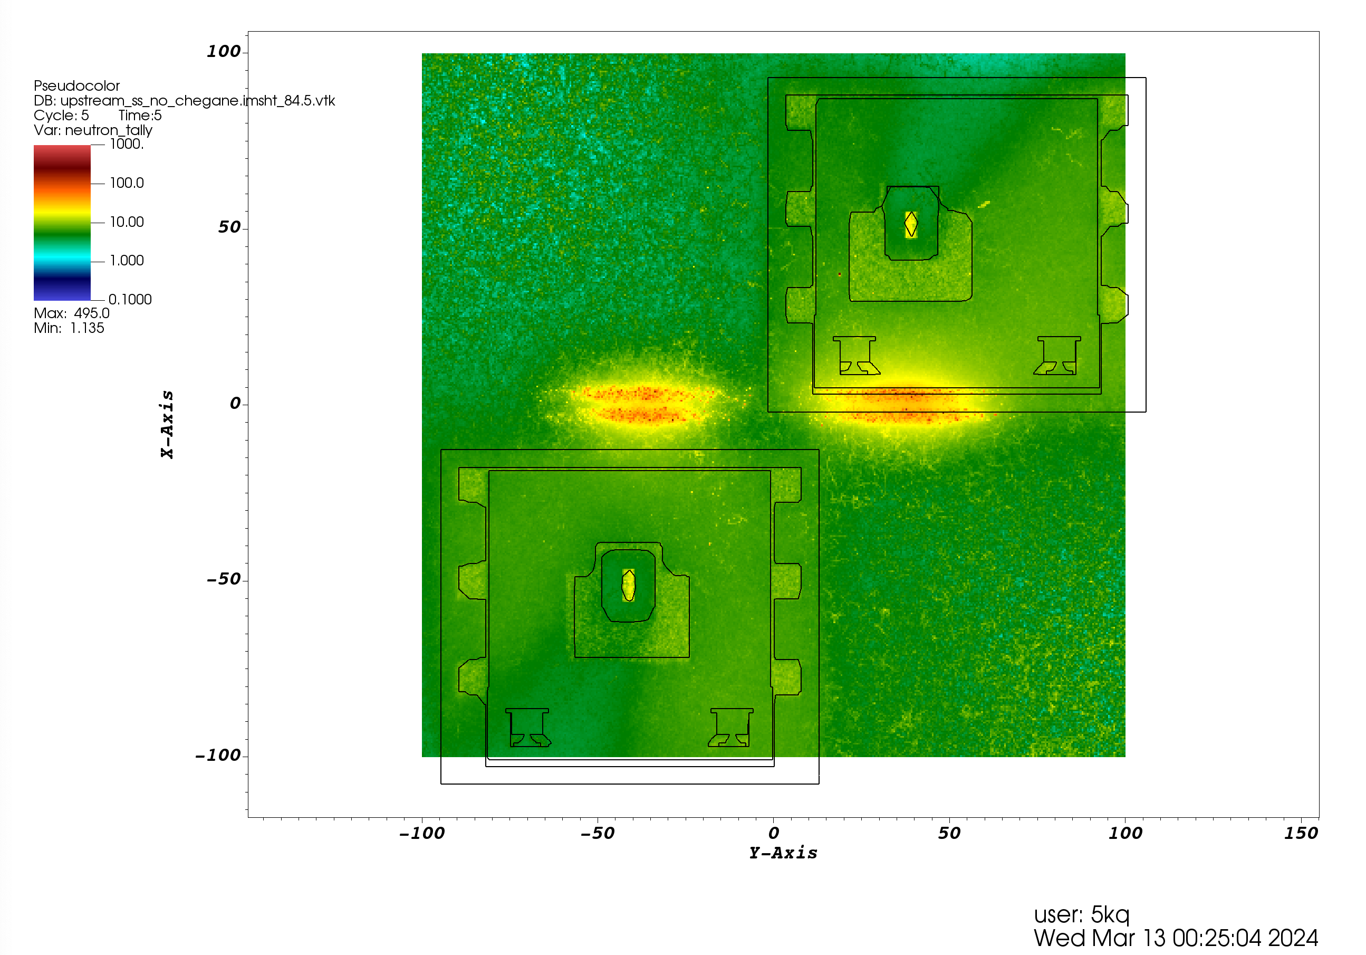
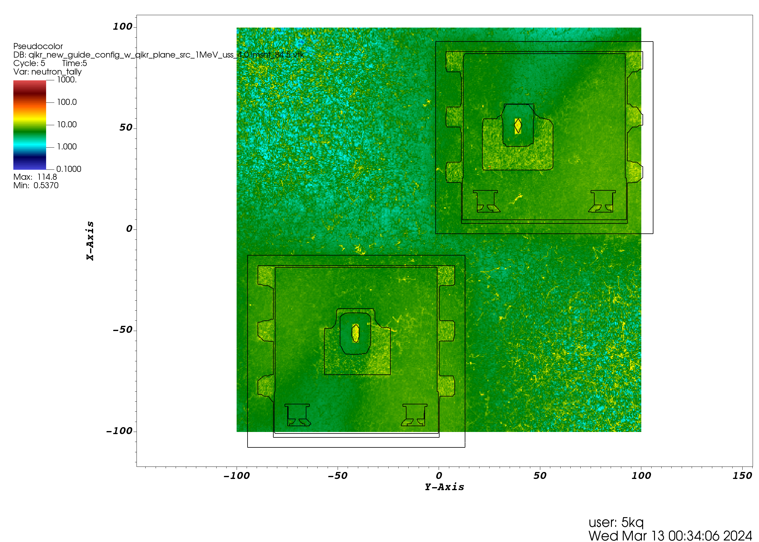
Assess the impact on USI on dose rates
Neutron dose rate
(mrem/hr)
HE neutrons ( > 1 MeV)
No upstream steel insert
Upstream steel insert, no chicane
Upstream steel insert, with chicane
Vertical cut-view at the bunker wall (view from the monolith)
Removing chicane will introduce straight streaming pathways along the monolith insert!
Therefore, relatively higher dose rates on the bunker wall face
Upstream steel insert with chicane is neutronically best (better shielding performance)

Slide 25
Questions??

