Slide 1
STS QIKR Shielding Preliminary Design Review Welcome & Introduction
Van Graves
March 3, 2025

Slide 2
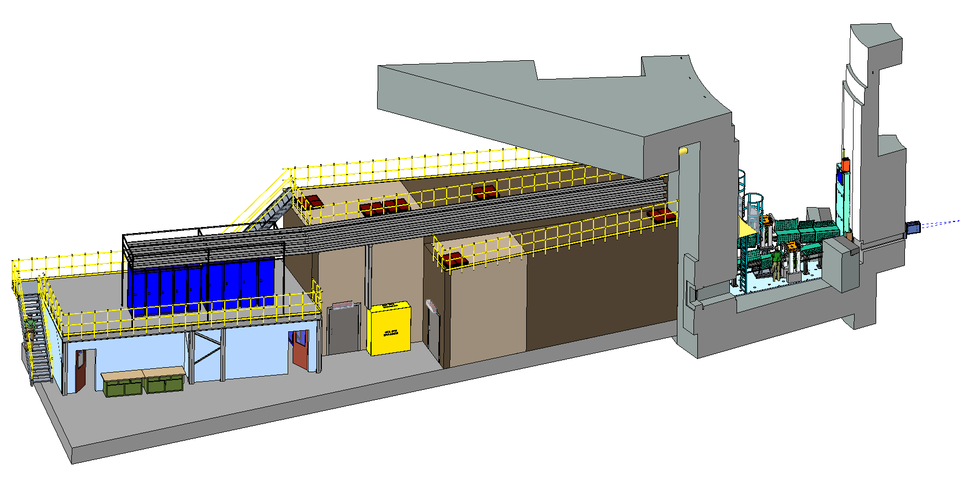
Why are we here?
Preliminary design review of the Quite Intense Kinetics Reflectometer (QIKR) shielding components and structures
QIKR is unique among the initial STS instruments in that it has two beam paths from the same source moderator
These paths are separated both vertically and horizontally
The instrument has two independent end stations within a single cave with an interior dividing wall
Two of the beam ports on the north side of the facility will also be capable of supporting two instruments, but they will be horizontally separated only, not vertically
This is a neutronics-heavy review, but the operation and design of the instrument will be described as they are relevant to the shielding design

Slide 3
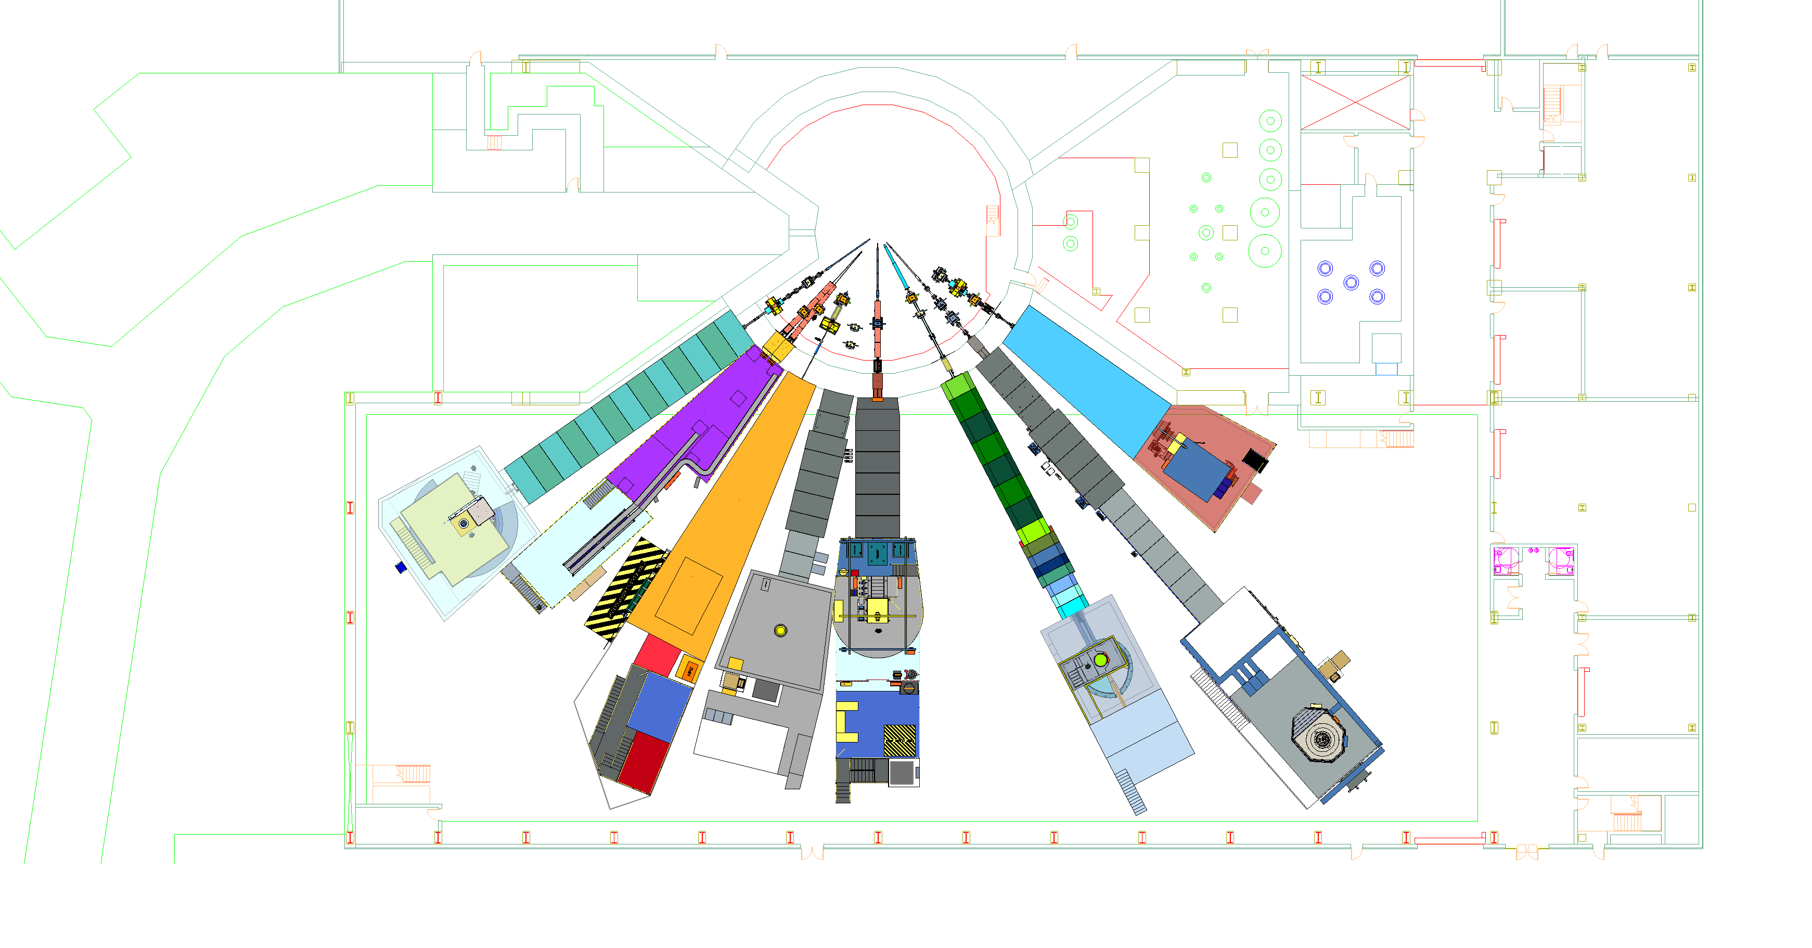
STS Instrument Suite
North Hall
(ST10-ST18)
Monolith Region
Proton Beam
Target Bay
South Hall
(ST01-ST09)
ST01
EXPANSE
ST02
QIKR
ST03
CUPI2D
ST04
BWAVES
ST05
CHESS
ST06
Future
ST07
VERDI
ST08
PIONEER
ST09
CENTAUR

Slide 4
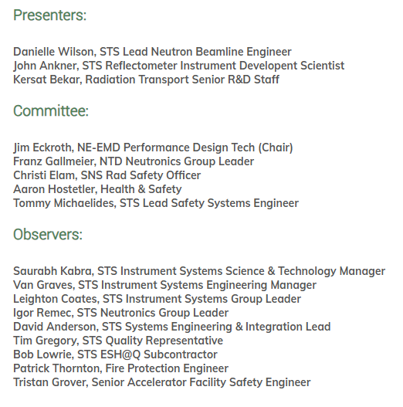
Participants

Slide 5
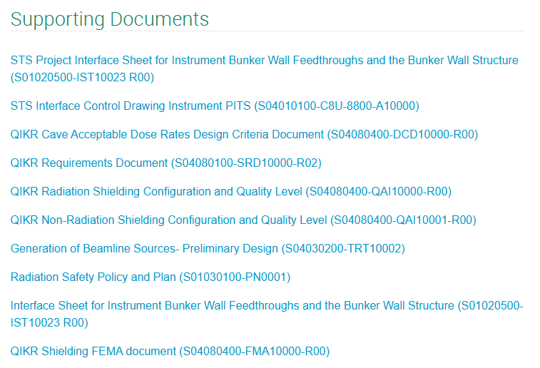
Supporting Documents
Requirements Documents
Radiation Policy and QIKR Cave Acceptable Dose Rates
Configuration and Quality Level Documents
Interface Documents and Drawings
Design, Analyses & Calculations (DAC) info is contained within the presentation material
Many are released, others are still draft
Note: for PDRs, STS does not require DACs (including Neutronics) be formal, signed reports

Slide 6
Review Charges
Is the scope of the shielding included in this design review clearly defined? (Wilson presentation 1)
Are the shielding requirements adequately defined? (Ankner, Wilson 1, Bekar 1)
Does the analyzed design of QIKR caves shielding adequately meet the radiation protection requirements and the Second Target Station (STS) Project Radiation Safety Policy and Plan? (Bekar 1)
Have the radiation source terms against which QIKR shielding must provide protection been adequately defined? (Bekar 1)
Are shielding calculations explained and documented in materials available to safety reviewers? (Bekar 1 & 2)
Does the committee feel the design changes implemented or proposed in some of the shielding components should be further evaluated during final design? (Bekar 2 & Wilson 2)
Deliverables: close-out presentation with comments and recommendations followed by a written report within 2 weeks.

Slide 7
Agenda

