Slide 1
QIKR Shielding PDR: Mechanical Overview
D. Wilson, Lead Engineer
March 03, 2025

Slide 2
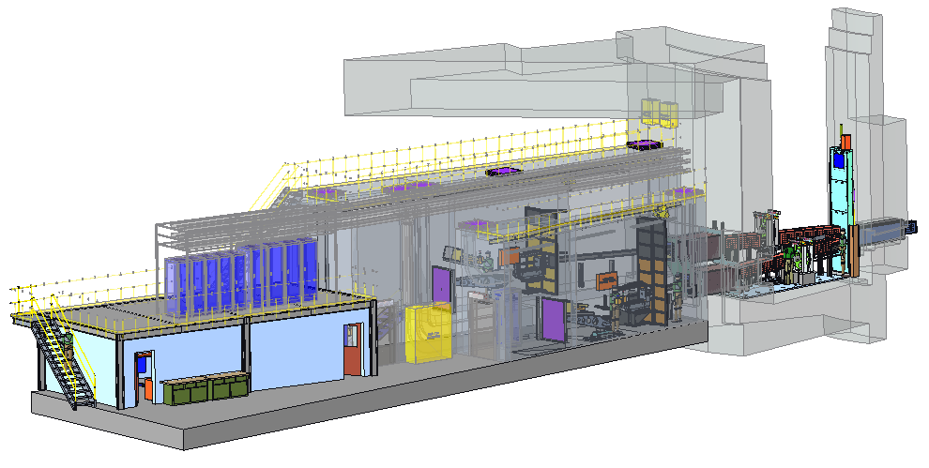
Outline
Model Changes Following Neutronic Analysis
Target Area Shielding
Monolith Optics Insert
Bunker Feed-Through Shielding
Cave
Components Not Neutronically Analyzed
Background Shield Wall
Component Acquisition, Manufacturing, Installation Strategies & Costs

Slide 3
Target Area Shielding/ Monolith Optics Insert

Slide 4
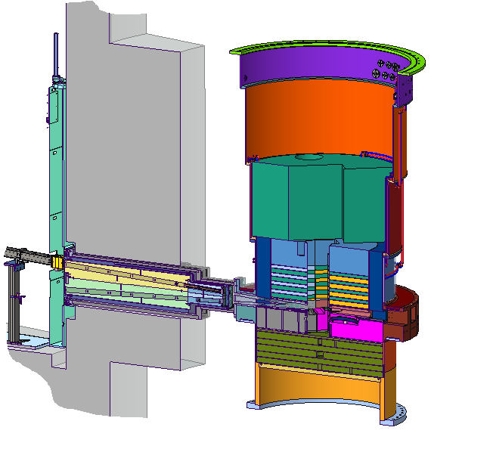
Monolith Shielding, Upstream & Optics
Monolith Wall
Bunker
Area
Core Vessel
Monolith Insert
Neutrons
Optics Insert (Shielding)
Upstream Shielding Area
Additional Shielding
(not shown)

Slide 5
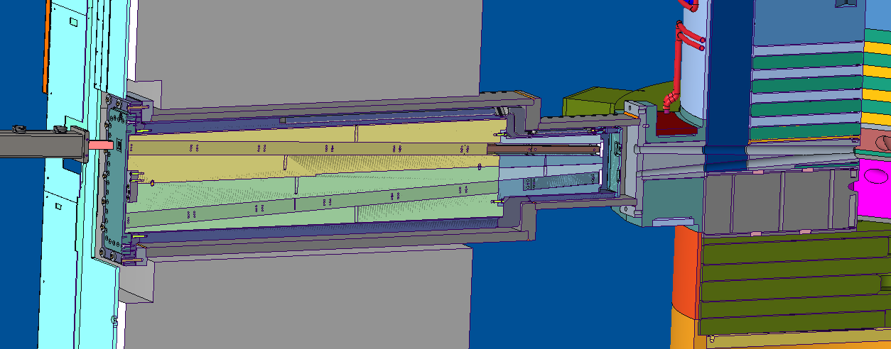
Monolith Shielding, Upstream & Optics
Core Vessel
(Steel)
Nozzle Extension (Steel, owned by Target)
Monolith Insert
(Steel)
Neutrons
Monolith Upstream Shielding (Steel, owned by Target)
Optics Insert (Steel)
Belt Line
(Steel)

Slide 6
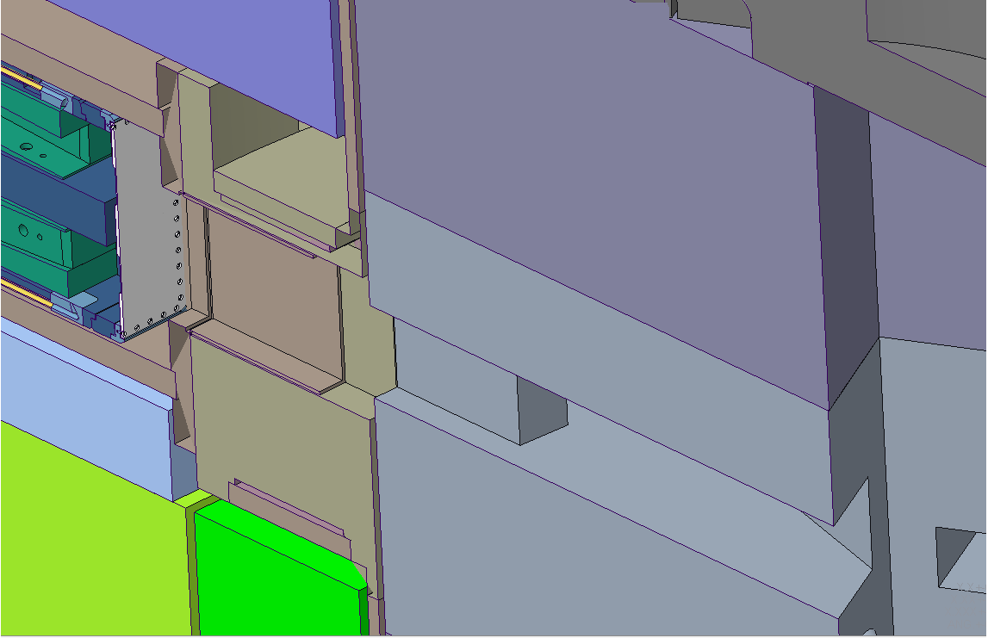
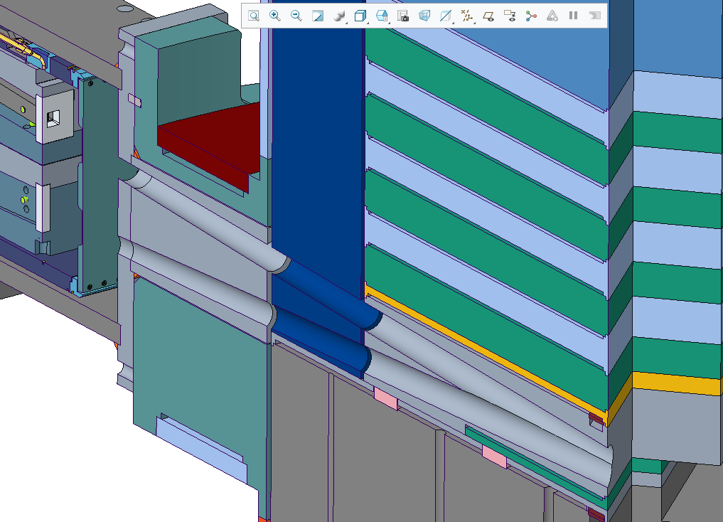
Monolith Upstream Shielding – Current vs. Neutronics Model
Original Design
Current Design
Empty Space
Filled Space
not cooled
water-cooled
water-cooled
Neutrons
Neutrons
Version initially used in Neutronics Analysis
One variant was to fill the space completely with steel with circular openings circumscribing the guide path dimensions… this led to the design shown at right
Current Design
Target shielding includes two water-cooled sections of steel (upstream) and one non-cooled section of steel attached to the nozzle extension
Guide paths pass through oversized (∅60mm) circular openings in the steel (guide paths = 30mm x 26.5mm)

Slide 7
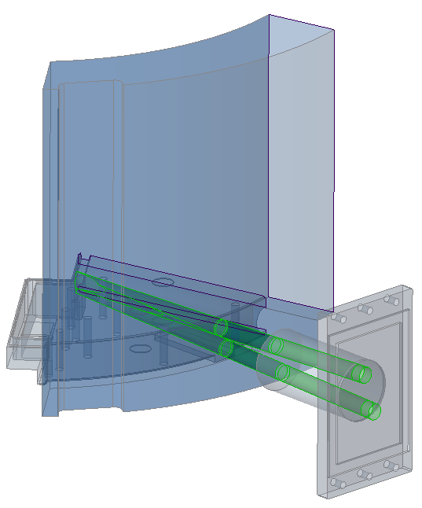
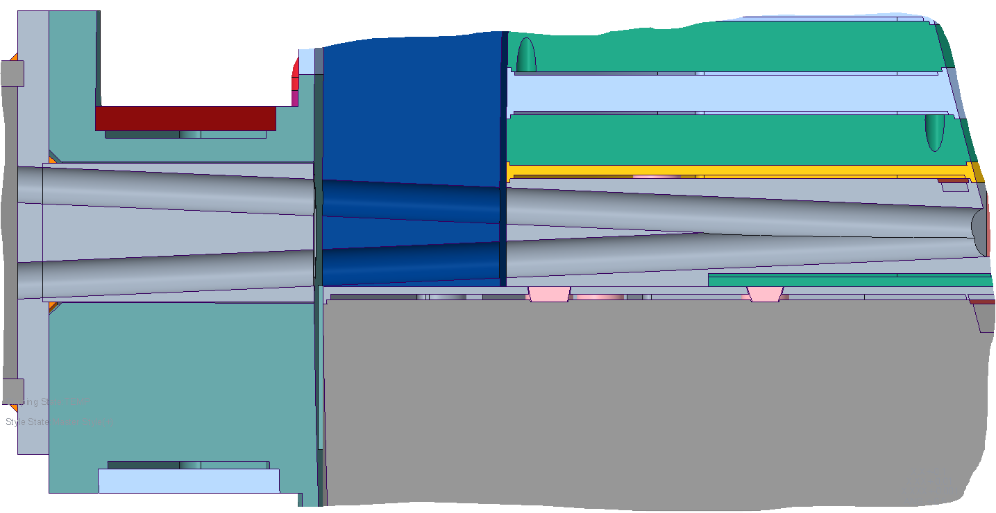
Monolith Upstream Shielding – Current Design
Nozzle Flange
Shielding with circular beam paths
Core Vessel
Core Vessel
Nozzle Flange
Neutrons
Neutrons
X-sec through both beam paths simultaneously
Beltline
This section is not cooled, the other sections are water-cooled
Steel shielding surrounds gun-drilled circular beam paths (∅ 60mm)
(desired guide path dimensions: 30mm W x 26.5mm H)
Surrounding belt line shielding is not shown here

Slide 8
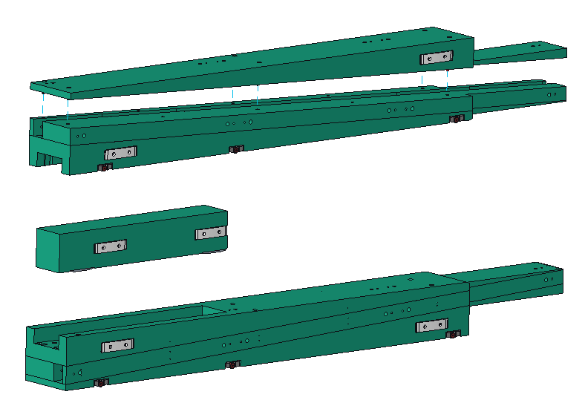
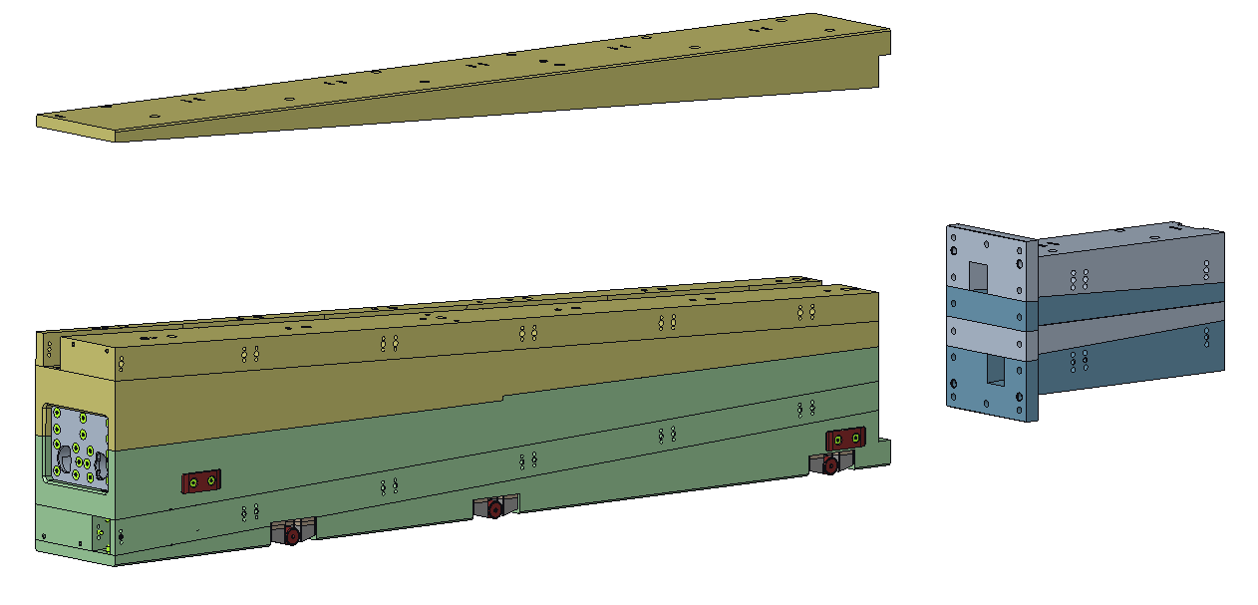
Monolith Optics Shielding
Previous, Neutronics Analysis Design
New Design
Design credit: Cameron Hart
Lower Optics Insert
Upstream section
Upper Optics Insert
Upper Optics Insert
Small anti-streaming chicane
Anti-streaming block
Design credit: Ryan Butz
Lower Optics Insert
Steel layers, combined upper and lower insert… built as a single assembly in layers
Upstream section is separate but attached in layers along with the downstream section
Entire assembly inserted into monolith in one operation
Fewer gaps & streaming paths compared to original version
Steel layers, separate upper and lower insert… each built and installed separately
Anti-streaming block installed separately (after inserts) to compensate for the very small chicane between the optics inserts and the monolith insert shelf that separates them (see next slide)
Significant streaming paths seen in neutronics analysis

Slide 9
Monolith Optics Shielding – Old Design
Previous Design, Used in Neutronics Analysis
Anti-streaming block, provides more of a chicane than the 9mm step upstream
Monolith Insert
Thin sections (difficult to manufacture)
Upper Optics Insert
Lower Optics Insert
The anti-streaming chicane
9mm step each side
6mm gaps b/w optics & monolith inserts
Monolith Insert Shelf

Slide 10
Monolith Optics Shielding – New Design
New Design, not yet analyzed
Handler attachment features (likely no significant shielding benefit)
Monolith Insert
Upper Optics Insert (yellow)
Thicker sections
Lower Optics Insert (green)
Two anti-streaming chicanes with no nominal gaps (12mm upstream, 11mm downstream)

Slide 11
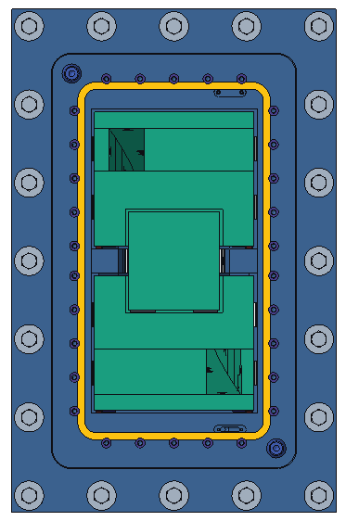
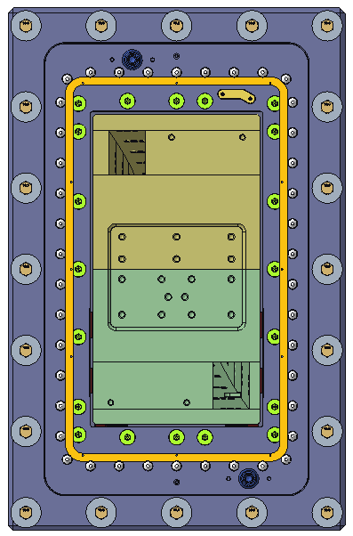
Monolith Optics Shielding
Previous Design, Used in Neutronics Analysis
New Design, not yet analyzed
Significant Gaps (red)…
fewer for the new design

Slide 12
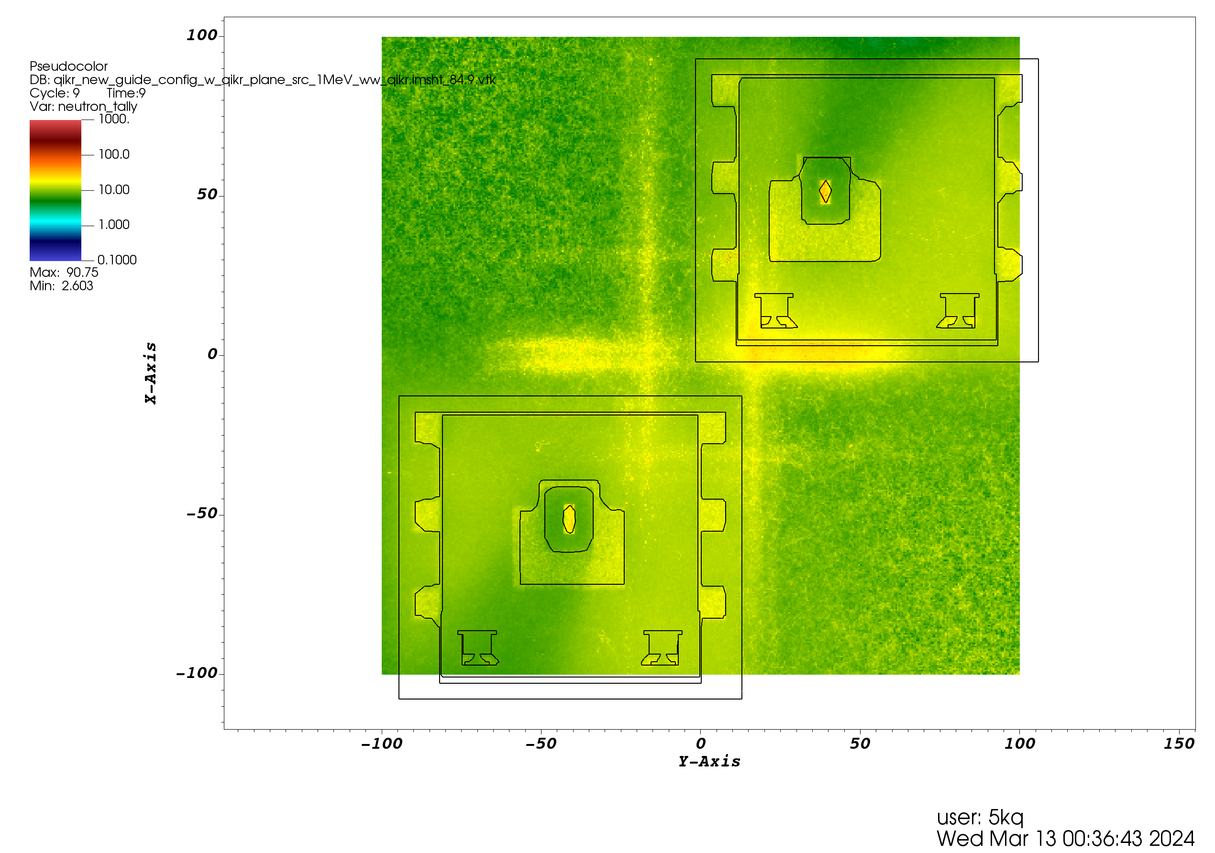
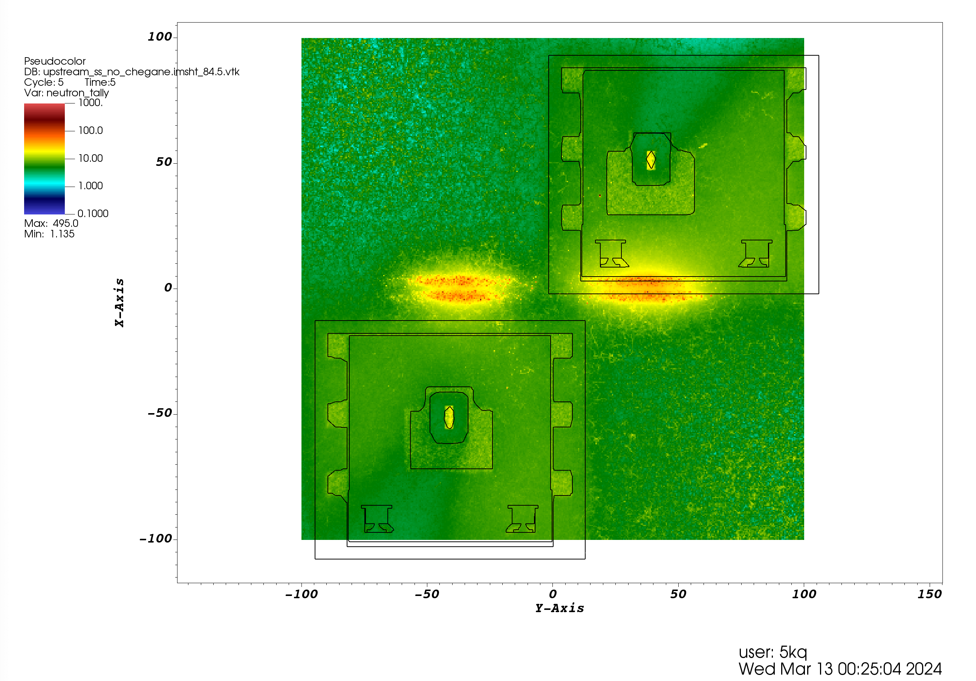
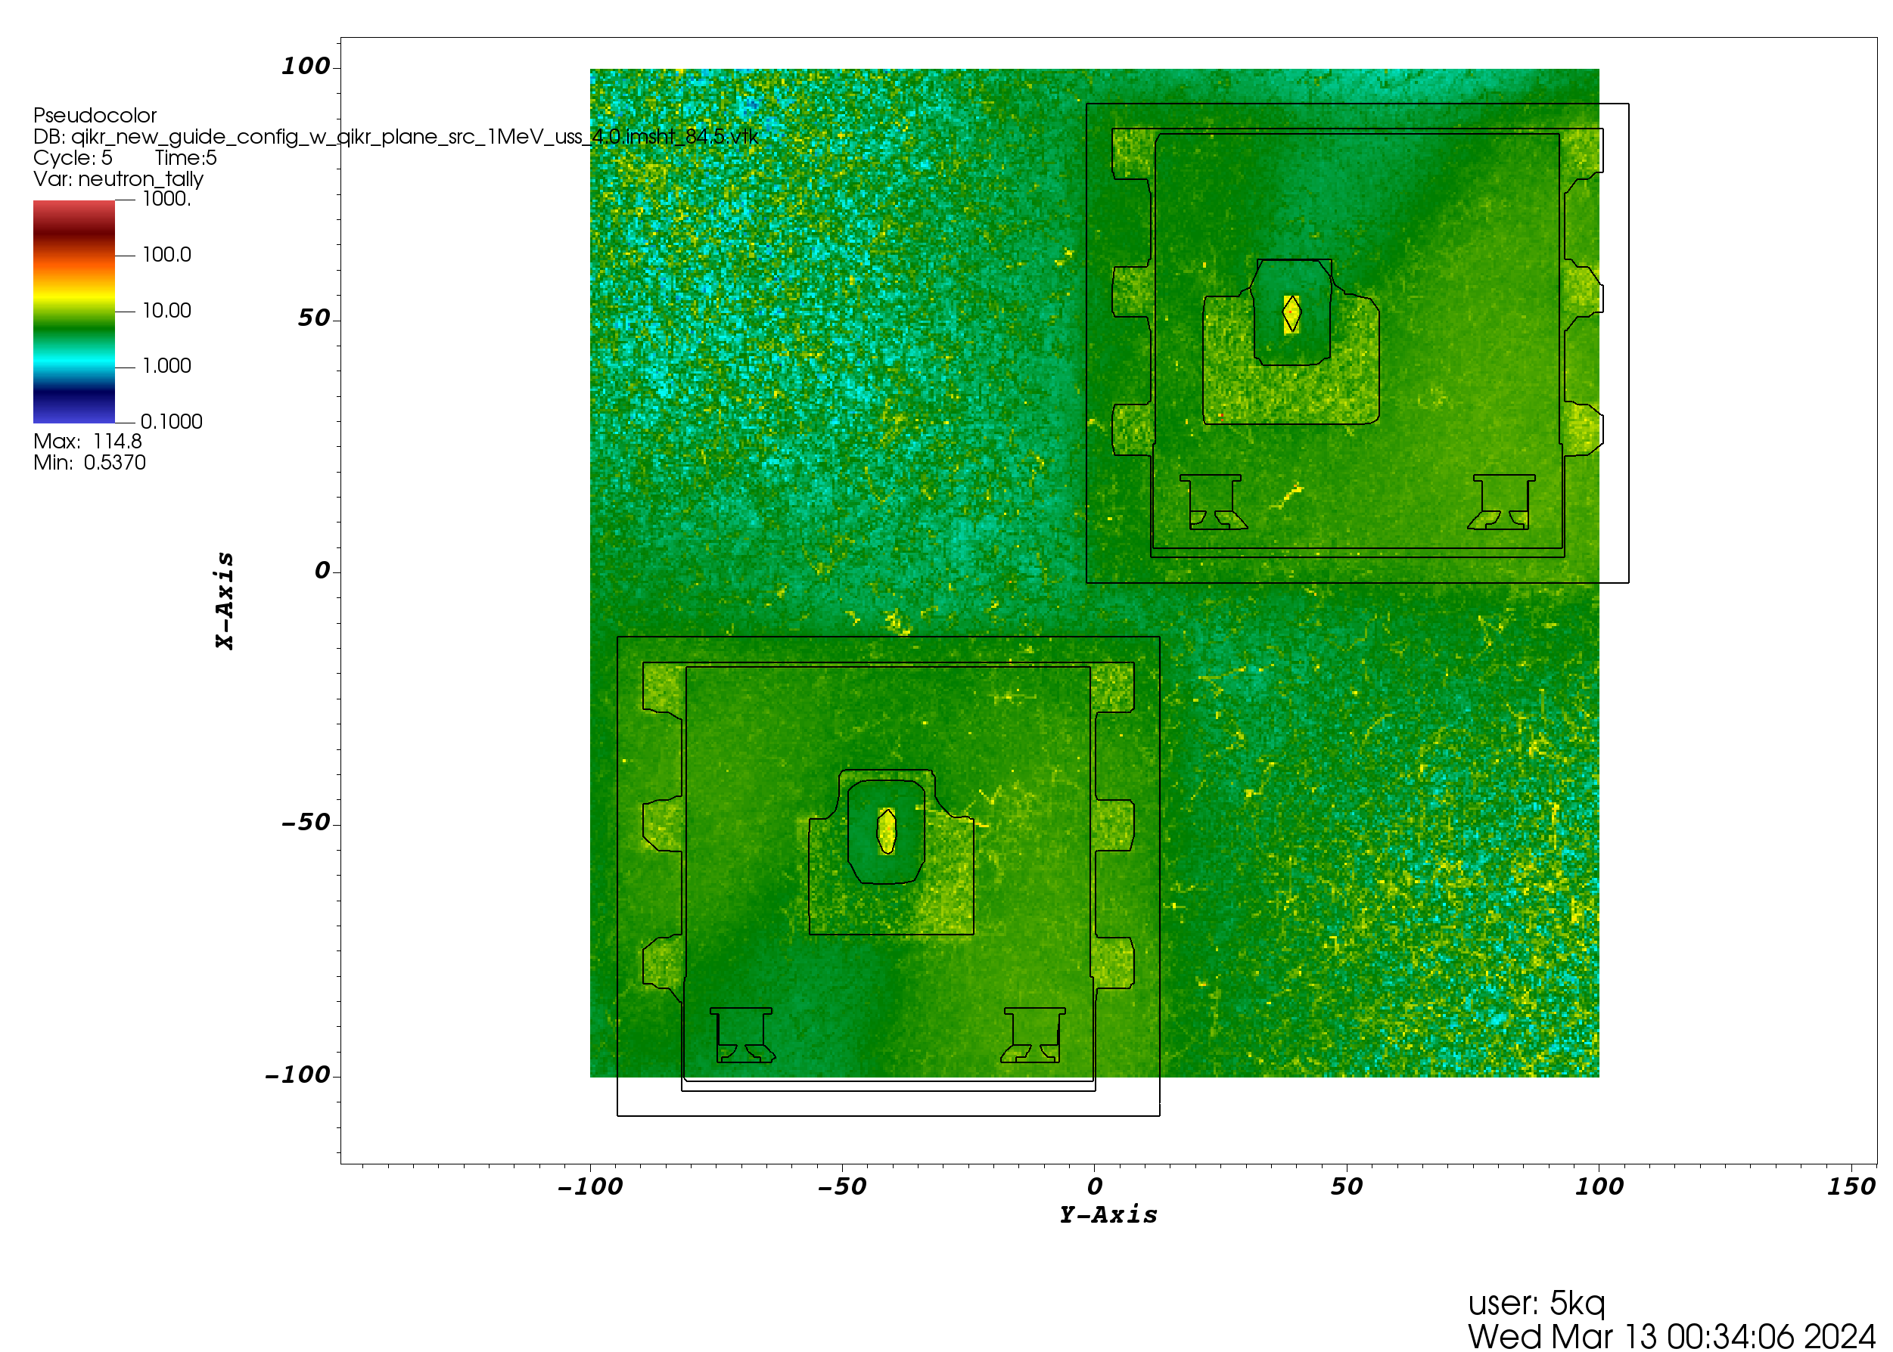
Neutronics Analysis with Upstream Steel
Screenshots taken from Kursat Bekar’s analysis of QIKR
Neutron dose rate
(mrem/hr)
Vertical cut-view at the bunker wall (view from the monolith)
No upstream steel insert
Upstream steel insert, no chicane
Upstream steel insert, with chicane
Removing chicane will introduce straight streaming pathways along the monolith insert!
Therefore, relatively higher dose rates on the bunker wall face
Upstream steel insert with chicane is neutronically best (better shielding performance)
Current design now most closely matches this scenario

Slide 13
Guide Installation

Slide 14
Guide Shielding – Reminder
Horizontal cross-section of an in-bunker guide housing, shows change in shielding layer thickness due to guide curving/angling
Plan view
Guide Glass (float or borofloat glass)
Steel Shielding Layer
Stainless Steel Vacuum Jacket
Neutronics analysis used the same guide construction except for a steel vacuum jacket… current design is stainless steel
Vertical cross-section of the last in-cave guide housing (QIKR-U), shows change in shielding layer thickness due to guide taper
Elevation view

Slide 15
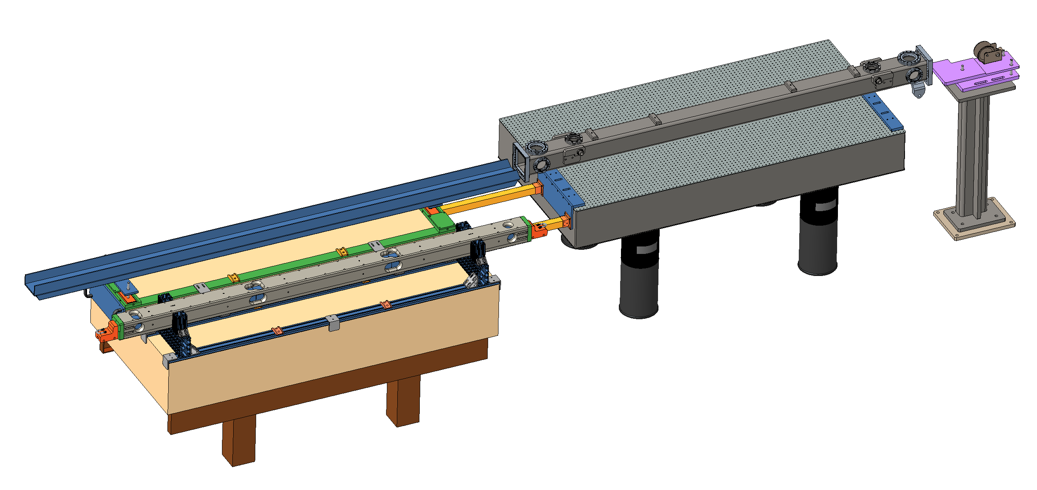
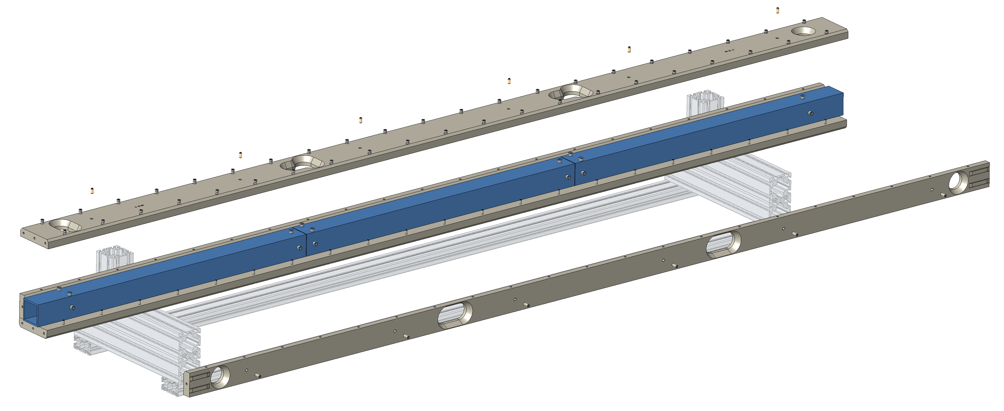
Slide modified from Cristina Boone & Pete Torres’ presentation: “20241204 STS In-Bunker Guide Housings for Scientists.pptx”
Guide Shielding – Installation
The guide segments and shielding layers are assembled, guide segments aligned. Wheeled “trucks” are attached to the ends.
Guide/shielding assembly is lifted and placed on the sled assembly
The crank assembly is used to pull the guide/shielding assembly (rolling on the truck wheels) into the vacuum housing sleeve
The trucks are removed, and flange covers & windows are installed; the guide housing is ready for transport.
C
Optics Module is placed on Sled Assy and inserted into Vacuum Housing with Crank Assy
Crank Assy
B
Sled Assy
Standard In-Bunker Guide Housing Assembly
(QIKR will use the same process)
A
Cradle Assy
Guide & Shielding are assembled on Cradle Assy
Windows installed
D
Flange and Window covers are installed before transport

Slide 16
Bunker Wall & Feed-Through Shielding

Slide 17
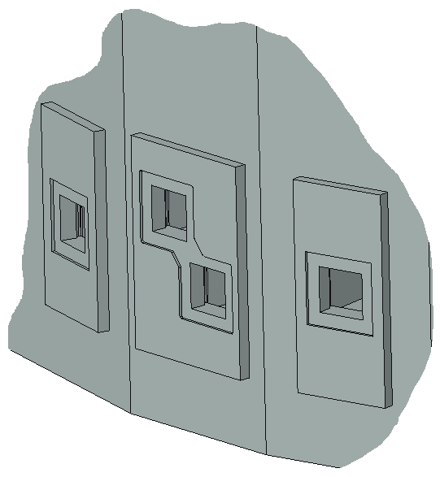
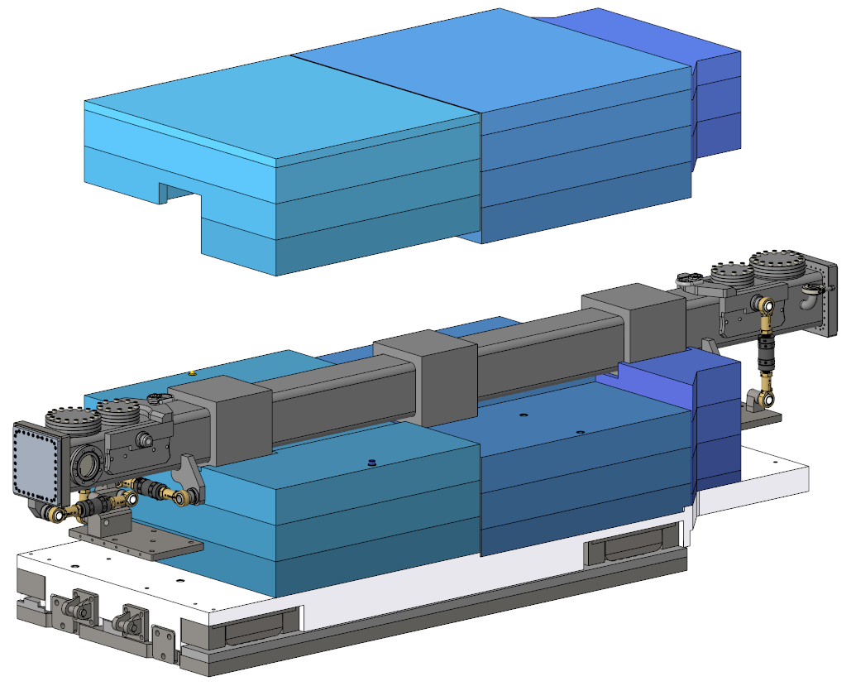
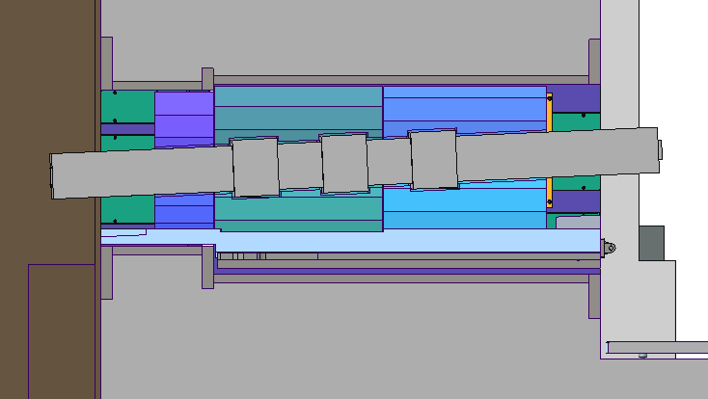
Exterior bunker wall
Standard guide and shielding
Bunker Wall – New
QIKR-U
Shielding mating surfaces are staggered between sections
7’4” = 6’8” bunker wall + 8” cave-side protrusion
Upper shielding
Cave-side protrusion
QIKR-L
QIKR-B cross-section
Sled
Anti-streaming bands
Baseplate
Hilman rollers
Baseplate
Lower shielding
Sled on Hilman rollers
Grout layer
Embedded frame supplied by CF
Current Design
Screenshot taken from Cristina Boone & Pete Torres’ presentation: “20241204 STS In-Bunker Guide Housings for Scientists.pptx”
Lower and upper shielding
QIKR follows the standard design for bunker wall shielding and chicanes (steel)
Shielding is layered with no nominal gaps between layers, each section of shielding is staggered relative to the next to prevent streaming paths
The feedthrough frame is wider on the bunker side than on the cave side to provide an anti-streaming chicane
Gaps are cut into the center of the shielding to fit the guide and its anti-streaming bands

Slide 18
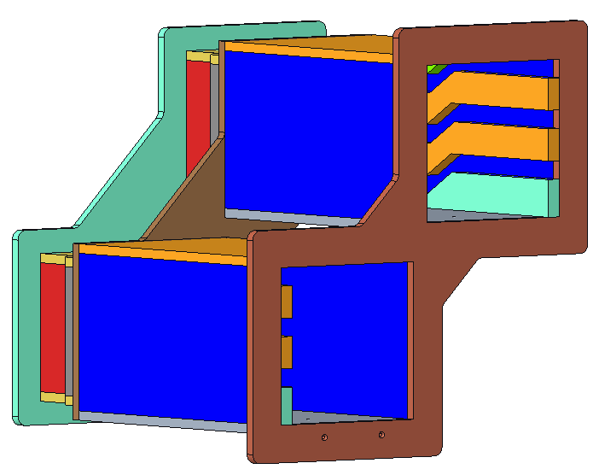
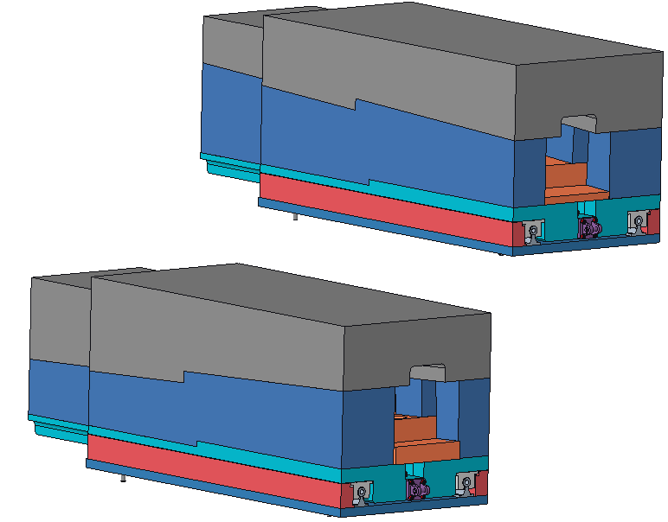
Bunker Wall – Shielding & Cable Channels Used in Analysis
Stepped frame and shielding
Solid shielding (not layered), chicaned
Stepped Cable Passages
Similar baseplate, sled, rollers, grout layer (not shown)
Cable Passages removed from the inner sides to avoid overlap with monolith optics insert streaming neutrons
The current standard design was based on the one shown here, which was used in QIKR’s neutronic analysis… the current standard design is expected to have a similar neutronic performance
The standard design has the inner cable passages in place. QIKR may remove those again, but the new optics insert may help eliminate the need for that

Slide 19
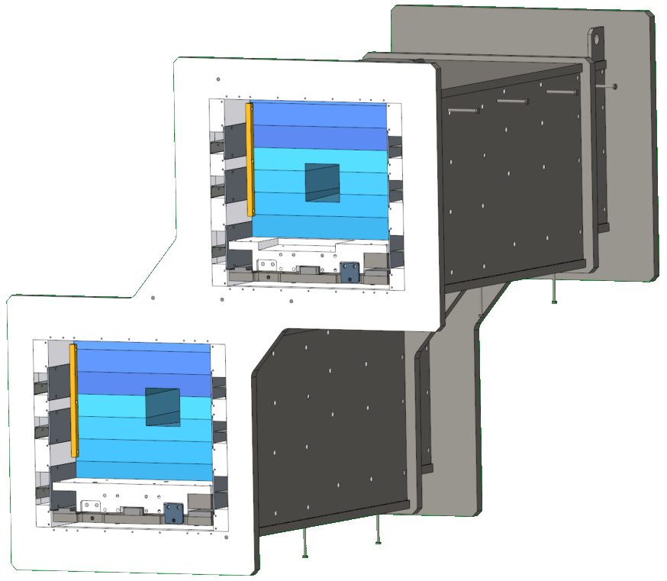
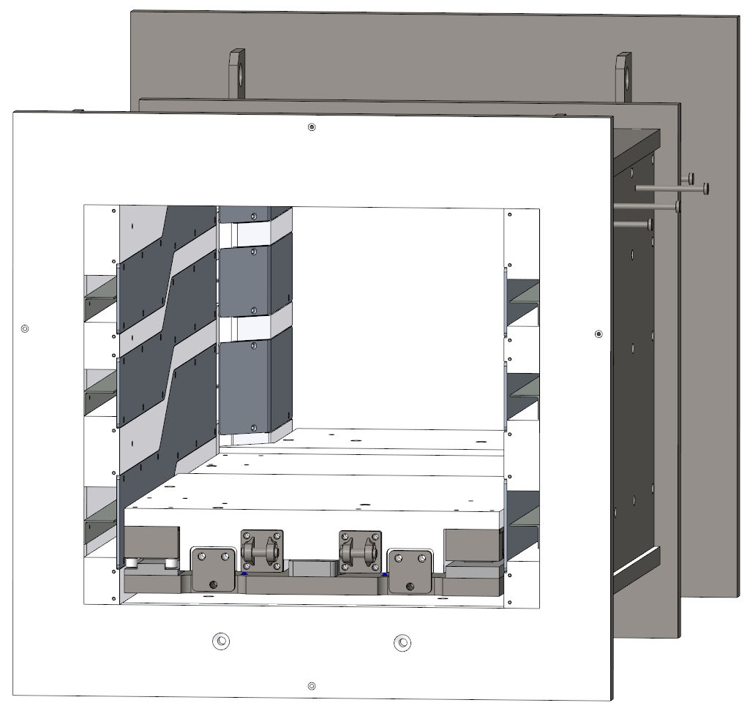
Screenshots taken from Cristina Boone & Pete Torres’ presentation: “20241204 STS In-Bunker Guide Housings for Scientists.pptx”
Bunker Wall – Cable Channels (New)
QIKR-U
Cable Passage Covers
y
QIKR-L
Current Design
Smaller Cable Passages
Larger Cable Passages
New design is very similar to the old design. Rather than remove the inner cable channels though, QIKR would fill them with steel
Cable Passages are stepped in “y” to avoid streaming

Slide 20
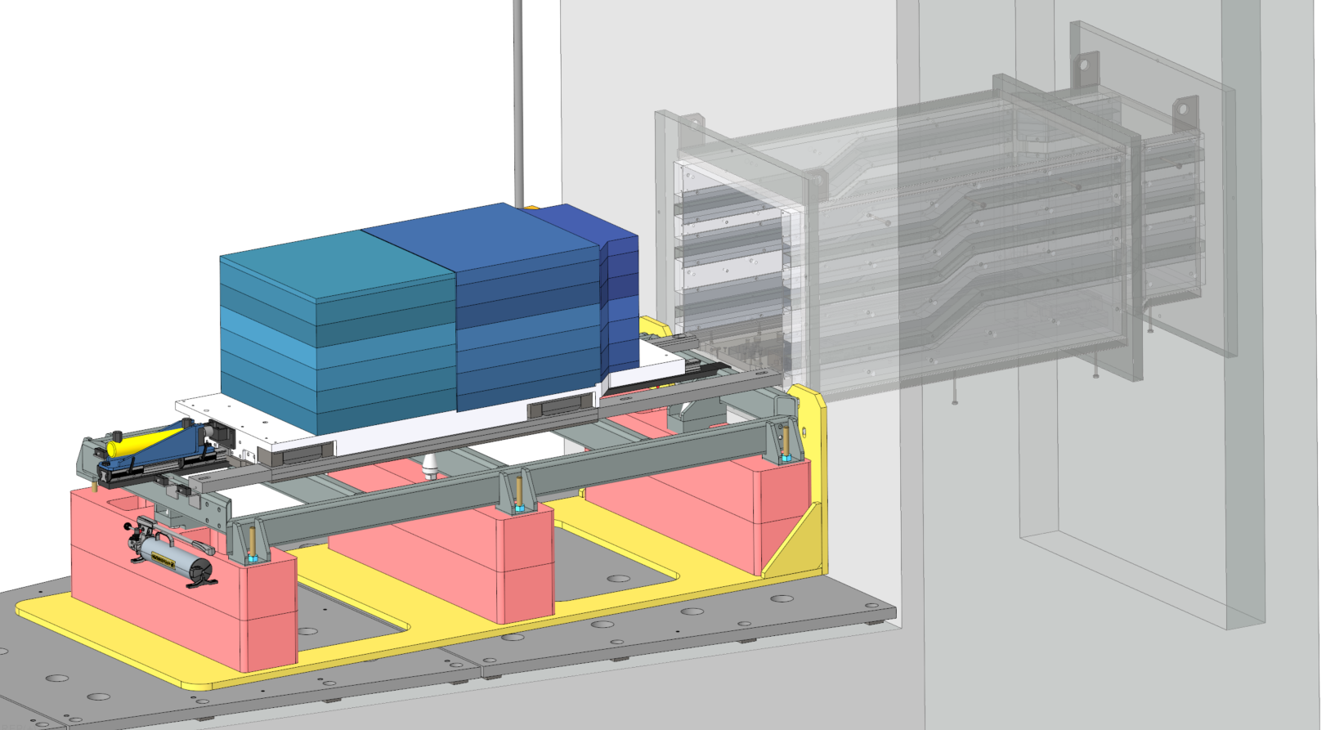
Bunker Wall – Shielding and Guide Installation
Modified slide taken from Cristina Boone & Pete Torres’ presentation: “20241204 STS In-Bunker Guide Housings for Scientists.pptx”
BFIT is aligned to the BWF
The sled is placed on the BFIT, the guide housing and shielding layers are built up
The BFIT is then used to transfer the optics/shielding package into the BWF
All components are placed in the bunker with the 50-ton high bay overhead crane
Bunker Wall Feedthrough
Bunker Wall
Optics/Shielding Package
(guide not shown)
Bunker Wall Feedthrough Insertion Tool (BFIT)

Slide 21
Cave

Slide 22
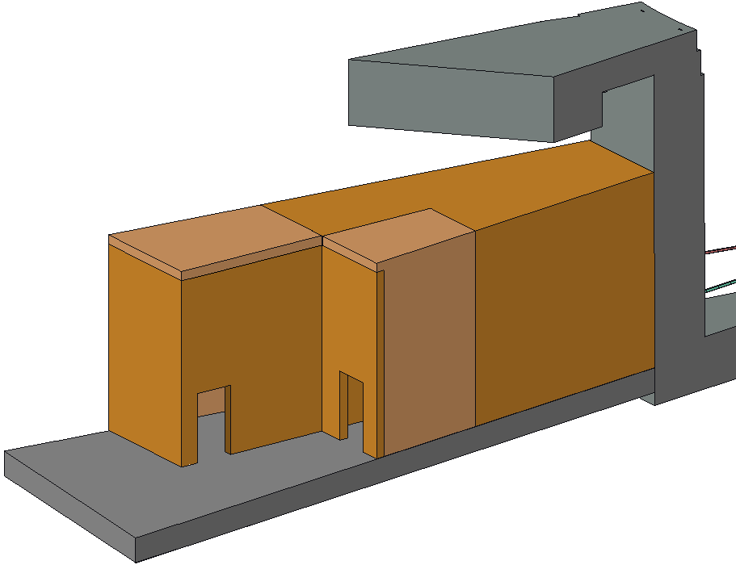
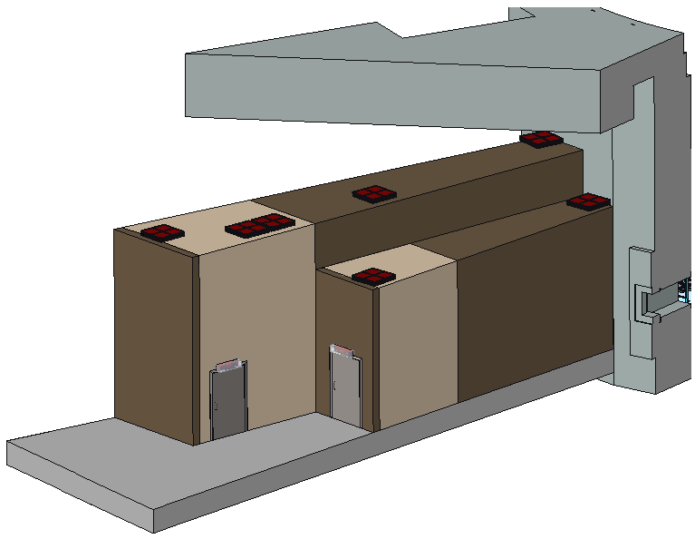
Cave Exterior – Design Updates
Original (analyzed) Design
Current (un-analyzed) Design
600cm
RWC
HDC
HDC
HDC
520cm
RWC ST01-side
HDC
RWC
HDC
HDC
HDC
RWC
RWC ST01-side
QIKR-L roof is lower
Improves cave structure, reduces cost
Cable pass-thrus added to the roof
QIKR-U RWC section shortened, end portion of center wall converted to RWC
Reduces cost; dose rates are very low on this section of the center wall

Slide 23
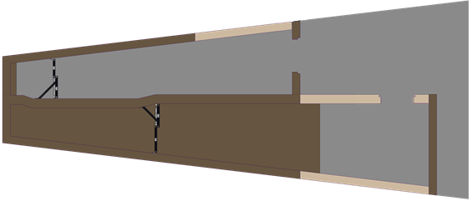
Cave Interior – Design Updates
Original (analyzed) Design
QIKR-L
QIKR-U
Single dog-leg to accommodate components
HDC
Current (un-analyzed) Design
HDC
Center wall has 2 dog-leg features instead of 1
Allows additional room for components and QIKR-U monorail hoist motor
Background shield walls added
Their presence was known at the time of neutronic analysis, but they were not included because they are not intended to provide radiation shielding for personnel safety
HDC
Background shield walls
QIKR-L
QIKR-U
Two center wall dog-legs to accommodate components & QIKR-U monorail hoist

Slide 24
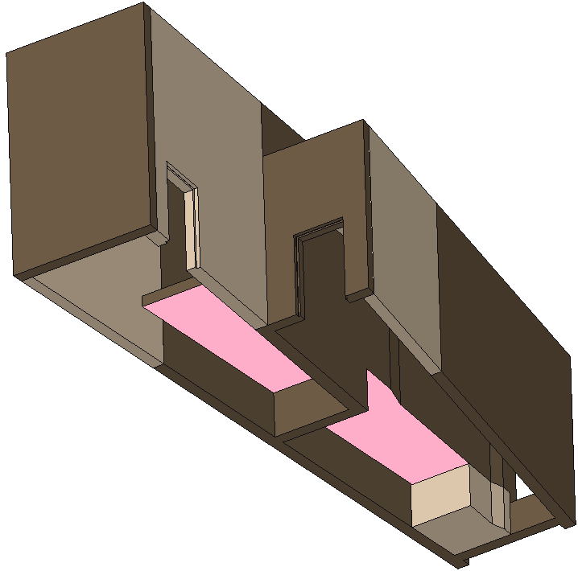
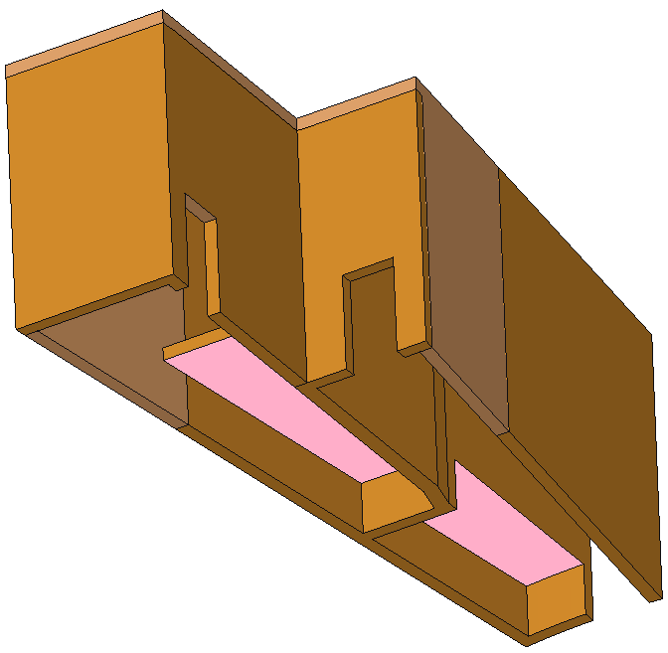
Cave – Cubby Spaces
Original (analyzed) Design
Current (un-analyzed) Design
QIKR-U “cubby” space
QIKR-U “cubby” space
QIKR-L “cubby” space
QIKR-L “cubby” space
Cubby spaces are all ~4ft in height
Additional RWC concrete to fill in space up to the background shield wall (prevents personnel from going behind the wall through the cubby space)

Slide 25
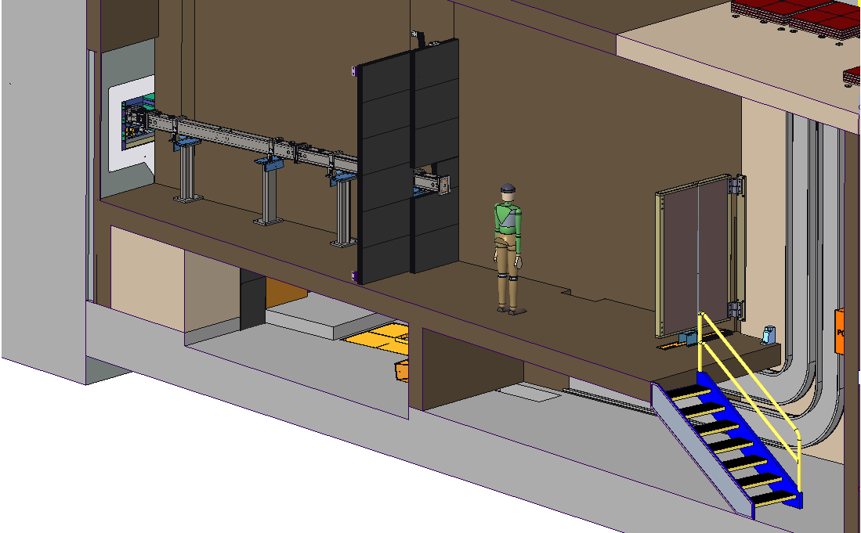
Cave – QIKR-U View of Cubby Spaces
QIKR-U cable access to end station
High density concrete
Regular weight concrete
QIKR-L cubby
QIKR-L cable channel
QIKR-U cubby

Slide 26
Cave Installation
Cave will be pour-in-place (PIP) concrete, poured in sections
The current thickness of the walls may not support the current wall height, particularly for QIKR-U
If this is confirmed, the plan will be to install a steel girder skeleton first, then pour the concrete around it… the skeleton will provide additional structural support

Slide 27
Background Shield Walls

Slide 28
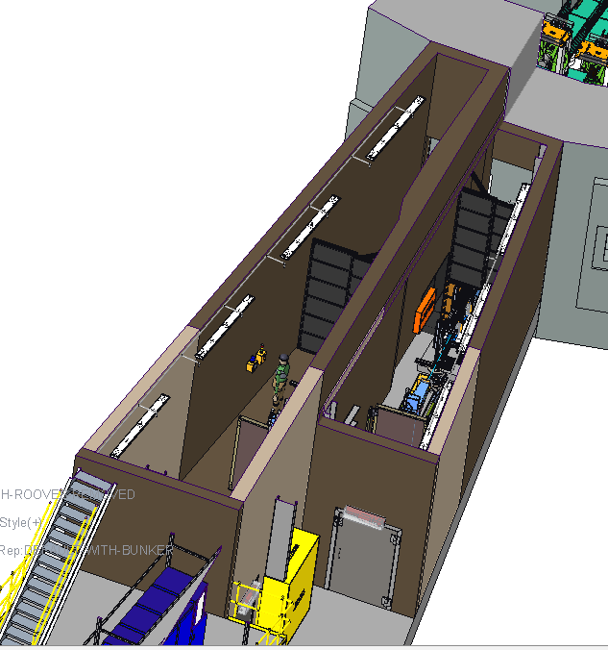
Background Shield Wall (for Detector Background Reduction)
Bunker wall
Background Shield Walls are placed at the end of the guides in each of the QIKR-U and QIKR-L caves
One half of the wall is fixed, the other is hinged to allow personnel access to the in-cave portion of the guides
The hinged half is configuration-controlled and remains manually locked unless either both beamlines are inactive, or the proton beam is off
The QIKR-U wall is slightly wider and shorter than the QIKR-L version because of the different detector locations in the cave and the detectors’ different view angles (QIKR-U looks more downward, QIKR-L looks more upward)
The primary purpose of the background shield walls is to fill the detector’s view with B₄C (ZHIP mix panels) to reduce background noise from concrete surfaces (cave walls and floor)
The walls are not intended as radiation shielding for personnel but do block personnel access to areas of the cave that may have higher dose rates in certain operating conditions.
Movable Shield Walls
QIKR cave
QIKR-U
QIKR-L

Slide 29
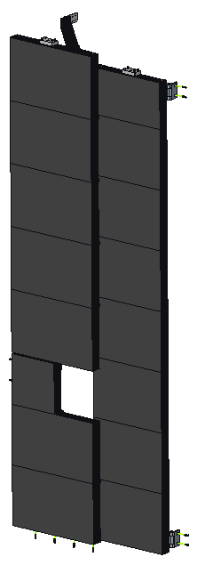
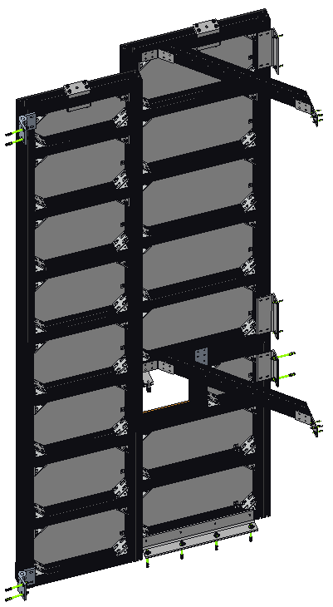
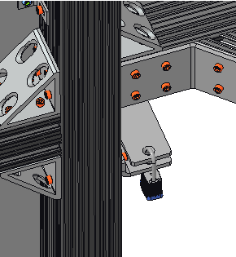
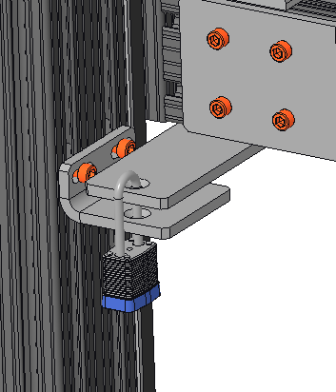
Background Shield Wall – QIKR-L (mirrored for QIKR-U)
Hilti anchors
Custom SS 90° L-brackets (4x)
Swing open
Attachment for swivel hoist ring
(steel, custom)
Fixed Side
Hinges (2x)
Steel, 2000lb capacity
Braces (2x)
80/20 aluminum
Movable Side (downstream view)
80/20 aluminum extrusion rail, 30-series, 3”x3”
Hilti anchors
Opening for guide end
Lock for configuration control
80/20 corner brackets, aluminum
Hilti anchors (for hinges)
Hilti anchors

Slide 30
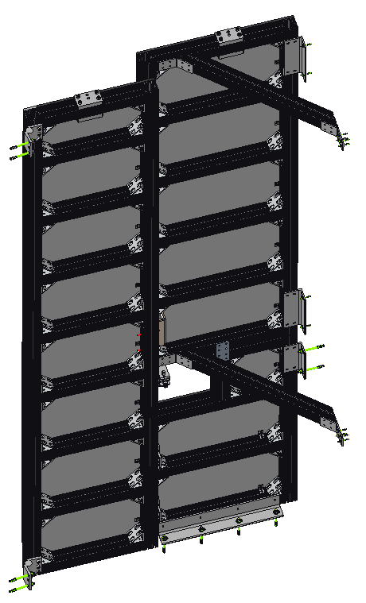
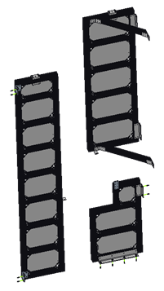
Background Shield Wall – QIKR-L
Each background shield walls is built in three sections for easier installation around the guide
The larger sections have plate to attach a swivel hoist ring for crane transport
All sections are intended to be assembled in-cave by ORNL staff. If built elsewhere, the two heaviest sections may be transported by crane using swivel hoist ring lift points.
Construction is an aluminum 80/20 frame with ZHIP mix panels mounted to the downstream side
The ZHIP mix panels have an aluminum backing plate with threaded studs pre-installed by Dielectric Sciences
Panels are attached to the 80/20 frame using two COTS L-backets… this method keeps the attachment hardware from being visible to the detector
The hinged side of the door (500lbs) is supported by 2000lb capacity hinges & padlocked to the fixed side & configuration controlled
All attachment to the concrete walls & floor is done with Hilti anchors
465lbs/ 202lbs
500lbs/ 375lbs
200lbs/ 156lbs
Weights of QIKR-U version shown in red

Slide 31
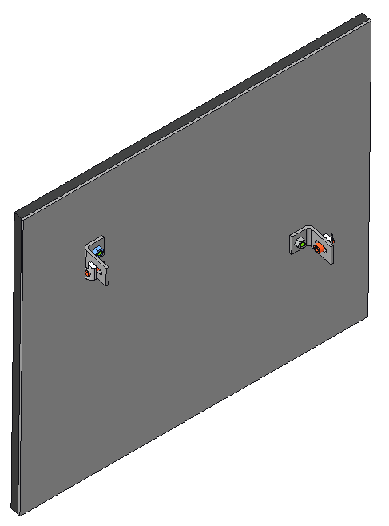
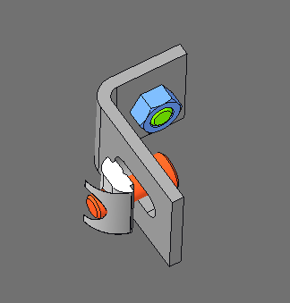
Movable Shield Wall – ZHIP mix panels
ZHIP mix panels are procured from Dielectric Sciences (single source)
The vendor provides the ZHIP mix on an aluminum backing panel with threaded studs pre-installed
ZHIP mix layer is 11mm thick, aluminum layer is 3mm thick (may need to increase the aluminum layer to 6mm, waiting for vendor feedback)
Panels are attached to the 80/20 frame with COTS aluminum L-bracket & 80/20 spring-loaded T-nuts
T-nuts are spring loaded to stay in place if the panel is removed & replaced (may need to be done if panel becomes damaged
Highest ZHIP mix panel weight = 34lbs (QIKR-U)
Pre-installed threaded PEM stud (PENN Engineering)
Spring-loaded T-nut (80/20)

Slide 32
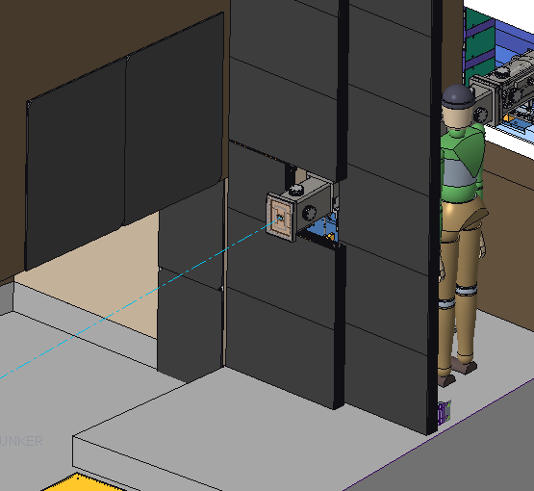
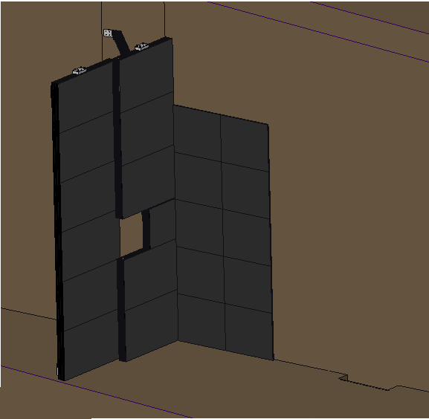
Background Shield Wall – ZHIP mix panels
Additional ZHIP mix panels are installed on the QIKR-L cave walls to block the detector’s view of concrete surfaces
Panels are attached via Hilti anchors at their corners (ZHIP mix is not present on the corners)
Heaviest panel = 34lbs
Extra ZHIP mix panels
QIKR-U
QIKR-U
QIKR-U needs more extra panels on the center cave wall
QIKR-L

Slide 33
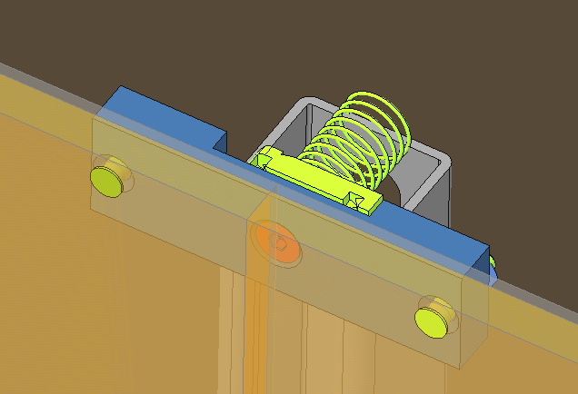
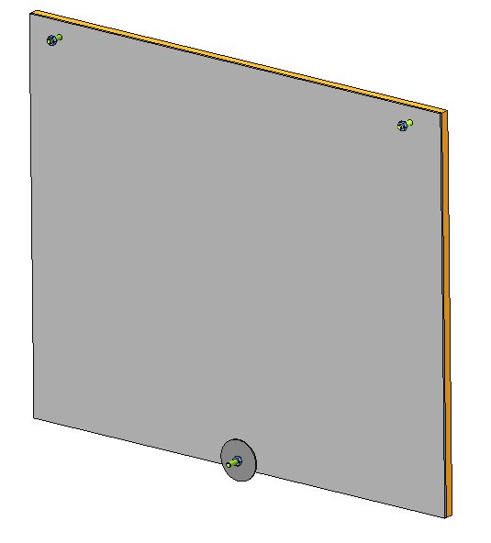
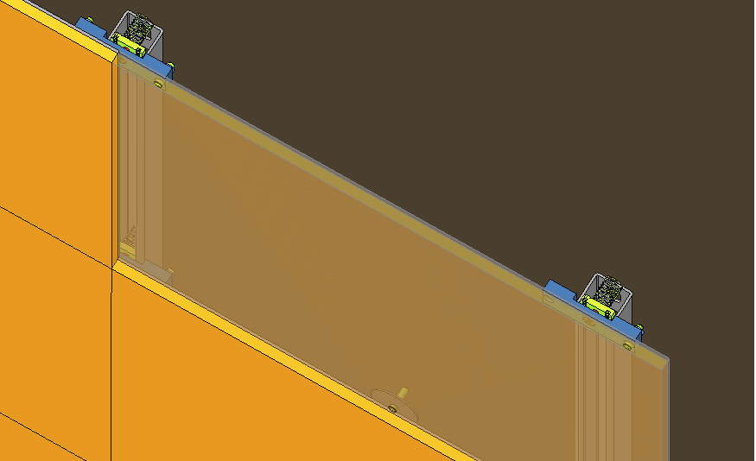
Background Shield Wall – ZHIP Mix Panels Attachment to Wall
Nut plate
Threaded studs with nuts
Screw
Unistrut
Fender washer with nut
Similar to the background wall panels, threaded studs are inserted into the ZHIP mix aluminum backing panels
Panels attach to Unistrut on the cave wall along their top edges (in-cave manual installation, ORNL labor)
Panels attach to the previous panel with pre-tightened fender washer on their bottom edges (in-cave manual installation, ORNL labor)

Slide 34
Acquisition, Manufacturing, Installation

Slide 35
Acquisition strategy
Shielding component | Competitive Bid or Sole Source | Vendor Location | Exotic Mat’ls | Supplier Constraints/ Comments
Lower Beam Stop | Competitive | Domestic | No
Bunker Wall Feed-Through (QIKR-L & QIKR-U) | Competitive/ Sole Source | Domestic | No | Rollers are sole sourced from Hilman, steel shielding is competitively bid
QIKR-L Background Shield Wall | Sole Source | Domestic | No | ZHIP mix panels are sole source, frame is sourced from 80/20
Cave, RWC | Competitive | Domestic | No
Cave, HDC | Competitive | Domestic | No
Note: not currently planning to purchase an upper beam stop or background shield wall unless contingency allows

Slide 36
Manufacturing strategy
Optics component | Manufacturing Strategy
Lower Beam Stop | Beam Stop Panel: Build-to-print Hardware & PPS Switches: COTS In-house assembly of some components (e.g. hinges, PPS switches, latches)
Bunker Wall Feed-Through (QIKR-L & QIKR-U) | Build-to-print fabrication, in-house assembly
QIKR-L Background Shield Wall | Build-to-print ZHIP mix panels, wall-attach brackets All other components are COTS or modified-to-print COTS (hinges, 80/20 frame) In-house assembly of all components
Cave, RWC | Design/build subcontract with specifications supplied by ORNL
Cave, HDC | Design/build subcontract with specifications supplied by ORNL

Slide 37
Installation Plan
Optics component | Installation Plan
Lower Beam Stop | The beam stop/ B4C sub-asm supplied by a vendor, final installation done by in-house SNS technicians
Bunker Wall Feed-Through (QIKR-L & QIKR-U) | Installed in-house by SNS technicians and SAM team
QIKR-L Background Shield Wall | Installed in-house by SNS technicians
Cave, RWC | Installed on-site by subcontractors
Cave, HDC | Installed on-site by subcontractors

Slide 38
Costs

Slide 39
Total Costs – Original P6 Estimate vs. Current Design
Year 2030 dollars
Component | Original P6 Estimate | Current Cost
Lower Beam Stop | $109,724 | $75,267
Bunker Wall Feed-Through | $318,352 | $224,828
QIKR-L Background Shield Wall | $383,424 | $50,754
Cave, RWC | $55,441* | $65,056*
Cave, HDC | $1,503,422 | $1,405,691
*Cost does not include installation
Includes labor costs

Slide 40
Summary

Slide 41
Summary
Neutronics analysis shows that the dose rates within the analyzed cave design are below the limits set in S04080400-DCD10000-R00 in most cases
Some exceptions in certain accident scenarios… may be dealt with using radiation monitors
Design changes since neutronic analysis will need follow-up analysis prior to FDR
Some changes are expected to be an improvement:
Additional steel upstream of the monolith insert
Conversion of the optics insert from two separate components to one combined assembly
Reduction in volume of the QIKR-L cubby
Some changes are expected to have the same shielding performance
Guide shielding unchanged from first round of analysis
Bunker feed-through shielding very similar to the analyzed design
Some changes may be detrimental
Lowering of QIKR-L roof
Additional of cable openings in both the QIKR-U and QIKR-L roof
Conversion of some HDC to RDC, shortening of QIKR-U RDC section

Slide 42
Questions?

