Slide 1
QIKR Shielding PDR: Mechanical Overview
D. Wilson, Lead Engineer
March 03, 2025

Slide 2
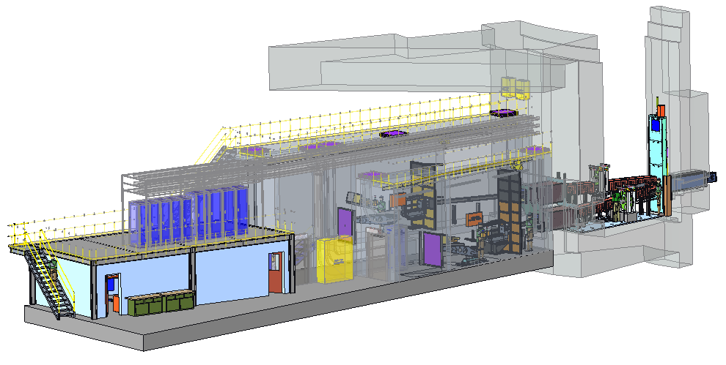
Outline
QIKR Overview
Review Scope
Documentation
High level QIKR description
Shielding Components
Monolith Shielding
Optics Insert
Guide Shielding
Shutter
Bunker Wall and Wall Insert Shielding
Cave
Beam Stop

Slide 3
QIKR Overview

Slide 4
Review Scope
Included
Not Included
Description of model used in Neutronics Analysis (safety shielding components only)
Monolith & guide shielding (Overview)
Shutter beam blocker thickness
Bunker wall shielding (Overview)
QIKR cave (shielding functionality only, no discussion of structural design)
In-cave beam stop
Neutronic Analysis Results
Discussion of current state of design (design evolution beyond what was analyzed)
Changes to monolith shielding, shutter, bunker wall, cave
Background Reduction Shield Wall
Details of the monolith wall shielding (installation, cost, etc.)… this is part of Target design reviews
Details of the monolith optics & guide shielding… this will be part of the QIKR Optics FDR
Details of the bunker wall shielding… this will be part of the Bunker Shielding PDR
Cave structural analysis will be done at FDR & will not be discussed at PDR

Slide 5
Requirements, CQLD, Interface, FMEA Documents
Requirements Documents:
QIKR Instrument Requirements: S04080100-SRD10000-R02 (not released)
The latest revision (R02) has not been released yet, awaiting optics alignment updates
CQLD Biological Radiation Shielding:
Quality Level 2, Configuration Level 2: S04080400-QAI10000-R00 (released)
Quality Level 2 is because of radiation safety impact of shielding failure, Configuration Level 2 is because radiation shielding is defined as a Configuration Item which requires a Level 2 rating
CQLD Non-Safety Related Shielding:
Quality Level 3, Configuration Level 3: S04080400-QAI10001-R00 (released)
Interface Documents:
Interface CF to Bunker wall feedthrough: S01020500-IST10023-R00 (not released)
Interface to CF (pits in the cave): S04010100-C8U-8800-A10000 r5 (updates not released)
FMEA for Shielding: S04080400-FMA10000-R00 (not released)

Slide 6
Requirements, CQLD, Interface, FMEA Documents
Neutronics Analysis:
Bunker Wall, in-Bunker Guide Shielding, Shutter Beam Blocker, Monolith Wall Shielding: TBD (WIP)
Cave, Beam Stop, In-Cave Guide Shielding: TBD (WIP)
Cave analysis includes operating and accident scenarios using input conditions from analyses done for the upstream areas of QIKR (monolith, bunker, etc.)
The data from this document & the one above is presented in this PDR in the Neutronics slides
QIKR Cave Acceptable Dose Rates: S04080400-DCD10000-R00 (released)
This also defines the approved normal use and accident case scenarios

Slide 7
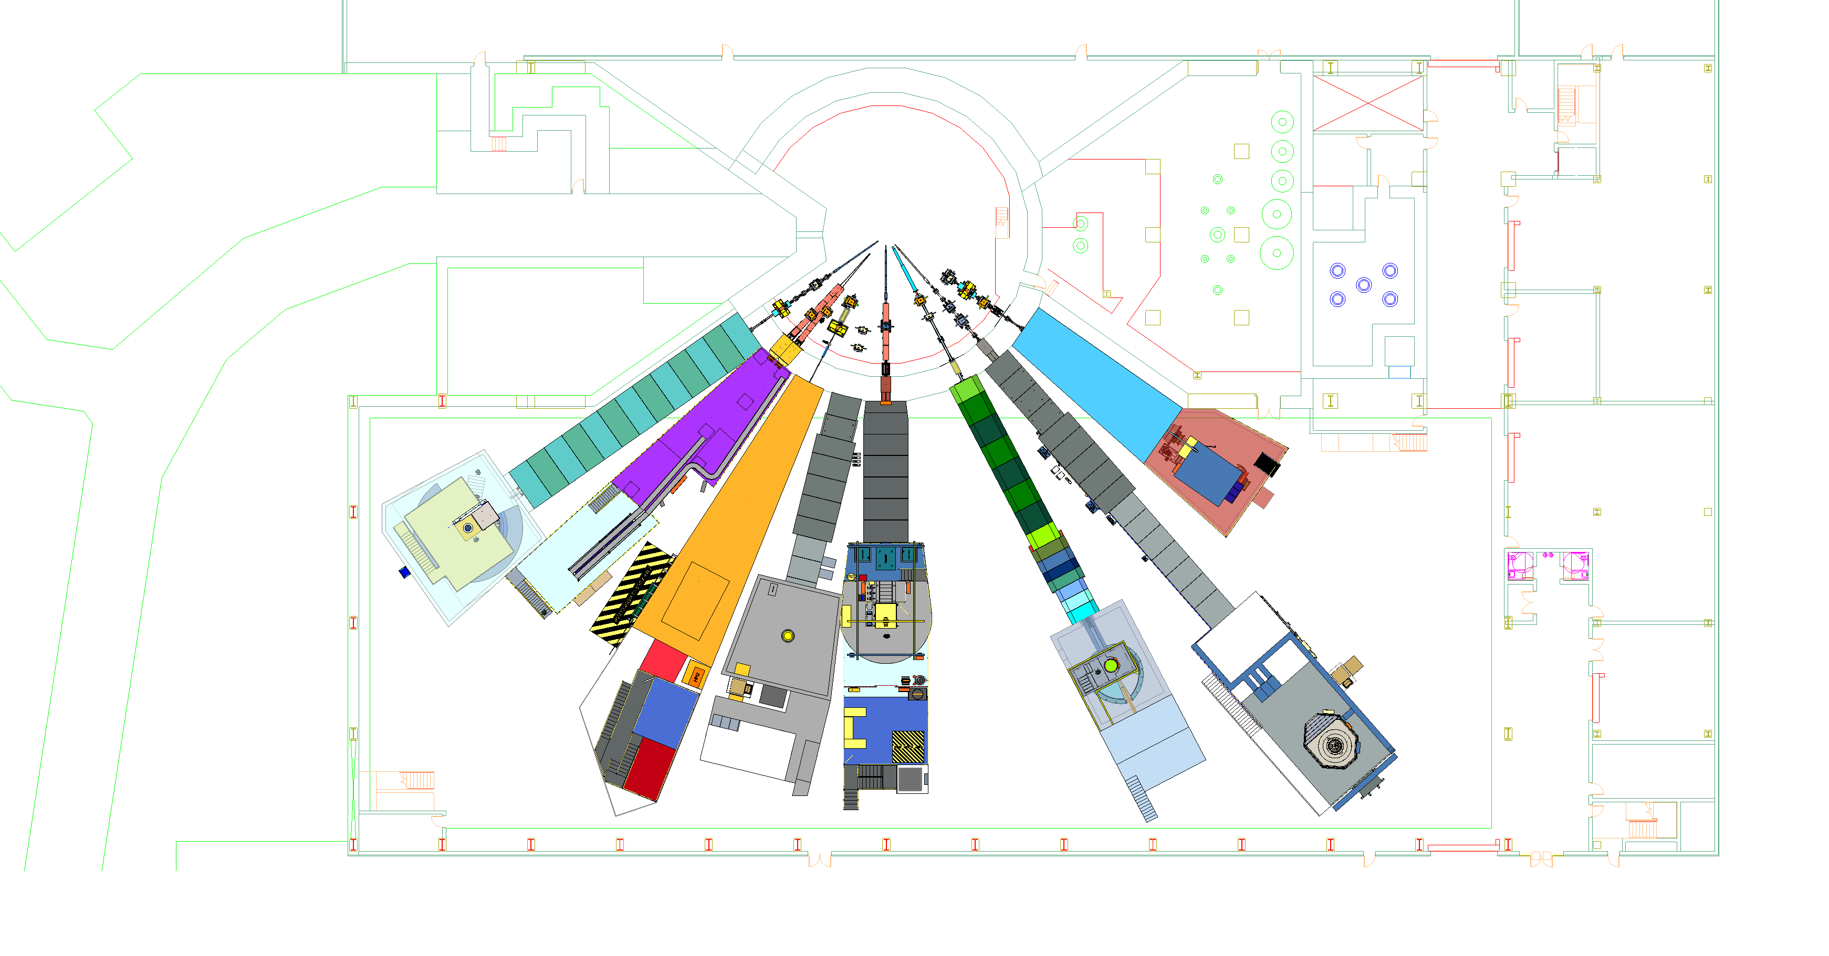
STS Instrument Suite
North Hall
(ST10-ST18)
Monolith Region
Proton Beam
Target Bay
South Hall
(ST01-ST09)
ST01
EXPANSE
ST02
QIKR
ST03
CUPI2D
ST04
BWAVES
ST05
CHESS
ST06
Future
ST07
VERDI
ST08
PIONEER
ST09
CENTAUR

Slide 8
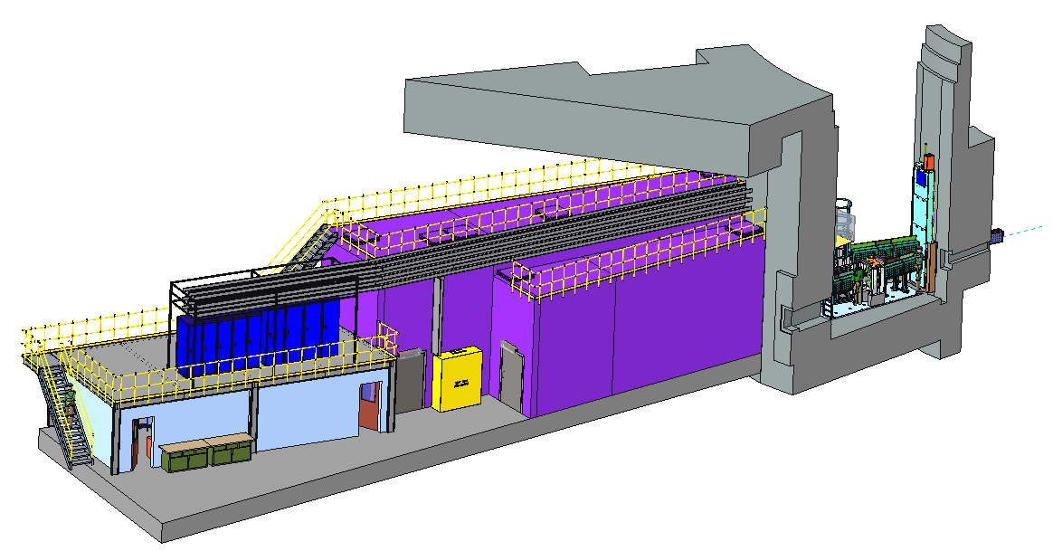
QIKR Instrument Sections
Lintel
QIKR-L
QIKR-U
ST02
Bunker
Cave
Hutch

Slide 9
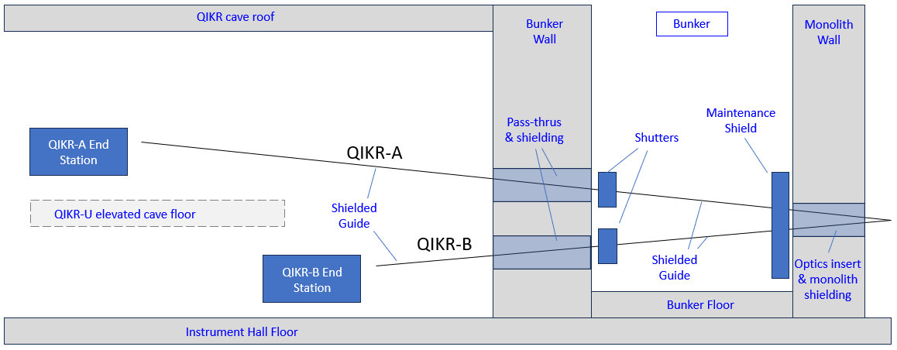
QIKR – Schematic View
As oriented in this view, QIKR-U occupies the back half of the instrument wedge & cave, and QIKR-L occupies the front half
QIKR-U End Station
QIKR-U
Neutrons
ST02
QIKR-L
QIKR-L End Station
The maintenance shield does not perform a beam blocking function
The End Station consists of the Incident Table with Slits and Frame Overlap Mirror, the Sample Table, the Detector Table, and the Sample Changer

Slide 10
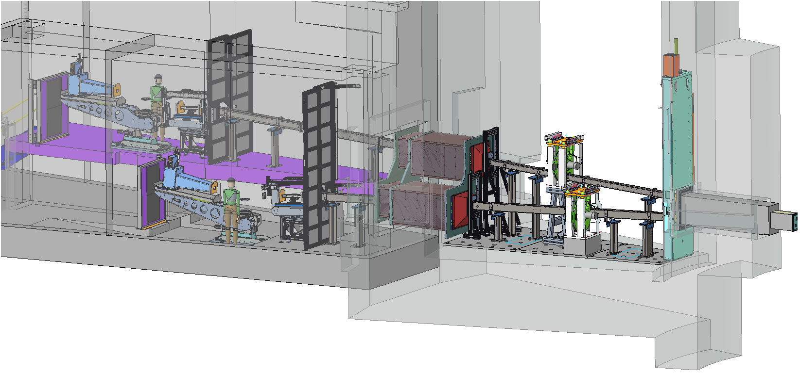
QIKR –3D Model View
Once in the cave the two beam paths are shielded from each other by a central cave wall
Bunker wall pass-thrus & shielding
QIKR-U
Maintenance Shield
Shutters
Beam stops
Monolith Insert
Raised QIKR-U cave floor
Neutrons
QIKR-L
Sample and Detector Tables, Sample Changer
Incident Table with Slits & Frame Overlap Mirror
Shielded guides (both in-bunker and in-cave)
End Station

Slide 11
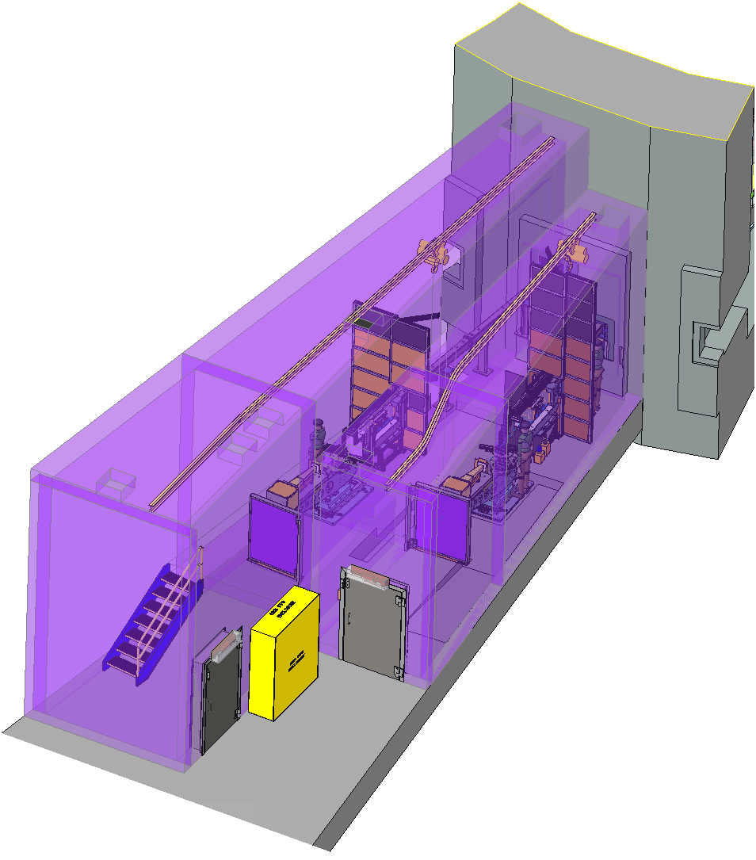
Installation of Components
All QIKR in-bunker components will be installed by removing the bunker roof panels and using the 50-ton high bay gantry crane
Most QIKR in-cave components will be installed by bringing the components into each cave on a cart, then carrying them to their final location with a 2-ton monorail hoist
The monorail will also be used during operations to swap sample environments and to service end station components
2-ton monorail in each cave for component installation, & sample environment changes
Beam stops are hinged and swing out of the way to allow user or component access when needed

Slide 12
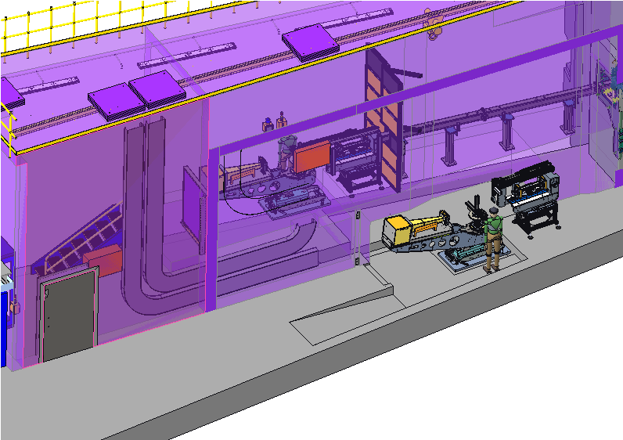
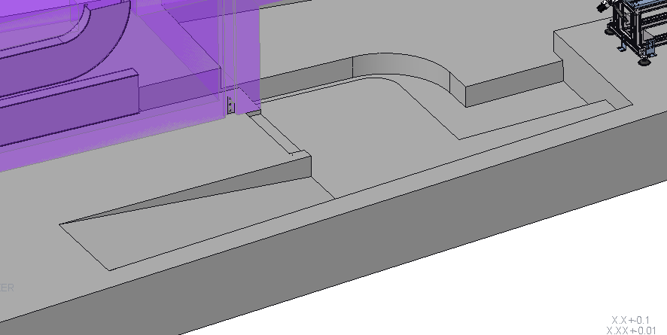
Need for a QIKR-L Pit
End station pit, allows room for a grout plate and 2” of grout for end station installation
Cable Channel from QIKR-U into QIKR-L
User will need to step up 6” to access the incident table
Ramp for user and cart access
QIKR-L requires a pit for the end station because of the downward sloping beam
The pit is two-level to allow a reasonable height for the user to stand & to wheel in equipment carts
The end station pit is combined with a cable channel to route motion cables into the upper cave (QIKR-U), then out to the control racks through the QIKR-U roof

Slide 13
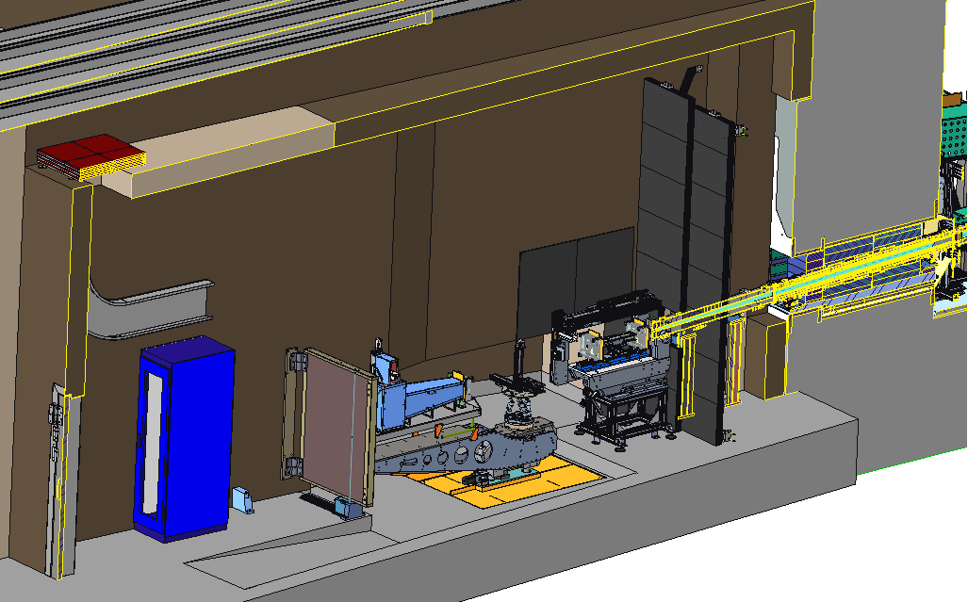
Component Details – QIKR-L Shown (QIKR-U is Similar)
Dividing Wall Between QIKR-U and QIKR-L
Cave Roof (RW)
Cave Roof (HD)
Background Shield Wall
Exterior Cave Walls (HD)
Bunker Wall Shielding
Guide with Steel Shielding

Slide 14
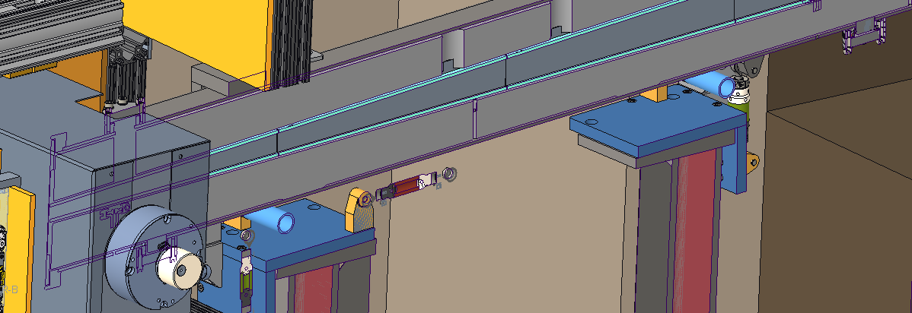
Component Details – QIKR-L Shown (QIKR-U Similar)
Steel guide shielding
Guide narrows, steel shielding increases to fill in the space

Slide 15
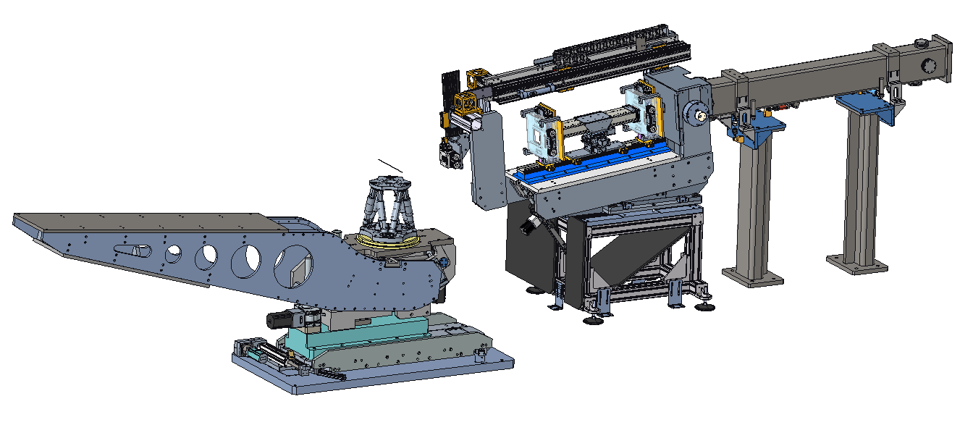
Component Details – QIKR-L Shown (QIKR-U is Similar)
Slits (Locked in place)
Configuration controlled hood
Guide & Housing
Location of Sample (not shown)
Hexapod
Detector Arm
Incident Table
Sample Table

Slide 16
QIKR Shielding Requirements (S04080100-SRD10000-R02)

Slide 17
Monolith Shielding

Slide 18
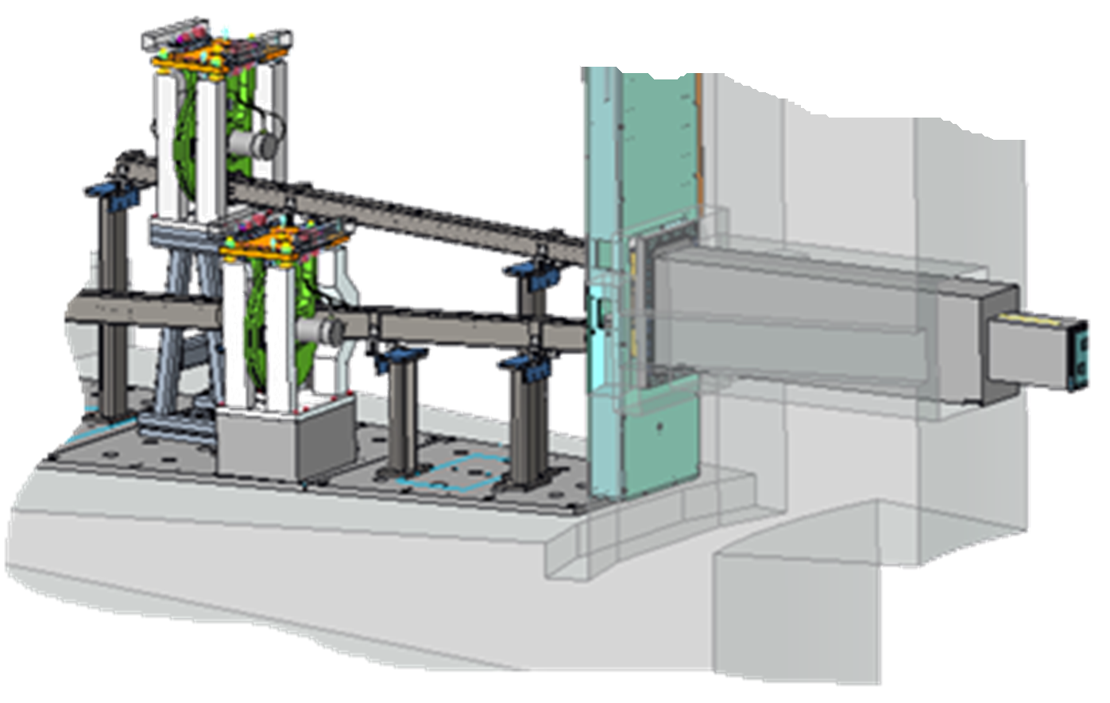
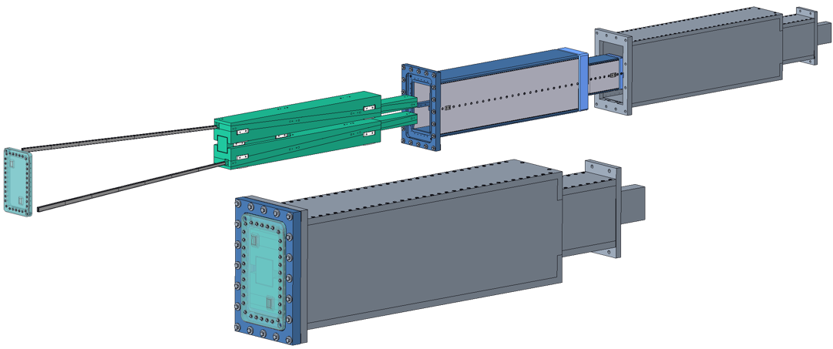
Monolith and Optics Inserts
Credit: Cameron Hart
Both upper and lower beam paths will be contained together within the monolith section. They will be installed (and can be removed) using a bunker-designed handler.
The monolith section consists of:
One Nozzle Extension (provided by Target, vacuum env)
One Monolith Insert, 1x (Bunker-designed, QIKR-owned, helium env)
Two Optics inserts (QIKR-designed & owned, helium env)
Nozzle Extension
Monolith Insert
Optics Modules
Guide Glass
Window
Neutrons
Monolith insert will be removable, even after Operations begin
QIKR Monolith Insert Assembly

Slide 19
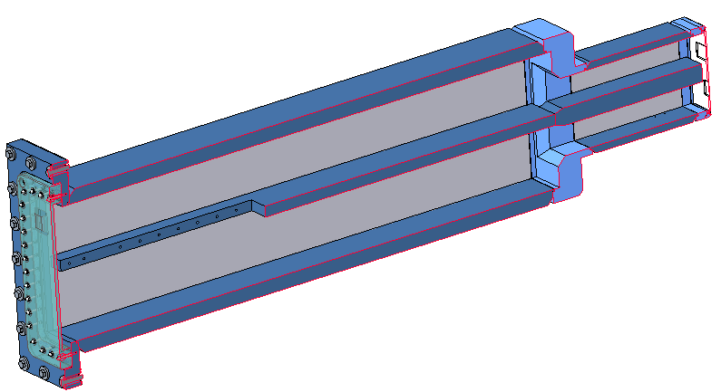
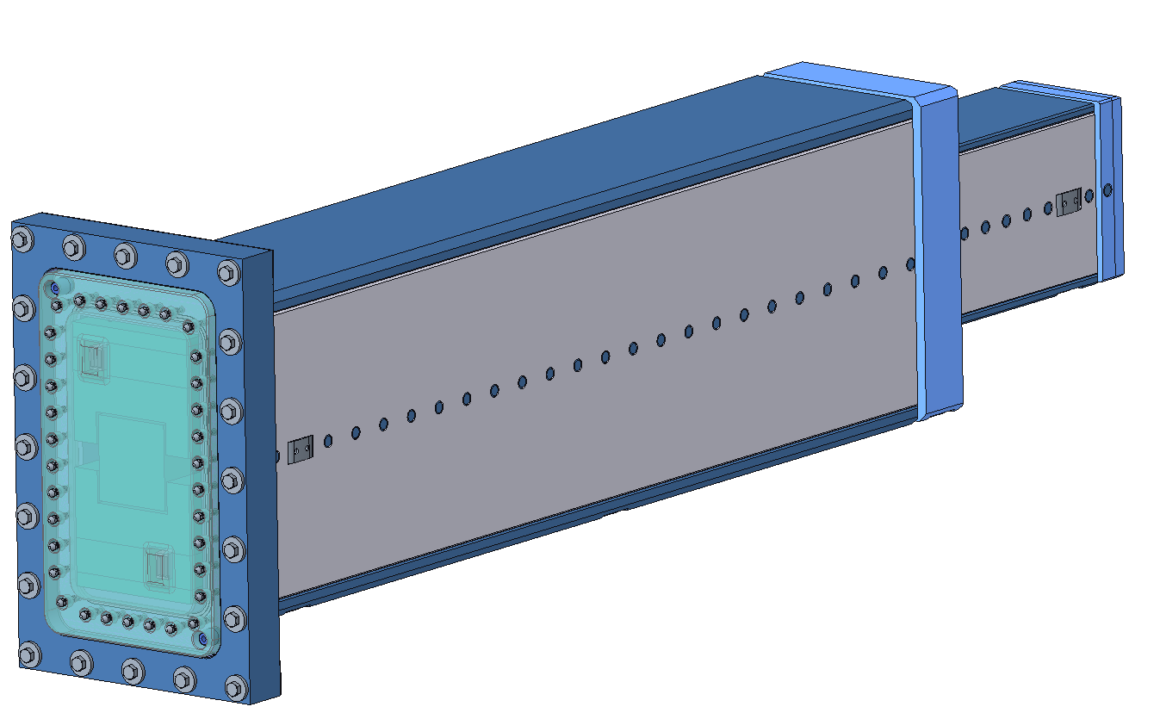
Monolith Insert
Credit: Cameron Hart
Small upstream anti-streaming chicane
Upstream window (aluminum)
Shelf to separate upper and lower optics inserts
Downstream window
(aluminum)
Cutout for anti-streaming block
The monolith insert has two windows to isolate the guide environment (helium) from either the target environment (vacuum) or the bunker environment (air)
The monolith insert has a center shelf to allow the lower and upper optics inserts to be separate from each other
It was originally though that combined optics inserts would be too heavy for the bunker’s insert handler to manage
The center shelf has a downstream cutout to allow for an anti-streaming block

Slide 20
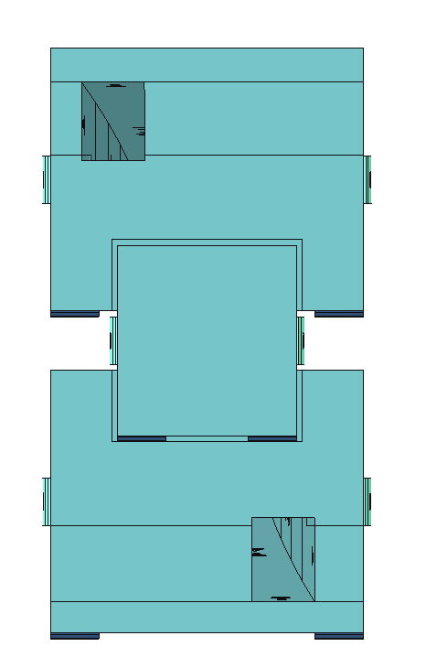
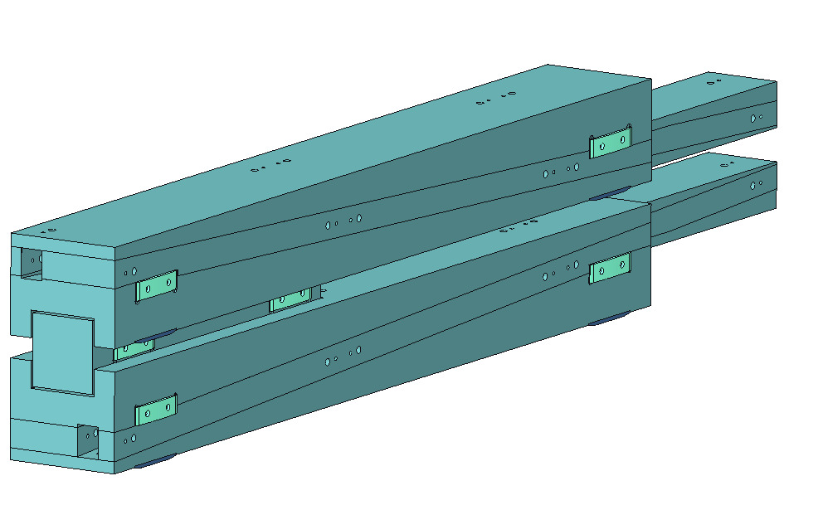
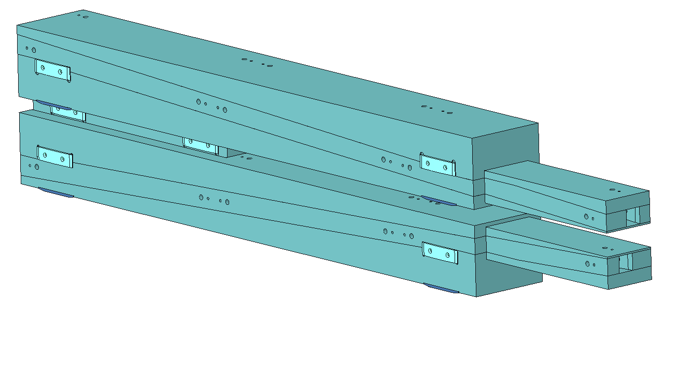
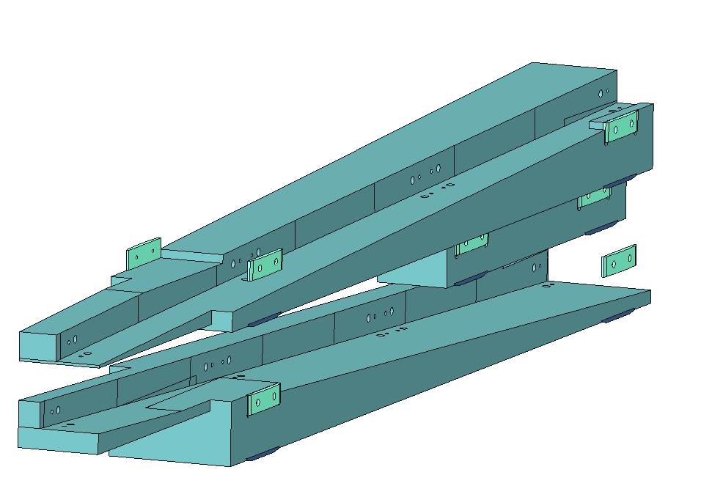
Optics Inserts
31mm
Credit: Cameron Hart
Small upstream anti-streaming chicane
Rectangular outer geometry, inner geometry tailored to the guide
Lower insert
Upper insert
64.4mm
Monolith insert contact pads
Downstream end
Anti-streaming block
Each insert consists of four pieces: a floor, a roof, and two side walls Material = anti-corrosion coated steel, custom fabricated
Pieces generally mate to each other along a +2.5° ramped surface except in areas where monolith insert contact pads are located
Pieces could be split up along the z-dir to aid in fabrication, but ORNL manufacturing confirms they can handle 3.25m as a single length
The anti-streaming block compensates for having very limited space for chicane features between the monolith and optics inserts
Guide routing is constrained by available width for the optics inserts… guides cannot curve or angle in a way that causes them to be outside the optics insert boundaries
Guide support surfaces

Slide 21
Monolith/ Optics Insert Assembly
Anti-streaming block, provides more of a chicane than the 9mm step upstream
Monolith Insert
Thin sections (difficult to manufacture)
Upper Optics Insert
Neutrons
Lower Optics Insert
The anti-streaming chicane
9mm step each side
6mm gaps b/w optics & monolith inserts
Monolith Insert Shelf
Elevation (Side) View

Slide 22
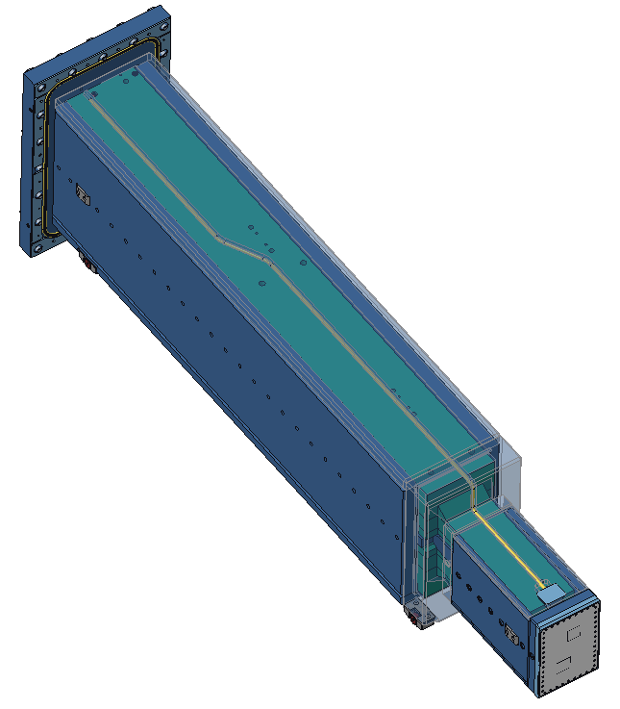
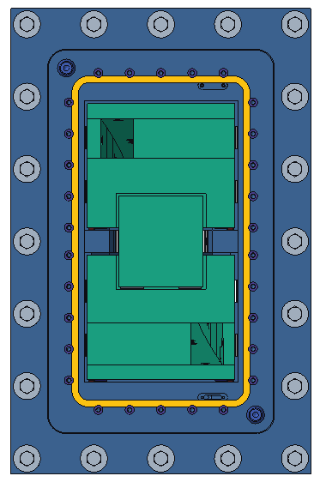
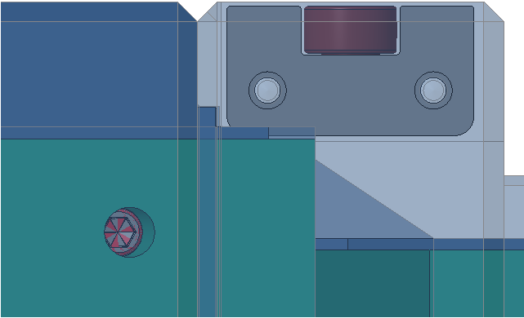
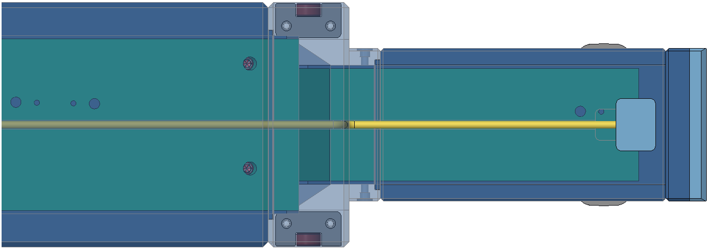
Monolith/ Optics Insert Streaming Paths
6mm gaps (red) allow neutron streaming
6mm
50.45mm
6mm
The 6mm gaps along the insert sides are long and have only a single chicane

Slide 23
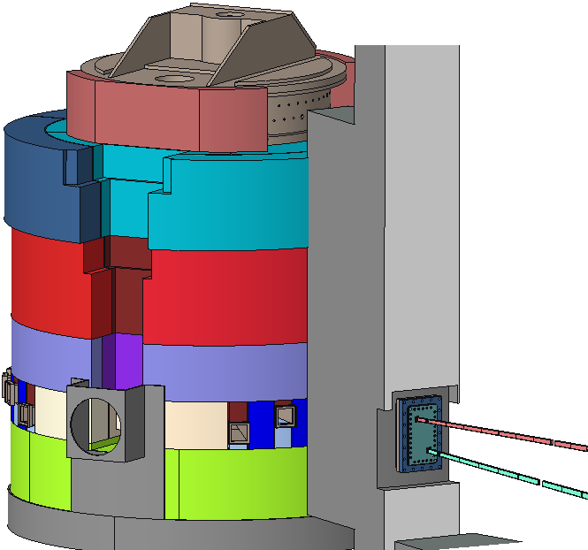
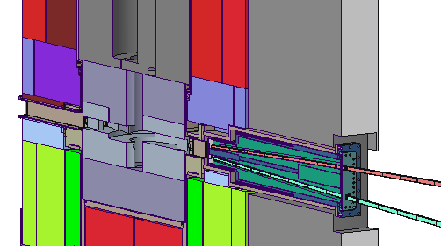
Monolith Shielding
Core Vessel
Core Vessel Shielding
QIKR’s segment of the monolith wall
QIKR monolith & optics inserts
QIKR-U guide glass
ST02 moderator location
Beltline
QIKR-L guide glass
Target’s Core Vessel, Belt Line, and Shielding

Slide 24
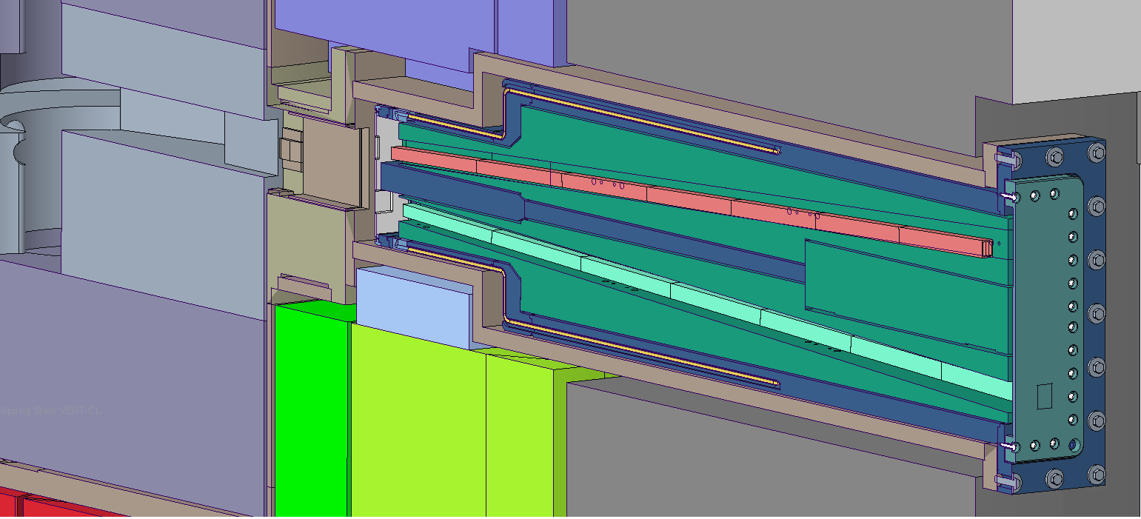
Monolith Shielding – Upstream Empty Space (Vacuum)
Neutrons
Empty space (vacuum) upstream of the monolith insert window. No shielding.

Slide 25
Guide Shielding

Slide 26
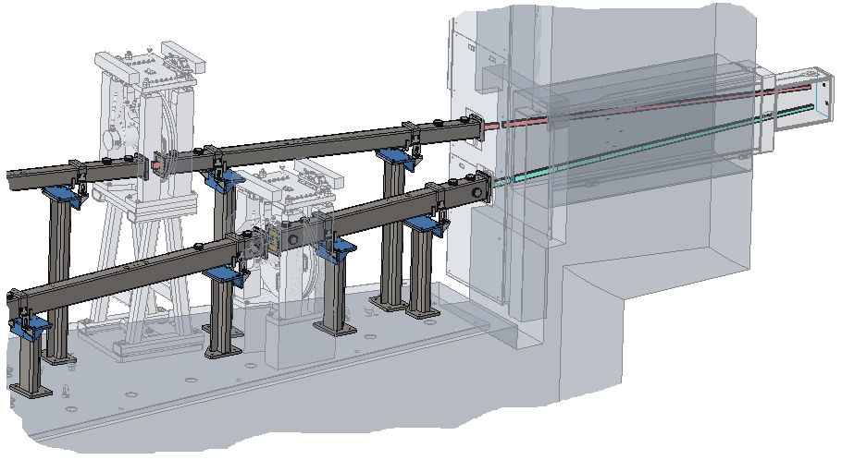
Guide Shielding
Shielded Guide Housings
The QIKR guides are enclosed in two-layer housings from the bunker start to the guide ends
Vacuum environment inside the housings
The outer housing layer (steel) provides the vacuum boundary
The inner housing layer is steel and provides shielding around the guide glass… 3mm gaps surrounding each layer

Slide 27
Guide Shielding
Horizontal cross-section of an in-bunker guide housing, shows change in shielding layer thickness due to guide curving/angling
Plan (Top) view
Guide Glass (float glass in the bunker, borofloat glass in the cave)
Steel Shielding Layer
Stainless Steel Vacuum Jacket
Vertical cross-section of the last in-cave guide housing (QIKR-U), shows change in shielding layer thickness due to guide taper
Elevation (Side) view

Slide 28
Shutter

Slide 29
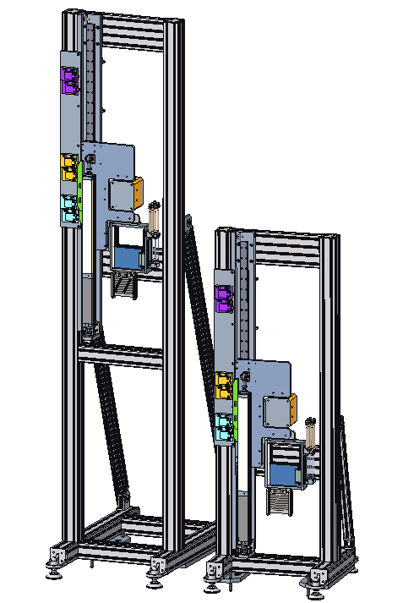
Shutter – Description
Upper beamline (QIKR-U) Shutter
Downstream side (looking upstream)
Beam Blocker
The Shutter blocks the neutron beam to allow personnel access to the cave… there is one shutter per beamline (two total)
The QIKR shutter follows the standard design for failsafe operation, support structure, and control & PPS switches
The beam blocker will drop into position to block the beam if there is a loss of power or compressed air
The composition of the beam blocker is 10cm of tungsten (upstream) followed by 1cm of boron carbide
Lower beamline (QIKR-L) Shutter
Beam Open (with optional attenuation)
Beam Monitor
The 10cm tungsten thickness is more conservative than required by neutronic analysis… 8.11cm is sufficient for QIKR-U, 6.52cm is sufficient for QIKR-L
Design credit: Rudy Thermer

Slide 30
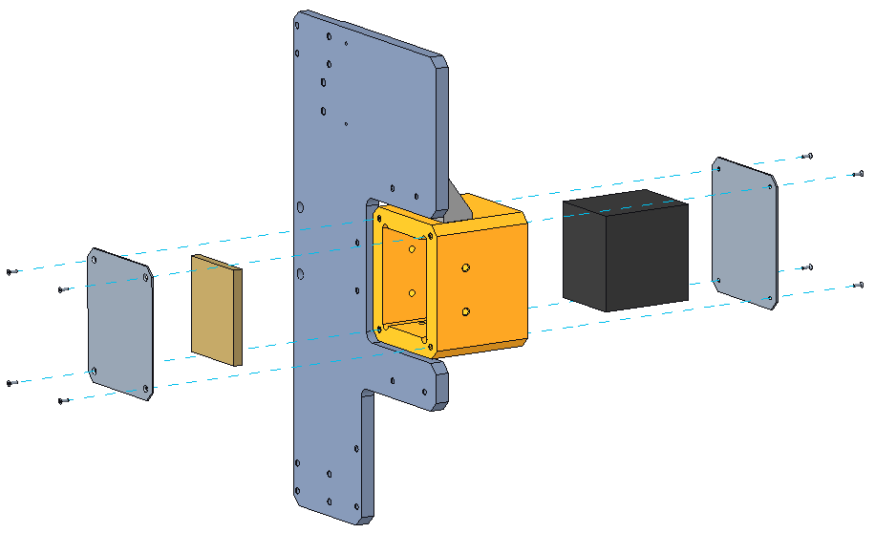
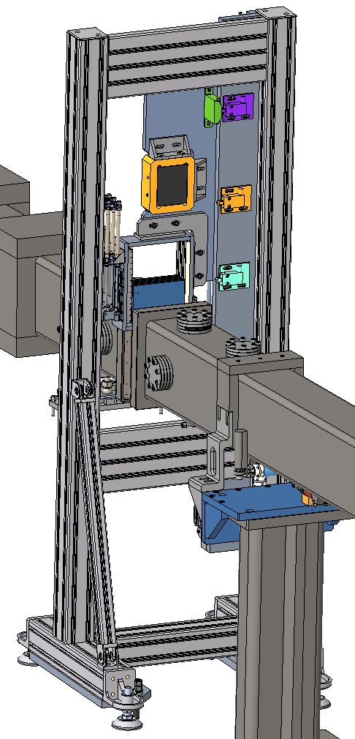
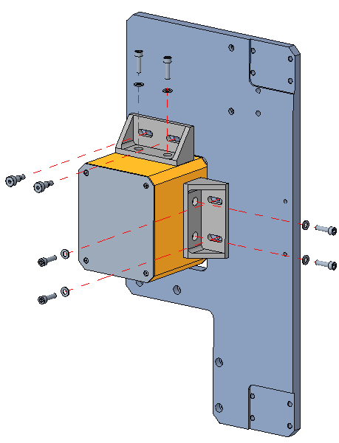
Shutter – Beam Blocker
Beam blocker is 10cm of tungsten followed by 1cm B₄C
Produces <.25mrem/h dose rate from the blocked beam at the sample location
The tungsten and B₄C are placed in a housing and secured with aluminum sheet metal end caps and (if needed) setscrews
The housing is attached to the shutter carrier plate by two brackets & M6 screws
Top bracket is attached to carrier plate by shoulder screws to provide good vertical location
Side bracket and housing are attached by socket cap screws
10cm thick tungsten
12-gauge aluminum sheet metal (2 places)
1cm thick B₄C
Machined aluminum housing
Blocker can removed/ replaced/adjusted while installed in the beamline
M3 flat head screws (8x)
Setscrew holes to help secure the tungsten, if needed
Machined aluminum carrier plate
M6 shoulder screws (2x)
M6 socket cap screws (6x)

Slide 31
Bunker Wall and Feed-Through Shielding

Slide 32
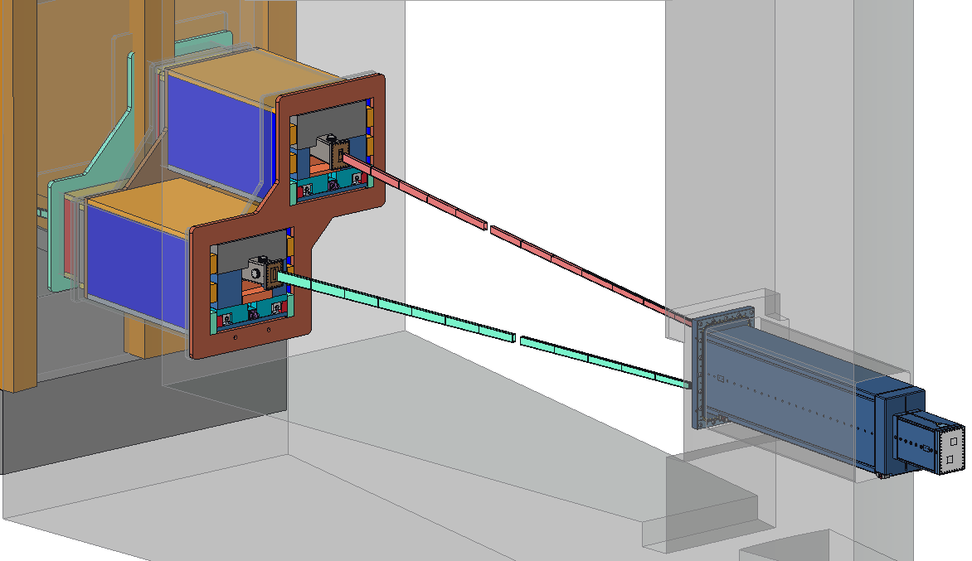
Bunker Wall & Feed-Throughs
The bunker wall contains feed-through openings to allow the guide to pass from the bunker into the cave
On either side of the feed-through, there are chicaned channels to allow cables to pass between the bunker & cave (needed for shutter and chopper power & signals)
Steel shielding is placed between the guide housing and walls of the feed-throughs
Both the steel shielding and cable channels are chicaned to minimize neutron streaming
Bunker Wall = 203.2cm thick HDC
353.8cm above the cylindrical moderator center (RWC above that) --HDC = High Density Concrete --RWC = Regular Weight Concrete
Bunker wall feed-throughs
Cable channels
Steel shielding

Slide 33
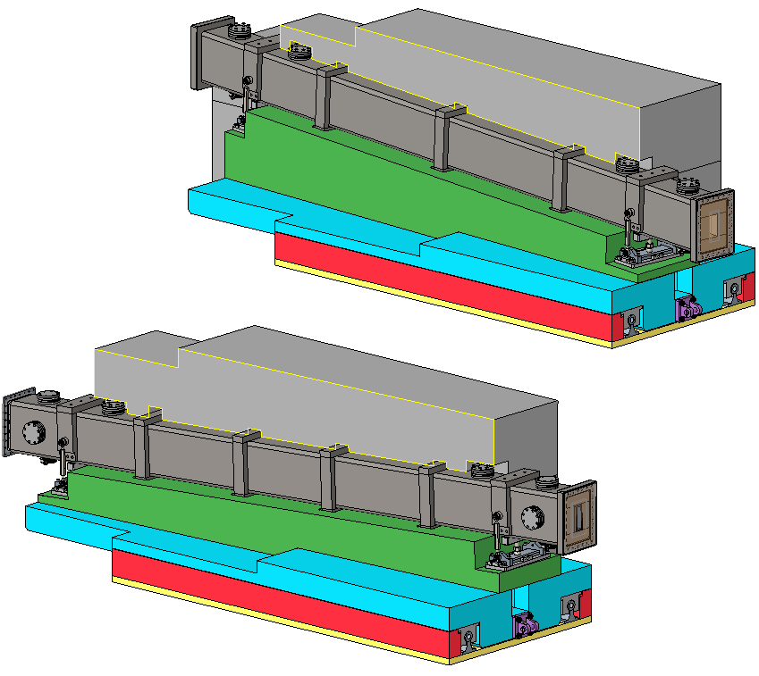
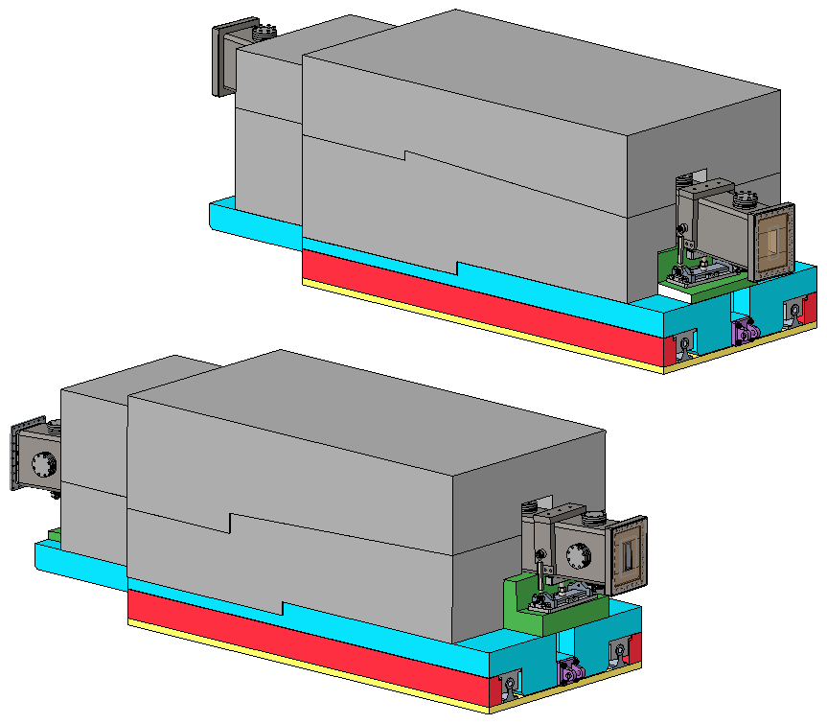
Steel bands serve as anti-streaming features
Feed-Through Shielding & Optics
Upper beam
Credit: Art Diaz
Shielding
Shielding (A36 Steel, Corrosion coated)
Upper beam
Shielding chicanes
Sled / Shielding
Leveled mounting plate (yellow) with grout layer (not shown) beneath
Lower beam
Steel bands encircling the housings serve as anti-streaming features
Exterior of the shielding is rectangular, interior is contoured to fit the guide path
Mounting base plate is leveled with a regular weight concrete (RWC) grout layer (not shown) underneath
Housing and shielding assembly is slid into the bunker feed-through opening on rails attached to the mounting base plate
Lower beam
Rails and pillow blocks (old design, see next slide)

Slide 34
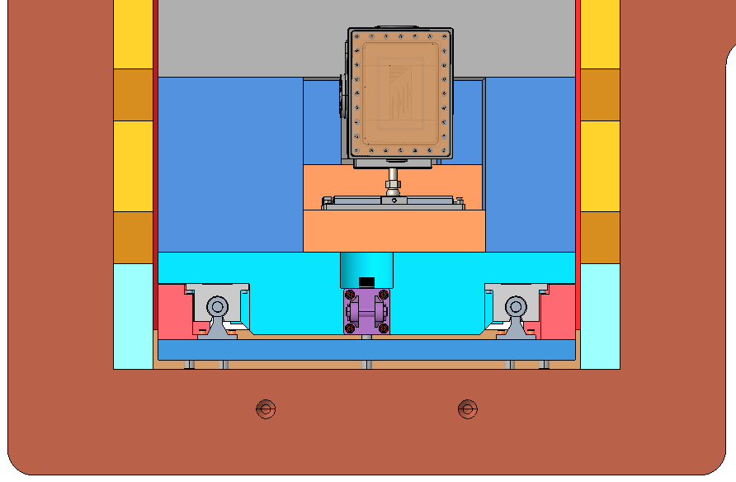
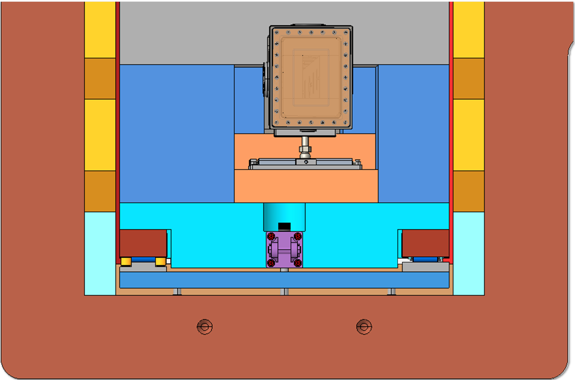
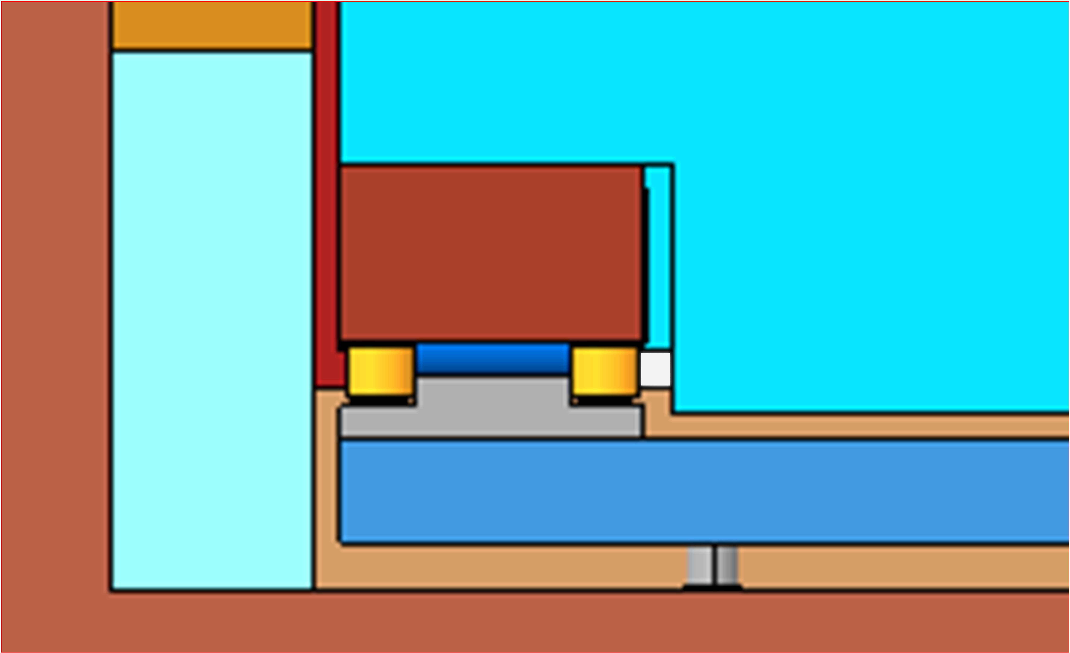
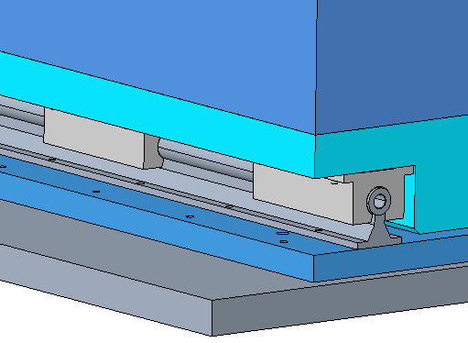
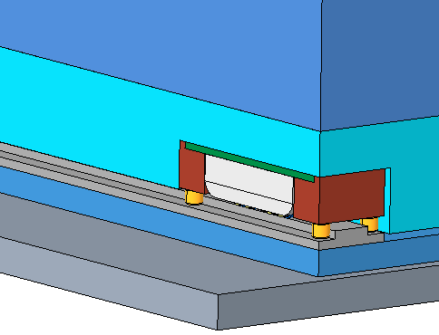
Change in Feed-Through Rollers
Original Design
Neutronic Analysis Design
Rails on both sides need good alignment to each other
Only one side of the Hilman roller system provides lateral motion constraint… the two rails do not need to be tightly aligned to each other
There are gaps, but no unobstructed streaming paths except at the Hilman roller corners (white)
Original (pillow block bearings and rails)
Hilman
Empty space (non-shielded)
Alignment rollers on one side only
Shielded space
Benefits of Hilman rollers:
allow for easier rail alignment
Less empty space, better anti-streaming

Slide 35
Cave

Slide 36
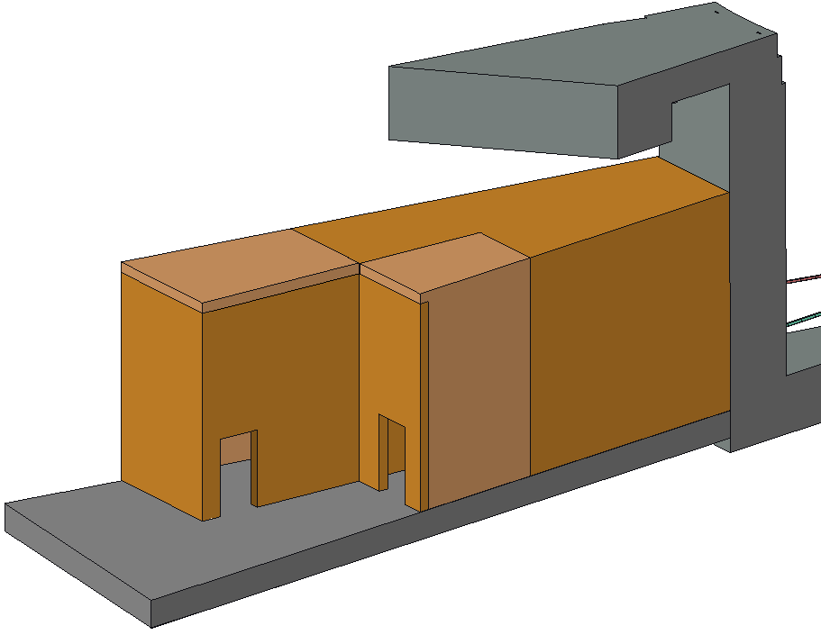
Cave – Exterior
Cave dimensions and materials match those used in the neutronics analysis
Cave doors (not shown) are 70mm thick steel, PPS interlocked
2500cm to moderator
600cm
2100cm to moderator
QIKR-U
400cm
HDC
HDC
HDC
HDC
RWC ST01-side
RWC
QIKR-L

Slide 37
Center wall is 350mm thick HDC
Outer walls are 300mm thick HDC or RWC (see previous slide)
QIKR-U has an elevated floor to hold the guide supports and end station equipment
User will stand on the elevated floor to access the QIKR-U sample environments and end station
Space beneath the QIKR-U floor is accessible to QIKR-L for sample environment equipment (called the QIKR-L “cubby”)
Space beneath the QIKR-U on the downstream end is used for QIKR-U sample environment equipment
Also used to route cables from both the QIKR-U and QIKR-L end stations
Personnel access to the guides upstream of both end stations is blocked by a movable but locked & configuration-controlled wall
These walls were not part of the neutronics analysis… they play no role in radiation shielding except to create personnel-inaccessible areas where dose rates are allowed to be unlimited
Cave – Interior
Elevated QIKR-U floor
Cave
Elevation View
Upper Guide
Lower Guide
Bunker Wall
Configuration-controlled walls
Shutter locations
QIKR-L
QIKR-U
Cave
Plan View
Elevated QIKR-U floor

Slide 38
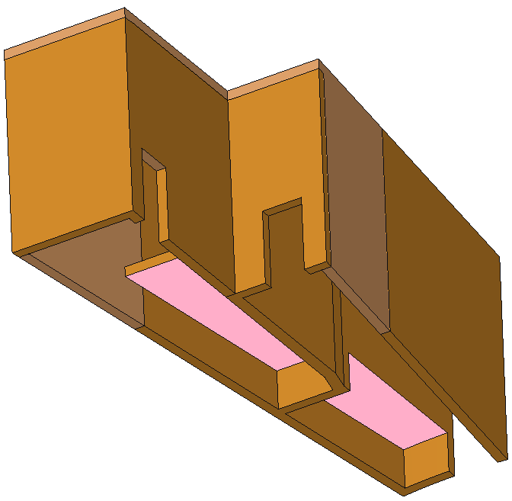
Cave – Cubby spaces
Cubby spaces are both ~4ft in height
Space beneath the QIKR-U floor on the upstream end is accessible to QIKR-L for sample environment equipment (called the QIKR-L “cubby”)
Space beneath the QIKR-U on the downstream end is used for QIKR-U sample environment equipment
Also used to route cables from both the QIKR-U and QIKR-L end stations
QIKR-U “cubby” space
QIKR-L “cubby” space

Slide 39
Discussion of Allowable Dose Rates in the Cave
S04080400-DCD10000-R00 describes the reasonable normal operating and accident scenarios to be evaluated for the QIKR cave
Normal operating scenario:
Slits present and open to the max values used in an experiment
Water sample present at the sample location
Accident scenarios:
Slits present and open to their max widths & heights
Water sample present at the sample location
Stainless steel sample present at the sample location
Acceptable max dose rates in the cave during both operating and accident scenarios:
No limit inside the cave in areas where personnel cannot access
2mrem/h in personnel-occupied spaces inside the cave
Up to 5rem/h at the sample location within a 30cm radius of the sample
Up to 2mrem/h outside the cave with no need for signage where personnel access is limited
Up to 5rem/h outside the cave with radiation area signage in place

Slide 40
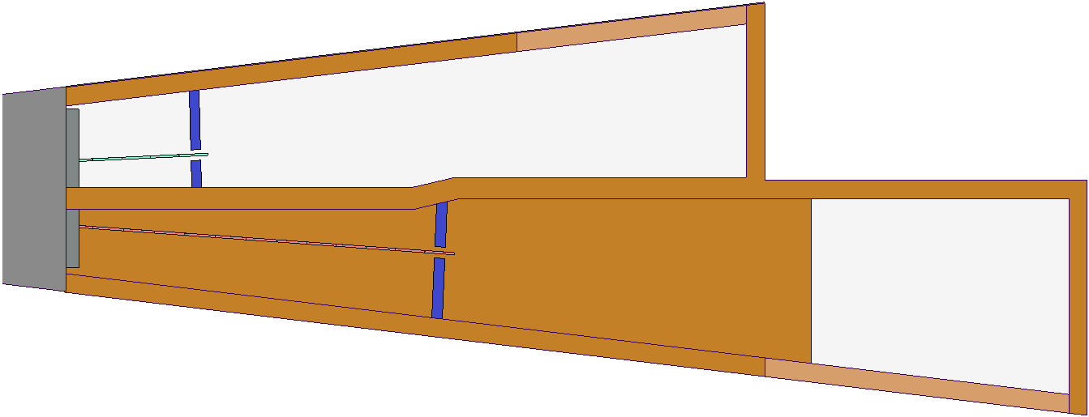
Discussion of Allowable Dose Rates In & Above the Cave
Inaccessible or staff-only access (magenta)
Dose rate max =
-- 2mrem/h without need for action
-- 5mrem/h with radiation area markings
Cave roof = staff-only access
Locked wall
Generally-inaccessible (green)
Dose rate max = 0.25mrem/h
User & staff accessible (blue)
Dose rate max =
-- 2mrem/h generally
-- 5mrem/h inside 30cm radius of the sample
Personnel-inaccessible (red)
No dose rate limits
Locked wall

Slide 41
Summary: Normal Operation
No significant elevated dose rates inside/outside the QIKR instrument cave enclosure
normal operation (QIKR-L active and QIKR-U active)
Cave | Location |  | maximum total dose rate (mrem/h)
QIKR-L | Outer wall, ST03 side | Upstream (HDC) | 0.72
 |  | Downstream (RDC) | 0.28
 | Back Wall |  | < 0.25
 | Roof | Upstream (HDC) | < 0.25
 |  | Downstream (RDC) | 0.43
QIKR-U | Outer wall, ST01 side | Upstream (HDC) | 0.64
 |  | Downstream (RDC) | 0.34
 | Back Wall |  | < 0.25
 | Roof | Upstream (HDC) | 0.31
 |  | Downstream (RDC) | 0.51
normal operation (only QIKR-U active)
QIKR-L | in-beam |  | 0.27
 | bisector wall (inside cave) | Upstream (HDC) | 1.02
 |  | Downstream (RDC) | 0.49
normal operation (only QIKR-L active)
QIKR-U | in-beam |  | 0.28
 | bisector wall (inside cave) | Upstream (HDC) | 0.71
 |  | Downstream (RDC) | 0.29
The normal operating scenarios here use slits at max aperture… more conservative than required
Data table from Kursat Bekar’s analysis

Slide 42
Summary: Accident Conditions
Data table from Kursat Bekar’s analysis
accident condition (QIKR-L normal operating and QIKR-U accident)
Cave | Location |  | maximum total dose
 |  |  | rate (mrem/h)
QIKR-L | Outer wall, ST03 side | Upstream (HDC) | 0.72
 |  | Downstream (RDC) | 0.31
 | Back Wall |  | < 0.25
 | Roof | Upstream (HDC) | < 0.25
 |  | Downstream (RDC) | 0.43
QIKR-U | Outer wall, ST01 side | Upstream (HDC) | 1.79
 |  | Downstream (RDC) | 0.30
 | Back Wall |  | < 0.25
 | Roof | Upstream (HDC) | 0.65
 |  | Downstream (RDC) | 0.88
accident condition (QIKR-L accident and QIKR-U normal operating)
QIKR-L | Outer wall, ST03 side | Upstream (HDC) | 2.70
 |  | Downstream (RDC) | < 0.25
 | Back Wall |  | 0.31
 | Roof | Upstream (HDC) | 0.38
 |  | Downstream (RDC) | 0.71
QIKR-U | Outer wall, ST01 side | Upstream (HDC) | 0.94
 |  | Downstream (RDC) | 0.34
 | Back Wall |  | < 0.25
 | Roof | Upstream (HDC) | 0.31
 |  | Downstream (RDC) | 0.51
accident condition (QIKR-L inactive and QIKR-U accident)
QIKR-L | in beam |  | 0.28
 | bisector wall | Upstream (HDC) | 1.01
 |  | Downstream (HDC) | 2.76
accident condition (QIKR-L accident and QIKR-U inactive)
QIKR-U | in beam |  | 0.27
 | bisector wall | Upstream (HDC) | 2.35
 |  | Downstream (HDC) | 0.35
This area outside the cave may need radiation area markings, depending on which beamline is on ST03. Currently, this area is blocked by CUPI²D & is inaccessible to personnel. Is it a concern for beamline cross-talk?
normal
accident
This dose rate is in a personnel- occupied section of the QIKR-L cave & is above the allowed max of 2mrem/h, but is located high on the wall where users would not be (see next slide)
This dose rate is in an area inaccessible to personnel while either beamline is operating.

Slide 43
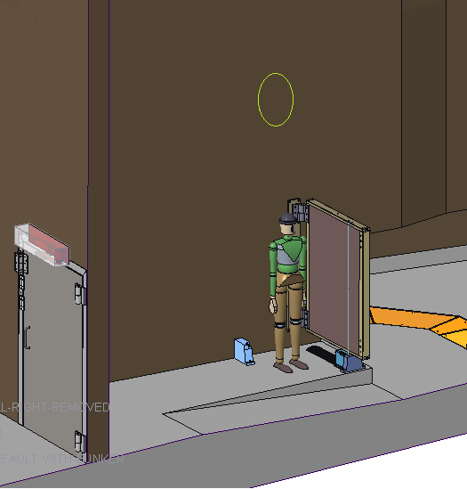
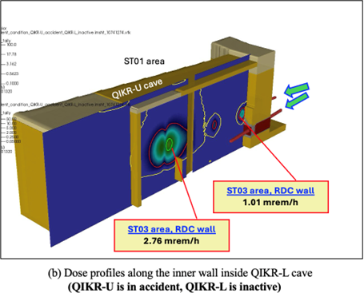
Discussion of Allowable Dose Rates In & Above the Cave
Figure from Kursat Bekar’s analysis
Location of 2.76mrem/h dose rate in QIKR-L

Slide 44
Beam Stop

Slide 45
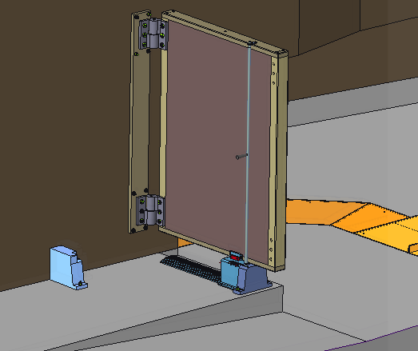
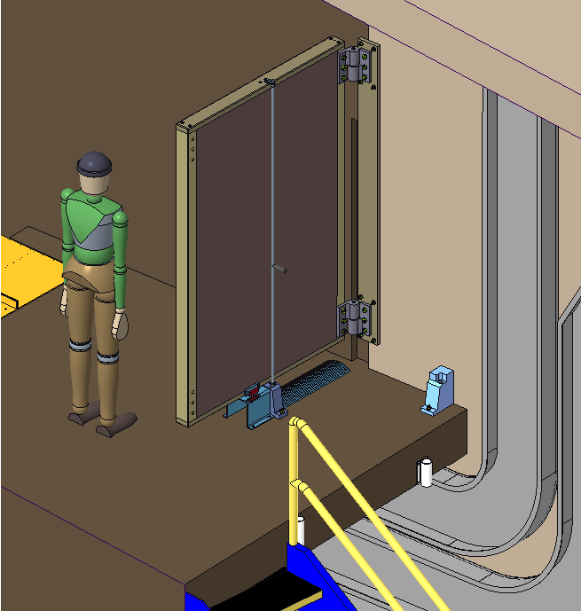
Beam stop weight: 1970lbs
Beam Stops – Overview
QIKR-L
Hinge weight capacity: 8000lbs axial
3500lbs radial
QIKR-U
Both QIKR-L and QIKR-U beam stops are hinged to allow easier access to the back side of the end stations when needed (expected to be infrequent)
Beam stops are manually moved and manually latched in the “open” and “closed” positions
“closed” position is for “beam on” condition & is indicated to IPPS via magnetic sensor (two sensors for redundancy)
Beam stop weight: 2860lbs

Slide 46
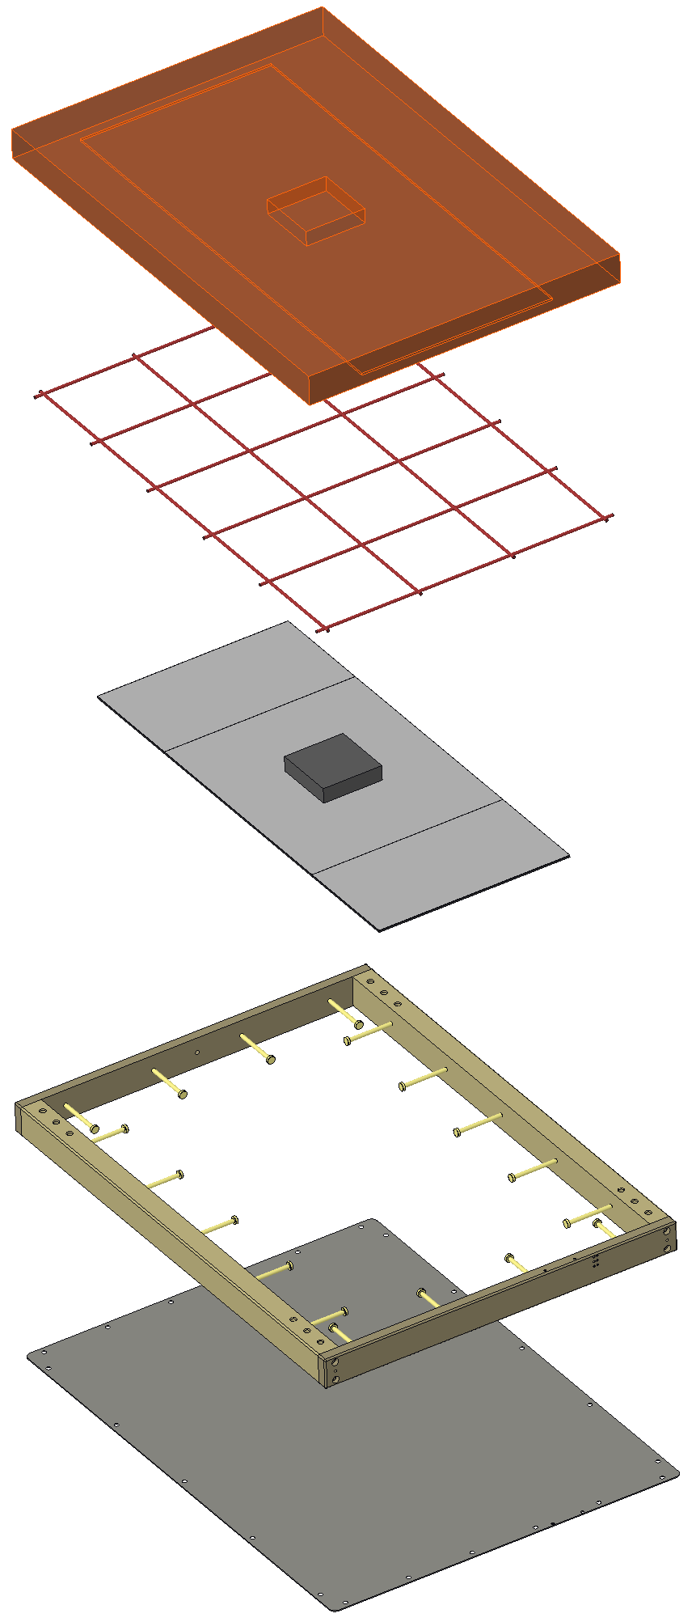
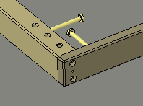
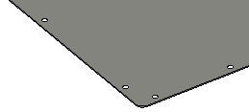
Beam Stop – Construction
HD Concrete 100mm thick
Screwed-together steel frame construction
Steel rebar .375” diameter
~12” spacing
Neutronics analysis model for the beam stop has the same B4C, HDC, and steel block thicknesses & HxW dimensions
Steel frame, Nelson studs, aluminum face plate, and reinforcing steel rods (rebar) are departures from the MCNP model
Changed made to make the beam stop manufacturable
Because of concerns the HDC concrete may crack when suspended from one side by the hinges, beam stop construction may change to only B₄C + steel
Will need re-evaluation by neutronics at FD
Steel block 200mm square 50mm thick
3 B₄C Panels, 5mm thick, with 2mm thick aluminum backing
H=1450mm, W=600mm
Aluminum face plate is screwed to the steel frame in multiple locations
Screwed-together steel frame with Nelson studs
Creates a can for containing the HDC
Aluminum face plate, ~3mm thick

Slide 47
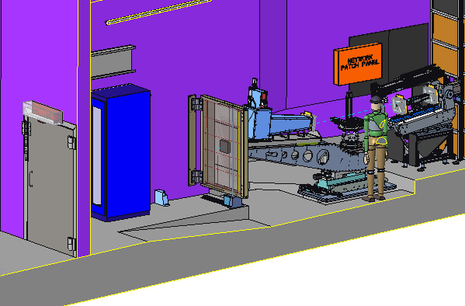
Beam Stop – QIKR-L
Hinges, Brookfield W125HD-RH (same as used for cave door)
Steel frame
Nelson studs
Steel block
HD Concrete
Beam stop is hinged to swing up against the cave wall when needed.
Steel frame contains lift attachments on the top, Nelson studs along the inside surfaces, and attachments for a latching rod and a magnetic sensor on the bottom
Aluminum sheet face
Rebar
B4C panels

Slide 48
Beam Stop – QIKR-L
Latching rod
Latching/stop blocks
Non-wired magnetic sensor half
Two latching/stop blocks that stop the beam stop in the correct position (open or closed) and provide a means of latching the beam stop in place
In the closed position, there are two magnetic PPS sensors on the bottom edge, one on the back, one in the front.
The non-wired halves of the sensors are attached on adjustable brackets on the beam stop steel frame
The wired halves are attached to an aluminum sheet metal box, the cables run along the floor to the center cave wall
Sheet metal box with wired sensor half
Cable cover

Slide 49
Beam Stops – QIKR-L
Magnetic sensor
Latching rod, bottom portion
Chamfer ramp
Cable cover
Latching/stop block
Latching rod, top portion

Slide 50
Beam Stop – QIKR-U Safety
The upper beamline version is the same as the lower except mirrored and taller, with the stops shifted inboard
Inward shift of the stops is because of the length of the upper floor relative to the length of the beam stop
Additional vertical length is because of the upward angle of the beam that shifts the beam stop upward away from the floor
The sensor is shifted inboard as well here, but could actually be shifted outward to the free end of the beam stop
The section of railing behind the beam stop would be lifted and rotated out when the beam stop is swung open… can be rotated back into place once the beam stop is open (railing = 37lbs)
Railing closed
Railing weight = 37lbs
Railing open

Slide 51
Questions?

