Slide 1
Introduction - Preliminary Design Review of the STS Vessel Systems & Target Station Shielding
April 21, 2025
Presented by
Mike Strong
Group Leader, Interface Systems

Slide 2
Participants
Project Team, Presenters
Review Committee
Chris Anton – Lead Engineer, Vessel Systems & Target Station Shielding
Cam Eiland – Mechanical Designer
Hogan Knott – Mechanical Design Engineer
Darren Dugan – Mechanical Design Engineer
Tom McManamy - Senior Analyst, Nuclear Engineer
Min-Tsung Kao – Engineering Analyst
Steve Schrick – Lead Engineer, Remote Handling
Igor Remec – Group Leader, Neutronics
Mike Strong – CAM and Group Leader, Interface Systems
Mike Dayton (Chair) – Section Head, RAD Target & Mechanical Systems
Wei Lu – Neutronics Scientist, NTD Neutronics Group
Jacob Platfoot – Accelerator Safety Program Lead, Nuclear & Radiological Protection Division
David Vandergriff – Sr. Project Engineer, US ITER
Other Collaborators
Lukas Zavorka, Thomas Miller, Tucker McClanahan and the rest of the STS Neutronics team
Devin Malone – Senior Structural Engineer

Slide 3
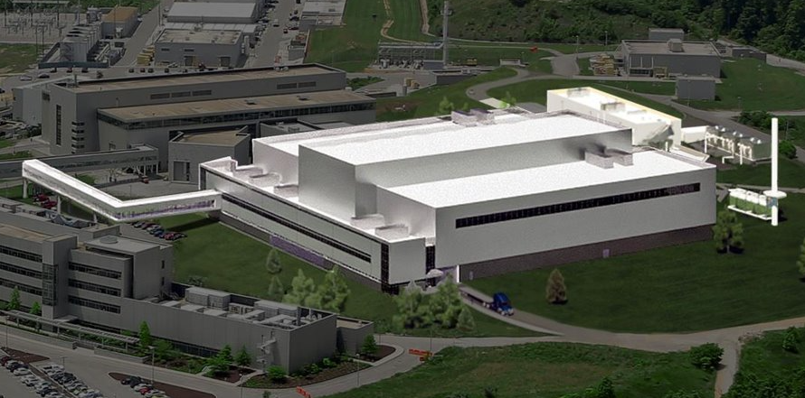
Getting us oriented
Target Systems Scope and Location in the STS Target & Instrument Building
Scope of this Preliminary Design Review
What is a Preliminary Design Review?

Slide 4
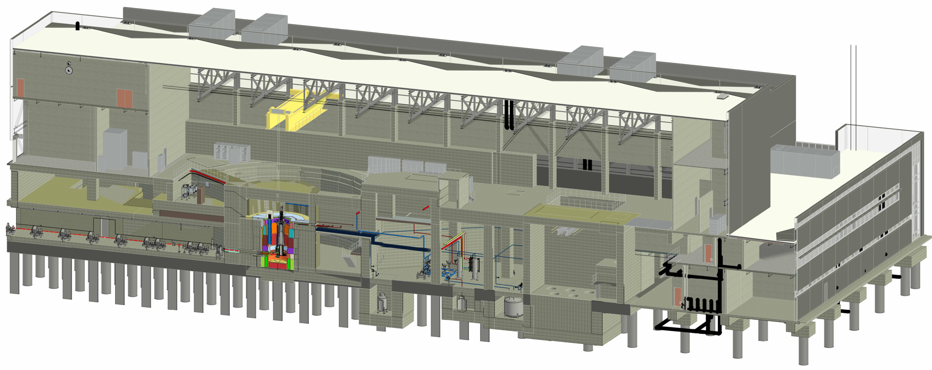
Target & Instrument Building
Cryogenic Moderator System rooms
Target Drive
Room
Service cell
Mock-up test stand
Monolith Vacuum Systems
Monolith
Delay tank & gas-liquid separator vaults
Hot process vault

Slide 5
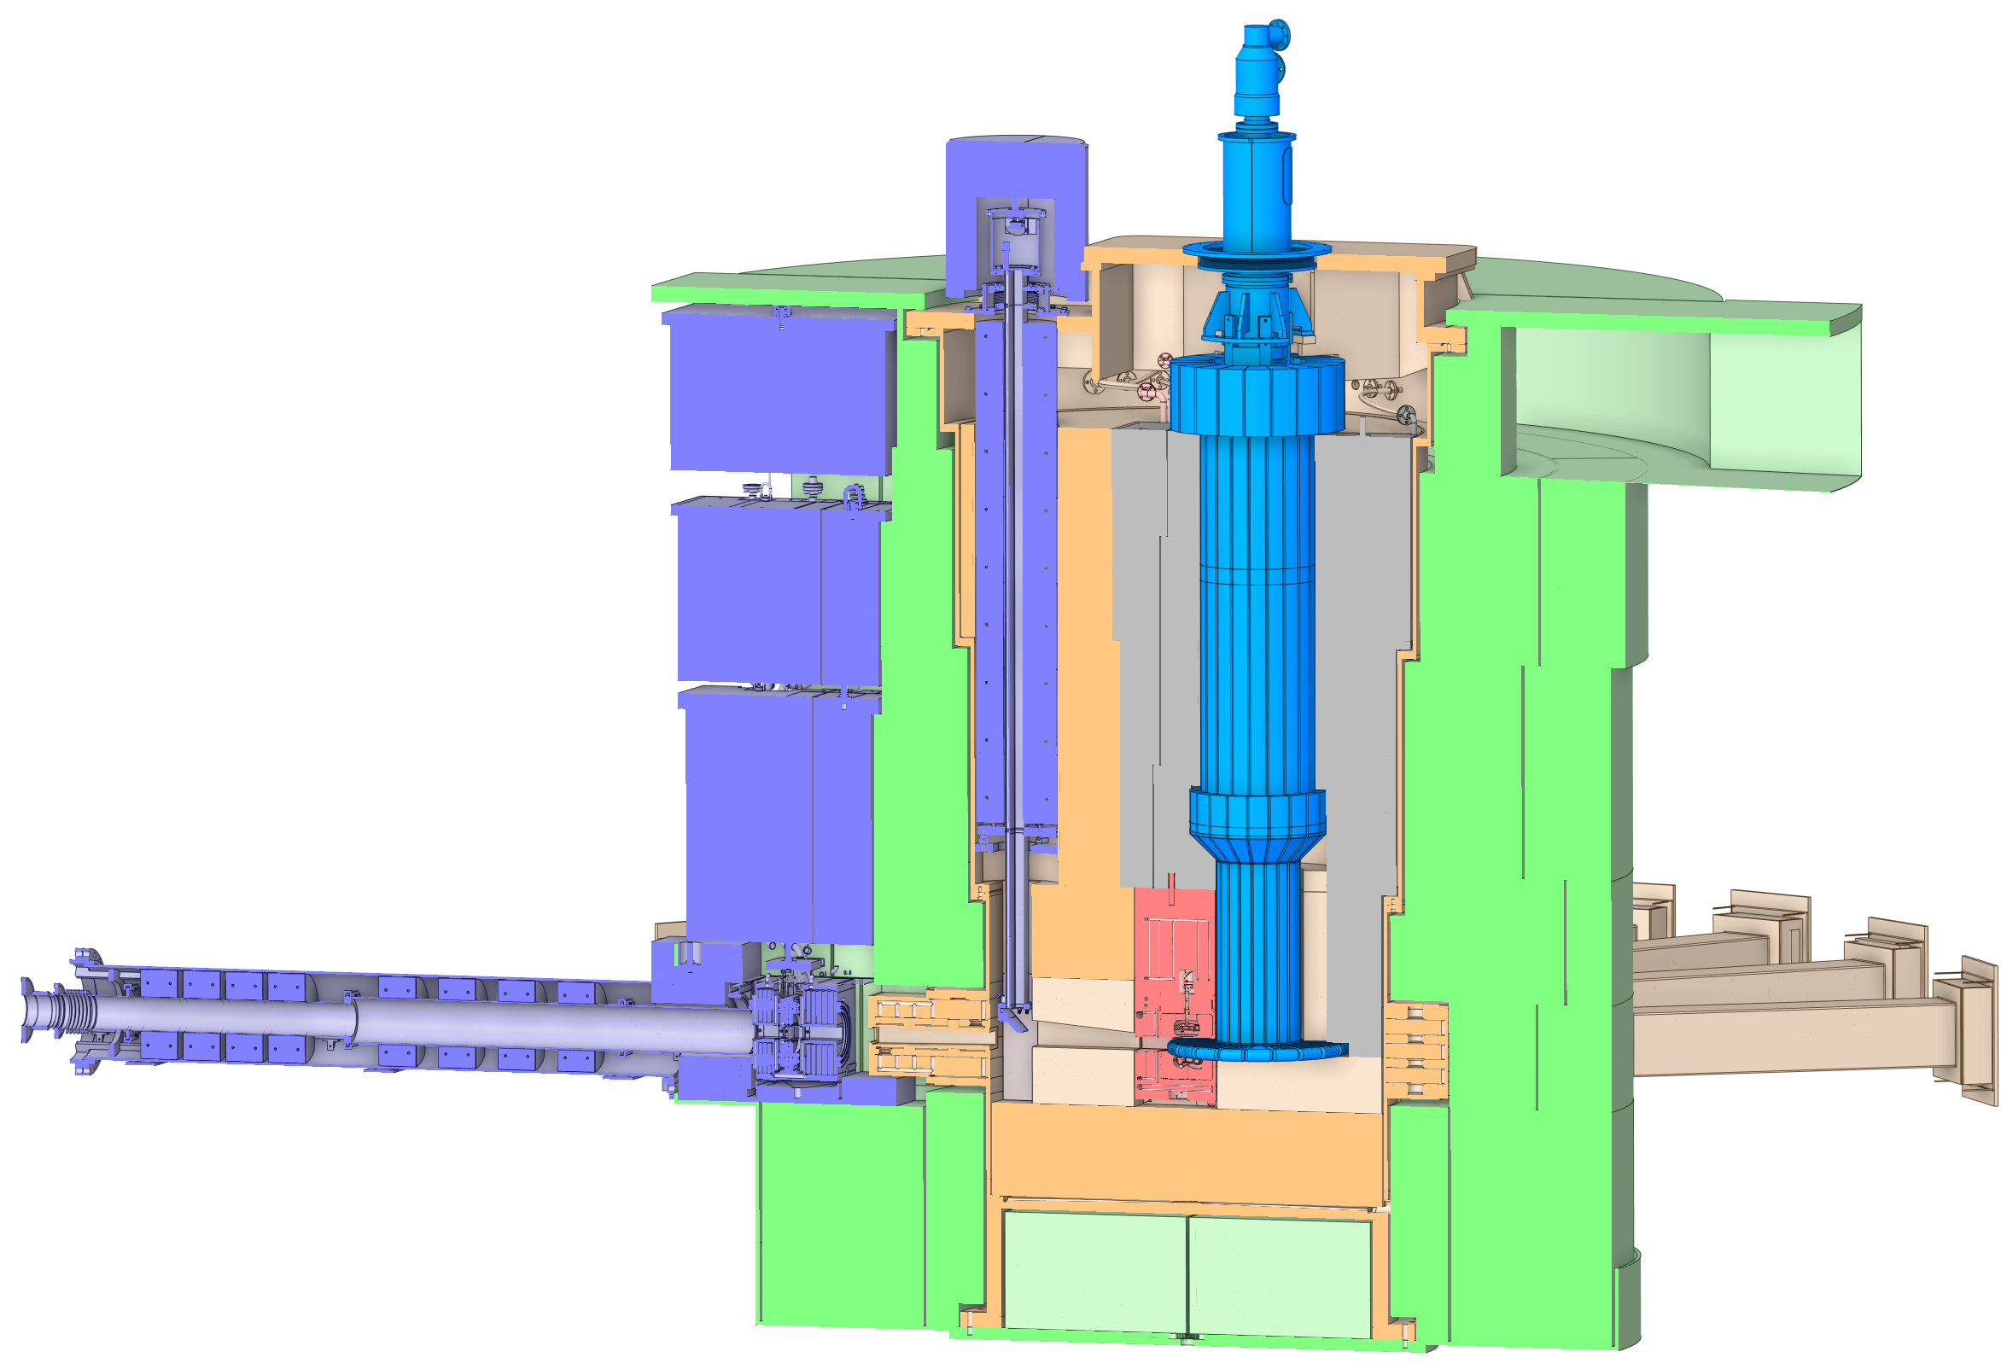
Monolith components scope
Target Drive
Target Viewing Periscope
Core Vessel
Pipe Pan
Core Vessel Shielding
Rotating Target Shaft
Bulk Shielding
Moderator Reflector Assembly
Nozzle Extensions
Rotating Target
Proton Beam Window
Bulk Shielding Liner, Baseplate

Slide 6
Scope of this Preliminary Design Review covers several parts of Target Systems
S.P1 Subproject 1 Early Science
S.P2 Subproject 2 Instruments
S.P1.03 Target Systems
S.P1.07 Research and Development (R&D)
S.P1.03.01
Management and System Integration
S.P1.03.07
Target Station Shielding
S.P1.07.03
Research and Development
S.P1.03.02
Target Assembly
S.P1.03.08
Installation of Target Monolith Systems
Vessel Systems (VS) and Target Station Shielding (TSS) design includes interfaces with all other Target Systems scope, and interfaces with all other STS technical groups with the exception of Accelerator Systems.
In addition to the VS and TSS, a portion of the Target Vacuum Systems covering Core Vessel Vacuum and the R&D studies conducted for Vessel Systems design will be presented.
S.P1.03.03
Cryogenic Moderator Systems (CMS)
S.P1.03.09
Target Process Systems
S.P1.03.04
Moderator Reflector Assembly (MRA)
S.P1.03.10
Remote Handling Systems
S.P1.03.05
Accelerator Interface Components (AIC)
S.P1.03.11
Target Vacuum Systems
S.P1.03.06
Vessel Systems
S.P1.03.12
Neutronics

Slide 7
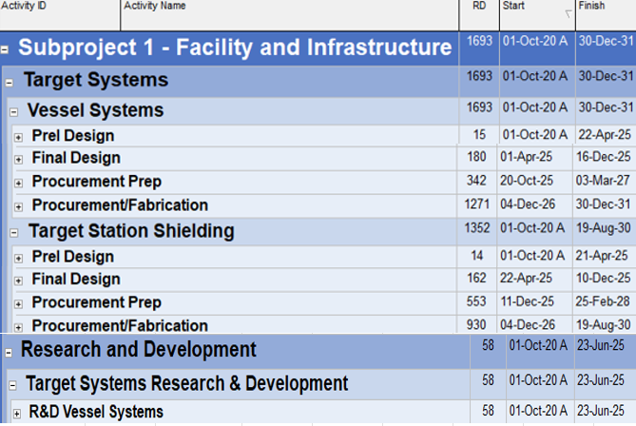
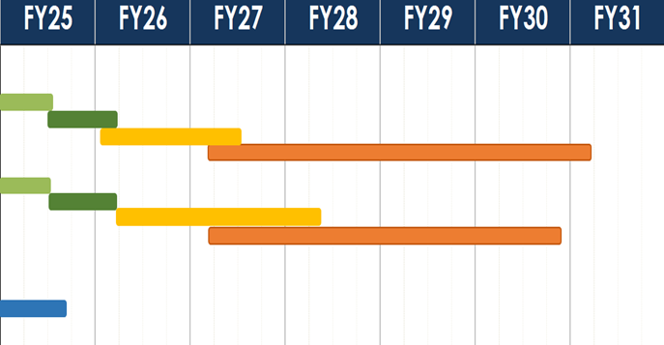
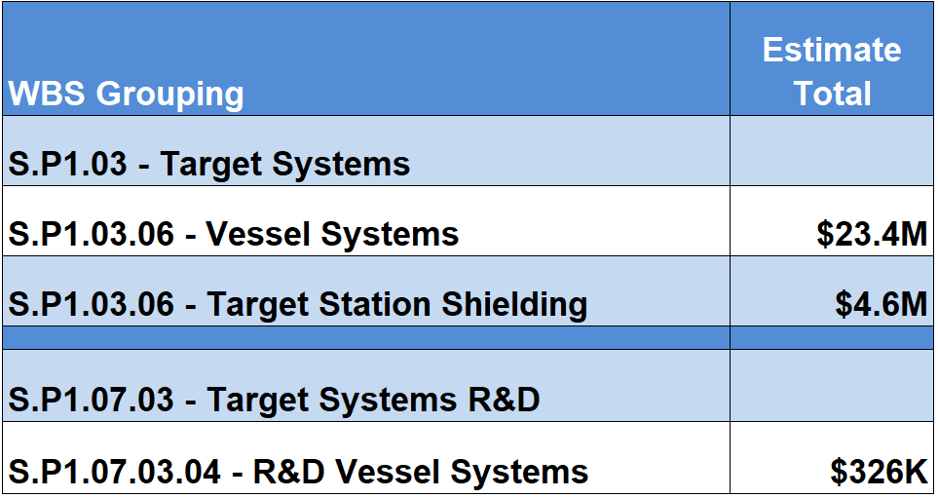
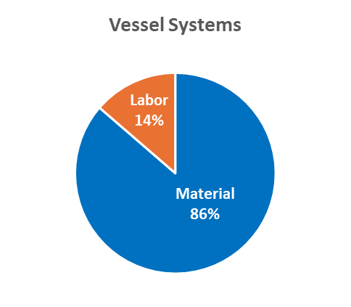
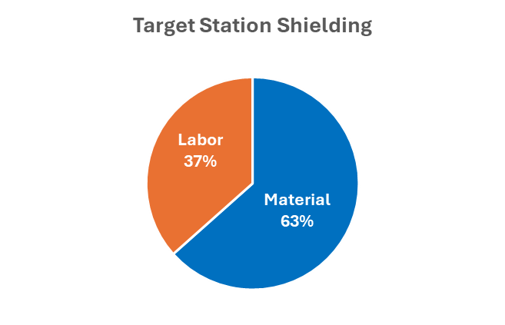
Cost estimates for VS and TSS have been developed and the schedule meets project milestones

Slide 8
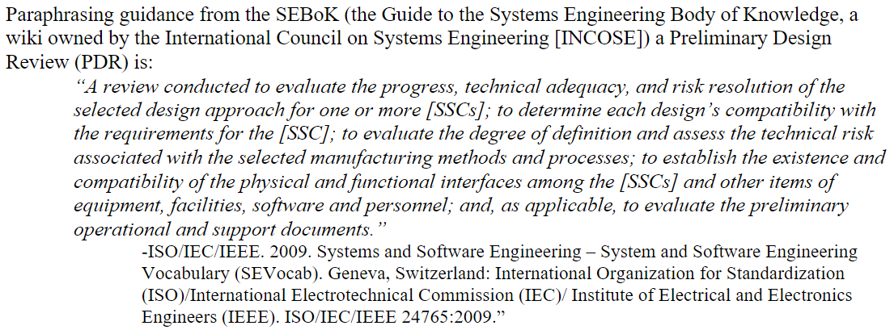
What is a PDR? STS Project Preliminary Design Definition
From S01020500-PIN10000:
The Preliminary Design Review assesses whether the design has progressed enough to support the proposed performance baseline (CD-2) and is ready to proceed to the detailed/final design phase, in line with STS Design Development Procedure and Preliminary Design Definition.
Sufficient design decisions have been made during the Preliminary Design phase for confidence that the design will meet requirements and will support the project’s needs.
Design change is expected to be minimal during the Final Design phase.

Slide 9
Charge to the committee: Preliminary Design Questions
1. Are the requirements as written sensible and verifiable?
2. Are interfaces adequately identified and defined?
3. Are relevant PHAR cases appropriately defined and addressed by the preliminary design?
4. Is the proposed design sufficiently mature to proceed to final design?

Slide 10
Committee deliverables
Prepare and present a closeout report
Answers to charge questions
Findings (statements of fact; what the project told the committee)
Comments (the committee’s opinion or assessment of what they heard)
Recommendations, if applicable (specific actions recommended to fix a problem or strengthen the project, will be tracked by the project)
A PowerPoint template for the committee’s closeout report is available on the Indico site

Slide 11
With the following presentations, we will show the preliminary design is complete, and we are ready to begin the final design phase
The requirements for the Systems are known.
Interfaces with other STS technical groups and within the Target Systems group are understood and being managed.
The design can meet project schedule requirements.
The design has satisfied the Preliminary Design Definition.
Materials for evaluating preliminary design status including all of today’s presentations as well as relevant design documentation in EDRM can be found on Indico.

Slide 12
Agenda
Day 1 - Monday, April 21
Time | Topic | Speaker
8:00 – 8:30am | Introduction | Mike Strong
8:30 – 9:00am | STS & Target Systems Overview | Peter Rosenblad
9:00– 10:00am | VS/TSS Project & Scope | Chris Anton
10:00 – 10:15am | Break
10:15 – 11:30am | VS/TSS Requirements, Interfaces & Relevant PHAR Cases | Chris Anton
11:30am – 12:30pm | Working Lunch Requirements (cont’d), QA as needed
12:30 – 1:45pm | VS/TSS Design | Chris Anton
1:45 – 2:00pm | Break
2:00 – 3:00pm | VS/TSS Shielding Neutronics Analysis | Igor Remec
3:00 – 3:30pm | Core Vessel Vacuum System | Mike Strong
3:30 – 4:00pm | VS/TSS Remote Handling | Steve Schrick
4:00 – 4:30pm | Committee Session, Q/A as needed
Day 2 - Tuesday, April 22
Time | Topic | Speaker
8:30 – 9:15am | VS/TSS Thermal-Hydraulic Analysis | Chris Anton
9:15 – 10:30am | VS/TSS Structural Analysis | Chris Anton
10:30 – 10:45am | Break
10:15 – 11:30am | Acquisition/Manufacturing Plan Core Vessel Manufacturability Study & Nozzle Extension Prototype | Chris Anton
11:30am – 12:30pm | Working Lunch Installation Sequence, Q/A as needed
12:30 – 1:15pm | VS/TSS Budget Estimate | Chris Anton
1:15 – 1:30pm | Break
1:30 – 2:00pm | Path to Final Design Completion & Verification Plan | Chris Anton
2:30 – 4:00pm | Committee Session, Q/A as needed
4:00 – 4:30pm | Closeout

Slide 13
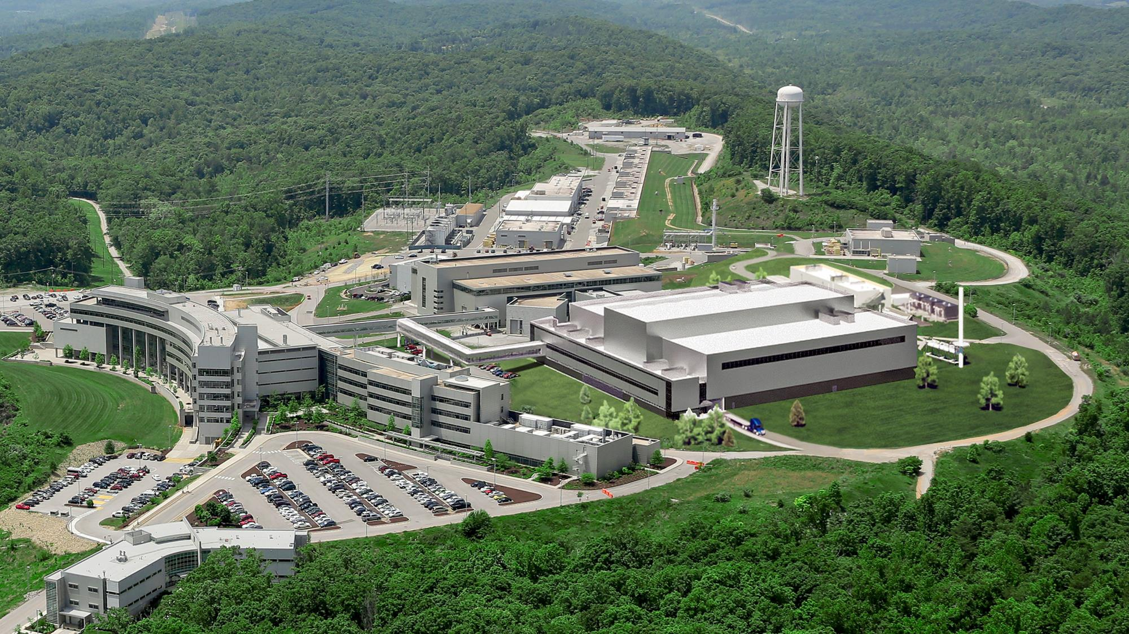
Let’s get started!

