Slide 1
Vessel Systems and Target Station Shielding Project and Scope
Chris Anton
Cam Eiland
Hogan Knott
Darren Dugan
Mike Strong
April 21, 2025

Slide 2
S.03.06 Vessel Systems and S.03.07 Target Station Shielding
Vessel Systems
Target Station Shielding

Slide 3
Vessel Systems Scope
Gamma Gate Assembly
Core Vessel Assembly
Core Vessel Shielding Assembly
Nozzle Extension Assemblies

Slide 4
Core Vessel Assembly
Utility Hatch
Target Segment
Access Hatch
MRA Access Hatch
CV Lid Tent
CV Primary Lid
Utility Hatch
CV Upper Weldment
CV Lower Weldment

Slide 5
Core Vessel Lower Weldment
CV Center Split Flange
Lower Weldment Upper Shell
CV Beltline
Lower Weldment Lower Shell
CV Drain
CV Bottom Plate
CV Skirt
CV Bottom Flange

Slide 6
Core Vessel Upper Weldment
Utility Nozzles
(Qty. 44)
CV Top Flange
Upper Weldment
Intermediate Flange
Upper Weldment
Upper Shell
Upper Weldment
Middle Shell
Upper Weldment
Intermediate Flange
Upper Weldment
Lower Shell
CV Split Flange

Slide 7
Core Vessel Lid Assembly
Utility Hatch
Primary Lid
MRA Hatch
Target Hatch
Lid Tent
Utility Hatch

Slide 8
Core Vessel Primary Lid

Slide 9
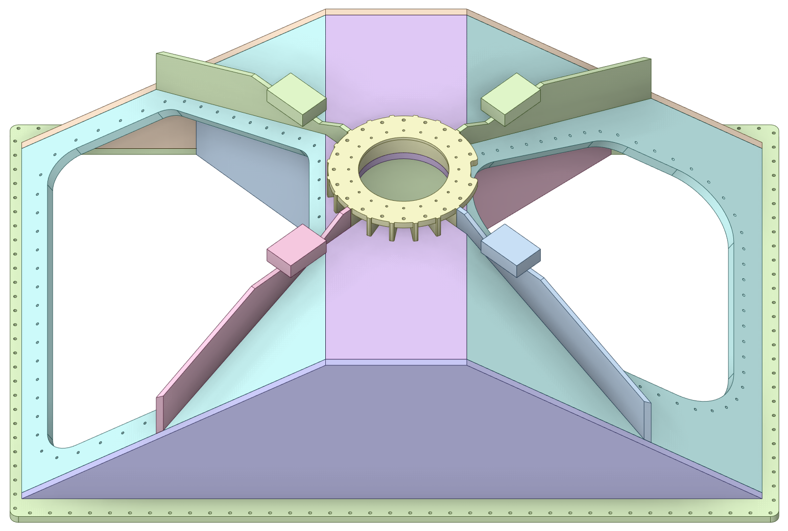
Core Vessel Lid Tent

Slide 10
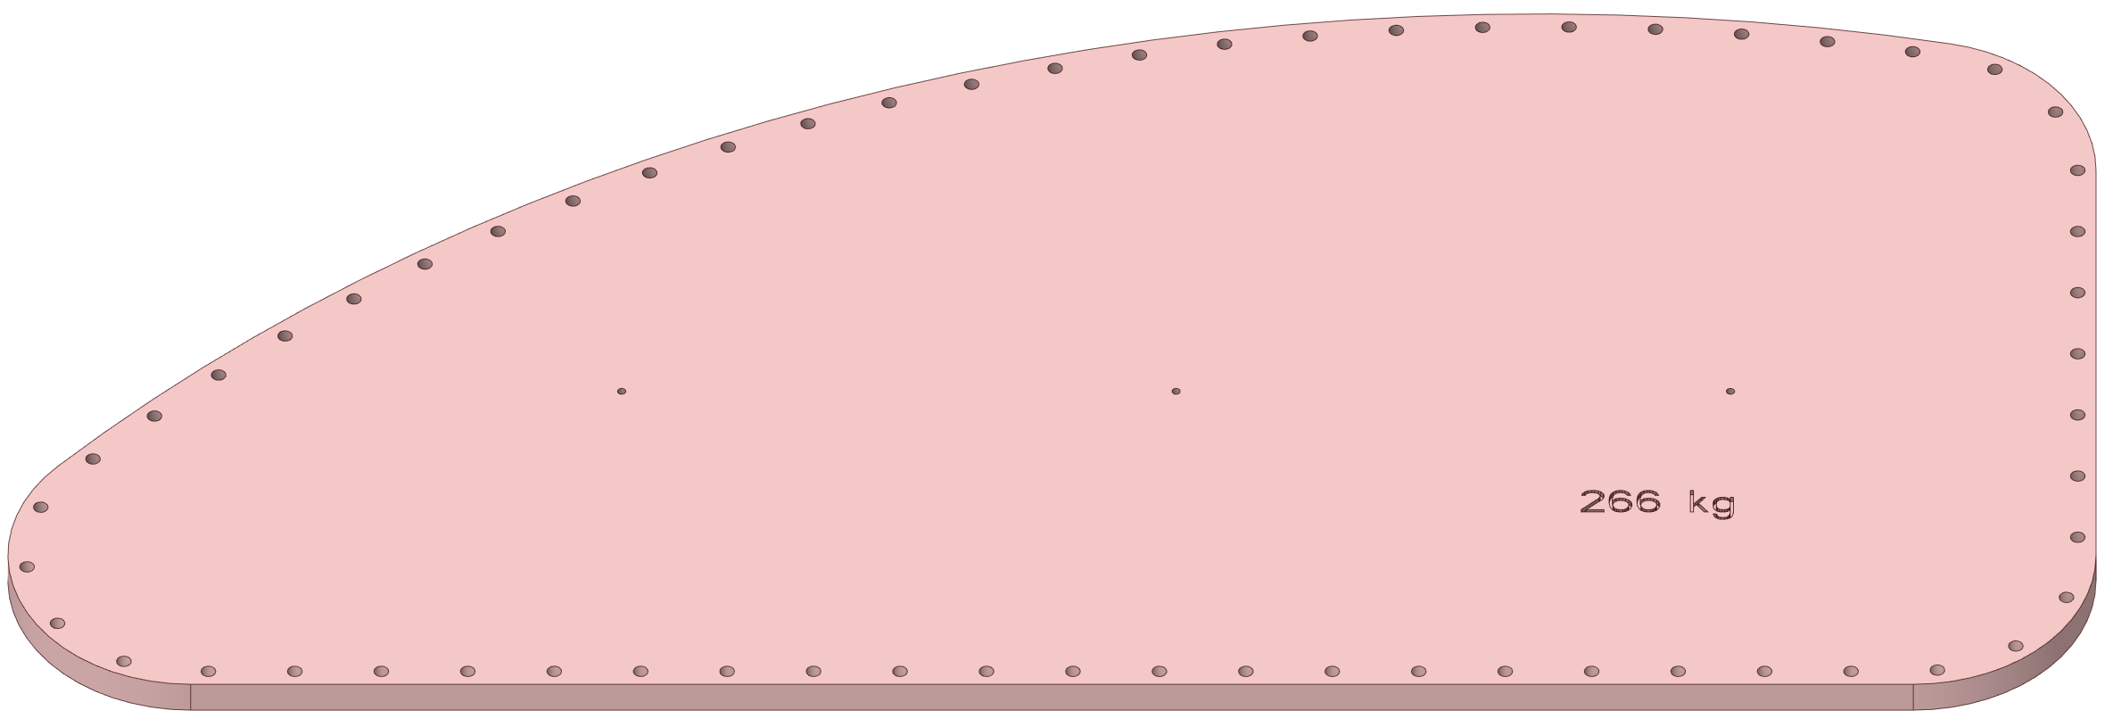
Core Vessel Lid Hatches
MRA Access Hatch
Target Segment Access Hatch
Utility Hatches

Slide 11
Core Vessel Shielding
MRA Utility Line
Shielding
Target Segment
Removable Shield
Block
MRA Removable
Shield Block
Layer 5 Uncooled Shielding
Layer 4 Uncooled
Shielding
Upper Ring Uncooled Shielding
Layer 1 Cooled Shielding
Lower Ring
Uncooled Shielding

Slide 12
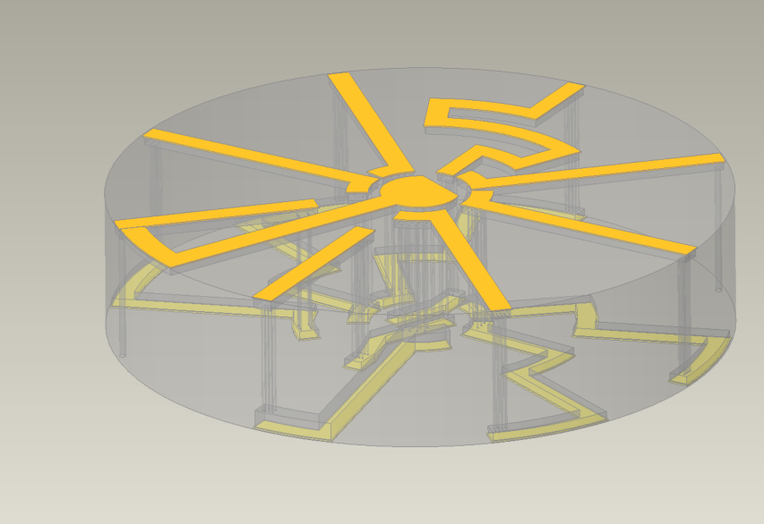
CV Shield Block #1
Previous laminated plate design
Current gun drilled forged design

Slide 13
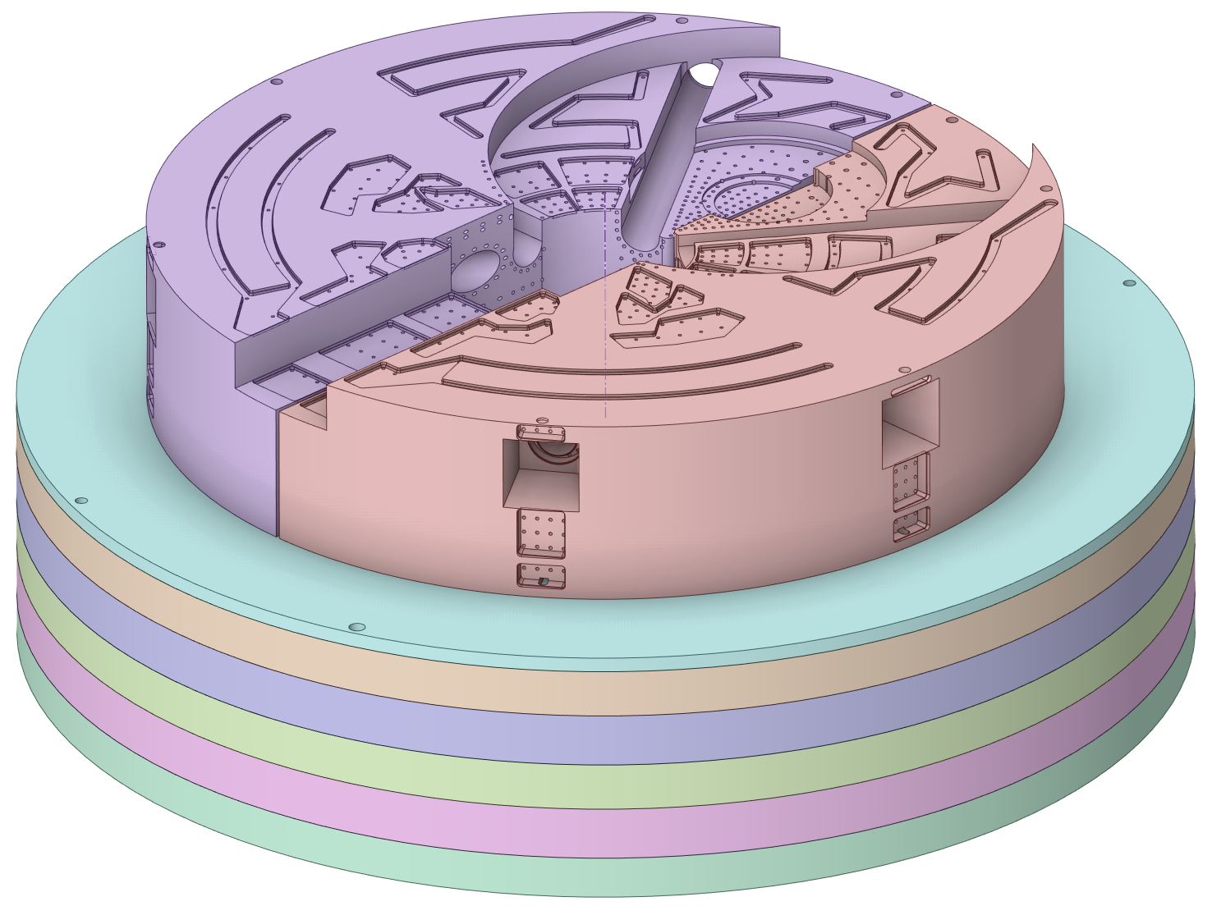
CV Cooled Shield Block Layer 2

Slide 14
CV Cooled Shield Block Layer 3

Slide 15
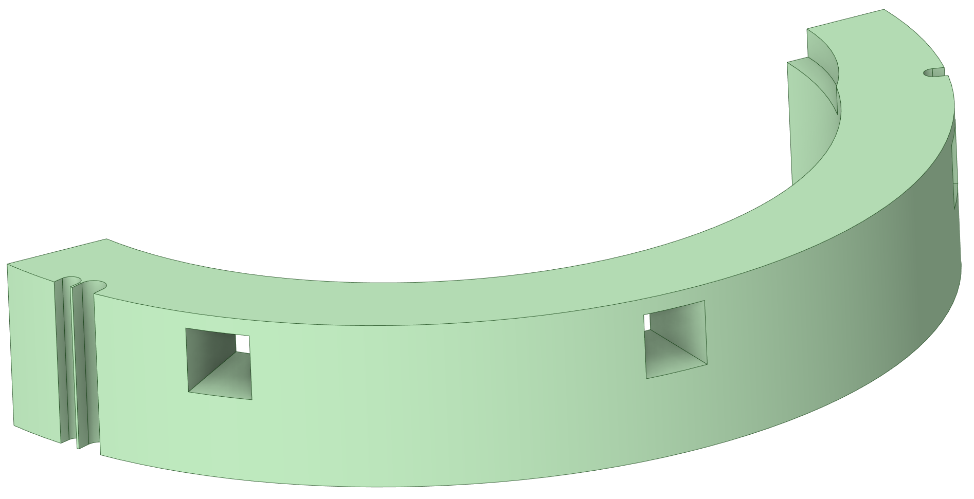
CV Lower Ring Shielding

Slide 16
CV Upper Ring Shielding

Slide 17
CV Layer 4 Shielding

Slide 18
CV Layer 5 Shielding

Slide 19
CV Removable Shielding

Slide 20
CV MRA Utility Shielding

Slide 21
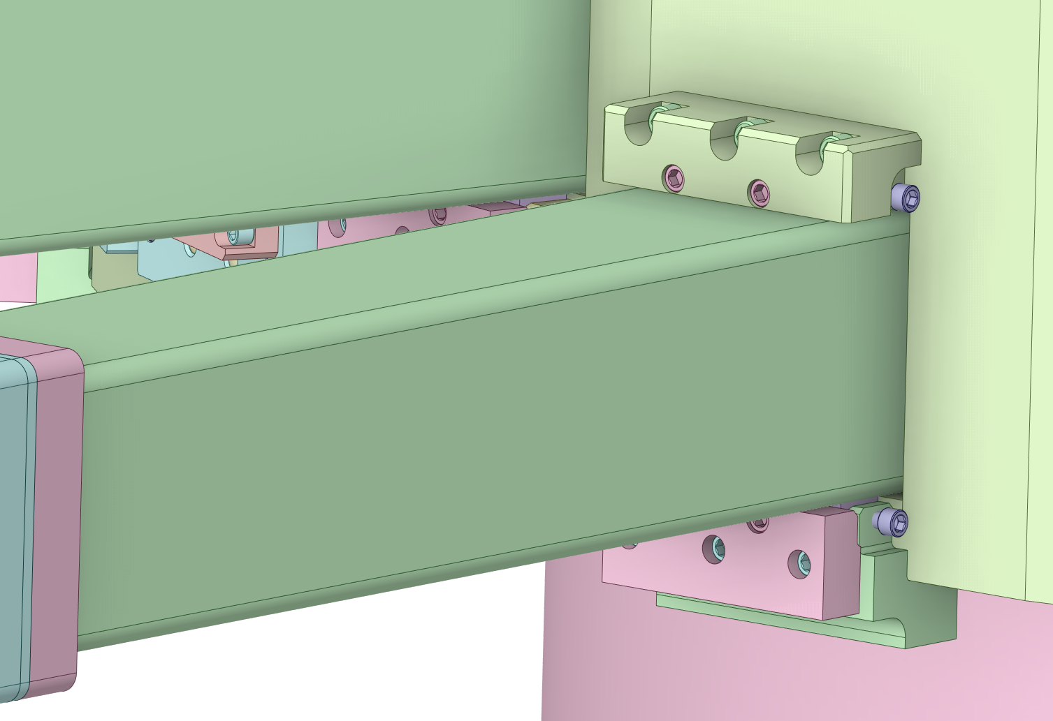
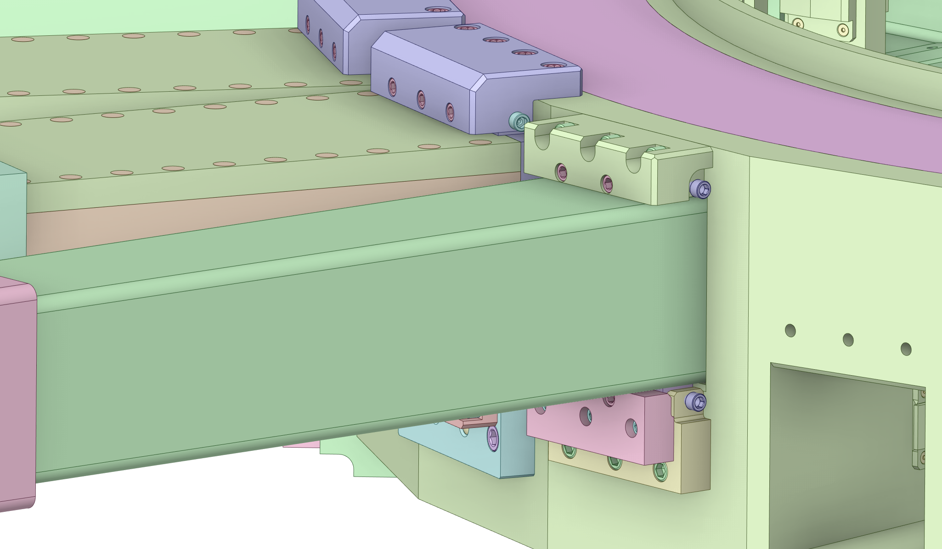
Standard Nozzle Extension Assembly
Lower Bracket Assembly
Upper Bracket Assembly

Slide 22
QIKR Nozzle Extension Assembly

Slide 23
Dual Channel Nozzle Extension Assembly
Dual Channel Nozzle Extension
Bracket Assemblies

Slide 24
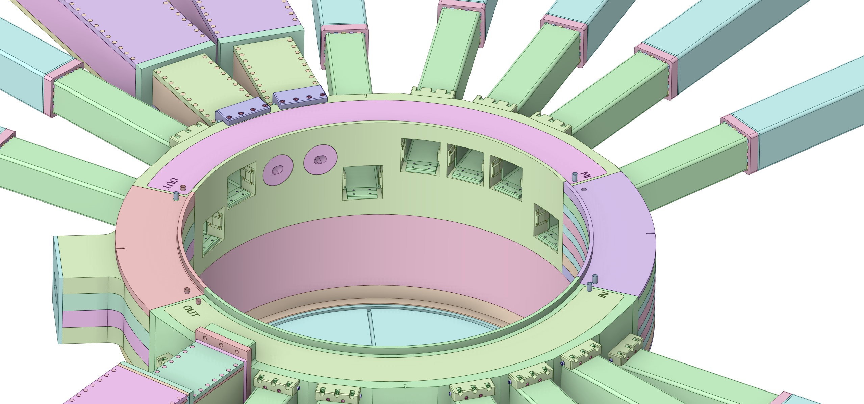
Monolith Insert Landing Pads

Slide 25
MRA Utility Jumpers

Slide 26
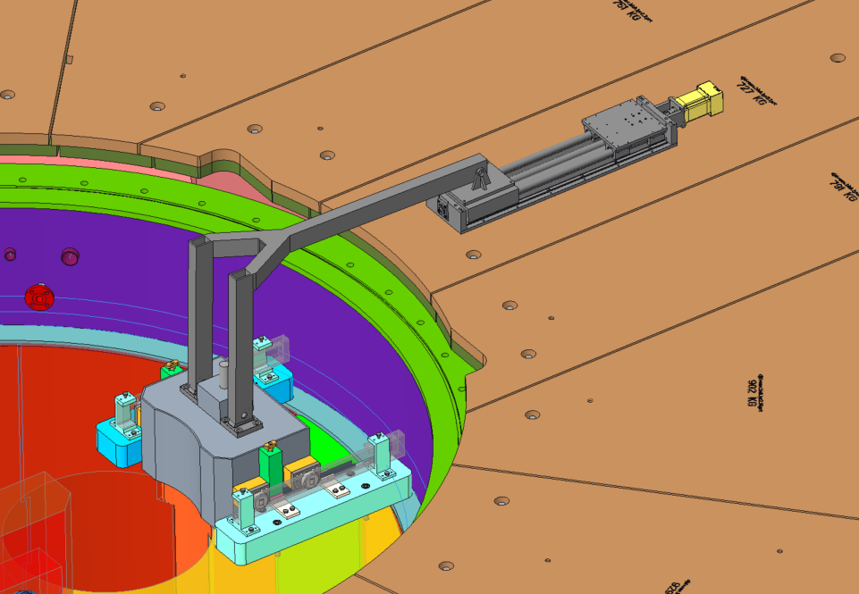
Gamma Gate Assembly

Slide 27
Target Station Shielding Scope
Pipe Pan
Removable Shielding
Pipe Pan
PBW Removable Shield
Layer 6
Bulk shielding
PBW Shielding
Removable Shield
PBTA Remote Clamp
Removable Shield
Layer 5
Bulk shielding
Layer 4
Bulk shielding
Layer 3
Bulk shielding
Layer 2
Bulk shielding
Layer 1
Bulk shielding

Slide 28
Bulk Shielding Scope
Layer 6
Bulk shielding
Layer 5
Bulk shielding
Layer 4
Bulk shielding
Layer 3
Bulk shielding
Layer 2
Bulk shielding
Layer 1
Bulk shielding
Nozzle extension
clearance ports

Slide 29
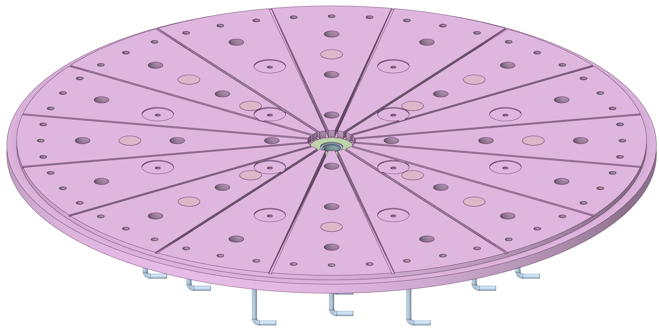
Core Vessel Baseplate

Slide 30
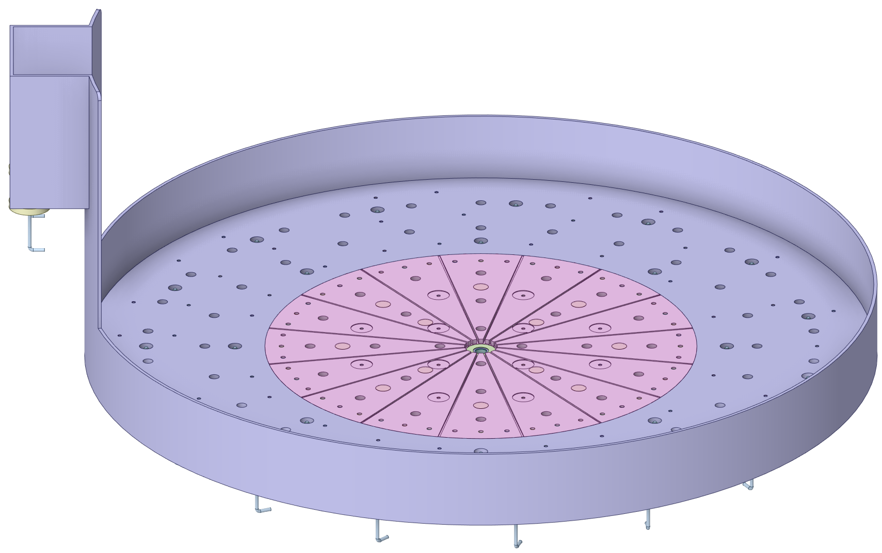
Bulk Shielding Liner

Slide 31
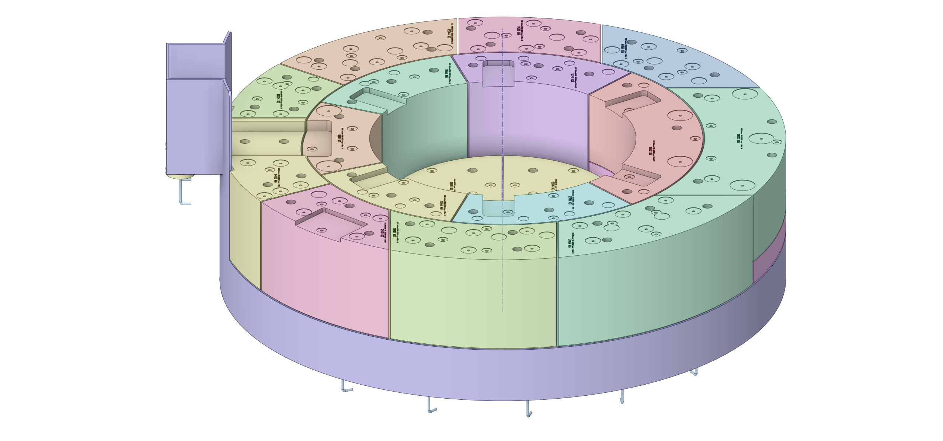
Bulk Shielding Layer 1

Slide 32
Bulk Shielding Layer 2

Slide 33
Bulk Shielding Layer 3

Slide 34
Bulk Shielding Layer 4

Slide 35
Bulk Shielding Layer 5

Slide 36
Bulk Shielding Layer 6

Slide 37
Pipe Pans

Slide 38
Pipe Pan Removable Shielding

Slide 39
AIC Removable Shielding

