Slide 1
Vessel Systems and Target Station Shielding Requirements, Interfaces and PHAR Cases
Chris Anton
Cam Eiland
Hogan Knott
Darren Dugan
Mike Strong
April 21, 2025

Slide 2
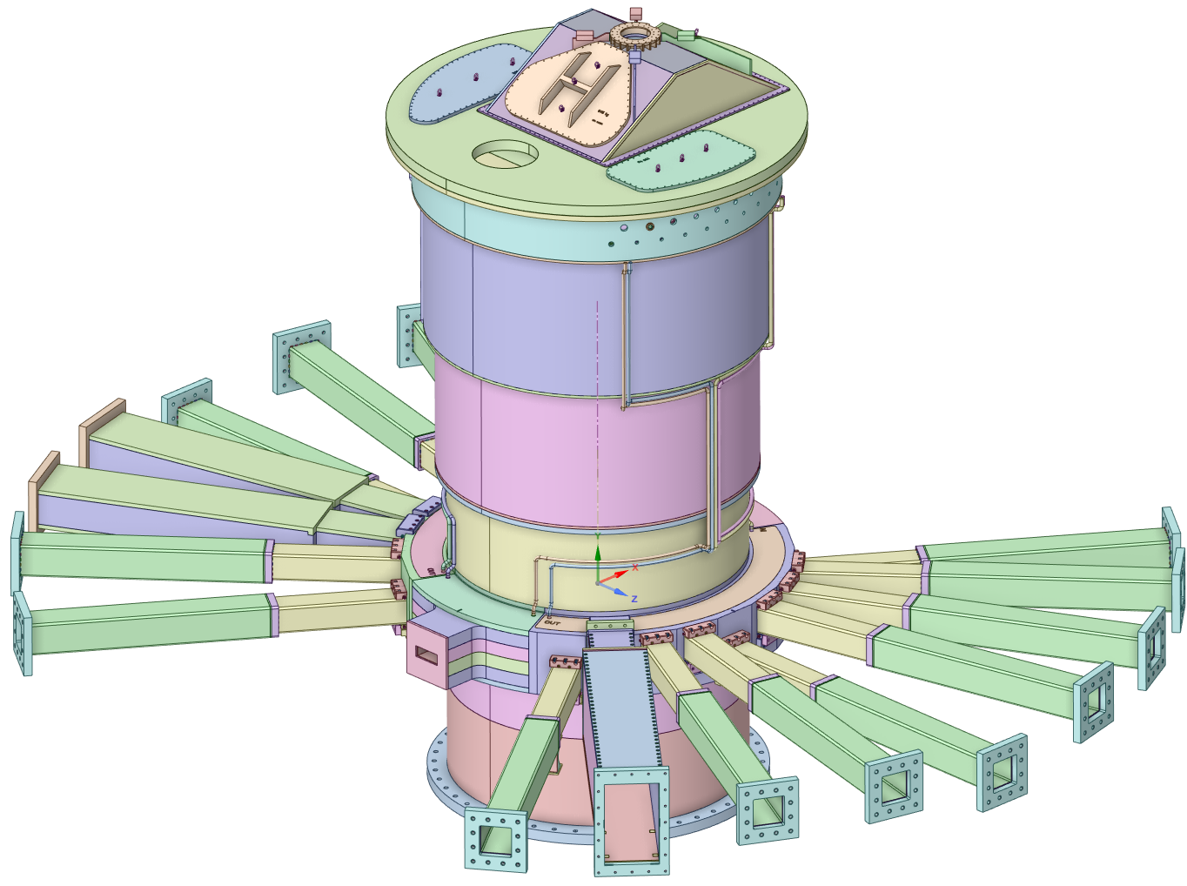
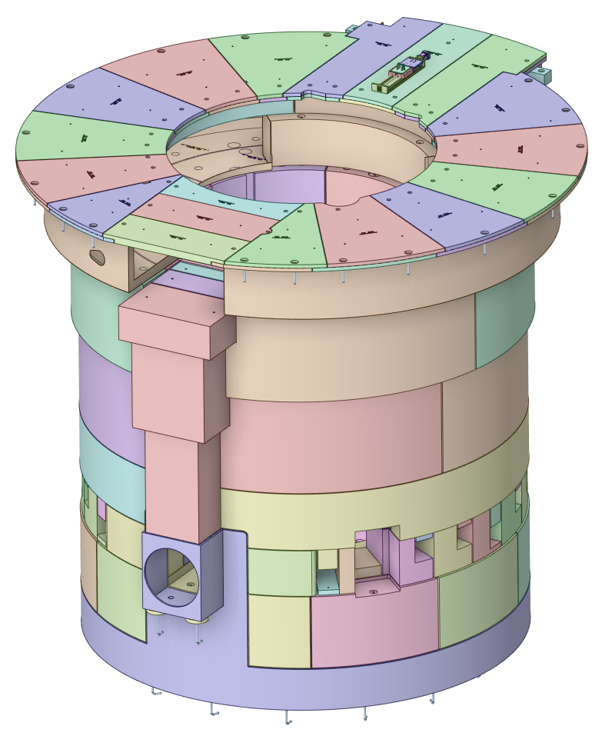
Presentation Overview
Vessel Systems
Target Station Shielding

Slide 3
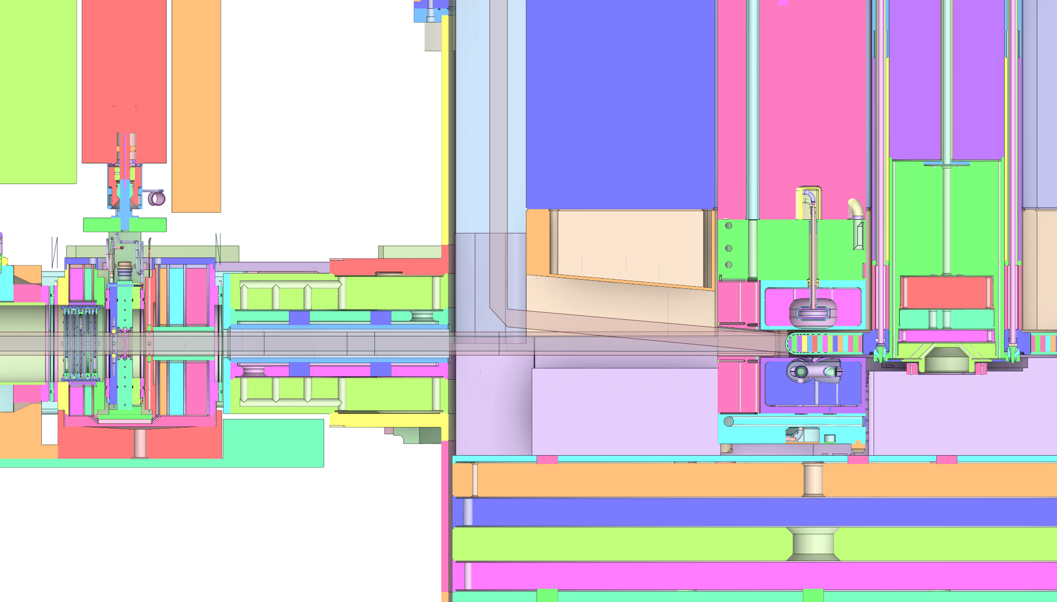
Vessel Systems Requirements
General Requirement:
Derived from: Target Systems Requirements

Slide 4
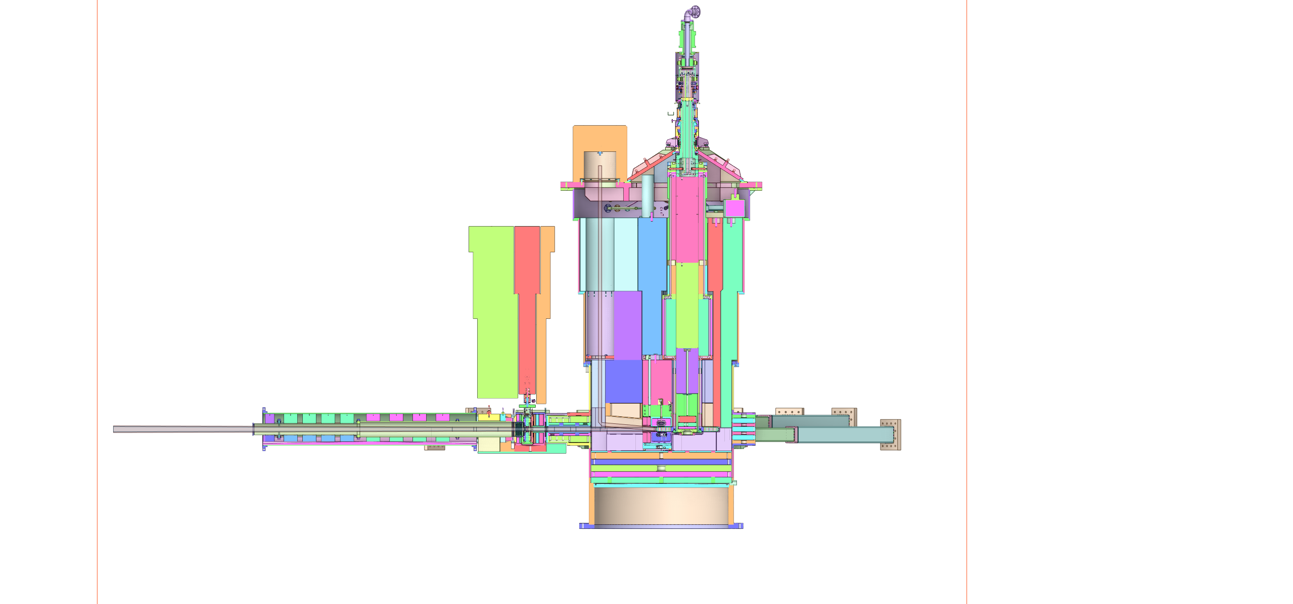
Vessel Systems Requirements
General Requirement:
Derived from: Target Systems Requirements

Slide 5
Vessel Systems Requirements
General Requirement:
Derived from: Target Systems Requirements

Slide 6
Vessel Systems Requirements
General Requirement:
Derived from: Target Systems Requirements

Slide 7
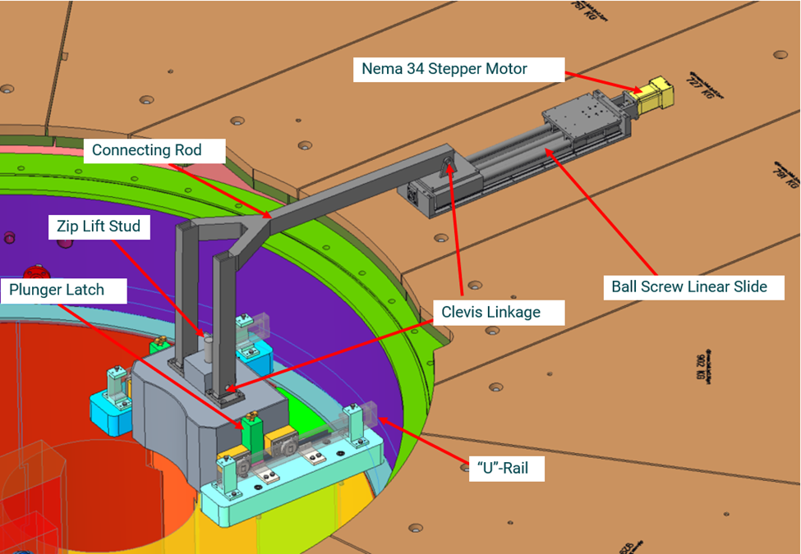
Vessel Systems Requirements
General Requirement:
Derived from: Target Systems Requirements

Slide 8
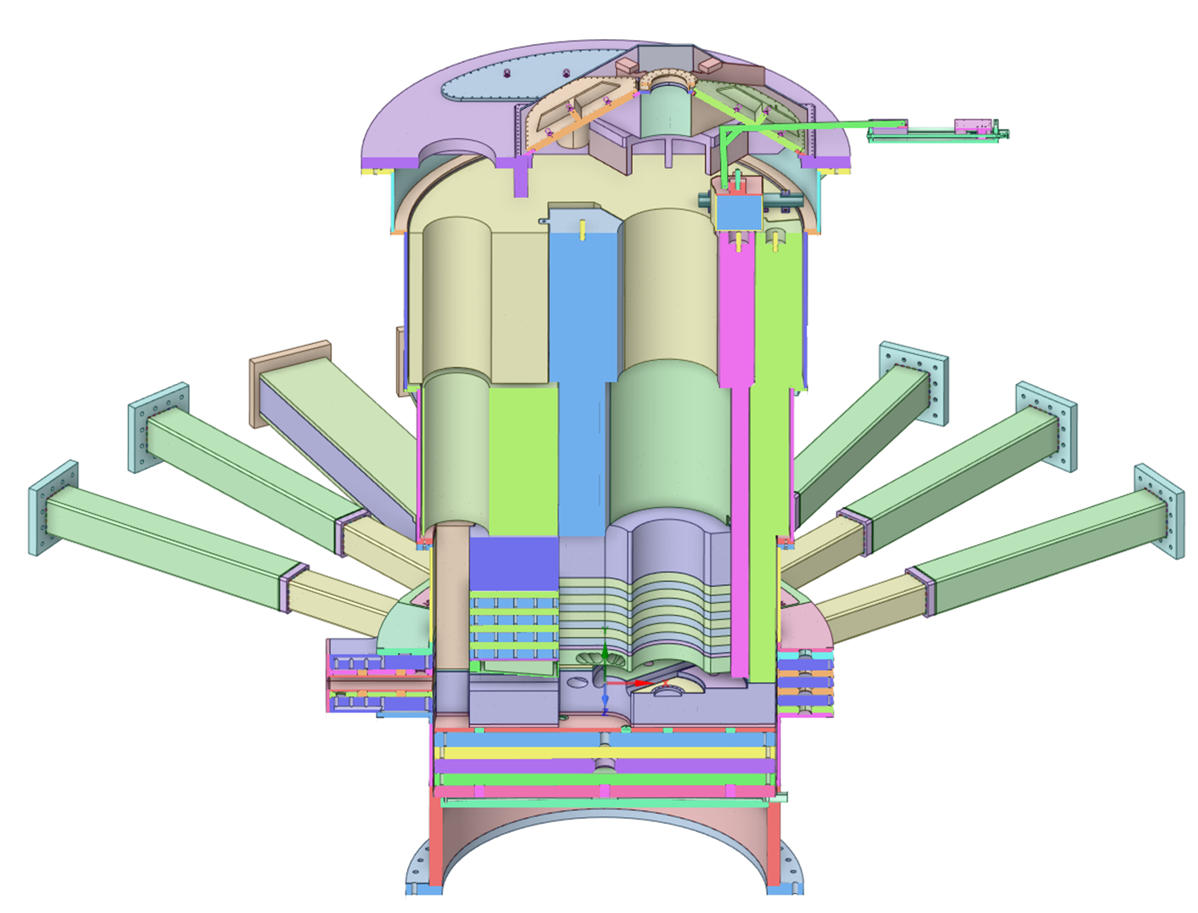
Vessel Systems Requirements
General Requirement:
Derived from: Target Systems Requirements

Slide 9
Vessel Systems Requirements
General Requirement:
Derived from: Target Systems Requirements

Slide 10
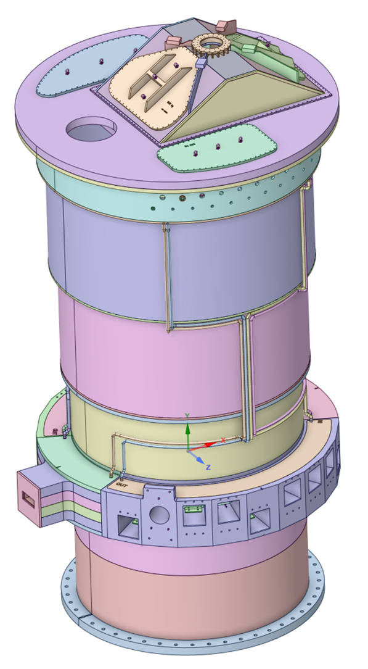
Vessel Systems Requirements
General Requirement:
Derived from: Target Systems Requirements

Slide 11
Vessel Systems Requirements
General Requirement:
Derived from: Target Systems Requirements

Slide 12
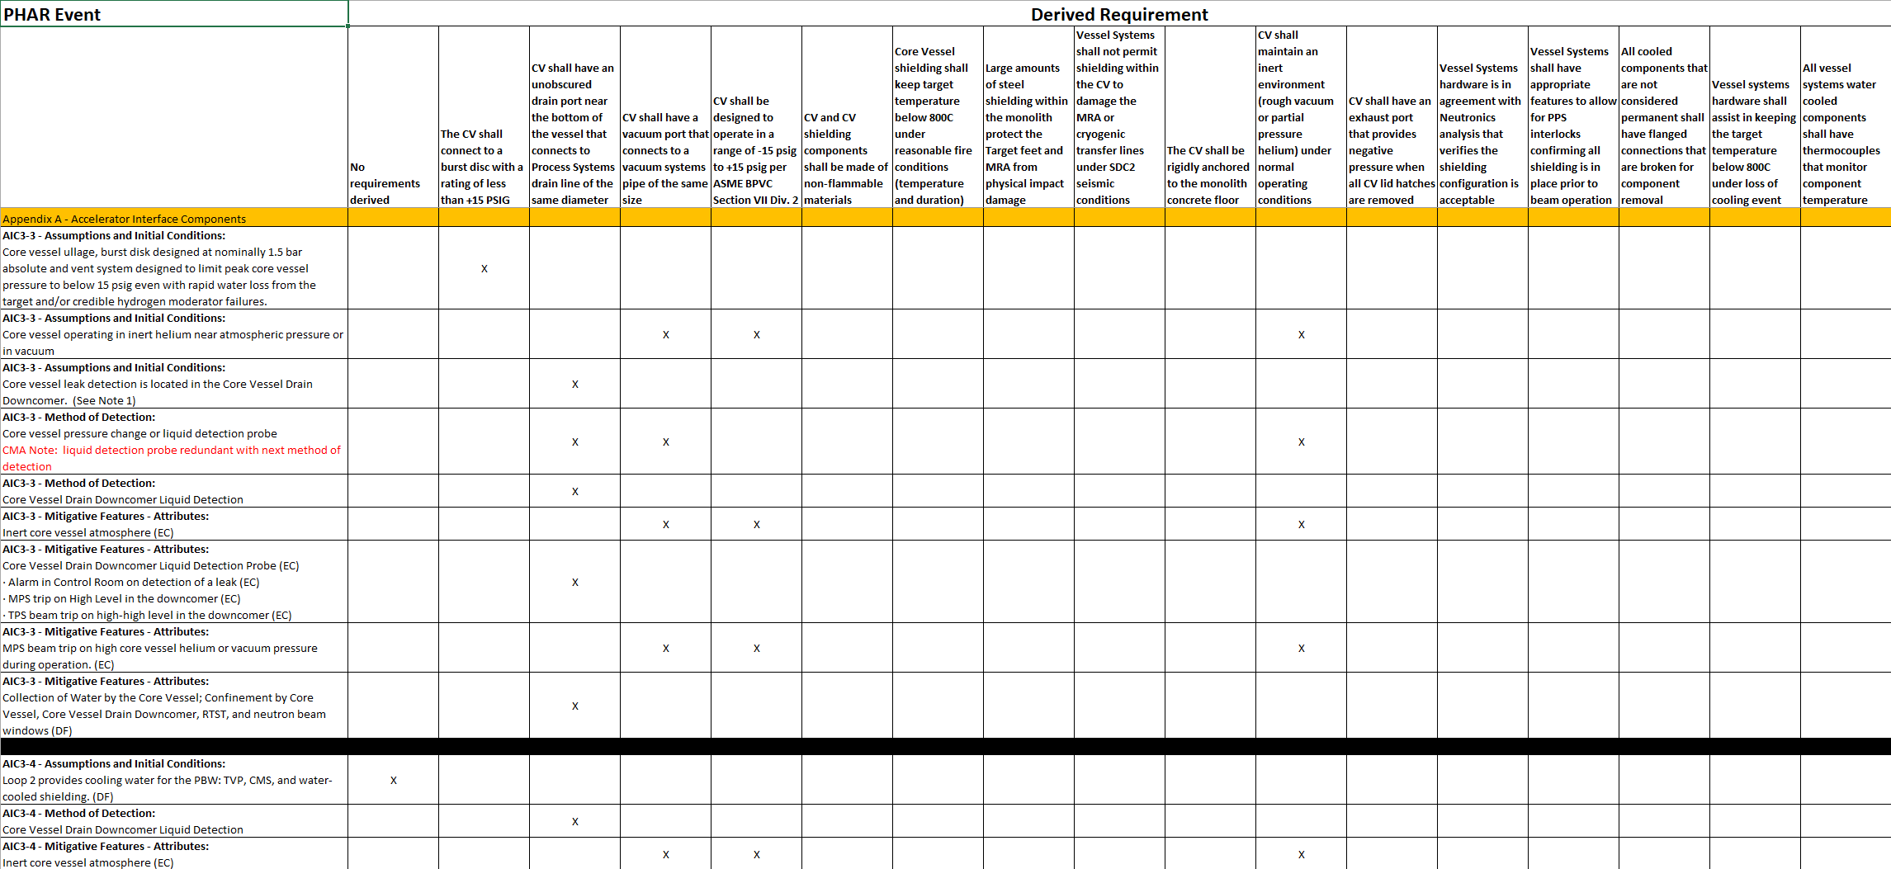
A detailed PHAR review was performed to determine requirements

Slide 13
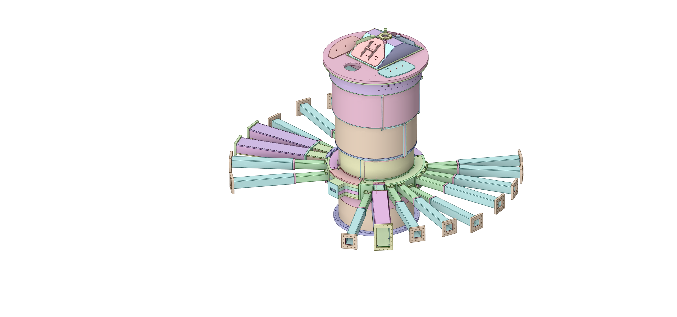
Vessel Systems Requirements
Safety Requirement:
Derived from: PHAR

Slide 14
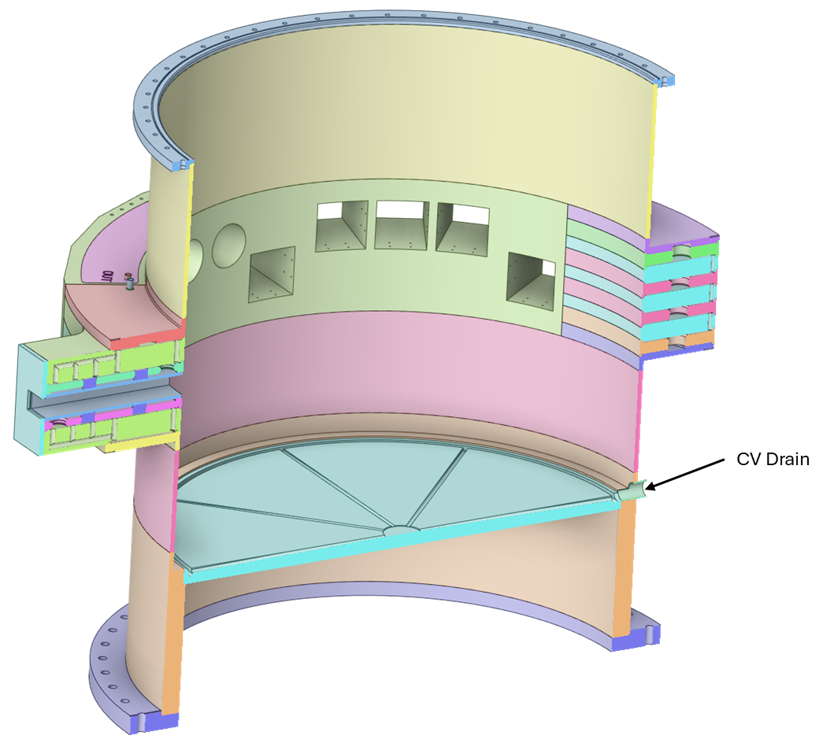
Vessel Systems Requirements
Safety Requirement:
Derived from: PHAR

Slide 15
Vessel Systems Requirements
Safety Requirement:
Derived from: PHAR

Slide 16
Vessel Systems Requirements
Safety Requirement:
Derived from: PHAR

Slide 17
Vessel Systems Requirements
Safety Requirement:
Derived from: PHAR

Slide 18
Vessel Systems Requirements
Safety Requirement:
Derived from: PHAR

Slide 19
Vessel Systems Requirements
Safety Requirement:
Derived from: PHAR

Slide 20
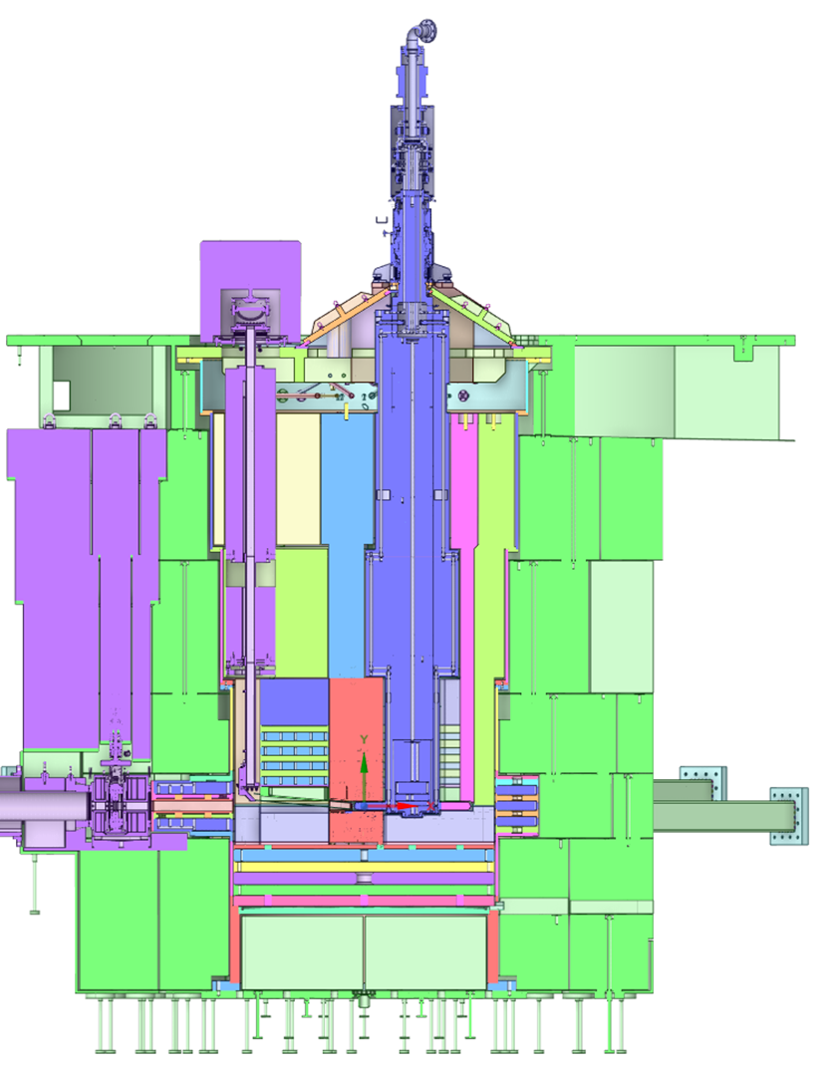
Vessel Systems Requirements
Safety Requirement:
Derived from: PHAR

Slide 21
Vessel Systems Requirements
Safety Requirement:
Derived from: PHAR

Slide 22
Vessel Systems Requirements
Safety Requirement:
Derived from: PHAR

Slide 23
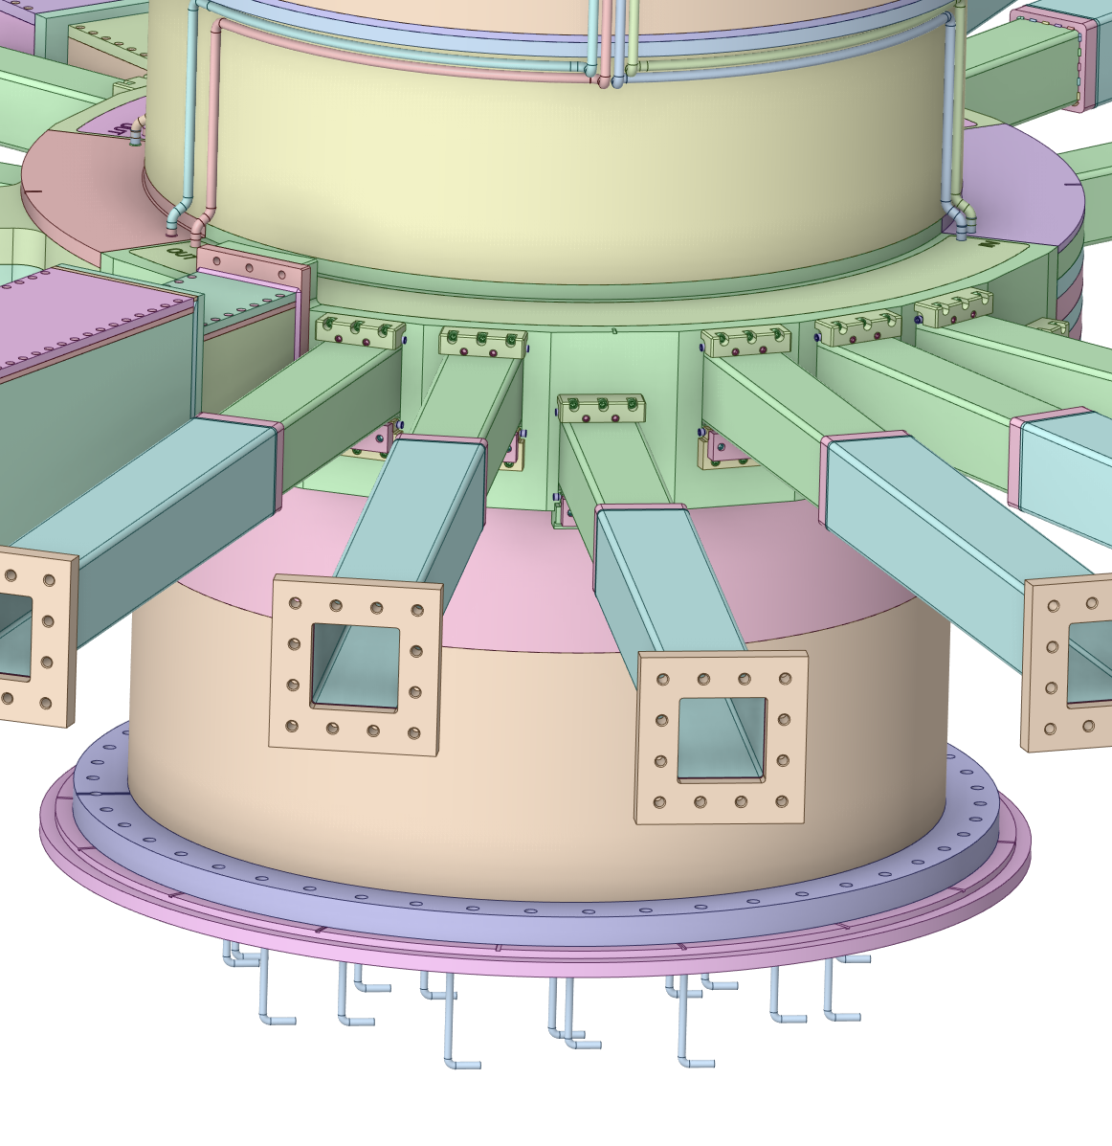
Vessel Systems Requirements
Safety Requirement:
Derived from: PHAR

Slide 24
Vessel Systems Requirements
Safety Requirement:
Derived from: PHAR

Slide 25
Vessel Systems Requirements
Safety Requirement:
Derived from: PHAR

Slide 26
Vessel Systems Requirements
Safety Requirement:
Derived from: PHAR

Slide 27
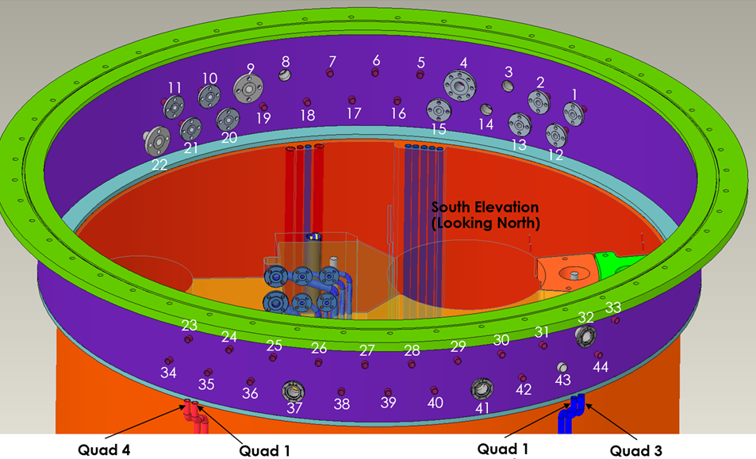
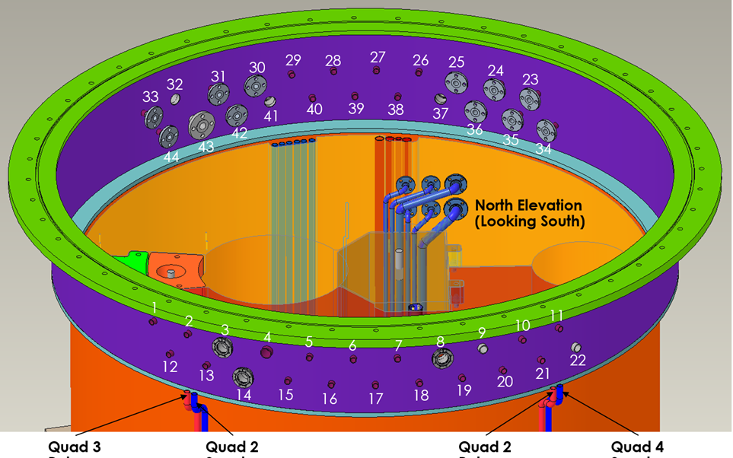
Vessel Systems Requirements
Safety Requirement:
Derived from: PHAR

Slide 28
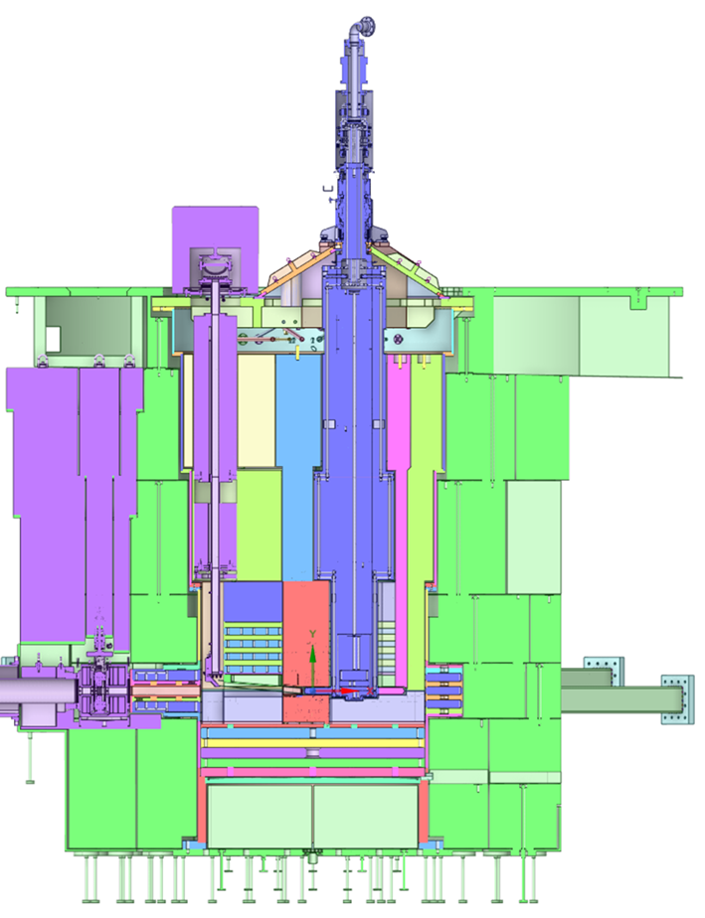
Vessel Systems Requirements
Safety Requirement:
Derived from: PHAR

Slide 29
Vessel Systems Requirements
Safety Requirement:
Derived from: PHAR

Slide 30
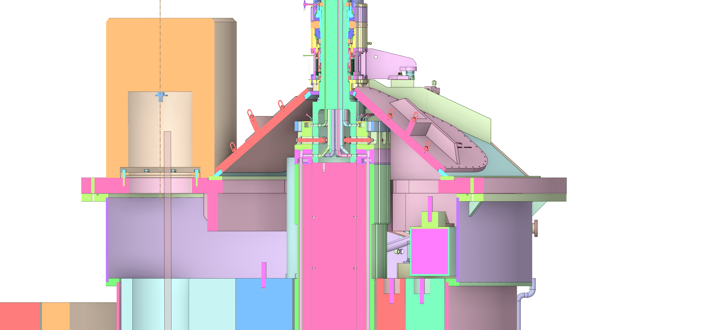
Vessel Systems Requirements
Interface Requirement:
Derived from: S01020500-IST10209 VS-Target Assembly Interface Sheet

Slide 31
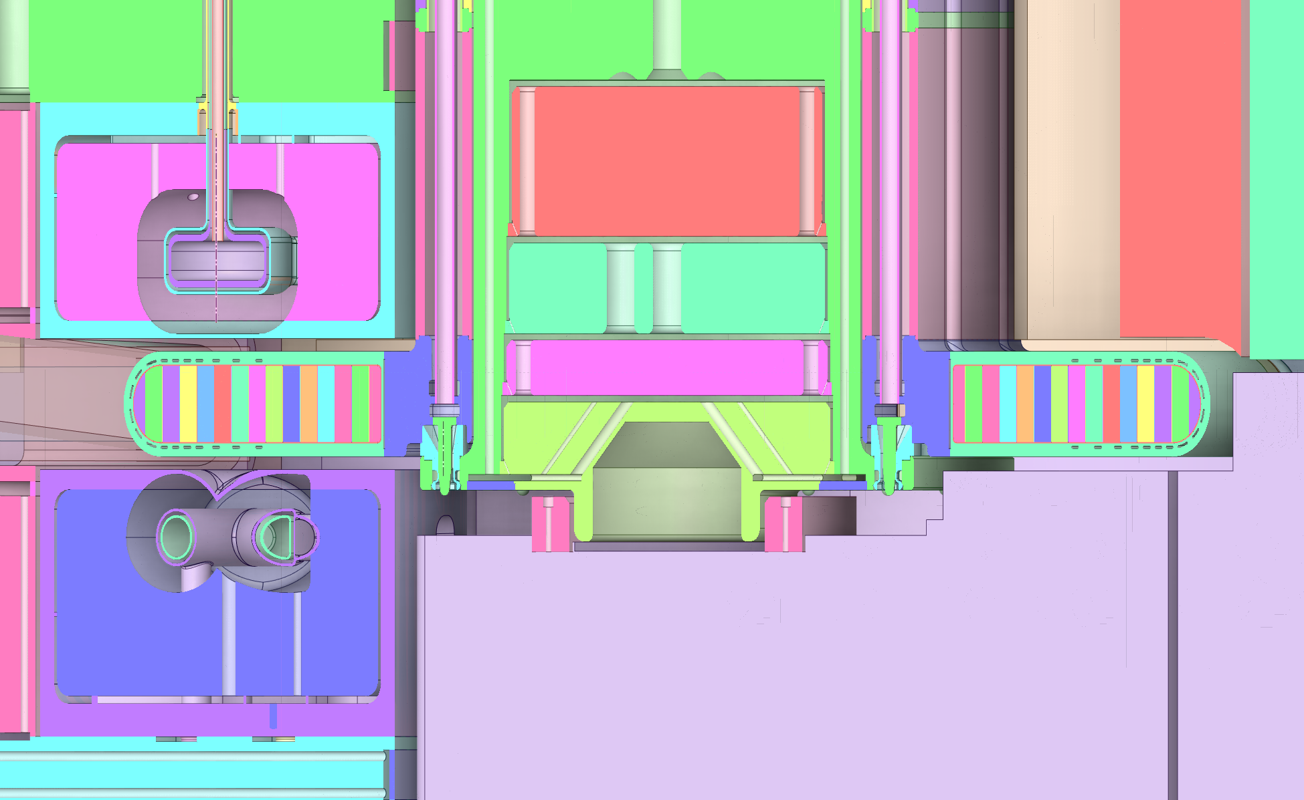
Vessel Systems Requirements
Interface Requirement:
Derived from: S01020500-IST10209 VS-Target Assembly Interface Sheet

Slide 32
Vessel Systems Requirements
Interface Requirement:
Derived from: S01020500-IST10209 VS-Target Assembly Interface Sheet

Slide 33
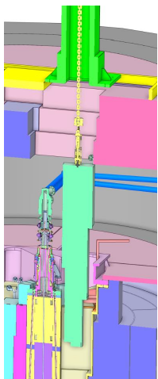
Vessel Systems Requirements
Interface Requirement:
Derived from: S01020500-IST10209 VS-Target Assembly Interface Sheet

Slide 34
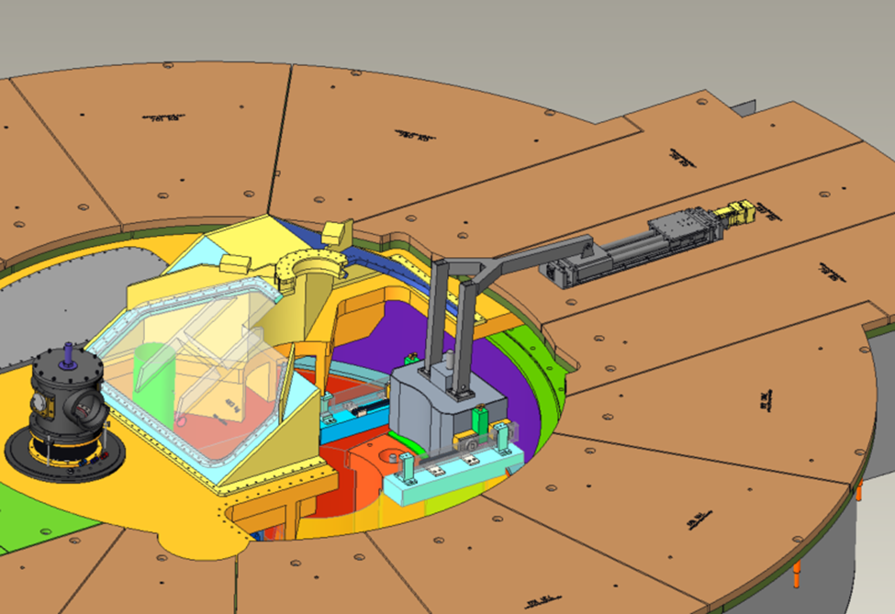
Vessel Systems Requirements
Interface Requirement:
Derived from: S01020500-IST10209 VS-Target Assembly Interface Sheet

Slide 35
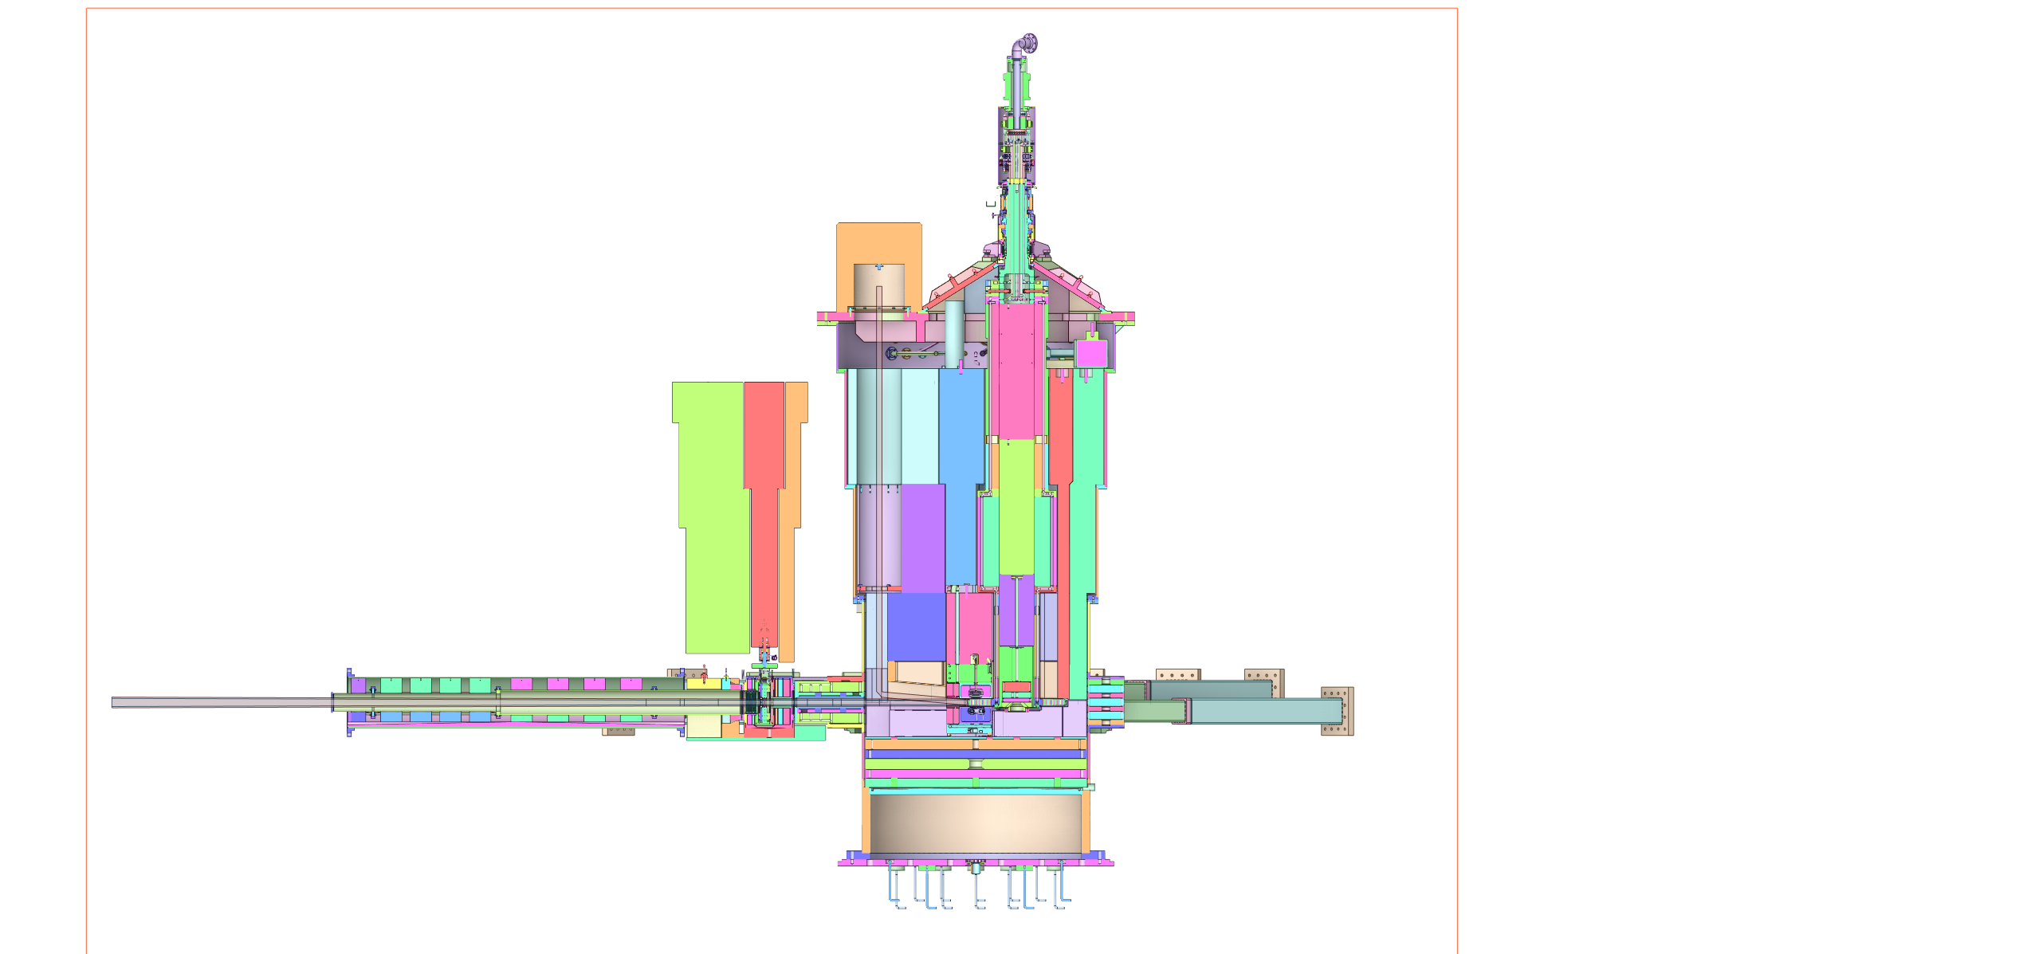
Vessel Systems Requirements
Interface Requirement:
Derived from: S01020500-IST10209 VS-Target Assembly Interface Sheet

Slide 36
Vessel Systems Requirements
Interface Requirement:
Derived from: S01020500-IST10209 VS-Target Assembly Interface Sheet

Slide 37
Vessel Systems Requirements
Interface Requirement:
Derived from: S01020500-IST10209 VS-Target Assembly Interface Sheet

Slide 38
Vessel Systems Requirements
Interface Requirement:
Derived from: S01020500-IST10209 VS-Target Assembly Interface Sheet

Slide 39
Vessel Systems Requirements
Interface Requirement:
Derived from: S03000000-IST10010 VS-CMS Interface Sheet

Slide 40
Vessel Systems Requirements
Interface Requirement:
Derived from: S03000000-IST10010 VS-CMS Interface Sheet

Slide 41
Vessel Systems Requirements
Interface Requirement:
Derived from: S03000000-IST10010 VS-CMS Interface Sheet

Slide 42
Vessel Systems Requirements
Interface Requirement:
Derived from: S03000000-IST10010 VS-CMS Interface Sheet

Slide 43
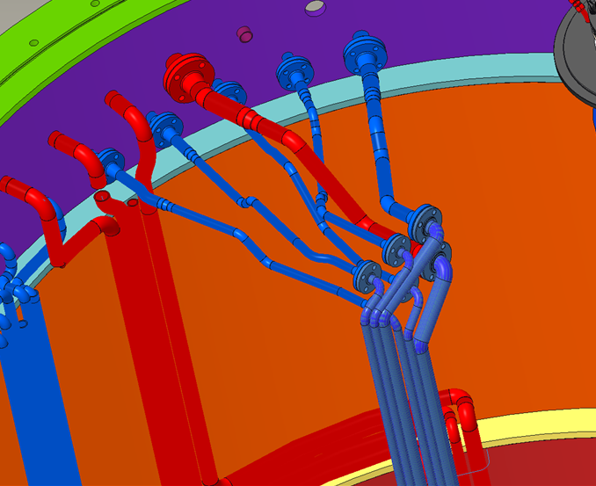
Vessel Systems Requirements
Interface Requirement:
Derived from: S03000000-IST10009 VS-MRA Interface Sheet

Slide 44
Vessel Systems Requirements
Interface Requirement:
Derived from: S03000000-IST10009 VS-MRA Interface Sheet

Slide 45
Vessel Systems Requirements
Interface Requirement:
Derived from: S03000000-IST10009 VS-MRA Interface Sheet

Slide 46
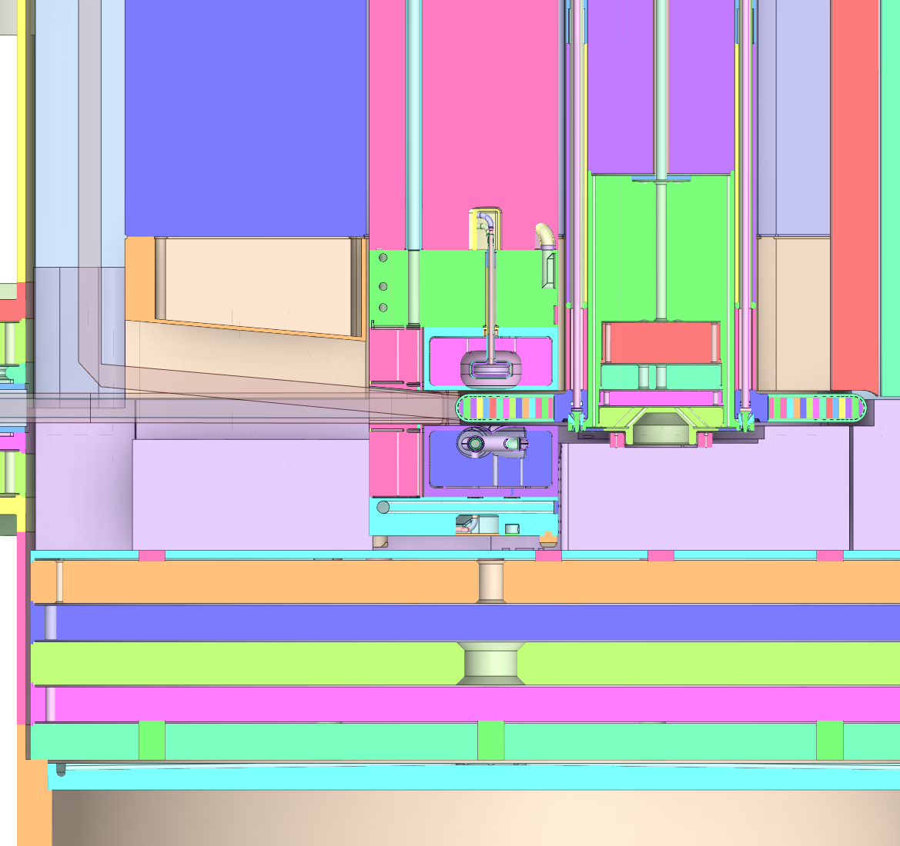
Vessel Systems Requirements
Interface Requirement:
Derived from: S03000000-IST10009 VS-MRA Interface Sheet

Slide 47
Vessel Systems Requirements
Interface Requirement:
Derived from: S03000000-IST10009 VS-MRA Interface Sheet

Slide 48
Vessel Systems Requirements
Interface Requirement:
Derived from: S01020500-IST10205 VS-MRA-Target Interface Sheet

Slide 49
Vessel Systems Requirements
Interface Requirement:
Derived from: S01020500-IST10205 VS-MRA-Target Interface Sheet

Slide 50
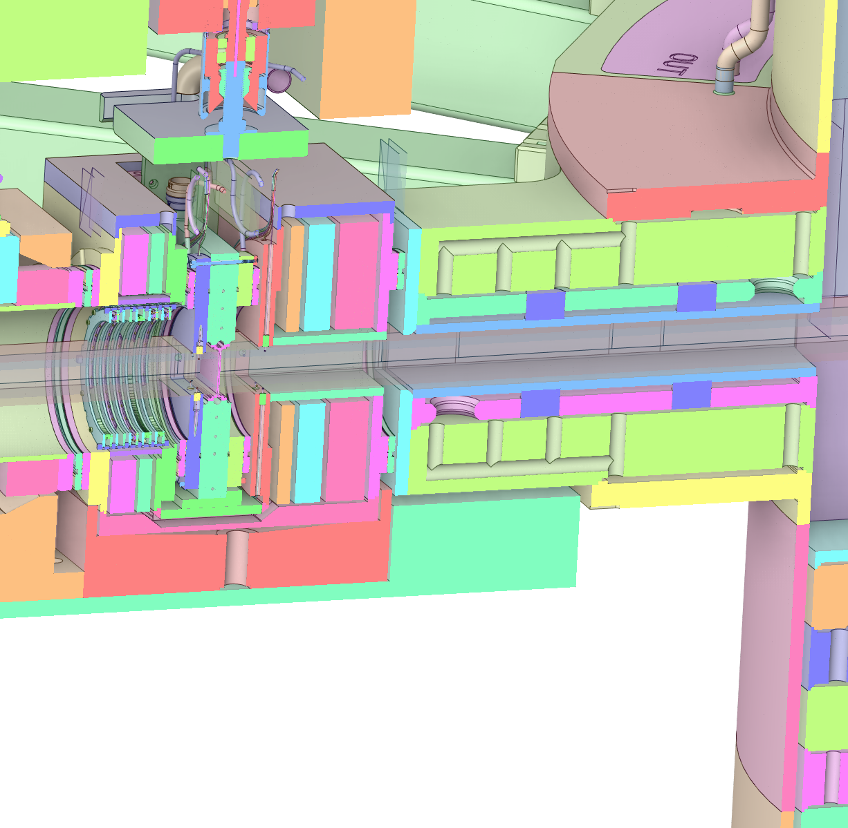
Vessel Systems Requirements
Interface Requirement:
Derived from: S01020500-IST10217 VS-AIC Interface Sheet

Slide 51
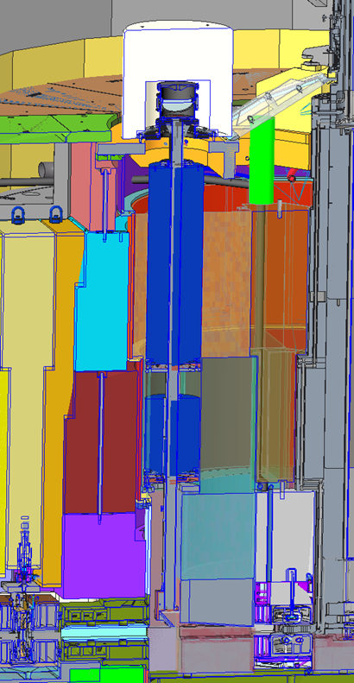
Vessel Systems Requirements
Interface Requirement:
Derived from: S01020500-IST10217 VS-AIC Interface Sheet

Slide 52
Vessel Systems Requirements
Interface Requirement:
Derived from: S01020500-IST10217 VS-AIC Interface Sheet

Slide 53
Vessel Systems Requirements
Interface Requirement:
Derived from: S01020500-IST10217 VS-AIC Interface Sheet

Slide 54
Vessel Systems Requirements
Interface Requirement:
Derived from: S01020500-IST10217 VS-AIC Interface Sheet

Slide 55
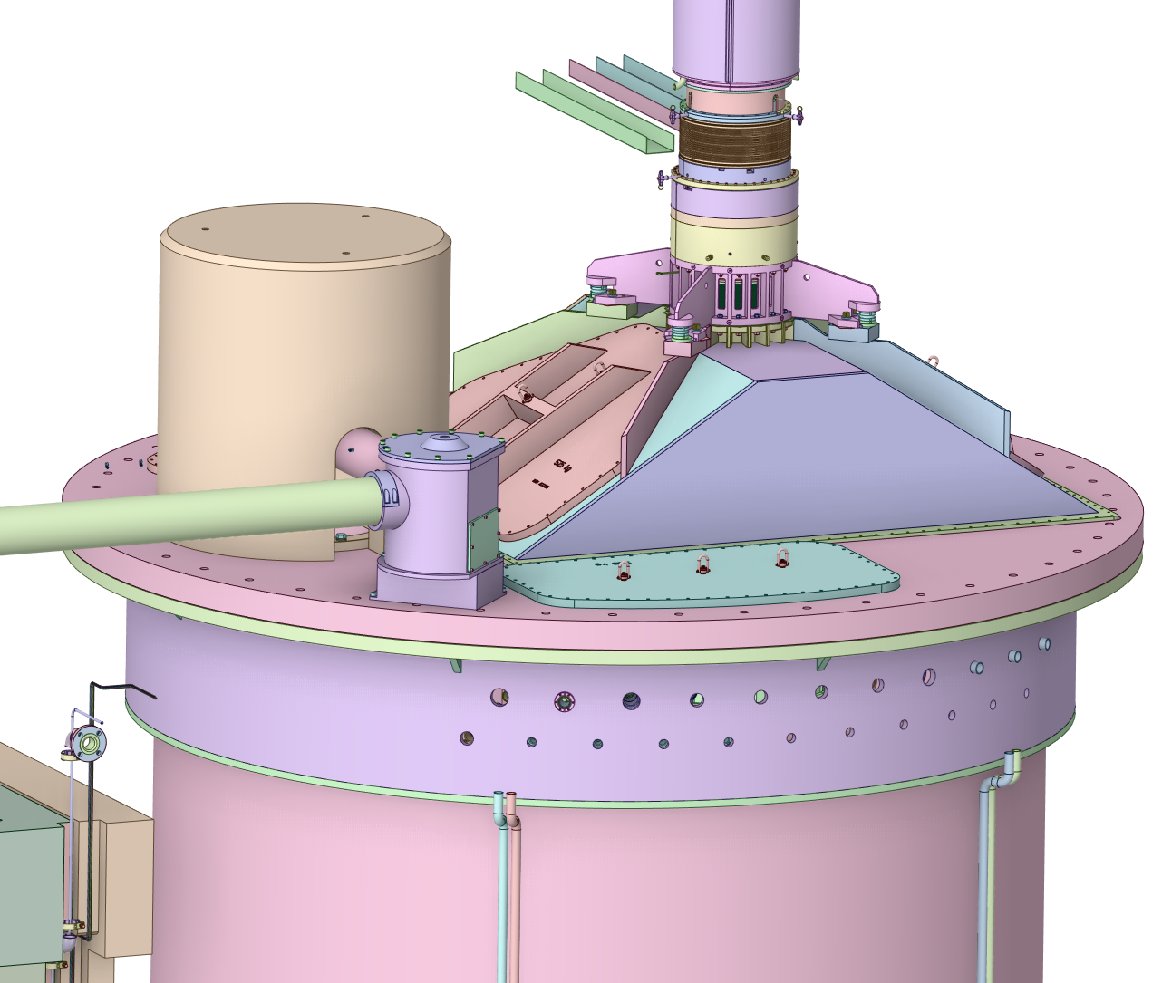
Vessel Systems Requirements
Interface Requirement:
Derived from: S01020500-IST10217 VS-AIC Interface Sheet

Slide 56
Vessel Systems Requirements
Interface Requirement:
Derived from: S01020500-IST10217 VS-AIC Interface Sheet

Slide 57
Vessel Systems Requirements
Interface Requirement:
Derived from: S01020500-IST10217 VS-AIC Interface Sheet

Slide 58
Vessel Systems Requirements
Interface Requirement:
Derived from: S01020500-IST10217 VS-AIC Interface Sheet

Slide 59
Vessel Systems Requirements
Interface Requirement:
Derived from: S03000000-IST10004 VS-Process Systems Interface Sheet

Slide 60
Vessel Systems Requirements
Interface Requirement:
Derived from: S03000000-IST10004 VS-Process Systems Interface Sheet

Slide 61
Vessel Systems Requirements
Interface Requirement:
Derived from: S03000000-IST10004 VS-Process Systems Interface Sheet

Slide 62
Vessel Systems Requirements
Interface Requirement:
Derived from: S03000000-IST10004 VS-Process Systems Interface Sheet

Slide 63
Vessel Systems Requirements
Interface Requirement:
Derived from: S03000000-IST10004 VS-Process Systems Interface Sheet

Slide 64
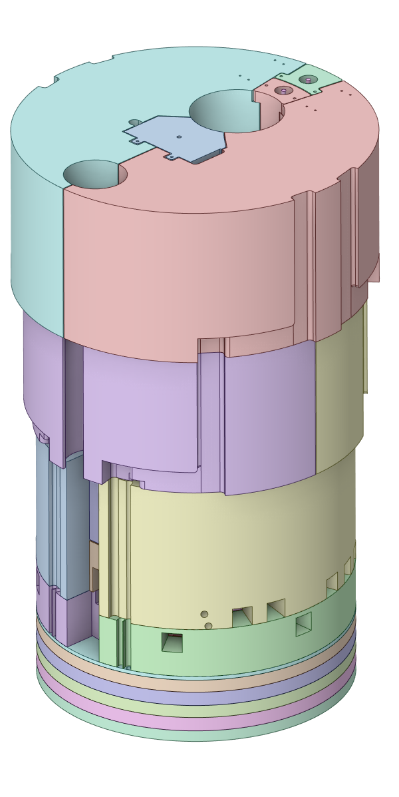
Vessel Systems Requirements
Interface Requirement:
Derived from: S03000000-IST10006 VS-Remote Handling Interface Sheet

Slide 65
Vessel Systems Requirements
Interface Requirement:
Derived from: S03000000-IST10006 VS-Remote Handling Interface Sheet

Slide 66
Vessel Systems Requirements
Interface Requirement:
Derived from: S03000000-IST10008 VS-Vacuum Systems Interface Sheet

Slide 67
Vessel Systems Requirements
Interface Requirement:
Derived from: S03000000-IST10008 VS-Vacuum Systems Interface Sheet

Slide 68
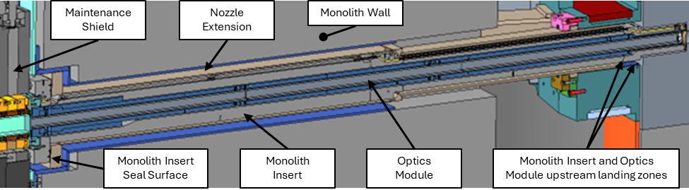
Vessel Systems Requirements
Interface Requirement:
Derived from: S01020500-IST10025 VS-Instrument Systems Interface Sheet

Slide 69
Vessel Systems Requirements
Interface Requirement:
Derived from: S01020500-IST10025 VS-Instrument Systems Interface Sheet

Slide 70
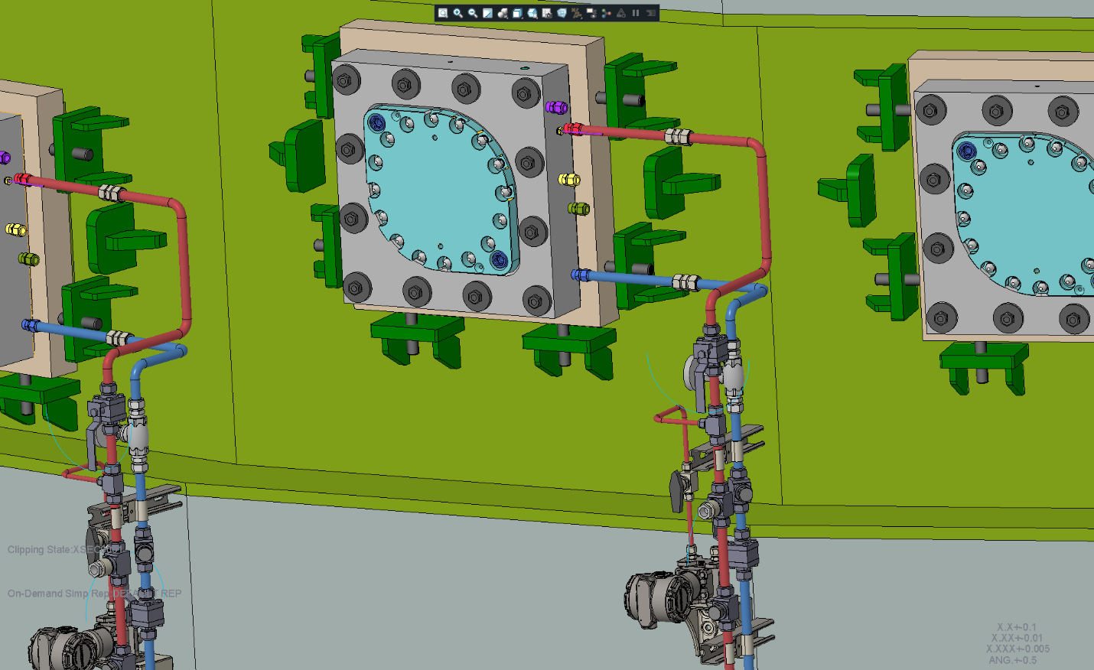
Vessel Systems Requirements
Interface Requirement:
Derived from: S01020500-IST10025 VS-Instrument Systems Interface Sheet

Slide 71
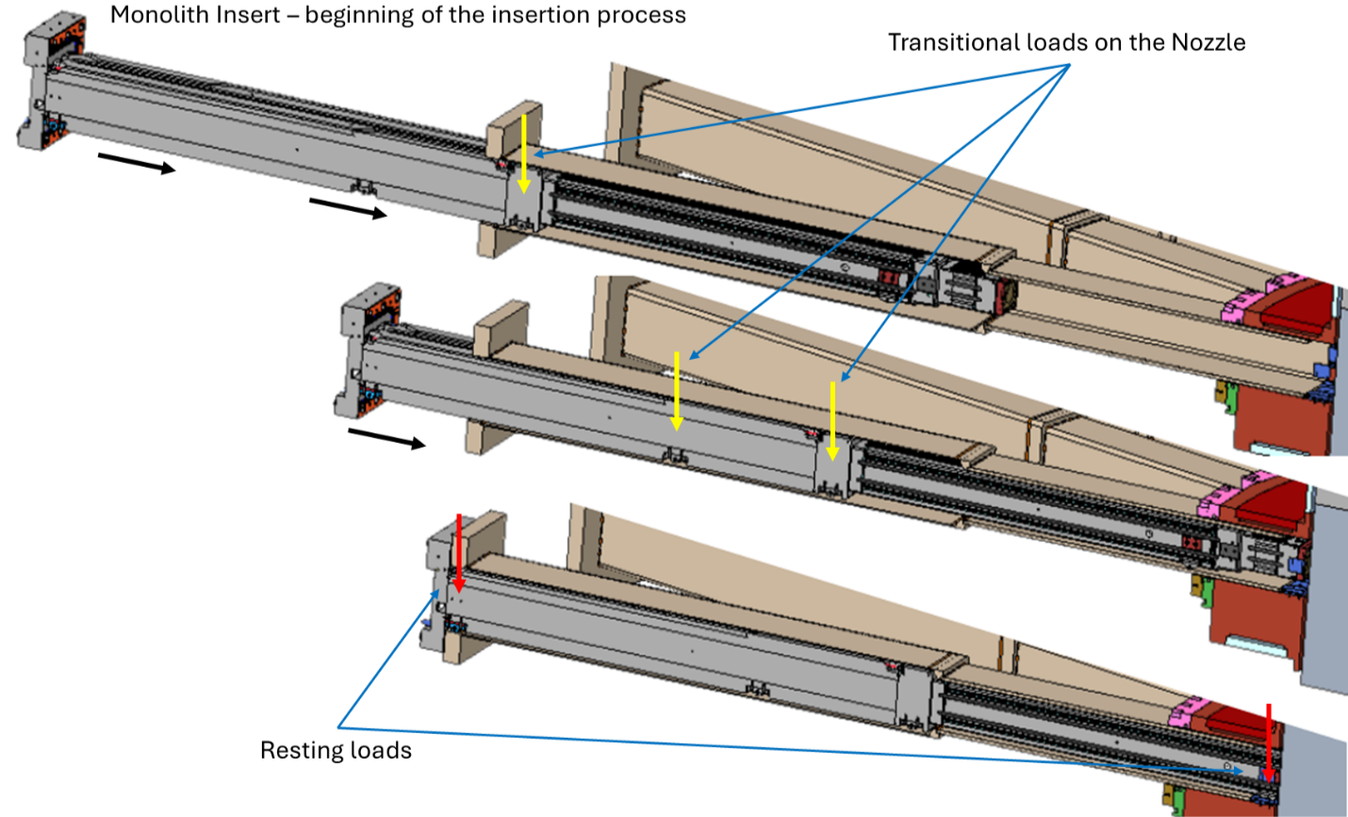
Vessel Systems Requirements
Interface Requirement:
Derived from: S01020500-IST10025 VS-Instrument Systems Interface Sheet

Slide 72
Vessel Systems Requirements
Interface Requirement:
Derived from: S01020500-IST10025 VS-Instrument Systems Interface Sheet

Slide 73
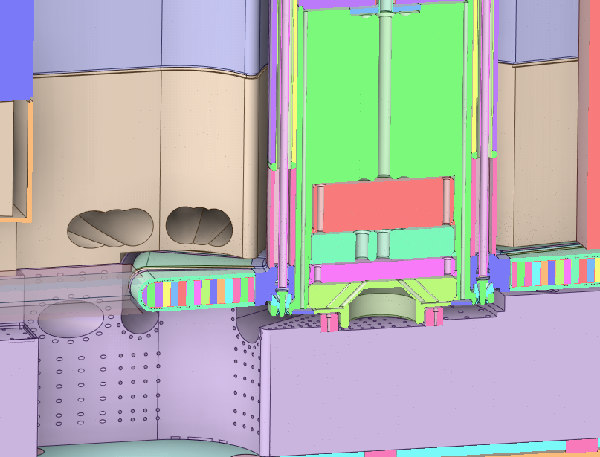
Vessel Systems Requirements
Interface Requirement:
Derived from: S01020500-IST10025 VS-Instrument Systems Interface Sheet

Slide 74
Vessel Systems Requirements
Interface Requirement:
Derived from: S01020500-IST10025 VS-Instrument Systems Interface Sheet

Slide 75
Vessel Systems Requirements
Interface Requirement:
Derived from: S01020500-IST10025 VS-Instrument Systems Interface Sheet

Slide 76
Vessel Systems Requirements
Interface Requirement:
Derived from: S01020500-IST10128 VS-Integrated Controls Interface Sheet

Slide 77
Vessel Systems Requirements
Interface Requirement:
Derived from: S01020500-IST10128 VS-Integrated Controls Interface Sheet

Slide 78
Vessel Systems Requirements
Interface Requirement:
Derived from: S01020500-IST10128 VS-Integrated Controls Interface Sheet

Slide 79
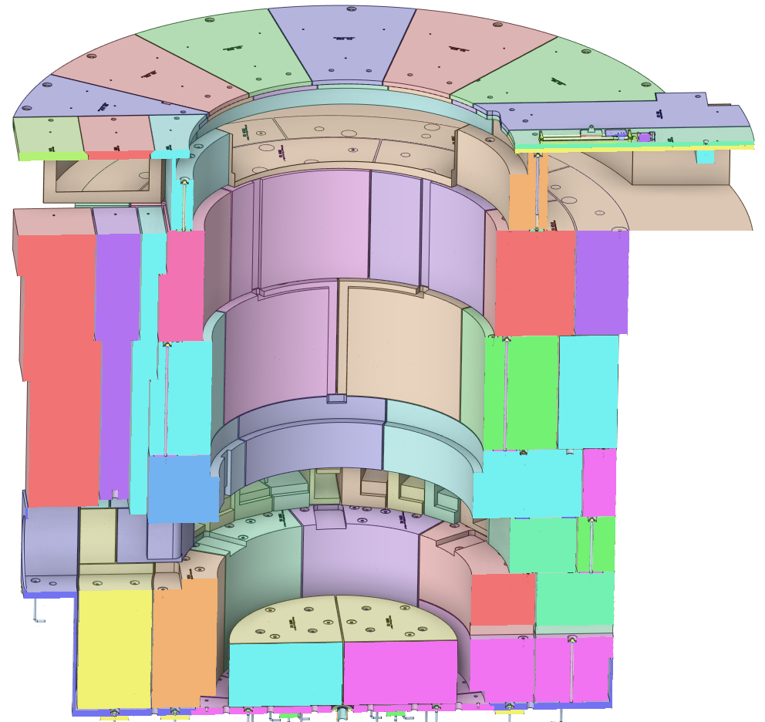
Target Station Shielding Requirements
General Requirement:
Derived from: Level 2 Target Systems Requirements

Slide 80
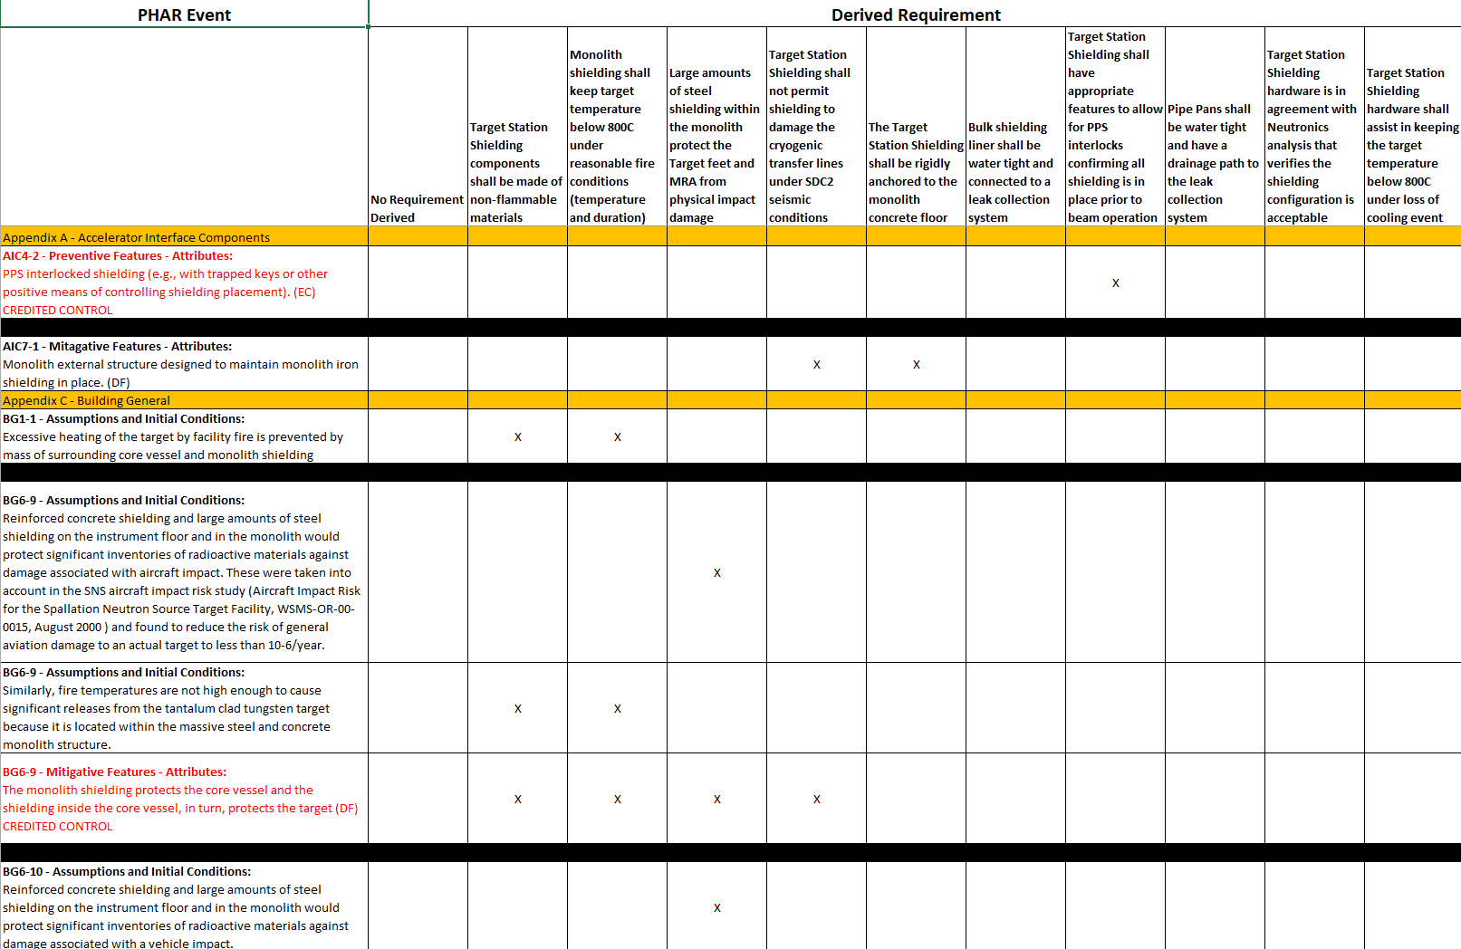
A detailed PHAR review was performed to determine requirements

Slide 81
Target Station Shielding Requirements
Safety Requirement:
Derived from: PHAR

Slide 82
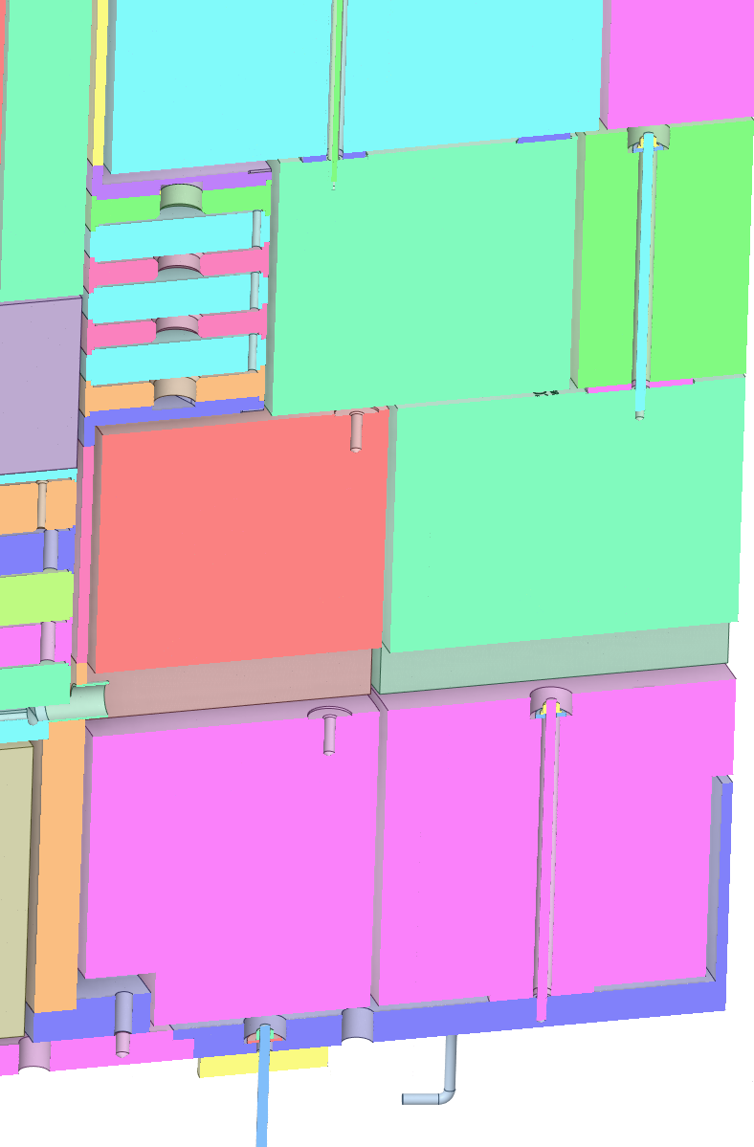
Target Station Shielding Requirements
Safety Requirement:
Derived from: PHAR

Slide 83
Target Station Shielding Requirements
Safety Requirement:
Derived from: PHAR

Slide 84
Target Station Shielding Requirements
Safety Requirement:
Derived from: PHAR

Slide 85
Target Station Shielding Requirements
Safety Requirement:
Derived from: PHAR

Slide 86
Target Station Shielding Requirements
Safety Requirement:
Derived from: PHAR

Slide 87
Target Station Shielding Requirements
Safety Requirement:
Derived from: PHAR

Slide 88
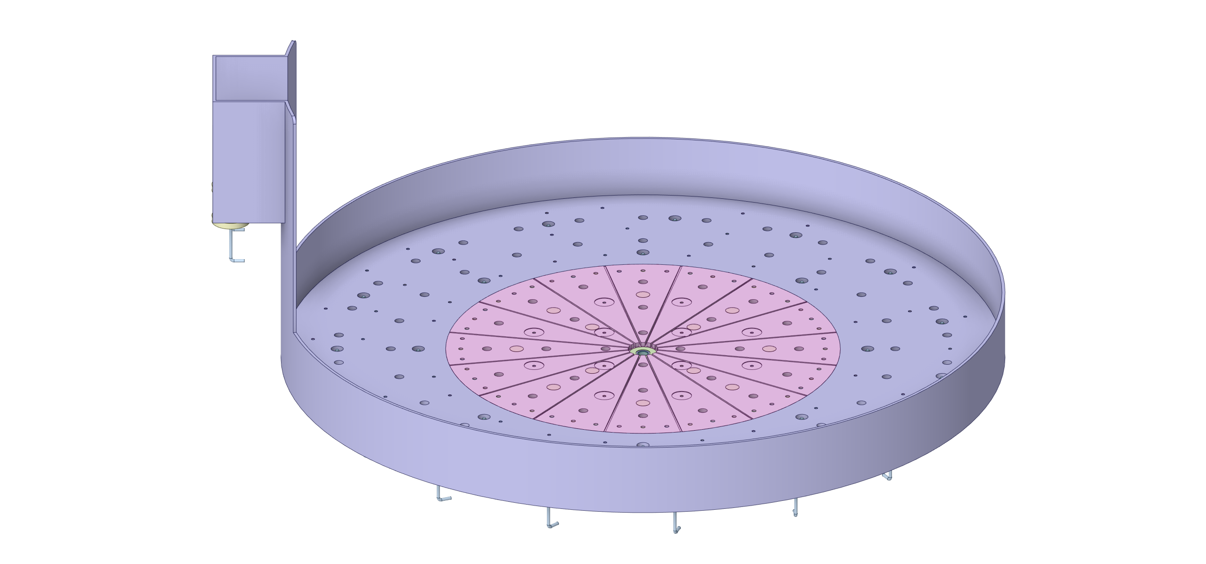
Target Station Shielding Requirements
Safety Requirement:
Derived from: PHAR

Slide 89
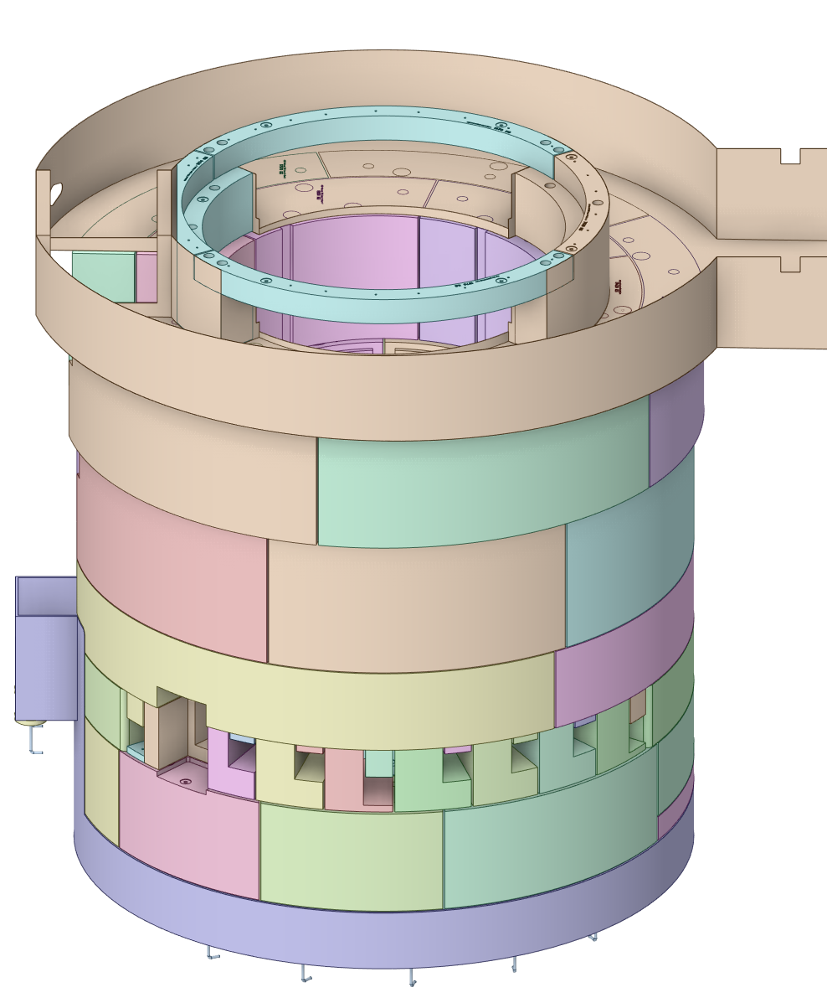
Target Station Shielding Requirements
Safety Requirement:
Derived from: PHAR

Slide 90
Target Station Shielding Requirements
Interface Requirement:
Derived from: S03000000-IST10011 TSS-CMS Interface Sheet

Slide 91
Target Station Shielding Requirements
Interface Requirement:
Derived from: S03000000-IST10011 TSS-CMS Interface Sheet

Slide 92
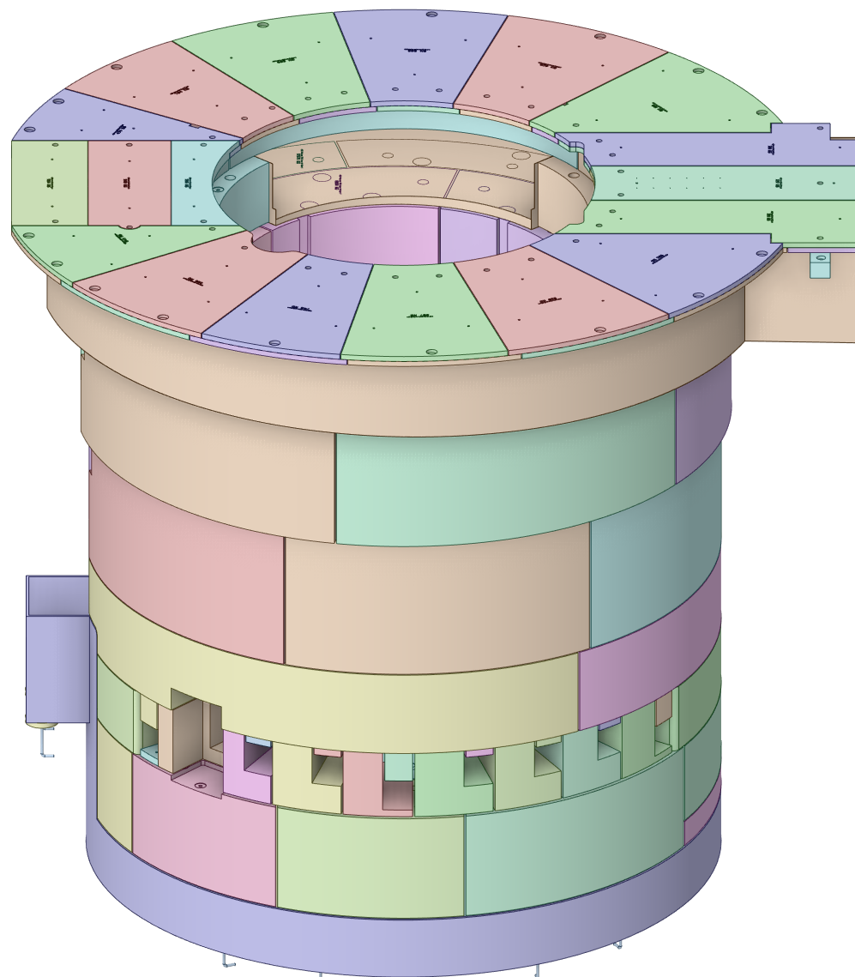
Target Station Shielding Requirements
Interface Requirement:
Derived from: S03000000-IST10011 TSS-CMS Interface Sheet

Slide 93
Target Station Shielding Requirements
Interface Requirement:
Derived from: S03000000-IST10011 TSS-CMS Interface Sheet

Slide 94
Target Station Shielding Requirements
Interface Requirement:
Derived from: S03000000-IST10011 TSS-CMS Interface Sheet

Slide 95
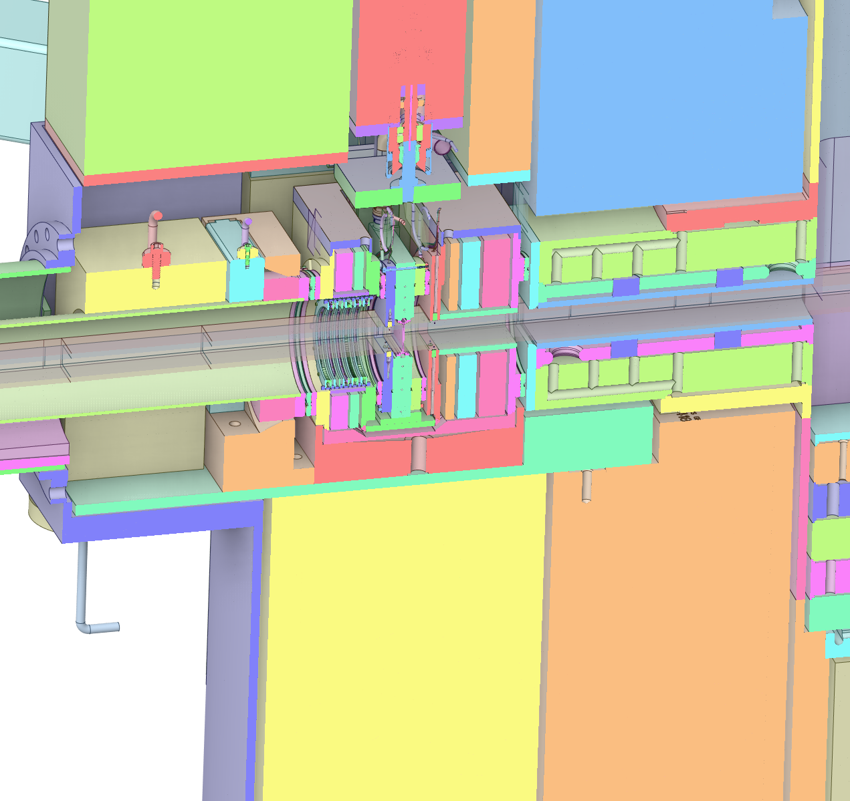
Target Station Shielding Requirements
Interface Requirement:
Derived from: S01020500-IST10217 TSS-AIC Interface Sheet

Slide 96
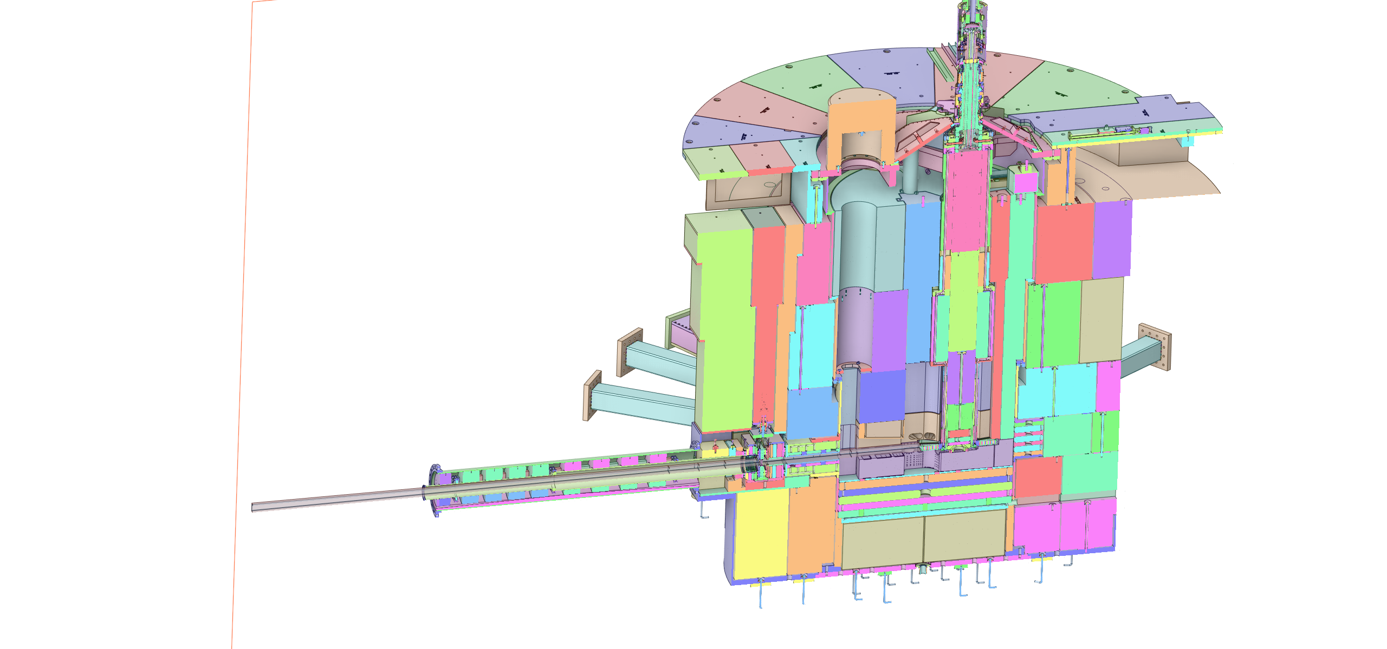
Target Station Shielding Requirements
Interface Requirement:
Derived from: S01020500-IST10217 TSS-AIC Interface Sheet

Slide 97
Target Station Shielding Requirements
Interface Requirement:
Derived from: S01020500-IST10217 TSS-AIC Interface Sheet

Slide 98
Target Station Shielding Requirements
Interface Requirement:
Derived from: S01020500-IST10217 TSS-AIC Interface Sheet

Slide 99
Target Station Shielding Requirements
Interface Requirement:
Derived from: S01020500-IST10217 TSS-AIC Interface Sheet

Slide 100
Target Station Shielding Requirements
Interface Requirement:
Derived from: S01020500-IST10217 TSS-AIC Interface Sheet

Slide 101
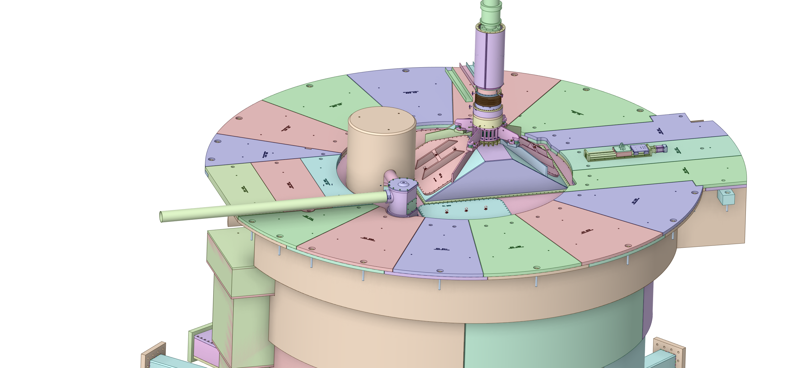
Target Station Shielding Requirements
Interface Requirement:
Derived from: S01020500-IST10217 TSS-AIC Interface Sheet

Slide 102
Target Station Shielding Requirements
Interface Requirement:
Derived from: S03000000-IST10005 TSS-Process Systems Interface Sheet

Slide 103
Target Station Shielding Requirements
Interface Requirement:
Derived from: S03000000-IST10005 TSS-Process Systems Interface Sheet

Slide 104
Target Station Shielding Requirements
Interface Requirement:
Derived from: S03000000-IST10005 TSS-Process Systems Interface Sheet

Slide 105
Target Station Shielding Requirements
Interface Requirement:
Derived from: S03000000-IST10005 TSS-Process Systems Interface Sheet

Slide 106
Target Station Shielding Requirements
Interface Requirement:
Derived from: S03000000-IST10005 TSS-Process Systems Interface Sheet

Slide 107
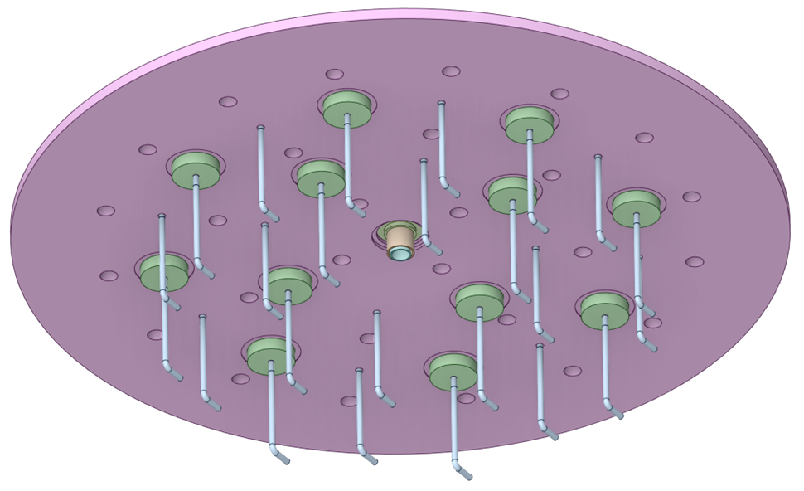
Target Station Shielding Requirements
Interface Requirement:
Derived from: S03000000-IST10005 TSS-Process Systems Interface Sheet

Slide 108
Target Station Shielding Requirements
Interface Requirement:
Derived from: S03000000-IST10005 TSS-Process Systems Interface Sheet

Slide 109
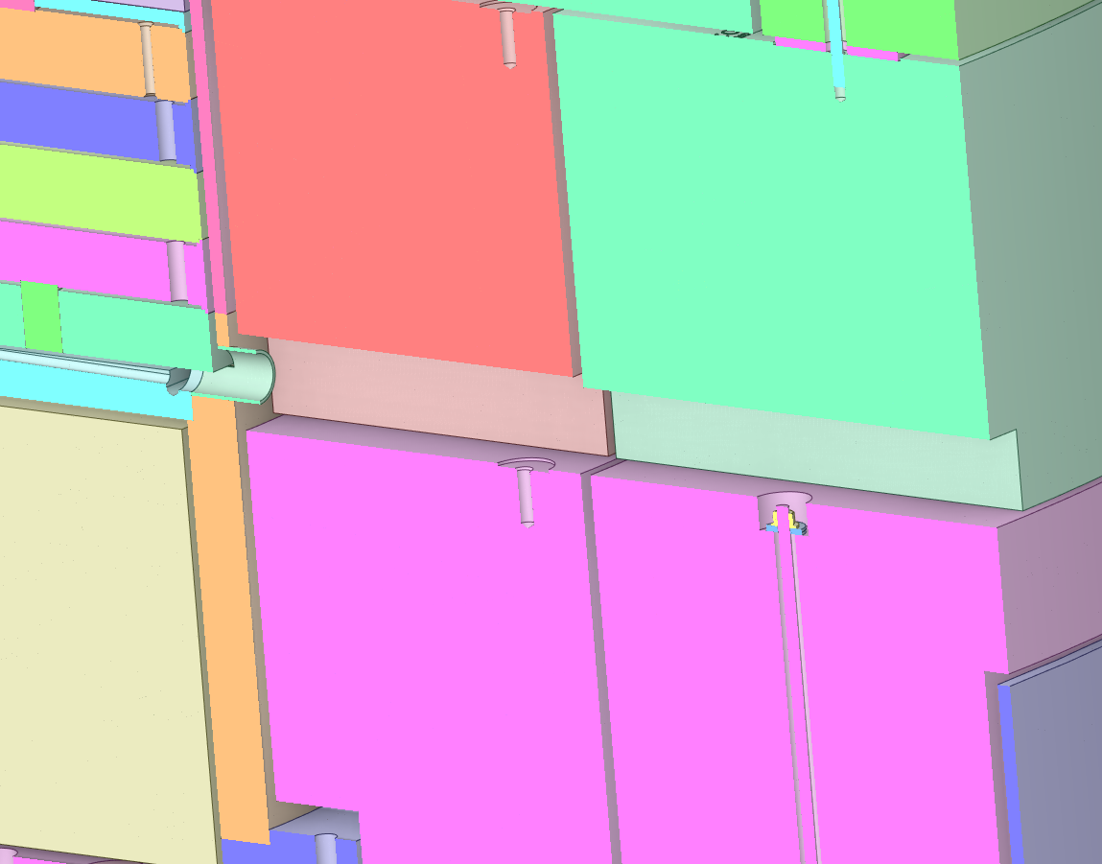
Target Station Shielding Requirements
Interface Requirement:
Derived from: S03000000-IST10005 TSS-Process Systems Interface Sheet

Slide 110
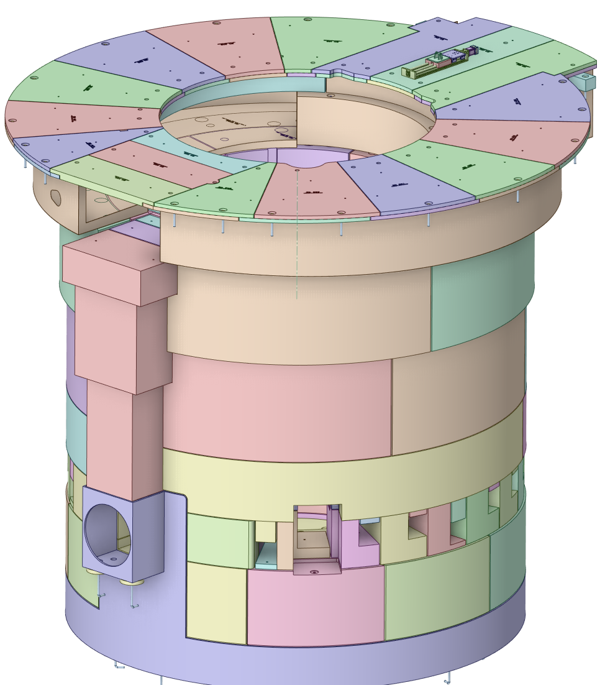
Target Station Shielding Requirements
Interface Requirement:
Derived from: S03000000-IST10007 TSS-Remote Handling Interface Sheet

Slide 111
Target Station Shielding Requirements
Interface Requirement:
Derived from: S01020500-IST100025 TSS-Instrument Systems Interface Sheet

Slide 112
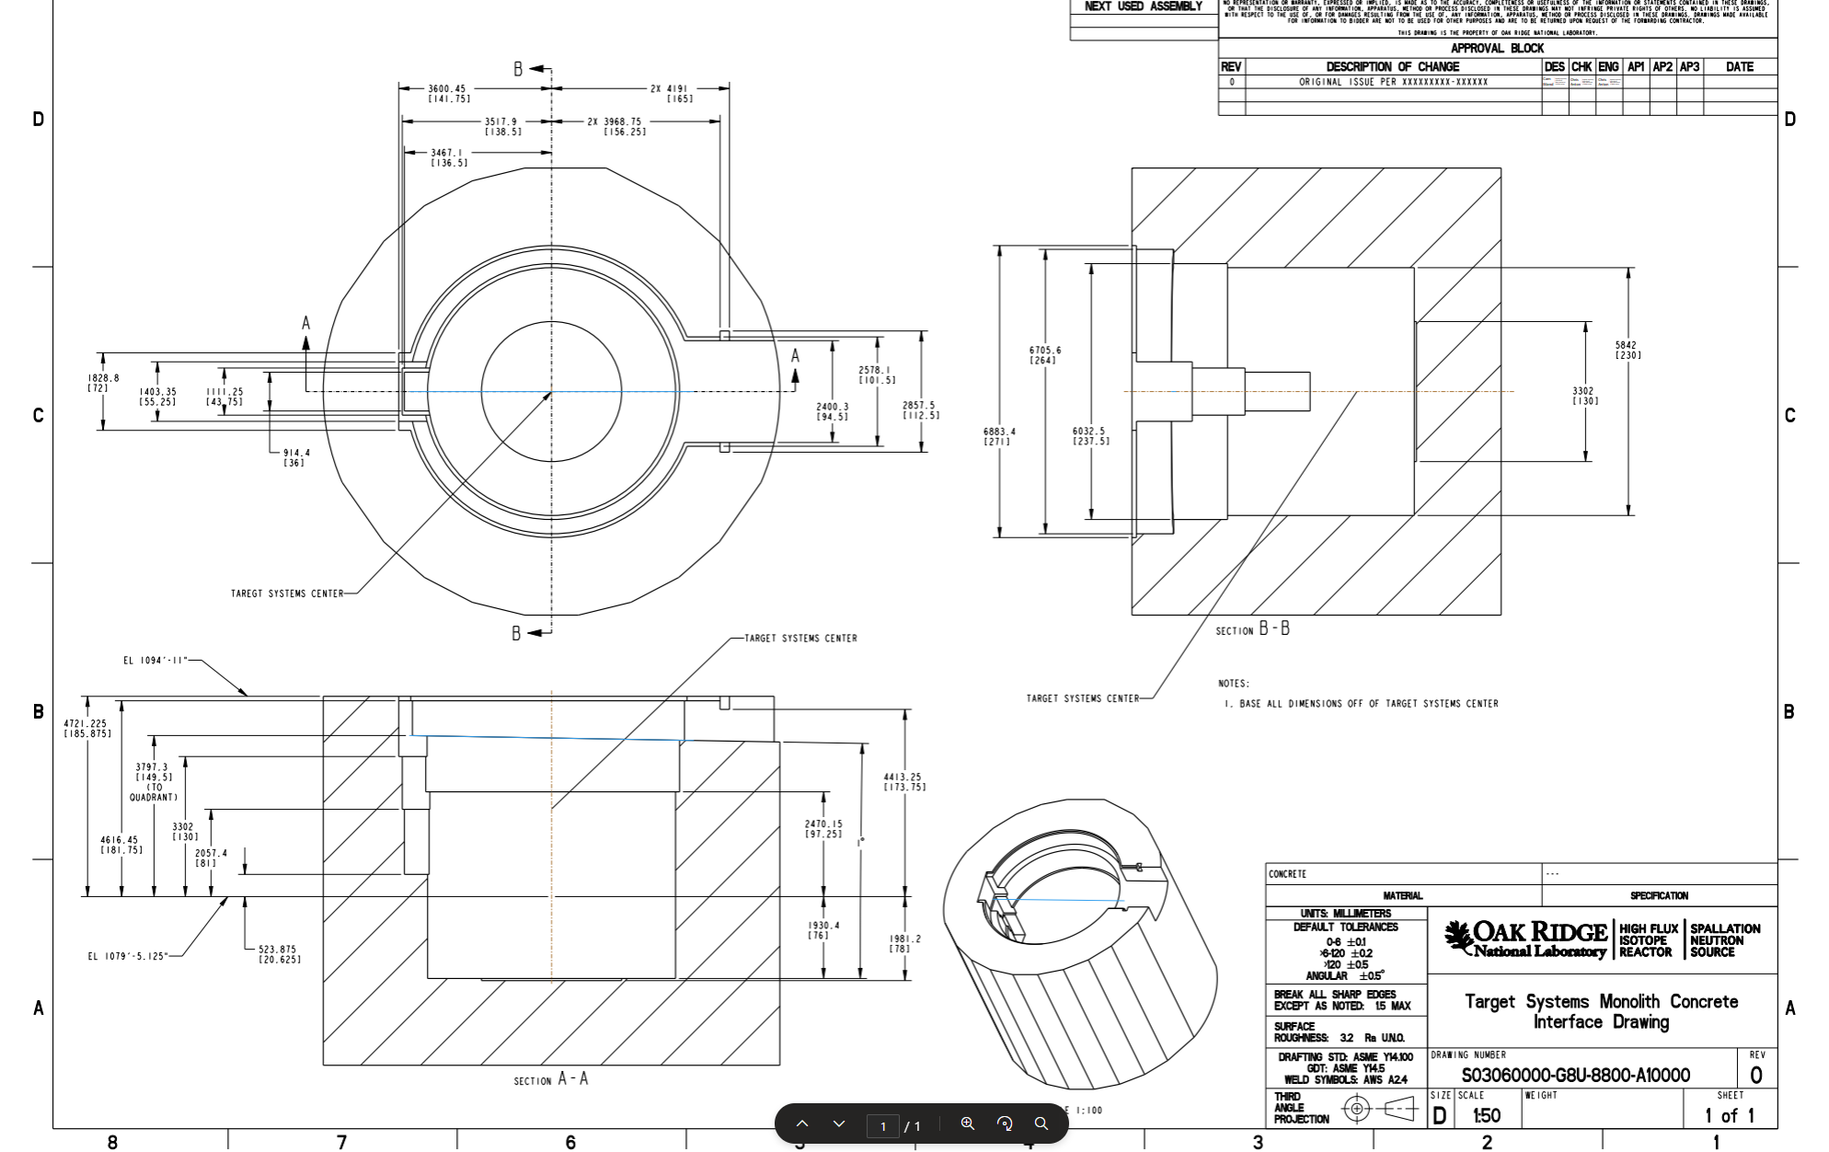
Target Station Shielding Requirements
Interface Requirement:
Derived from: S01020500-IST100064 TSS-Conventional Facilities Interface Sheet

Slide 113
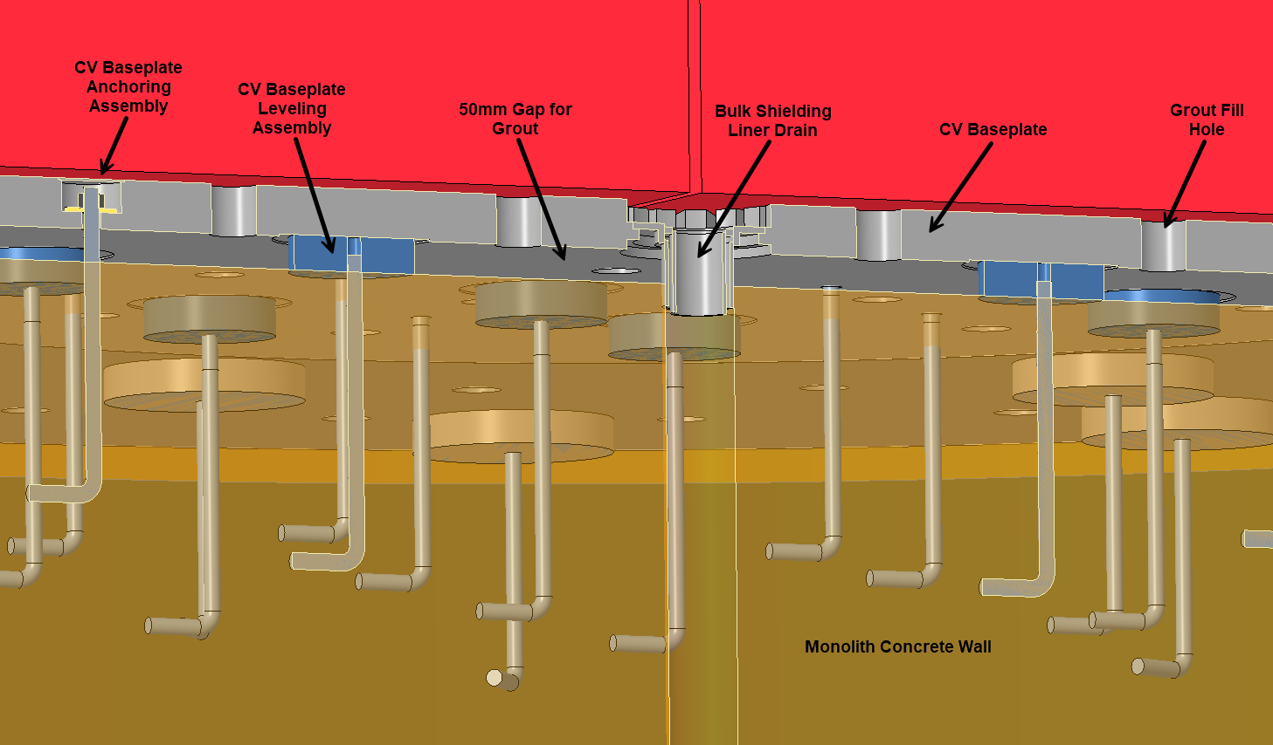
Target Station Shielding Requirements
Interface Requirement:
Derived from: S01020500-IST100064 TSS-Conventional Facilities Interface Sheet

Slide 114
Target Station Shielding Requirements
Interface Requirement:
Derived from: S01020500-IST100064 TSS-Conventional Facilities Interface Sheet

Slide 115
Target Station Shielding Requirements
Interface Requirement:
Derived from: S01020500-IST100064 TSS-Conventional Facilities Interface Sheet

Slide 116
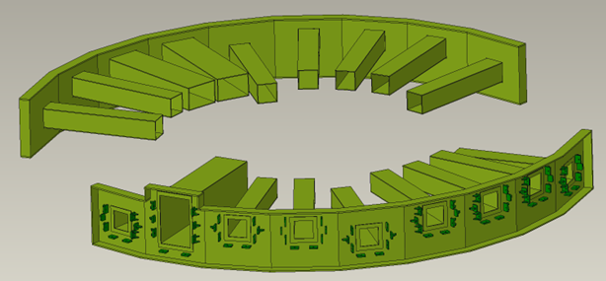
Target Station Shielding Requirements
Interface Requirement:
Derived from: S01020500-IST100064 TSS-Conventional Facilities Interface Sheet

Slide 117
Target Station Shielding Requirements
Interface Requirement:
Derived from: S01020500-IST100064 TSS-Conventional Facilities Interface Sheet

Slide 118
Target Station Shielding Requirements
Interface Requirement:
Derived from: S01020500-IST100220 TSS-Integrated Controls Interface Sheet

Slide 119
Target Station Shielding Requirements
Interface Requirement:
Derived from: S01020500-IST100220 TSS-Integrated Controls Interface Sheet

