Slide 1
Vessel Systems and Target Station Shielding Neutronics Analysis
Presented by
Igor Remec
STS Neutronics Group Leader
Analyses by Lukas Zavorka, Thomas Miller, Kristel Ghoos, Tucker McClanahan, Kumar Mohindroo
Preliminary Design Review of the Second Target Station Vessel Systems and Target Station Shielding
Oak Ridge National Laboratory, Oak Ridge, TN, April 21-22nd, 2025

Slide 2
Introduction: Neutronics View of the Vessel Systems and Target Station Shielding
Core vessel contains and supports vital STS systems:
  Target
  Moderator Reflector Assembly
  Target Viewing Periscope
Core vessel shielding and target station shielding:
  Provides protection against radiation heating and damage
  Influences radiation dose rates everywhere around STS
Neutronics analyses need to consider interplay between these systems and address sometimes conflicting design objectives.

Slide 3
Outline
STS Neutronics
  Neutronic scope includes all STS project neutronics
  Software, models, and data
VS/TSS Neutronics Analyses
  Core Vessel and CV Shielding Energy deposition, Radiation damage
  Target, Target Shaft, Target Drive Room and High Bay
  Target Viewing Periscope
  Proton Beam Window
  Gamma Gate Assembly
  Core Vessel Nozzle Extensions and Monolith Inserts
  Target Station Shielding, Monolith, and Bunker
Current and Future Work
Summary

Slide 4
Neutronics Analyses - Tools
Radiation transport:
  MCNP 6.2
  ADVANTG, Attila4MC-Cottonwood (for deterministic weight window generation)
  MCNPX 2.6, 2.7 with enhancements (phased out, used for early work)
  DAGMC: Direct Accelerated Geometry Monte Carlo toolkit (based on MCNP 6.2)
Activation:
  CINDER 2008, AARE (Activation in Accelerator Radiation Environments)
  CINDER 90, Activation scripts (phased out, used for early work)
CAD to MCNP conversion, model development:
  Attila4MC(unstructured mesh generation)
  Space Claim, Cubit, Solidworks (for CAD to MCNP conversion)
  GEOUNED ( CAD to CSG conversion)
Optimization:
  DAKOTA, STS automated CAD-MCNP-Dakota optimization workflow
Cross-Sections mostly based on ENDF-VII
Notes:
Traditional neutronics tools include
Radiation transport code MCNPX 2.6, 2.7 with enhancements (most work to date),
Transmutation code CINDER 90
and Activation scripts
Recently added new tools include:
MCNP 6.1, 6.2
DAGMC: Direct Accelerated Geometry Monte Carlo toolkit implemented in MCNP 6.1 and MCNP 6.2
CINDER 2008, a modern version of CINDER 90
ADVANTG code used for weight window generation, for advance variance reduction in MCNP
and Space Claim and Cubit, which are used for DAGMC model preparation

Slide 5
Neutronics Analyses for VS & TS Shielding
Start with the proton beam on target
Require large models
Provide results on:
  Energy deposition from the beam-on operations to provide input for the subsequent structural stress and thermal analyses, mainly to design efficient cooling and maintain structural integrity throughout the service life-time
  Radiation damage to determine the service life-time
  Prompt radiation dose rate from the beam-on operations to guide the effective radiation shielding design
With additional activation and delayed gamma-ray transport steps:
  Shutdown radiation dose rates needed for maintenance and replacement operations

Slide 6
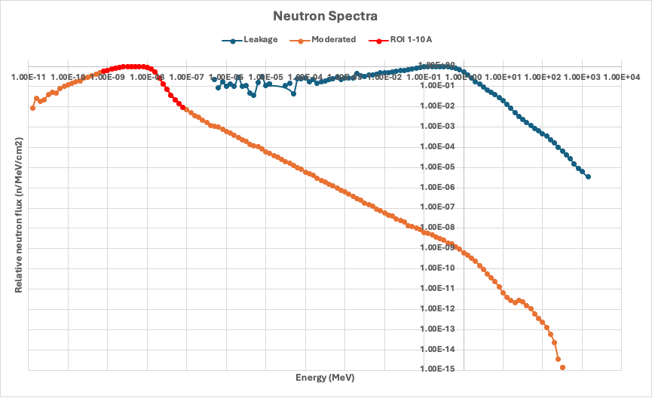
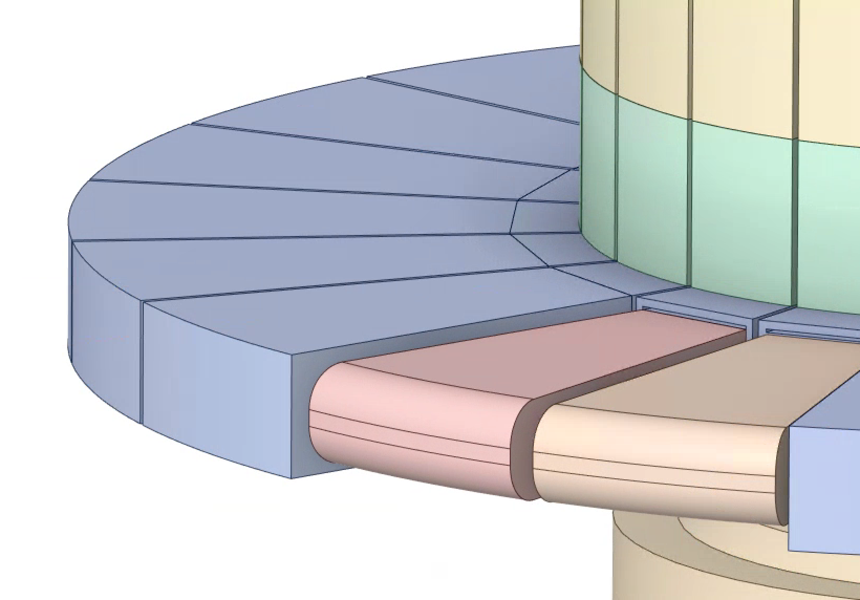
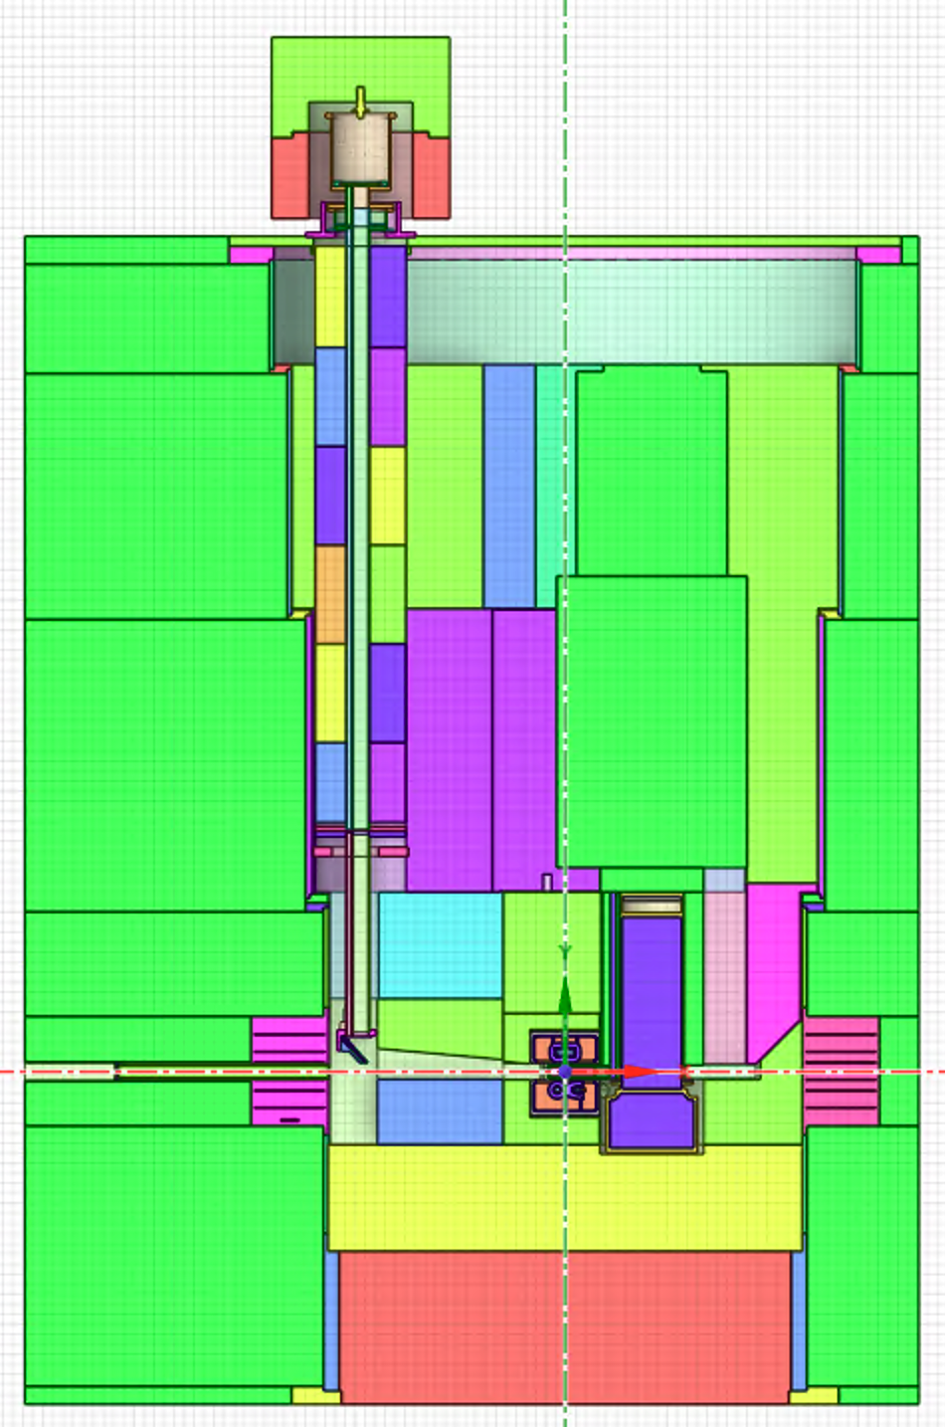
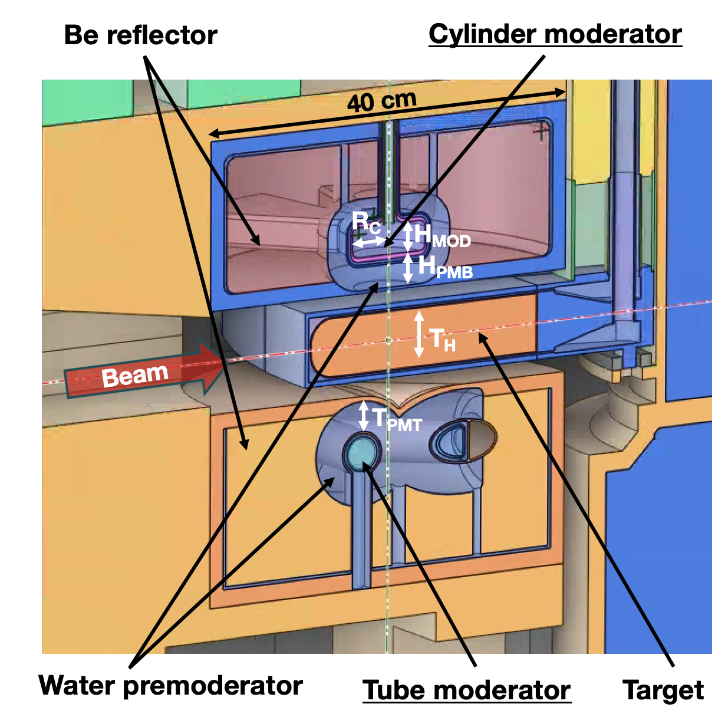
Neutronics Analyses
(continued)
Source:
0.7 MW pulsed proton beam,
1.3 GeV protons, 3.36x10¹⁵ p/s, 15 Hz, 46.7 kJ/pulse, (<1 μs)
For most cases: 95% of beam within 62.5 cm²
Rotating W target
Spallation neutrons moderated in coupled low-dimensional (flat) cylindrical and tube moderators designed for high brightness
Para-hydrogen at 20 K
Water premoderator, Be reflector
1.3 GeV protons
CORE VESSEL
VS SHIELDING
5 m
TS
SHIELDING
n
g
TVP
hdta
1.3 GeV protons
n
π, μ
MODERATORS
TARGET

Slide 7
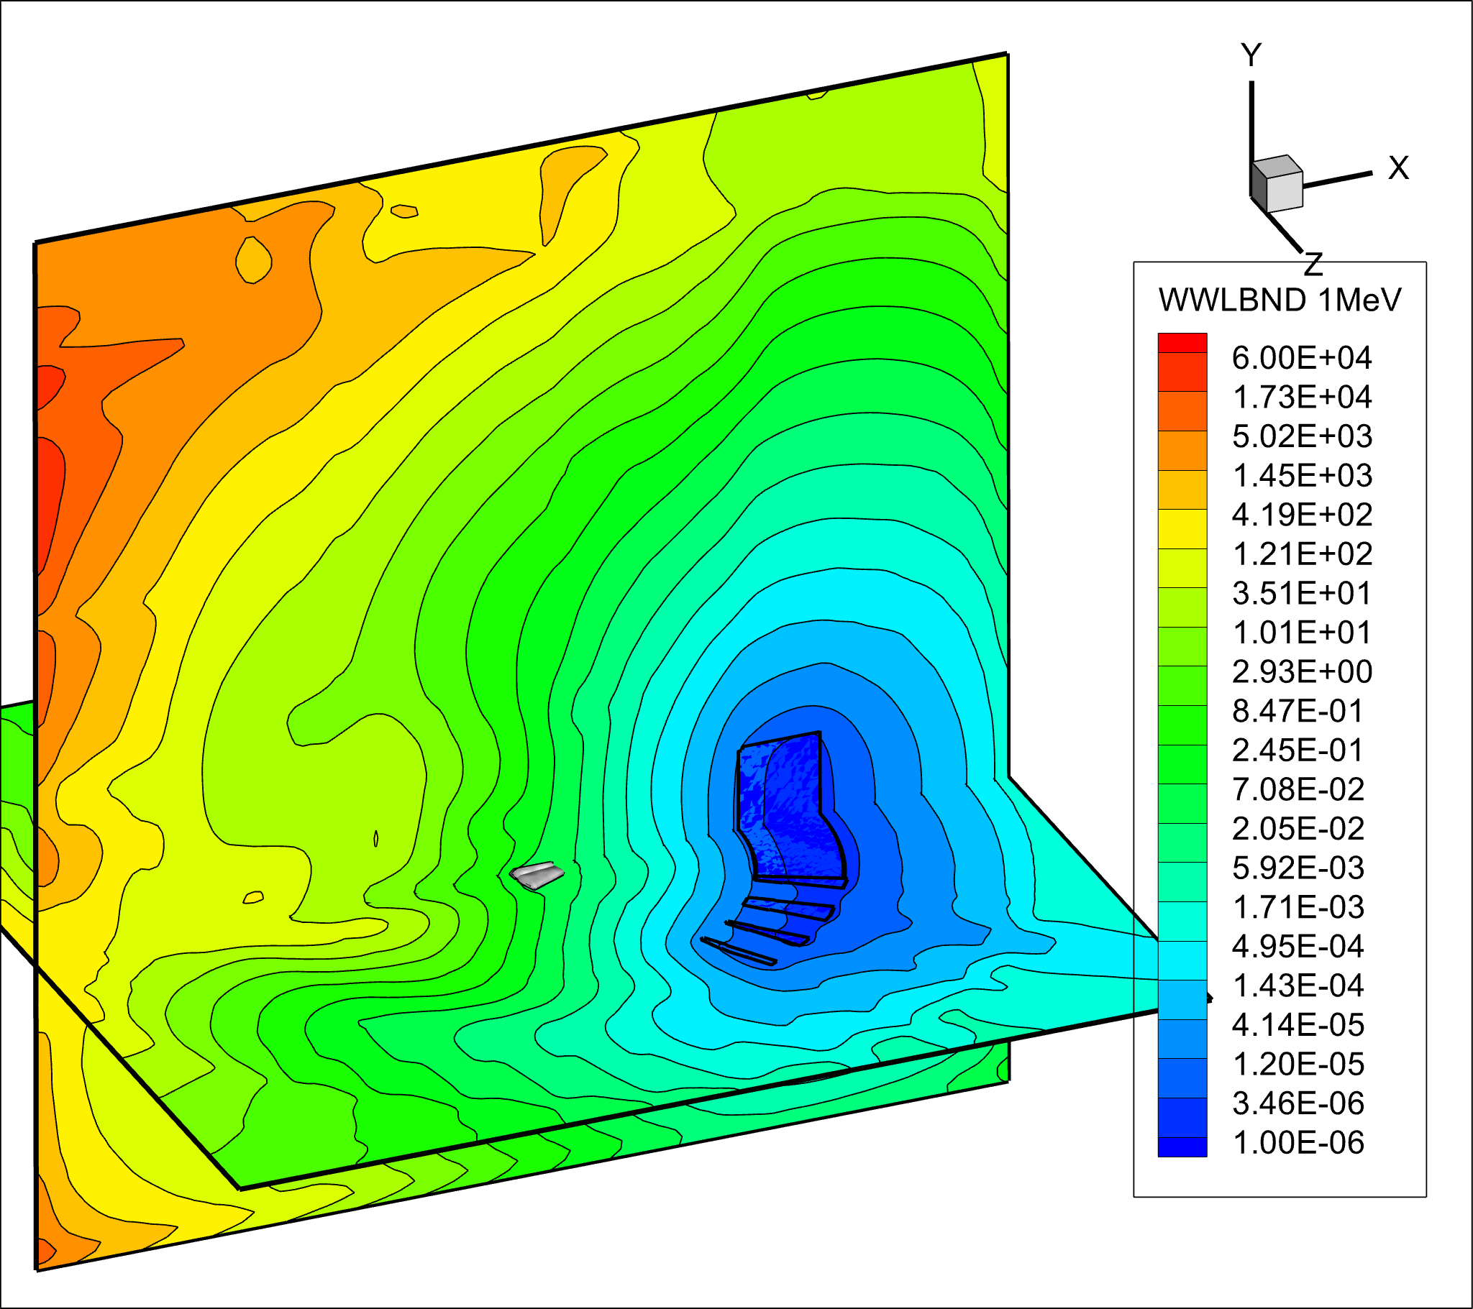
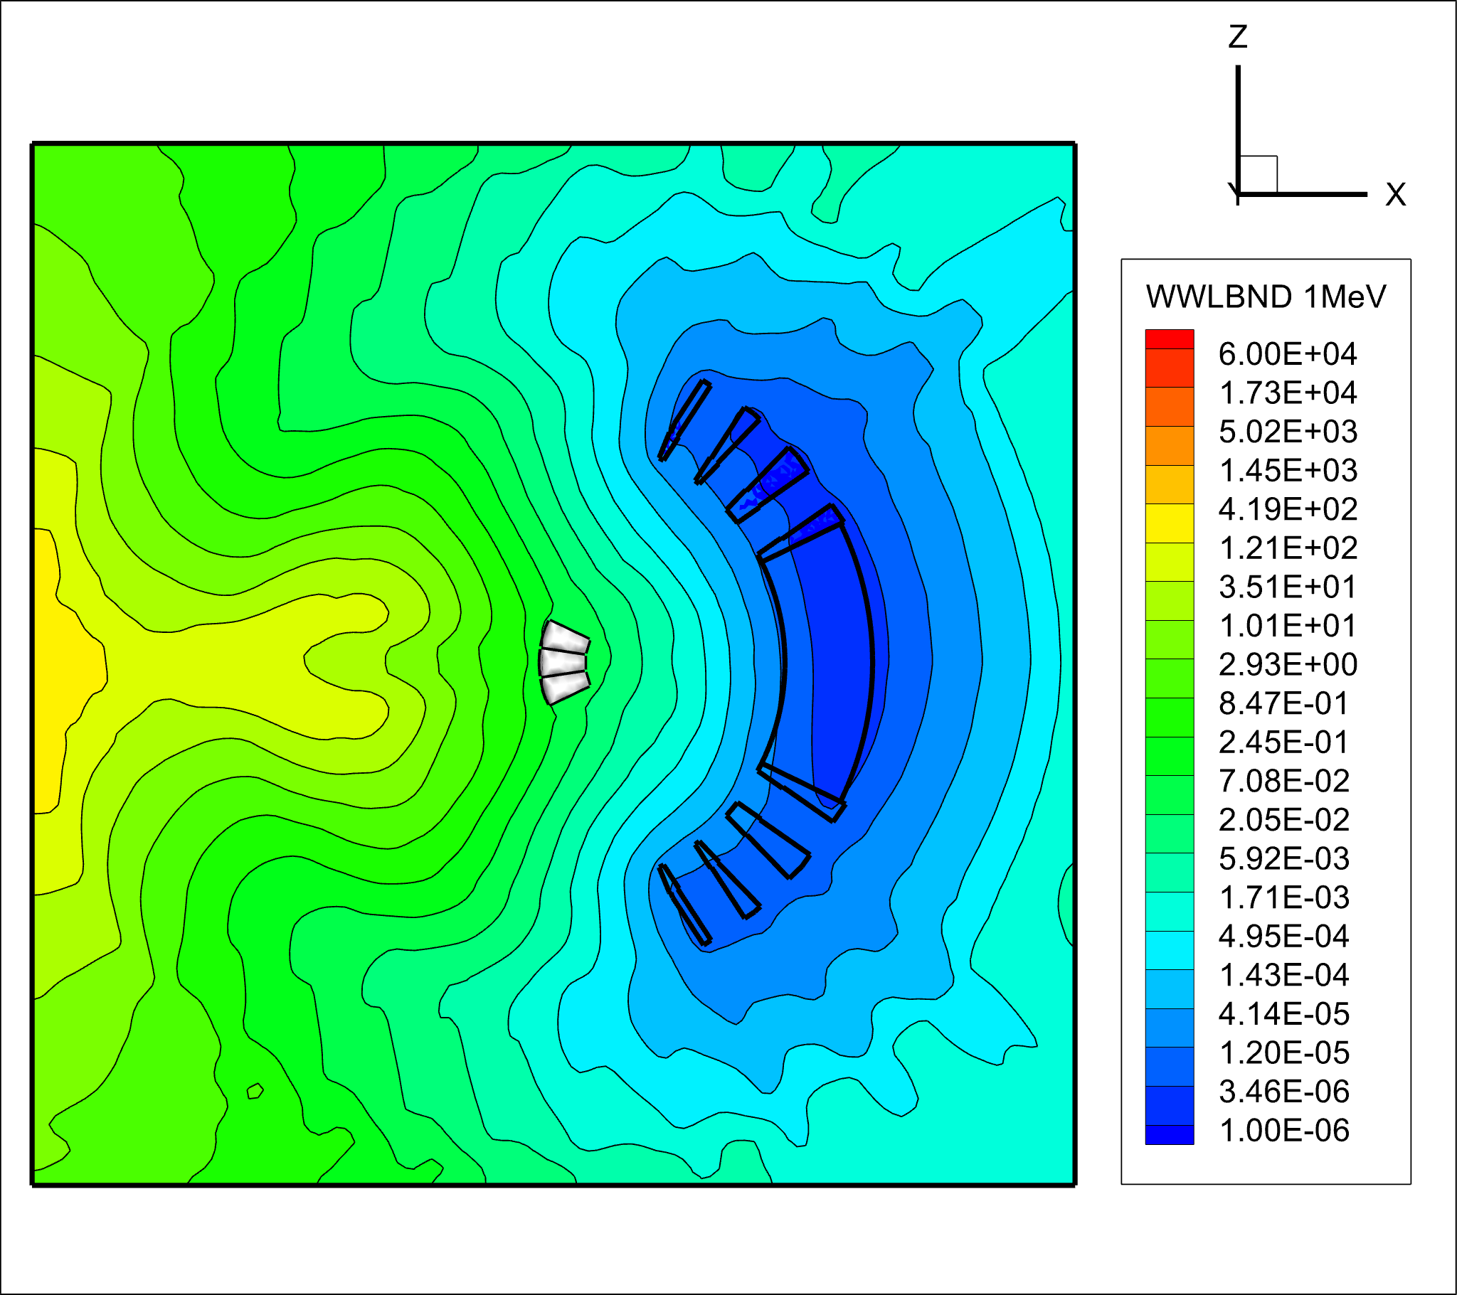
Neutronics Analyses – Variance Reduction
Deterministic energy-dependent n/p weight windows necessary for faster MCNP convergence calculated with ADVANTG or Attila4MC/Cottonwood
FW-CADIS starting with a secondary neutron source in the target
HILO2K materials library used for neutrons up to 1.3 GeV
Target segments
Downstream CV beltline
Weight windows for 1 MeV neutrons with the FW-CADIS motivating tally in the downstream CV beltline

Slide 8
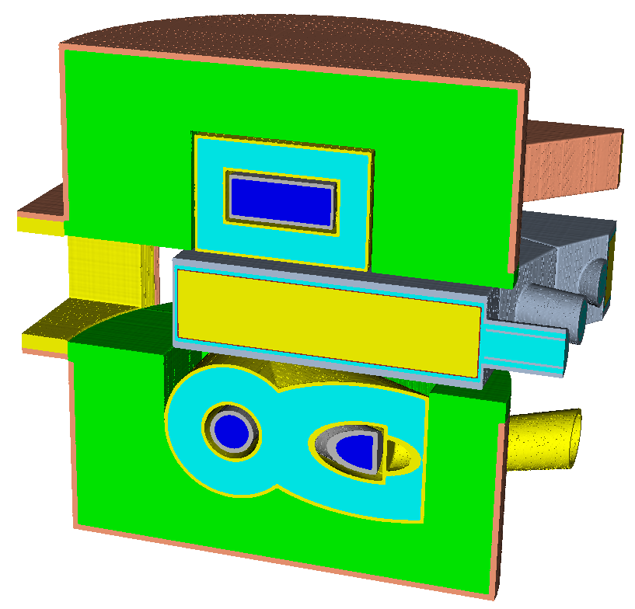
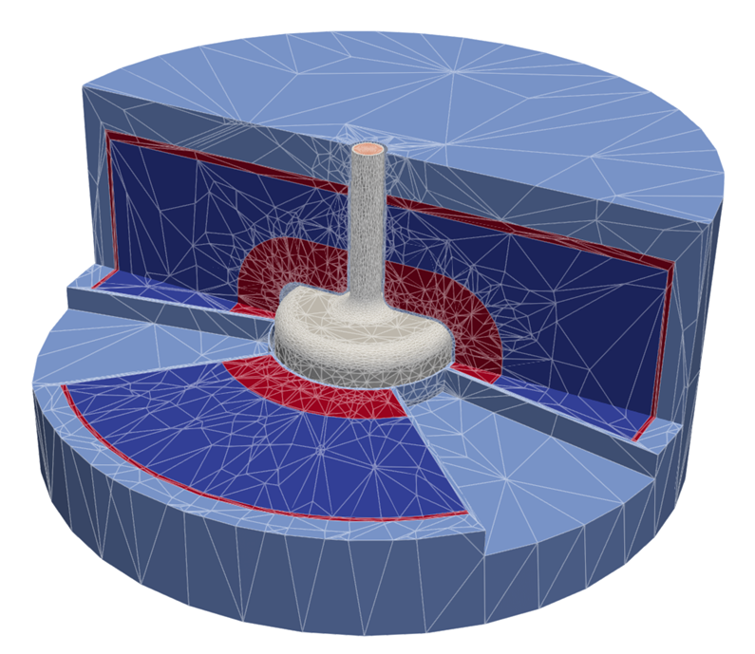
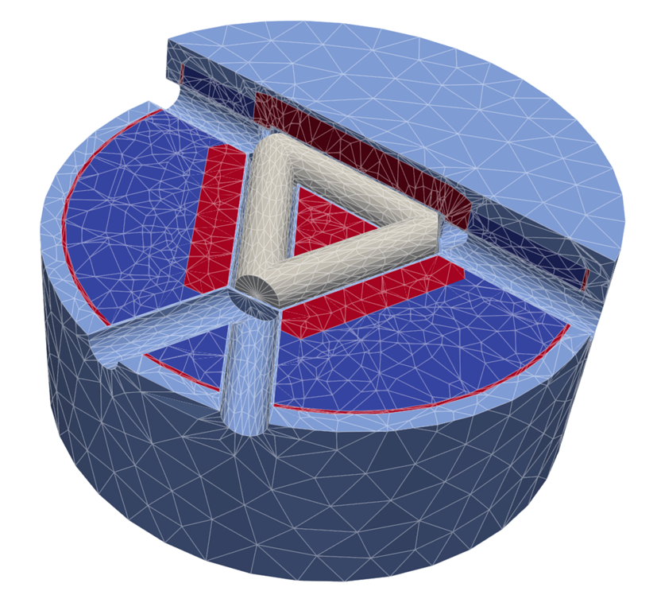
Neutronics Analyses – MCNP Models: CSG, UMG, and Hybrid
CSG MCNP model of the MRA
UM MCNP model of the MRA
CSG
UM
Transition from CSG to UM models provides ability to generate MCNP models that closely match engineering design.

Slide 9
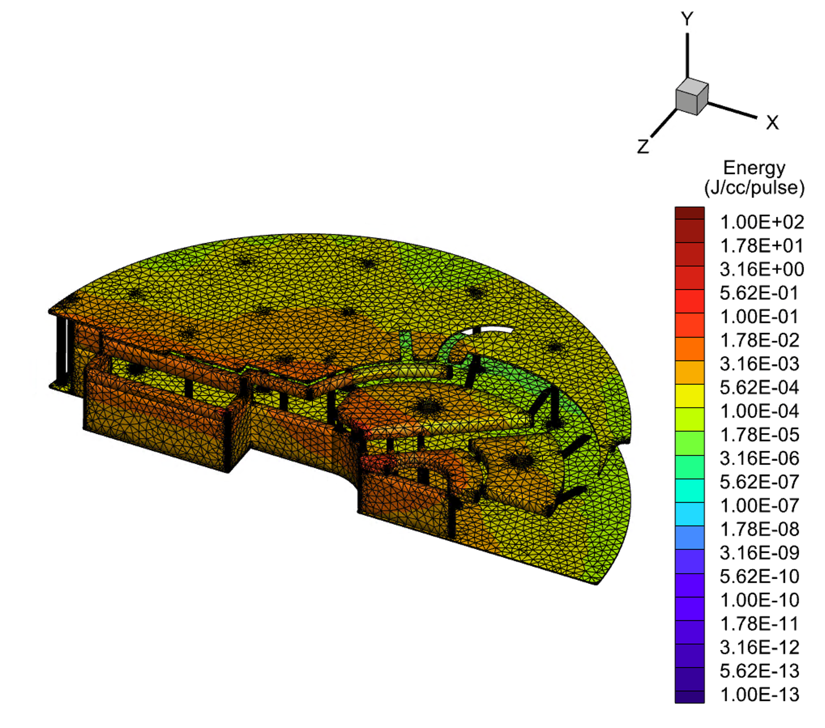
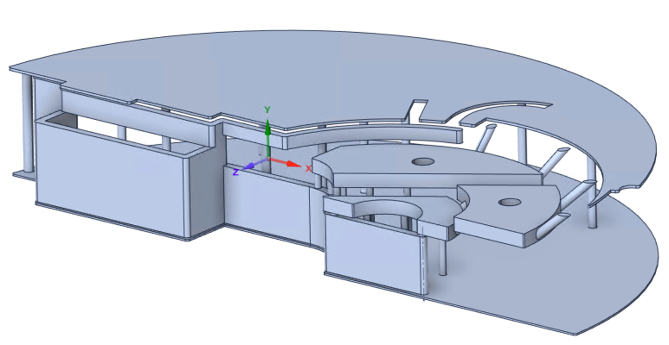
Unstructured Mesh (UM) Geometry (UMG) Application
The analyses rely heavily on the recently developed UMG capability of MCNP6.2 and Attila4MC’ volumetric mesh generator
UM enables conversion of the solid CAD models directly for MCNP, which significantly improves both the efficiency and quality of the neutronics models’ generation
Volumetric (3D) UM provides data with high spatial resolution that can be used as input for subsequent Finite Element Analyses (FEA)
The use of UM has been thoroughly validated against the traditional MCNP’s Constructive Solid Geometry (CSG) modeling
UM
CAD

Slide 10
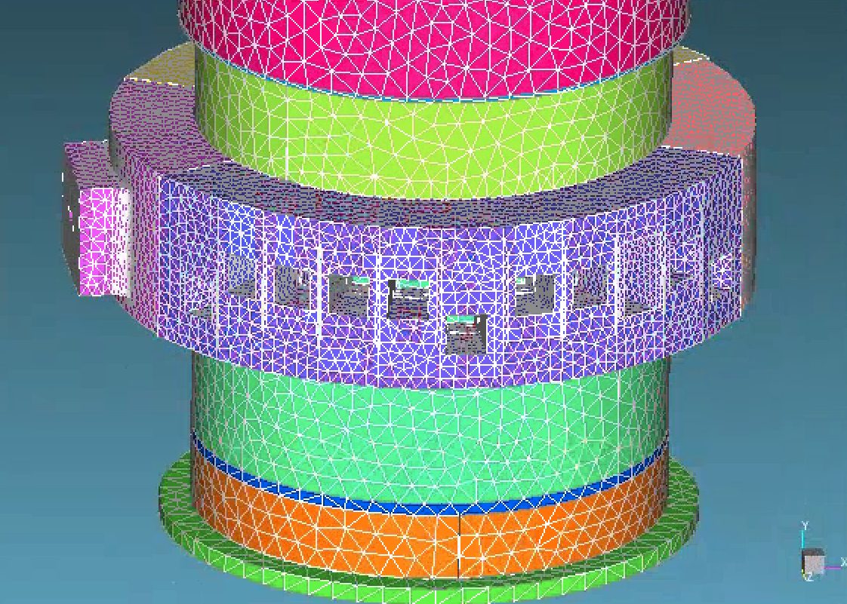
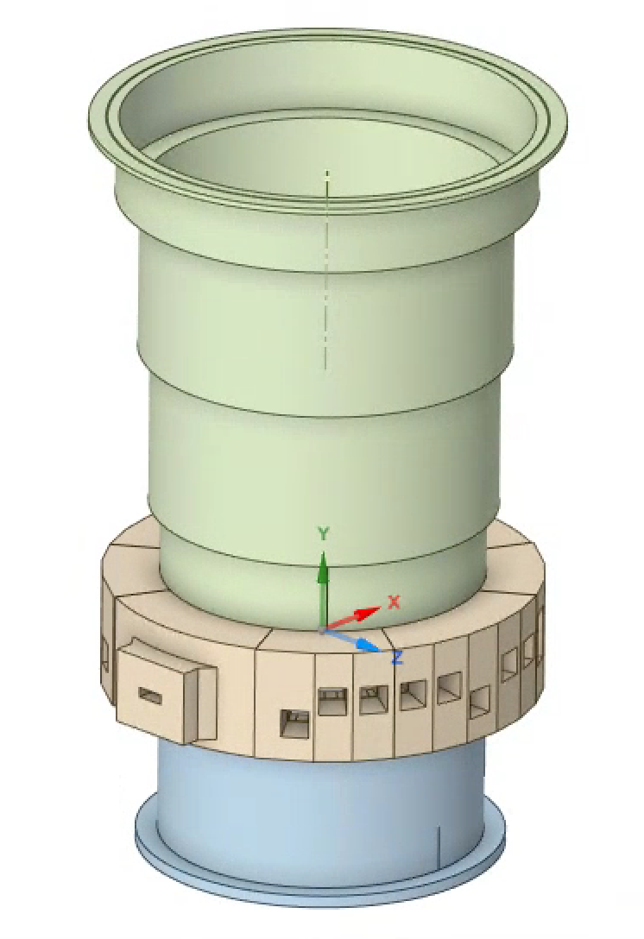
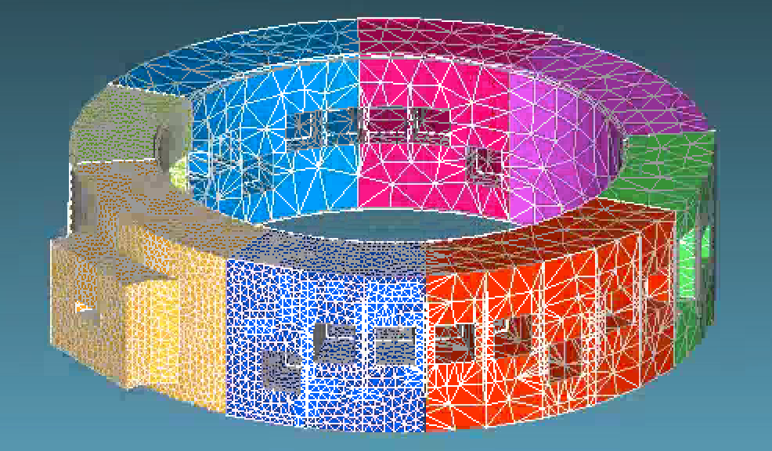
Core Vessel UM Model for MCNP
6 m
CV belt line
1.3 GeV protons
3.5 m

Slide 11
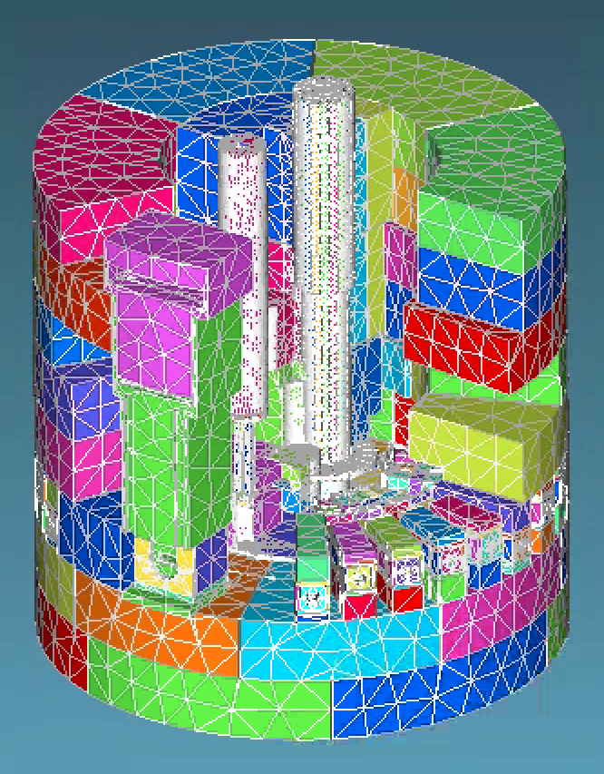
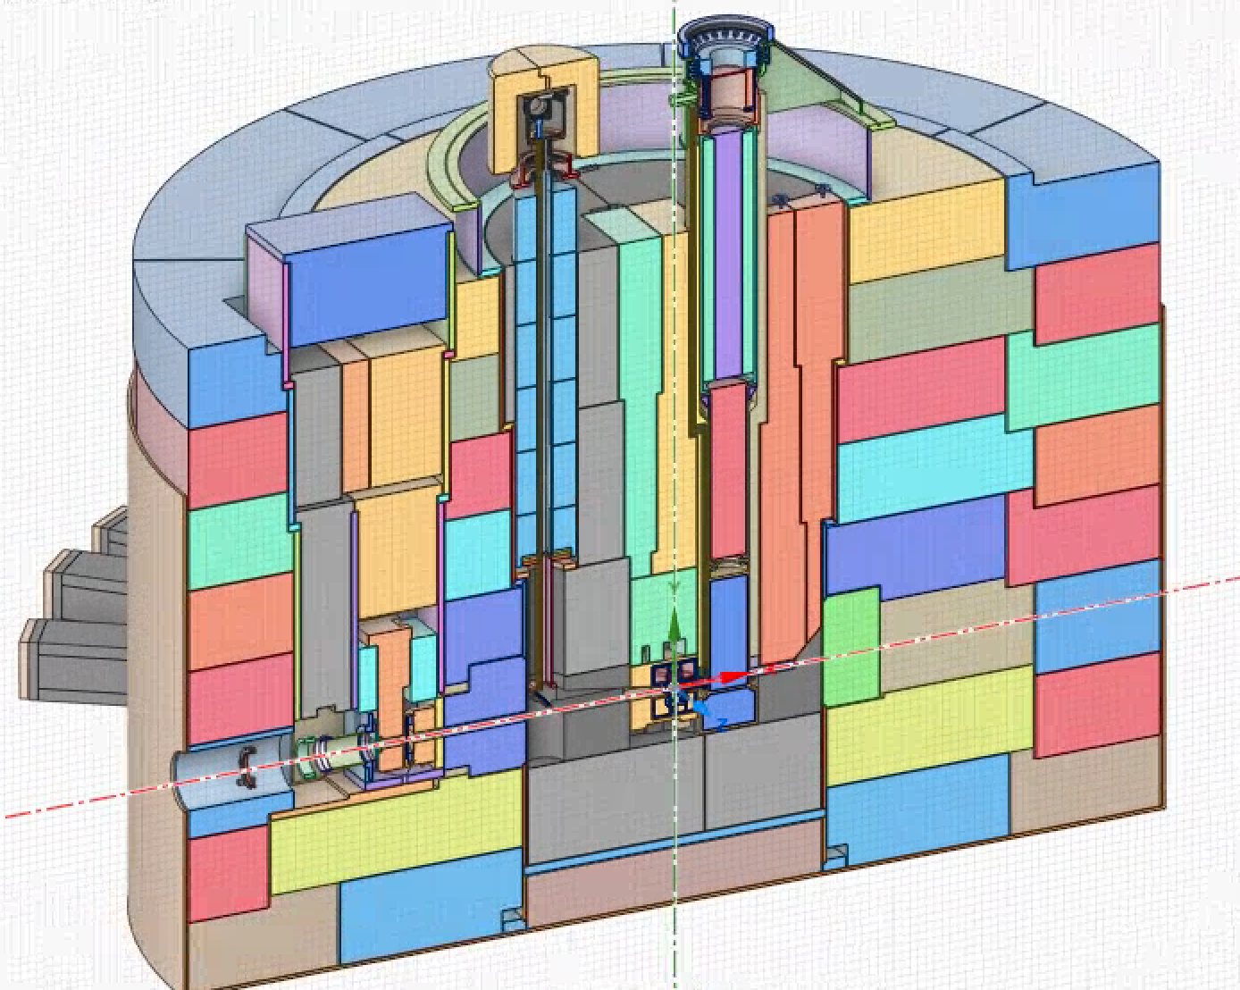
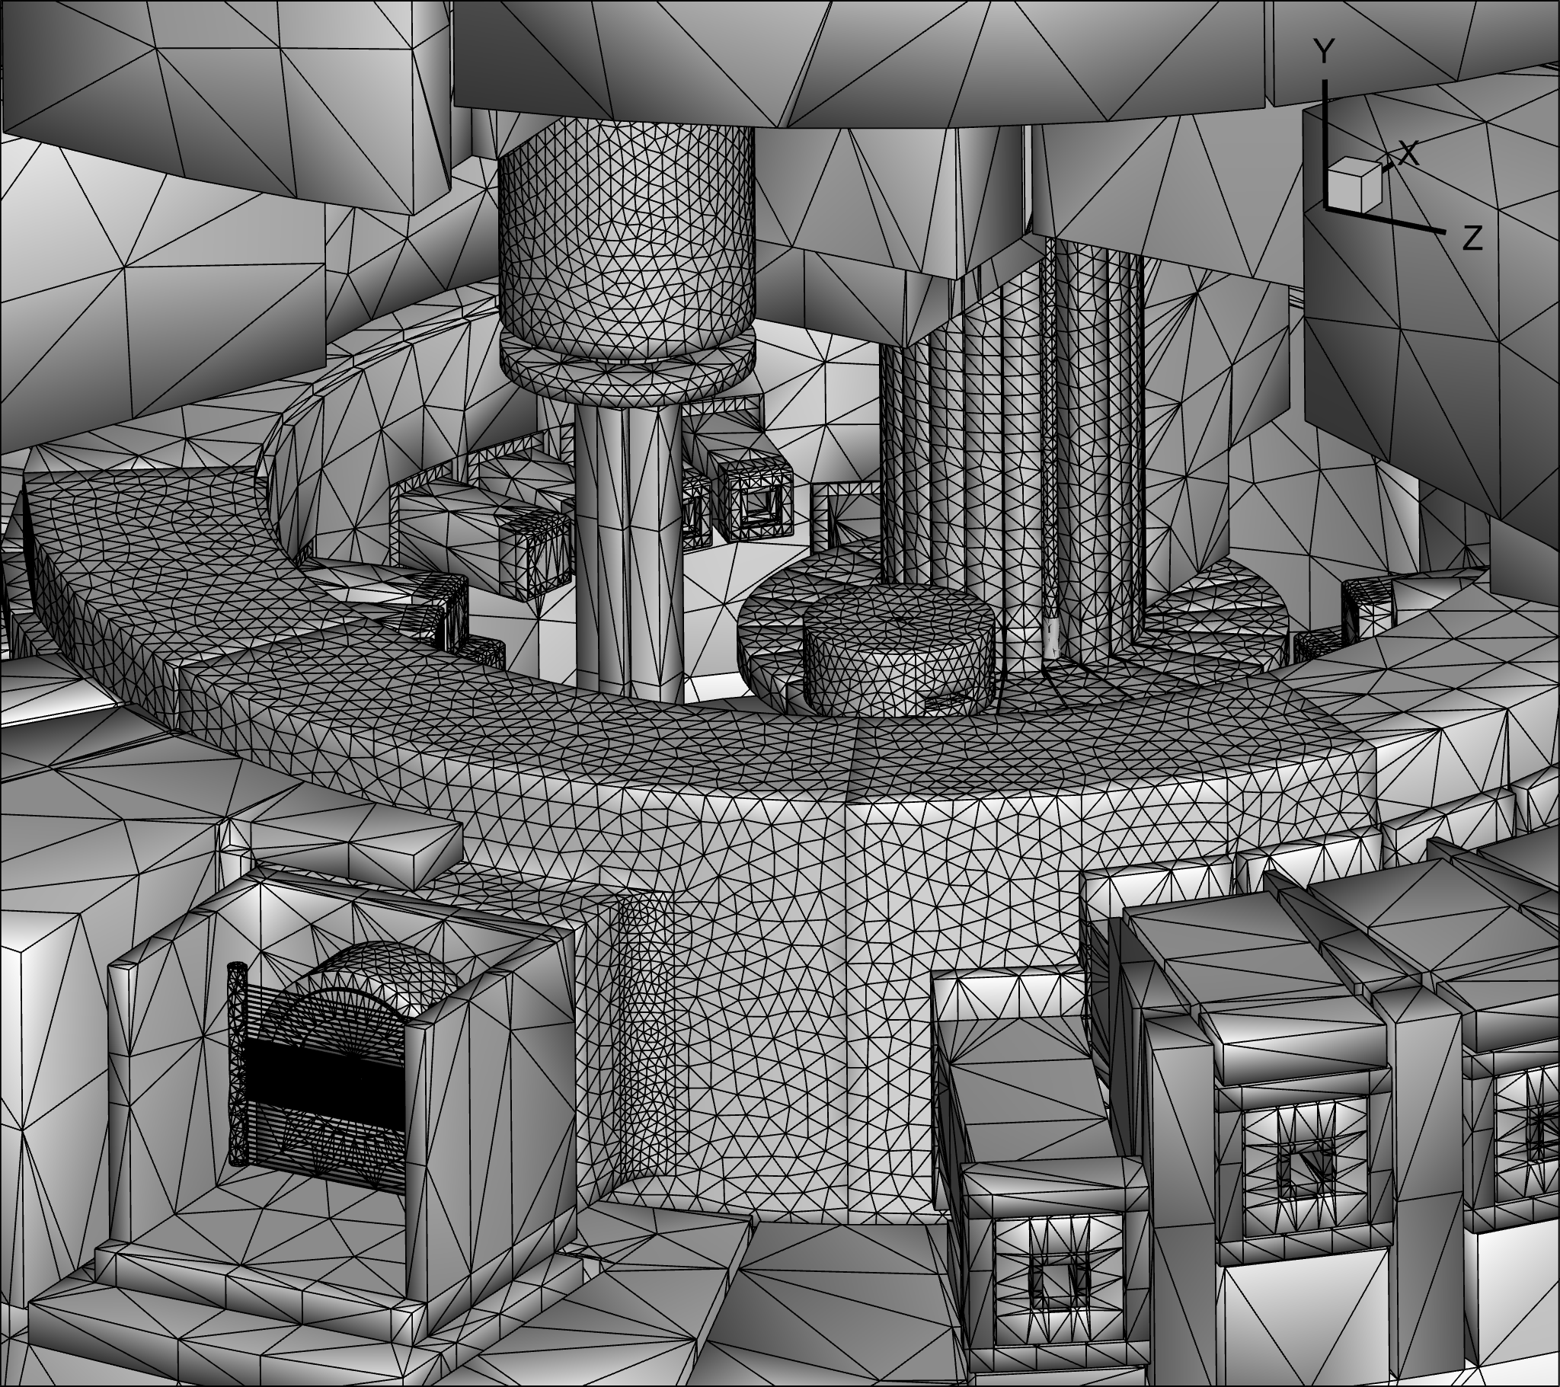
Large Geometry Models with UMG Require Large Computer Resources
6 m
9 m

Slide 12
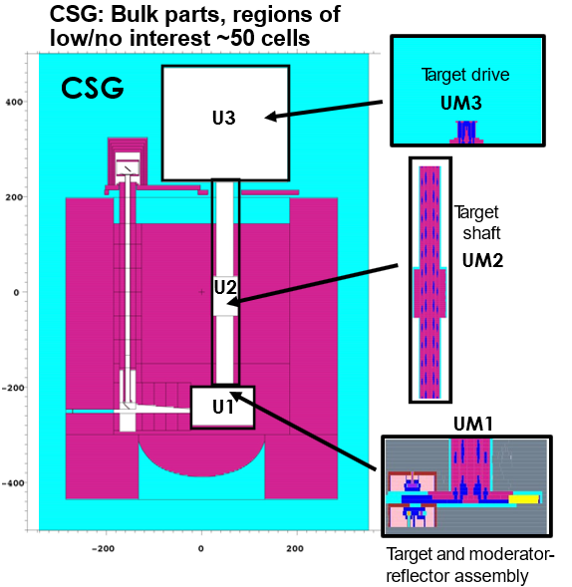
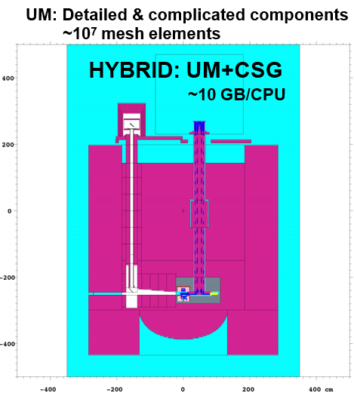
Hybrid CGS and UMG Models Used to Avoid Excessive Computing Requirements (Memory and CPU Time)
Potential advantages over full UM:
Reduced computer memory requirement
Reduced MCNP running time
Changing just UM part of the model

Slide 13
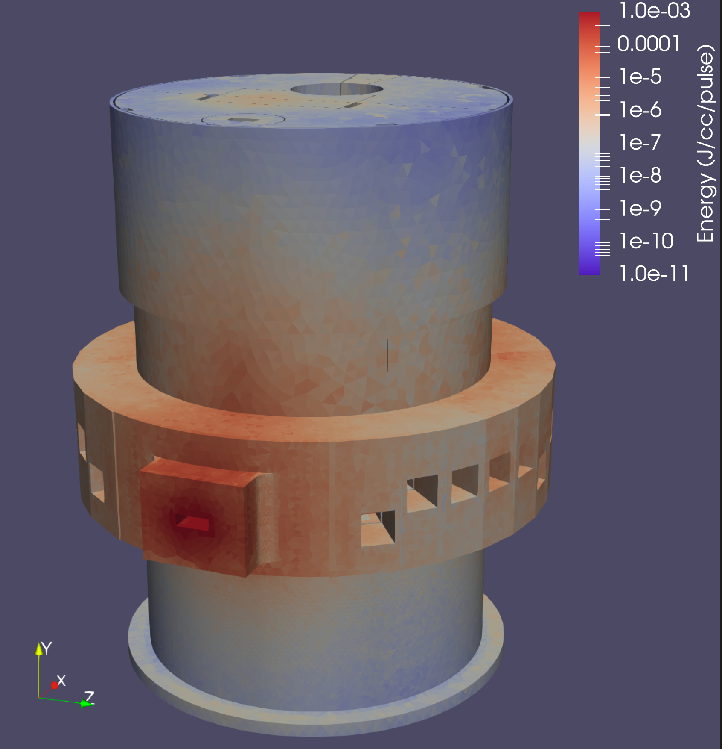
Core Vessel and CV Shielding Energy deposition, Radiation Damage

Slide 14
Energy Deposition – CV and CV Shielding
Initial Analysis:
  energy deposition calculated for a homogenized mixture of SS-316L (90%) and water (10%) for cooled blocks
  performed with monolithic target block design (21 segments) and 90 cm² proton beam profile (more conservative)
Based on this data, cooling channels designed for “warmest” blocks #4 & 5 around the target, and a new analysis was carried out (slide #18)
Subsequent Analysis:
  used “Lasagna” target design (20 segments) and 62.5 cm² beam profile
  used detailed model converted from CAD

Slide 15
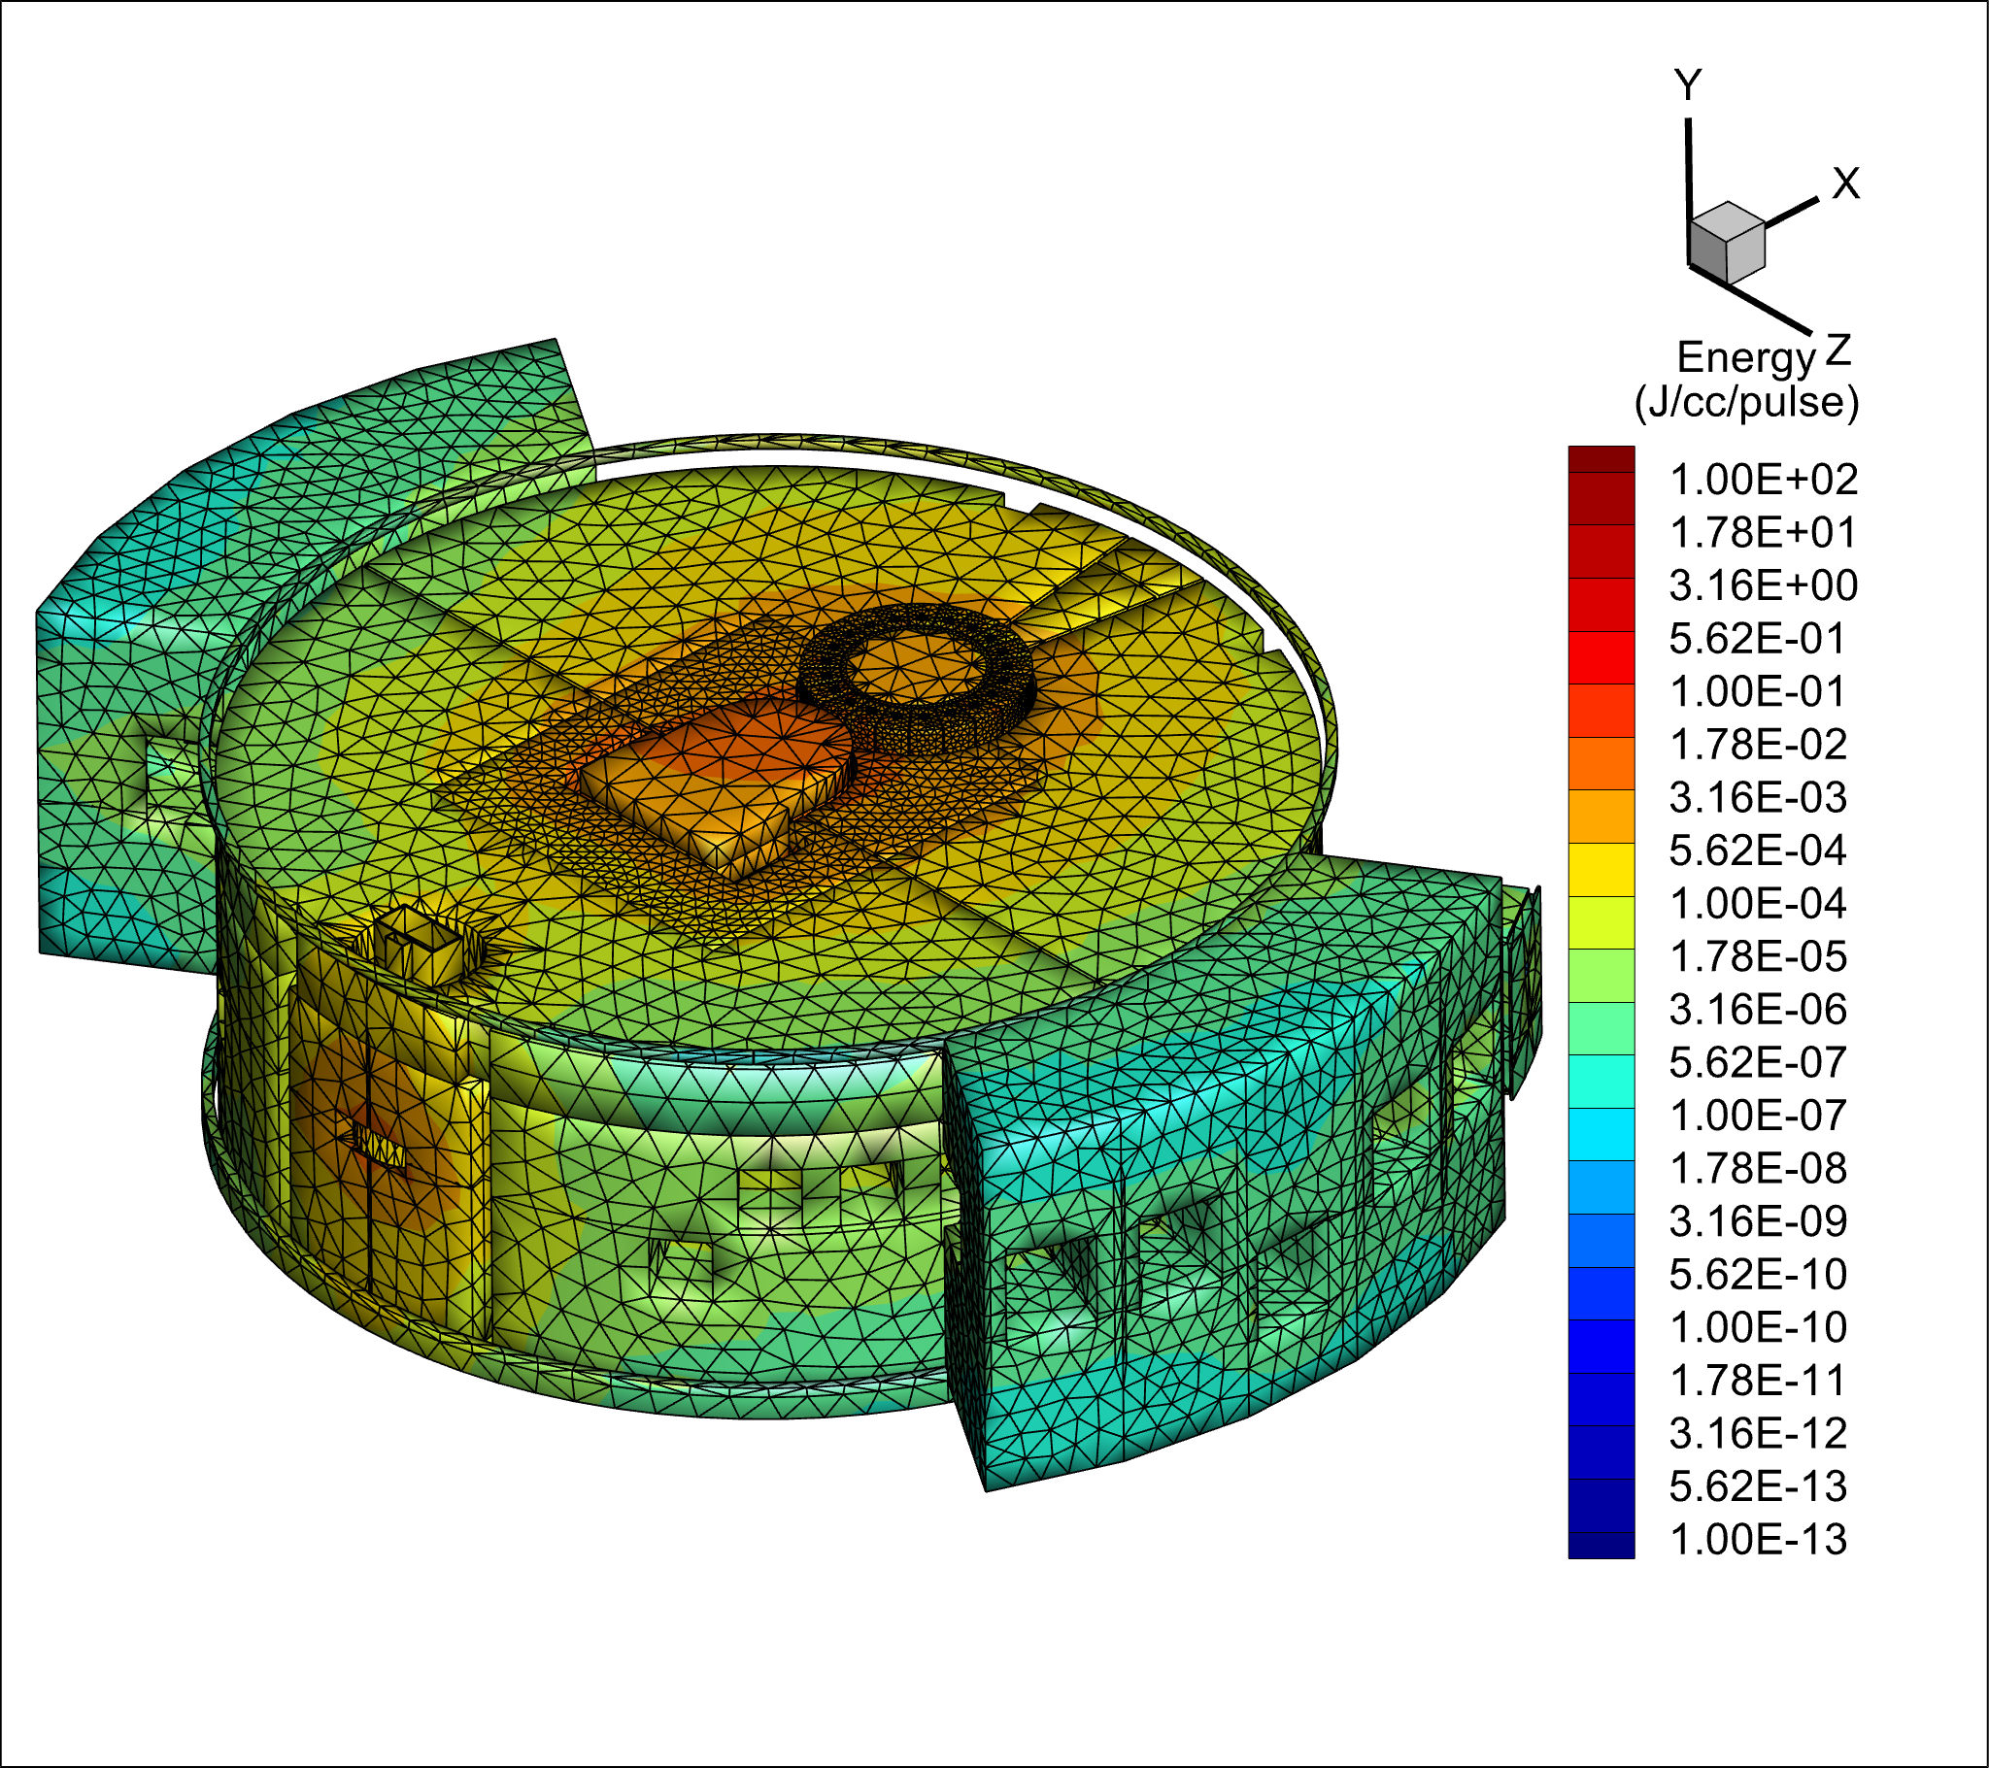
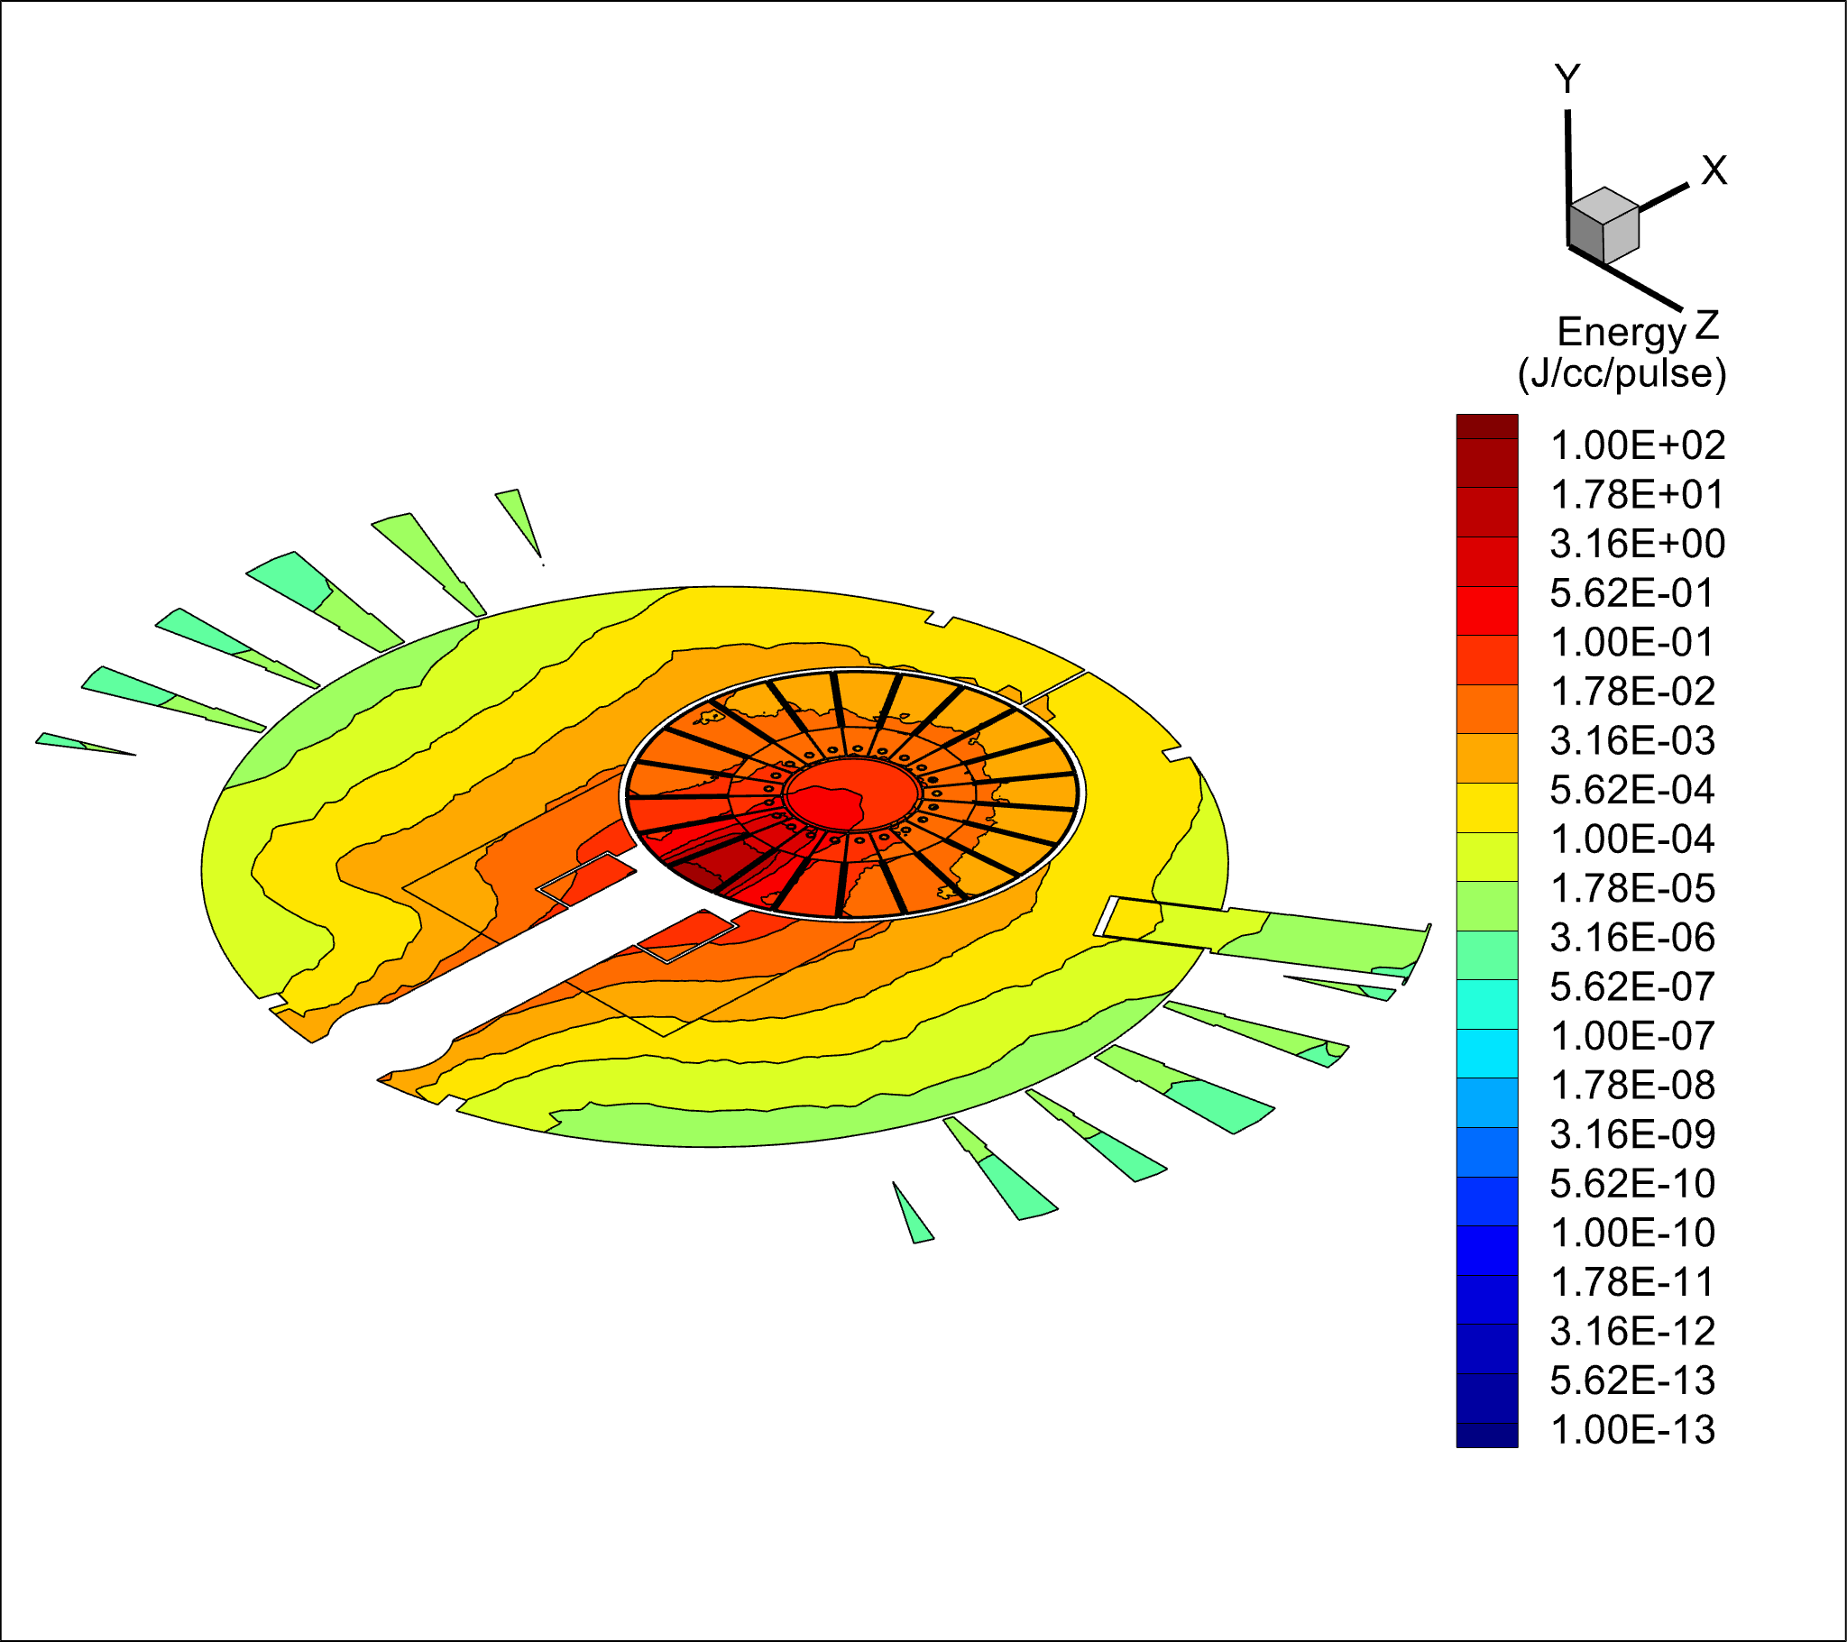
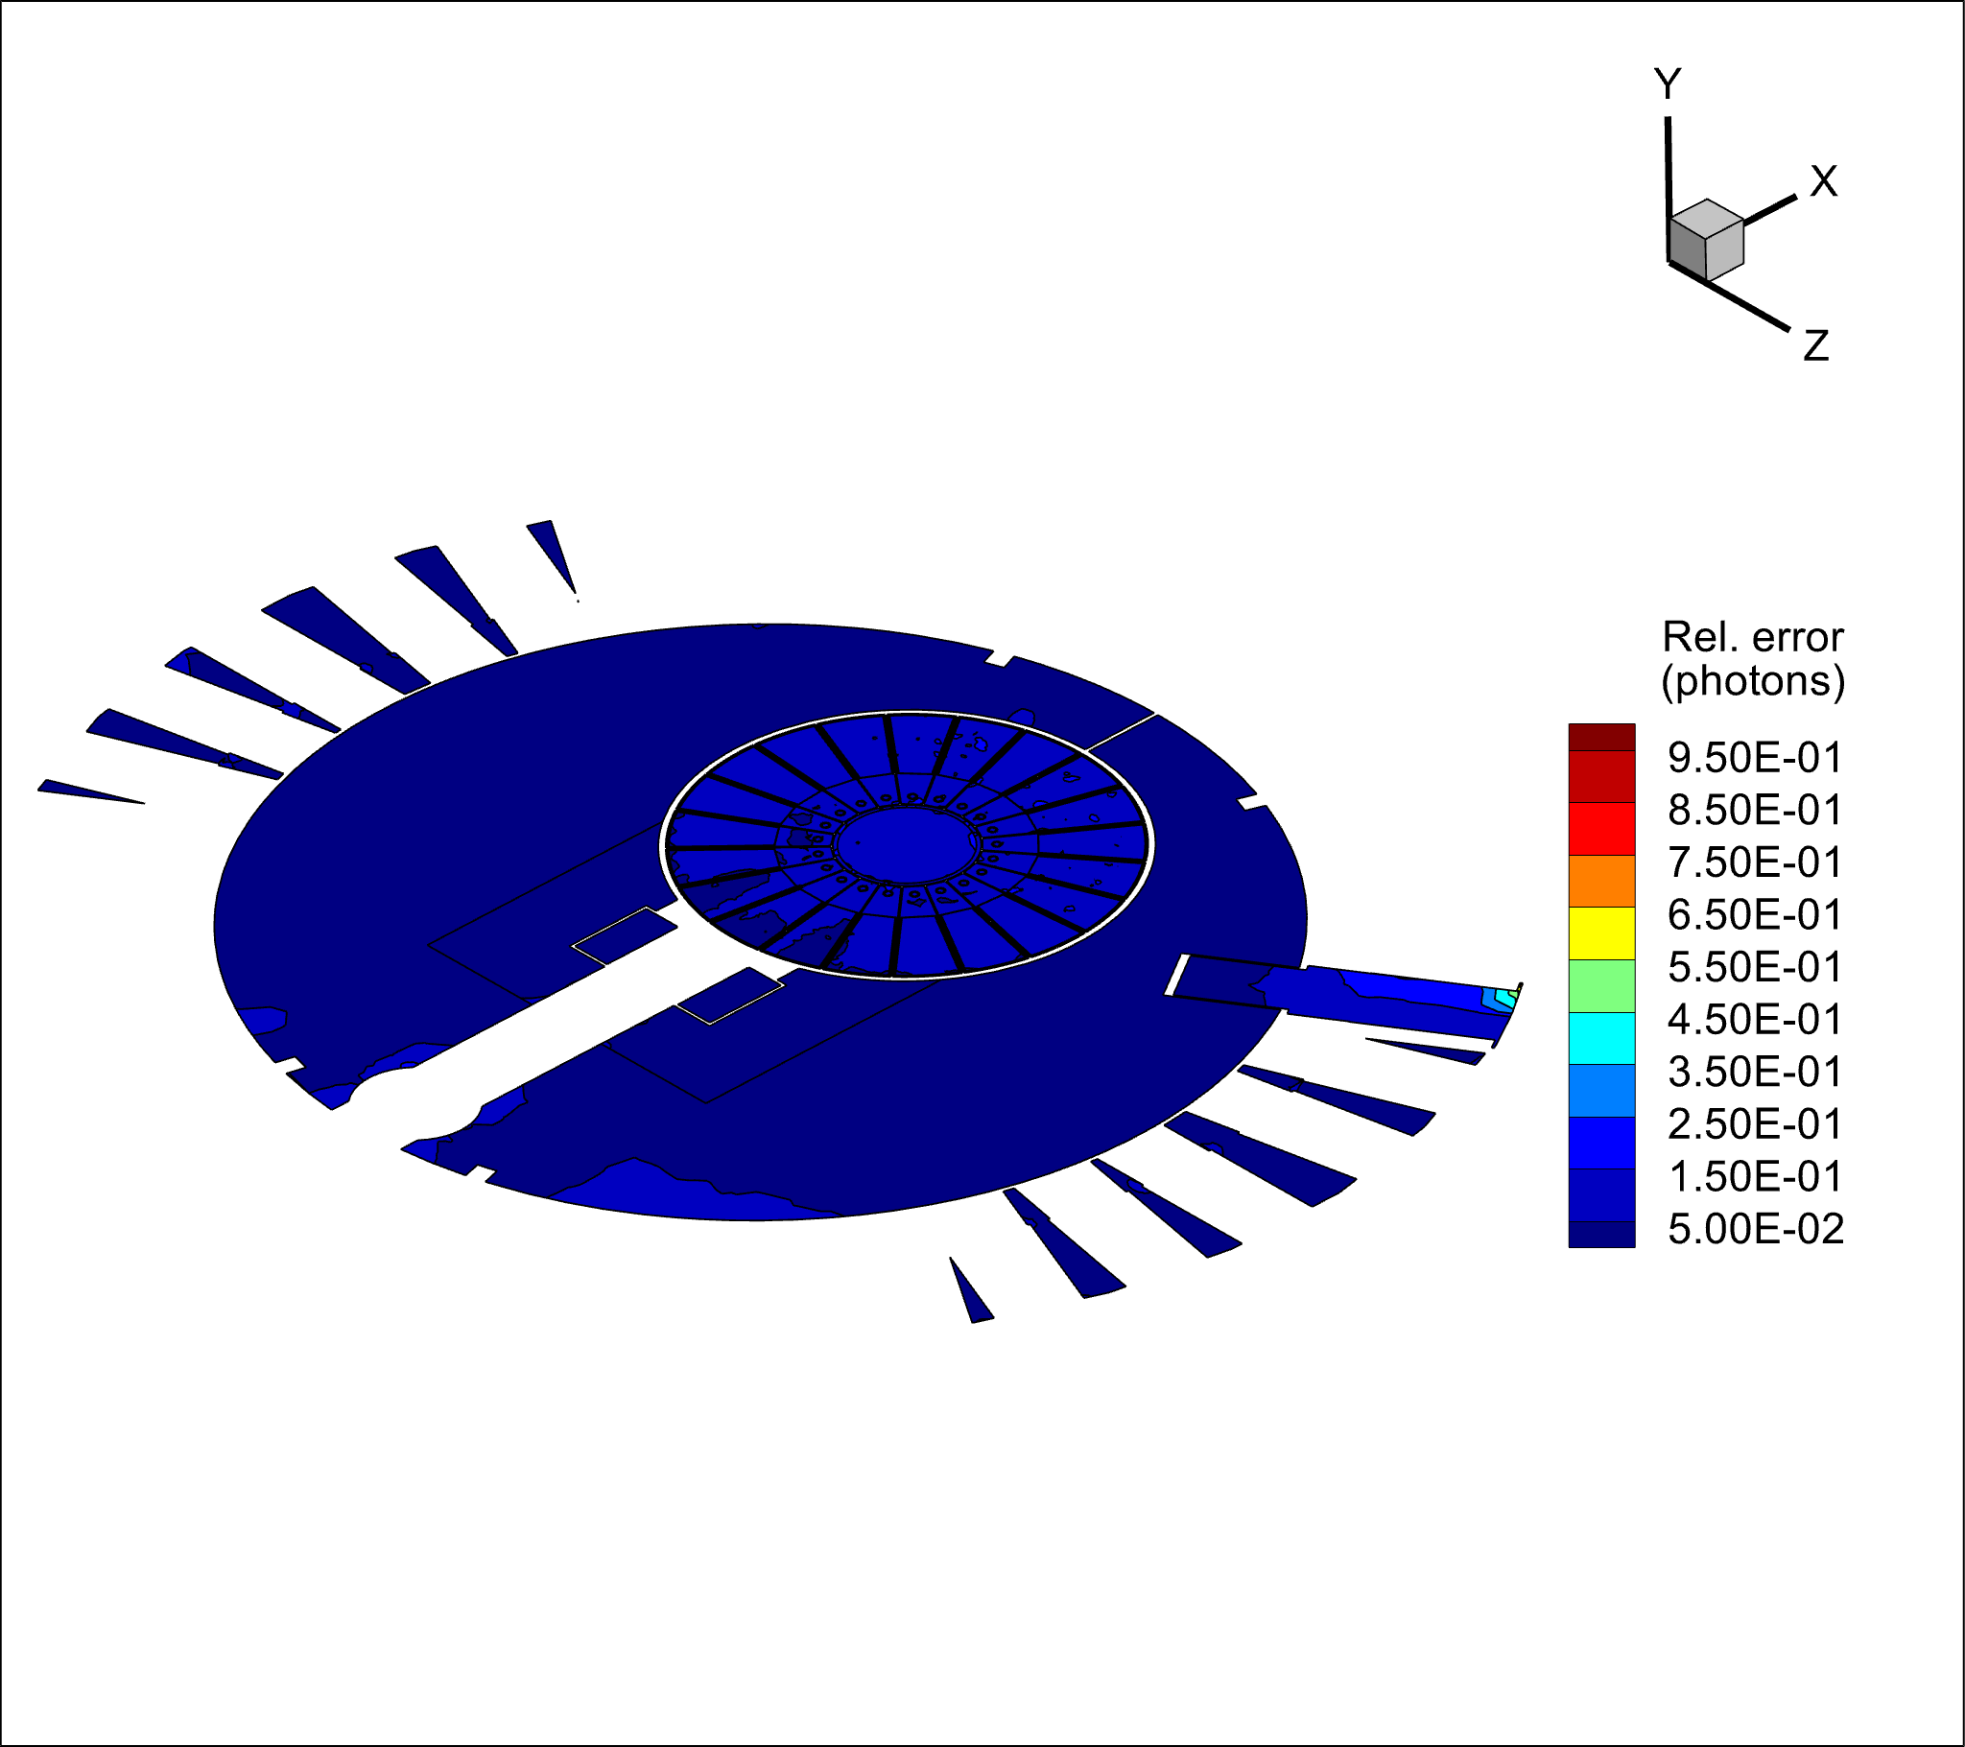
CV and CVS Energy Deposition
Central CVS blocks and a cut through the proton beam level (y=0)
3D view
y = 0 cm
y = 0 cm
1.3 GeV protons

Slide 16
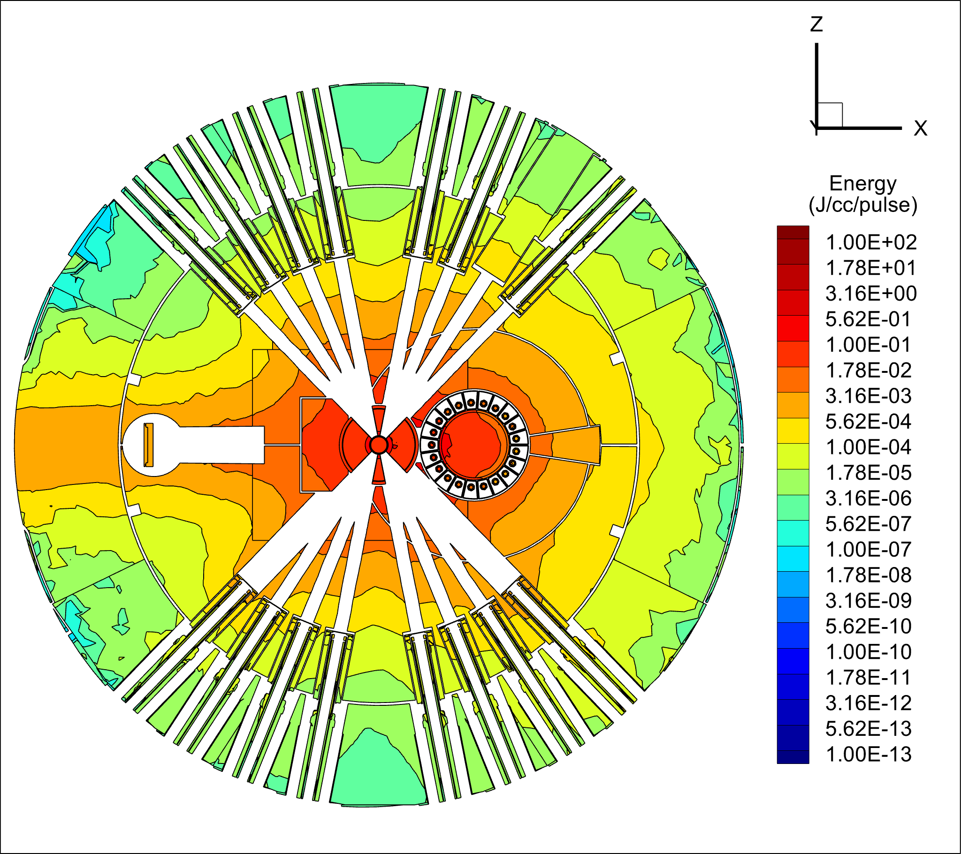
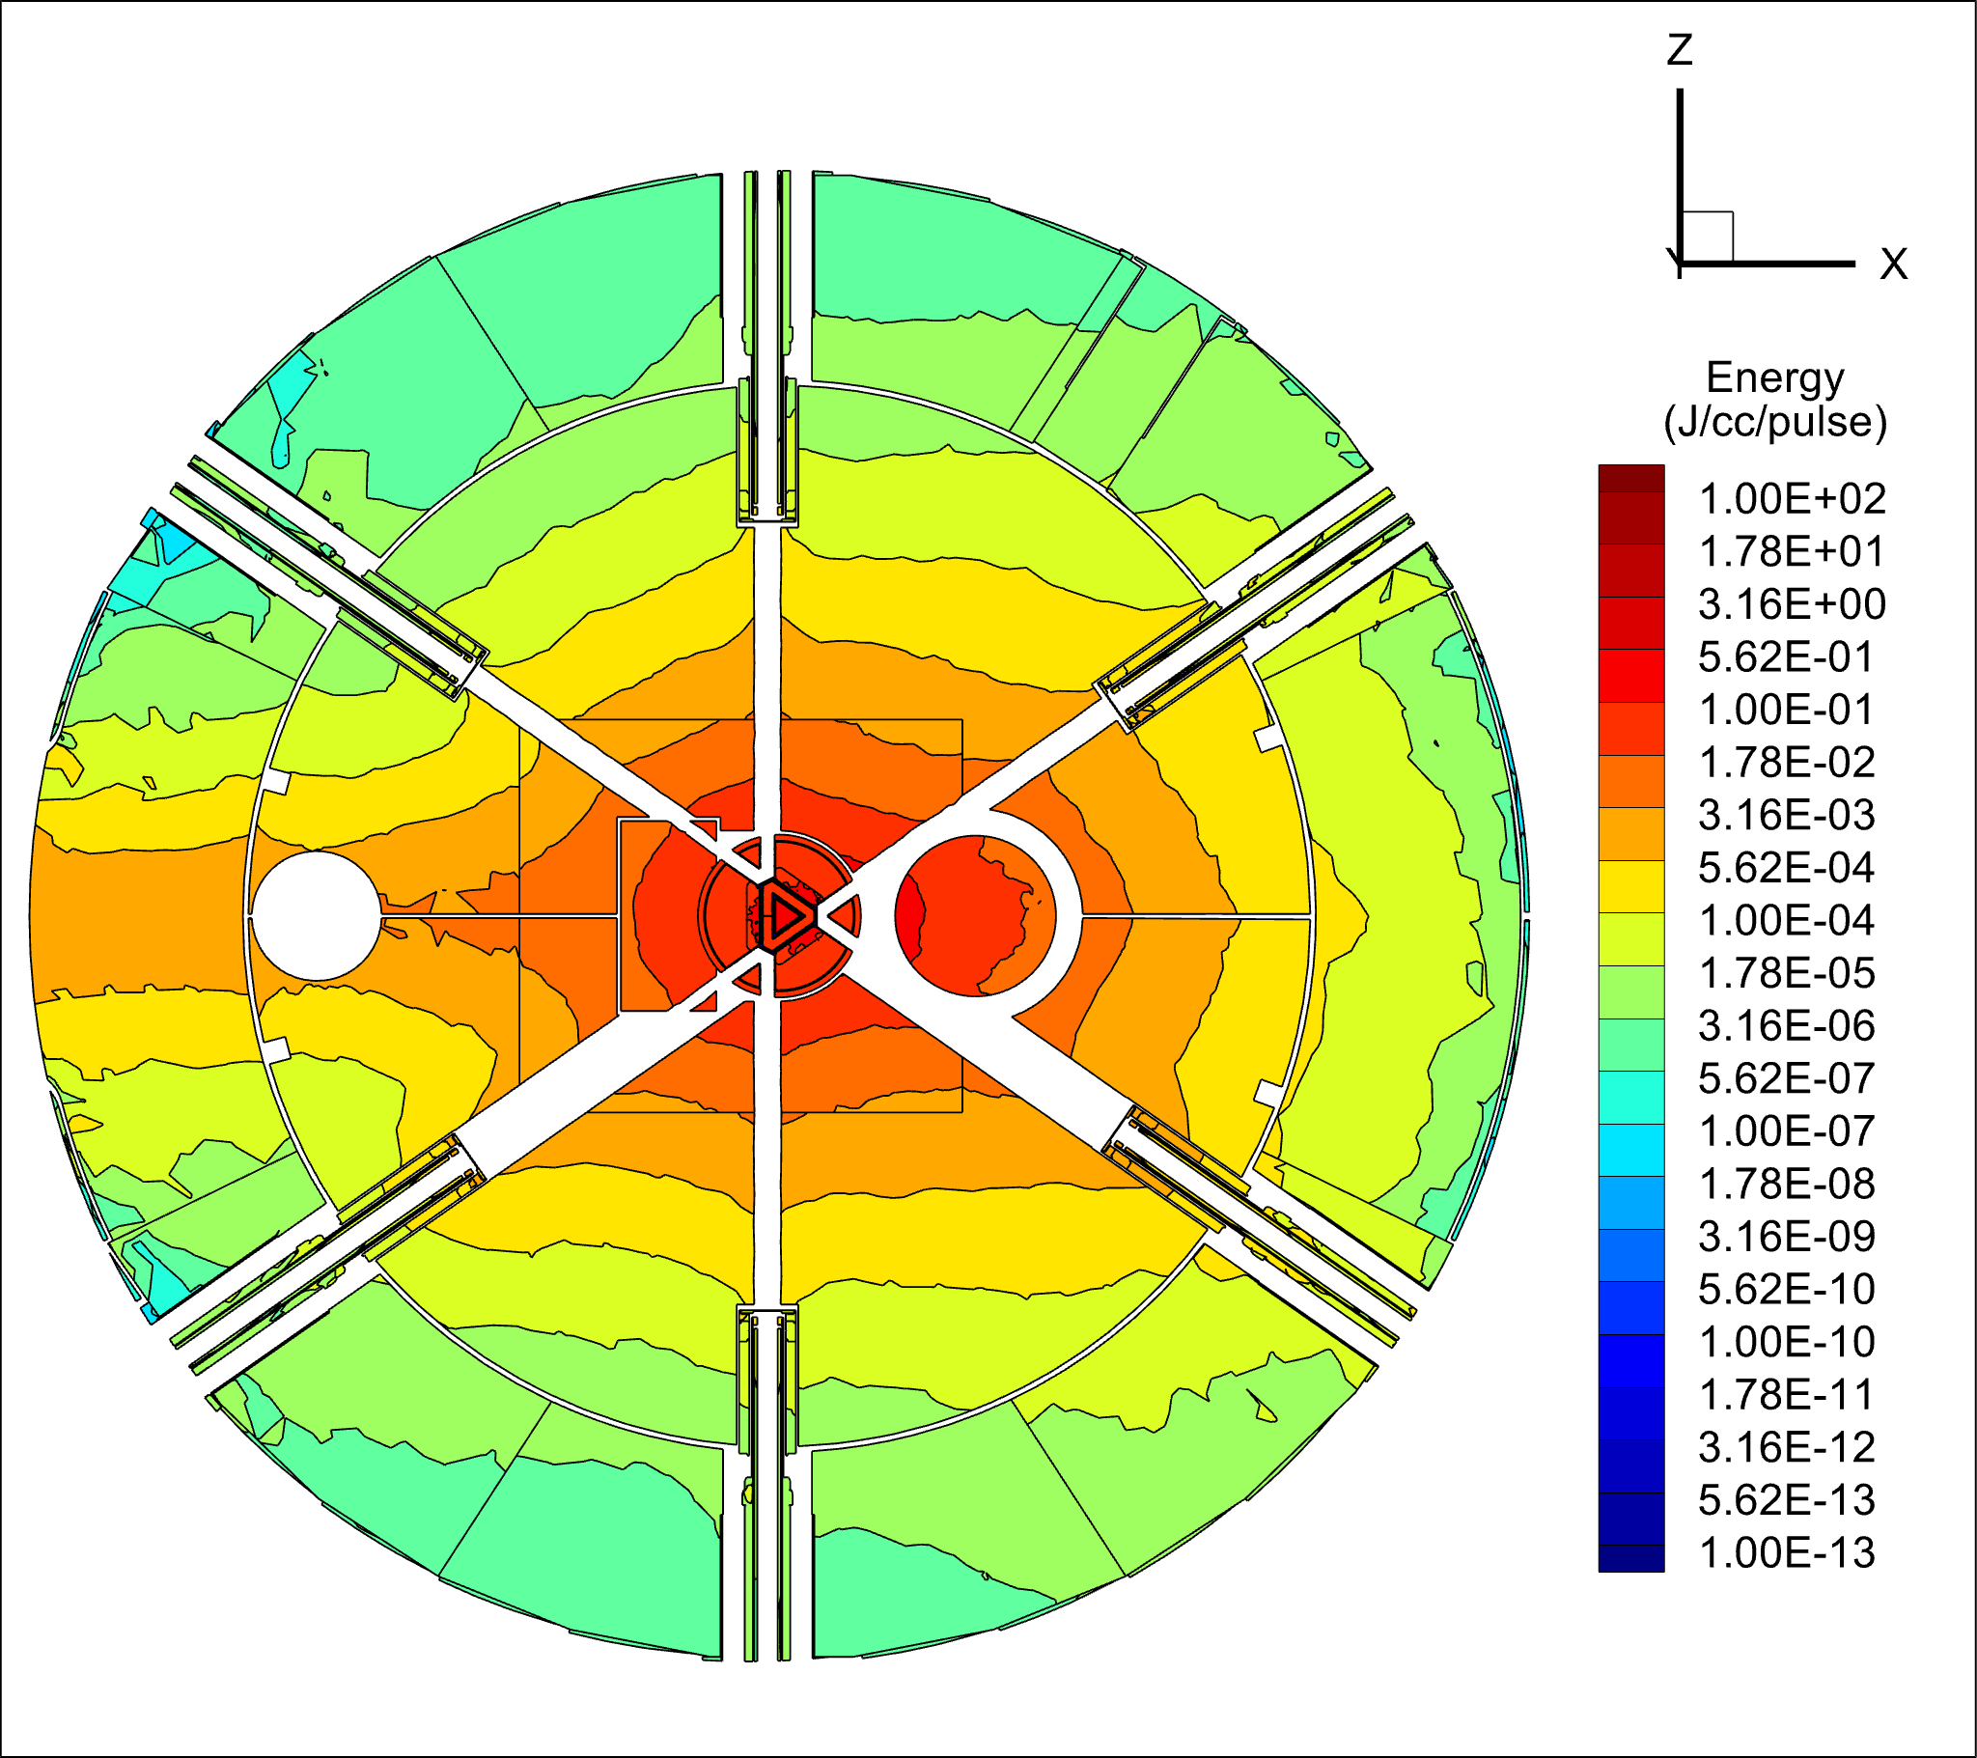
CV and CVS Energy Deposition
Cut through the neutron beam levels, with narrow and wide extractions
y = +10 cm (cylinder moderator level)
y = -10 cm (tube moderator level)
Narrow extraction
Wide extraction, increased heating

Slide 17
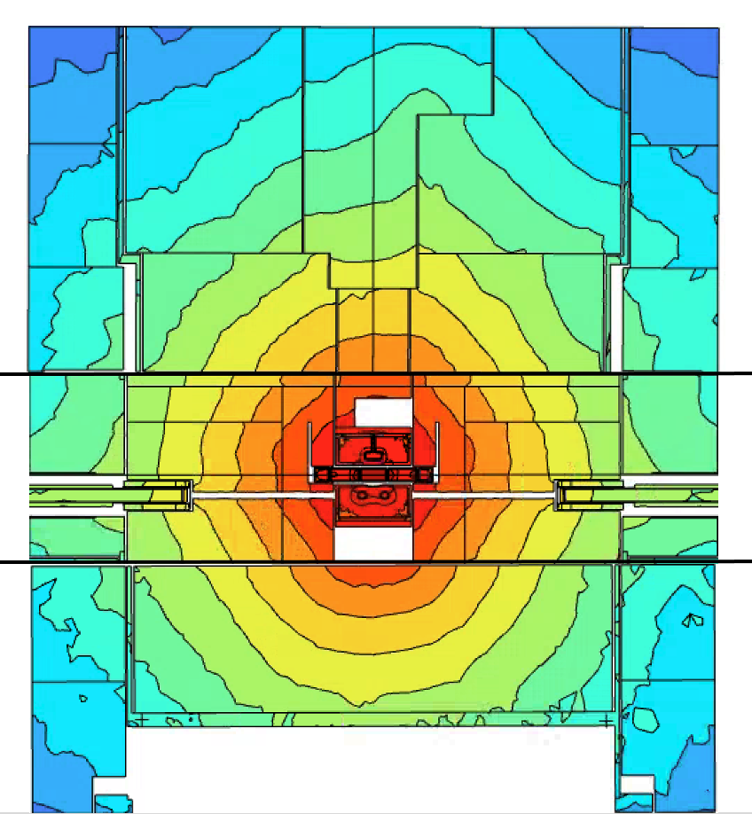
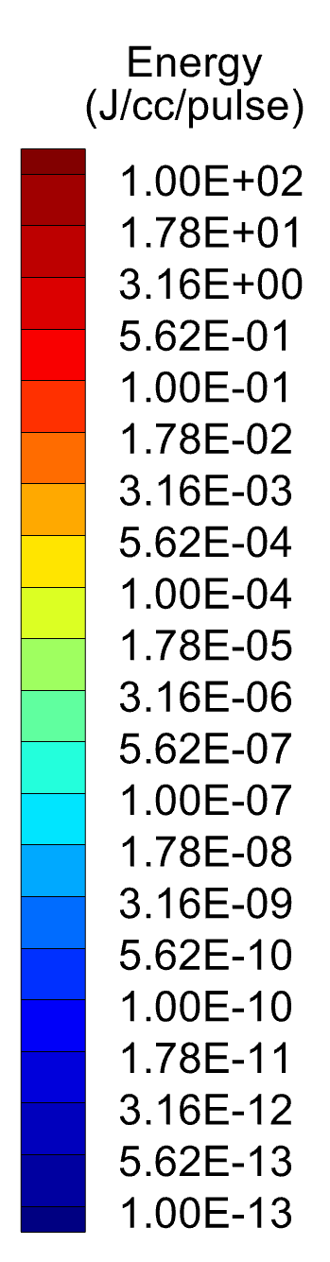
CV and CVS Total Heating
Elevation plot through X=0
3D view
CV: 4 kW
CV Shielding: 121 kW

Slide 18
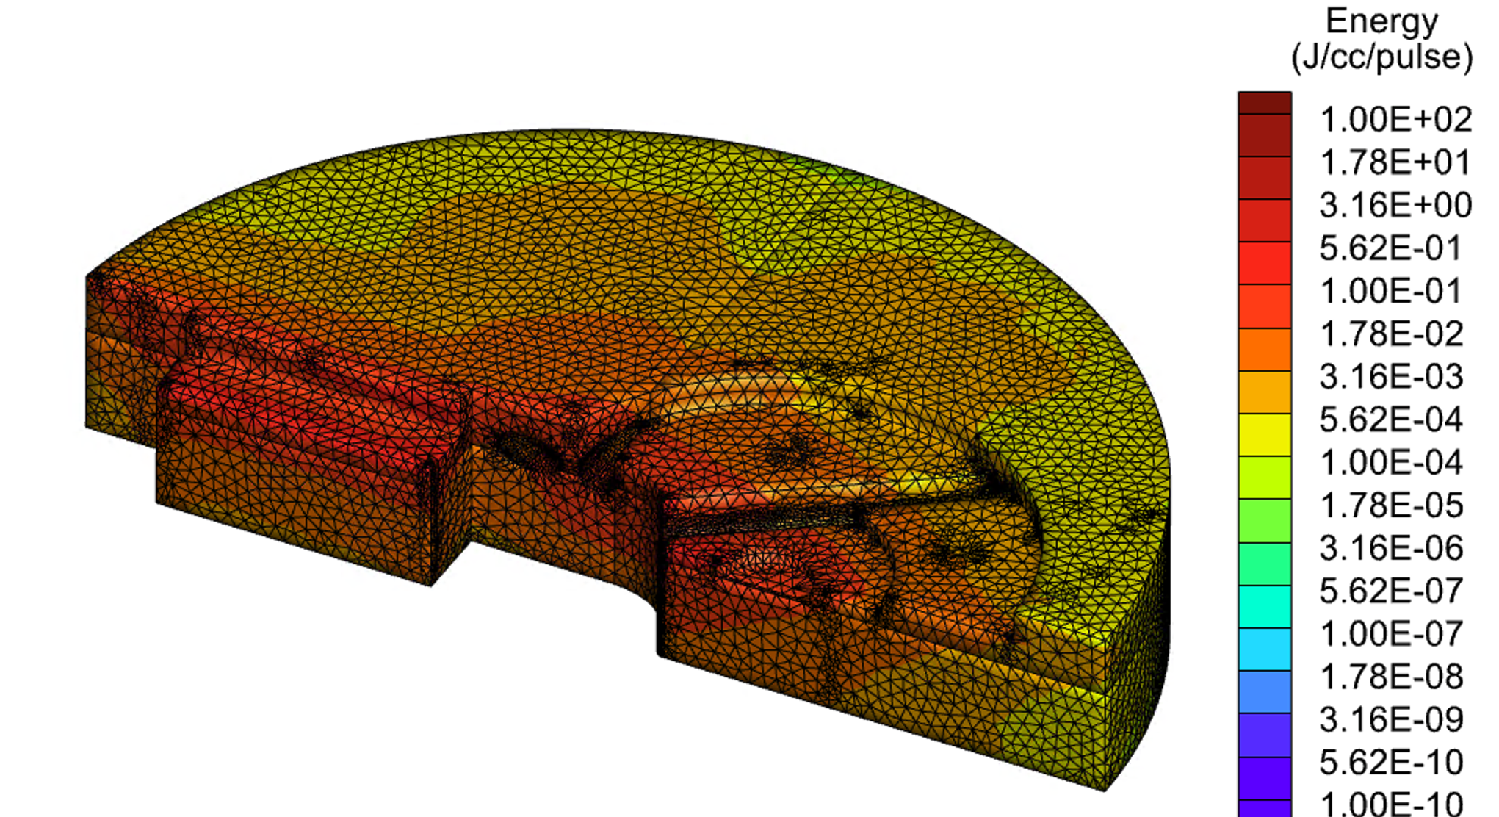
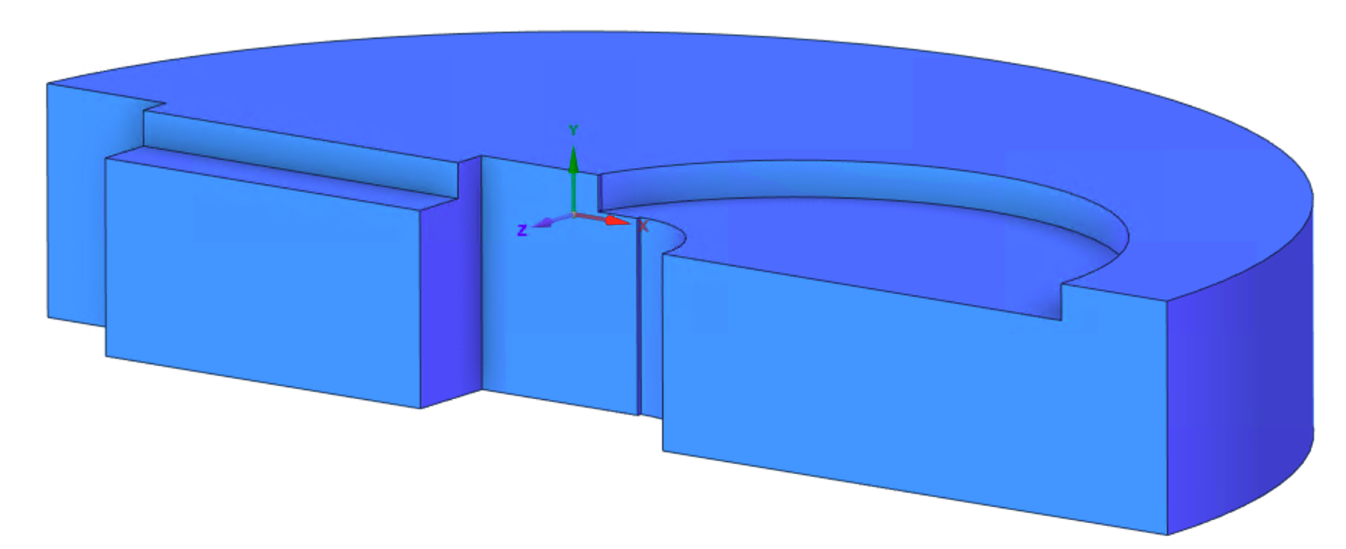
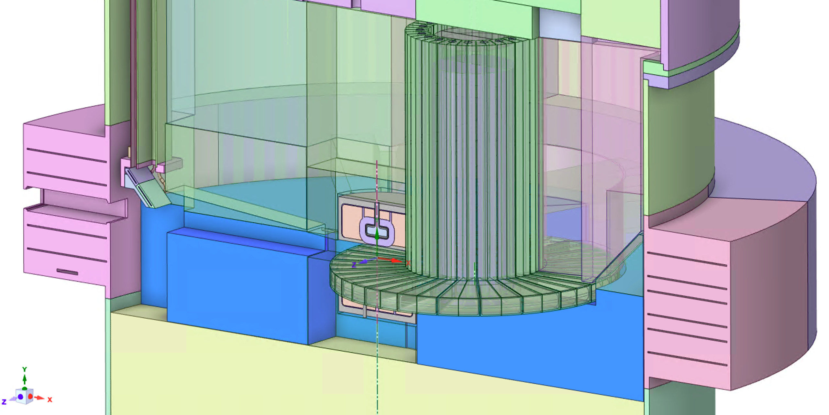
Detailed Energy Deposition in Block #4
High-fidelity energy deposition calculated for the shielding block surrounding the target with the designed water cooling channels
Block
Protons
Total heating:
Block 25 kW
Water 2.5 kW
Cooling water

Slide 19
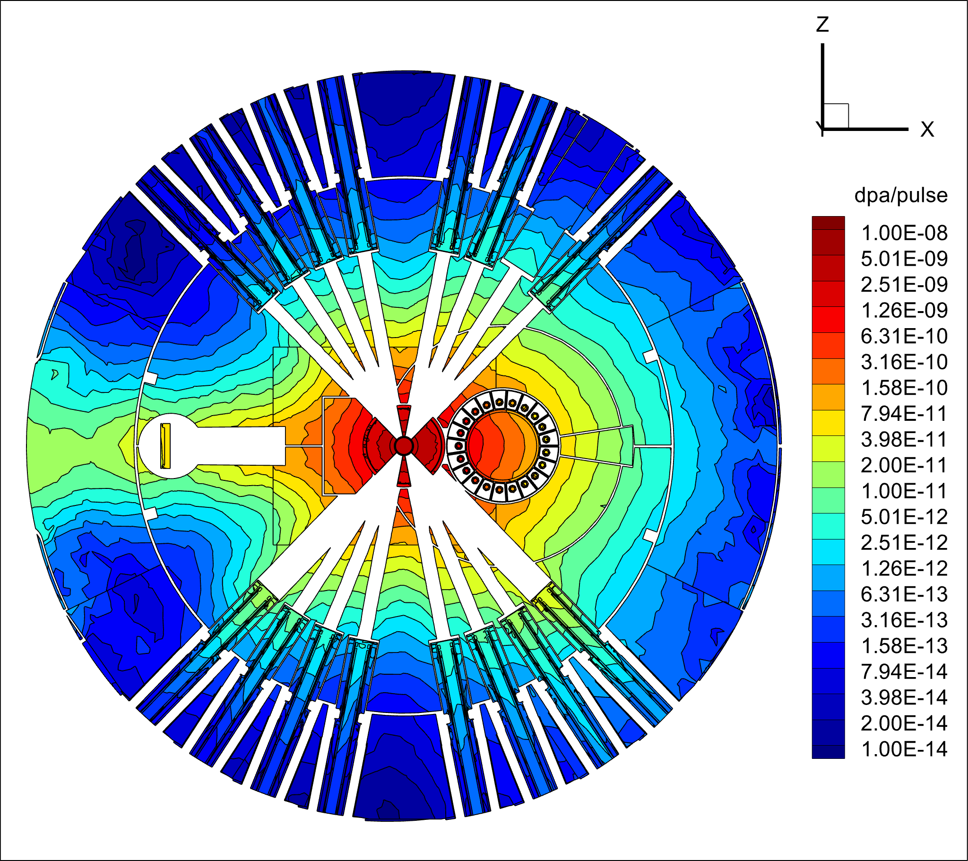
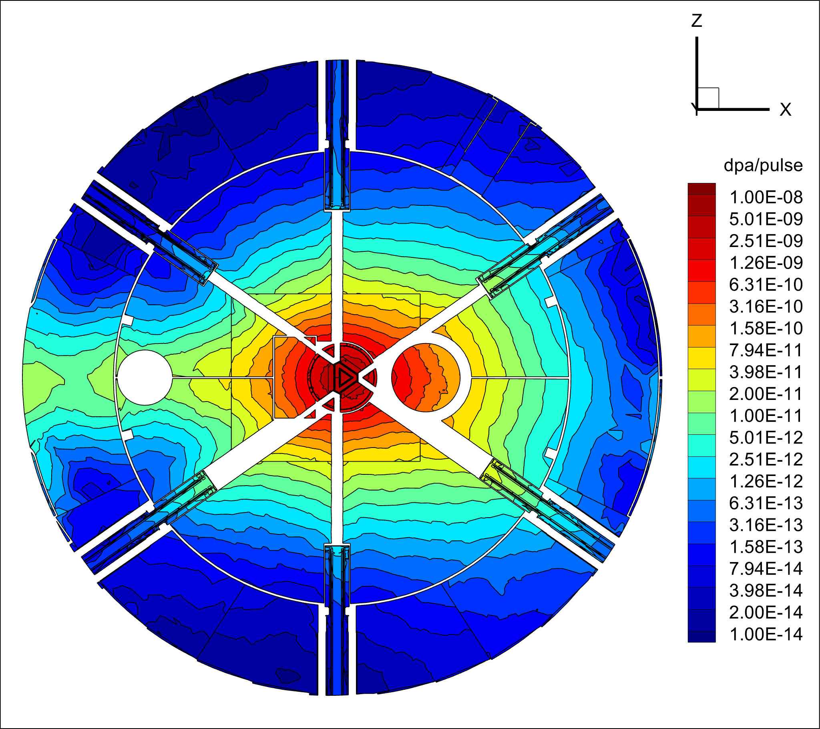
CV and CVS Radiation Damage (Neutron Extraction Levels)
y = +10 cm
y = -10 cm
Narrow extraction
Wide extraction, increased dpa
Radiation damage characterized in terms of displacement per atom (dpa) for SS316L.
Dpa cross sections from W. LU, et al., “A reevaluation of radiation damage
cross-section”, Journal of Nuclear Materials 431, 33, (2012).

Slide 20
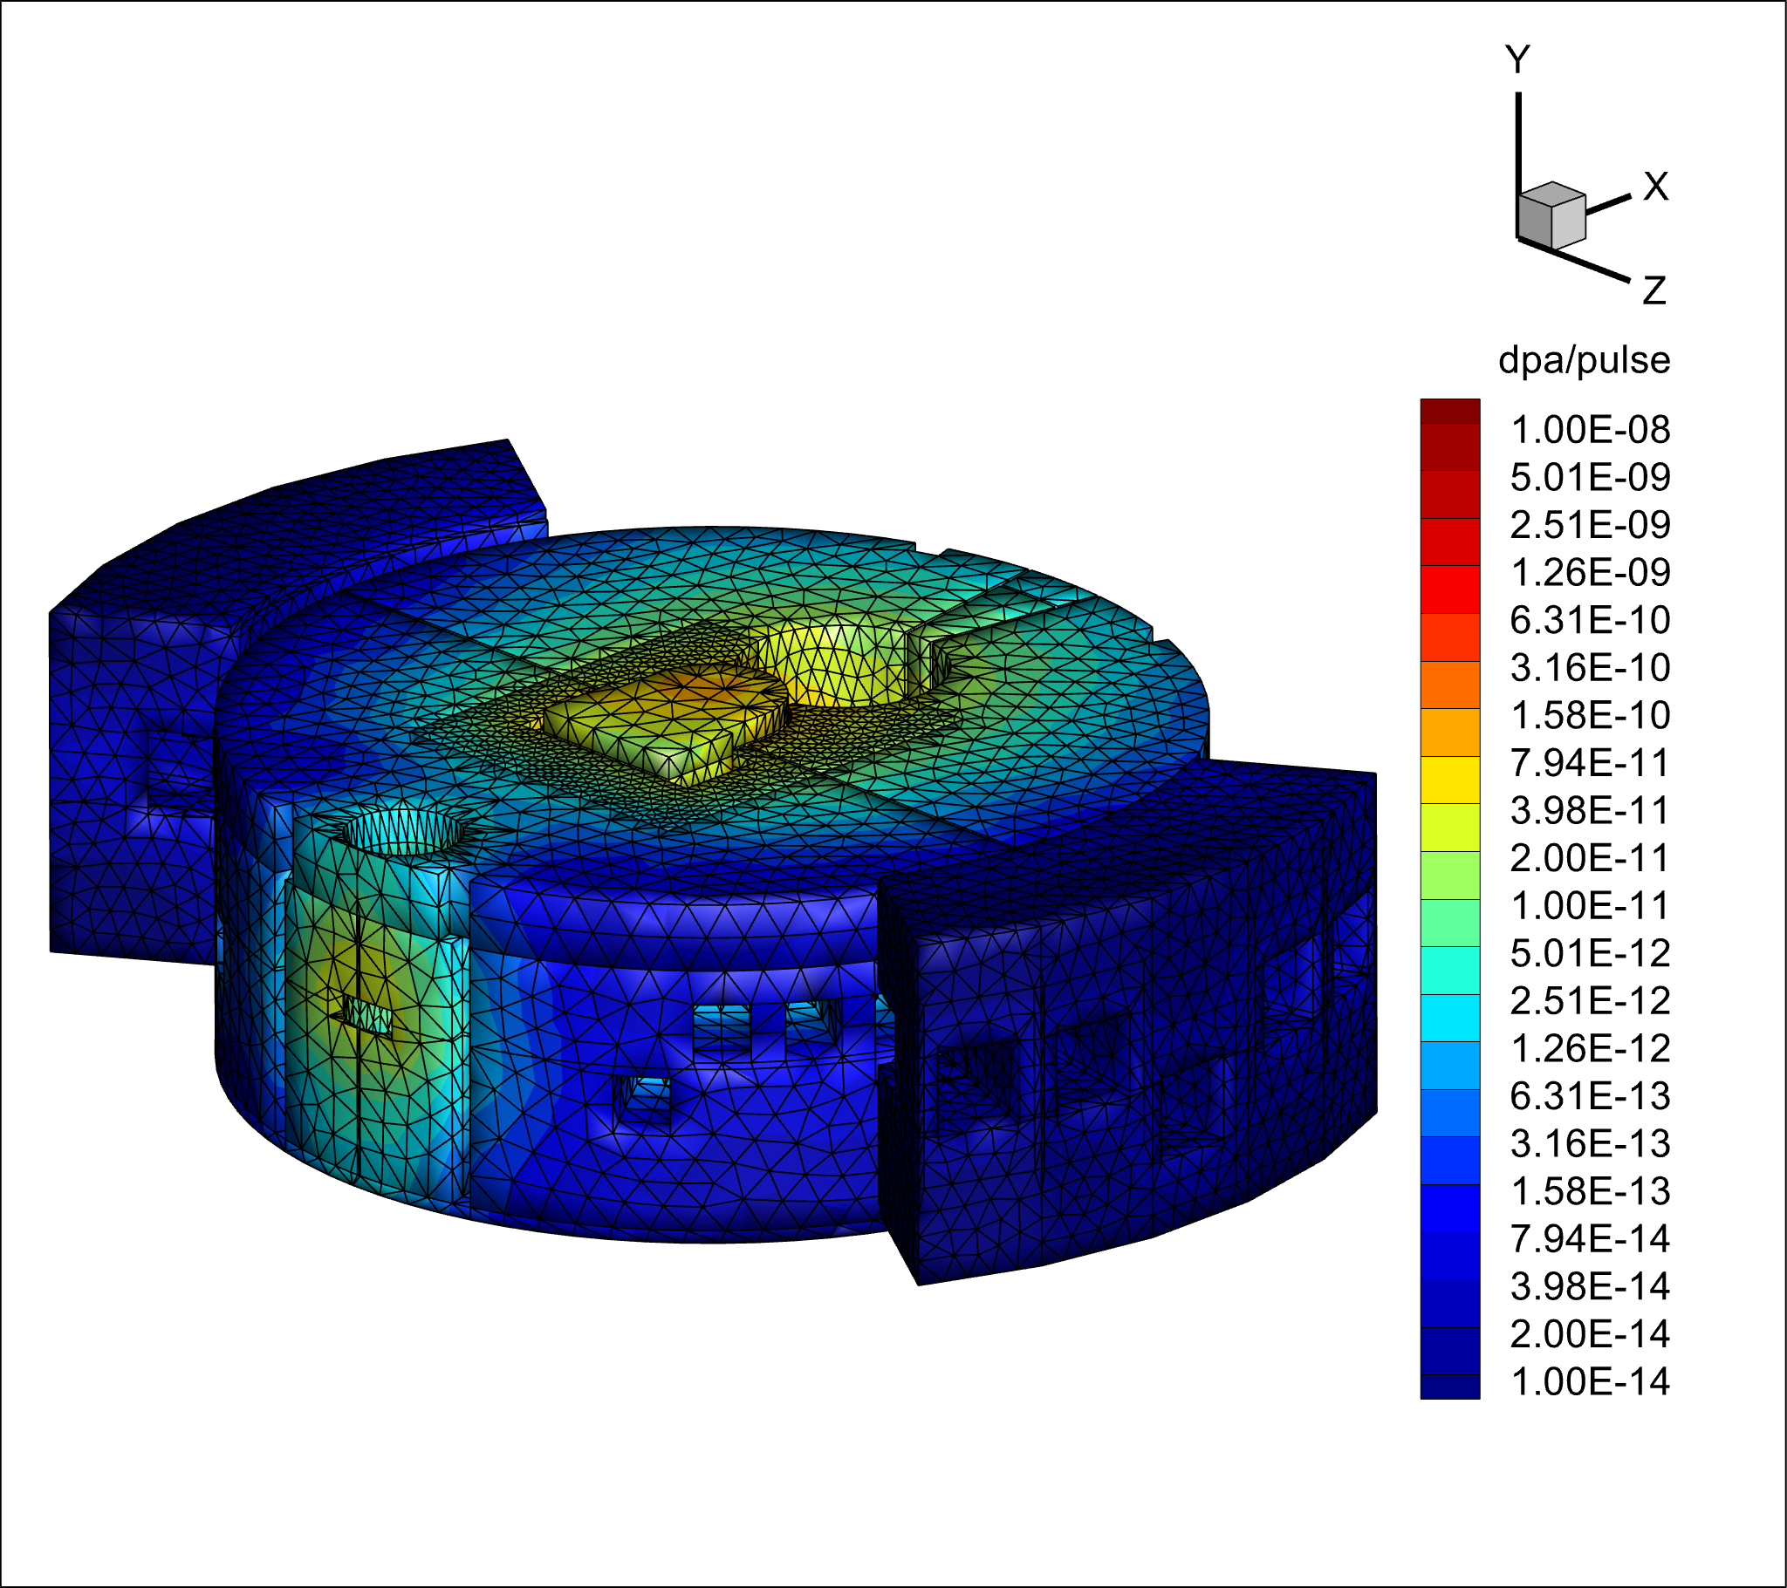
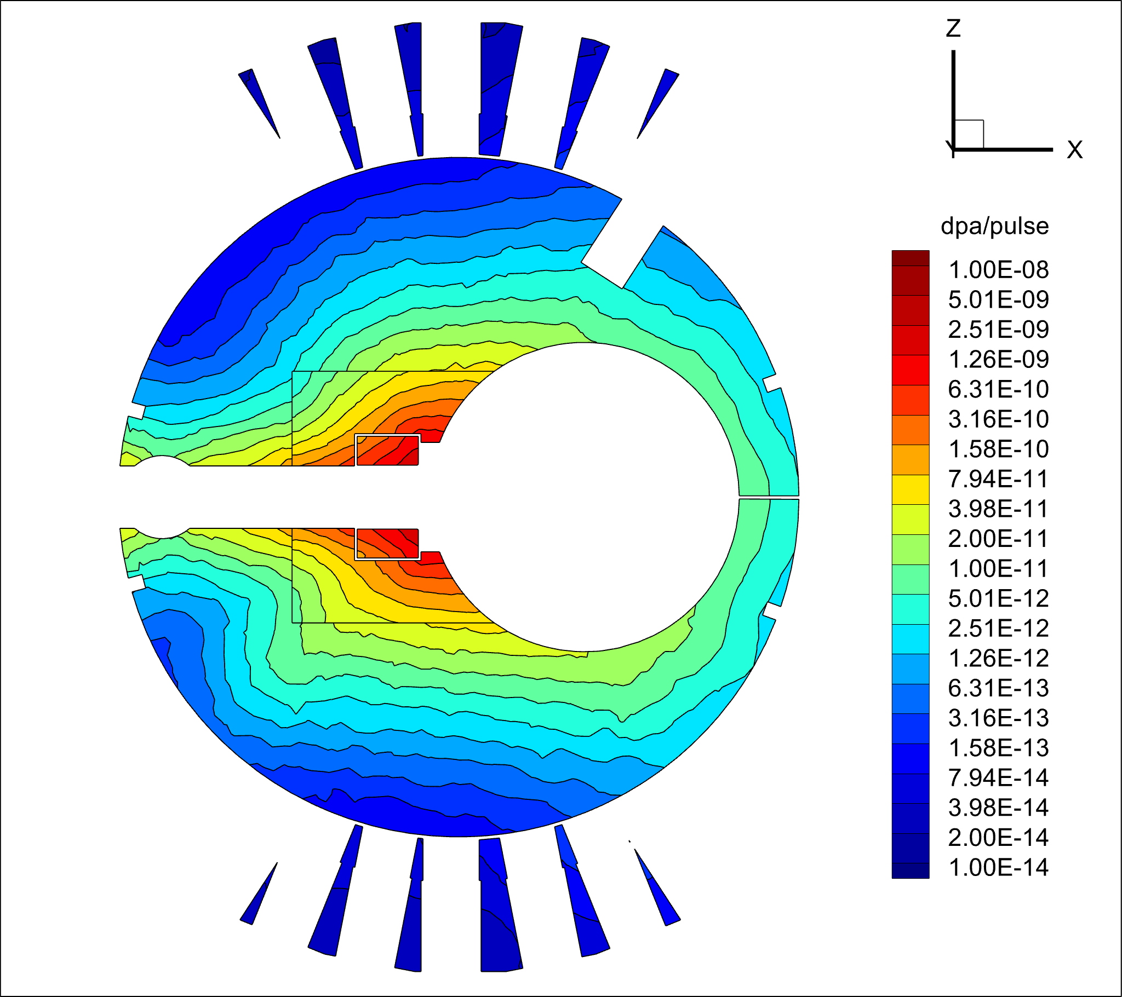
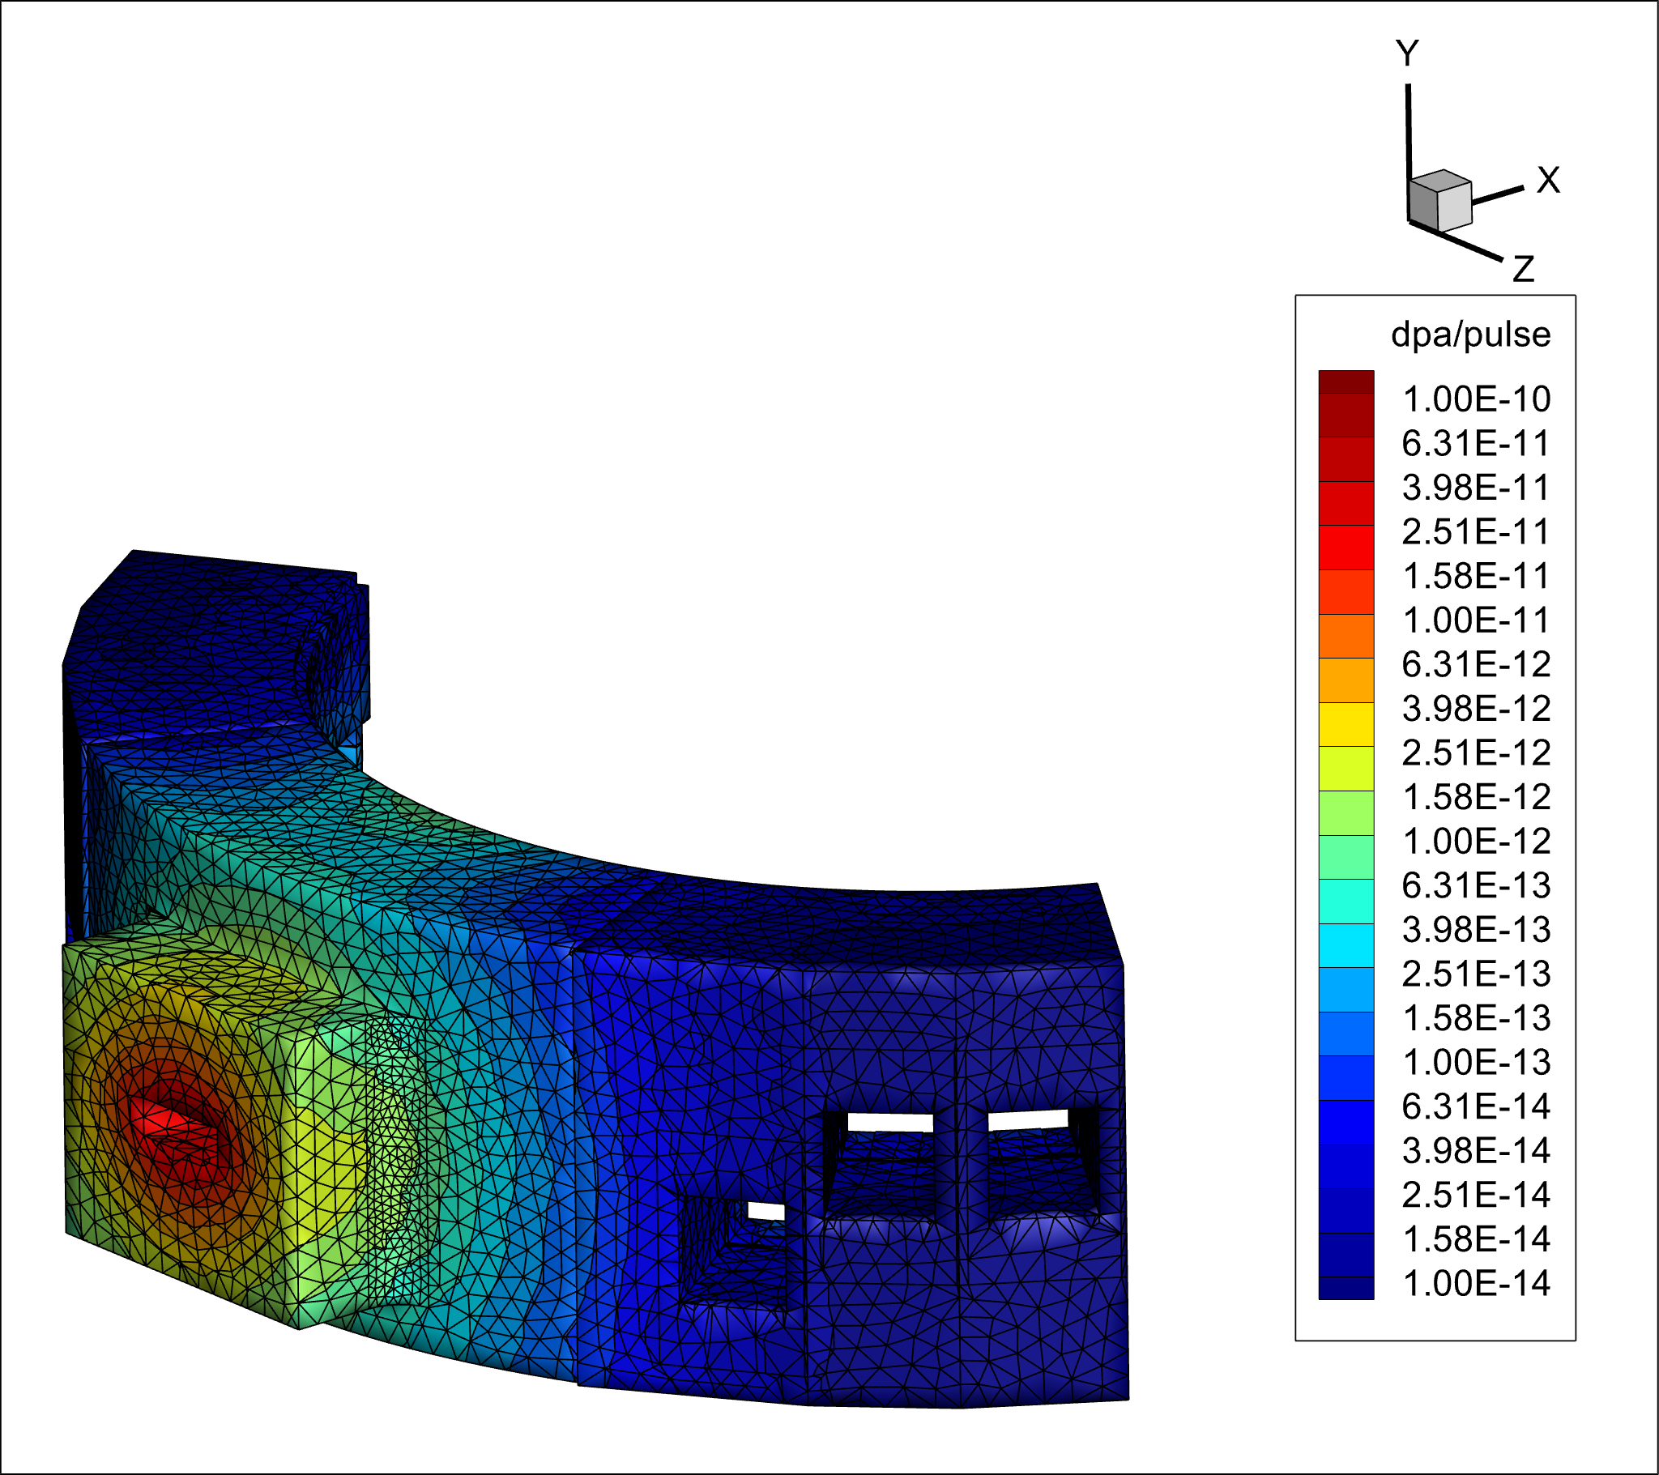
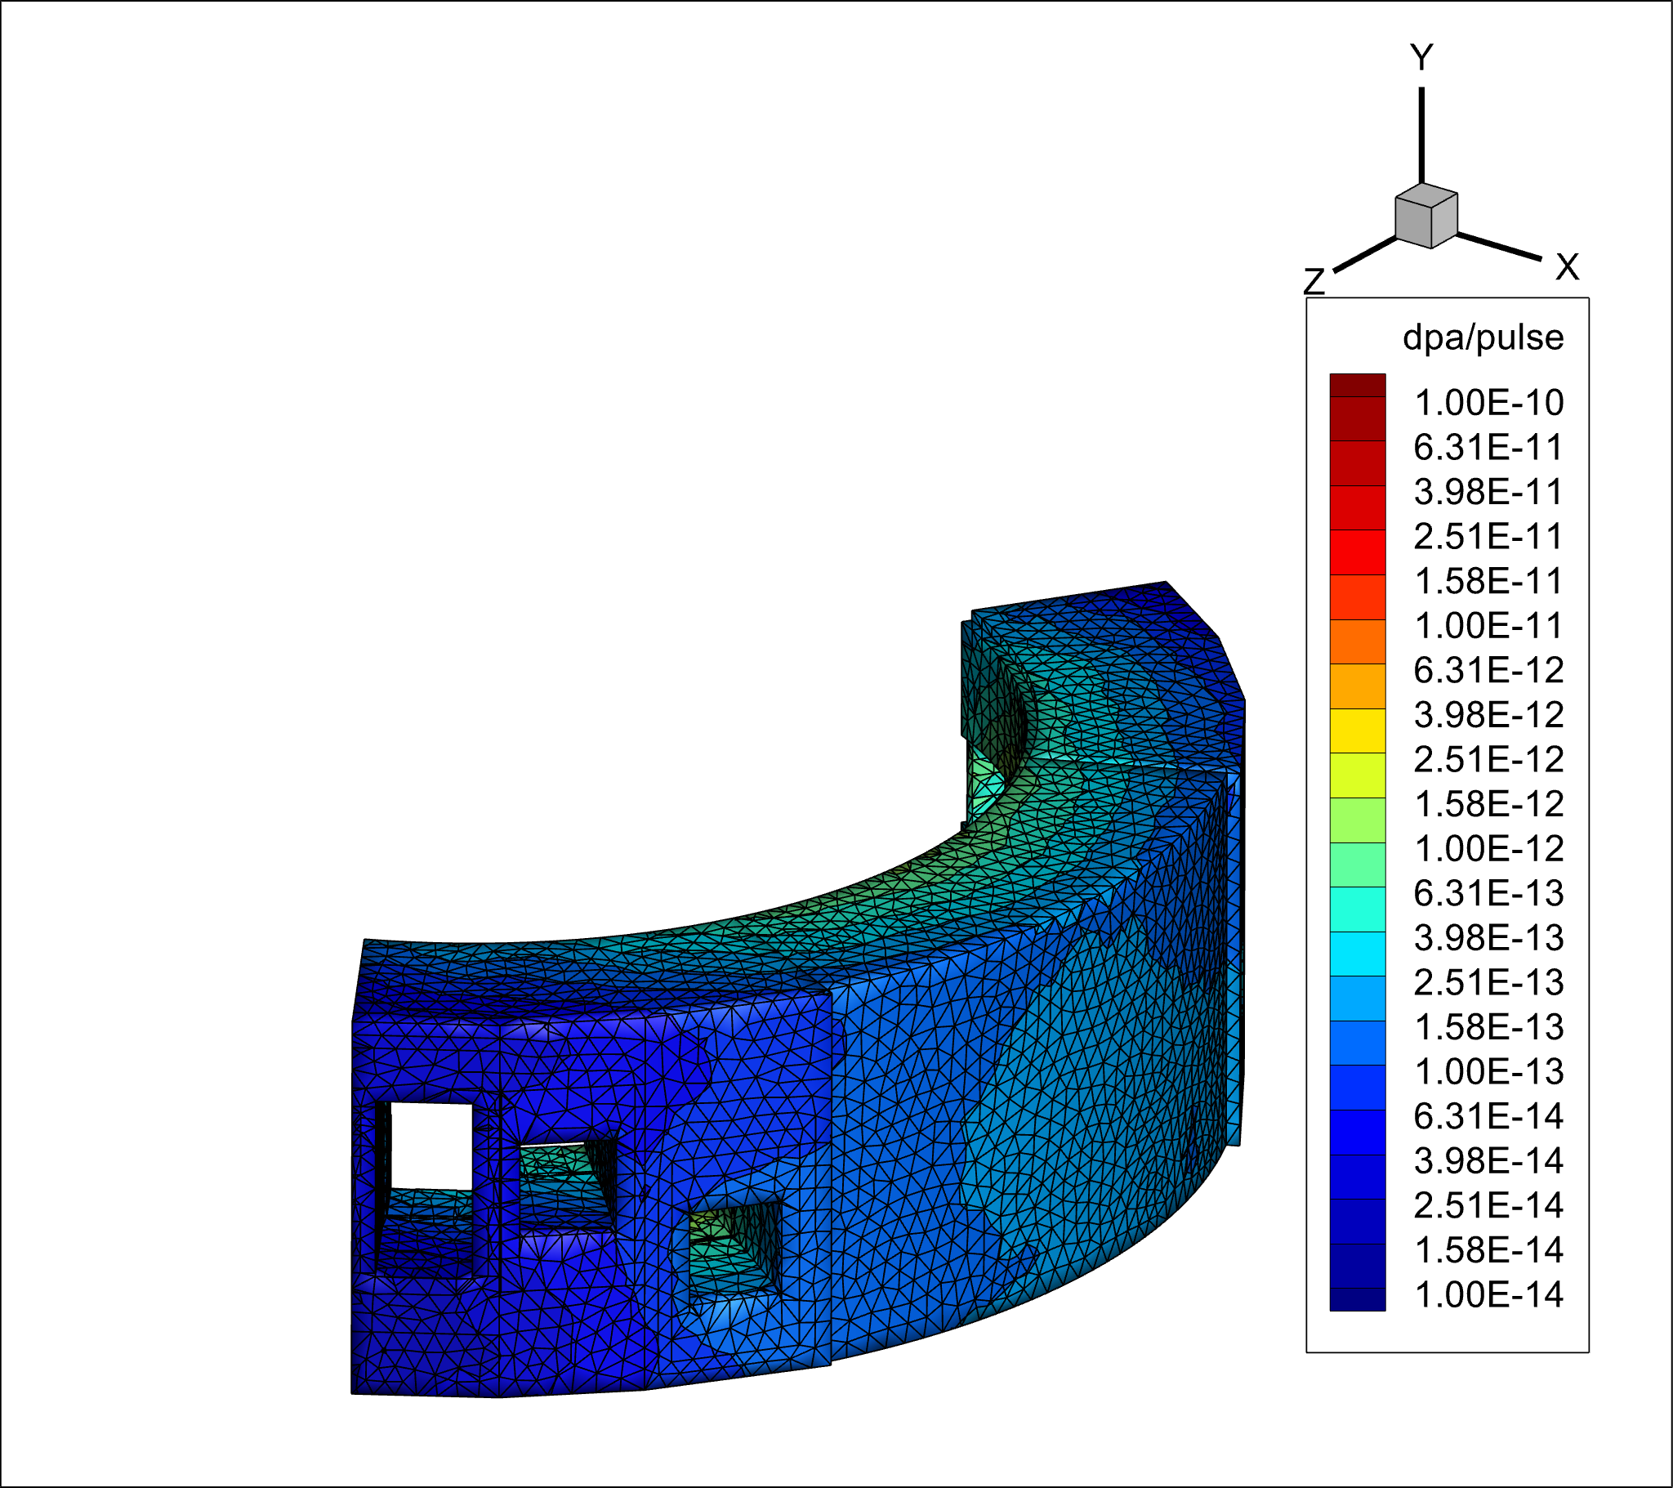
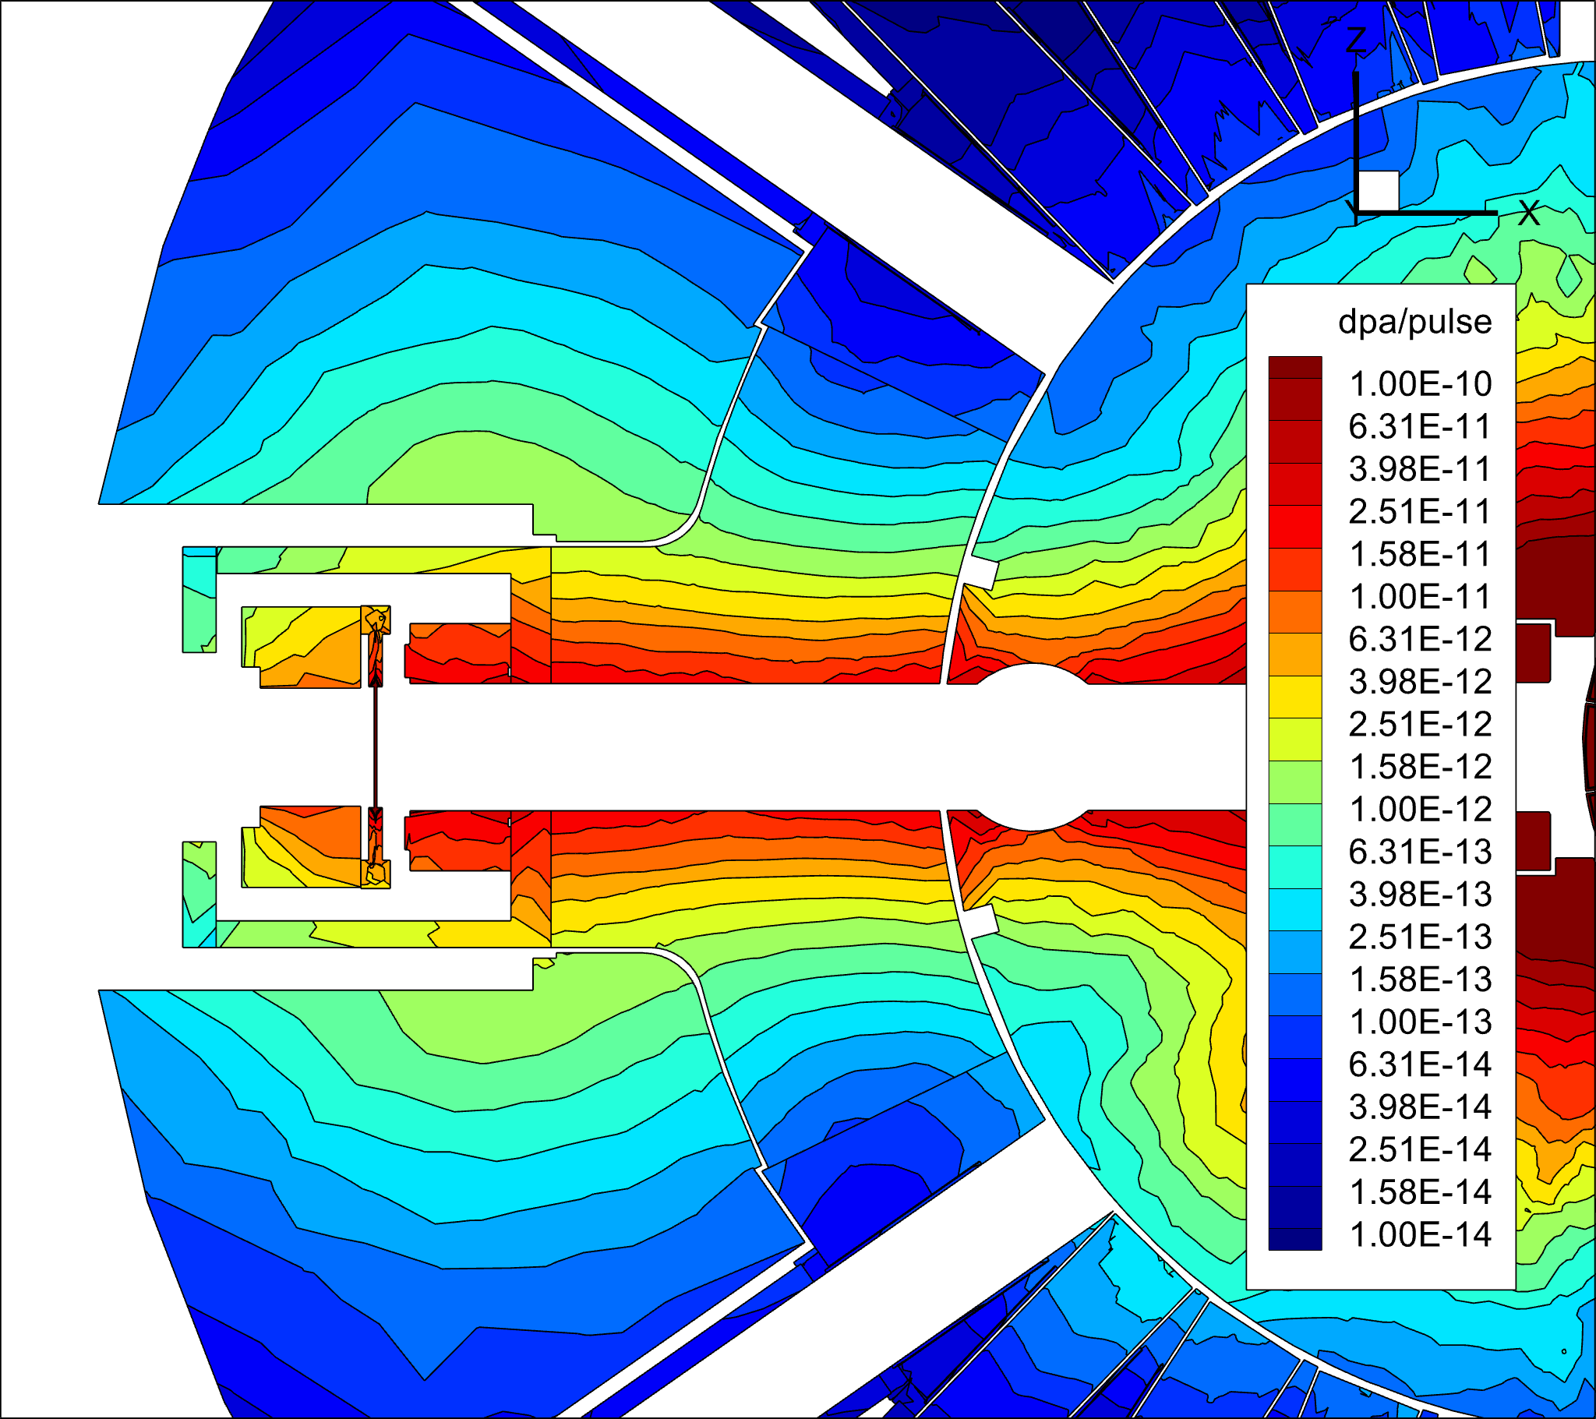
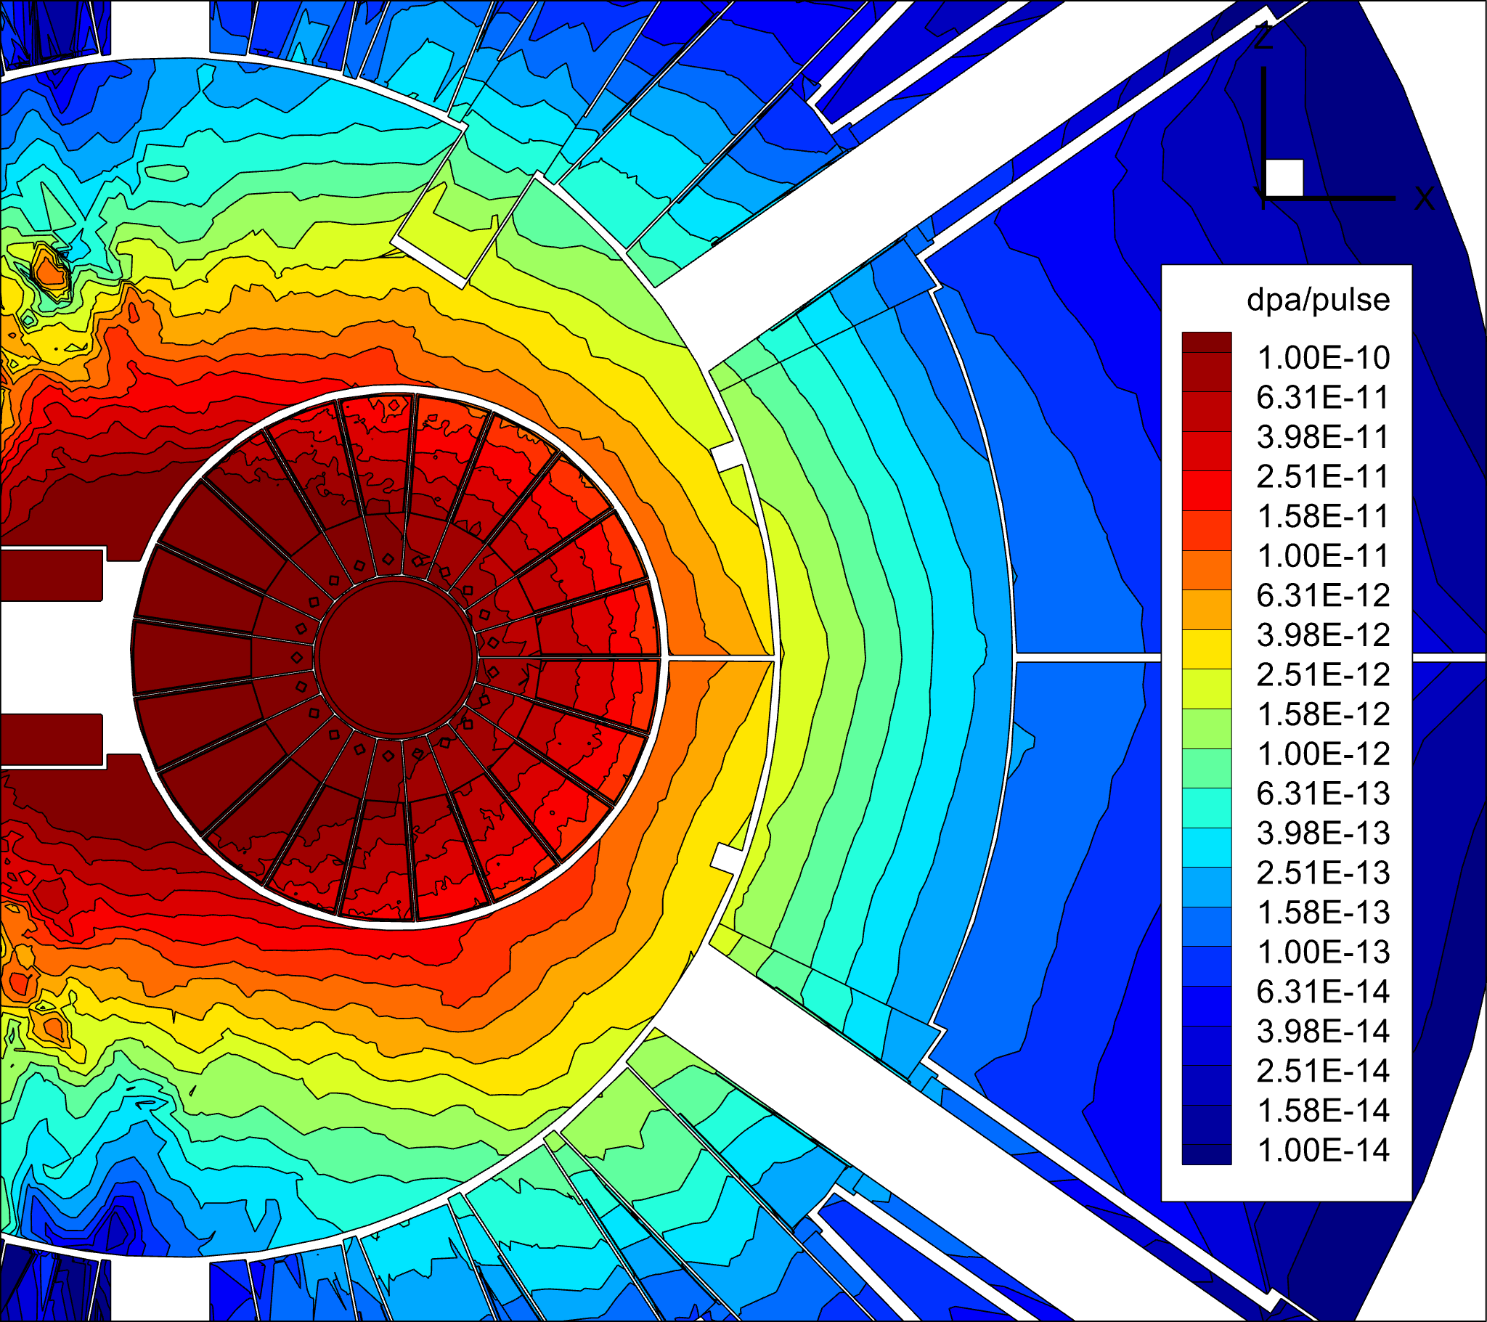
CV and CVS Radiation Damage (Continued)
y = 0 cm
Proton
beam
level
3D view – central blocks

Slide 21
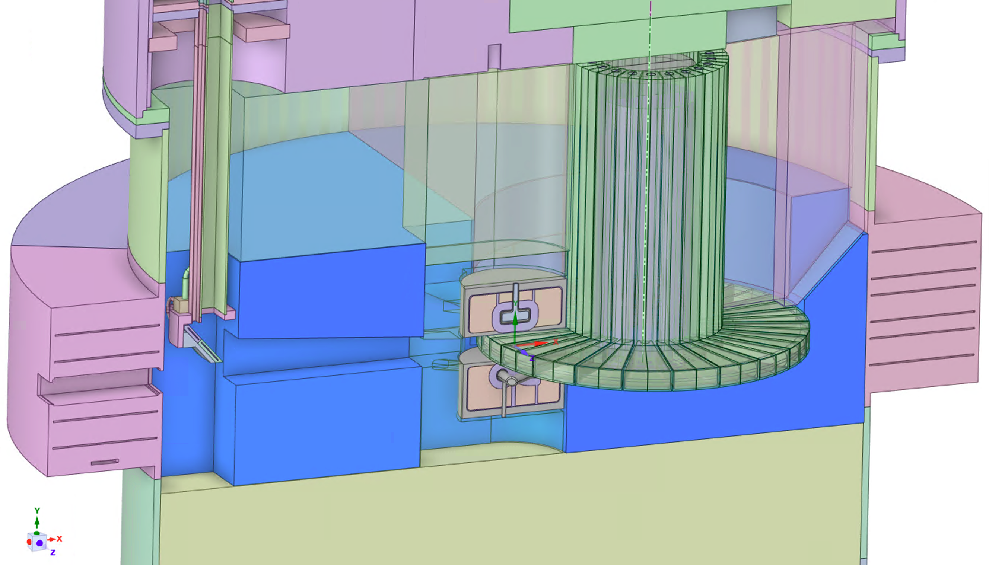
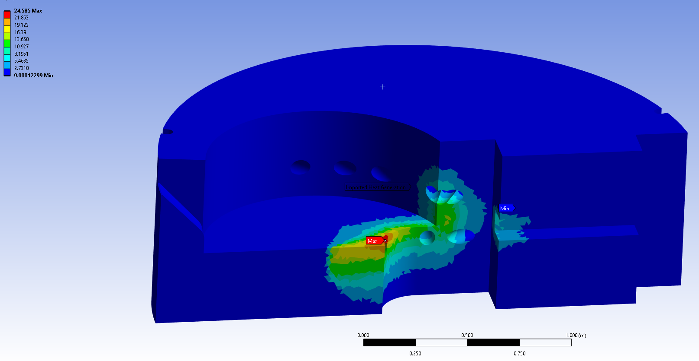
CV and CVS Radiation Damage (Continued)
Maximum radiation damage within 1 m from the proton beam level is 0.6 dpa/year or 25 dpa after 40 years of operation
The minimum lifetime of the CVS is 100 years based on 60 dpa limit for SS316L and beam non intercepting components

Slide 22
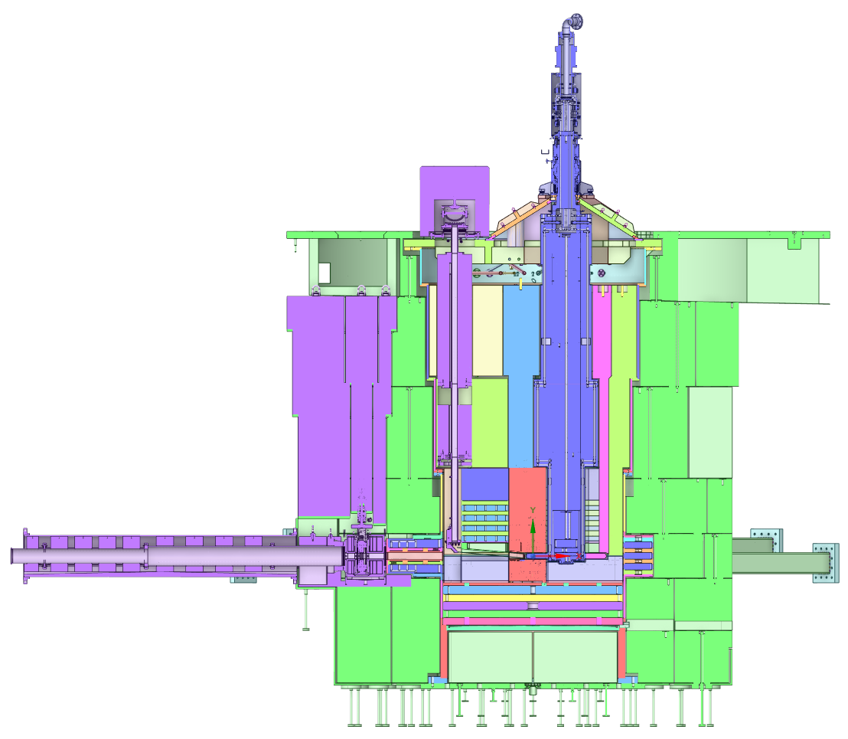
Target, Target Shaft,
Target Drive Room, and
High Bay

Slide 23
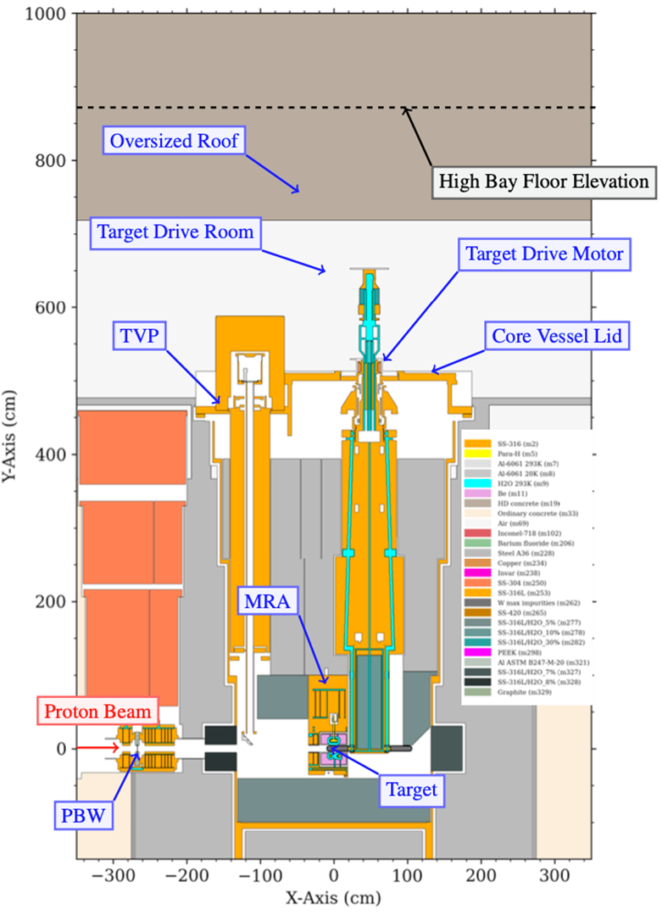
Clearances between rotating components and static shielding introduce gaps.
Vertical Gaps Allow Radiation Streaming
GAPS
Cross Section view of MCNP STS Geometry

Slide 24


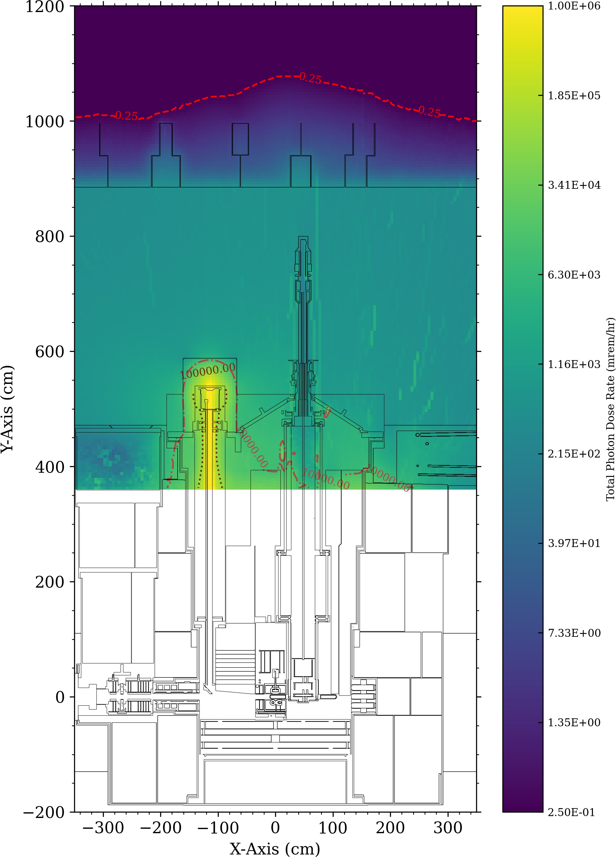
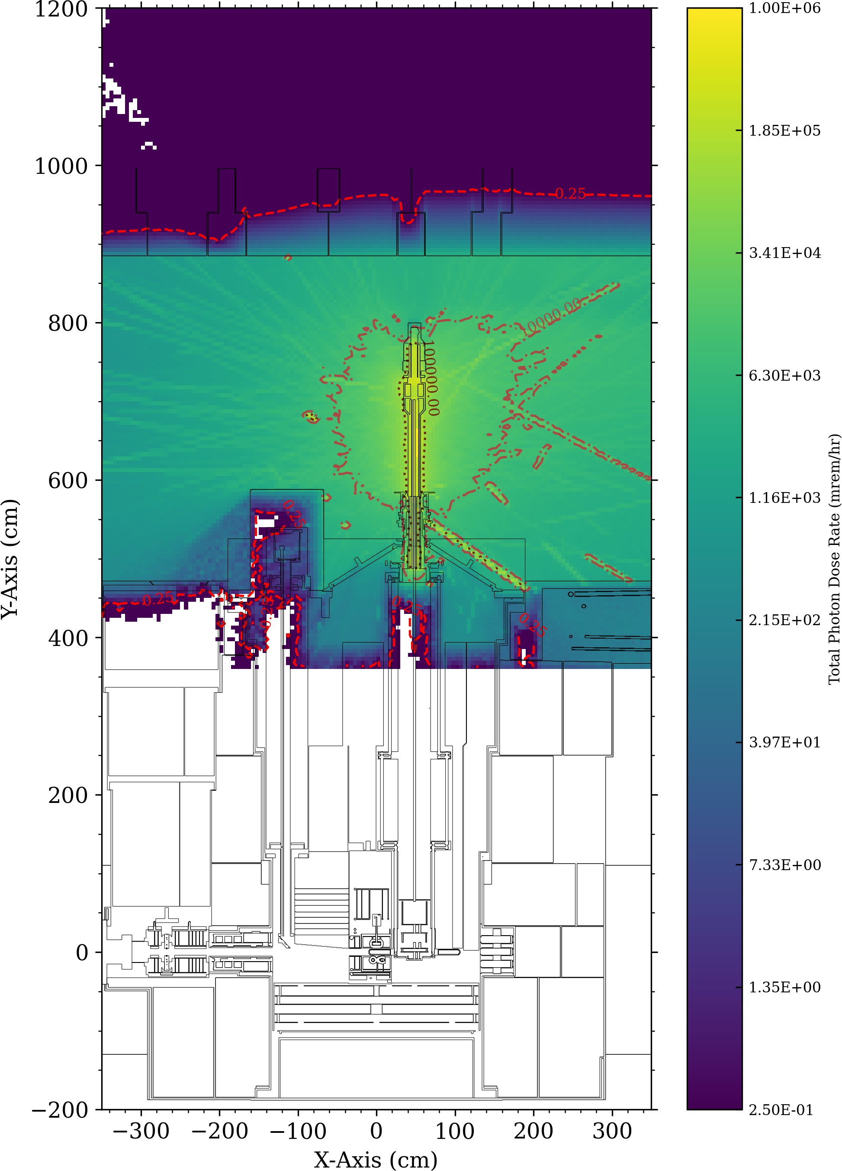
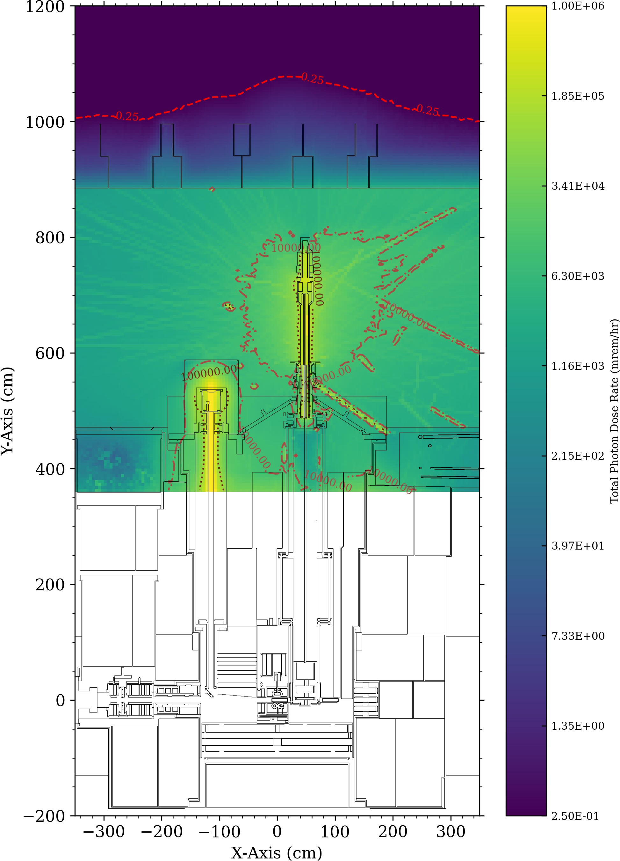



Beam On Total Dose Rates
Proton Source Dose Rates
Activated Water Source Dose
Total Beam On Dose Rates
Rates
Top of Permanent Shielding
Top of Permanent Shielding
Top of Permanent Shielding
89 cm
0.25 mrem/hr
0.25 mrem/hr
0.25 mrem/hr
Target Water
Target Water
Target Water
Proton Beam
Proton Beam
Proton Beam
SECOND TARGET STATION
The TDR roof thickness is driven by neutrons leaking from the target.
2

Slide 25
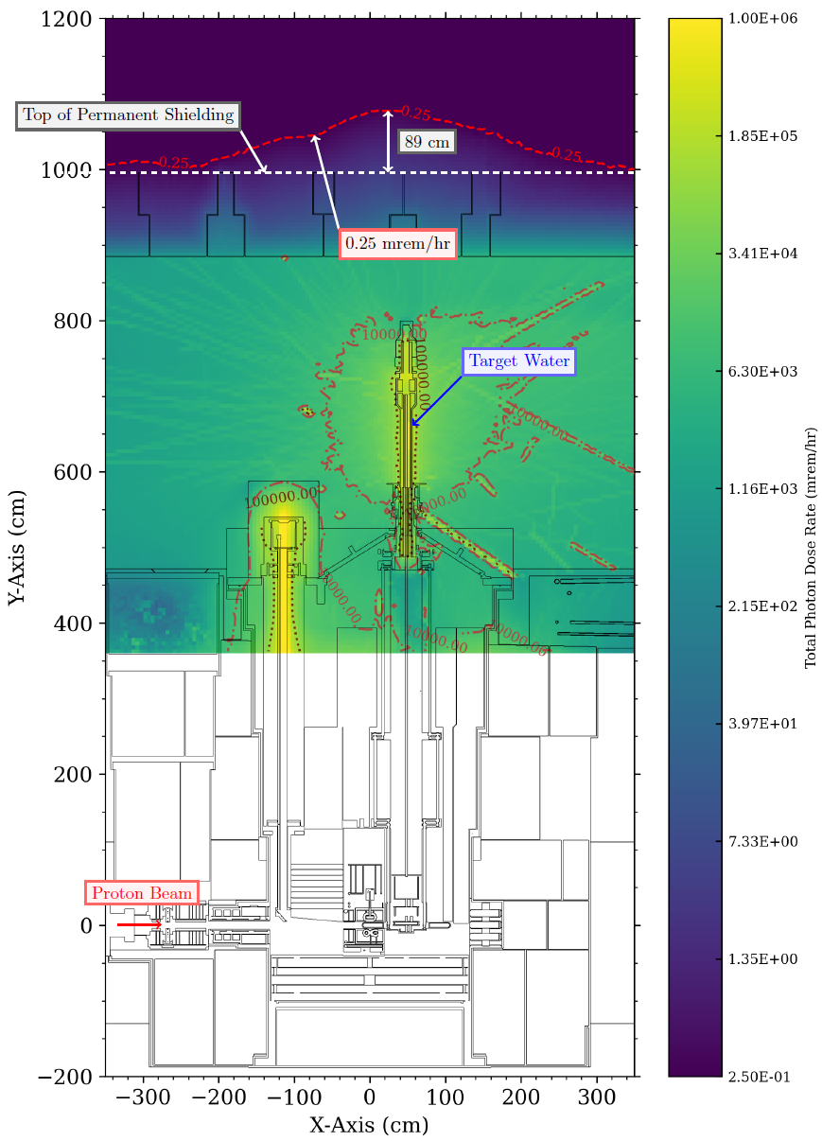
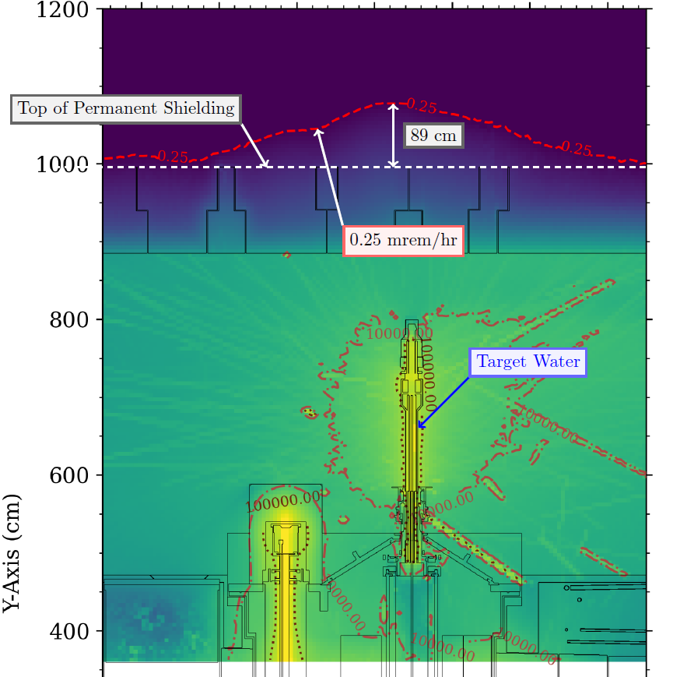
Final TDR Roof Thickness
Final TDR roof thickness is 1.99 m of HD Concrete Removable stacked shielding is 89 cm of HD concrete

Slide 26
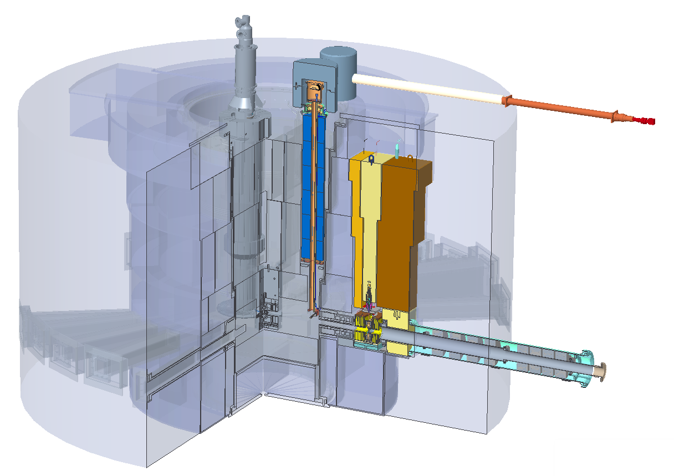
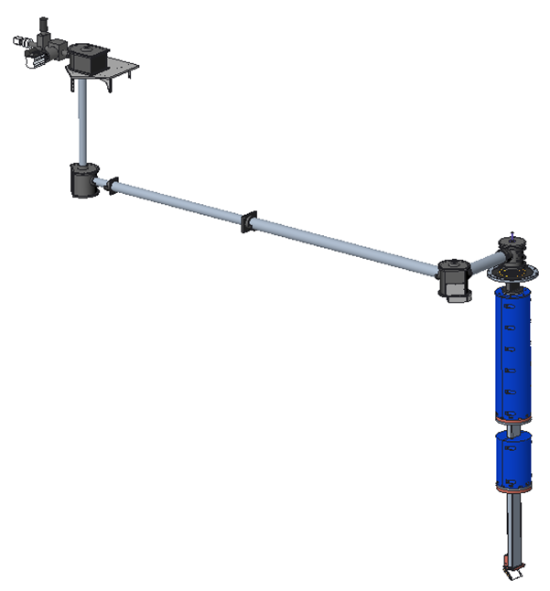
Target Viewing Periscope
1454

Slide 27
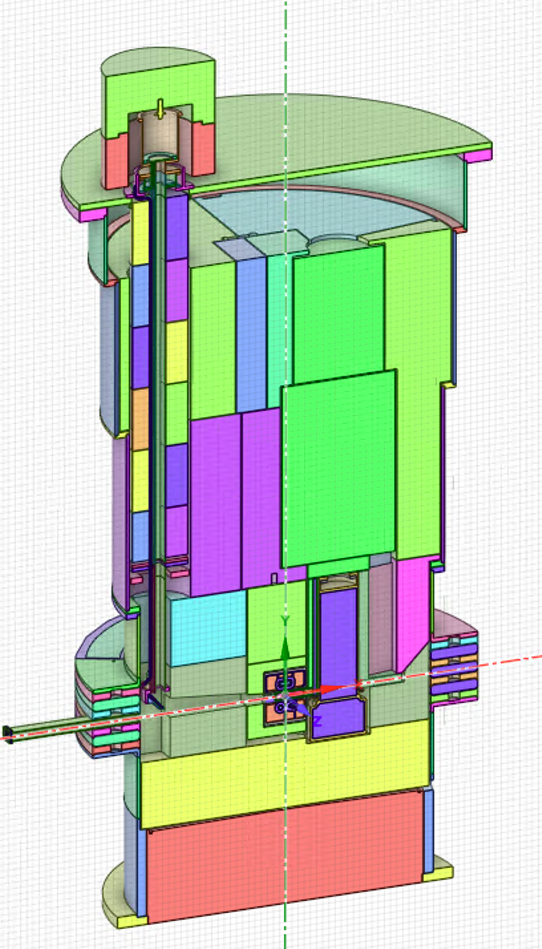
TVP Model
DOGHOUSE SHIELDING
AIR
TARGET DRIVE ROOM
DOGHOUSE SHIELDING
TVP
TVP
Neutronics
perspective:
AIR
5 m tall,10 x 20 cm
opening represents
a streaming gap in the steel shielding between the target and the target drive room (TDR)
2ND
MIRROR
STEEL SHIELDING
5 m
STEEL SHIELDING
1.3 GeV protons
1.3 GeV protons
1ST MIRROR
MODERATORS
TARGET
1ST MIRROR
MODERATORS
TARGET

Slide 28






Energy Deposition
Energy deposition calculated in the entire TVP to determine its elongation
Energy deposition calculated in the 1st mirror to guide the cooling design:
1st mirror heating:
Al 12 W
Steel 47 W
Water 4 W
Starts with 1.3 GeV protons

Slide 29

Prompt Radiation Dose Rate (Beam-On)
DOGHOUSE
10 rem/hr
Target Drive Room Floor
AIR
STEEL
Starts with
1.3 GeV
protons
BEAM

Slide 30


Residual Dose Rates with Removed Doghouse
Residual dose rate (mrem/hr) in TDR at 8 hours of decay (40 years of operation)
Elevation plot through Z = 0
Horizontal view in TDR at Y = 5 m
10 mrem/hr
10 mrem/hr
5 mrem/hr

Slide 31

Proton Beam Window

Slide 32


Geometry Model: Hybrid UM/CSG
Horizontal cross-section (Y = 0 cm)
Vertical cross-section (Z = 0 cm)
Materials in UM
Steel A36
Steel SS316
Steel SS316L
Concrete
Aluminum
Water
z
x
CSG
UM
y
4 m
x
CSG
UM
2 m
≈7 m

Slide 33



Energy Deposition and dpa in the Beltline
Beam Footprint | PBW max energy deposition [J/cc/pulse] | Beltline max energy deposition [J/cc/pulse]
Qd 60 cm² centered on target → pictures below) | 5.3 | 0.02
Qd 60 cm² offset (+6mm hor., +4 mm ver.) | 5.3 | 0.03
Qd 90 cm² centered on target | 5.8 | 0.05
Qd 90 cm² offset (+6mm hor., +4 mm ver.) | 5.8 | 0.08
Vertical slice (Z=0 cm) of energy deposition
3D picture of energy deposition in beltline
3D picture of dpa in beltline
Max 0.02 J/cc/pulse
(up to 0.08 J/cc/pulse for different beam profile)
Max 1.65e-2 dpa/year
(3,600 years for 60 dpa)
Notes:
Differences between the results with the different beam footprints were small in general. The maximum energy deposition increased to 0.08 J/cc/pulse with beam profile 4 (90 cm² with nominal offset) compared to beam profile 1 (60 cm² in center). The profile with 90 cm² has a smaller footprint on the PBW than the 60 cm² profile.
Pictures on this slide are for beam profile 1. In this analysis, the opening for the proton beam is relatively small/narrow. I believe it was decided to increase this opening. This is expected to decrease the maximal value of the energy deposition.
DPA was only evaluated for beam profile 1 (60 cm² in center), as the margin is very large, thus no problem expected for the other beam profiles.

Slide 34



PBW Replacement: Upstream Shield Blocks Removed, 1 Week Decay
Dose rates at target drive room level >500 mrem/h
Dose rates at high bay floor level ≈150 mrem/h
Main source from components in PBW assembly
Red contour = 100 mrem/h
Yellow contour = 5 mrem/h
200
100
100
Dose rates at Y = 500 cm
Target Drive Room
5
5
500
≈110 cm
1000
2000
100 mrem/h
≈50 cm
5 mrem/h

Slide 35

Gamma Gate Assembly
1454

Slide 36


Geometry Overview
Gamma Gate
Gamma Gate Details:
  30 cm lead
  0.5-inch SS-316L cladding
Cross-section view through proton beam
2

Slide 37




Gamma Gate Gaps
Gamma Gate Gaps:
  0.75 cm horizontal gaps
  1.7 cm vertical gaps
0.75 cm Gap
1.70 cm Gap
A
A
Plan view at A-A (Y=410 cm)
Detailed Cross-section view through proton beam
3

Slide 38

Decay Gamma-ray Source Terms
Decay Time: 8 Hours
Operational Periods:
  Target Segments: 10 years
  Target Shaft and Drive: 40 years
  MRA: 6 years
  TVP: 40 years
  Core Vessel and Shielding: 40 years
4
Gamma Sources Cross-section view

Slide 39


8-hour Decay Dose Rates Overview
All dose rates calculated with Denovo (Discrete Ordinates Method)
A
A
Dose Rates Plan View at A-A (Y=400 cm)
Dose Rates Cross-section view
5

Slide 40

Gamma Gate Assembly Residual Dose Rates Detail (8-hour decay)
Dose rates around gamma gate:
Radial gap is acceptable
Grate may be added downstream of the gamma gate
6

Slide 41

Core Vessel Nozzle Extensions and
Monolith Inserts
1454

Slide 42



CV Nozzle Extensions and Monolith Inserts

Slide 43




Heat Source, Nozzle Extensions of ST10 & ST11
ST10
ST11
Total Heat: 8.5 W
Peak: 42.2°C
Total Heat: 12.6 W
Peak: 46.6°C

Slide 44



Heating in Monolith Inserts
Total Heat = 240 W
Total Heat = 82 W
ST-11 Monolith Insert
ST-10 Monolith Insert
Total = 2.3W
QIKR monolith insert has additional shielding in front compared to other beamlines results in much lower heating rates
>50% of this heating is in the front component attached to the core vessel
QIKR (ST-02)

Slide 45


Target Station Shielding,
Monolith, and Bunker

Slide 46





The TSS and Monolith Design Changed
Conceptual design
Preliminary design variants
Preliminary design variants
Reduced steel ,
Increased ordinary
concrete
thickness
Ordinary concrete
~ 0.90 m
Diameter ~ 10.55 m
Diameter ~ 10.55 m
Diameter ~ 11 m
Notes:
Conceptual design of the monolith was for 0.25 mrem/h on the surface. With bunker added allowable dose rate on the surface of the monolith may be increased and the monolith design may be changed and made less expensive. Possibilities are replacing HD with normal concrete and reduce the amount of steel shielding.

Slide 47

Dose Rates in Bunker During Beam-on
Vertical cut through ST-09 (to the right, opened) and ST-18.
The dose rates shown are for the T0 opened and shutter closed.

Slide 48



Dose Rates in Bunker During Beam-on
1 rem/h
2 rem/h
5 Rem/h
Vertical cut along ST-09. The dose rates shown are for the ST-09 T0 and shutter opened.

Slide 49


Dose Rates in Bunker During Beam-on
2 rem/h
1 rem/h
5 rem/h
The dose rates shown are for the ST-09 T0 and shutter opened, T0’s of other beamlines are closed.

Slide 50









Target Station Shielding and Monolith Concrete Heating
Volumetric Heat Sources
$$Q_Top_Steel=519W$$
$$Q_Top_Concrete=12.7W$$
The volumetric heat sources were calculated from MCNP with rectangular meshes, which did not exactly capture the geometry boundaries.
Q_Total = 546 W
$$Q_Bottom_Steel=12.3W$$
$$Q_Bottom_Concrete=2W$$
For the worst case analyzed in this presentation, the peak concrete temperature is 47°C, well below 65°C.

Slide 51


Details of CV Nozzle Extension and Monolith Insert
Y
Z
Nozzle extension
Neutrons
Monolith insert
Optics module
Gap sizes
  6 mm between the guide substrate and the optics module
  6 mm between the optics module and the monolith insert
  10 mm between the monolith insert and the nozzle extension
  20 mm between the nozzle extension and the surrounding shielding
Y
X
Nozzle extension
Two water cooling channels.
In the “front half” of the inserts, there are 8 water channels surrounding the optics module.
Guide substrate
(float glass)
Optics module
Monolith insert

Slide 52


Effect of the Gaps Sizes Around Nozzle Extension on Dose Rates Outside Bunker
Performed earlier with an older design, but results considered to show the trends
Outside the bunker and beam transport shielding (accessible area)
25 mm gaps and less are statistically the same (MC error ~3.5% or less)
40 mm gap ~10% increase compared to 6.5 mm (conservatively)
2-sigma error bars
(95% confidence interval)
Notes:
All gaps (nominal size) contribute ~0.008 mrem/h out of 0.176 mrem/h

Slide 53

Dose Rates Outside the Bunker
The red contour line is 0.25 mrem/h
The allowed limit outside the bunker is 0.25 mrem/h, 30 cm from the outside bunker wall
This design, including the nozzle extension, meets the dose rate requirements
Notes:
A cost savings in shielding is to use less HD concrete in the bunker wall and roof.
These results show that HD concrete in the bunker wall is only needed ~3.5 m above the neutron beamlines.

Slide 54
Current and Future work
1454

Slide 55


Ongoing: energy deposition throughout the monolith with detailed model

Slide 56

Energy deposition throughout the monolith (Preliminary)
Contours:
Red = 0.001W/cc,
Blue = 0.01 W/cc,
Yellow = 0.1 W/cc.

Slide 57

Energy deposition throughout the monolith (Preliminary)
Contours:
Red = 0.001W/cc,
Blue = 0.01 W/cc,
Yellow = 0.1 W/cc.

Slide 58
Conclusion
Neutronics team provided support for the preliminary design of the Vessel Systems and Target Station Shielding
Calculated:
  Energy deposition from the beam-on operations
  Radiation damage
  Prompt radiation dose rate from the beam-on operations
  Shutdown radiation dose rates for Target/MRA/TVP/PBW replacement
Future work:
  Update and refine the analyses for the final design

Slide 59




Thank you for your attention

Slide 60
Additional Slides

Slide 61

Target Viewing Periscope
Target drive
Core Vessel
Core Vessel Shielding
Rotating target shaft
Bulk Shielding
Moderator Reflector Assembly
Rotating target
Proton beam window

