Slide 1
Core Vessel
Vacuum System Preliminary Design
April 21, 2025
Austin Chaires
Mike Strong

Slide 2
Core Vessel Vacuum is a separate WBS element from Vessel Systems but is within the scope of this review
Vacuum system design and analysis is being performed by resources both internal and external to Target Systems.
  Overall design, component selection and VacTran performance analysis is being performed with matrixed support from the STS Accelerator Systems group (Austin Chaires) in consultation with the RAD Vacuum Systems group.
  Vacuum tube routing design is being performed by Target Process Systems.
Where it’s practical to do so, design is based on the SNS Core Vessel vacuum system.
  There will be common sourcing for vacuum pumps, gauges, valves, etc. based on selection of vacuum components in accordance with the SNS-RAD-VAC-TS-0001 spec and in collaboration with the RAD Vacuum Systems group.

Slide 3
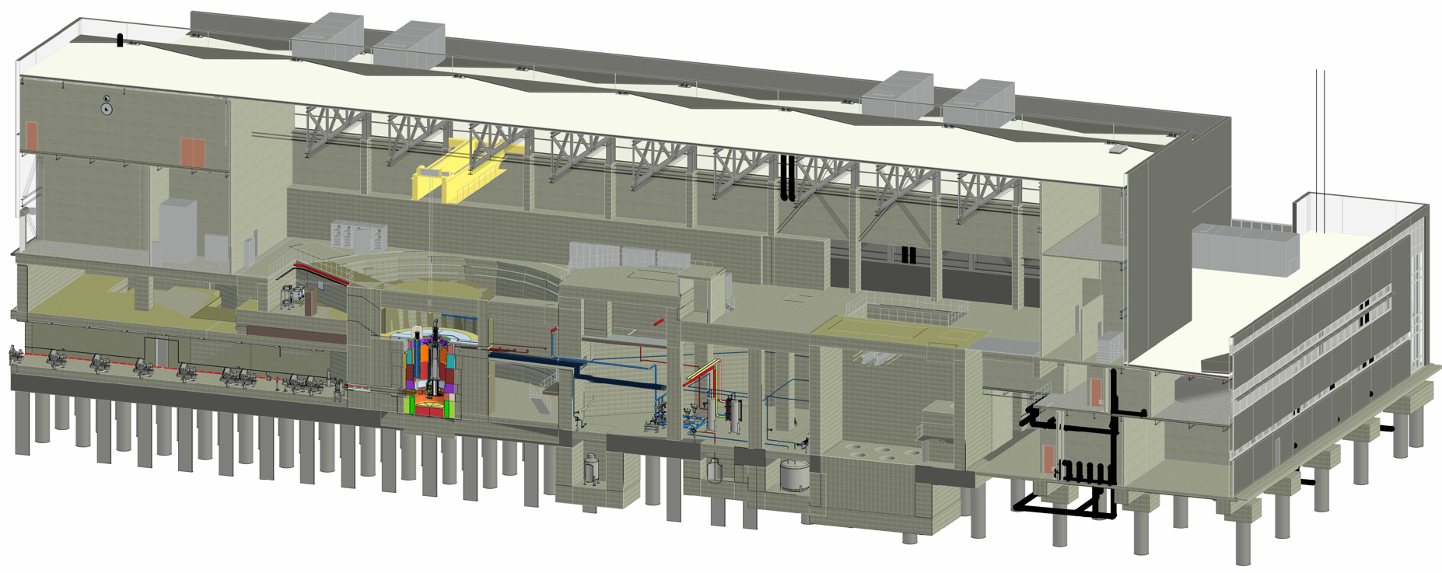
Core Vessel Vacuum System is located adjacent to the Monolith
Target Drive
Room
Monolith Vacuum Systems
Monolith

Slide 4
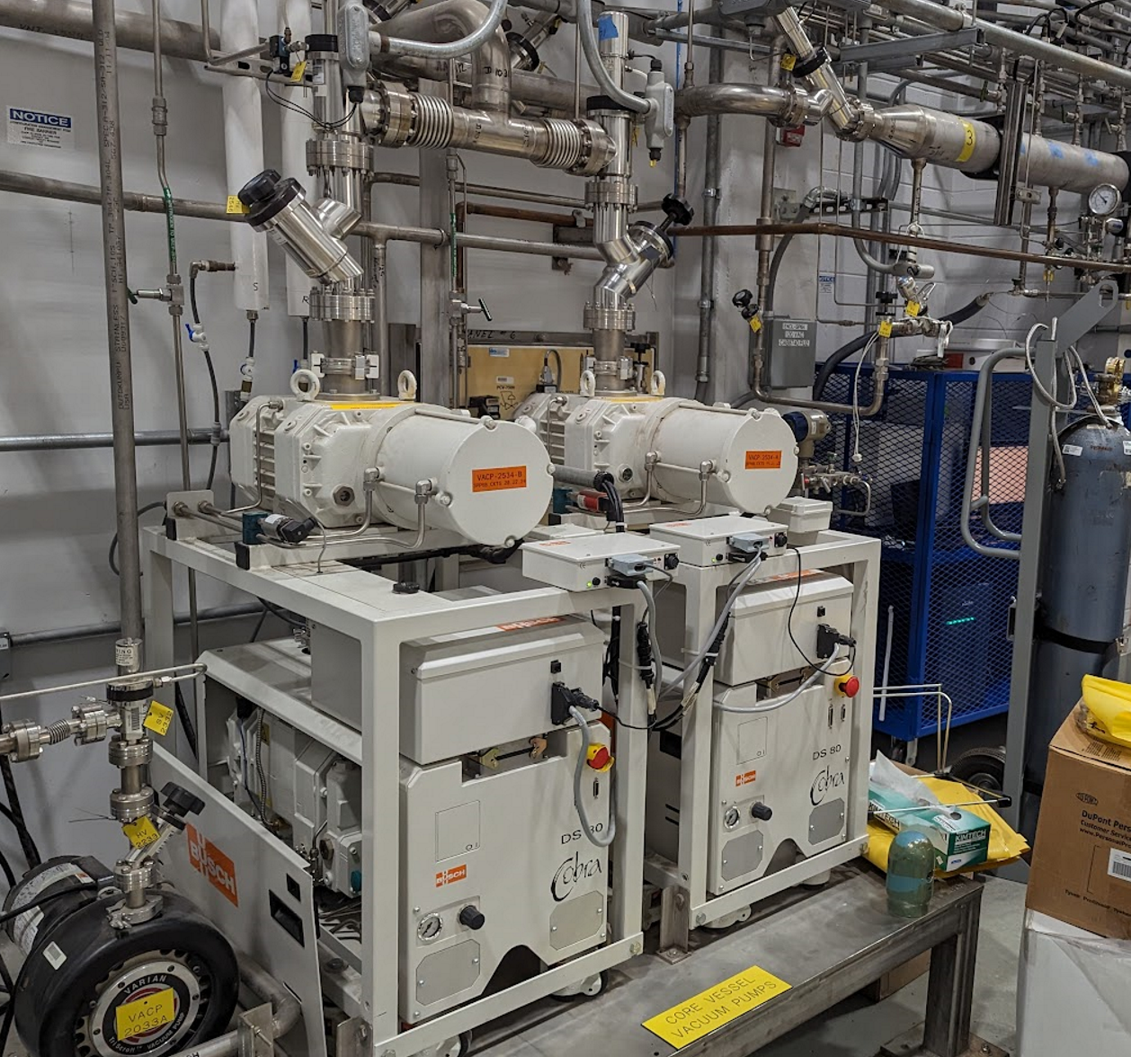
Core Vessel Vacuum System Description
When the Core Vessel is operated in vacuum mode the Vacuum System maintains a rough vacuum environment surrounding the target systems technical components. When the Core Vessel is operated in Helium mode, the Vacuum System provides a purge of the CV environment prior to Helium fill.
The system includes a vacuum pump (with redundancy), a primary evacuation route (tubing) connecting to the CV, branches for other integrated processes, isolation valves, pressure gauges, and gas composition monitoring.
System architecture models the SNS CV vacuum system, with the same or similar commercial off-the-shelf components (COTS) selected to routing and other process connections.
SNS Core Vessel Vacuum Pump Station

Slide 5
Requirements Summary & Key Functions
ID | Requirement Summary
S.03.11-6176 | The Core Vessel Vacuum System shall be capable of maintaining of pressure of ≤1 Torr either during operations or during preparation for Helium fill.
S.03.11-7731 | The Core Vessel Vacuum System shall include features that allow operation with either vacuum or a Helium fill in the Core Vessel.
S.03.11-7618 | The Core Vessel Vacuum System shall allow for monitoring of the composition of the Core Vessel environment drawn through the vacuum system.
For brevity, only Core Vessel-specific requirements are shown. General requirements, PHAR-derived safety requirements and interface-derived requirements also apply and can be found in the S03110000-SR0001 Target Vacuum Systems Requirements.
From general lifetime and maintenance requirements, it’s also important that the vacuum system can pump down the Core Vessel to ≤1 Torr within a timeframe that supports the start of operations after a service event.

Slide 6
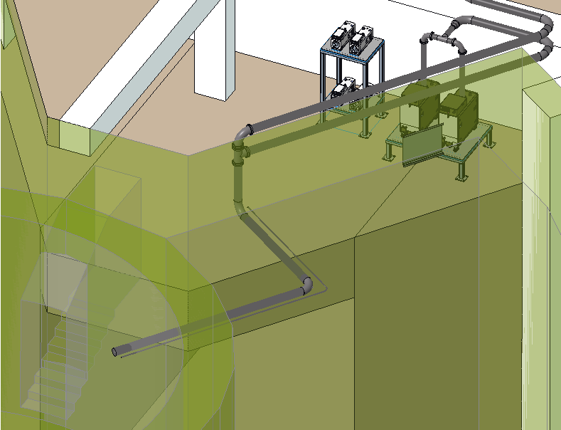
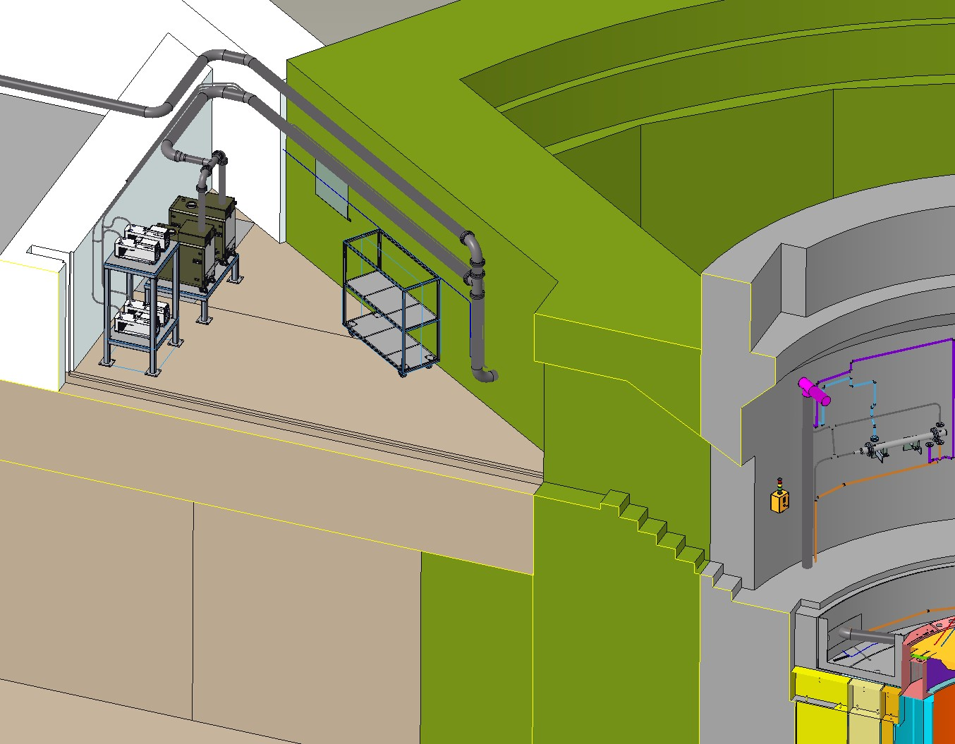
Major Interfaces internal and external to Target Systems
3
Welded vacuum connection to the Core Vessel.
Power, compressed air, anchorage and Hot Offgas connections with Conventional Facilities (CF).
Control via Vacuum Control System PLCs in Integrated Control Systems (ICS) scope.
Connection to Helium distribution system in Target Process Systems scope (not shown).
2
1

Slide 7
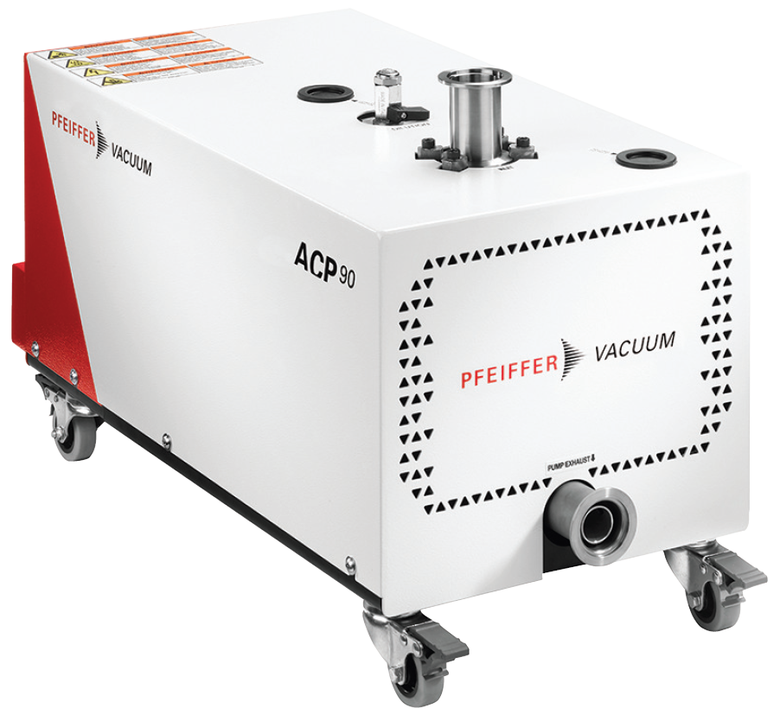
Pumping Selection & Venting Design
SNS has used the Busch Cobra DS/DL 500, 502 since start-up. A newer variant of this pump was initially considered but the RAD Vacuum Systems group indicates those pumps are being replaced with Pfeiffer ACP 90s in April 2025.
Roughing Vacuum Pump – A single dry-roots Pfeiffer ACP 90 pump will provide evacuation of the Core Vessel through the Vacuum tubing. The pump has a working base pressure of ~10 mTorr.
Inlet and outlet connections are DN40 ISO-KF flanges, with the inlet connected via flex hose to the tubing and the outlet connected via flex hose to the HOG.
Redundant Pump – A second pump stationed in parallel provides redundancy in case of primary pump failure to maintain the CV’s inert environment. During operation, the redundant pump will be isolated from the system and in standby.
Venting & Backfilling – Helium provided by the Target Process Systems Helium Distribution is used for backfill by connection directly to the Core Vessel.
Pfeiffer ACP 90

Slide 8
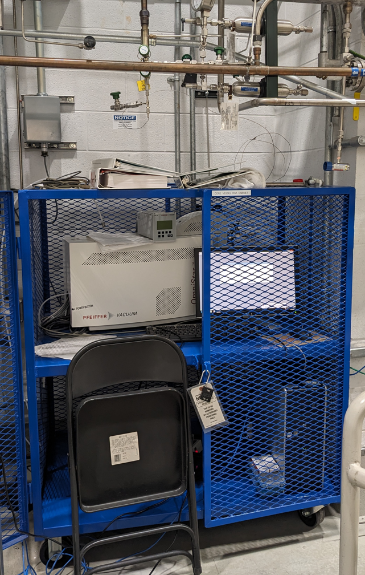
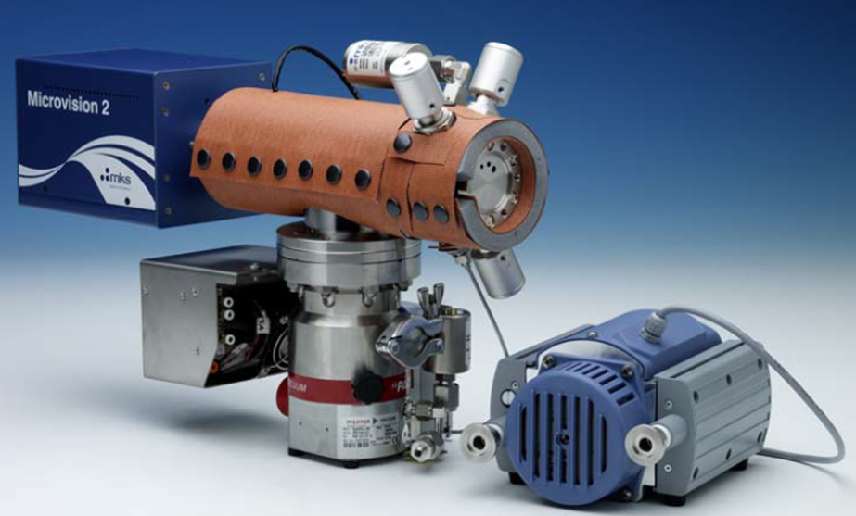
Instrumentation Selections
Pressure Measurement – There are various gauge options for being able to measure pressure for multiple gas environments. MKS offers the AA04 capacitance manometer, a gas-independent gauge that measures pressure directly, though two gauges are required to cover the full pressure range across the planned CV operating modes.
Gas Composition Monitoring – Performed by an MKS Vision 2000-P residual gas analyzer, which offers easy product configurations to adjust over a large range of vacuum regimes up to atmospheric pressure.
The current SNS MKS Cirrus3XD RGA is designed for monitoring the CV in Helium mode and can only operate down to ~20 Torr.
Diaphragm Pump
MKS Vision 2000-P System Solution
Turbo Pump
Obsolete Pfeiffer RGA Station at SNS (Jan 2025)

Slide 9
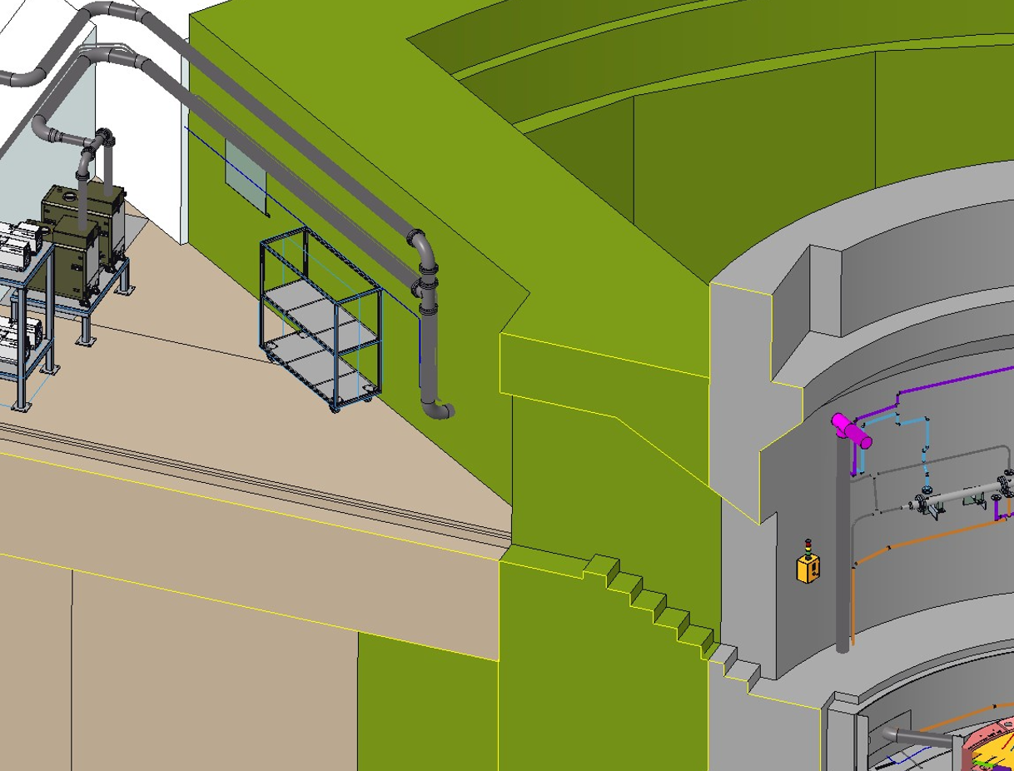
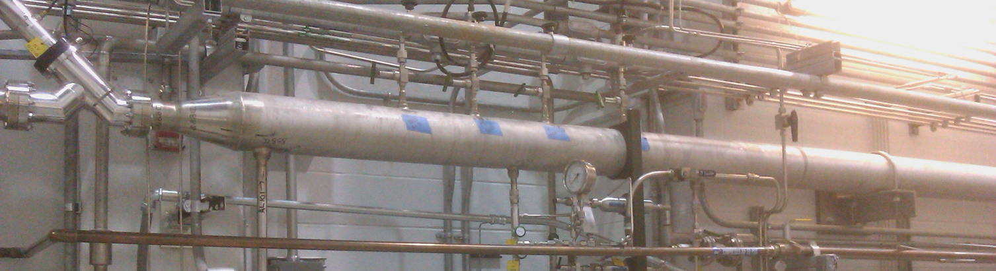
Tubing & Routing Design
The evacuation route from pump to CV is stainless-steel tubing, starting with 1.5” OD at the pump inlet and then transitioning to 6” OD for most of the distance to connection to the CV.
Tubing – 304L or 316L stainless steel, defined by nominal OD. Standard vacuum industry practice uses tubing with vacuum flange systems. Wall thicknesses are thinner than piping schedule designations.
Welded conical adaptors are used for transition between tube sizes.
Tubing for SNS CV Vacuum System

Slide 10
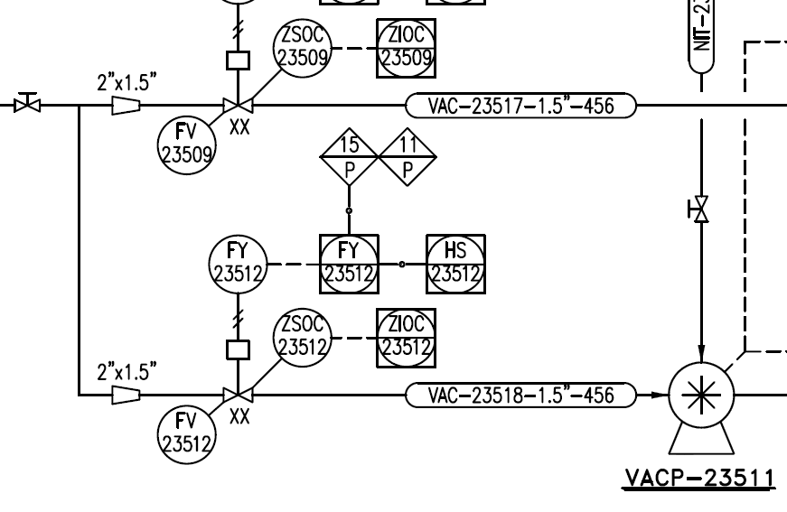
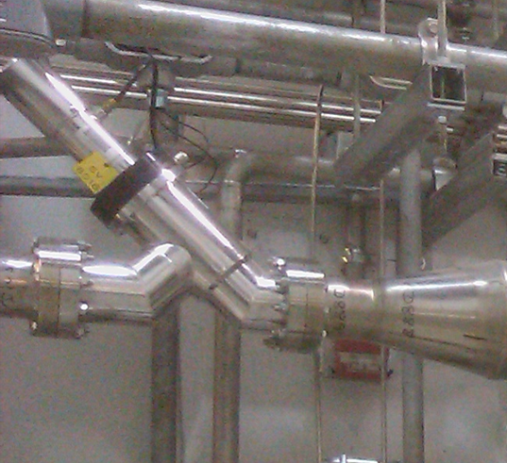
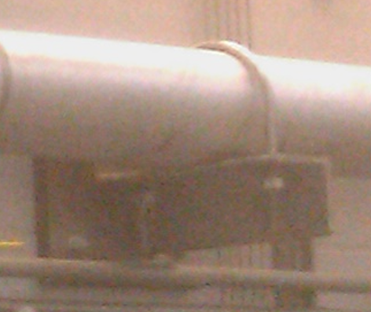
Vacuum Valving & Supports
Isolation Valves – With several other processes sharing the tubing, a mixture of actuated and manual vacuum valves will be employed for isolating the vacuum process.
Each pump also has an isolation valve for switching pump operation or for servicing.
Supports – Design to be completed during Final Design phase with Target Process Systems piping support design.
P&ID by Target Process Systems
In-line Valve on SNS CV Vacuum System
Support on SNS CV Vacuum System

Slide 11
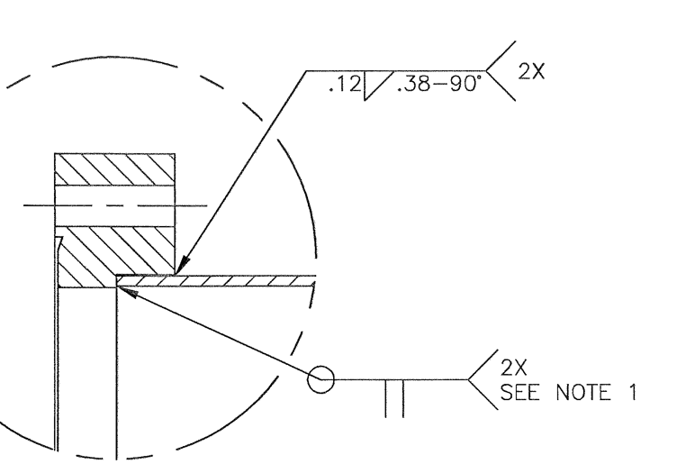
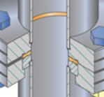
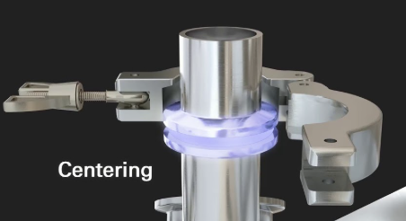
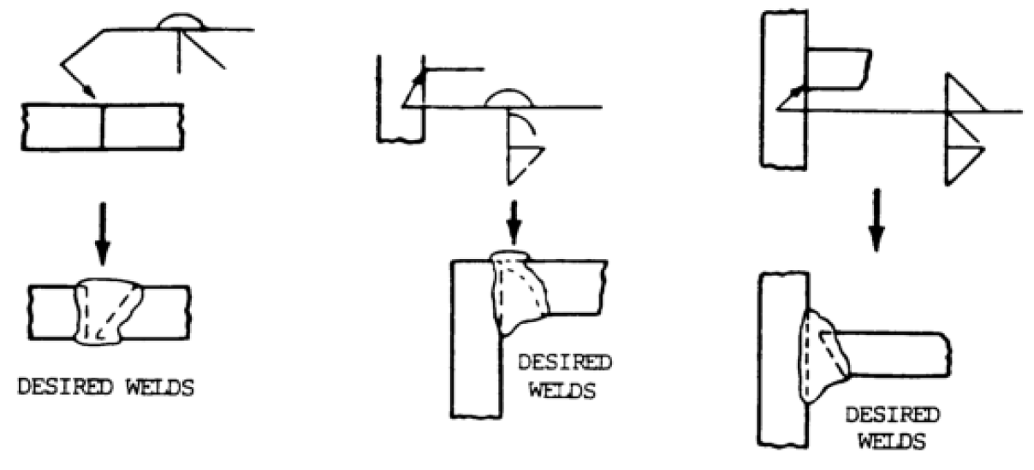
Component Connections
Flanged Types – ConFlats and ISO-KF for removable (serviceable) connections. ConFlats include fixed or rotating options with tapped or clearance bolt hole, and will use oxygen-free Copper gaskets.
Vacuum Welds – For life-of-facility connections. Specific requirements for vacuum welds will include full penetration, limit welds from exterior, no multiple passes, etc.
Standard Tube to Flange Welds
Example of Fixed ConFlat to Rotatable ConFlat using 1/4 hard, high purity, OFC gaskets
ISO-KF
Other Standard Welds

Slide 12
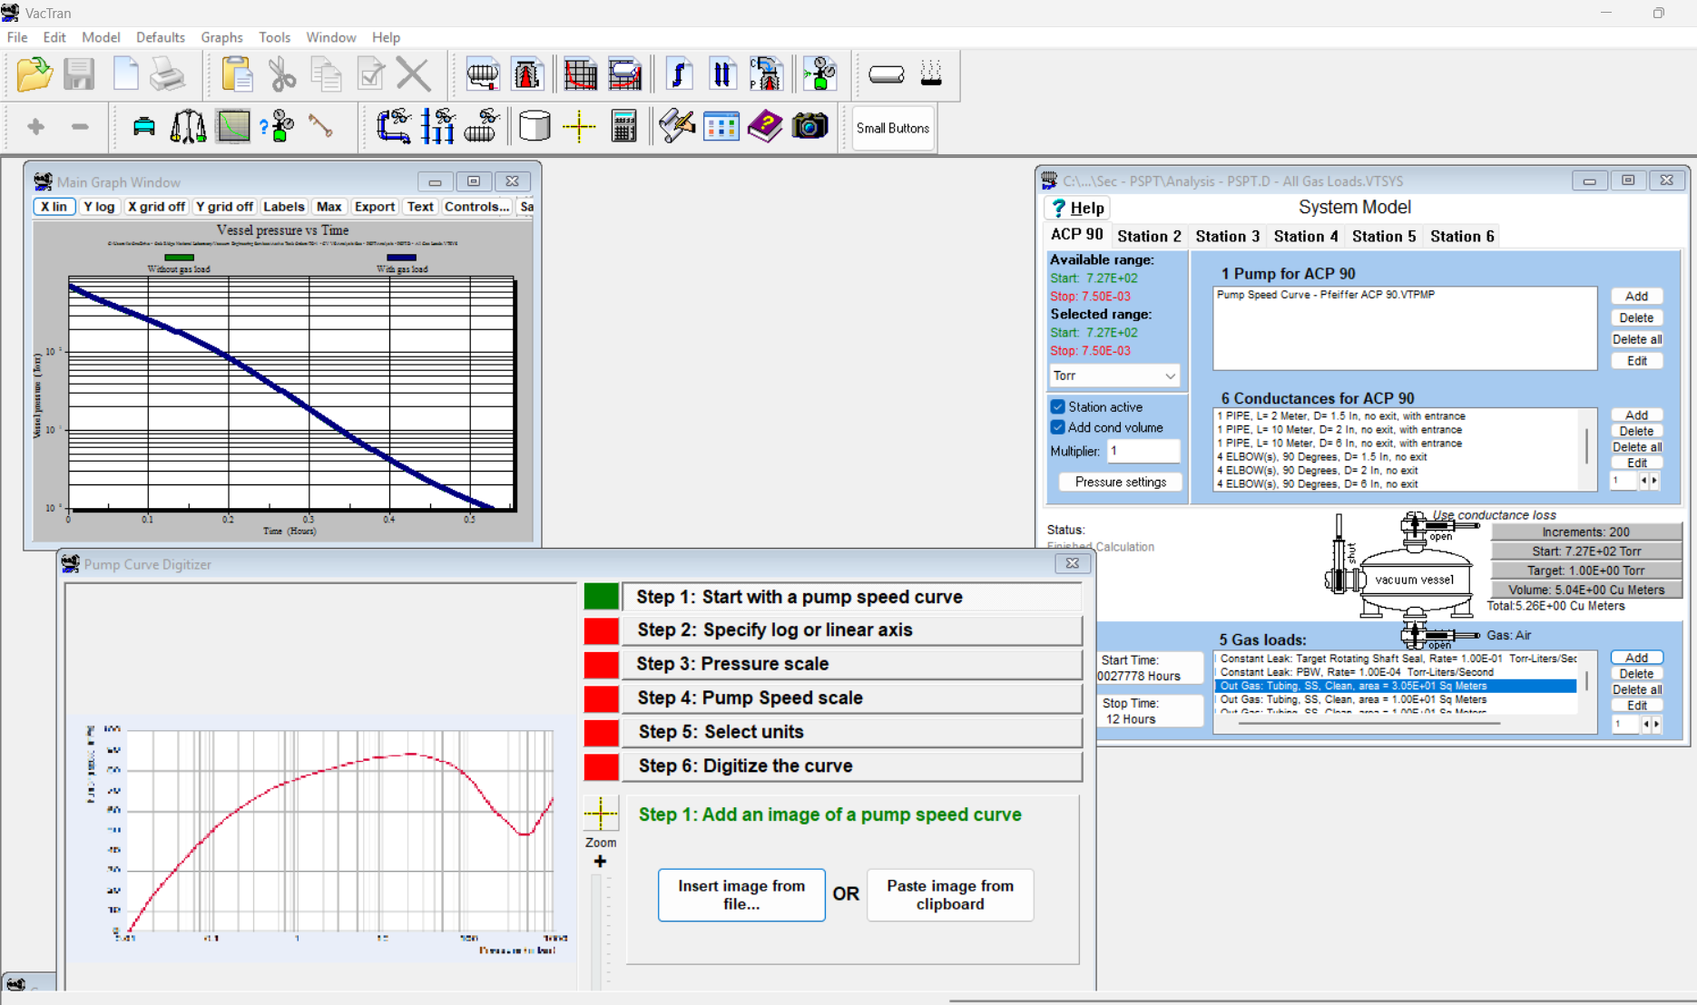
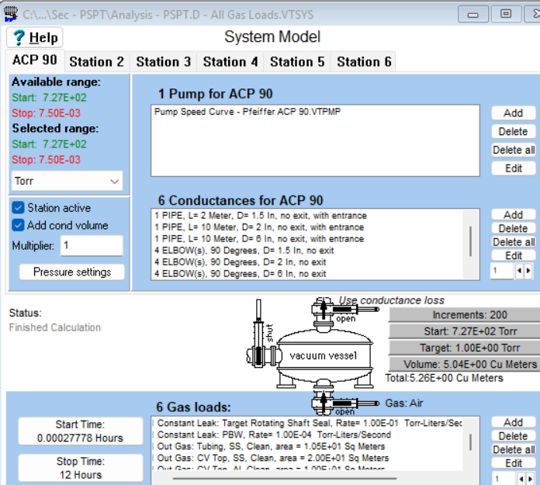
Pumpdown time analysis is conducted using VacTran
VacTran is the preferred software for its ability to provide detailed pumpdown plots, adjustable performance targets, and the ability to add complex conductance and gas load inputs.
Software limits:
  Ideal Gas Law – Treats air as an ideal gas at standard temperature and pressure (STP), adding a small acceptable error (but significant at elevated temperatures).
  Water in Air Only – No liquid water present in system, exploration of this condition is active.
  Lower Starting Pressure – The pumpdown time is slightly under-calculated due to a starting pressure of ~727 Torr.
Excerpt from VacTran User Interface

Slide 13
VacTran Software & System Model
VacTran system model of the CV Vacuum System includes a pump, dimensions of the evacuation route from the vessel, and the Core Vessel itself. Data input includes the pump’s speed curve, gas loads from leaks and offgassing, conductance of tubing elements, and summation of volumes.
Model Assumptions:
  Approximate Volume and Surface Areas – Total volume and surface areas of material based on preliminary design & CAD.
  Environment at Start Up – The gas mixture present in the system at startup is air at STP. In Final Design an additional pumpdown model will be developed for Helium composition.

Slide 14
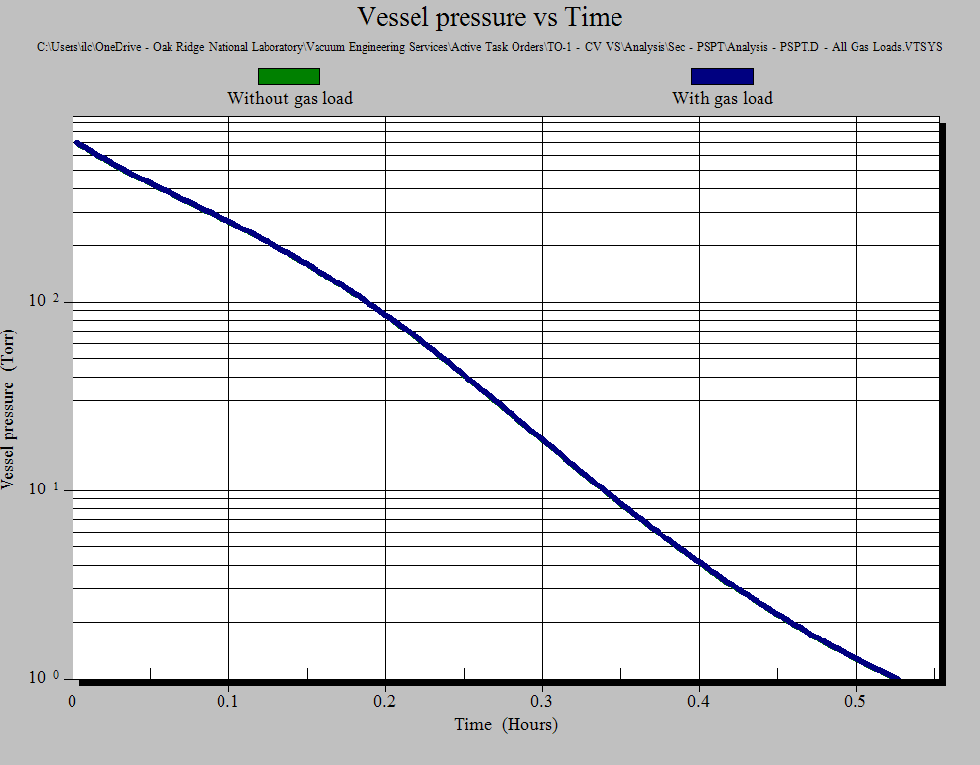
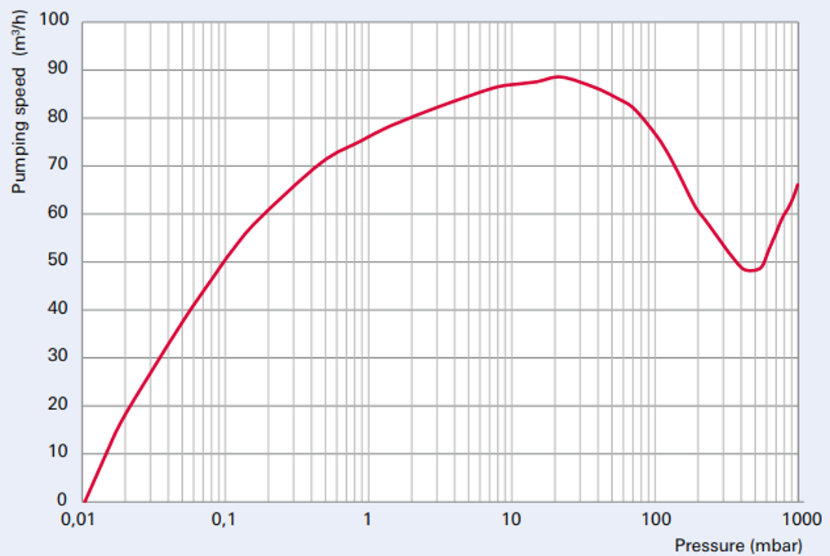
Pumping analysis demonstrates suitable CV pump down time
The analysis calculates approximately 32 minutes to reach 1 Torr from atmosphere using the current vacuum system design.
Considers all system conductance, gas loads, tubing volume, and vessel volume using the Pfeiffer ACP 90 pump.
After 12 hours of pumping, the system could achieve 0.144 Torr.
Addition analysis shows the system has significant margin to ensure ≤1 Torr operational pressure.
Analysis with additional gas load of 0.5 Torr∙L/s did not significantly increase time to reach 1 Torr.
System Conditions | Time hrs:min | Operational Pressure Torr
All vacuum loads (All conductance, gas loads, volumes) | 0:32 | 1
All vacuum loads | 12:00 | 0.144
Pumping Curve for Pfeiffer ACP 90
Notes:
Additional analysis was performed exploring a 0.5 Torr-L/s leak rate for the rotating Target Shaft seal. The pumpdown time to 1 Torr was unaffected, but the ultimate achievable base pressure was increased from 144 mTorr to ~300 mTorr.

Slide 15
Use of the Vacuum System for CV Helium Operational Mode
Helium fill is governed by the Target Process Systems Helium Distribution System with direct connection to the Core Vessel.
CV Vacuum System will provide purge of air or Helium from the Core Vessel.
Helium overpressure protection includes 3psig pressure relief valve on the Helium line (same as SNS).
Helium ejection intersects the Vacuum System tubing between the Core Vessel and the pump.
Helium Line
Vacuum Line
Vacuum Line
Core Vessel
Helium Line

Slide 16
Procurement Plan
COTS Components – Expected to be sole-sourced justified by integration with current SNS systems, commonization, and limiting unique spares and hardware.
Build-to-Print Components – Include the tubing spools and the pump stand and will be sent to vendors for bid. Spools will be shipped fully cleaned, nitrogen backfilled and either capped or bagged. SNS RAD Vacuum System group will aid in inspection, Helium leak check, and prep for storage if needed.

Slide 17
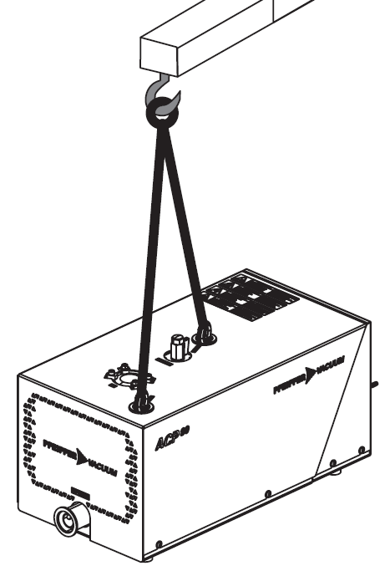
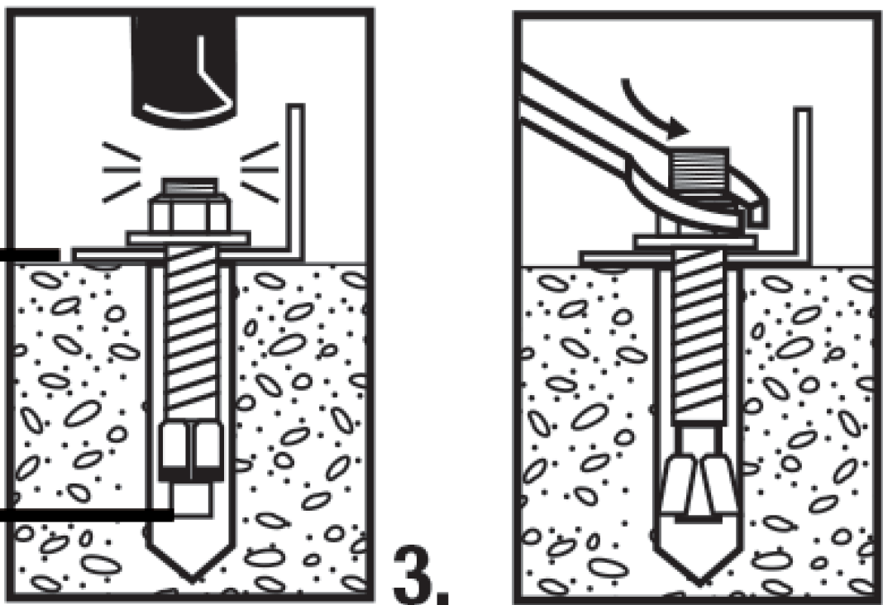
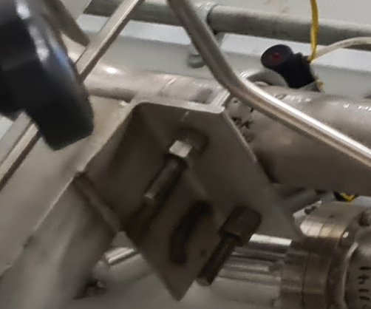
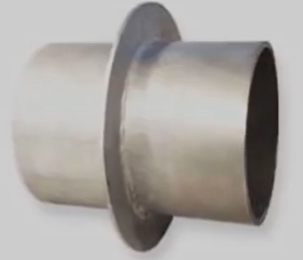
Installation Plan
Penetrations – Sleeves will be cast in place during CF wall construction.
Tube Spools and Supports – Tubing can be installed independently of the pump station since connections will be flexible.
Budgetary estimates for installation were provided by ORNL F&O, and further discussions are required to clarify scope and costs.
Pump Station Assembly – Stand and pump can be lifted by High Bay crane. The stand will be anchored to the floor and pumps secured on top.
Lifting Points for ACP 90
Galvanized Pipe Wall Sleeve
Sample Expansion Anchors for Stands and Supports
SNS Pipe Support

Slide 18
Like the Vessel Systems, the Core Vessel Vacuum System preliminary design is complete, and we are ready to begin the final design phase
The requirements for the Core Vessel Vacuum Systems are known and can be achieved.
Interfaces with other STS technical groups and within the Target Systems group are documented and being managed.
The preliminary design can meet project schedule requirements, has satisfied the Preliminary Design Definition and is ready for detail design.

Slide 19
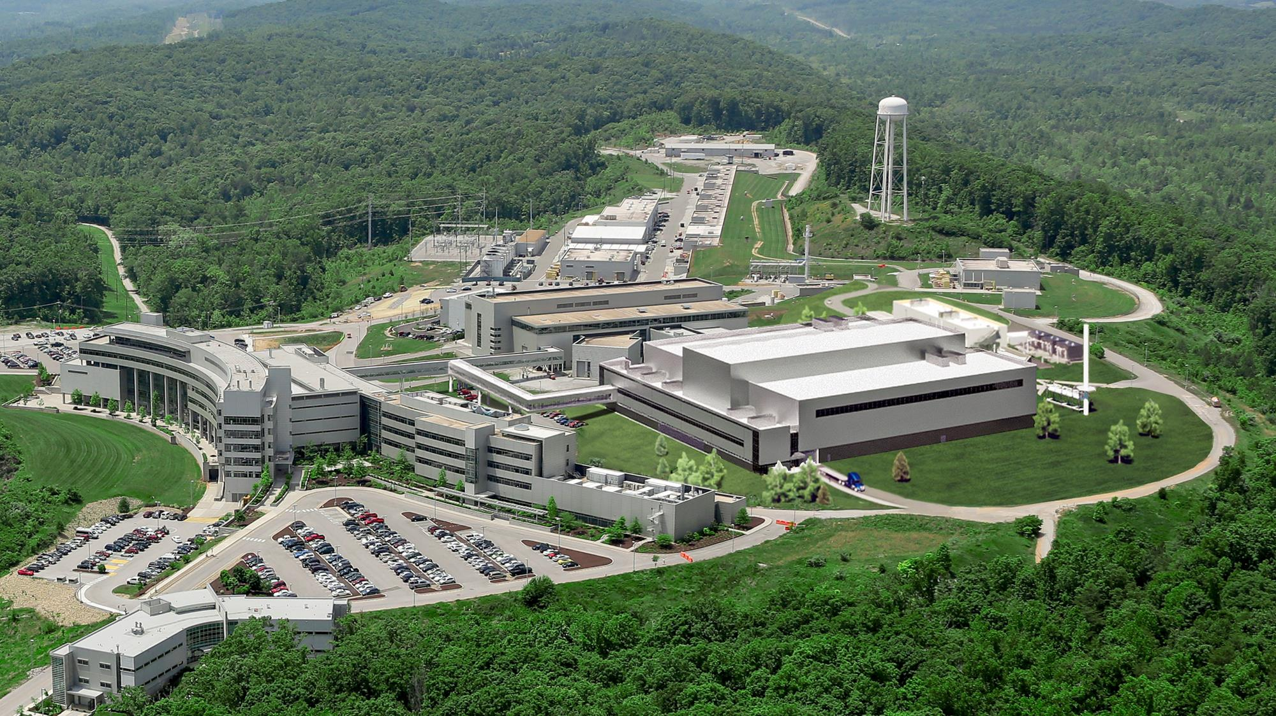
Any Questions?

Slide 20
Additional system information and VacTran model setup

Slide 21
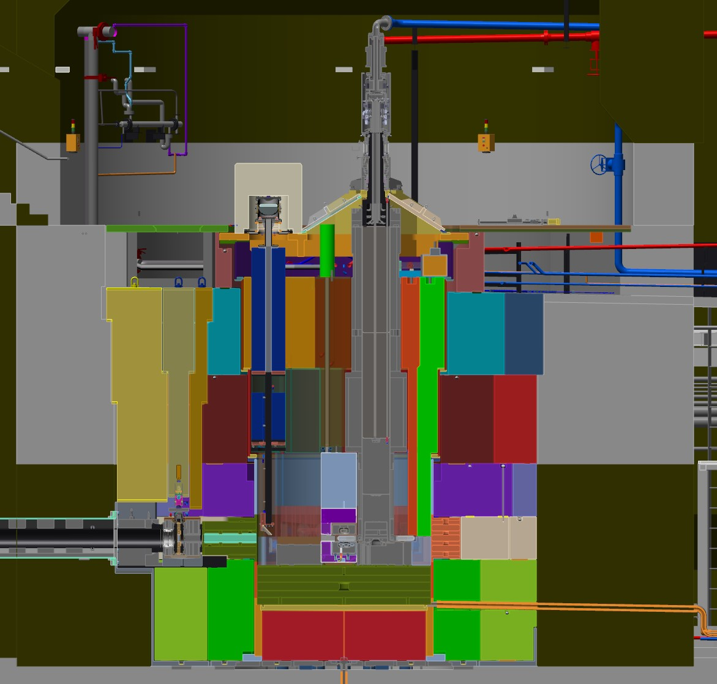
System as considered for VacTran model
For analysis work, the system was divided into three subsections:
Vacuum Tubing – Volume and conductance of the tubing, branches, and components starting at the pump inlet connection and ending at the CV.
Top of Core Vessel – Evacuated space of the vessel that contains components including the target, drive shaft seal, proton beam window and seal, target cooling connections, etc.
Bottom of Core Vessel – Interstitial space between Nozzle Extensions and Monolith Inserts, stacked shielding blocks, and blocks to vessel wall (including Instrument Systems Monolith Inserts) and is continuous with the top half evacuated space.
Top
Bottom
tubing Routing

Slide 22
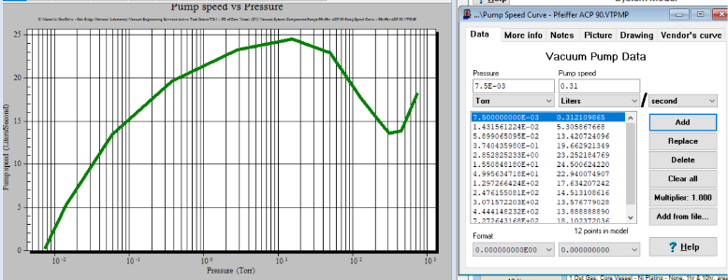
System VacTran Model & Pump Setup
Pump Options – The Busch Cobra DS/DL 500, 502 , a newer variant of this pump, and the Pfeiffer ACP 90 were analyzed, and both were determined to meet performance requirements. Analysis shown here is only for the ACP 90.
Digitalized Pumping Speed Curve – the empirical data from the vendor’s pumping speed curve (typically based on Nitrogen) is translated into a working graph and data set for VacTran to apply.
Pumping Curve for Pfeiffer ACP 90
Digitalized Pumping Curve for Pfeiffer ACP 90

Slide 23
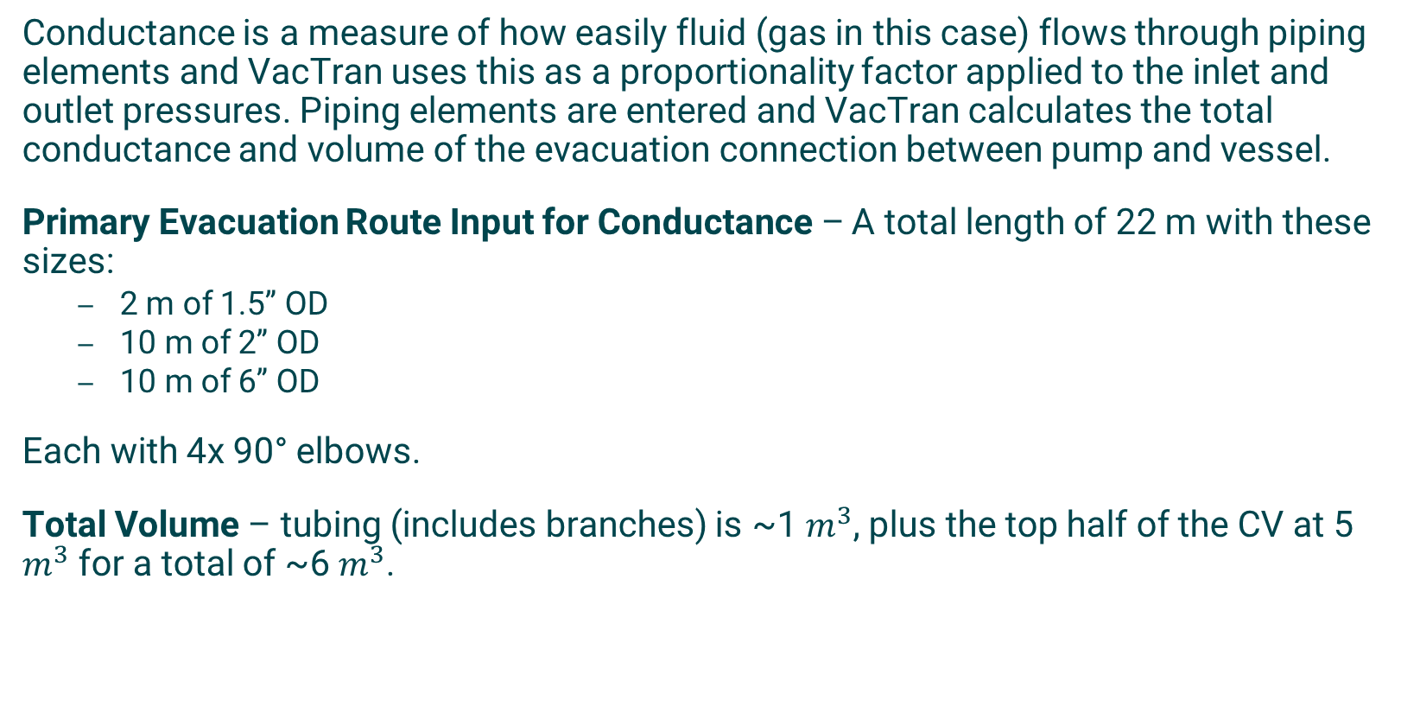
Conductance and Volumes used in VacTran model
Conductance is a measure of how easily fluid (gas in this case) flows through piping elements and VacTran uses this as a proportionality factor applied to the inlet and outlet pressures. Piping elements are entered and VacTran calculates the total conductance and volume of the evacuation connection between pump and vessel.
Primary Evacuation Route Input for Conductance – A total length of 22 m with these sizes:
  2 m of 1.5” OD
  10 m of 2” OD
  10 m of 6” OD
Each with 4x 90° elbows.
Total Volume – tubing (includes branches) is ~1 $m^{3}$, plus the top half of the CV at 5 $m^{3}$ for a total of ~6 $m^{3}$.

Slide 24
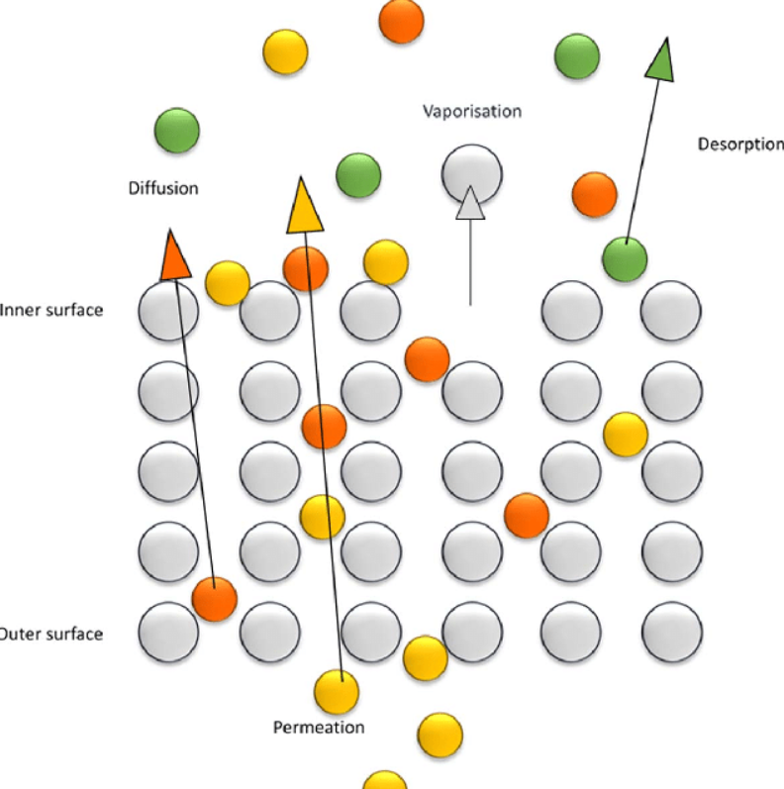
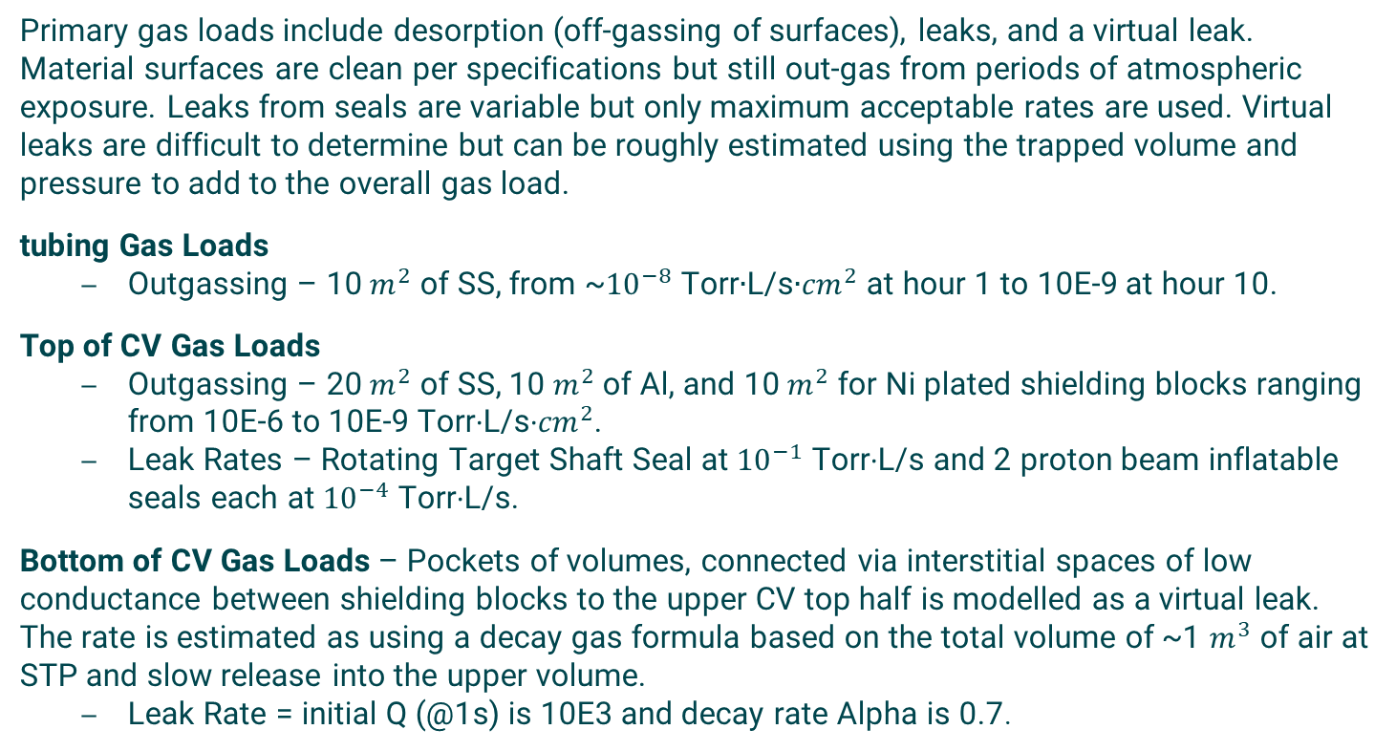
Gas Loads used in VacTran model
Primary gas loads include desorption (off-gassing of surfaces), leaks, and a virtual leak. Material surfaces are clean per specifications but still out-gas from periods of atmospheric exposure. Leaks from seals are variable but only maximum acceptable rates are used. Virtual leaks are difficult to determine but can be roughly estimated using the trapped volume and pressure to add to the overall gas load.
tubing Gas Loads
  Outgassing – 10 $m^{2}$ of SS, from ~${10}^{−8}$ Torr∙L/s∙${cm}^{2}$ at hour 1 to 10E-9 at hour 10.
Top of CV Gas Loads
  Outgassing – 20 $m^{2}$ of SS, 10 $m^{2}$ of Al, and 10 $m^{2}$ for Ni plated shielding blocks ranging from 10E-6 to 10E-9 Torr∙L/s∙${cm}^{2}$.
  Leak Rates – Rotating Target Shaft Seal at ${10}^{−1}$ Torr∙L/s and 2 proton beam inflatable seals each at ${10}^{−4}$ Torr∙L/s.
Bottom of CV Gas Loads – Pockets of volumes, connected via interstitial spaces of low conductance between shielding blocks to the upper CV top half is modelled as a virtual leak. The rate is estimated as using a decay gas formula based on the total volume of ~1 $m^{3}$ of air at STP and slow release into the upper volume.
  Leak Rate = initial Q (@1s) is 10E3 and decay rate Alpha is 0.7.

Slide 25
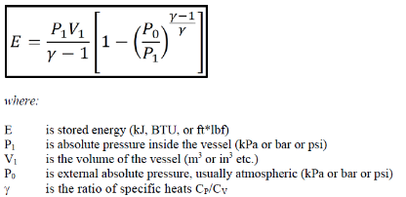
Pressure system safety classification and relief device design discussions are ongoing
Per ORNL SBMS, vacuum systems are considered pressure systems and categorized by the Stored Energy formula with certain exceptions. Most systems are backfilled from a supply of gas, and vacuum systems with <15psig backfill are by SBMS definition Moderate Energy. STS Pressure and Vacuum Systems S01020000-PC0007 requirements instead determine classification based on Stored Energy alone.
Based on the total volume (CV+vacuum tubing), the moderate to high energy transition pressure of ~0.4psig has been calculated, which is not a practical pressure relief.
Depending on the whether the system is determined to be moderate or high, a determine pressure relief mitigation must be determined.
Design options currently being explored:
Safety exemption to allow SMBS moderate energy requirements.
Rupture disc for Hydrogen release event (<7.35psi).
Custom vacuum PRD + Glovebox + Routing to Hot Offgas.
Stored Energy Formula from S01020000-PC0007

Slide 26
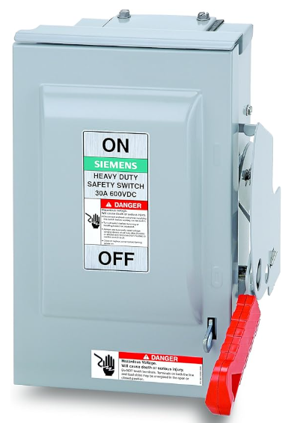
Compressed Air & Electrical Utility Interfaces
Pump Electrical – 3Φ, 200-240 V, routed to dedicated 208V to fused disconnect and signal connections to PLC.
Actuated Solenoid VAT Series 24.5 Inline Valves – 24 V, supplied through PLC and compressed air ranging from 58 to 116 psi.
Residual Gas Analyzer – All power and communication routed to PLC.

Slide 27
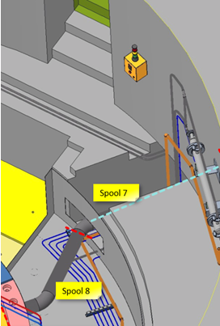
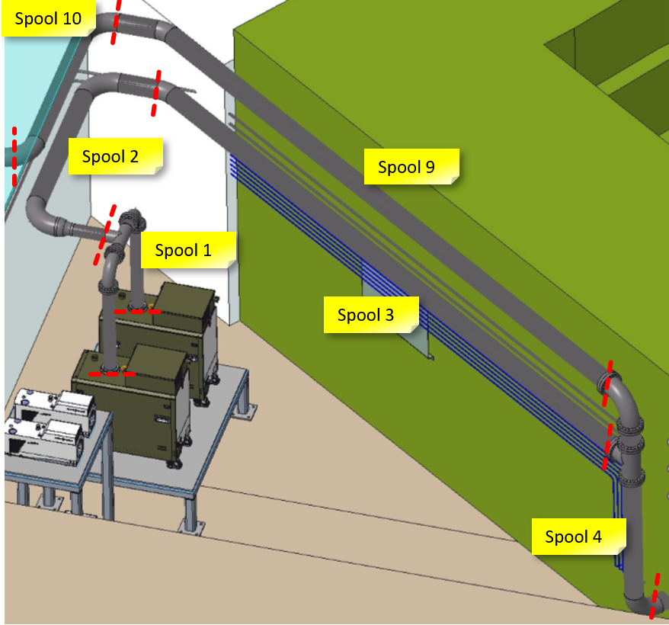
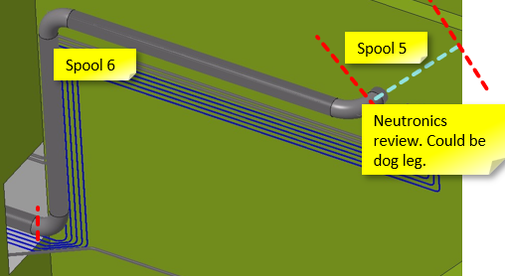
Tubing design used for VacTran model, fabrication estimating and installation planning
Tubing Spools – In considering procurement and installation plans, the tubing is broken into spools. This has the added benefit of ensuring vacuum cleaning processes are performed and can be maintained.

Slide 28
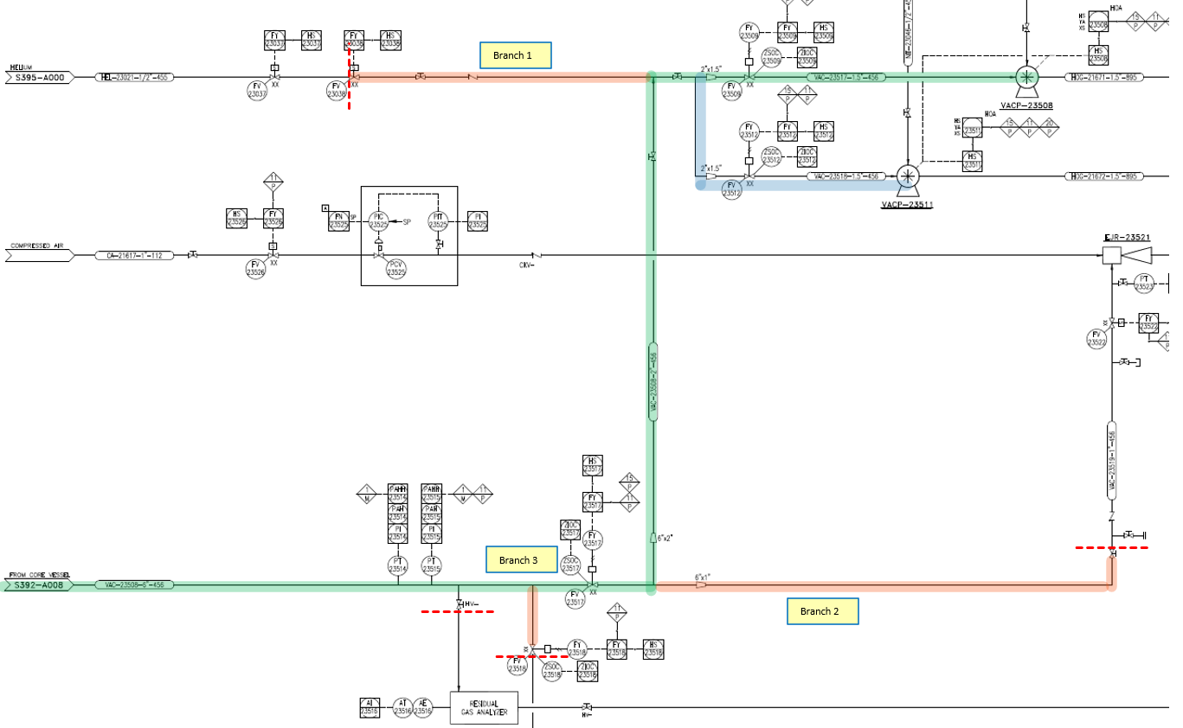
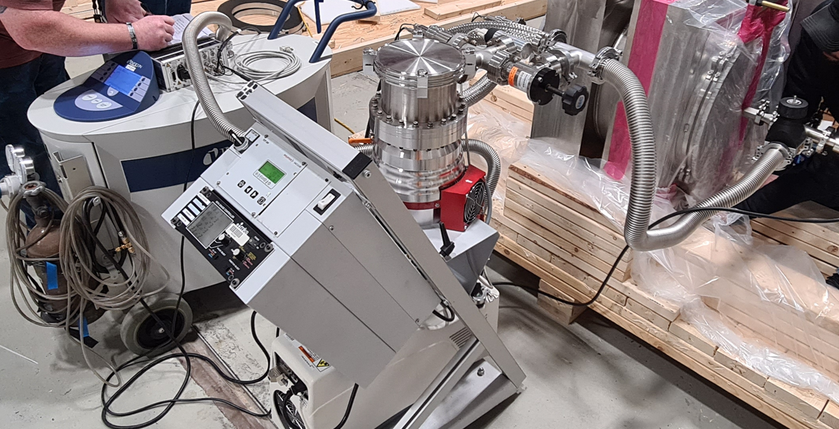
Testing & Inspection
Completed tubing – Spools ends are blanked, valves closed, and the system is evacuated using a pump cart and helium leak checker.
Isolated Vacuum System Test – Pumps, valves, and gauges are connected to utilities and PLC connections. System is then isolated and evacuated via PLC and leaked checked.
Primary Evacuation Route (Green)
Branches & Isolation Valves (Orange)
Evacuation with Pump Cart and Helium Leak Check

Slide 29
Testing & Inspection
Welded Connections – Between spool ends, tube to tube, are vacuum tight (full penetration) butt welds. Orbital or manual GTAW is acceptable and weld prep per section U328.4.2 End Preparations per ASME B31.3.
Possible application of QG-106, organizational responsibility and QW-191, Volumetric NDE sections of ASME BPVC Sec 9 – qualified welders and radiography testing success/failure criteria. Quality assurance:
  100% visual inspection
  5% radiography testing (RT)
  Welder signature each weld
  Helium leak testing shall show a total leak rate less than 1.0E-7 Torr-L/second using a mass spectrometer leak detector (MSLD).

