Slide 1
Vessel Systems/Target Station Shielding PDR - Remote Handling Overview
S03100000-TDO10000 R00
Steve Schrick
4/21/2025

Slide 2
Objective – Show RH features to meet VSS/TSS requirements
VS-Remote Handling Interface - PASS
Vessel Systems shall provide lifting interfaces for all removable Vessel Systems components per Interface Sheet S03000000-IST10006.
Vessel Systems shall provide power and control requirements for the gamma gate linear actuator to Remote Handling per Interface Sheet S03000000-IST10006.
TSS-Remote Handling Interface - PASS
Target Station Shielding shall provide lifting interfaces for all removable Target Station Shielding components per Interface Sheet S03000000-IST10007.

Slide 3
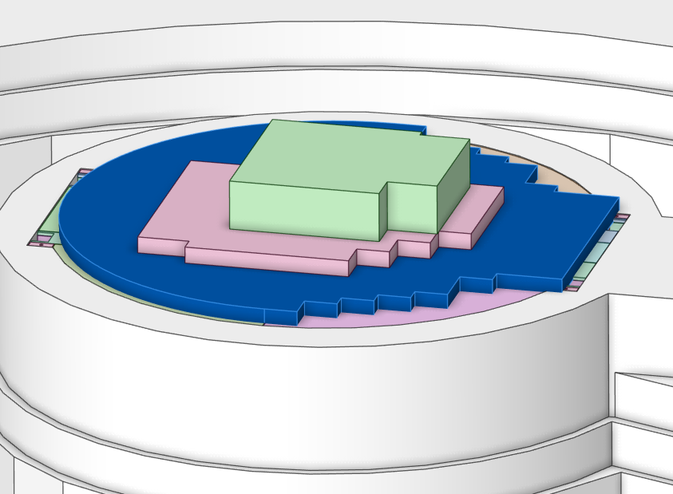
Preliminary RH Procedure
*Assumes beam-off conditions established. Entry into TDR after 8 hours of decay time.
Access into TDR from high bay during maintenance event
High bay crane removes TDR supplemental shielding

Slide 4
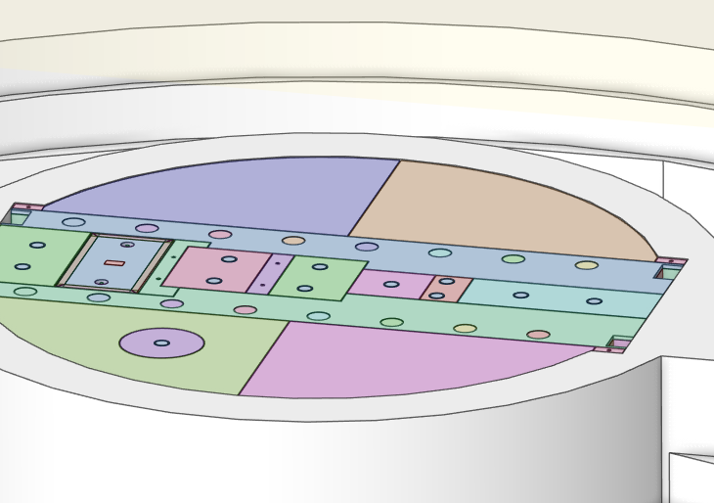
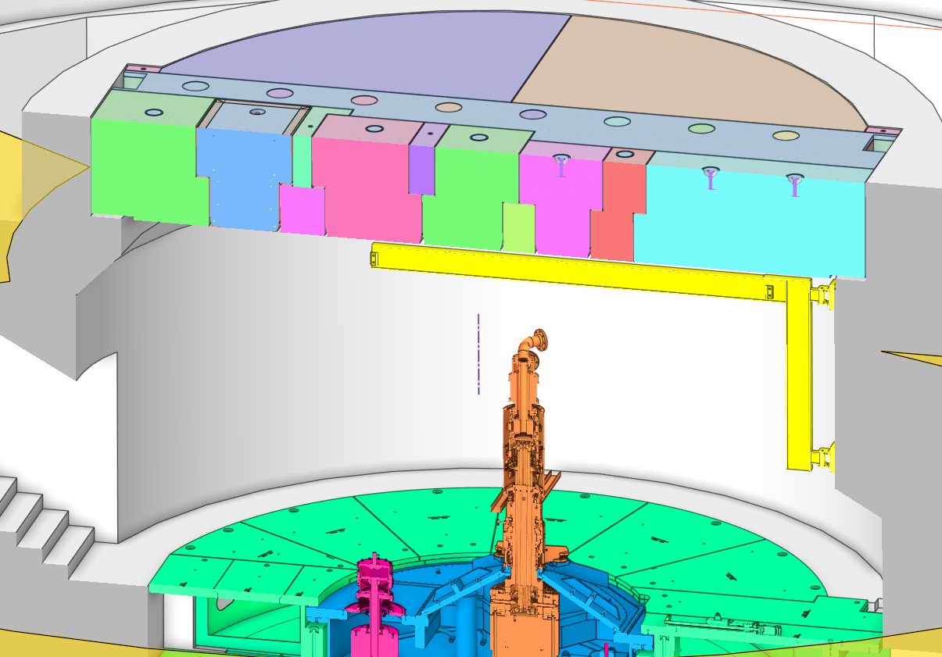
Preliminary RH Procedure
Remove specific TDR roof hatch plug based on maintenance activity to be performed.
For removal/replacement of a core vessel component, only one TDR plug will be removed during that operation.
Target
Segment
PBW
TVP
MRA

Slide 5
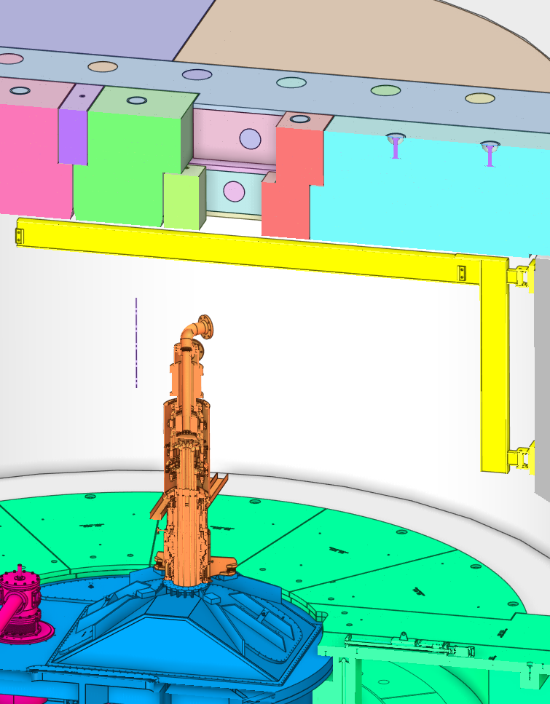
Preliminary RH Procedure
Remove specific core vessel tent hatch cover (MRA or target segment) based on maintenance activity to be performed.
Use internal jib crane and chain hoist (not shown) to rig to hatch cover and lift off.
Transfer within TDR and place on floor.
Personnel accessible

Slide 6
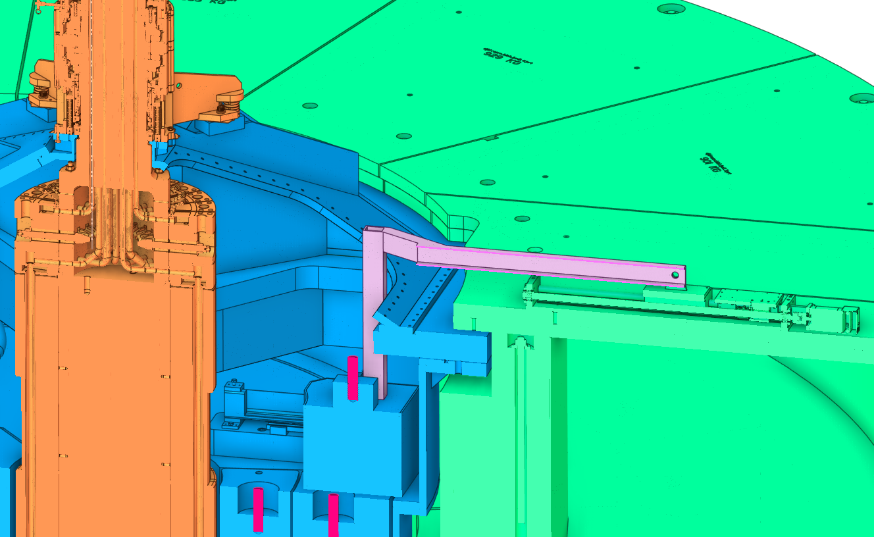
Preliminary RH Procedure
Connect CV gamma door linkage to drive system
Personnel accessible

Slide 7
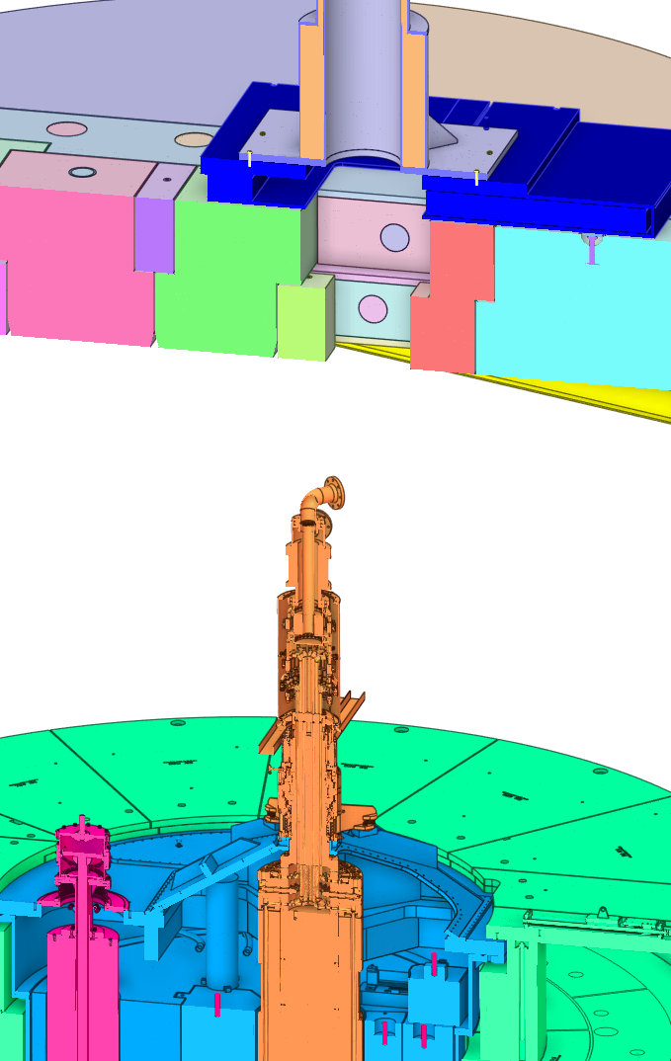
Preliminary RH Procedure
Transfer and install gamma door onto TDR roof
Transfer and install shield block cask onto gamma door
Install portable hoist on top of cask

Slide 8
Preliminary RH Procedure
Retract shield block up into cask using portable hoist.
Remote viewable (rad tolerant) cameras will be positioned within TDR to provide visual observation of lifting process.
Standard interface with core vessel removable shield blocks is the Ziplift grapple – 1.5” threaded stud
No personnel in TDR during lifting operations

Slide 9
Preliminary RH Procedure
Close CV gamma door
Close TDR gamma door
Pin shield block to cask
Secure bottom closure on shield block cask
Remove portable hoist
Transfer cask + shield block to high bay temporary storage area.

Slide 10
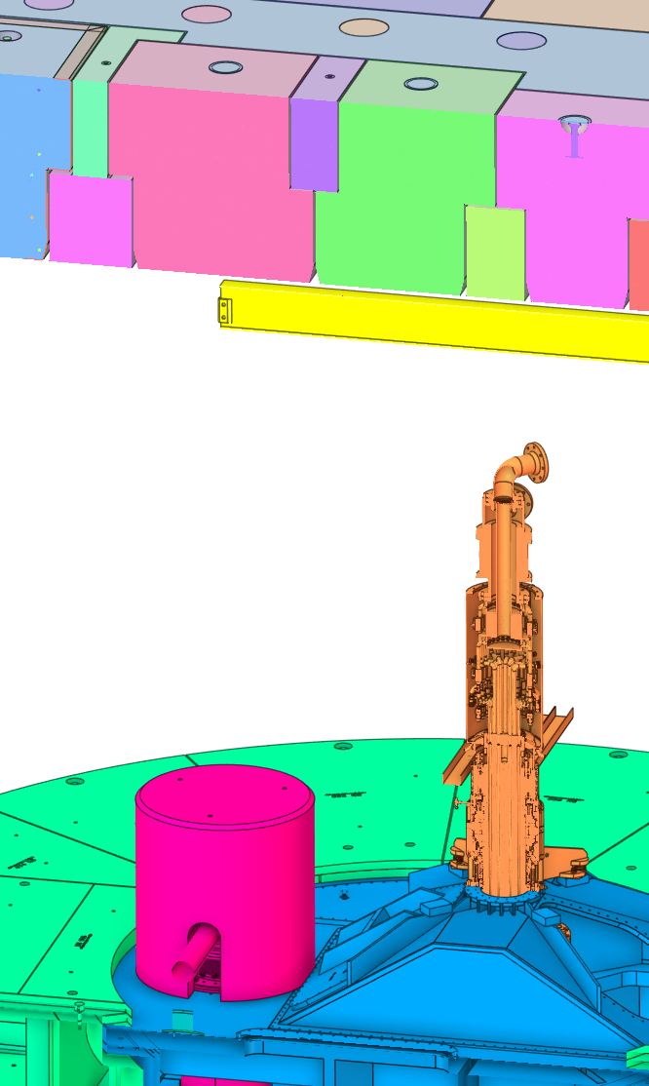
Preliminary RH Procedure
MRA hatch access via jib crane. General removal operations similar process as for target segment
TVP (doghouse) shielding removed thru TDR roof hatch via highbay crane

Slide 11
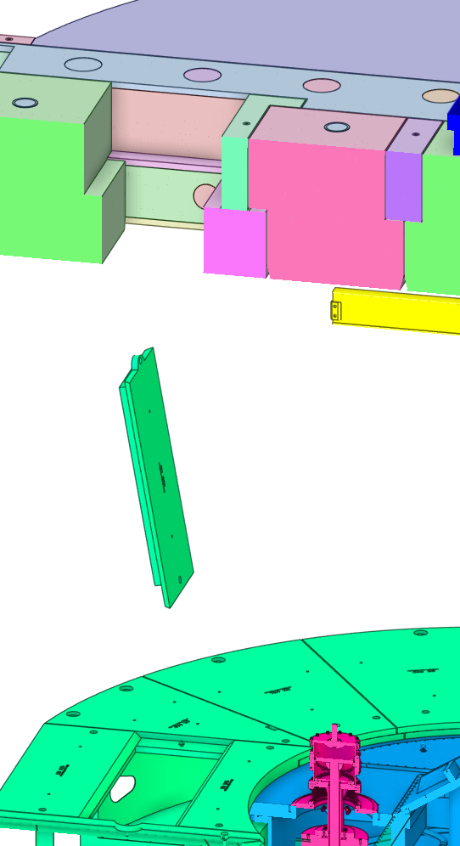
Preliminary RH Procedure
PBW access requires multiple manipulations of pipe pan cover plate to extract from TDR using high bay crane.
TDR jib crane cannot reach.
Alternate portable lifting solutions within the TDR might be viable.

Slide 12
Conclusion
Overall development of remote handling tooling and processes seems appropriate to support vessel systems and target station shielding preliminary design.
All RH requirements are satisfied
Additional planning, development, and testing will occur to support RH operations

