Slide 1
Vessel Systems and Target Station Shielding Installation Plan
Chris Anton
Darren Dugan
Cam Eiland
Hogan Knott
Mike Strong
April 22, 2025

Slide 2
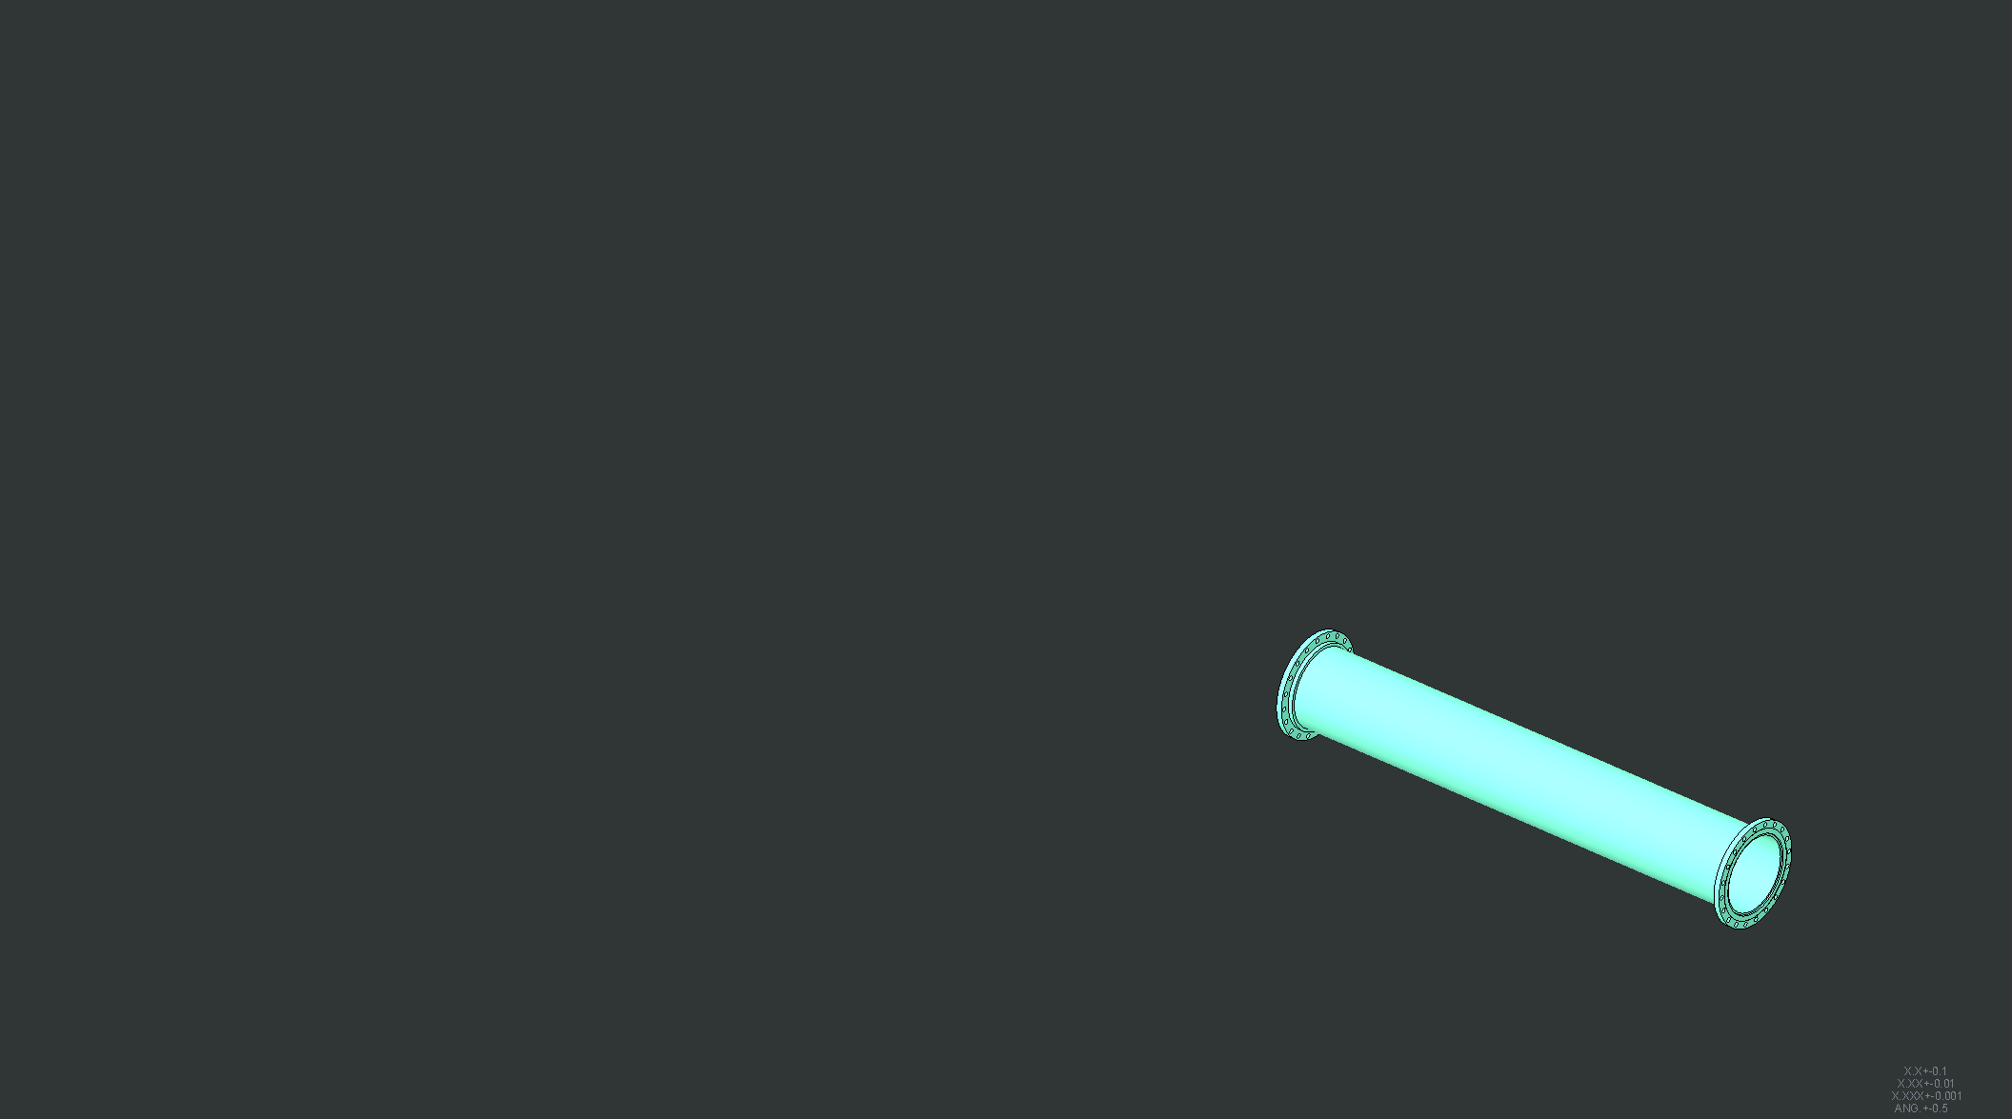
Proton Beam Tube pipe imbedded in concrete (not shown)

Slide 3
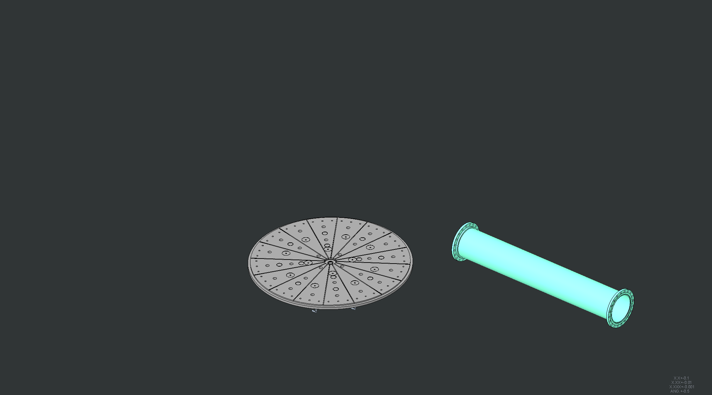
Core Vessel Baseplate Installed

Slide 4
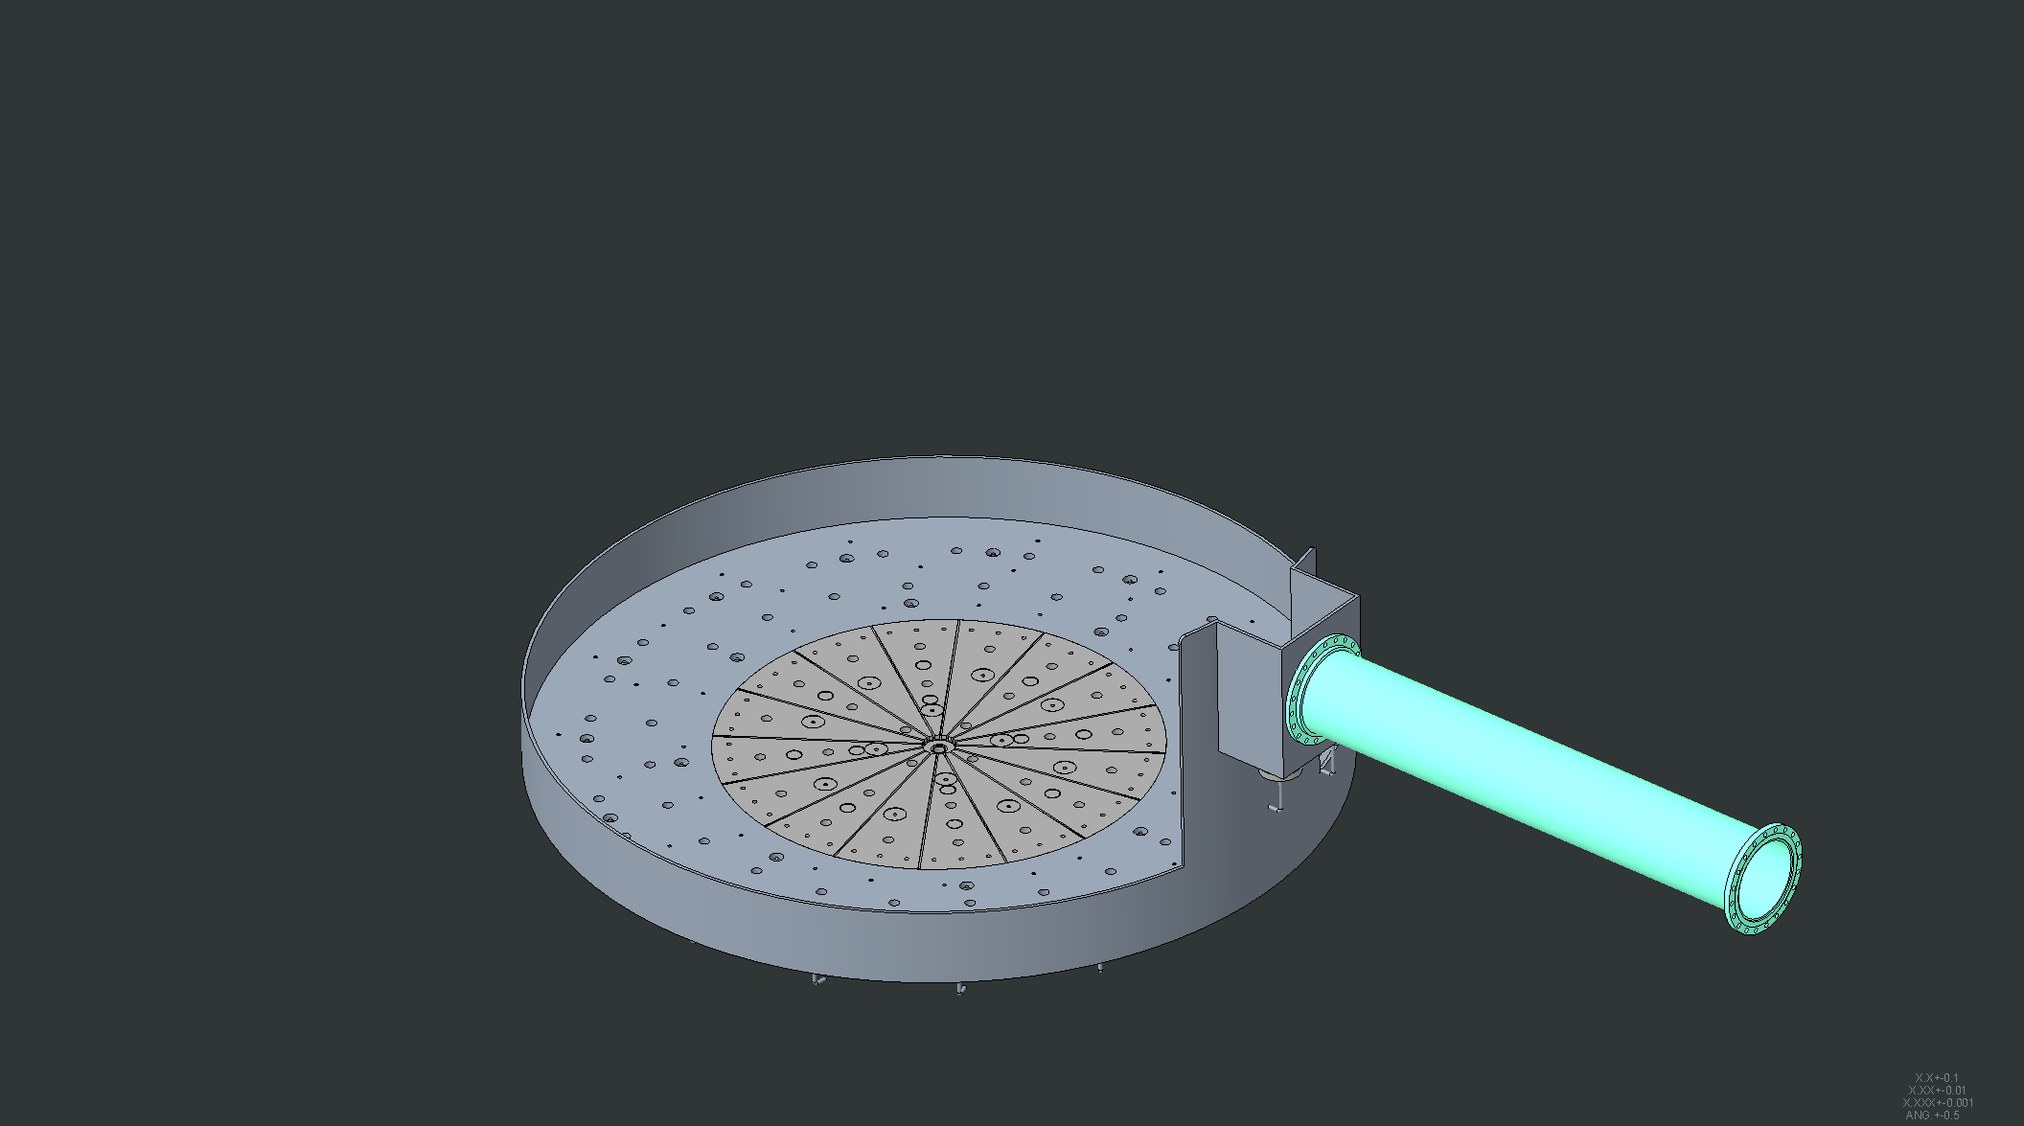
Bulk Shielding Liner Installed

Slide 5
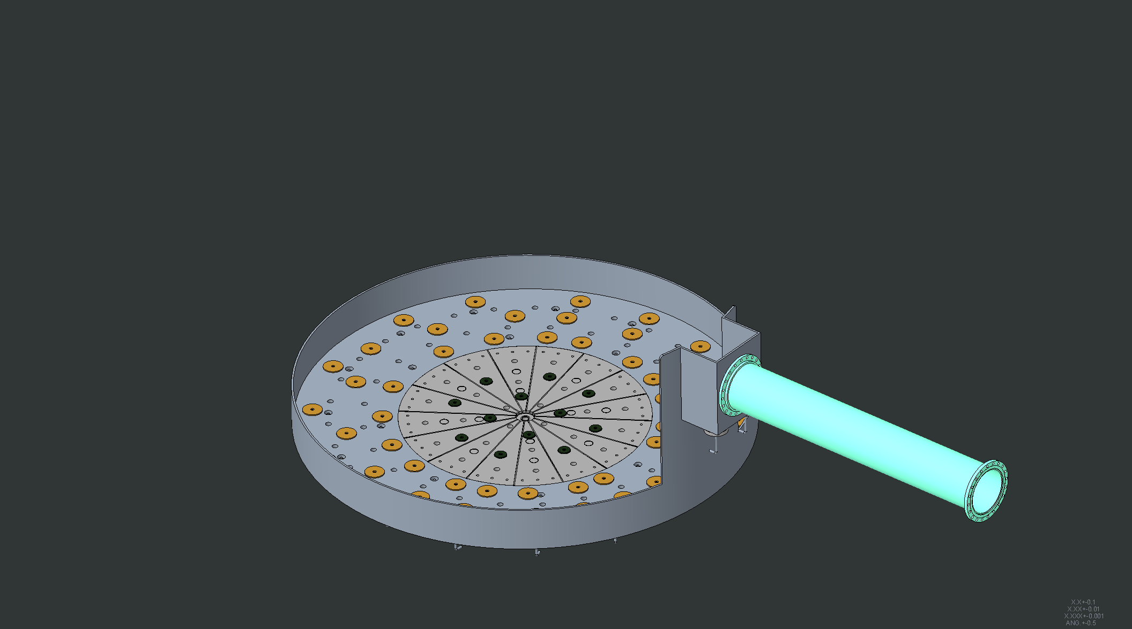
Bulk shielding layer 1 bottom shims installed

Slide 6
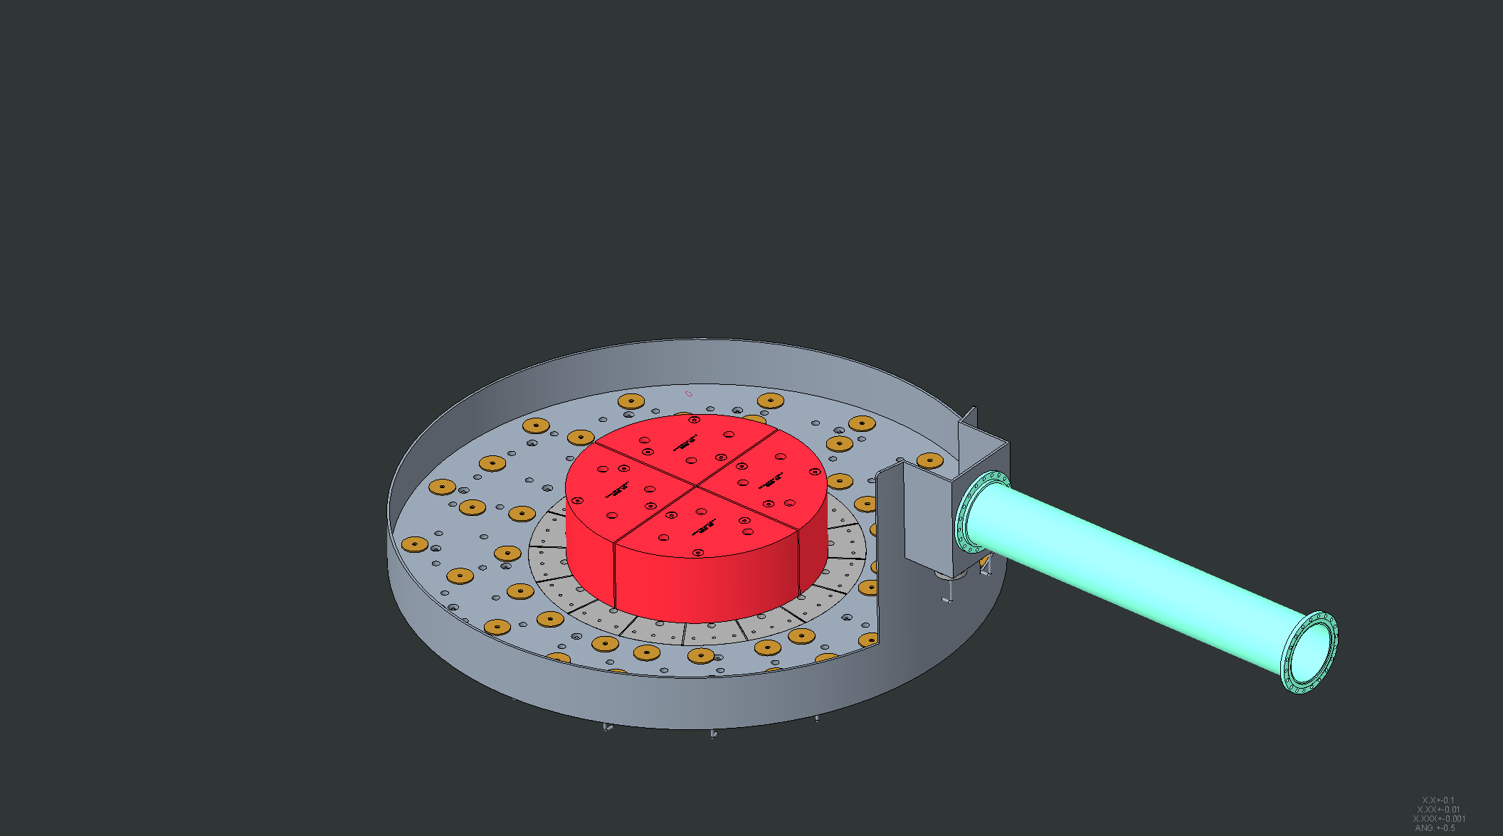
Layer 1 shield blocks under Core Vessel installed

Slide 7
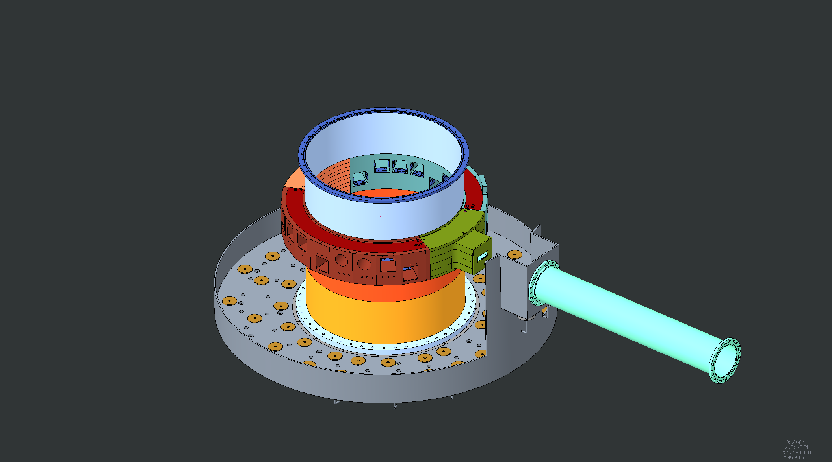
Lower Core Vessel weldment installed

Slide 8
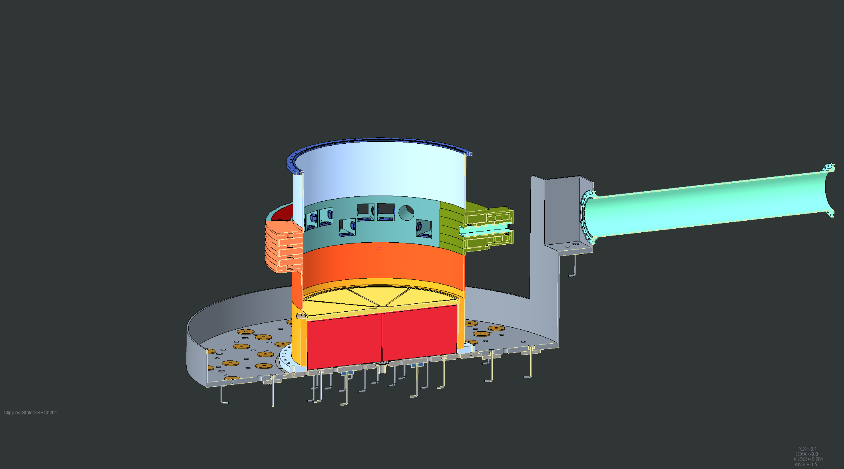
Cross Section view of lower Core Vessel installation

Slide 9
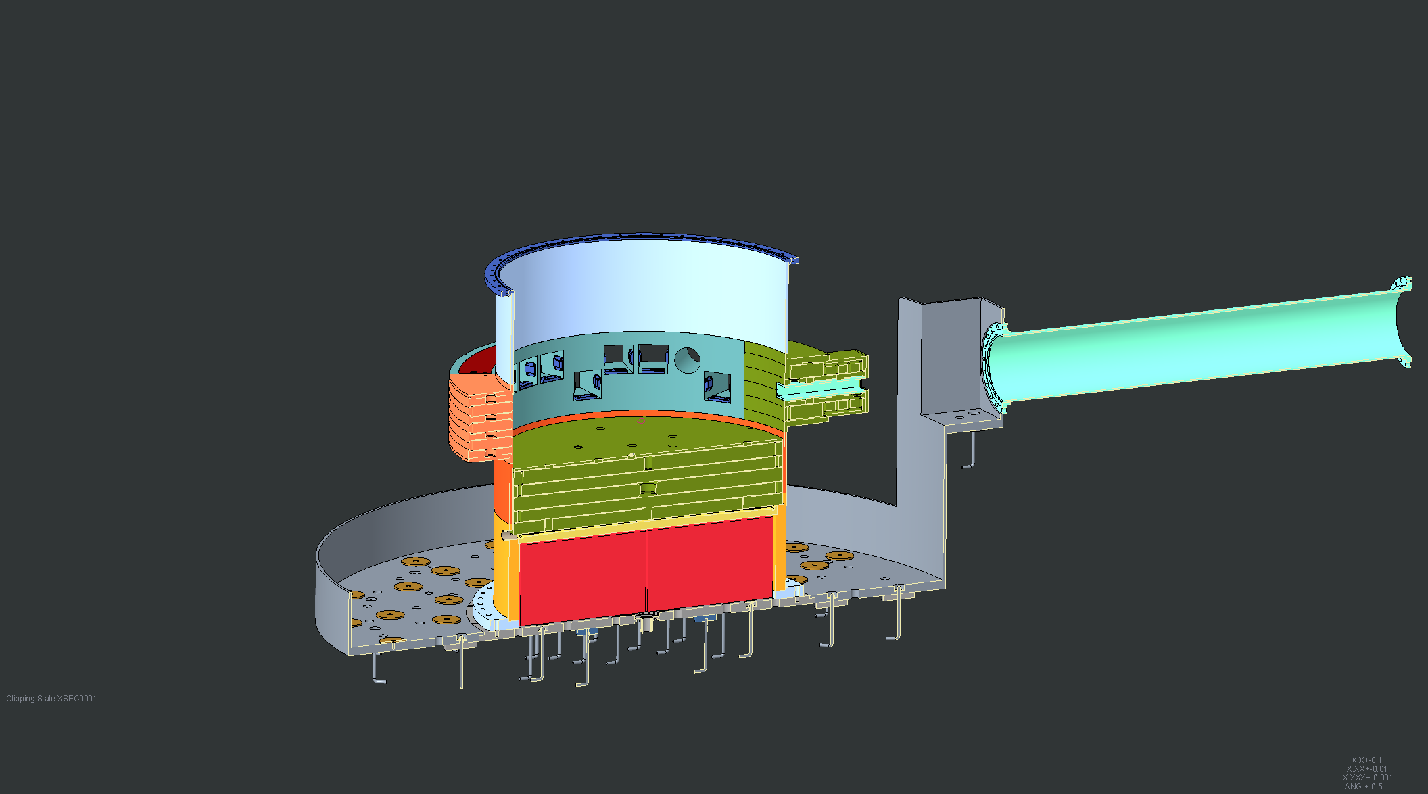
Core Vessel internal shield block #1 installed

Slide 10
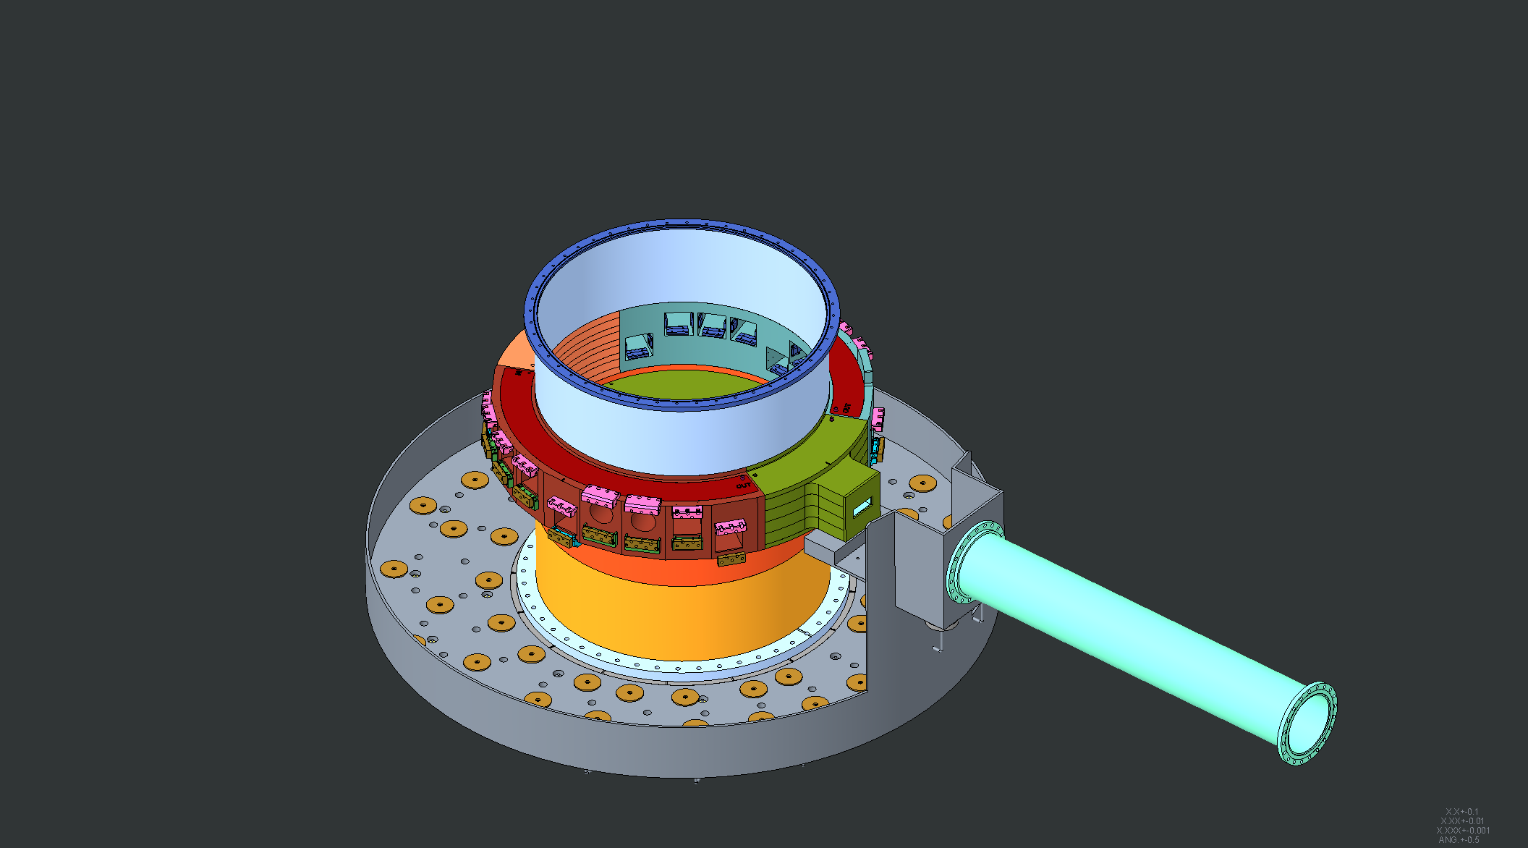
Nozzle extension mounting hardware shown out of sequence

Slide 11
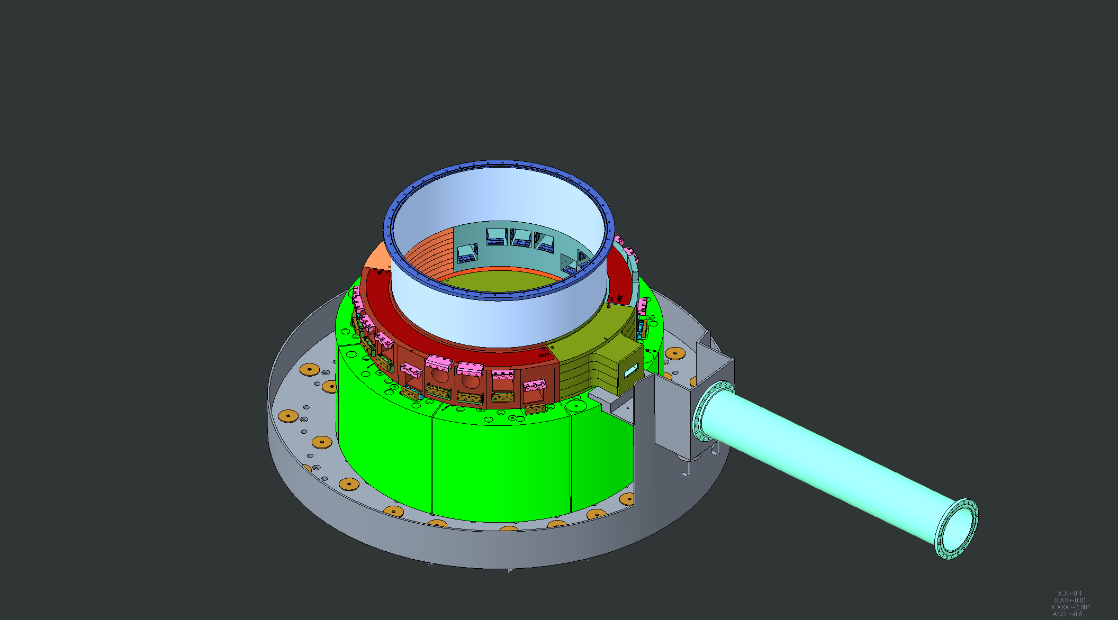
Inside course of Bulk Shielding Layer #1 installed

Slide 12
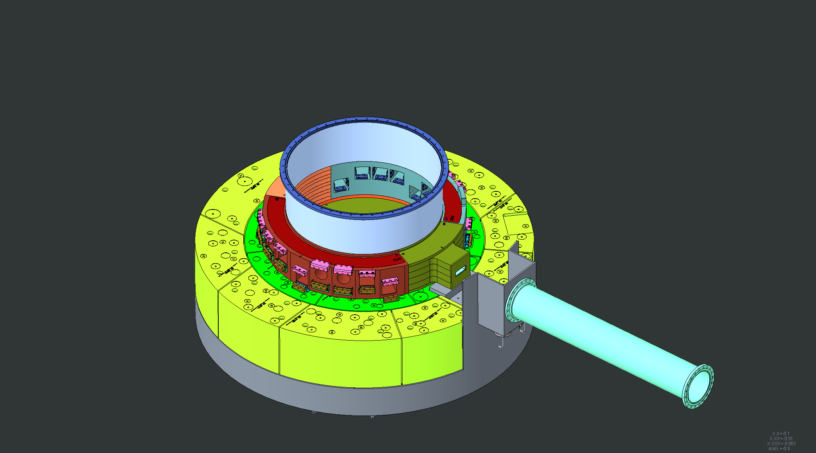
Outer course of Bulk Shielding layer #1 installed

Slide 13
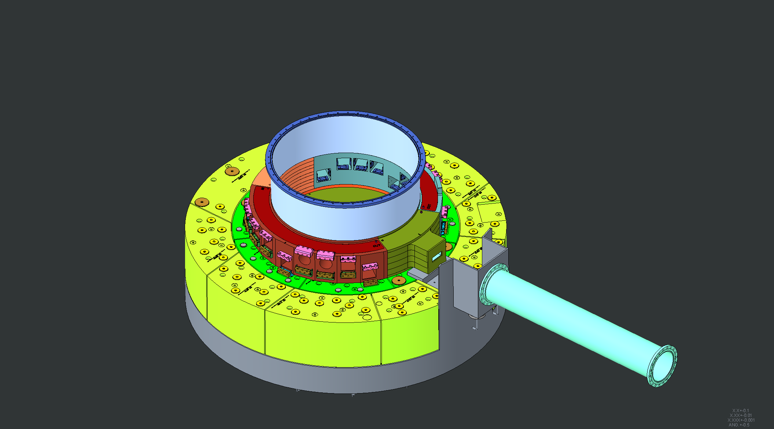
Layer 2 shim pucks installed

Slide 14
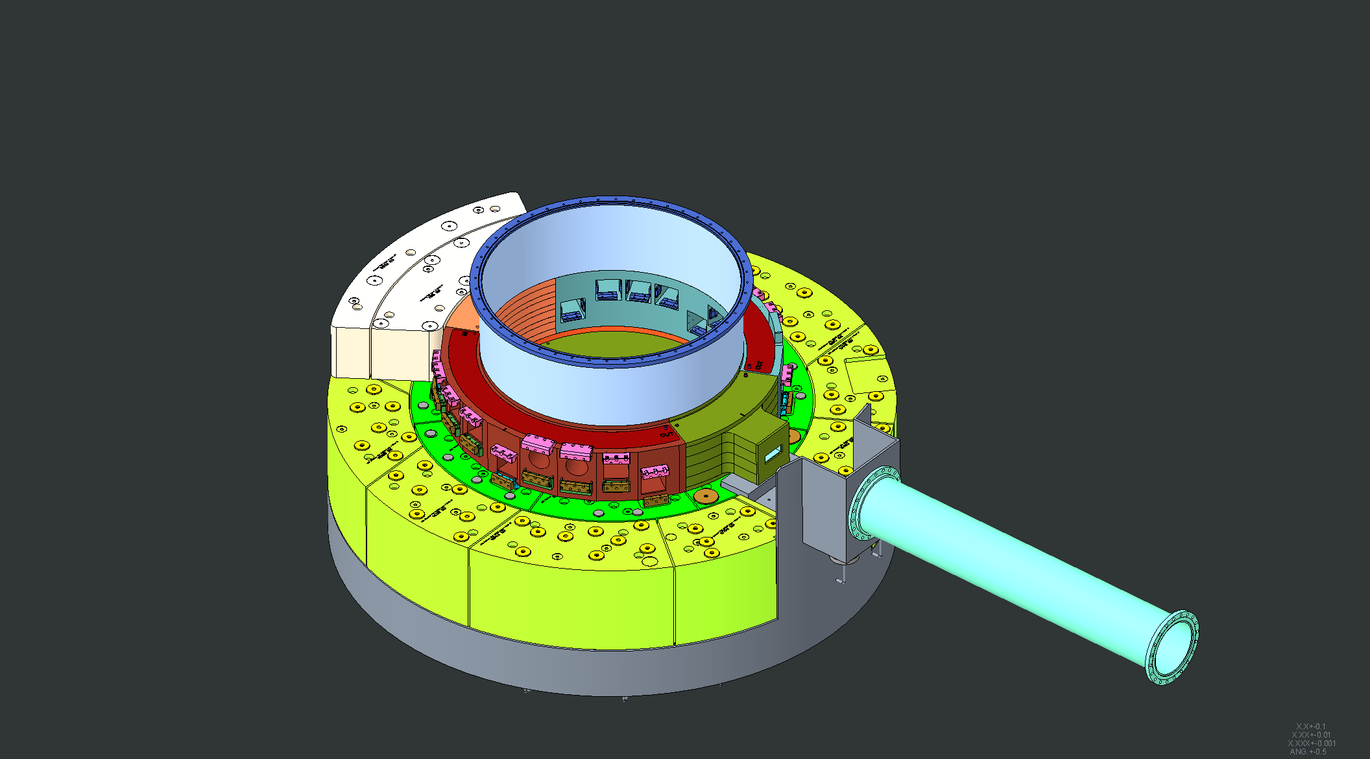
Bulk Shielding layer #2 downstream blocks installed

Slide 15
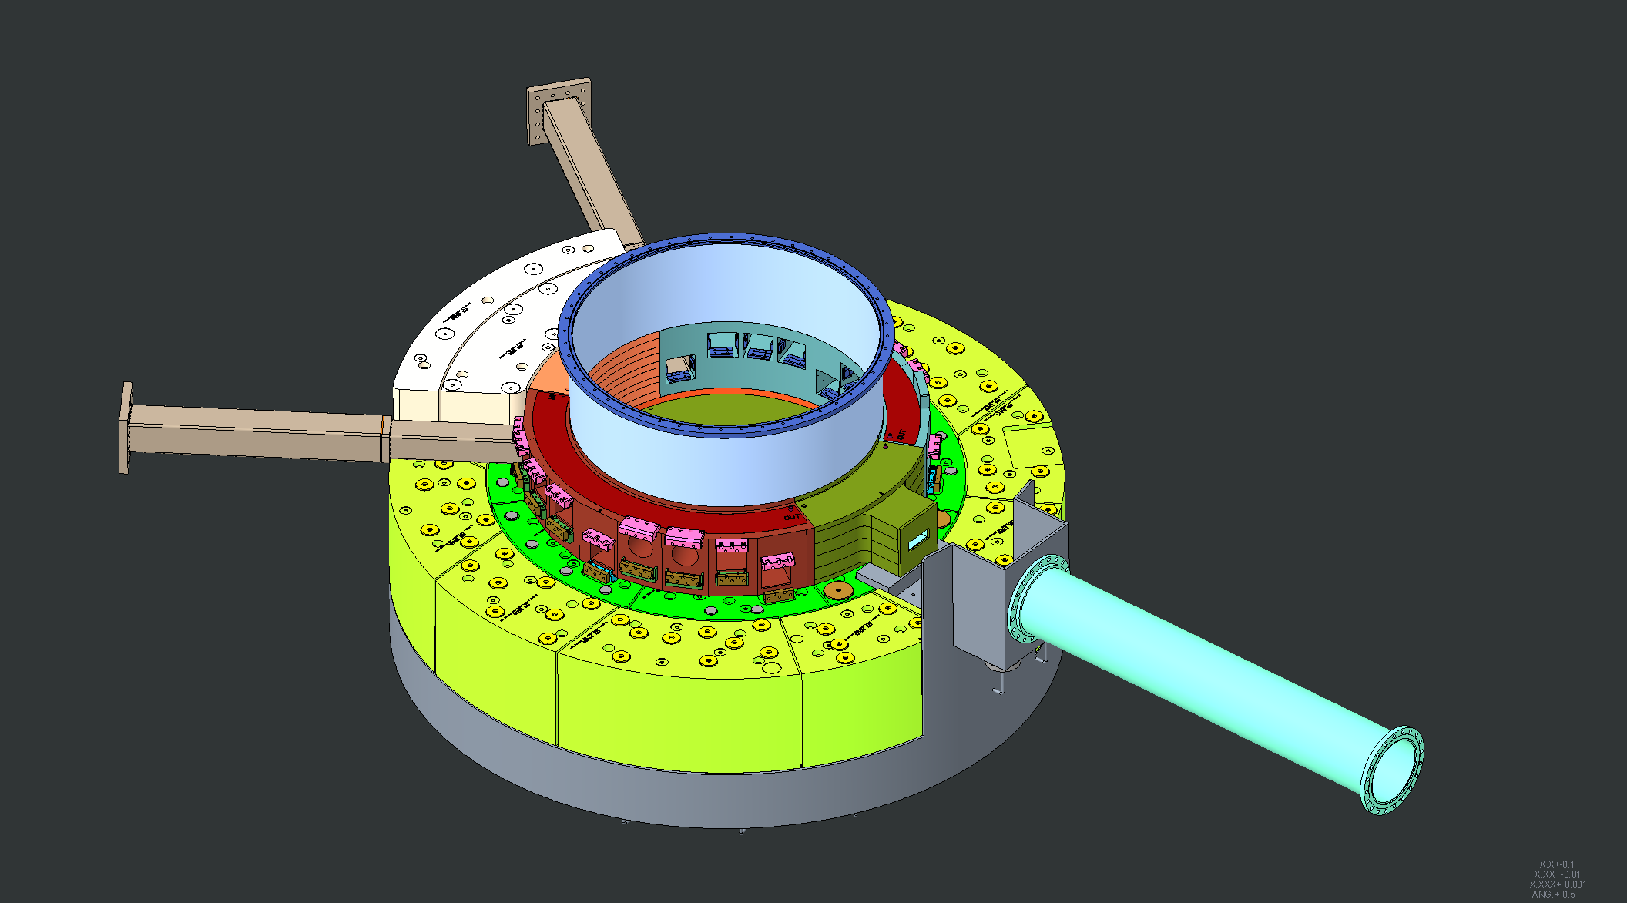
Nozzle Extensions #9 and #10 installed

Slide 16
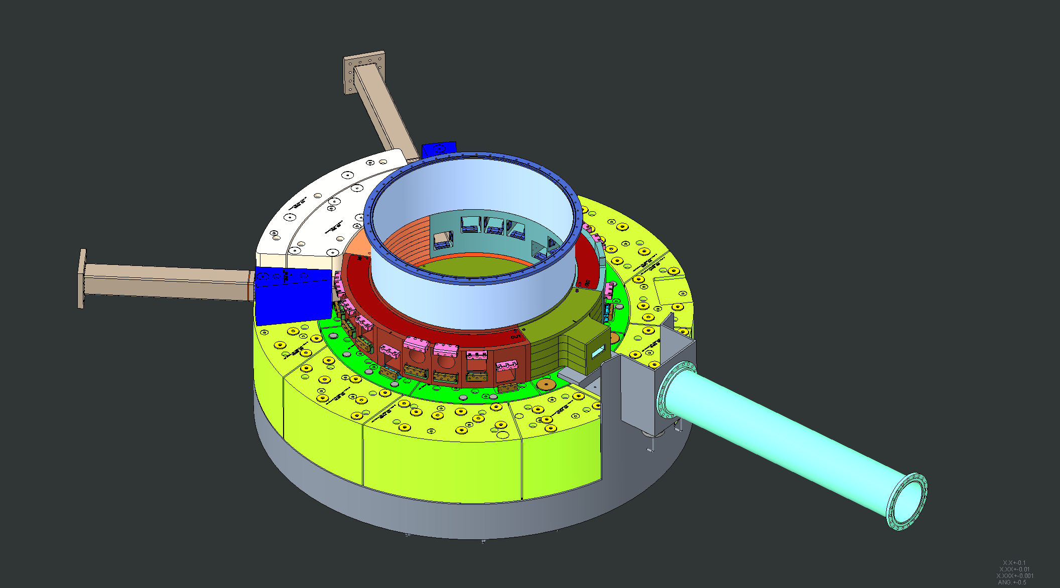
Shielding around Nozzle Extensions #9 and #10 installed

Slide 17
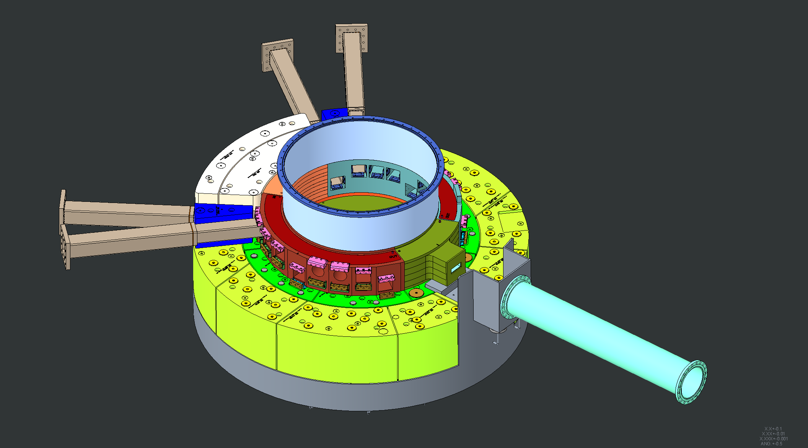
Nozzle Extensions #8 and #11 installed

Slide 18
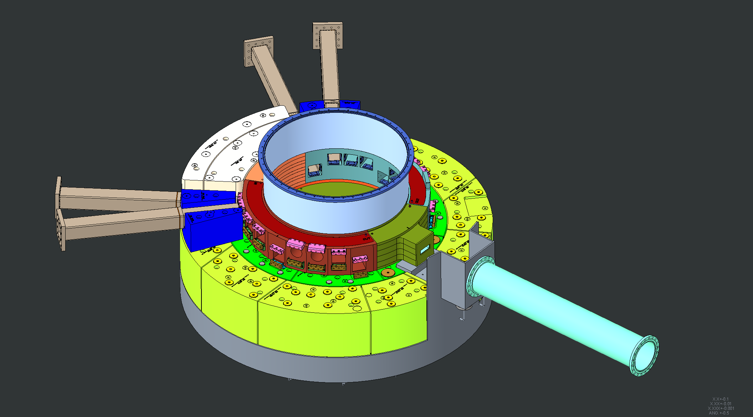
Shielding around Nozzle Extensions #8 and #11 installed

Slide 19
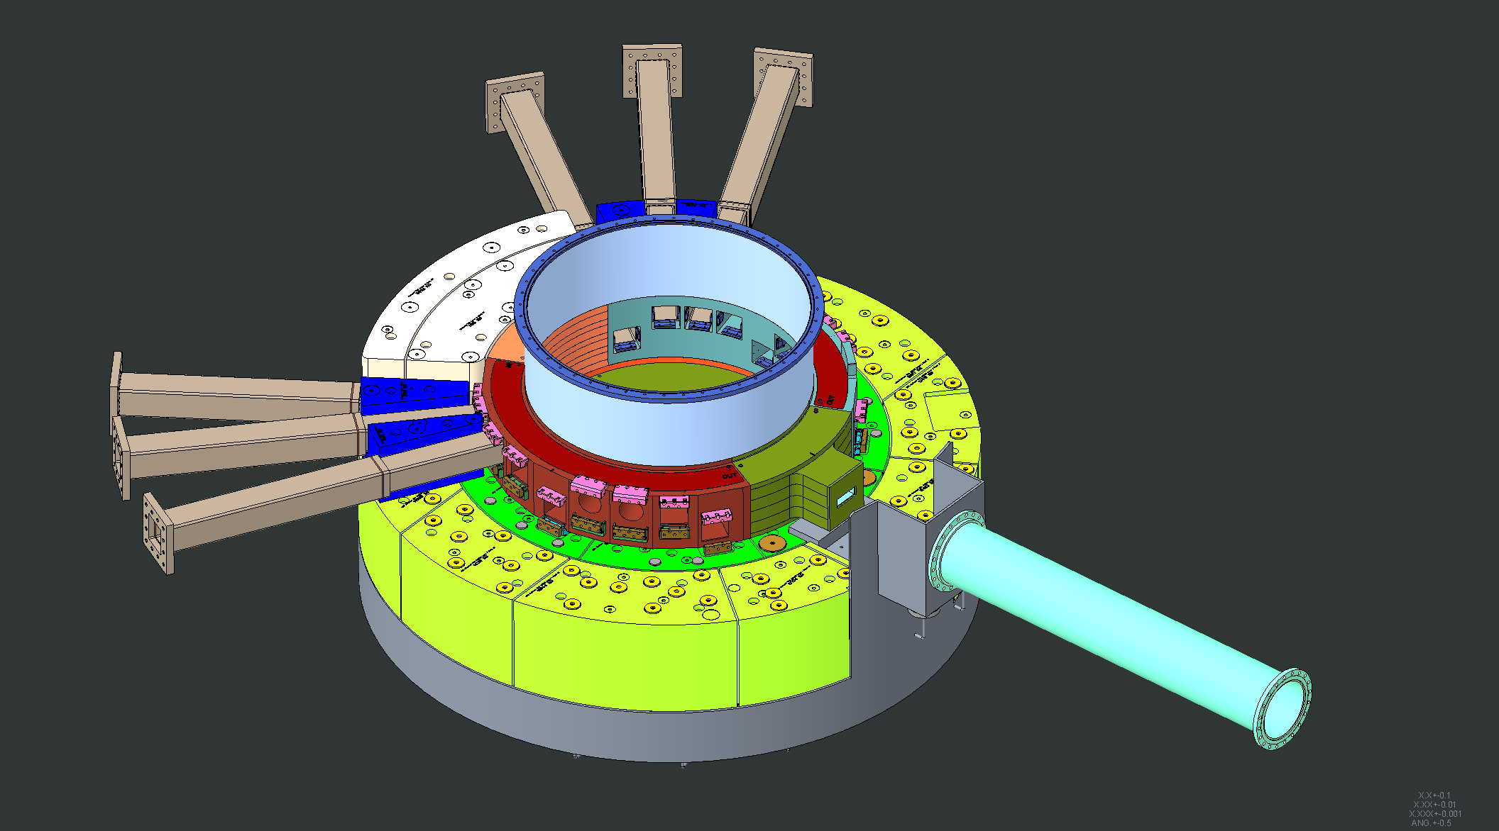
Nozzle Extensions #7 and #12 installed

Slide 20
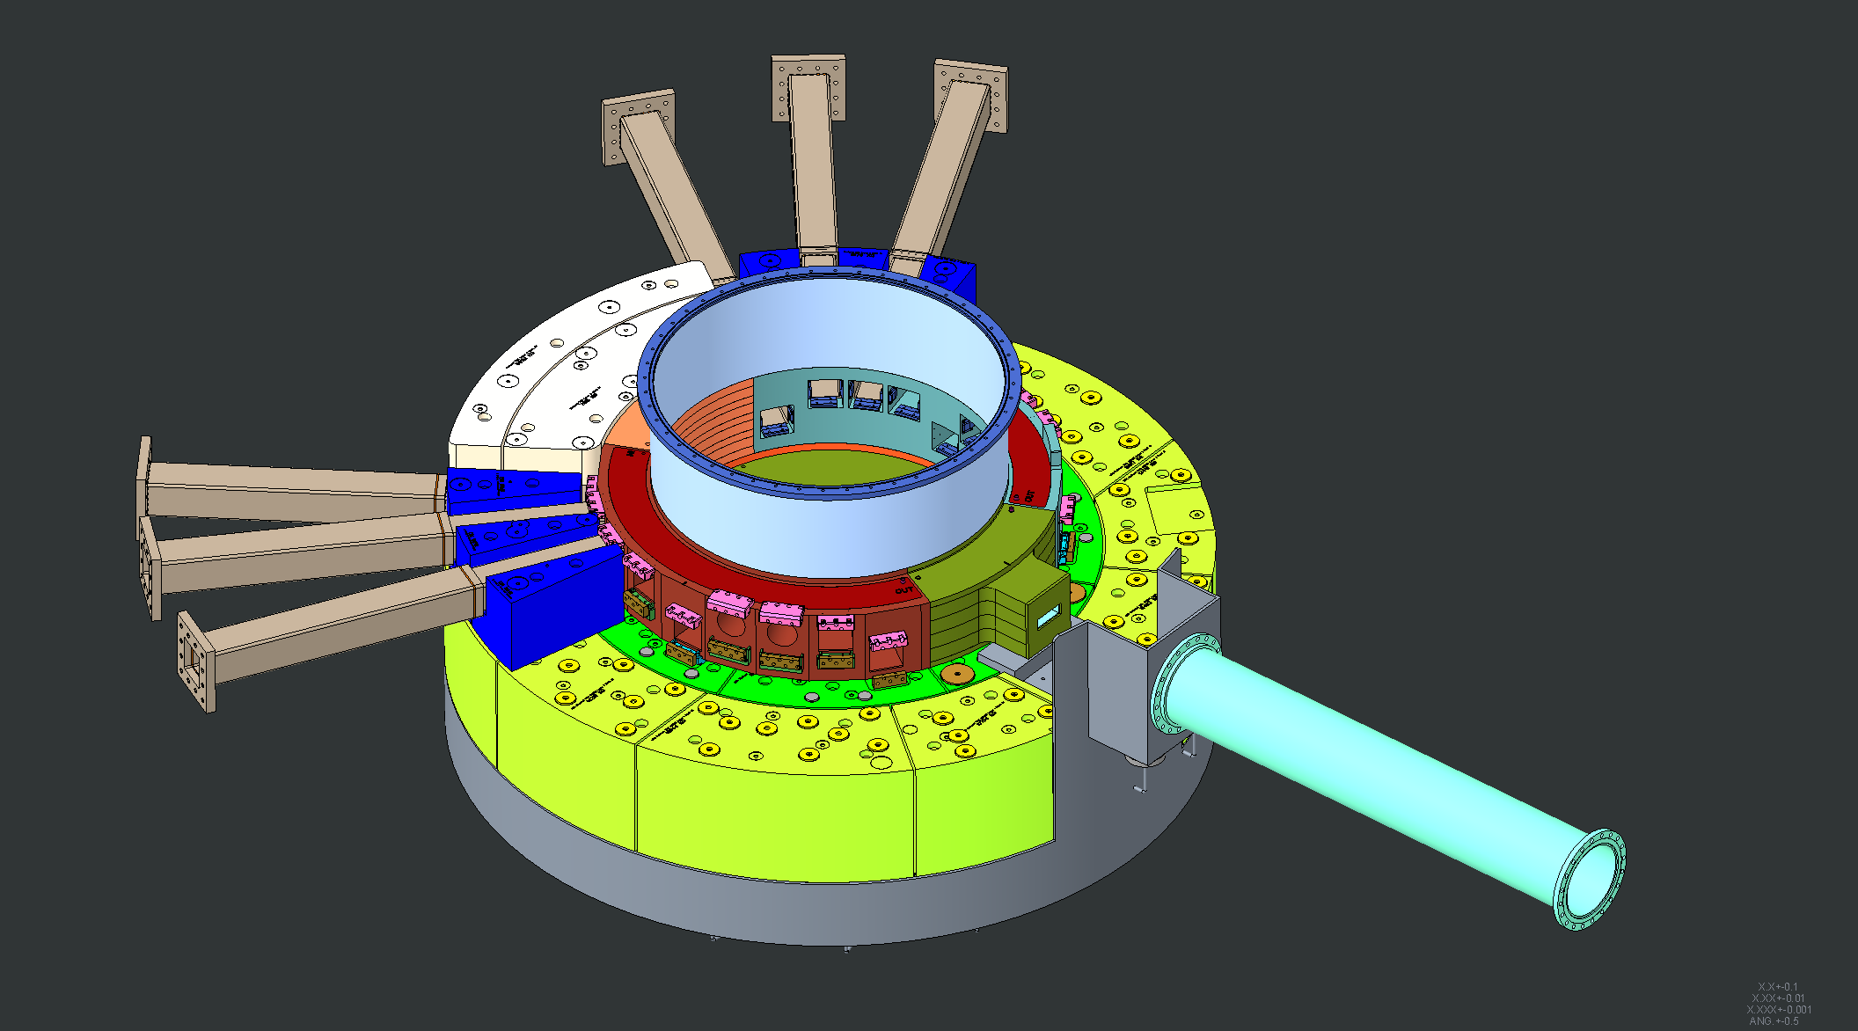
Shielding around Nozzle Extensions #7 and #12 installed

Slide 21
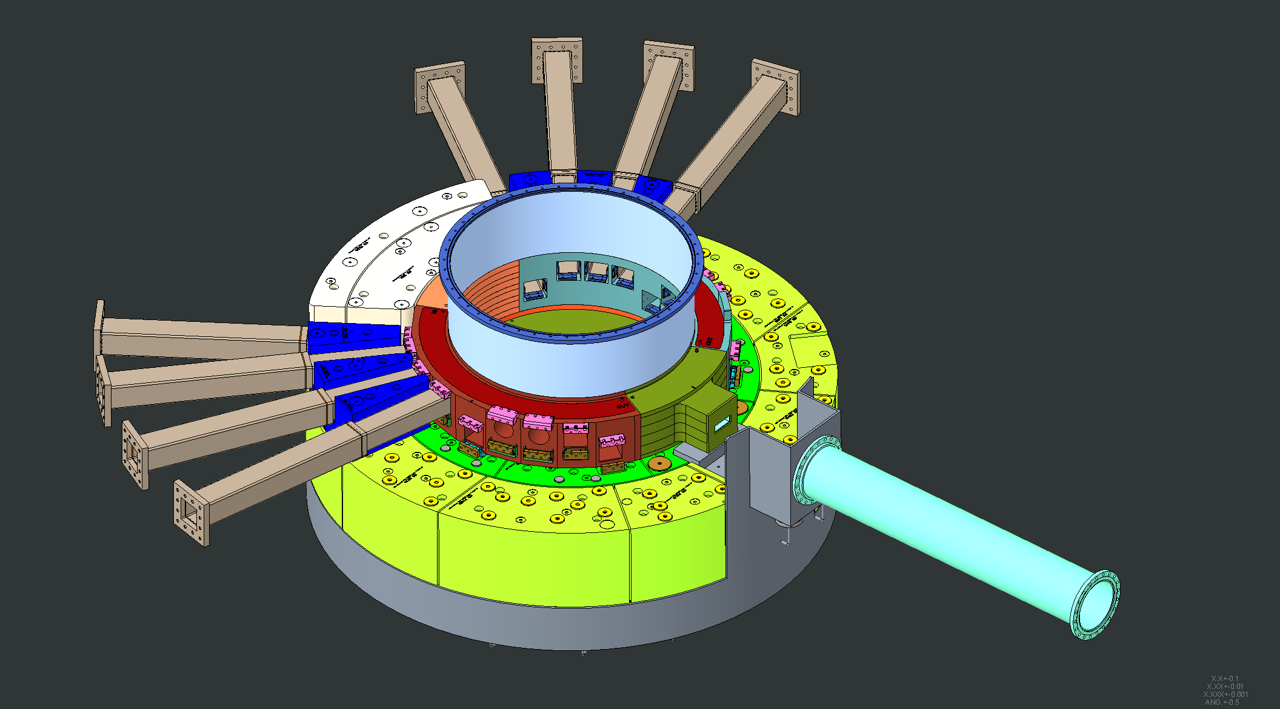
Nozzle Extensions #6 and #13 installed

Slide 22
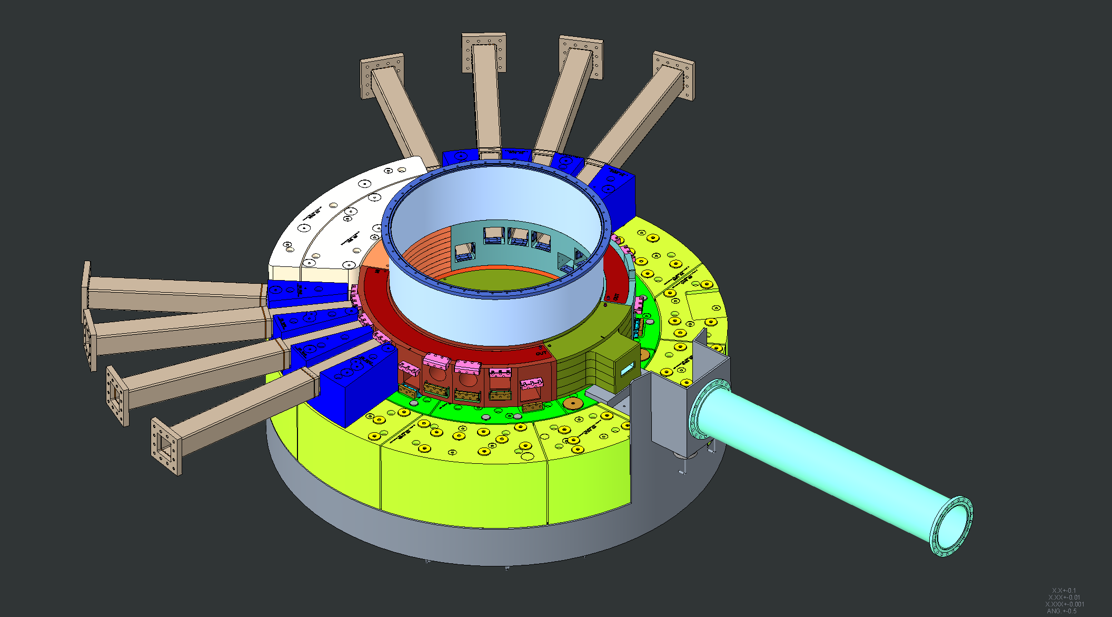
Shielding around Nozzle Extensions #6 and #13 installed

Slide 23
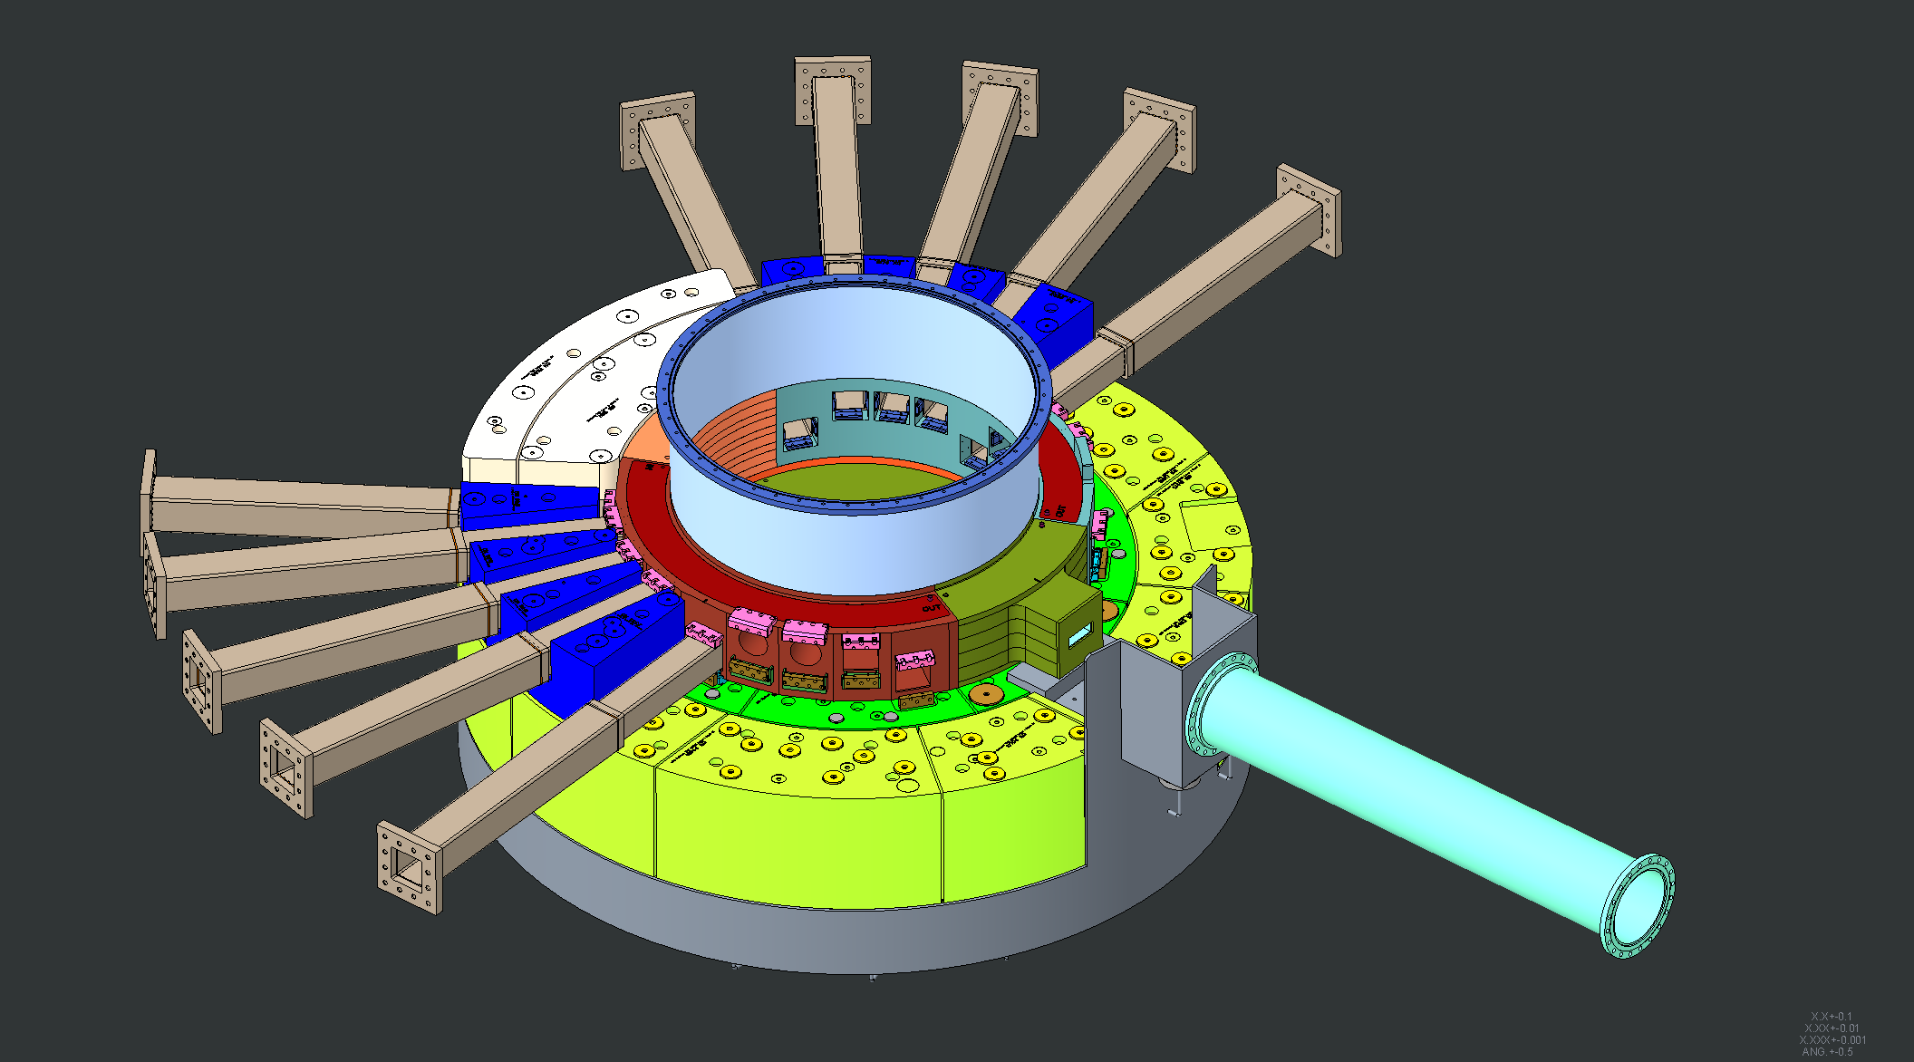
Nozzle Extensions #5 and #14 installed

Slide 24
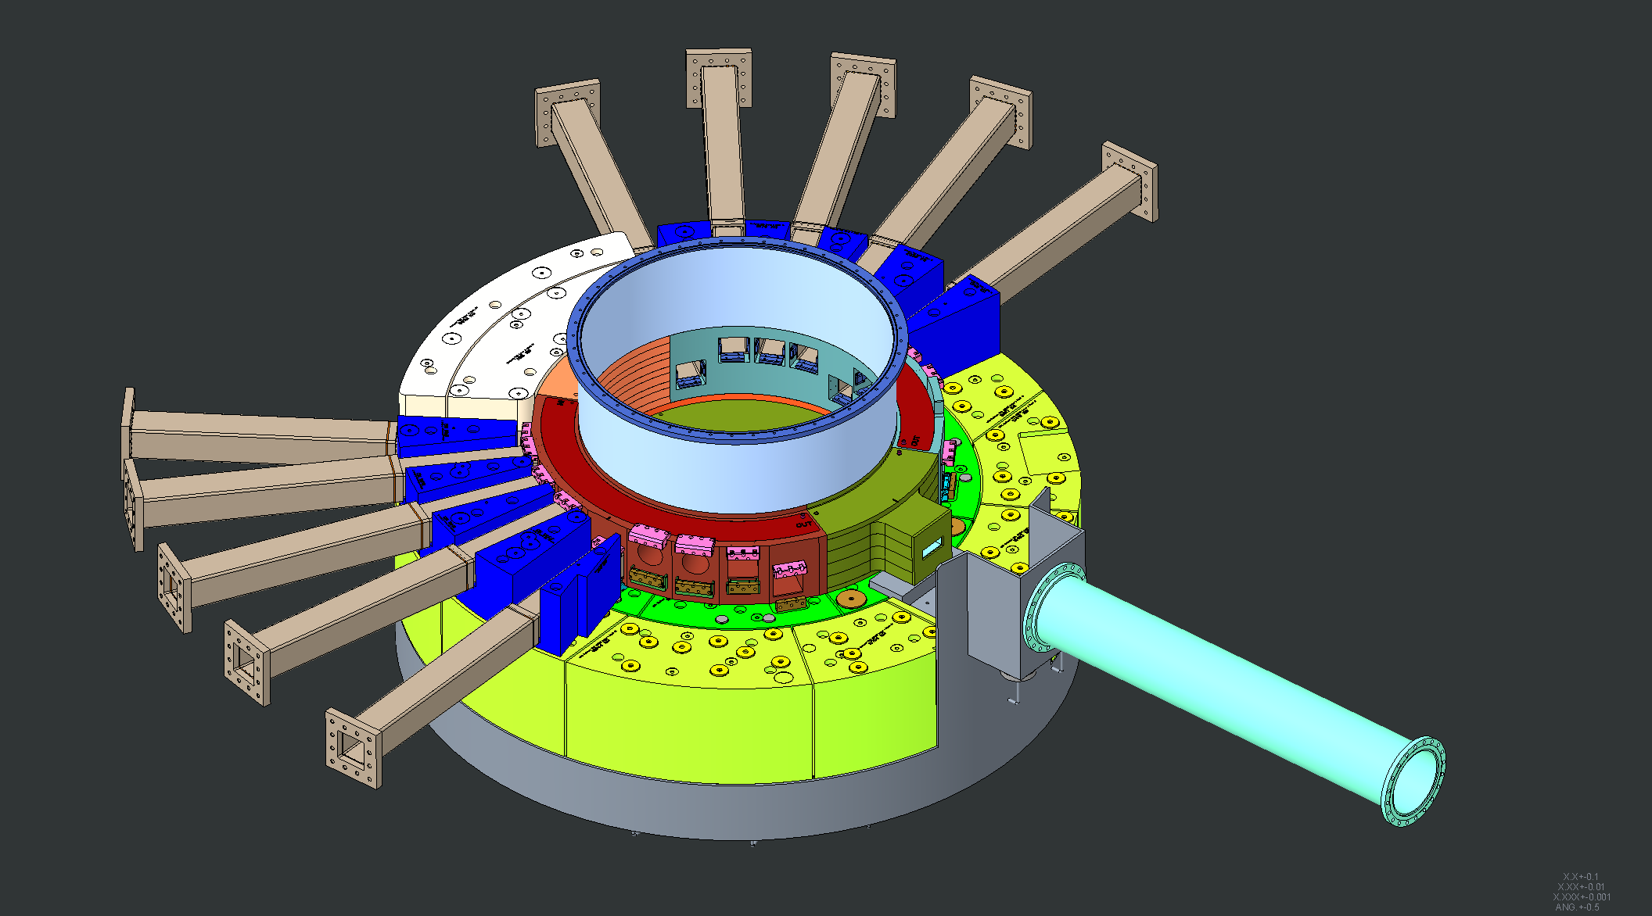
Shielding around Nozzle Extensions #5 and #14 installed

Slide 25
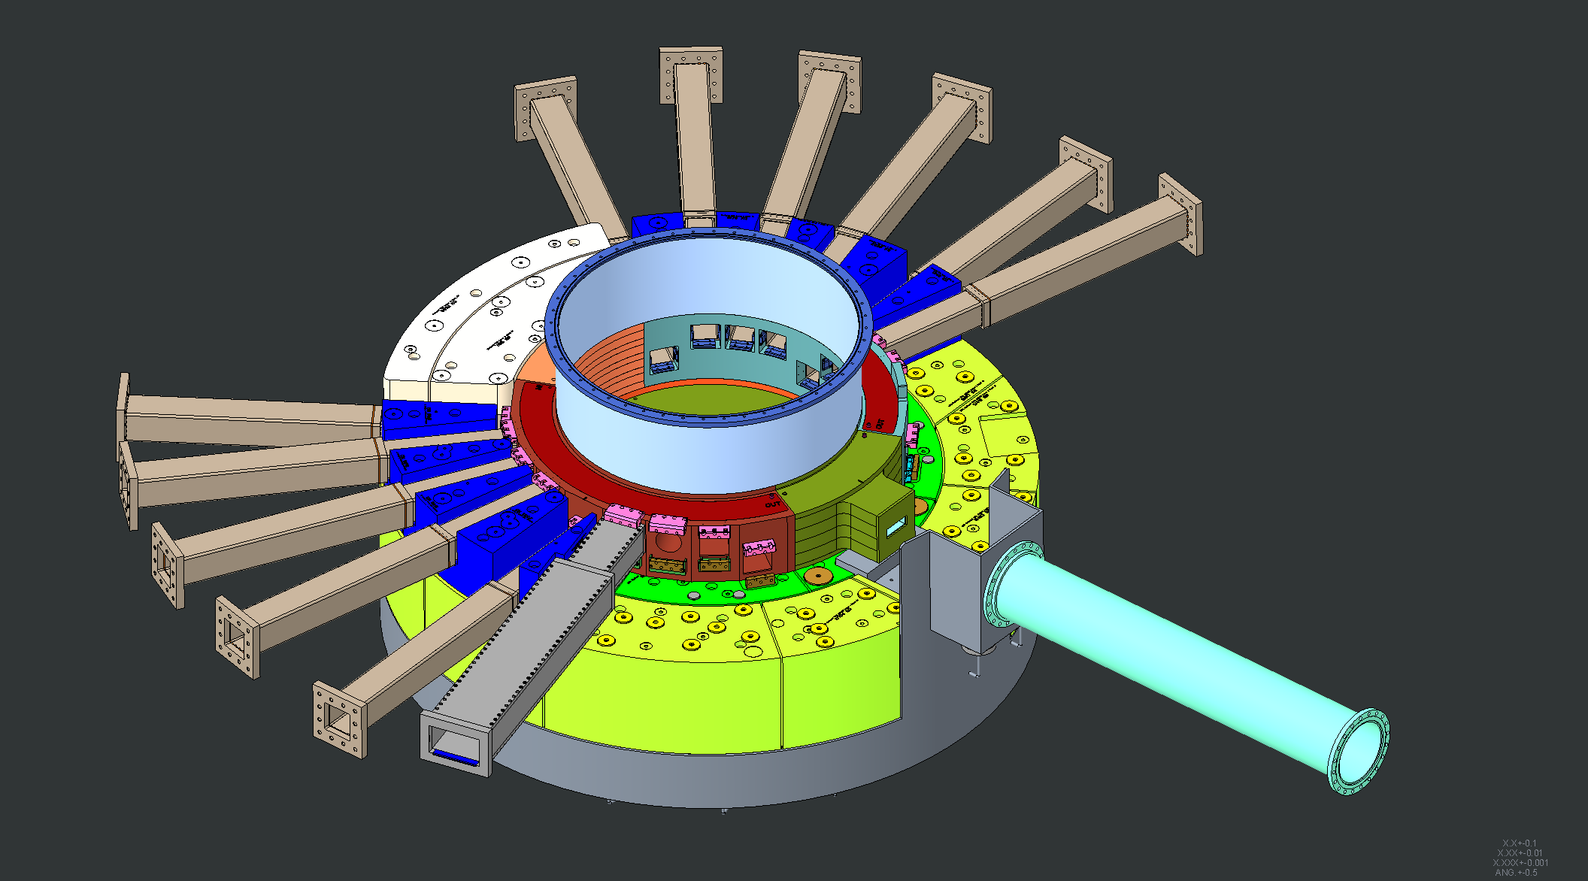
Nozzle Extensions #4 and #15 installed

Slide 26
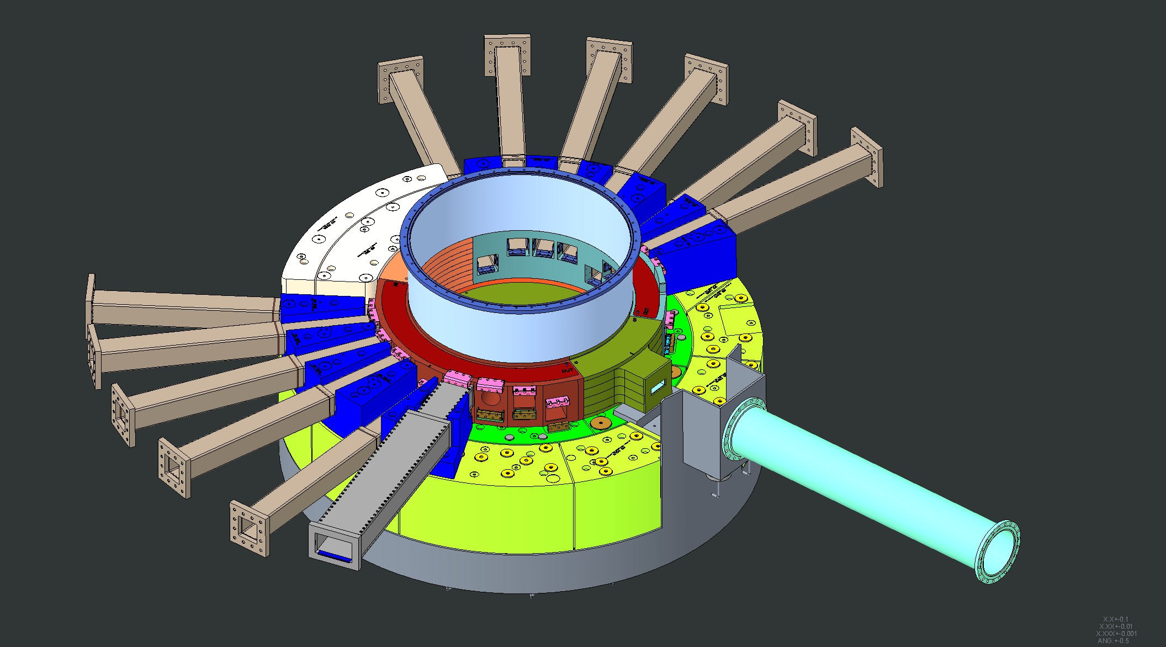
Shielding around Nozzle Extensions #4 and #15 installed

Slide 27
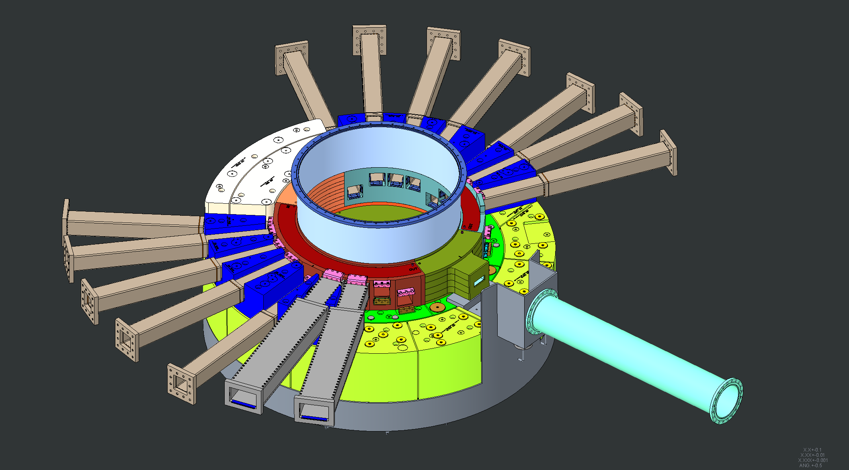
Nozzle Extensions #3 and #16 installed

Slide 28
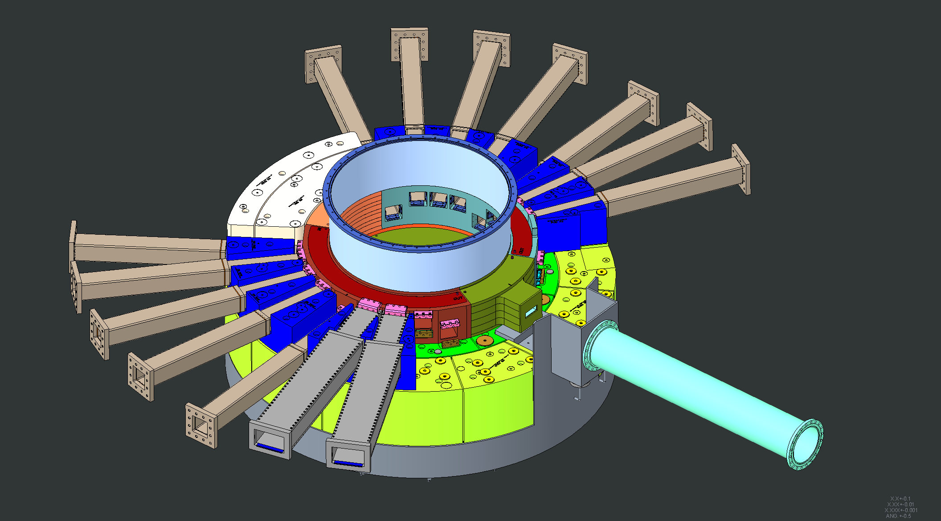
Shielding around Nozzle Extensions #3 and #16 installed

Slide 29
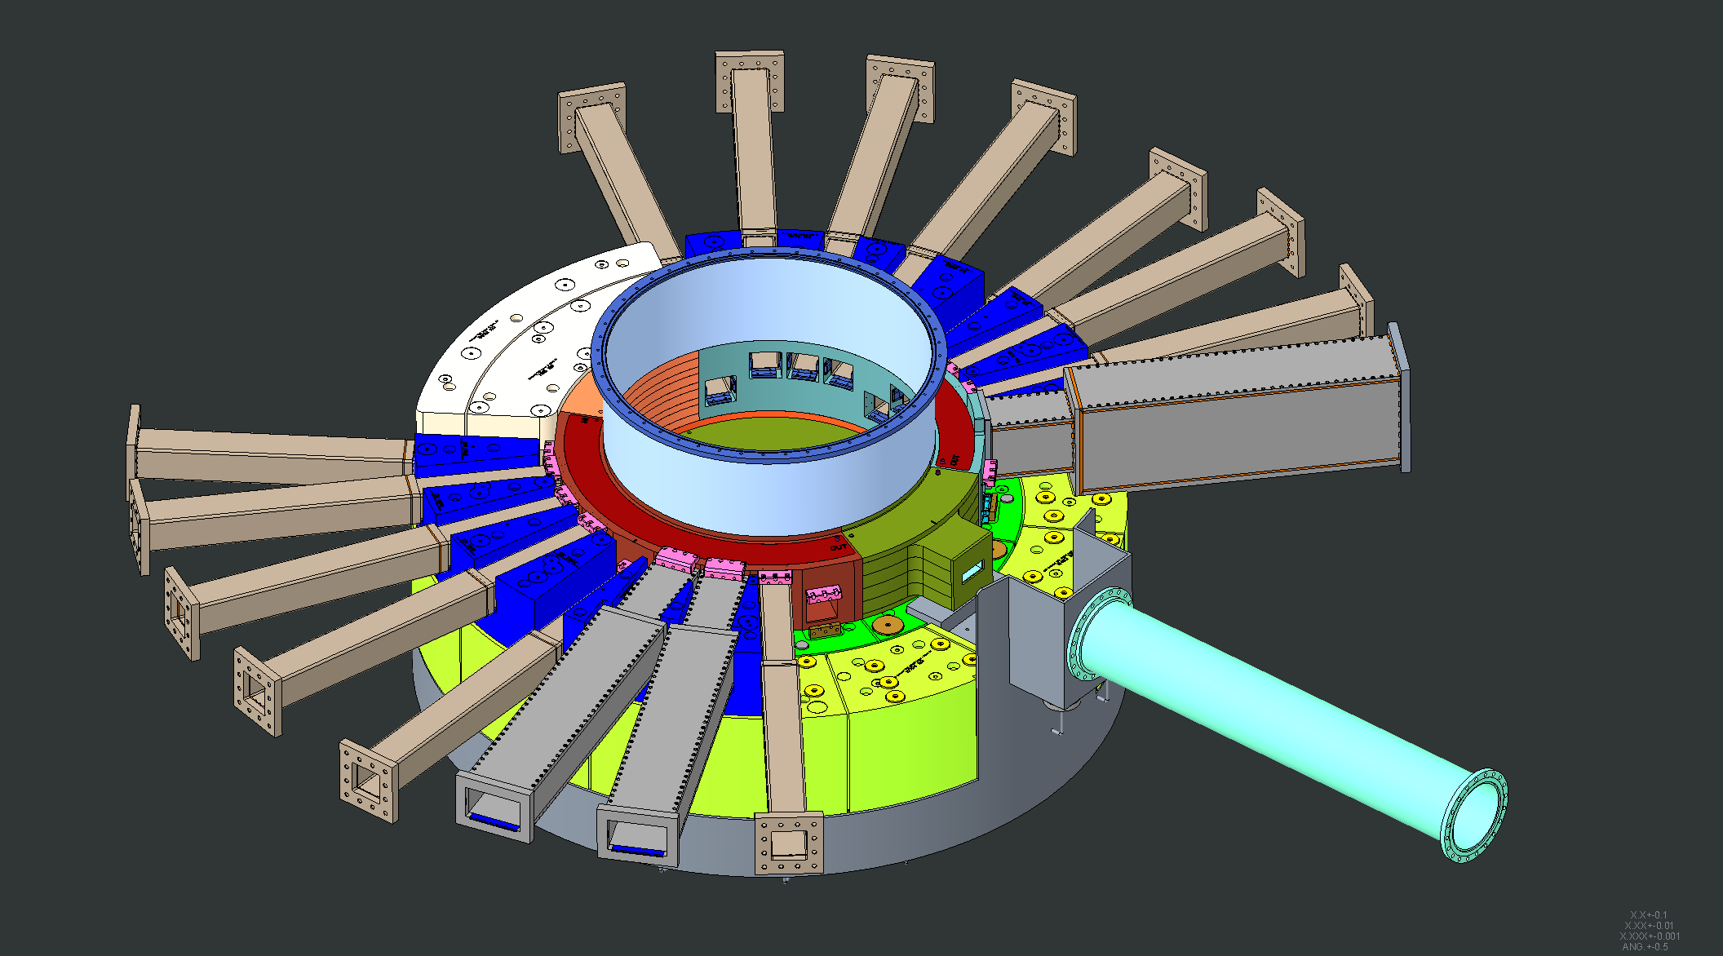
Nozzle Extensions #2 and #17 installed

Slide 30
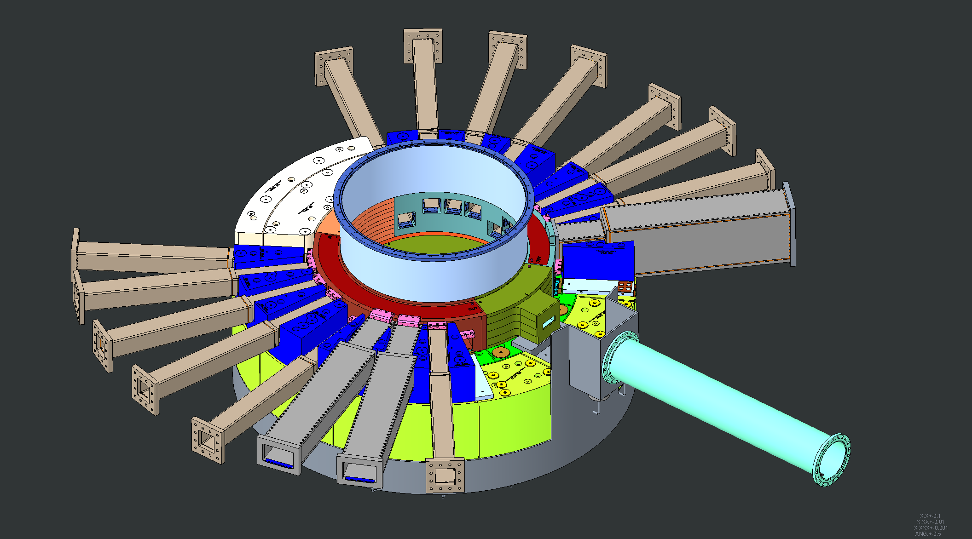
Shielding around Nozzle Extensions #2 and #17 installed

Slide 31
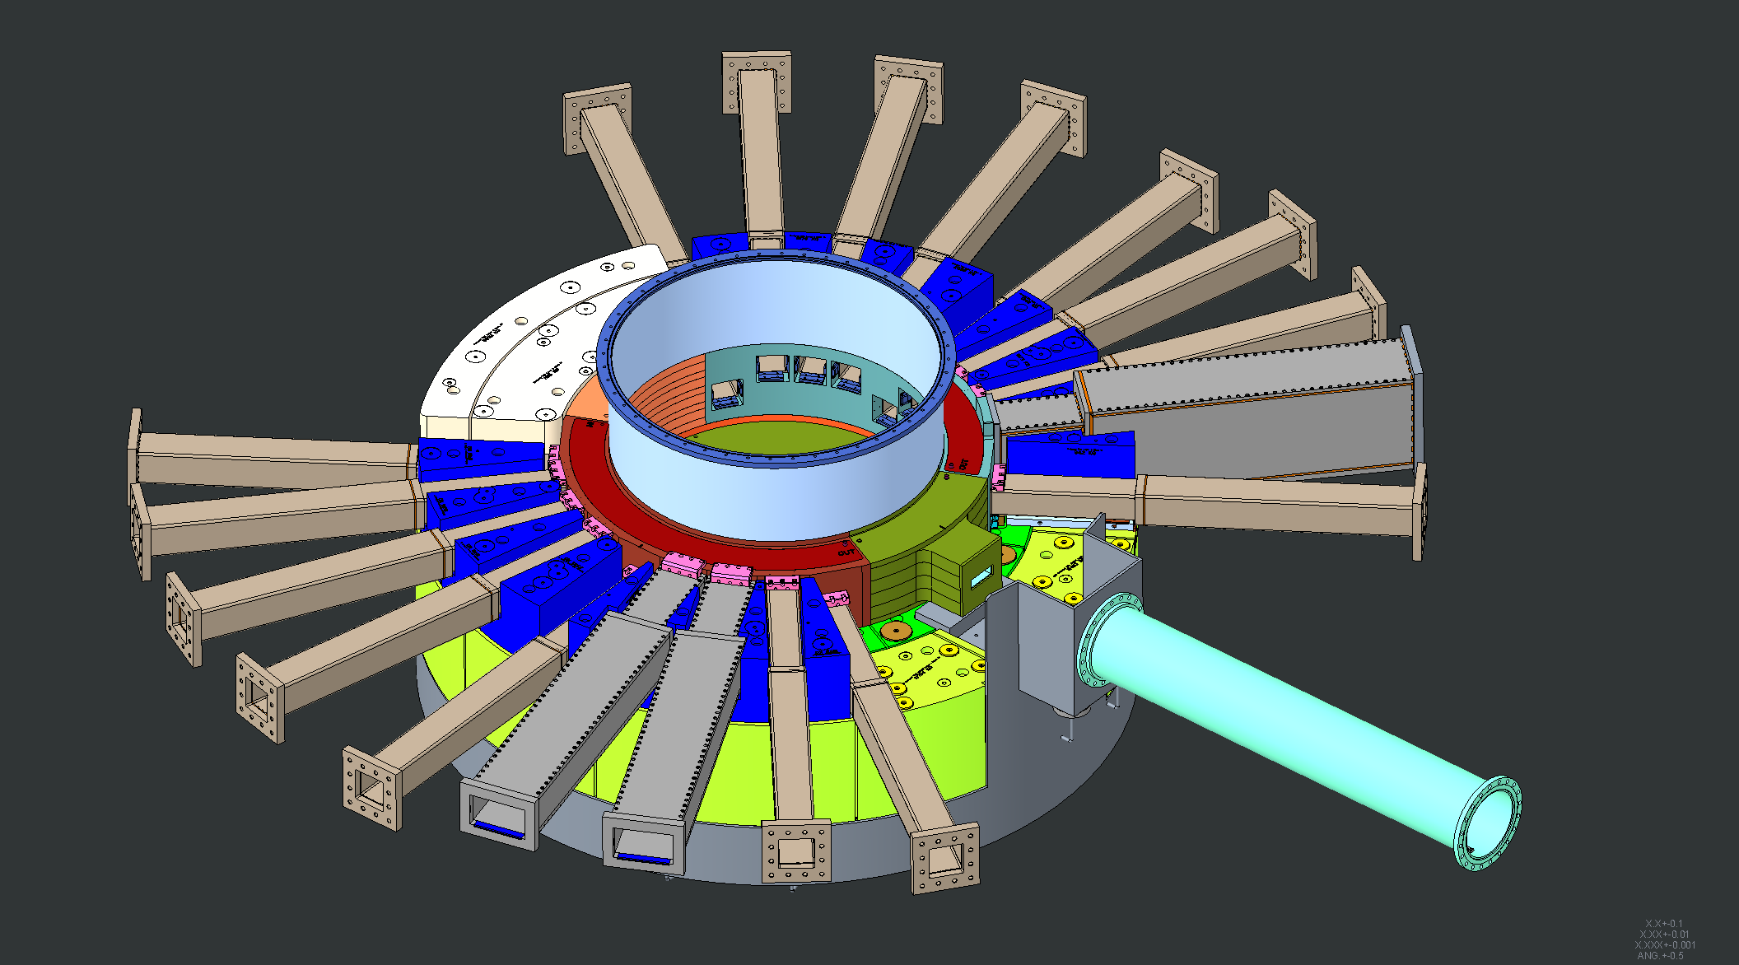
Nozzle Extensions #1 and #18 installed

Slide 32
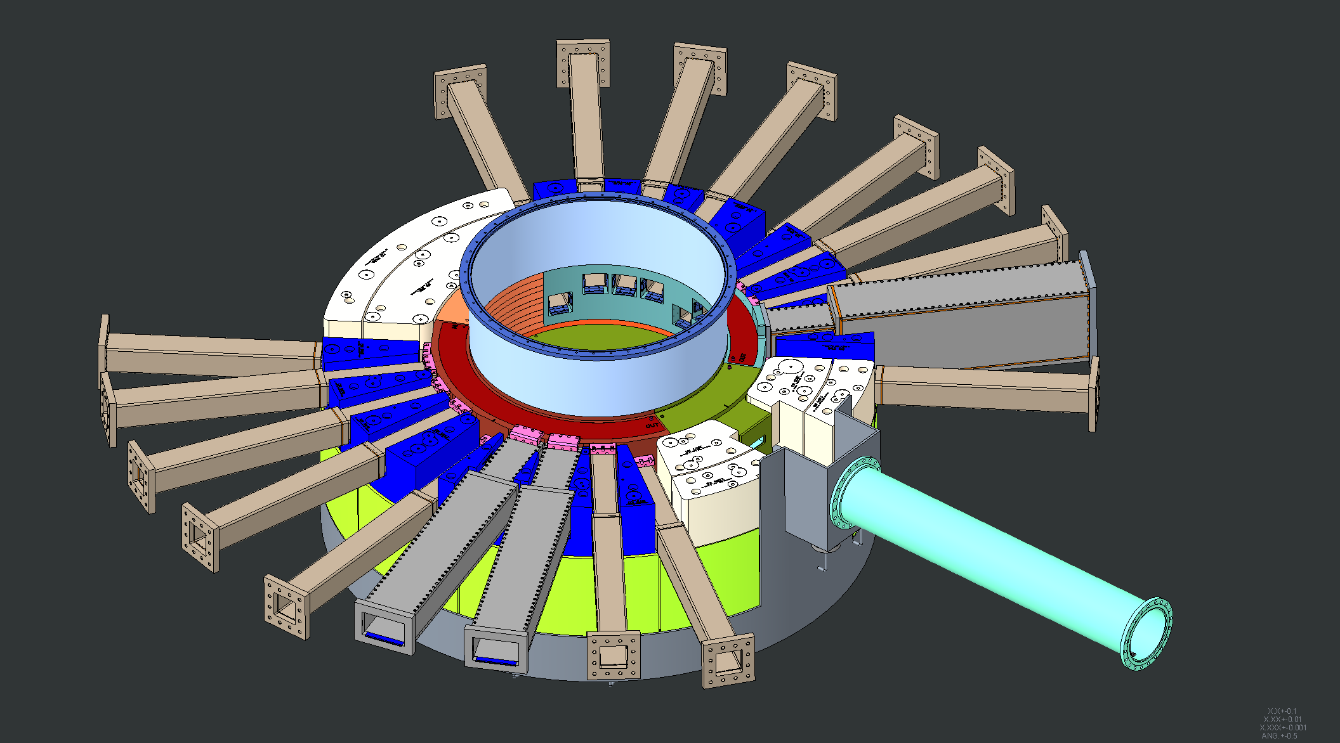
Shielding around Nozzle Extensions #1 and #18 installed

Slide 33
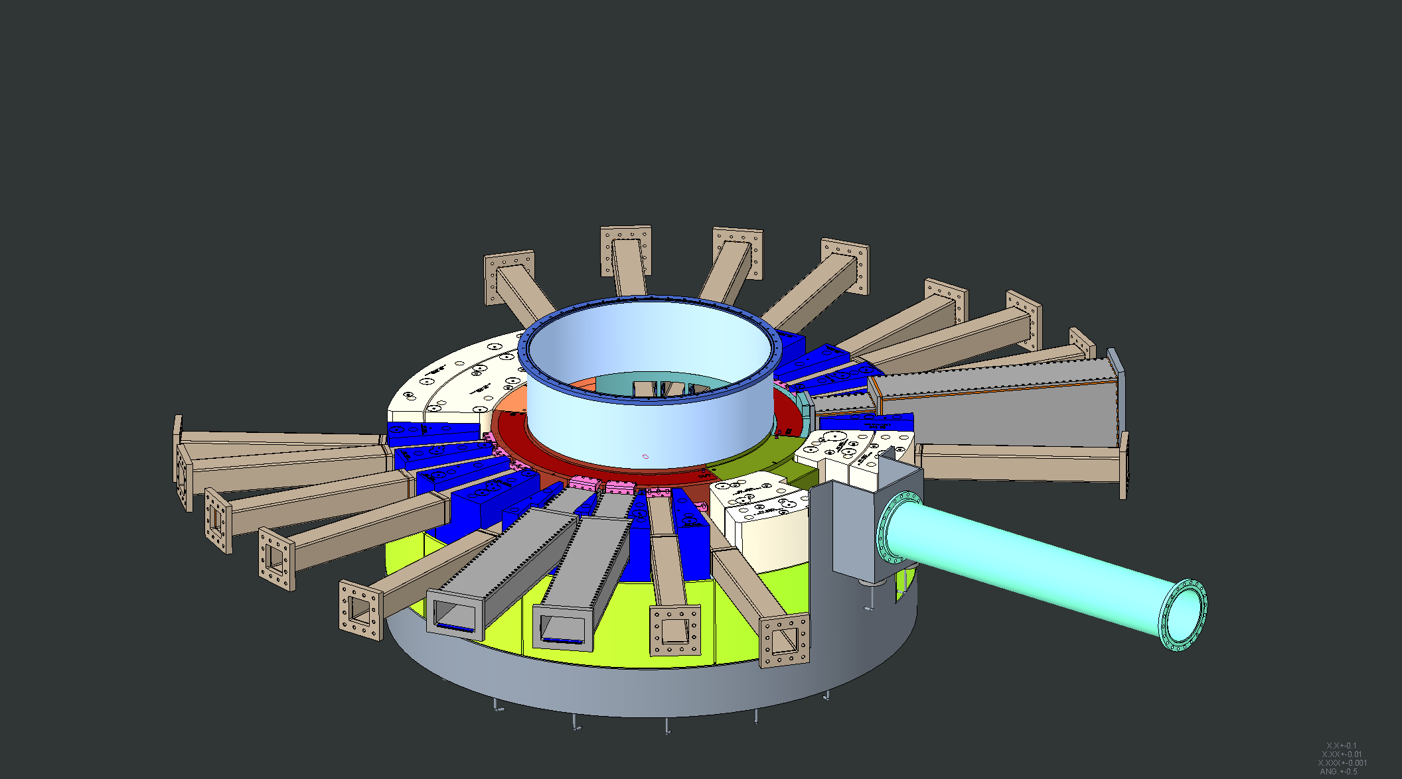
Upstream Bulk Shielding layer #2 installed

Slide 34
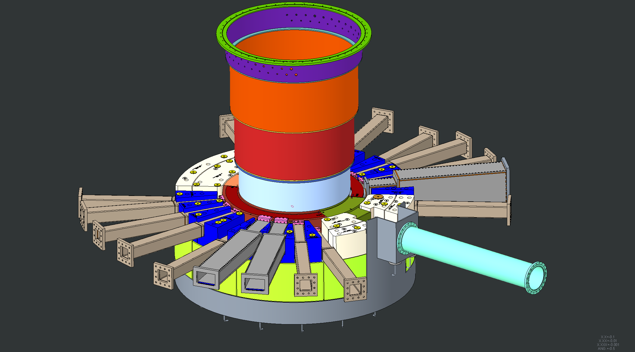
Layer 3 shim pucks installed

Slide 35
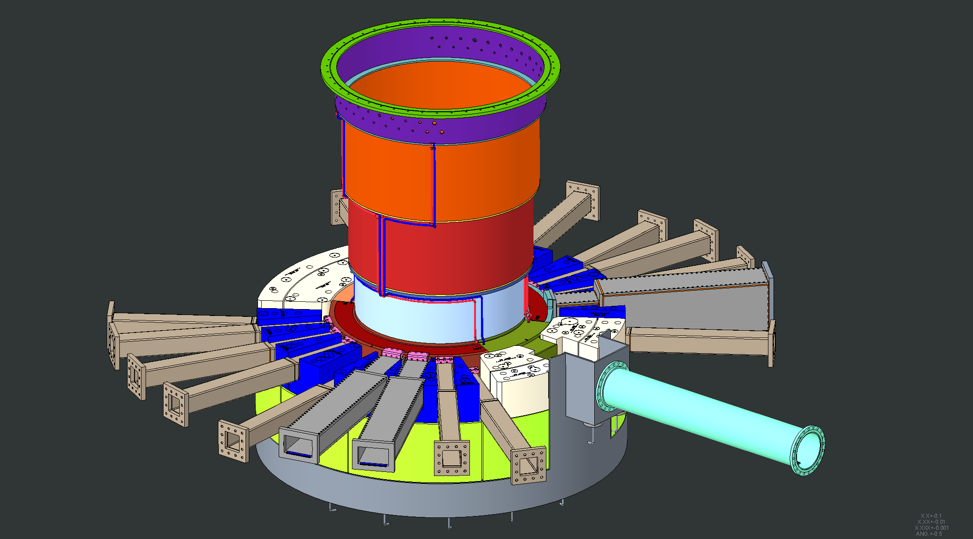
Core Vessel beltline water lines welded in place

Slide 36
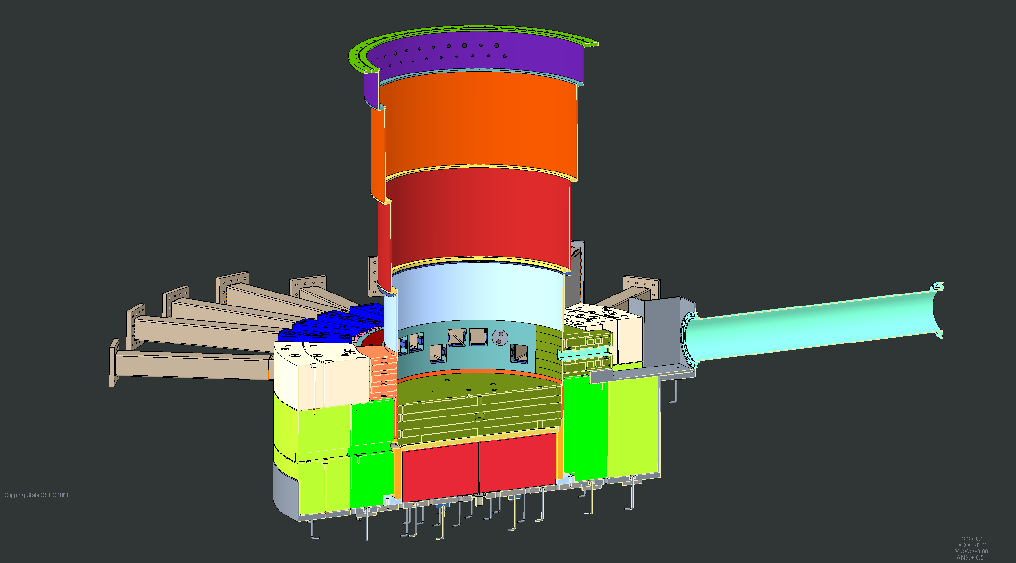
Cross section view of installation up to this point

Slide 37
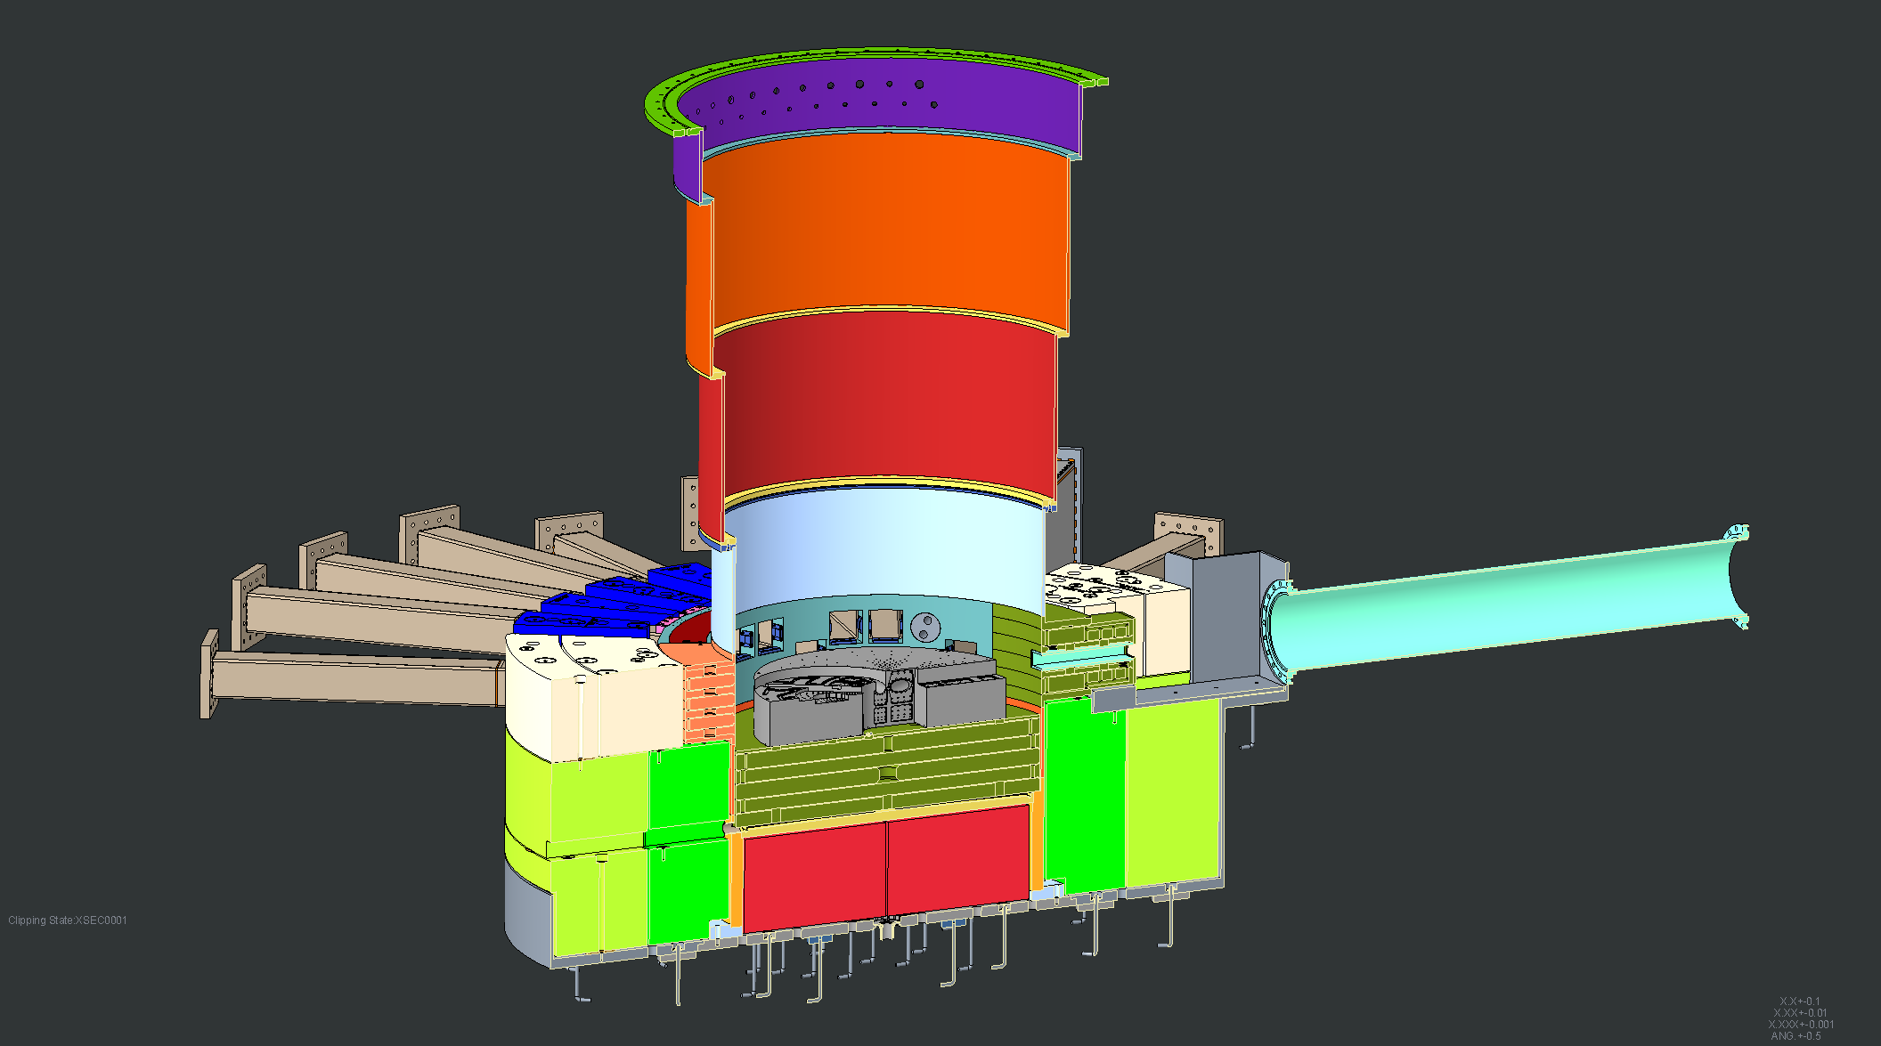
Core Vessel cooled layer #2 shield blocks installed

Slide 38
Core Vessel uncooled layer #2 shield blocks installed

Slide 39
Core Vessel cooled layer #3 cooled shield blocks installed

Slide 40
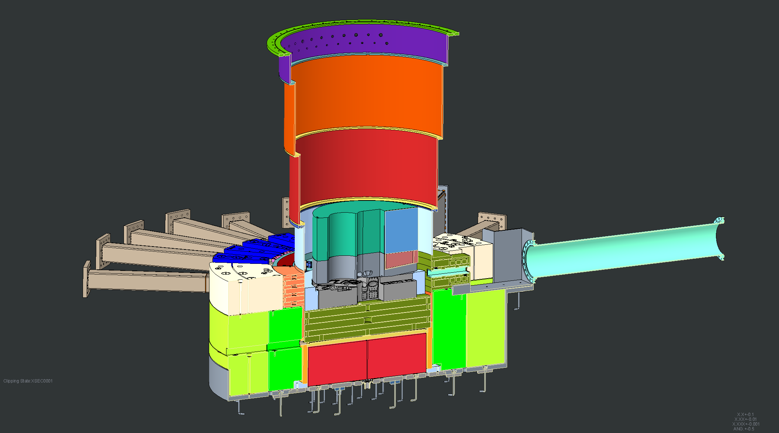
Core vessel uncooled layer #3 inner shield blocks installed

Slide 41
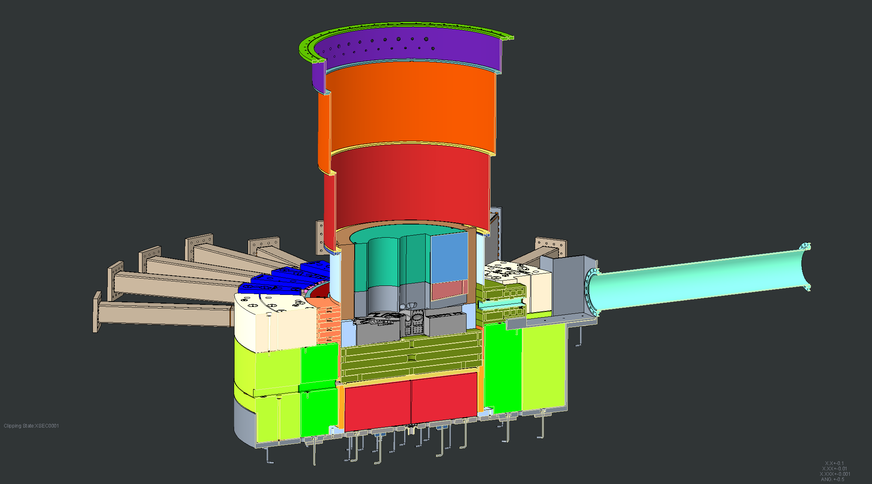
Core vessel uncooled layer #3 outer shield blocks installed

Slide 42
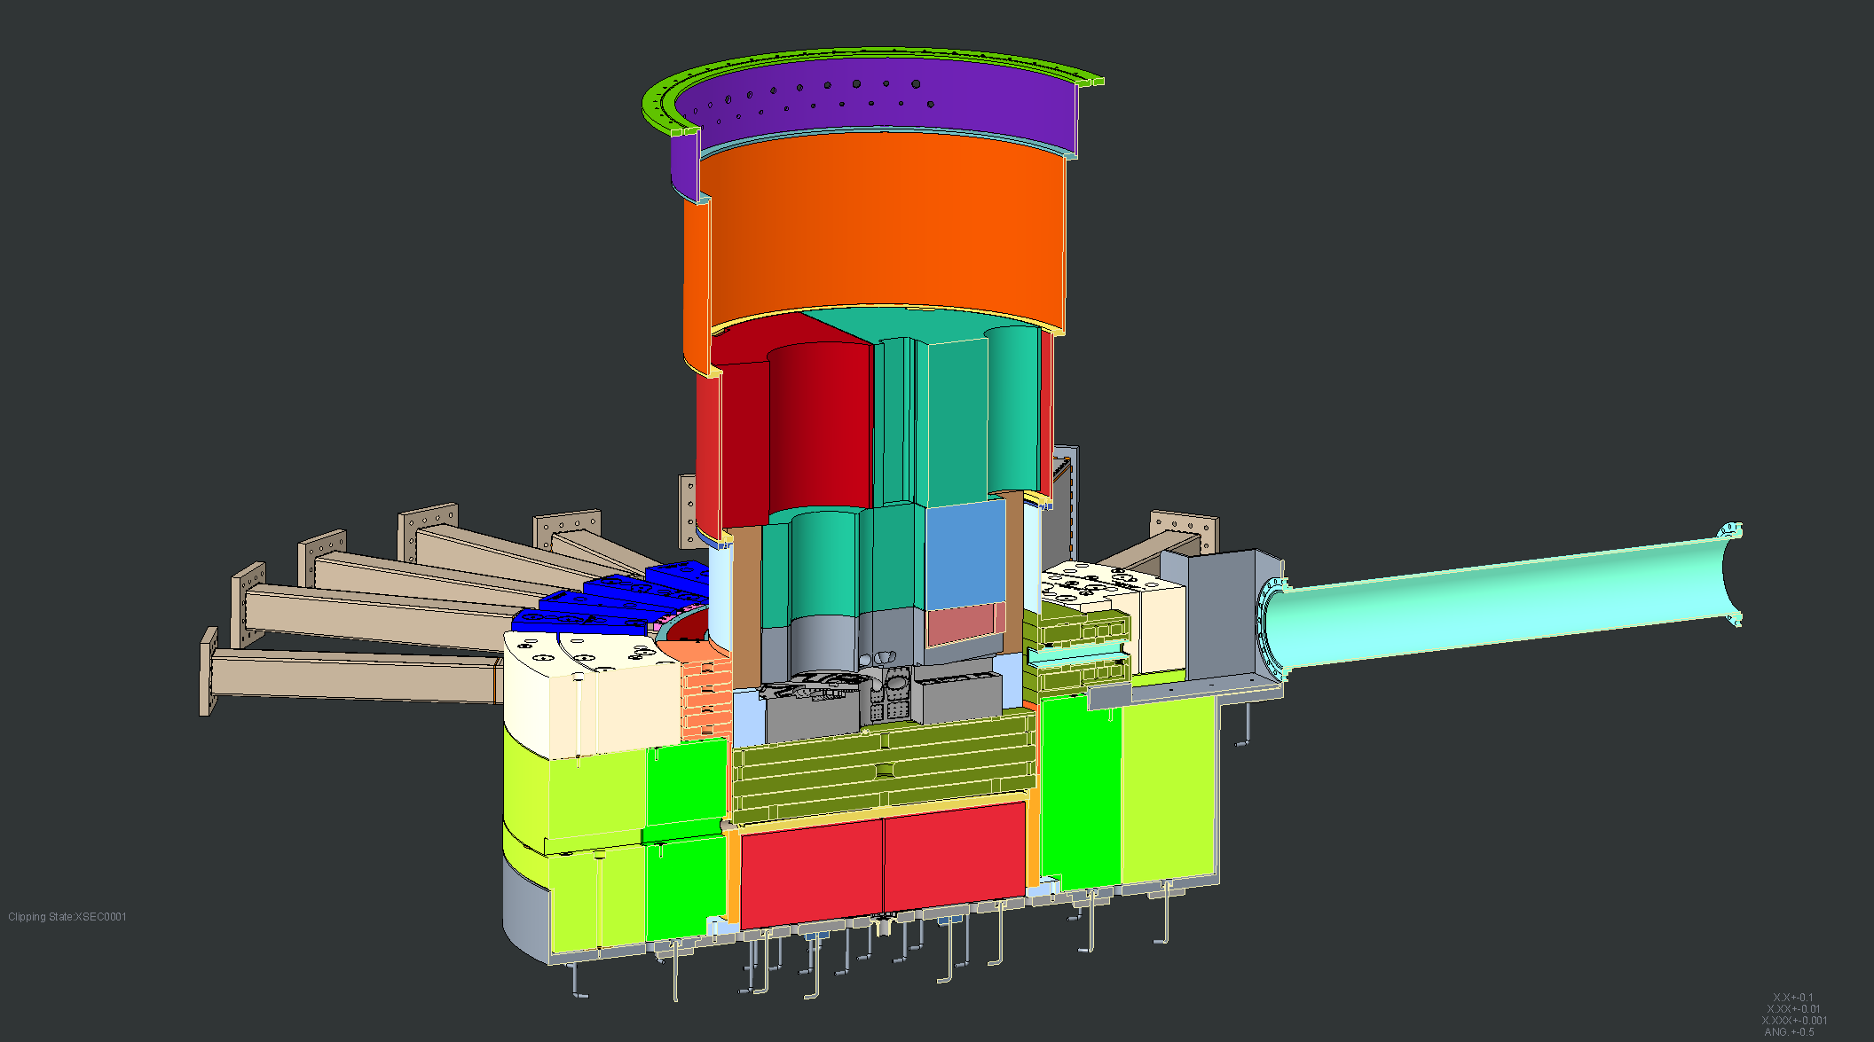
Core vessel uncooled layer #4 shield blocks installed

Slide 43
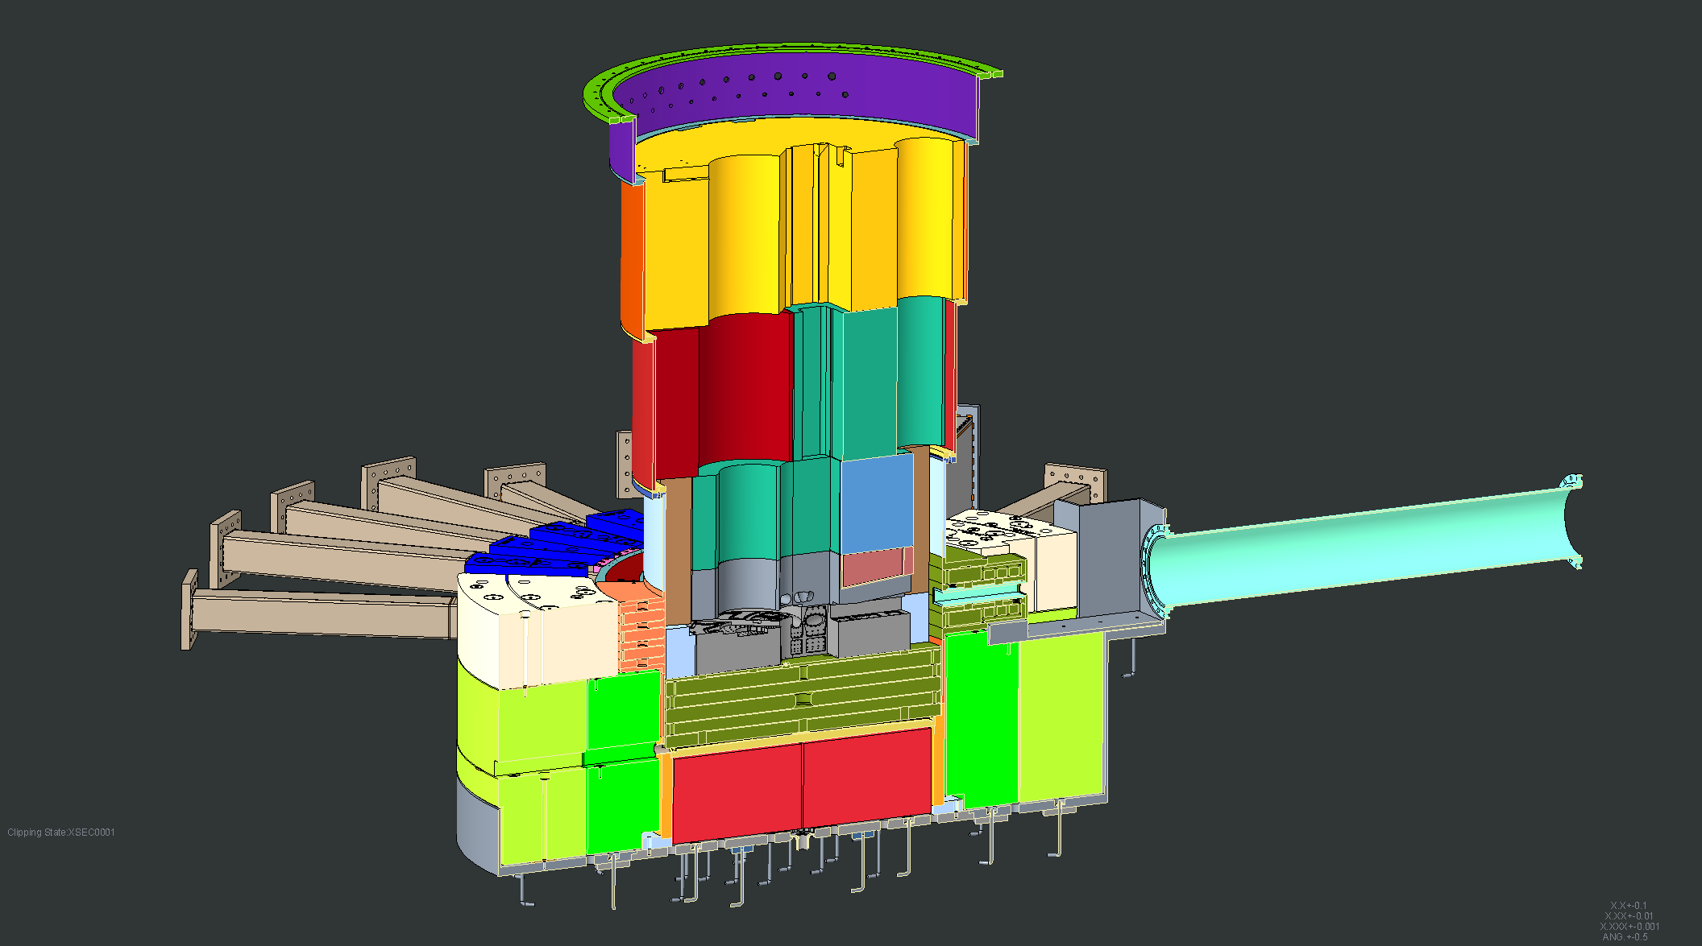
Core vessel uncooled layer #5 shield blocks installed

Slide 44
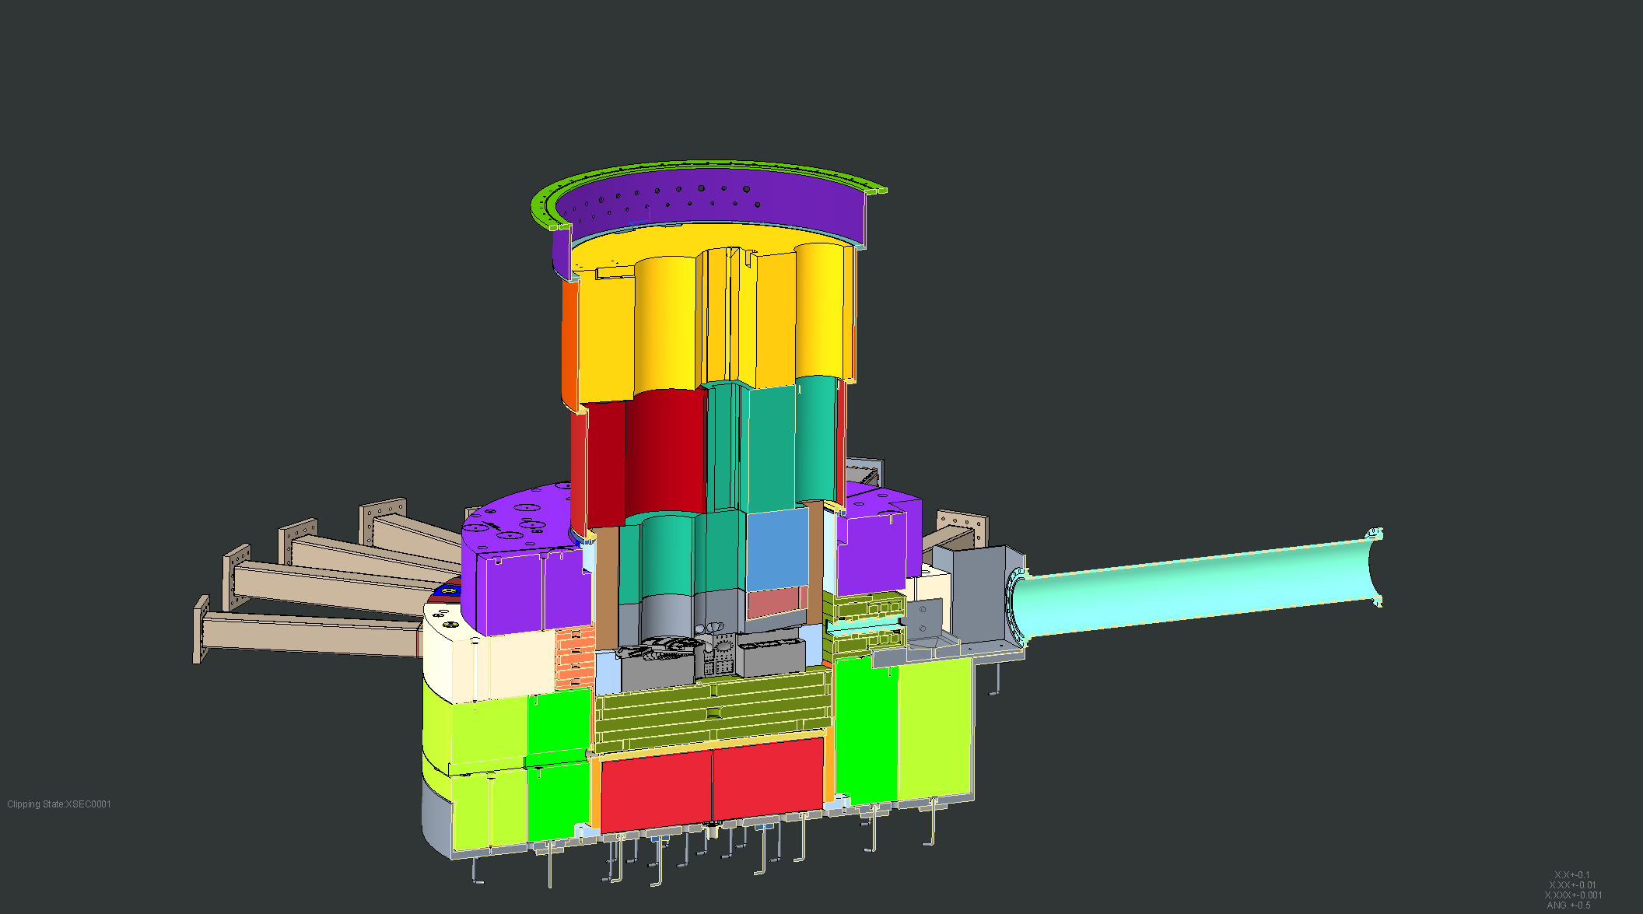
Bulk Shielding layer #3 inside course installed

Slide 45
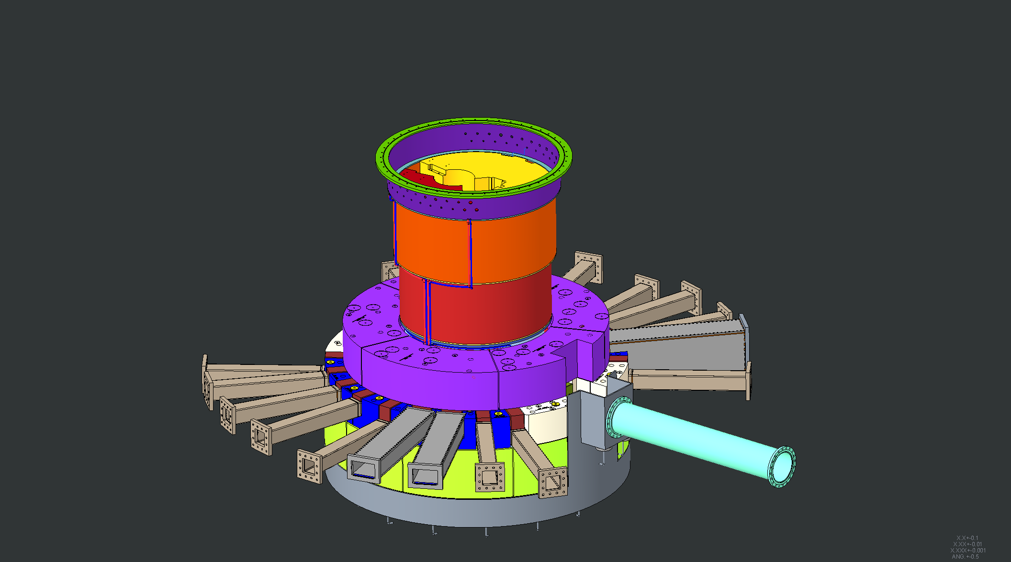
Bulk Shielding layer #3 inside course installed

Slide 46
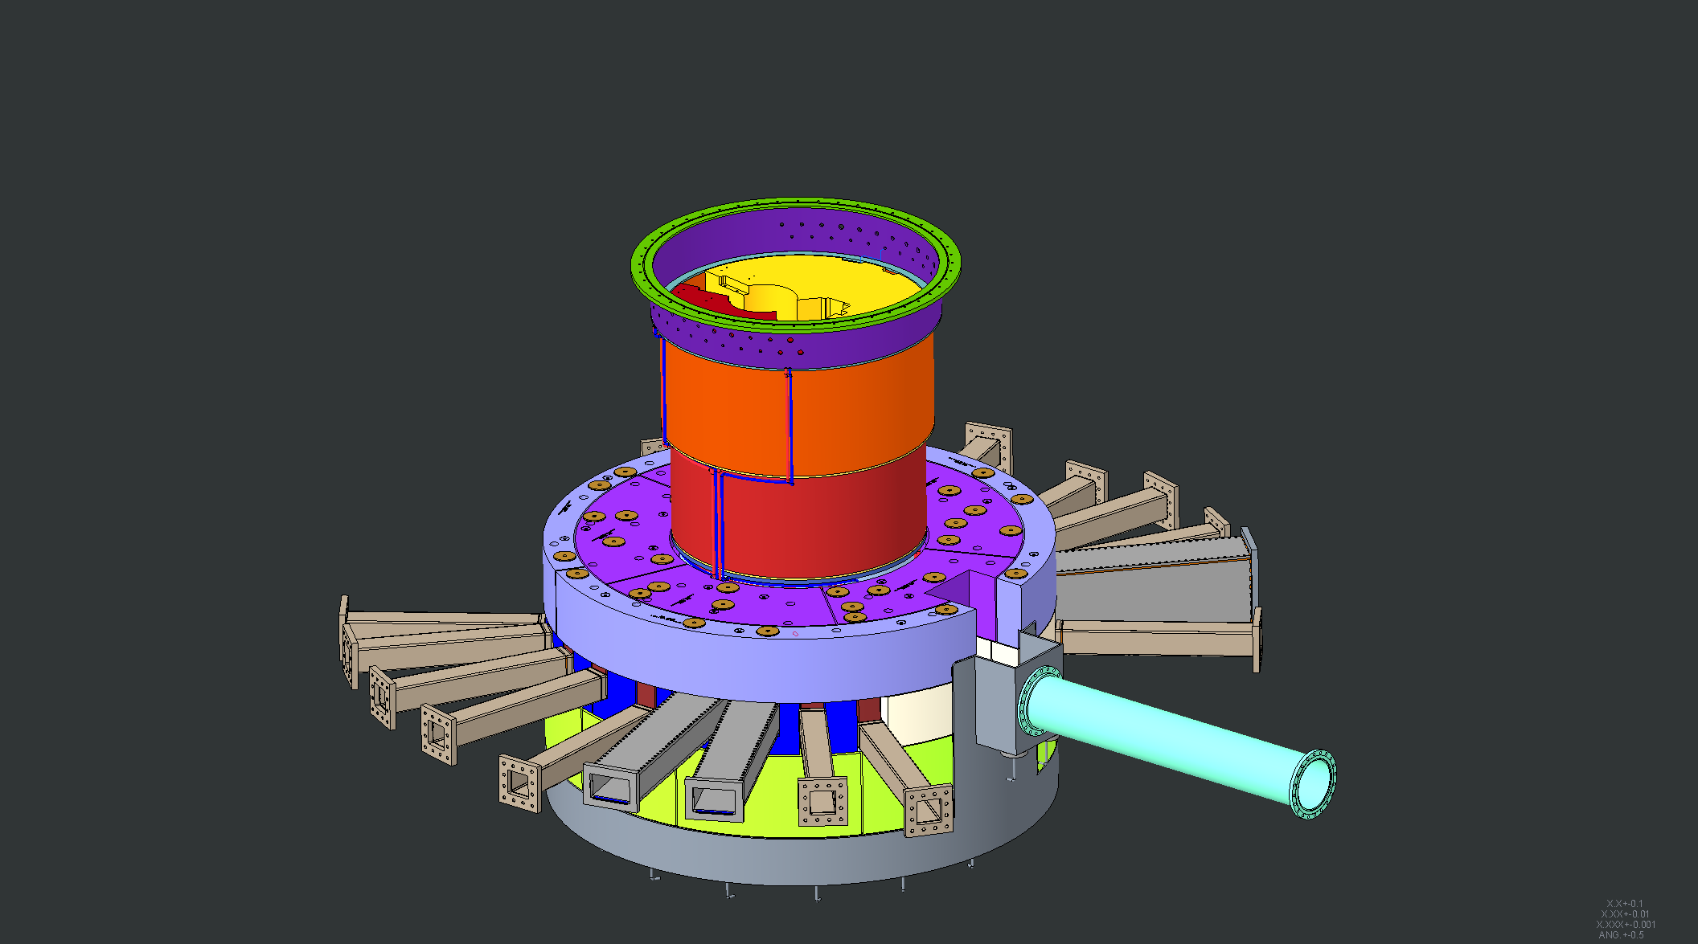
Bulk Shielding layer #3 outside course installed

Slide 47
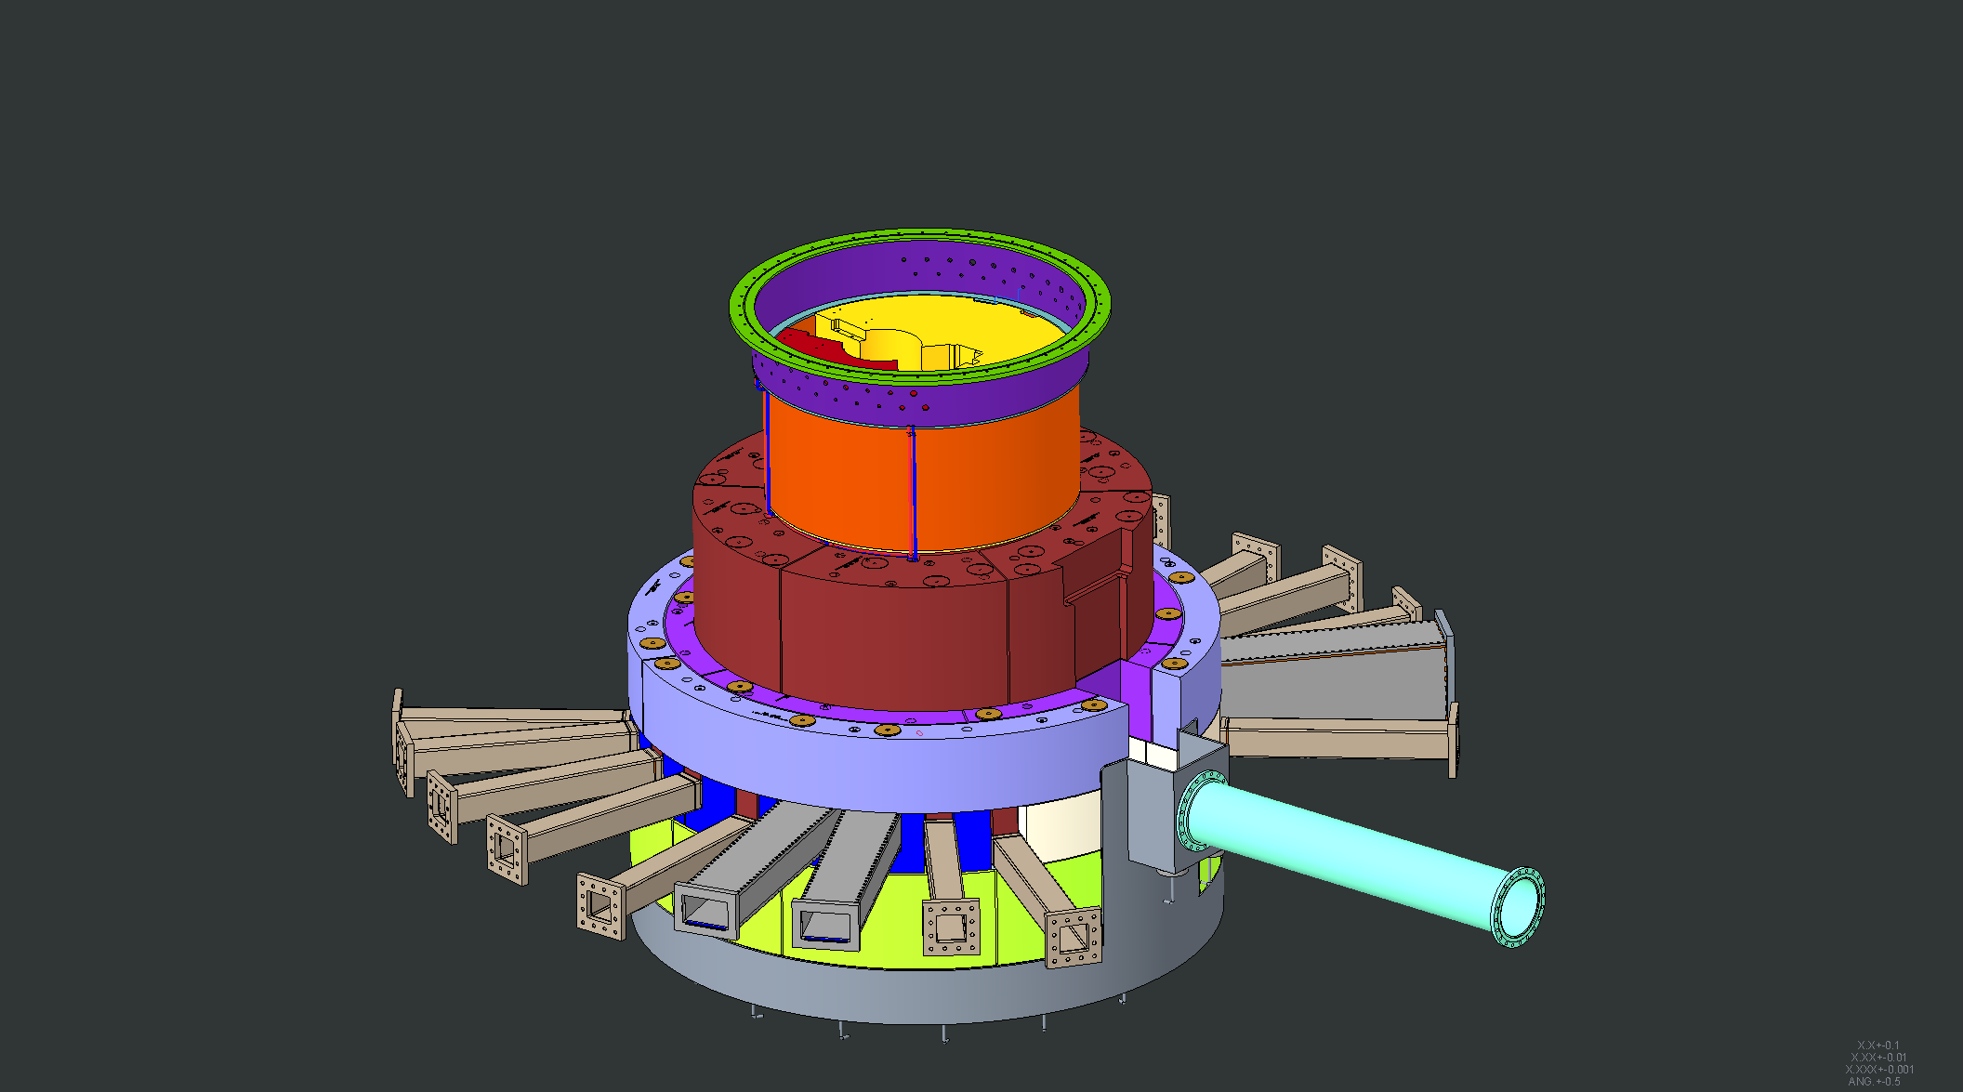
Bulk Shielding layer #4 inside course installed

Slide 48
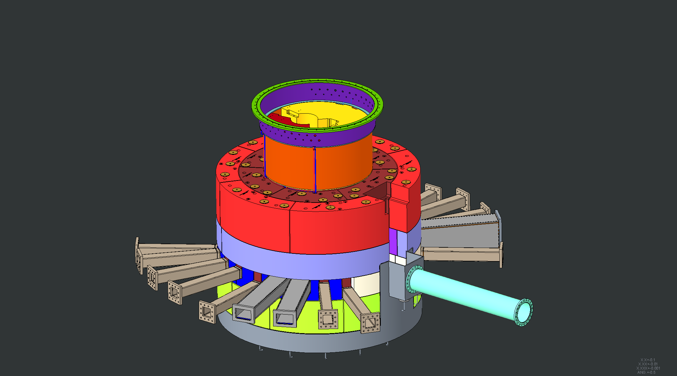
Bulk Shielding layer #4 outside course installed

Slide 49
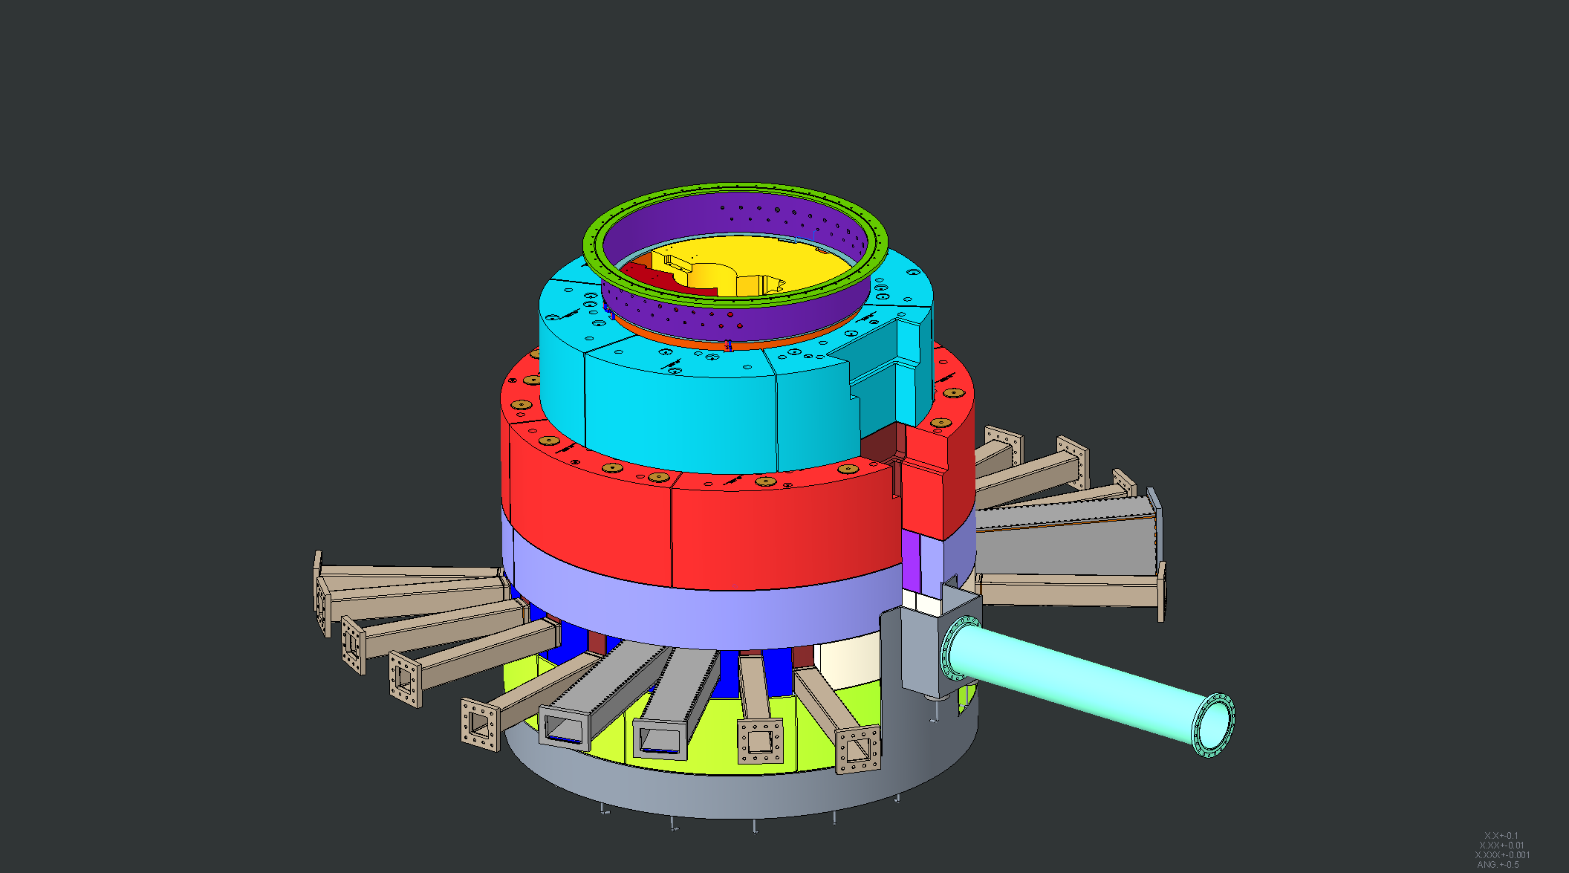
Bulk Shielding layer #5 inside course installed

Slide 50
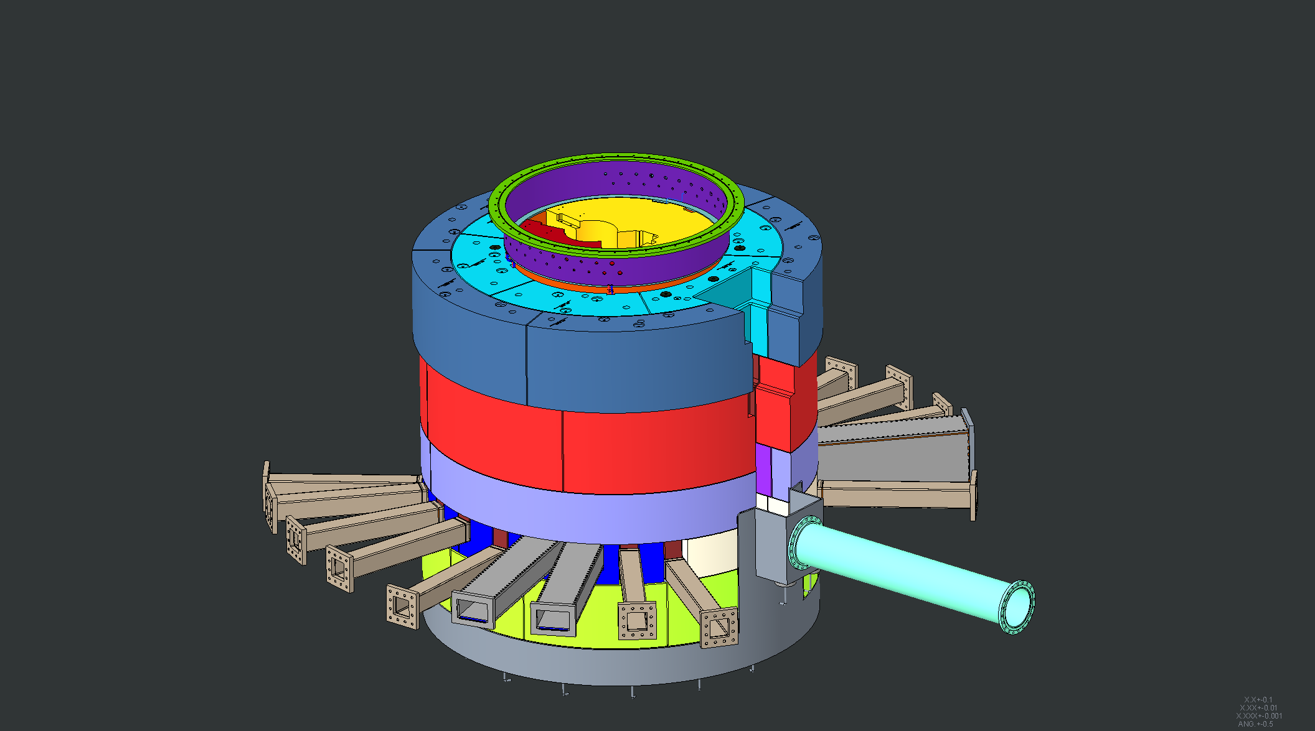
Bulk Shielding layer #5 outside course installed

Slide 51
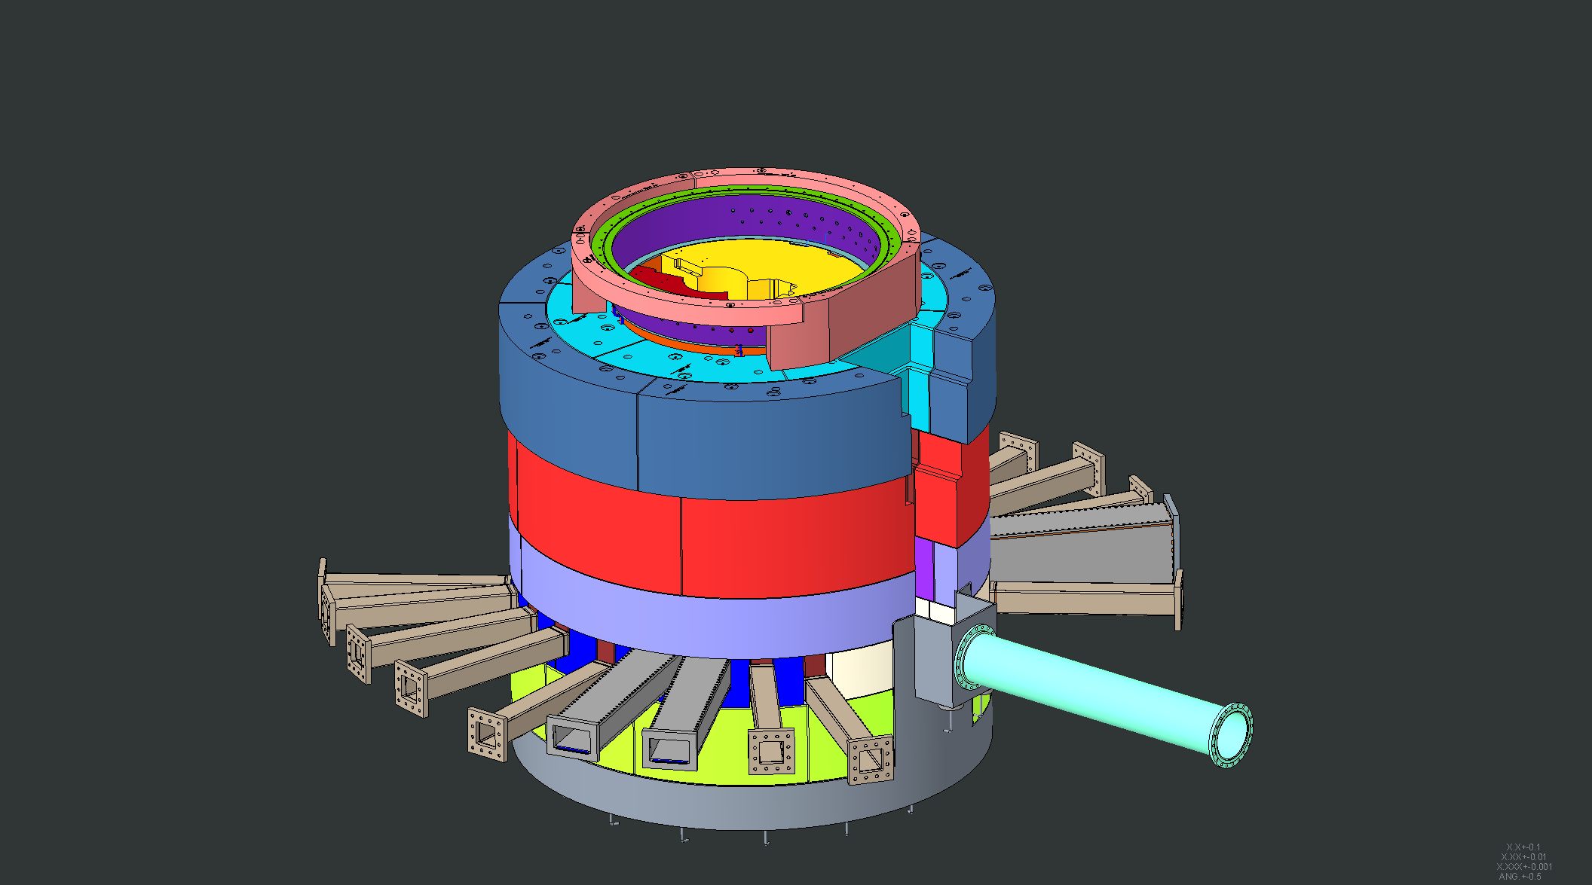
Bulk Shielding layer #6 inside course installed

Slide 52
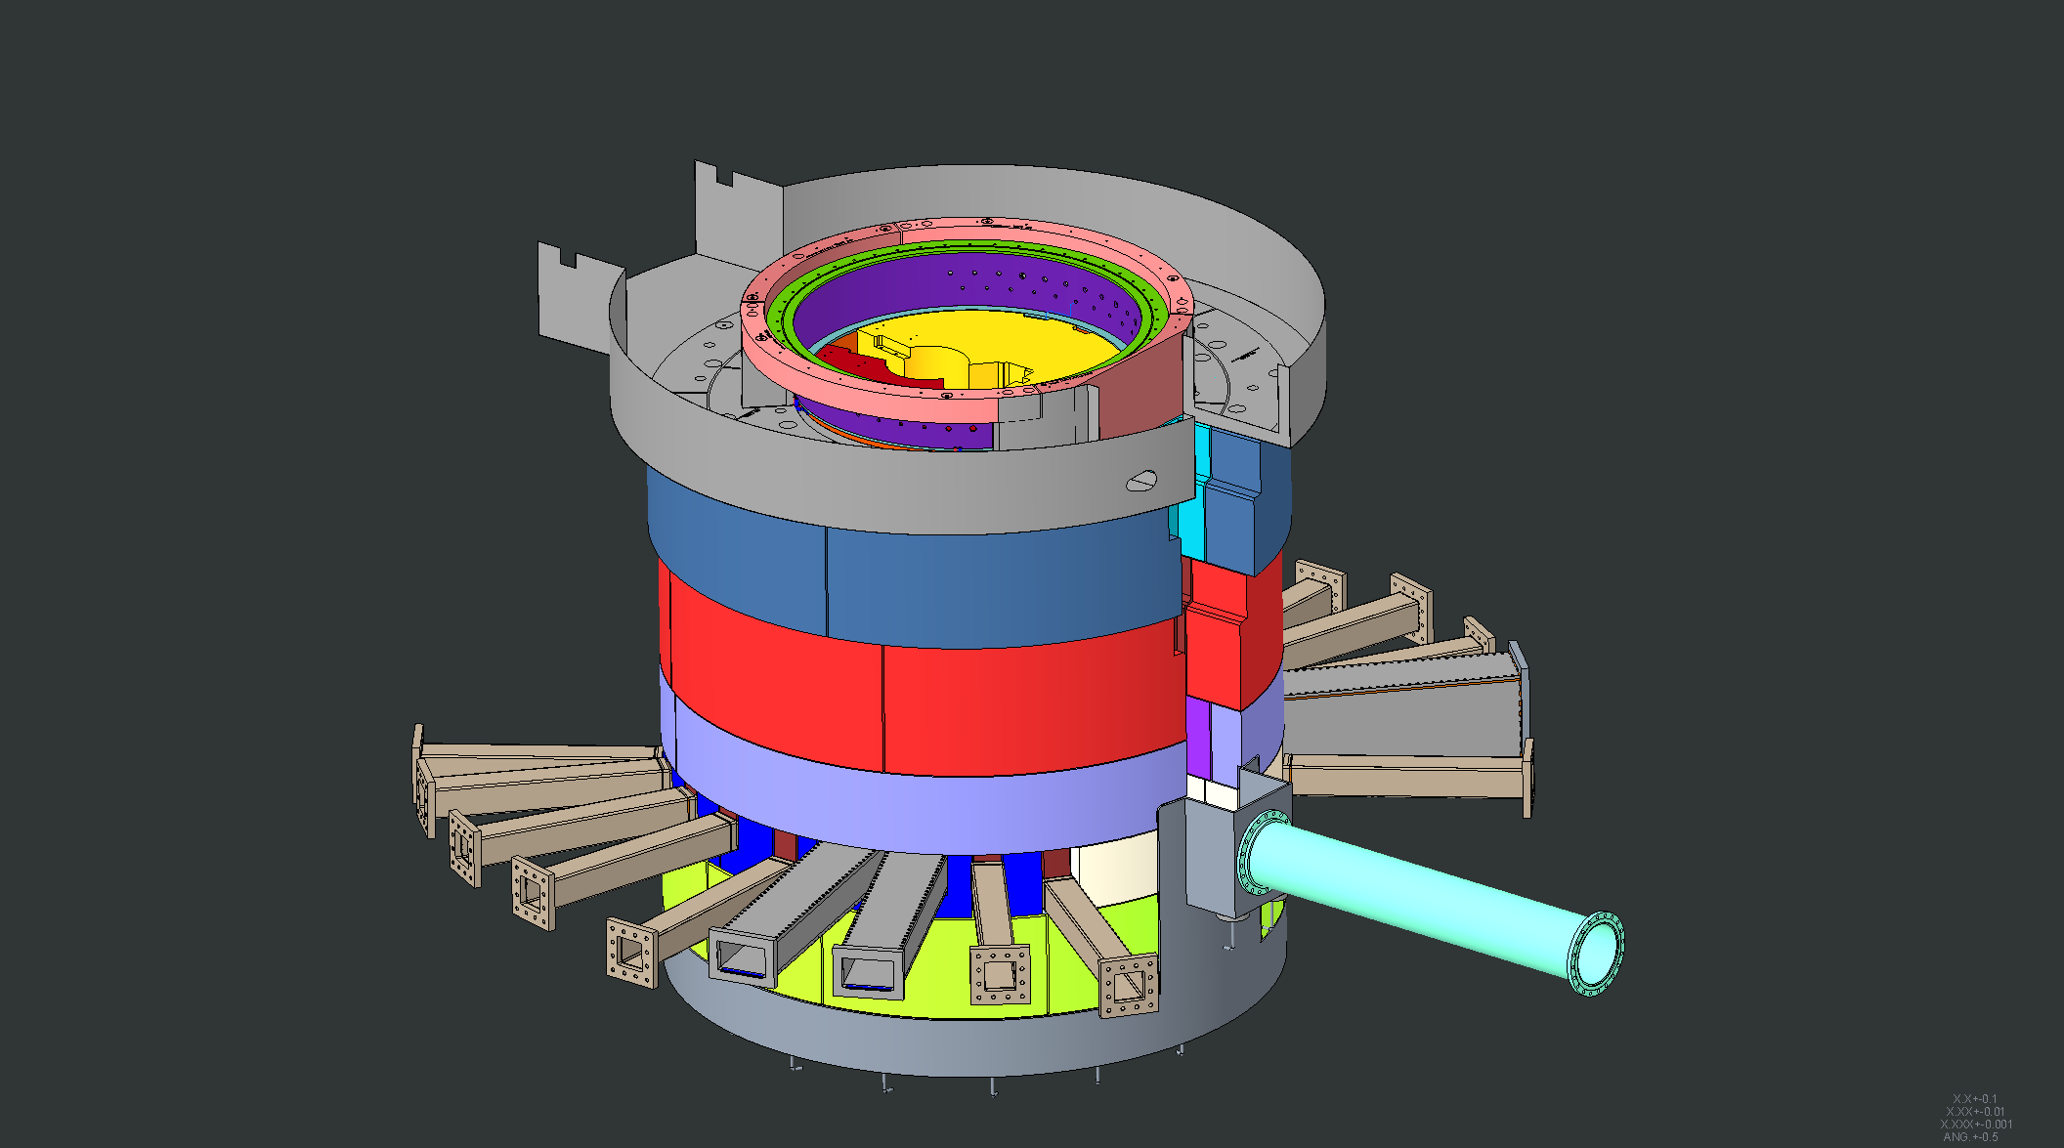
Pipe pans installed

Slide 53
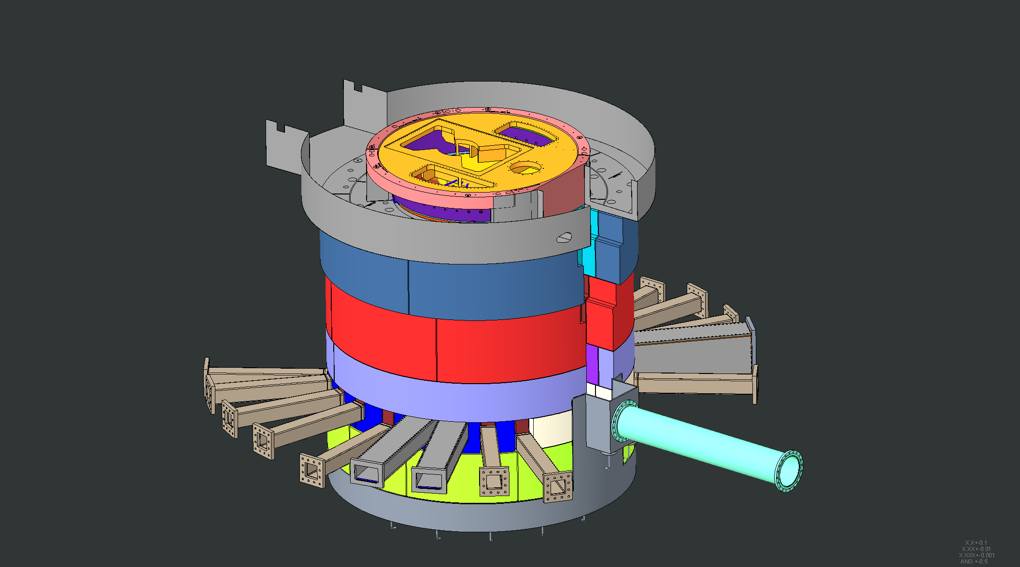
Core Vessel lid installed

Slide 54
Pipe pan cover shield plates installed

Slide 55
Cross section view of installation to this point

Slide 56
Proton Beam Window, PBW Shielding, PBTA Clamp installed

Slide 57
Removable bulk shielding above AIC installed

Slide 58
Removable shielding plates above AIC installed

Slide 59
Moderator Reflector Assembly installed

Slide 60
Moderator Reflector Assembly removable shielding installed

Slide 61
MRA utility pipe shielding installed

Slide 62
Target Assembly and lid tent installed

Slide 63
Target segment removable shielding installed

Slide 64
Gamma Gate installed

Slide 65
Target and MRA lid hatches installed

Slide 66
Target Viewing Periscope installed

Slide 67
Monolith technical components fully installed

