Slide 1
Vessel Systems and Target Station Shielding Budget Estimates
Chris Anton
Mike Strong
April 22, 2025

Slide 2
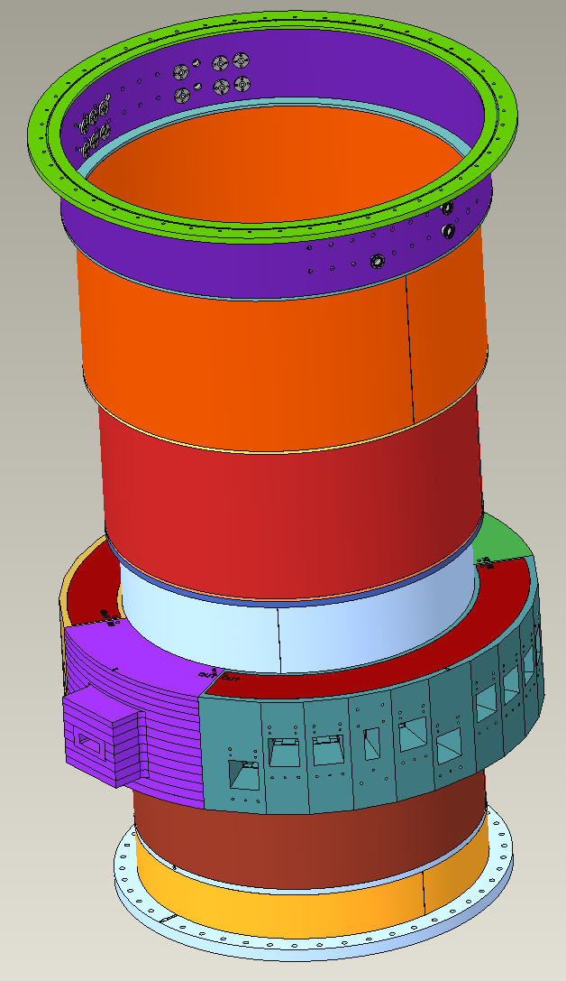
Cost Estimation Method
Metalex was contracted in the Fall of 2022 to provide budgetary pricing on the STS Core Vessel weldment and standard nozzle extensions
A fully detailed cost estimation from Metalex was received in Spring 2023
The Metalex budgetary quote was broken into sections representing different components within the Core Vessel
Changes to the beltline portion of the CV have occurred over the past 2 years as the design has been optimized for function and manufacturability

Slide 3
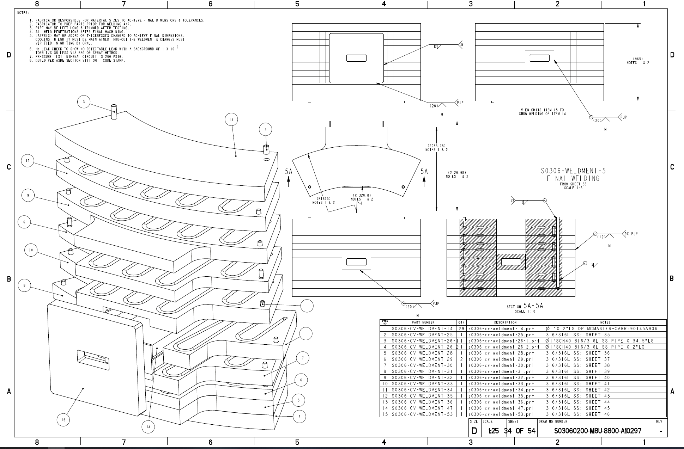
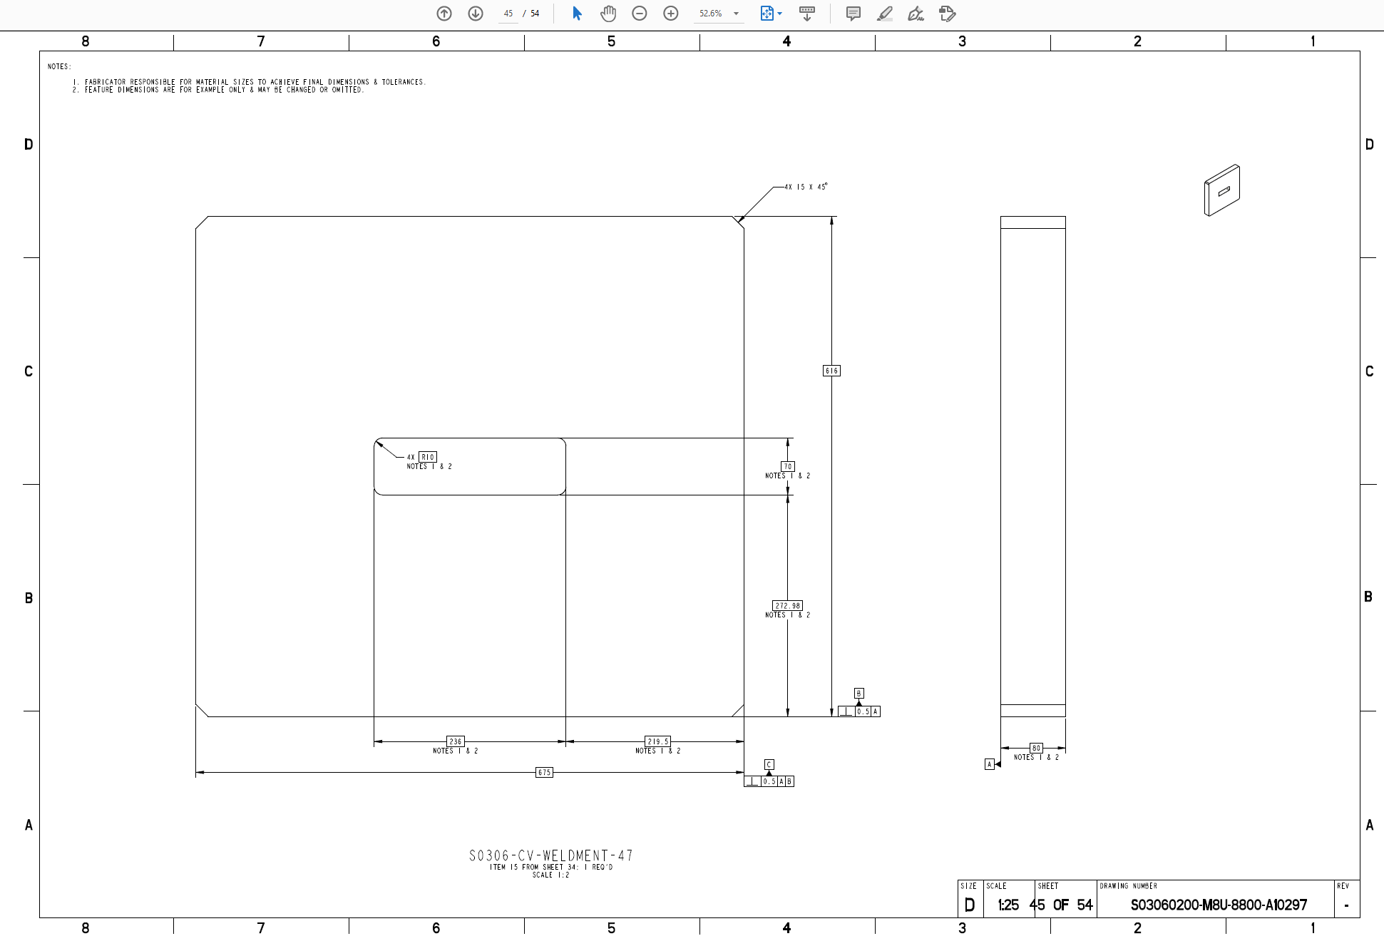
West beltline Plate -53
Interface plate between Core Vessel and PBW assembly
Material = Stainless Steel 316L
80mm x 616mm x 675mm

Slide 4
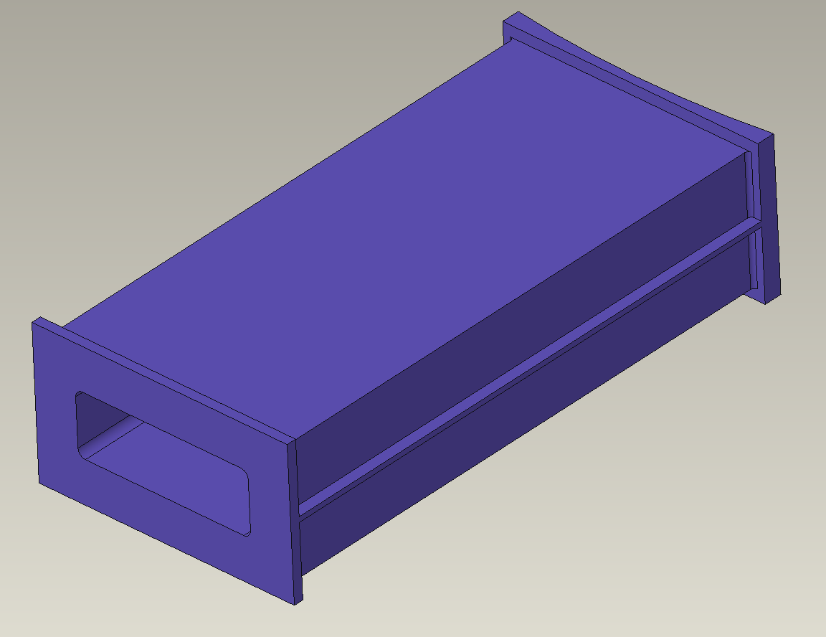
West beltline Plate -47
Proton beam flight port through CV Beltline
Material = Stainless Steel 316L
Machined from single forging
200mm x 358mm x 745mm

Slide 5
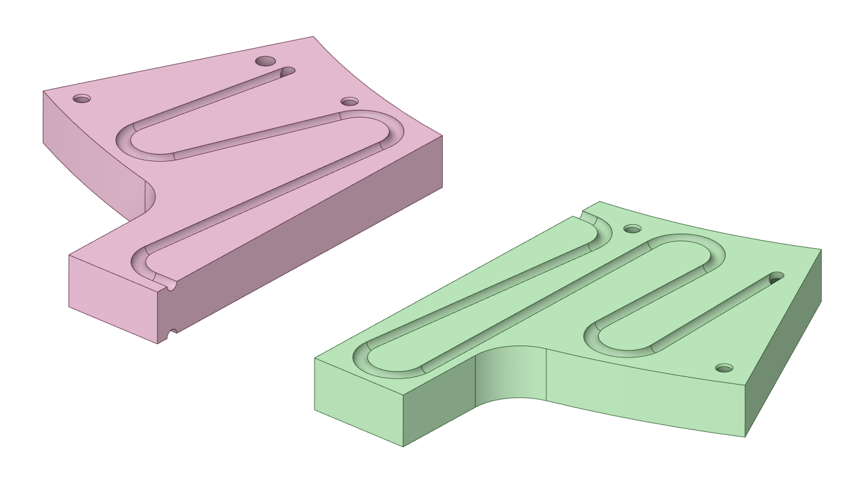
West beltline Plates -31, -34
West beltline cooled plates
Material = Stainless Steel 316L
102mm x 625mm x 700mm
Water channels on both sides

Slide 6
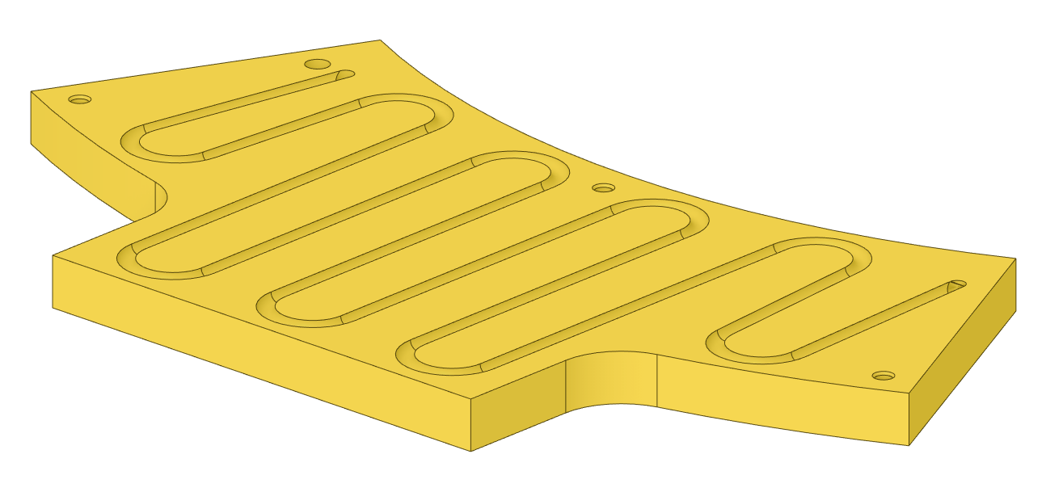
West beltline Plates
West beltline cooled plates
Material = Stainless Steel 316L
100mm x 800mm x 1600mm
Water channels on both sides

Slide 7
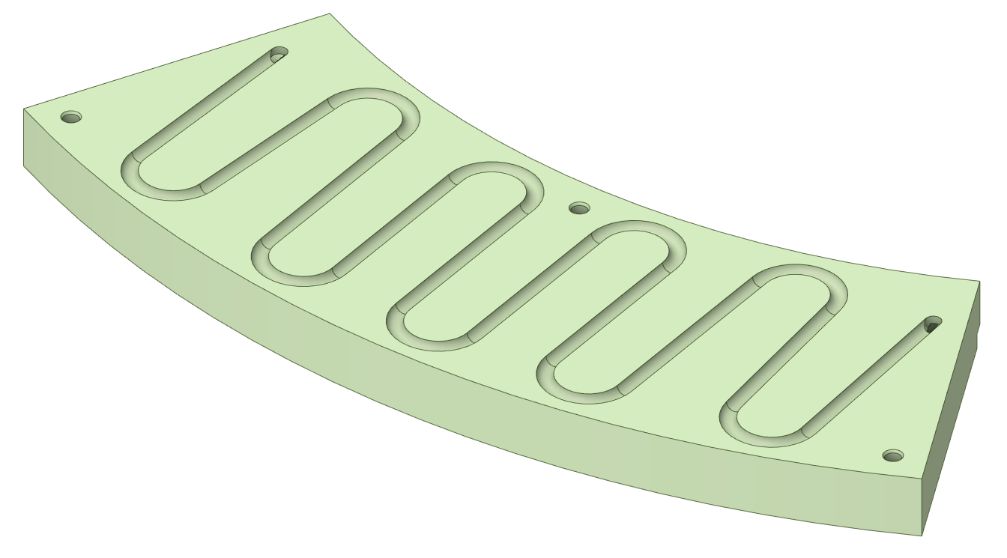
West beltline Plates -25, -36
West beltline cooled plates
Material = Stainless Steel 316L
100mm x 500mm x 1600mm
Water channels on 1 side

Slide 8
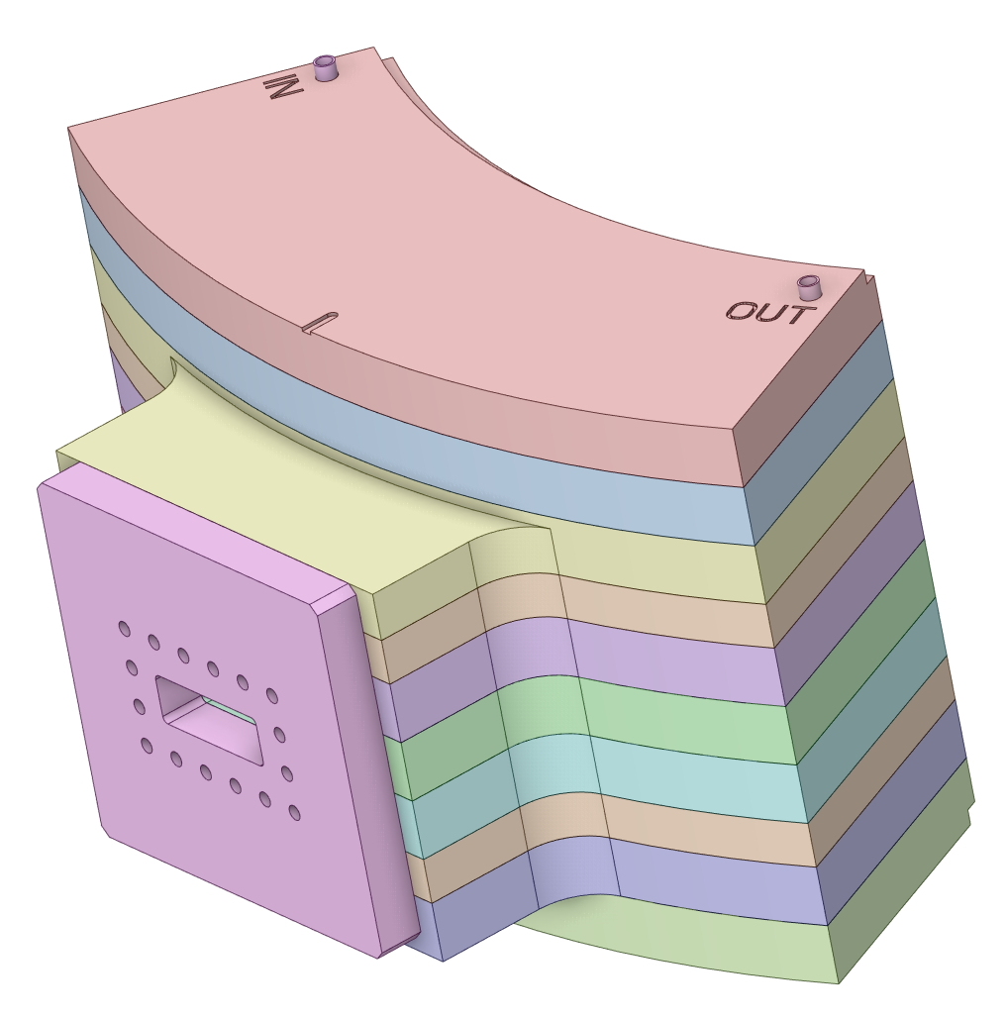
West beltline Welding -5
West beltline plates assembled and welded
Material = Stainless Steel 316L
Perimeter welding, 12mm groove
965mm tall

Slide 9
West beltline Overall Cost -5
Combined cost to fabricate west beltline to an intermediate state
Final machining of proton port, ID and PBW flange face done later

Slide 10
West beltline Overall Cost -5
Combined cost to fabricate west beltline to an intermediate state
Final machining of proton port, ID and PBW flange face done later

Slide 11
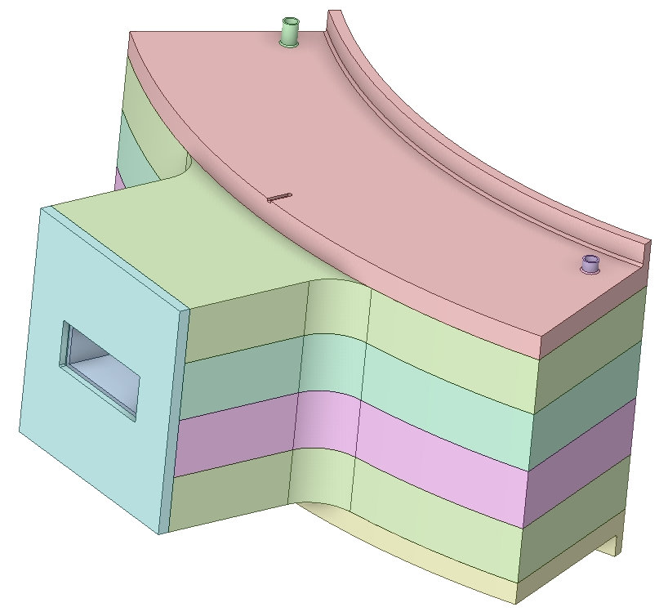
Updated West Beltline Overall Cost
Reduced height and OD
Reduced plate count
We plan to update this block from plates to a forging with vertical cooling holes

Slide 12
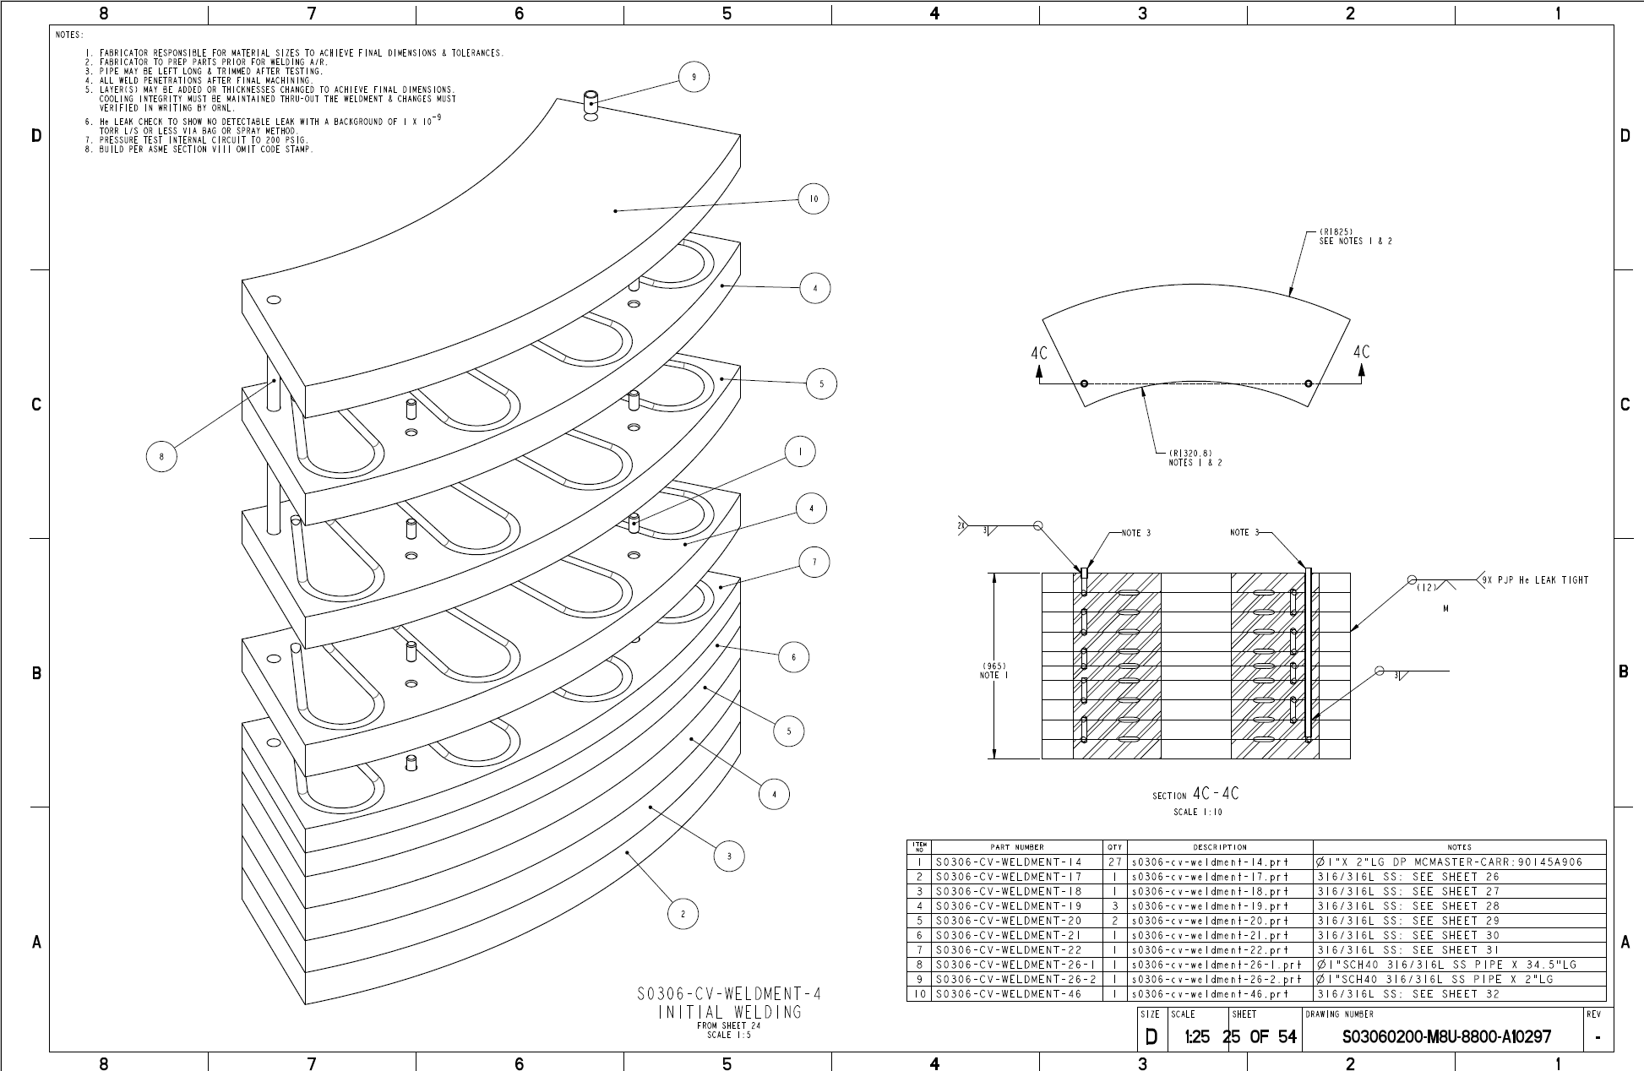
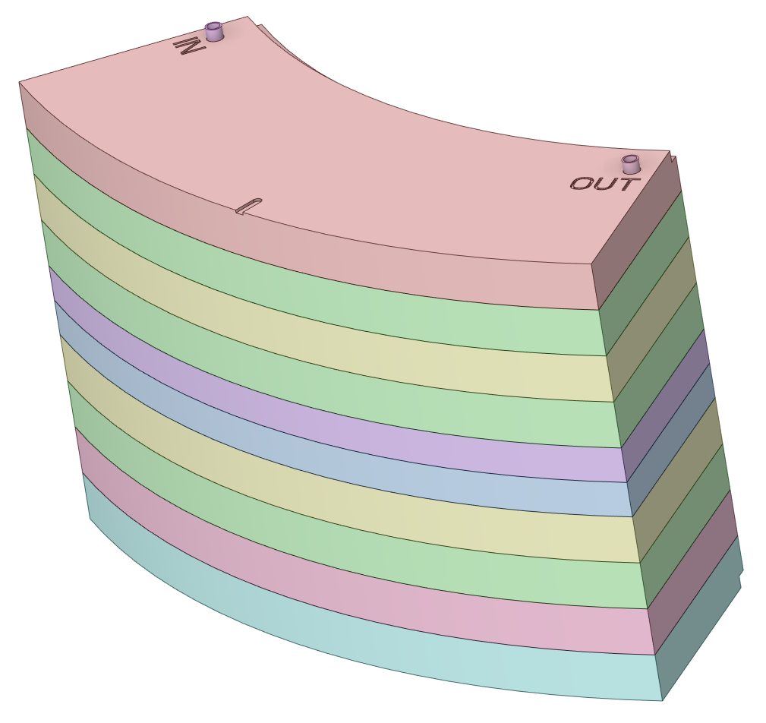
East beltline Overall Cost -4
Combined cost to fabricate west beltline to an intermediate state
Final machining of proton port, ID and PBW flange face done later

Slide 13
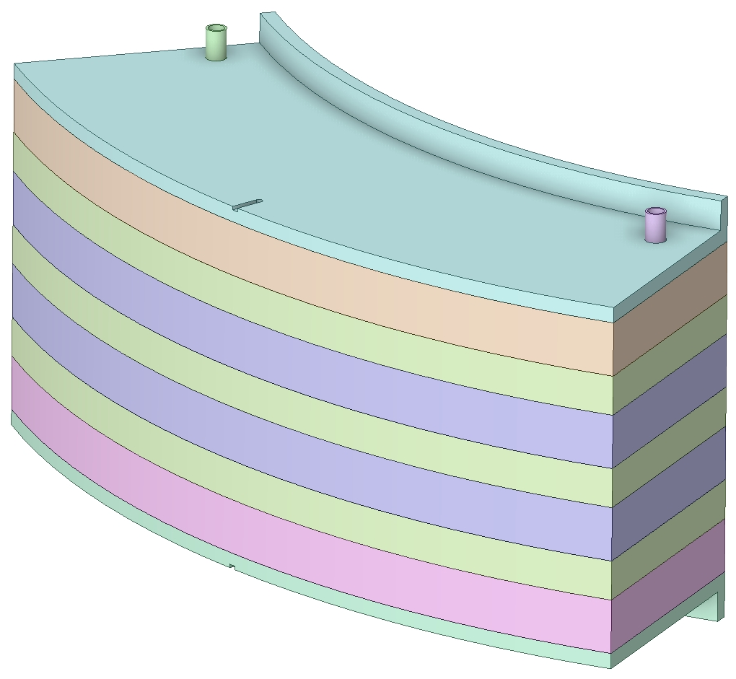
Updated East beltline Overall Cost
Reduced height and OD
Reduced plate count
We plan to update this block from plates to a forging with vertical cooling holes

Slide 14
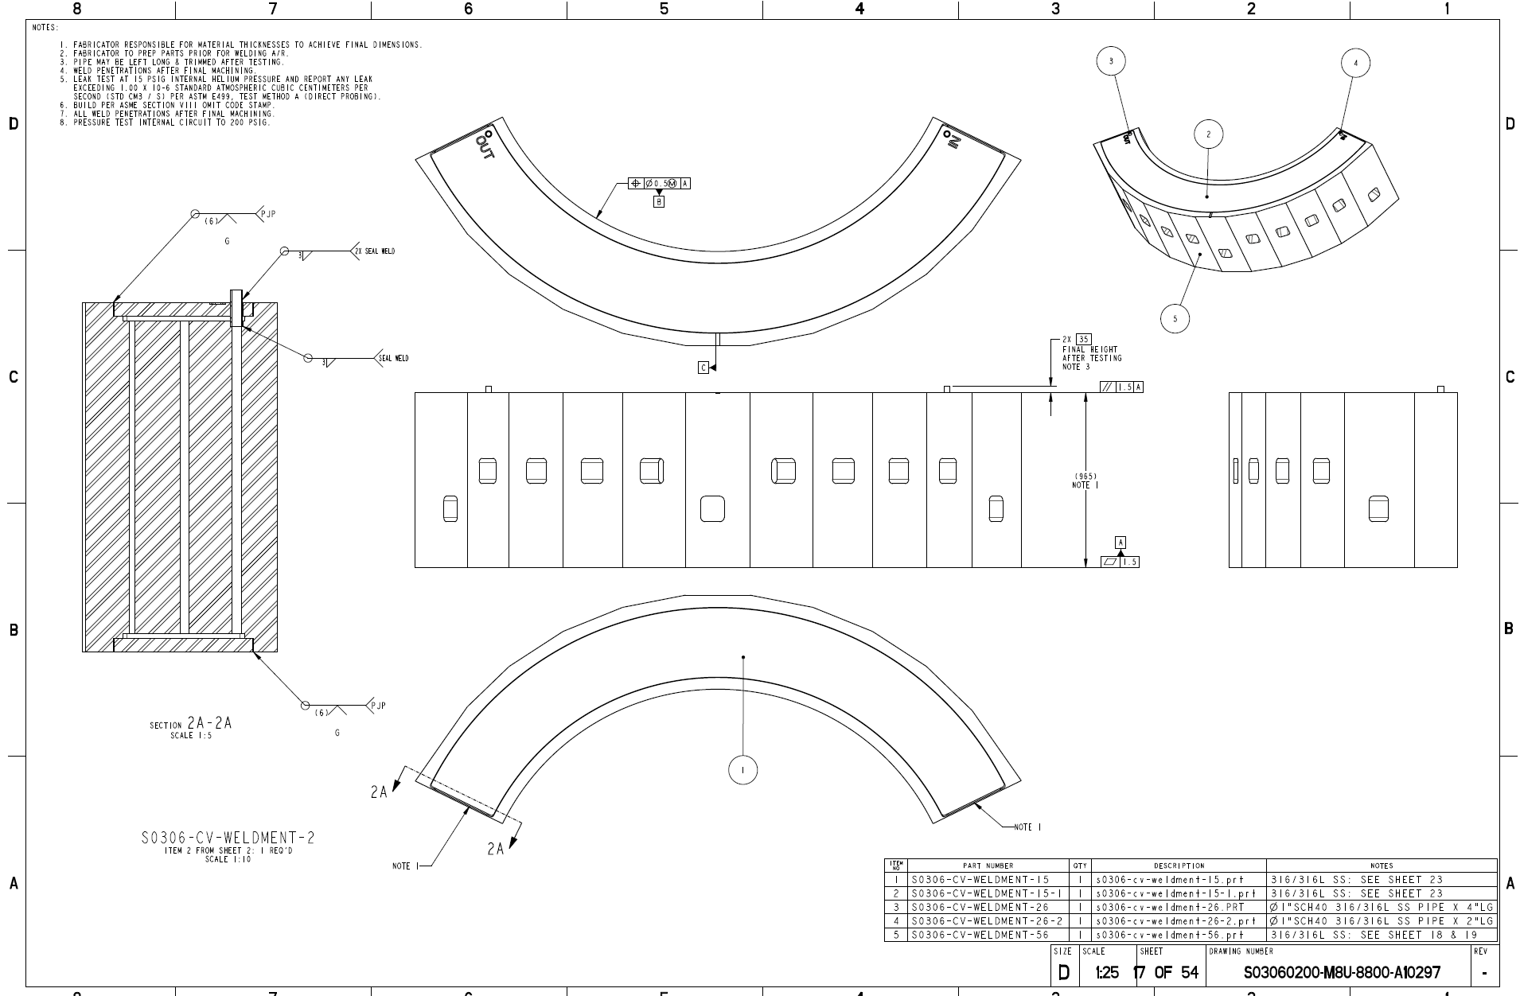
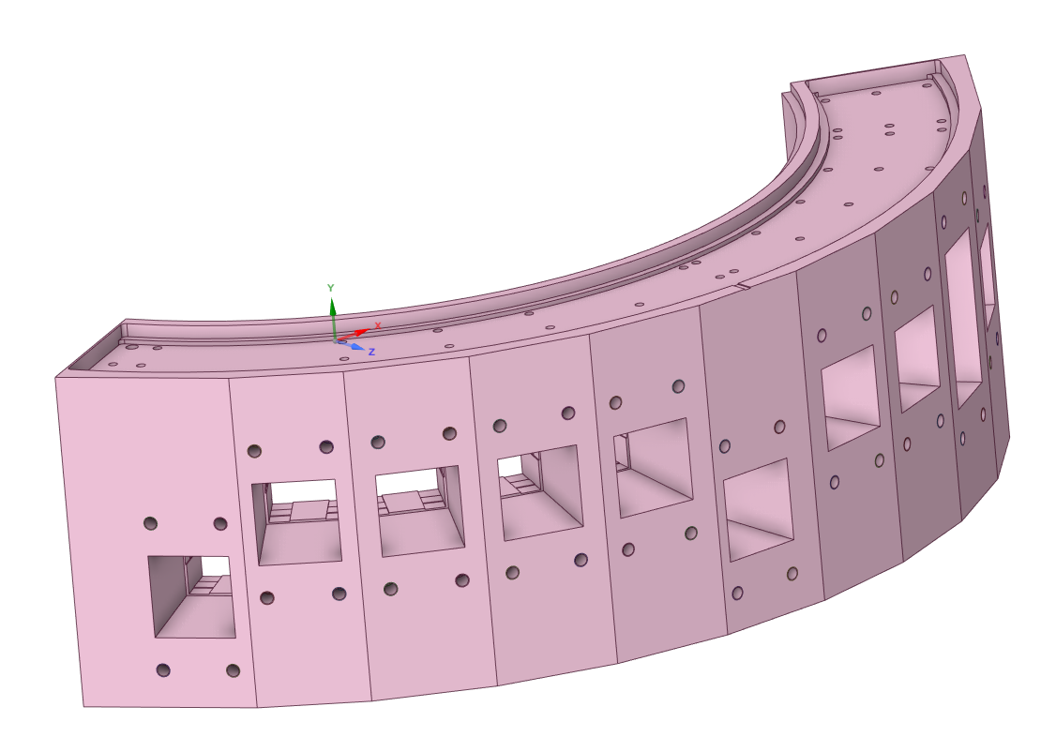
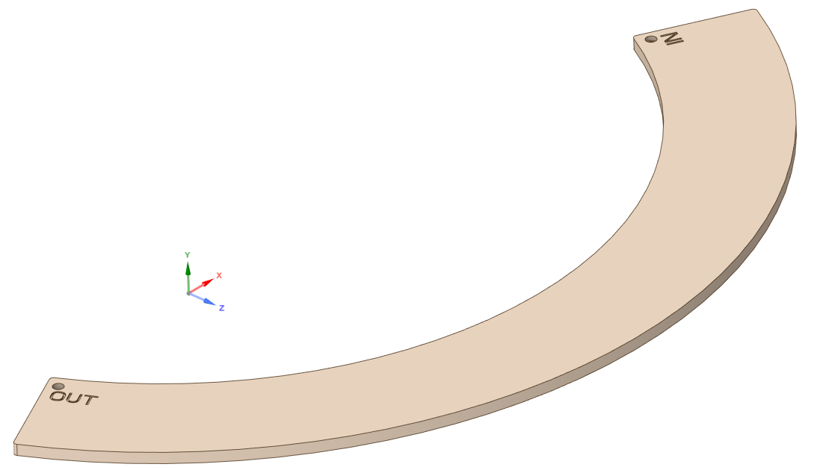
North and South beltline
North and south beltline forged block pre-weld machining
Material = Stainless Steel 316L
550mm x 1100mm x 3500mm forging
Rough mill outer profile and beam port holes

Slide 15
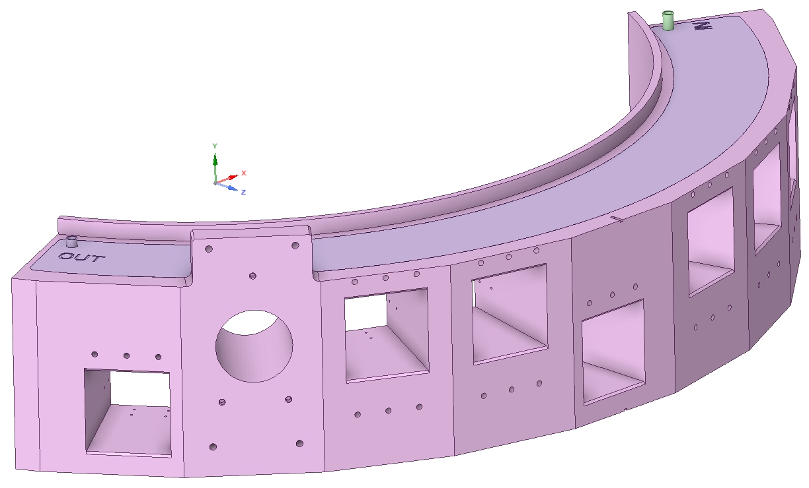
Updated East beltline Overall Cost
Reduced height and OD
Reduced vertical cooling holes
Added shim plates to monolith insert landing zones

Slide 16
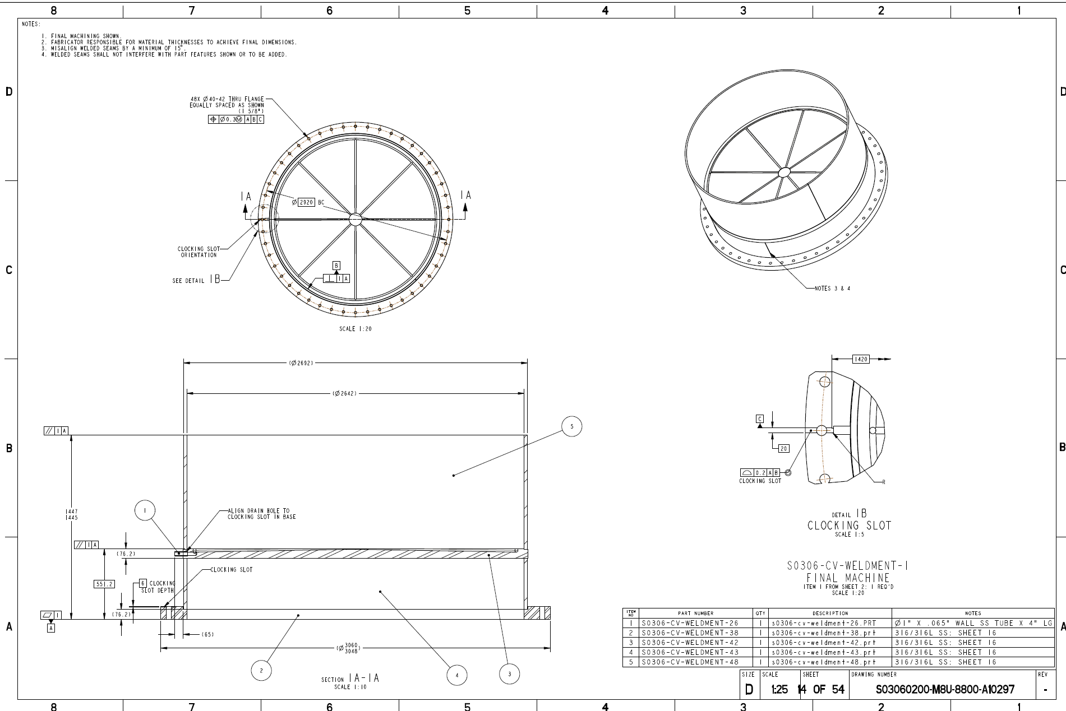
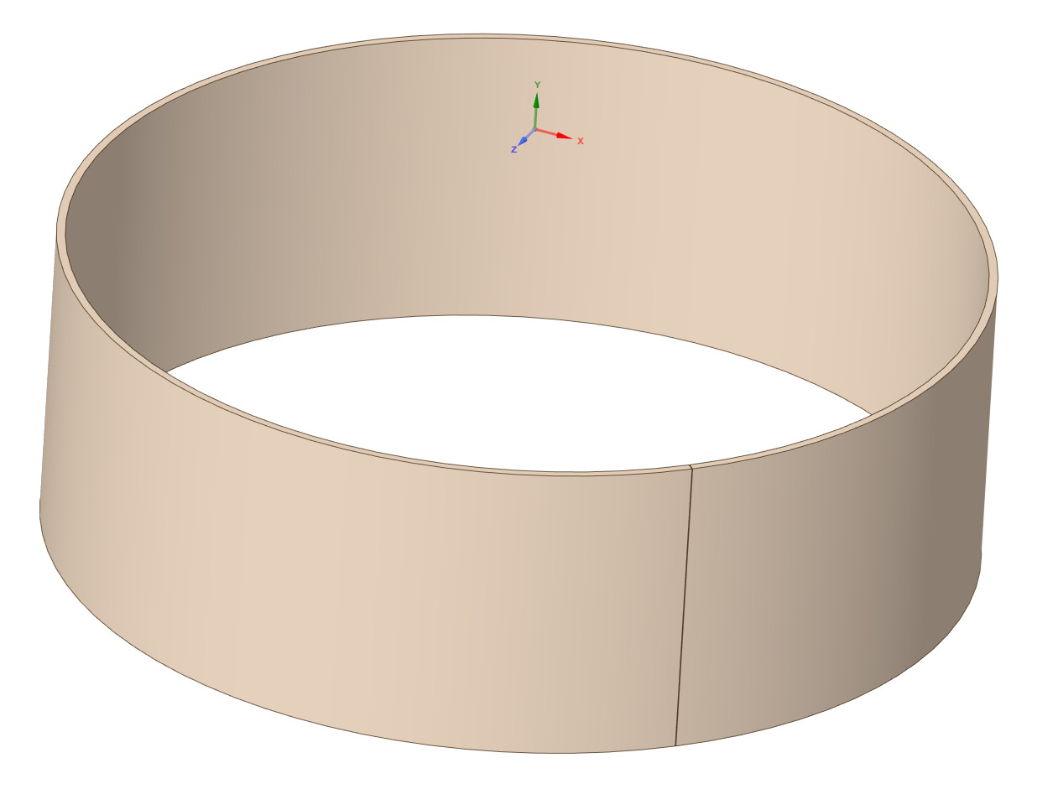
Lower Weldment Upper Shell
Material = Stainless Steel 316L
1’’ x 900mm x 2692mm OD
Rolled and welded shell

Slide 17
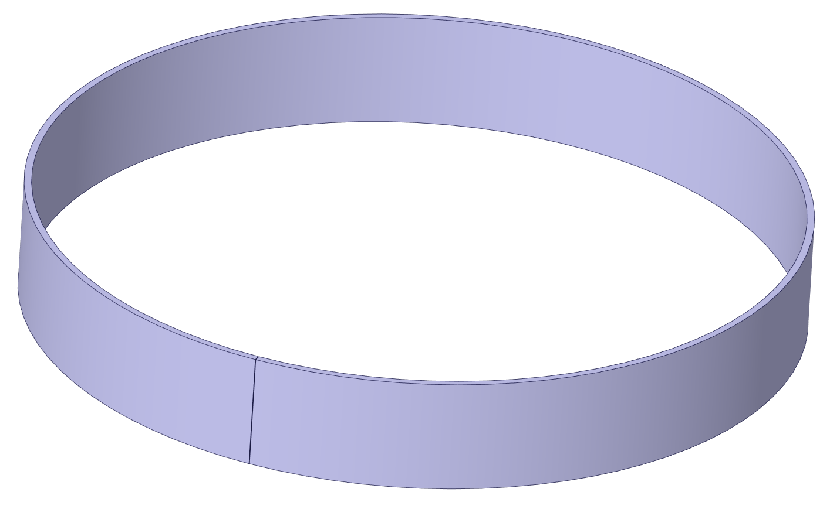
Lower Weldment Lower Shell
Material = Stainless Steel 316L
25.4mm x 400mm x 2692mm OD
Rolled and welded shell

Slide 18
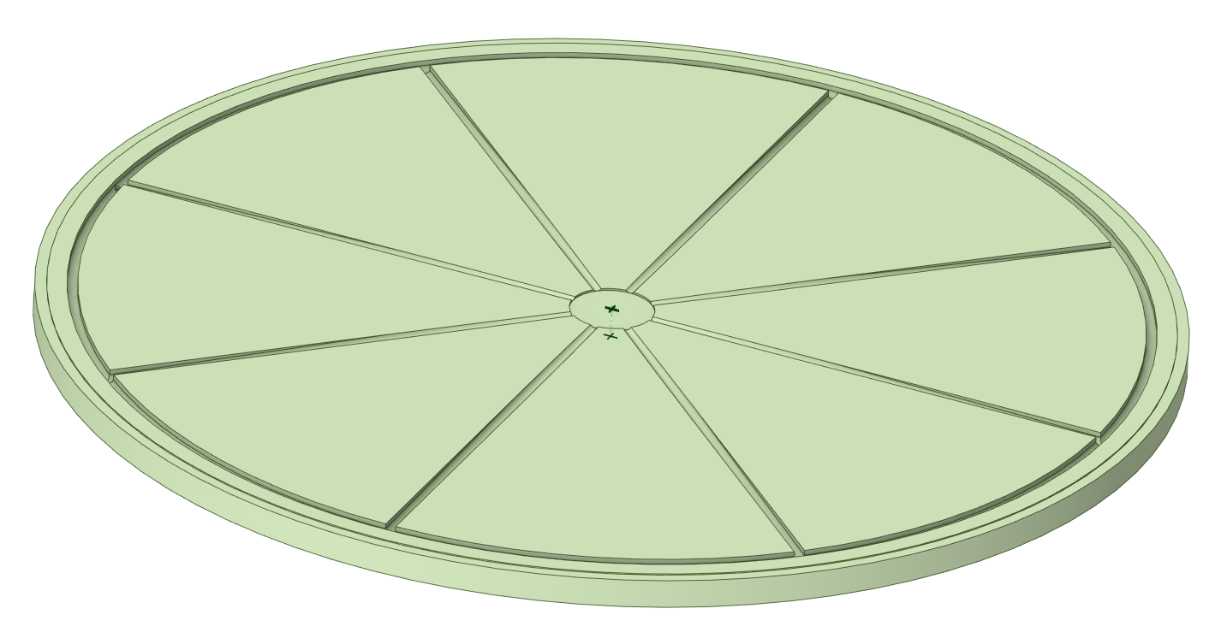
Lower Weldment Baseplate
Material = Stainless Steel 316L
76.2mm x 2696mm OD
Vendor has added weld necks to both sides of part (not shown) to ease plate to shell welding

Slide 19
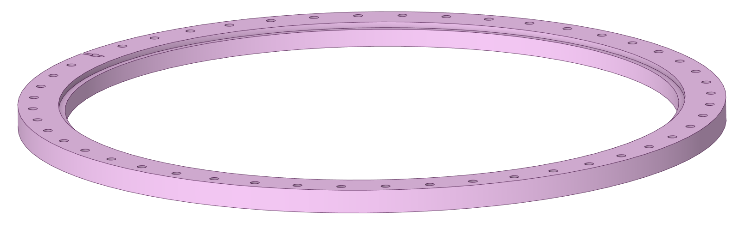
Lower Weldment Bottom Flange
Material = Stainless Steel 316L
101.6mm x 2641mm ID x 3048mm OD
Vendor has added weld neck to top side of part (not shown) to ease plate to shell welding

Slide 20
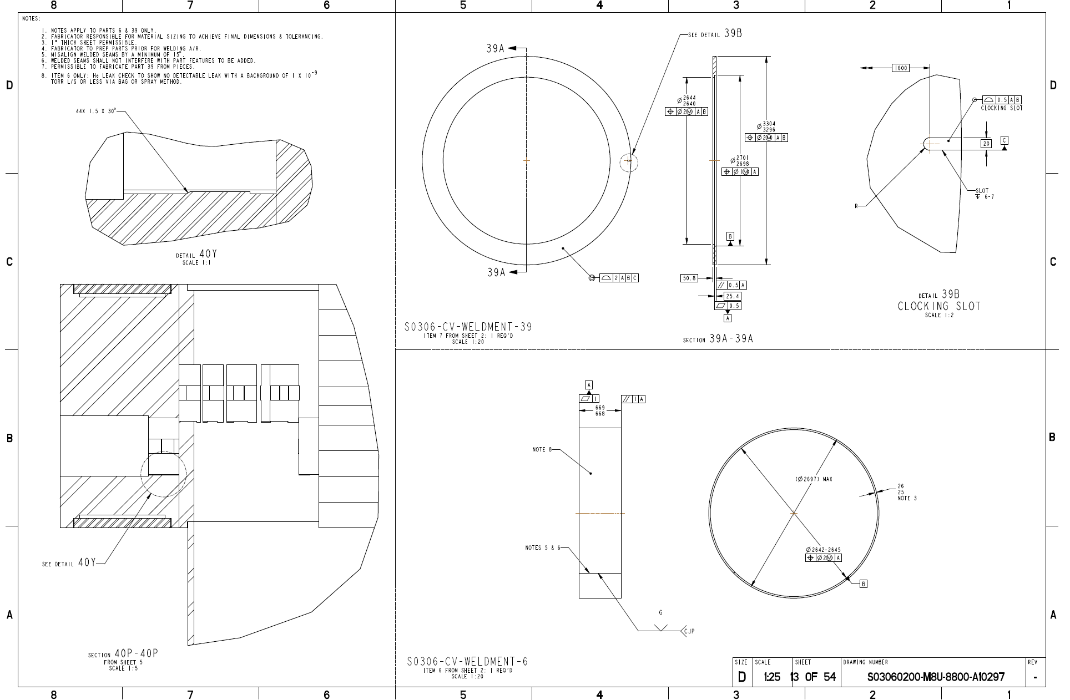
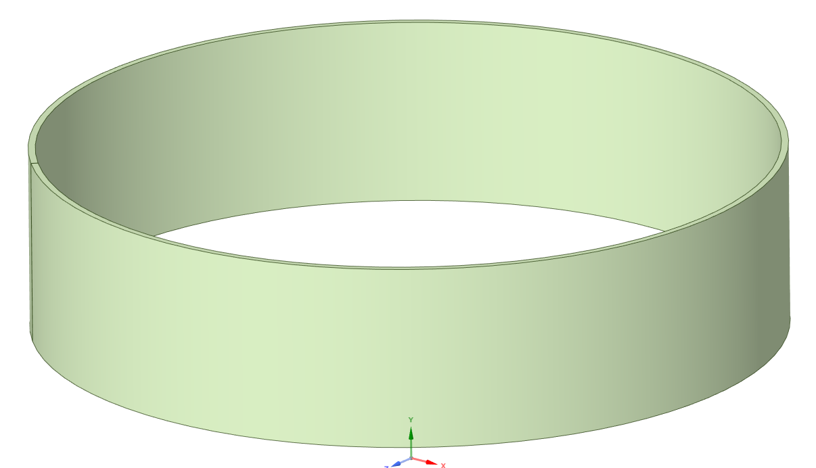
Lower Weldment Top Shell
Material = Stainless Steel 316L
25.4mm x 670mm x 2692mm OD
Rolled and welded shell

Slide 21
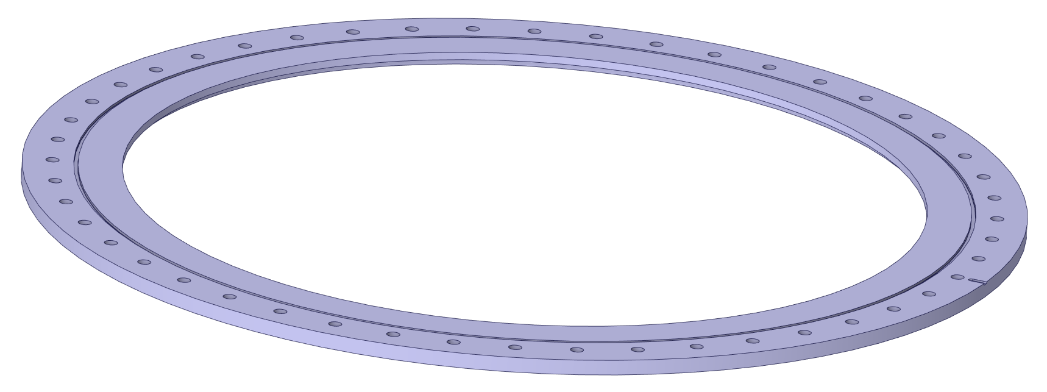
Lower Weldment Baseplate
Material = Stainless Steel 316L
50.8mm x 2641mm ID x 3300mm OD
Vendor has added weld neck to bottom side of part (not shown) to ease plate to shell welding

Slide 22
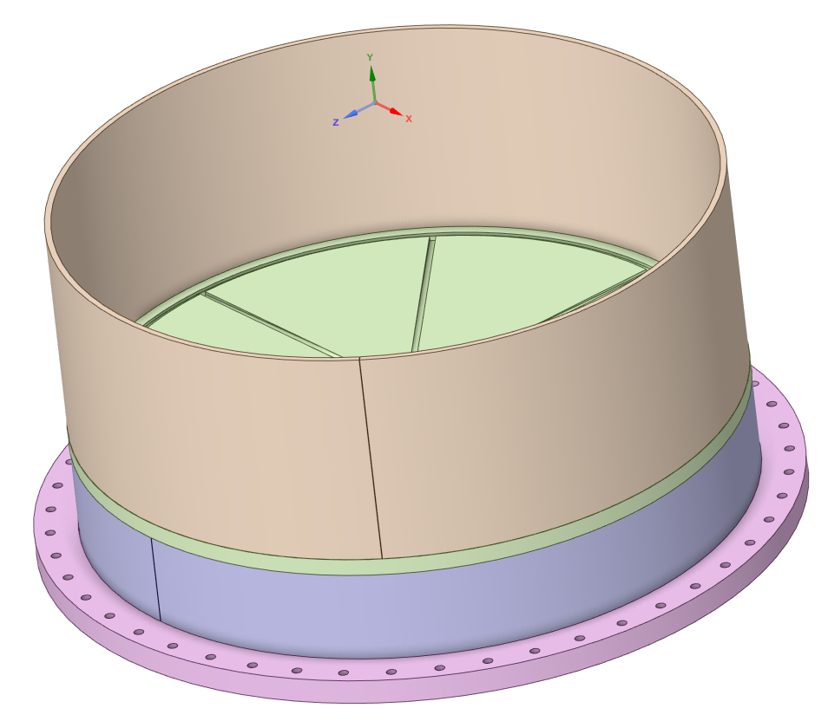
Lower Weldment Welding
Material = Stainless Steel 316L
Lower weldment assembled and welded
Full penetration shell welds
Intermediate machining completed

Slide 23
Lower Weldment Overall Cost
Material = Stainless Steel 316L
Lower weldment assembled and welded
Full penetration shell welds
Intermediate machining completed

Slide 24
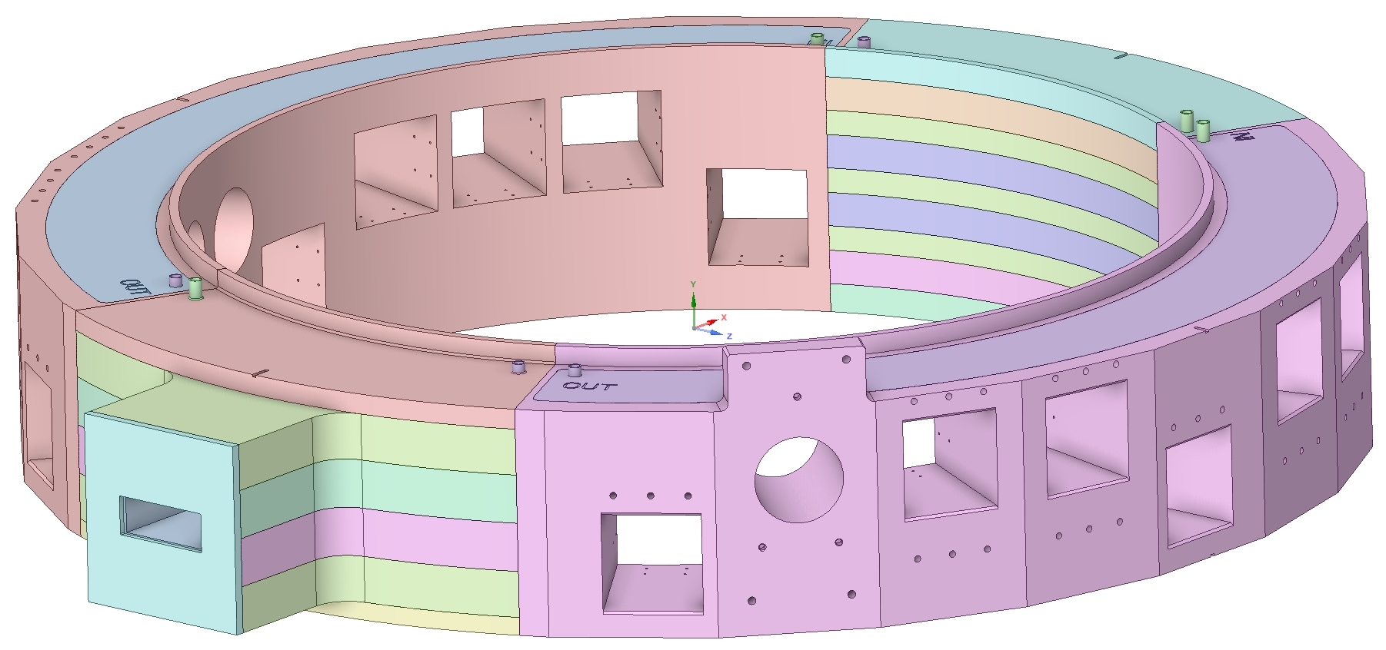
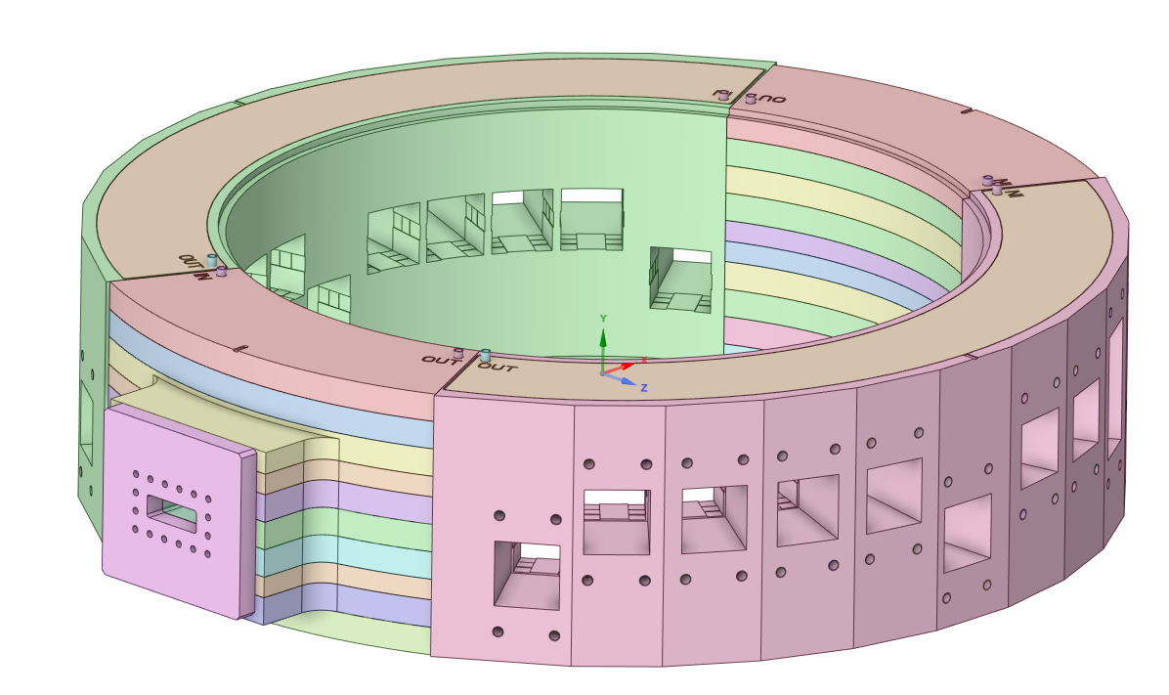
Beltline Final Welding
Material = Stainless Steel 316L
Beltline fitted and welded
Intermediate machining completed

Slide 25
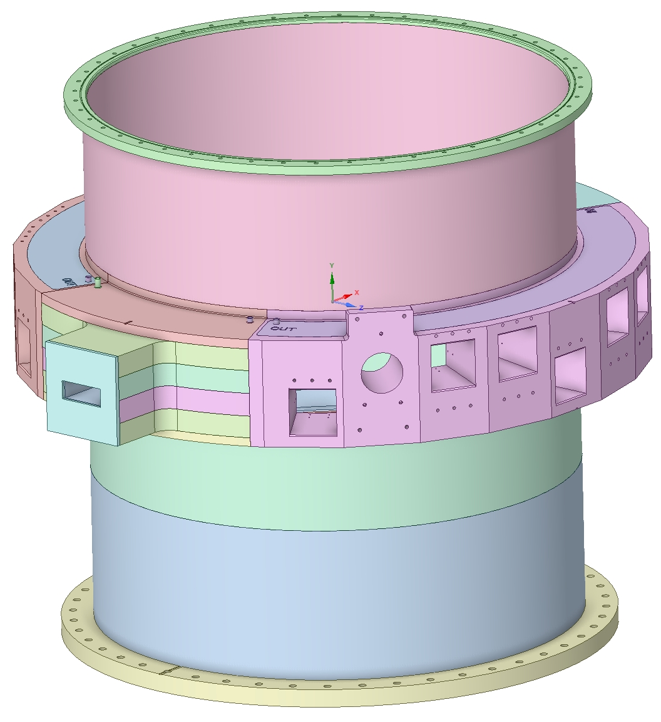
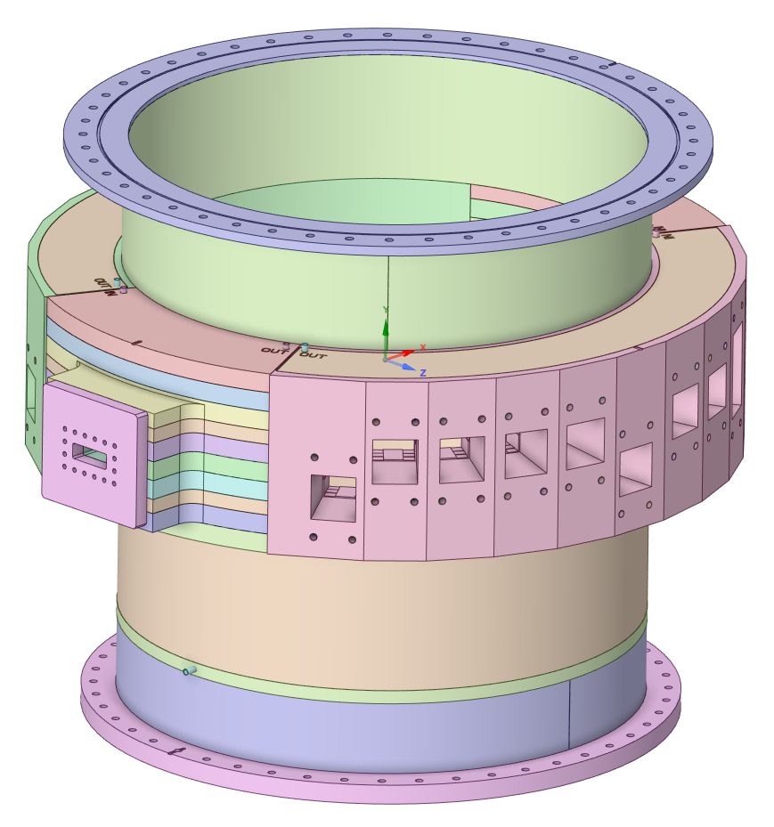
Lower Weldment Final Fab.
Material = Stainless Steel 316L
Final welding
Final machining

Slide 26
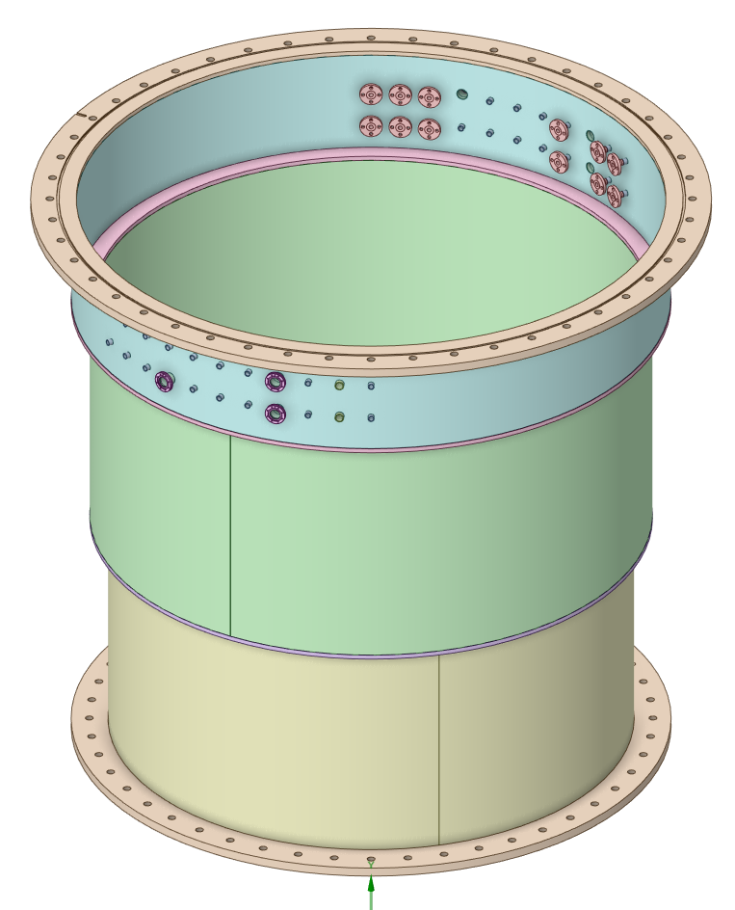
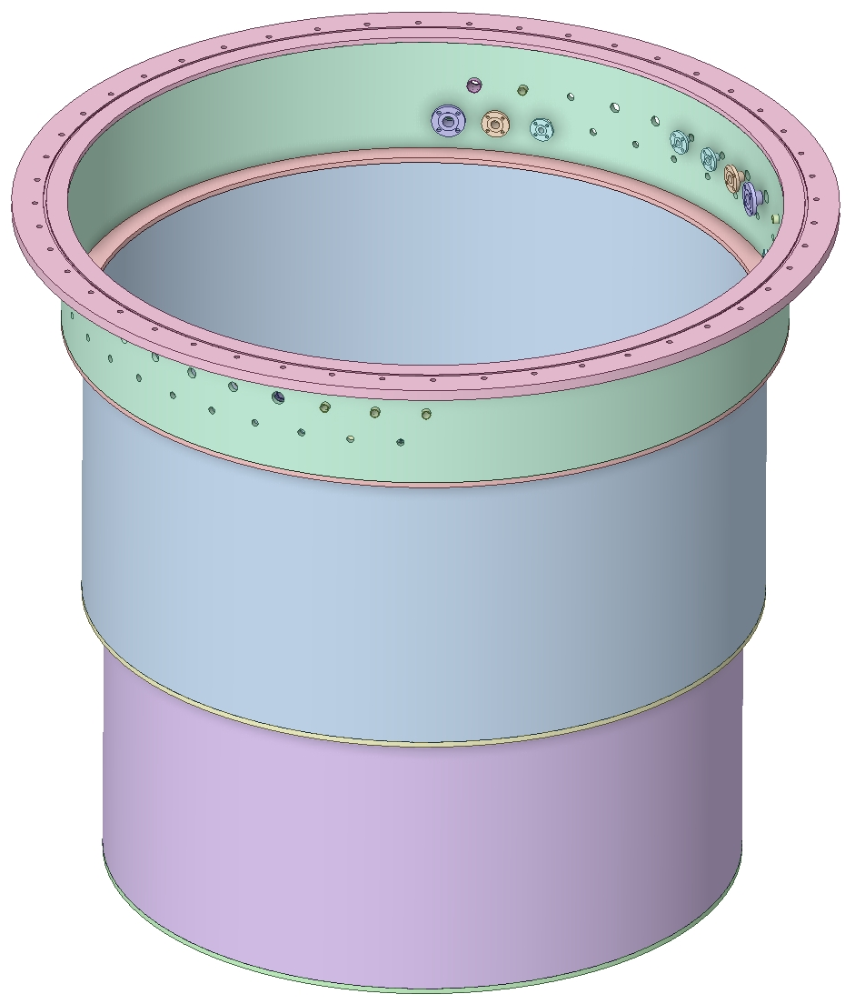
Upper Weldment Final Cost
Weldment fabricated by outside vendor (reflected in material costs)
Final machining and nozzle welding by Metalex
Minor revisions to upper weldment design not expected to impact overall cost estimation

Slide 27
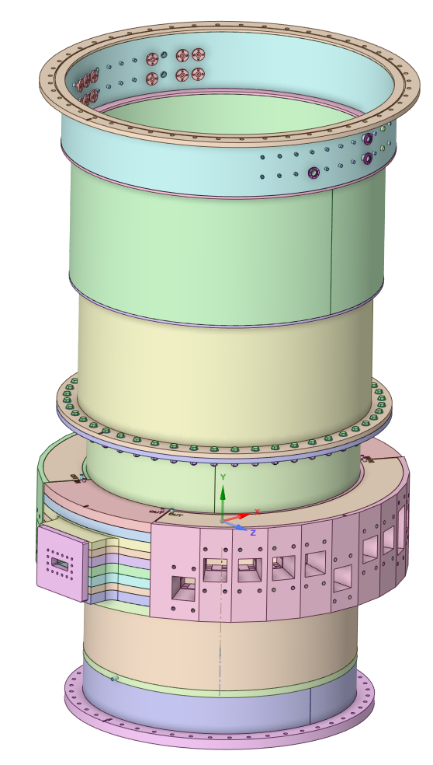
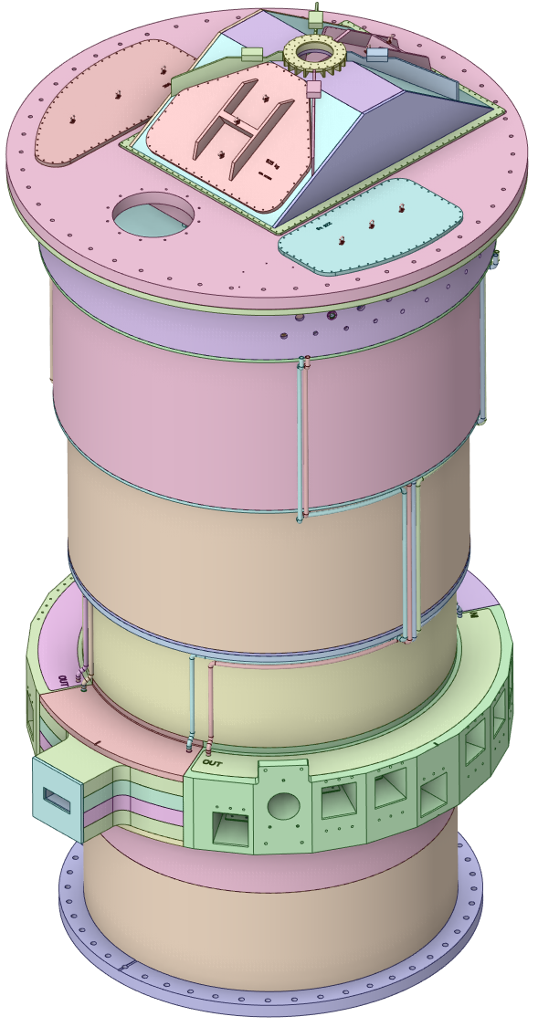
Core Vessel Overall Costs
CV Lid was not included in original cost estimation
An outdated CV lid cost estimate is included in the revised cost
A cost reduction of ~ $ 1.8M is estimated due to design updates

Slide 28
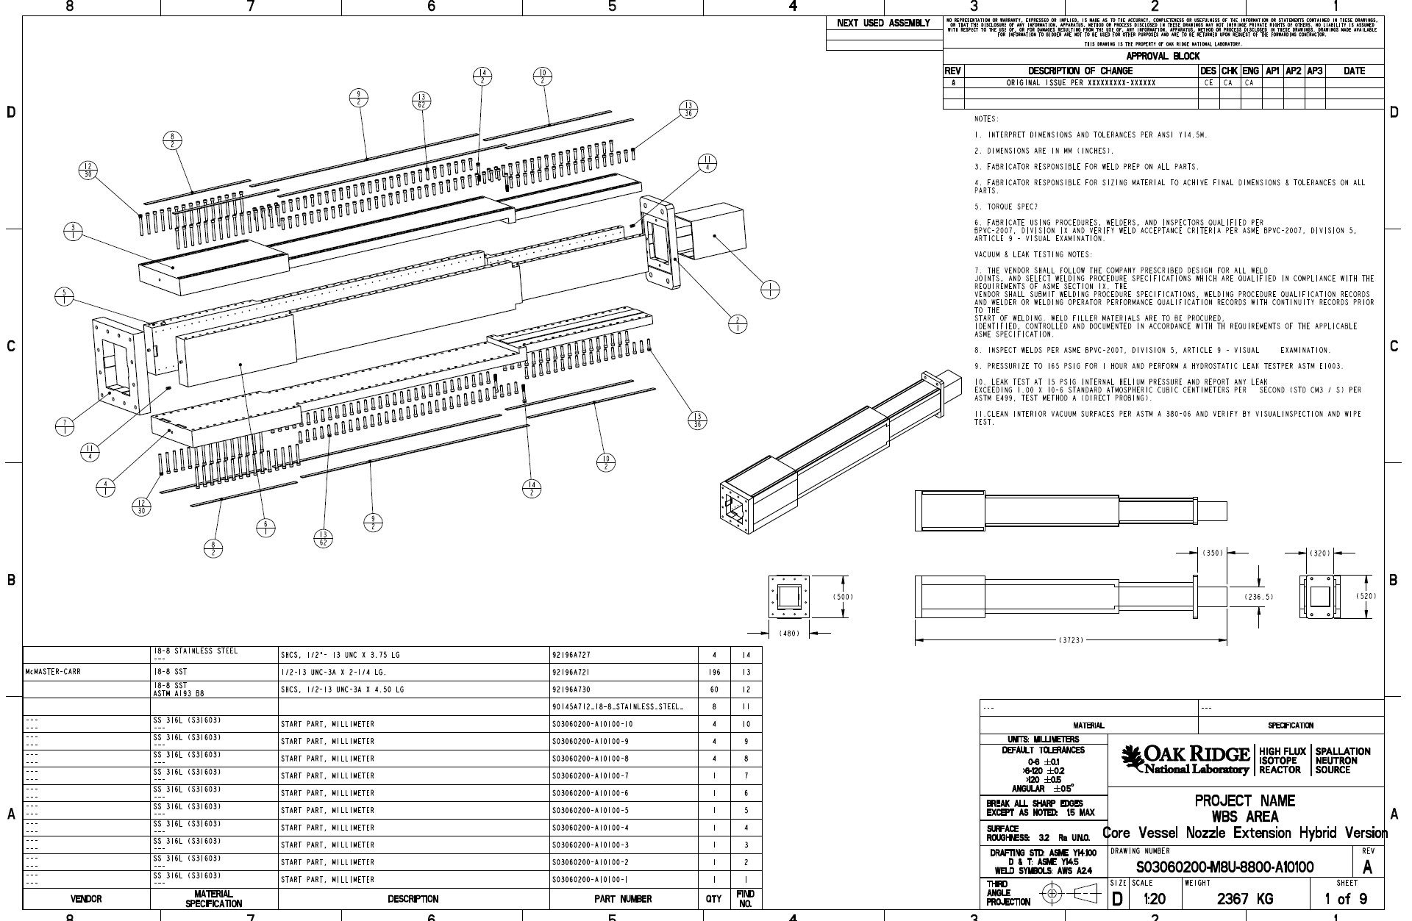
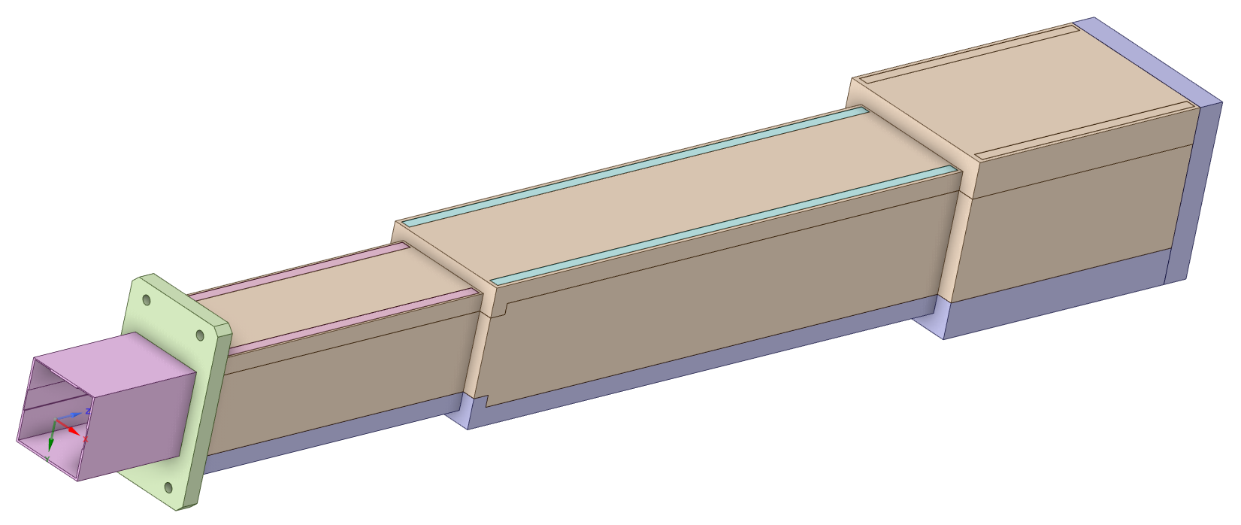
Standard Nozzle Extension estimate
Bolted and welded design
Material = Stainless Steel 316L
Both first article with NRE and Unit 2-22 costs shown below

Slide 29
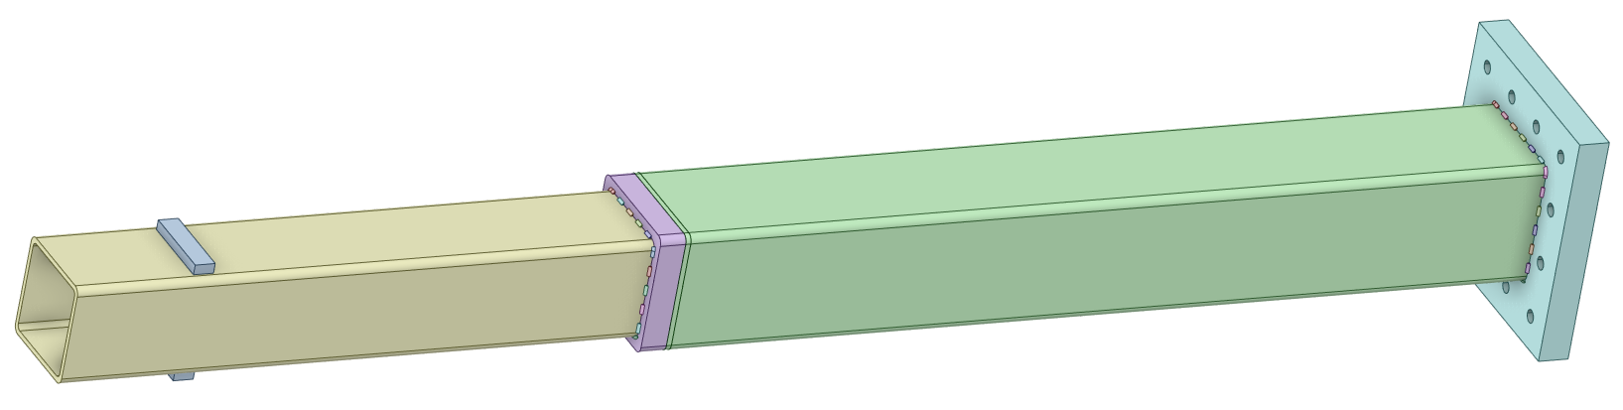
Standard Nozzle Extension estimate
COTS tube based design
Material = Stainless Steel 316L
Cost savings of ~ $485,000 per nozzle
Much less welding and machining provides a more reliable design

Slide 30
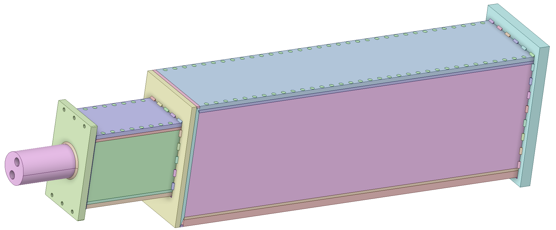
QIKR Nozzle Extension estimate
Bolted and welded design (similar to original nozzle design)
Material = Stainless Steel 316L
Qty 1 QIKR nozzle

Slide 31
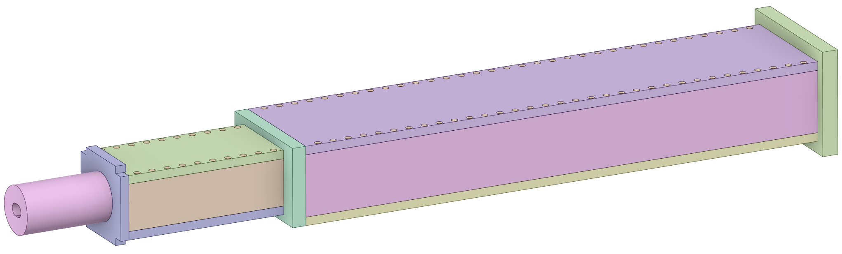
Dual Channel Nozzle Extension estimate
Added to the project scope in 2024
Bolted and welded design (similar to original nozzle design)
Material = Stainless Steel 316L
Qty 2 Dual Channel nozzle

Slide 32
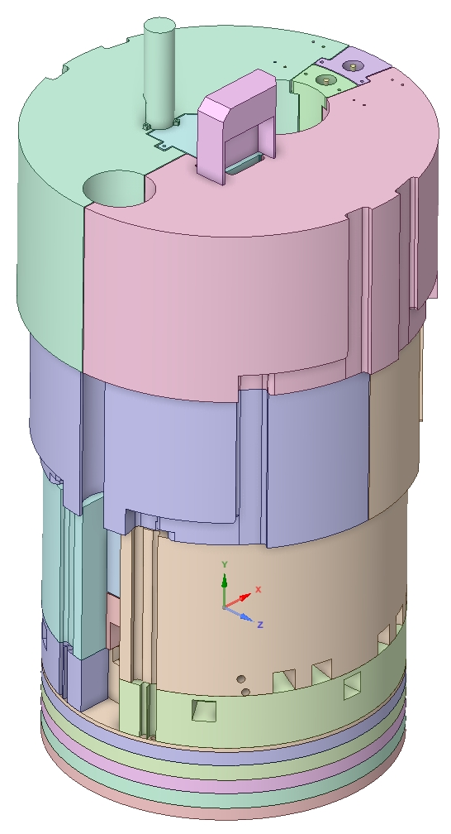
Core Vessel Shielding Cost Estimate
Cooled shield blocks (316LSS) estimates based off of East and West beltline (laminated) designs
Uncooled blocks made from low cost carbon secondary plate steel
Rough estimates based on mass

Slide 33
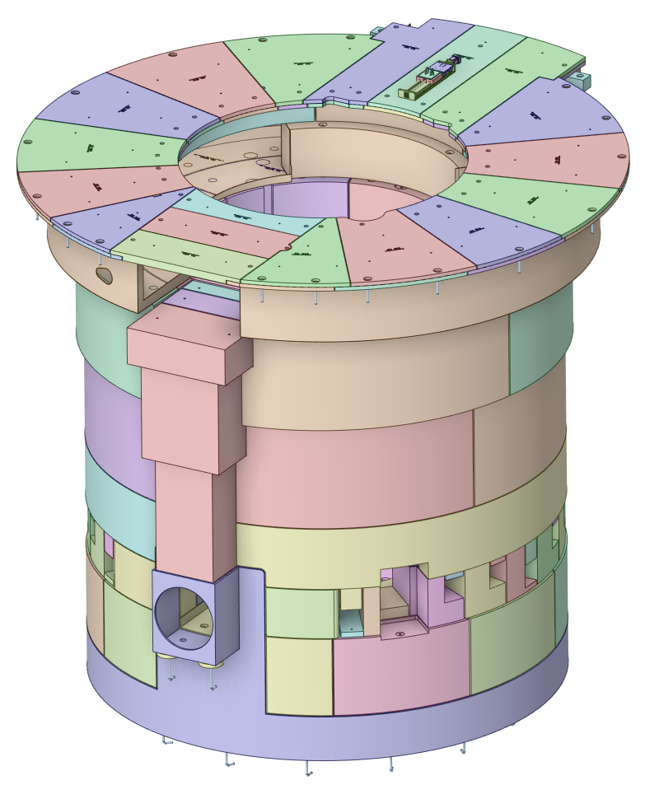
Bulk and Removable Shielding Cost Estimate
Shield blocks made from low cost carbon secondary plate steel
Rough estimates based on mass
Based on outdated block design, but overall mass is accurate

Slide 34
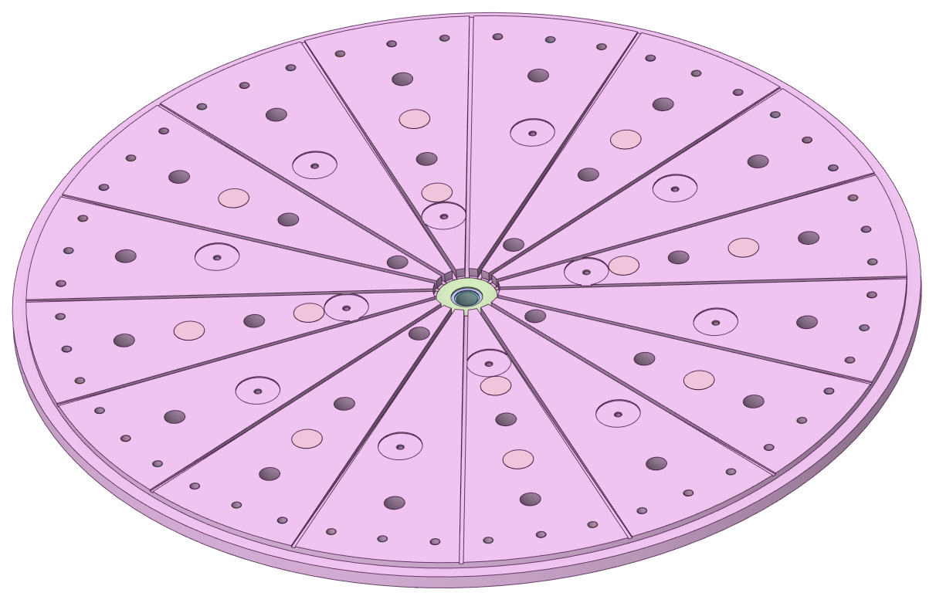
Core Vessel Baseplate Cost Estimate
Made from A36 carbon steel plate
Estimate based on a more simplified design with less thru holes
Based on 2023 material pricing
Latest design has increased in thickness from 75 mm to 100 mm

Slide 35
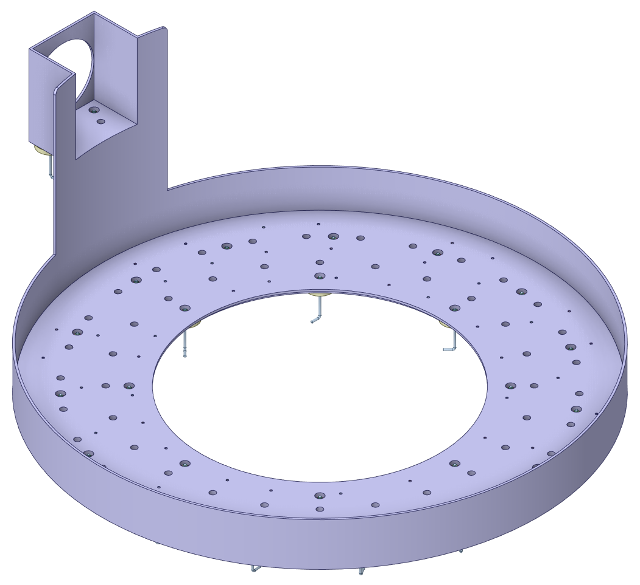
Bulk Shielding Liner Cost Estimate
Made from A36 carbon steel plate
Estimate based on a more simplified design with less thru holes
Based on 2023 material pricing
Latest design bottom plate has increased in thickness from 25 mm to 75 mm

Slide 36
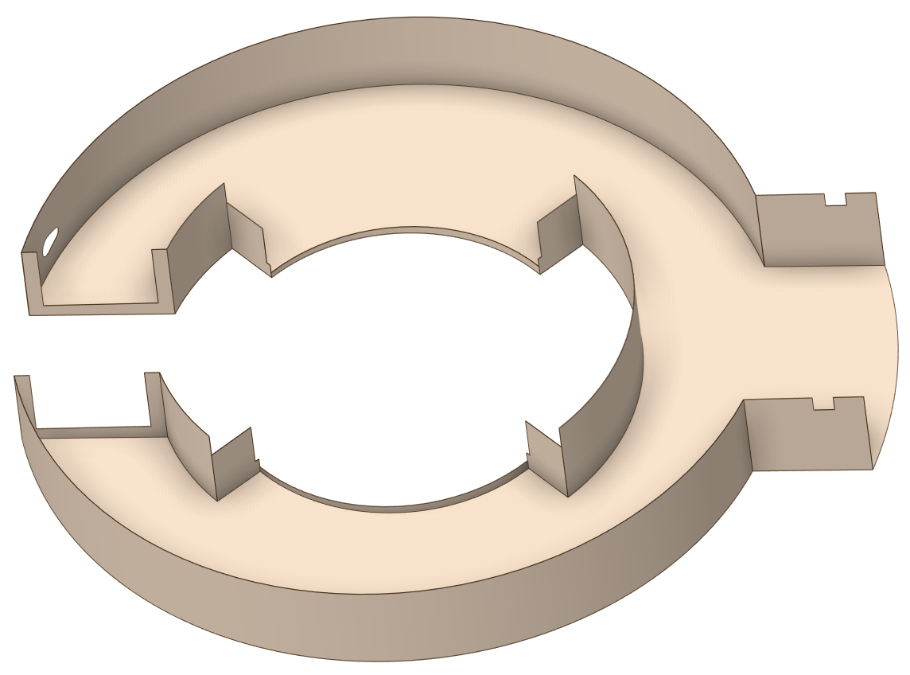
Pipe Pan Cost Estimate
Made from 16 Ga 316LSS sheet
Welded in place during installation
Based on 2023 material pricing
Sheet laser cut to size
Rolling costs included in material cost

Slide 37
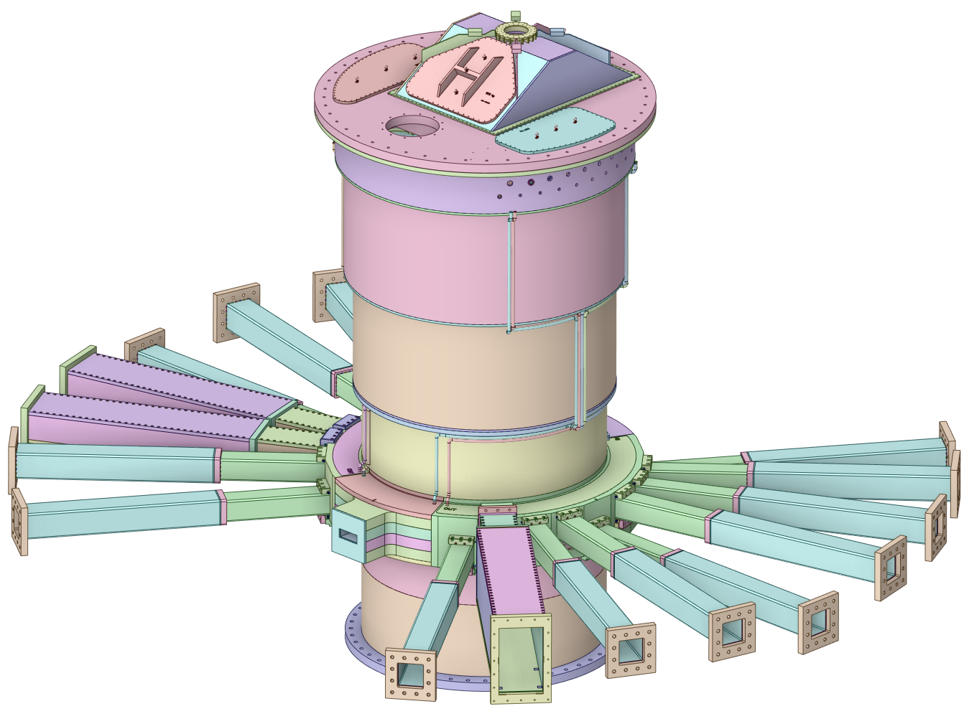
Vessel Systems Cost Estimate Summary
Total estimated procurement cost = $9.382M
Based on 2023 cost estimations in non-escalated state

Slide 38
Target Station Shielding Cost Estimate Summary
Total estimated procurement cost = $2.344M
Based on 2023 cost estimations in non-escalated state
Assumes use of secondary steel fabricated to shape at a cost of $2.20/lb

Slide 39
Future Cost Estimation Efforts during final design
Revise cost estimations based on current market material costs
Detailed cost estimate of CV lid
  Current lid complexity is significantly increased
Add cost of nozzle extension brackets and hardware
Add cost of CV lid hatches
Add cost of TVP utility shields
Add cost of gamma gate assembly

