Slide 1
Vessel Systems and Target Station Shielding Preliminary Design
Chris Anton
Cam Eiland
Hogan Knott
Darren Dugan
Mike Strong
April 21, 2025

Slide 2
S.03.06 Vessel Systems and S.03.07 Target Station Shielding
Vessel Systems
Target Station Shielding

Slide 3
Vessel Systems Scope
Gamma Gate Assembly
Core Vessel Assembly
Core Vessel Shielding Assembly
Nozzle Extension Assemblies

Slide 4
Core Vessel Assembly
Utility Hatch
Target Segment
Access Hatch
MRA Access Hatch
CV Lid Tent
CV Primary Lid
Utility Hatch
CV Upper Weldment
CV Lower Weldment

Slide 5
Core Vessel Lower Weldment Details
CV Center Split Flange
Key Features:
Contain CV environment (vacuum or helium)
Support internal shielding and technical components
Leak collection and draining
Allow passing of proton beam
Support and alignment of monolith inserts containing guide optics
Minimal thermal deflection due to beam operation required to maintain guide optic alignment
Design for manufacturability to reduce procurement cost and schedule
Lower Weldment Upper Shell
CV Beltline
Lower Weldment Lower Shell
CV Drain
CV Bottom Plate
CV Skirt
CV Bottom Flange

Slide 6
Core Vessel Lower Weldment Details
CV Split Flange with weld prep and o-ring groove
25 mm rolled and welded vacuum shell
Dual Channel and QIKR nozzle extensions weld to ID of beltline
Flood cooled north and south beltline quadrants
Monolith insert alignment shim mounting holes
PBW Sealing Interface
Laminated east and west beltline quadrants
Proton Beam Clearance Opening
25 mm rolled and welded vacuum shell
Sits below tan skirt shelf
Drainage grooves
Weight of internal shielding supported here
Core Vessel drain hole
100 mm thick rolled and welded shell
Alignment Notches set orientation of CV in monolith
Clearance holes allow for CV fine alignment
100 mm thick flange bolts to CV Baseplate

Slide 7
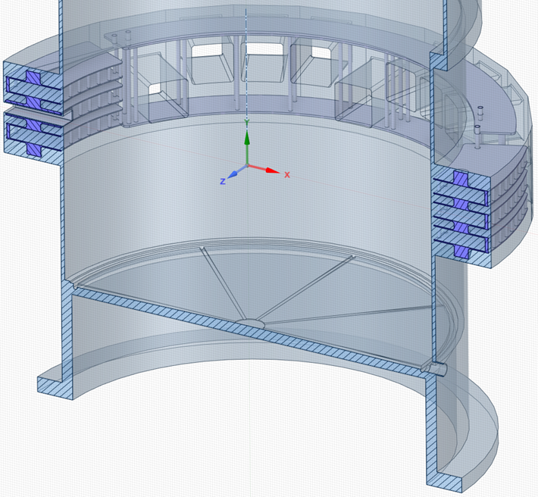
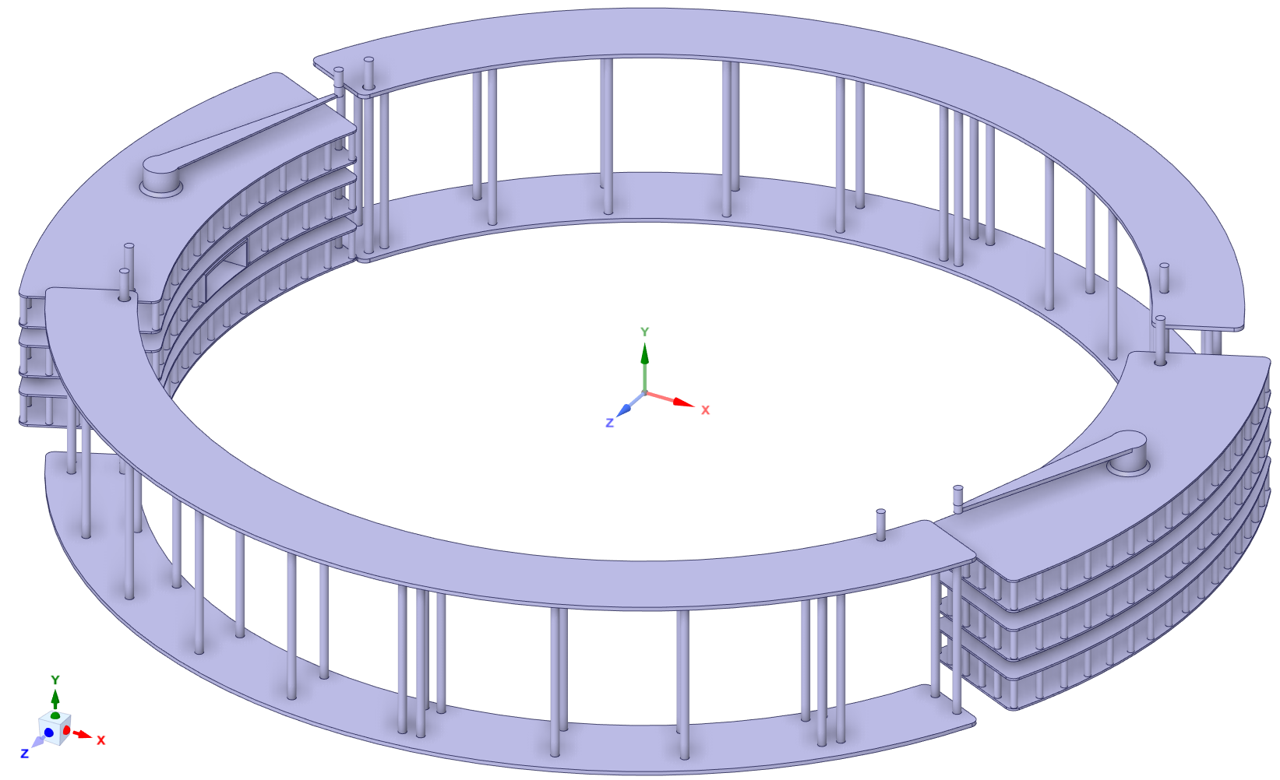
Core Vessel Beltline Details
Forged cooling block design
Laminated cooling block design
Pros
Much less welding
Less weld distortion
Less post-weld machining
Greater reliability
Greater flexibility in cooling designs
Cons
Raw material cost is higher
Limited suppliers for large forgings
Pros
316 plates are easy to source
Cons
Complex welding required
Extensive post-weld machining
Reduced reliability

Slide 8
Core Vessel Upper Weldment Details
Utility nozzles accommodate water cooling, helium filling and sensor passthroughs
Thick top flange to reduce vacuum induced deflections
Key Characteristics:
Contain CV environment (vacuum or helium)
Minimize radiation shine up CV side walls
Leak collection and draining
Minimal thermal deflection due to beam operation required to maintain target alignment
Design for manufacturability to reduce procurement cost and schedule
Accommodate all utility feedthroughs with spares for flexibility during operational life
Top step allows for utility lines to clear shield blocks during vertical removal
Steps in sidewall to reduce radiation shine
CV Split Flange allows for factory leak testing, installation via high bay crane, and welded final seal

Slide 9
Core Vessel Lid Assembly Details
Utility Hatch
Primary Lid
Key Characteristics:
Contain CV environment (vacuum or helium)
Support target assembly mass
Minimize all target flange deflections
Design for manufacturability to reduce procurement cost and schedule
Enable MRA, Target segment and TVP removal
Provide access to CV interior utility connections
Target Hatch
MRA Hatch
Lid Tent
Utility Hatch

Slide 10
Core Vessel Primary Lid Details
TVP, tent and hatch covers with bolt patterns and sealing surfaces
Stiffening ribs to reduce lid deflections under gravitational and vacuum loading

Slide 11
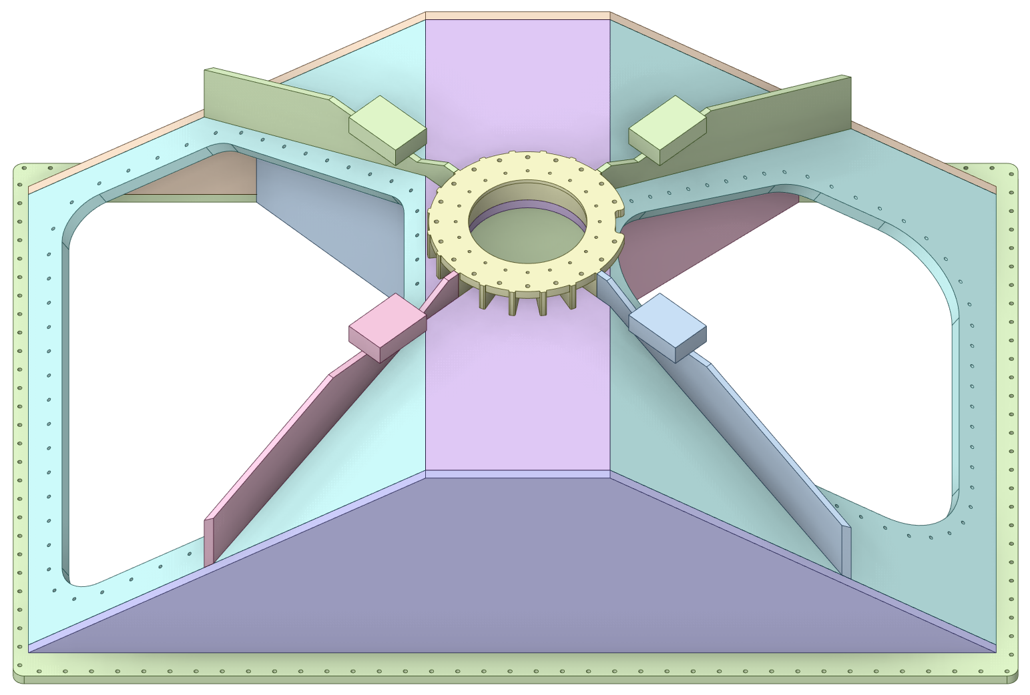
Core Vessel Lid Tent Details
Target Assembly mounting flange
MRA removal hatch
Target outrigger supports
Stiffening ribs to reduce lid deflections under gravitational and vacuum loading
***Tent is captured by the target shaft
Target segment removal hatch

Slide 12
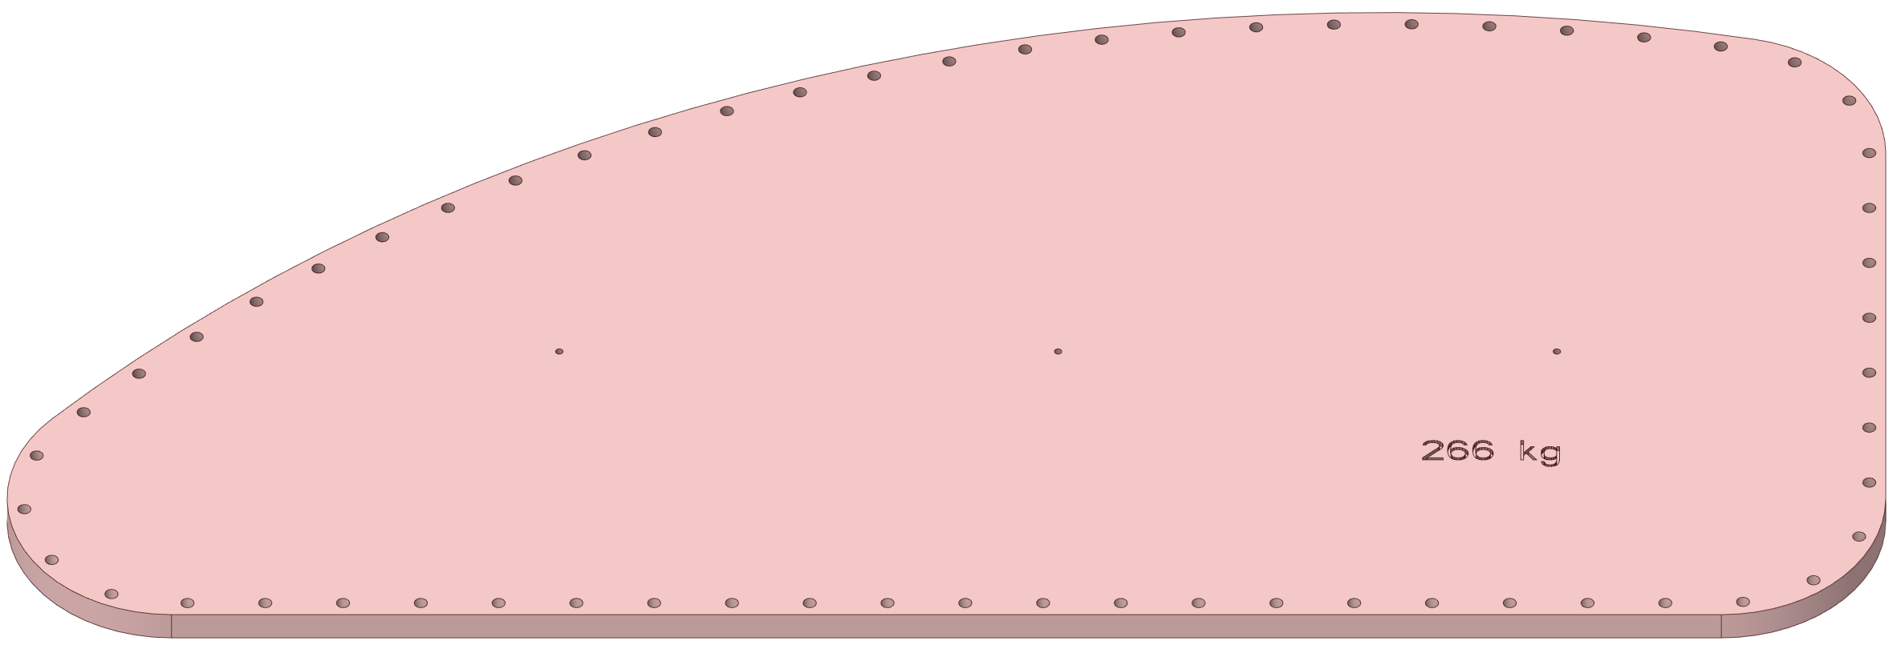
Core Vessel Lid Hatch Details
MRA Access Hatch
Target Segment Access Hatch
Utility Hatches
Stiffening ribs to resist vacuum induced deflections

Slide 13
Core Vessel Shielding
Key Characteristics:
Provide radiation shielding
Minimize thermal deflection of surfaces interfacing with technical components
Allow for vertical extraction of the target segments, MRA and TVP
Allow for vertical extraction of target shaft
Minimize radiation streaming
Protect the MRA hydrogen lines from physical damage
Provide clear neutron flight paths between MRA and guide optics
Provide clear proton flight path
Restrain target during seismic event
Support and align MRA
MRA Utility Line
Shielding
Target Segment
Removable Shield
Block
MRA Removable
Shield Block
Layer 5 Uncooled Shielding
Layer 4 Uncooled
Shielding
Upper Ring Uncooled Shielding
Layer 1 Cooled Shielding
Lower Ring
Uncooled Shielding

Slide 14
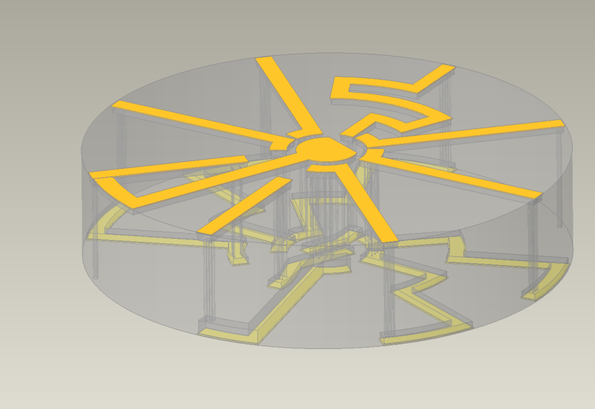
CV Shield Block #1 Details
Current gun drilled forged design
Previous laminated plate design
Gun-drilled vertical cooling holes
Water plenums
Current design is transitioning from stacked plate design to machine forging design
Superior pressure-bearing performance
Significantly less welding
MRA supported off of this shield block

Slide 15
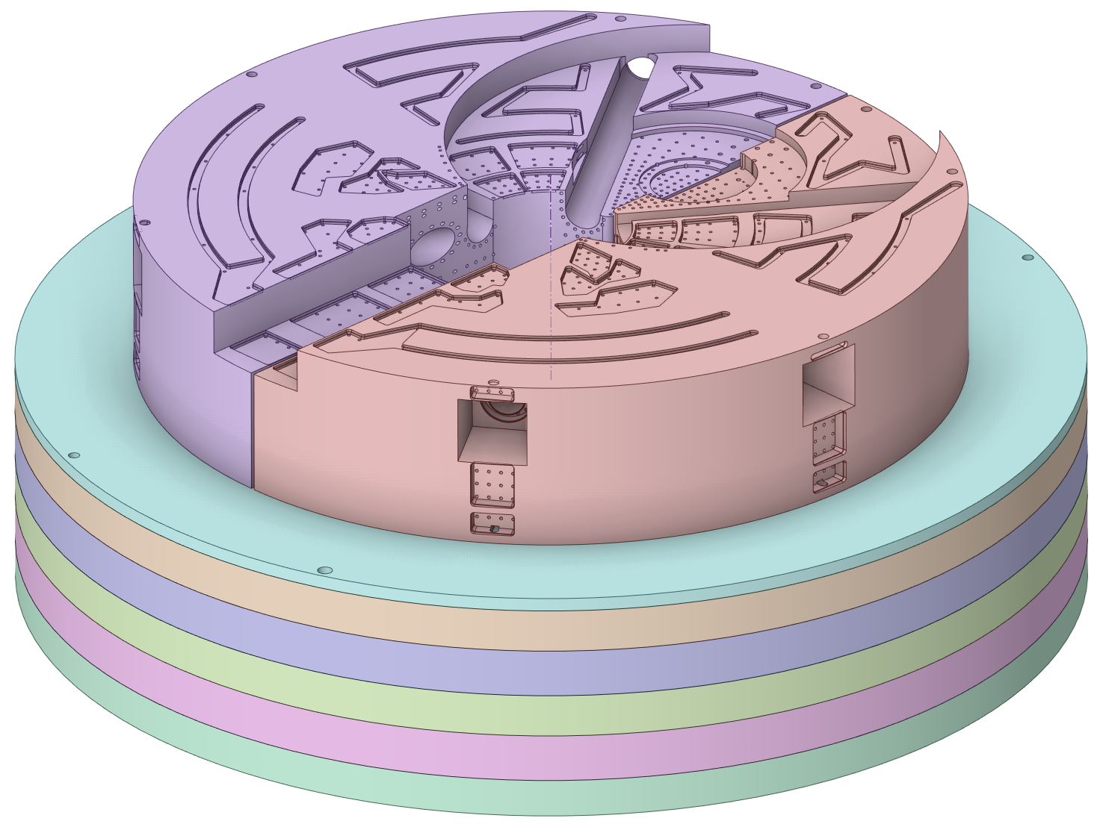
CV Cooled Shield Block Layer 2 Details
Neutron beam clearance
Target wheel cutout
MRA Cutout
Current design is transitioning from stacked plate design to machine forging design
Superior pressure-bearing performance
Significantly less welding
Target snubber ring mounted to these shield blocks
Lower neutron beams (6x total) pass through these shield blocks
High heat loads require complex cooling scheme

Slide 16
CV Cooled Shield Block Layer 3 Details
Uncooled carbon steel
Cooled stainless steel
TVP clearance notch
Target clearance
MRA clearance
Neutron beam clearance
Current design is transitioning from stacked plate design to machine forging design
Development of layer 3 shielding has intentionally lagged behind layer 2 due to their similar thermal profiles
Target and MRA are surrounded by these shield blocks
Upper neutron beams (12x total) pass through these shield blocks
High heat loads require complex cooling scheme

Slide 17
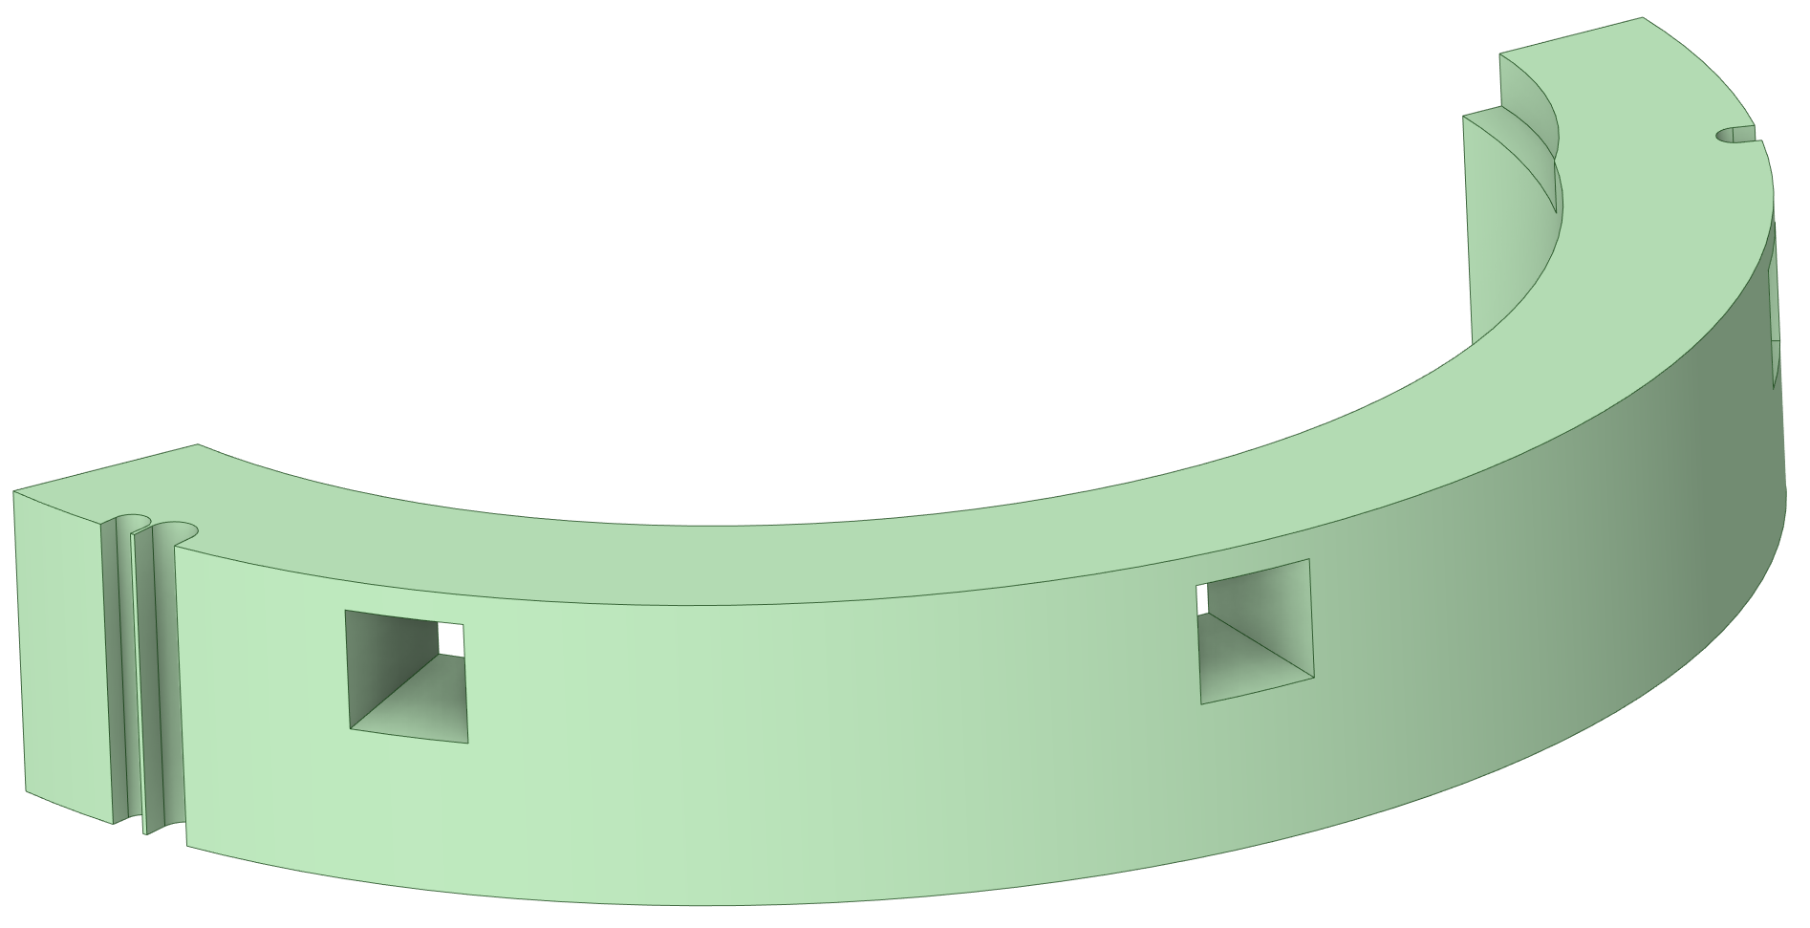
CV Lower Ring Shielding Details
Utility line galleries
Monolith Insert clearance holes
Carbon steel ring shields serve two primary purposes:
Facilitate extraction of a fully populated target assembly that is unable to rotate
Reduce the volume of cooled shielding, reducing CV shielding costs

Slide 18
CV Upper Ring Shielding Details
Utility line galleries
Monolith Insert clearance holes
QIKR neutron beam clearance
Carbon steel ring shields serve two primary purposes:
Facilitate extraction of a fully populated target assembly that is unable to rotate
Reduce the volume of cooled shielding, reducing CV shielding costs

Slide 19
CV Layer 4 Shielding Details
Target shaft clearance
TVP clearance
MRA clearance
Utility line galleries

Slide 20
CV Layer 5 Shielding Details
MRA clearance
Target shaft clearance
TVP clearance
Target segment clearance
Utility line galleries

Slide 21
CV Removable Shielding Details
Target segment removable shield block
MRA removable shield block

Slide 22
CV MRA Utility Shielding Details
Hydrogen transfer line shine shield
MRA utility line shine shield

Slide 23
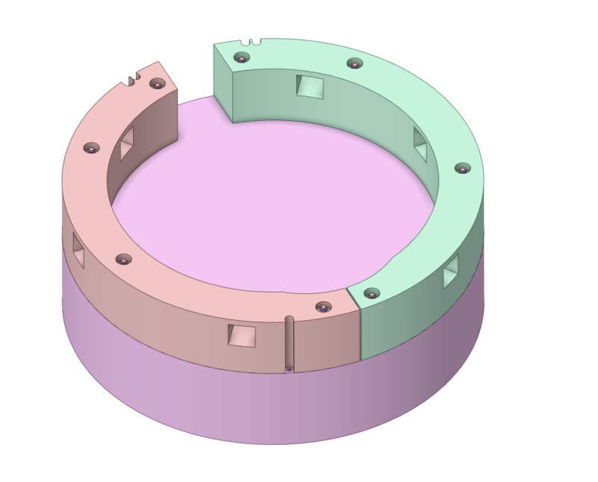
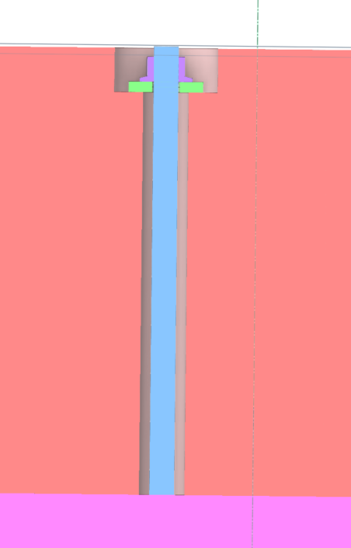
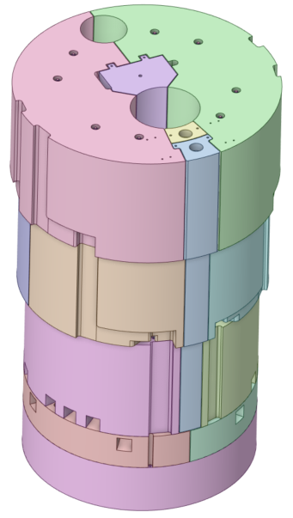
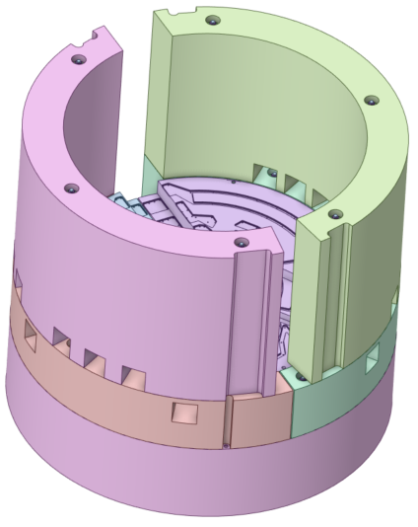
Core Vessel Shielding Restraint System

Slide 24
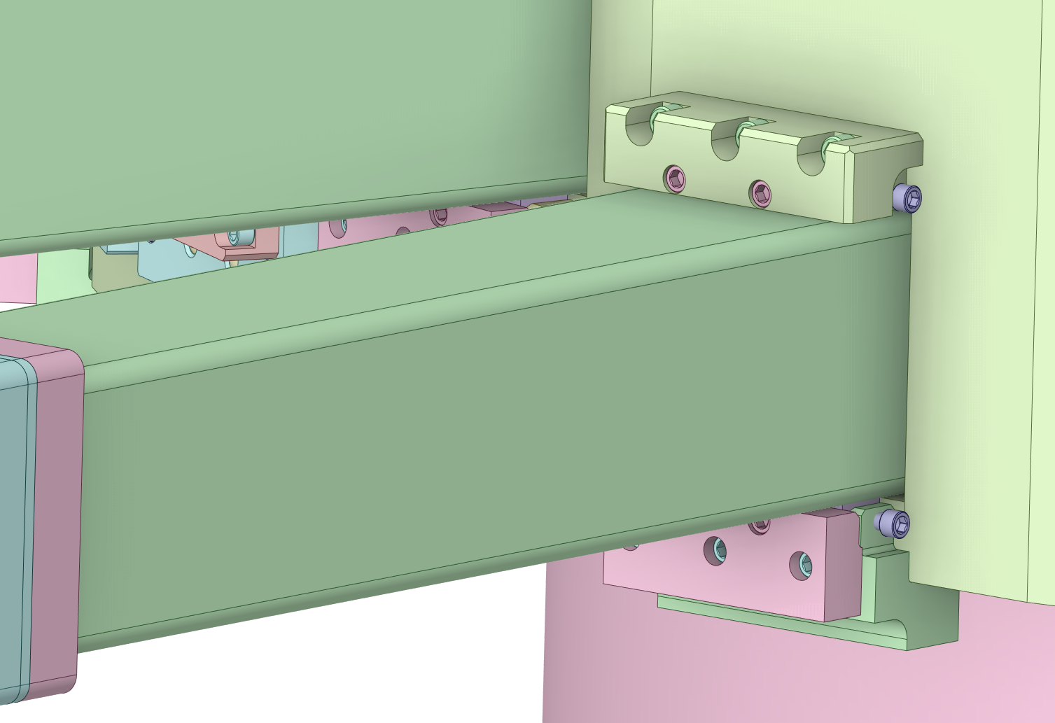
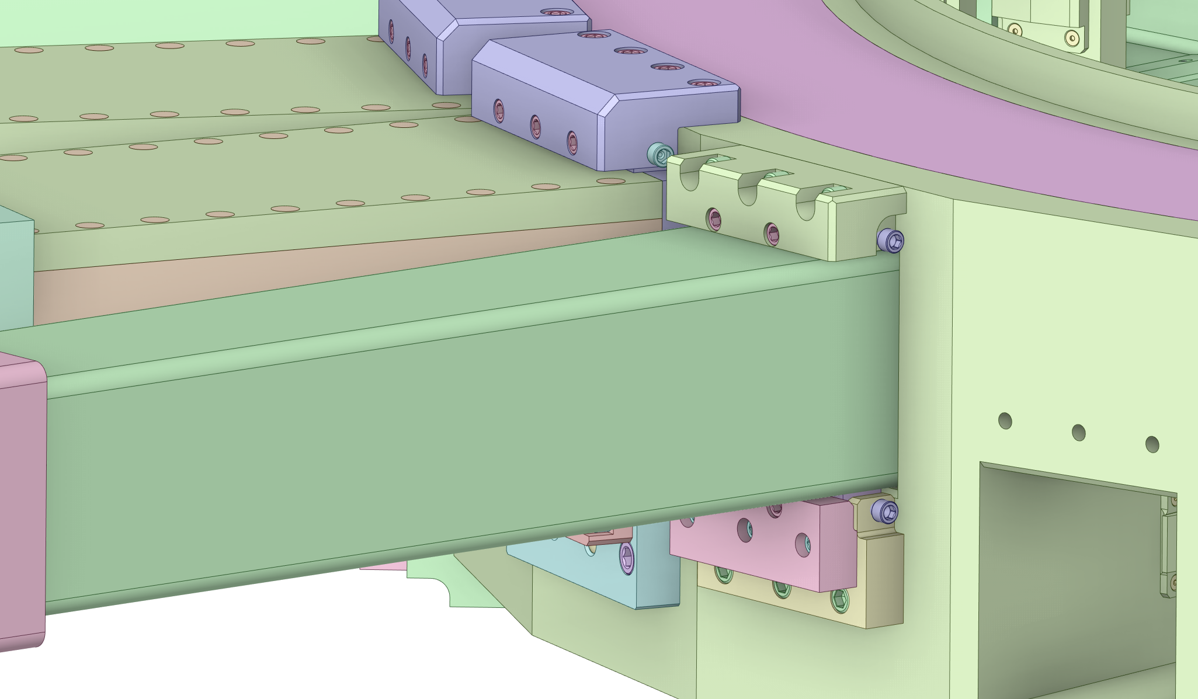
Standard Nozzle Extension Assembly Details
10’’ Sq. Tubing
12’’ Sq Tubing
Rear Flange
Transition Flange
Mounting Bars
Lower Bracket Assembly
Upper Bracket Assembly

Slide 25
QIKR Nozzle Extension Assembly Details
Screw Caps
(welded)
Large Boxed
Section
Rear Flange
Transition Flange
Small Boxed
Section
Welded to CV
Inside Diameter
Round Nose
Front Flange
Seal Welds

Slide 26
Dual Channel Nozzle Extension Assembly Details
Large Boxed
Section
Rear Flange
Transition Flange
Mounting
Bar
Small Boxed
Section
Welded to CV
Inside Diameter
Dual Channel Nozzle Extension
Bracket Assemblies
Round Nose
Front Flange

Slide 27
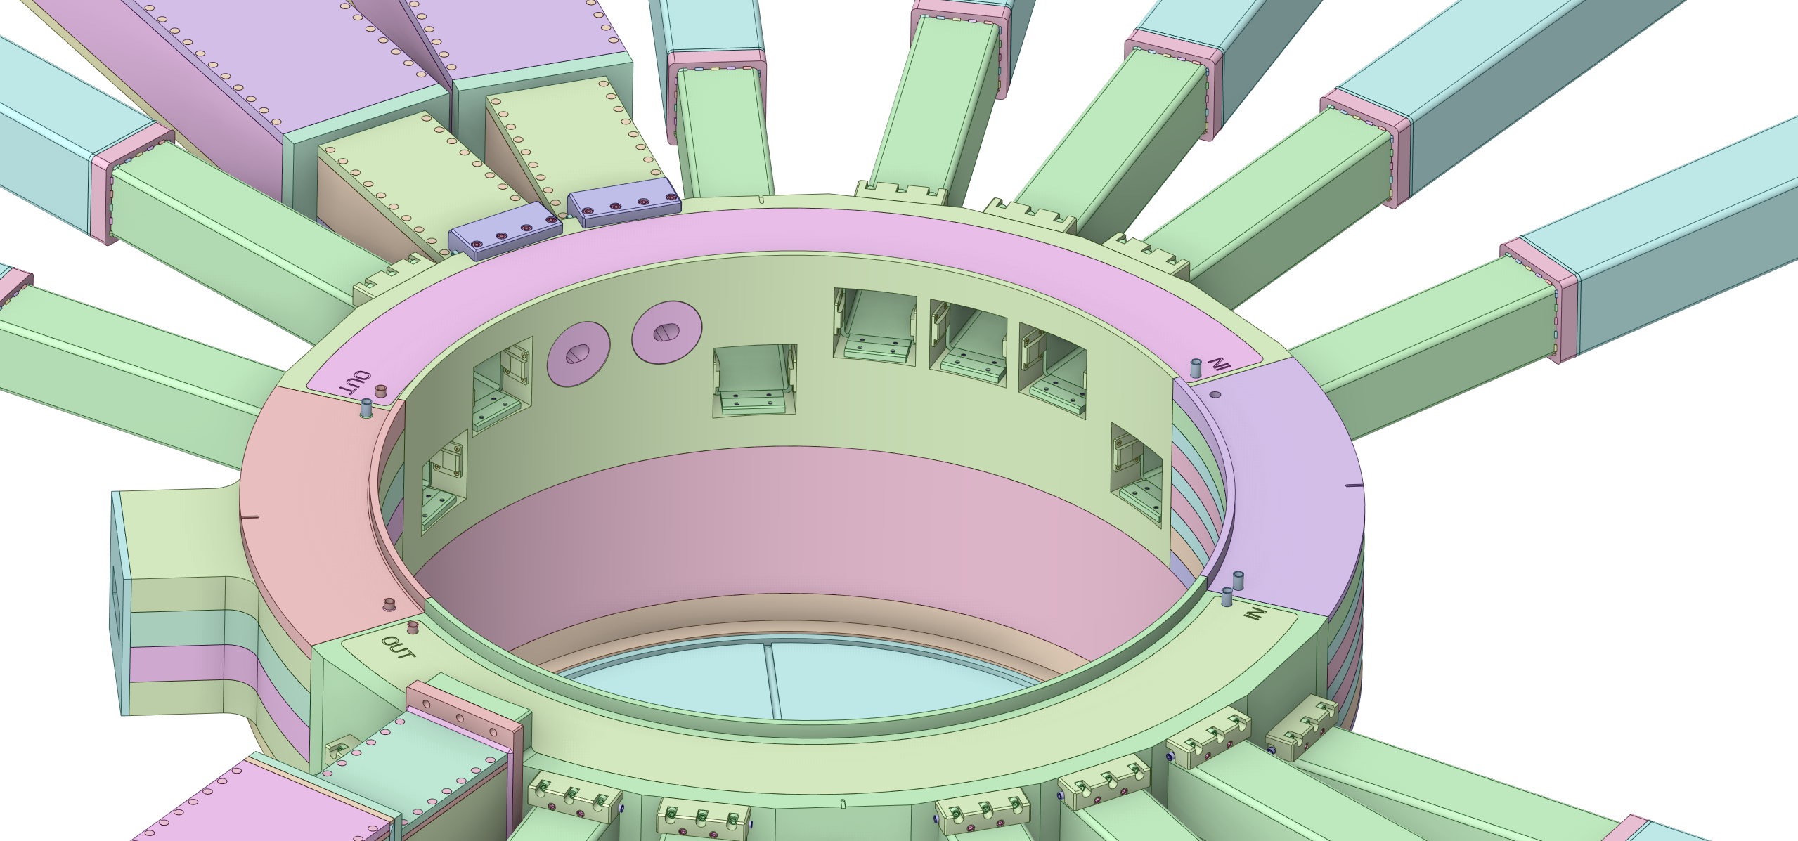
Nozzle Extension Seal Welds and Monolith Insert shims
Seal Weld
Seal Weld to ID
Monolith Insert
Shims

Slide 28
MRA Utility Jumpers
Connect MRA flanged connections to corresponding flanged connections on CV side walls
Each line will include a flex line portion
Flex lines allow for MRA connections to be broken and the jumper lines moved during MRA removal and installation

Slide 29
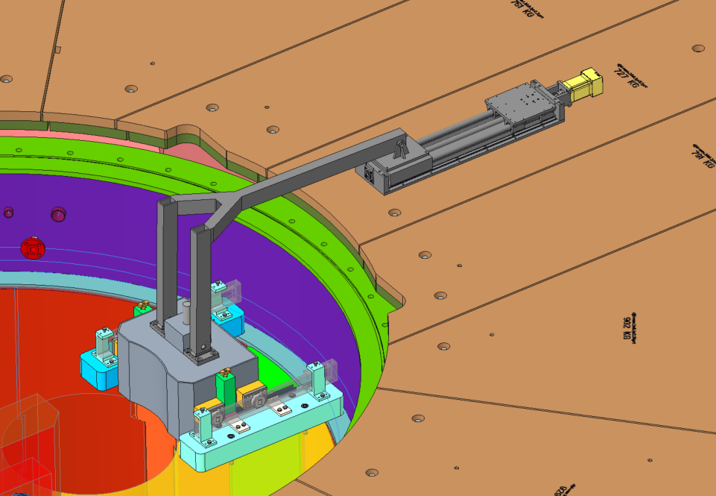
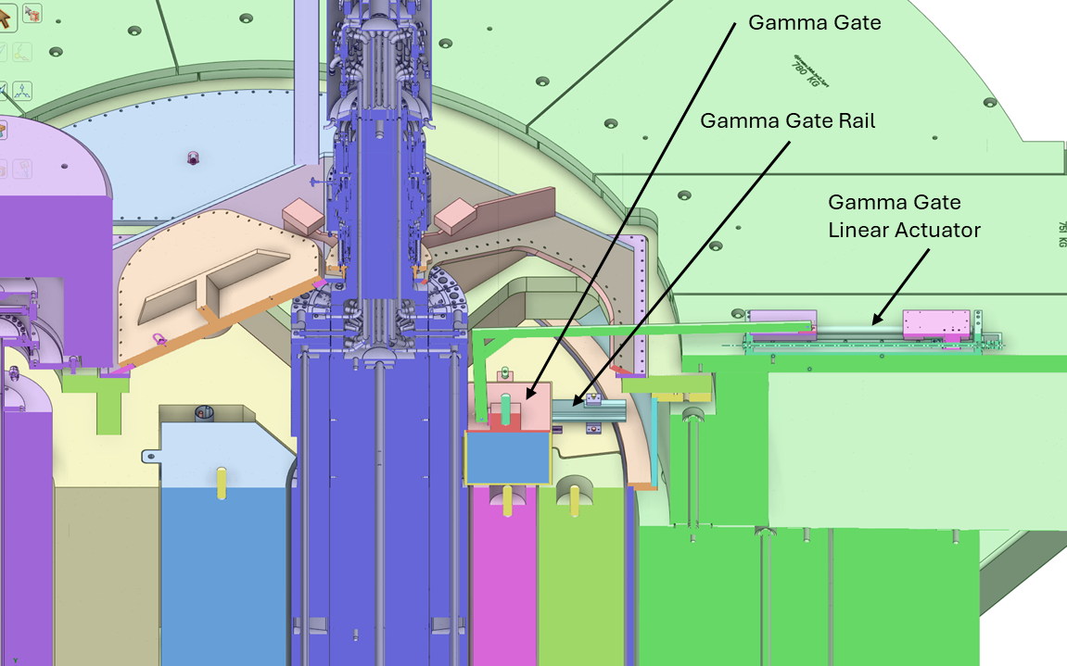
Gamma Gate Assembly
The gamma gate provides radiation protection during target maintenance activities
Remote actuation is required
Facilitates hands-on target maintenance
Lead filled stainless steel
Actuator Arm
Locking Pins
Rollers
Rail Mounts
Linear Rails

Slide 30
Target Station Shielding Scope
Pipe Pan
Removable Shielding
Pipe Pan
PBW Removable Shield
Layer 6
Bulk shielding
PBW Shielding
Removable Shield
PBTA Remote Clamp
Removable Shield
Layer 5
Bulk shielding
Layer 4
Bulk shielding
Layer 3
Bulk shielding
Layer 2
Bulk shielding
Layer 1
Bulk shielding

Slide 31
Bulk Shielding Scope
Layer 6
Bulk shielding
Layer 5
Bulk shielding
Layer 4
Bulk shielding
Layer 3
Bulk shielding
Layer 2
Bulk shielding
Layer 1
Bulk shielding
Nozzle extension
clearance ports

Slide 32
Core Vessel Baseplate Details
CV Mounting Holes
Water drain grooves
Water Drain Port
TSS Mounting Holes
CV Baseplate Anchors
Leveling Assembly
Grout Holes
Welded Covers Over CV Baseplate Anchors

Slide 33
Bulk Shielding Liner Details
PBW Bump-Out
Bulk Shielding Liner
Anchor Holes
Bulk Shielding Liner Anchors
Leveling Pucks
Grout Holes
TSS Mounting Holes

Slide 34
Bulk Shielding Layer 1 Details
Nozzle Extension
Bracket Notch
Anchor Tie Rods
Leveling Pucks
PBW Alignment Plate
Clearance
Anchor Tie Rods
4x Shield Blocks
Under CV
CV Drain Pipe Clearance Channel

Slide 35
Bulk Shielding Layer 2 Details
Bolt to the next layer of shield block
L shaped blocks are slid underneath each installed nozzle extension

Slide 36
Bulk Shielding Layer 3 Details

Slide 37
Bulk Shielding Layer 4 Details

Slide 38
Bulk Shielding Layer 5 Details

Slide 39
Bulk Shielding Layer 6 Details
Forms support for removable shield plates above pipe pans

Slide 40
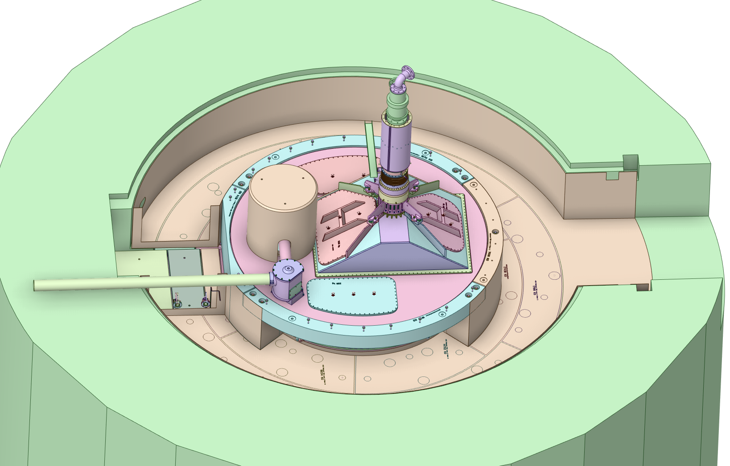
Pipe Pan Details

Slide 41
Pipe Pan Removable Shielding Details

Slide 42
AIC Removable Shielding Details
PBW Shielding
Shield Block
PBW Shield
Block
PBTA Clamp
Shield Block

Slide 43
BACKUP SLIDES

Slide 44
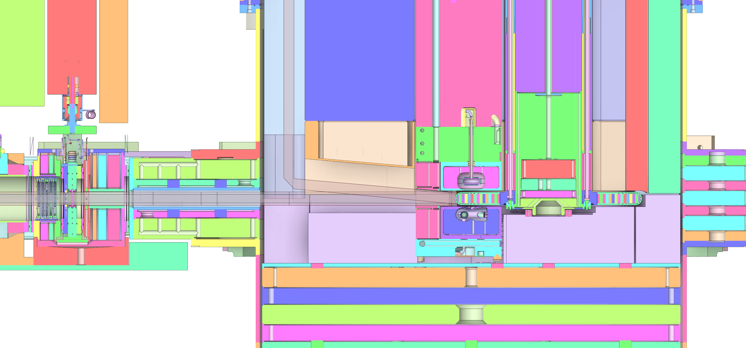
BACKUP SLIDES

Slide 45
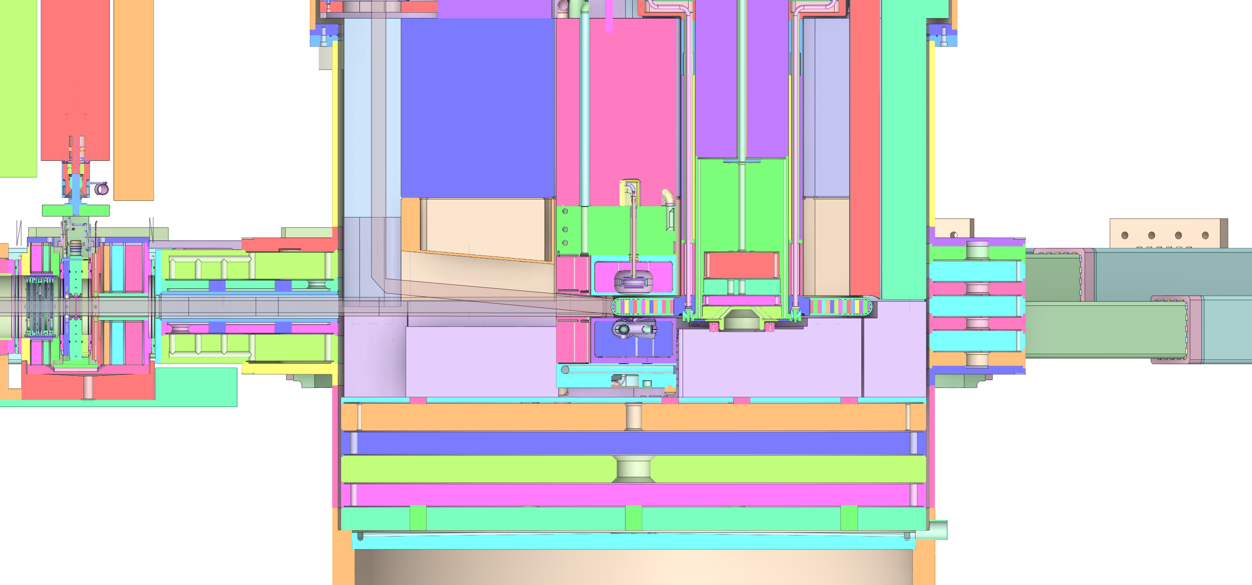
BACKUP SLIDES

Slide 46
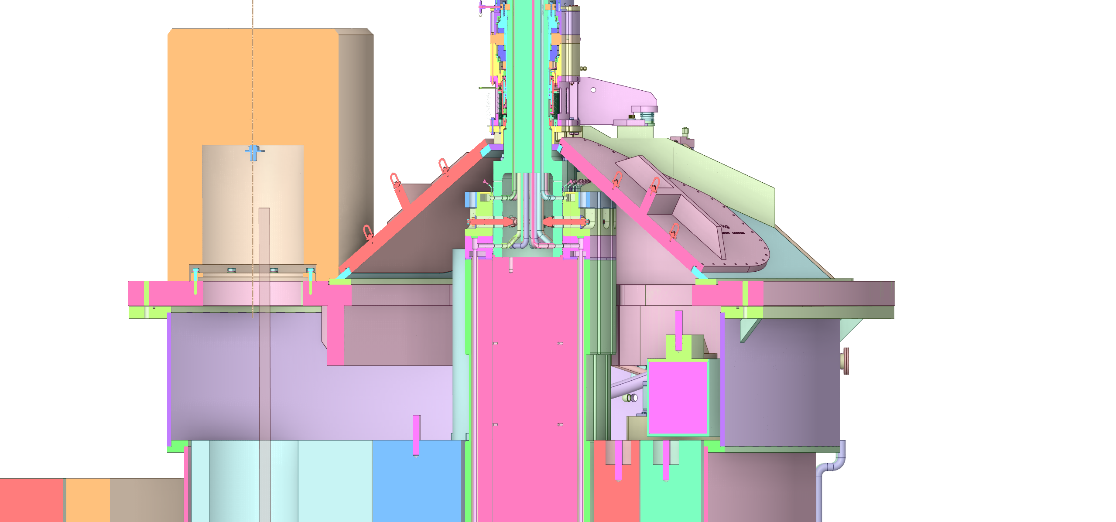
BACKUP SLIDES

Slide 47
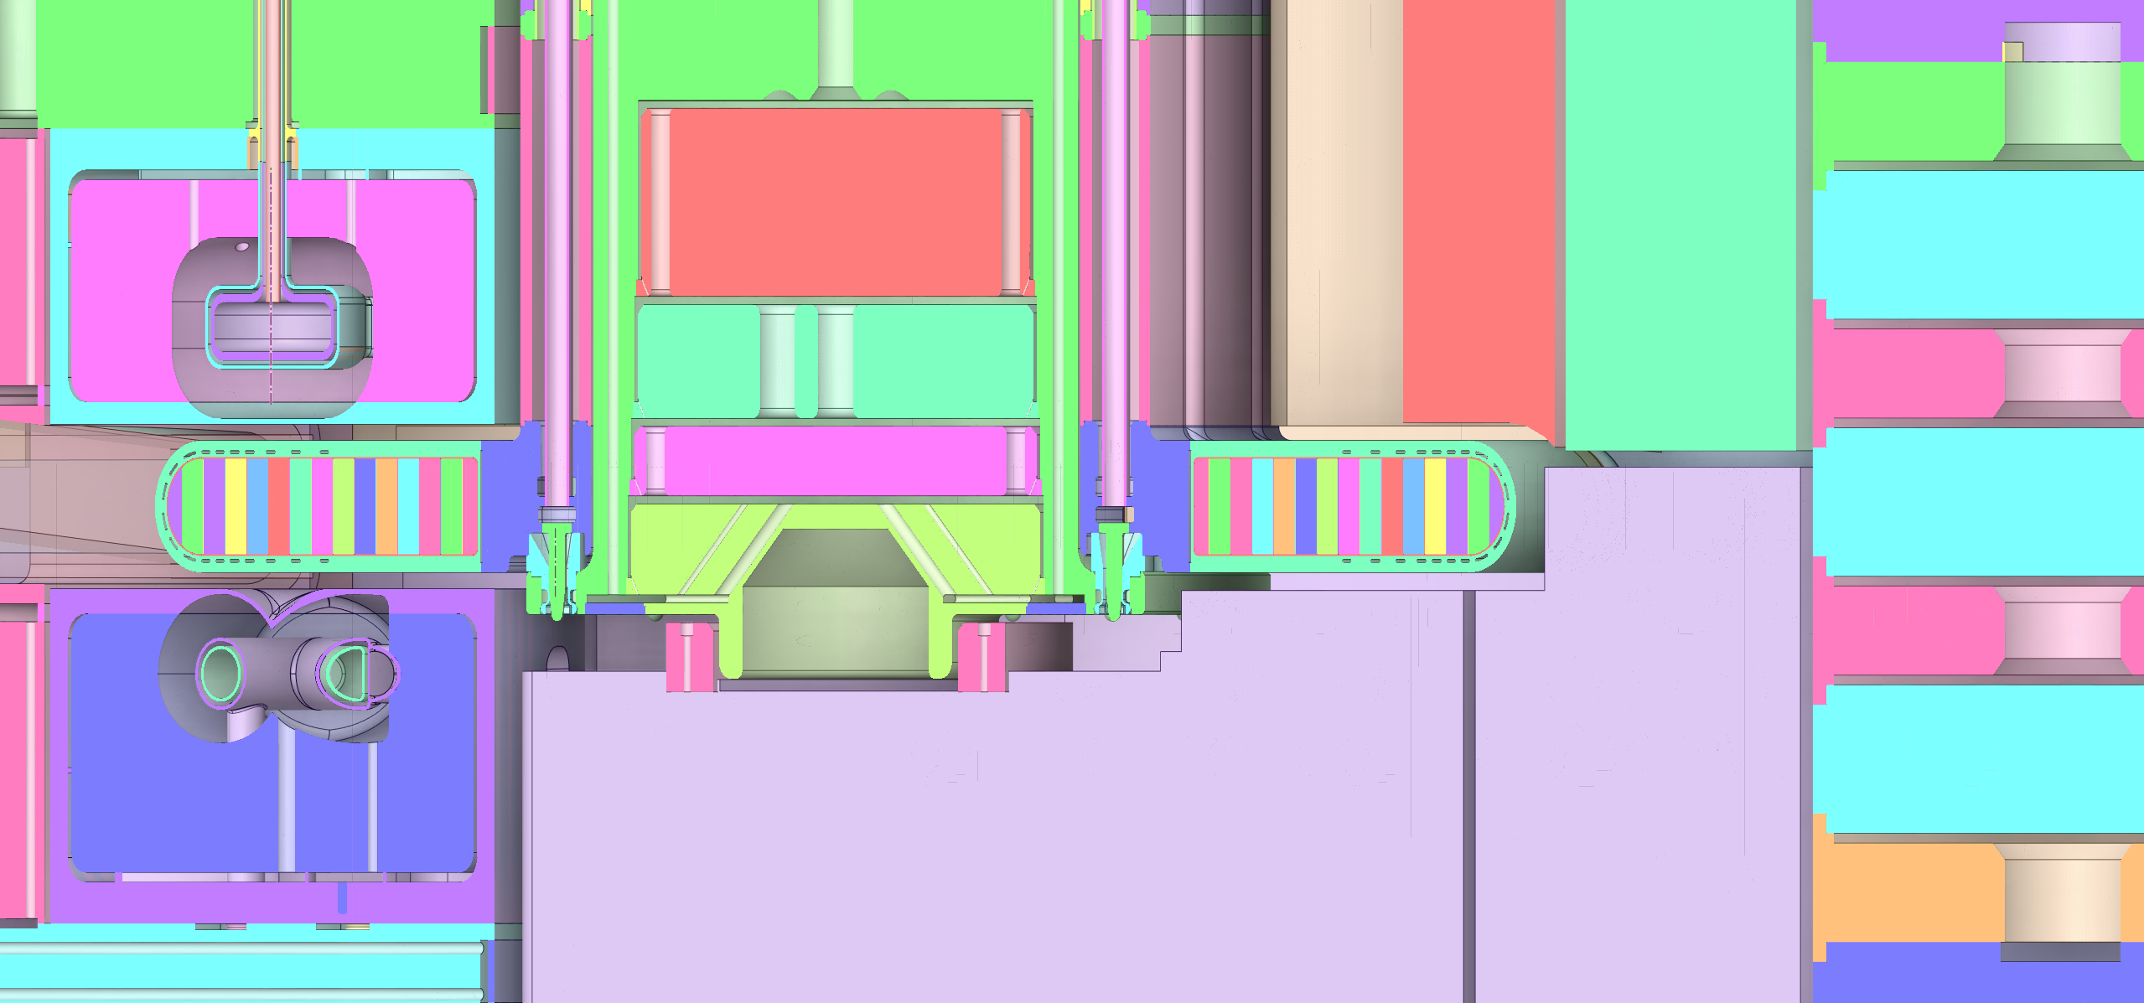
BACKUP SLIDES

