Slide 1
Vessel Systems and Target Station Shielding Path to Final Design Completion
Chris Anton
Cam Eiland
Hogan Knott
Darren Dugan
Mike Strong
April 22, 2025

Slide 2
Current Status of Verification Plan Steps – Not Tested or Failed

Slide 3
Current Status of Verification Plan Steps – Not Tested or Failed

Slide 4
Current Status of Verification Plan Steps – Not Tested or Failed

Slide 5
Interface and Requirements Status
Interface Sheets:
All interface sheets are signed off and released as Rev0 except for VS to Bunker
Interface sheets have been developed for all Target Systems internal interfaces
Requirements Status:
All VS and TSS requirements have been generated and inputted into Code Beamer
PHAR derived requirements have been fully reviewed with the ESHQ team
Interface derived requirements have been peer reviewed within the STS project as well as by Drew Winder at SNS
A fully linked verification plan and associated test cases have been input into Code Beamer

Slide 6
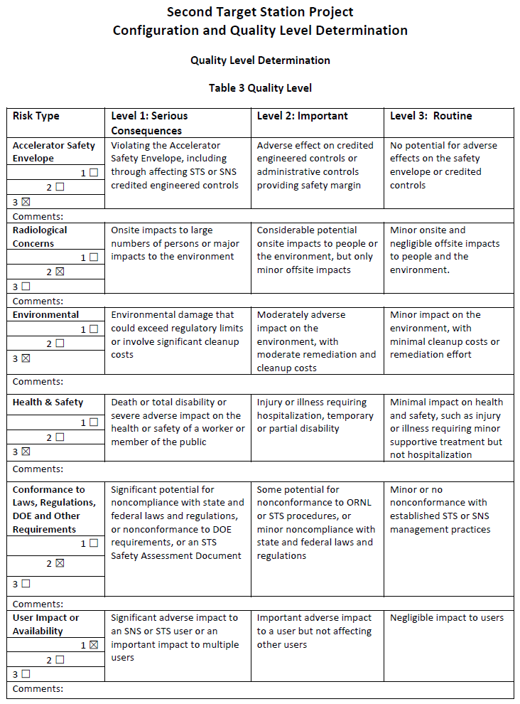
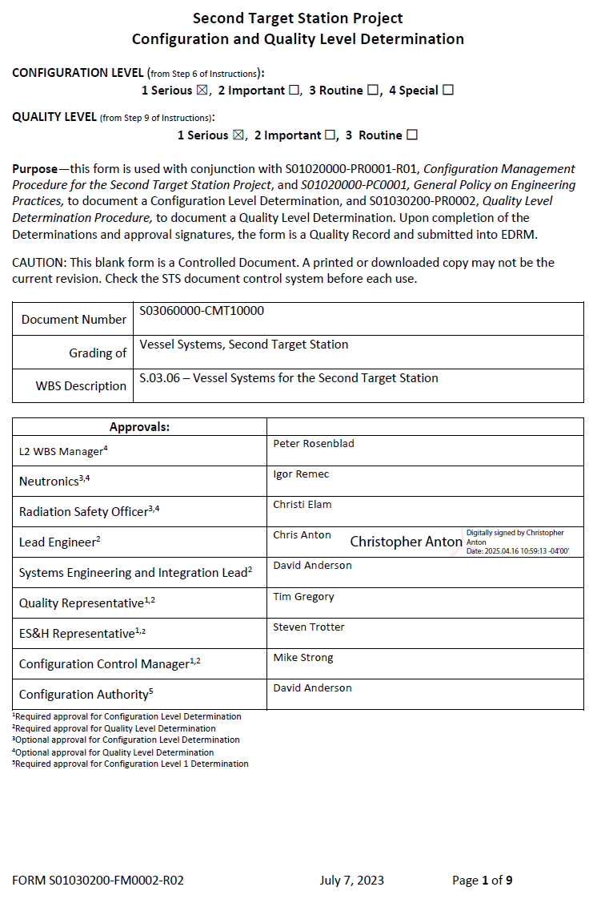
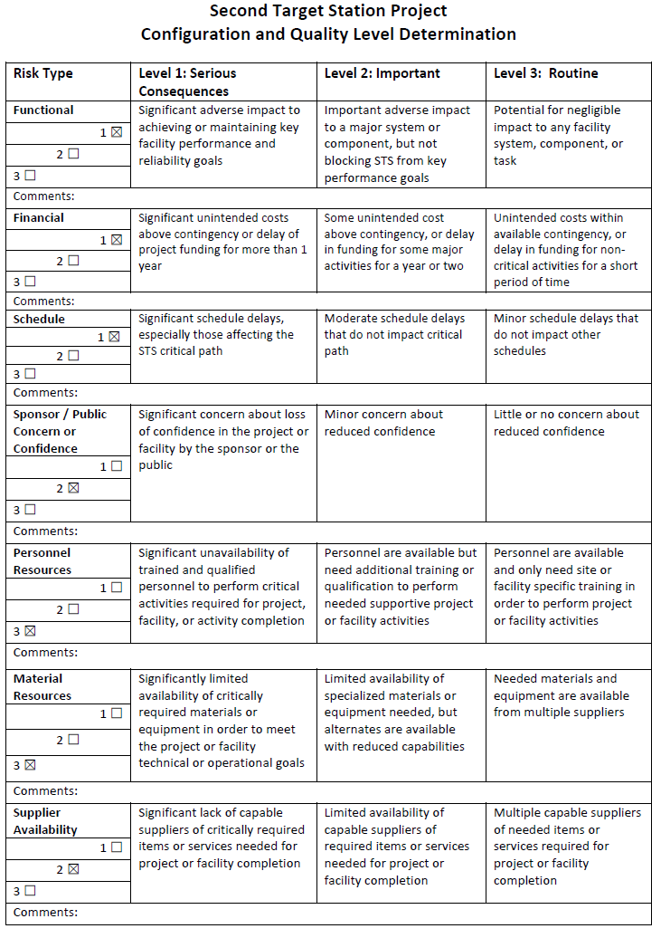
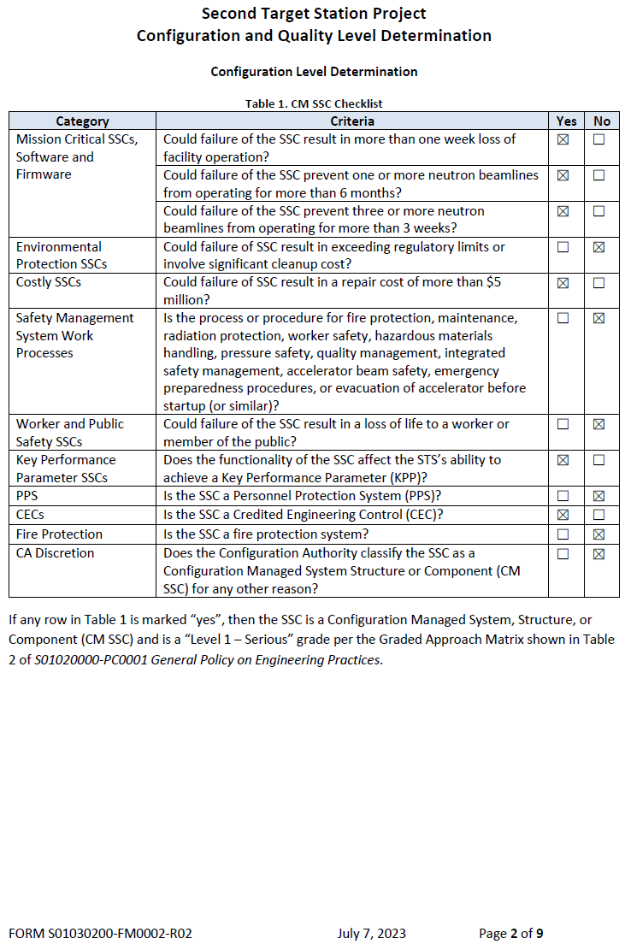
Vessel Systems Configuration and Quality Level Determination

Slide 7
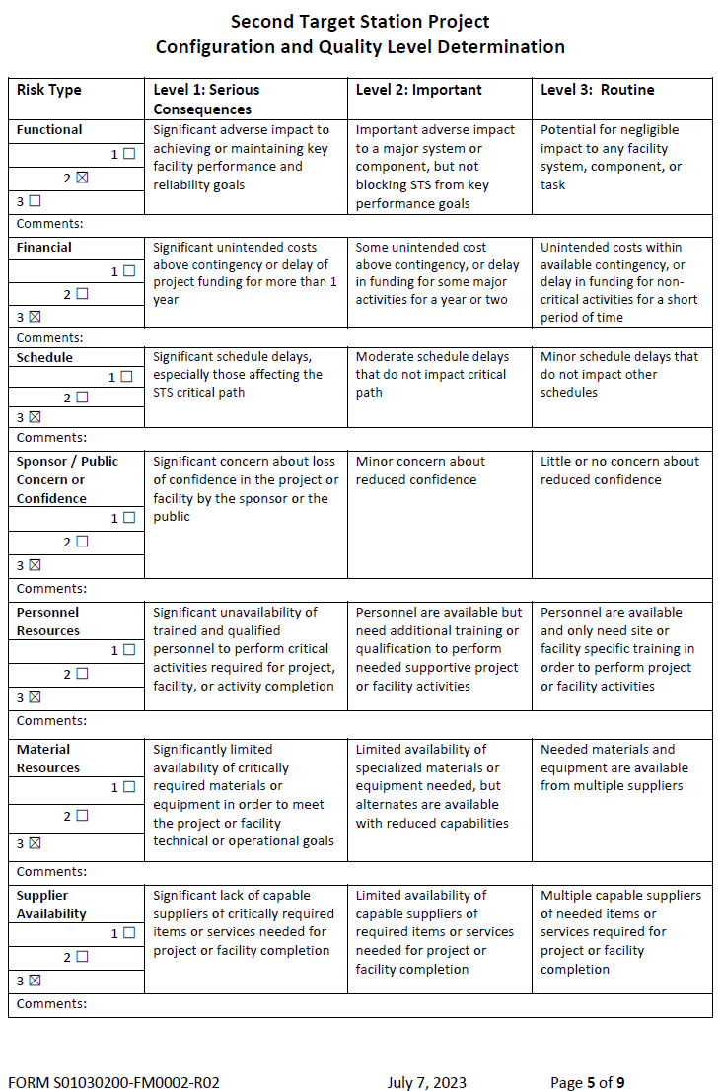
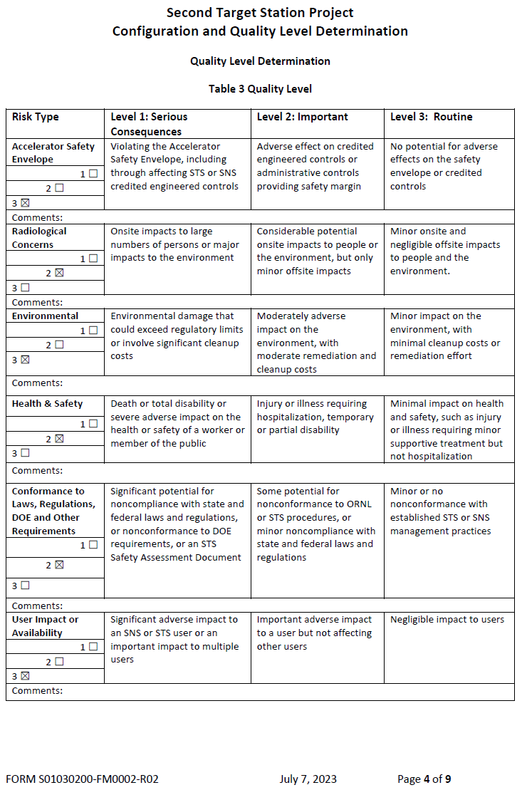
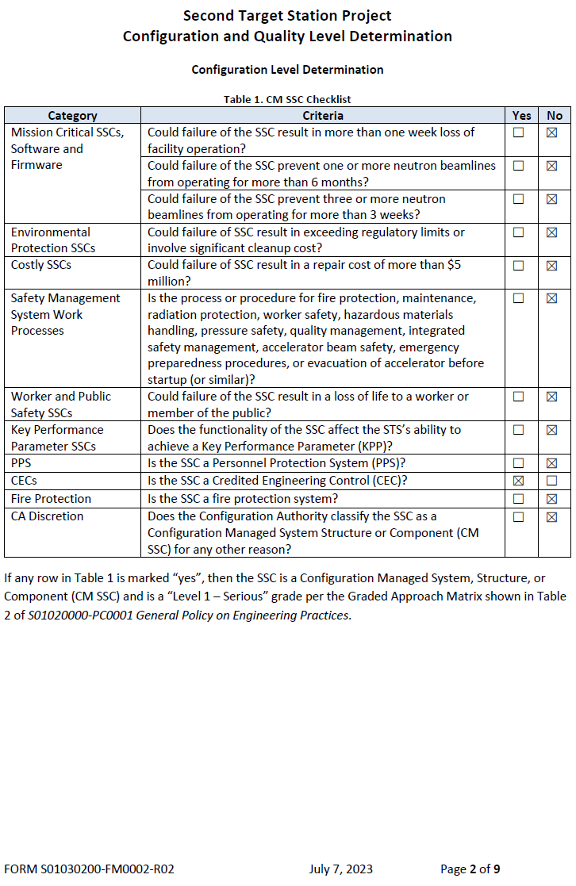
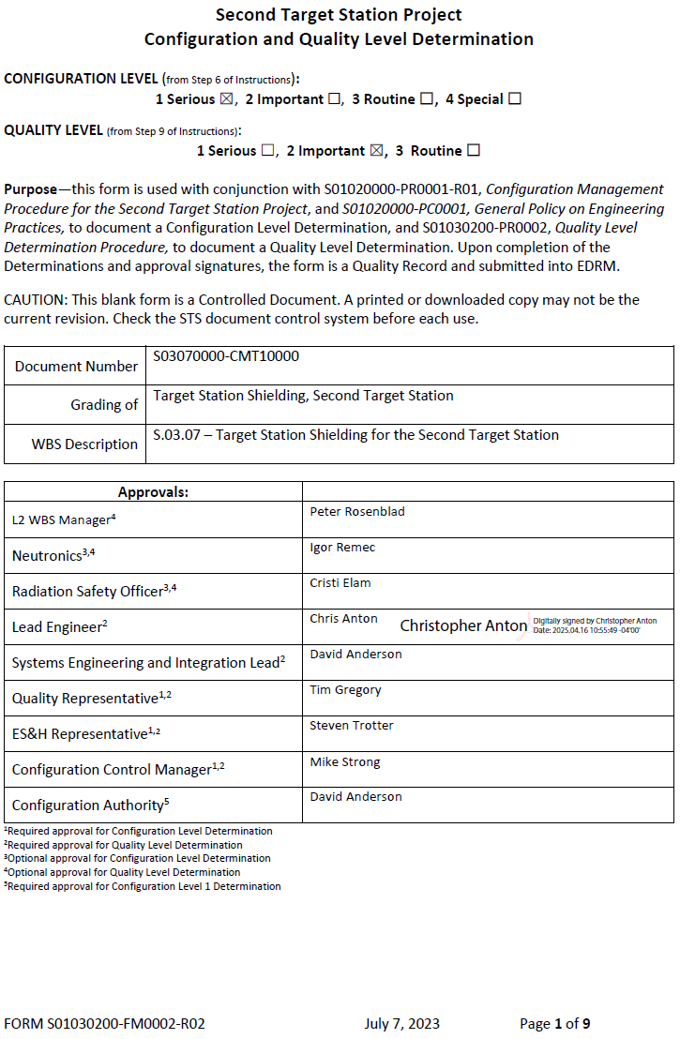
TSS Configuration and Quality Level Determination

Slide 8
Relevant Risk Registry Entries
Risk 30 is impossible to mitigate, and is a risk that will be carried through manufacturing
Risk 102 is still an active threat that could negatively impact final design and procurement
Risk 122 has largely been mitigated through the execution of a CV manufacturing study during preliminary design
Risk 124 has already been realized, and redesign efforts to accommodate dual channel monolith inserts on beamlines 15 and 16 have been completed at a cost to both budget and schedule
Risk 126 is difficult to mitigate and is still an active threat. A number of changes to Target Systems technical components have required design changes within VS and TSS scope. Future changes to technical components will have a negative impact on schedule during final design and cost implications during procurement

Slide 9
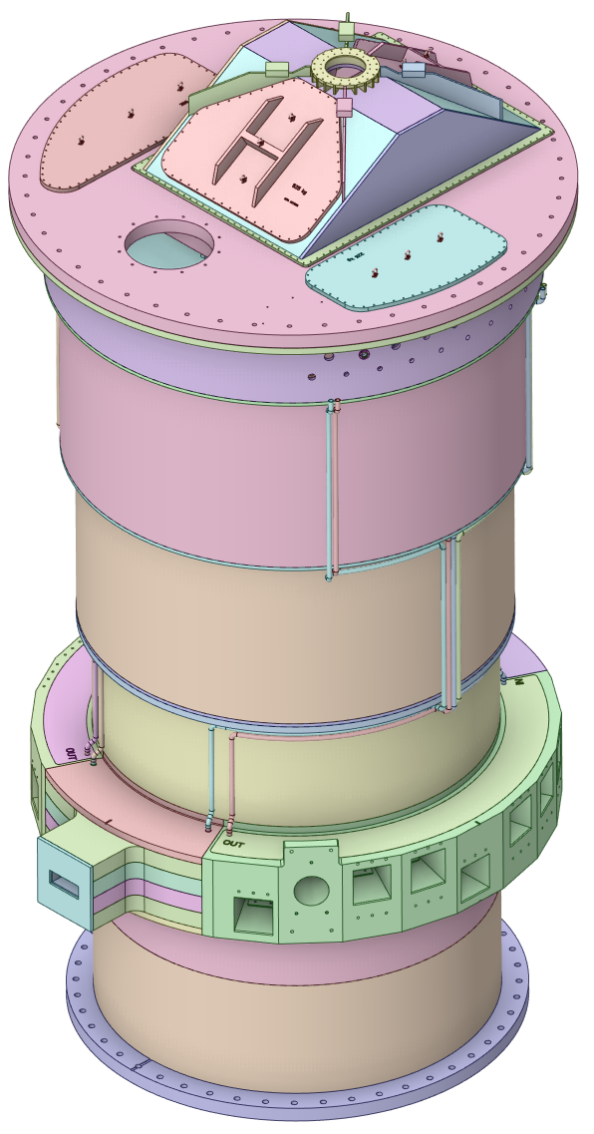
Core Vessel Work During FDR
Design Changes:
Redesign east and west beltline quadrants to forged designs
  Update thermal and mechanical analysis based on new designs
Add alignment features to the CV skirt to align CV shielding
Add survey and alignment fiducials
Implement hydrogen transfer line nozzle
Additional Analysis Required:
Updated neutronics heating and DPA analysis
Update thermal analysis based on new Neutronics heating data
Update structural analysis based on new heating data
Evaluate pressure bearing capacity of north and south beltline quadrants and revise top and bottom plenum designs if necessary
Evaluate thermal and seismic deflections of all key interfacing surfaces

Slide 10
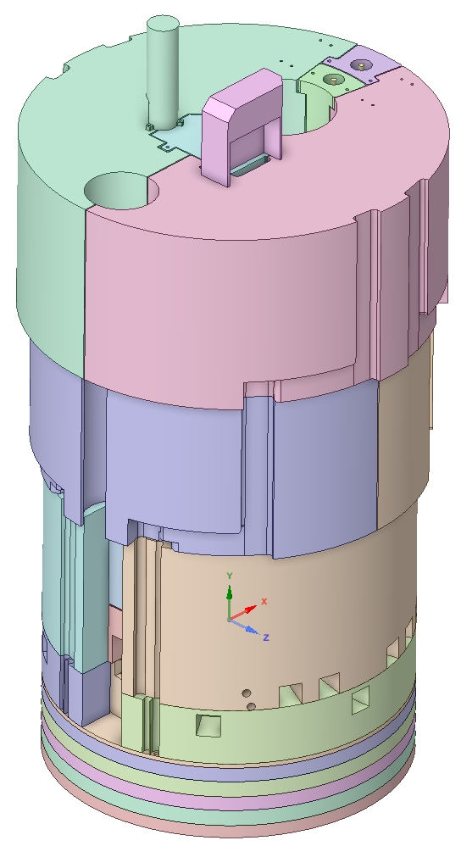
Core Vessel Shielding Work During FDR
Design Changes:
Continue refining design of all three cooled shielding layers
  Optimize design of Layer 1 to minimize thermal deflection
  Revise layer 2 design to reduce stress and plenum deflection
  Implement gun drilled forging design on layer 3 cooled shielding
Fully implement seismic restraint anchor system
Modify removable target shield block to reduce temperature
Revise uncooled shielding as necessary to accommodate water line routing
Implement temperature monitoring
Add survey and alignment fiducials
Additional Analysis Required:
Perform steady state followed by CFD analysis of all 3 cooled shield layers
Once designs are validated update Neutronics model with new geometry
Obtain updated Neutronics heating and DPA data based on new designs
Run updated thermal and structural analysis based on updated Neutronics data
  Validate seismic restraint system via structural analysis
Evaluate thermal and seismic deflections of all key shield surfaces

Slide 11
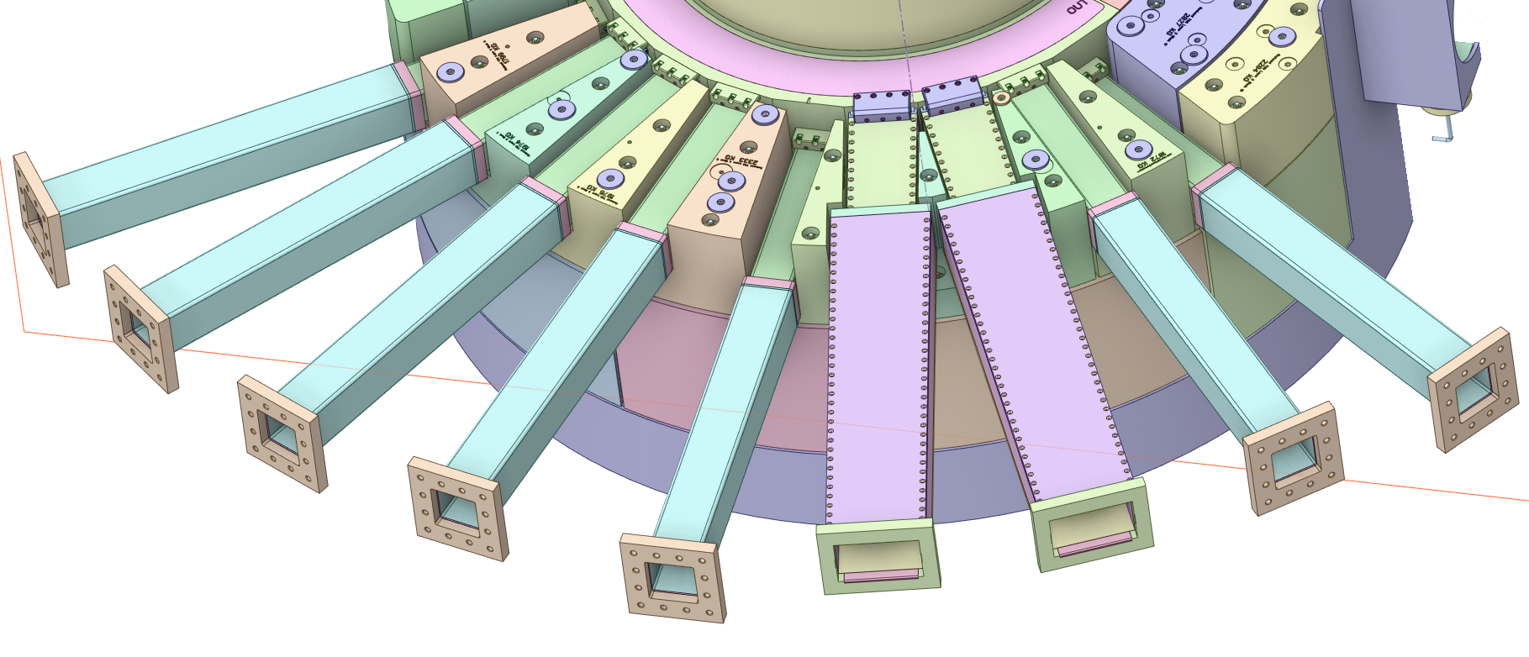
Nozzle Extension Work During FDR
Design Changes:
Considering revision to the standard nozzle extension to eliminate plastic deformation results
Add survey and alignment fiducials
Additional Analysis Required:
Perform structural analysis of fully featured dual channel nozzle extension to evaluate weld stresses
Run updated standard nozzle extension structural analysis based on redesign
  Include seismic loading in this analysis
Perform final calculations on nozzle extension and beltline thermal deflections and the impact on monolith insert alignment

Slide 12
Pressure Relief / Vent Work During FDR
Design Changes:
Design pressure relief system including rupture disc and piping system
  Include piping run to vacuum system
  Include piping run to negative air draw maintenance system
Model piping system in Creo, incorporate into CV design
Additional Analysis Required:
Complete hand calculations validating CV venting design
Complete hand calculations validating CV negative air draw

Slide 13
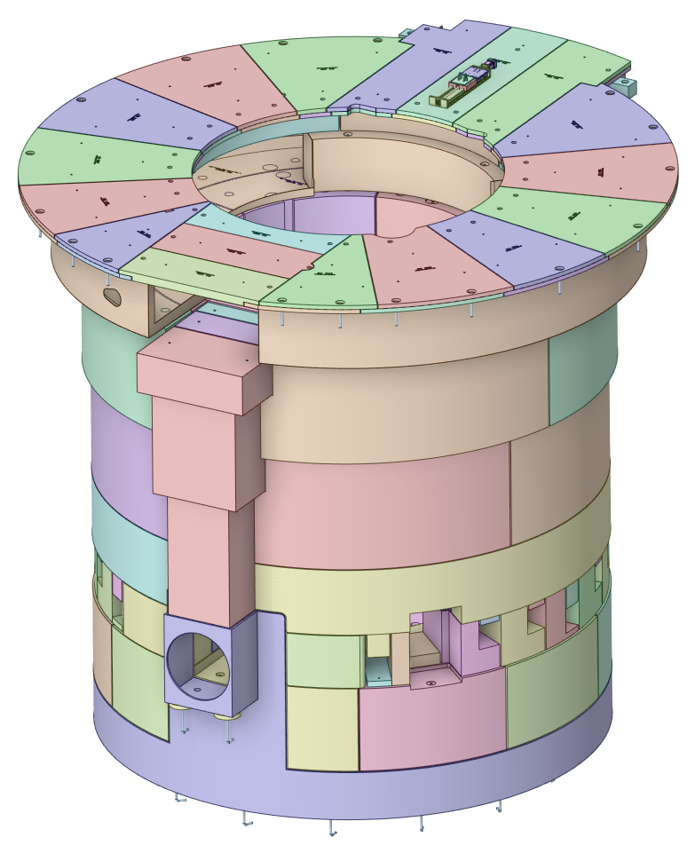
Target Station Shielding Work During FDR
Design Changes:
Adjust pipe pan design to accommodate all penetrations
Extend pipe pan through the East pipe chase and connect to drain
Adjust pipe pan top shield plates to accommodate all utility penetrations required by Target and TVP subsystems
Adjust the CV drain line shield clearance to match the latest Process Systems design
Add survey and alignment fiducials
Additional Analysis Required:
Complete seismic calculations validating the seismic restraint system

Slide 14
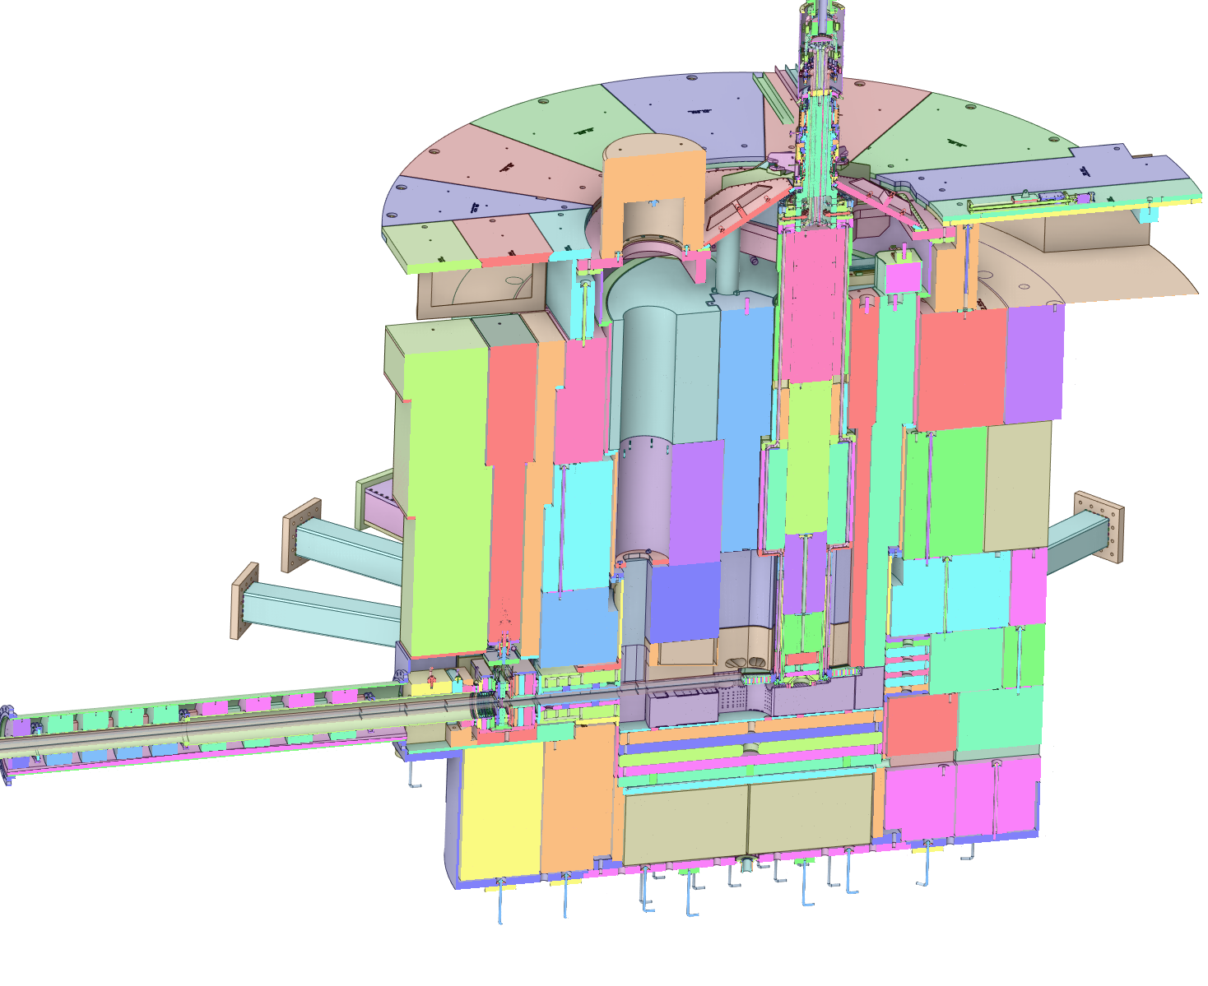
Thank you for your time!

