Slide 1
SNS Continuous Commissioning Review In-Brief
April 7, 2025
Brian Weston
Chief Operating Officer, NScD

Slide 2
Emergencies at SNS
Take Cover in buildings 8600 and 8700
8600 Ground floor away from glass or basement
Corridors C and D on the ground floor and basement
8700 basement outside of the Target Control Room

Slide 3
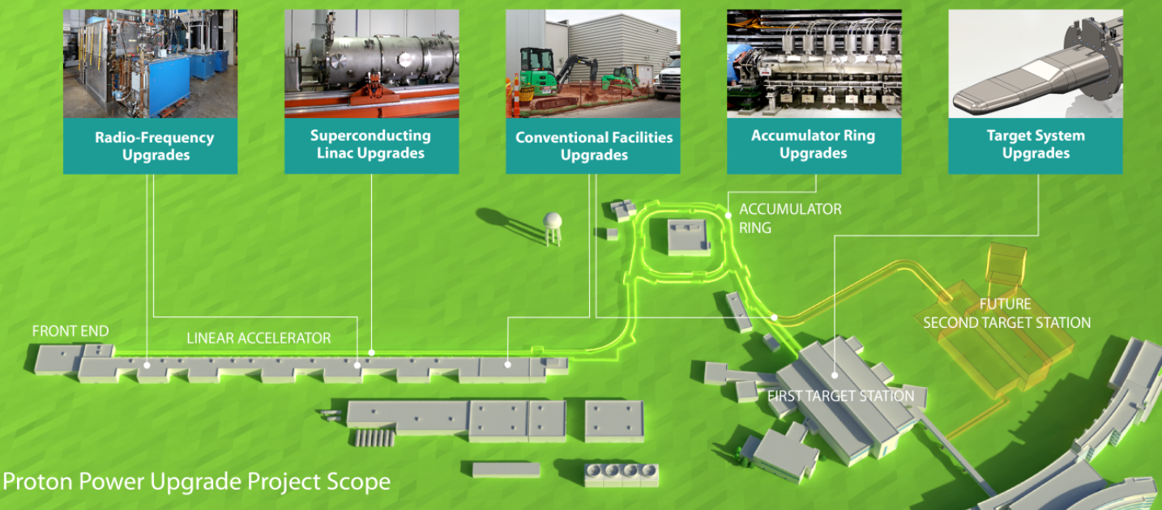
The Proton Power Upgrade has brought SNS unprecedented capabilities but also new operating challenges
Proton energy went from 1.0GeV to 1.3GeV
Power on target increased from 1.4MW to 1.7MW and is heading toward 2MW
Gas accumulation in mercury loop
Increased stack emissions
Increased radiation at instruments

Slide 4
Thanks to the CCR Team for helping us ensure we are well-poised for continued operational success
Charge questions for the Team:
Is the organization managing operations at increased power effectively?
Is leadership appropriately engaged in operational decision-making and oversight?
Is the organization demonstrating the Safe Conduct of Research principles?
Are processes* working effectively to maintain safety and compliance under changing conditions?
(* work control, design control, and conduct of operations)
The Team is not limited to these topics.
These are the key areas where we covet the Team’s insights.

Slide 5
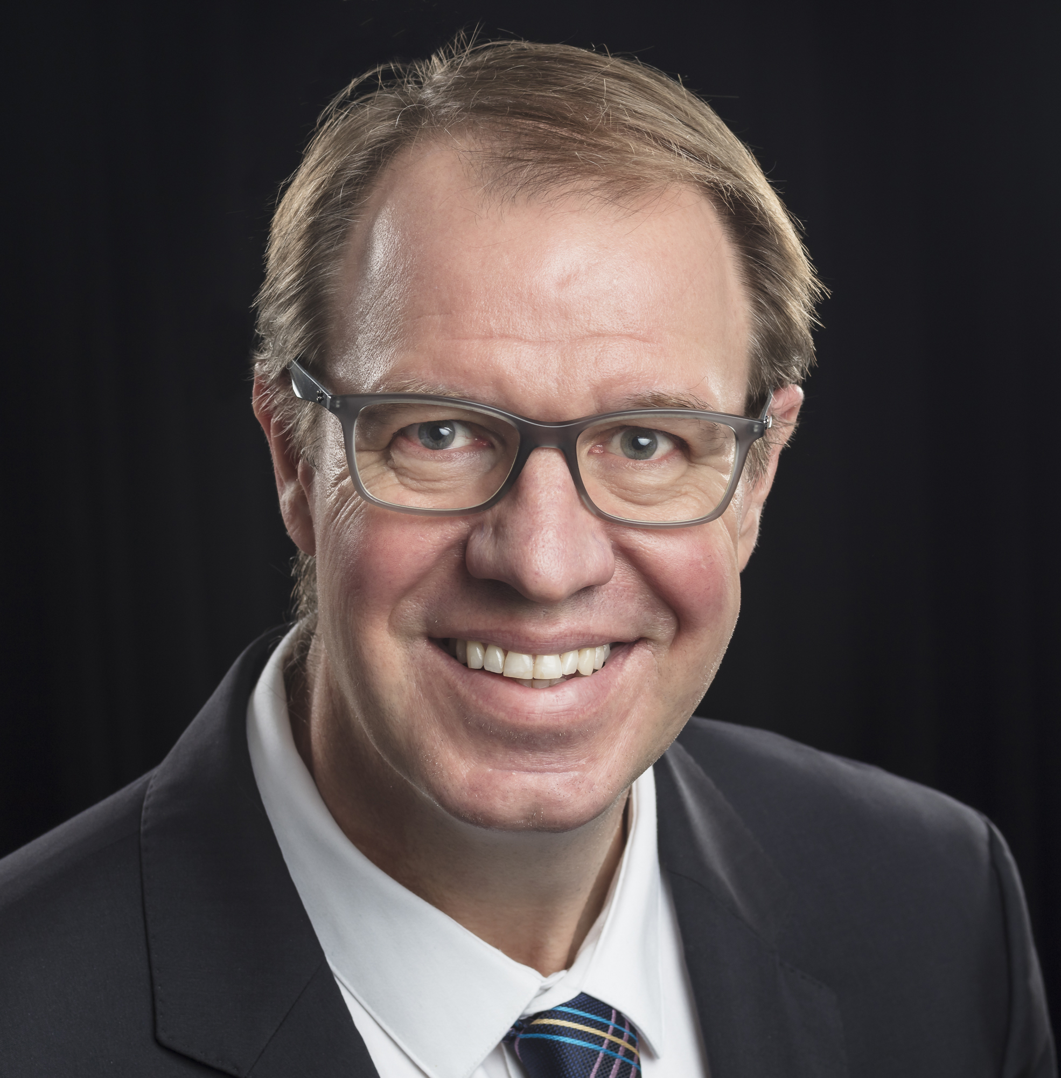
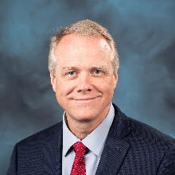
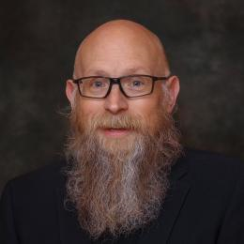
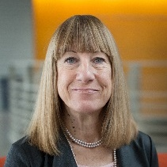
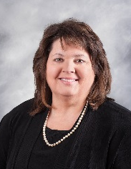
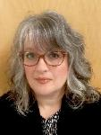
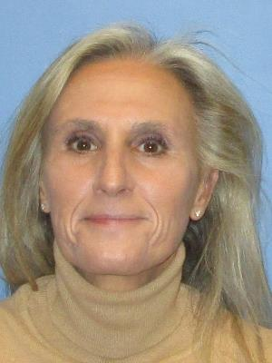
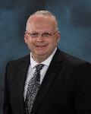
Neutron Sciences Directorate
Jens Dilling, Interim Associate Laboratory Director
Brian Weston, Chief Operating Officer
Jeanine Evans, Executive Assistant
Programs and Planning Specialist
Theresa Ahearn
Administrative Services Coordinator
Melissa Richards
Neutron Scattering Division
Jon Taylor, Director
Neutron Technologies Division
Richard Ibberson, Director
Research Accelerator Division
Fulvia Pilat, Director
Research Reactors Division
Mike Pierce, Director
Matrix Support
Business Manager: Lorie Hickey
Communications Manager: Amy Keller
HR Manager: Michelle Mazerolle
Procurement Manager: Markus Camfield
ESH&Q: Eric Griffis

Slide 6
Research Accelerator Division
Fulvia Pilat, Division Director
Division Mission
The Research Accelerator Division (RAD) operates the Spallation Neutron Source (SNS) accelerator complex
At 1.7 megawatts, the SNS is the most powerful of its kind in the world
After upgrades, it will reach 2 MW and then 2.8 MW to support STS
Staff
Safely, sustainably, and efficiently operate and improve the SNS accelerator complex for optimum scientific productivity and capability
~219 Staff
Research Accelerator Division
Fulvia Pilat, Director
Operations, Integration, and Maintenance Section
Glen Johns
Accelerator Science and Technology Section
Sarah Cousineau
Accelerator Systems Section
Sang-ho Kim
Target and Mechanical Systems Section
Michael Dayton
Control Systems Section
Karen White
Integration and Planning Group
Accelerator Physics Group
Electrical Power Conversion Group
Cooling Systems Group
Control Systems Group
Accelerator Operations Group
Beam Instrumentation Group
Front End Systems Group
Vacuum Systems Group
Protections Systems Group
Mechanical Support Group
Mechanical Engineering Group
Superconducting RF Group
Target Systems Group
Cryogenics and Target Group
Electrical Support Group
RF Systems Group
Target Operations Group
Conventional Facilities and Vacuum Group

Slide 7
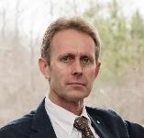
Neutron Technologies Division
Richard Ibberson, Division Director
Division Mission
The Neutron Technologies Division (NTD) provides innovation in neutron technologies and methodologies
Innovation supports the operations, improvements, and research and development of the world-class neutron scattering instrumentation at both SNS and HFIR
NTD supports target systems that convert the accelerator proton beam to useful neutrons at SNS
Staff
Instrument R&D and improvements
IRP design and production
Target design and production
~115 Staff
Neutron Technologies Division
Richard Ibberson
Neutron Instrument Technologies Section
Richard Ibberson (acting)
Neutron Technologies Engineering Section
Mark Lyttle
Site Services Section
Bob Eason
Neutronics Group
Instrument Engineering Group
Facilities Management and Engineering Group
Instrument Development Group
Design Services Group
Electrical Engineering Group
Neutron Optics and Polarization Group
Survey, Alignment, and Metrology Group
Materials Management
Detectors Group
Source Development and Engineering Group
DAQ Integration Group
Manufacturing Group
DAQ Development Group

Slide 8
Neutron Scattering Division
Jon Taylor, Division Director
Division Mission
The Neutron Scattering Division (NSD) is responsible for the user program at all scattering instruments
Staff are contributing to the development of innovative scattering approaches, data analysis methods, and novel sample environments
Staff
Scattering science at 12 HFIR and 18 SNS beamlines
Sample environments, labs, ancillary techniques
Data reduction and analysis
~169 Staff
Neutron Scattering Division
Jon Taylor, Director
User Programs and Outreach Group
Janell Thomson
Diffraction Section
Matt Tucker
Large Scale Structures Section
Volker Urban
Spectroscopy Section
Mark Lumsden
Sample Environment and User Labs Section
Gary Lynn
HFIR Beamline Operations Section
John Carruth
SNS Beamline Operations Section
Kevin Hamby
Powder Diffraction
Group
Bio-Facilities
Group
Chemical Spectroscopy Group
High Pressure
Group
HFIR Instrument
Support Group
SNS Operations
Support Group
Single Crystal Diffraction Group
Material Engineering Group
Direct Geometry
Group
High Temperature Group
HFIR Science Support Group
SNS Science Support 1 Group
Reflectometry
Group
Triple-Axis
Group
Labs and Soft Matter Group
SNS Science Support 2 Group
SANS and Spin Echo Group
HFIR Low Temperature and Magnets Group
Scientific Software Development for Neutron Science Team
Addi Malviya-Thakur
(matrixed/CCSD)
SNS Low Temperature and Magnets Group

Slide 9
Structure and planning for the review
CCR Teams
Management: Jimmy Stone, Quinn Windham
Engineering & Operations: Dave Price, David Rohrig, Kevin Shaw
Facility Safety: Natasha Blair, Joel Sadikoff
Health & Safety / Radiological: Bryan Mason, Scott Schwahn, Jeff Sickau, Jarrad Stump
Accelerator & Target Operations: Phil Ferguson, Steve Hartman, Peter Rosenblad
Approach
Teams are grouped by expertise but not restricted by topic
Initial interviews have been scheduled, and follow on discussions will be planned based on those conversations (schedule is flexible)
Closeout is planned for Thursday at 4:00, but this can be adjusted, if needed
Room availability changes by day, so for Team members, refer to your agenda or see Jennifer if you have questions

