Slide 1
Innovate 2.0 at ORNL Recap of Day 1
September 10, 2025
Rob Saethre
ORNL

Slide 2




Welcome to Innovate 2.0, a dynamic workshop designed for early to mid-career engineers from the Department of Energy's National Laboratory complex. An engaging experience focused on career development, configuration management, and cutting-edge engineering practices. This workshop aims to foster connections among peers while enhancing your knowledge of engineering practices across various facilities.

Slide 3
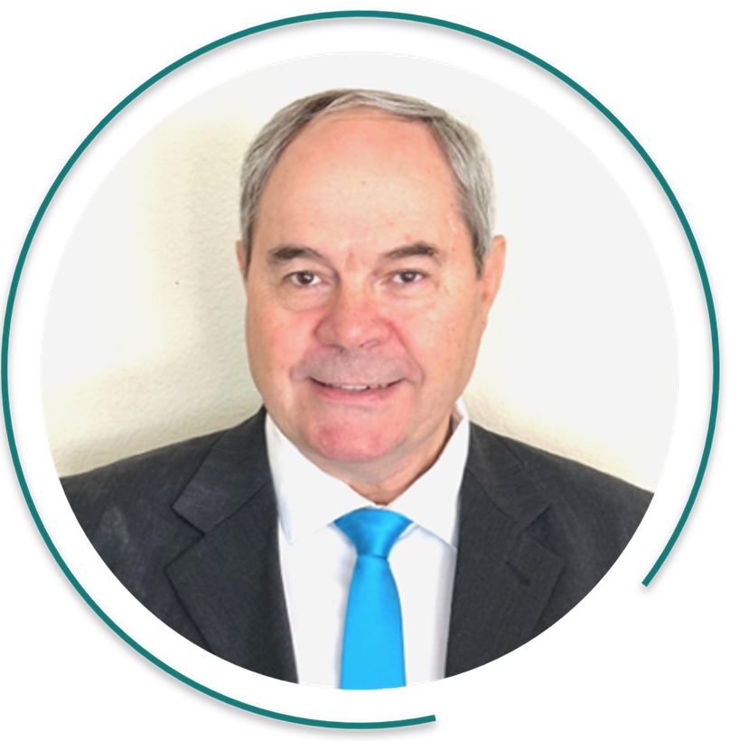
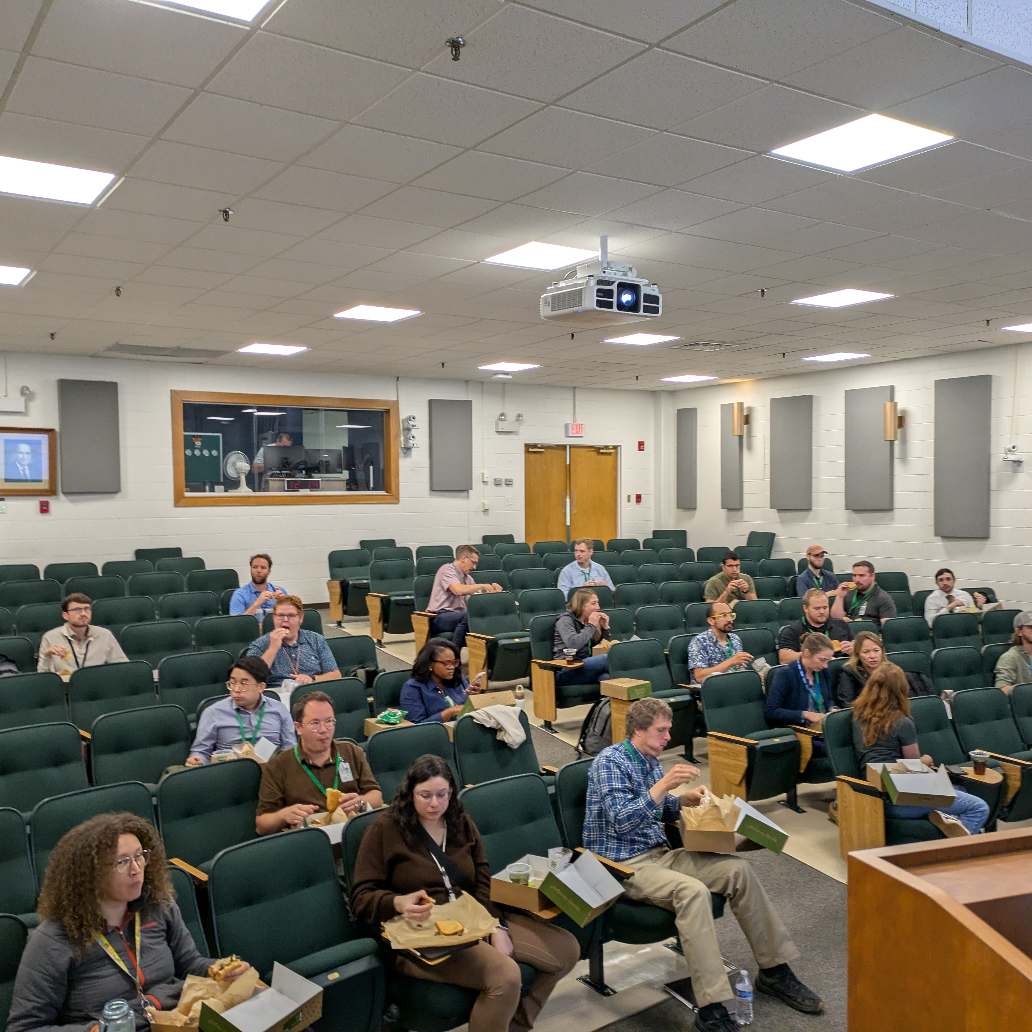
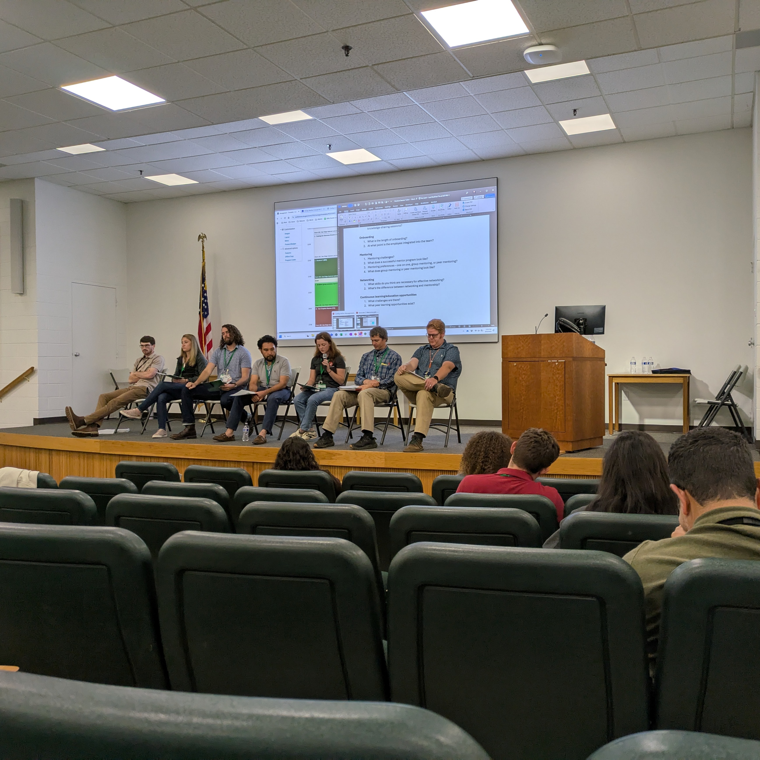
Thank you for a great day yesterday
Keynote by Christo Liedenberg
Discussion on Collaboration
Breakout session on Career Development

Slide 4
Take Aways from yesterday
Collaboration
Handover to operations isn’t well defined
Ownership is unclear
Collaboration within Labs are difficult
There are groups trying to help “Star Lab”, “EFCOG”, Chief Engineers @ Battelle Affiliated Labs, Six-Way Labs
Career Development
Training Resources are available but mostly for business systems, specific job related is “sink or swim”
Onboarding takes
Mentoring programs exist but take time away from job, need mgmt. support
Networking is this type of program
Continuous Education is mostly on the engineer to initiate and manage. Limited $ are available in most cases.
Need $ and time

Slide 5
It is worth it to take on mentoring
Group setting is a good idea
LIDAR
Post processing take stime
Matter port
Create a website in Sharepoint System descriptions for training and onboarding self learning.
Duplication of information could be a maintenance of information.
Single source of truth
Can we use AI to summarize and collate publications
Collaboration between labs
HFIR fuel elements example
Is there a guide for collaborations?

