Slide 1
Neutron Reflectometry Suite Review
February 10, 2026
Jim Browning
Neutron Reflectometry Group Leader

Slide 2
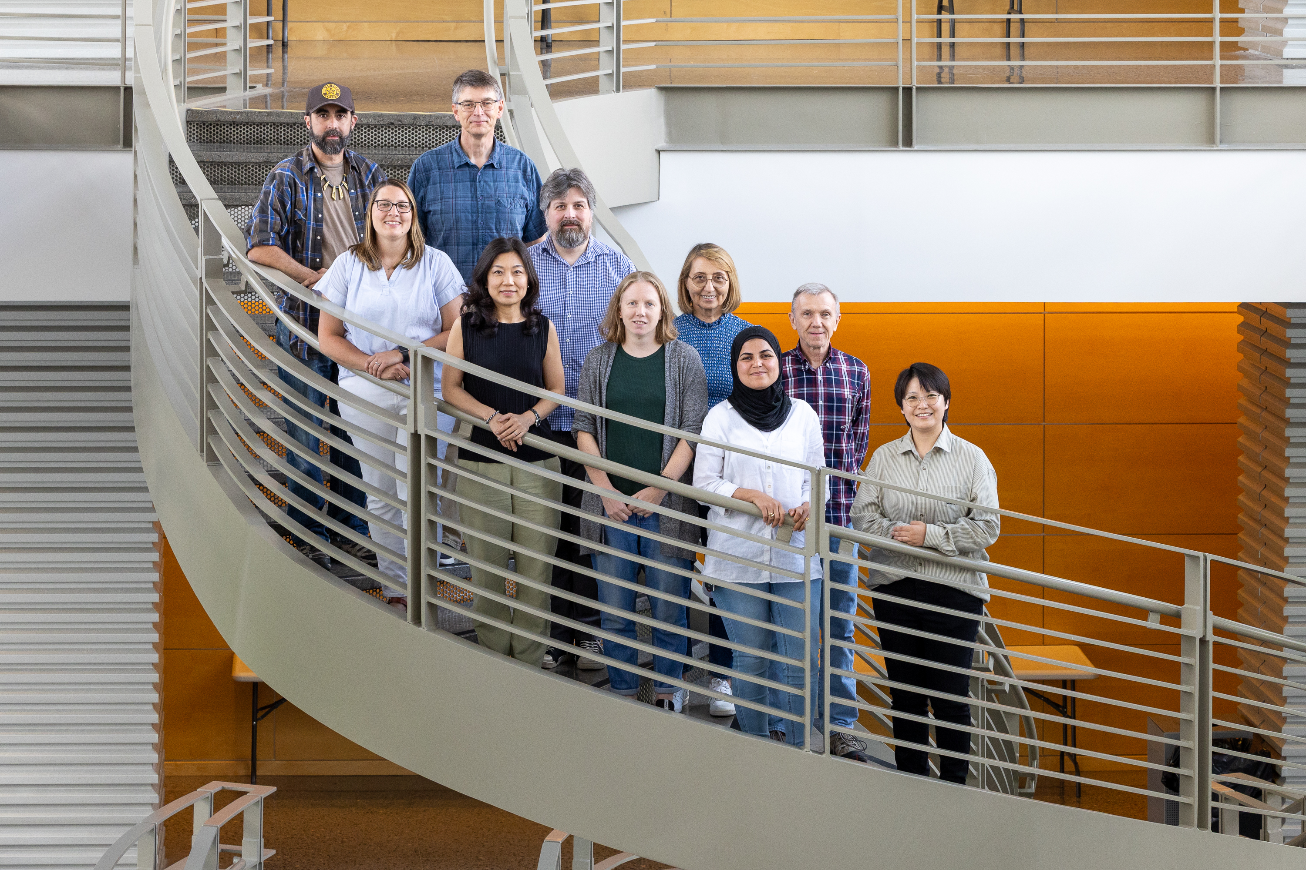


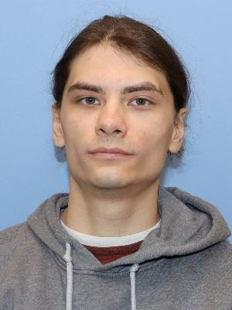
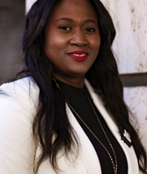
Neutron Reflectometry Group and Beamline Team Members
MagRef BL-4A
Valeria Lauter – Neutron Scattering Scientist
  Joined April 14, 2008
Tim Charlton - Neutron Scattering Scientist
  Joined Dec 14, 2015
Asmaa Qdemat - Neutron Scattering Scientist
  Joined Jan 13, 2025
Haile Ambaye – Scientific Associate
  Joined Jan 1, 2011
LiqRef BL-4B
Erik Watkins – Neutron Scattering Scientist
  Joined Aug 29, 2022
Becky Anderson – Neutron Scattering Scientist
  Joined Nov 25, 2024
Hanyu Wang - Neutron Scattering Scientist - Macro Group CNMS
  Joined July 6, 2020
Candice Halbert - Scientific Associate
  Joined July 13, 2006
NR Computational Scientist
Bogdan Vacaliuc
  Joined Oct 1, 2025
Post Docs
Jeehye Kim – Electrochemistry
Igor Gussev – Surface Diffraction

Slide 3
Is there a strong and sustainable user community and clear case for future scientific demand?
Average over-subscription ratio for both reflectometers ~ 2.5
BL
-
BL
4A (MAGREF) General User Days Requested vs Allocated
-
4A (MAGREF) General User Proposals Submitted vs Allocated
30
27
160
150
25
24
24
140
137
127
25
116
116
21
20
20
120
101
107
104
MagRef oversubscription ratio – 2.6
20
17
100
95
15
16
Sum of Prop. Submitted
Sum of Days Req
15
80
70
Sum of Days Allo
11
10
Sum of Prop. Alloc.
60
59
49
10
7
7
8
8
7
39
40
37
41
38
5
40
26
5
20
0
0
0
0
2020-A
2020-B
2021-A
2021-B
2022-A
2022-B
2023-A
2024-B
2025-A
2025-B
2020-A
2020-B
2021-A
2021-B
2022-A
2022-B
2023-A
2024-B
2025-A
2025-B
BL
-
BL
4B (LIQREF) General User Days Requested vs Allocated
-
4B (LIQREF) General User Proposals Submitted vs Allocated
40
37
180
160
LiqRef oversubscription ratio – 2.4
35
32
34
34
160
148
30
31
140
125
129
120
119
25
100
97
20
20
19
20
Sum of Prop. Submitted
89
Sum of Days Req
15
15
Sum of Prop. Alloc.
80
64
72
Sum of Days Allo
10
12
11
12
10
10
12
60
44
42
47
50
48
10
8
6
40
39
32
34
40
5
0
20
0
0
0
2020-A
2020-B
2021-A
2021-B
2022-A
2022-B
2023-A
2024-B
2025-A
2025-B
2020-A
2020-B
2021-A
2021-B
2022-A
2022-B
2023-A
2024-B
2025-A
2025-B

Slide 4
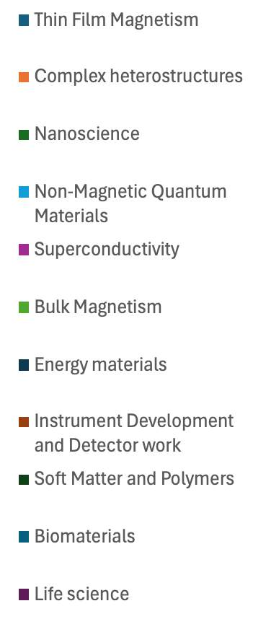
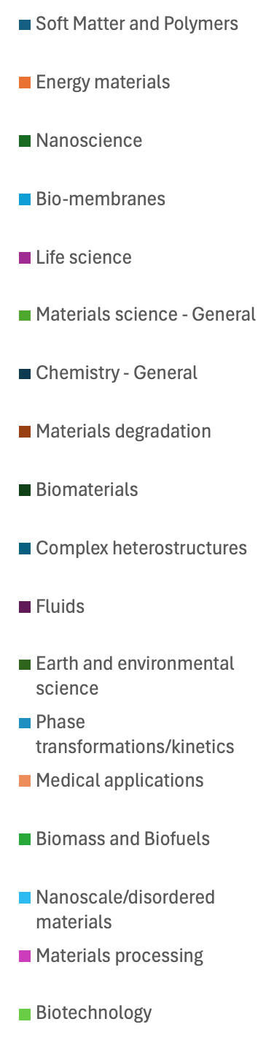
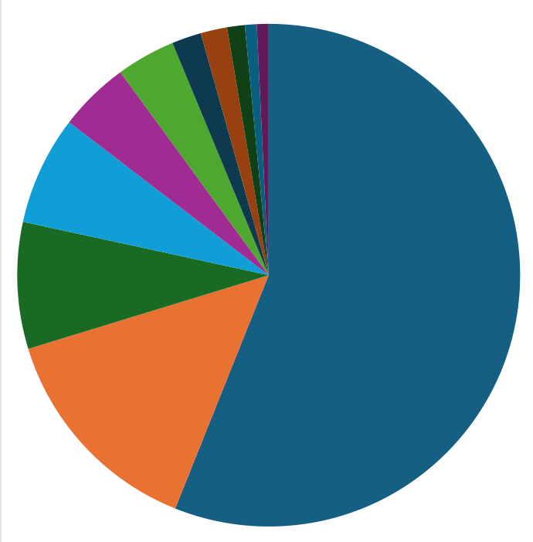
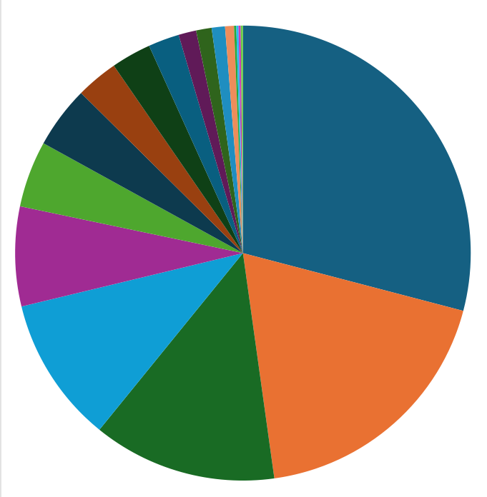
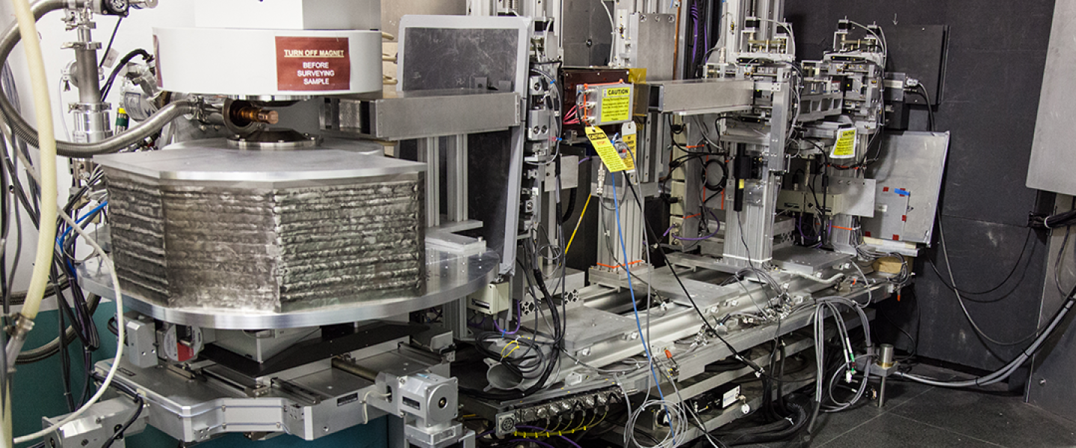
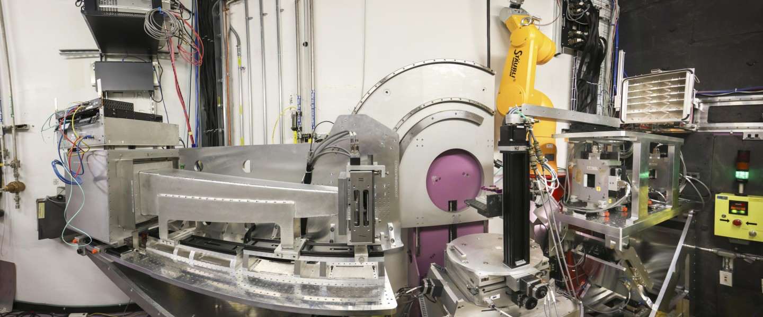
Is there a strong and sustainable user community and clear case for future scientific demand?
14.59%
21.73%
29.05%
7.01%
8.14%
56.06%
7.08%
14.20%
10.38%
18.71%
13.05%
BL-4A Research Areas 2020 – 2025
BL-4B Research Areas 2020 – 2025

Slide 5
Is the number of instruments in the suite proportionate to the user community demand?
The Strategic Impact of Reflectometry
Reflectometry serves virtually every scientific area ranging from fundamental condensed matter physics to the very application-based questions in energy storage.
Reflectometry plays a central role in advancing research on many of today’s high-priority scientific challenges.
  Probing quantum materials and emergent phenomena, e.g. spin orbit coupling and altermagnetism.
  Redox and separations chemistries addressing critical challenges in national security, energy, and environmental sciences.
  Probing membrane–protein interactions relevant to drug delivery and antimicrobial resistance.
Many, if not most, contemporary NR experiments performed in situ or operando
  Drives need for advancements in sample environments

Slide 6
Is the number of instruments in the suite proportionate to the user community demand?
 | US | Europe | Asia + Australia
Total Operational | 3* | 9** | 7
Polarization | 2* | 5 | 4
Free Liquids Capable | 1 | 4 | 3
US | Europe | Asia/Australia
MagRef | SuperADAM | Platypus
LiqRef | D17 | Spatz
CANDOR | FIGARO | REF-V
 | SURF | REF-H
 | INTER | SOFIA
 | PolRef | SHARAKU
 | OffSpec | SUIREN
 | AMOR
 | Nariss
As of right now, there are only 2 reflectometers running in the US, both at SNS!
*When CANDOR comes online this summer
** Two additional when ESS comes online 2027/2028?

Slide 7
Is the number of instruments in the suite proportionate to the user community demand?
Optimal instrument suite to meet user community needs beyond what’s available today
  Looking to the future, take advantage of STS beam characteristic and build two reflectometers to support both vertical and horizontal scattering geometries
  CANDOR like instrument at HFIR?

Slide 8
Performance of instruments in suite relative to leading national and international facilities
Benchmarking Instrument Productivity (2020 -2025)
Instrument | Average pubs per year* | Total Number of Publications*
MagRef | 11.7 | 70
LiqRef | 8.7 | 52
D17 | 13.0 | 78
FIGARO | 17.0 | 102
SuperADAM | 8.8 | 53
PolRef | 8.0 | 48
INTER | 9.7 | 58
OFFSPEC | 6.8 | 41
SHARAKU | 7.3 | 44
SOFIA | 12.7 | 76
Platypus | 11.5 | 69
*Peer review only
Red text = polarized beam

Slide 9
Performance of MagRef relative to similar instruments at ISIS, ILL, J-PARC and ANSTO
Total MagRef Pubs – 70
No. of high impact – 31
6 % of D17 pubs PNR
40 % of SuperADAM pubs PNR
16 % of Platypus pubs PNR

Slide 10
Performance of LiqRef relative to similar instruments at ISIS, ILL, J-PARC and ANSTO
Total LiqRef Pubs – 52
No. of high impact – 20
94 % of D17 pubs NR
60 % of SuperADAM pubs NR
84 % of Platypus pubs NR

Slide 11
MagRef SWOT Analysis
Strengths
Weaknesses
Opportunities
Threats
Magnetic field maximum near 5T, broad temperature range 1.5K to 850K
Flexible rep rate: 30, 60 Hz
Automated reduction system is unique among other similar sources
Routine measurement of specular, off-specular and GSANS with on polarized instrument
Detector: low count rate, small detection area
SE changes currently labor-intensive limiting flexibility
Single point failures
Software
  Fragile DAS
  Long lead time on features and bug fixes in the reduction tools
  Realtime preview of the data buggy and often completely unavailable.
Further application of magnetic contrast experiments
Real-time user-friendly time-dependent capability in software
Collaborations combining PNR with resonant soft X-ray reflectometry to broaden the user base
Enhanced training and onboarding programs for inexperienced neutron users
Resonant soft x-ray reflectometry
The delay in the development of a high-speed, large-area detectors
Users are lacking knowledge in neutron scattering compared to other characterization techniques
Other neutron sources have more reflectometers (capacity) & Large, better supported groups (NIST, ISIS, )
International facility growth: New instruments (e.g., ESS).

Slide 12
LiqRef SWOT Analysis
Strengths
Weaknesses
Opportunities
Threats
Breadth of Instrument staff skills drive ongoing instrument / technique development
Flexible instrument operation and fast data acquisition
High data quality / information content, based on user feedback
Capabilities for electrochemistry, recent growth of biophysics at interfaces
Issues with reduction software are delaying the delivery of data to users
Barriers to visualization and interpretation of reflectivity curves
Sample environment underdeveloped compared to other facilities
Improve output and impact of neutron experiments using additional techniques
Complementary in-plane information (interfacial tomography, off-specular, grazing incidence diffraction)
Growth of user community in underrepresented soft-matter science areas
Cross-laboratory collaborations (e.g. CNMS)
Improved methods for direct beam normalizations
No agility addressing problems involving multiple groups/sections
  Stove piping mentalities
Analysis approaches developed case-by-case by instrument staff (bottleneck to publication)
User community expertise / reduced user commitment to the technique
Irradiated liquid handling requirements starting to limit range of scientific questions we can address

Slide 13
Summary: Suite Status & Impact
User Program Demand is high:
  With an oversubscription ratio of 2.5
  With both instruments supporting broad and diverse science communities
Publication output is good:
  MagRef outperforms like instruments in the peer group
  Total number from suite – 122
  High Impact – 51
  Total number of Ph.D. Dissertations supported – 26
Going forward:
  Need to increase number of reflectometers running in US to remain globally competitive
  Increase our investment in sample environment support to keep pace with evolving science

Slide 14
Extra slides

Slide 15
Review Questions
The panel is asked to address the following questions:
(Instrument Team) Do the technical capabilities and performance of the individual instruments and instrument suites compare favorably with peer instruments at leading national and international neutron facilities?
(Group Leader) Does the scientific productivity and impact of the instrument programs compare favorably with comparable programs at peer facilities?
(Instrument Team) Do the beamlines meet users’ day-to-day needs for data collection, reduction, and analysis? Are planned software developments sufficient to meet anticipated future user needs?
(Section Head) Is the current scientific portfolio and business case for each instrument competitive nationally and internationally (e.g., user demand, breadth of scientific applications, scientific impact, mission relevance, agency support, and/or industrial engagement)?
(Group Leader) Are there a strong and sustainable user community and a clear case for future scientific demand for these instruments? Is the number of beamlines in a suite proportionate to user community demand?
(Instrument Team) Are the plans for development appropriate and well justified to meet current and future user requirements? Please consider aspects of instrument techniques, sample environments, sample preparation and characterization infrastructure, data analysis and modeling capabilities.
(Instrument Team) Are there well-defined and credible plans for future automation and integration of artificial intelligence or machine-learning approaches?
(Group Leader) Have the strengths, weaknesses, opportunities, and threats for each instrument or suite been clearly identified, and are there realistic plans to address them where feasible?
(Instrument Team) Are there additional developments, capabilities, or provisions that could enhance the capacity, effectiveness, or scientific impact of diffraction science at SNS and HFIR that were not presented by the instrument teams?
2
1
3

