Slide 1
Liquids Reflectometer
Suite Review 2026
February 10th, 2026
Erik Watkins
Neutron Scattering Division
Notes:
This talk is about the Liquids Reflectometer, but it’s also about a system problem that’s bigger than any one instrument.

Slide 2
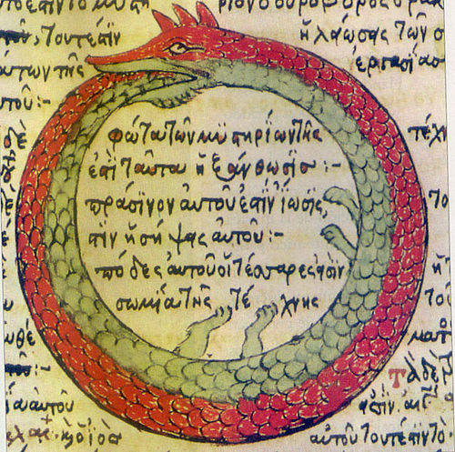
Ouroboros
Notes:
“tail-eater”: Ending something by becoming it, return to the same state but altered
Sometimes progress can be circular not linear
Unity of opposites: Life/death cycle, reviewer/reviewee cycle
David: lots of things presented in collaboration. As a reviewer he is now eating his own tail

Slide 3
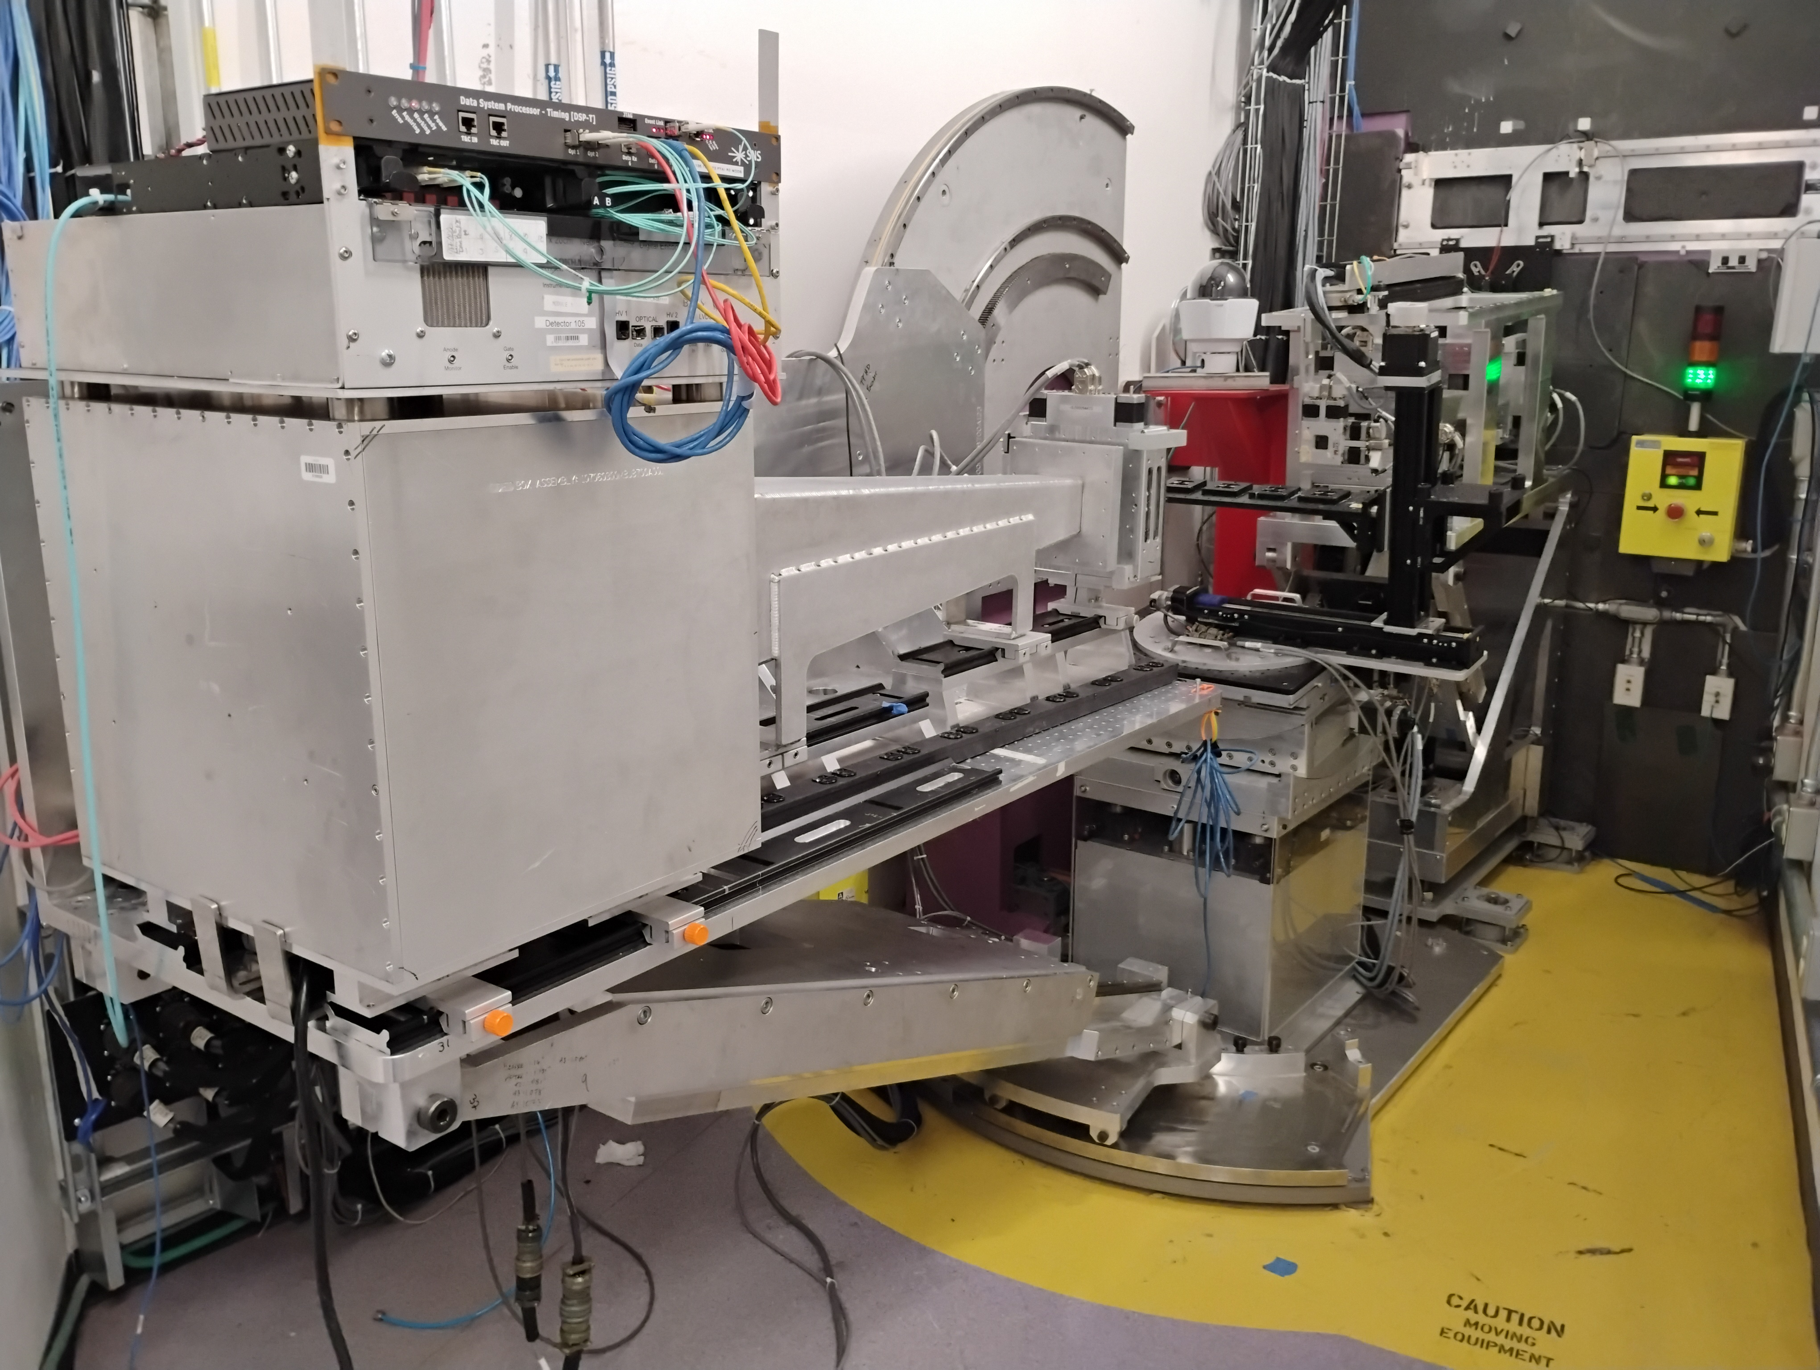
Key Takeaways
Improved instrument flexibility is enabling new science
  Tailoring measurement to the experiment’s needs
  New capabilities for automation and increased throughput
  More diverse science portfolio
Organizational barriers are slowing instrument evolution
  Breakdown between capability development and deployment to the user program
  Poor resource allocation to address instrument needs
  Stove-piping inhibits agile problem solving

Slide 4
Previous Suite Review Recommendations
Refortify the LR user program with particular emphasis on biomembranes
  Biophysics makes up ~25% of General User experiments (2024-2025), enabled by SE improvements
  Boost in portfolio correlates with NCNR outage, but not a zero-sum game!
Better engage external users in data analysis
  ~3/4 of LR users lead data analysis with input from instrument staff to guide the process
Develop a coherent GISANS strategy at the LoQ group level
  SANS instruments were determined to be better suited for soft matter GISANS experiments
The committee encourages acceleration of the polarized neutron option
  NR group efforts to secure funding were not successful, other priorities are being pursued now
Maintain an active upgrade schedule on MR and LR in parallel with STS reflectometer development
  Completed a major upgrade of the sample goniometer (awarded 2022, completed 2024)
  Commissioned a Cd attenuator system to enable normalization of high flux beams (2024-2026?)
Create a detector roadmap for reflectometry needs in NSD
  There is no defined NR detector roadmap. Our detector is an antique, but a good one!
Improve Sample Environment team support for soft matter
  Addition of SE staff members, most developments still driven by the instrument team.
  This is the biggest limitation on growth of the LR science program
Notes:
Some recommendations moved forward, some stalled.
SUCCESS: biophysics program, user driven analysis
FAILURE: soft matter SE, detector roadmap

Slide 5
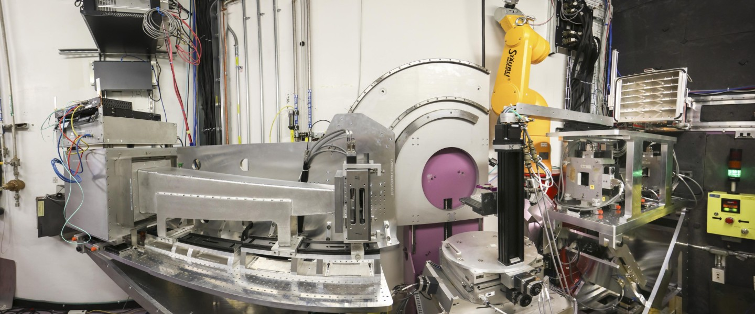
Where We Were
Producing high quality data, but limited instrument operations
  Measurements restricted to the same 7 or 8 configurations at 60Hz
  Streamlined workflow including one button-click automated alignment
  Direct beam normalization required overnight data acquisition
  Not possible to normalize 30Hz or free liquid (θ - θ) measurements
  Robotic sample changer limited to specific sample geometries
  Sample alignment not leveraging PSD capabilities
Notes:
A fairly conventional TOF reflectometer, on high flux source but high freq of source is limiting,
unusual features: 4 degree guide inclination, high divergence. no bending optics for free liquids.
“We weren’t failing to do good science—we were boxed into a narrow operating envelope.”
Can't get peak of spectrum on sample at low angles, no hope for reflection down theta-theta
7 configs to 0.2 or 8 configs to 0.4 A-1, no in between. Step through lambda bands
Auto alignment ~20-30m, very nice streamlined workflow
Band-aids on band-aids, house of cards: The system appears stable but is actually fragile
Point detector style alignments

Slide 6
Timeline
Hanyu Wang (IS) in
Previous suite review
COVID shutdown
John Ankner (IS) out
2021
Minh Phan (PD) out
1.4 MW
2022
Erik Watkins (IS) in
$325k midscale for goniometer
1.55 MW
Robot died
2023
New sample changer
Jeehye Kim (PD) in
PPU outage
$150k BRaVE funding for SE
2024
Sample goniometer upgrade
Detector on blocks
Becky Anderson (IS) in
1.7 MW
Mat Doucet (CIS) out
2025
Bogdan Vacaliuc (CIS) in
1.9 MW
Igor Gussev (PD) in
Notes:
Highlight transition and change over the review period: both in terms of staff and instrument operations
Timeline of this review overlaps with the NCNR outage.

Slide 7
Timeline
Hanyu Wang (IS) in
Previous suite review
COVID shutdown
John Ankner (IS) out
2021
Minh Phan (PD) out
1.4 MW
2022
Erik Watkins (IS) in
1.55 MW
2023
Jeehye Kim (PD) in
PPU outage
Commissioned 30Hz operation mode
Commissioned fluid handling and upgraded x4 solid-liquid cell SE
2024
Detector on blocks
Demonstrated divergent beam NR and direct beams using Cd attenuators
Becky Anderson (IS) in
1.7 MW
Mat Doucet (CIS) out
Demonstrated anharmonic chopper modes
2025
Added chopper cut to Cd direct beam method
Bogdan Vacaliuc (CIS) in
Commissioned multi-channel e-chem SE
Igor Gussev (PD) in
1.9 MW
First experiments with x8 solid-liquid cell SE
Notes:
Highlight transition and change over the review period: both in terms of staff and instrument operations
fundamentally destabilizing but in a good way
Timeline of this review overlaps with the NCNR outage.

Slide 8

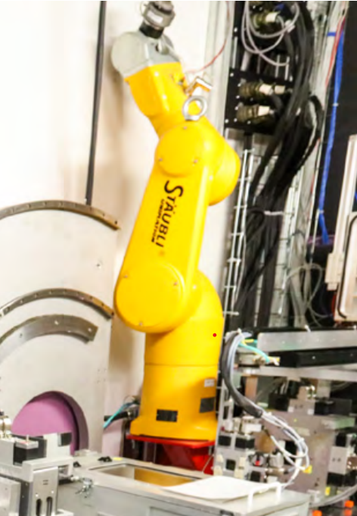
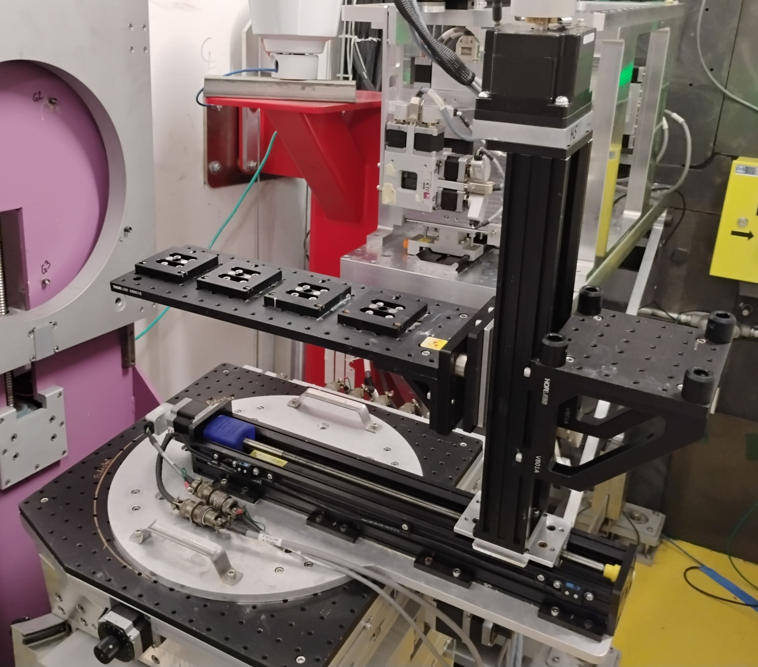
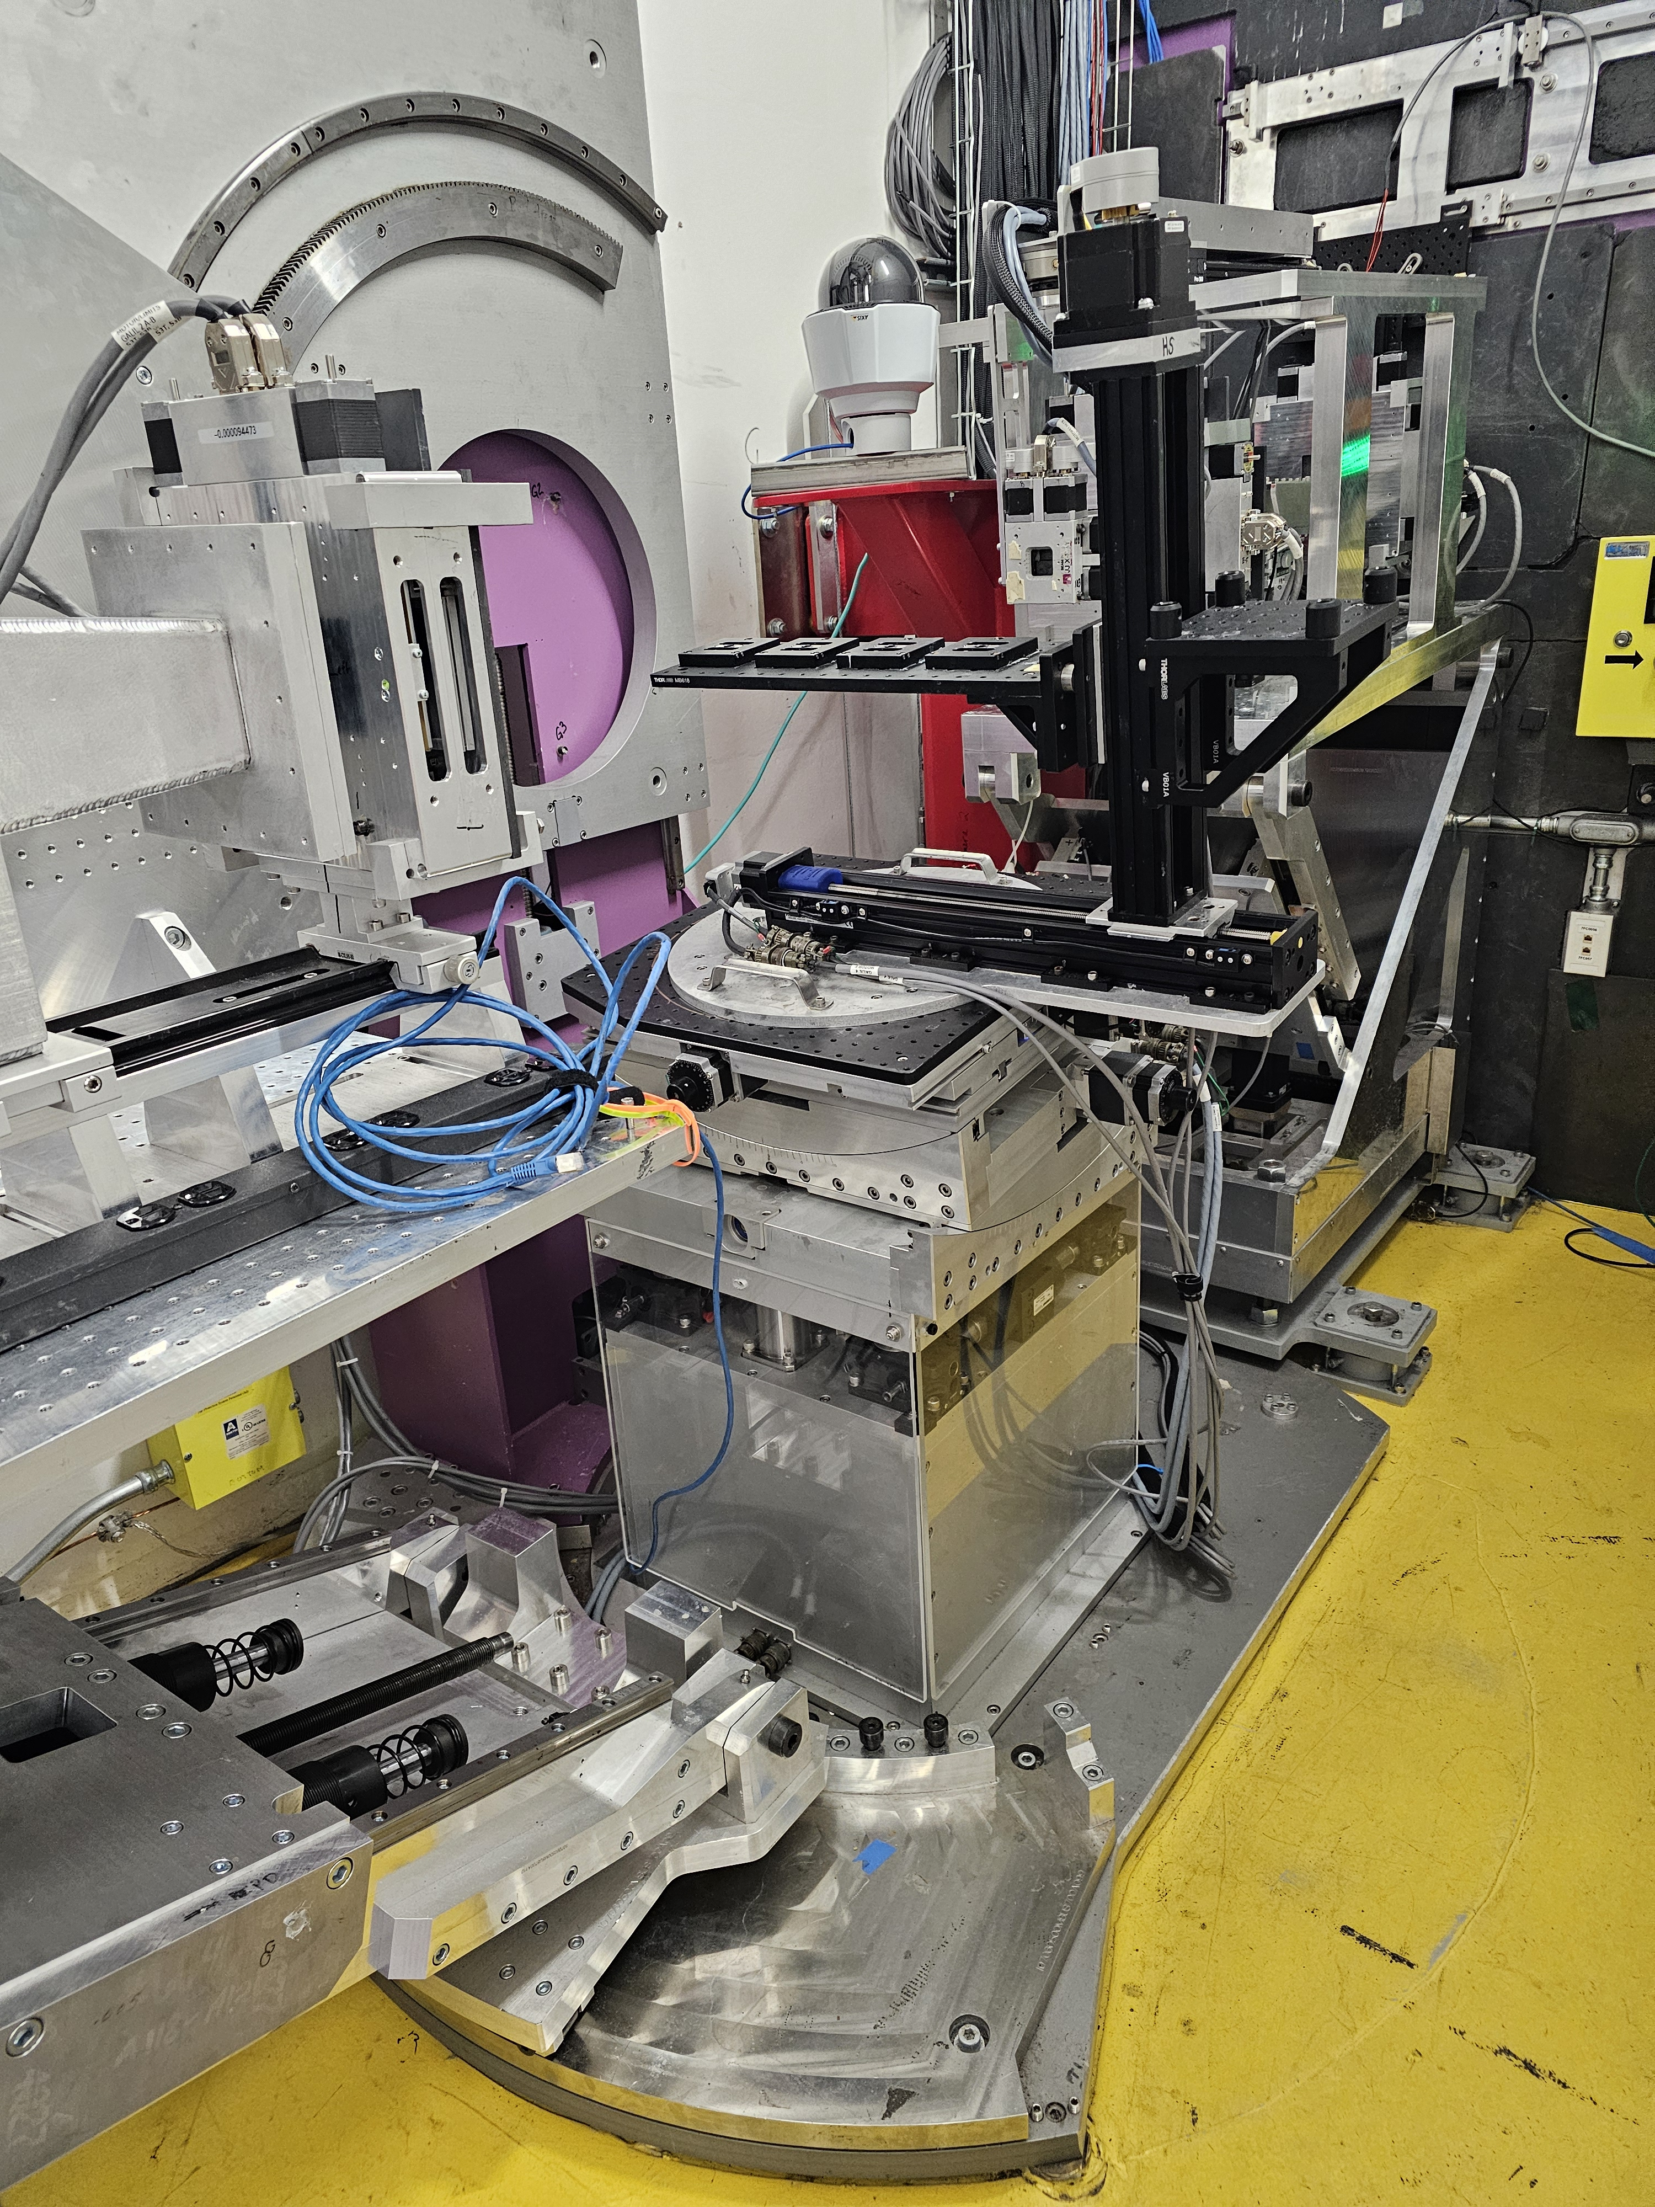
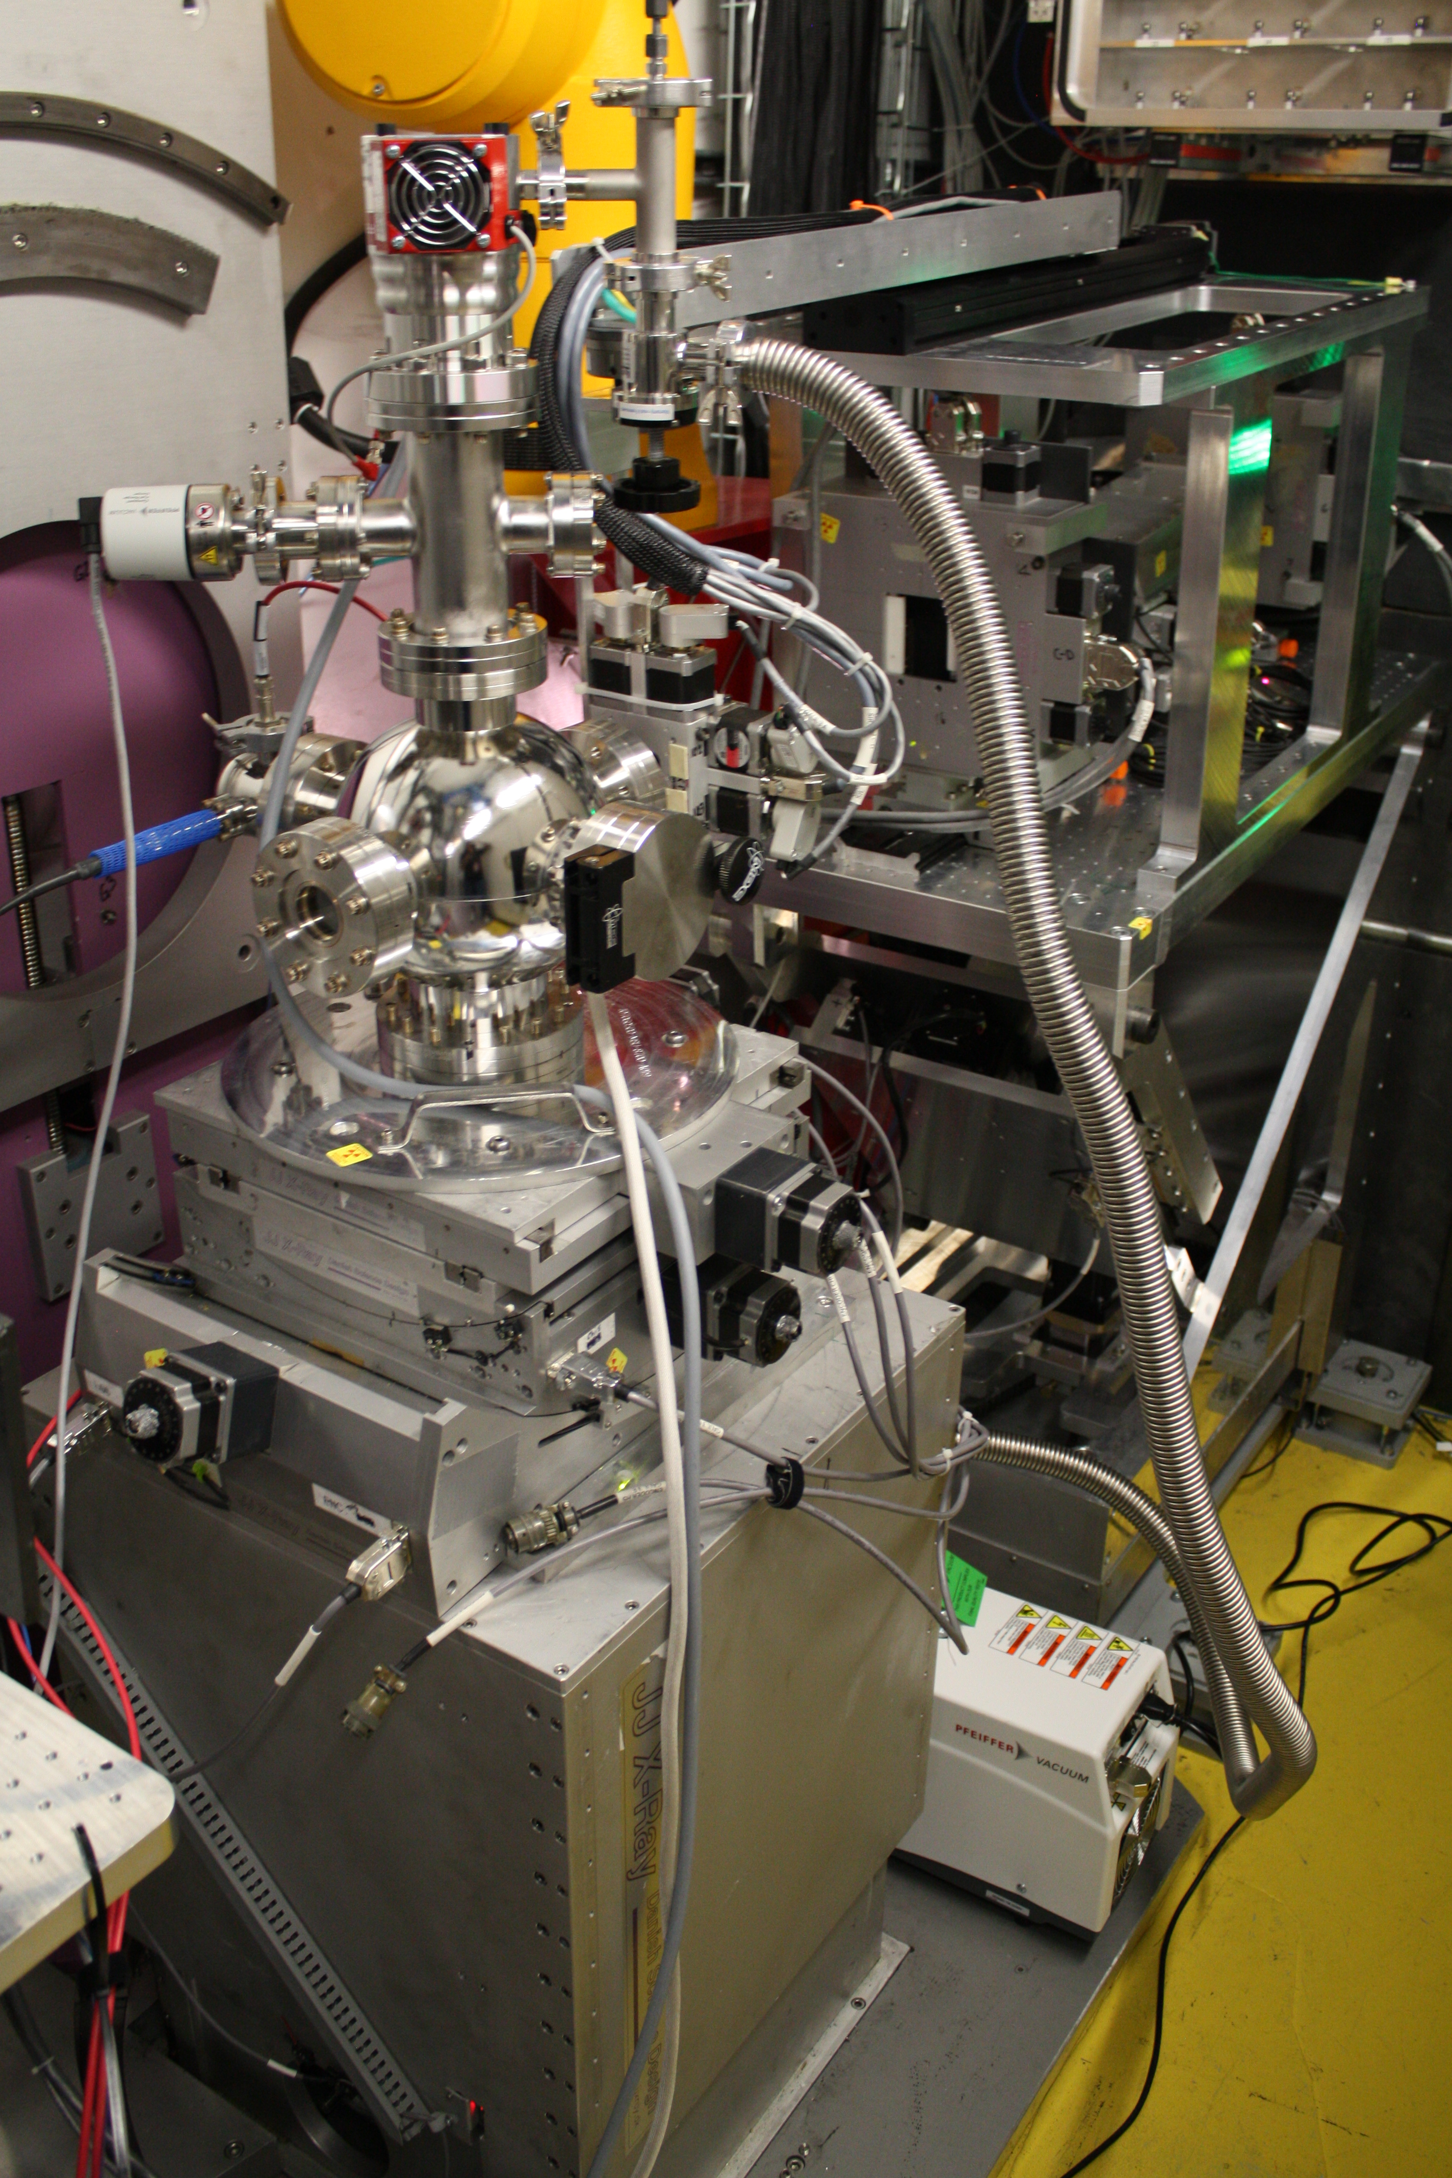
Instrumentation Developments
R I P
Sample goniometer upgrade (2024)
Increased:
Motion ranges
Load capacity
Center of rotation
died Dec. 2022
Robot replaced with linear translation sample changer
low-tech solution, more flexible sample automation
need higher capacity as acquisition times drop
Other small developments:
Cd attenuators
Laser for rough sample alignment
Notes:
REST OF FACILITY MOVING TO ROBOTS, WE MOVED AWAY
Need more automation capacity (if not changing sample conditions), especially with decreasing acquisition times.
Now that we have caught up with the early 2000s, New robot in the future?
COR: 170 to 350mm, Load: doubles to 370kg, Motion: +/-75mm
midscale Awarded $325,300 November 2022 which included new goniometer and upgrade to Galils. Installed June 2024

Slide 9
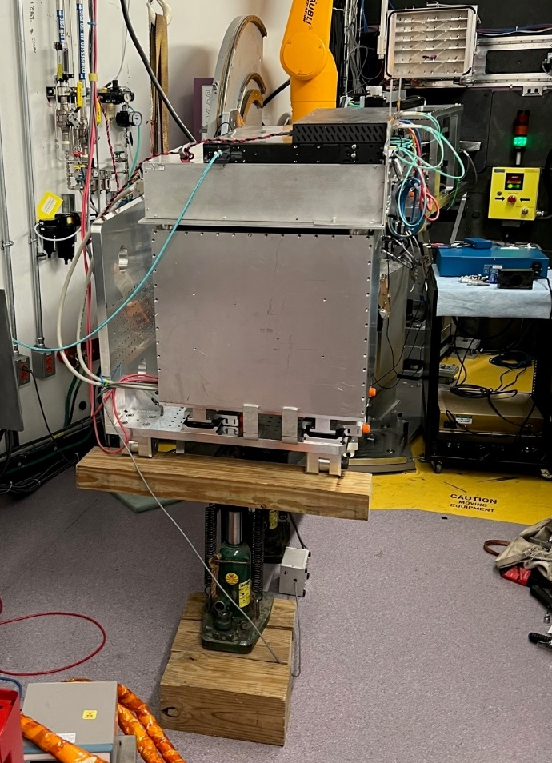
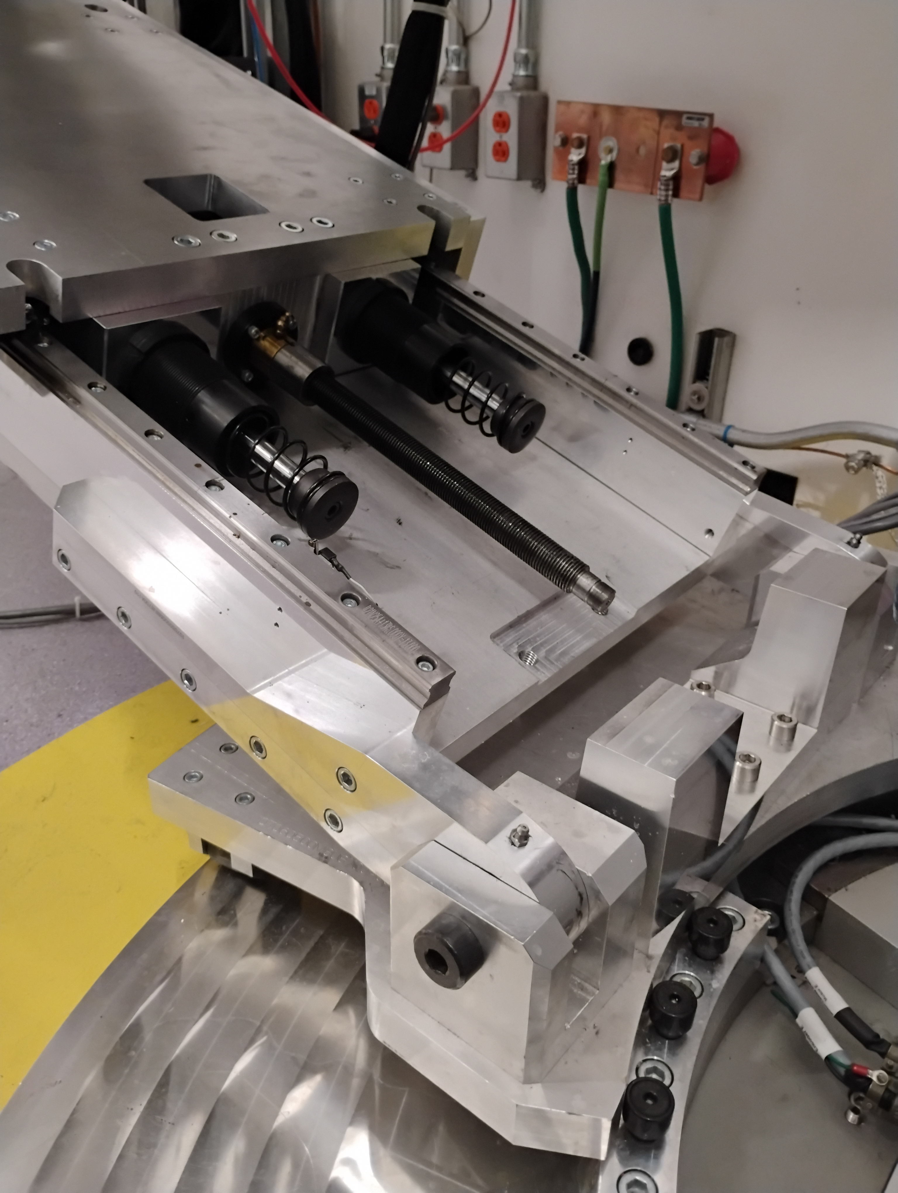
The Detector Arm Saga
Mechanical drive of the detector arm failed four times in 2023
  First failure attributed to wear and tear, subsequent failures to mechanical misalignment
  Root cause determined to be a mechanically over constrained system, but issue not addressed
After PPU, detector arm failed again. Detector put on blocks for the cycle
  We decided to remain in the user program with a fixed detector position
  New data collection and alignment methods developed, supported ~80% of experiments
Engineering solution implemented in January 2025
removed bearing block
Failures 1 & 2 (1/15/23)
added spherical bearing
Failure 3 (2/6/23)
2023
Failure 4 (8/2/23)
curved guide rails
vertical translation
(ZD)
TTHD
PPU shutdown
2024
2D detector
Failure 5 (8/21/24)
linear translation (PD)
Detector on blocks
sample goniometer
Engineering solution implemented (1/10/25)
on blocks for a run cycle
Notes:
HIGH LEVEL: Systematic failure of a critical instrument component
Took 2 years from identifying the root issue to implementing a solution
New methods rolled out during this saga are now foundation of the new instrumental flexibility
First repair replaced drive assembly, failed in 30h.
During 2nd repair: see a crowbar needed to force the assembly together. More rigorous attempts to align assembly after failures. All on research mechanics, limited support for instrument engineers
Failure 4: software glitch made ZD and TTHD move together, broke it. Afterwards, software interlock
During PPU, couldn’t get resources to deal with over constraints. Fabricated new components from stronger 6061-T6 alloy. Installed higher torque motor as our best option for mitigation
After PPU, totally stripped nut with higher torque motor, whole thing crashed to the ground. This is when engineering started to look into a design mod to deal with the issue
2.5min to move for a standard measurement

Slide 10
Recent Technique Developments
Improving direct beam measurements
30Hz is the new standard
Free liquid interfaces back on the table
Getting more neutrons with divergent beams
Anharmonic choppers access broad λ bands

Slide 11
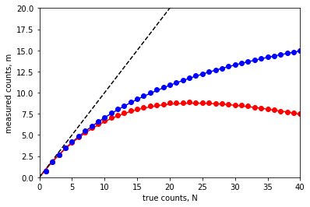
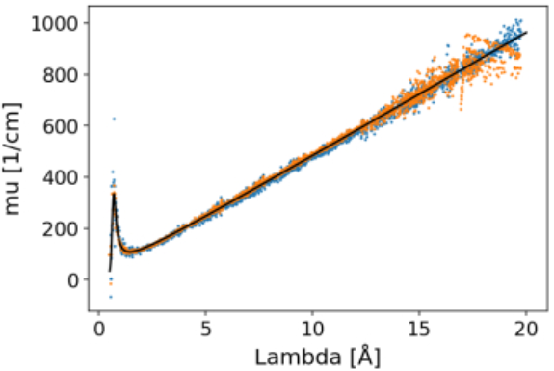
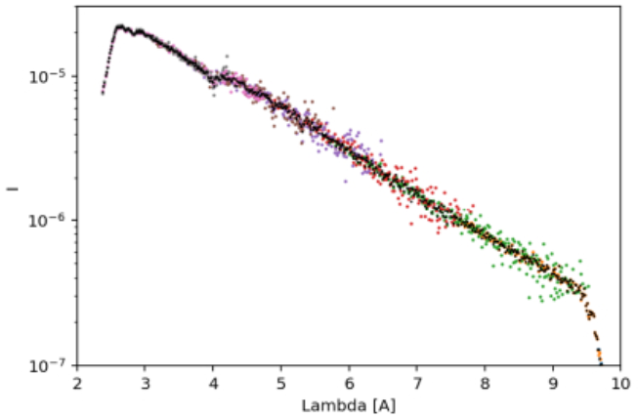
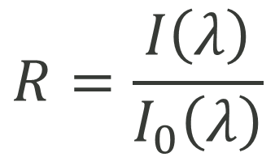
New Data Normalization Methods Improve Instrument Flexibility and Throughput
Technical challenge: count rate limited to <1,000 cps for linear detector response
Plastic attenuator method: measure transmission ratios with different attenuator thickness
  Used linear approximation to the ratio of intensities vs. λ
  ~8 hours to obtain a set of normalization measurements
  Approach fails at 30Hz: linear approx. insufficient for wider λ band
  Approach fails with high flux beams: artifacts from multiple scattering in thick plastic
$$R=\frac{I\left(λ\right)}{I_{0}\left(λ\right)}$$
Slit scanning method: use slits to divide the beam into bite-sized pieces and add them up
  Works at 30Hz and 60Hz
  ~1 hour to obtain a set of normalization measurements
  Dead time correction enables > 20,000 cps
  Approach fails with high flux beams: artifacts from parallax/reproducibility with small slit gaps
Cd attenuator method: transmission measurement through Cd attenuators
  Chopper used to cut off low λ, Cd thickness adjusted for remaining λ
  ~1 hour to obtain a set of normalization measurements
  Demonstrated mid 2024, not currently available to the user program
Notes:
New methods for data normalization are needed to move the instrument forward
Critical to address as accelerator power increased
Slit scanning method could work with better slit packages and upgraded detector electronics.
Electronics are in development to decrease deadtime by x4 and enable coincidence counting.
Slit scanning method is more direct, but….
Cd method demonstrated 2024, can’t roll out because needs reduction software integration
Other option, using monitor

Slide 12
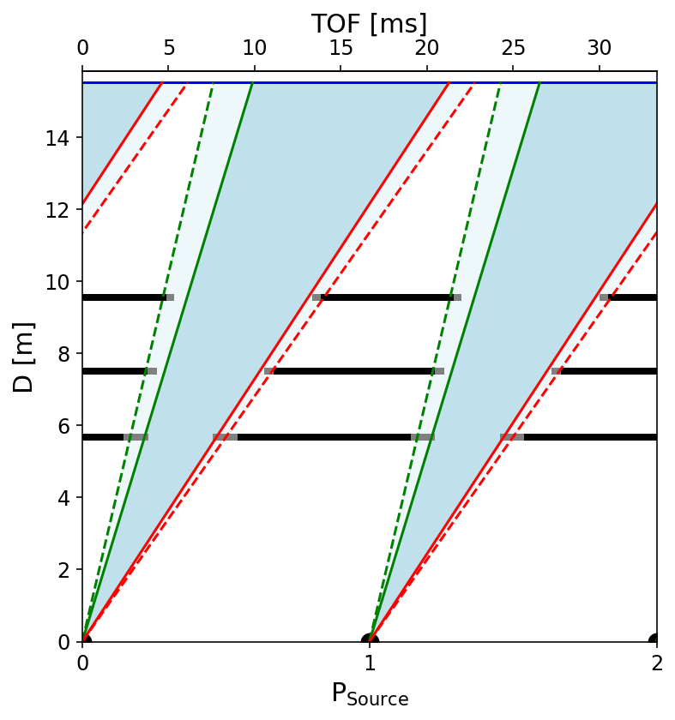
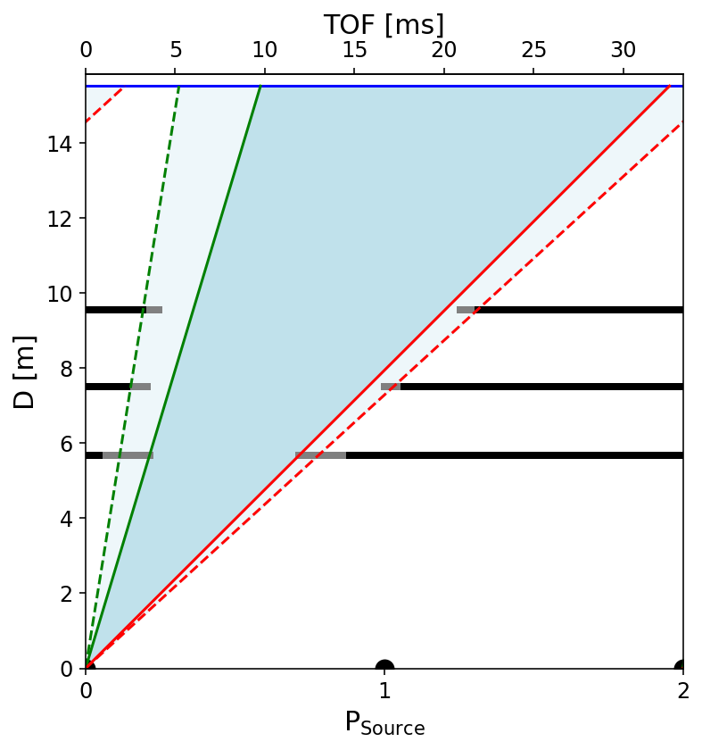
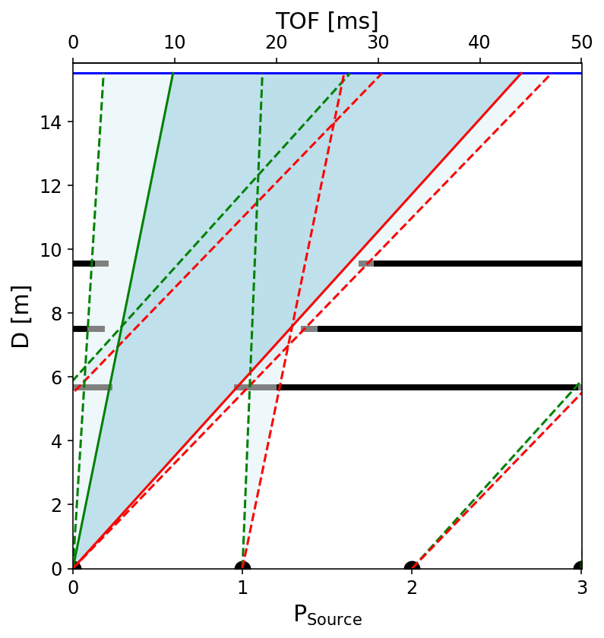
Getting More Bandwidth: Frame Skipping Modes
Chopper partially open
Frame overlap!
smallest λ
largest λ
60 Hz
30 Hz
20 Hz
λ ~ 2.5 – 13 Å
2 settings to Q = 0.2 Å⁻¹
λ ~ 2.5 – 6 Å
7 settings to Q = 0.2 Å⁻¹
λ ~ 2.5 – 9.5 Å
3 settings to Q = 0.25 Å⁻¹
λ ~ 2.5 – 13 Å
2 settings to Q = 0.2 Å⁻¹
Notes:
NEW NORMALIZATION HAS ENABLED 30HZ MODE, GIVES LARGER BANDWIDTH.
BECOME MOST COMMON OPERATION MODE.
BUT WE CAN’T CONTINUE SKIPPING MORE FRAMES
We get frame overlap at 30Hz above ~11A.
Only way to have no frame overlap at 20Hz or less is a chopper closer to the moderator

Slide 13
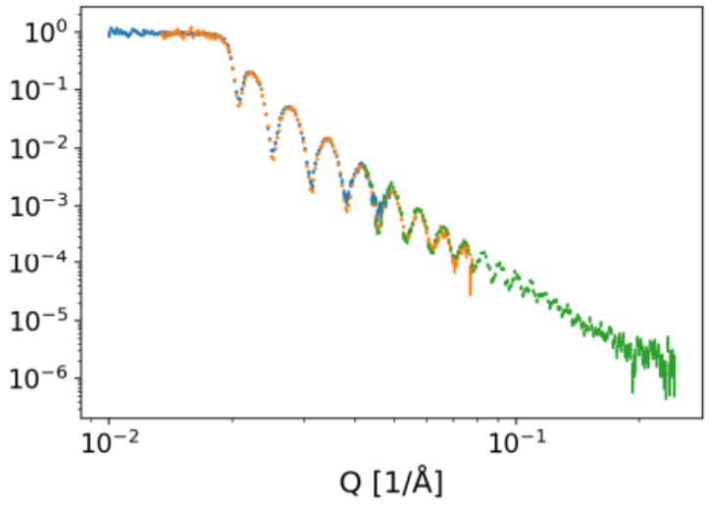
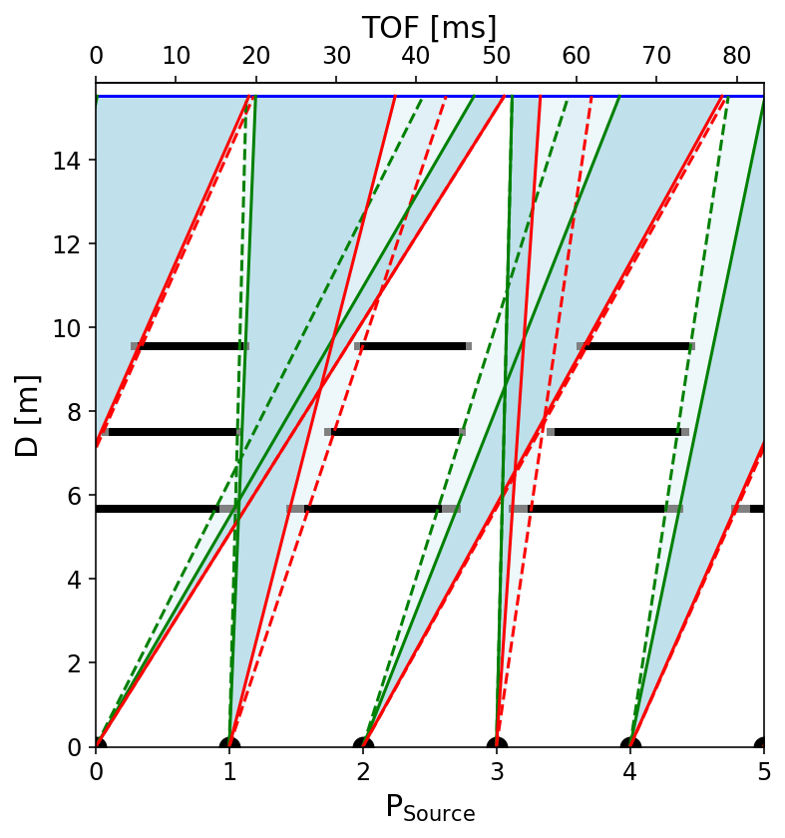
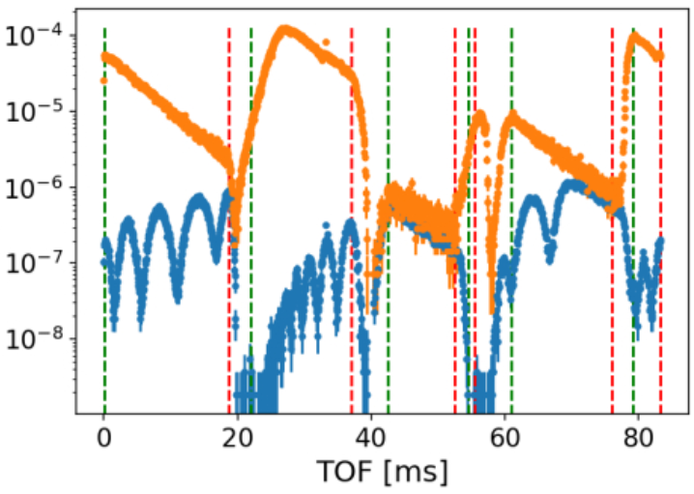
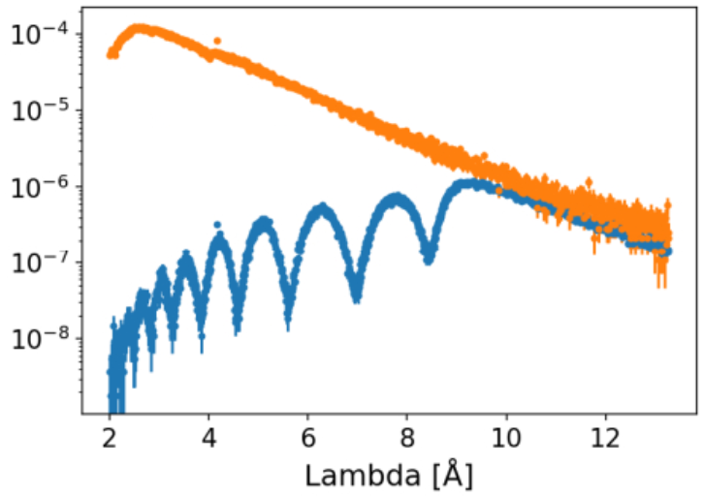
Chopper Tricks!
Spin the choppers at 36Hz, no longer a subharmonic.
Fundamental frequency is 12Hz,
periodicity is 83 ms (5 source periods)
50% increase in λ range over 30Hz mode!
2 settings to Q = 0.2 Å⁻¹
1
2
3
4
5
Notes:
WE ARE EXPLORING NEW METHODS TO GET WIDER Q-RANGE
THIS CAN ENABLE: wider q-range kinetic measurements, on par with capabilities at other sources
For the 20Hz and 30Hz case, the chopper frequency is the fundamental and the source frequency is a higher harmonic.
But we can also imagine spinning the choppers at frequencies where the source frequency is no longer a higher harmonic.
Fundamental is the greatest common denominator of the 2 freq

Slide 14
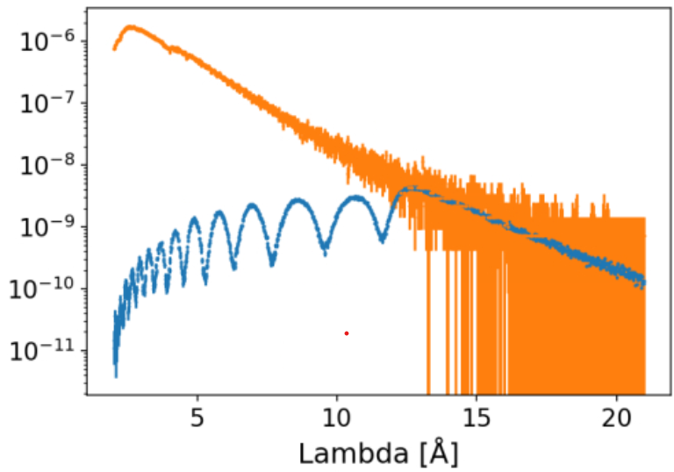
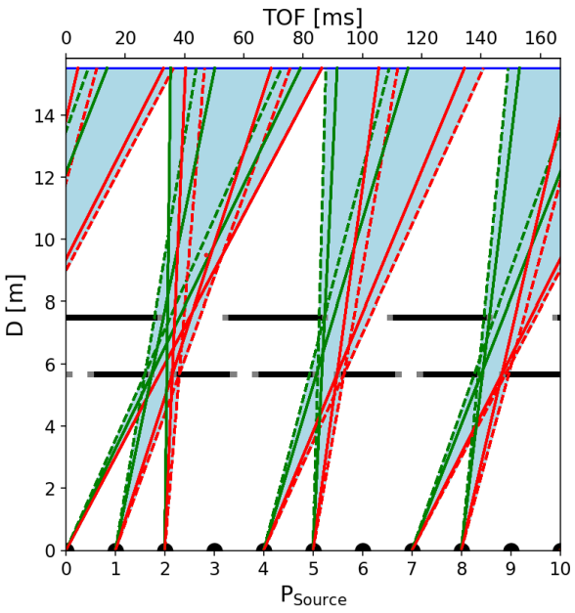
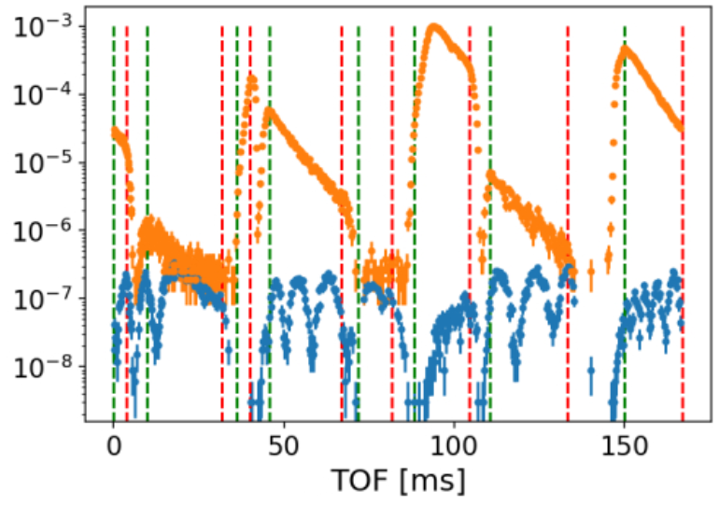
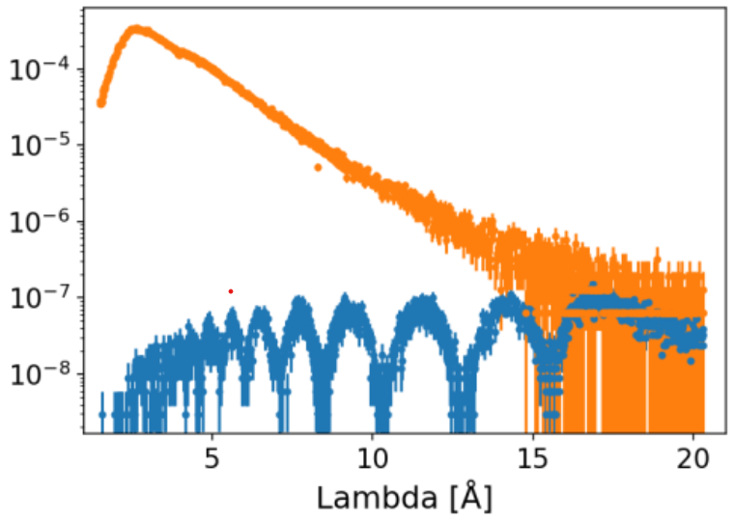
Potential For Very Wide λ Band Modes
Source at 10Hz
Chopper1 spinning at 36 Hz, Chopper 2 at 18 Hz.
Fundamental frequency is 6 Hz, 10 source periods.
Comparable λ range to 10Hz operations
Notes:
Can push this approach even further, most if not all q-range in 1 shot
Equivalent to a 10Hz spallation source.

Slide 15
Key Takeaways
Improved instrument flexibility is enabling new science
  Tailoring measurement to the experiment’s needs
  New capabilities for automation and increased throughput
  More diverse science portfolio
30Hz timeline
Benchmarked dead time correction and slit scan DBs
2023
PPU outage
2024
Slit scan DBs and 30Hz mode become routine
Organizational barriers are slowing instrument evolution
  Breakdown between capability development and deployment to the user program
  Poor resource allocation to address instrument needs
  Stove-piping inhibits agile problem solving
2025
Demonstrated anharmonic chopper modes
Projected integration of new alignment and DB scans
2026
Notes:
Wider bandwidth operation @30Hz gives us a lot of flexibility, which is great.
2 YEARS FROM COMMISSIONING OF SLIT SCAN METHOD, STILL NOT INTEGRATED INTO DATA ACQUISITION SOFTWARE
THIS LAG IS WHY WE CAN’T PUT EFFORT INTO DEPLOYING NOVEL THINGS LIKE ANHARMONIC CHOPPER MODES
Slit scan DBs was a small change to reduction pipeline and was integrated rapidly
30Hz not compatible with the auto-alignment algorithm (OK it works, but you have to switch back and forth from 60Hz to 30Hz which takes several minutes)
Running slit scan DBs still not well integrated into data acquisition software: was external python script, now script scan

Slide 16
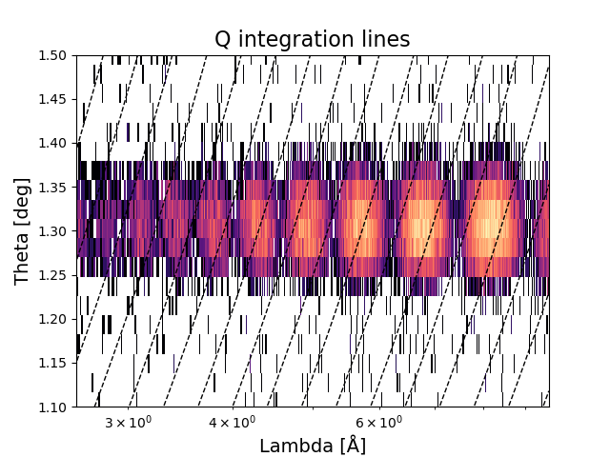
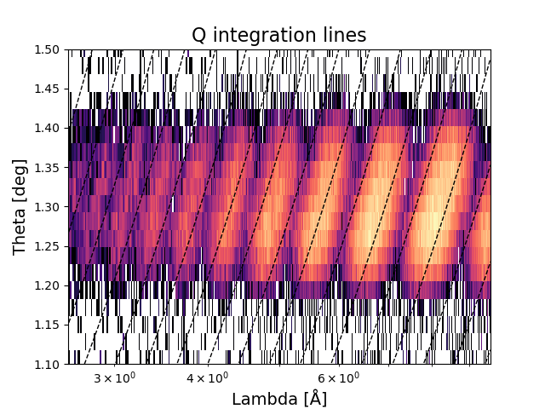
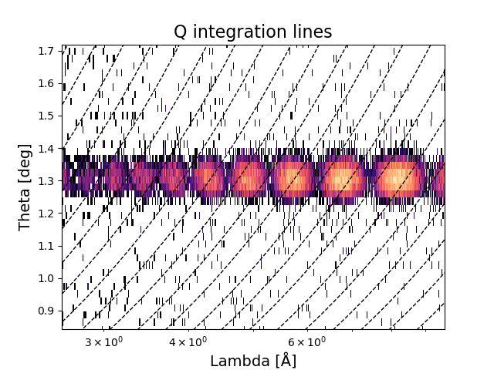
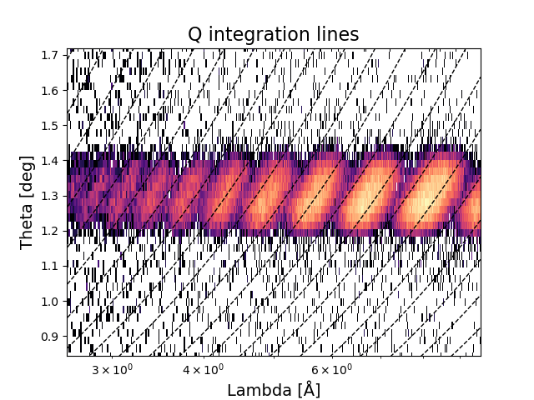
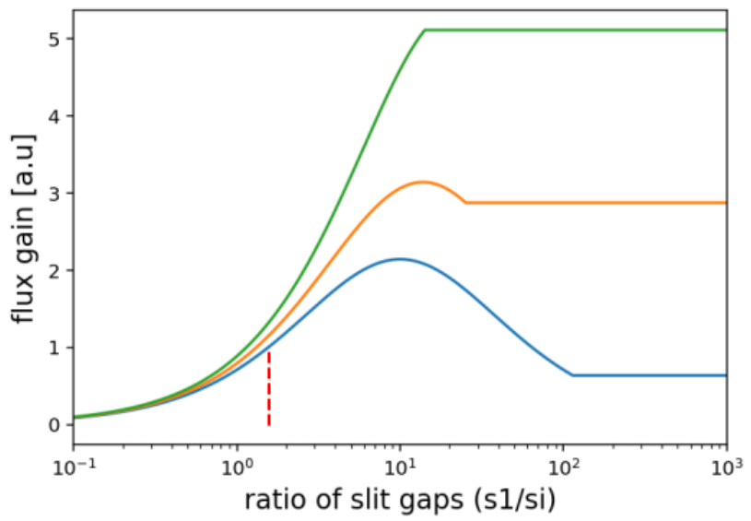
Faster Measurements With Divergent Beams
d_{si-sam}= 65 mm
guide size limit
105 mm
Divergent beams put more neutrons on the sample
‘typical’ collimated beam
PSD determines theta, no loss of q resolution if scattering is specular and samples are flat
145 mm
Moving the slit closer to the sample maximizes flux
Notes:
Approach demonstrated in 1990s, now common measurement mode for most NR instruments
Frequent comment : ‘Isn’t this obvious’, but roadblocks to user deployment
Recently added binning algorithm in reduction code, need DB measurements to catch up
Needs flat samples and minimal off-specular scattering

Slide 17
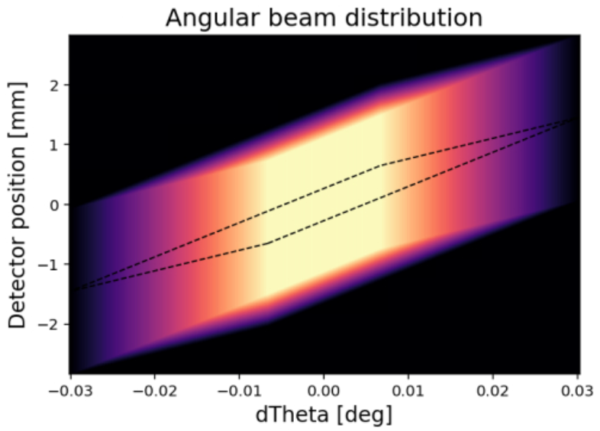
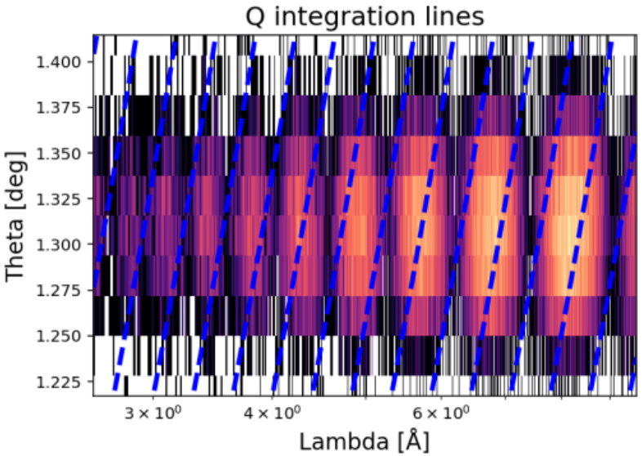
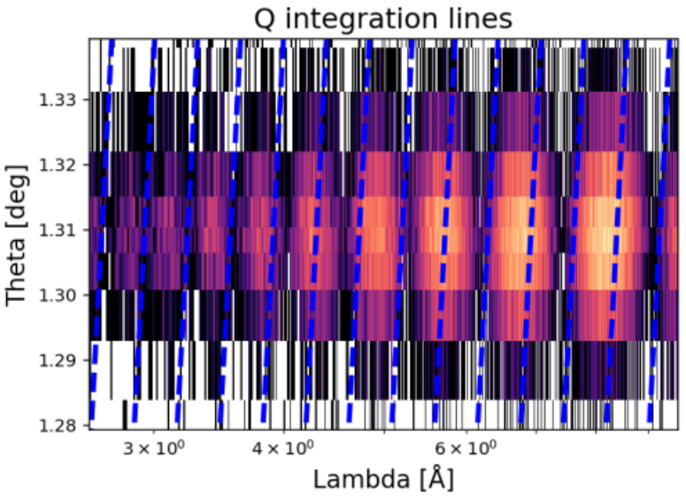
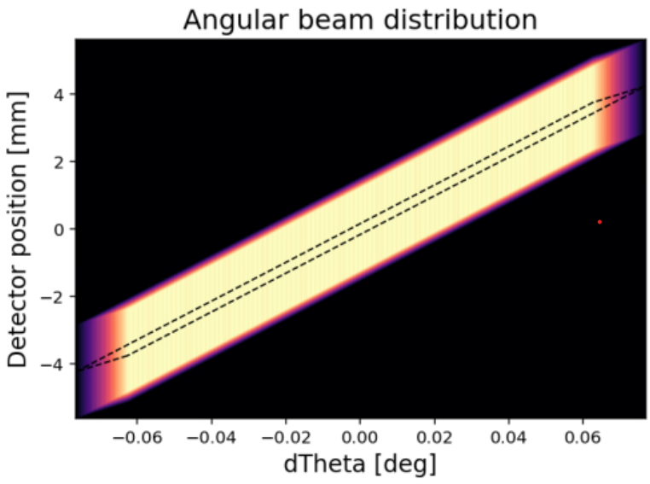
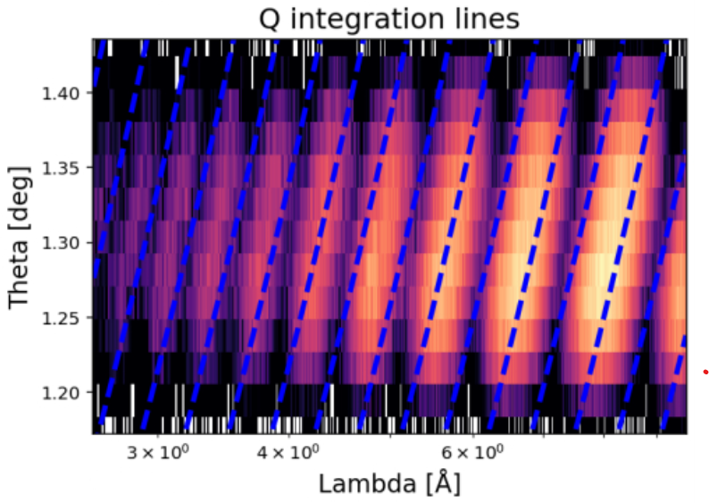
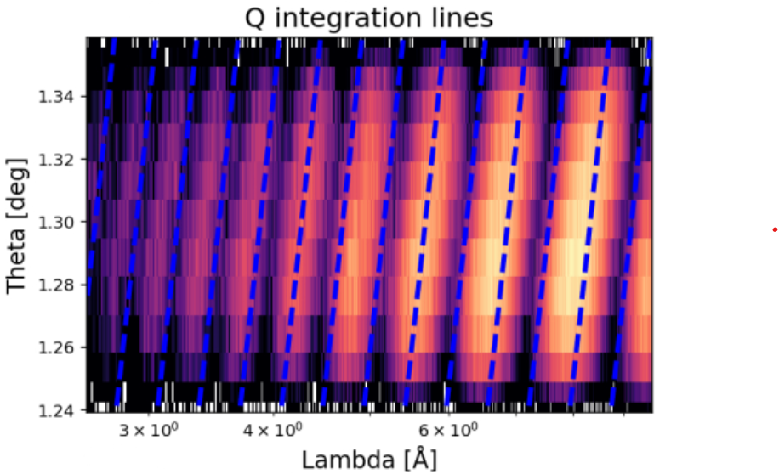
New Approach To Constant Q Binning
Accounting for incident optics improves resolution of Kiessig fringes
detector resolved method
‘mean theta’ method
CollimatedS1/Si = 1.5
Divergent
S1/Si = 10
Notes:
Conventional approach: use angular acceptance of detector pixels to determine theta and map to Q (center panels)
Look at the calculated constant Q lines : Works well for highly divergent beams (bottom), but not collimated beams (top).
Constant TOF assumes parallel beam, this assumes infinitely small samples.
Novel approach using incident optics to determine the angular distribution on the detector.
The gray between the black and white of the other approached: works for BOTH collimated and divergent beams.
Note the theta ranges on the images are different depending on the method

Slide 18
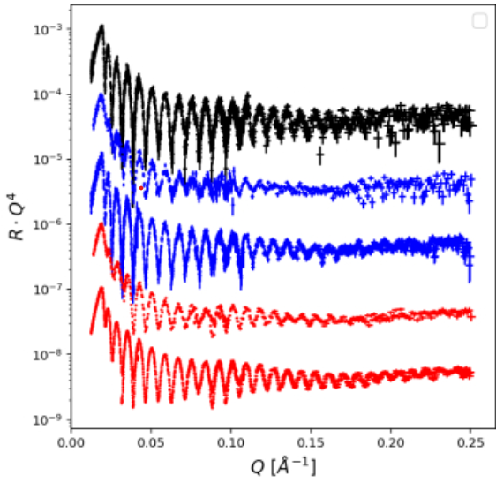
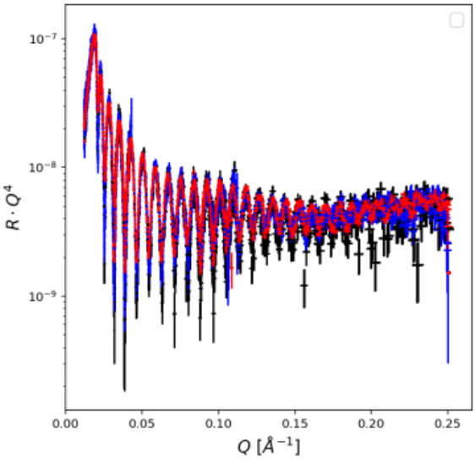
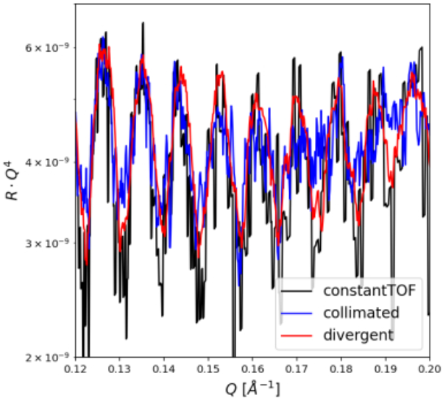
Faster Measurements With Divergent Beams
Combined with PPU (+40%) and optimizing beam width (+50%), potential for x10 gains!
d_{si-sam}= 65 mm
demonstrated
Aug. 2024
first user exp.
Aug. 2025
105 mm
collimated TOF
145 mm
coll. conQ
coll. MeanTheta
divergent conQ
divergent MeanTheta
Notes:
Using this binning method we can choose different incident beam configurations without sacrificing resolution
Recently demonstrate x4 gains (slit width, PPU + divergence
PPU: x1.4, Width: x1.5, Divergence: x5
Total = x10, 60m -> 6m

Slide 19
Key Takeaways
Cd attenuator normalization timeline
Improved instrument flexibility is enabling new science
  Tailoring measurement to the experiment’s needs
  New capabilities for automation and increased throughput
  More diverse science portfolio
2023
Cd attenuator proof of concept
PPU outage
2024
Demonstration of Cd normalization with div. beams
Organizational barriers are slowing instrument evolution
  Breakdown between capability development and deployment to the user program
  Poor resource allocation to address instrument needs
  Stove-piping inhibits agile problem solving
2025
Optimized with chopper cut
Deploy with alternate reduction code
2026
Notes:
This can dramatically increase throughput, but….
>2 YEARS SINCE DEMONSTRATION, ~1 YR FROM OPTIMIZATION OF APPROACH
PLAN TO LAUNCH WITH USERS NEXT CYCLE, BUT NOT WELL INTEGRATED INTO EXISITING REDUCTION CODE
Rollout delayed by adapting reduction code to use the Cd attenuator normalization method
During PPU the Cd attenuator package was installed and integrated into CSS.
Note: no engineering support, 3d printing and Thorlabs stuff

Slide 20
Sample Environment Capabilities
Several advanced sample environments for specialized applications
Gaps in basic capabilities: standard ‘workhorses’ are not competitive
Falling behind on multimodal measurements
Solid-liquid
Electrochemistry area of strength
Sample changer and fluid handling
Air-solid
Multi-environment chamber area of strength
Increasing demand for humidity, more advanced setup in initial development
Air-liquid
Mode recently recommissioned
Trough auto-alignment in development
Gaps: sample changer, irradiated liquid handling, gas handling
Liquid-liquid
No development
Gaps: automation, temp. control
Gaps: Multiple sample temperature control (under development)
Notes:
We have leveraged $150k BRavE funding to buy a bunch of kit, but no SE support for developments
We have made progress, but still a long way to go to match state-of-the-art of other large facilities.
Playing catch-up makes it hard to make progress on more advanced SE
S-L: Added multi channel e-chem capability, rheology shear, cartridge heater T control. Moving toward chiller plate and Peltier
A-S: automation of conditions in MEC, sample changer limited for all. No sample change automation for MEC. Need an in between SE
A-L:
L-L: can’t do reflection down L-L w/o mirrors to bend beam
Maintenance…?

Slide 21
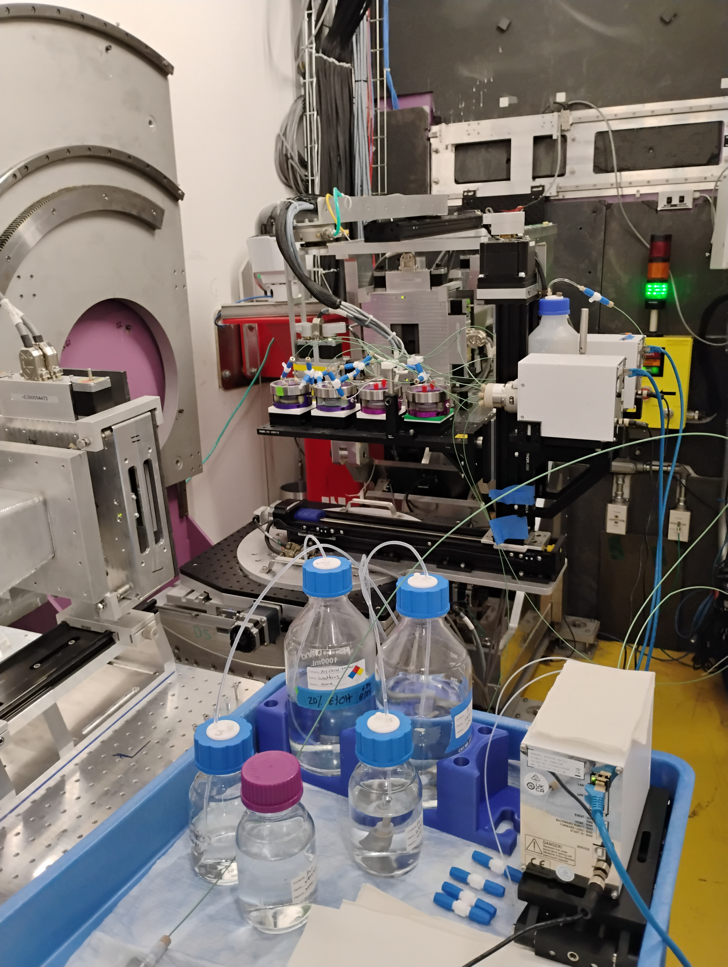
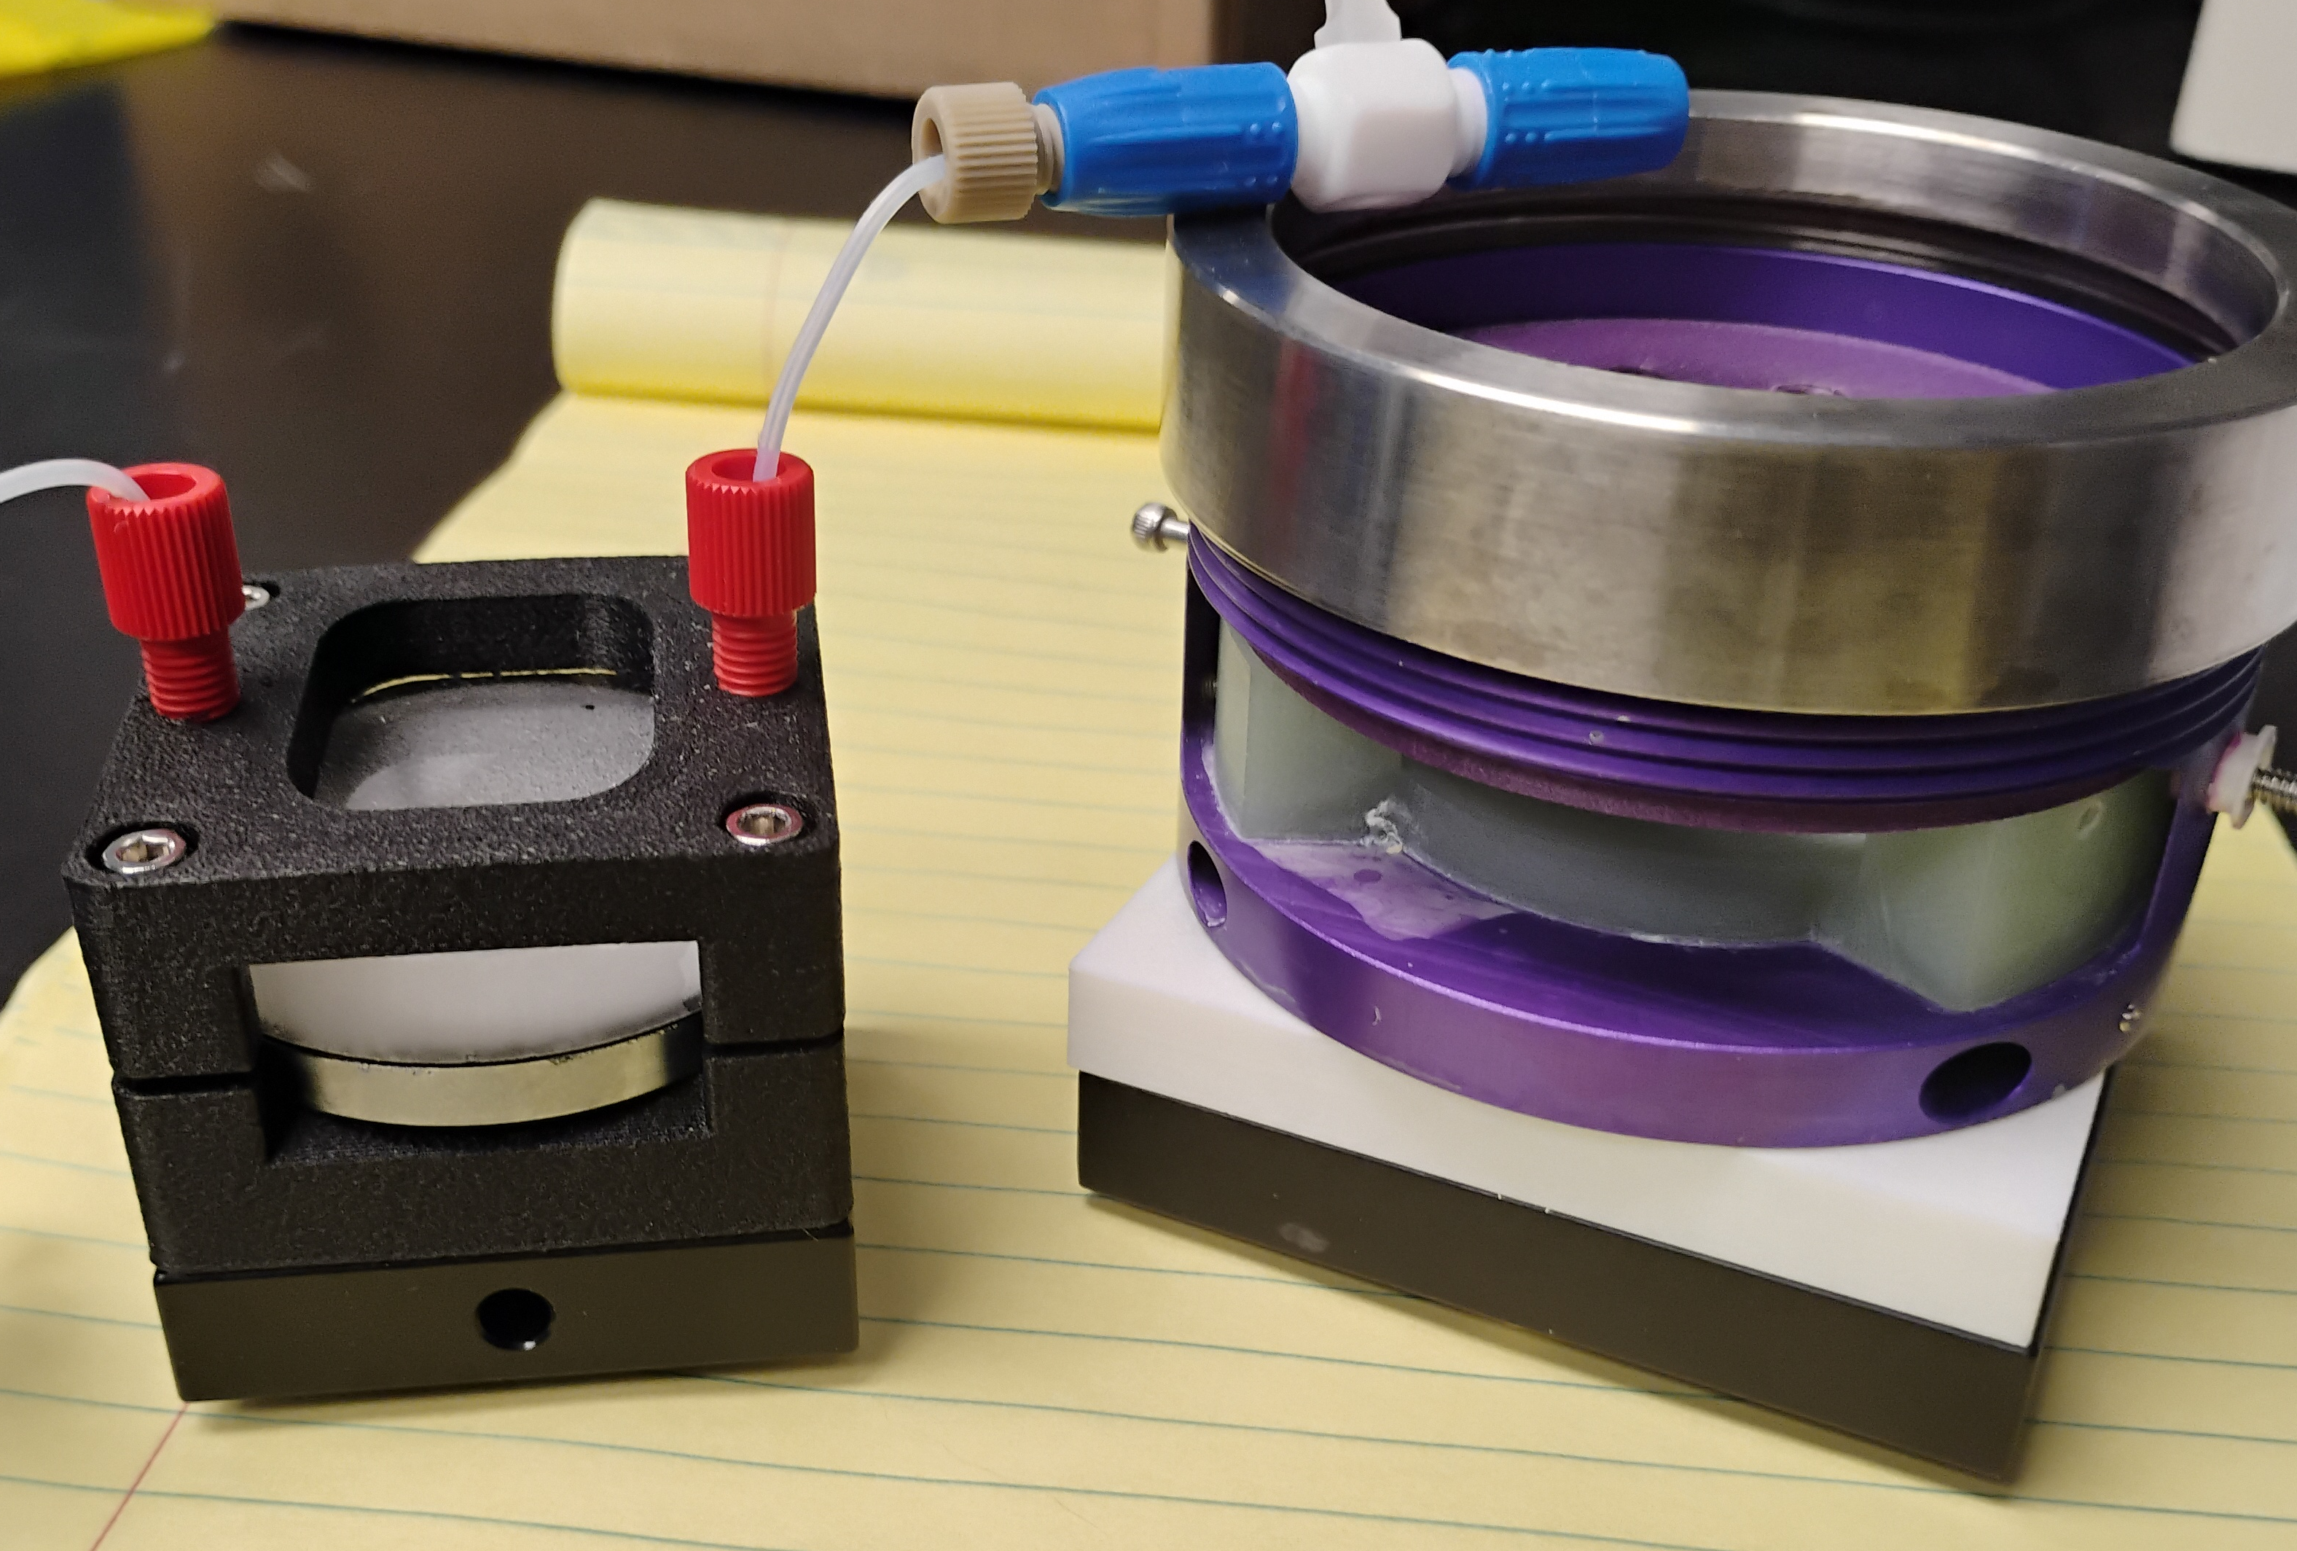
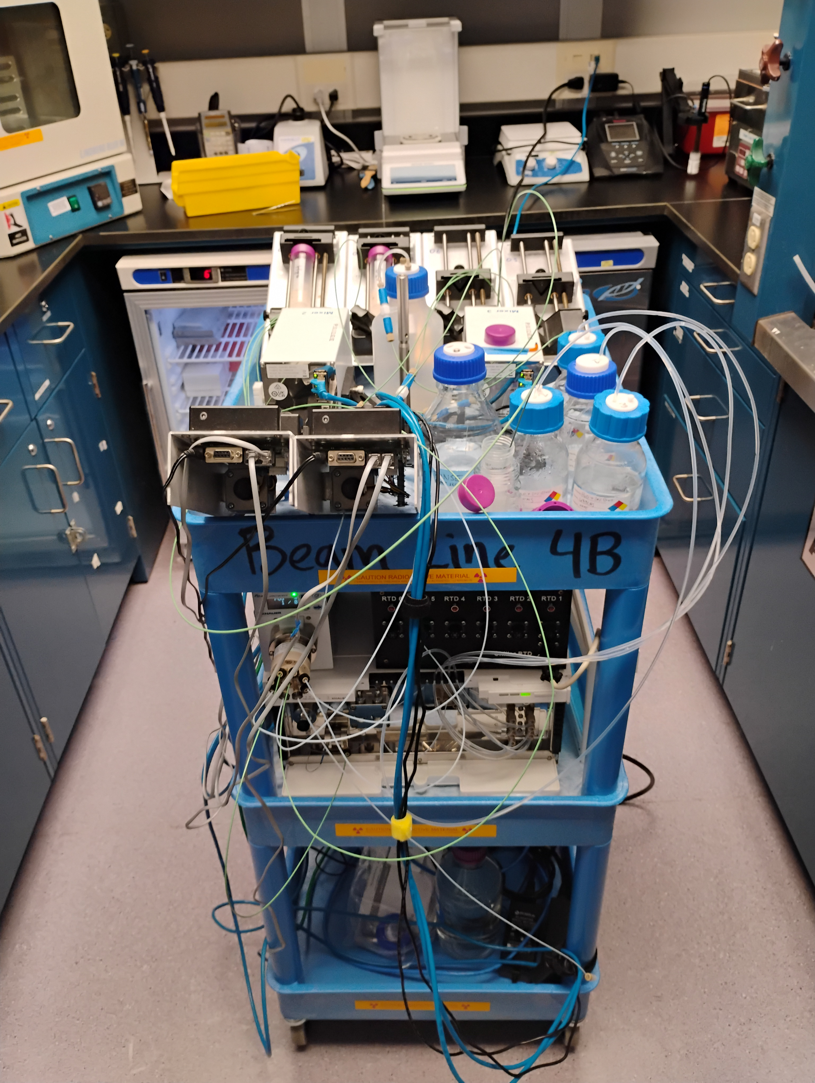
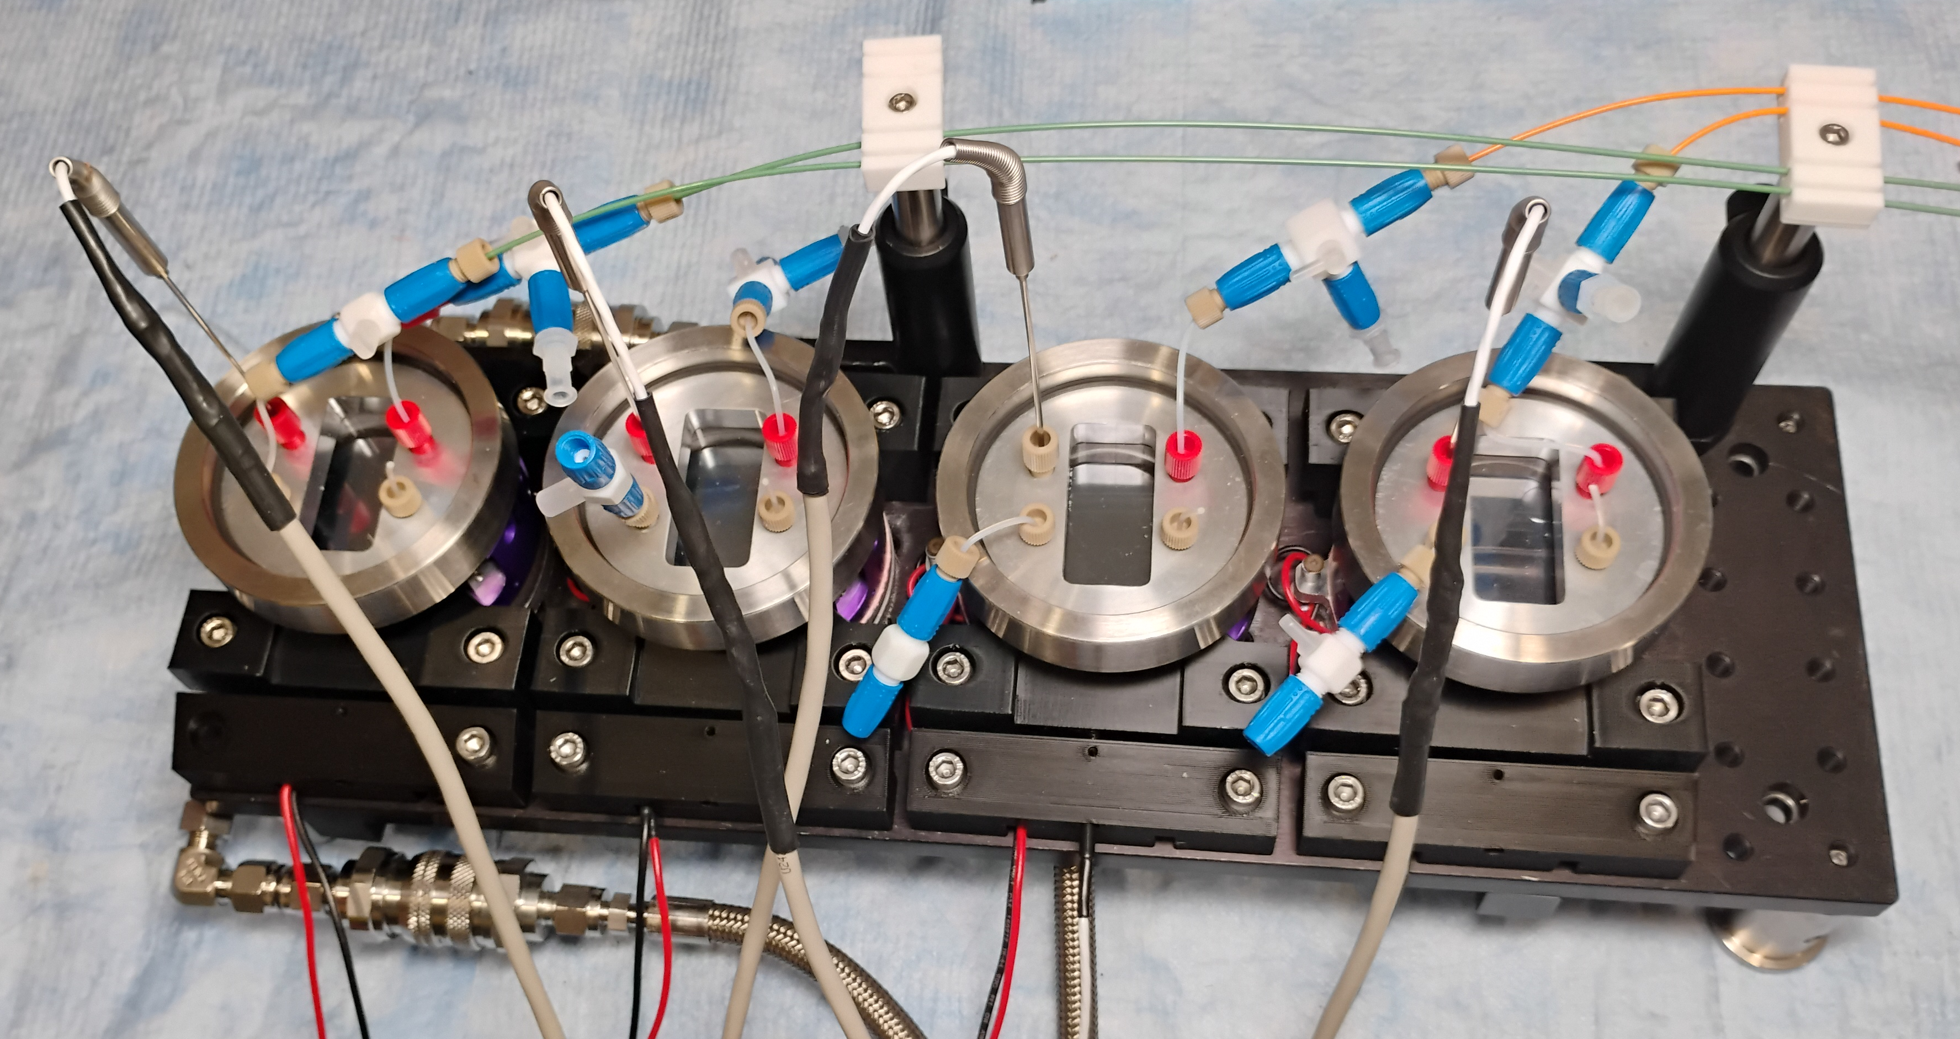
Fluid Handling Automation for Biophysics and Beyond
Electrochemical solid-liquid cells modified for biophysics studies
  reduced volume, improved fluid exchange
  interfaces with standard HPLC fittings
  4-port version for T monitoring at sample
Flexible fluid handling system
  quaternary HPLC pump
  6 independent syringe pumps
4-to-8 channel Peltier temperature control under development
Notes:
Recent success with S-L cell SE development with a focus on biophysics.
Gives us capability comparable to other major sources, although in a 3D printed kludgey kind of way.
Leveraging developments of BL4A for fluid handling, BL4B e-chem cell
2” diameter si wafer, 30x30mm footprint, works in reflection down geometry, ports for fluid exchange out the top
Not fully there:
Still fighting HPLC integration issues: recently added error handling, discovered purge vs ramp
Arroyos arrive Apr 2024. ~2yr and still working on developing SE.

Slide 22
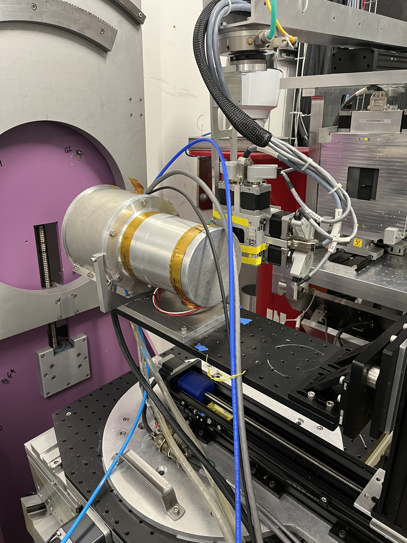
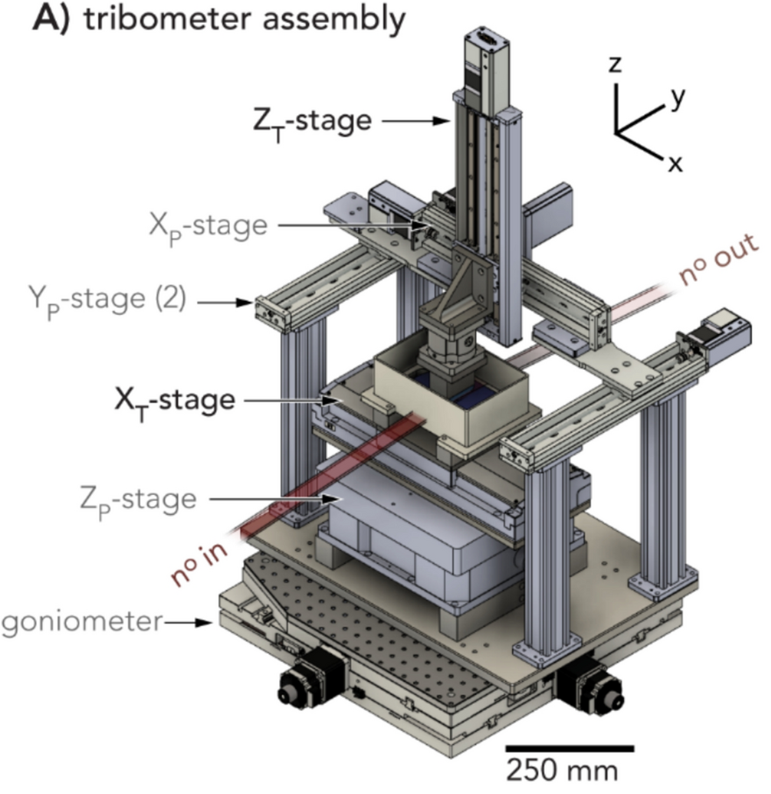
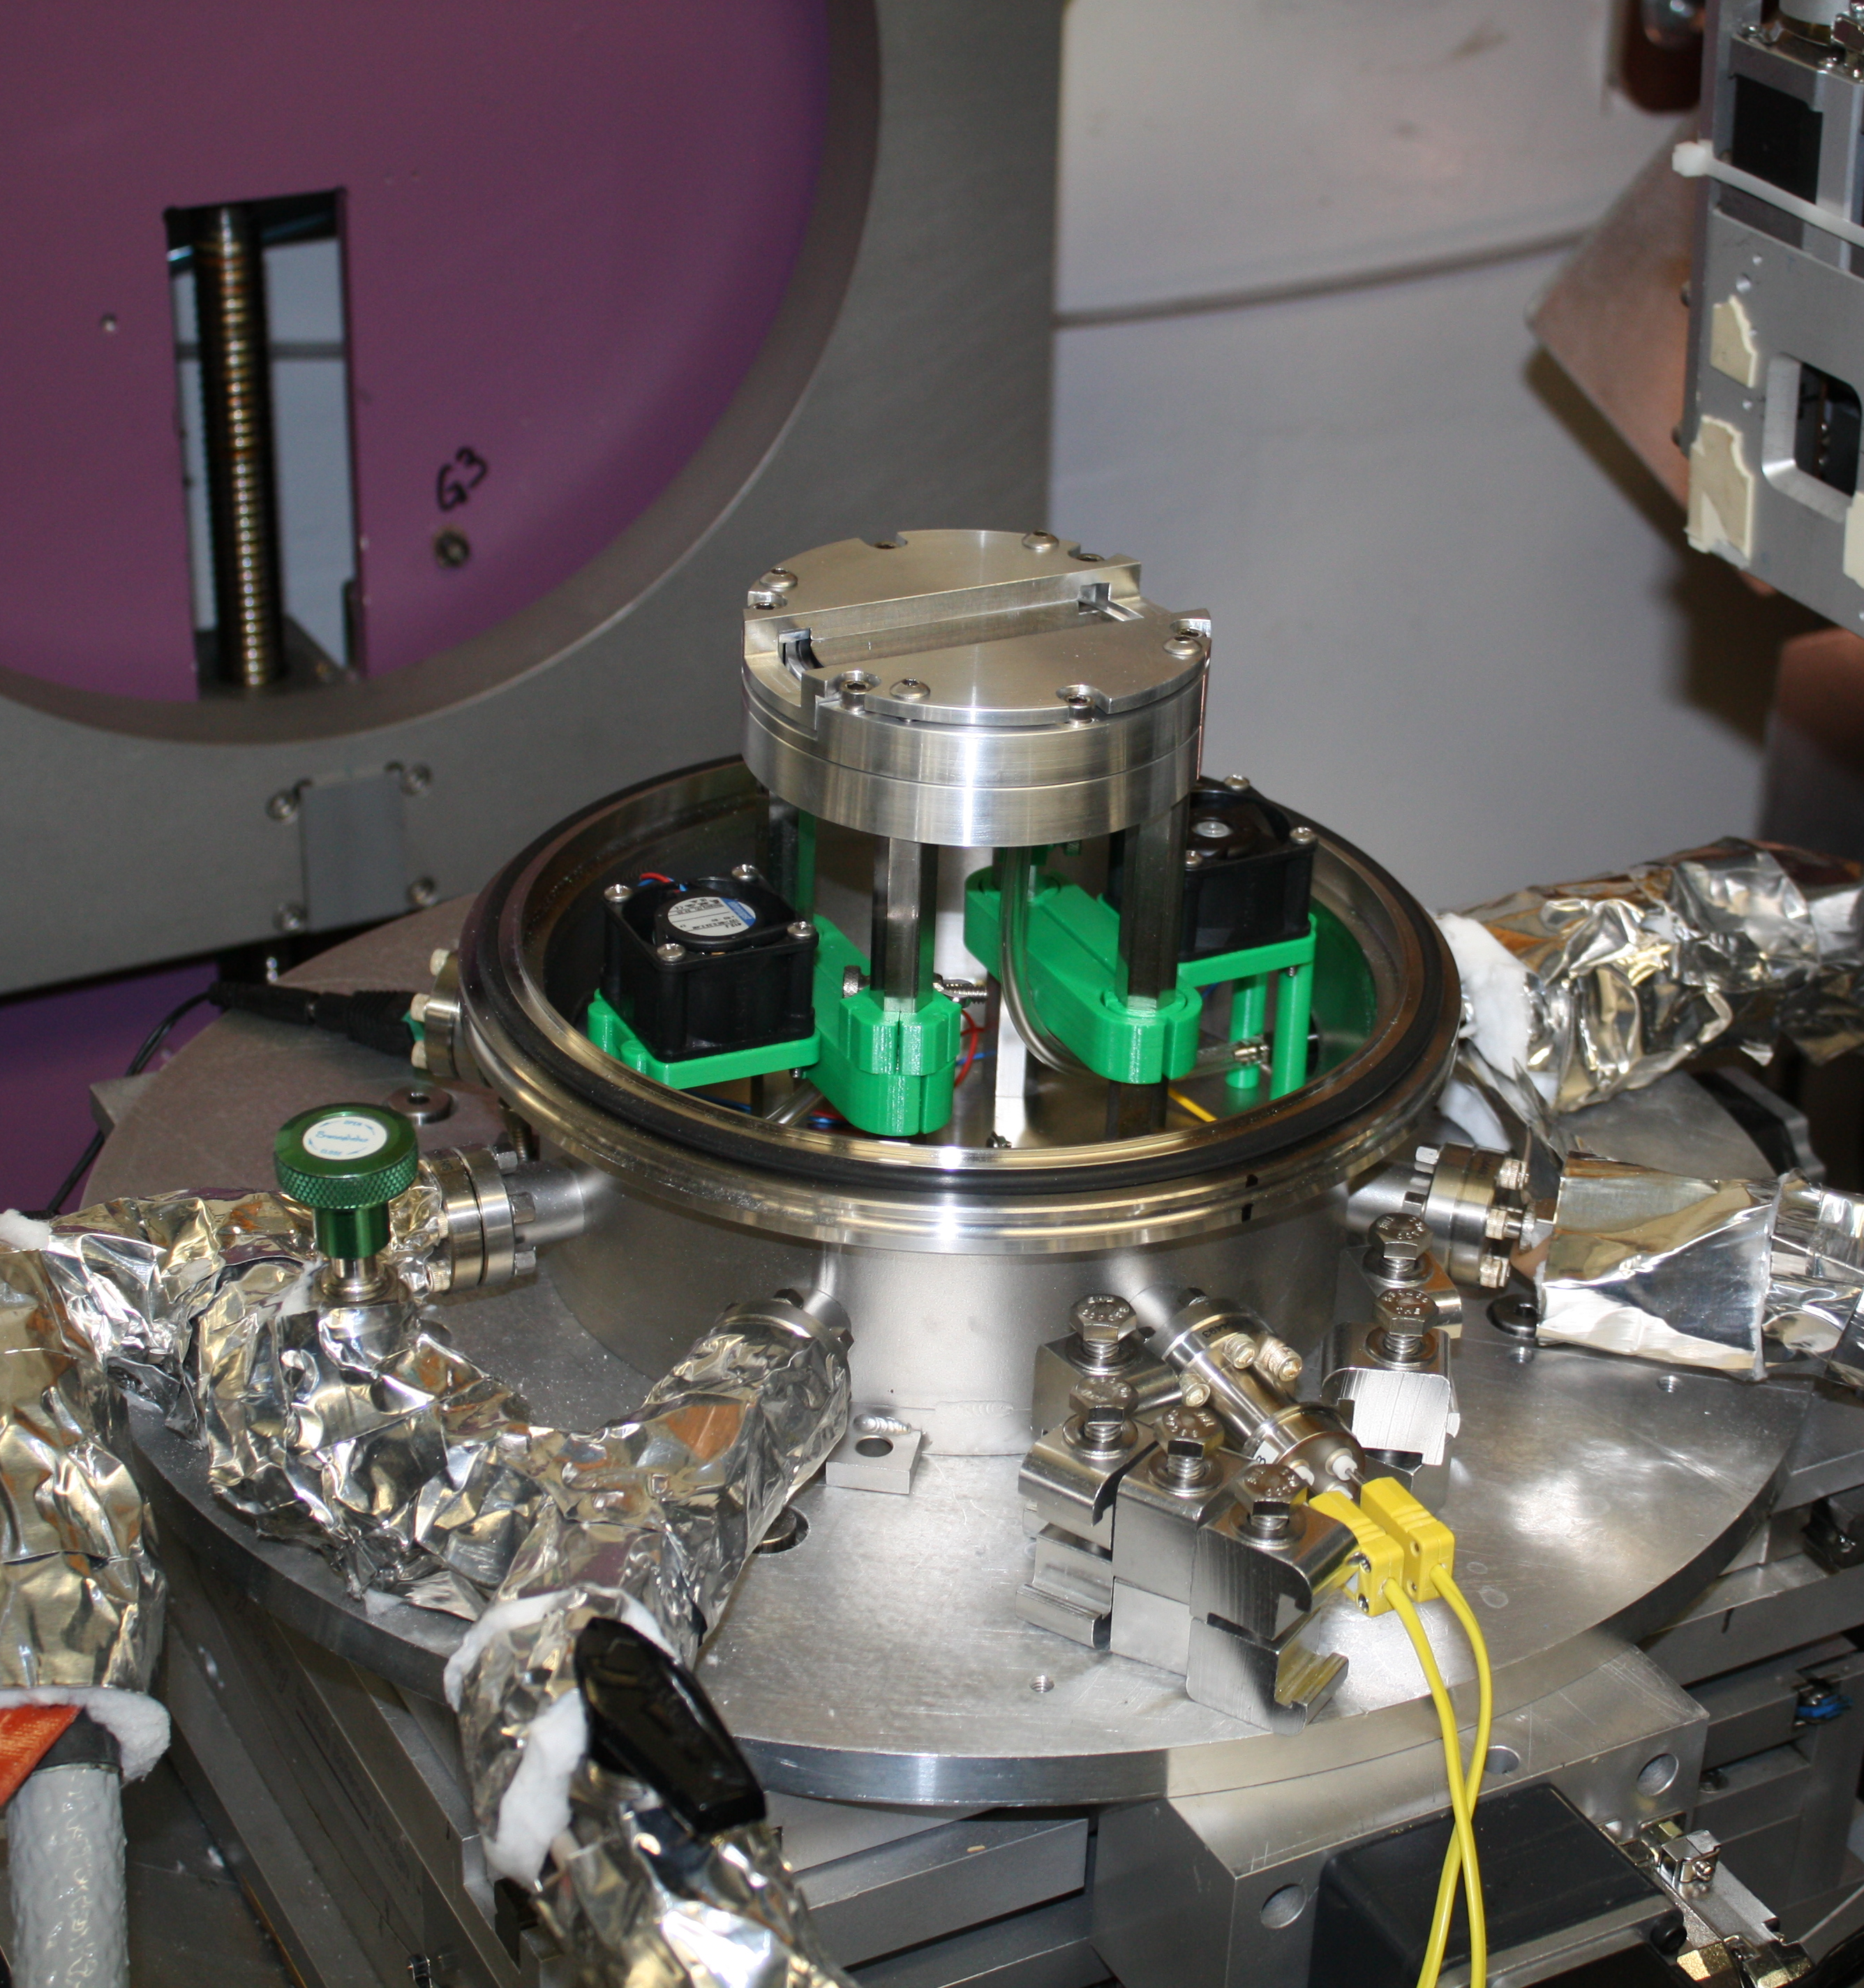
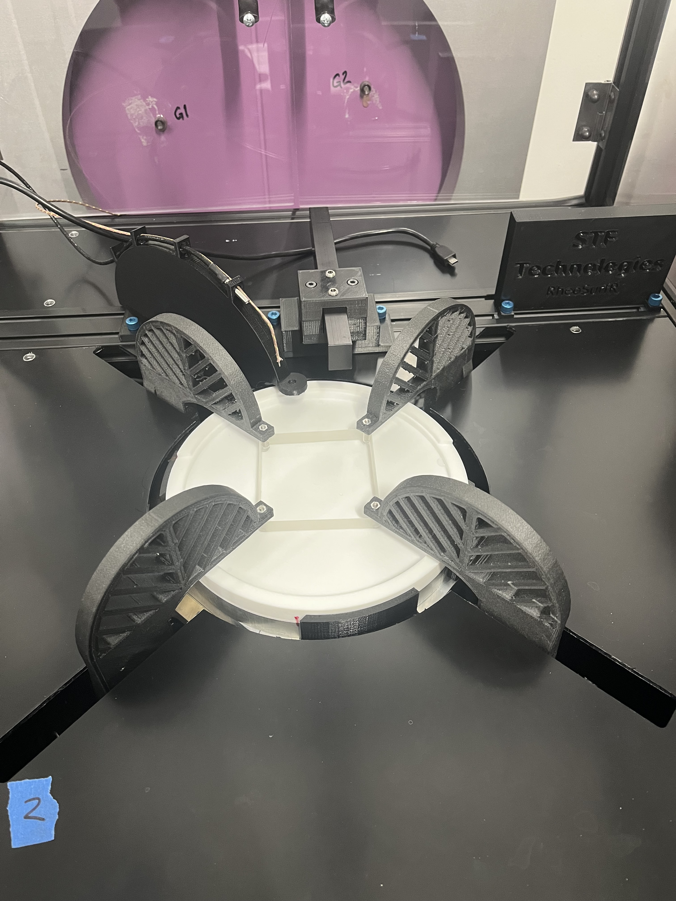
User Developed Advanced Sample Environments Probe New Interfacial Science
Humidity chamber
Joe Dura (NIST)
Membrane diffusion cell
Steven DeCaluwe (Colorado School of Mines)
Tribometer (S/L)
Prof Angela Pitenis (UCSB)
Tribol Lett 73, 112 (2025).
Advanced Materials Interfaces (submitted).
Quadrotrough (A/L)
Norm Wagner & Ben Thompson (U of Delaware)
Notes:
On LR the SE that pushes the state-of-the-art come from external users.
Two new collaborative development proposals have just begun: Tribometer setup and biomembranes setup.
Quadrotrough: Controlled dilation and shear

Slide 23
LR Sample Environments: the list
Molten salt solid/liquid cell (up to 850ºC): non-functioning
Membrane diffusion humidity cell: non-functioning
High pressure solid/liquid cell (up to 175ºC, 50 MPa): recently recommissioned
Rheo-NR solid/liquid environment: recently recommissioned, SE supported
High electric field, vacuum chamber air/solid (up to 200ºC, up to 10 kV): operational, lost HV SE support
Multi-environment vacuum chamber gas/solid (up to 600ºC, 1 mTorr-1000 Torr): operational
Full solar spectrum light source: operational
4 position vapor/solid sample changer (e.g. humidity with salts): no T control or humidity control
HPLC and syringe pump fluid handling system: operational
Electrochemistry solid/liquid interface cells (RT-50ºC): operational and highly regarded
6 position solid sample changer (ambient T): operational prototype, no T control
4 position solid/liquid sample changer (RT-50ºC): operational, limited T control
8 position solid/liquid sample changer (ambient T): operational prototype
Langmuir trough air/liquid (10-50ºC): operational, no gas handling
Advanced/specialized SE
workhorses
Humidity control system: initial design stage
Air/liquid sample changer (10-50ºC): missing
Notes:
Advanced sample environments get headlines, but workhorses drive the program
World leading in some specific areas, lacking on workhorses.
No plan for maintenance and support.
Only 1 of these is supported by a SE group.

Slide 24
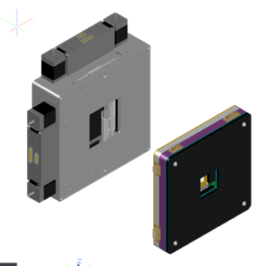
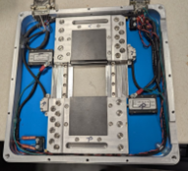
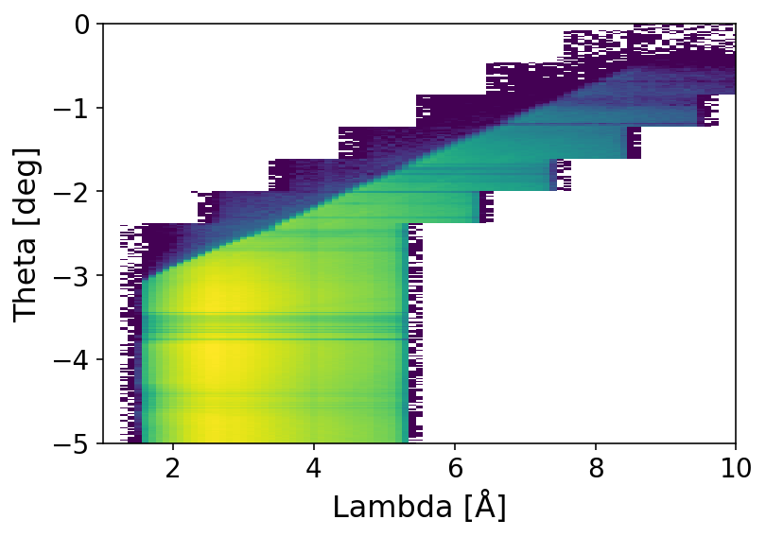
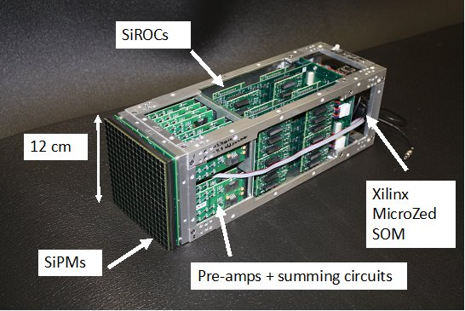
Where We Are Going
First thing: close the loop on on-going developments
Next priorities: more capacity for automation, cover basic SE needs
Some other ideas we are interested in exploring: pump-probe, Grazing Incidence Neutron Diffraction, variable opening chopper, tomography
Slit package upgrade: piezo linear motors, compact, reduced parallax
Detectors: ³He electronics to reduce dead time, enable coincidence counting. Beam monitor. Anger and LumaPix?
Bending beams for better free-liquid measurements: use peak spectrum at low θ, enable 30Hz
Notes:
It would be nice to be ambitious with future plans….
Reality is closing the loop on modest developments is on the multi-year time frame
“We traded a streamlined workflow for capability. That trade was intentional, but we haven’t yet been resourced to complete the cycle and combine the polished user interface with the new level of flexibility.”
more automation. Need min 8-12hr for most experiments. Ideally much more to go thru weekend
Dead time from 4.2 to 0.7 us.
Anger: 50kcps

Slide 25
Ouroboros
Notes:
Progress is cyclical, you return to the same stage but altered
We traded streamlined workflows for flexibility and are currently stalled mid-cycle. new capabilities exist, but haven’t yet been deployed as streamlined workflows.
We didn’t lose the polished UI because we regressed, we outgrew it.
Ouroboros. The system eating itself or sustaining itself, depending on whether the loop is healthy.
“The same loop can either sustain growth—or trap us.”

Slide 26
Key Takeaways
Improved instrument flexibility is enabling new science
  Tailoring measurement to the experiment’s needs
  New capabilities for automation and increased throughput
  More diverse science portfolio
Organizational barriers are slowing instrument evolution
  Breakdown between capability development and deployment to the user program
  Poor resource allocation to address instrument needs
  Stove-piping inhibits agile problem solving

Slide 28





Time-resolved study of Li-Mediated Nitrogen Reduction
Scientific Achievement
The formation of a lithium-rich layer at the electrode-electrolyte interface was observed in situ with a 60-second time resolution. No evidence of a thick solid-electrolyte interphase (SEI) was observed.
Significance and Impact
Li-mediated electrochemical nitrogen reduction is seen as an alternative to the Haber-Bosch process for ammonia production. This work supports the approach of using short cycles to produce ammonia in real-world applications in order to limit SEI formation and help efficiency.
Molybdenum thin films in N₂ saturated THF-based electrolyte were studied with time-resolved neutron reflectometry (upper left). The graph above shows the thickness of the plated layer during the first 6 minutes at constant current. The bottom graph shows the SLD profile evolution over the same period of time.
Research Details
  In situ neutron reflectometry was performed on Mo thin film electrodes in contact with THF/LiClO₄ electrolyte at constant current (-0.1 mA/cm²) to follow the formation of the electrode-electrolyte layer.
  Measurements with and without EtOH proton source in the electrolyte were compared.
S.J. Blair, M. Doucet et al, ACS Energy Lett. (2022)
DOI: 10.1021/acsenergylett.1c02833
Work performed at the Liquids Reflectometer, SNS BL-4B
Notes:
Summary
We employed time-resolved, in situ neutron reflectometry to observe a dynamic electrode-electrolyte interface under conditions relevant to Li-mediated electrochemical N₂ reduction reaction (NRR). This method leverages the Li sensitivity of neutrons and fast time resolution (~1 minute) to observe the formation of a layer containing Li species at the electrode surface within minutes of applying current (-0.1 mA/cm²). Notably, within the first six minutes, we did not observe a solid-electrolyte interphase (SEI) distinct from this layer, providing insight into recent reports demonstrating performance advantages of short current cycles interspersed with open-circuit conditions for NRR. At longer timescales following chronopotentiometry (~2 hours), a multilayer SEI remained, though the presence of Li was not evident, indicating that the layers containing Li species observed over shorter timescales degrade almost entirely under open-circuit conditions, leaving SEI layers consisting of electrolyte decomposition products. We thus present the first application of neutron reflectometry toward the NRR. By employing fast time-resolved measurements, we have enabled new avenues toward understanding the electrochemical NRR as well as systems that are dynamic on small timescales across a wide range of energy technologies.
Work was performed at
The Liquids Reflectometer at Oak Ridge National Laboratory’s Spallation Neutron Source.
Collaborating Institutions
Oak Ridge National Laboratory, Oak Ridge, Tennessee 37831, USA
Stanford
SLAC
Funding details for all sources (from paper Acknowledgments)
This work was supported by the Villum Foundation V-SUSTAIN Grant 9455 to the Villum Center for Science of Sustainable Fuels and Chemicals. Preliminary testing of in situ methods and sample preparation was supported by the U.S. Department of Energy, Office of Science, Office of Basic Energy Sciences, Chemical Sciences, Geosciences, and Biosciences Division, Catalysis Science Program through the SUNCAT Center for Interface Science and Catalysis. A portion of this research used resources at the SNS, a Department of Energy (DOE) Office of Science User Facility operated by ORNL. Neutron reflectometry measurements were carried out on the Liquids Reflectometer at the SNS, which is sponsored by the Scientific User Facilities Division, Office of Basic Energy Sciences, DOE. ORNL is managed by UT-Battelle LLC for DOE under Contract DE-AC05-00OR22725. XPS characterization of the cathode was performed at the Stanford Nano Shared Facilities (SNSF), supported by the National Science Foundation under award ECCS-2026822. This material is based upon work supported by the National Science Foundation Graduate Research Fellowship under Grant No. DGE-1656518. Any opinion, findings, and conclusions or recommendations expressed in this material are those of the authors and do not necessarily reflect the views of the National Science Foundation.
Publication
Sarah J. Blair^{♰,1,3}, Mathieu Doucet^{♰,2}, James F. Browning², Kevin Stone⁴, Hanyu Wang⁵, Candice Halbert², Jaime Aviles Acosta^{1,3}, José A. Zamora Zeledón^{1,3}, Adam C. Nielander*³, Alessandro Gallo*^{,3}, Thomas F. Jaramillo*^{,1,3}
https://doi.org/10.1021/acsenergylett.1c02833
♰These authors contributed equally to this work

Slide 29

In Situ Measurement of Buried Electrolyte−Electrode Interfaces for Solid State Batteries with Nanometer Level Precision
Scientific Achievement
The work revealed the formation of a Li-rich, 7 nm thick, interphase between the solid electrolyte LiPON and Li metal plated onto a nickel oxide working electrode in an all-solid-state battery.
Significance and Impact
This work provides the first evidence of the stable solid-electrolyte interphase formation believed to be responsible for the enhanced performance of LiPON and lays the groundwork for the design of electrolytes for larger scale high-energy solid-state Li batteries.
(a) Illustration of the combined
experimental approach.
(b) Schematic of the sample
geometry: quartz substrate, nickel
oxide (NiO) current collector,
lithium phosphorus oxynitride
(LiPON), and Li metal.
Black lines represent electrical
connections of the potentiostat to the NiO and Li current collectors.
b)
Research Details
  NiO was sputtered onto a 50 mm diameter, 5 mm thick quartz substrate.
  To form the thin film solid-state battery, 1 μm of LiPON was subsequently sputtered onto the NiO film followed by the thermal evaporation of 10 μm of Li.
  In situ neutron reflectometry was performed during the electrochemical activation of the thin film battery.
K.L. Browning, A.S. Westover, J.F. Browning, et al., ACS Energy Lett. (2023), 8, 1985 -1991. DOI: 10.1021/acsenergylett.3c00488
Work performed at the Liquids Reflectometer, SNS BL-4B
Notes:
Summary
One of the most important, and least understood factors in Li and Li-ion batteries are reactions that occur at the electrode-electrolyte interface which lead to the formation of the so called solid-electrolyte interphase, or SEI. Understanding SEI formation is critical to developing batteries that are less expensive to produce, have higher energy densities, provide longer life and, most importantly, reduce or eliminate flammability risk. In this work we investigated the SEI formation in an all-solid-state battery comprising LiPON, a solid electrolyte invented at ORNL more than 30 years ago. To date, LiPON is one of the best performing solid electrolytes yet the underlying mechanism for its performance is not fully understood. For the first time, we have used neutron reflectometry, coupled with in situ electrochemical analysis to study SEI formation in an all-solid-state battery. This study identified a key element connected to the excellent performance of LiPON as being the formation of a very thin (7 nm) SEI that remained stable during charge and discharge conditions, thus allowing lithium ions to flow across the electrolyte without altering it chemical or physical state. This work lays the foundation for studying a broad-spectrum of solid-state electrolyte materials for high capacity, high energy density battery research.
Work was performed at
The Liquids Reflectometer at Oak Ridge National Laboratory’s Spallation Neutron Source.
Collaborating Institutions
Oak Ridge National Laboratory, Oak Ridge, Tennessee 37831, USA
Chemical Sciences Division
Neutron Scattering Division
Funding details for all sources (from paper Acknowledgments)
This work was funded by the Department of Energy’s Office of Energy Efficiency and Renewable Energy for the Vehicle Technologies Office’s US-German Cooperation on Energy Storage: Lithium-Solid-Electrolyte Interfaces program. A portion of this research used resources at the SNS, a Department of Energy (DOE) Office of Science User Facility operated by ORNL. Neutron reflectometry measurements were carried out on the Liquids Reflectometer at the SNS, which is sponsored by the Scientific User Facilities Division, Office of Basic Energy Sciences, DOE.
Publication
In Situ Measurement of Buried Electrolyte–Electrode Interfaces for Solid State Batteries with Nanometer Level Precision, Katie L. Browning, Andrew S. Westover, James F. Browning, Mathieu Doucet, Robert L. Sacci, and Gabriel M. Veith, ACS Energy Letters 2023 8 (4), 1985-1991. DOI: 10.1021/acsenergylett.3c00488

