Slide 1
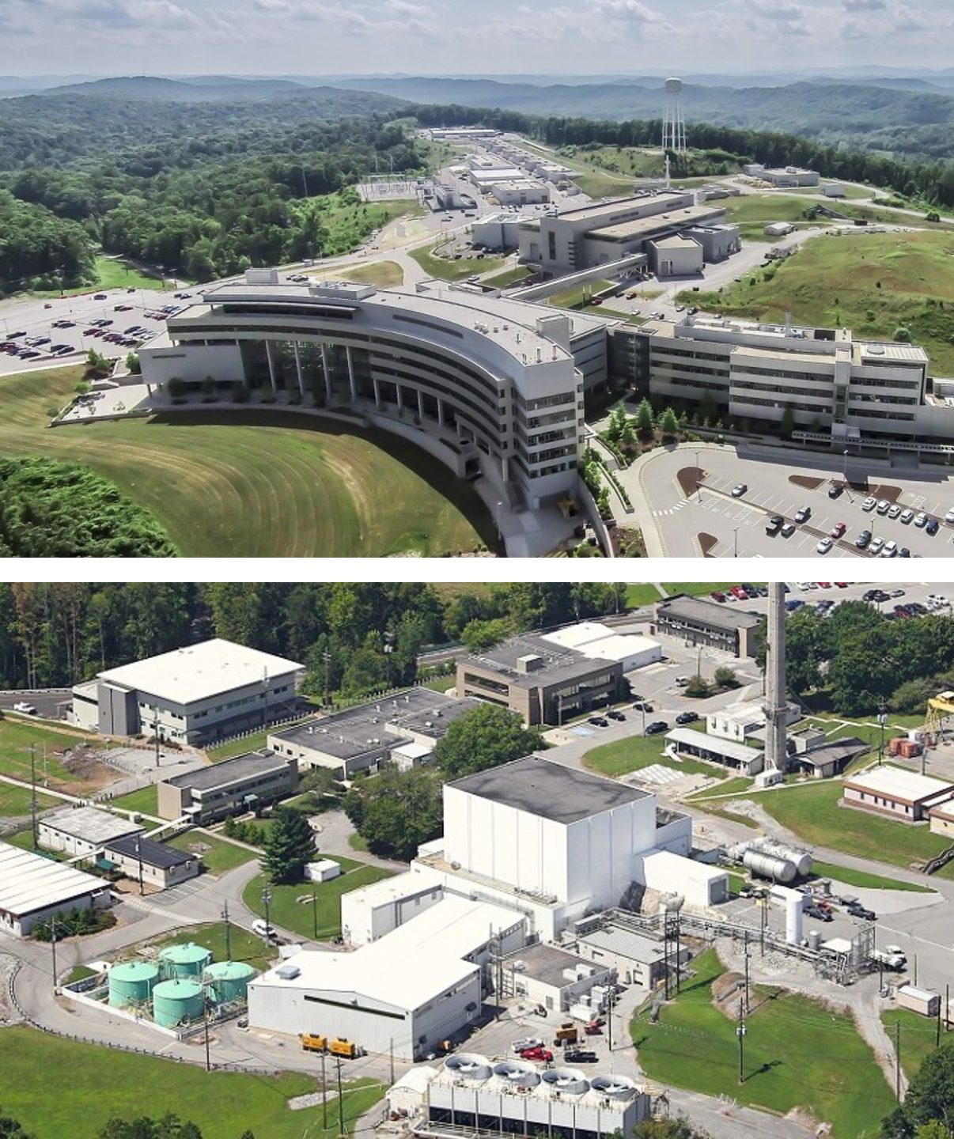
Review of the Neutron Reflectometry Instrument Suite
February 10, 2026
Volker Urban
Section Head, Large Scale Structures

Slide 2
Outline
Introduction of Review
Large Scale Structures Section Context
Neutron Reflectometry at ORNL
Review Charge Questions
Agenda & ‘Nuts & Bolts’

Slide 3


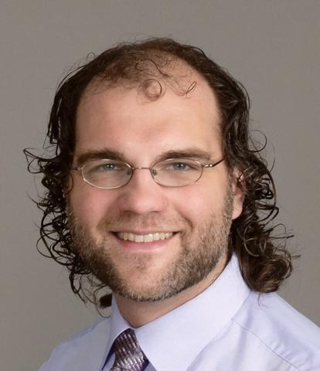
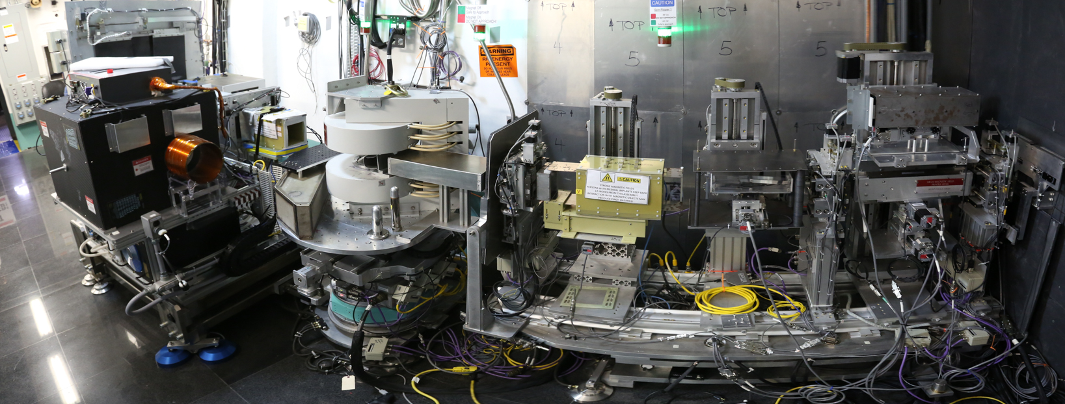
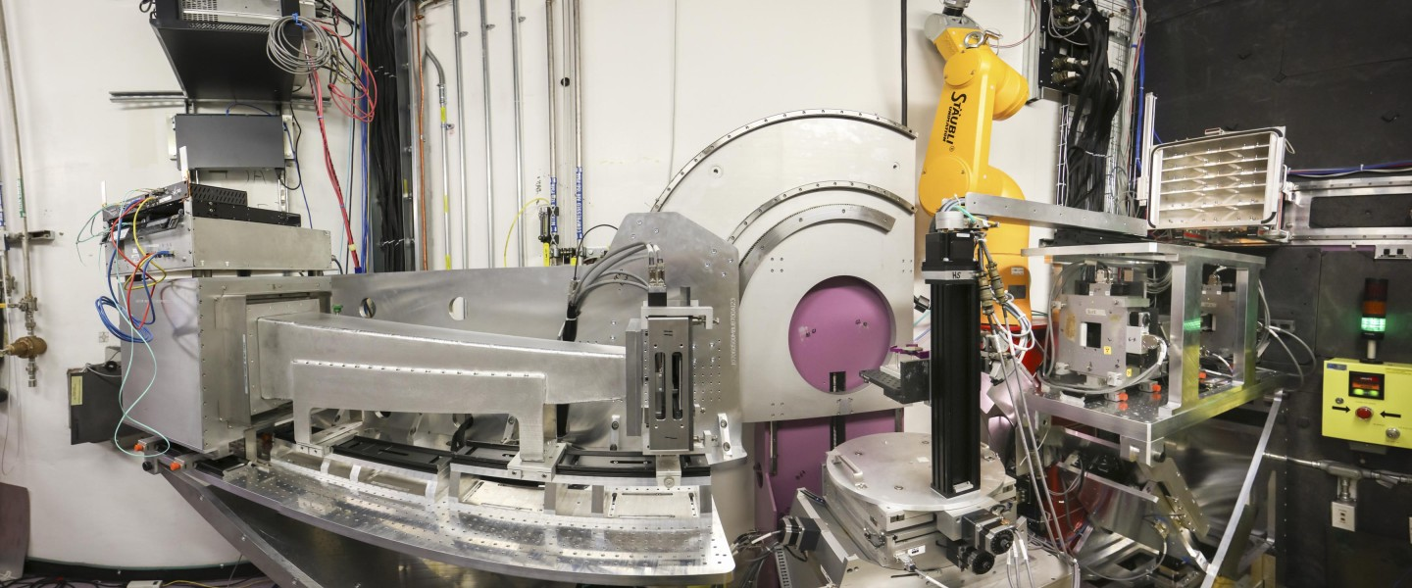
ORNL Neutron Reflectometry Suite Review
Welcome!
Review date: Feb 10-11, 2026
Reviewers
Brian Kirby, NCNR, NIST
Sean Langridge, ISIS, Rutherford Appleton Laboratory
David Hoogerheide, NCNR, NIST
Instruments
MAGREF, BL-4A, SNS
LIQREF, BL-4B, SNS

Slide 4
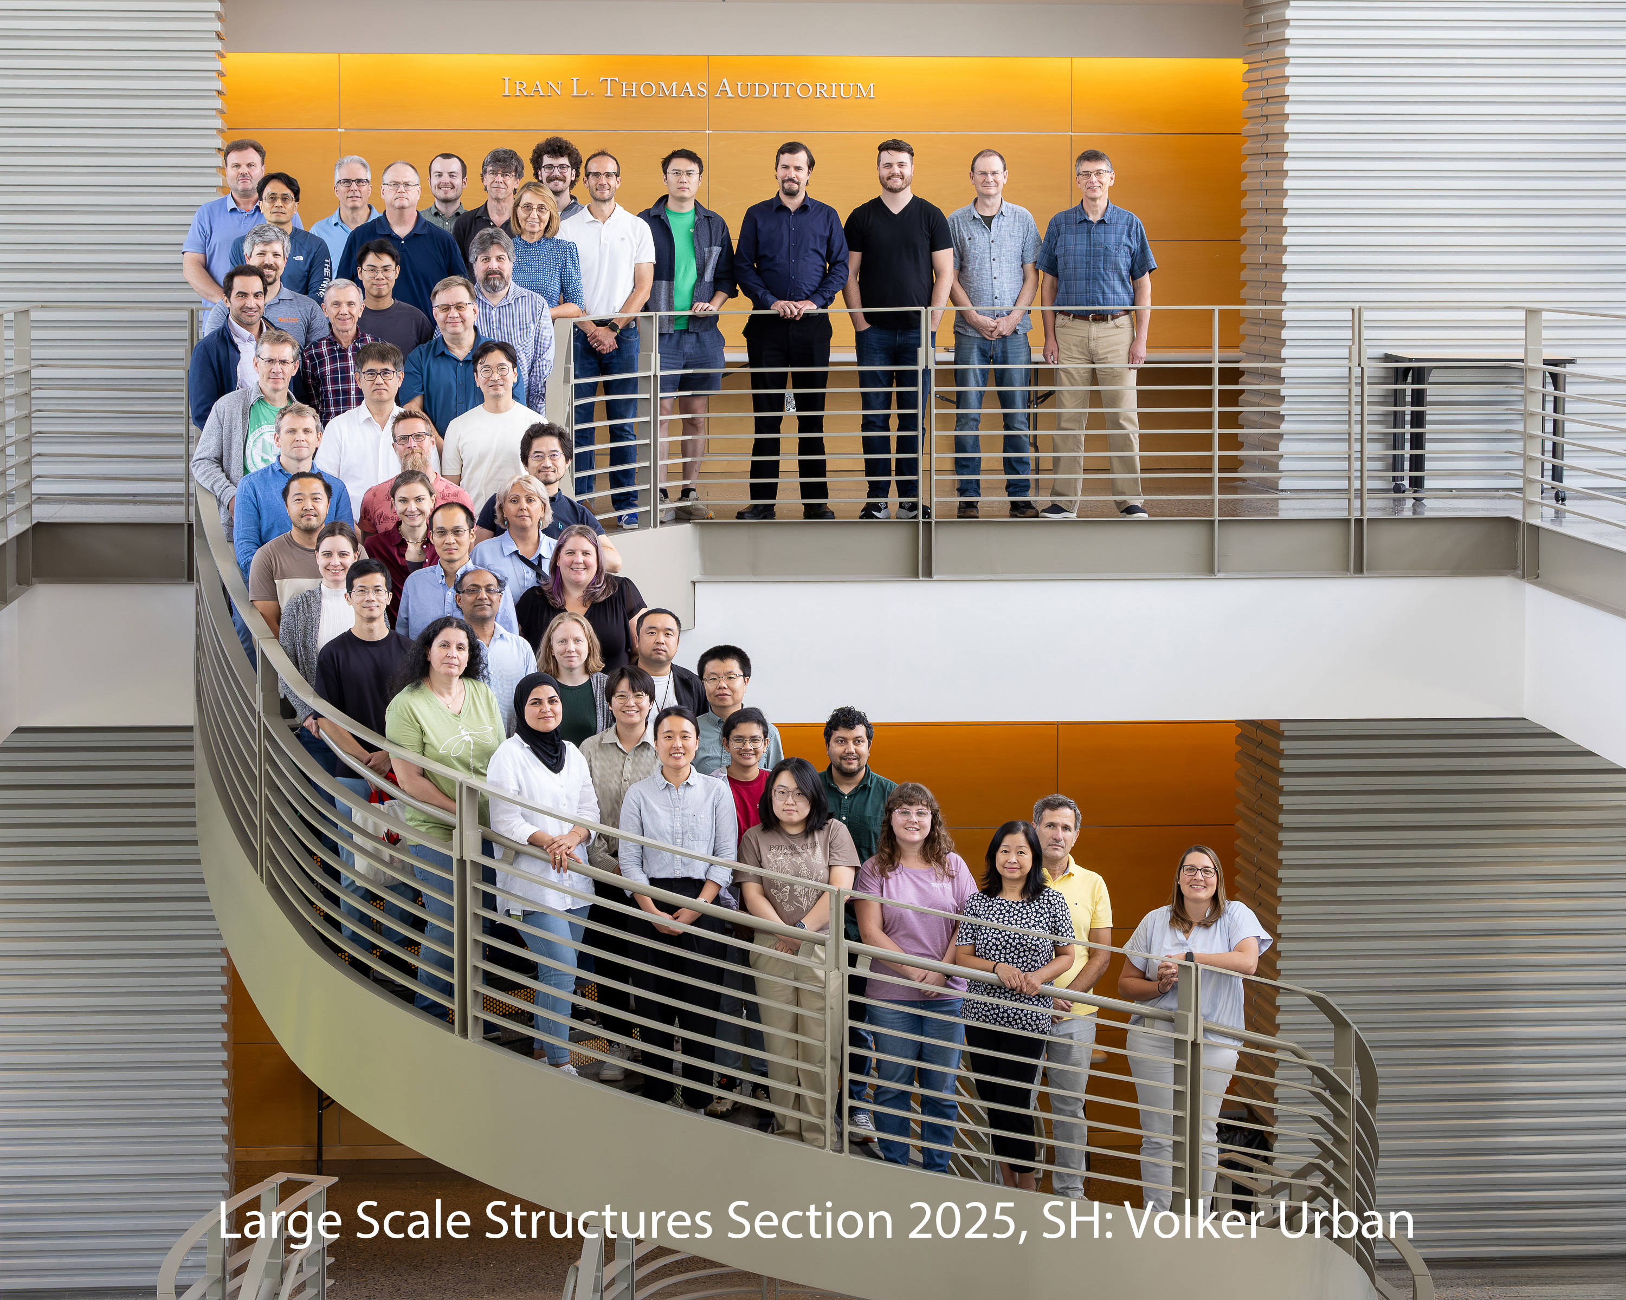
Large Scale Structures Section
Large Scale Structures Section
Four Groups
Materials Engineering Andrew Payzant
Neutron Reflectometry Jim Browning
SANS & Spin Echo William Heller
Biological Labeling and Scattering Hugh O’Neill

Slide 5
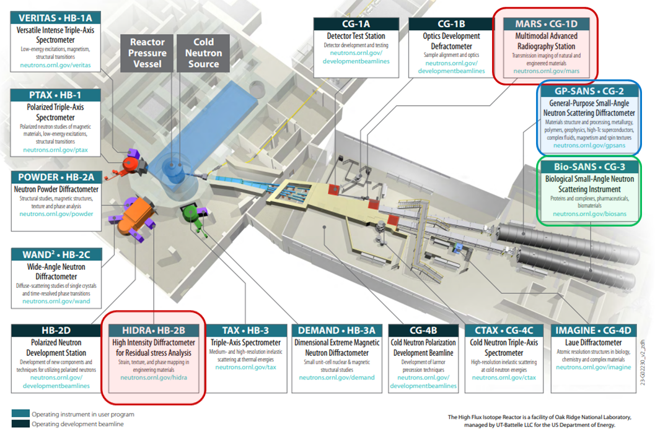
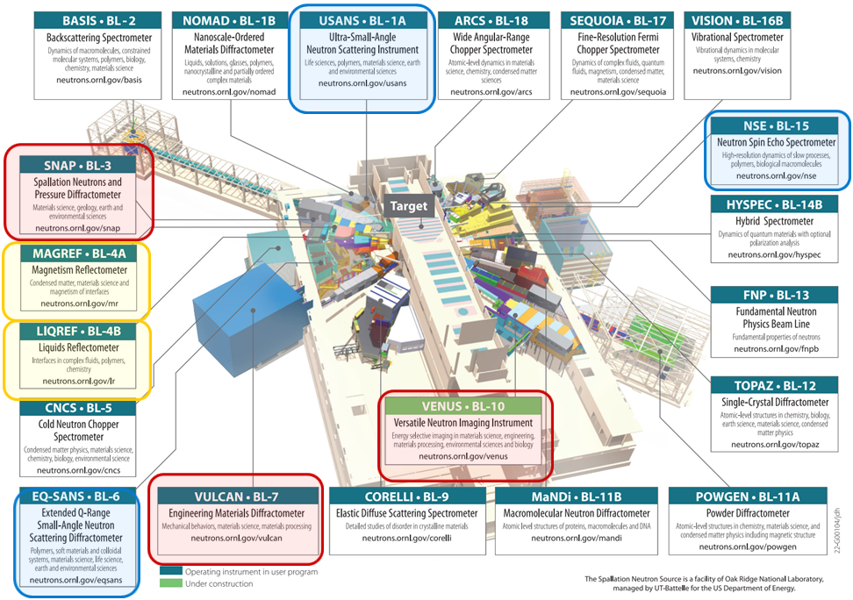
Large Scale Structures Section
High Flux Isotope Reactor
12 Instruments
4 at the HFIR
8 at the SNS
Spallation Neutron Source
4 Groups
Materials Engineering, A. Payzant
Neutron Reflectometry, J. Browning
SANS & Spin Echo, W. Heller
Biological Labeling and Scattering, H. O’Neill

Slide 6
Neutron Reflectometry at ORNL
[MIRROR reflectometer at HB-2D, HFIR, 1990s-2000s (Bill Hamilton)]
SNS BL-4A & 4B among first instruments at SNS ~2008
The suite:
Magnetism Reflectometer (MAGREF, MR), BL-4A SNS, dedicated to Polarized Neutron Reflectometry (PNR), vertical geometry
Liquids Reflectometer (LIQREF, LR), BL-4B, Neutron Reflectometry (NR), horizontal geometry

Slide 7
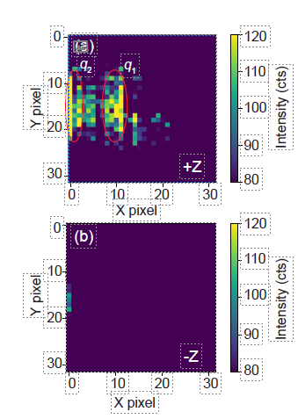
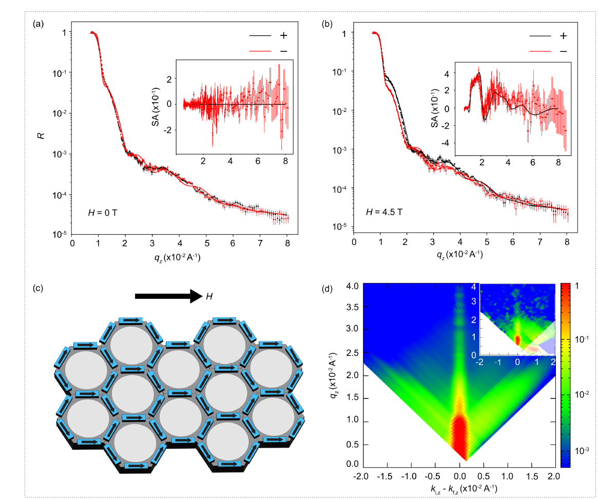

Revealing mysteries of artificial honeycomb system: Emergent topological quasiparticle kinetics in constricted nanomagnets
Joint PNR and NSE experiments on antiferromagnetic and paramagnetic neodymium honeycomb thin film
Magnetic dynamics in the Nd honeycomb nanomagnet of 6 nm thick.
NSE spectroscopy reveals the presence of dynamic behavior in the system without magnetic field application.
The absence of intensity for neutron polarization along -Z axis indicates the magnetic nature of the scattering
PNR Magnetization study of the Nd honeycomb in zero and finite applied field
The results of the modeling and experimental data obtained using PNR at 5 K and 4.5 T (inset) for the reflectivity and off-specular scattering of the magnetic honeycomb structure (left).
The dynamic behavior in constricted honeycomb lattices is mediated by vortex-type micro-spin proﬁle quasiparticles with a net magnetic core, canting out perpendicular to the plane
Experimental and theoretical study reveal that constricted honeycomb nanomagnets show fast kinetic events at picosecond timescales due to the relaxation of topological quasiparticles that persist to low temperature in the absence of any external stimuli.
This discovery is especially important considering the fact that paramagnets or antiferromagnets have no net magnetization.
J. Guo, D Singh et al Physical Review Research, 6, 043144 (2024)

Slide 8
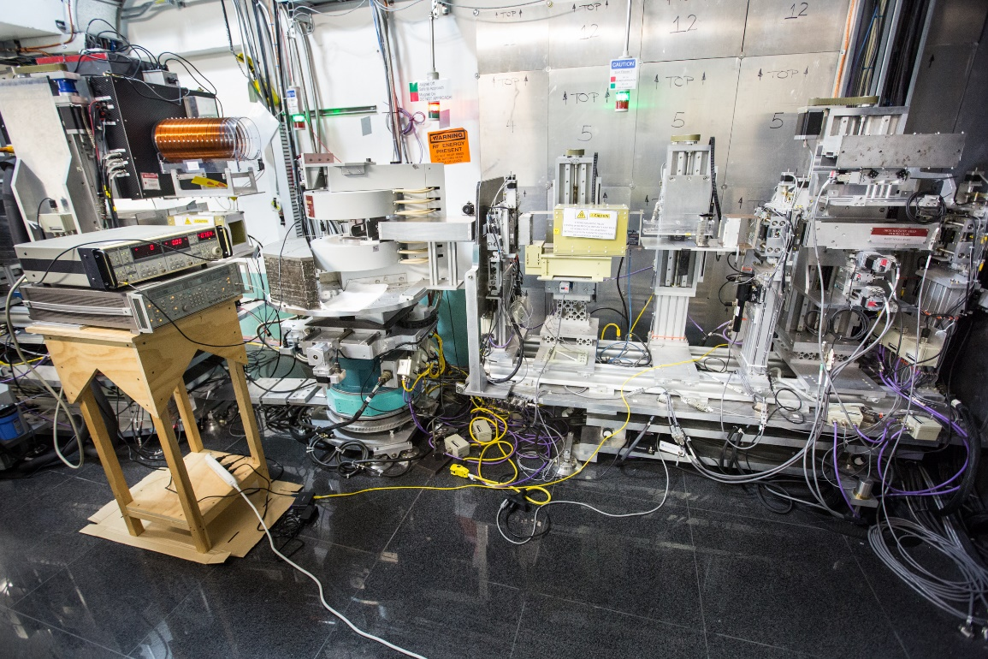
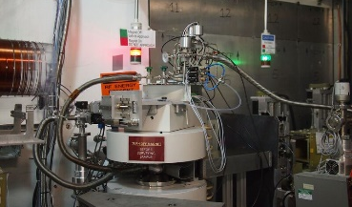
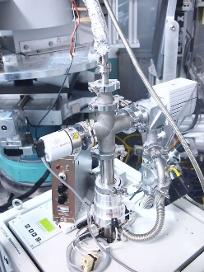
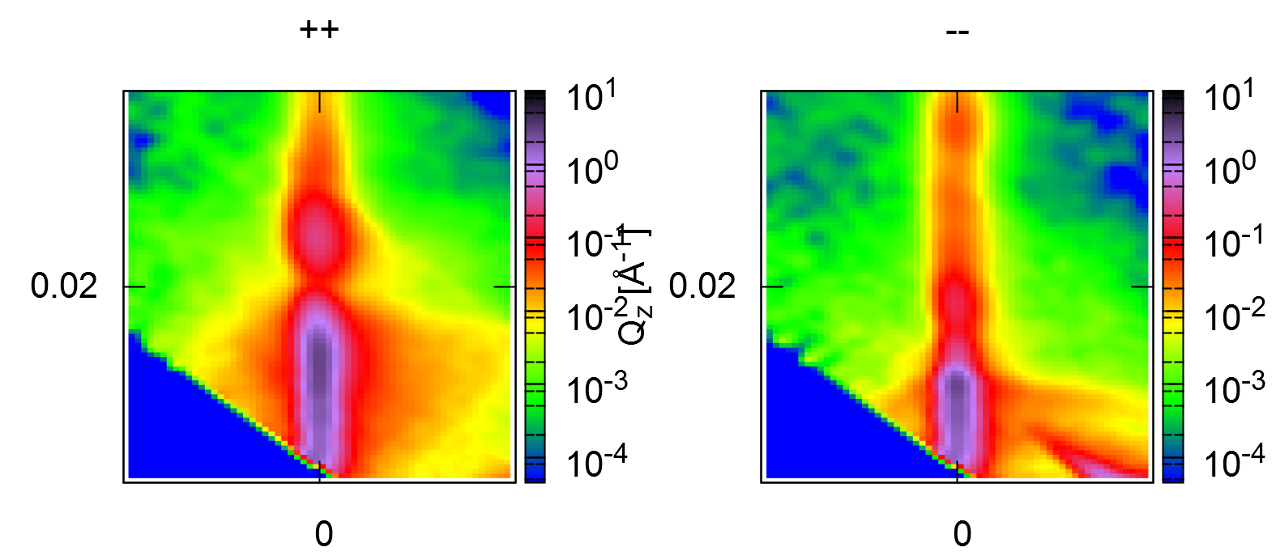
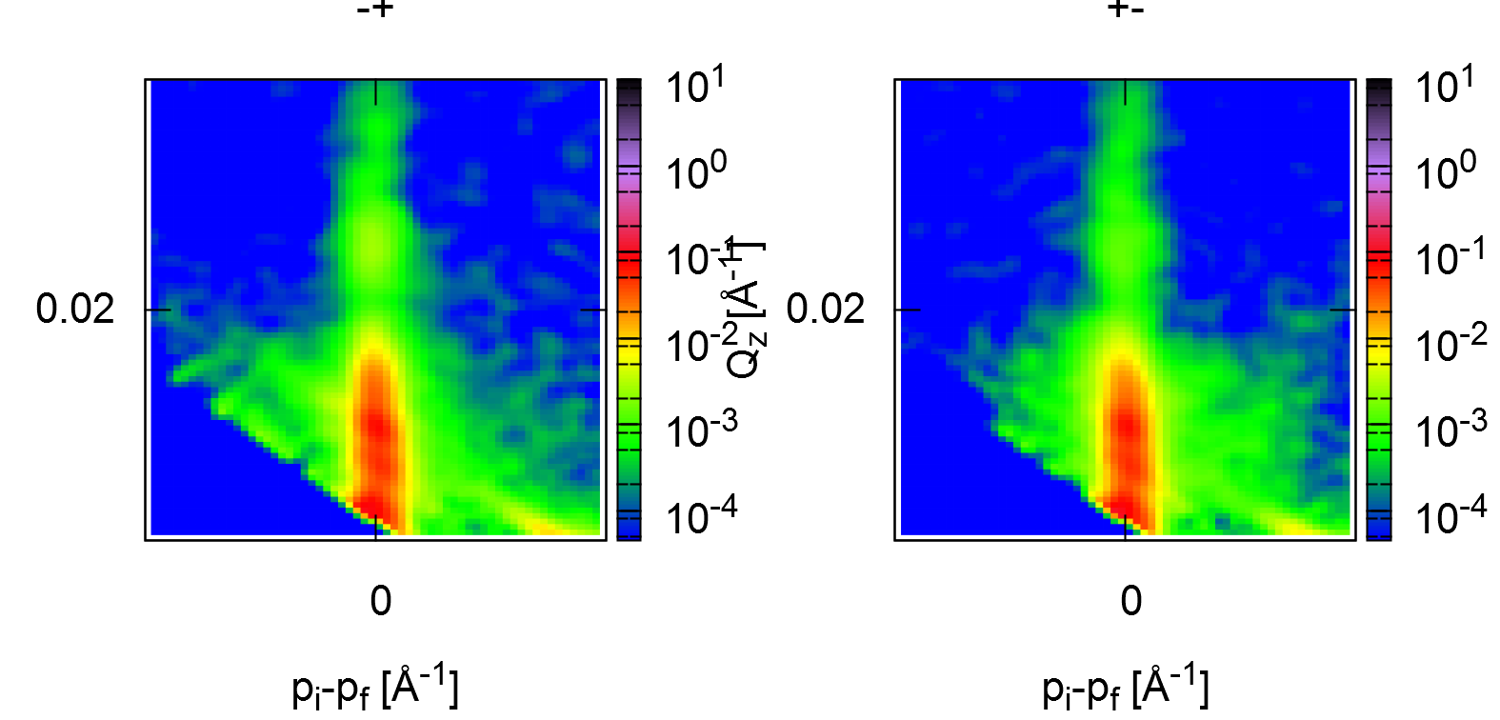
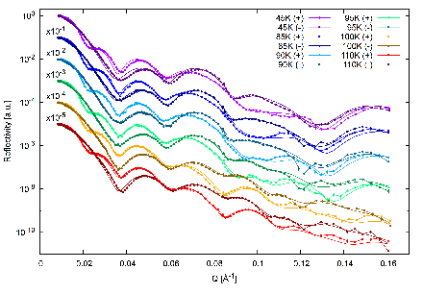
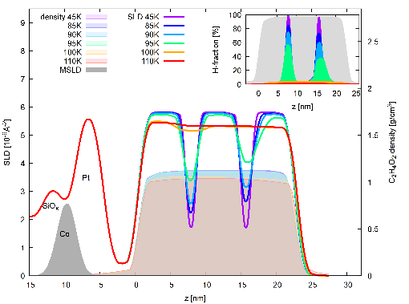
Unique experiments on MAGREF :
PNR with in situ Ferromagnetic Resonance
PNR experiments on Spontelectric films-new class of spontaneously polarized molecular solids grown in situ on magnetic reference layer
Combining spin-pumping with polarized neutron reflectometry for the direct measurement of the spin diffusion length in materials for spintronics
‘Spontelectric solids’ - a new form of molecular solid which spontaneously harbor electric fields of 10⁸ Vm⁻¹
Potential applications: in molecular optoelectronics, quantum well formation, solid-state q-bits, and nano-ion traps
The implications of this phenomenon range from understanding VUV spectra for condensed molecular solids to models of star formation
Demonstrated the ability of FMR to drive a spin polarized current into a normal metal with PNR using a coplanar waveguide structure
Developed a rectangular waveguide increase the microwave power and thus the spin accumulation in the spacer layer
Dedicated PNR setup to study molecular diffusion in layered spontelectric solids
growth in situ, under clean high vacuum conditions at cryo-temperatures
Experiment on Organic Spin valves
Coplanar waveguide
In-situ spin-pumping using
rectangular waveguide
Cassidy A.M., et al "A Spontaneously Electrical State of Matter", Accounts of Chemical Research, 56, 1909 (2023).
Cassidy A.M., et al "Hidden singularities in spontaneously polarized molecular solids", J Chemi Physics, 158 (2023).

Slide 9
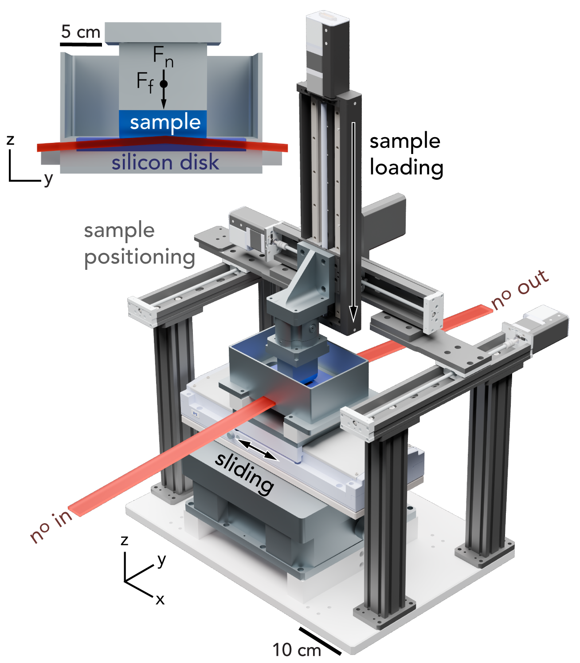
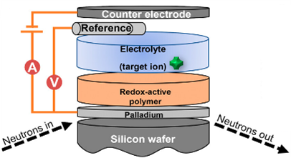

Technique Developments led by LIQREF staff
Electrochemical ion separation
Tribo-reflectometry
Neutron reflectometry in situ with / BioLogic VSP potentiometer determined nm scale solvent fraction profiles for understanding separation mechanisms that guide design of tunable metallopolymer systems for critical metals recovery, nutrient recycling and remediation
R. Candeago et al., JACS Au 4 (3), 919-929 (2024)
Liquids Reflectometer, SNS BL-4B
New apparatus for measuring structural changes in hydrogels (and other soft matter samples) under operando tribology (variable reciprocating linear shear and/or normal force) with Pitenis group (UCSB). E.g. understanding wear and tear on cartilage.
Shaffer et al. Tribol Lett 73, 112 (2025)
Shaffer et al. Adv. Mater. Interfaces (under review).
Recently accepted as collaborative user proposal.

Slide 10
Review Charge Questions
Do the technical capabilities and performance of the individual instruments and instrument suites compare favorably with peer instruments at leading national and international neutron facilities?
Does the scientific productivity and impact of the instrument programs compare favorably with comparable programs at peer facilities?
Do the beamlines meet users’ day-to-day needs for data collection, reduction, and analysis? Are planned software developments sufficient to meet anticipated future user needs?
Is the current scientific portfolio and business case for each instrument competitive nationally and internationally (e.g., user demand, breadth of scientific applications, scientific impact, mission relevance, agency support, and/or industrial engagement)?
Are there a strong and sustainable user community and a clear case for future scientific demand for these instruments? Is the number of beamlines in a suite proportionate to user community demand?
Are the plans for development appropriate and well justified to meet current and future user requirements? Please consider aspects of instrument techniques, sample environments, sample preparation and characterization infrastructure, data analysis and modeling capabilities.
Are there well-defined and credible plans for future automation and integration of artificial intelligence or machine-learning approaches?
Have the strengths, weaknesses, opportunities, and threats for each instrument or suite been clearly identified, and are there realistic plans to address them where feasible?
Are there additional developments, capabilities, or provisions that could enhance the capacity, effectiveness, or scientific impact of diffraction science at SNS and HFIR that were not presented by the instrument teams?
Any other comments or recommendations the panel wishes to provide to the NScD Associate Laboratory Director?

Slide 11
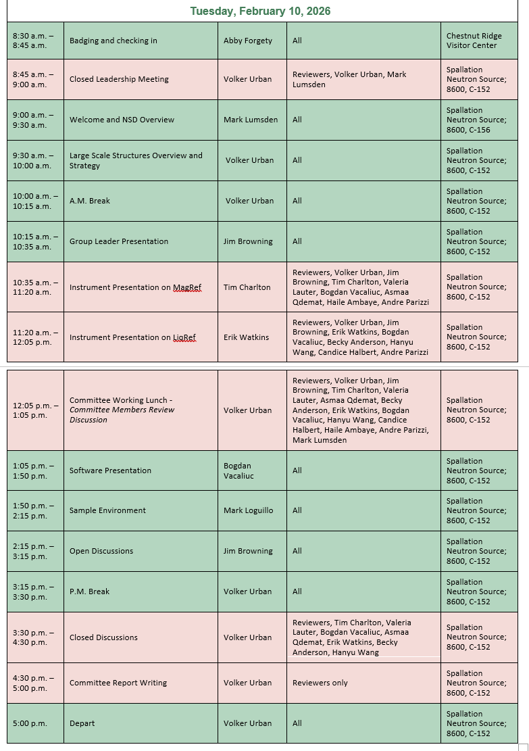
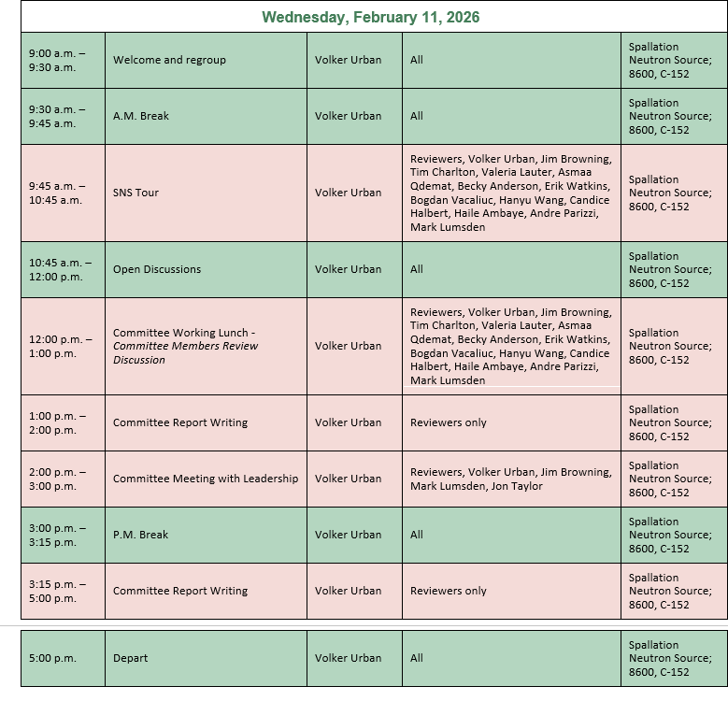
Review Agenda

Slide 12
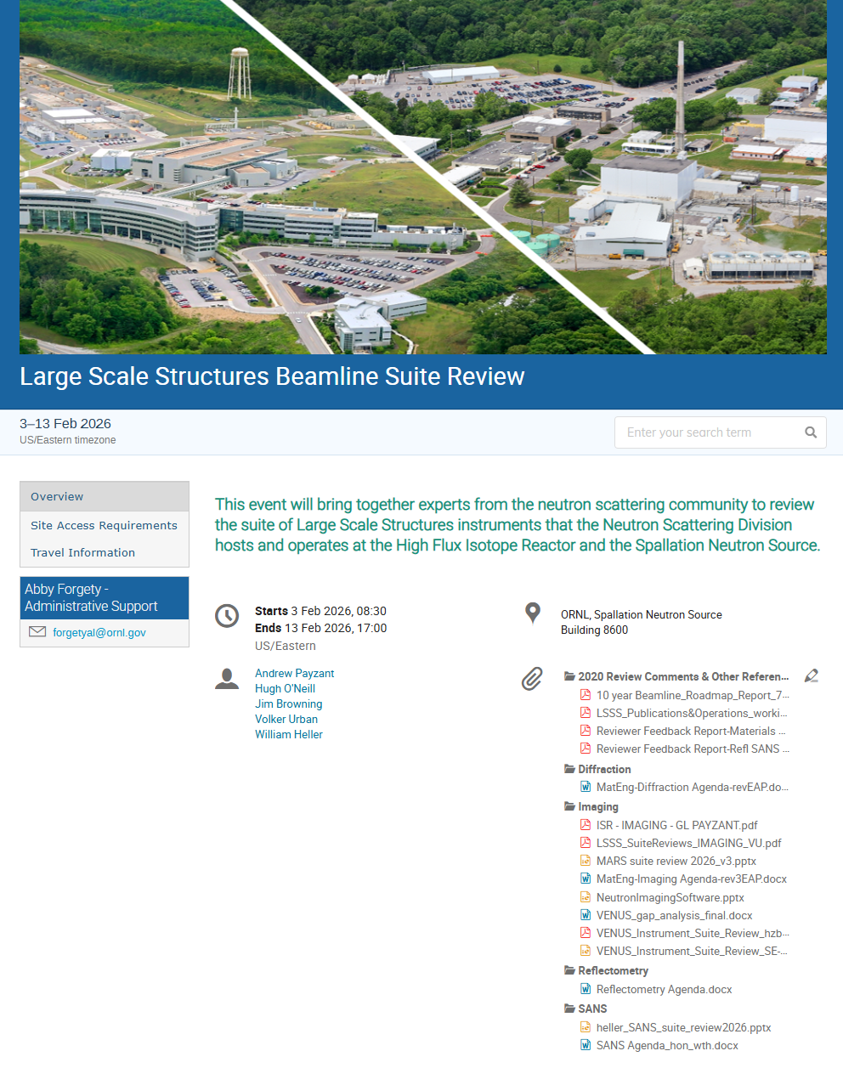
LSS Beamline Suites Review – nuts & bolts
Review Material: Agenda, Presentations, Additional Documentation: https://conference.sns.gov/event/529/
Some context
Previous suite reviews 2017, 2020
DOE reviews: …, 2018, 2023, 2027
Reviewers:
We can arrange additional discussions as needed.
We request report in 2 weeks.

Slide 13
A few recurring abbreviations…
CIS: Computational Instrument Scientist
SA: Scientific Associate (assigned to a beamline, staff in instrument support section)
SE: sample environment (generally and specifically SE Section)
HBRR: HFIR Beryllium Reflector Replacement
LSS(S): Large Scale Structures (Section)

Slide 14
Questions?
Next up: Group Leader Presentation, Jim Browning

Slide 15
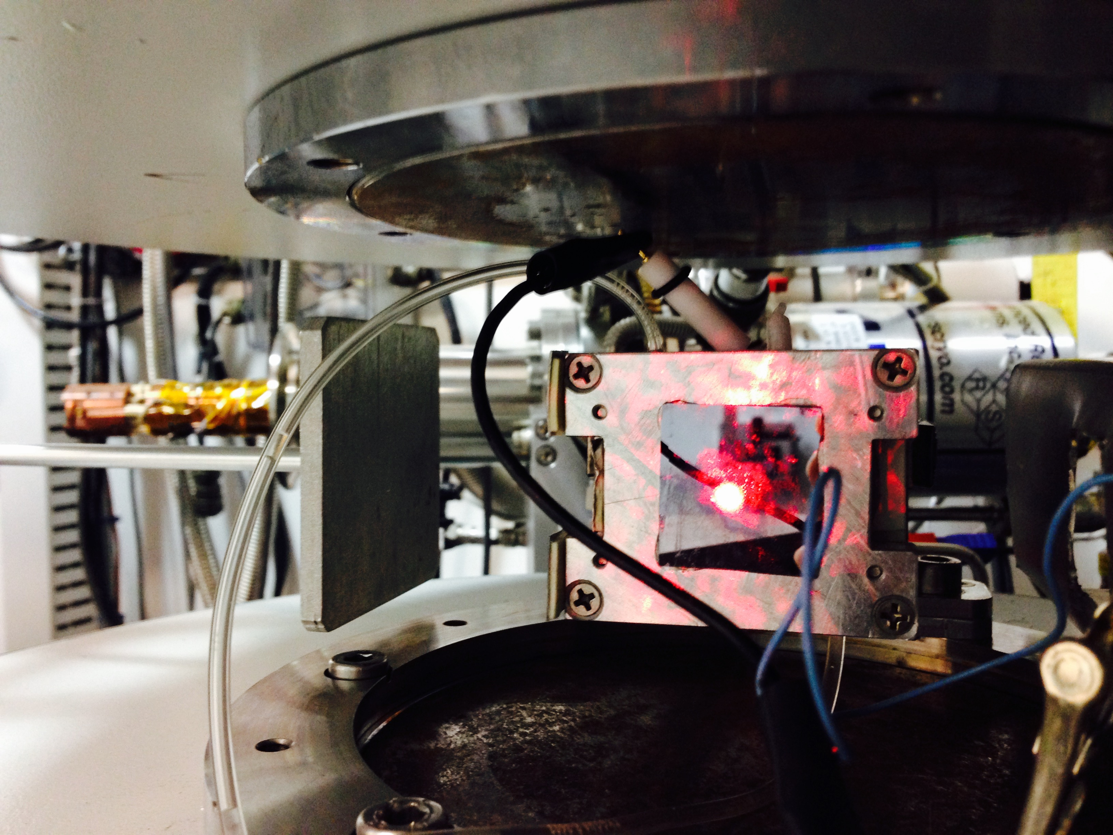
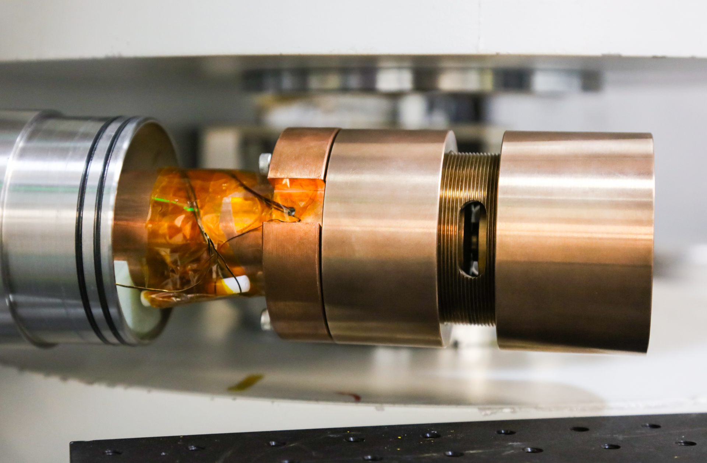

Unique Experiments on MAGREF:
Ferroelastic nature of LaCoO₃ confirmed with the in-situ application of hydrostatic pressure at low temperature
“Pump-probe” experiments with a switching of the transmembrane voltage, synchronized with each neutron pulse
A decrease in the magnetization of -20.4%/GPa and a return to the initial conditions with the removal of the load, confirming the ferroelastic nature of the LaCoO₃ thin film.
Time-Resolved Investigations of Potassium Ion Channel Proteins under Transmembrane Electric Potentials
Voltage-gated cation channels and their change to the transmembrane voltage are central to neurological signal transmission.
Time-resolved NR experiments directly determined the dependence of the profile structure of a VGK+ channel within single phospholipid bilayers and change of water distribution on the transmembrane voltage.
In a specially developed cell an alternating voltage (+V, 0V, -V) with a frequency of 60 Hz to 20 Hz can be applied to a thin membrane layer
Bulk LaCoO₃ is a ferroelastic and paramagnetic material.
Single crystal film demonstrates ferromagnetism.
The rich twin-morphology depends upon choice of substrate and on the imposed structural distortion.
Significance and Impact
The key NR results were compared with predictions by three different computational models. Only one was in agreement with the NR results. Thus, NR experiments provided a crucial impact and unique information on the mechanism of voltage gating.
May Steven et al, Pressure dependence of ferromagnetism of Kagome metal Fe3Sn2, 2026, in preparation
Guo, et al. Science Advances (2019)
Guo E.J., et al, Physical Review Letters, 122, 18, 187202 (2019)
V. Lauter, A. Parizzii, H. Ambaye et al, 2026, in preparation
A. Y. Tronin et al, Biophysical Journal, 117, 4, 751 (2019)

Slide 16
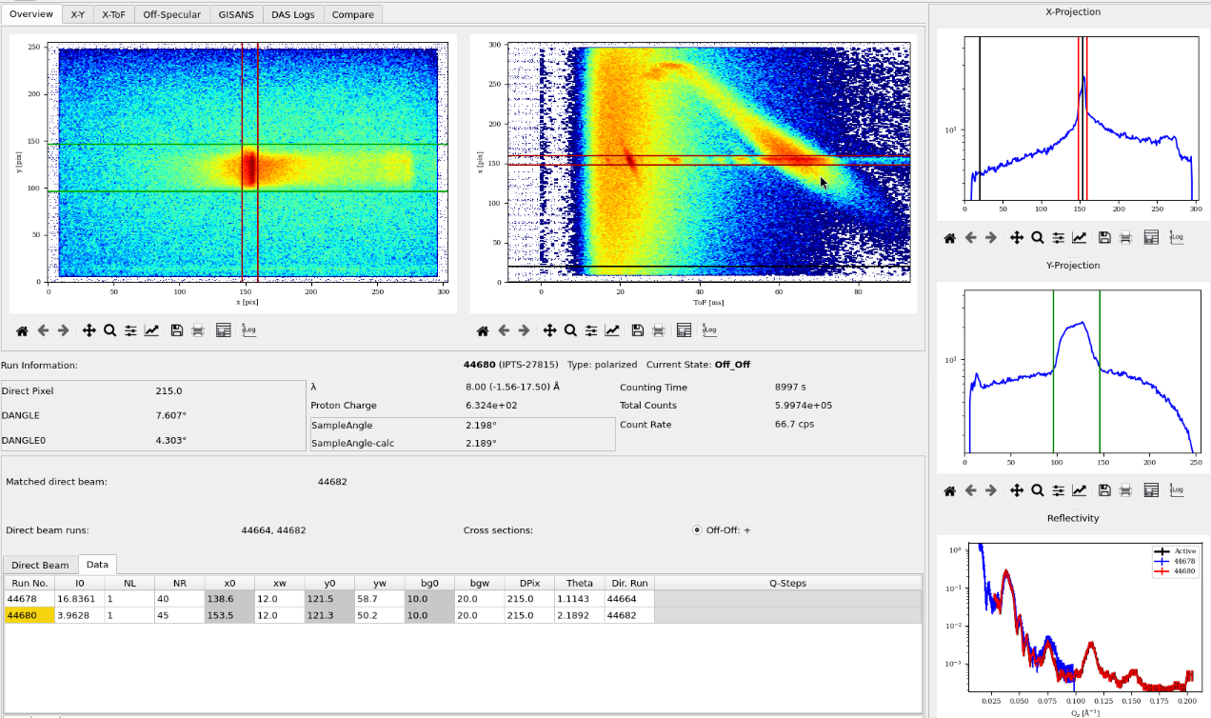
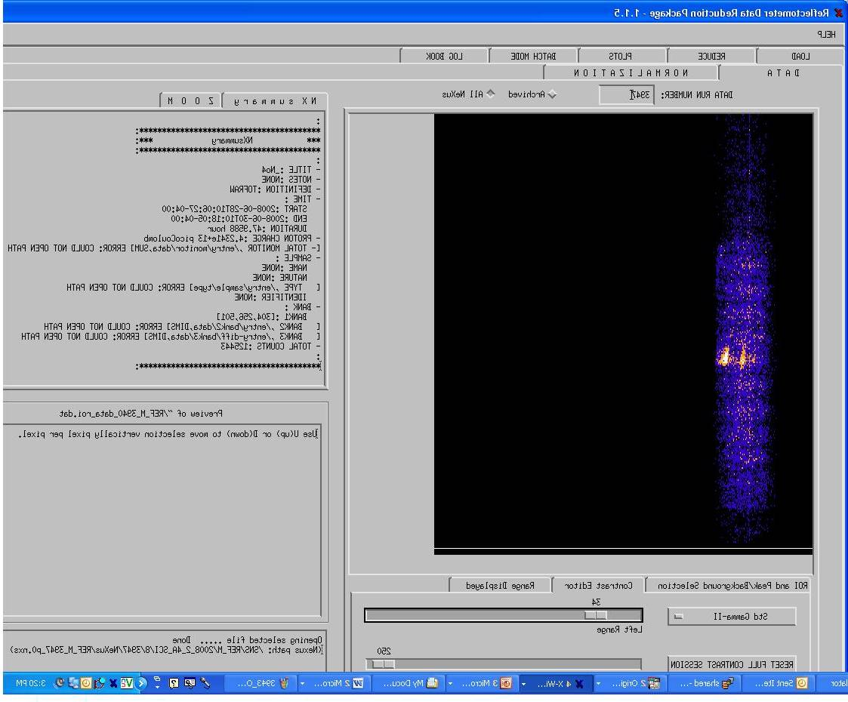
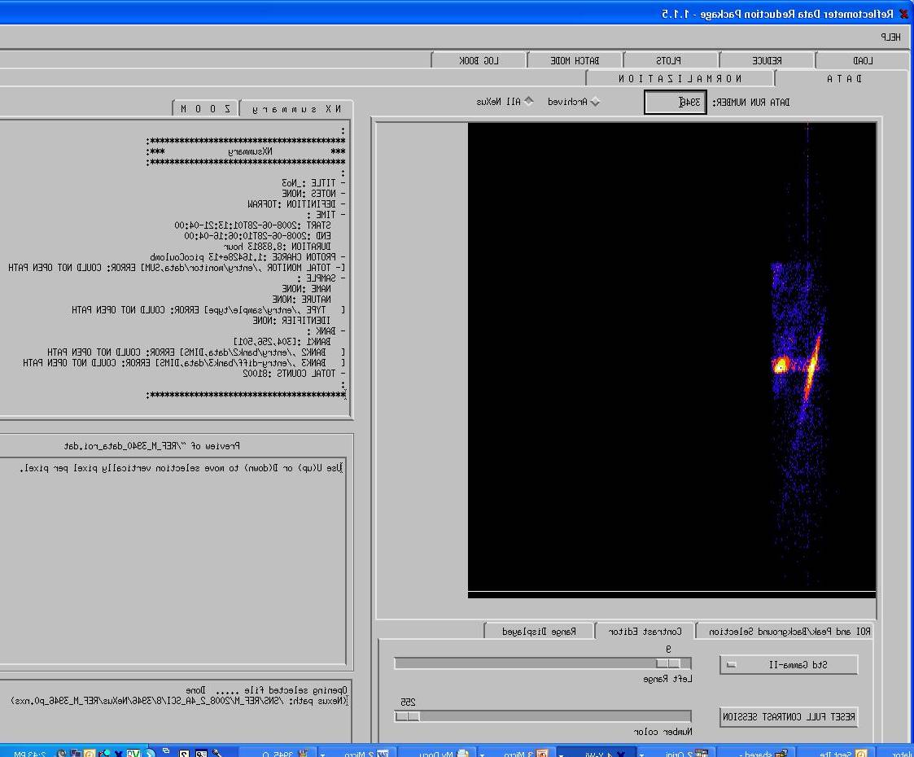
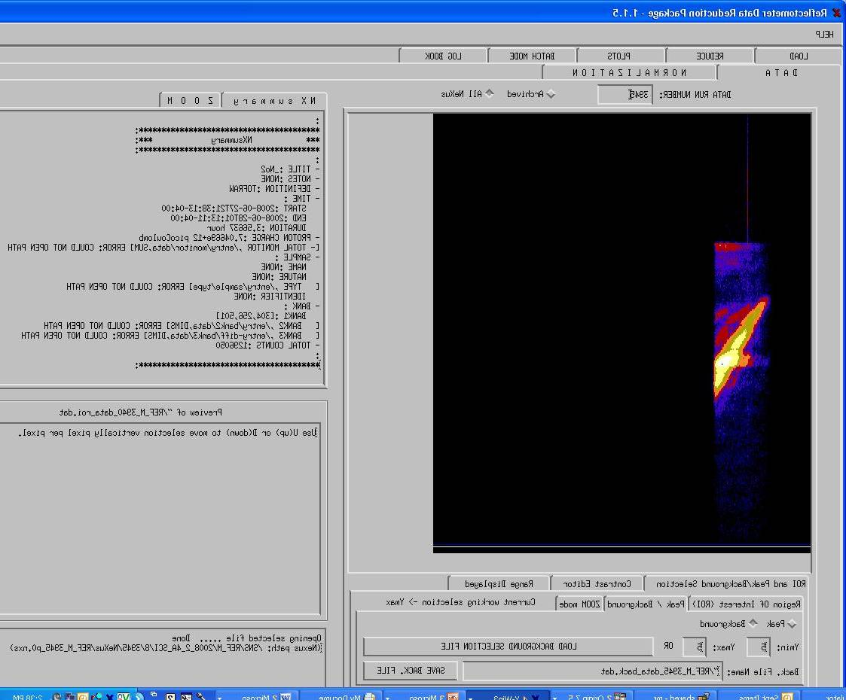
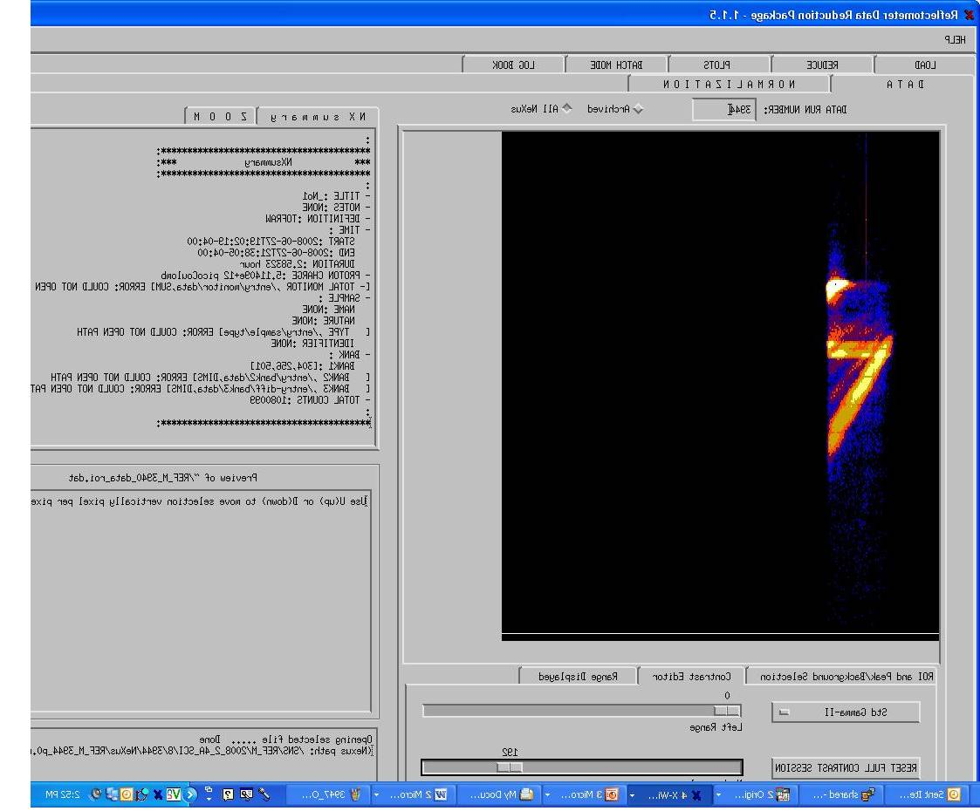
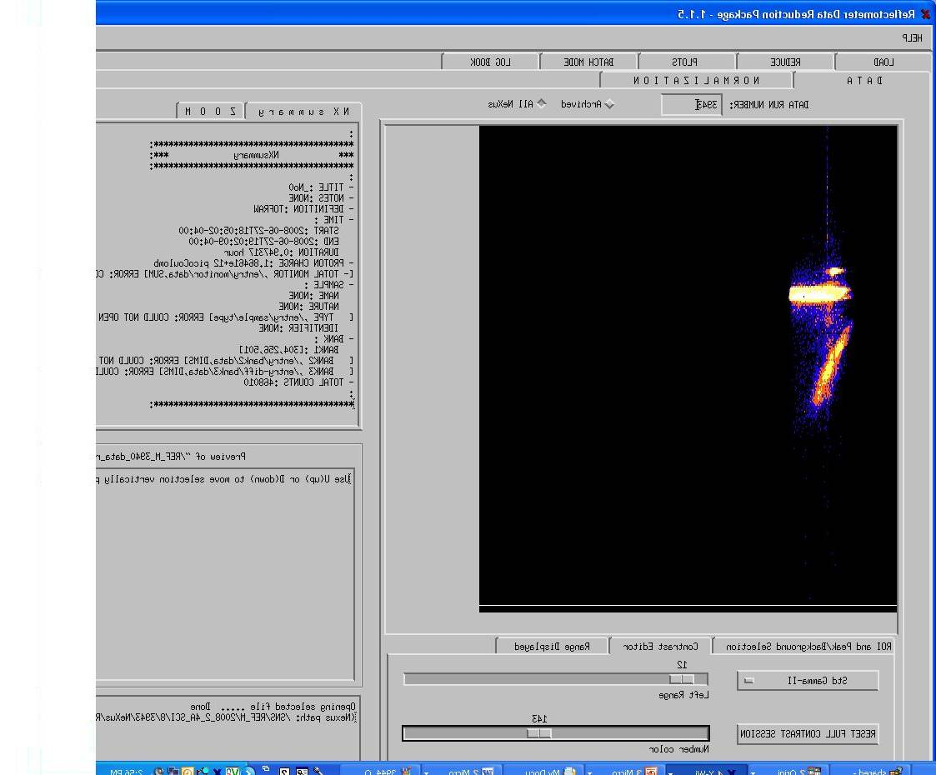
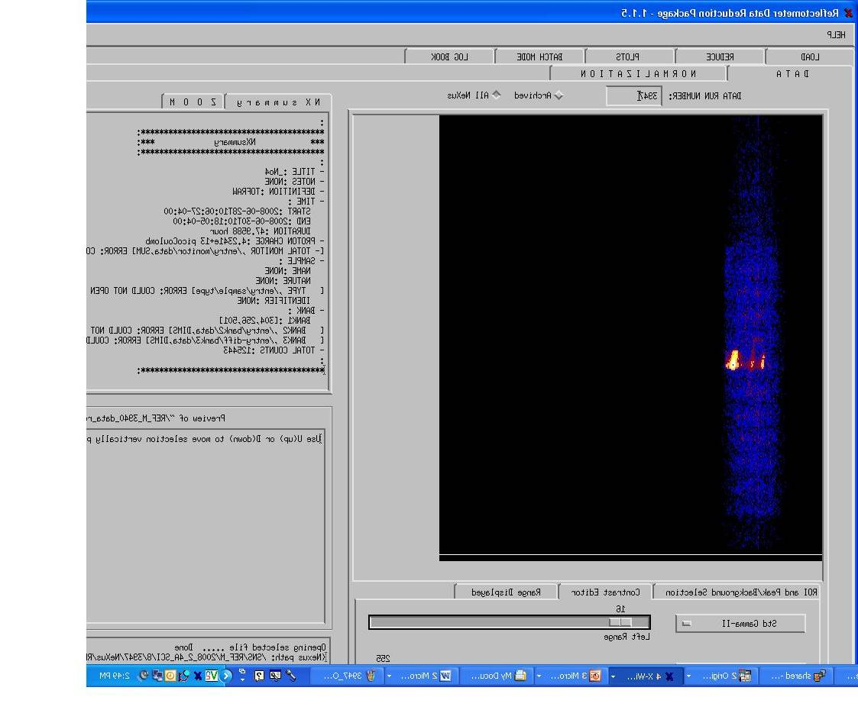
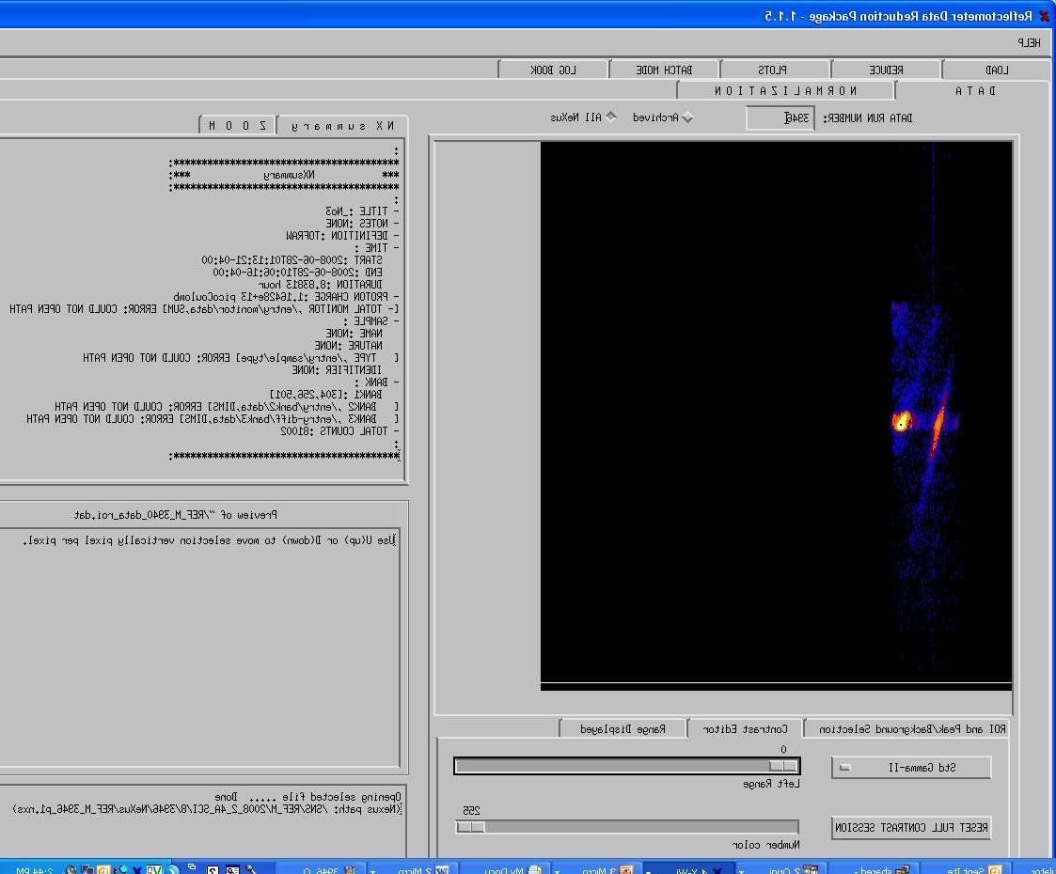

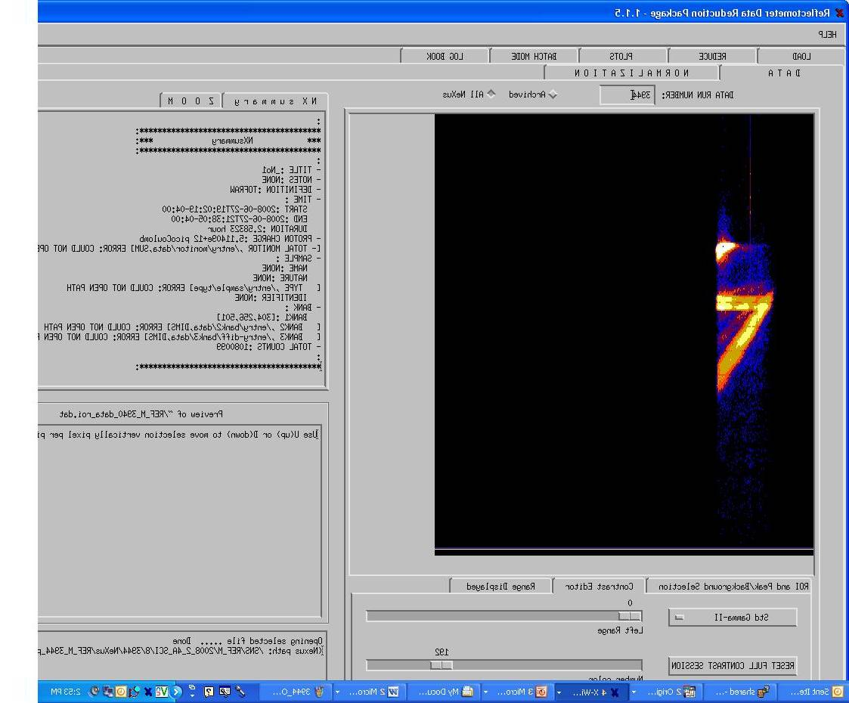
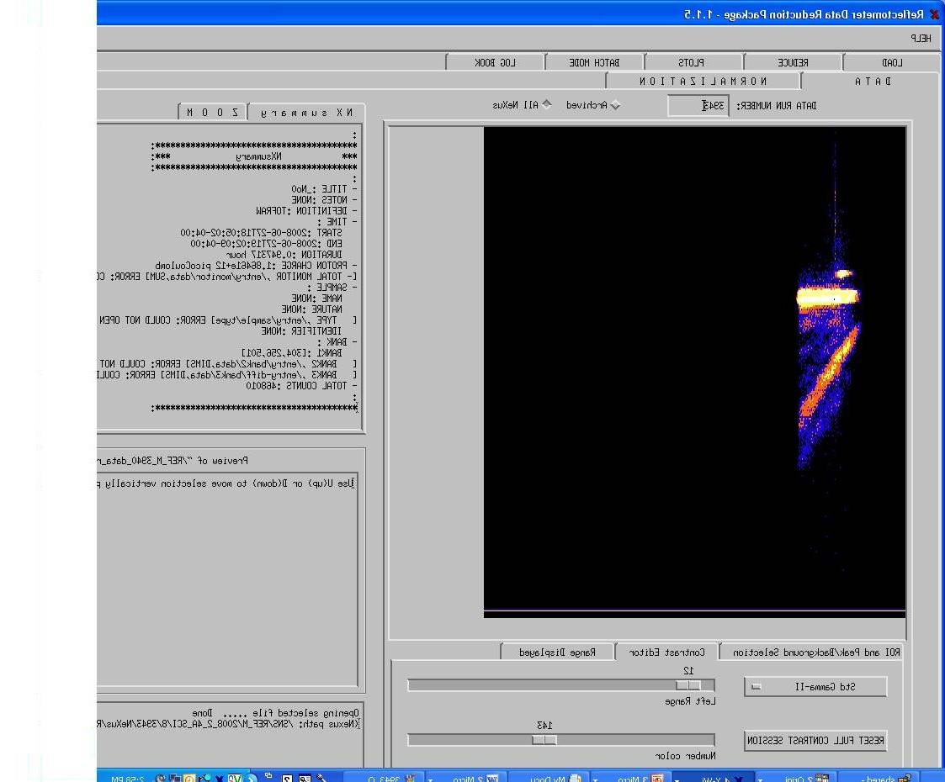
True ToF on MAGREF BL4A : 10 Hz test 380 kW 2.5A – 18 A
Scattering from magnetic multilayer film:
[Fe(70Å)Cr(10Å)]x12/Al₂O₃
At one incident angle :
Q -> 0.025 – 0.2 A⁻¹
Low Repetition Rate: Key elements delivering new capabilities
Large Q-range at one incident angle will enable time-resolved experiments
Large incident angles-> separation of reflected and direct beams resulting in reduction of background and high angular resolution for low Q
Very low instrument background
Very large bandwidth
Very small samples
PNR Experiment at 60 Hz on MAGREF – short wavelength band 2 – 4.74 A at 5 incident angles
α₅
α₄
α₃
α₂
α₁
Disadvantage of high Pulse Repetition Rate
5/2
3/2
1/2
Short Wavelength Band – multiple incident angles are necessary (time-resolved experiments are very limited)
Small incident angles-> NO separation of reflected and direct beams
Increased background
Lower angular resolution for low Q
At each angle we lose between 20% and 35% of the data due to overlap for stitching the data
Additional background from prompt pulse
R+
Reflectivity
2nd
1st
R-

