Slide 1
Reflectometry Software
Bogdan Vacaliuc
Reflectometry Group, LSS Section
Neutron Scattering Division
Reflectometry - Instrument Review, NSD ORNL, Oak Ridge, TN 10 February 2026 V1.1

Slide 2
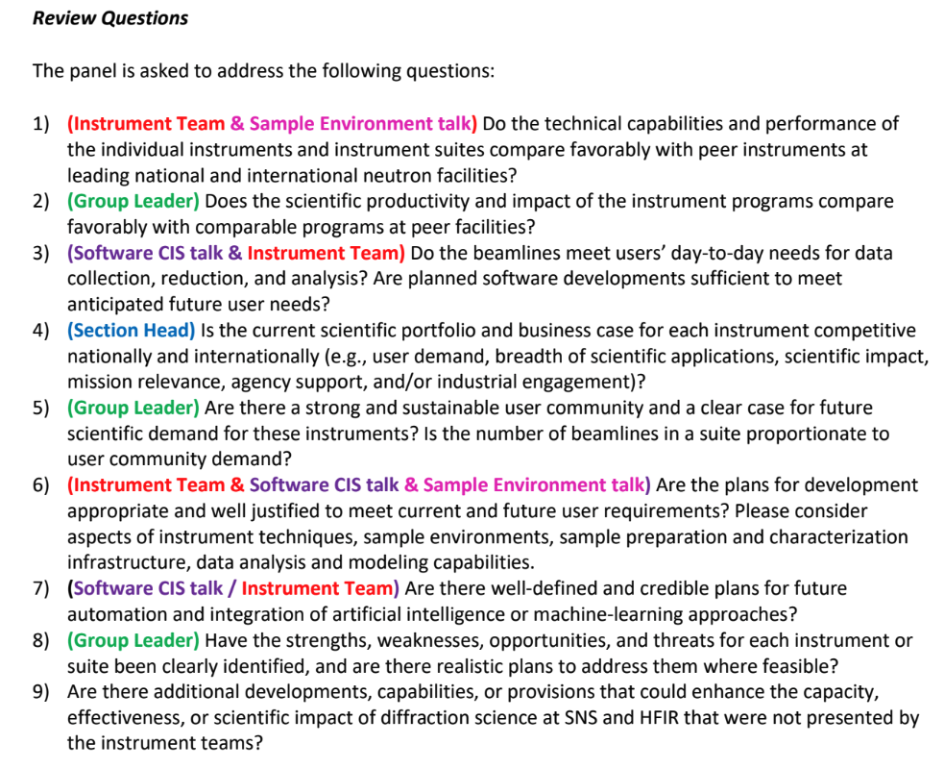
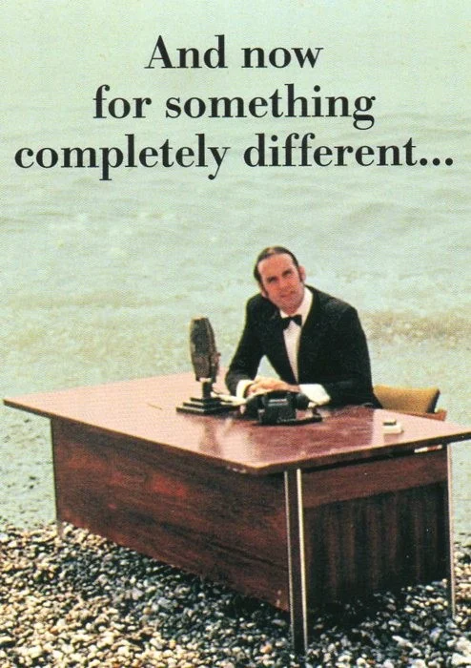
How this talk is organized.
Aim: Answer specific questions regarding software development process and provide details on future development.
Notes:
Charge questions.
Stock image

Slide 3
Overview
Recap: Experiment Process thru Analysis
Planning, Experiment, Reduction, Analysis, Insight
“Be a Defect, be a Story…”
How the reduction software development lifecycle operates
“Be a Bug, be a Feature…”
How data acquisition software development works
Challenges
Future Development

Slide 4


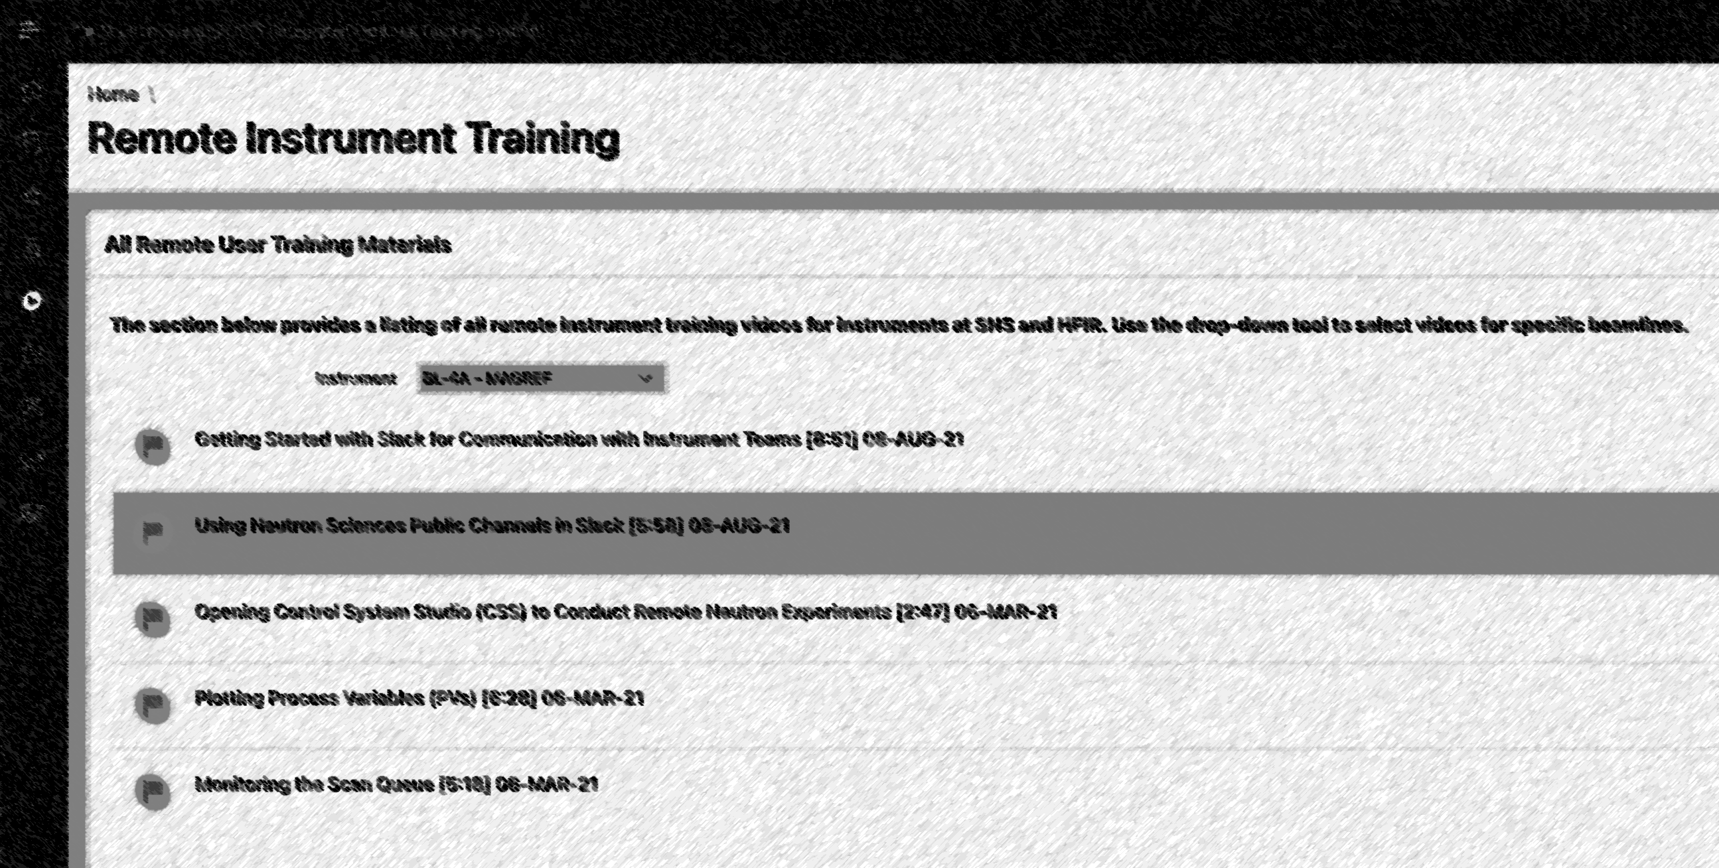
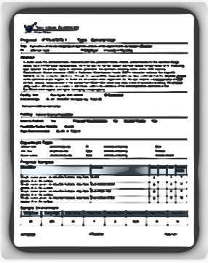
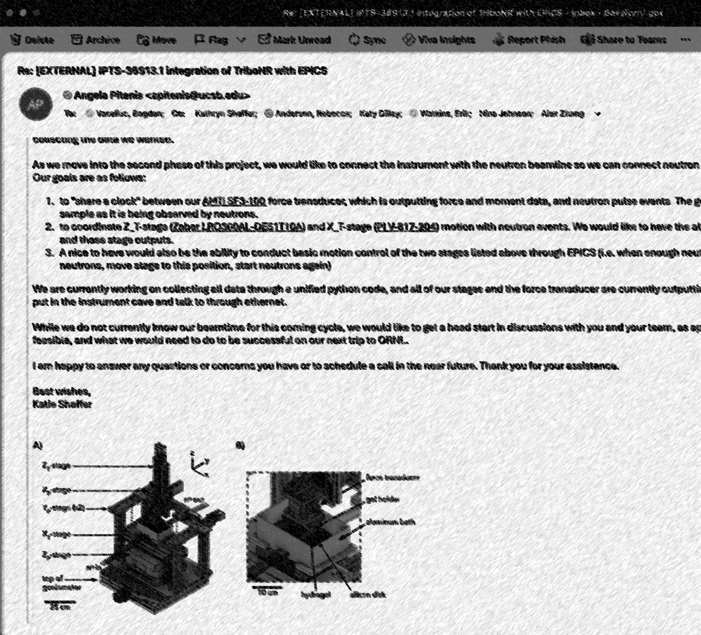
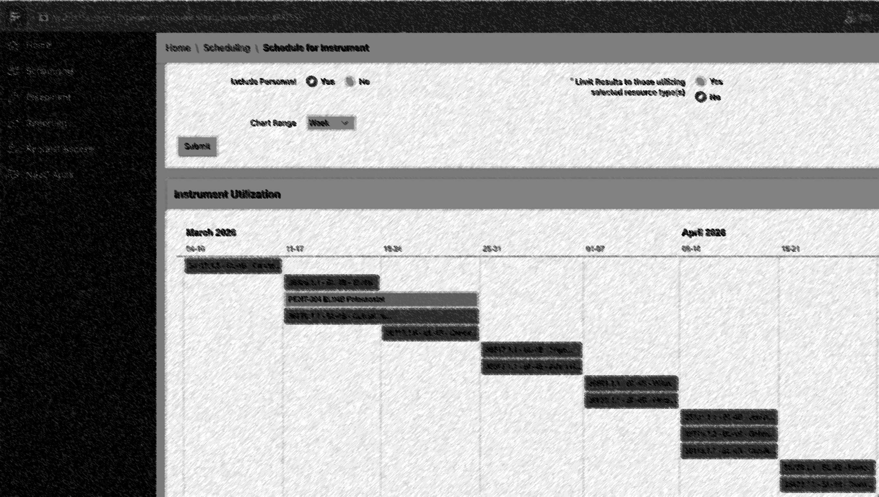
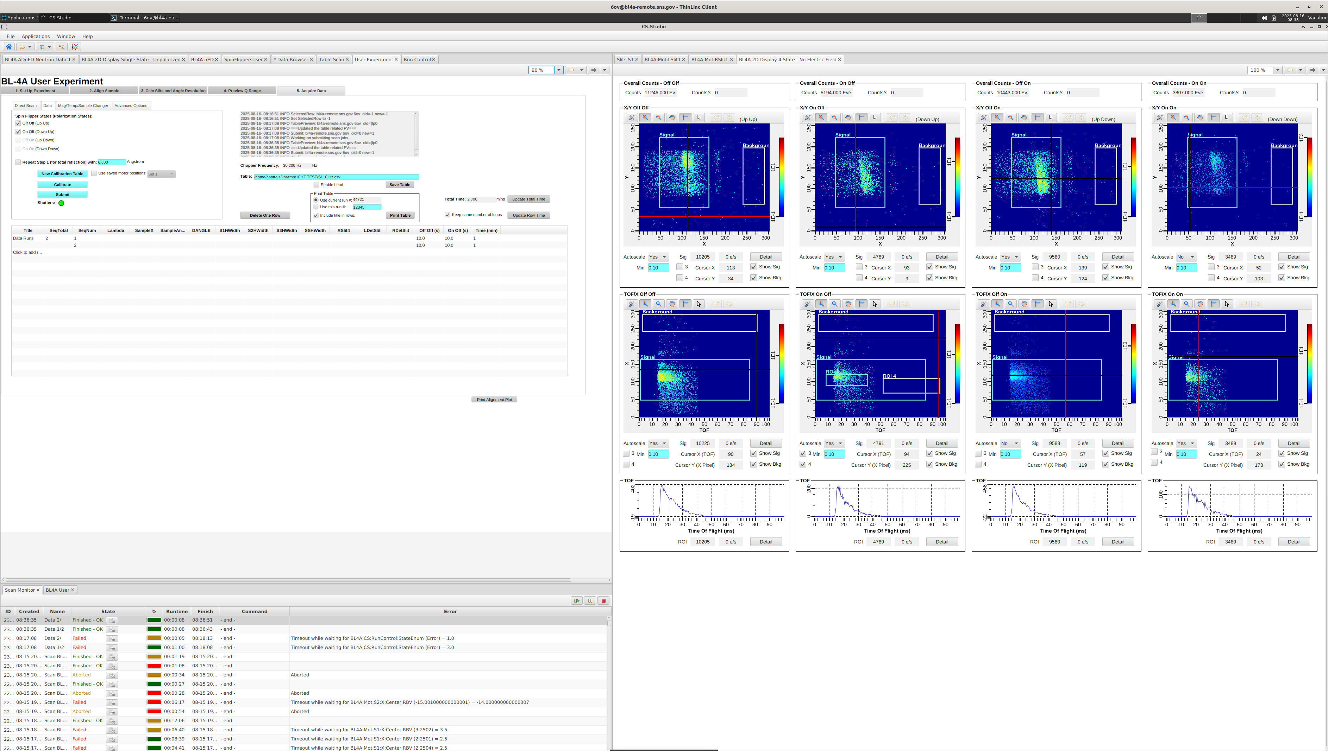
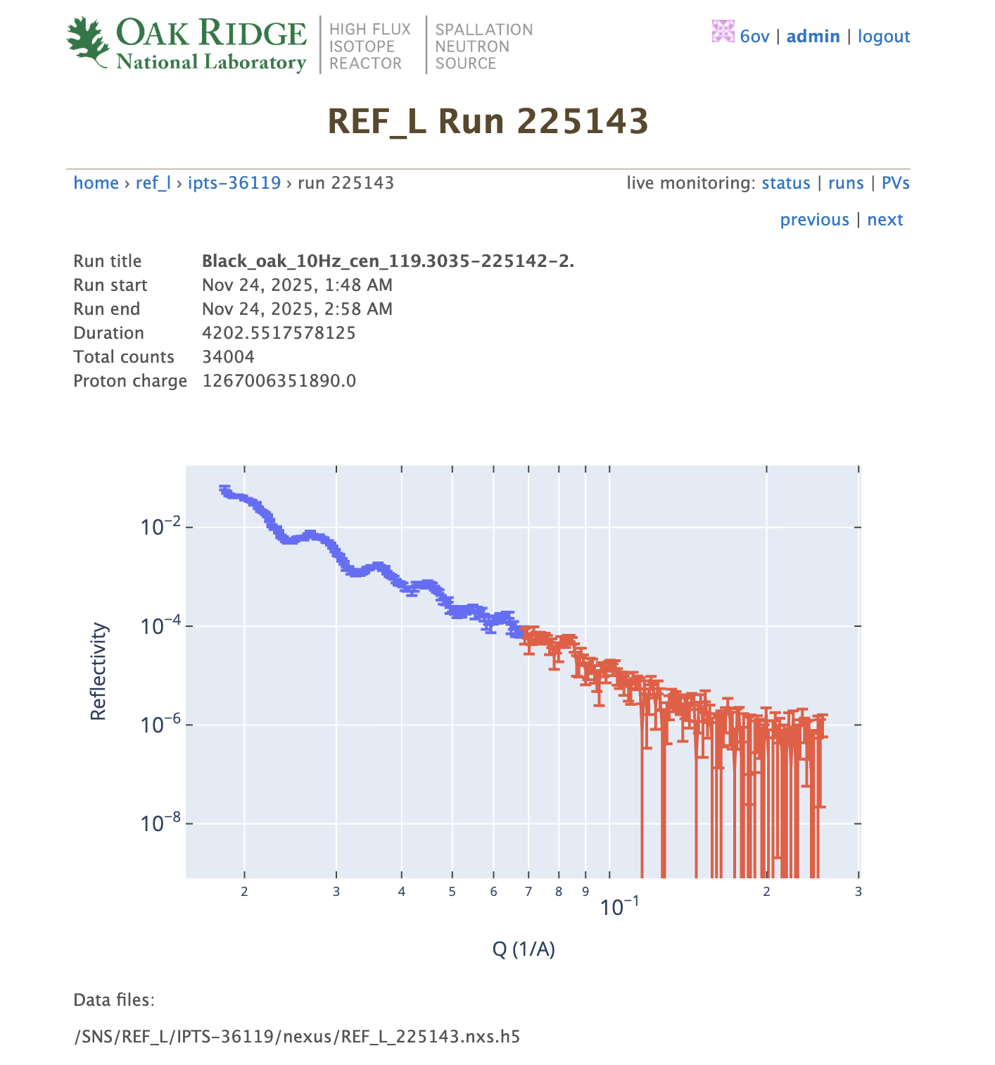
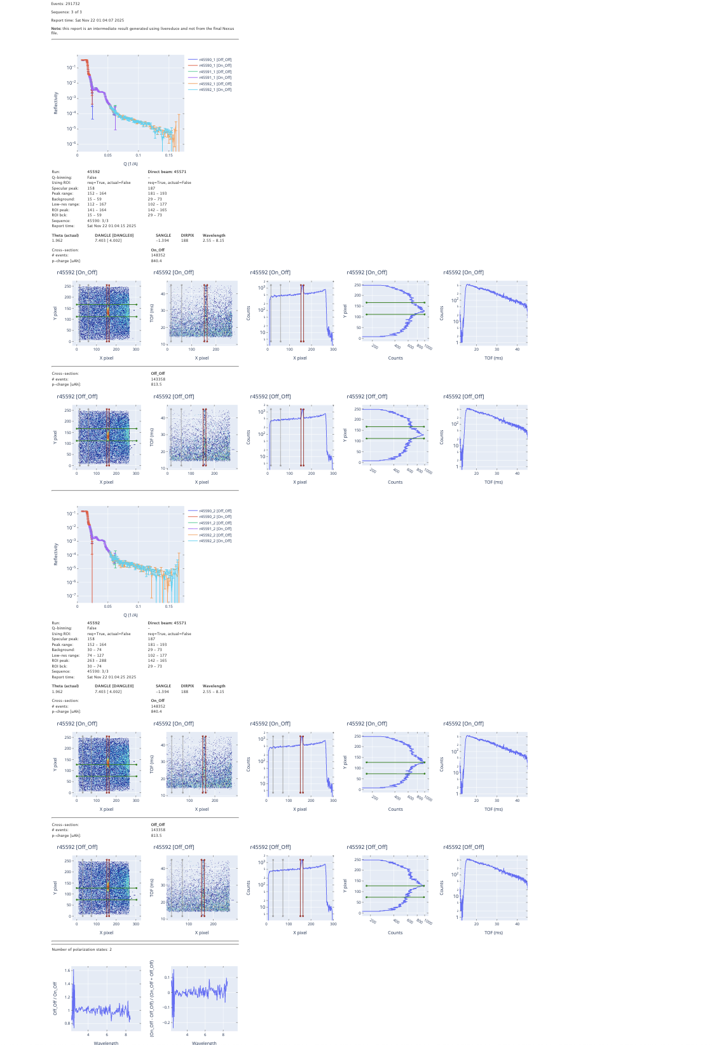
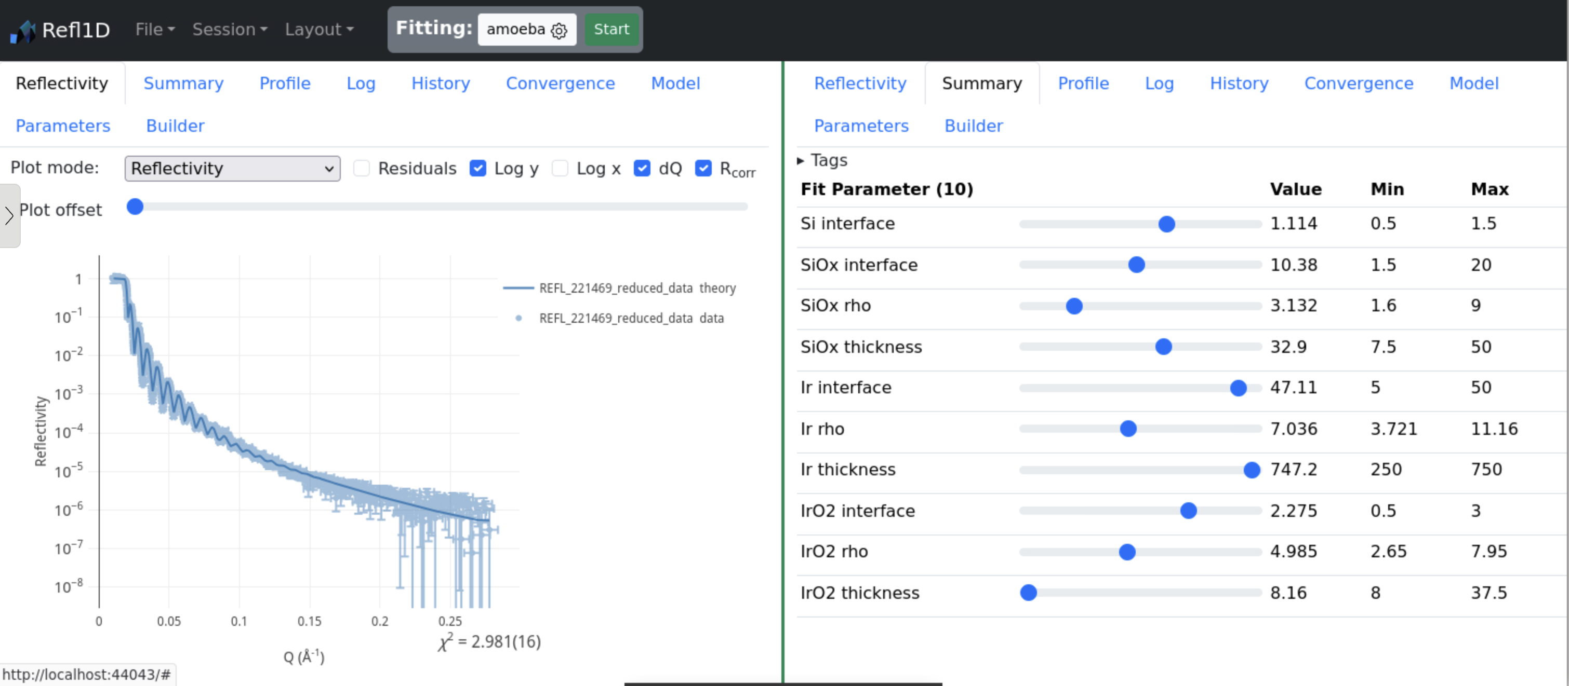
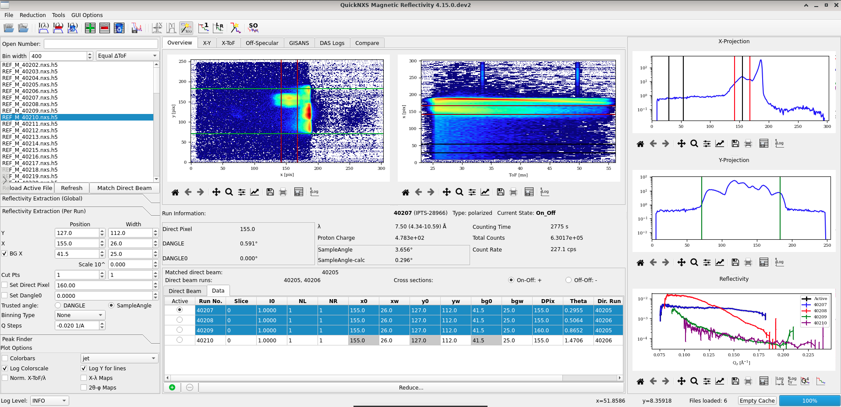
Recap: Experiment Process thru Analysis
Idea
Proposal
Pre-Experiment
Experiment/Data Collection
Analysis
Paper
Reduction
Notes:
Some software out of scope (make the picture gray for out-of-scope SW)
Software hits all these places, bits we will talk about are analysis and reduction and data collection sw
Ideal: doing analysis while still doing the experiment, feedback on what sample is doing, you can optimize your experiment (part of what AI/automation is trying to achieve)
Also while live reduction is so valuable

Slide 5
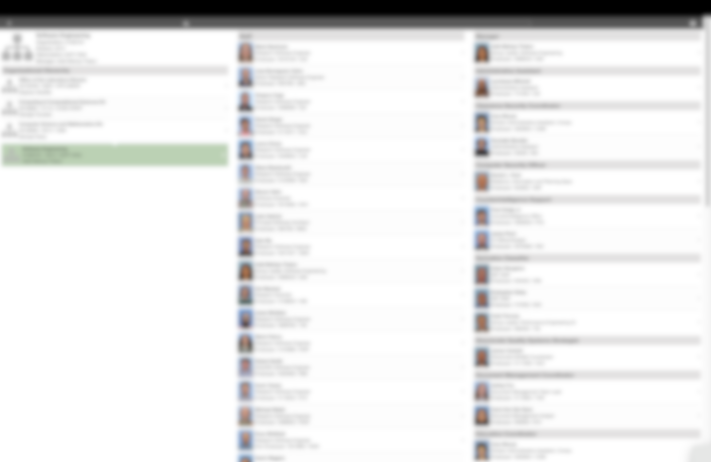
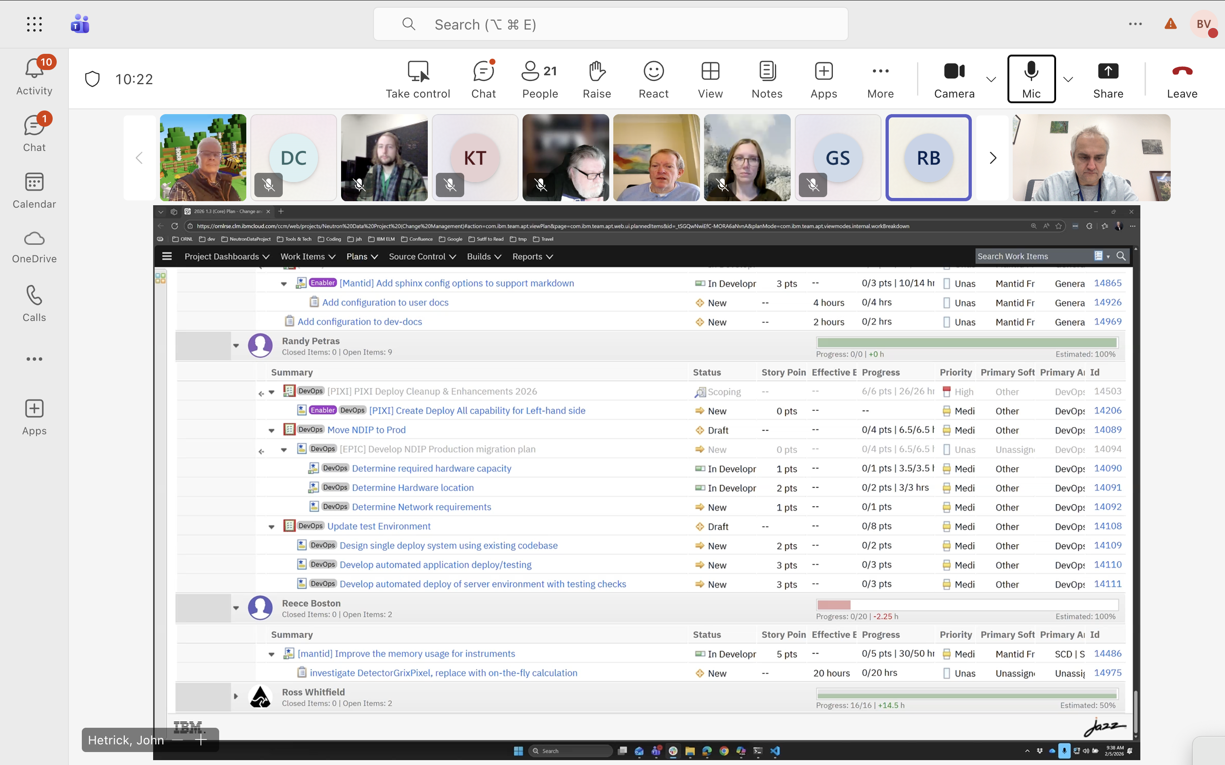
Be a Defect …, Be a Story… [Reduction Software Dev]
Reduction software is maintained and supported by a dedicated team of software engineers
13 + 1 mgr / 32 inst
Point of Contact:
Focus Team Leads
30min meetings daily
2 week “iterations” – periods of work that is pre-planned, then evaluated in a retrospective held on Wednesday mornings
Notes:
Addi requested removal of org chart, and clarified that only 13 persons are working on reduction software not 17.

Slide 6

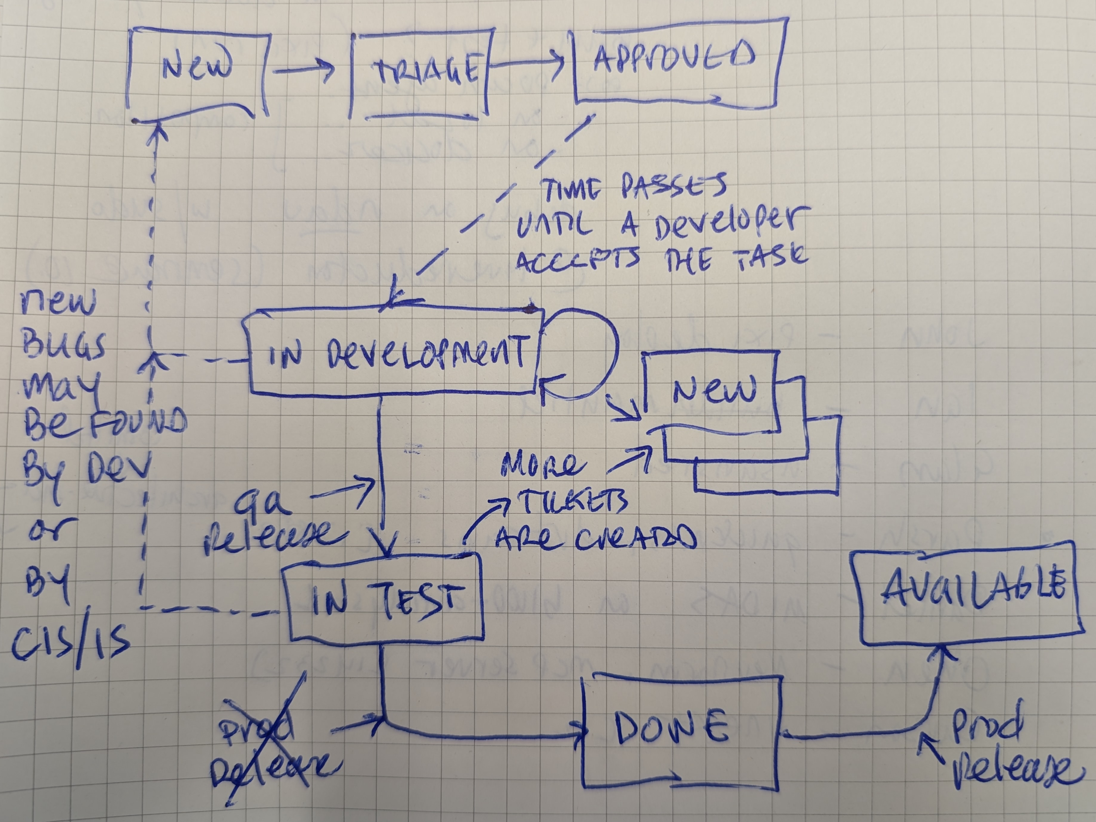




Be a Defect …, Be a Story… [“The Process”]
Notes:
Add stick figures (as animation?) to show progress in how each step of the process needs people to “move it along…”

Slide 7
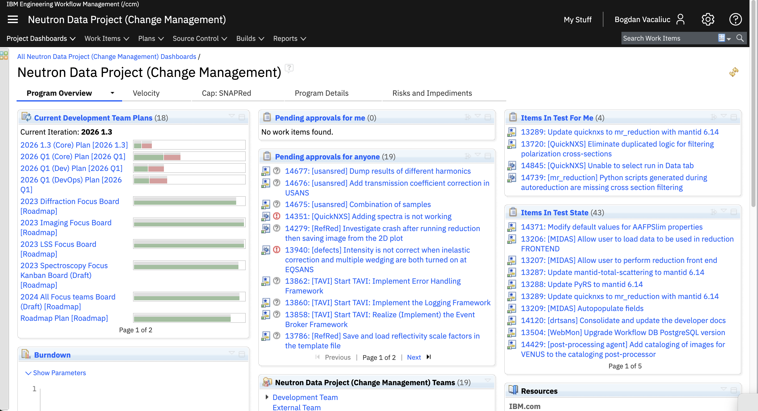

Be a Defect …, Be a Story… [”The Backlog”]
As of Jan 15, 2026
8 Capabilities/”EPIC”
Those features that require multiple “Stories”
24 Defects (3 critical, 10 high, 6 in-testing)
46 Stories (17 high, 8 in-development, 11 in-testing)
Average completion time of any Defect/Story is ~40days
(from a compilation of data spanning activity back to 2023)
At current metrics, 24*46*40 = 2800 days of activity (+10yrs)
(*) As a reference: SANS reduction software development was allotted 20FTE
Notes:
Slide 28-29 have alternate views where Accumulated is divided by number of tickets to record mean defect/story/task completion rate.

Slide 8

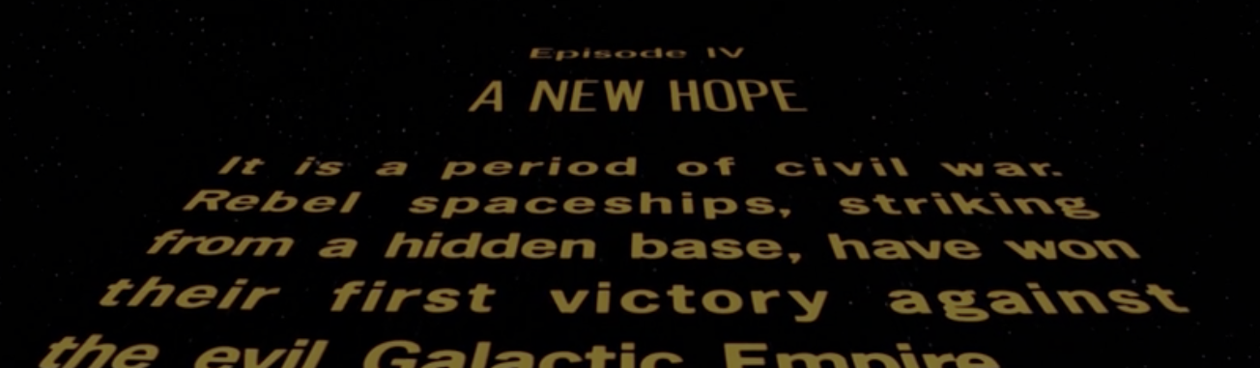
Be a Defect …, Be a Story… [”A New Hope”]
The software engineering group is going to revise this process over the next 18-24 months*
Doing research, accepting feedback now
Considering the open-source development model more closely
Reviewing for the next development thrust project now
(*) communicated to the CIS weekly meeting on Feb 6, 2026
Notes:
Notes on “Fair Use” and the reference to Star Wars (copyright Lucasfilm) in the graphic. Parody acceptable [1], “using a book as a prop in a stage performance” favors fair use [2] and the many derivative works that were acceptable to Lucasfilm [3]. Fair use definition in US Copyright Law [4]
[1] https://www.kleinlitigation.com/that-one-time-when-lucasfilm-sued-president-reagans-star-wars-program/
[2] https://guides.nyu.edu/fairuse#:~:text=What%20is%20Fair%20Use?,use%20falls%20under%20fair%20use.
[3] https://blogs.library.unt.edu/copyright/2018/03/02/star-wars-the-copyright-question/
[4] https://www.copyright.gov/fair-use/

Slide 9
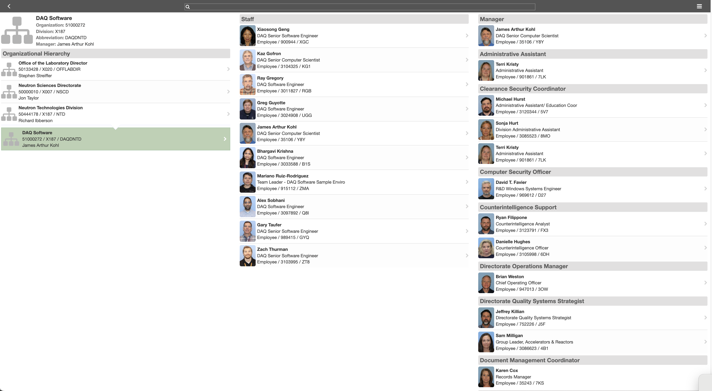
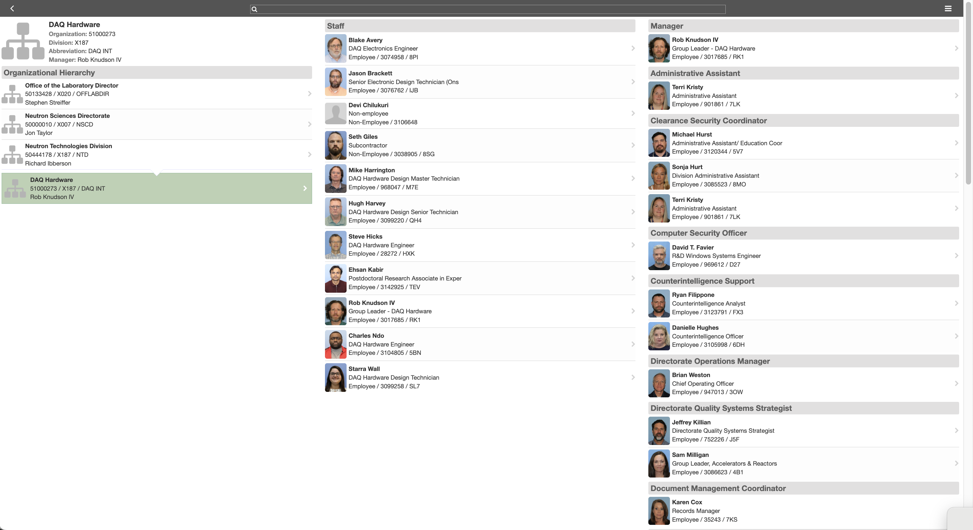
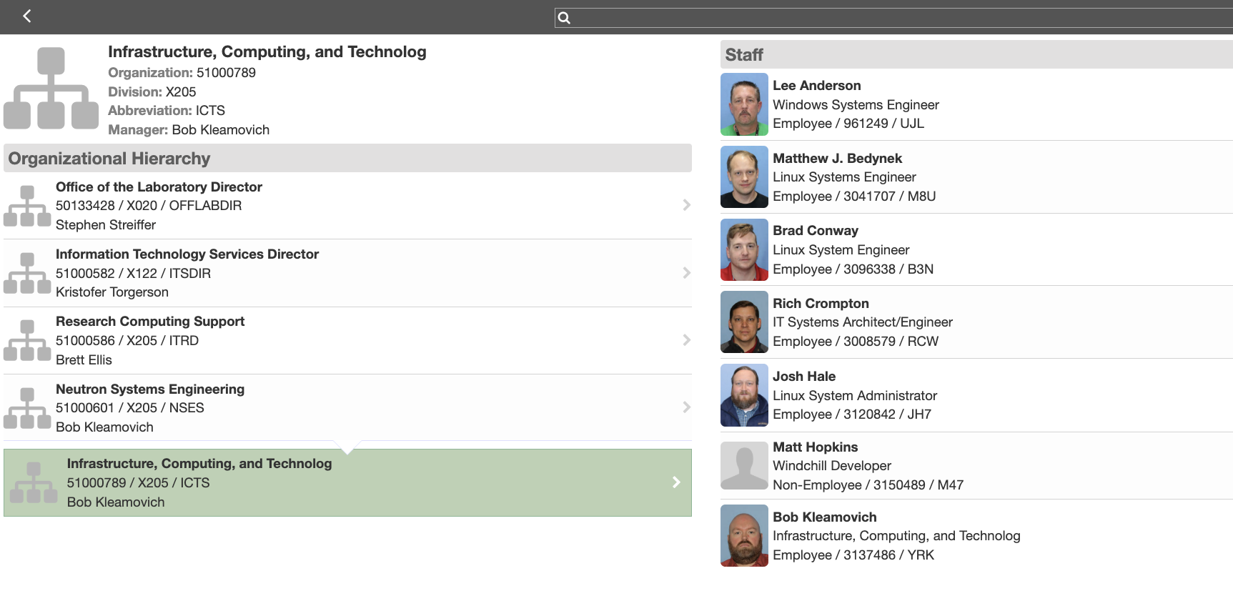
Be a Bug …, Be a Feature… [Data AcQuisition Side]
Instrument software and hardware are maintained and supported by three dedicated teams of engineers
25 + 3 mgr / 32 inst
60 min weekly “On Call Support”
Continuous Presence*
Notes:
* Bogdan is a former member, and the arrangement now is that he be primary POC for the two reflectometry instruments

Slide 10
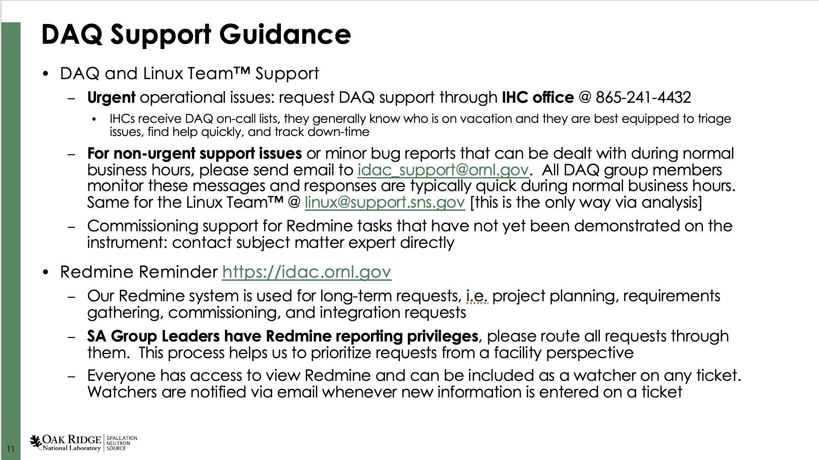
Be a Bug…, Be a Feature [“The Process”]
Urgent
Call IHC*: DAQ on-call triages, identifies subject-matter expert who can help
Non-Urgent
Email support during business hours
New Capability
Use the “Redmine” System for project management
(*) Instrument Hall Coordinator (IHC) – 24hr on-site personnel for immediate response and coordination ~ 911 for the facility
Notes:
This is the official guidance – consider putting this into a picture slide, keep bullets simple. Key is 3 routes: urgent, non-urgent, new capability important takeaway is that there are different routes
Concern :top half – rapid response. Bottom half not so much but you can get things done

Slide 11
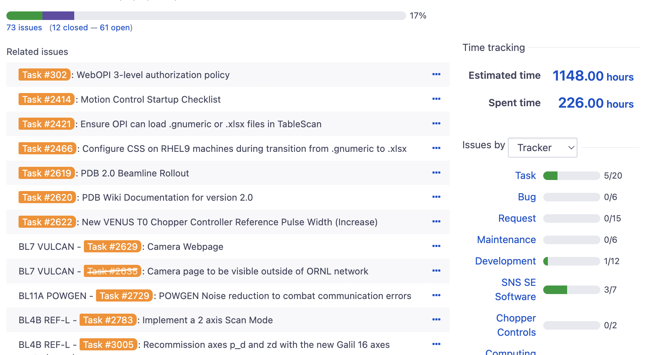
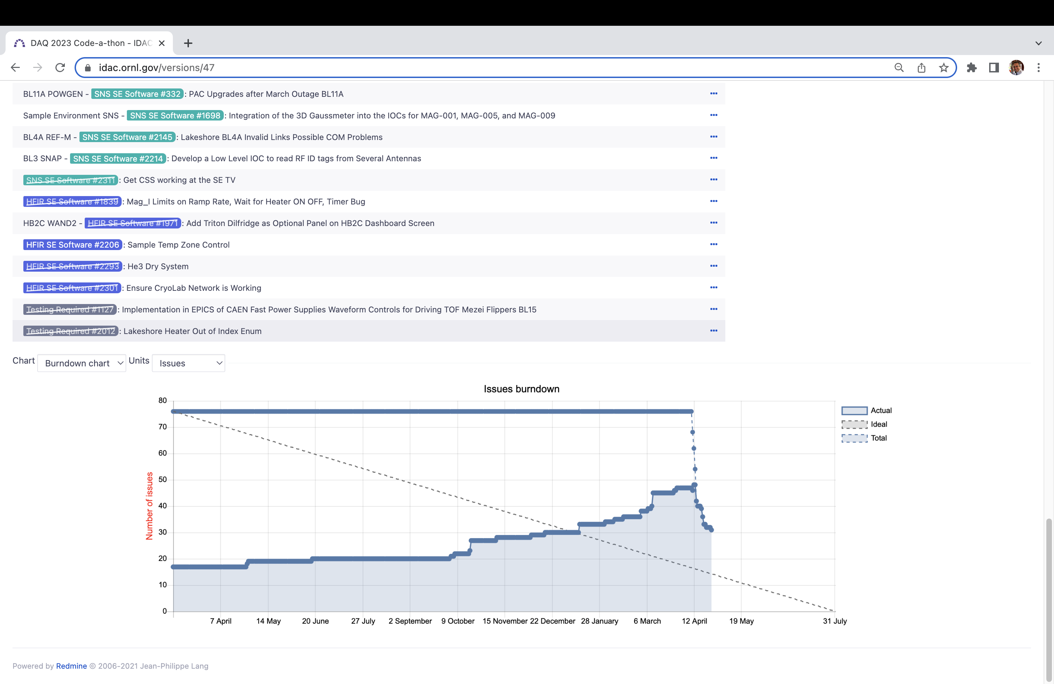

Be a Bug…, Be a Feature [The “Redmine” System]
Triage with SA GLs every two weeks
Priority-based tasking
Subject-Matter-Expert-based assignments
Heroic Efforts are Common!
Notes:
Often a target date for the experiment and proximity to the required date are required to obtain attention

Slide 12
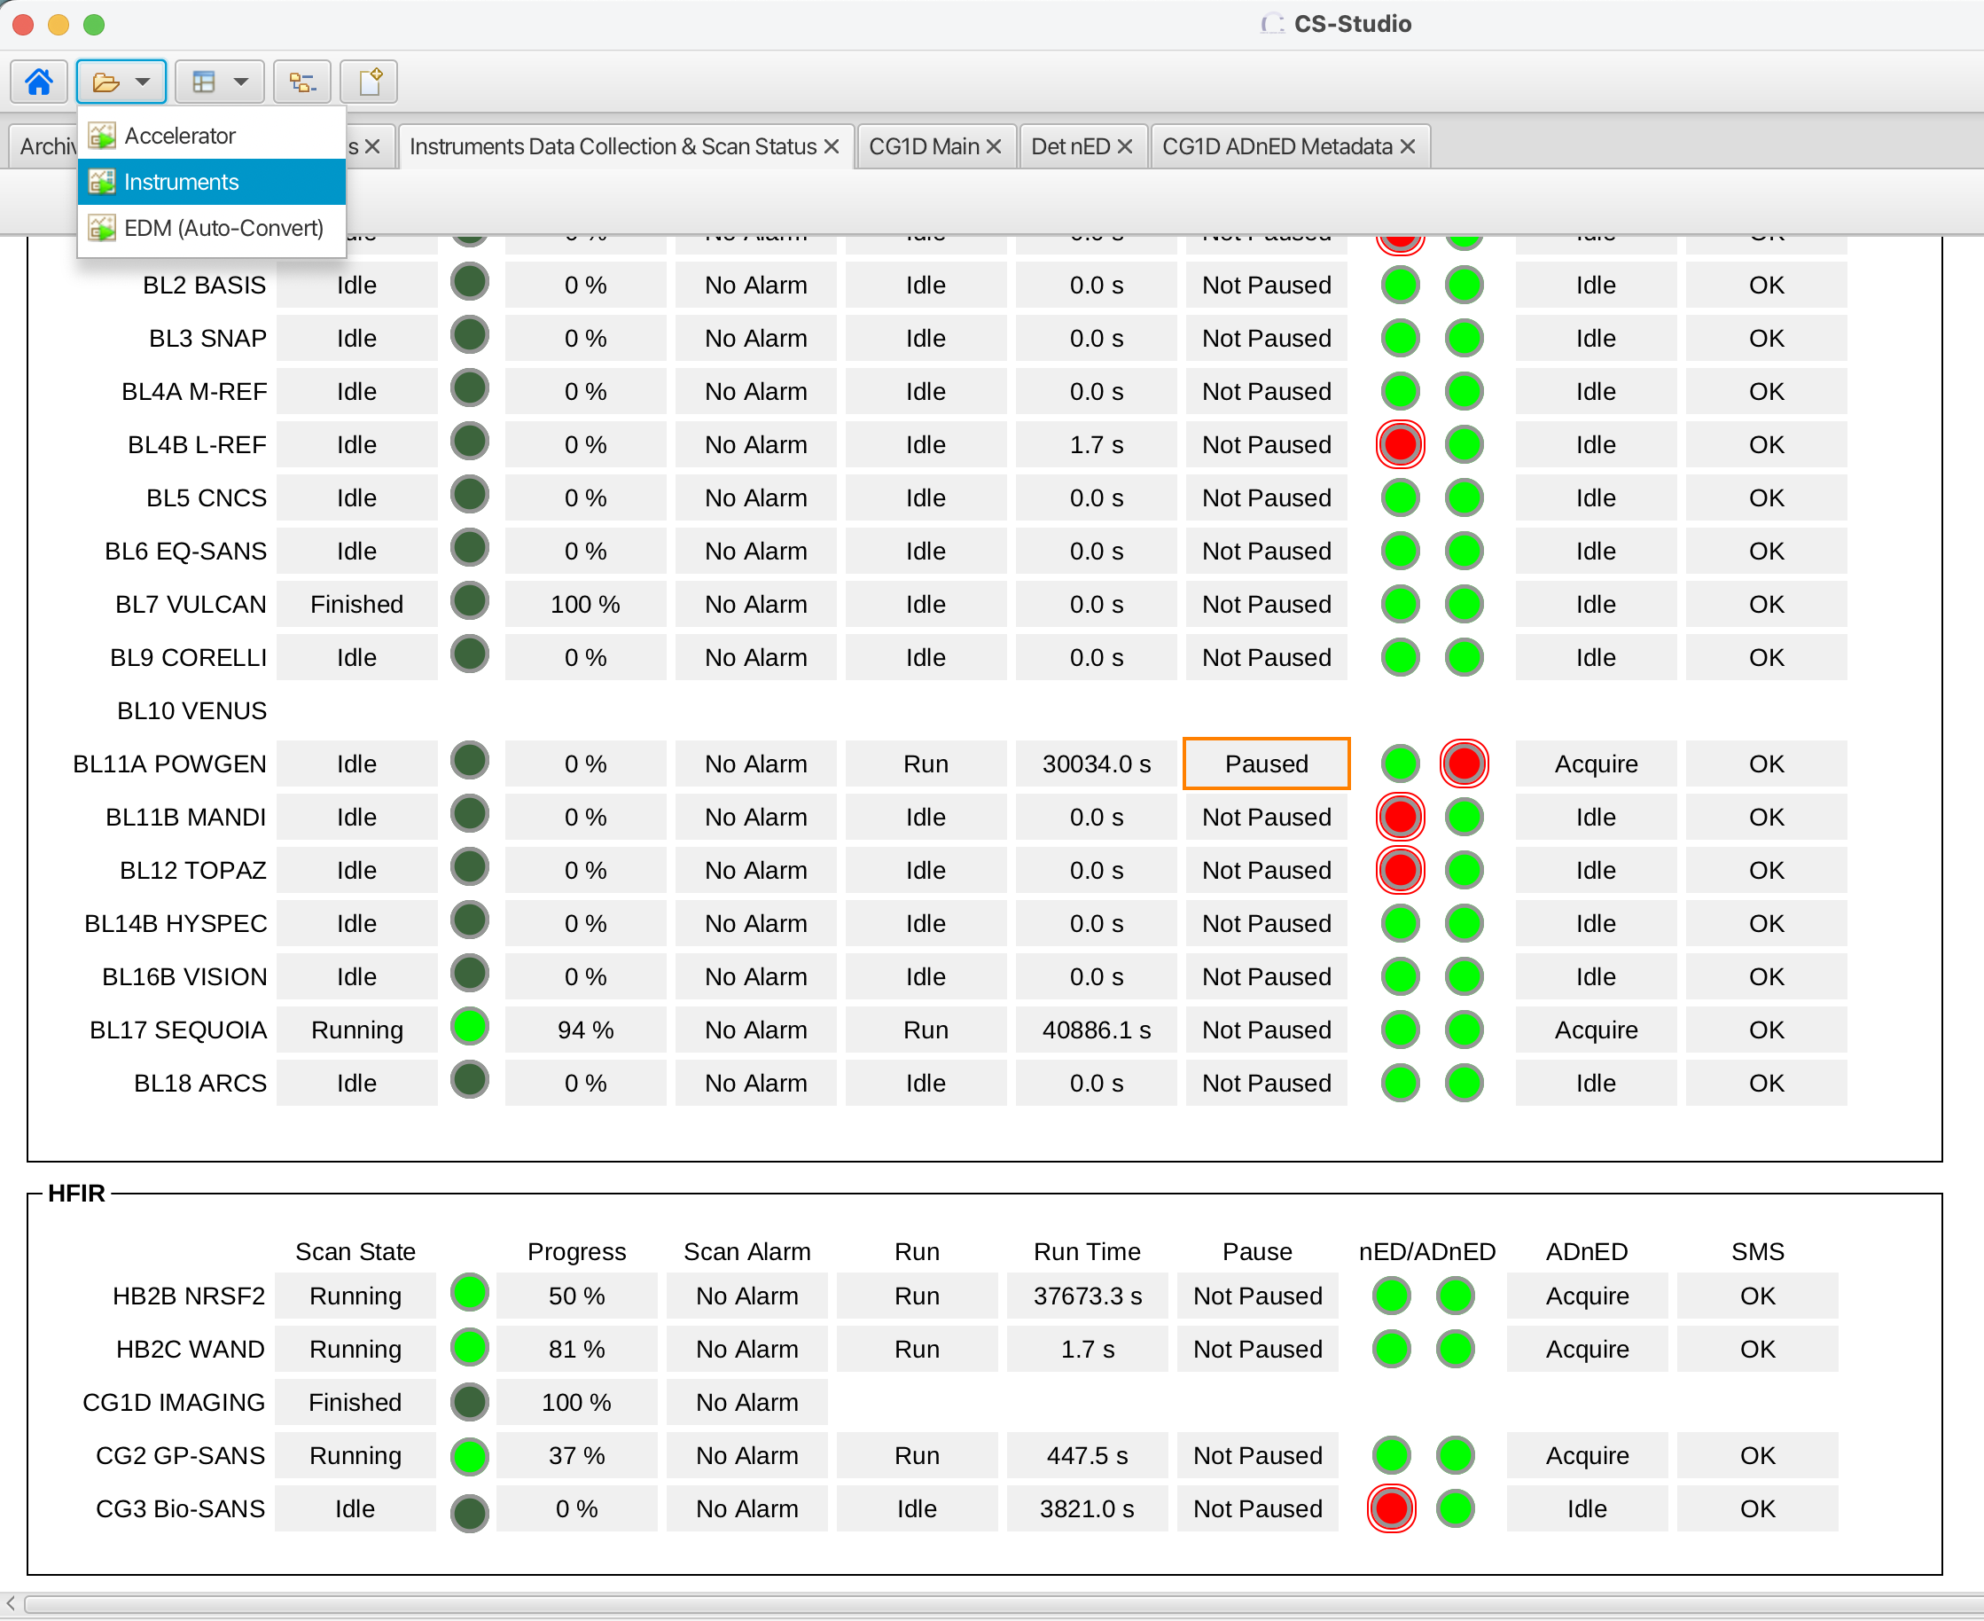
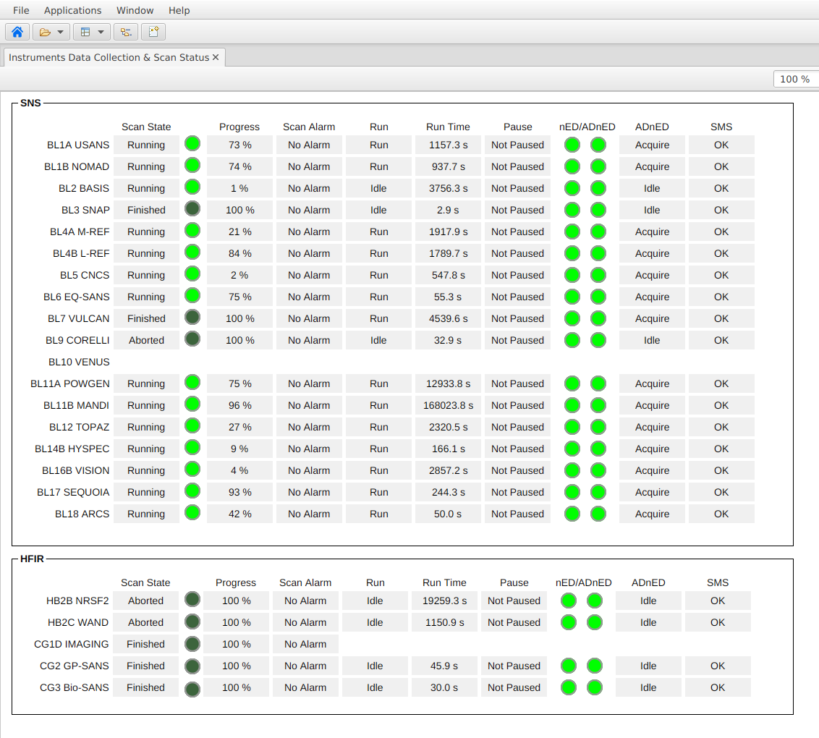
Be a Bug…, Be a Feature [Parting Thoughts]
IHC have visibility into control system
Problems are triaged by DAQ on-call
DAQ personnel are empowered to resolve issues
Process is setup to optimize for problem solving over long-term development

Slide 13
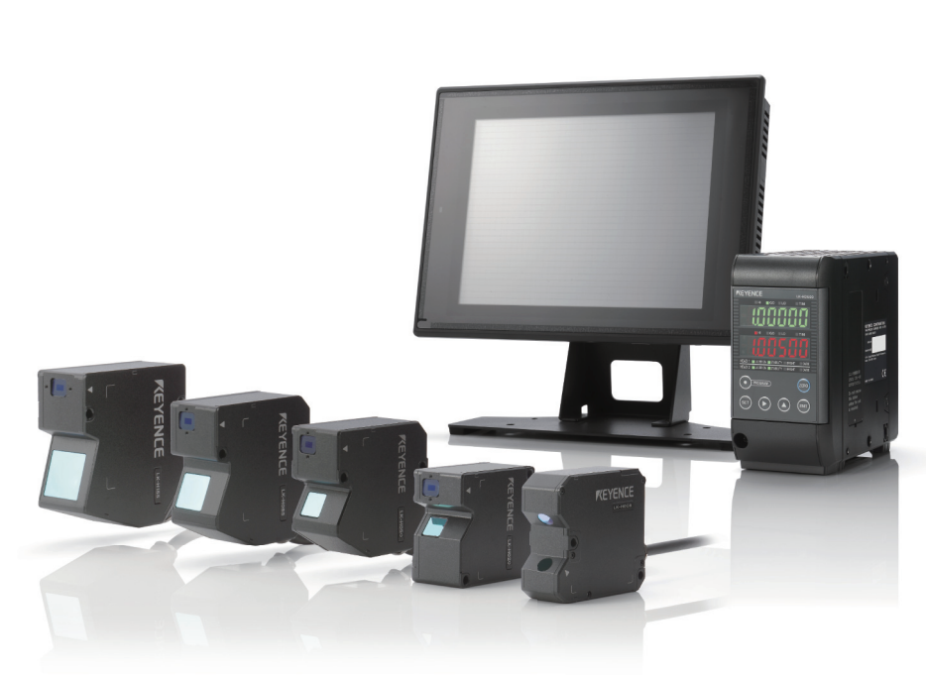
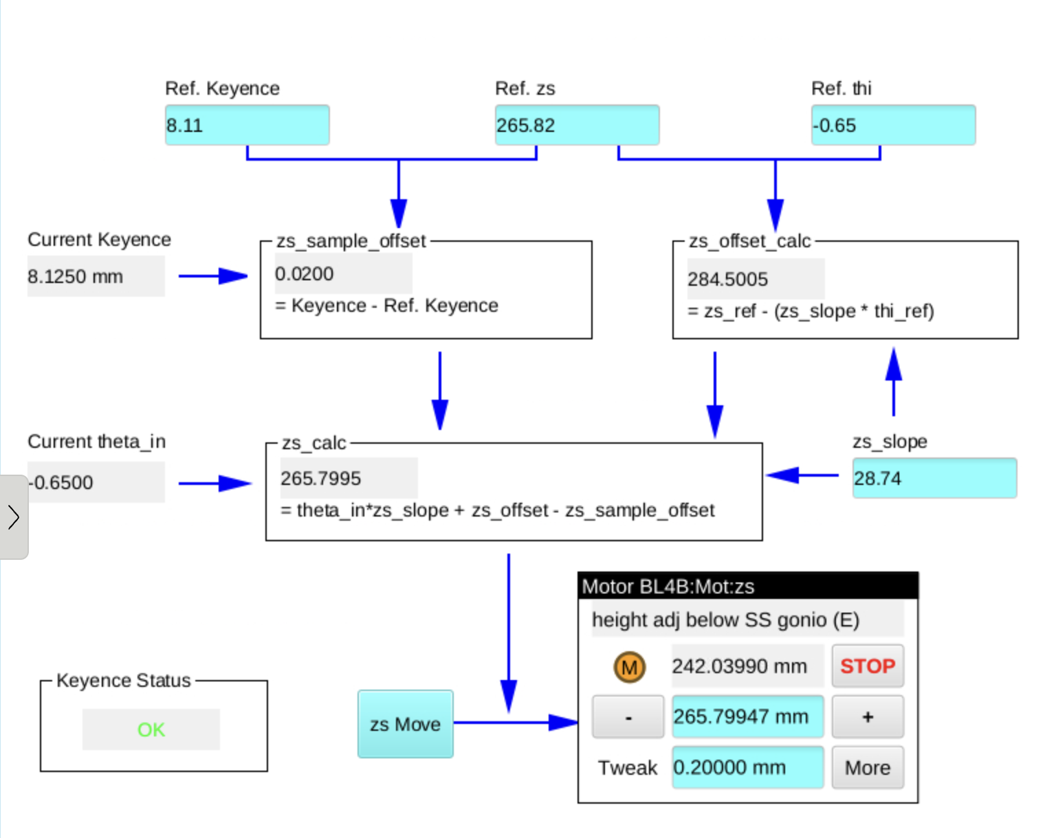
Challenges: REF_L Keyence Rangefinder Integration
Laser Rangefinder to determine liquid surface
2025-06-06 Project Entered
2025-09-25 Discussion
Experiment Date assigned
Developer assigned
2025-10-09 In Test
2025-10-15 In Use
2025-10-17 Completed
Notes:
Example of a challenge that ended in a success and achievement
Some challenges arose in testing due to behavioral discrepancy just prior to use. They got sorted out and it’s was a successful integration! Total development time recorded: 22hrs

Slide 14
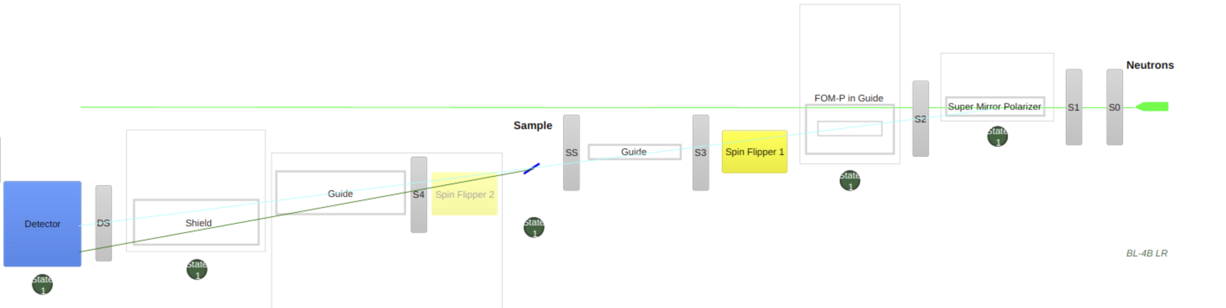
Challenges: REF_M reproducibility (pol/non-pol)
Motion Control Electronics (MCE) Refresh at REF_M
Solve instrument configuration repeatability issue
Problem: switching from polarized to unpolarized mode requires 1-2 days of instrument re-alignment due to non-repeatability, aging control hardware*
Control system struggles with coordinated movements at this scale…
Progress: refresh of MCE, careful reprogramming and extensive repeatability tests
(*) True nature of the root cause is currently under investigation as part of the MCE electronics refresh
Notes:
Example of more complex DAQ-side challenge
Instrument team records that the reproducibility became an issue in 2017 following the control system conversion…

Slide 15
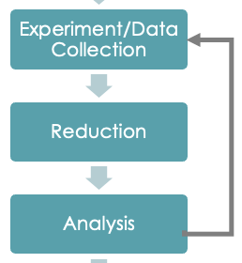
Challenges: Reduction
Instrument staff is heavily involved in reduction
Generally, reduction is complete by the end of the experiment
Partial reduction with instrument staff support is enough to guide the experiment along
Goal: reduction step to be seamless
high throughput, no problems in reduction
reduced data is available continuously and correct
Notes:
Key points: often its IS that is heavily involved in reduction process. Also who is doing it and how long it is taking. Positive: what our plan is. We have a plan, bigger picture of why we need to solve the problem
There are several cases where we are doing the loop – not really the data we will act upon, but its close enough to guide us (better confidence)
Whole theme about the loop (if that loop is seamless – instrument running fast, high throughput, no problems in that loop, must be flawless – then the AI can accelerate it…)
Scientist is an educator – teaching the technique, but hampered by issues in the reduction codes. 1st intro in person is much better than in teams later
If were really next on the list – talk about possibility of a requirements document to get that level of support from the software engineers. This gives the team a lot of hope. We want the review committee to latch on and tell them “you have to invest in this”…

Slide 16
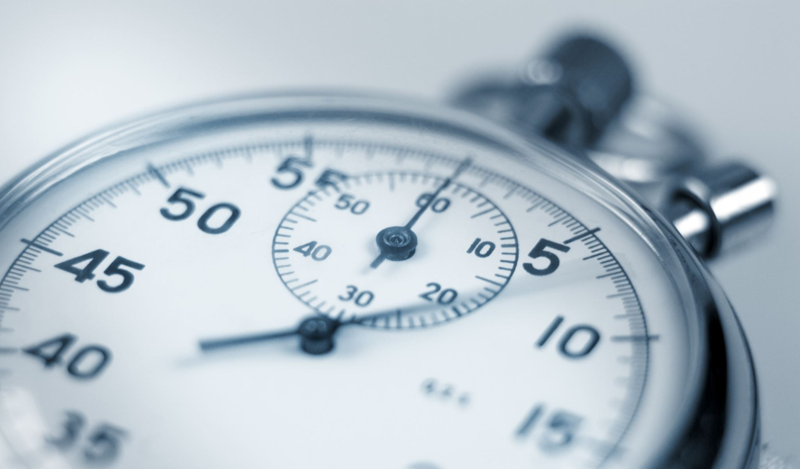


Challenges: Cybersecurity patching causes glitches
Cybersecurity requires monthly updates
Frequent [documented] breakage that requires efforts on the part of instrument staff
Our software is too fragile to cope with this condition at the moment
Solution: verify proposed patches in advance of deployment
Patching of development DAQ machines occurs 1 week in advance of deployment
Data acquisition and Reduction software need automated validation testing on these systems
Progress: Virtual Twin, Automated reduction and comparison with “golden” datasets
Notes:
Stock image(s)
There is some “friction” with the current Redhat Support Model: we do not pay for workstation licenses, so we are not entitled to our own patch schedule – the patching process gets “whatever” the RedHat versions are on the date/time of the patch operation. Discussions with the Linux team have indicated that there are options, but they require more $$$ or complex configurations to achieve.

Slide 17
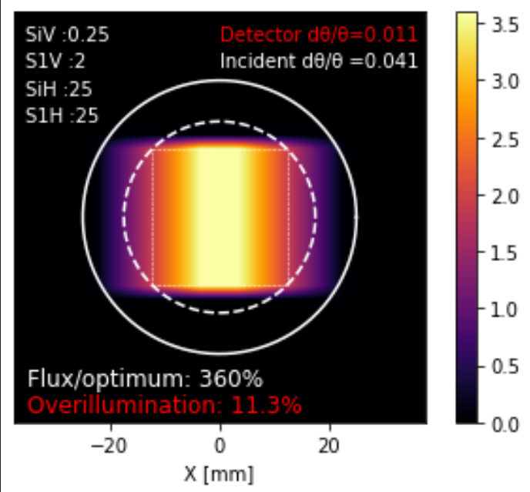
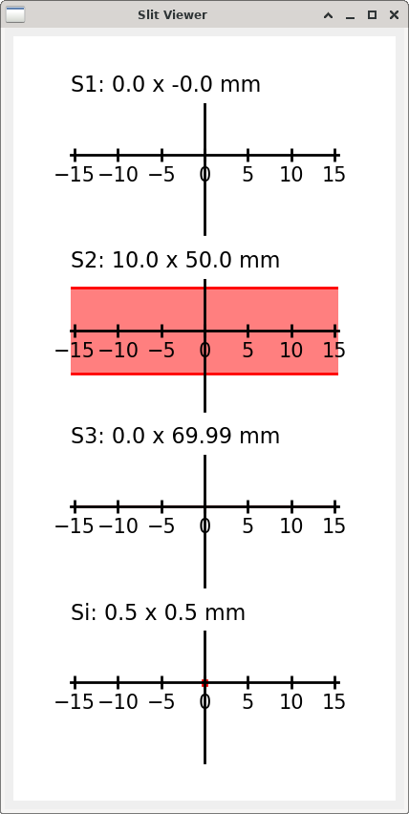
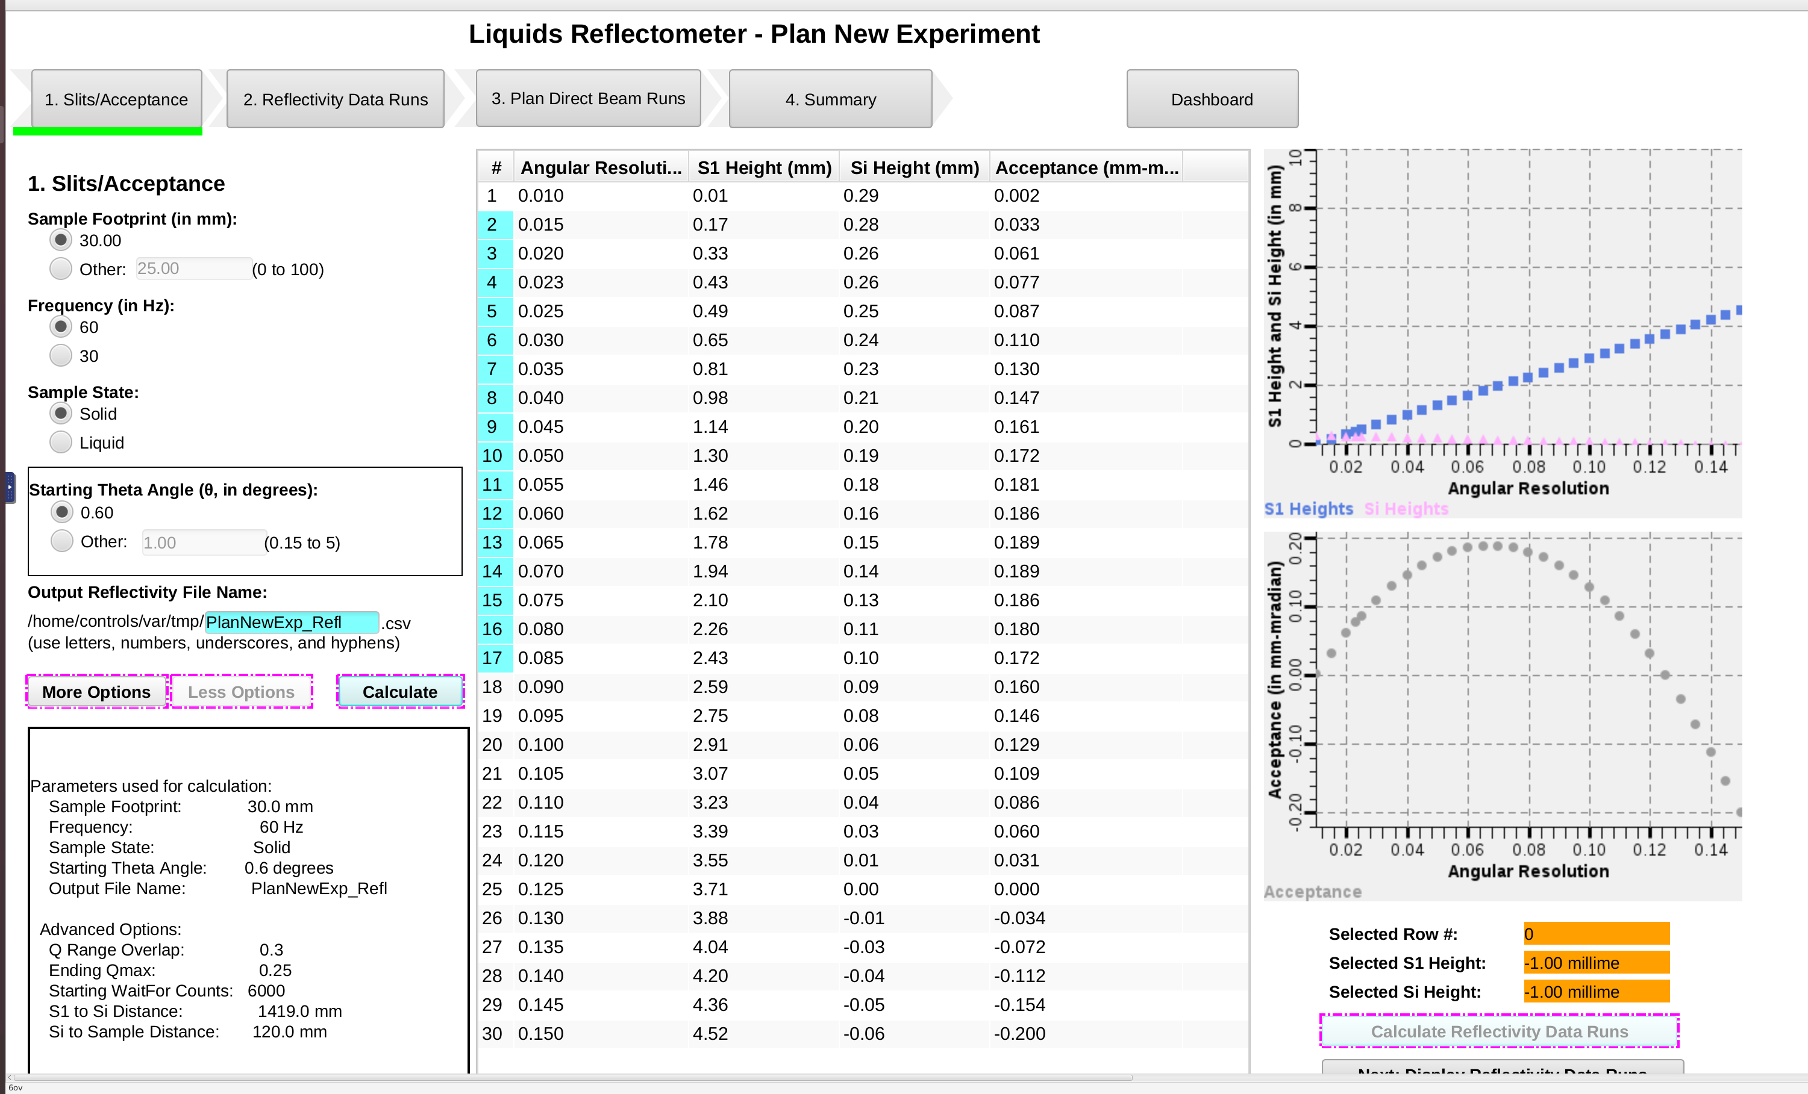
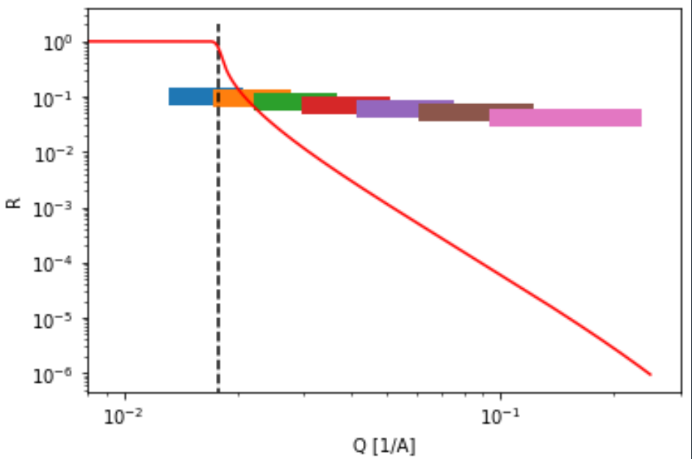
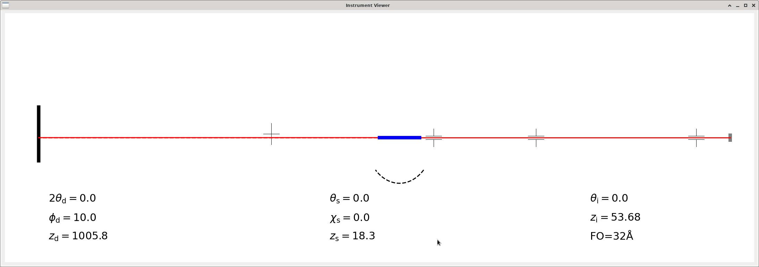
Near term Future Development: REF_L DAQ
Integrating “2D” Detector operation into UI
Standalone python scripting in regular use for 2 cycles
Cd filters for direct beam attenuation (commissioning in 2026A)
Beam footprint calculator
New alignment method (chi motor, solid theta motor alignment, …)
Notes:
Erik left a thread – here is where we are in the technique – demonstrated that, now 2yrs and are going to be integrating these tools in to roll out to users.
Started from nice workflows and tools and a good user experience. Now the focus is to get these new flexibilities are integrated into a nice workflow again (see upper right plot)

Slide 18
Mid term Future Development
Improve live data reduction
Eliminate elements that make the software fragile
Complex configuration files
Complex pre-existing/assumed values
Improved testing of reduction codes
daily automated reduction that compares outputs of deployed codes with established known-good
Notes:
Important part of this is that it’s about improving the live data reduction. Step back from the details and think at long term levels. Keep going back to the feedback loop motif.

Slide 19

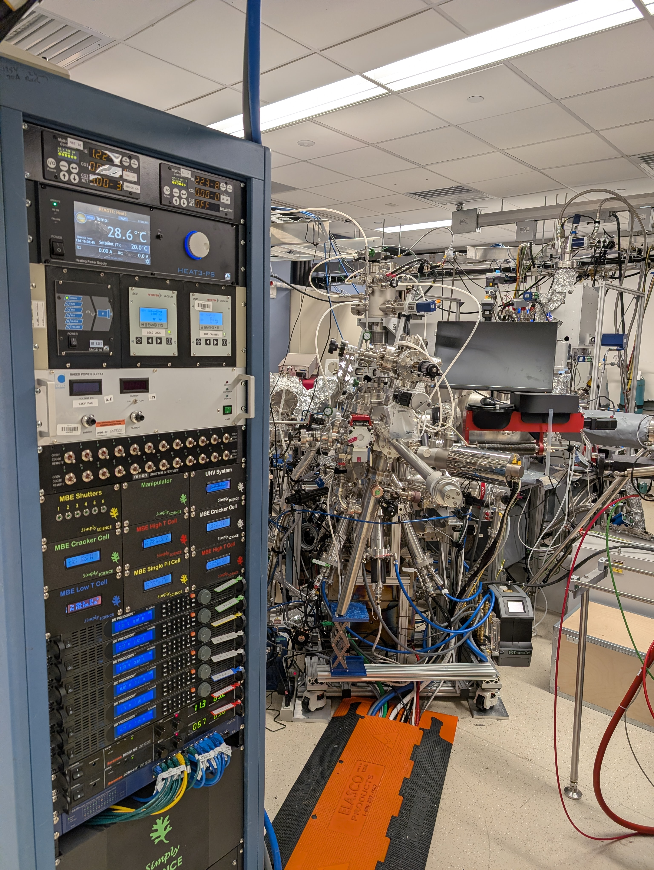
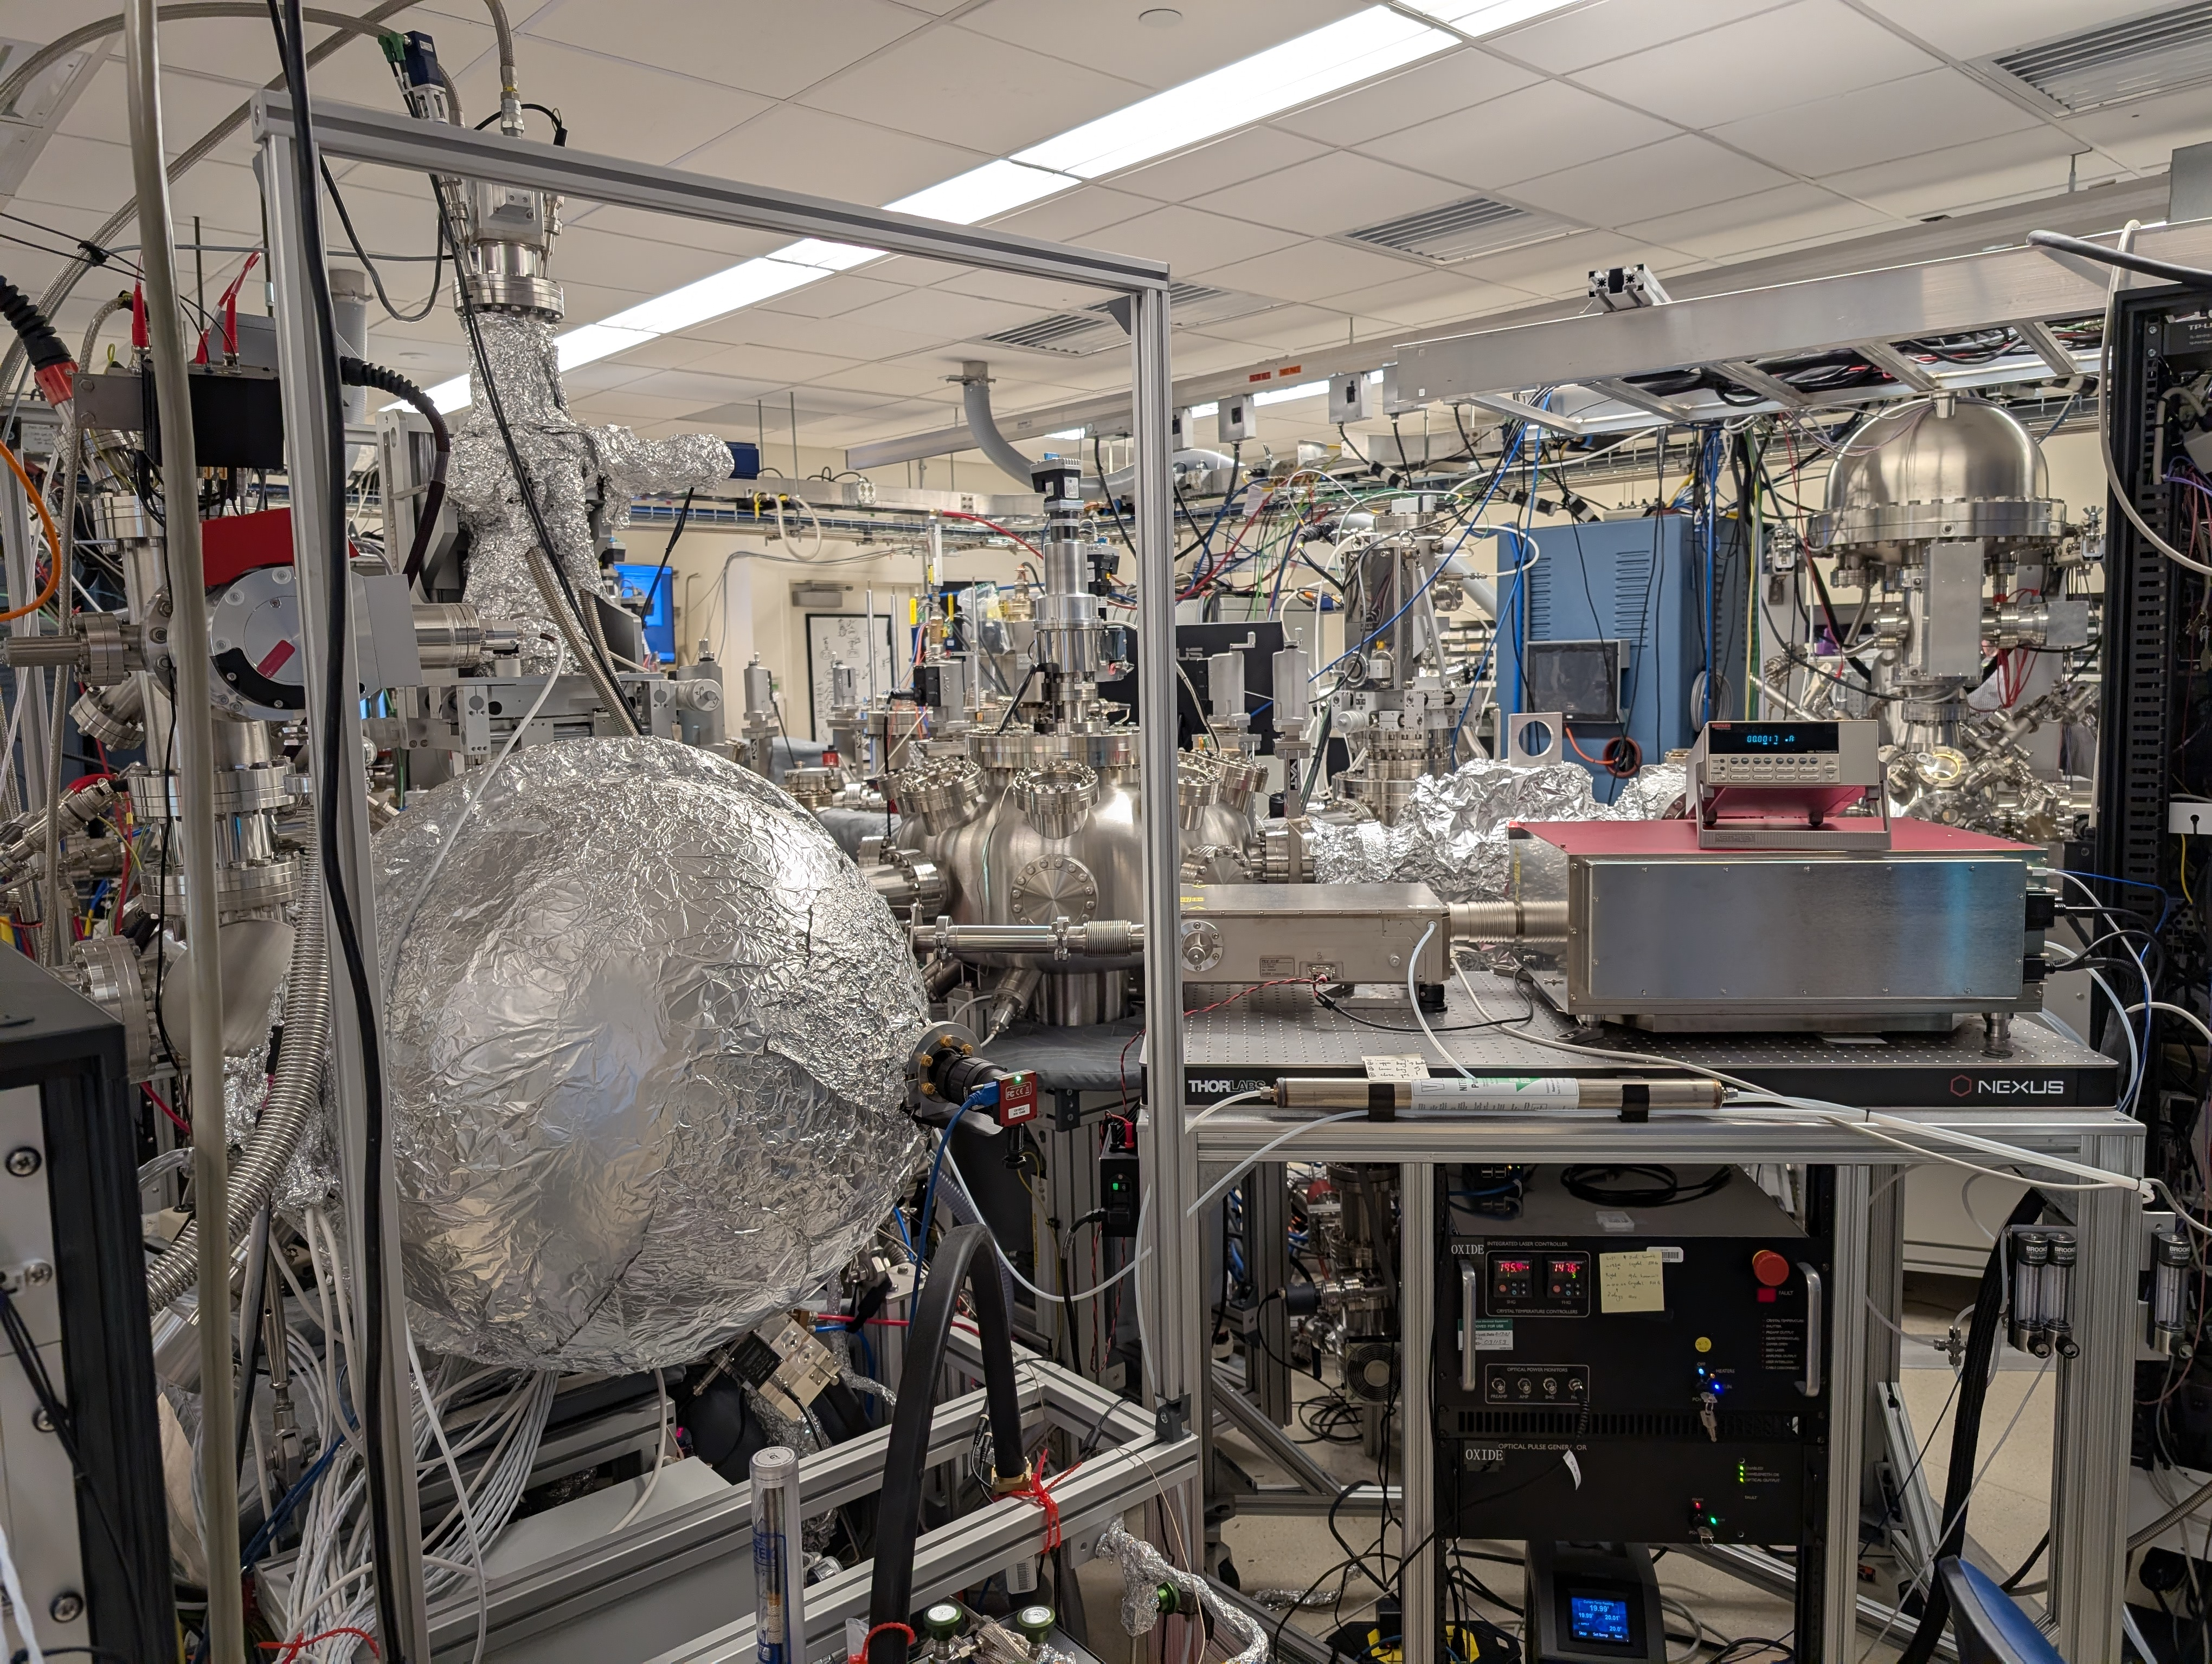
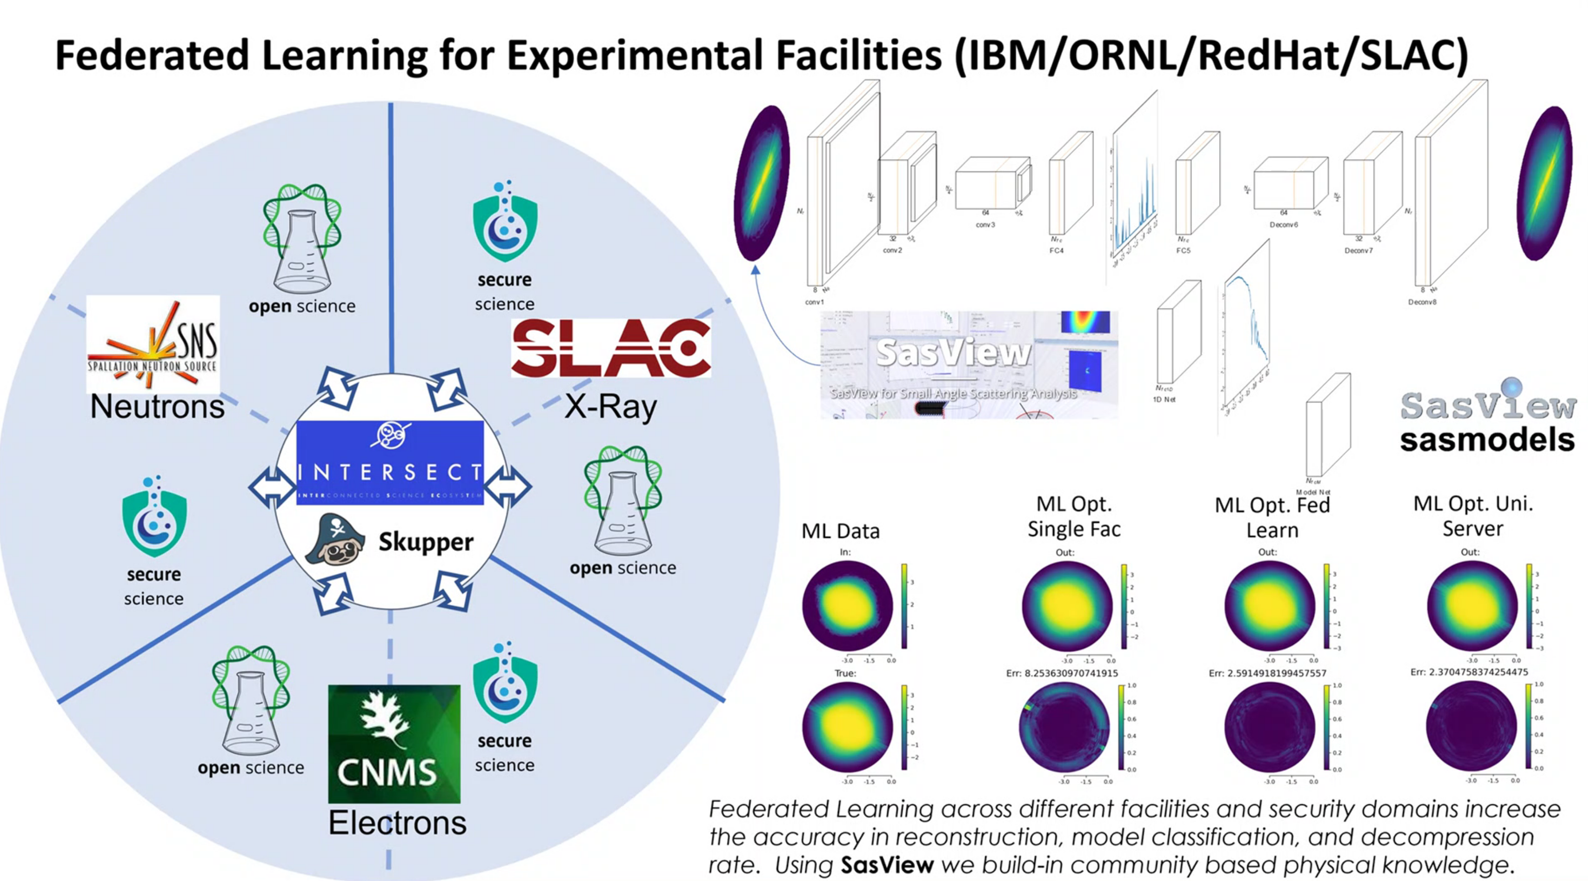
Laboratory Directed Research and Development
“Materials by Design”
Predictive Theory
Autonomous Synthesis
Multimodal Characterization
Agentic AI determines next steps based on results
Molecular Beam Epitaxy
Angle Resolved Photoemission Spectroscopy
X-Ray Diffraction
Polarized Neutron Scattering
Validation
Notes:
Every software part of this system is generated with AI assistance: the control of the MBE are all Raspberry-PI components with digital/analog conversion hats and control software written in conjunction with ChatGPT.
It is a requirement of the project to use AI assistance in developing the codes used.
TODO: add feedback (vacuum) and theory inform loops (make it clear not in tight loop). Part is to verify theory of distribution of magnetism of thin film
Image credits: Bogdan Vacaliuc (photos), Intersect presentations,

Slide 20
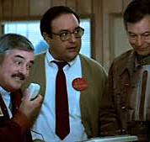
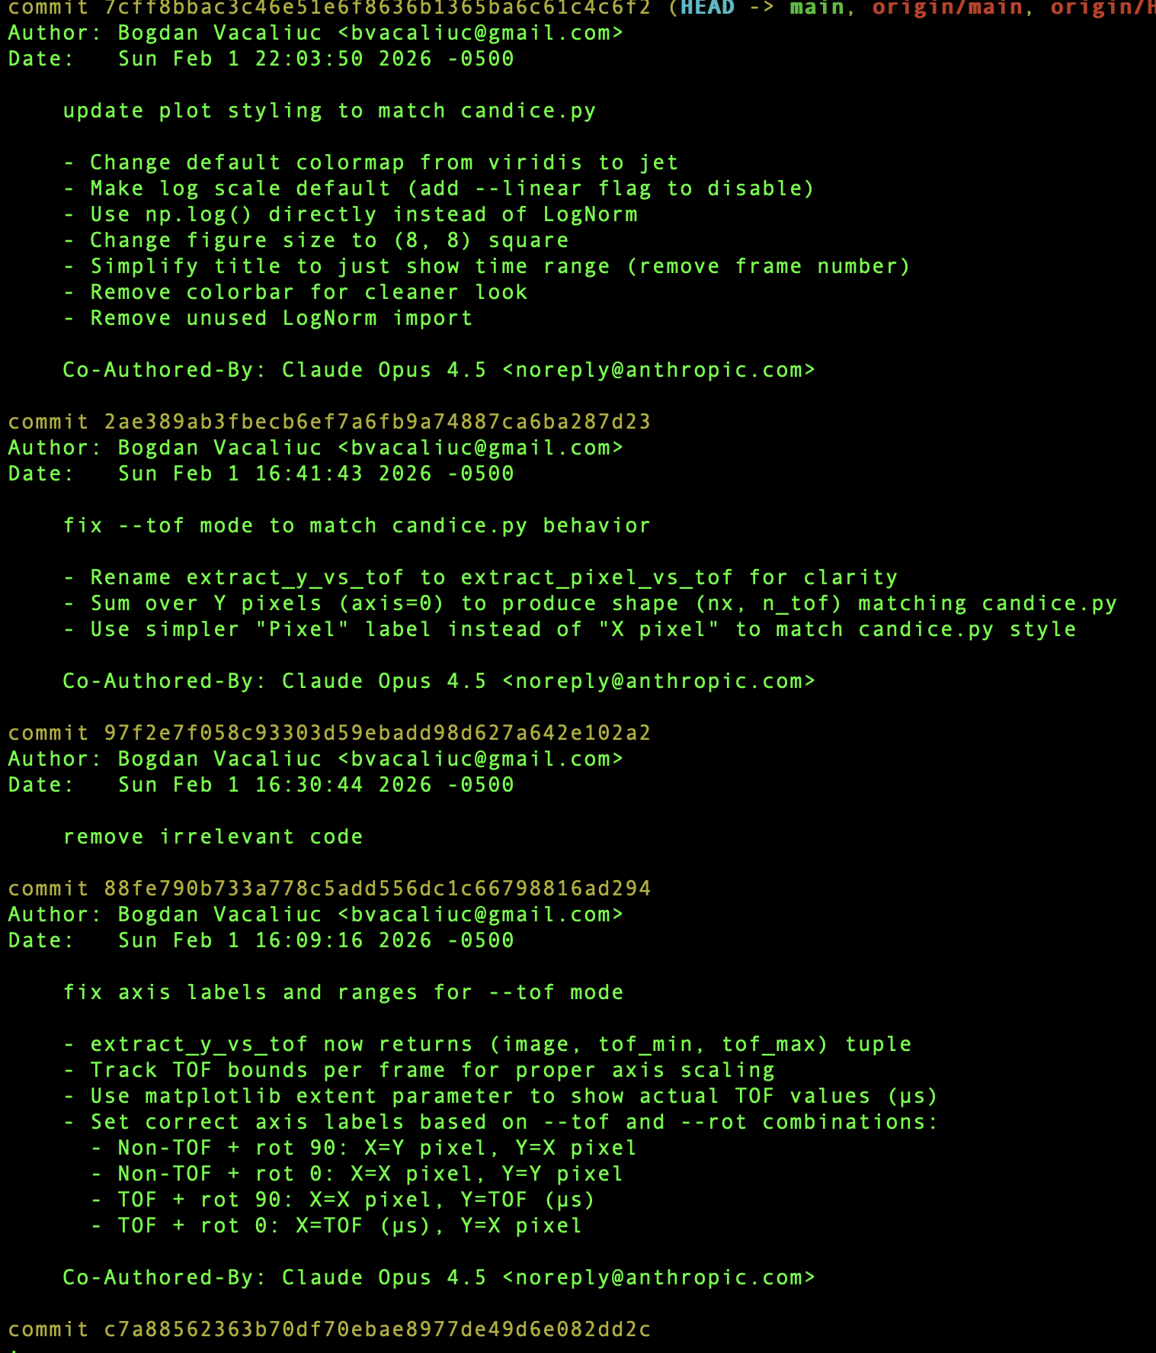
Research / Development Plan
Agent AI augmented software development
Successful Examples
Movie generator for scattering with T dependency
Refactoring of control interface for RHEED* device
QuickNXSv1 adaptation
Solve constraint layer modeling in Refl1d
(*) Reflected High Energy Electron Diffraction
Notes:
go/no-go decision on QuickNXSv1 adaptation once this pilot project results are demonstrated
Put movie into extra slides
Image Credit: https://deanhallpass.wordpress.com/2013/08/29/hello-computer/ (scotty), Copyright Paramount Pictures, acceptable under fair use principles

Slide 21
Summary
Reflectometry software has a vision
Improving Reduction is central
Investment at ~20FTE is requested
Notes:
Does agent AI live up to promise of 5x productivity gain? Still need 4FTE in that case…
Do we hope to get half of what we ask: 10FTE (2 FTE+agent AI)?

Slide 22
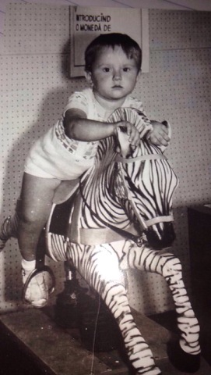
Acknowledgements
Software: X. Geng, K. Gofron, R. Gregory, G. Guyotte, J. Kohl, B. Krishna, M. Ruiz-Rodriguez, A. Sobhani, G. Taufer, Z. Thurman, K. Vodopivec, M. Waddel
Computing aka Linux Team: M. Bedynek, B. Conway, R. Crompton, J. Hale
Computational: M. Doucet, M. Guthrie, A. Hicks, M. McDonnel
Scientific: R. Anderson, T. Charlton, G. Ehlers, E. Watkins
DAQ Hardware & Firmware: B. Avery, M. Bobrek, O. Fajardo-Osorio, S. Giles, P. Hansen, M. Harrington, H. Harvey, S. Hicks, C. Ndo, S. Wall
Detector Hardware & Firmware: J. Beal, V. Sedov
Mechanical: C. Sabens
This manuscript has been authored by UT-Battelle, LLC, under contract DE-AC05-00OR22725 with the US Department of Energy (DOE). The US government retains and the publisher, by accepting the article for publication, acknowledges that the US government retains a nonexclusive, paid-up, irrevocable, worldwide license to publish or reproduce the published form of this manuscript, or allow others to do so, for US government purposes. DOE will provide public access to these results of federally sponsored research in accordance with the DOE Public Access Plan (https://www.energy.gov/doe-public-access-plan).
Notes:
From the 2024 November Friday Forum.
Added key CIS folks now as well.
Image Credit: Bogdan Vacaliuc, personal archive

Slide 23
Supplementary slides

Slide 24
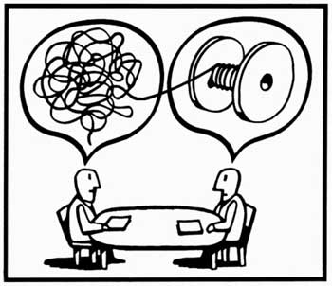
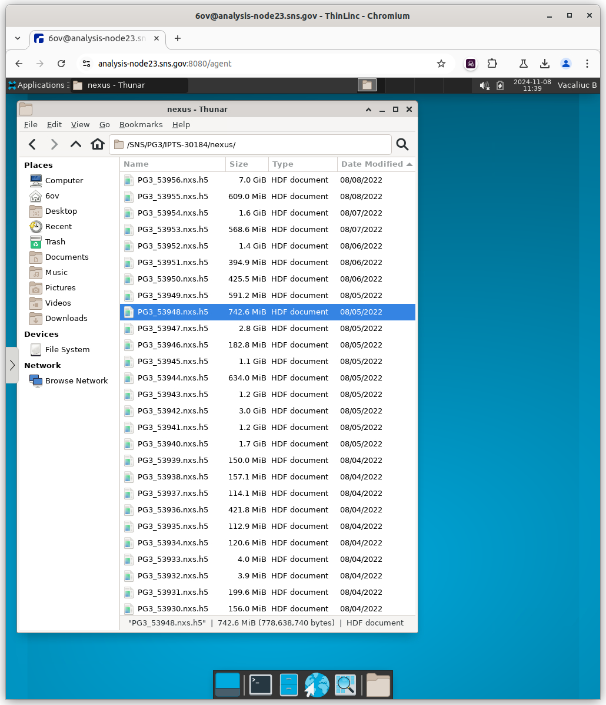
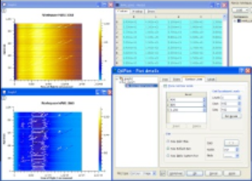
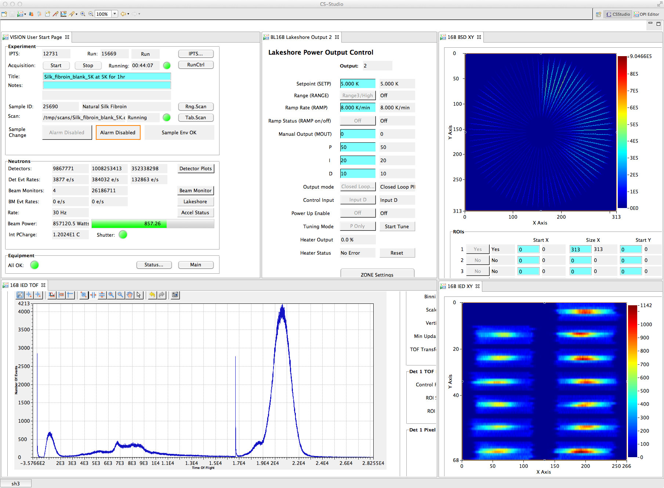
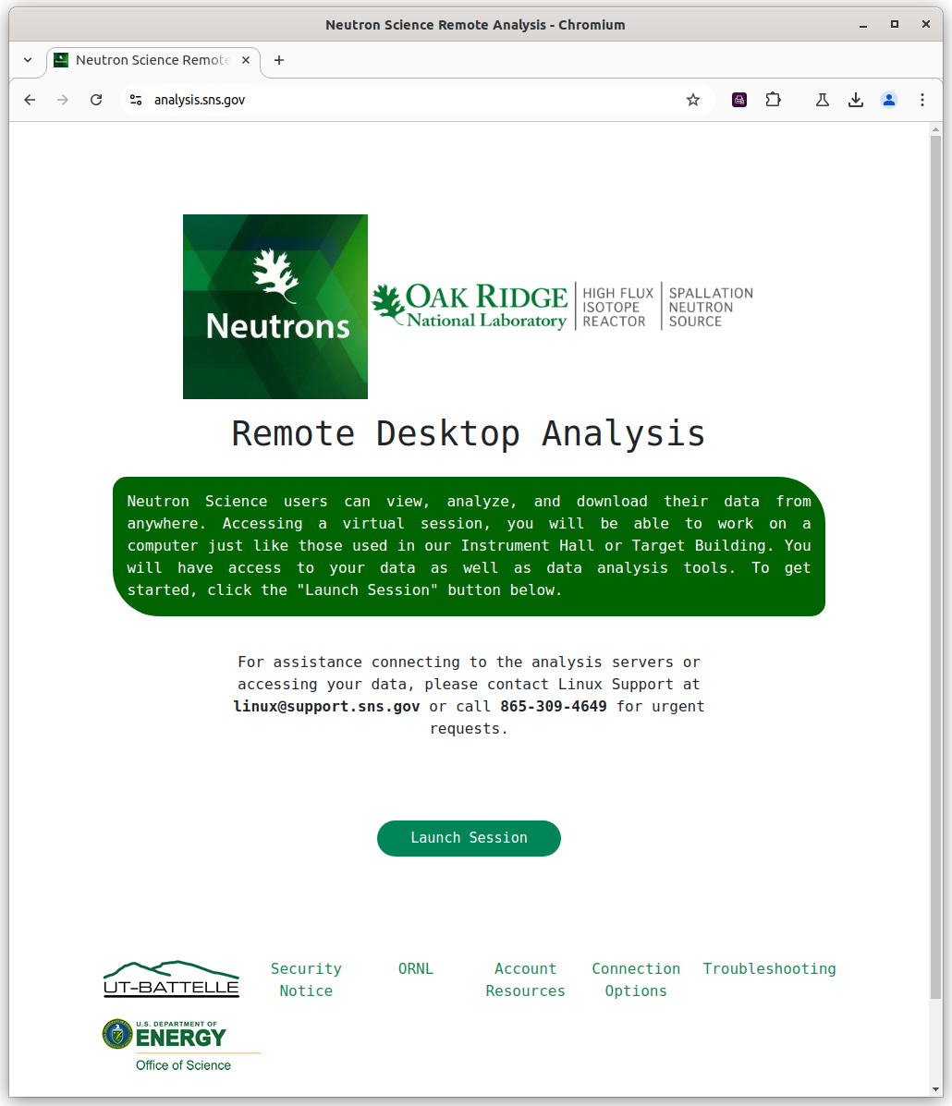
Overall Software Architecture
Detector
Streaming Message Service
nED
Streaming Translation Client
NeXus
HDF5 file with standard structure for neutron data.
PVStreamer
Sample Environment,
Beam Line Equipment
Mantid
Framework
w/AutoReduction
ADnED Neutron Statistics
Service
Scan Server
Beam line Workstations
CS-Studio
EPICS IOCs
MantidPlot
Mantid
ADARA
EPICS
Credit: Matt Pearson
Mantid (Neutron data analysis software)
Notes:
From the 2024 November Friday Forum.
This slide to be adjusted to describe {lr,mr}_reduction, quicknxs and refred

Slide 25
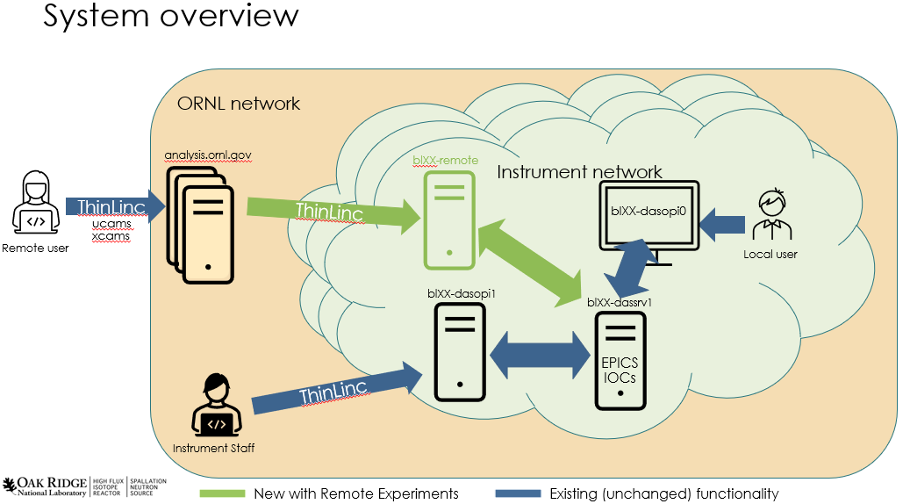
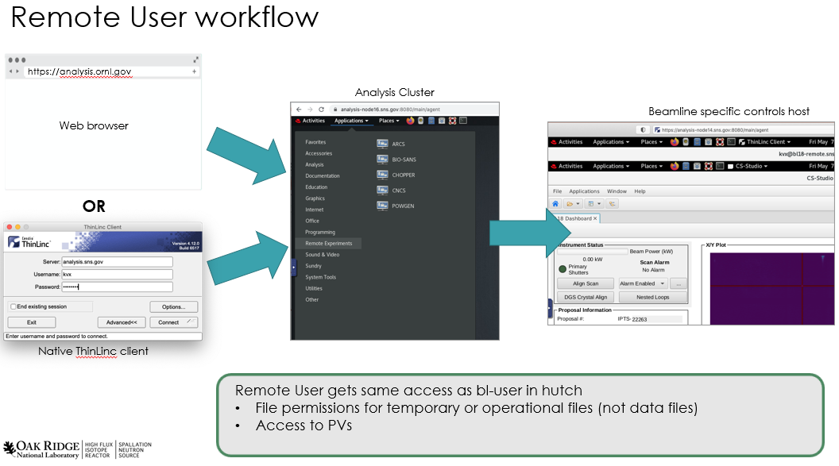
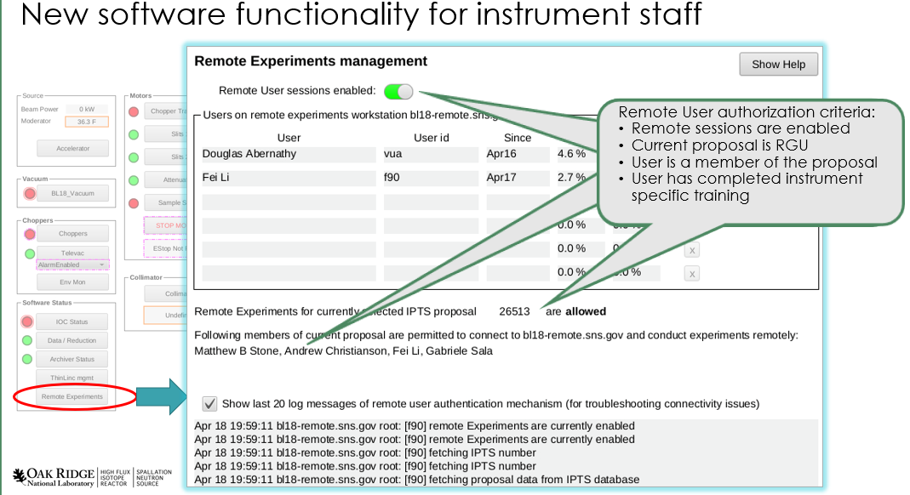
Remote experiments successfully deployed on all beamlines
Credit: Harley Skorpenske, Janell Thompson, Klemen Vodopivec, Jaimie Werner and David Cashion
Accomplishment
Directorate goal achieved: remote experiments deployed on all beamlines in the user program
Significance
Allows external users to control experiment as if they were at the beamline
Instrument Teams control access in real time with EPICS IOC tools
EPICS infrastructure installed on SpICE instruments, enables hybrid EPICS/SpICE functionality
Notes:
From the 2024 November Friday Forum
Developed during the pandemic years 2020-2021
Call out: flexibility to local users to not have to spend night at the beamline, increase size of experiment team [sentence or two]
Mention how many people in directorate participated to make this possible: user management, training, sample handling. Very much a whole-facility effort.

Slide 26
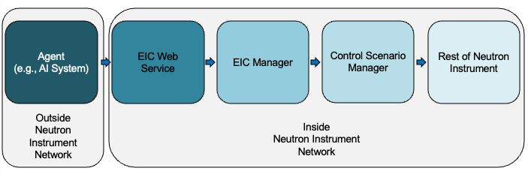
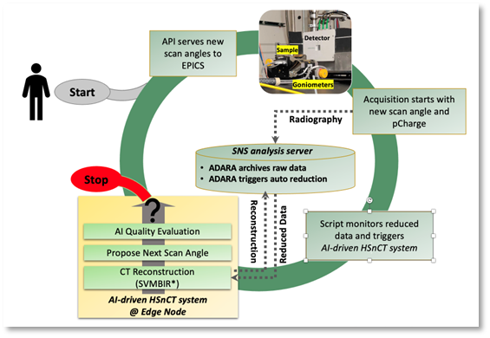


AI/ML closed loop experiment steering framework developed
External Instrument Control (EIC) enables automated control of experiments from a location beyond the extent of the instrument’s own network
Authenticated
Observable
Enables streamlined Advanced Computing collaboration
Credit: Ray Gregory, Jean-Christophe Bilheux
Notes:
From the 2024 November Friday Forum.
Built upon the implementations of ScanTools, EPICS, and the core instrument control system architecture at SNS+HFIR
Allows for *SAFE* manipulation of the instrument control system by arbitrary software *OUTSIDE* the beamline control system using a series of indirect operations. Changes to the ICS are "suggestions" that can be acted upon by automation processes withing the beamline control system that determine if the changes are a) safe, b) appropriate, c) authorized.

Slide 27












Network Fiber (25-100Gbps)
EPICS PVs
Network Cat5 (1-10Gbps)
Data Fiber (2.125Gbps)
PCIe over Fiber (2.5Gbps)
DETECTOR
OCP3.0
DPU Card
(2 port)
PCIe
DPU Card
(2 port)
nED
PCIe
SMS
Switched Network
PCIe
Modular DSP
CTRL/
STATUS
STC
Analysis
BLxx-daq1
ADARA
Instrument Position Feedback
(drive experiment autonomously)
A30X
Converged
Accelerator
Alternate Ecosystems for DPU/Accelerator
(selection to be determined, pros/cons defined)
PCIe
Direct visualization of
Sample behavior in scientific coordinates
BLxx-ai1
Side-by-side comparison with
modeled behavior and
immediate refinement
10-year Plan
Xiaojian Bai, Et. Al.,"Hybridized quadrupolar excitations in the spin-anisotropic frustrated magnet FeI2", Nature Physics Letters 17, April 2021
https://neutrons.ornl.gov/content/neutrons-piece-together-40-year-puzzle-behind-iron-iodide%E2%80%99s-mysterious-magnetism
Notes:
From the 2024 November Friday Forum.
Didn’t get adapted for reflectivity analysis and detector (but gives an idea of what it could be…)
Desire to show hardware-assisted reduction, analysis and feedback operating *at the beamline* vs. the development of federated and cross-facility efforts also described.

Slide 28

Be a Defect …, Be a Story… [”Data of The Backlog #1”]
For the defects/stories completed in the period, this is the accumulated time in each process step.
The composite of Defect + Story + Task = Accumulated Time
Notes:
Need to add slides

Slide 29

Be a Defect …, Be a Story… [” Data of The Backlog #2”]
Divide total accumulated time by the total number of defects/stories/tasks that completed in that interval
Tyipcal Defect/Story Completion delay approx. 40 days
Notes:
Slide 23 has an alternate view where Accumulated is divided by number of tickets to record mean defect/story/task completion rate.
For periods 3, 6, 9 only defects and stories were sampled (future automation is pending, the graph may be fully rendered by the time of the review…)

Slide 30

Event Movie

Slide 31
LR Analysis Tools
refl1d
Brian Benjamin Maranville, et al. Reflectometry/refl1d: V1.0.1a1. v1.0.1a1, Zenodo, 19 Nov. 2025, doi:10.5281/zenodo.17651288
Integrated with experiment file system and reduced data files produced by both ‘quicknxs’ and ‘refred’
genx
A. Glavic and M. Björck, “GenX 3: the latest generation of an established tool”, J. Appl. Cryst. (2022). 55, 1063-1071, doi:10.1107/S1600576722006653
BornAgain
Pospelov, Gennady et al. “BornAgain: software for simulating and fitting grazing-incidence small-angle scattering.” J. Appl. Cryst. (2020). 53,Pt 1 262-276, doi:10.1107/S1600576719016789
Notes:
G.L Payne, P.L. Von Behren, “Fortran program to calculate finite-range no-recoil DWBA transfer cross sections
“, Computer Physics Communications
Volume 7, Issue 1, January 1974, Pages 13-37, available=http://doi.org/10.1016/0010-4655(74)90054-x, https://elsevier.digitalcommonsdata.com/datasets/y2848yskcp/1

