Slide 1
Neutron Imaging Software
Presented by Jean Bilheux
Computer Instrument Scientist
Feb 3-4, 2026
Notes:
Image - 2021-P09584: Aerial overview of the Spallation Neutron Source, SNS, and the future location for the SNS Second Target Station, September 30, 2021. This image has been reviewed by an ORNL Releasing Official and is approved for public release, September 26, 2022.

Slide 2
Table of contents
What we have now
Process the timepix3 raw data
Data analysis and processing
Notebooks
standalone
Data Visualization
Web Applications
Documentation / tutorials
What we have been doing recently
What we are planning on doing

Slide 3
Table of contents
What we have now
Process the timepix3 raw data
Data analysis and processing
Notebooks
standalone
Data Visualization
Web Applications
Documentation / tutorials
What we have been doing recently
What we are planning on doing

Slide 4
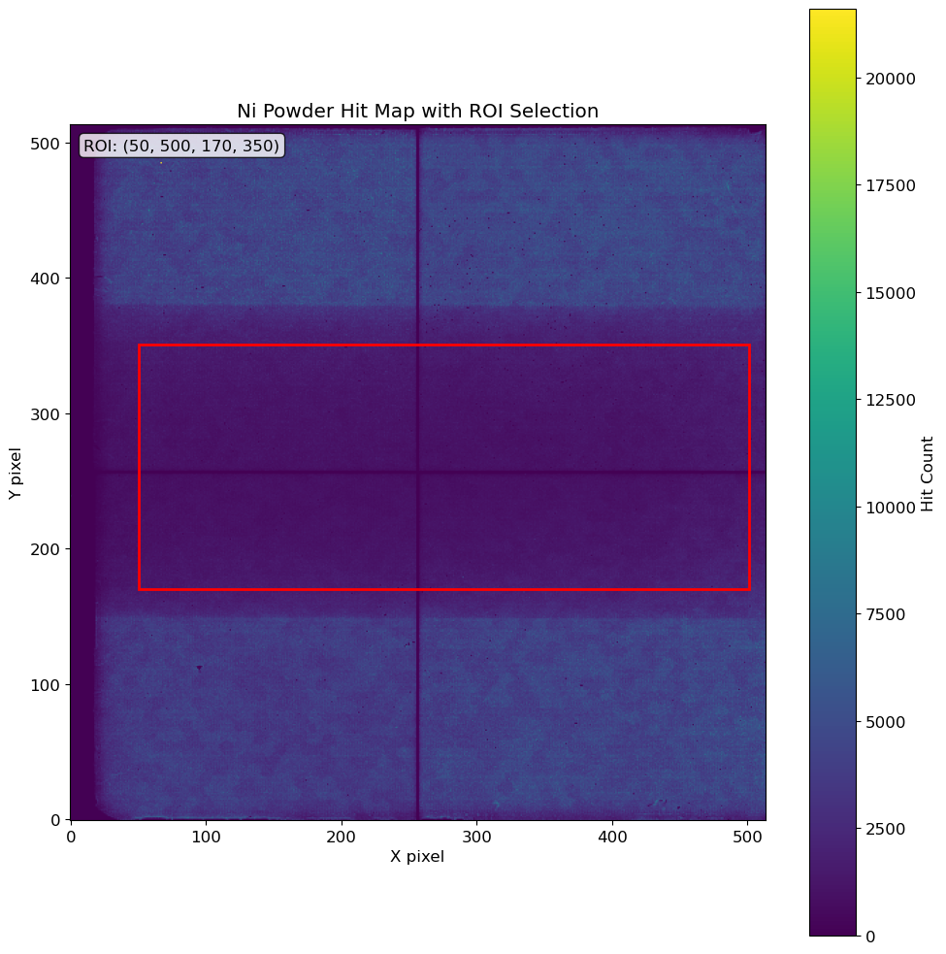

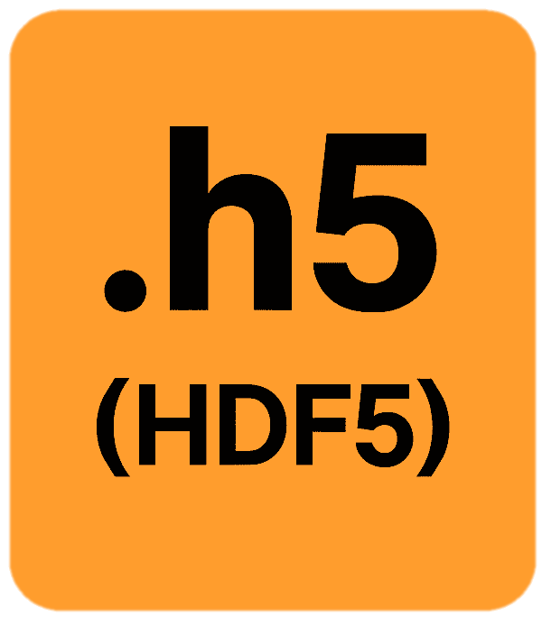
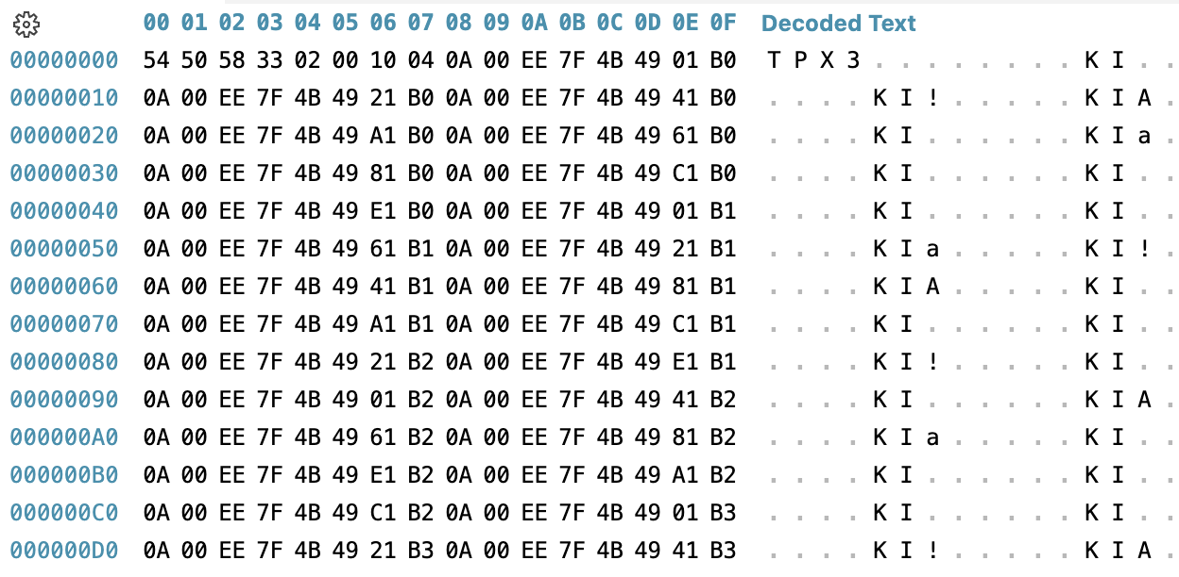
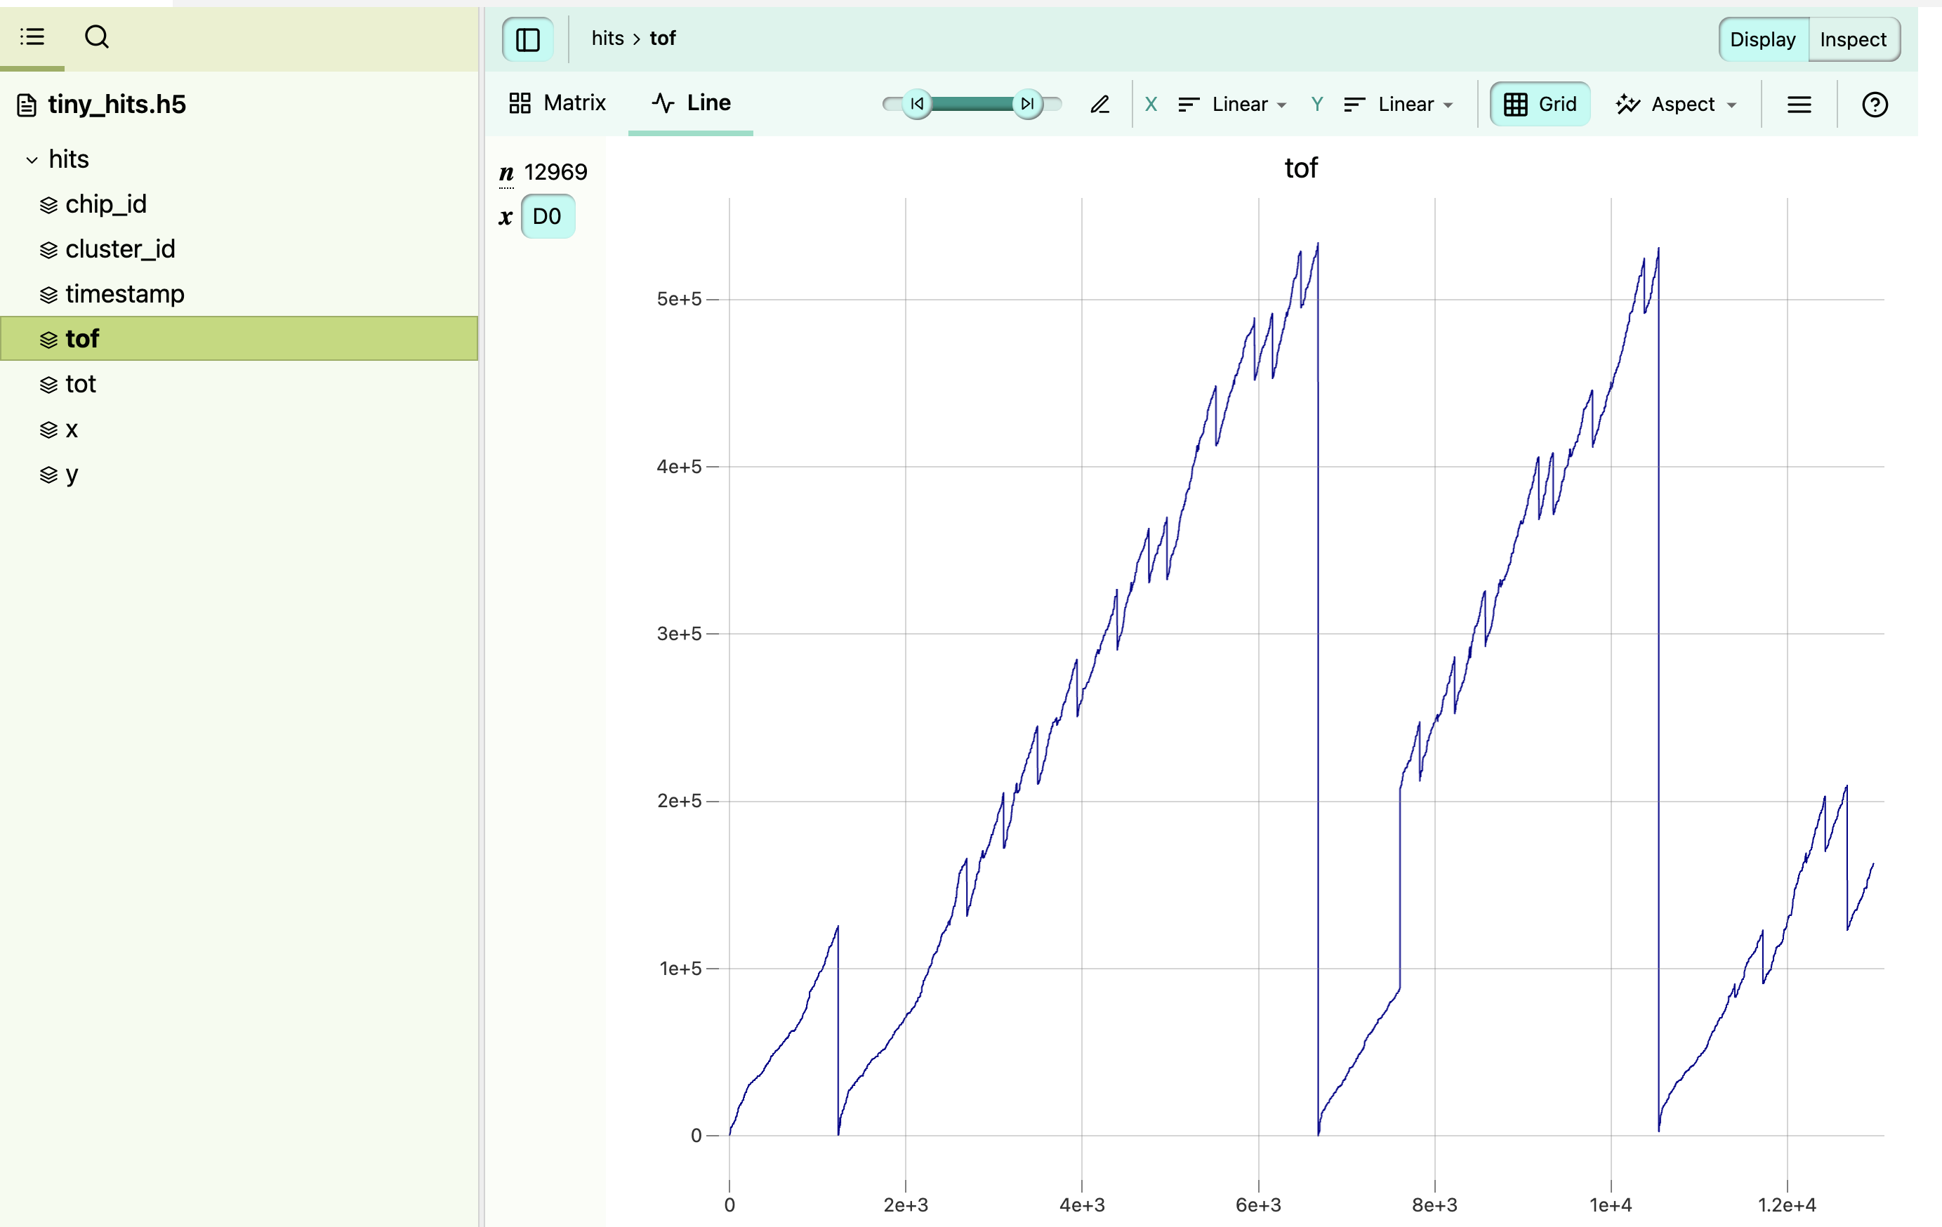
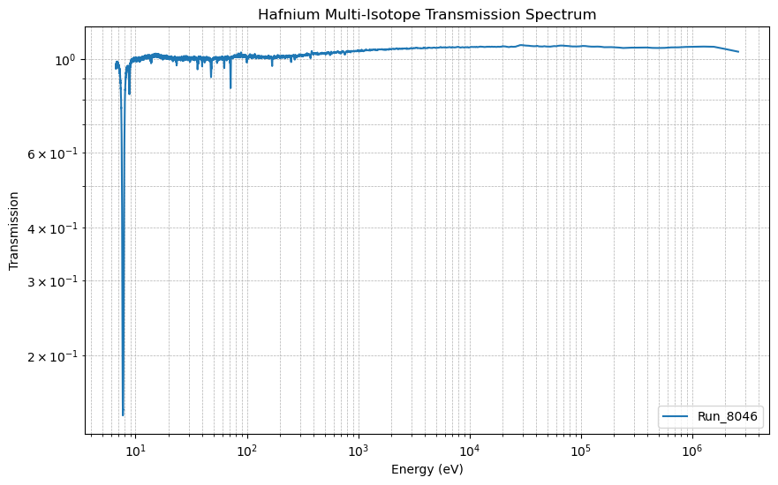
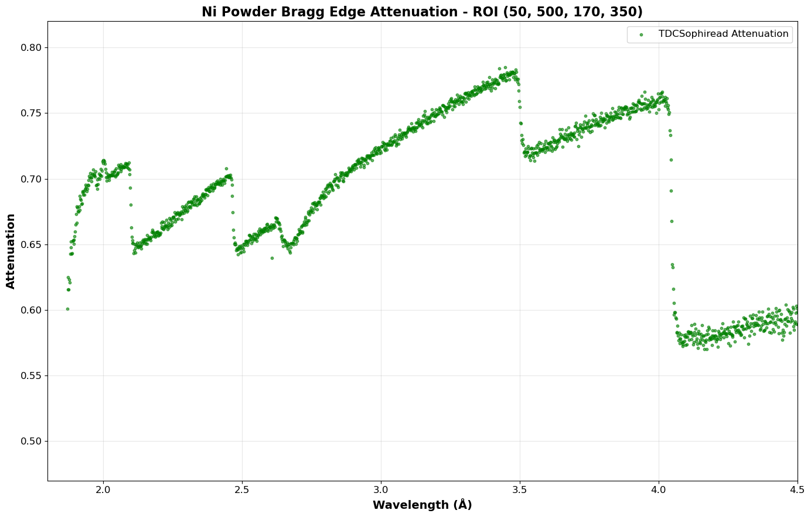
High-Performance Neutron Event Reconstruction
Timepix3 Detector software
Software that convert the binary Timepix3 detector file format into NeXus and TIFF file formats
Resonance
Bragg edge
Production-ready software delivering 96 million hits/second throughput, enabling VENUS to process the largest neutron imaging datasets without hardware limitations.
Notes:
---
OPENING
This slide highlights TDCSophiread, our production-grade data processing software that transforms raw TPX3 detector output into scientifically usable neutron events for VENUS.
---
HEADER TABS - Five Key Features
Five key capabilities define this software:
Extreme performance — processing 96 million hits per second, which is close to VNEUS’s detector’s theoretical maximum data rate (120 mhits/sec).
Hybrid architecture — a C++ computational core for speed, wrapped in Python for scientist accessibility.
Memory efficient — can process files exceeding 500 gigabytes using only 512 megabytes of RAM (bounded memory usage), through intelligent streaming.
Easy installation — available through standard package managers, pip and conda, with no compilation required.
Open and configurable — fully open source under GPL-3.0, with four selectable clustering algorithms for different experimental conditions.
---
DATA FLOW
The challenge we solve starts here. The TPX3 detector produces a continuous binary stream — millions of packets per second of raw bytes that are completely unreadable in their native form.
Each neutron interaction generates multiple pixel hits that arrive out of order and must be reconstructed. Without software to decode and cluster this data, the detector hardware is essentially unusable for science.
TDCSophiread transforms that binary stream into structured neutron events — each with precise X-Y position and time-of-flight — stored in standard HDF5 format compatible with the neutron science ecosystem.
With the neutron events, we can reconstruct multi-dimensional histograms that resolve both energy (tof) as well as spatial features.
Currente usage include neutron resonance imaging and Bragg edge strain mapping.
---
SOFTWARE ARCHITECTURE
At the top, a Python API provides the user-friendly interface that scientists expect — NumPy arrays, command-line tools, Jupyter notebook compatibility.
Pybind11 bindings connect Python to the C++ core with zero-copy data transfer — no performance penalty for the Python interface.
The C++ engine contains three parallel modules:
- A TPX3 parser handling section discovery and timing correction
- Four clustering algorithms optimized for different experimental conditions
- Streaming HDF5 output that enables processing of arbitrarily large files
All built on a parallel foundation using Intel's Threading Building Blocks library, memory-mapped I/O, and cache-optimized data structures.
This is not a prototype script — it's production software built to professional standards.
---
CLOSING
TDCSophiread is production-ready software delivering 96 million hits per second, enabling VENUS to process the largest neutron imaging datasets without hardware or software limitations. The development is a joint efforts between the software development team, VENUS instrument team, data acquisition team, and last but not the least, detector group.
The detector investment is only valuable if we can process its output — this software ensures we can do so at full data rates, with results published to PyPI, Conda, and archived on Zenodo for long-term sustainability.

Slide 5
Table of contents
What we have now
Process the raw data
Data analysis and processing
Notebooks
standalone
Data Visualization
Web Applications
Documentation / tutorials
What we have been doing recently
What we are planning on doing

Slide 6
Table of contents
What we have now
Process the raw data
Data analysis and processing
Notebooks
standalone
Data Visualization
Web Applications
Documentation / tutorials
What we have been doing recently
What we are planning on doing

Slide 7
Jupyter notebooks – What do they do ?
+80 notebooks
Data normalization
Basic data visualization
File Processing
Renaming
Grouping
Dealing
…
Image processing
Combining
Binning
Filtering
….
Data processing
Water intake
Profile
Radial
Linear
Circular
…
Debugging
Browsing / comparing data
…

Slide 8
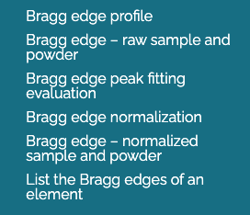
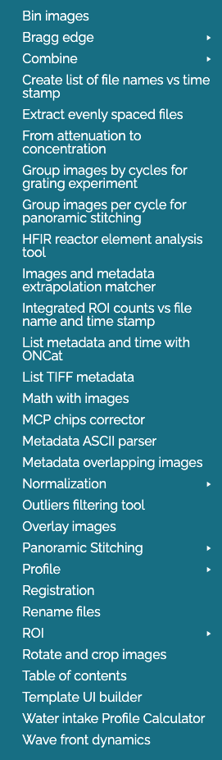
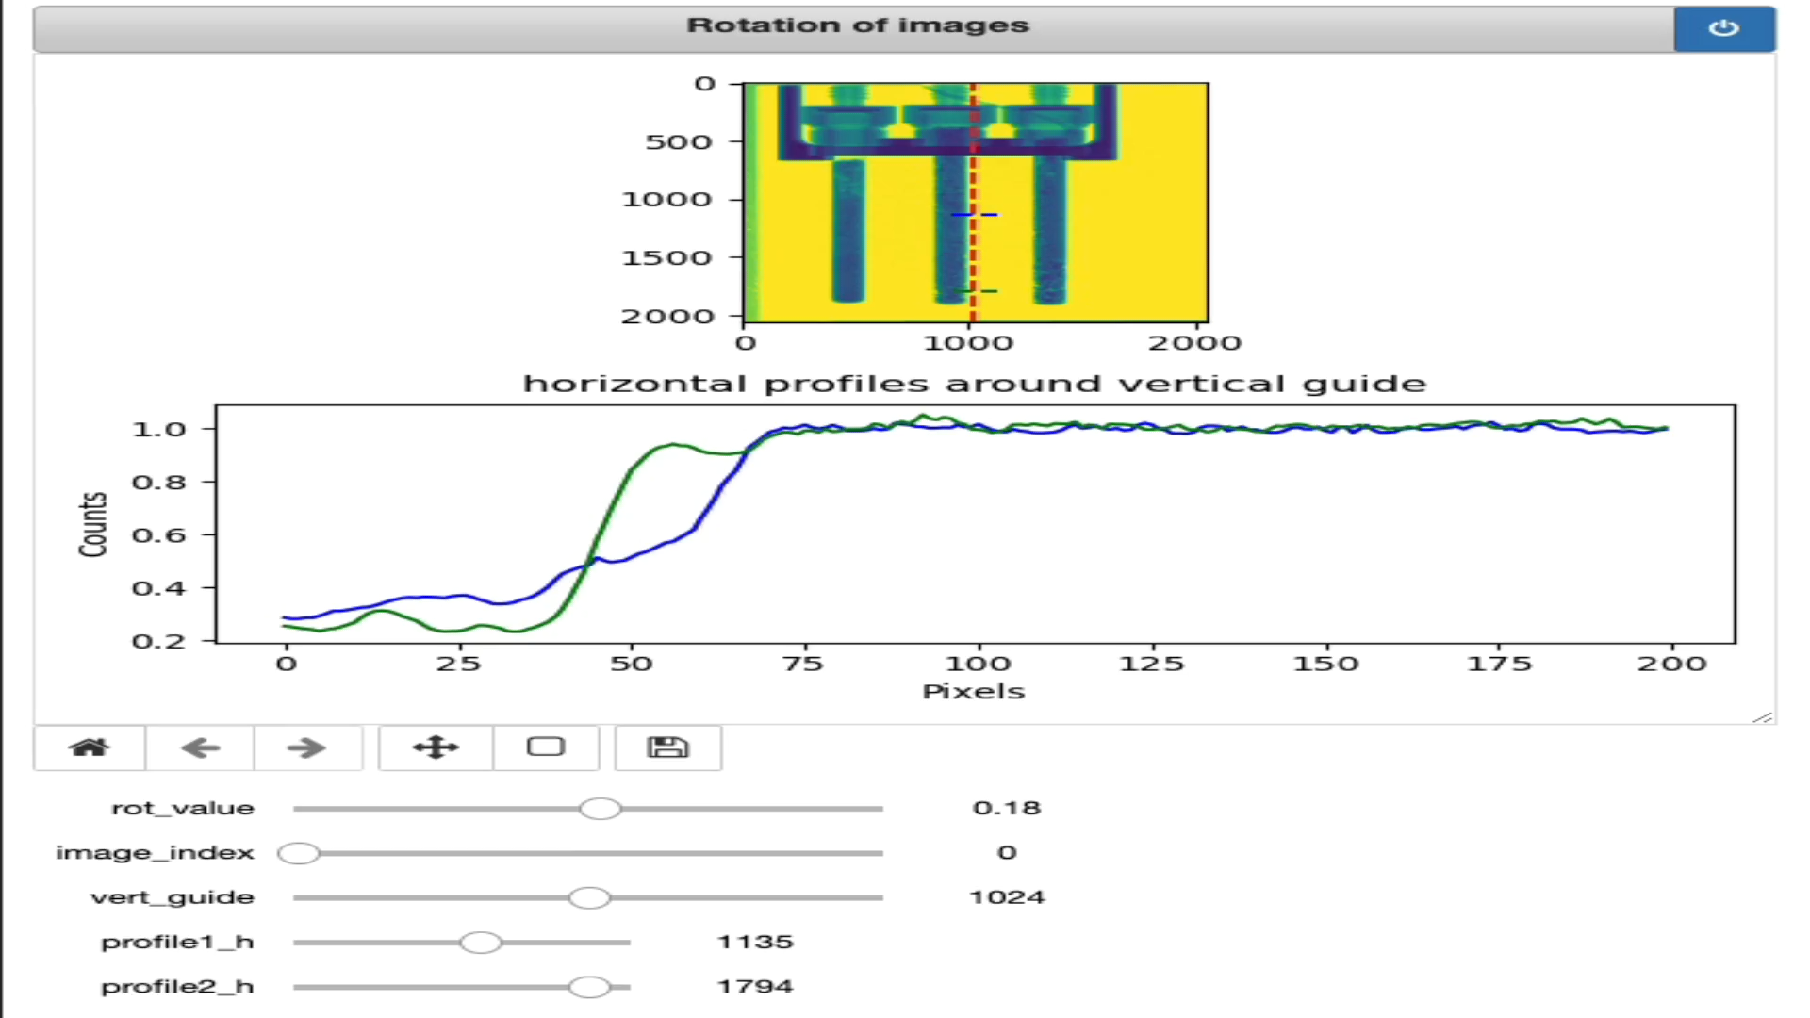
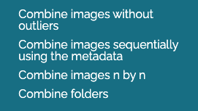




List of our Notebooks

Slide 9
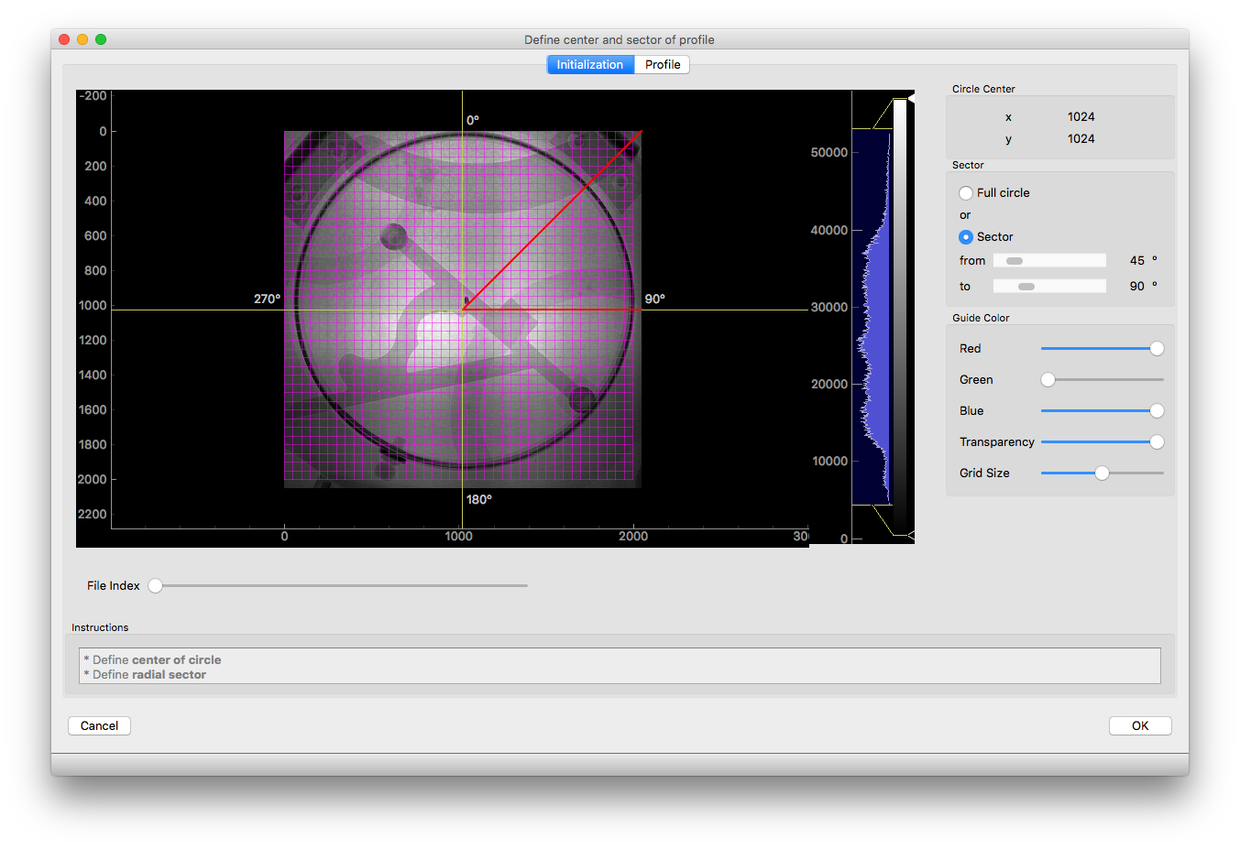
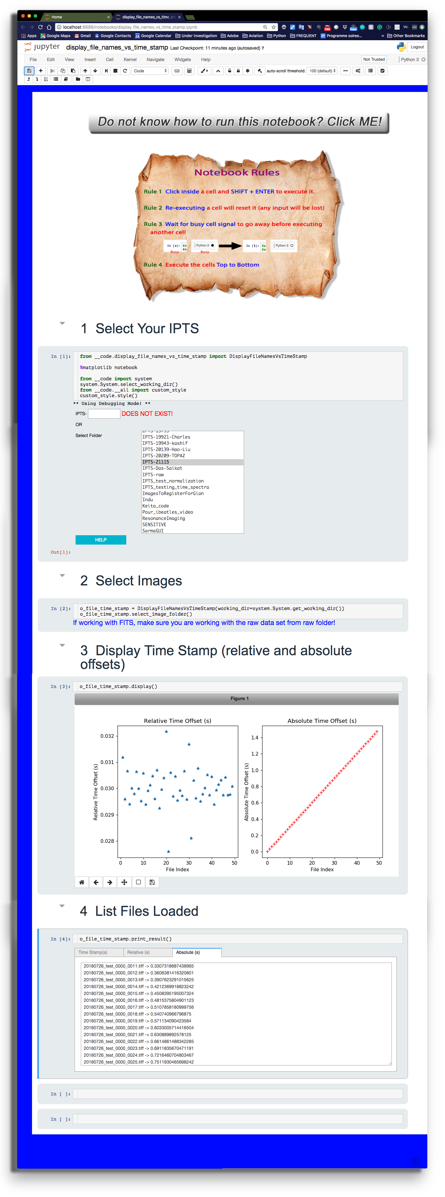
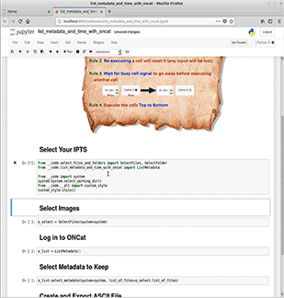
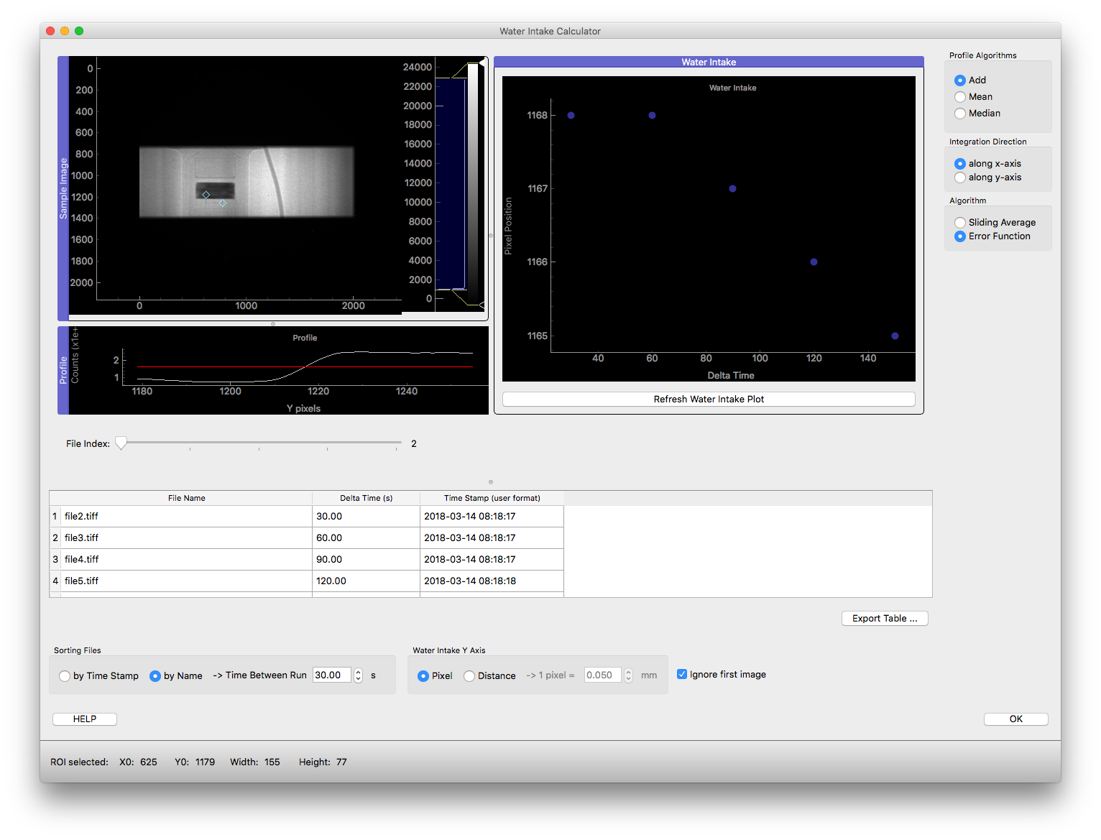
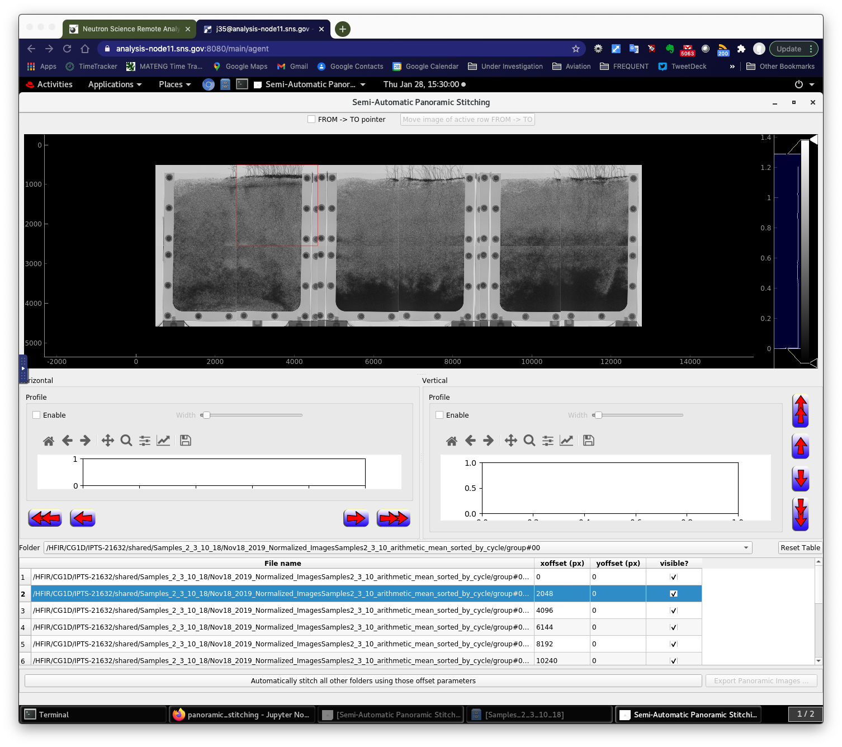
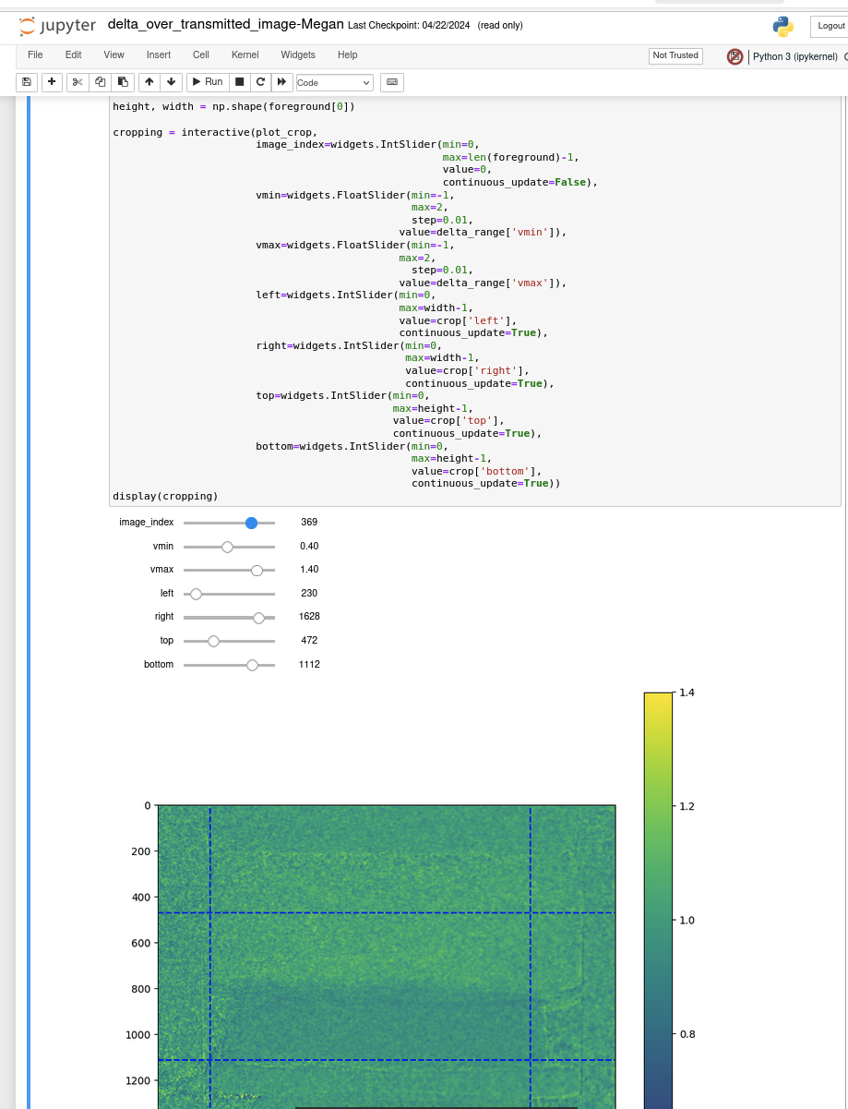
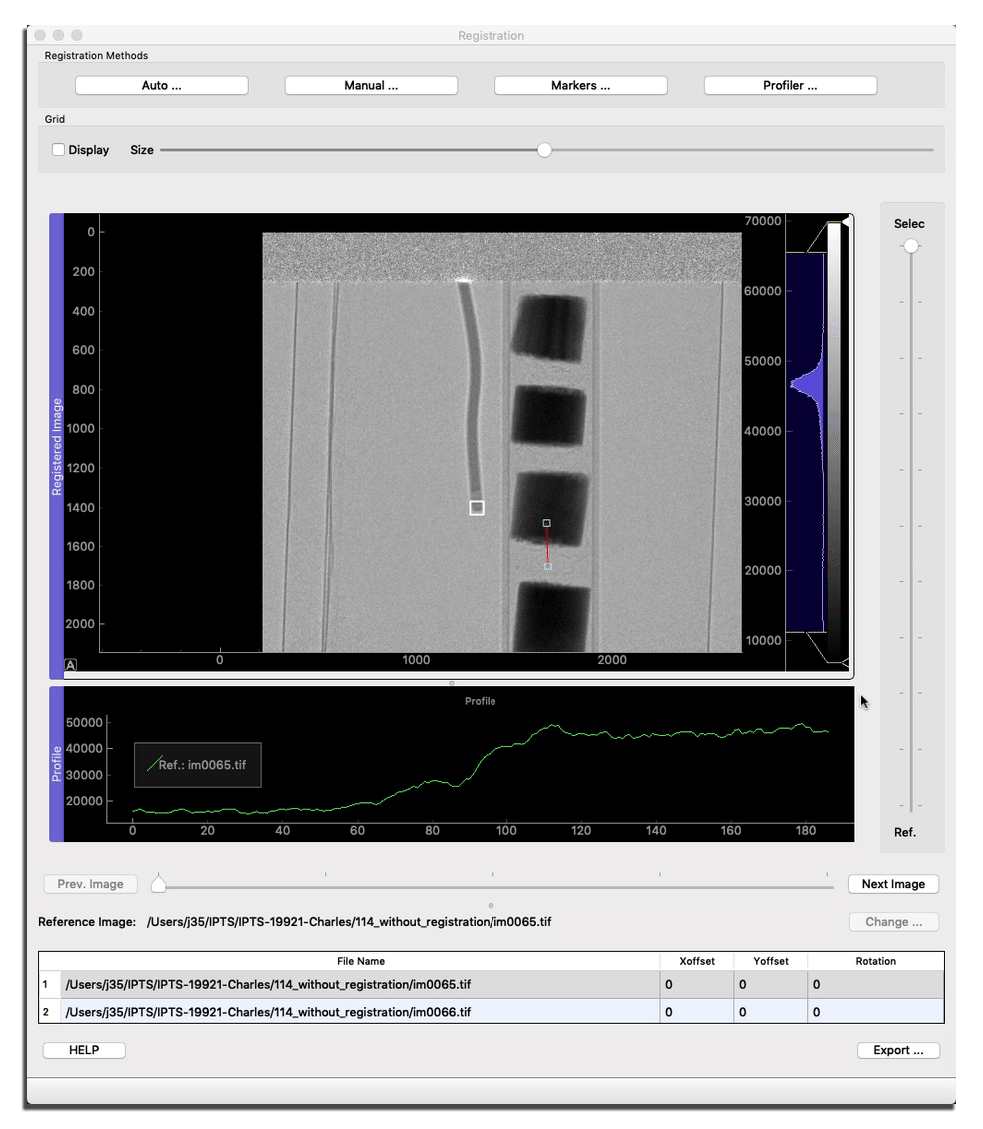
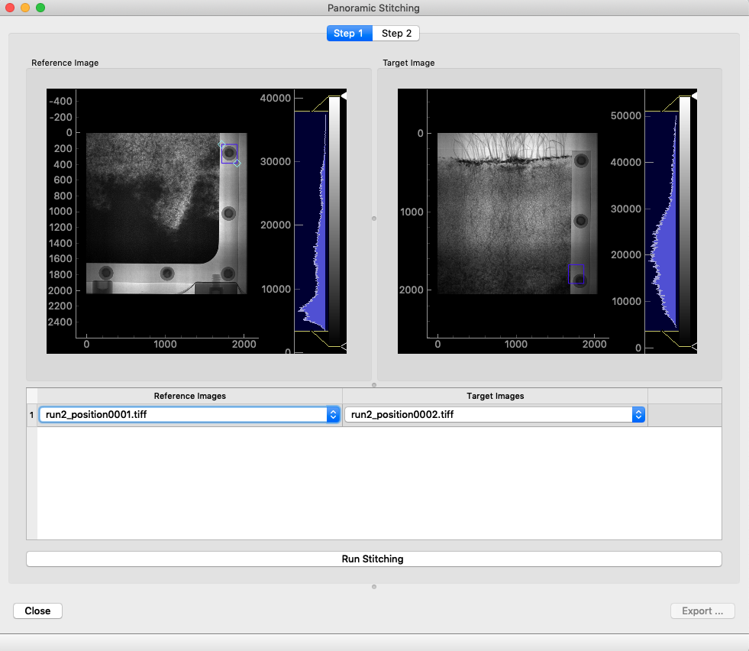
Jupyter notebooks
Some examples

Slide 10
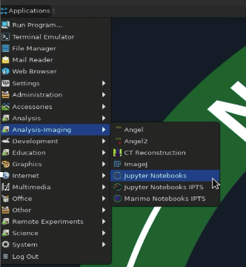
Why the choice of the notebooks
Easy to access
Easy to run, simple workflow
Easy to deploy – always using the latest version
Easy to modify and quickly make available the changes
Possibility to customize them for user needs
Excellent feedback from users

Slide 11
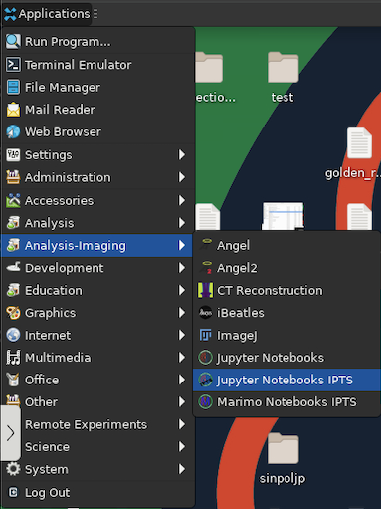
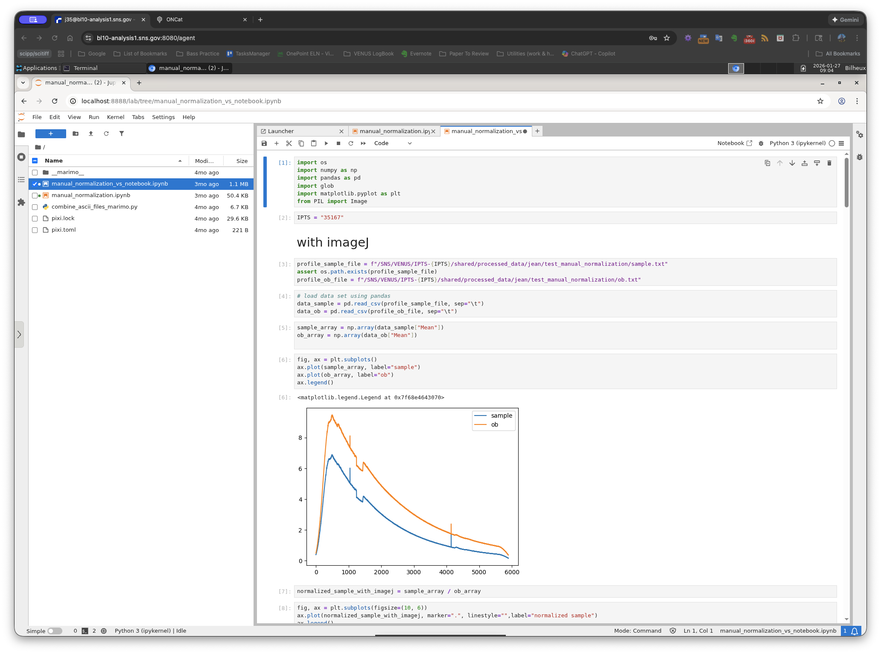
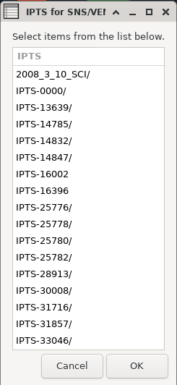
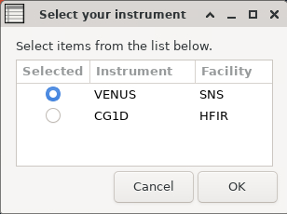

Experiment dedicated notebooks
Notebooks implemented for a single experiment and only accessible by that team.

Slide 12
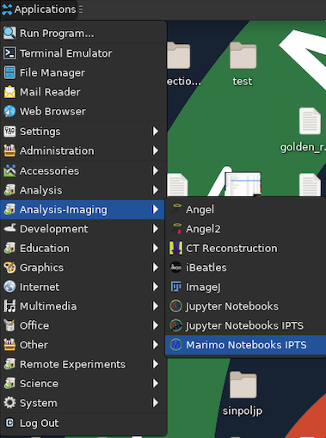
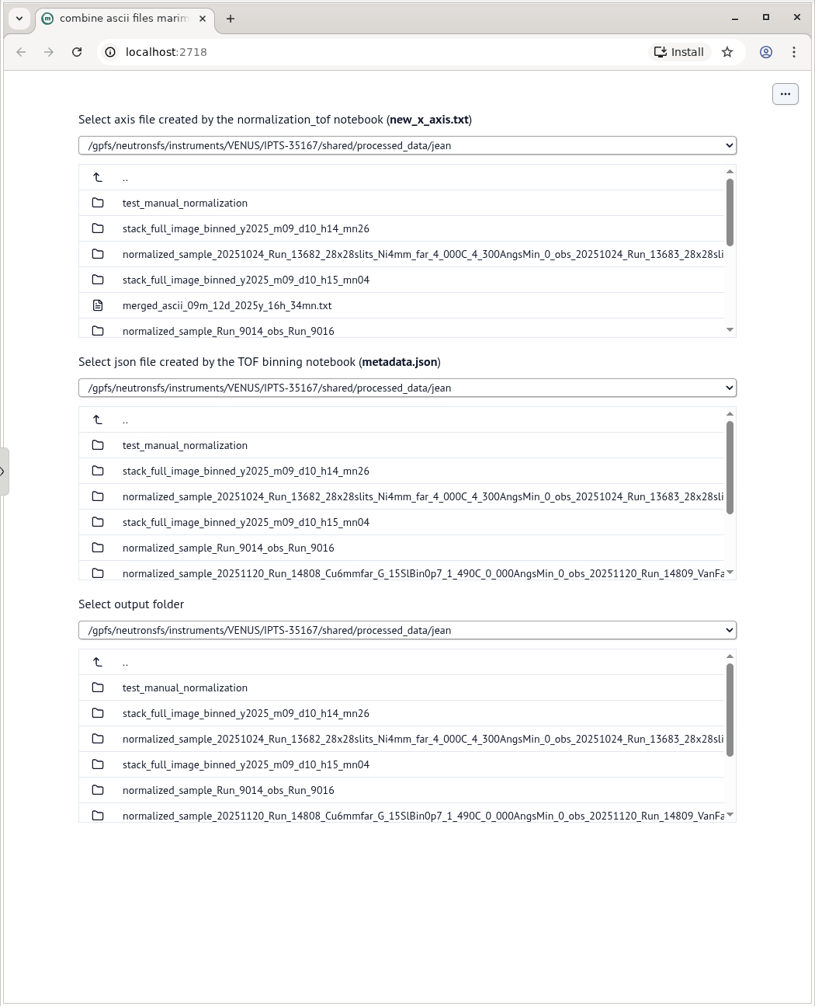

Experiment dedicated notebooks
Version of notebook available showing only widgets to the user – NO CODE!

Slide 13
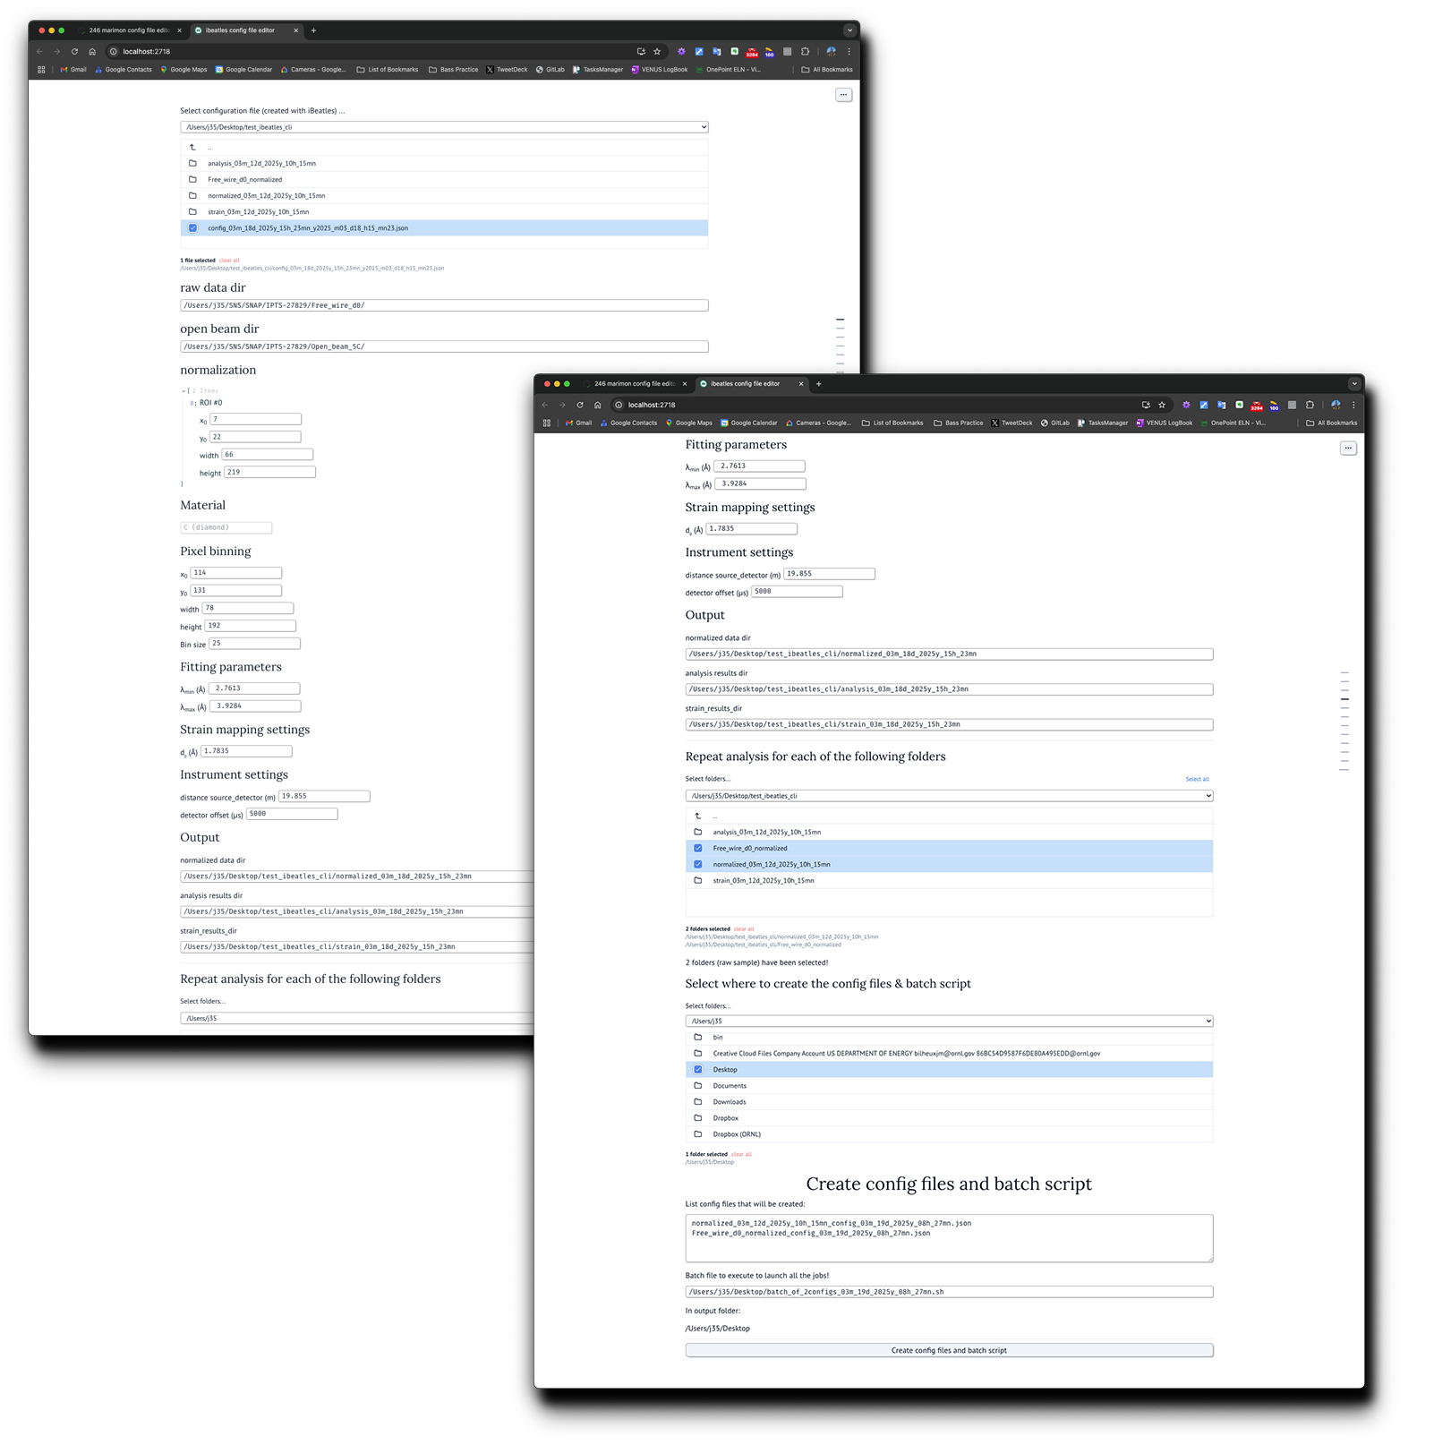
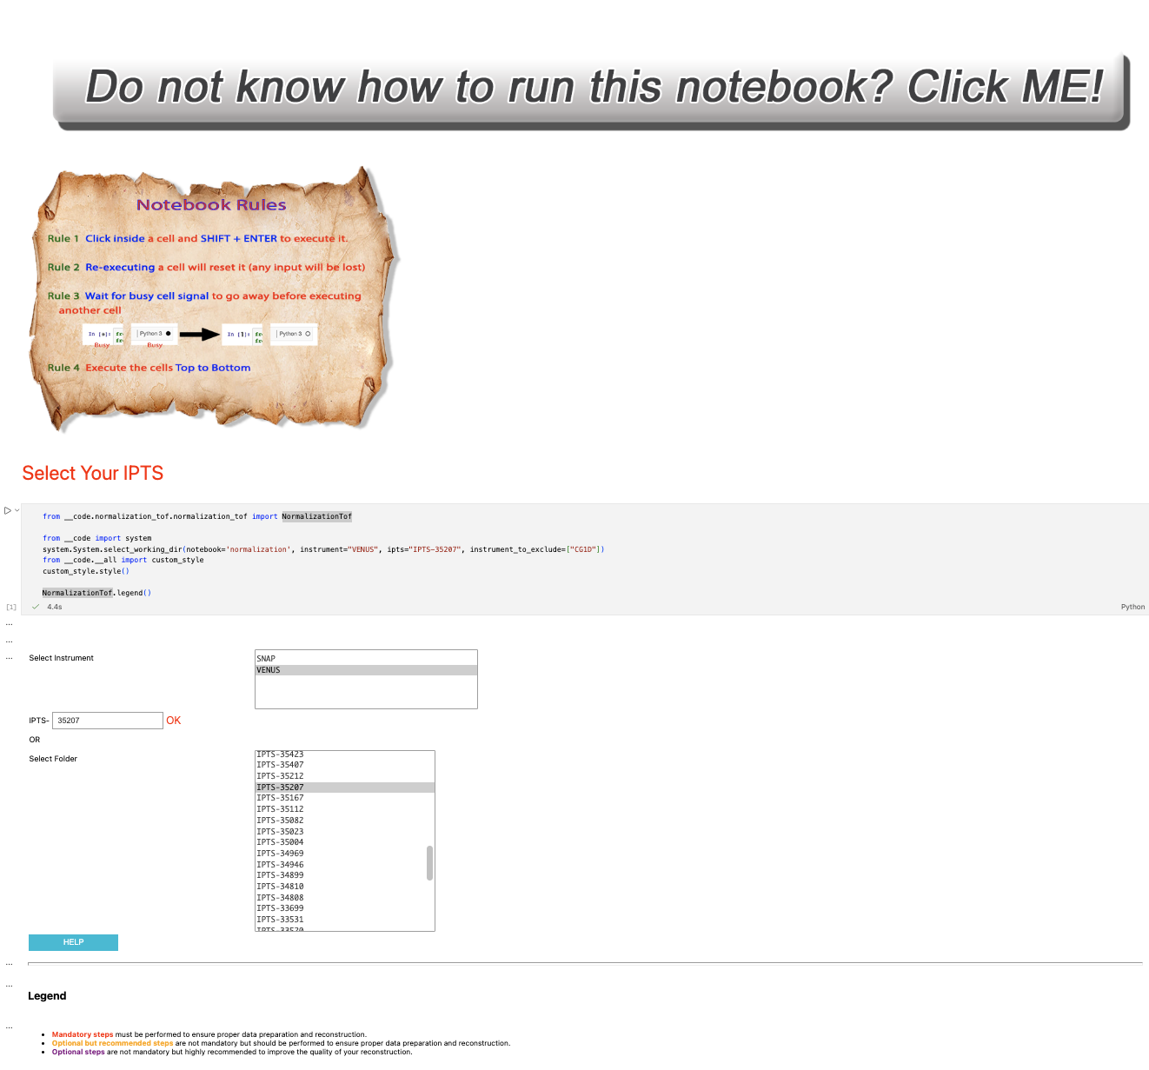
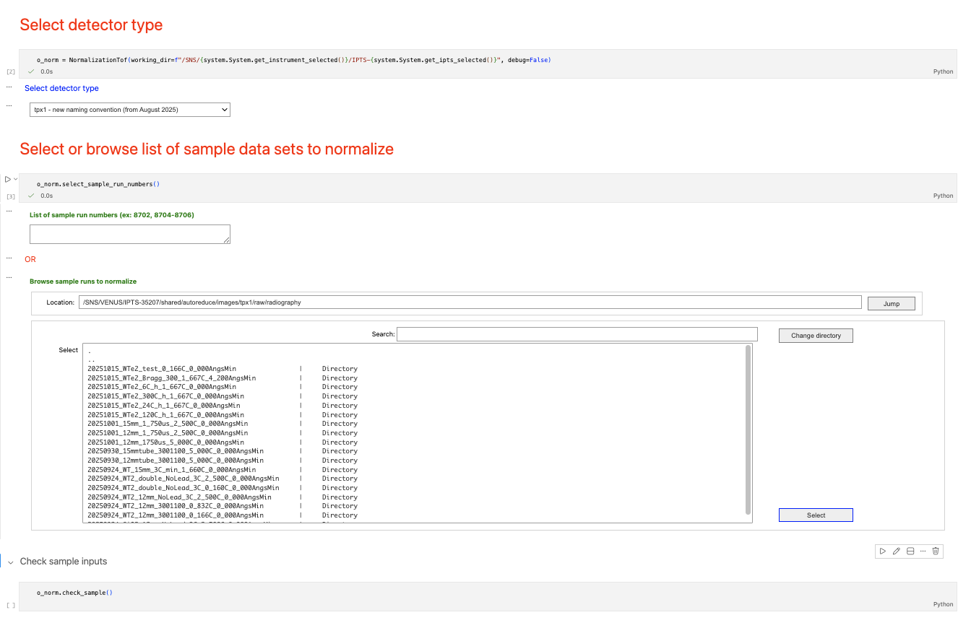
Jupyter Marimo

Slide 14

New notebooks (within the past few months)
CT reconstruction (MARS, VENUS)
TOF normalization
Resonance (collaboration with LANL)
Normalization
fitting
VENUS commissioning
Monitor counts
Display NeXus metadata (to compare runs)
Extract list of NeXus with predefined proton charge conditions
Timepix3
From event to histogram NeXus
NeXus event rebinning
Histo NeXus to profile
Image statistics
From raw to profile

Slide 15
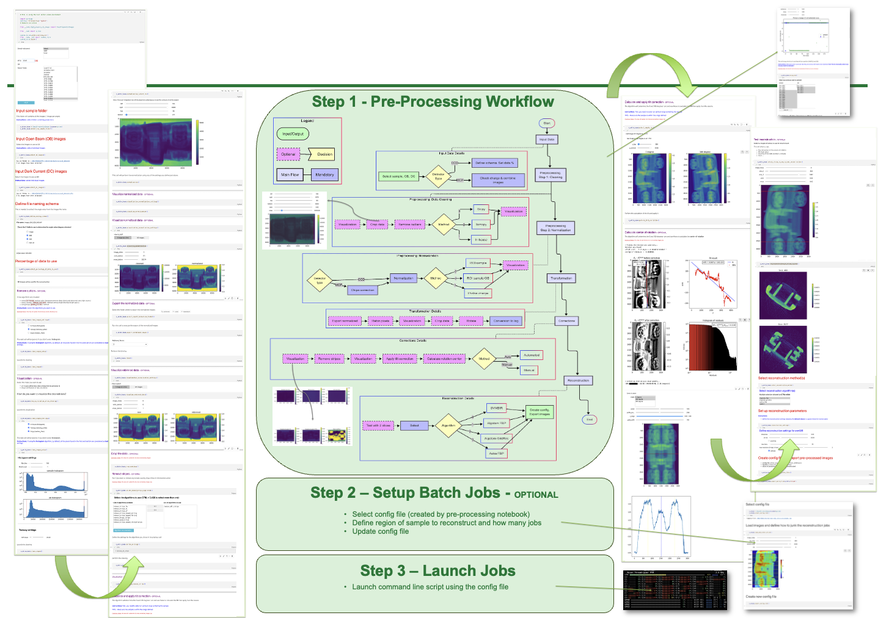
CT reconstruction notebook
svMBIR
MBIRjax
Astra
Tomopy
…

Slide 16


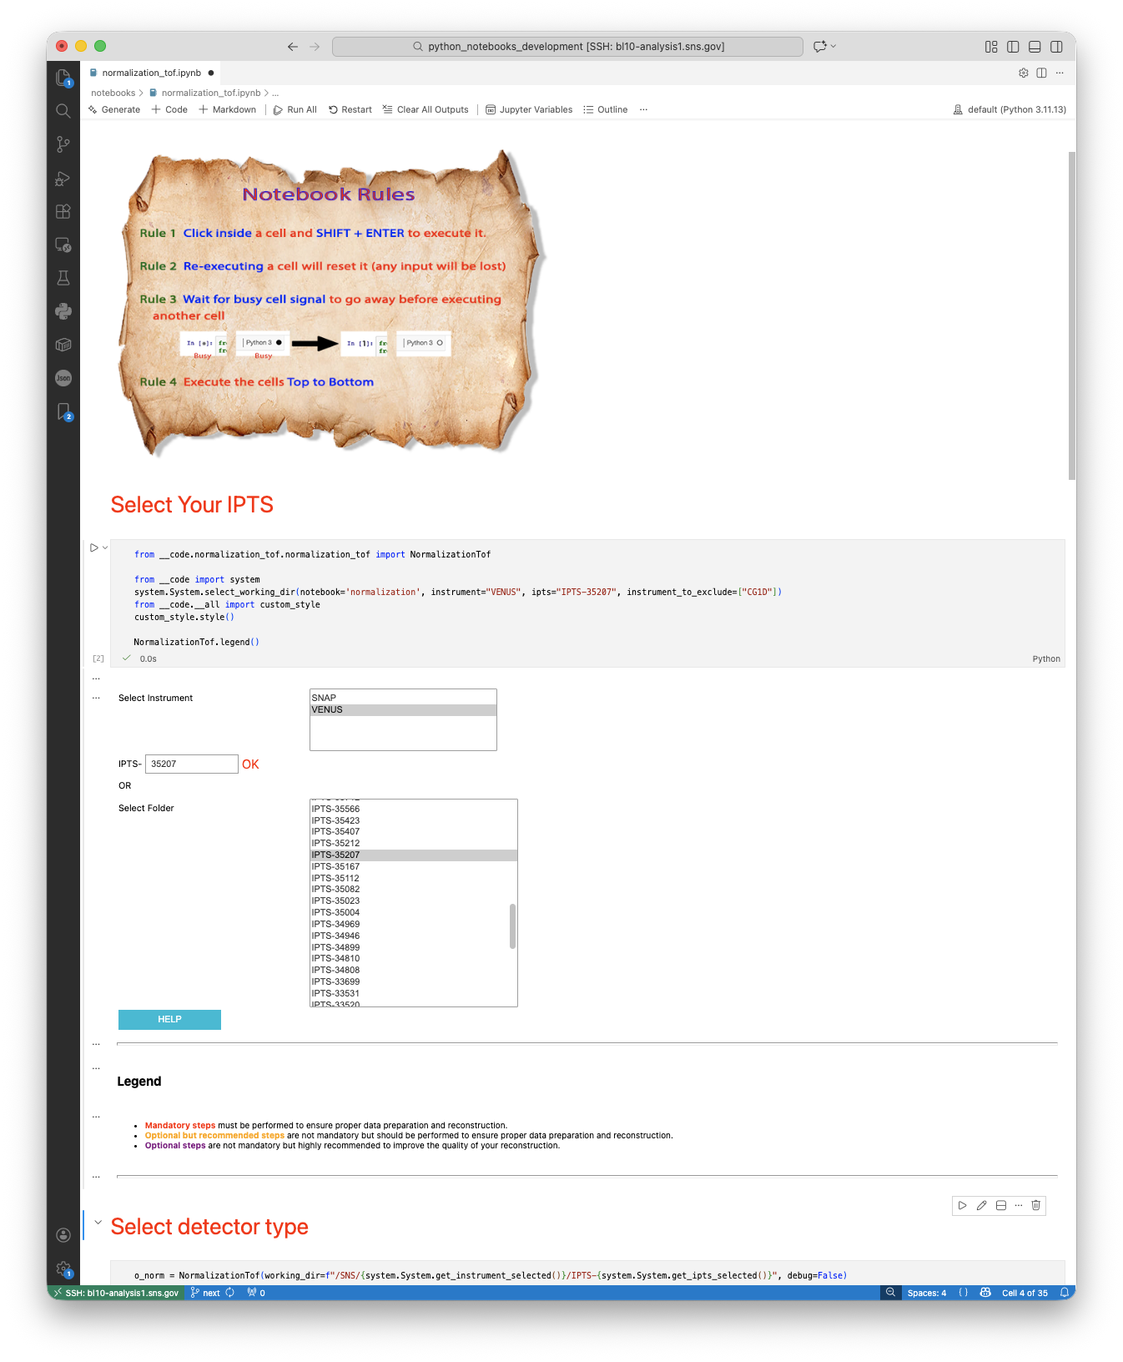
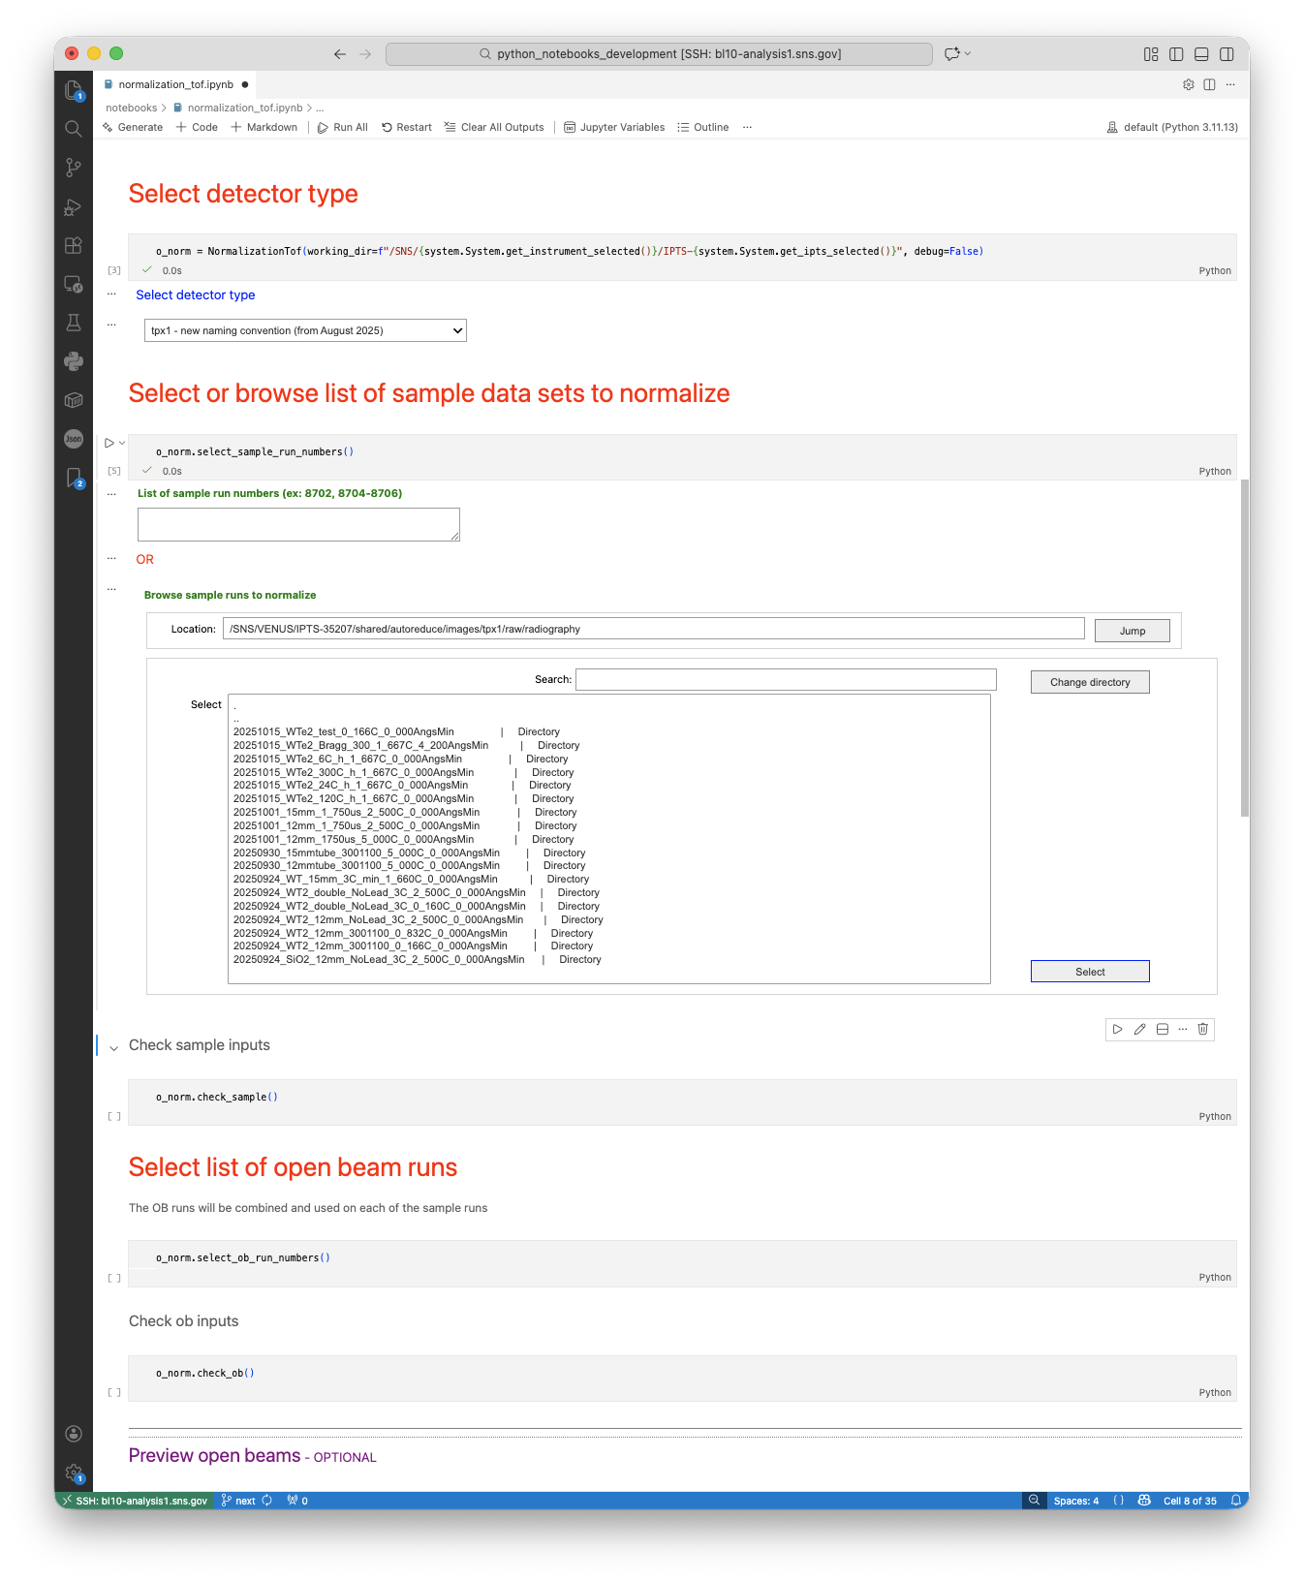
Normalization_tof notebook
Notebooks, not like UI, can be quickly modified as the requirements changed
Requirements
Browse or enter sample run number
Browse or enter open beam run number
Preview open beam (optional)
Select output folder
Run normalization
Requirements
Browse sample
Browse open beam
Select output folder
Run normalization

Slide 17
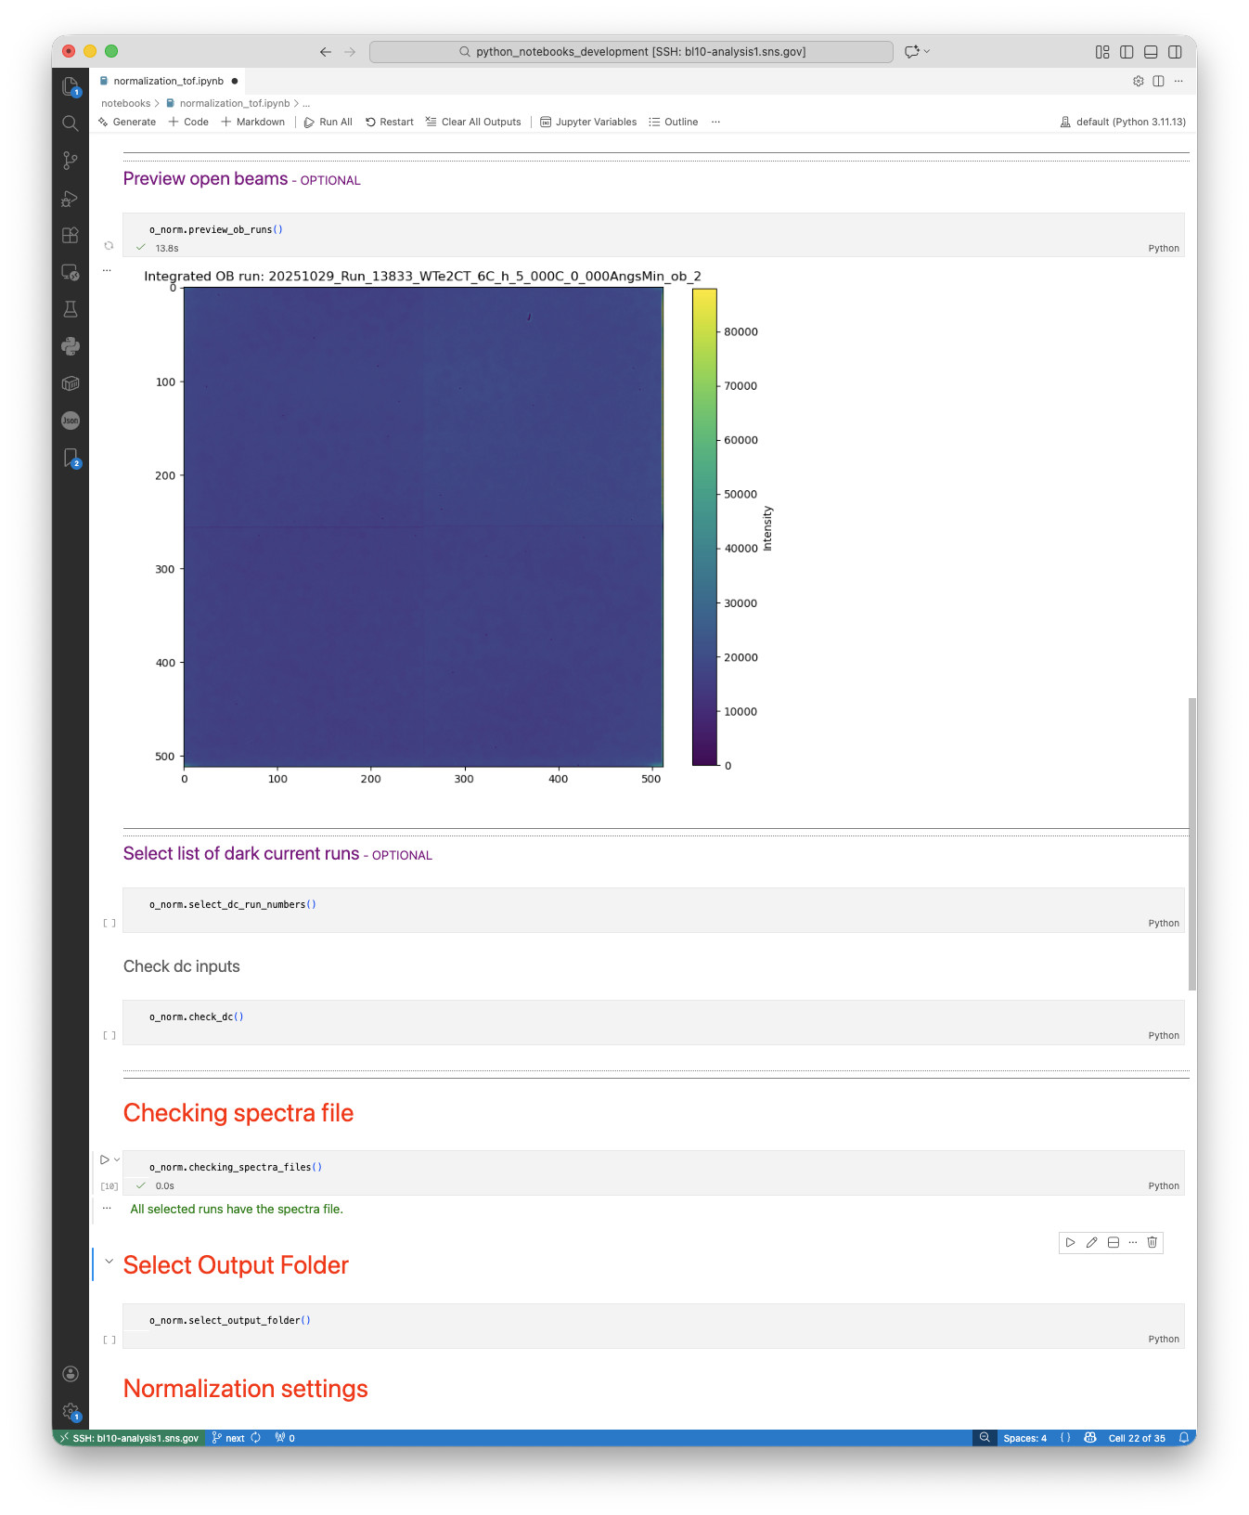
Normalization_tof notebook
Notebooks, not like UI, can be quickly modified as the requirements changed
Requirements
Browse or enter sample run number
Browse or enter open beam run number
Preview open beam (optional)
Select output folder
Run normalization
Requirements
Browse sample
Browse open beam
Select output folder
Run normalization

Slide 18
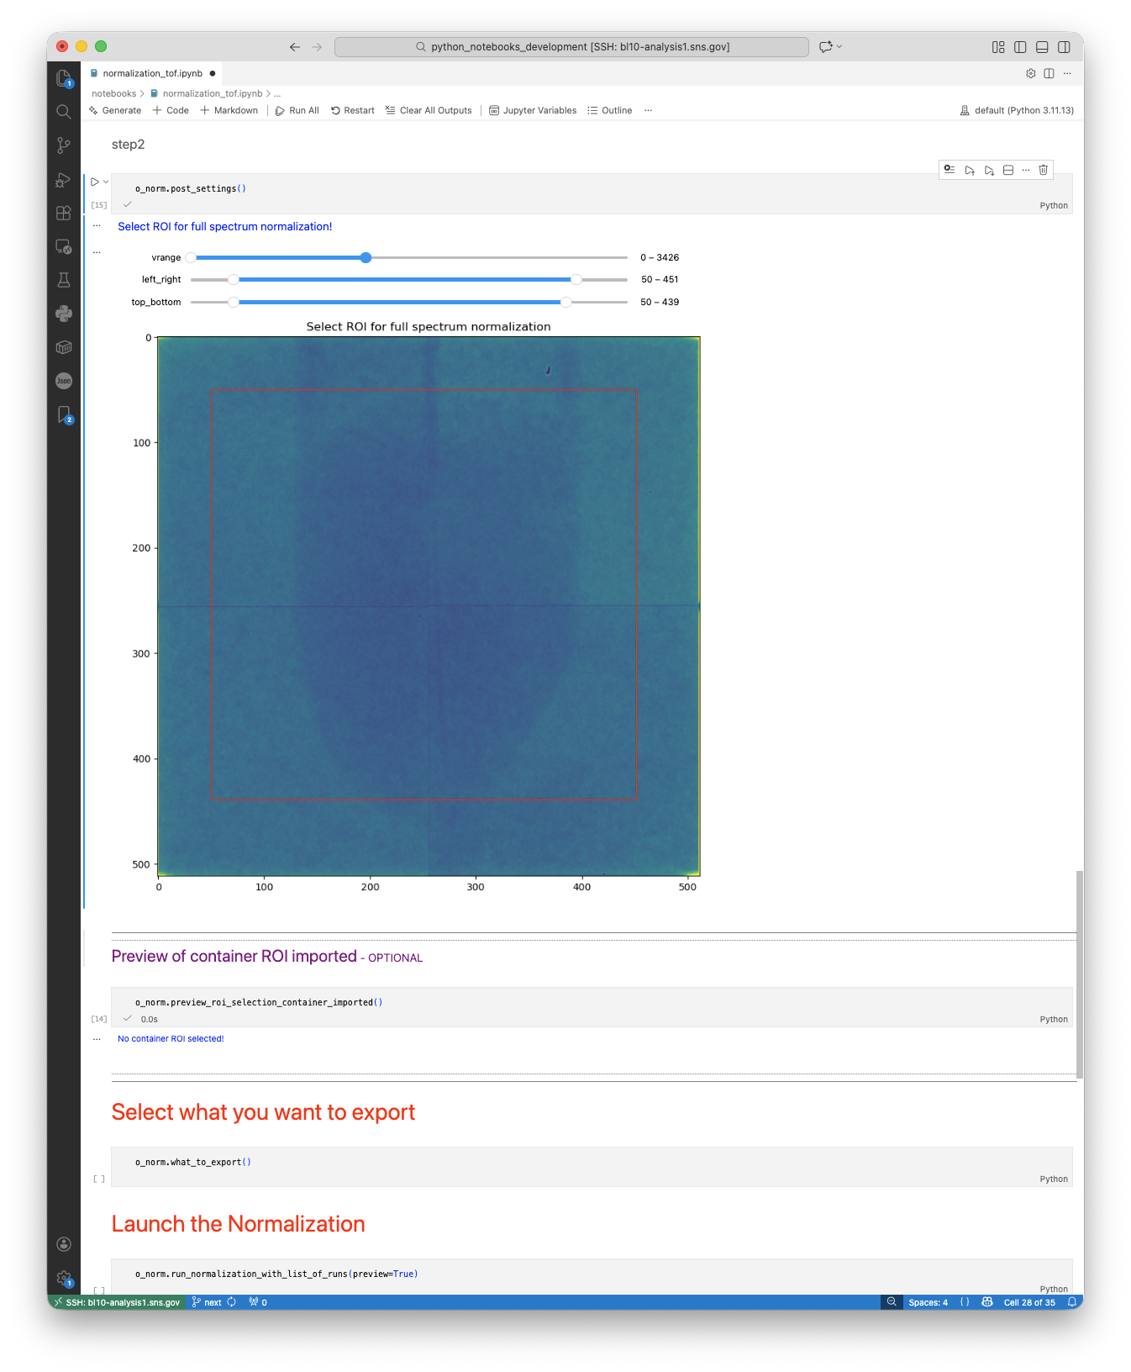
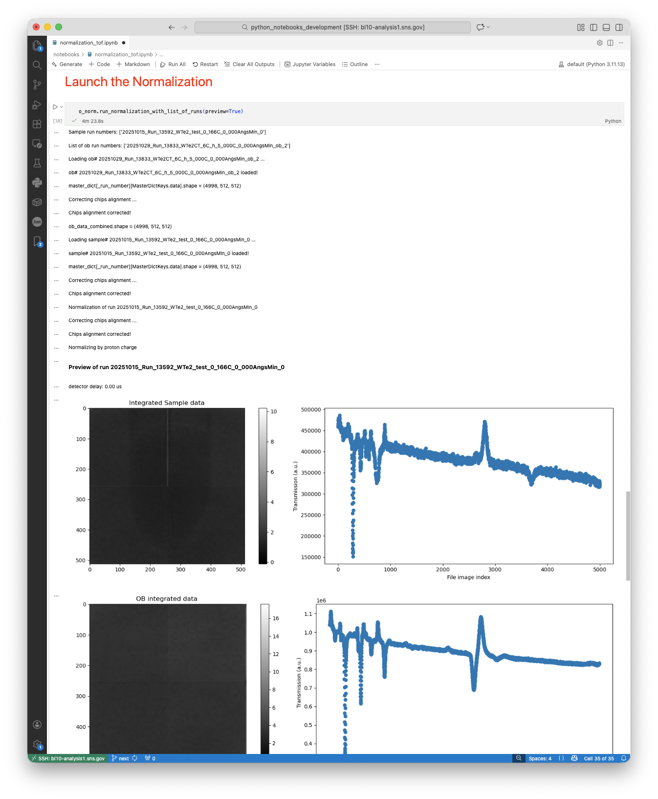
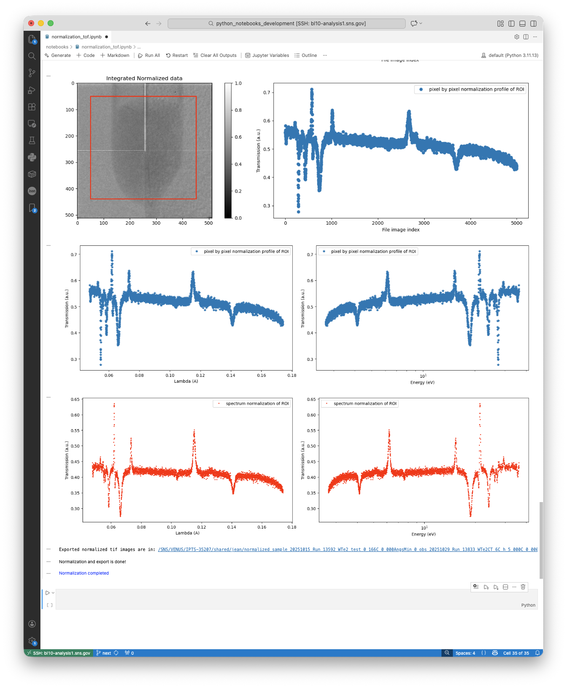
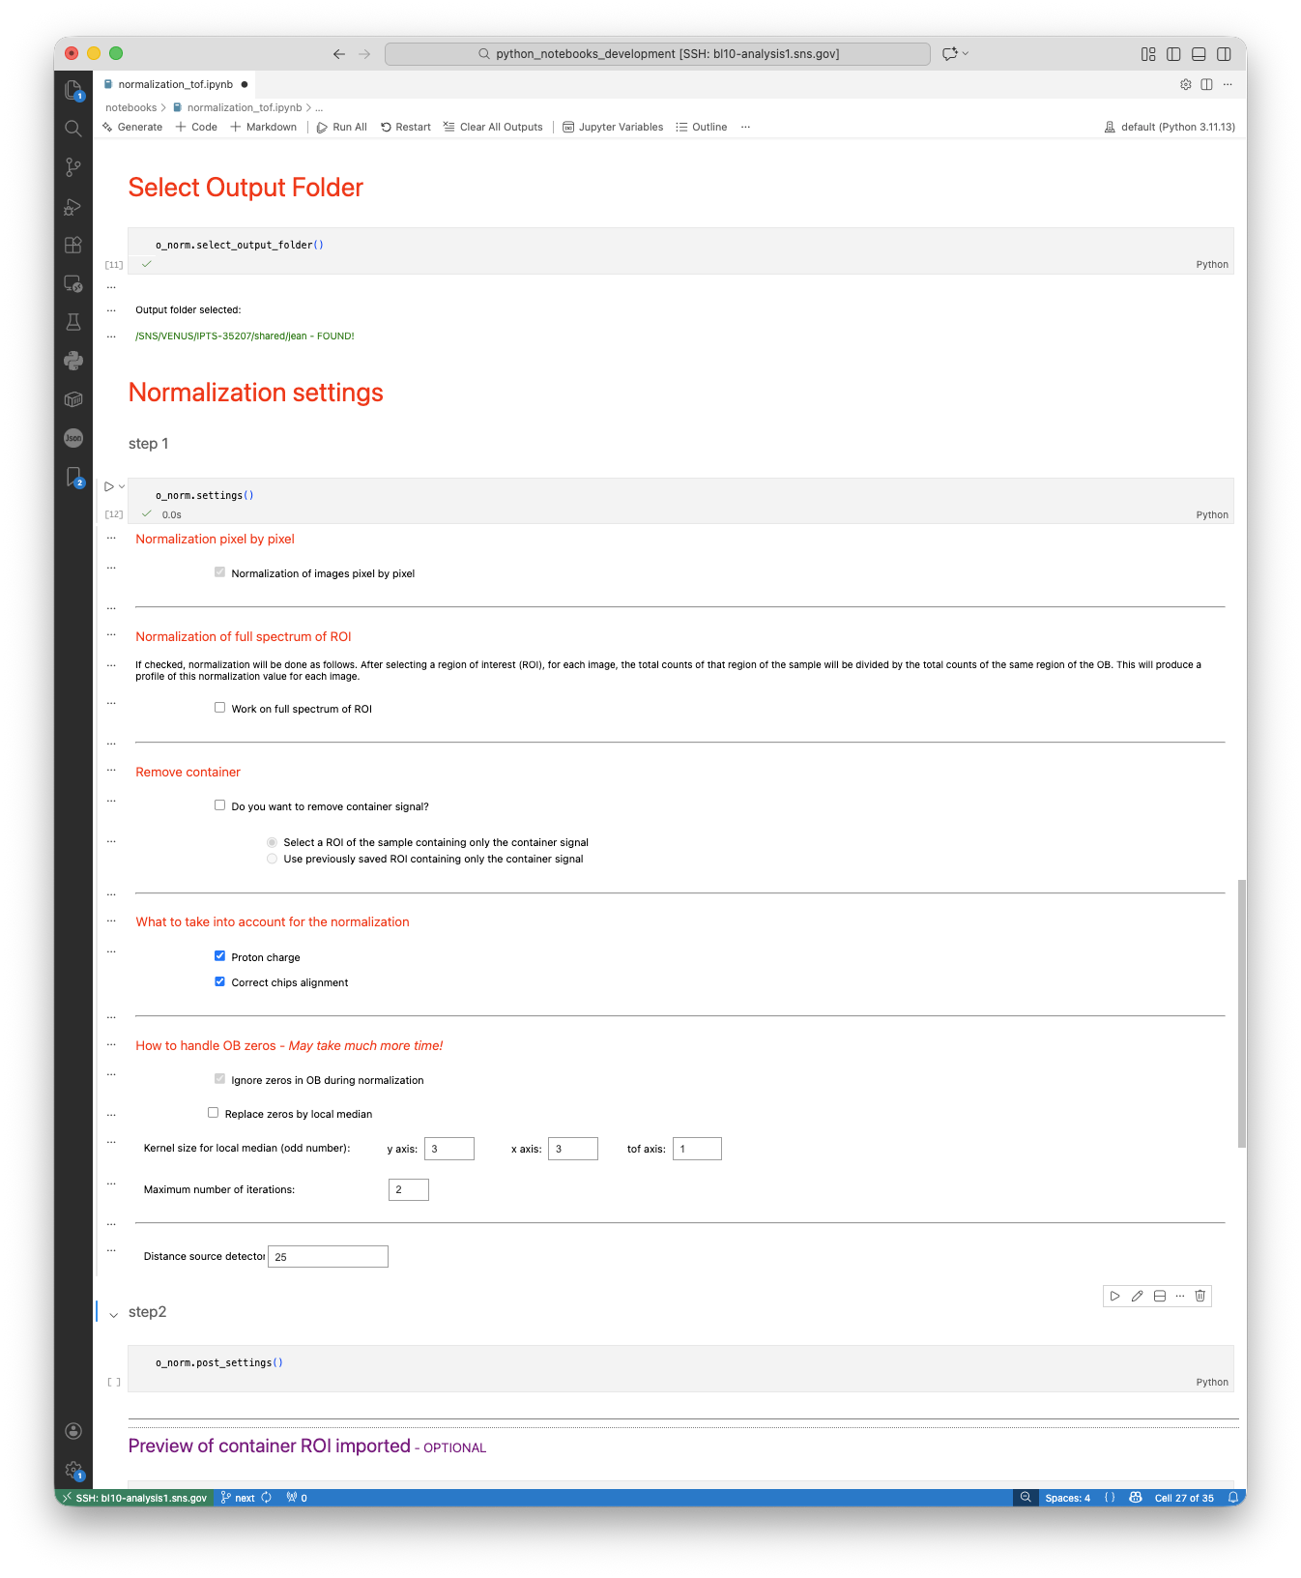
Normalization_tof notebook
Notebooks, not like UI, can be quickly modified as the requirements changed
Requirements
Browse or enter sample run number
Browse or enter open beam run number
Preview open beam (optional)
Select output folder
Run normalization
Requirements
Make it work for all naming convention
Browse or enter sample run number
Browse or enter open beam run number
Preview open beam (optional)
Browse or enter dark current (optional)
Allow to define manual spectra file
Add normalization settings
normalize by pixel
normalize by ROI
Remove container
Instrument settings
Filtering options
Select what to export
Select output folder
Run normalization

Slide 19
Table of contents
What we have now
Process the raw data
Data analysis and processing
Notebooks
standalone
Data Visualization
Web Applications
Documentation / tutorials
What we have been doing recently
What we are planning on doing

Slide 20
Table of contents
What we have now
Process the raw data
Data analysis and processing
Notebooks
standalone
Data Visualization
Web Applications
Documentation / tutorials
What we have been doing recently
What we are planning on doing

Slide 21
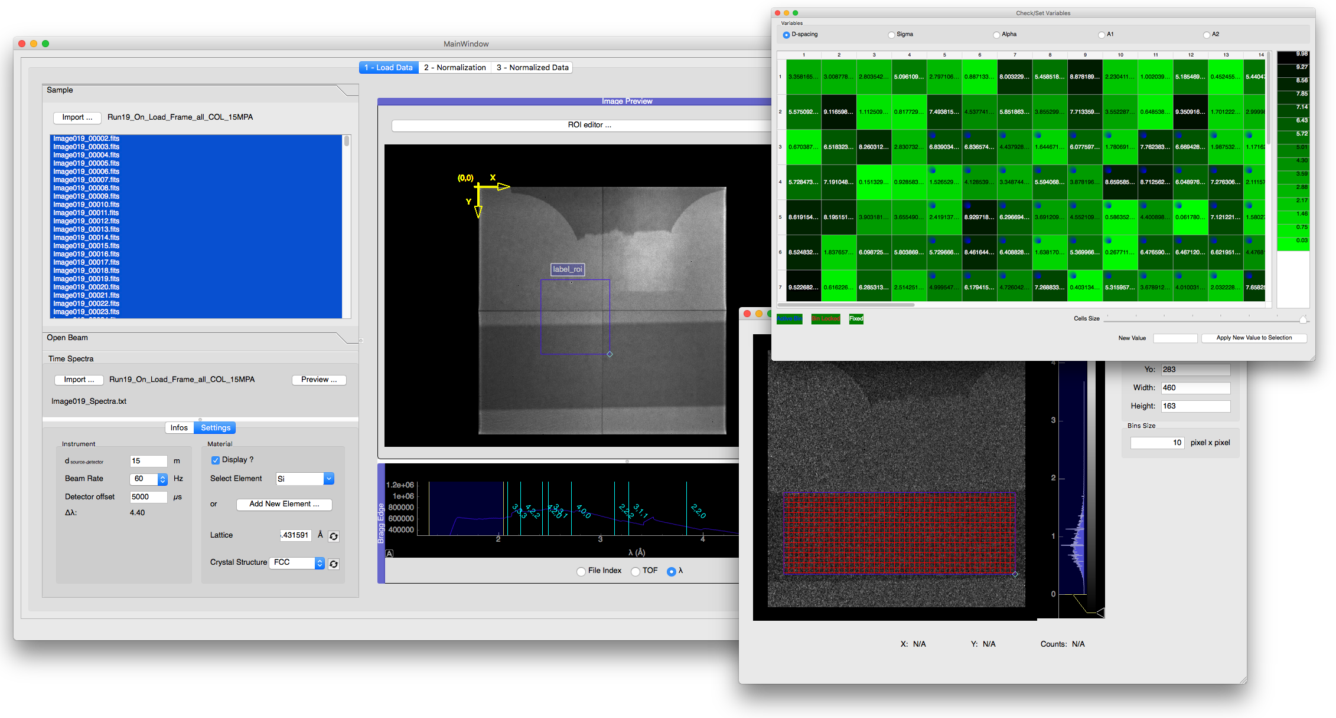
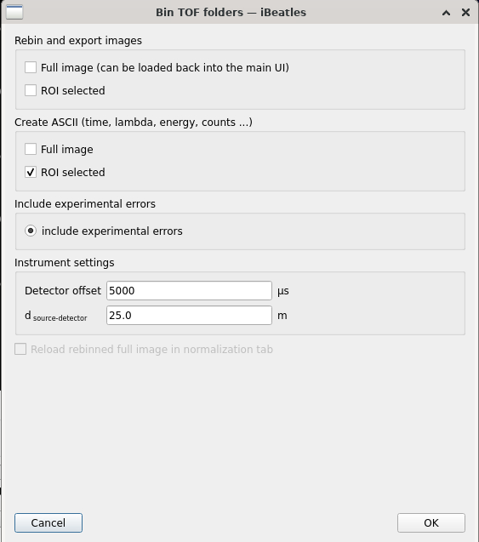
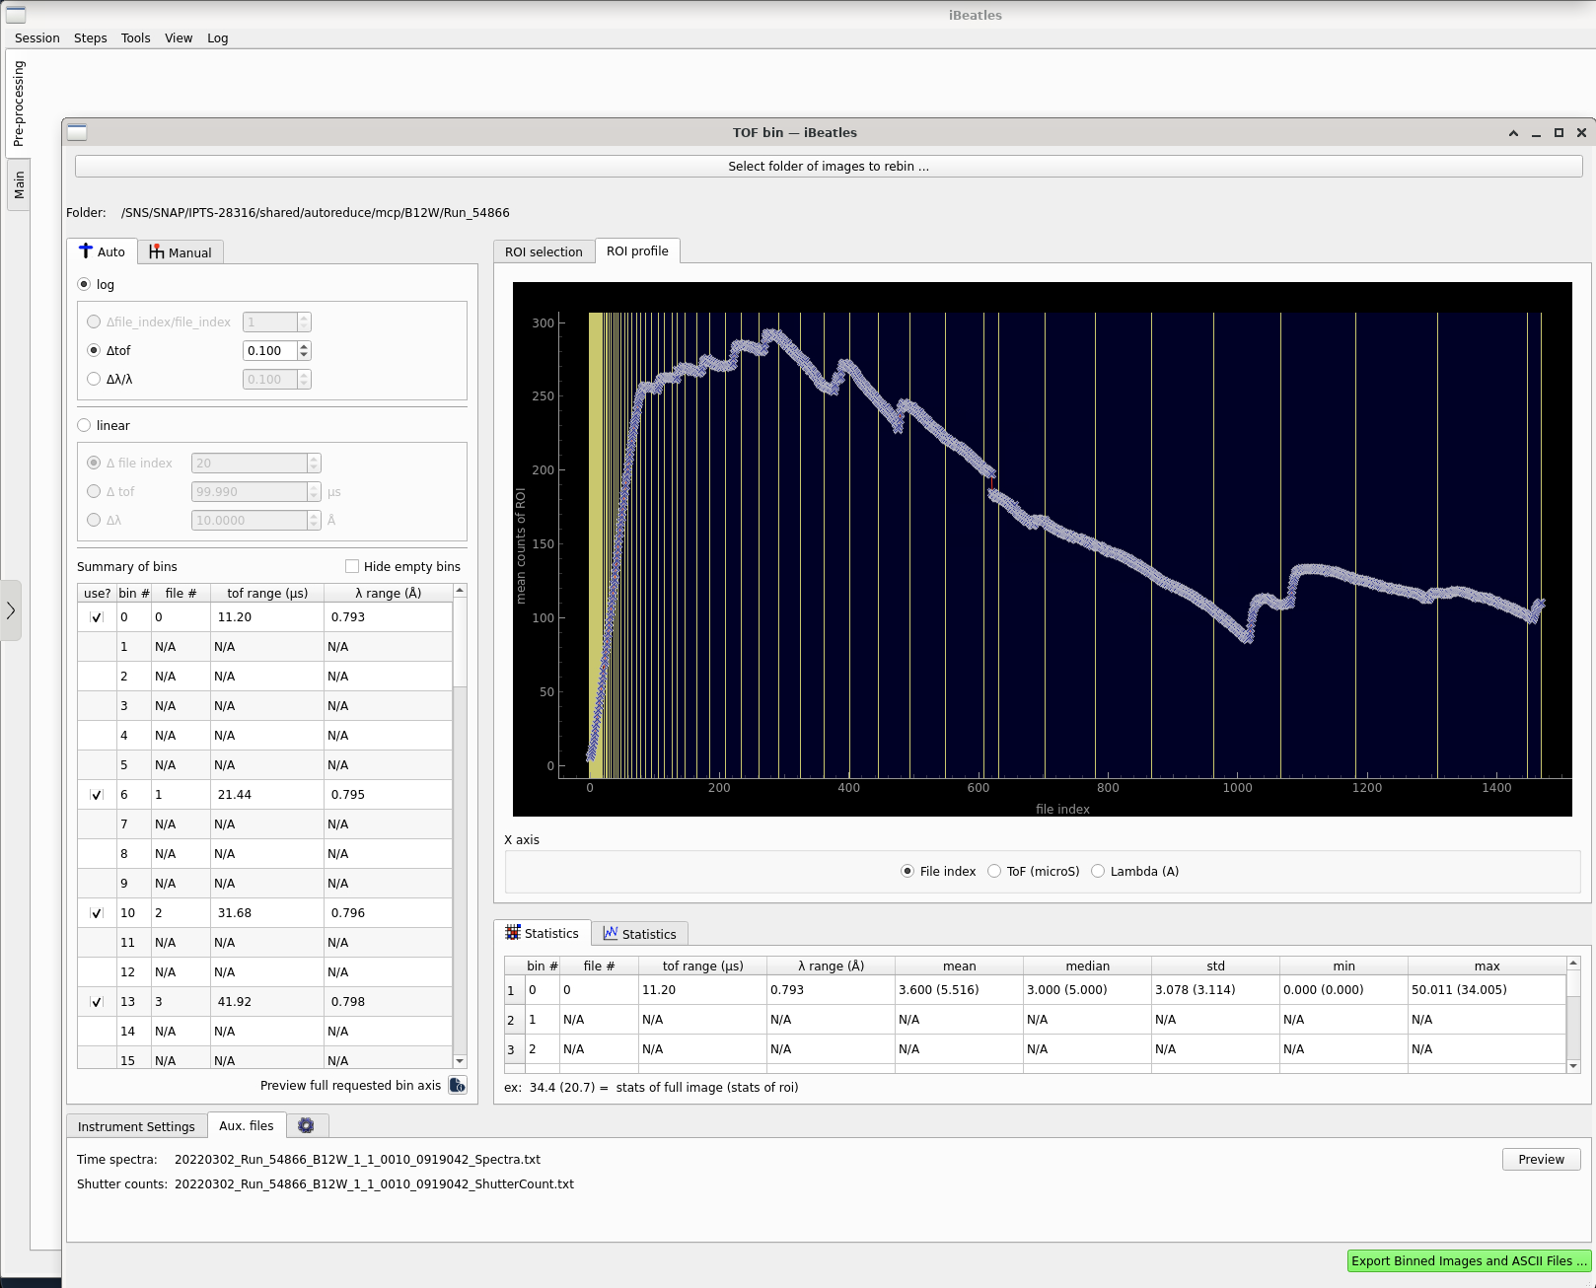
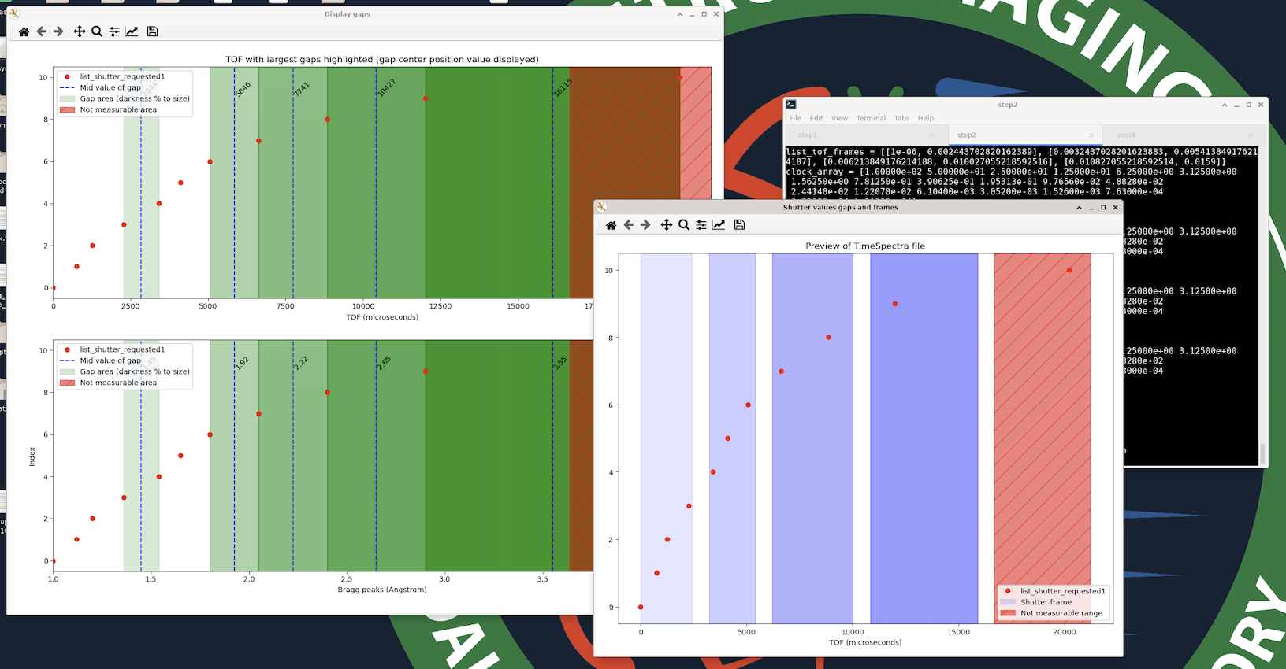
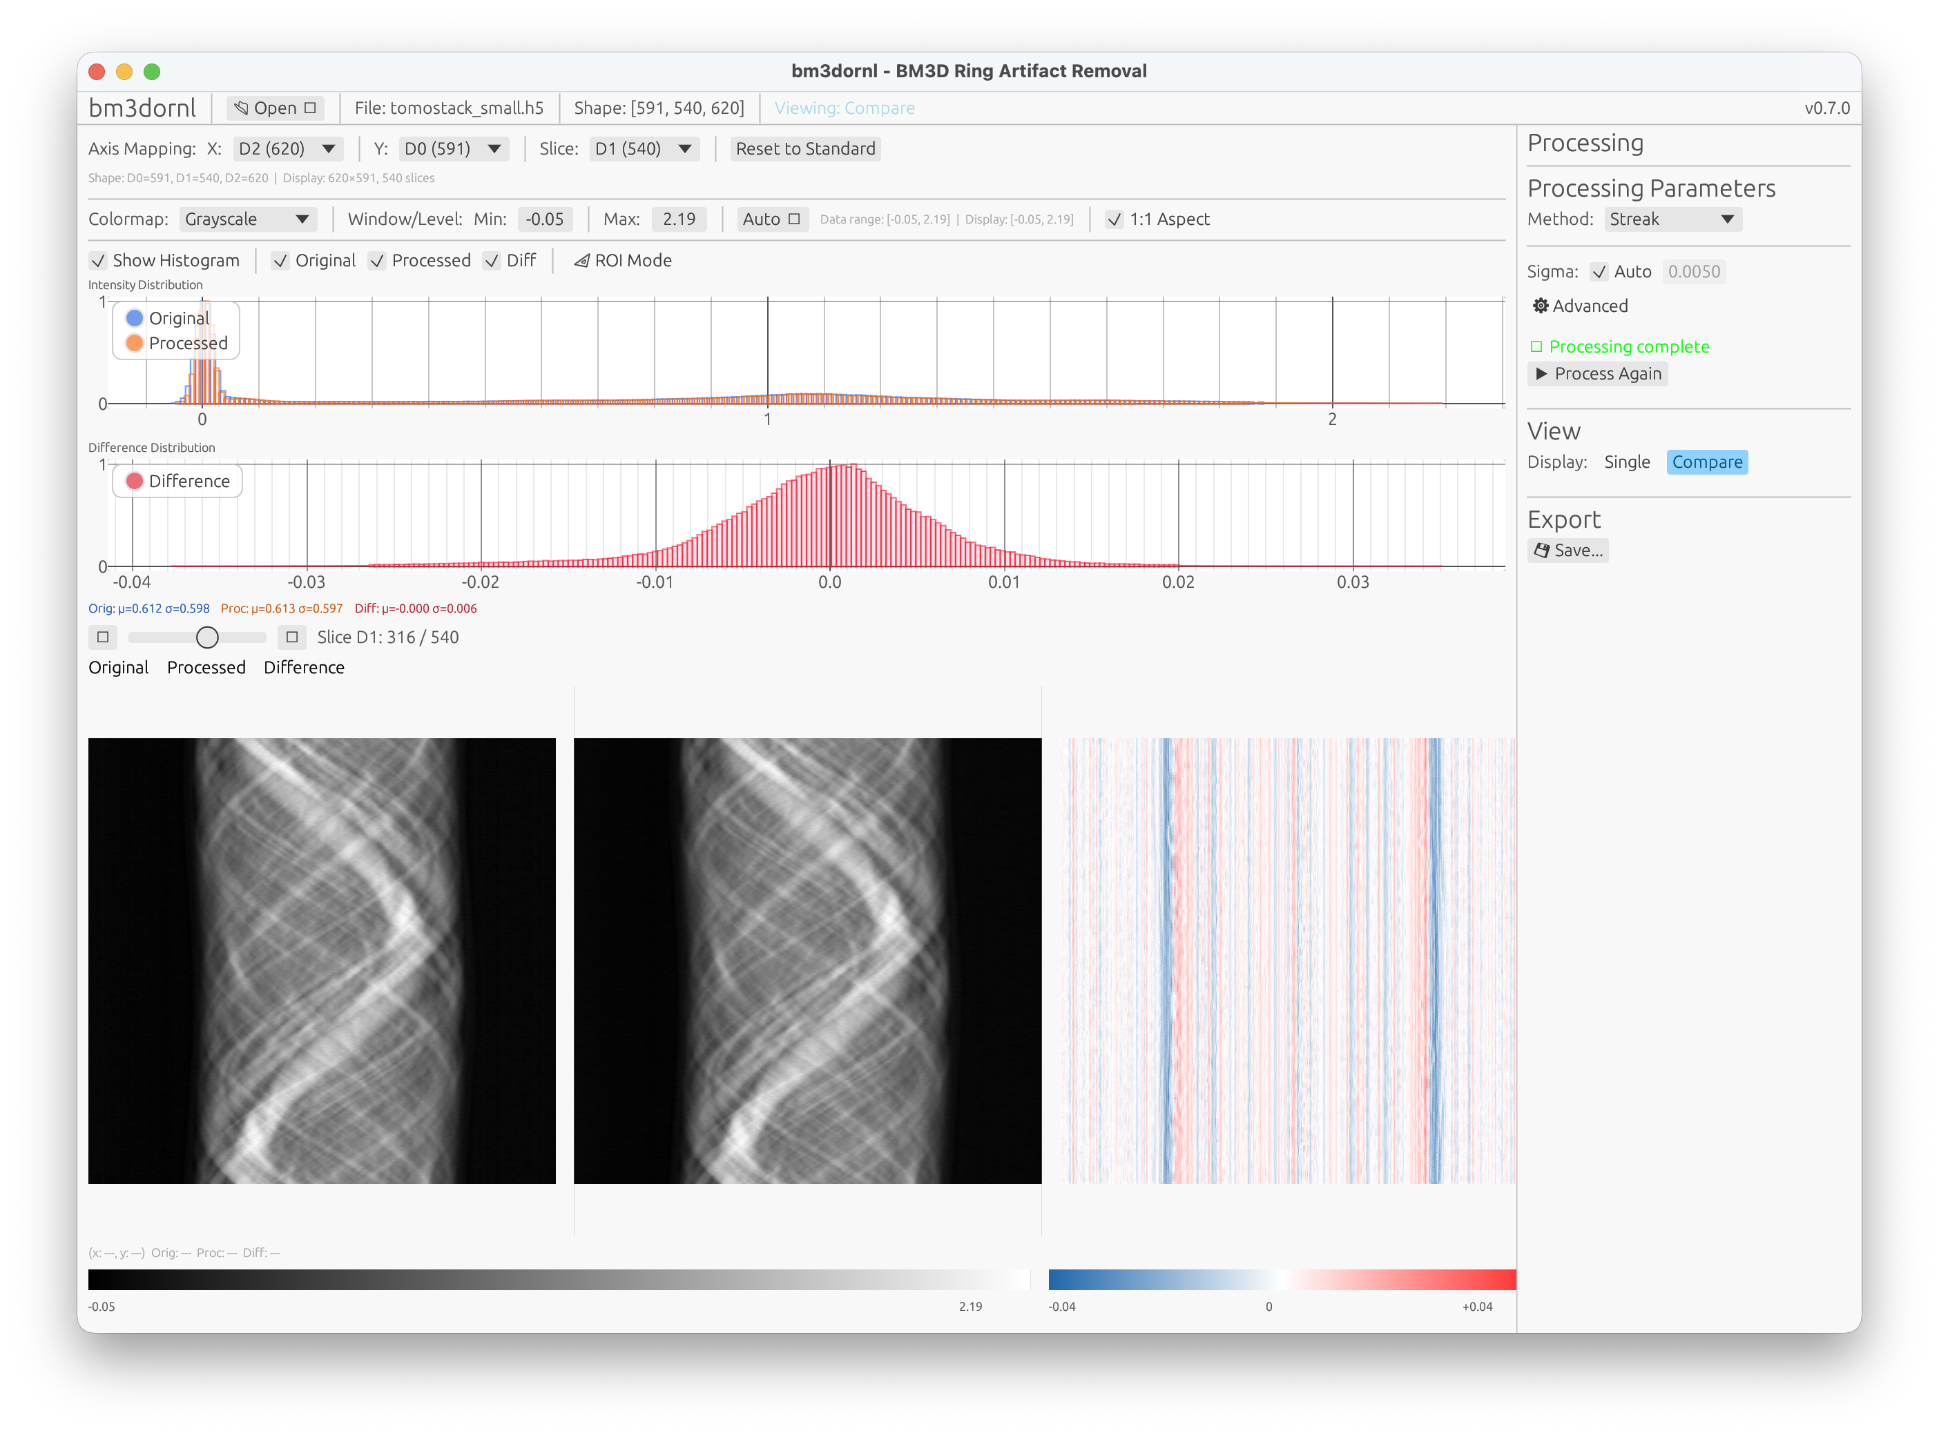
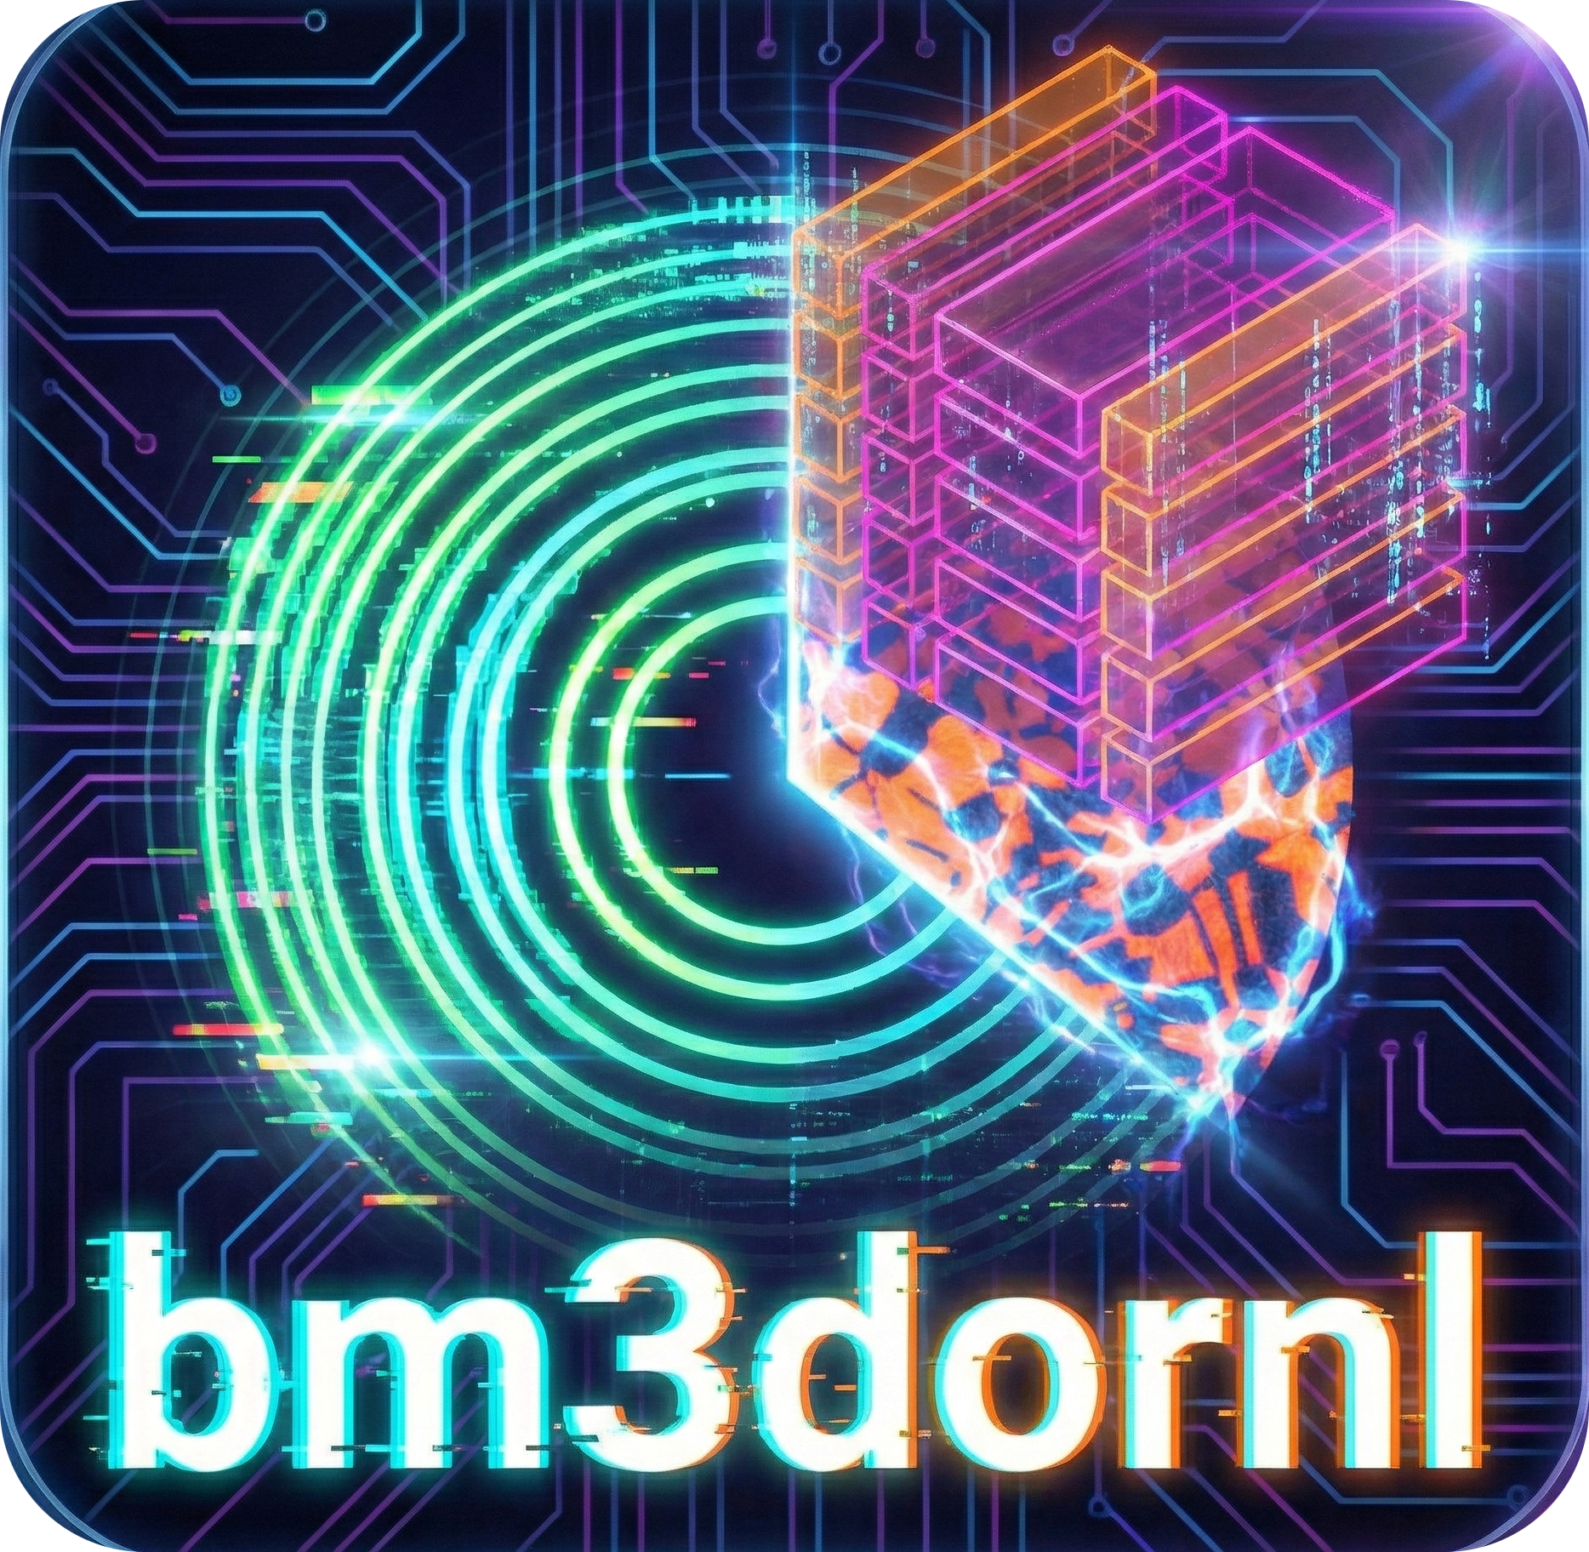
Standalone Applications
For more complex data analysis, standalone application are required.
iBeatles (strain mapping)
GUI
CLI
Conda -> pixi
GitHub action
Angel 2.0 – Grating interferometry
Shutter values generator (for timepix1)
HyperCTui – AI CT reconstruction
BM3DGUI – Ring artifact removal
iBeatles
Bm3dgui here
TOF binning
ShutterValues

Slide 22
Table of contents
What we have now
Process the raw data
Data analysis and processing
Notebooks
standalone
Data Visualization
Web Applications
Documentation / tutorials
What we have been doing recently
What we are planning on doing

Slide 23
Table of contents
What we have now
Process the raw data
Data analysis and processing
Notebooks
standalone
Data Visualization
Web Applications
Documentation / tutorials
What we have been doing recently
What we are planning on doing

Slide 24
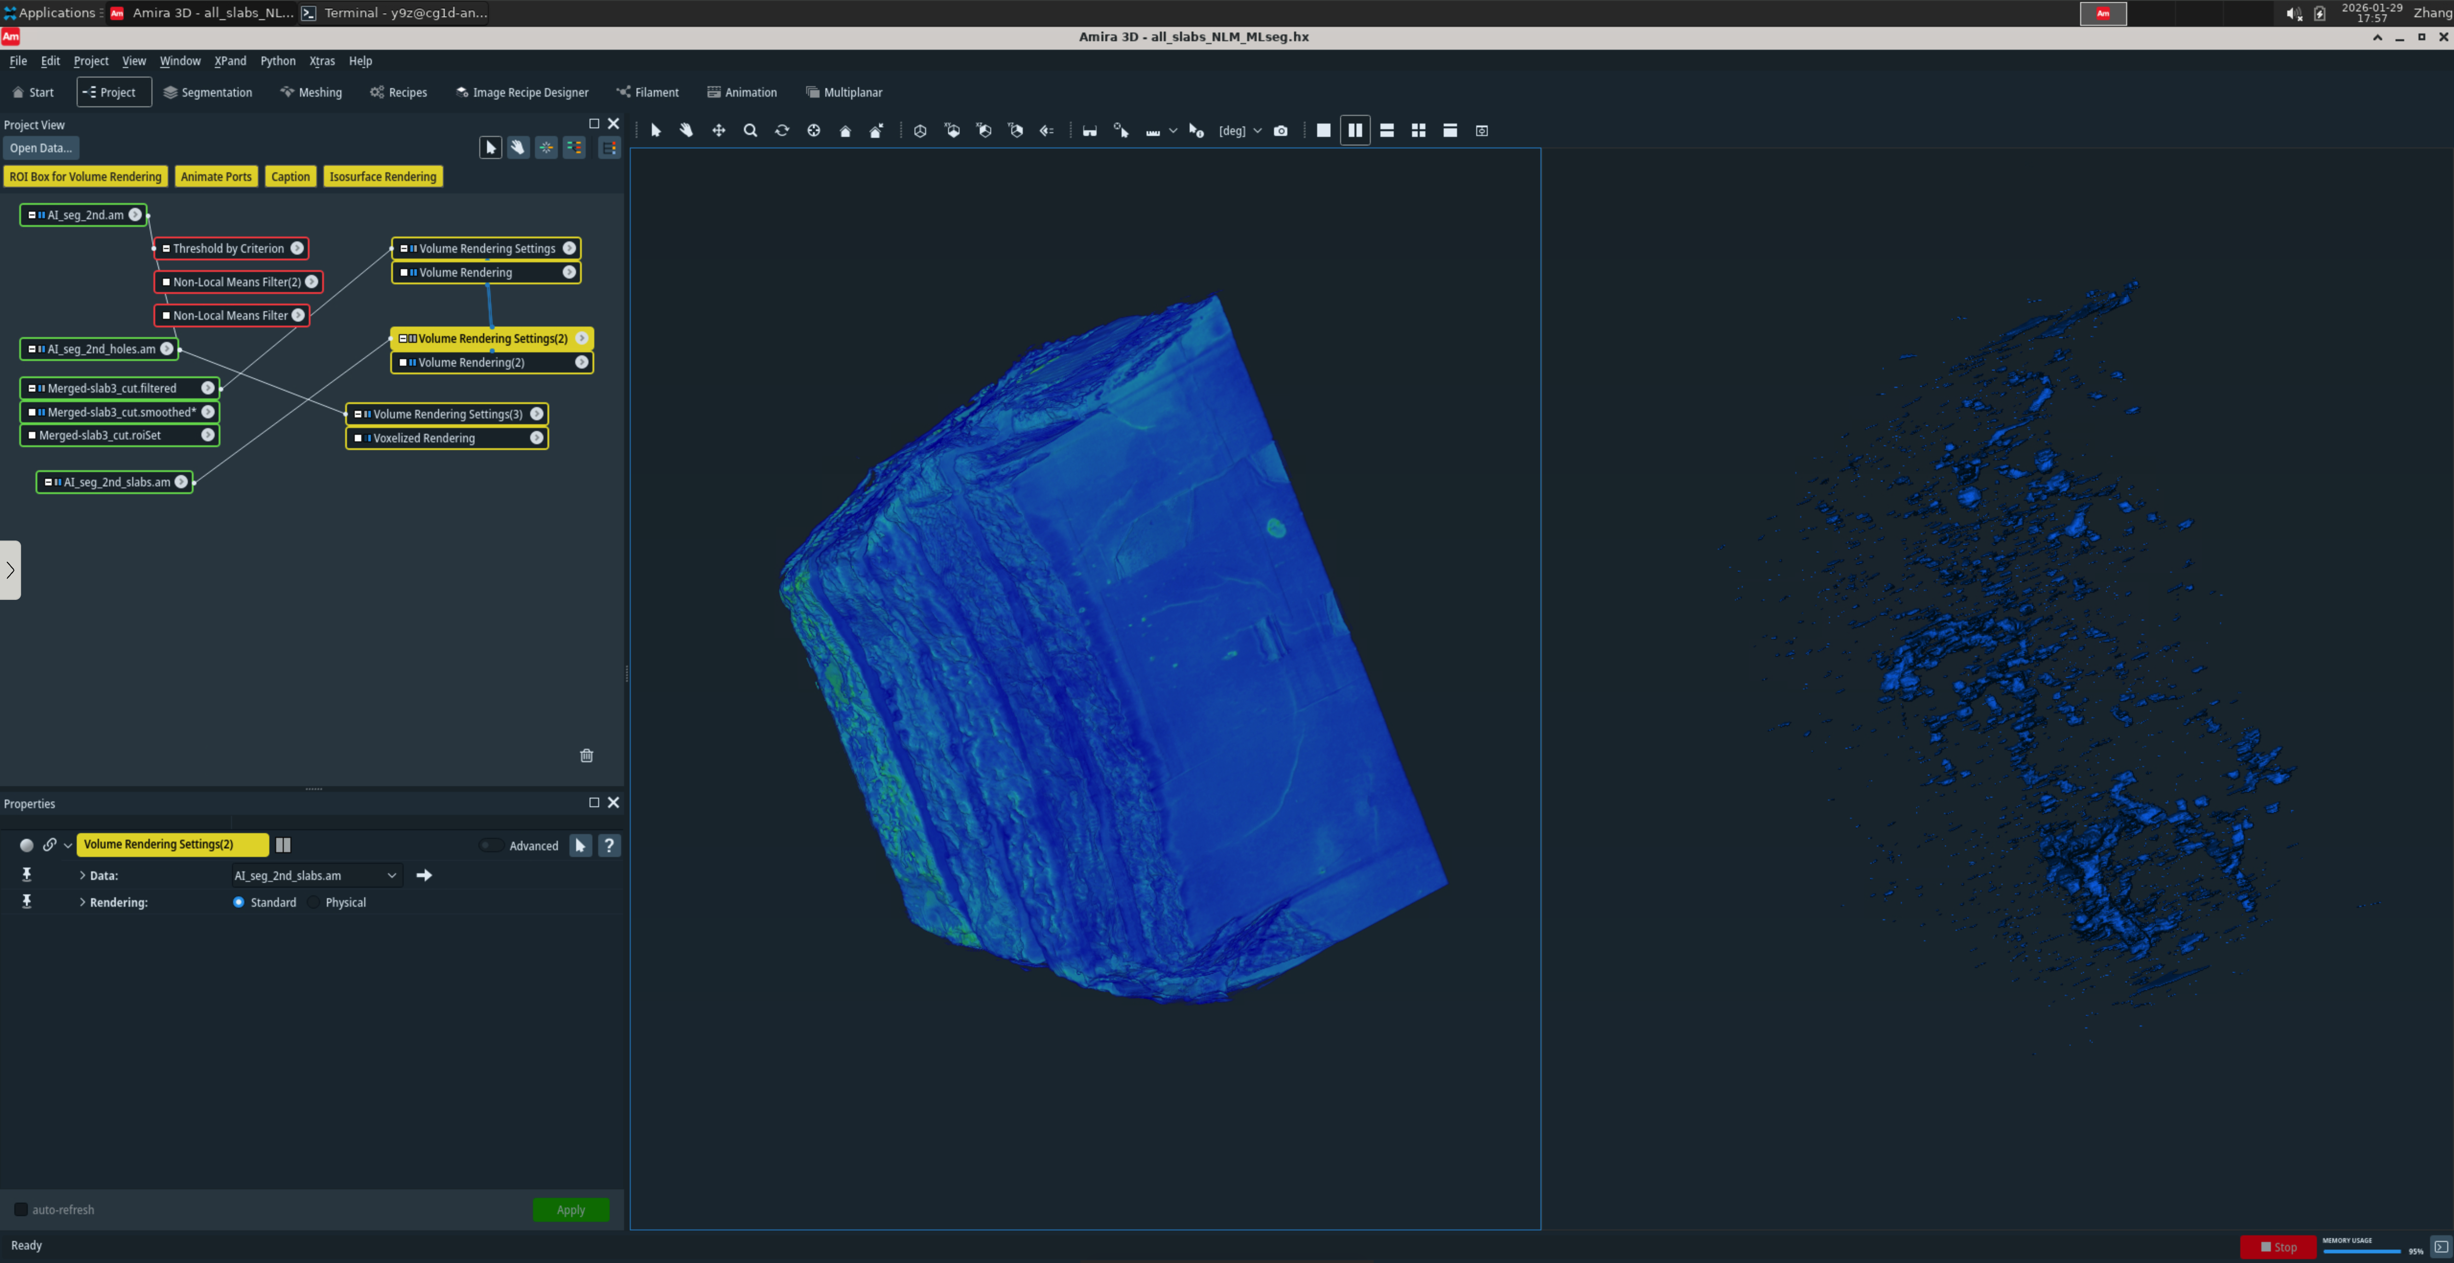

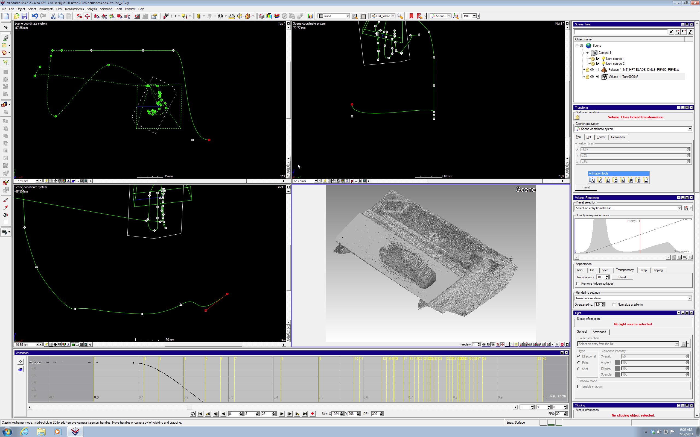

Visualization
3D visualization:
AMIRA
4 licenses at MARS
3 licenses at VENUS
VG Studio – node license
2D visualization and data processing
ImageJ (free)

Slide 25
Table of contents
What we have now
Process the raw data
Data analysis and processing
Notebooks
standalone
Data Visualization
Web Applications
Documentation / tutorials
What we have been doing recently
What we are planning on doing

Slide 26
Table of contents
What we have now
Process the raw data
Data analysis and processing
Notebooks
standalone
Data Visualization
Web Applications
Documentation / tutorials
What we have been doing recently
What we are planning on doing

Slide 27
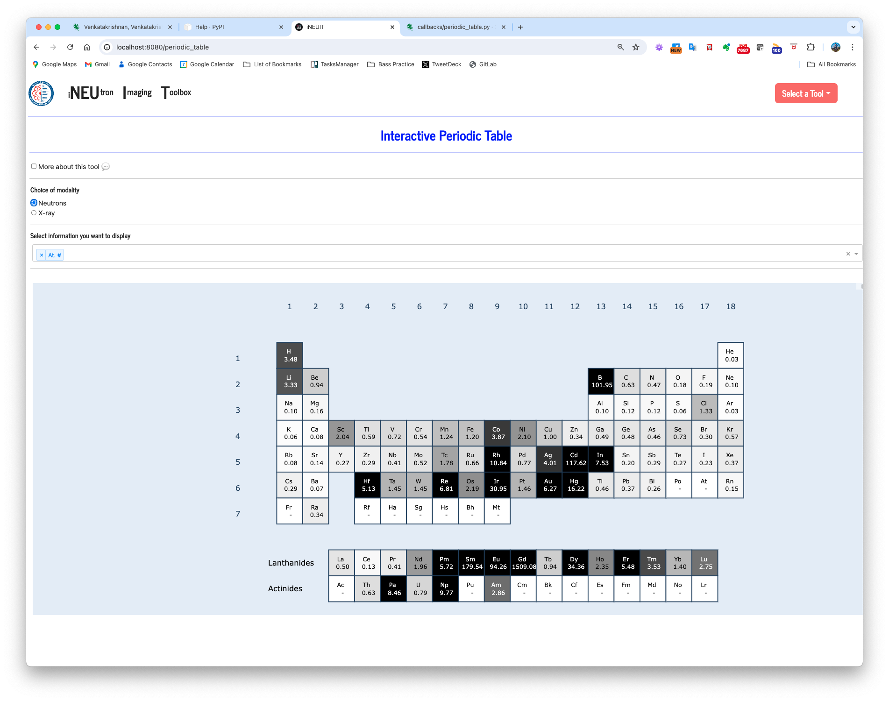
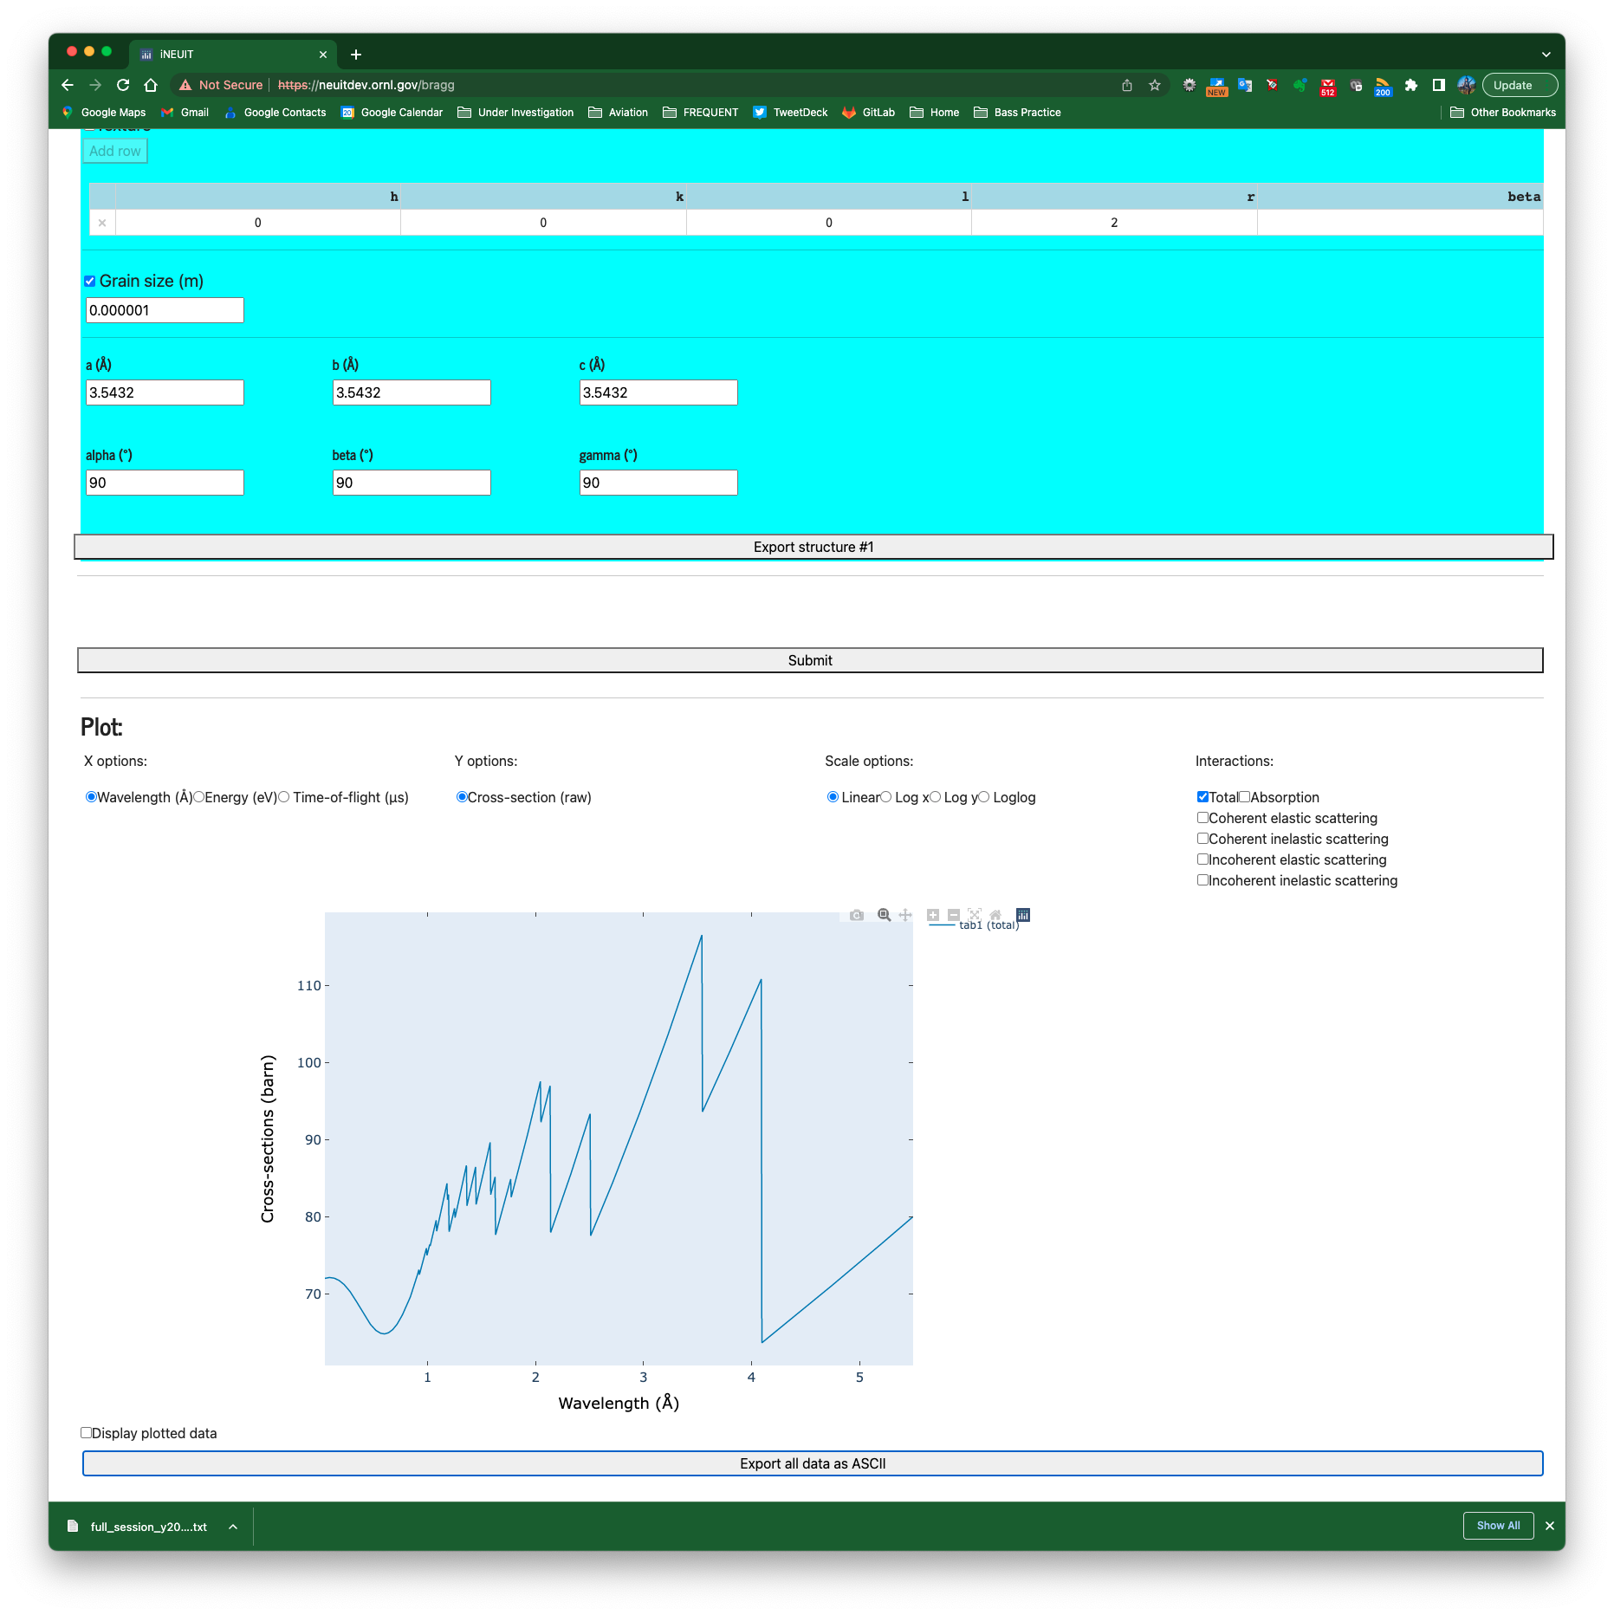
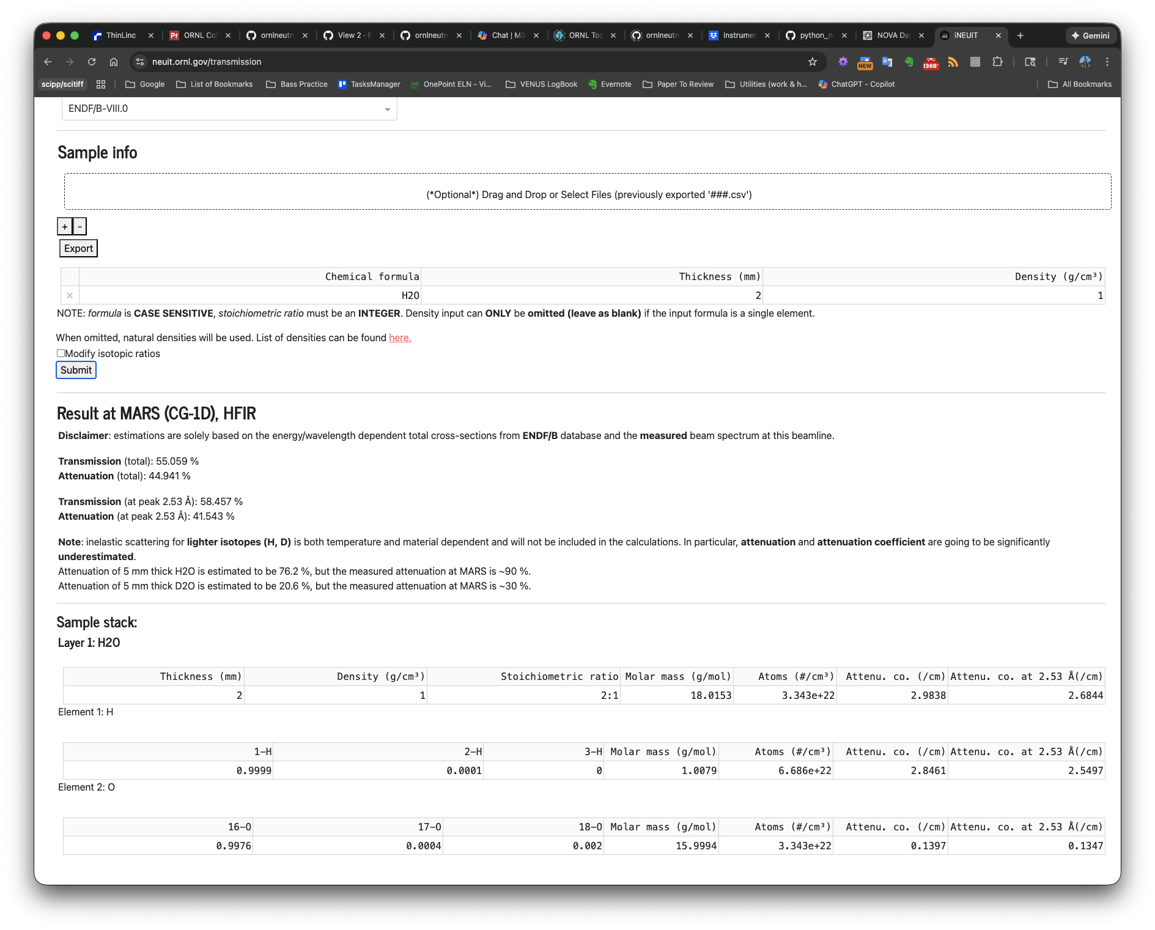
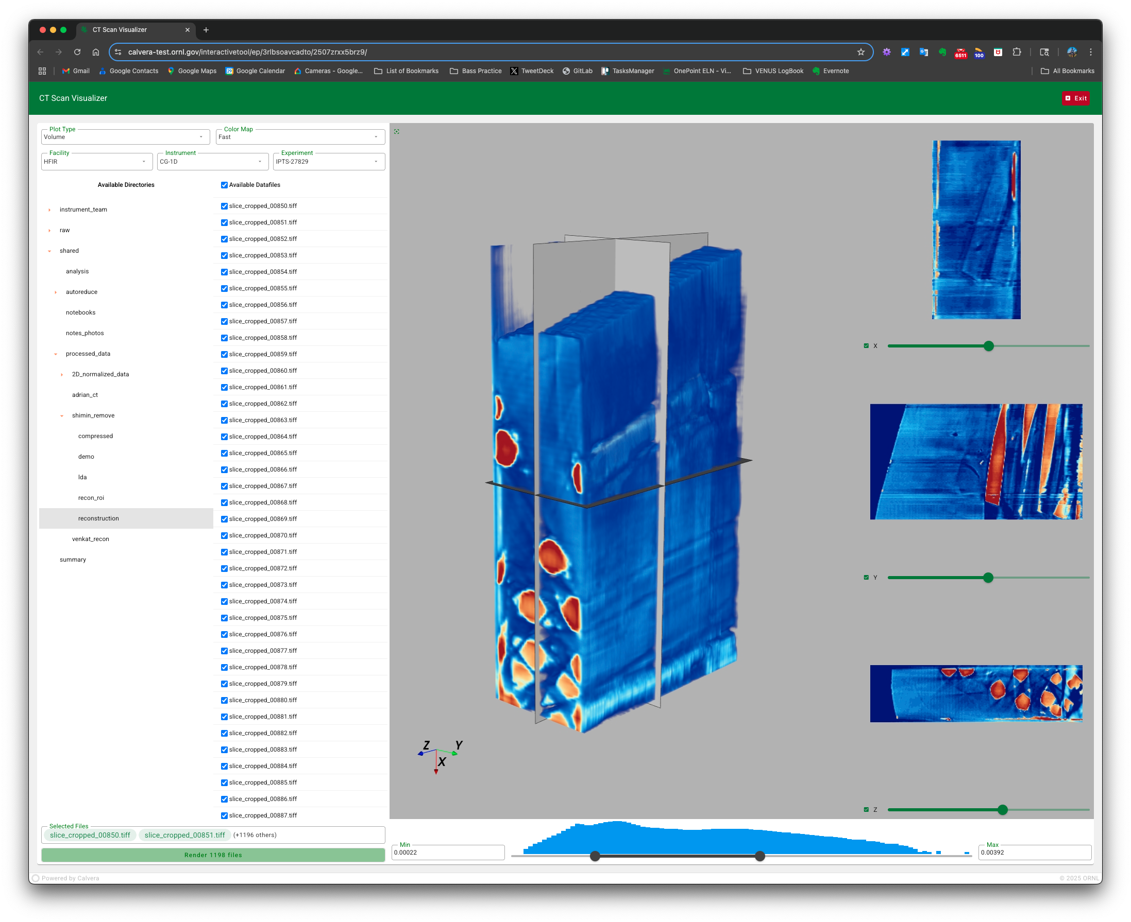
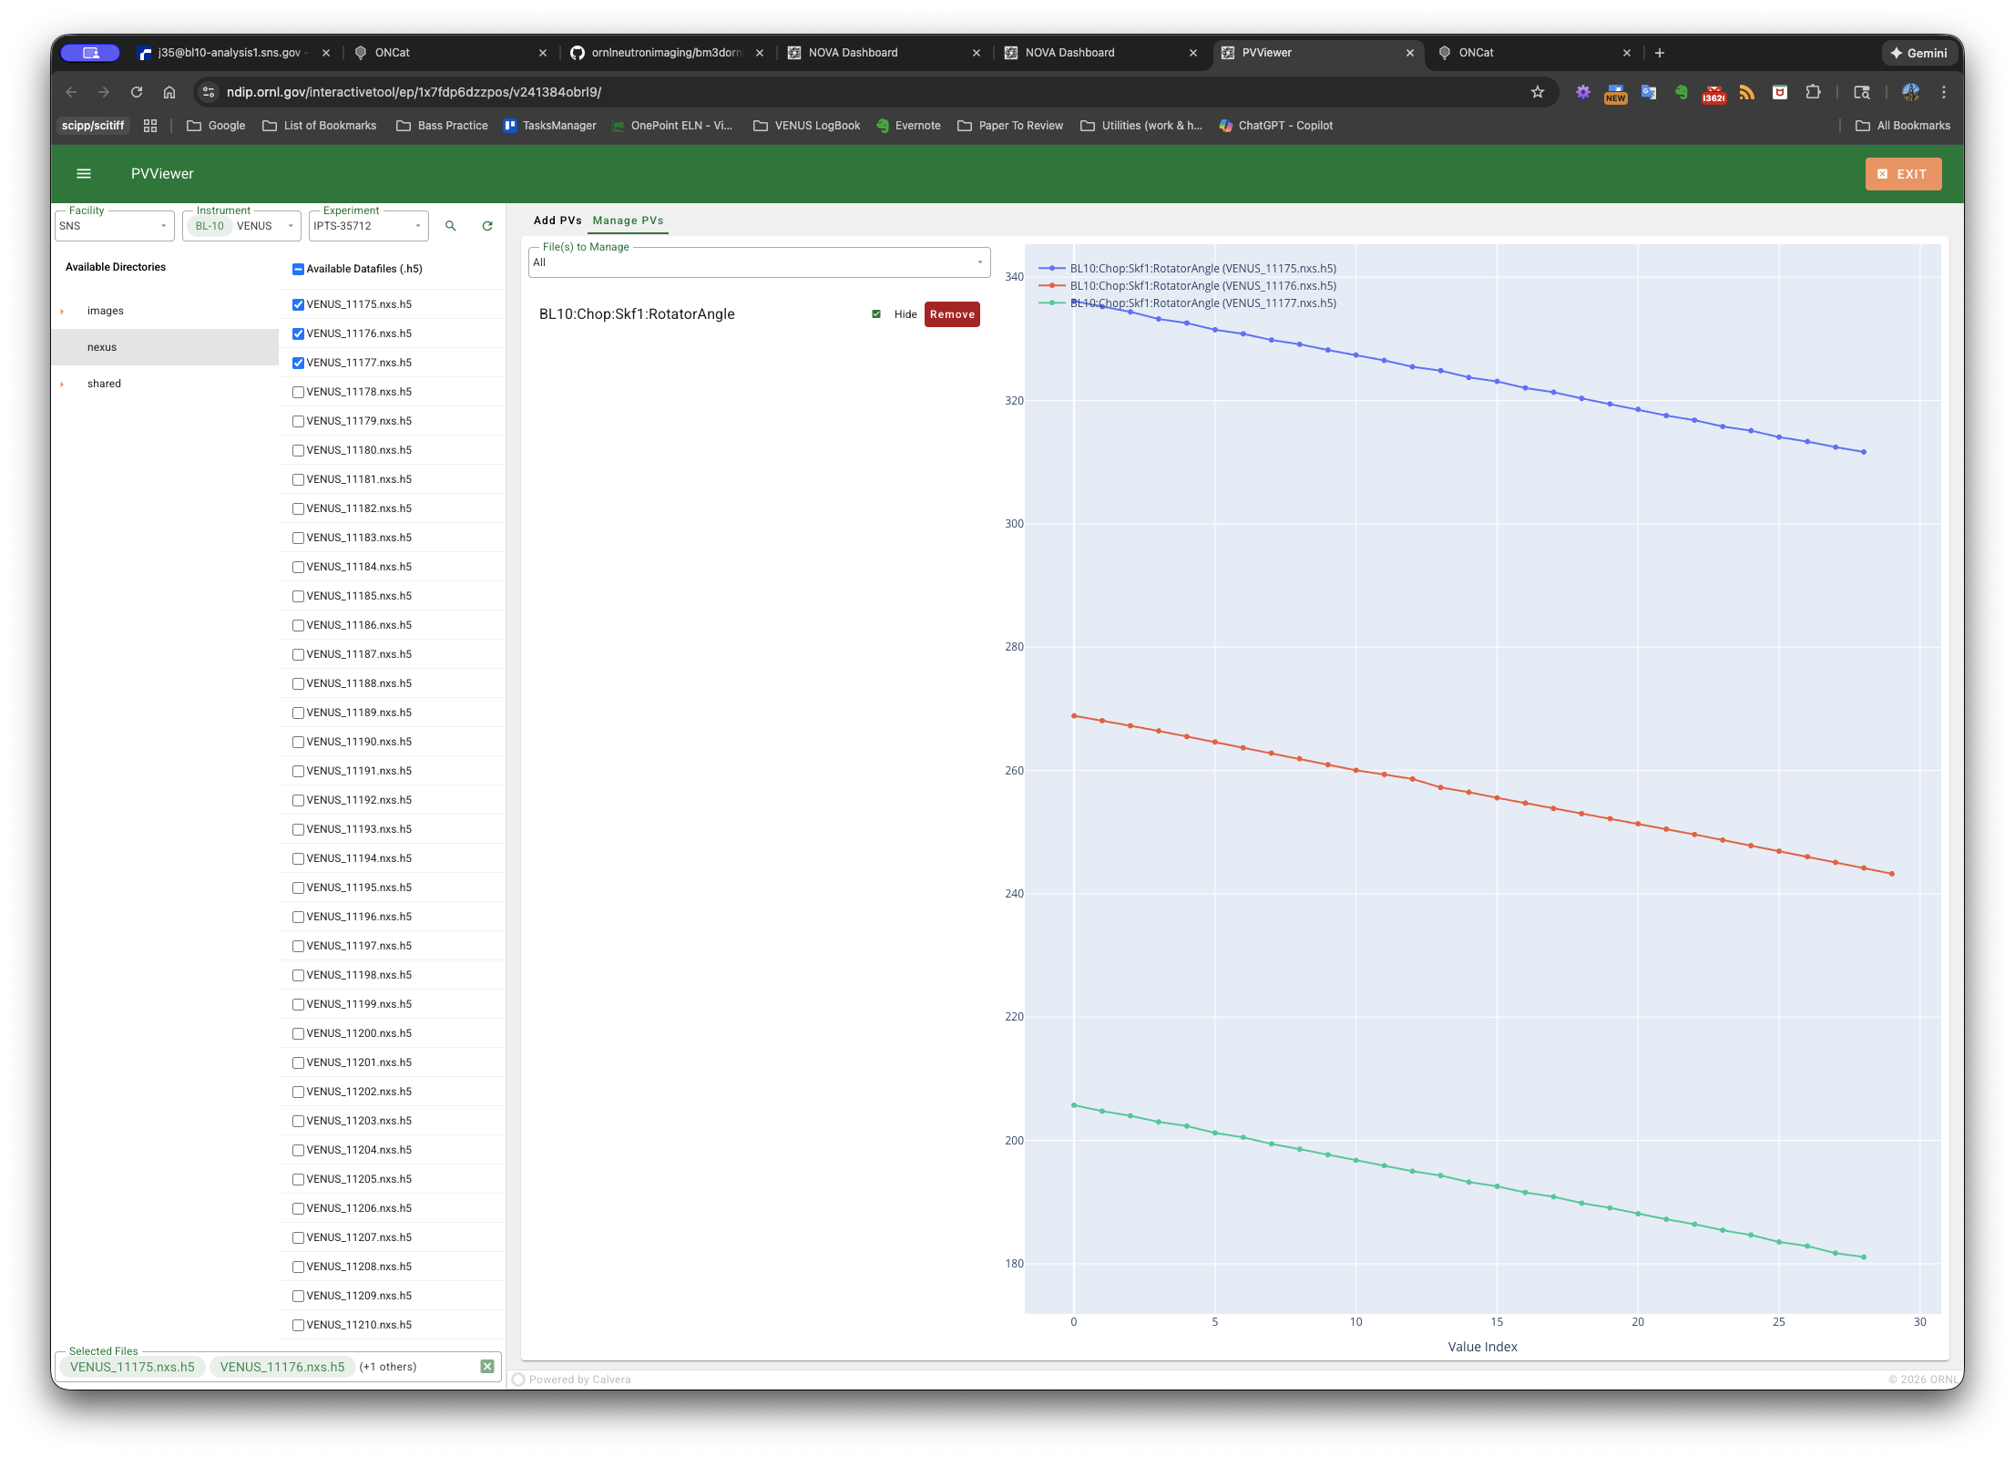
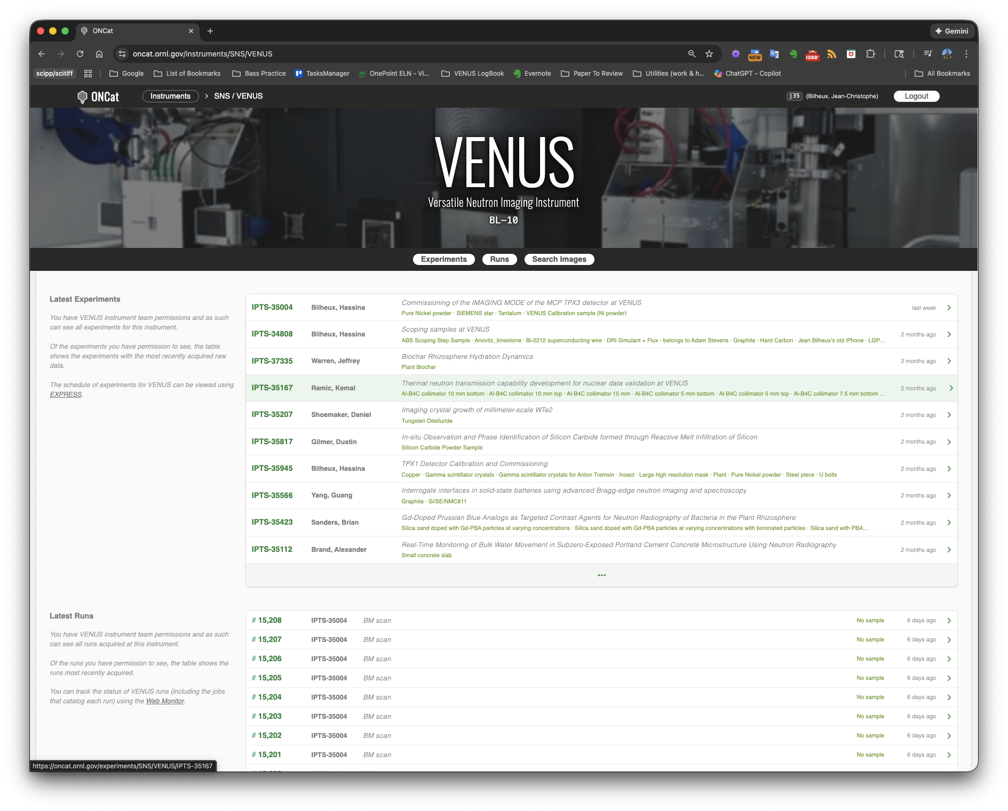

Web applications
Interactive Periodic Table
Bragg edge simulator
NEUIT (neuit.ornl.gov)
Transmission evaluation (ICON added)
Resonance evaluation
Composition converter
TOF plotter
Bragg edge simulator
Golden angles
From XRD to Bragg peaks
Interactive periodic table
ONCat – Web cataloguing tool (oncat.ornl.gov)
CT visualization (NOVA)
NeXus metadata viewer - PVViewer (NOVA)
Neutron transmission calculator
CT visualization
PVViewer
ONCat

Slide 28
Table of contents
What we have now
Process the raw data
Data analysis and processing
Notebooks
standalone
Data Visualization
Web Applications
Documentation / tutorials
What we have been doing recently
What we are planning on doing

Slide 29
Table of contents
What we have now
Process the raw data
Data analysis and processing
Notebooks
standalone
Data Visualization
Web Applications
Documentation / tutorials
What we have been doing recently
What we are planning on doing

Slide 30



Documentation - Tutorials
All our tools are open source
github.com/ornlneutronimaging
Librairies available via pip install
www.neutronimaging.ornl.gov
Guidance to users to use our tools
Access their data
Tutorials
Contacts

Slide 31
Table of contents
What we have now
Process the raw data
Data analysis and processing
Notebooks
standalone
Data Visualization
Web Applications
Documentation / tutorials
What we have been doing recently
What we are planning on doing

Slide 32
Table of contents
What we have now
Process the raw data
Data analysis and processing
Notebooks
standalone
Data Visualization
Web Applications
Documentation / tutorials
What we have been doing recently
What we are planning on doing

Slide 33
Recent work
Modernization of some of our tools (deployment, infrastructure, documentation, …)
BraggEdge library
iBeatles
Python notebooks
Timepix3 software to process the raw data into stack of TIFF
Timepix geometry correction – correct gaps between the chips
Suite of VENUS notebook implemented during commissioning
BM3D ring artifact filtering – GPU capable
Resonance notebooks (normalization and filtering) –
collaboration with LANL

Slide 34
Recent work (continued)
CT reconstruction suite of notebooks
New algorithms (svMBIR, MBIRjax)
Parallel processing for large data sets
Taking advantage of copilot/ML tools for programming (huge gain of time)
Create documentation
Create unit tests
Find and fix programming errors
Implement tools
Create requirement documents
…
3D strain mapping – ongoing international collaboration
NeXus metadata viewer
Web 3D visualization tool

Slide 35
Table of contents
What we have now
Process the raw data
Data analysis and processing
Notebooks
standalone
Data Visualization
Web Applications
Documentation / tutorials
What we have been doing recently
What we are planning on doing

Slide 36
Table of contents
What we have now
Process the raw data
Data analysis and processing
Notebooks
standalone
Data Visualization
Web Applications
Documentation / tutorials
What we have been doing recently
What we are planning on doing

Slide 37
Future work
NeuNorm – full modernization of our main normalization code
Make it work for white and TOF beams
Add uncertainties
Add new requirements we collected over the past few years
iBeatles – move to a more flexible code structure (+130,000 lines of code) where UI and code are not tangled.
Imaging notebooks – refactoring of structure
80+ notebooks that needs to be subdivided in sub-categories
Common tools will move to libraries (widgets, utilities…)
Notebooks were initially implemented for white beam imaging, they need to be modified to work with TOF data
Resonance – needs to be modified to work with 2D mapping for CT resonance reconstruction
ML Segmentation (GENESIS)

Slide 38
Future work (continued)
Add laminography CT reconstruction capability to notebooks
Add our in-house ring artifact filter (ORNLbm3d) to CT workflow
Add uncertainties to all tools
Switch to scitiff format (ESS standard)
Use of ML to replace scripts at the beam line
Ex: I want to run this sample for 2 hours at this position, then ….
Etc.

Slide 39


Contributors
Svmbir / mbirjax
Venkat Venkatakrishnan
Charlie Bouman (Purdue)
Greg Buzzard (Purdue)
Samin Chowdhury (Purdue)
iNEUIT
Yuxuan Zhang
Mark Zambito
Pleiades
Alex Long (LANL)
Tsviki Hirsh (LANL)
HyperCT
Greg Guyotte
Shimin Tang
Ray Gregory
Jean Bilheux
Chen Zhang
(matrix)
Angel 2.0
Simon Sebolt (FRMII)
Tobias Neuwirth (FRMII)
100%
50%
Nova
Sergey Yakubov
Dave Pugmire
Ken Moreland
Greg Cage
John Duggan
Andrew Ayres
Greg Watson
Kristin Maroun
timepix3
Zach Thurman
Greg Guyotte
Jim Kohl
Kaz Gofron
Klemen Vodopivec
3D strain mapping
Samin Chowdhury (Purdue)
Charlie Bouman (Purdue)
Greg Buzzard (Purdue)
Xiaogang Yang (BNL)
Prof Wensrich (Uni. Australia)
AI segmentation
Obaid Rahman
Anika Tabassum
Xiao Wang
Amir Ziabari
ONCat
Peter Parker
Collaborations color legend
ORNL
Outside ORNL
ORNL & Outside ORNL

Slide 40
Acknowledgements
Research sponsored by the Laboratory Directed Research and Development Program of Oak Ridge National Laboratory, managed by UT-Battelle LLC, for DOE.
Resources at the High Flux Isotope Reactor (HFIR) and Spallation Neutron source (SNS), U.S. DOE Office of Science User Facilities operated by ORNL, were used in the research.
Research at Manufacturing Demonstration Facility (MDF) was sponsored by the U.S. Department of Energy, Office of Energy Efficiency and Renewable Energy, Advanced Manufacturing Office, under contract DE-AC05-00OR22725 with UT-Battelle, LLC.
Research at National Transportation Research Facility was sponsored by the U.S. Department of Energy, Office of Energy Efficiency and Renewable Energy, Vehicle Technologies Office.
Notes:
LDRD

Slide 41
Thank you
Questions ?
Notes:
Image - 2021-P09584: Aerial overview of the Spallation Neutron Source, SNS, and the future location for the SNS Second Target Station, September 30, 2021. This image has been reviewed by an ORNL Releasing Official and is approved for public release, September 26, 2022.

Slide 42
Extra slides

Slide 43







High-Performance Neutron Event Reconstruction
Timepix3 Detector software
⚡ EXTREME PERFORMANCE
🔧 HYBRID ARCHITECTURE
💾 MEMORY EFFICIENT
96 Million hits/second
C++ speed + Python ease
500GB+ files, 512MB RAM
📦 EASY INSTALLATION
🔓 OPEN & CONFIGURABLE
PyPI & Conda packages
GPL-3.0 • 4 algorithms
resonance
Bragg edge
Production-ready software delivering 96 million hits/second throughput, enabling VENUS to process the largest neutron imaging datasets without hardware limitations.
Notes:
---
OPENING
This slide highlights TDCSophiread, our production-grade data processing software that transforms raw TPX3 detector output into scientifically usable neutron events for VENUS.
---
HEADER TABS - Five Key Features
Five key capabilities define this software:
Extreme performance — processing 96 million hits per second, which is close to VNEUS’s detector’s theoretical maximum data rate (120 mhits/sec).
Hybrid architecture — a C++ computational core for speed, wrapped in Python for scientist accessibility.
Memory efficient — can process files exceeding 500 gigabytes using only 512 megabytes of RAM (bounded memory usage), through intelligent streaming.
Easy installation — available through standard package managers, pip and conda, with no compilation required.
Open and configurable — fully open source under GPL-3.0, with four selectable clustering algorithms for different experimental conditions.
---
DATA FLOW
The challenge we solve starts here. The TPX3 detector produces a continuous binary stream — millions of packets per second of raw bytes that are completely unreadable in their native form.
Each neutron interaction generates multiple pixel hits that arrive out of order and must be reconstructed. Without software to decode and cluster this data, the detector hardware is essentially unusable for science.
TDCSophiread transforms that binary stream into structured neutron events — each with precise X-Y position and time-of-flight — stored in standard HDF5 format compatible with the neutron science ecosystem.
With the neutron events, we can reconstruct multi-dimensional histograms that resolve both energy (tof) as well as spatial features.
Currente usage include neutron resonance imaging and Bragg edge strain mapping.
---
SOFTWARE ARCHITECTURE
At the top, a Python API provides the user-friendly interface that scientists expect — NumPy arrays, command-line tools, Jupyter notebook compatibility.
Pybind11 bindings connect Python to the C++ core with zero-copy data transfer — no performance penalty for the Python interface.
The C++ engine contains three parallel modules:
- A TPX3 parser handling section discovery and timing correction
- Four clustering algorithms optimized for different experimental conditions
- Streaming HDF5 output that enables processing of arbitrarily large files
All built on a parallel foundation using Intel's Threading Building Blocks library, memory-mapped I/O, and cache-optimized data structures.
This is not a prototype script — it's production software built to professional standards.
---
CLOSING
TDCSophiread is production-ready software delivering 96 million hits per second, enabling VENUS to process the largest neutron imaging datasets without hardware or software limitations. The development is a joint efforts between the software development team, VENUS instrument team, data acquisition team, and last but not the least, detector group.
The detector investment is only valuable if we can process its output — this software ensures we can do so at full data rates, with results published to PyPI, Conda, and archived on Zenodo for long-term sustainability.

