Slide 1
VENUS Sample Environment
Imaging Instrument Suite Review from FY23 to FY25
February 3-4, 2026
Harley Skorpenske, on behalf of the neutron imaging team
Neutron Scattering Division
Notes:
Accessing Title Slide Options
The standard ORNL presentation template includes five branded title slide layouts:
Title | Standard. The preferred layout for lab-wide and general presentations. Features a default aerial photograph of the lab.
Title | Custom Image. Allows replacement of the default background with a custom full-slide image (16:9 or 4:3 landscape format).
Title | Custom Portrait Image. Supports inclusion of a custom 4:3 portrait image positioned next to the introductory text.
Title | Custom Landscape Image. Supports inclusion of a custom 16:9 landscape image positioned next to the introductory text.
Title | Text Only. Offers additional space for longer titles and multiple presenters.
Additional Lab-approved title slides specific to directorates and user facilities are available in PowerPoint under the following folders: Custom Title Slides and User Facility Templates, located in Presentation Templates.
Custom Title Slide Guidelines
Image Rights. Any custom images, graphics, or photography must be owned by ORNL or used with documented permission from the original creator or source.
Appropriate Image Use. Select images that work well with the layout. Ensure the focal point of the image is not obscured by the title text and white overlay box.
Relevance and Impact. Visuals are a key element of effective communication. Whenever possible, use imagery that enhances the message of your presentation and reflects ORNL’s mission and values.
Quality and Clarity. Use high-resolution images for clarity on large screens. Avoid overly complex or dark images that may conflict with the title text.
Text-Only Option. If no appropriate or approved imagery is available, or if imagery is not permitted for the subject matter, the Title | Text Only layout provides a clean, professional alternative.
Learn more about ORNL presentations
https://ornl.sharepoint.com/sites/branding/SitePages/presentations.aspx

Slide 2
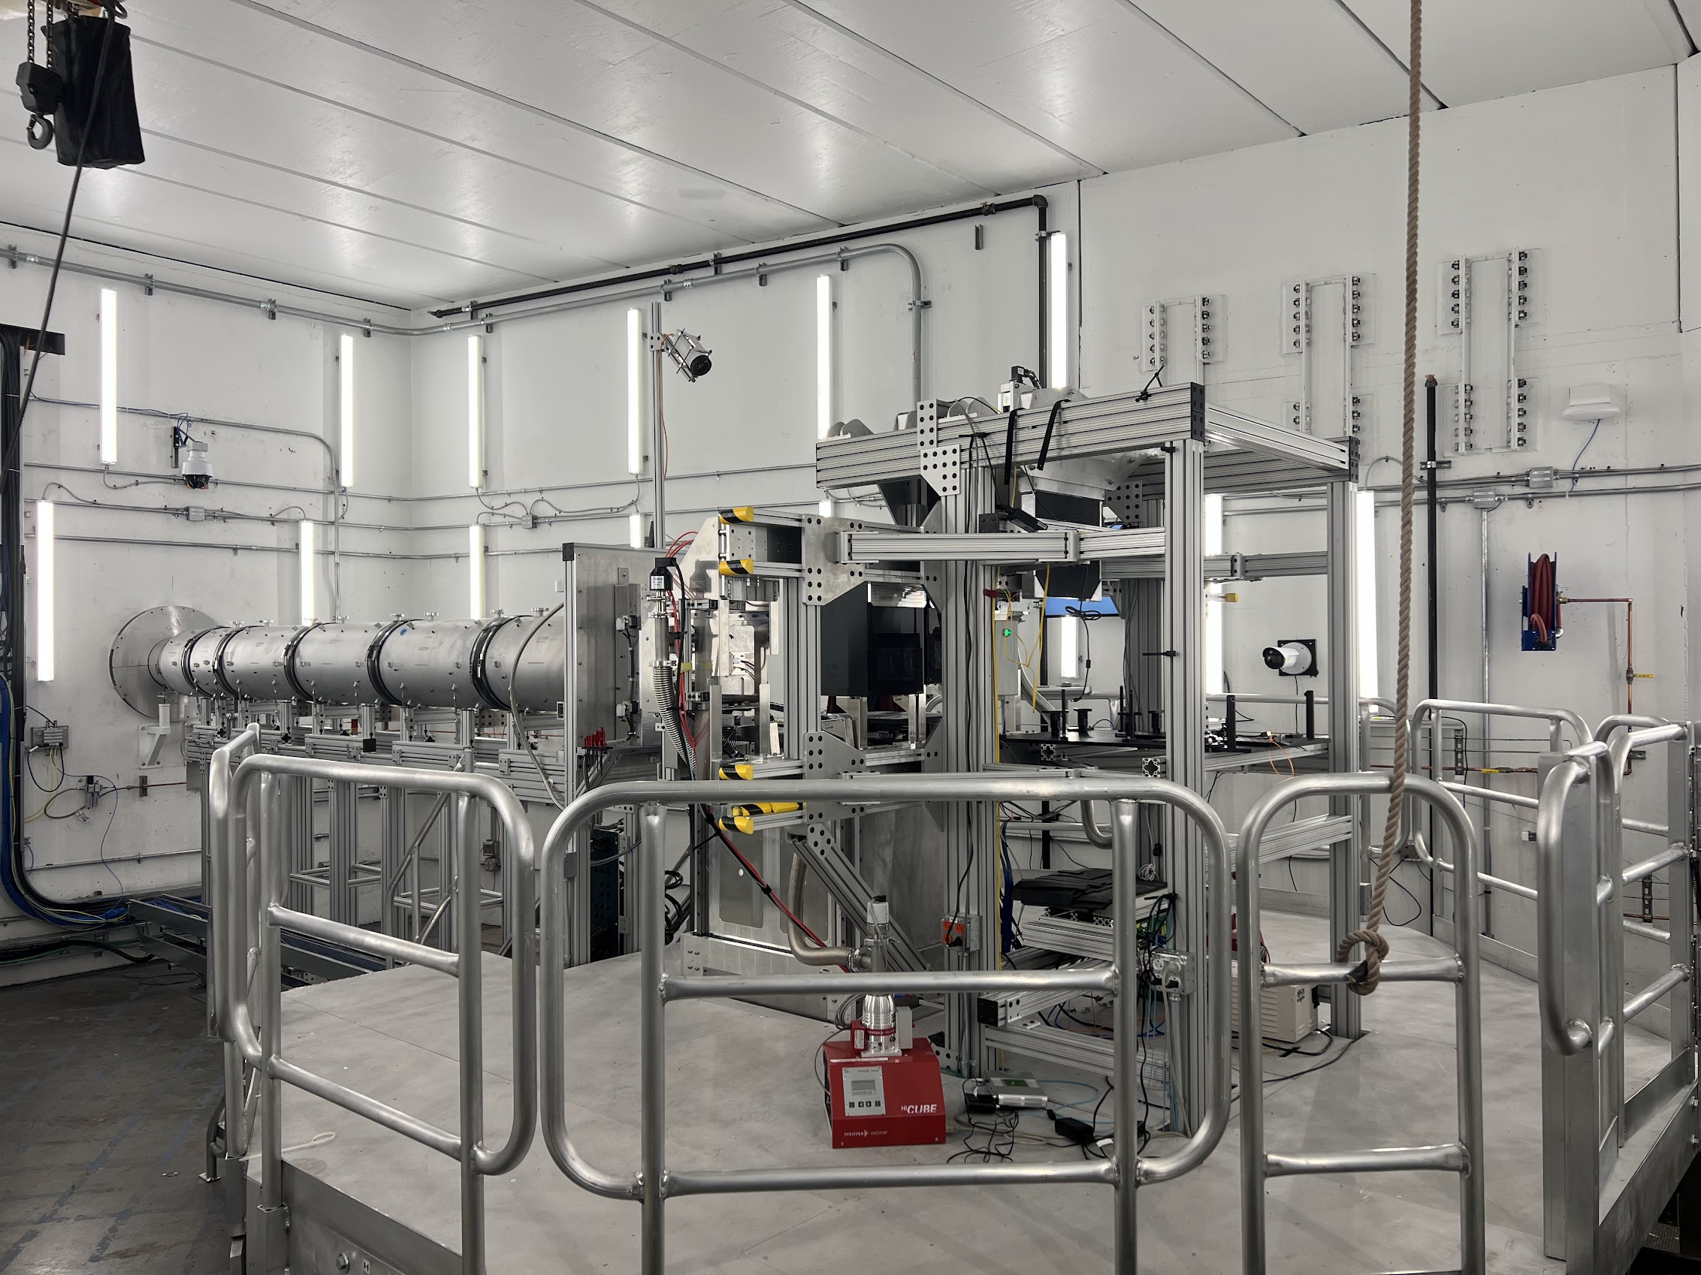
VENUS was built for maximum flexibility
2-ton crane
500kg capacity sample stage
0.6m x 0.9m breadboard interface
Dedicated 10kW chiller
VENUS can use the available suite of SE at SNS
Neutron beam
Sample/Sample environment platform

Slide 3
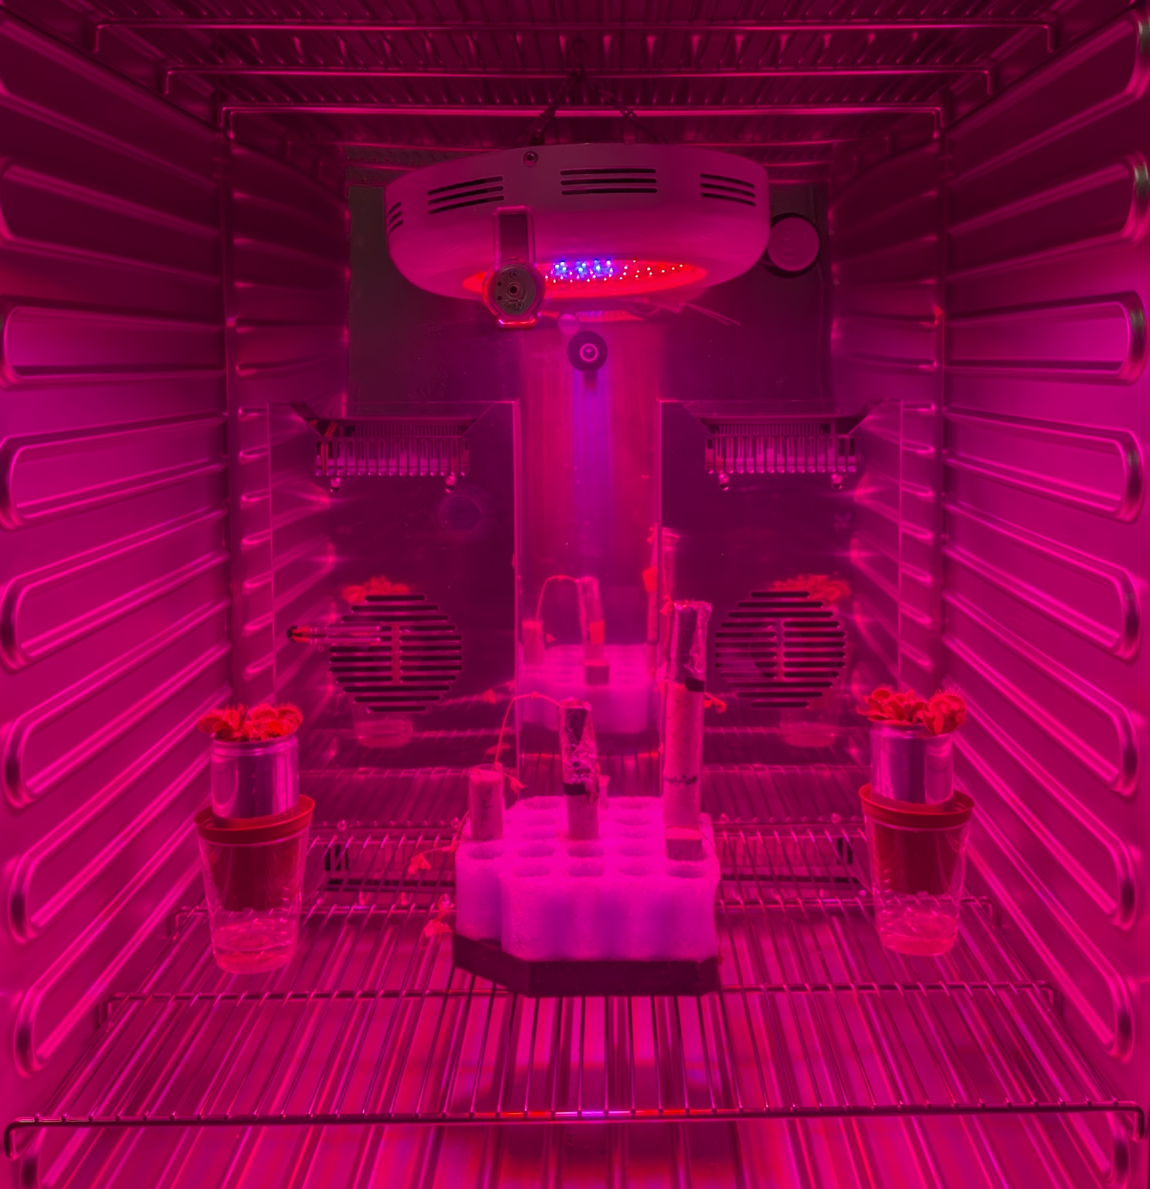
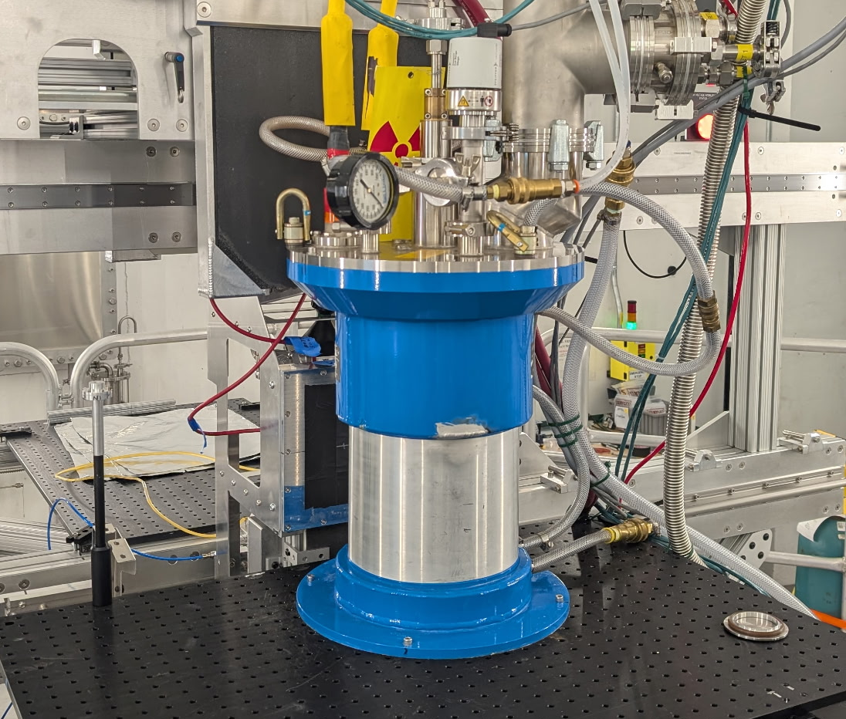
Community is Requesting Measurements with Advanced SE
2026A approved user experiments requiring 1500C Air Furnace, SNS vacuum furnace, and CCR
SNS vacuum furnace experiment November 2025
Potentiostat experiment November 2025
Growth chamber to keep plants alive for a large duration of time (weeks/months)
Refrigerator and freezer for biomedical and forensic research
User community is diverse, so we are continuously working to broaden the suite of capabilities

Slide 4
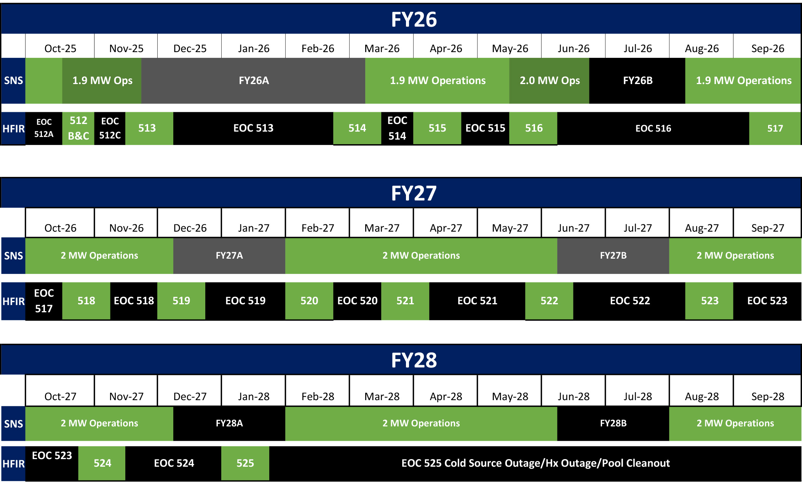
Tempo of Operations Cycles is Evolving
https://neutrons.ornl.gov/hfir/hfir-sns-5-year-working-schedule

Slide 5
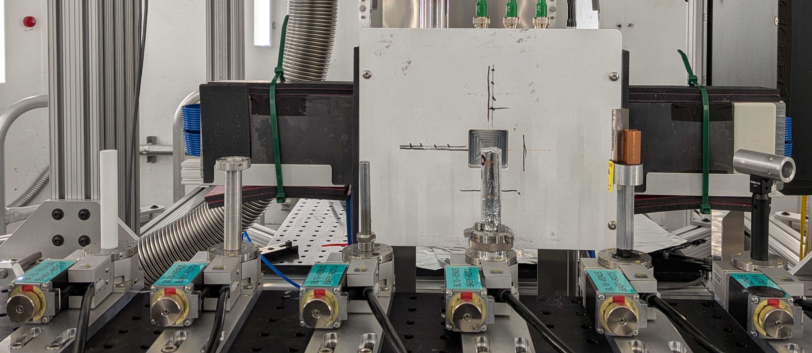
6 - Sample Changer Reliably Maximizes Beamtime Utilization
Sleep is possible and Mail-ins become feasible

Slide 6
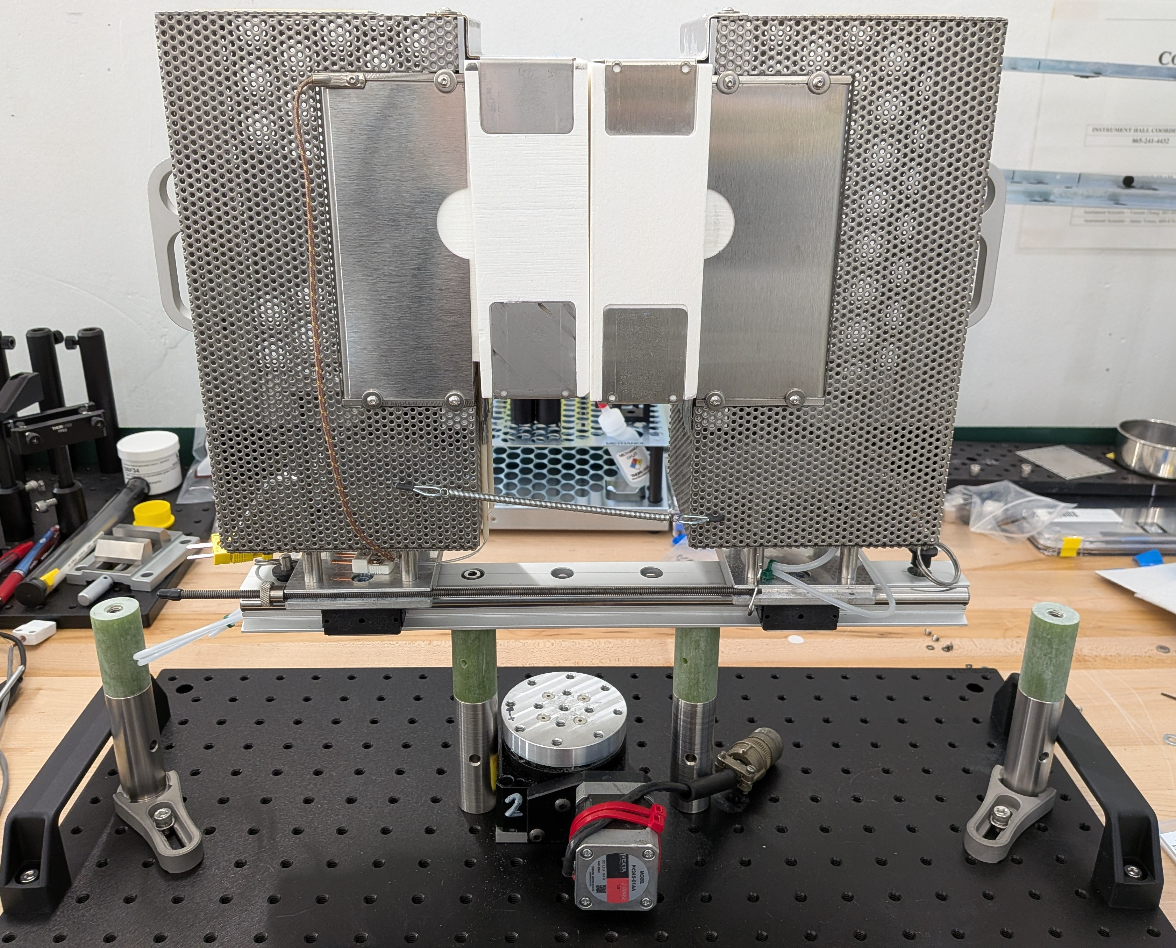
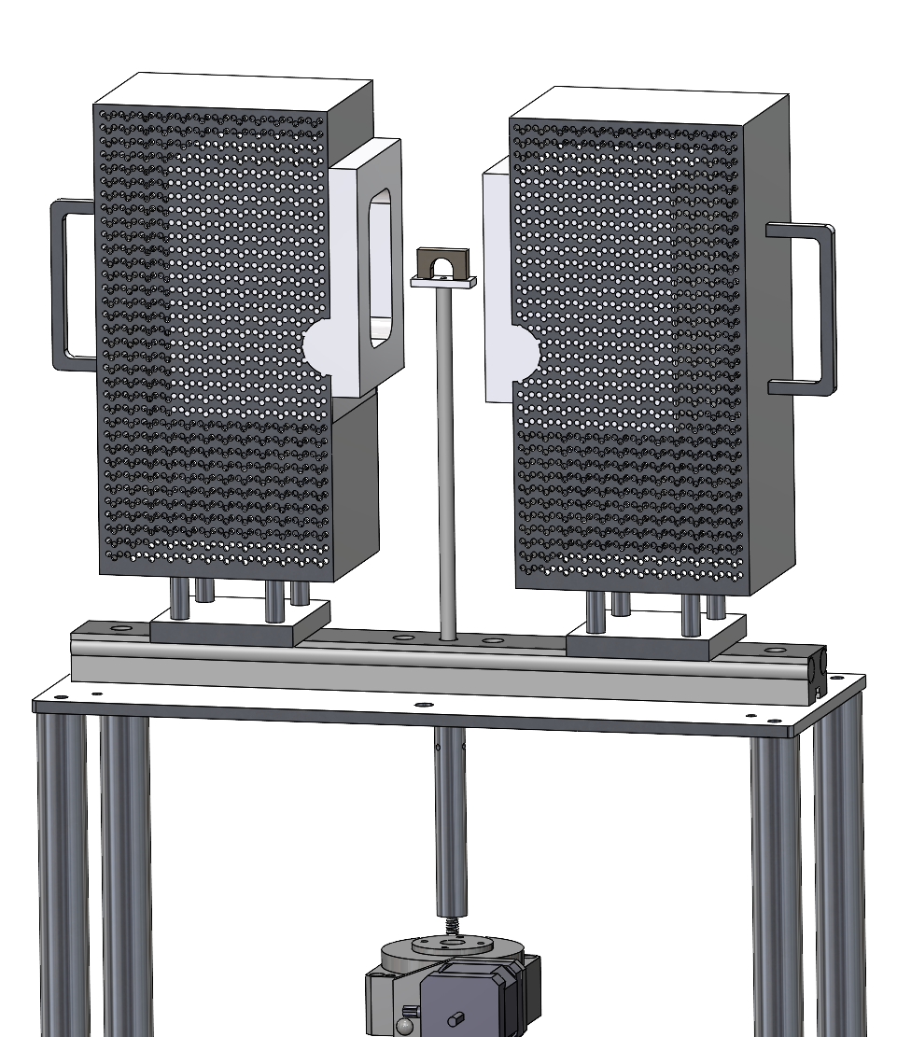
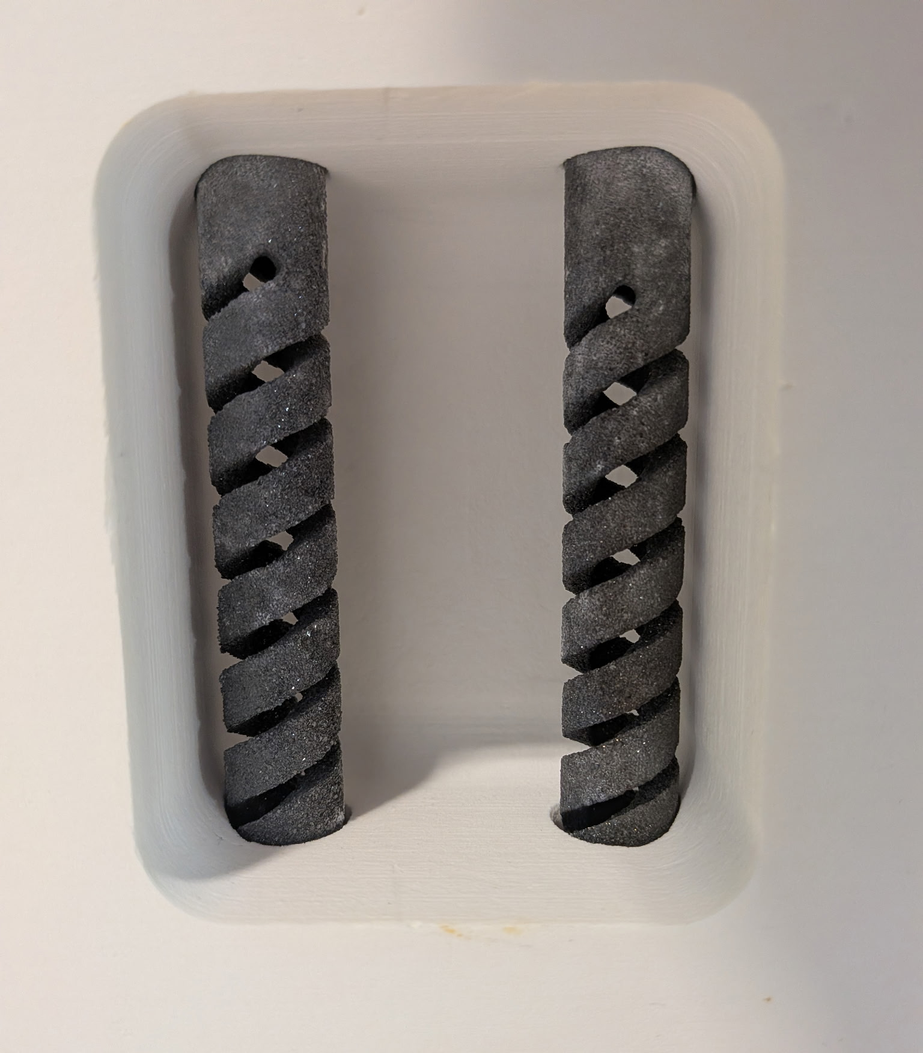
Air Furnace w/CT Capability for VENUS
1500°C SiC Elements
Integrated Rotation for CT Capability
Large Sample Chamber
  110mm x 70mm x 55mm

Slide 7
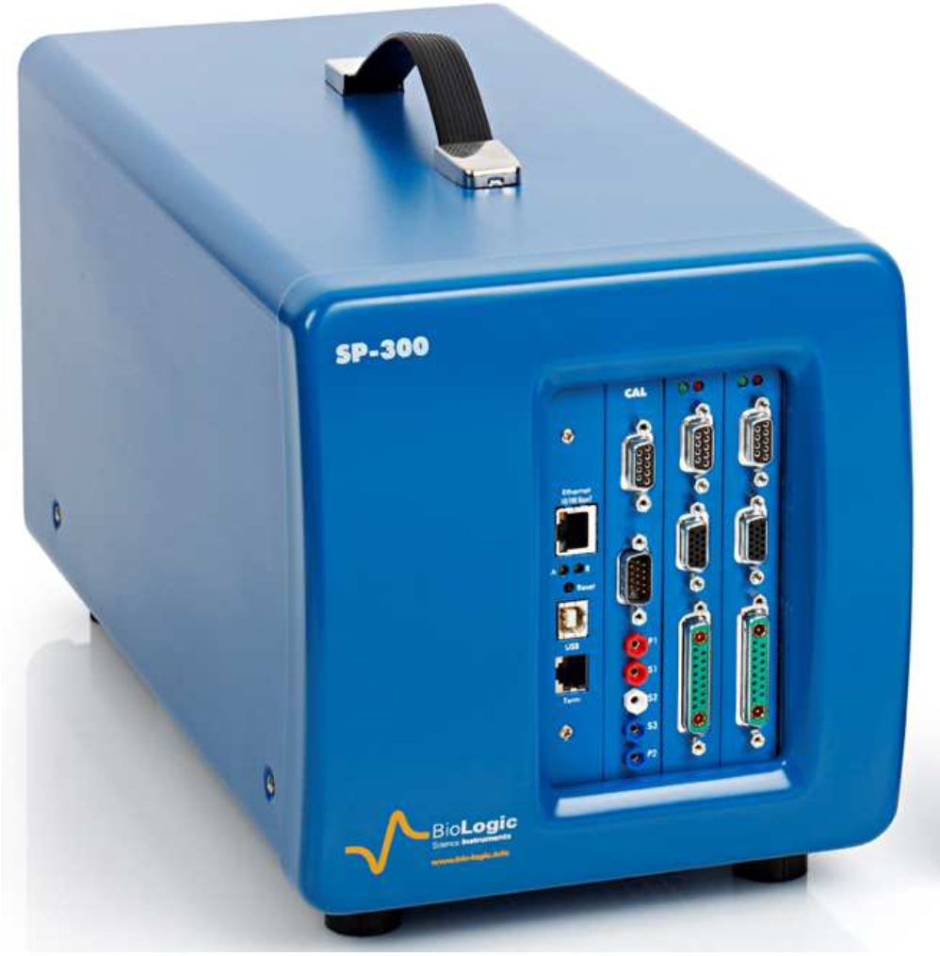
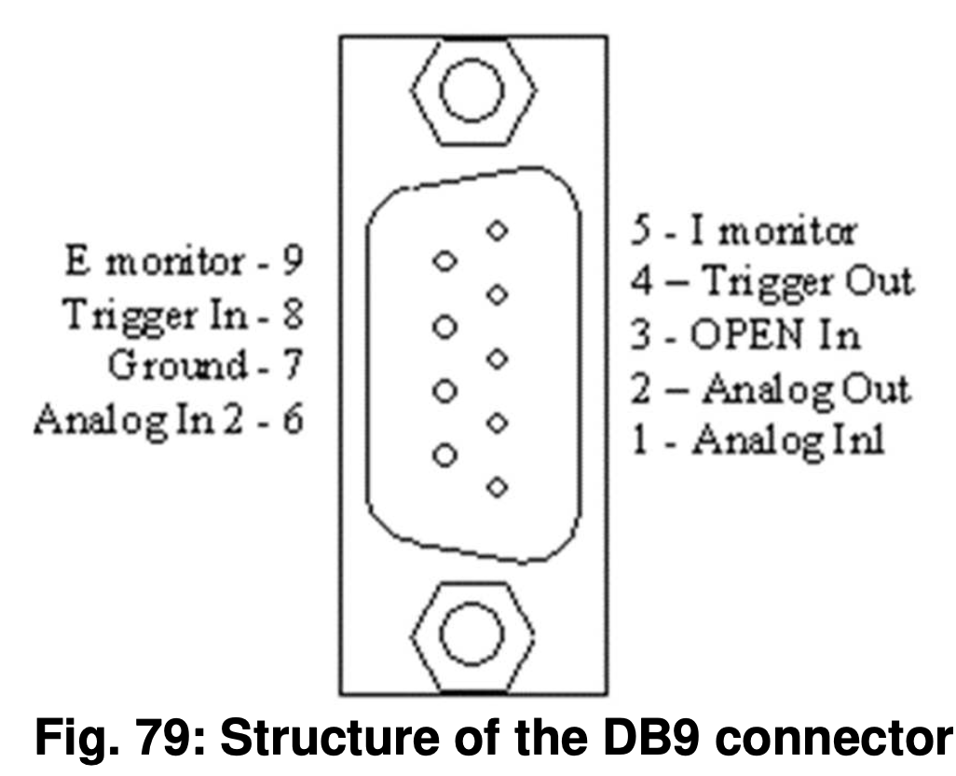
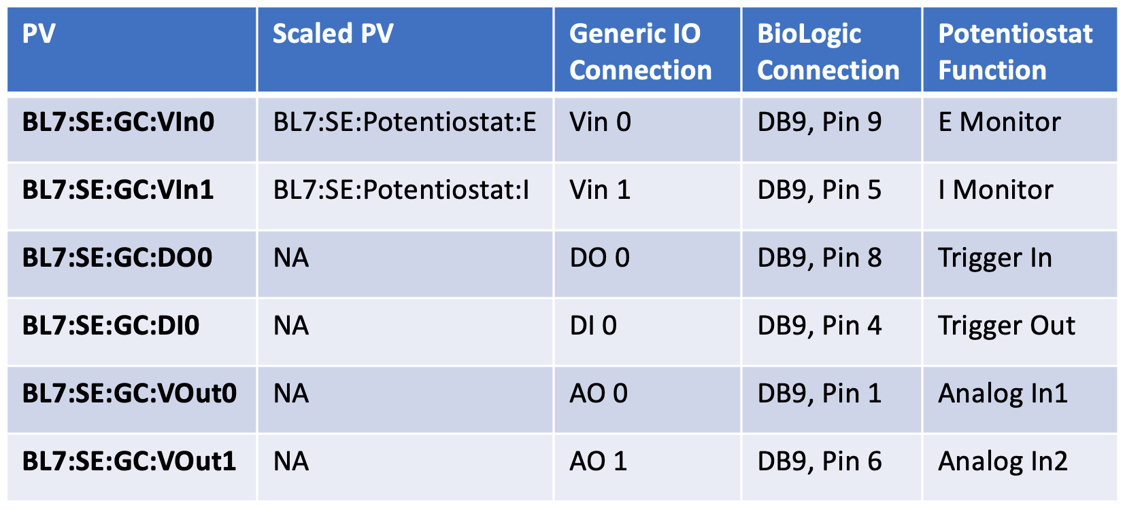
BioLogic Potentiostat for Electrochemistry

Slide 8
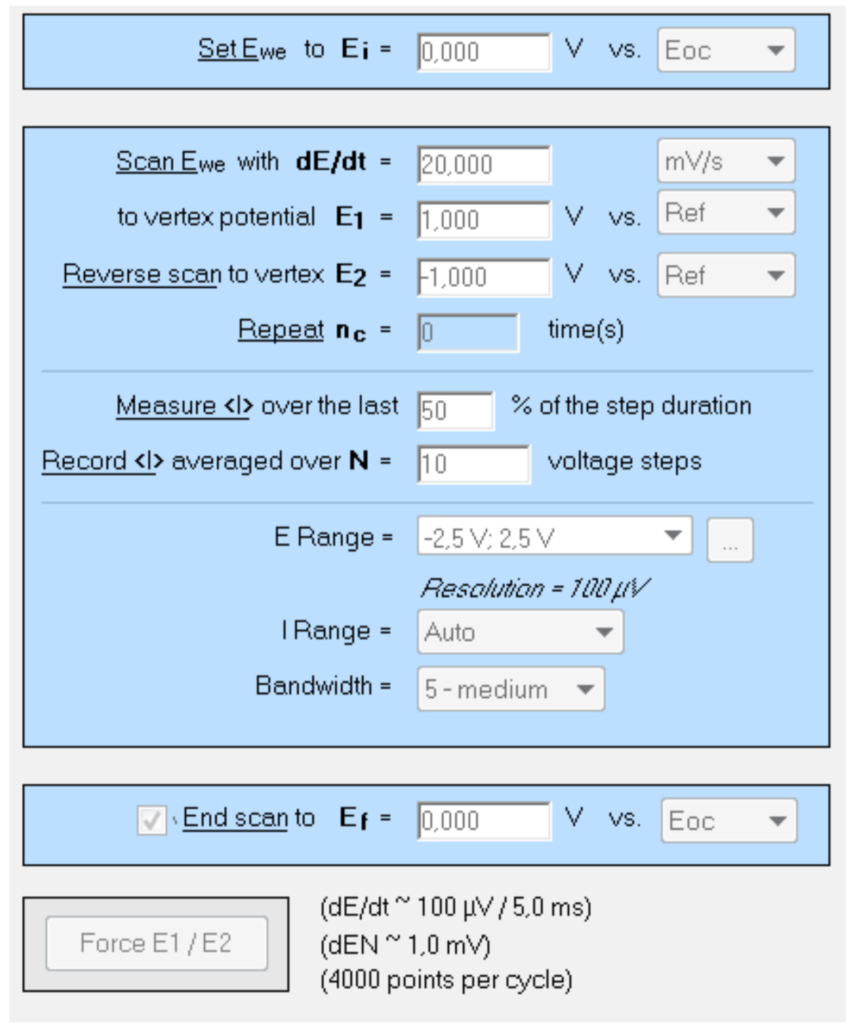
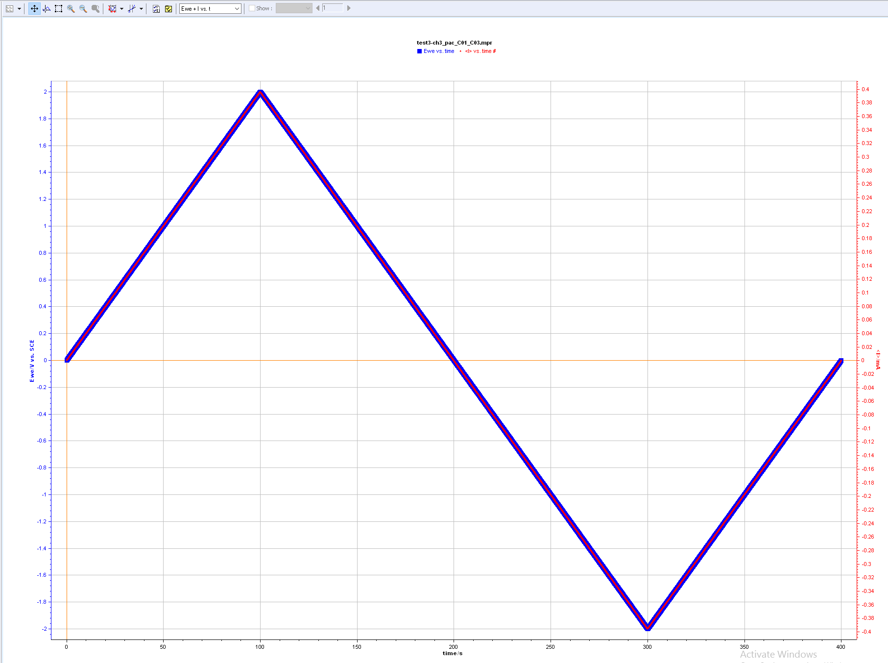
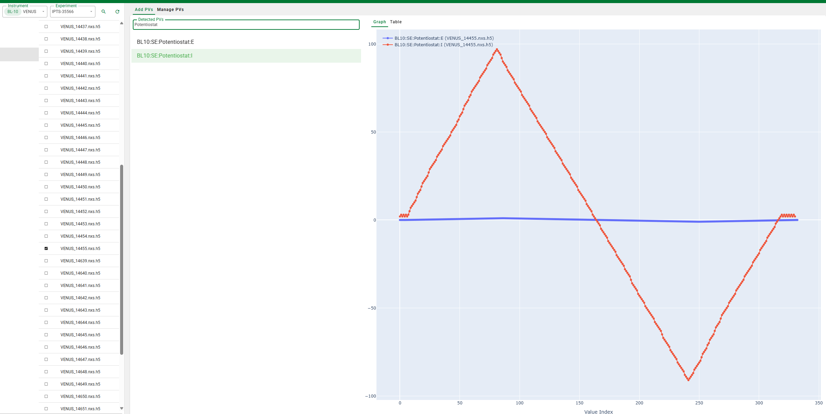
Vendor Software is Leveraged to Minimize Software Development
Signals are retransmitted to DAQ and ingested as PVs in the nexus file
Synchronization possible with triggers

Slide 9
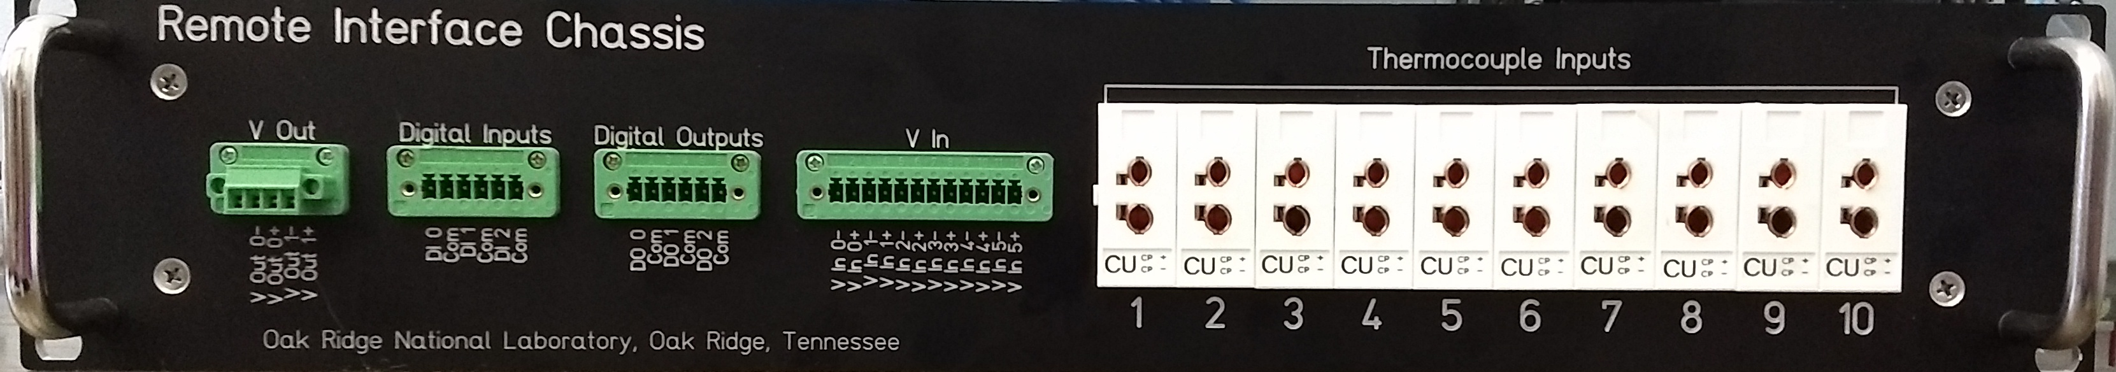
Generic Input/Output Interface –
For whatever users may bring
Enables significant versatility with no additional software development
  Parameter Value Re-transmission
  Digital I/O synchronization for sequencing runs
  OCD Level temperature characterization
  Need more? Just add another one!

