Slide 1
MARS
Imaging Instrument Suite Review from 2020 to 2025
February 3-4, 2026
Yuxuan Zhang, on behalf of the neutron imaging team
Notes:
Accessing Title Slide Options
The standard ORNL presentation template includes five branded title slide layouts:
Title | Standard. The preferred layout for lab-wide and general presentations. Features a default aerial photograph of the lab.
Title | Custom Image. Allows replacement of the default background with a custom full-slide image (16:9 or 4:3 landscape format).
Title | Custom Portrait Image. Supports inclusion of a custom 4:3 portrait image positioned next to the introductory text.
Title | Custom Landscape Image. Supports inclusion of a custom 16:9 landscape image positioned next to the introductory text.
Title | Text Only. Offers additional space for longer titles and multiple presenters.
Additional Lab-approved title slides specific to directorates and user facilities are available in PowerPoint under the following folders: Custom Title Slides and User Facility Templates, located in Presentation Templates.
Custom Title Slide Guidelines
Image Rights. Any custom images, graphics, or photography must be owned by ORNL or used with documented permission from the original creator or source.
Appropriate Image Use. Select images that work well with the layout. Ensure the focal point of the image is not obscured by the title text and white overlay box.
Relevance and Impact. Visuals are a key element of effective communication. Whenever possible, use imagery that enhances the message of your presentation and reflects ORNL’s mission and values.
Quality and Clarity. Use high-resolution images for clarity on large screens. Avoid overly complex or dark images that may conflict with the title text.
Text-Only Option. If no appropriate or approved imagery is available, or if imagery is not permitted for the subject matter, the Title | Text Only layout provides a clean, professional alternative.
Learn more about ORNL presentations
https://ornl.sharepoint.com/sites/branding/SitePages/presentations.aspx

Slide 2


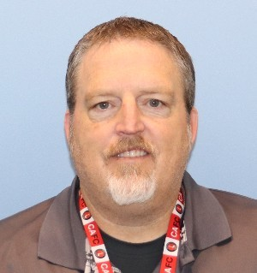
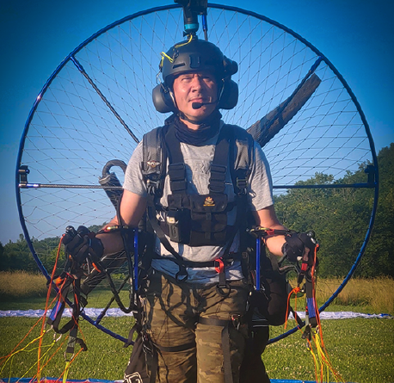

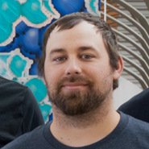
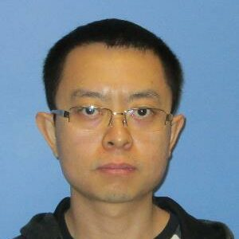
The MARS User Support Core Team (2020-2025)
 | 2020 | 2021 | 2022 | 2023 | 2024 | 2025
Yuxuan (IS) | 1 FTE | 1 FTE | 1 FTE | 1 FTE | 1 FTE | 1 FTE
Erik (SA) | 1 FTE | 1 FTE | 1 FTE | 1 FTE | .5 FTE
Jean (CIS) | .5 FTE | .5 FTE | .5 FTE | .5 FTE | <.5 FTE | <.5 FTE
Chen (CS) |  | .4 FTE | .4 FTE | .4 FTE | .4 FTE | .4 FTE
James (IS) |  |  |  | 1 FTE | 1 FTE | 1 FTE
Roger (SA) |  |  |  |  | .5 FTE | 1 FTE
Total | 2.5 FTE | 2.9 FTE | 2.9 FTE | 3.9 FTE | 3.9 FTE | 3.9 FTE
Since 2019.3
2019-2024
Yuxuan Zhang
Instrument Scientist
Erik Stringfellow
Scientific Associate
Jean Bilheux
Computational Instrument Scientist
Since 2023.7
Since 2024.2
Since 2021.6
James Torres
Instrument Scientist
Roger Hobbs
Scientific Associate
Chen Zhang
Computational Scientist
Notes:
This research used resources at the High Flux Isotope Reactor and Spallation Neutron Source, a DOE Office of Science User Facility operated by the
Oak Ridge National Laboratory. This work is based upon research sponsored by the Laboratory Directed Research and Development Program of Oak Ridge National Laboratory, managed by UT-Battelle LLC for the US Department of Energy.

Slide 3

The MARS User Support Core Team (2026)
 | 2020 | 2021 | 2022 | 2023 | 2024 | 2025 | 2026
Yuxuan (IS) | 1 FTE | 1 FTE | 1 FTE | 1 FTE | 1 FTE | 1 FTE | .5 FTE
Saurabh (IS) |  |  |  |  |  |  | .5 FTE
Erik (SA) | 1 FTE | 1 FTE | 1 FTE | 1 FTE | .5 FTE
Jean (CIS) | .5 FTE | .5 FTE | .5 FTE | .5 FTE | <.5 FTE | <.5 FTE | .5 FTE
Chen (CS) |  | .4 FTE | .4 FTE | .4 FTE | .4 FTE | .4 FTE | .4 FTE
James (IS) |  |  |  | 1 FTE | 1 FTE | 1 FTE | 1 FTE
Roger (SA) |  |  |  |  | .5 FTE | 1 FTE | 1 FTE
Total | 2.5 FTE | 2.9 FTE | 2.9 FTE | 3.9 FTE | 3.9 FTE | 3.9 FTE | 3.9 FTE
Since 2019.3
2026.2
Yuxuan Zhang
Instrument Scientist
Saurabh Kabra
Instrument Scientist
Jean Bilheux
Computational Instrument Scientist
Since 2023.7
Since 2024.2
Since 2021.6
James Torres
Instrument Scientist
Roger Hobbs
Scientific Associate
Chen Zhang
Computational Scientist
Notes:
This research used resources at the High Flux Isotope Reactor and Spallation Neutron Source, a DOE Office of Science User Facility operated by the
Oak Ridge National Laboratory. This work is based upon research sponsored by the Laboratory Directed Research and Development Program of Oak Ridge National Laboratory, managed by UT-Battelle LLC for the US Department of Energy.

Slide 4
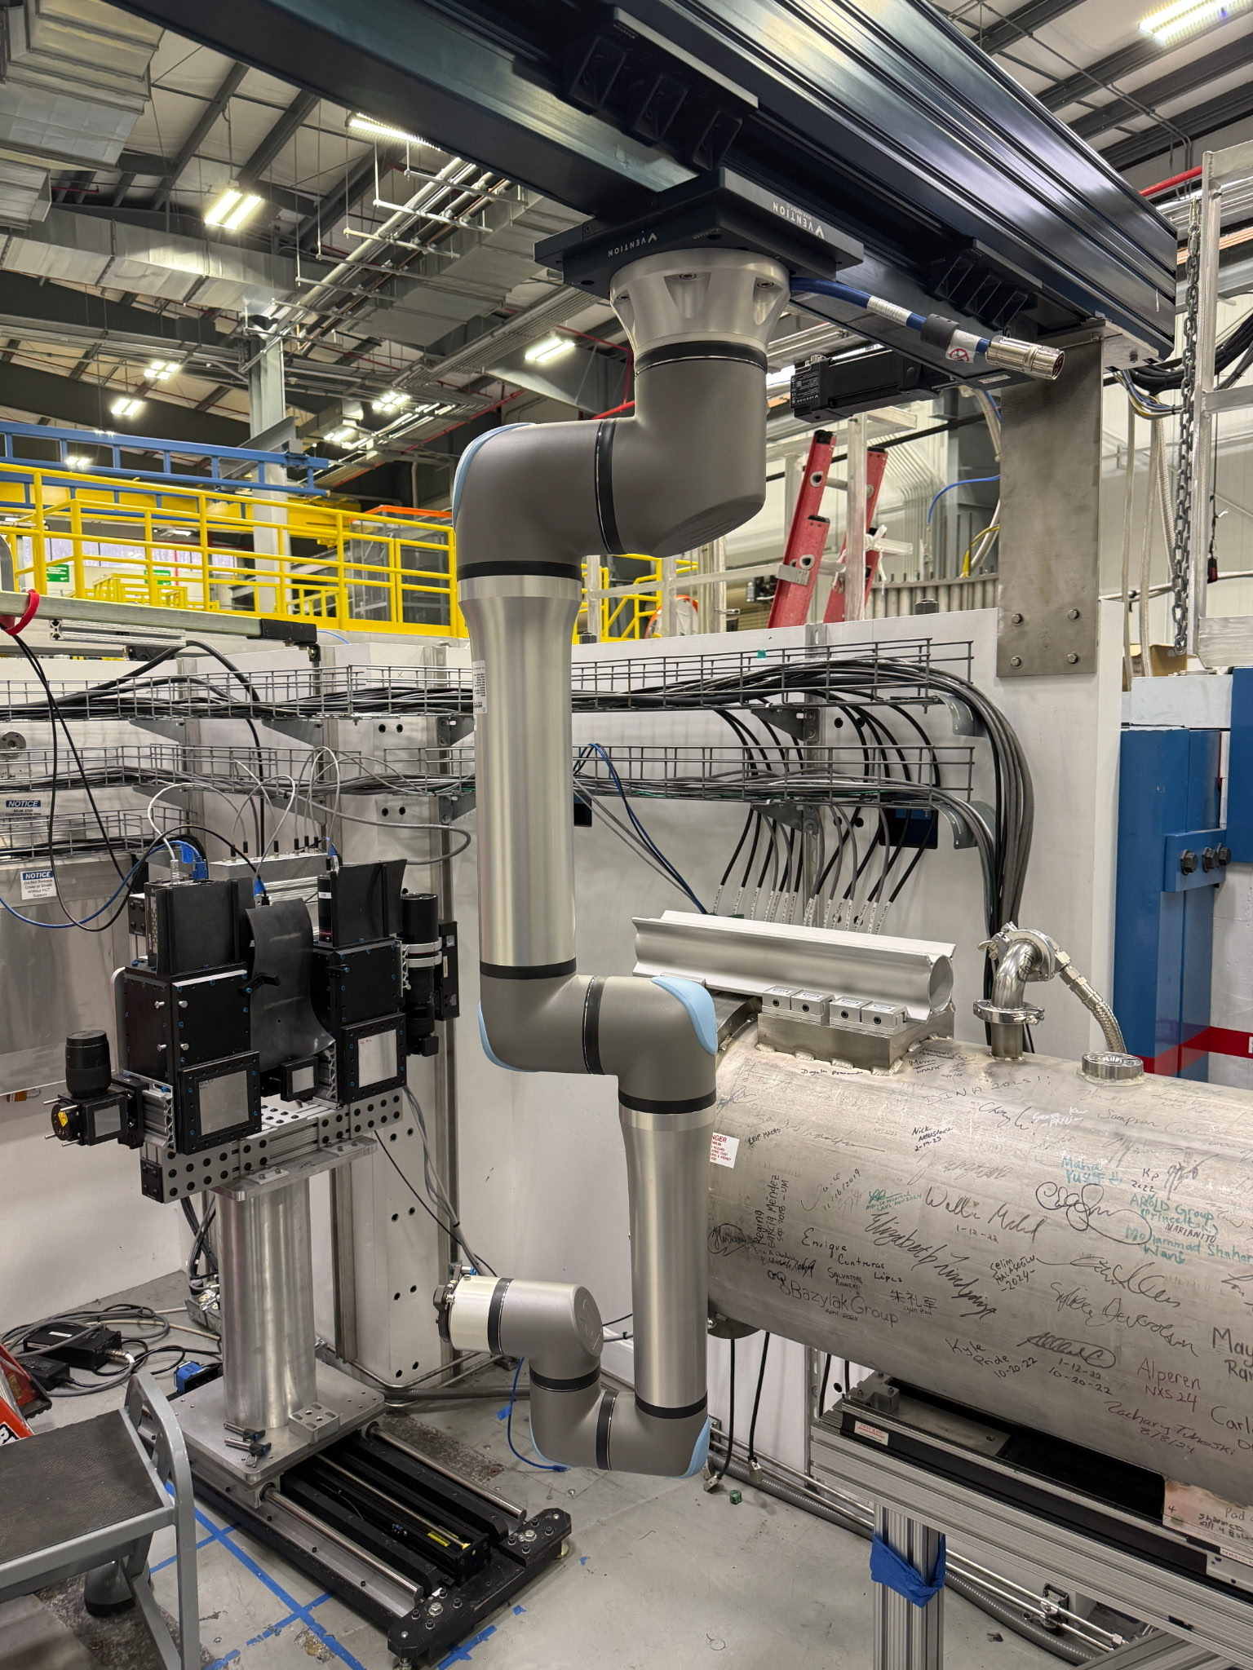
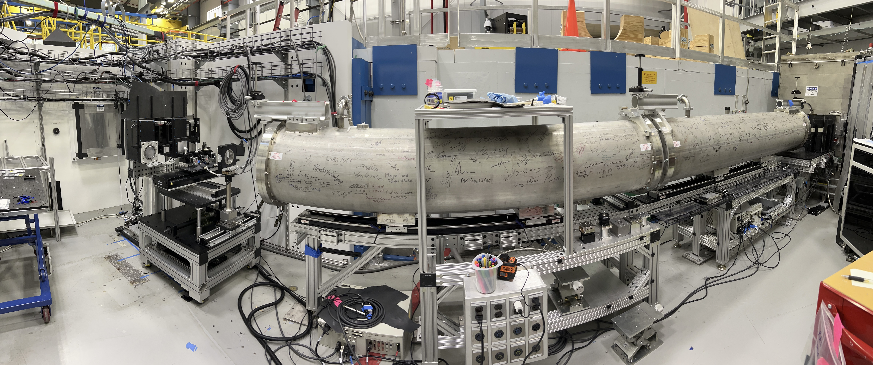
The Multimodal Advanced Radiography Station

Slide 5
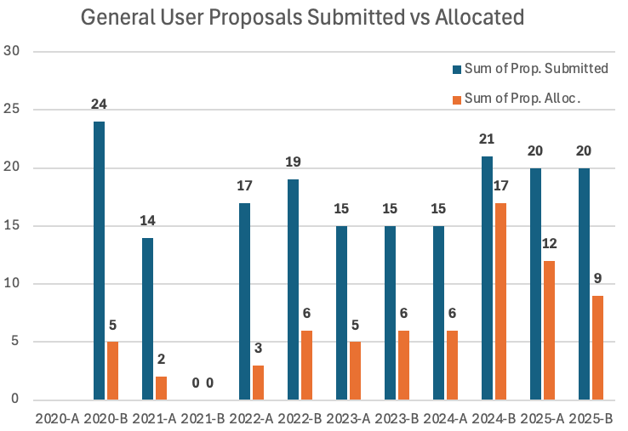
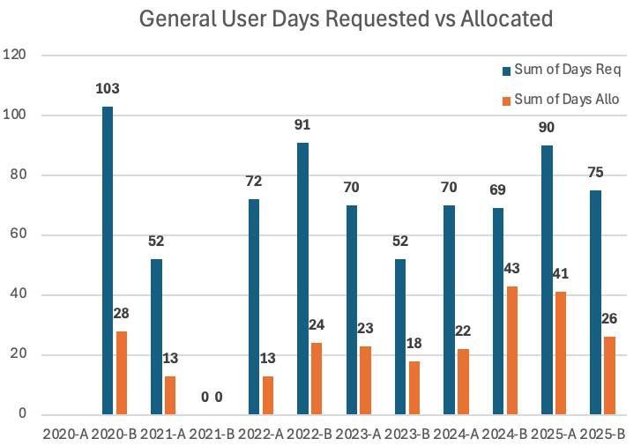
Oversubscription rate, average ≈ 2.96
The lowest score was 3.5

Slide 6
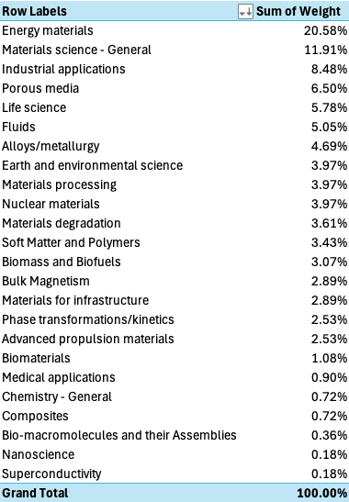
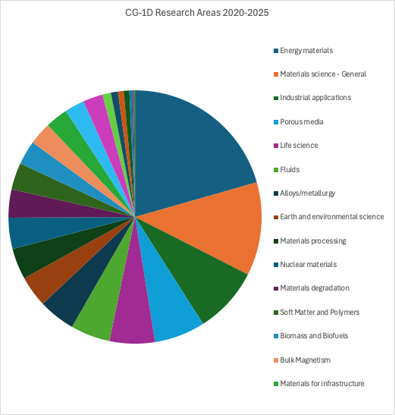
Research diversity at MARS

Slide 7
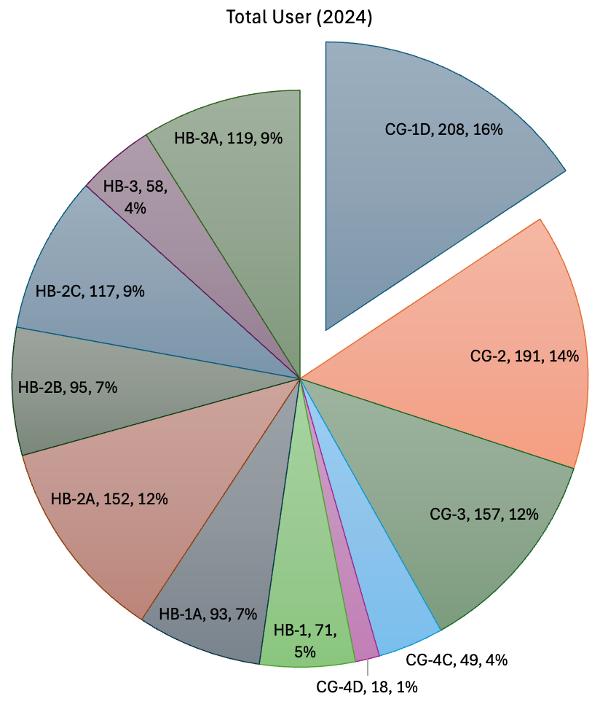
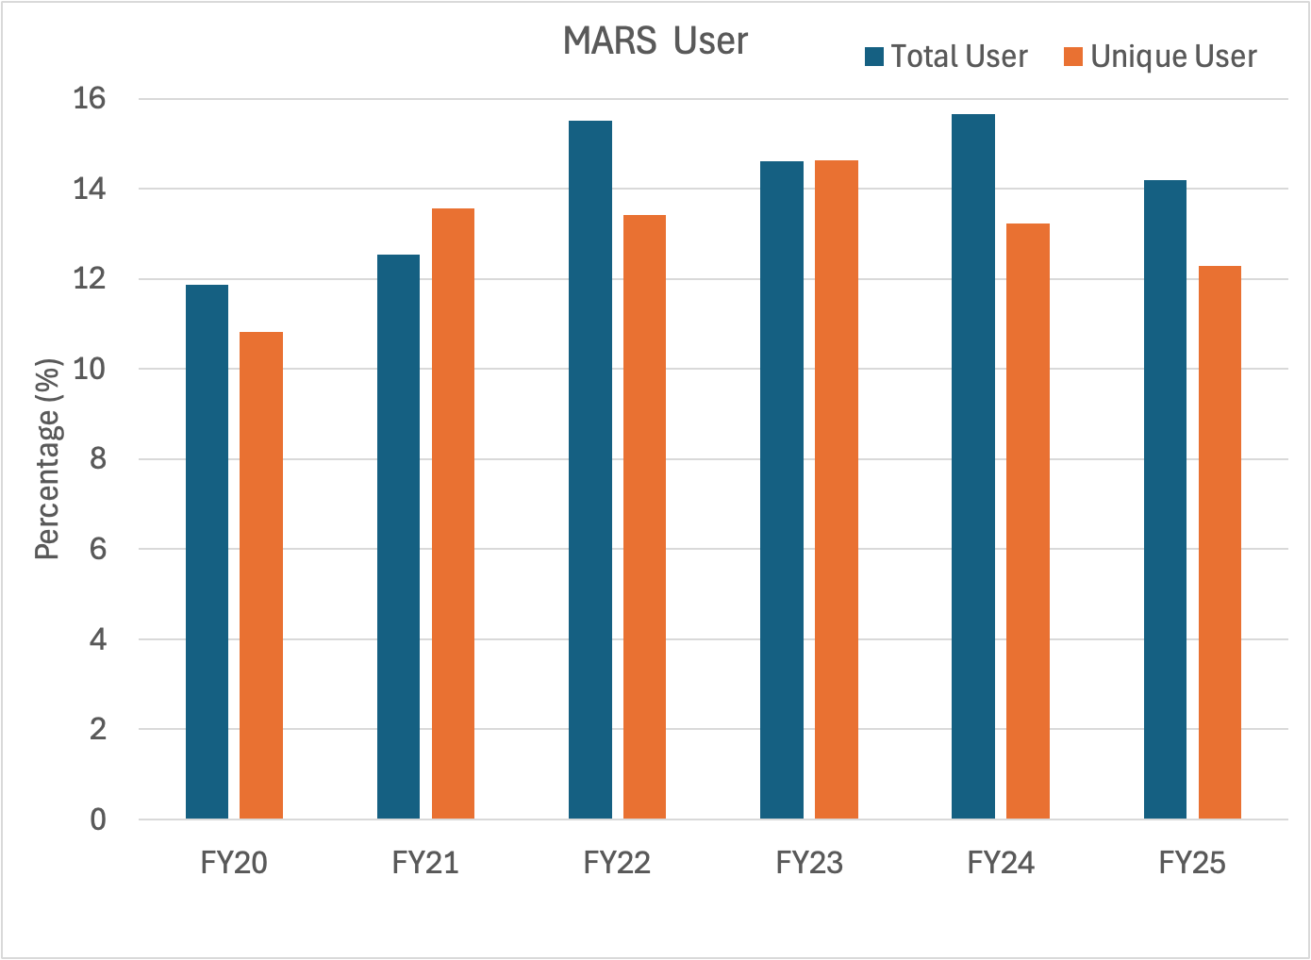
Since FY20, MARS users = 12-16% of HFIR users

Slide 8
Sample environments
Current
Custom user-supplied equipment
  Chiller and shielding (polarization)
  Concrete freezing stage
  H2 pressure cell
  Fuel cells
  Molten salt furnace
  TGA
  Battery cells
Biologic potentiostat
Shared SE
  Pressure (EAP) cells
  IR lamps
  Hot-A vacuum furnace
  Polarization (supermirror polarizer and 3He analyzer)
Amteco furnace: Molten salts
Plant growth chamber
Future
Expanded-cavity for Amteco furnace for larger samples
Replace aging plant growth chamber
Mechanical load frame(s)

Slide 9
MARS Highlights

Slide 10
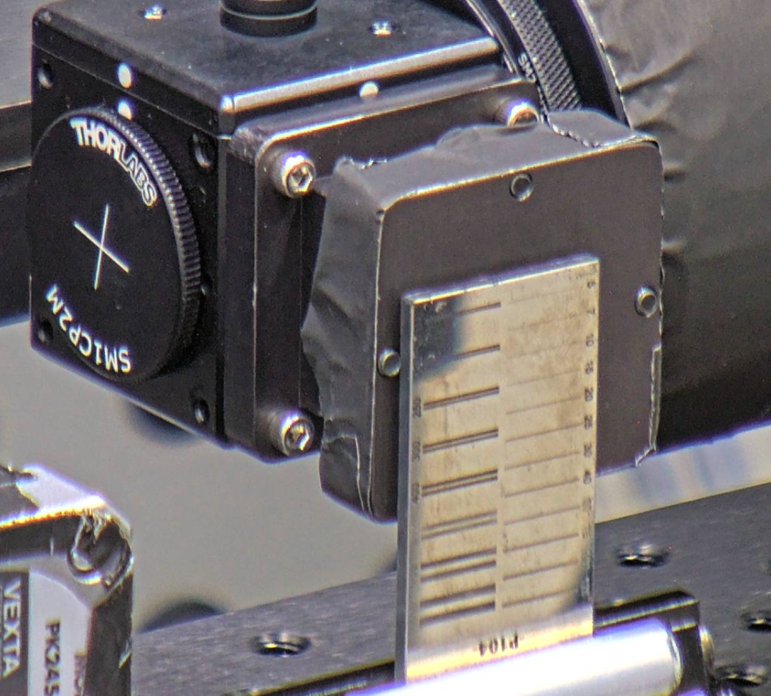
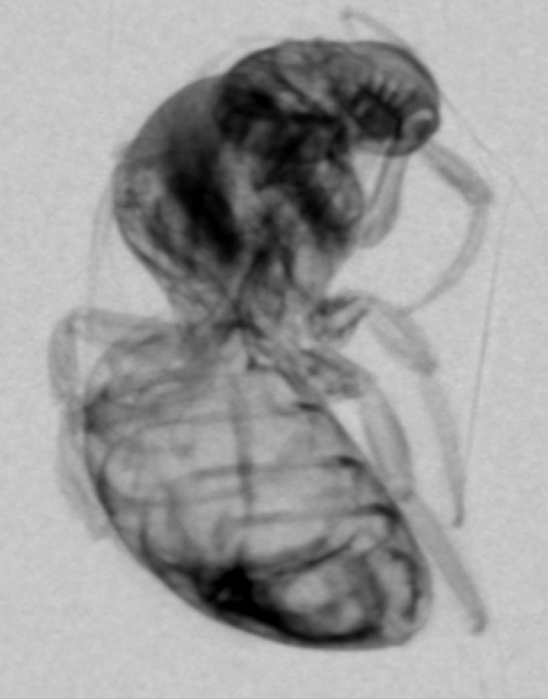
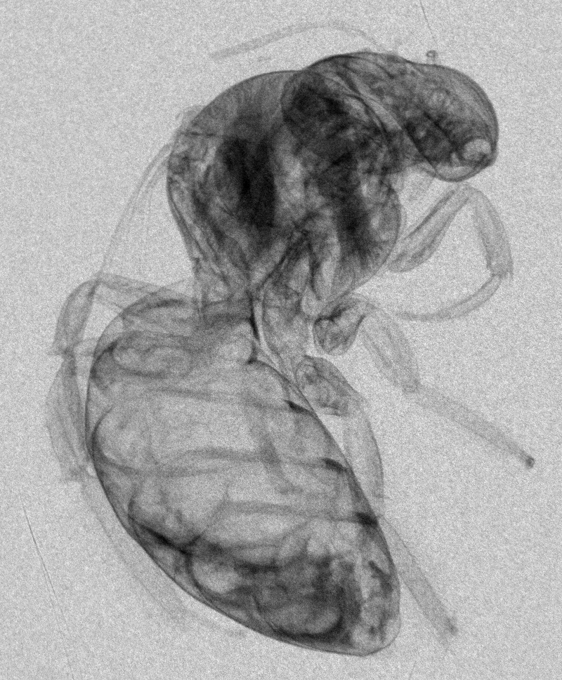
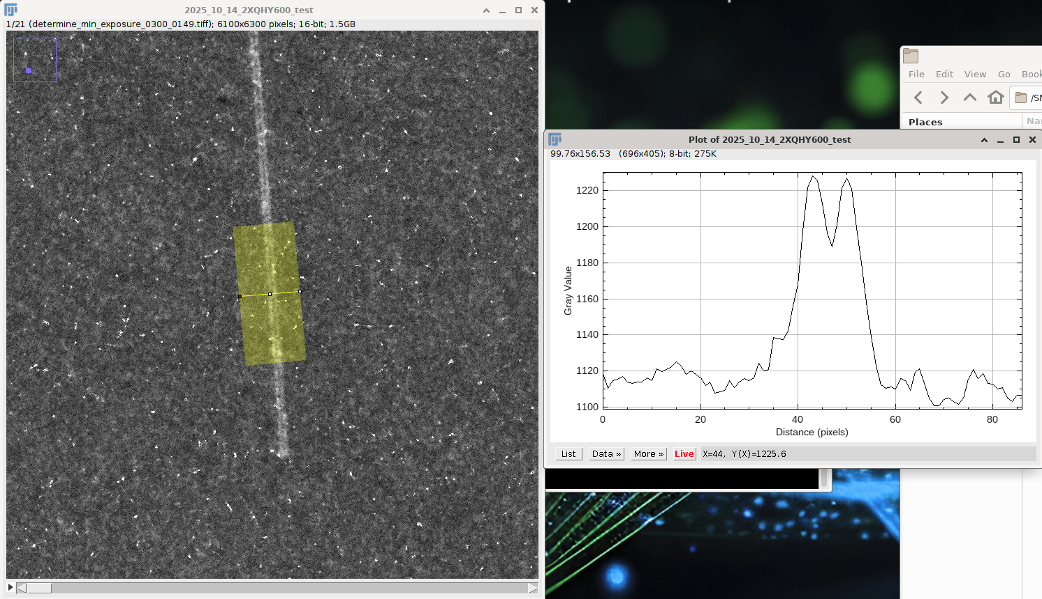
Effort in improving spatial resolution since 2021 (supported by instrument M&S)
High-res setups with achievable resolution of 7, 15 and 25 μm are routinely available
Routine setup
(before upgrade)
25 μm setup
7 um

Slide 11
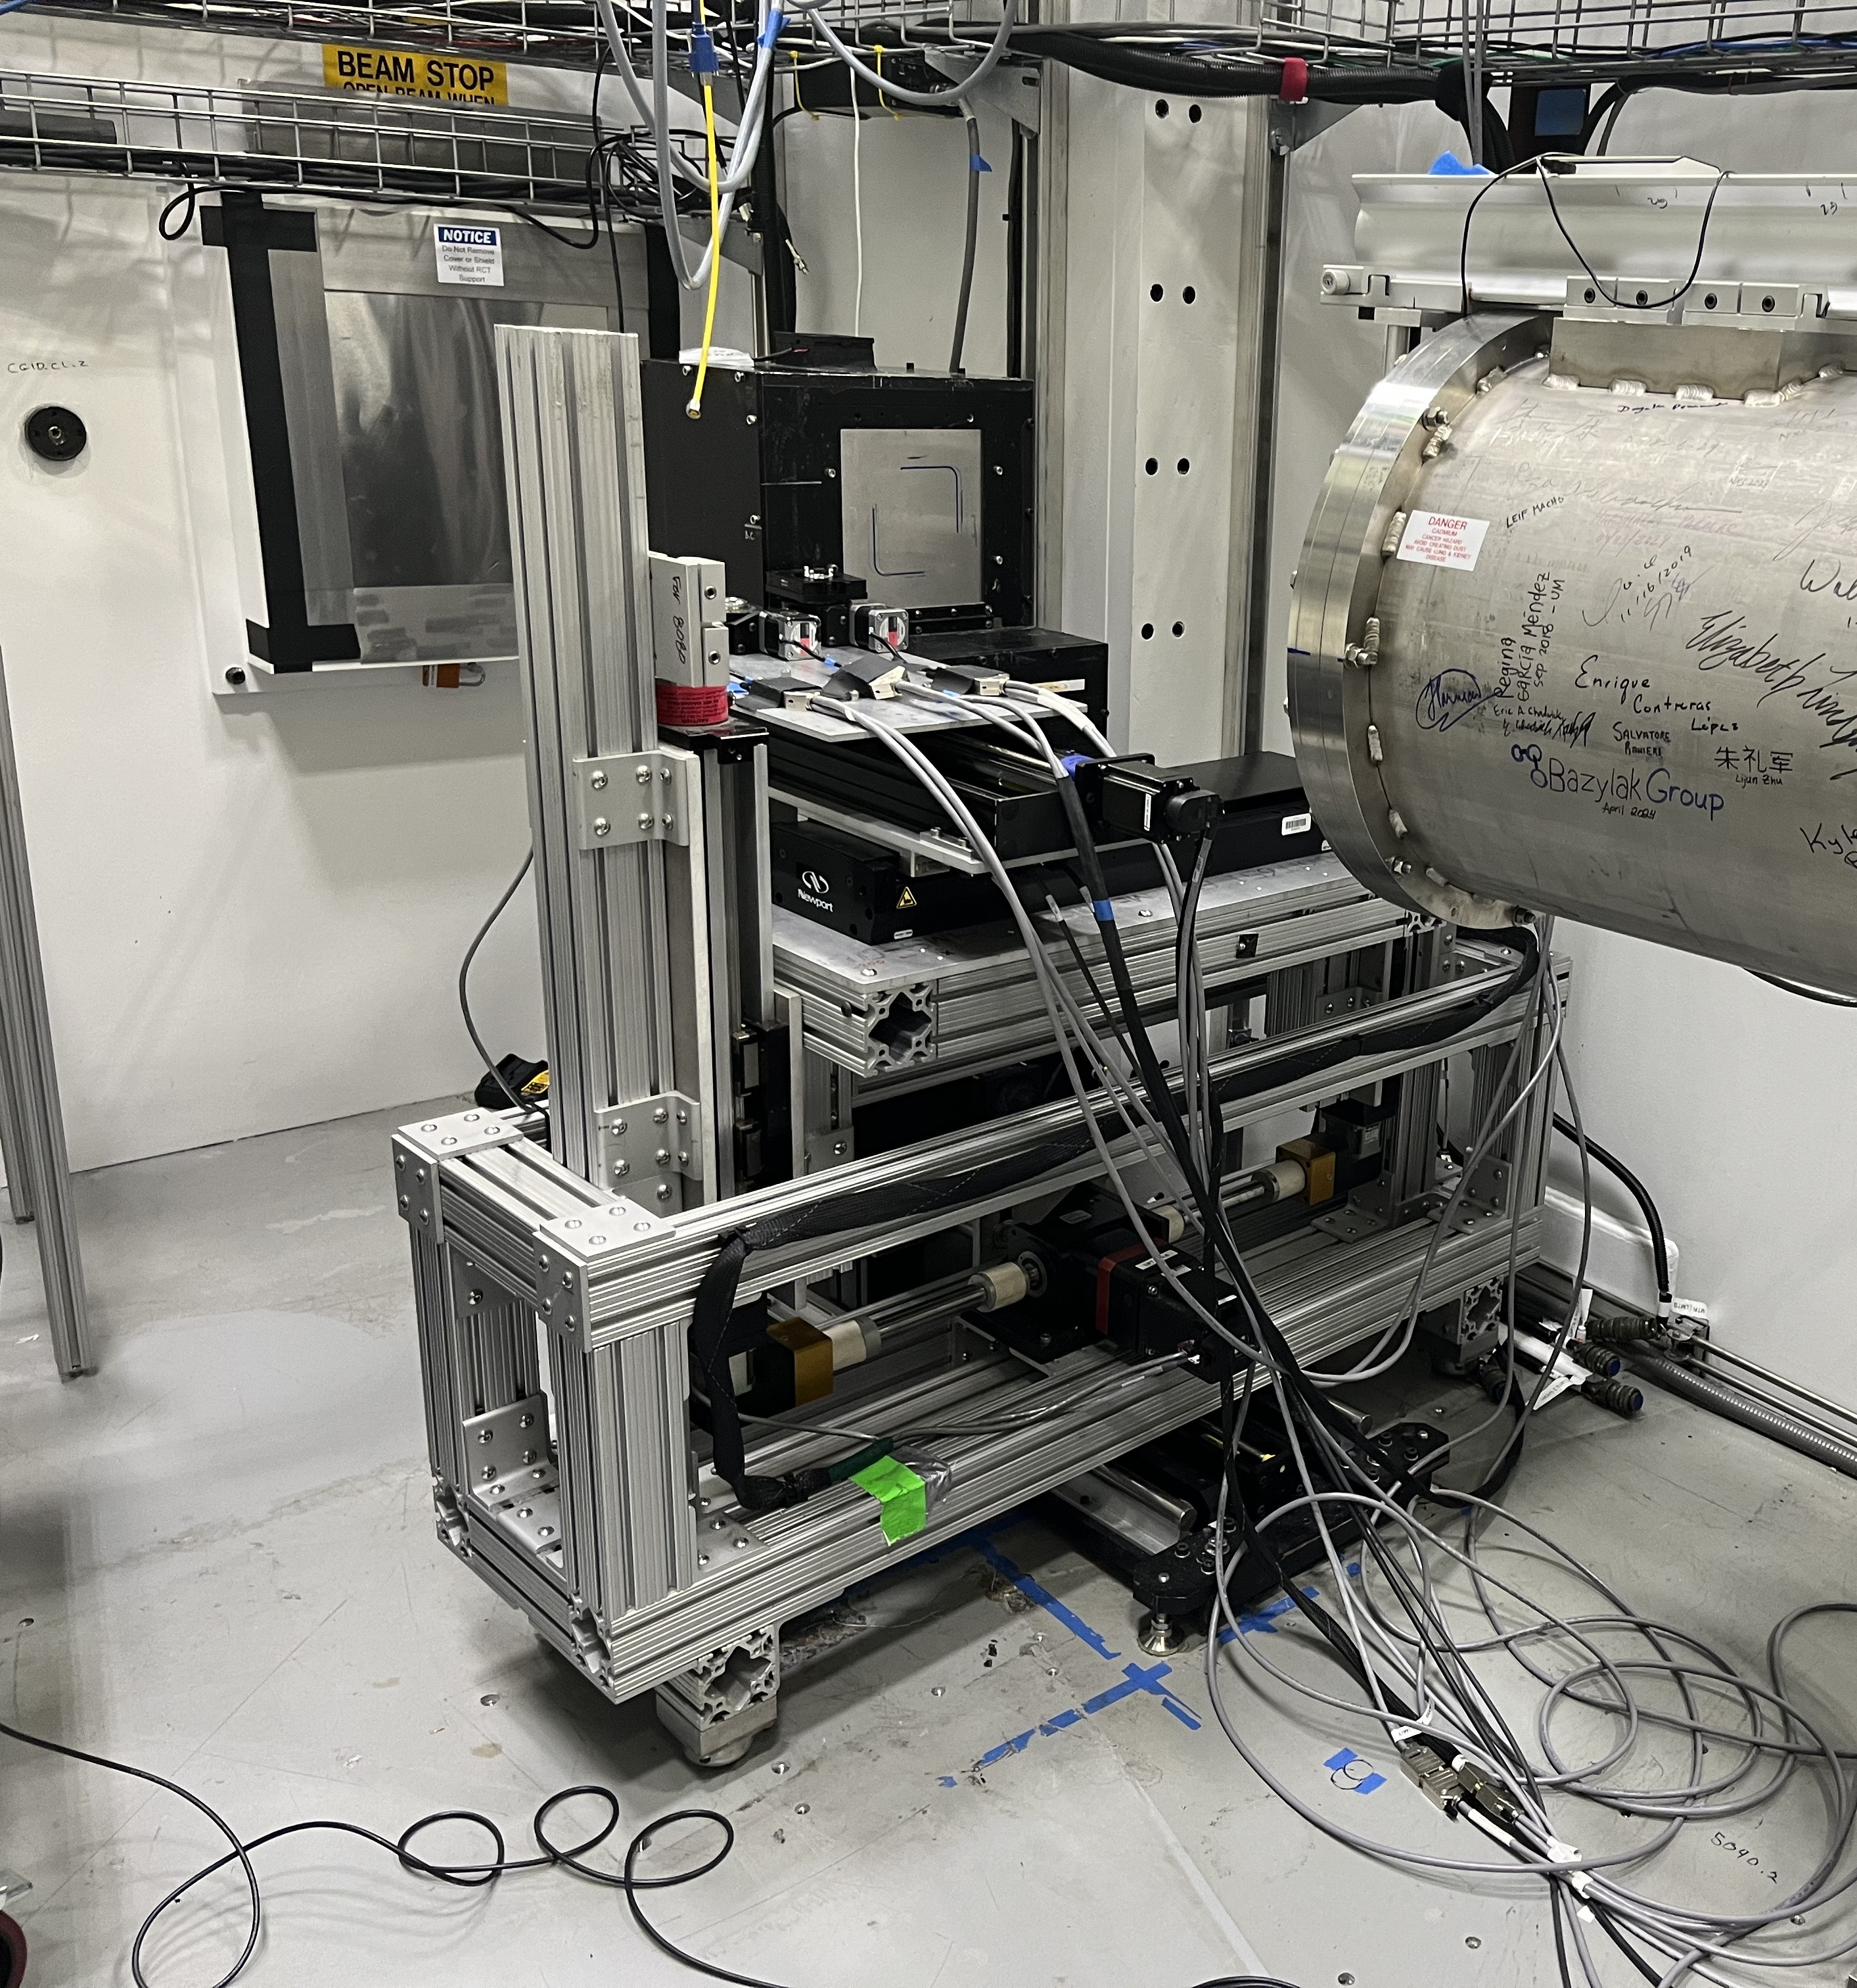
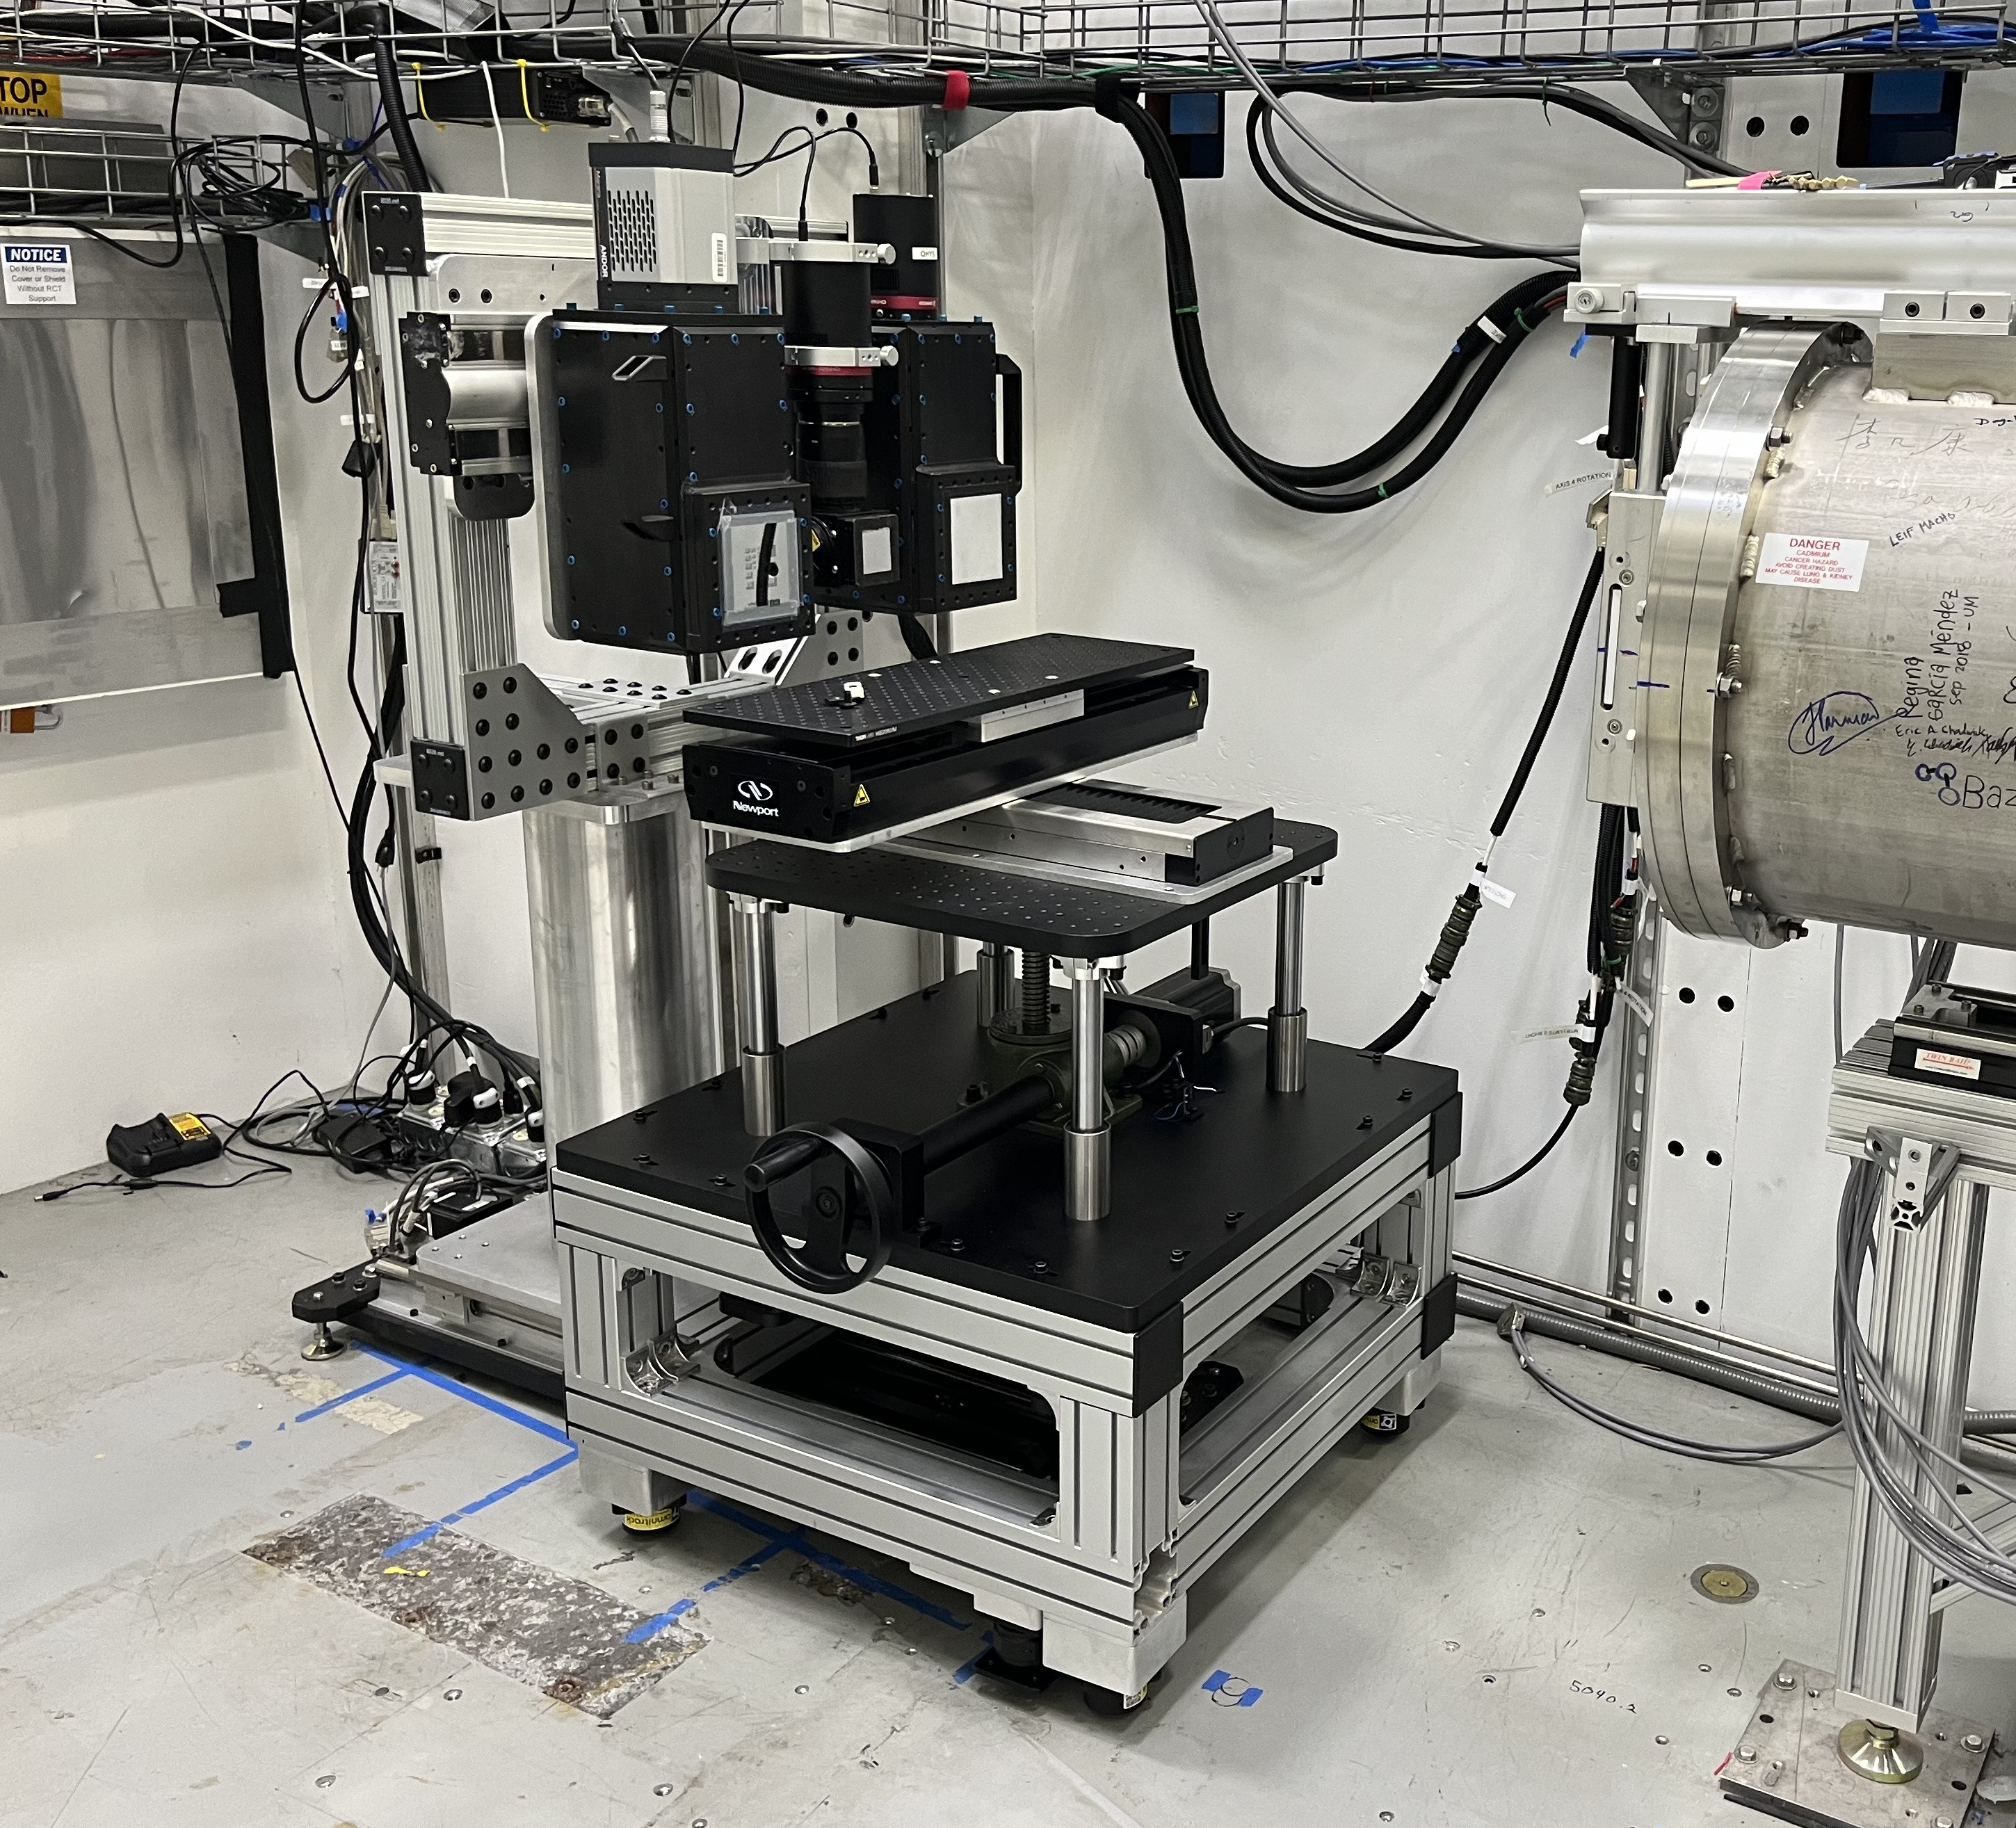
Upgrade of detector gantry and sample table (May 21, 2024)
Detector
Detector x 3
Sample Table
(XYZ)
New Sample Table
(XYZ)
y
y
x
x
z
z
Travel:
x: 400 mm
y: 50 mm
z: 200 mm
Travel:
x: 400 mm
y: 230 mm
z: 300 mm
Max. load capacity: 200 kg
Notes:
Note: this new table has vastly increased the space underneath the detector, allowing for larger and/or more complex materials to be placed against the detector

Slide 12
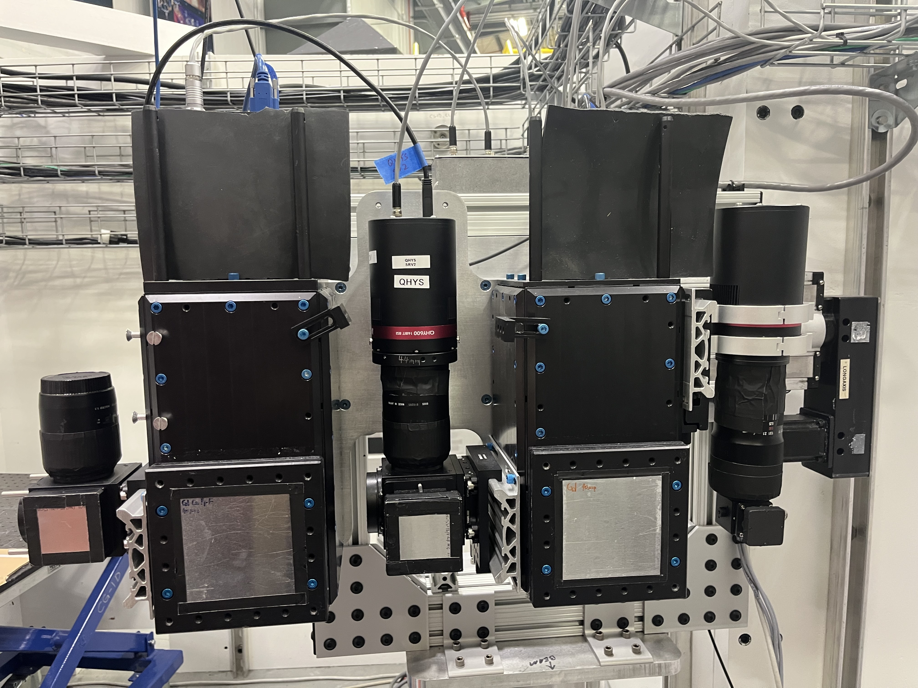
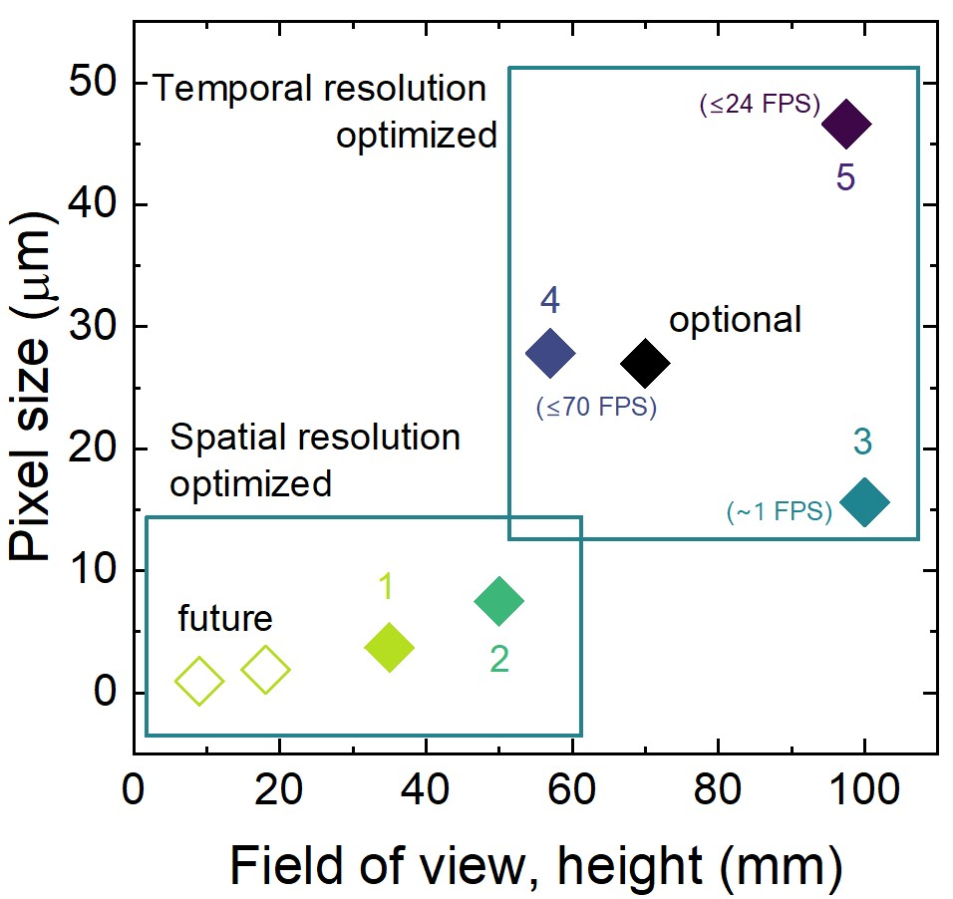
Multiple imaging detector systems tailored for different needs (at the downstream main sample pos.)
future
1
5
2
3

Slide 13
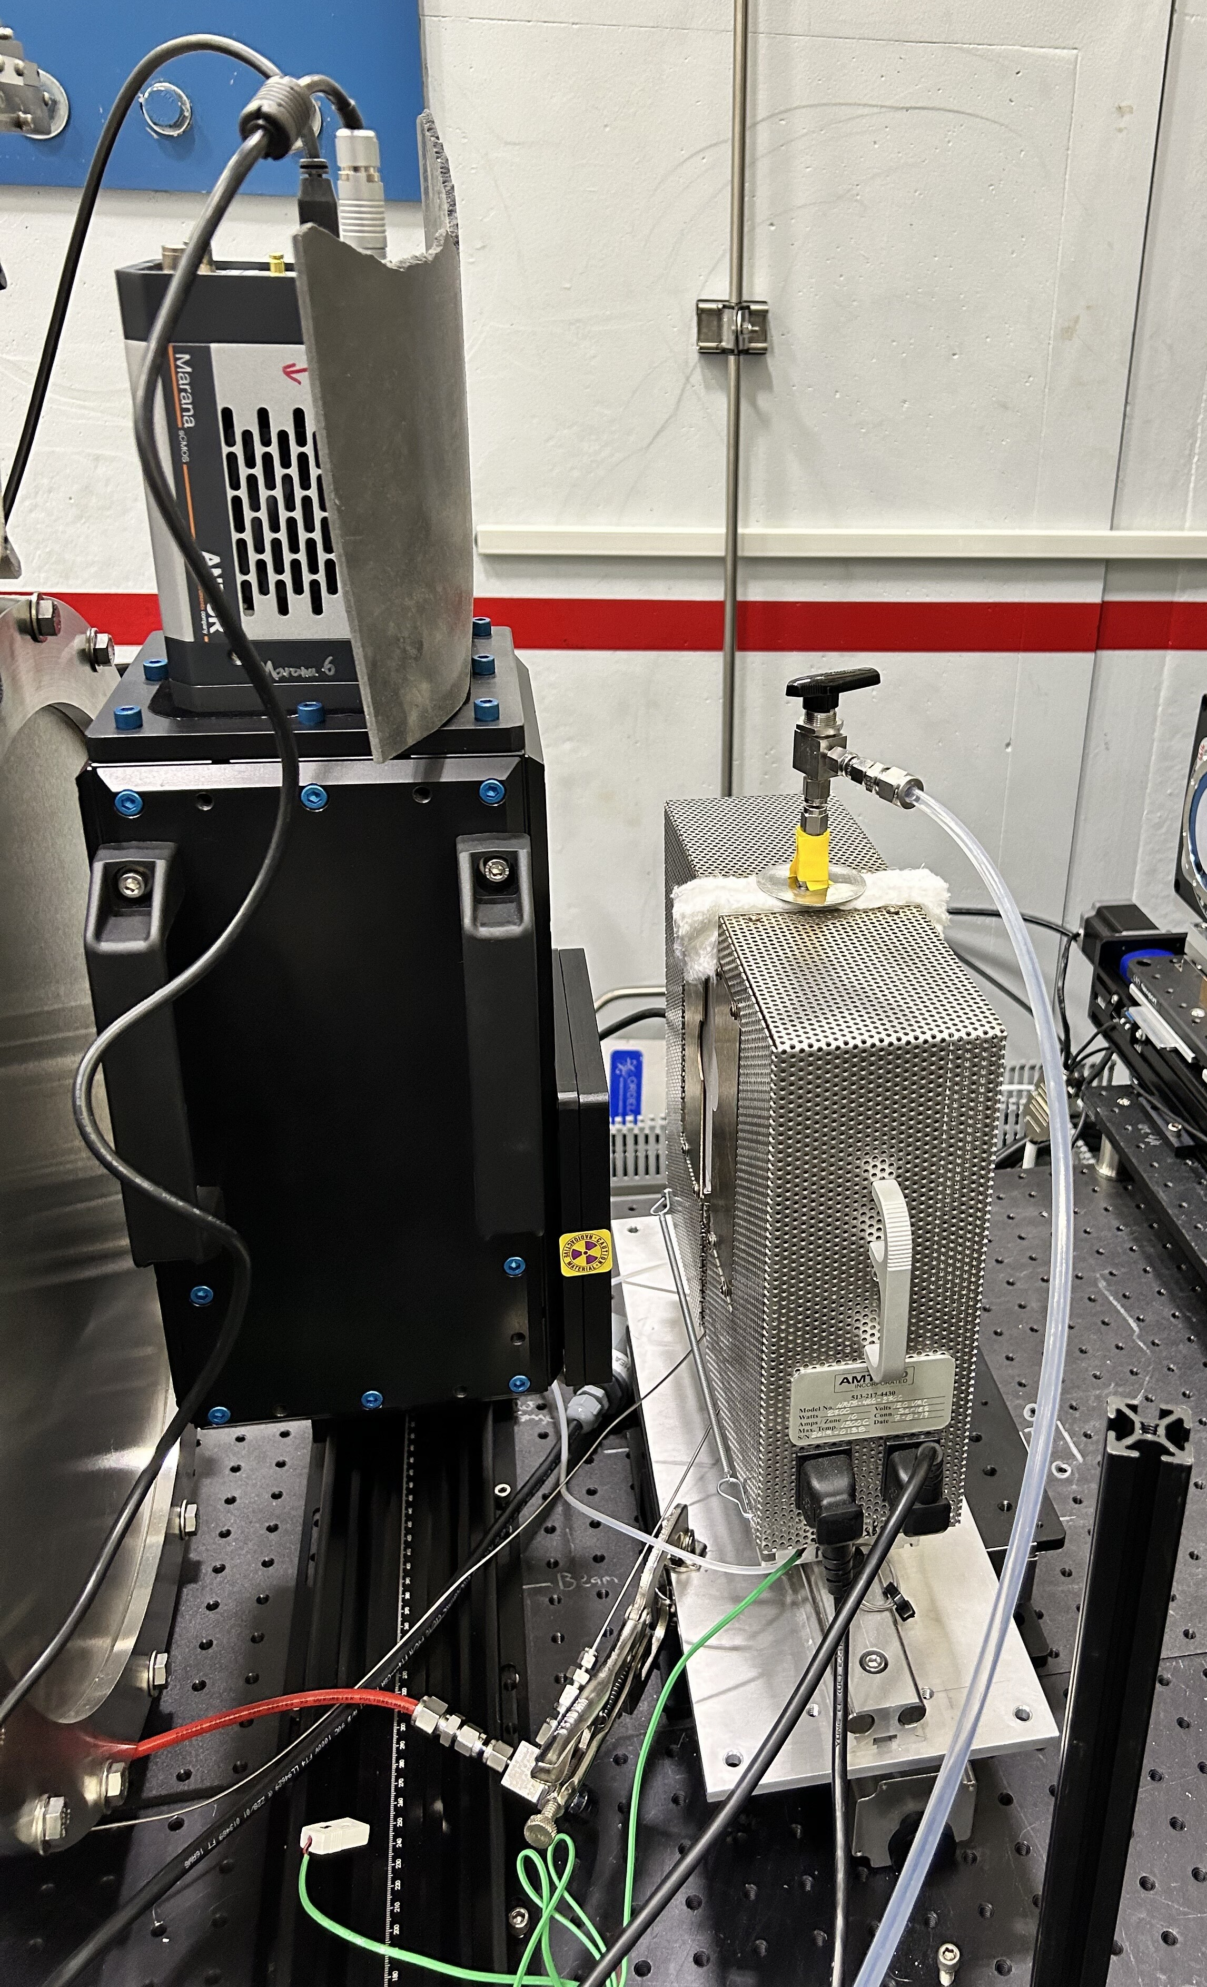
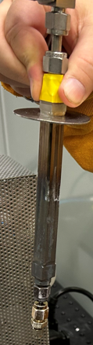
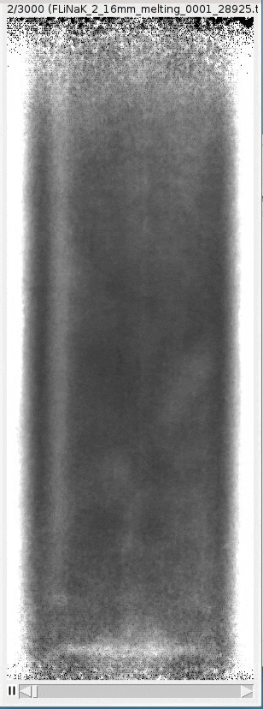
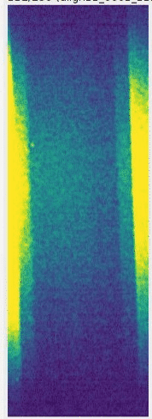
Upstream sample pos. also has a dedicated detector for high-speed imaging
High-speed imaging of molten salt dynamics at the upstream sample pos.
Imaging furnace
4
70 Hz
500 °C
70 Hz
700 °C
Upstream sample position for higher flux
Steel
container
1st melt
Gas bubbling

Slide 14
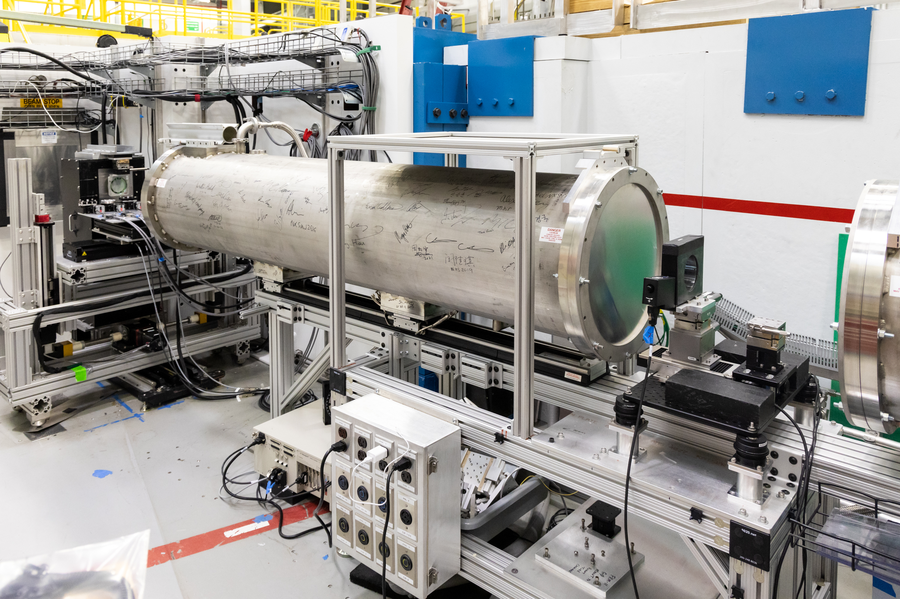
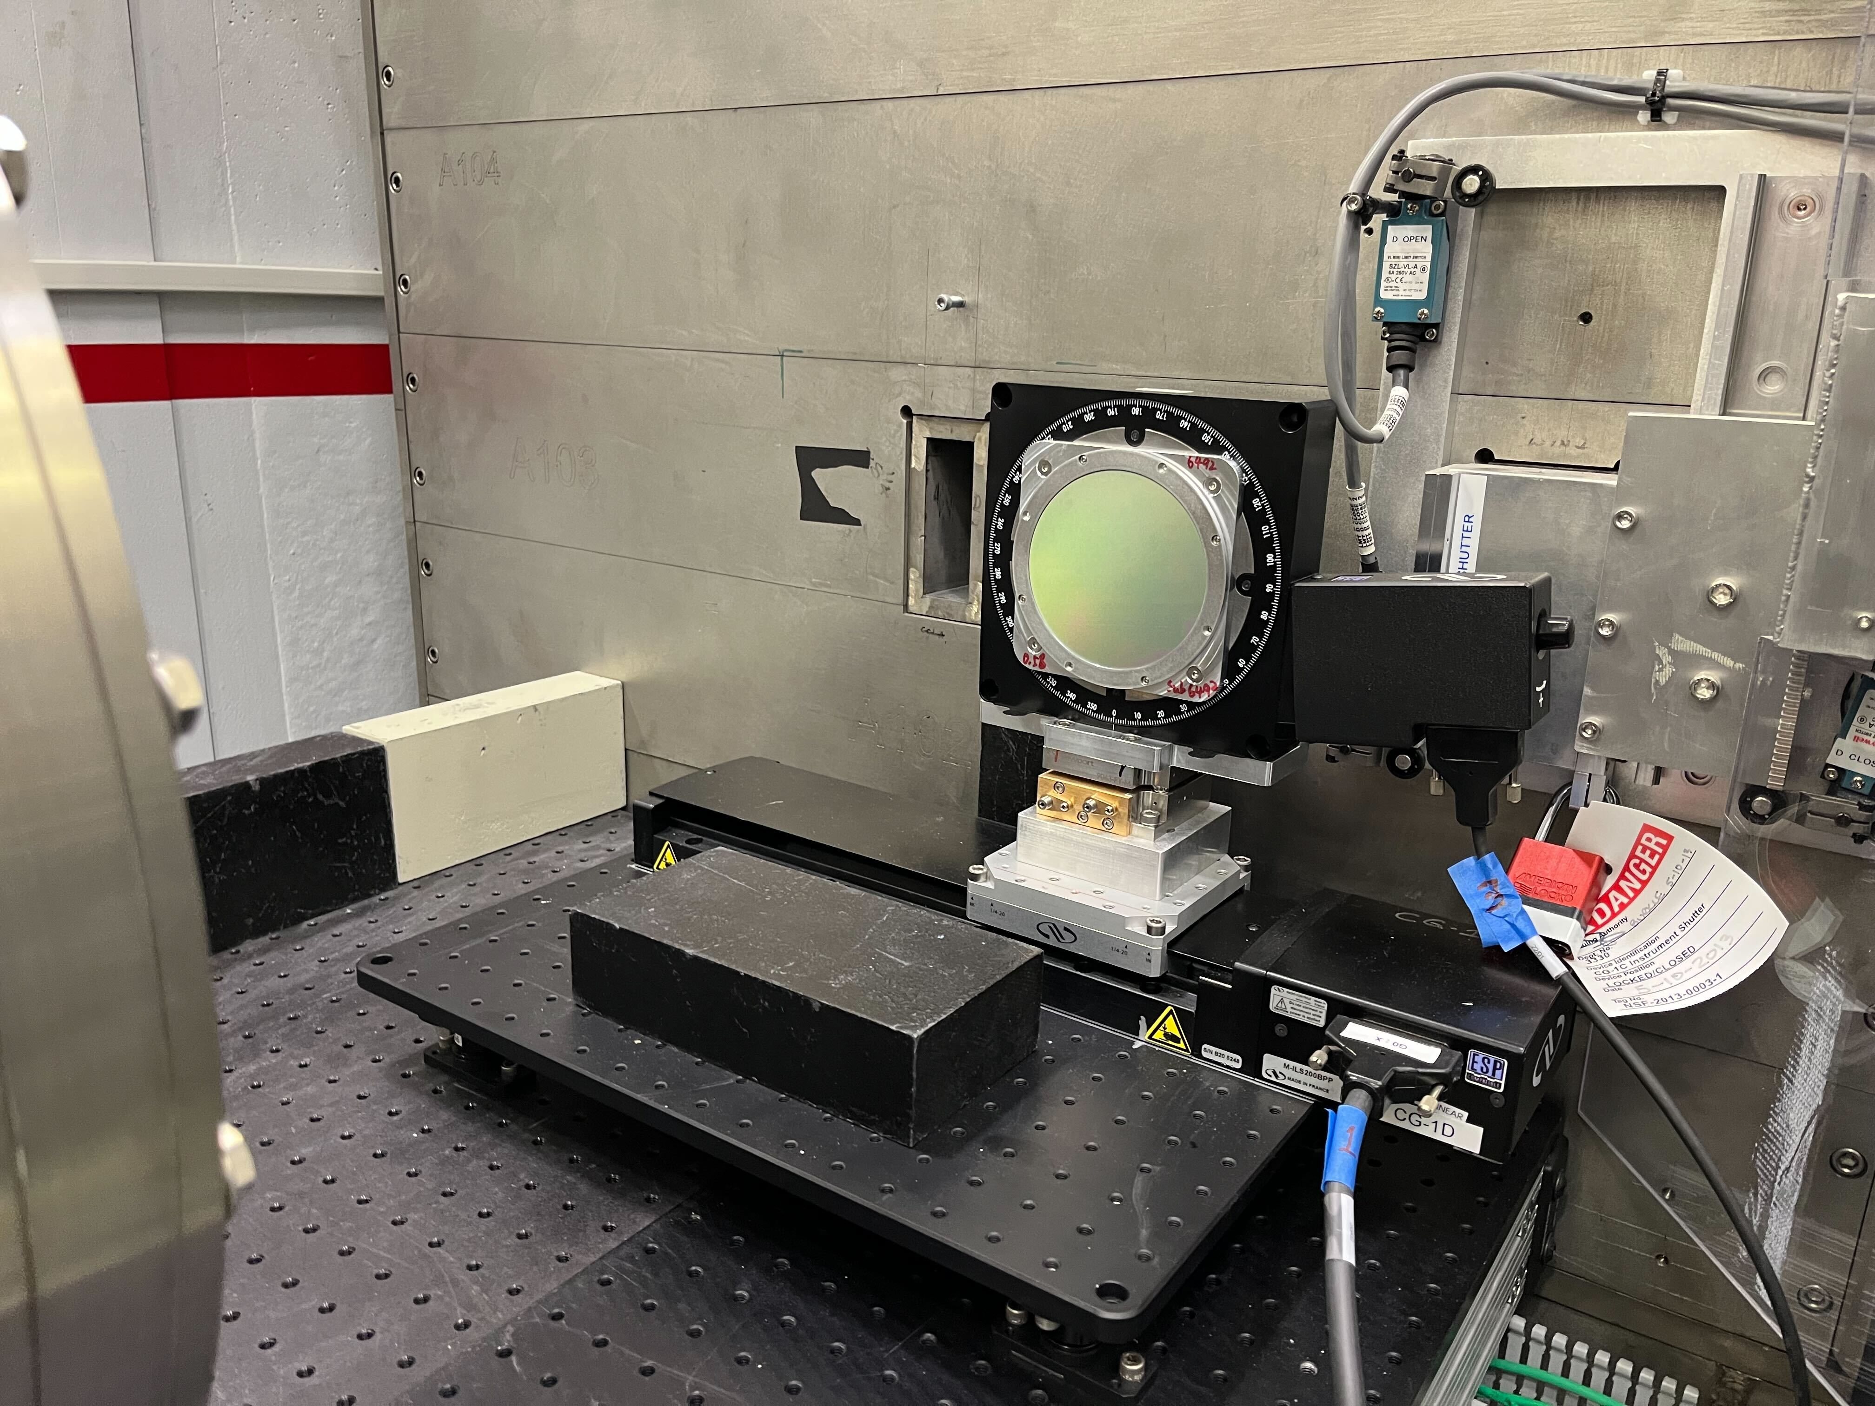
Development of neutron grating interferometry (nGI) (supported by division mid-scale investment)
Symm. and Asymm. nGI setup
G₂ & G₂
G₁
G₁
G₀ & G₀
Imaging Detector
Flight tube #1
Flight tube #2
Source
Sample

Slide 15
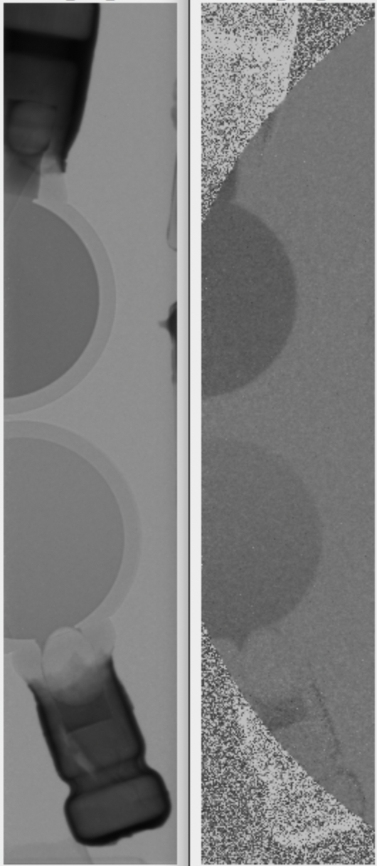
Demonstration using suspended nano PMMA spheres
The curves indicate the size of the PMMA spheres,which match well with the spec. (~100 nm in the top cell, ~150 nm in the bottom cell)
Some settling observed in the bottom cell, resulted difference in number density of PMMA can be observed
TI
DFI
(Sample courtesy of Dr. Fankang Li)

Slide 16
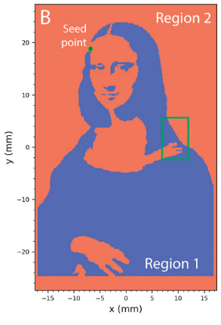
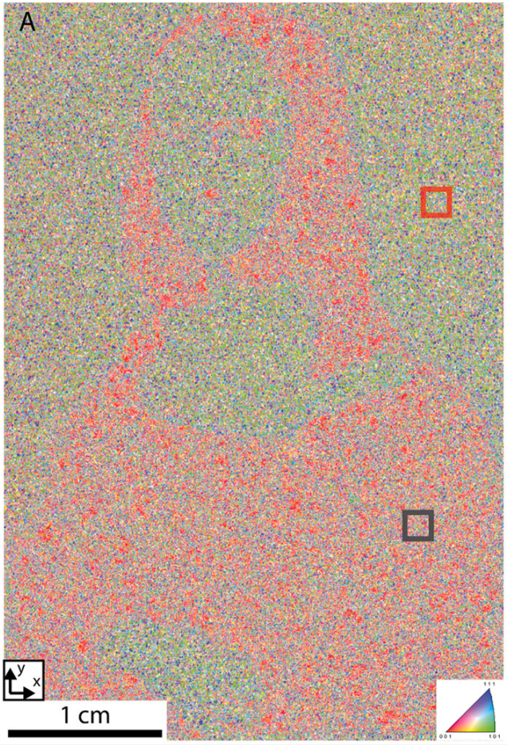
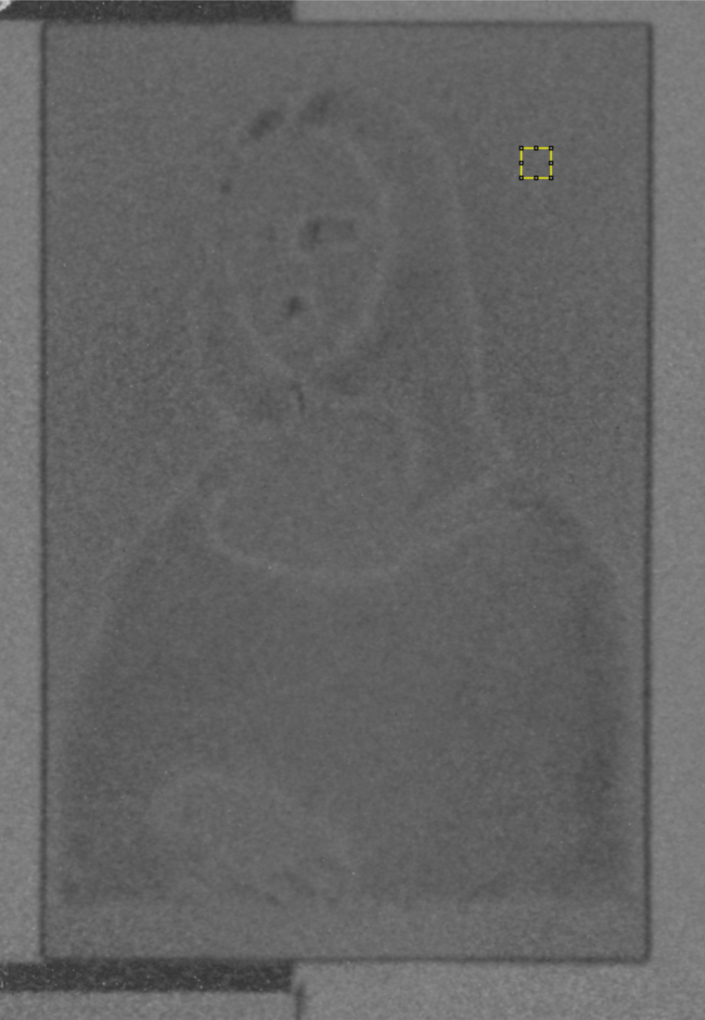
Applying nGI to study AM materials
3D printing Inconel with two cooling regions
Microstructures revealed by Electron backscatter diffraction
Dark-field revealing micro-/nano- scale structures
(Sample courtesy of Dr. Chris Fancher)
Indicating different microstructures between selected ROIs
  Two setups (Symm. and Asymm.) to cover ACL ranges from ~40 nm to ~3400 nm, push-button transition between setups
  Only has a monochromator fixed at 2.53Å
  Currently, no velocity selector (VS) to perform quantitative nGI efficiently. Usage is limited to studies only aim to get qualitative contrast.
  VS is proposed at the future MARS NB-4 location after HBRR

Slide 17
Addressing previous suite reviews

Slide 18
Given these successes, it was disappointing to learn from the team that ORNL plans to eliminate imaging from the CG1-1D and repurpose that beamline for another single-crystal spectrometer.
Furthermore, this decision is hard for the present committee to understand, given the potential and given the large number of neutron spectrometers that already exist at ORNL.
Concerns were raised by the committee about the need to have a plan for long term staffing and talent retention
team was challenged to think hard about expanding the user community, beyond the expert user. We believe there are many potential users within the communities of the ASNT, ASM, and TMS societies.
The need for improved spatial resolution is emphasized, since the user community is begging for it, and the neutron imaging community is falling further behind. make impactful demonstrations of what can be achieved with the highest resolution neutron imaging capabilities available. opportunities for battery and fuel cell applications of interest to the ORNL team

Slide 19
2017
2020
Current status
Greatest area of opportunity, supporting a diverse research program
Complex research projects
Recent beamline upgrades
Extensive software development
Scientific diversity and productivity
Software and novel ‘notebooks’ concept
Cross-institute collaboration
Status update
Maintained a diverse research program and user community
Achieved 7 μm spatial resolution
Increased number of staff
Made investments towards a mail-in program
Developed a pre-conceptual design of NB-4 with much improved instrument performance
Recruited scientists from National Museum of Natural History that expanded our existing user community
1 pub in 2022 collaborated with Vulcan team and GE, another work collaborating with industrial is planned in 2026
Notable strengths
Increase flight path
Add shielding and beam stop
Improve spatial resolution
Streamline & speed up data workflow
Increase staffing
Add Wavelength Resolved Tomography (WRT)
Long-term staffing & talent retention
Improve spatial resolution, opportunities for battery and fuel cell applications
Streamline 3D analysis flow with tutorials
Consider a remote experiment program
Expand user community especially with VENUS coming online
MCP integration into EPICS
Enhance collaboration with VULCAN team
Recommendations

Slide 20

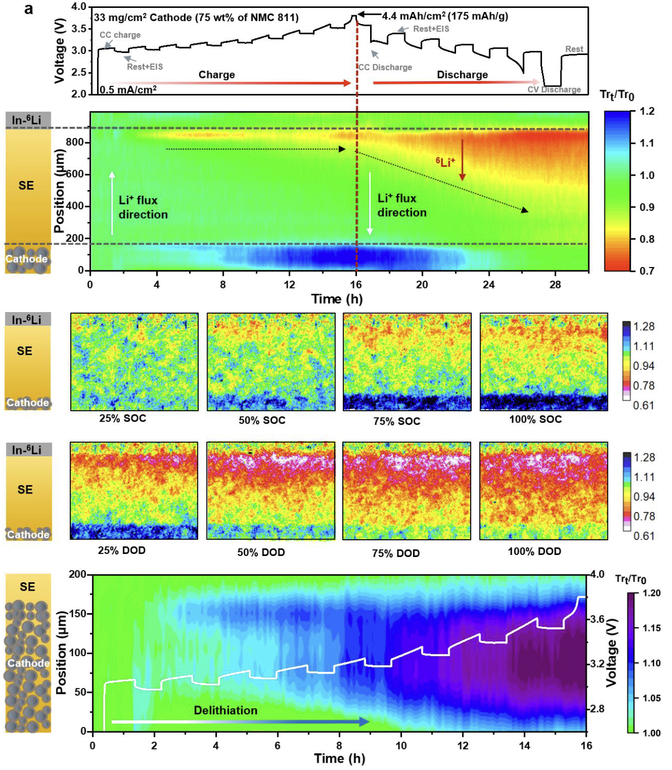




Operando Imaging-Guided Gradient Design for High-Mass-loading Cathodes
(a)
Scientific Achievement
Directly visualized Li reaction gradients in thick, high-mass-loading all solid-state batteries (ASSBs) cathodes. A Li⁺ flux–guided gradient catholyte design was developed, enabling superior rate capability.
(b)
Significance and Impact
This work provides the first direct evidence of Li⁺ flux mismatch in thick solid-state cathodes and offers a scalable design principle to overcome it.
Research Details
A 33 mg/cm² NMC811 cathode was monitored using operando neutron imaging. Lithiation inhomogeneity from the solid electrolyte (SE) side to the current collector was observed. A three-layer cathode—graded in SE content from high to low—significantly improved rate performance for NMC811 and LCO cathodes, with up to 171% capacity gain at high current.
(a) Position vs. time plots with the averaged neutron transmission (trans.) changes (Tr_{t}/Tr₀) represented in color. Tr_{t}/Tr₀<1 indicates reduced trans. due to Li increase or ^{nat}Li replaced by ⁶Li, Tr_{t}/Tr₀>1 indicates increased trans. due to delithiation.
(b) Zoomed in on the cathode side. Colormap has been slightly changed to enhance the contrast for better visualization. Voltage vs. time curve is overlayed in white color.
T. Ji , Y. Zhang , J. Torres , A. Mijailovic , Y. Tang , X. Zhao , J. Bilheux , J. Wang , B. Sheldon , O. Oyedeji and H. Zhu, Nature Communication, 16, 7667 (2025)., doi: 10.1038/s41467-025-62518-y.
Work was performed at MARS, HFIR CG-1D
Notes:
Operando neutron imaging is deployed on a high-mass-loading NMC 811 cathode of 33 mg/cm2 (5.0 mAh/cm2) and directly visualizes the lithiation prioritization of the cathode active material (CAM) from the solid electrolyte membrane side to the current collector side.
In addition to the tortuosity, another key limitation on ion transfer in the cathode arises from the mismatch between the uniform distribution of the solid electrolyte (catholyte) in the conventional composite cathode and the non-uniform Li+ flux generated by the faradaic reaction of CAMs.
A gradient in the catholyte concentration is engineered to match the Li+ flux distribution as a means of eliminating the ion transfer obstacle.
This approach demonstrates enhanced rate performance, even with high-mass-loading cathodes. A LiCoO2 composite cathode with 100 mg/cm2 high-mass-loading exhibits an areal capacity of 10.4 mAh/cm2 at a current density of 2.25 mA/cm2.
This work provides insight into the ion-transport limitation in thick cathodes and demonstrates an effective gradient design to overcome the kinetic barrier and achieve high battery performance.
Researchers: A. Mijailovic and B. Sheldon (Brown University); Y. Tang (Dartmouth College); T. Ji, J. Wang, and H. Zhu (Northeastern University); Y. Zhang, J. Torres, X. Zhao, J. Bilheux, and O. Oyedeji (Oak Ridge National Laboratory)
Acknowledgements: This research used resources at the High Flux Isotope Reactor, a DOE Office of Science User Facility operated by the Oak Ridge National Laboratory. H.Z. acknowledges the primary support of the US Department of Energy (DOE), Office of Science, Office of Basic Energy Sciences under award number DESC0024528. The authors would like to acknowledge support from the US Department of Energy (DOE) Bioenergy Technologies Office (BETO) Projects under contract with UT-Battelle LLC. This manuscript was partially authored by UT-Battelle LLC under contract DE-AC05-00OR22725 with DOE. The beam time was allocated to MARS on proposal number IPTS-30750.1.
Publication/ press releases/ related links:
“Operando Neutron Imaging-Guided Gradient Design of Li-ion Solid Conductor for High-Mass-loading Cathodes,“ Nature Communications, 16(7667) (2025)
https://doi.org/10.1038/s41467-025-62518-y

Slide 21
Summary

Slide 22
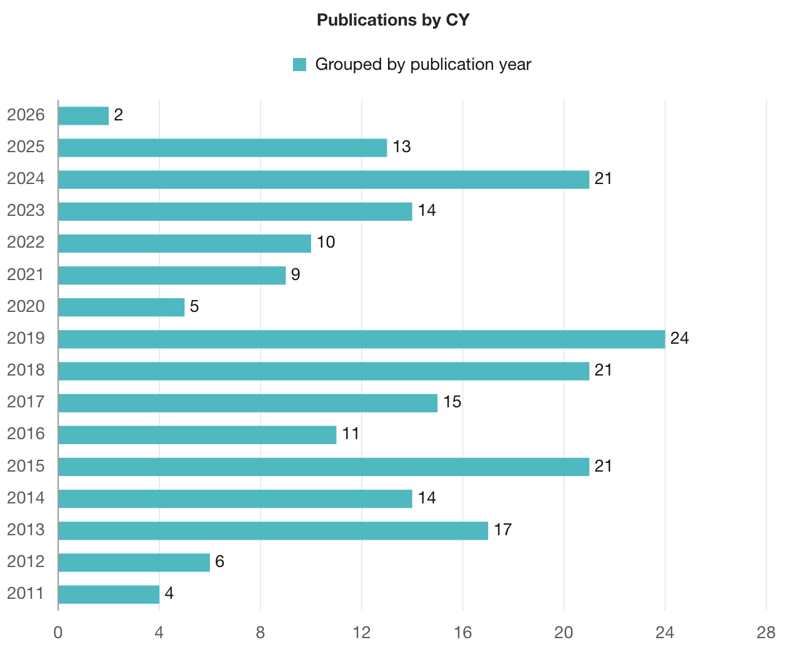
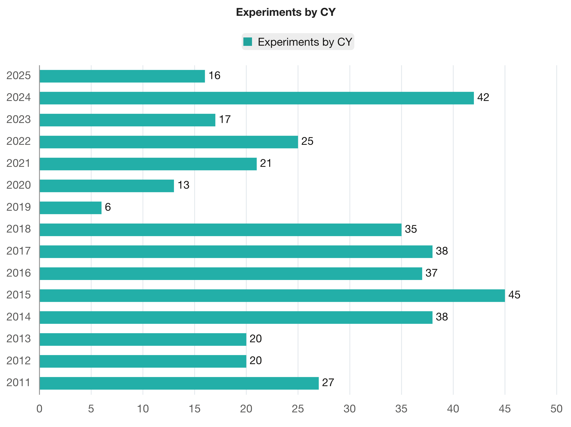
Instrument experiments vs. publications (since 2011)
Heat exchanger outage
COVID-19
HFIR unplanned outage (2018.11 – 2019.10)

Slide 23
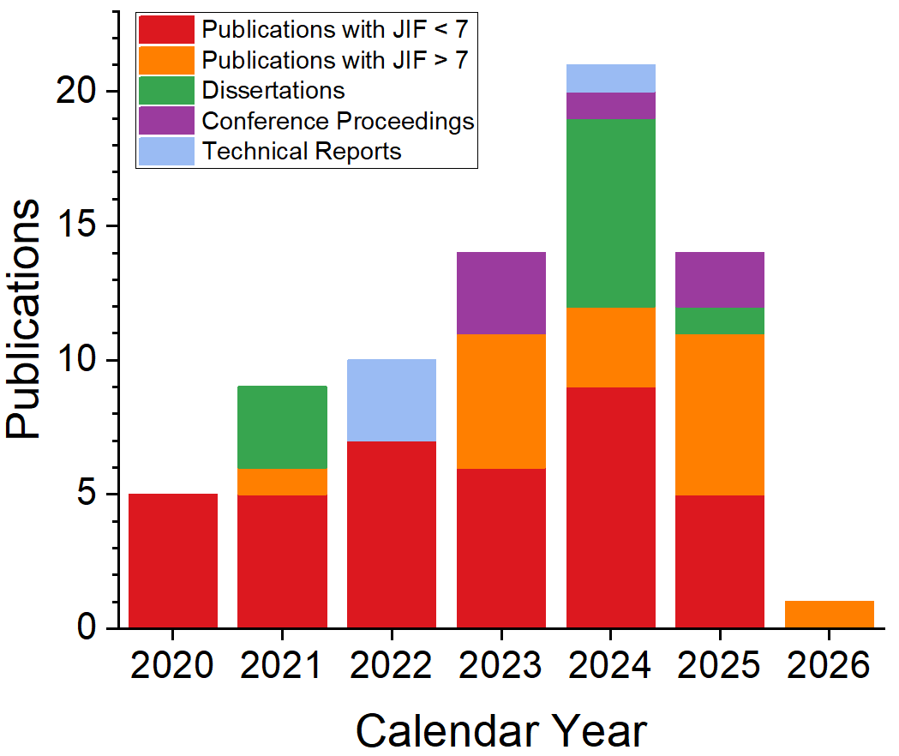
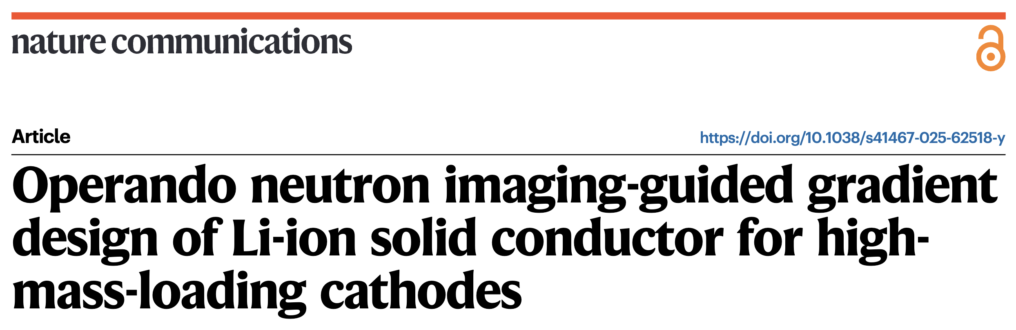

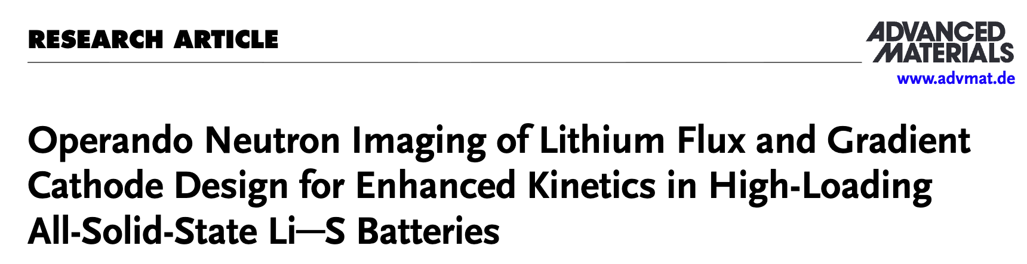
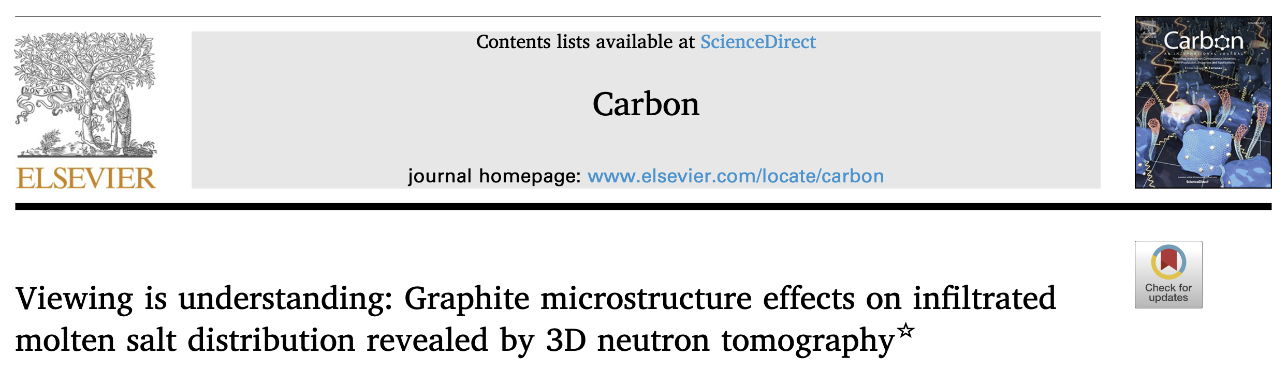
Instrument experiments vs. publications (since 2019)
Heat exchanger outage
COVID-19
HFIR unplanned outage (2018.11 – 2019.10)
Increasing pub # with JIF>7

Slide 24
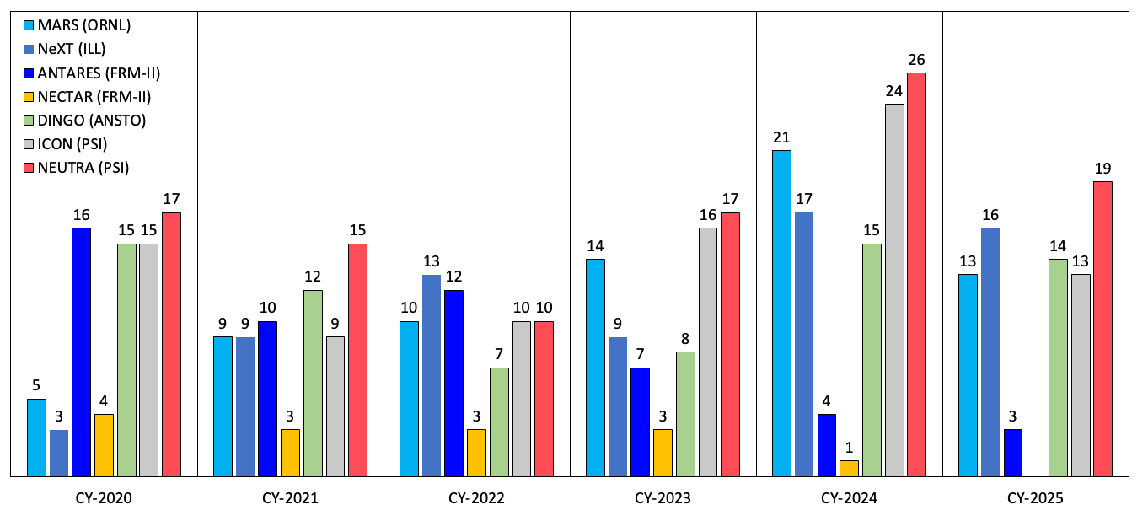
Publication # is comparable with a few selected world class imaging instruments
*FRM-II has been down for the recent years.

Slide 25
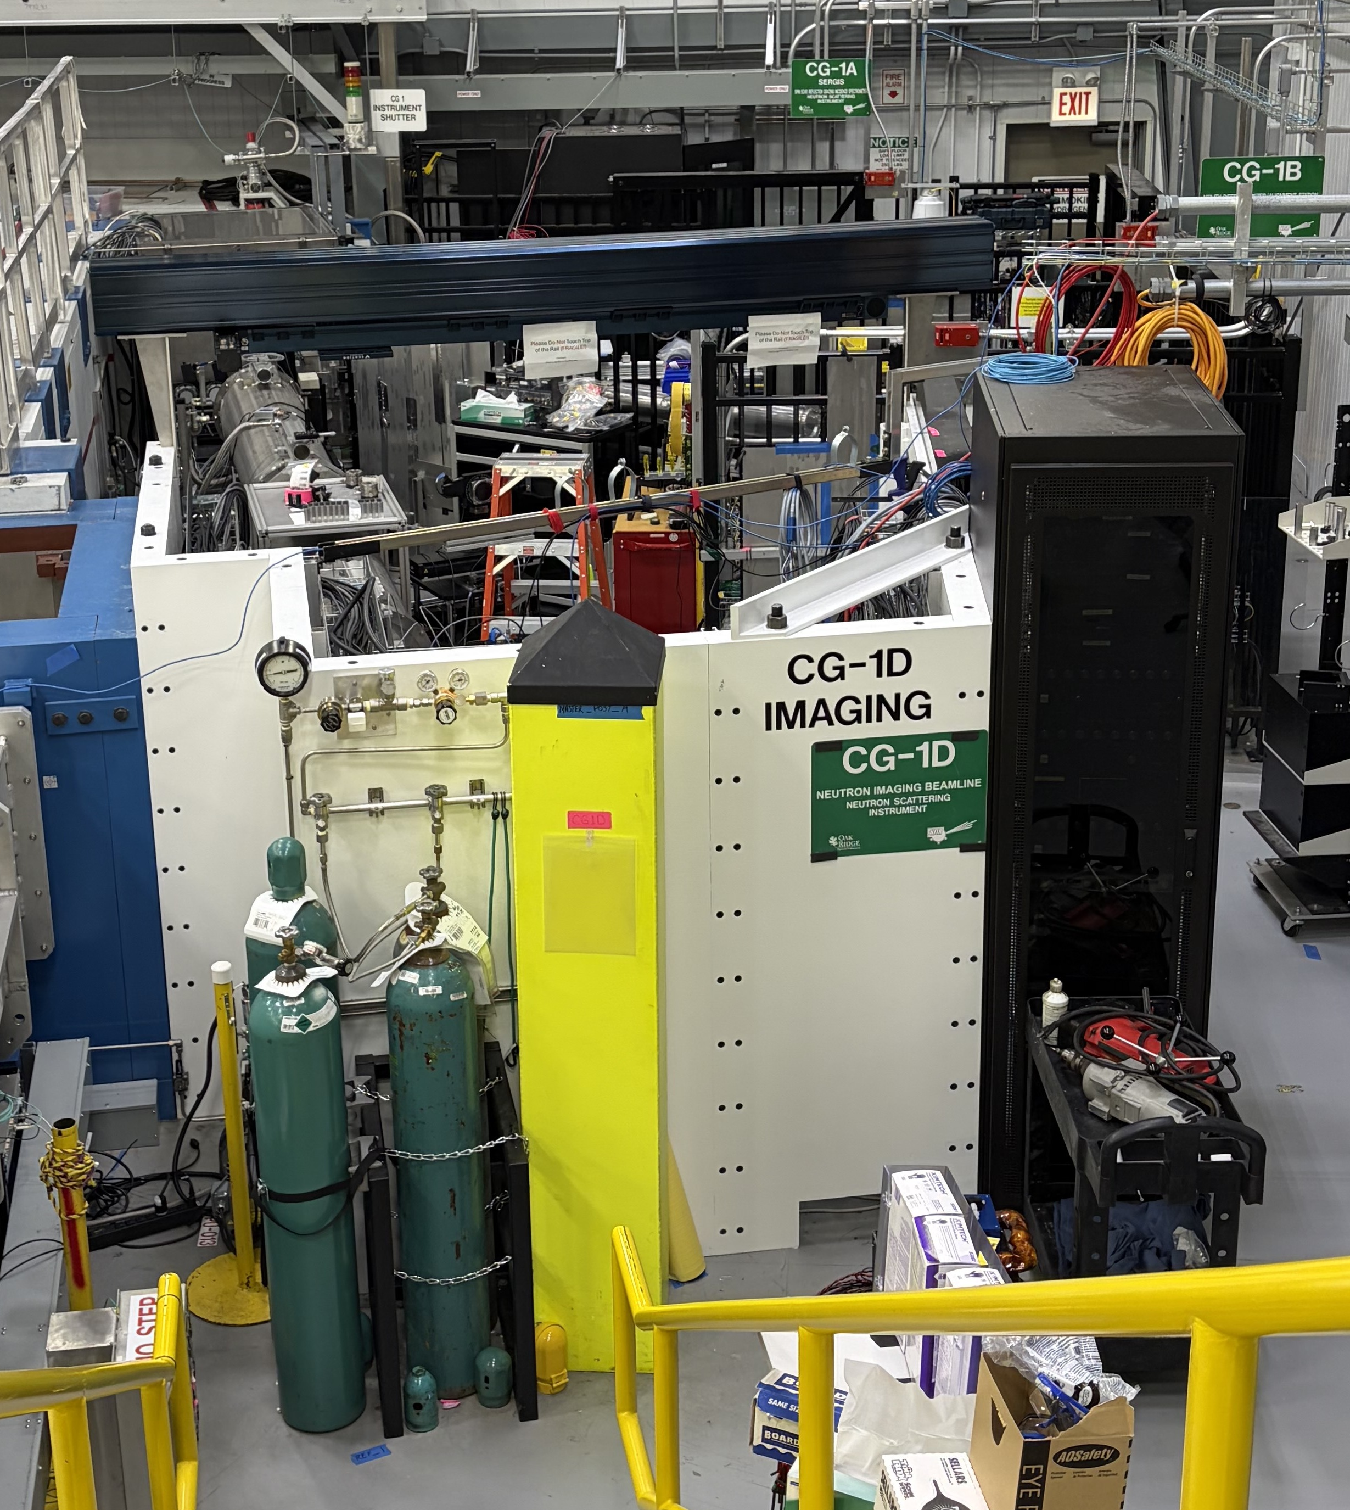
Near-term instrument upgrades
 | Upgrade | Funding | Timeframe
Active projects | Dedicated computing resource | NScD | Completed
 | Collaborative robot (cobot) | BRaVE midscale | 2024-2026
 | Detector active water cooling | MARS M&S | 2025-2027
 | Image intensifier | NScD midscale | 2025-2027
 | Slit apertures for interfaces | MARS M&S | 2025-2026
 | High-res., infinity-corrected optics | MARS M&S | 2026-2027
 | HFIR 20 kN load frame | NScD midscale | 2026-2027
 | Multipurpose sample environment chamber | MARS M&S | 2026+
Proposed/planed | Optimized imaging instrument at NB-4 | NScD | ASAP after HBRR
 | Simultaneous Neutron and X-ray (SNAX) | ICE (under final review)
 | Amteco extended cavity | TBD
 | Black-body grids (scattering corr.) | TBD
 | Sparse-view, AI/ML-assisted acquisition | TBD
Cobot installation

Slide 26
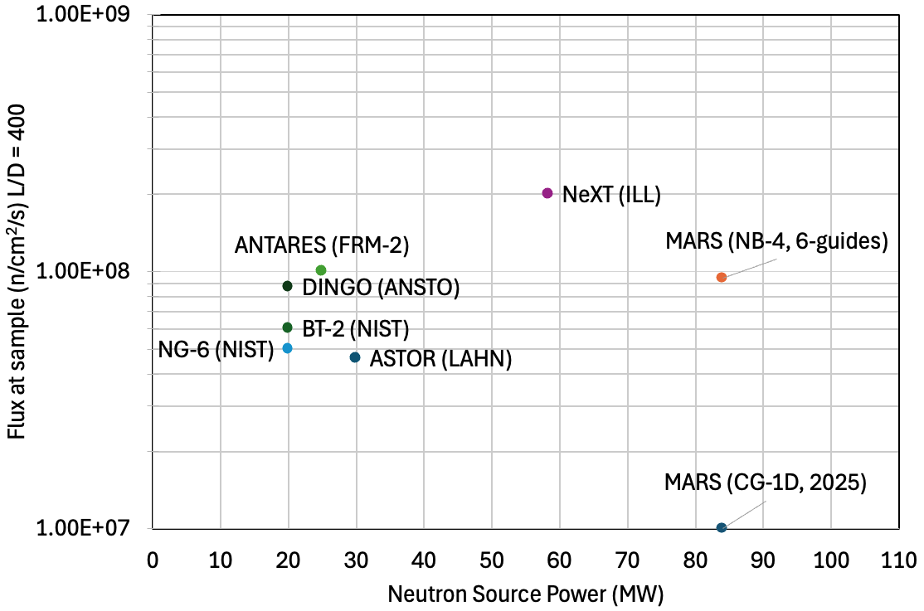
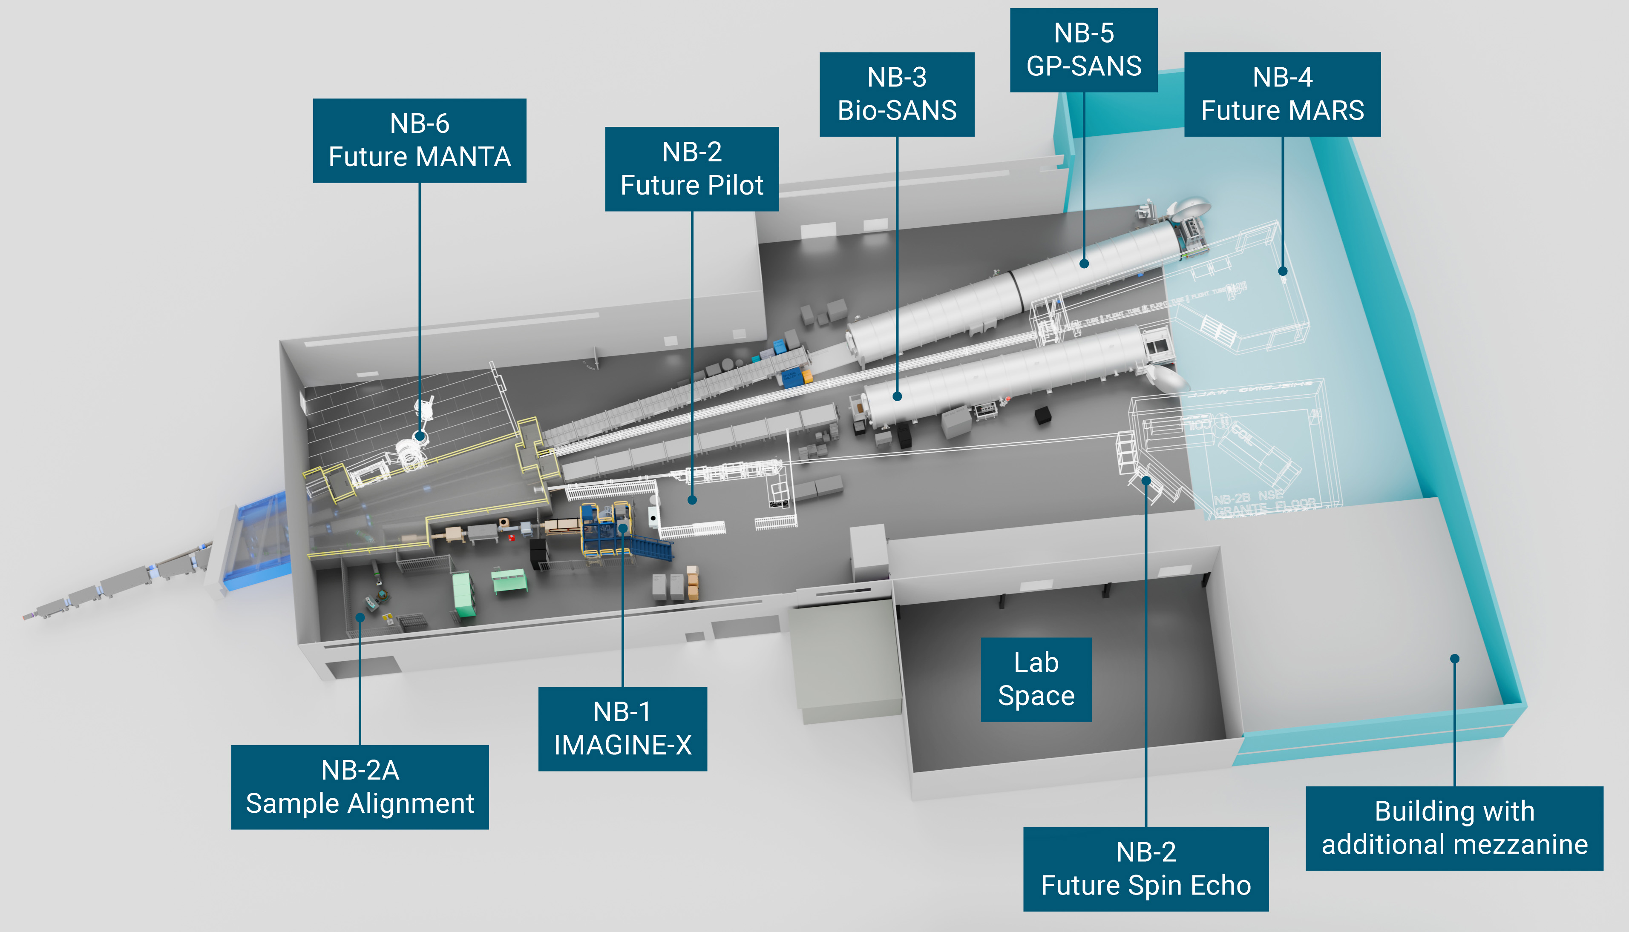
Future of MARS
HBRR starts Sep. 2029
Optimized guide design shows improved flux
MARS at CG-1D is a repurposed instrument, has evolved through various upgrades over the years
MARS at NB-4 will be the first purposely designed/optimized imaging instrument at HFIR

Slide 27
Vision of MARS
Near-term (1-3 years)
Long-term (3+ years)
Complete the conceptual and preliminary designs of NB-4
Successfully rebuild with equivalent or better capability at NB-4 after HBRR with minimum delay
Further improve the capabilities in spatial and temporal resolutions, and quantitative studies
Implement AI assisted sparse-view smart acquisition
Implement automated data reduction and tomographic reconstruction algorithms
Launch a mail-in/rapid-access program with automated sample changes and data acquisition
Commission samples environments, including a load frame and multi-atmosphere chamber
Following NB-4, MARS will be fully optimized for cold-neutron imaging on par with world-leading instruments
Integrate simultaneous X-ray imaging (SNAX concept) if funded

Slide 28
Acknowledgments
Thank you for your time in reviewing our imaging program!!!!
This research used resources at the High Flux Isotope Reactor, a DOE Office of Science User Facility operated by the Oak Ridge National Laboratory.
Operations support teams
ORNL User office
The ORNL neutron imaging team
The diverse imaging community that trusted us and helped us to improve

Slide 29
SWOT Analysis – MARS
Strengths
Weaknesses
A wide variety of detectors, motion control systems, and setup hardware
Possible to reconfigure instrument flight tubes for complex experiments
Highly diverse research and unique users
User-friendly software and online tools
Healthy funding and support for software and beamline improvements
Unique, large scale user experiments, including in-situ/in-operando device and material characterizations (batteries, fuel cells, molten salts) using shared SE equipment
Only 1 CIS for MARS and VENUS
CG-1 neutron guide was built for a spectrometer, not imaging, leading to suboptimal white-beam flux and beam uniformity
Lacking sufficient sample environment for soft matter and high pressure
X-ray imaging capability is lacking/weak
No velocity selector as needed for quantitative nGI measurements; monochromator upgrade needed
User guidance/instructions for proposal preparation and advertisement of nGI capabilities
Space limited for equipment, difficulties in returning user supplied equipment
Opportunities
Threats
Auto data reduction for standard processes (2D normalization, CT reconstruction)
Mail-in/rapid access program
AI/ML tools for data acquisition, reduction, and analysis
Widen slits/collimation and assemble larger detector to leverage large ~17cm diameter beam
Upgrade/optimization inside the CG1 optics box for reliable operation
Development of the neutron microscope (custom lens system and vibration-free platform)
Development of advanced optics for beam focusing and magnification
MARS (NB-4) conceptual design is delayed, lead to unknown delay of HFIR neutron imaging after HBRR
High complexity of user experiments that creates elevated risk for accidents and materials mishandling
Dependence on additional funding for outsourced and expensive visualization (Amira) and data-correction (BM3D) software

