Slide 1
VULCAN Software Instrument Review
February 12, 2025
Luc Dessieux
Neutron Sciences Division
Notes:
Accessing Title Slide Options
The standard ORNL presentation template includes five branded title slide layouts:
Title | Standard. The preferred layout for lab-wide and general presentations. Features a default aerial photograph of the lab.
Title | Custom Image. Allows replacement of the default background with a custom full-slide image (16:9 or 4:3 landscape format).
Title | Custom Portrait Image. Supports inclusion of a custom 4:3 portrait image positioned next to the introductory text.
Title | Custom Landscape Image. Supports inclusion of a custom 16:9 landscape image positioned next to the introductory text.
Title | Text Only. Offers additional space for longer titles and multiple presenters.
Additional Lab-approved title slides specific to directorates and user facilities are available in PowerPoint under the following folders: Custom Title Slides and User Facility Templates, located in Presentation Templates.
Custom Title Slide Guidelines
Image Rights. Any custom images, graphics, or photography must be owned by ORNL or used with documented permission from the original creator or source.
Appropriate Image Use. Select images that work well with the layout. Ensure the focal point of the image is not obscured by the title text and white overlay box.
Relevance and Impact. Visuals are a key element of effective communication. Whenever possible, use imagery that enhances the message of your presentation and reflects ORNL’s mission and values.
Quality and Clarity. Use high-resolution images for clarity on large screens. Avoid overly complex or dark images that may conflict with the title text.
Text-Only Option. If no appropriate or approved imagery is available, or if imagery is not permitted for the subject matter, the Title | Text Only layout provides a clean, professional alternative.
Learn more about ORNL presentations
https://ornl.sharepoint.com/sites/branding/SitePages/presentations.aspx

Slide 2
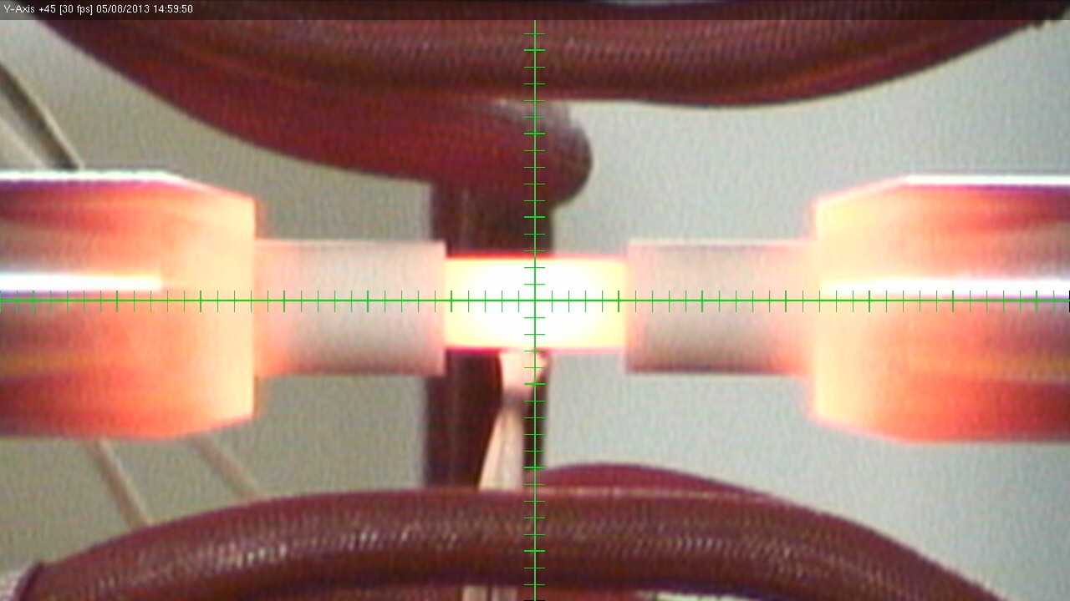
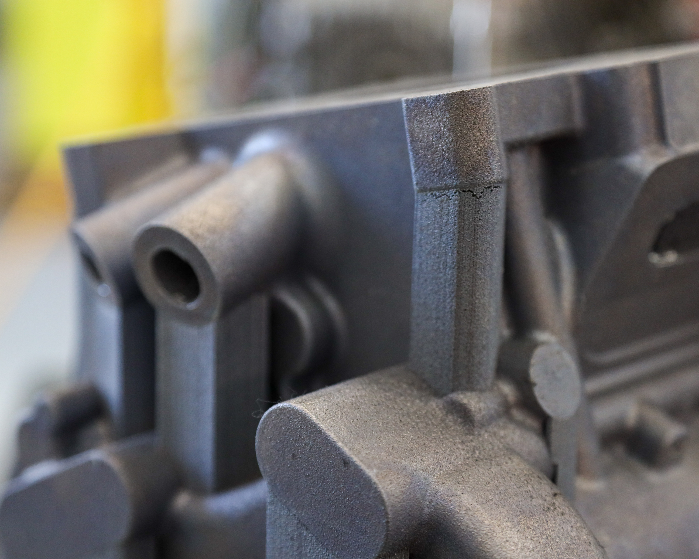
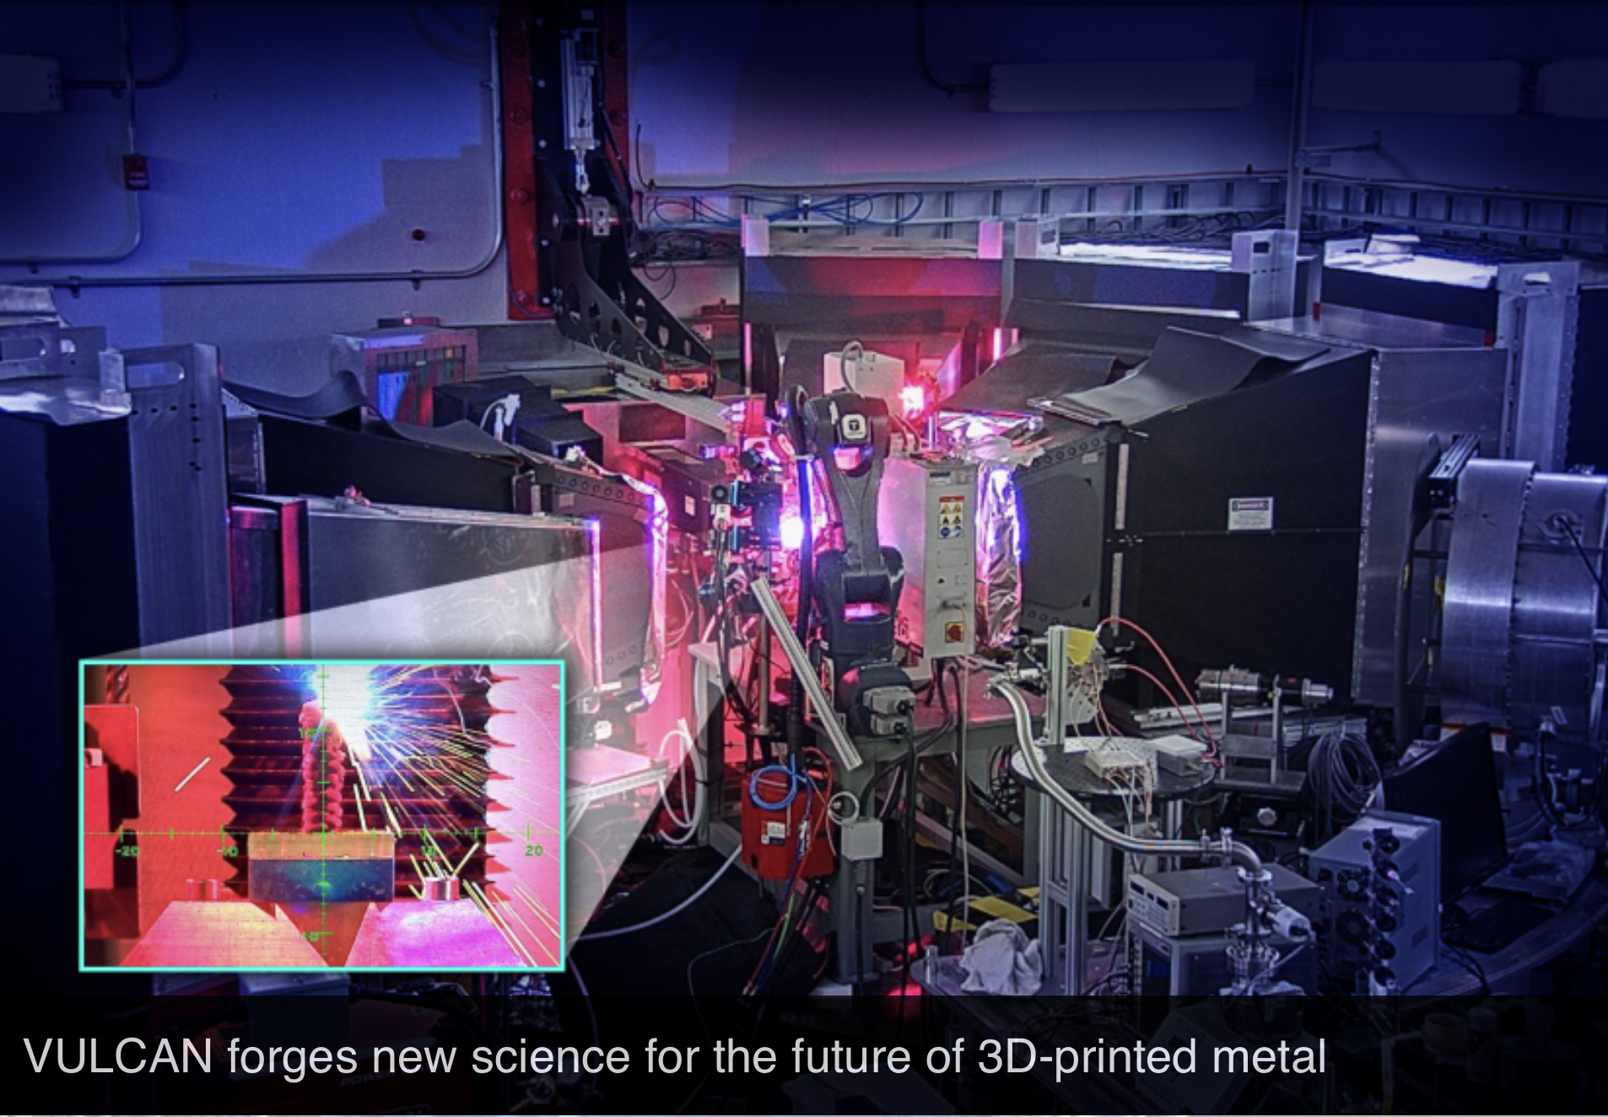
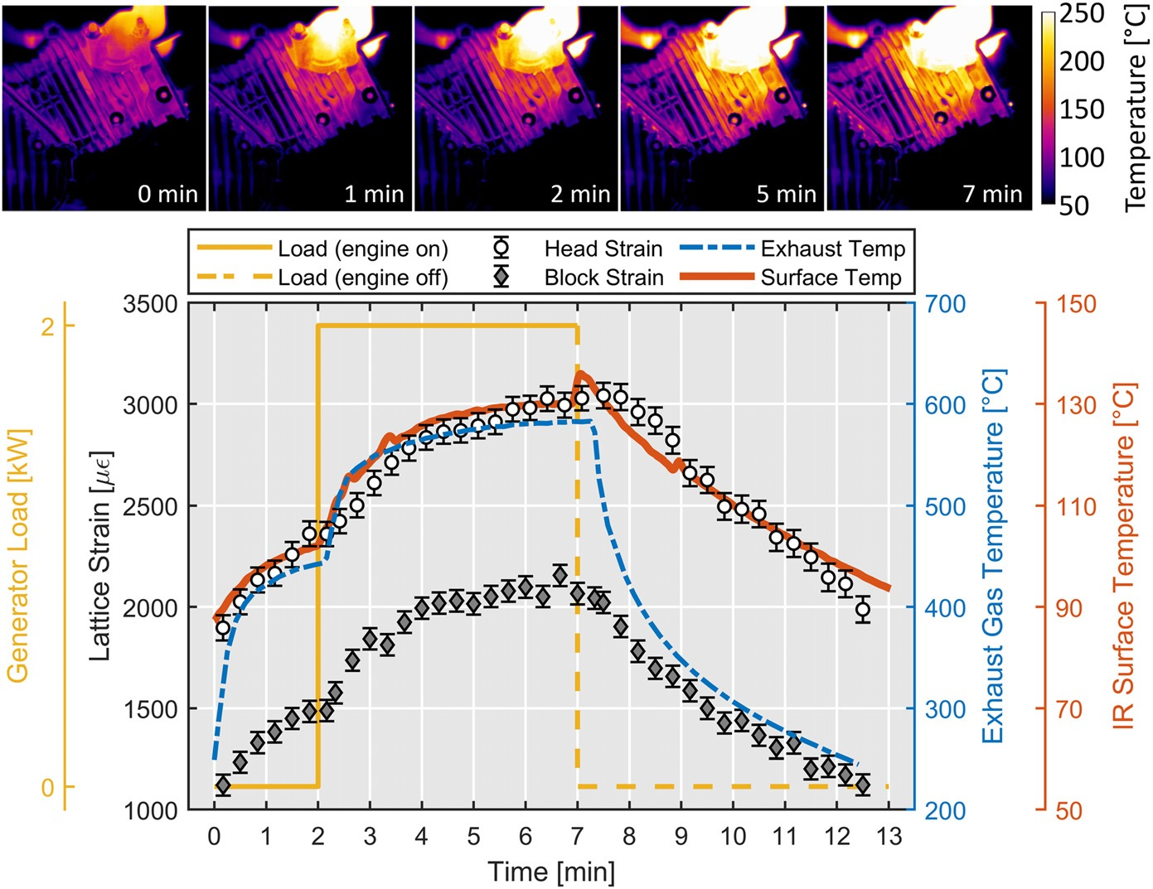
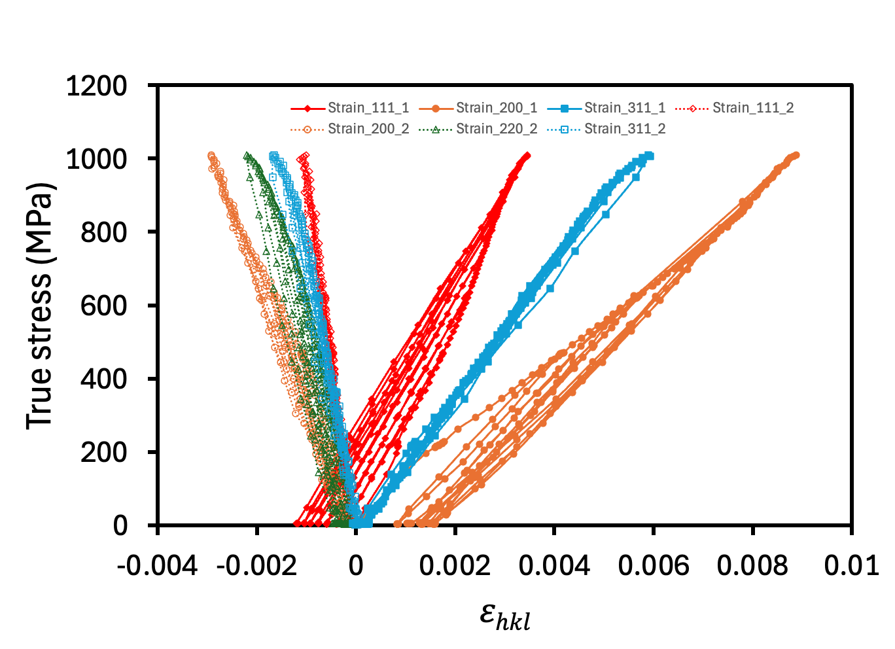
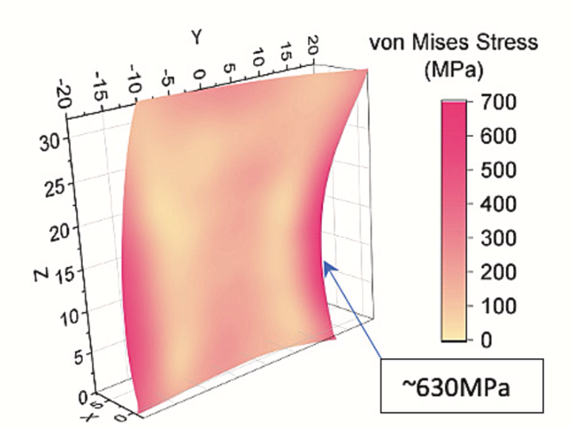
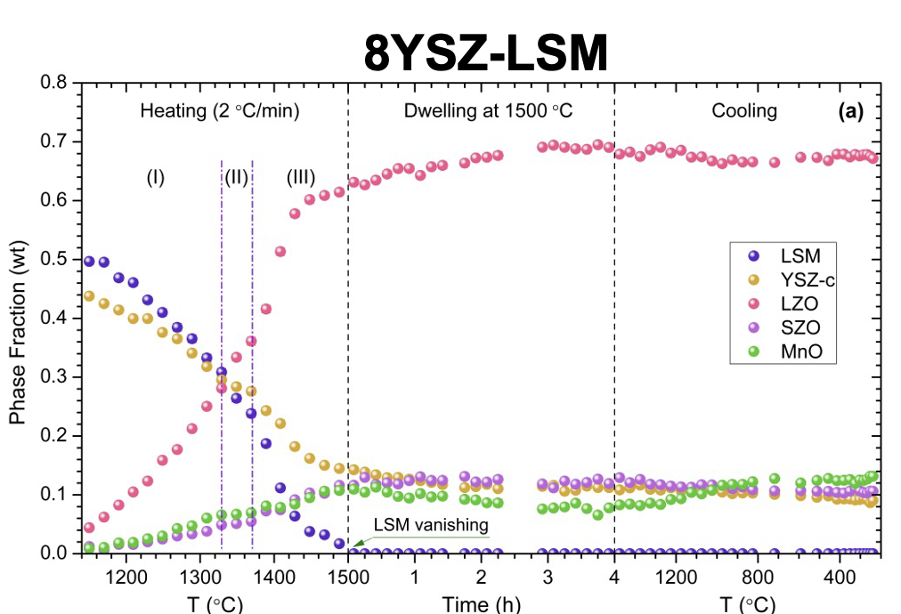
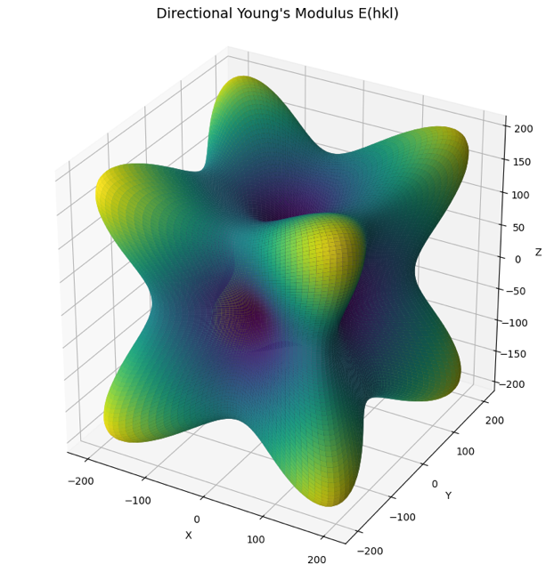
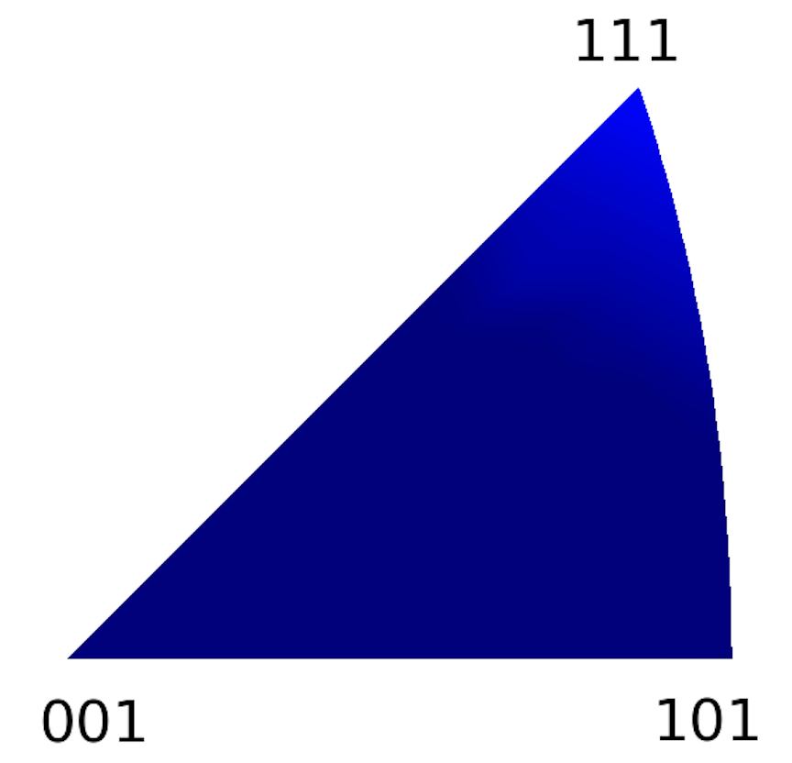
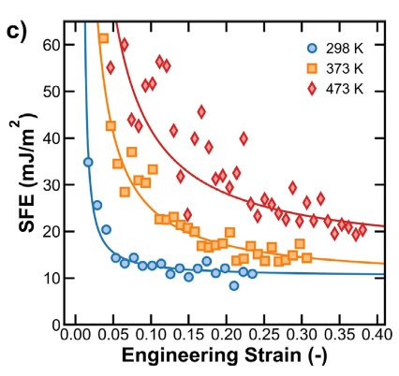
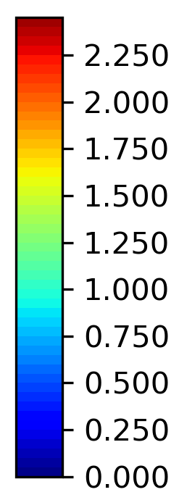
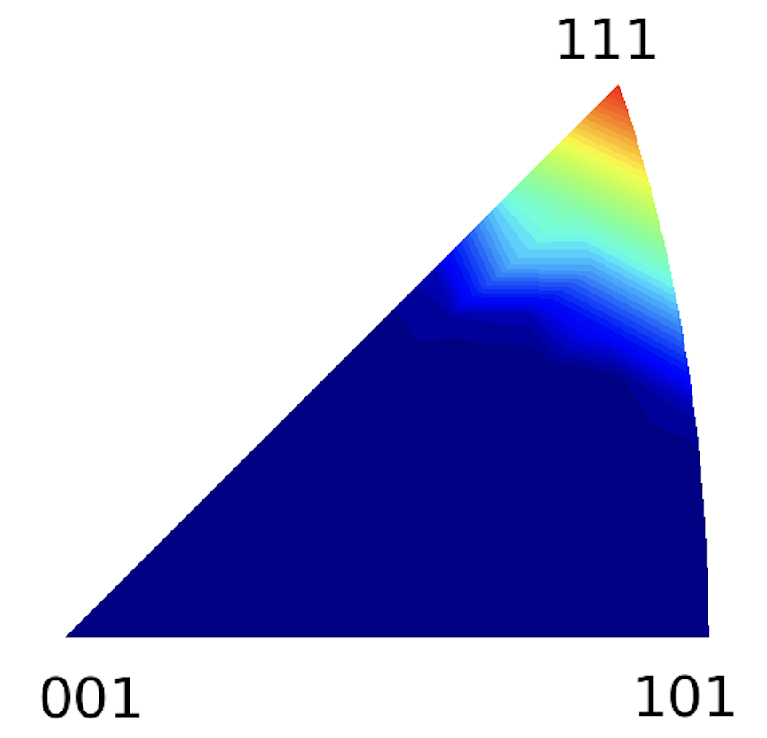
Science and Vision
Understanding engineering and functional materials behavior under complex environments.
VULCAN is designed for deformation, phase transformation, residual stress, texture, and microstructure studies.
In situ studies of materials behavior during processing, synthesis, and fabrication (AM).
In situ thermomechanical loading studies of materials: alloys, ceramics, functional materials.
In situ/operando studies of a real working system such as batteries and running engine.
Nondestructive residual stress (in AM), phase, texture, and other microstructure investigation in engineering components.

Slide 3
Challenges
Live data – need to make decision on the fly before continuous measurement is over.
Massive dataset-> can be hundreds of Gb or even up to Tb
Complex sample environments (all kinds of meta data)

Slide 4
Live data visualization and analysis at VULCAN

Slide 5
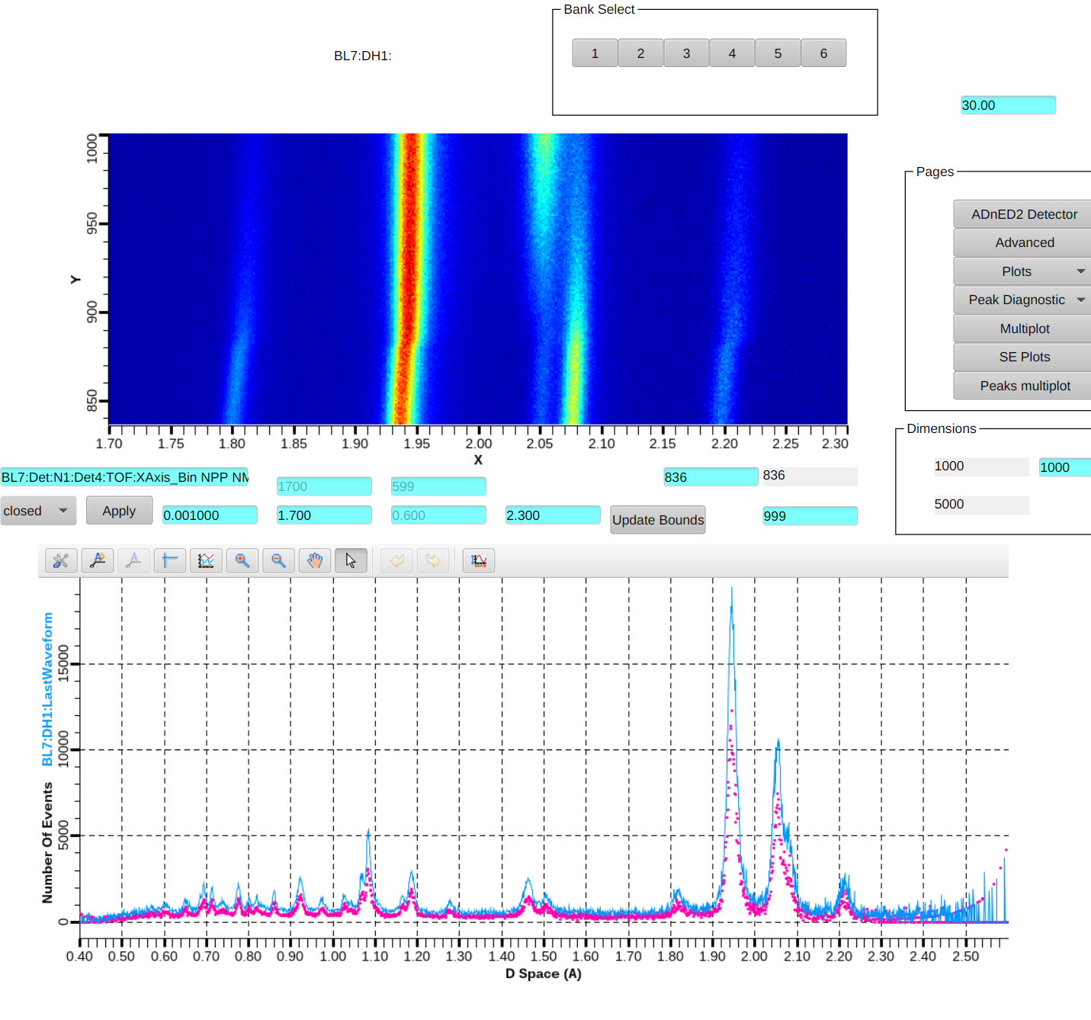
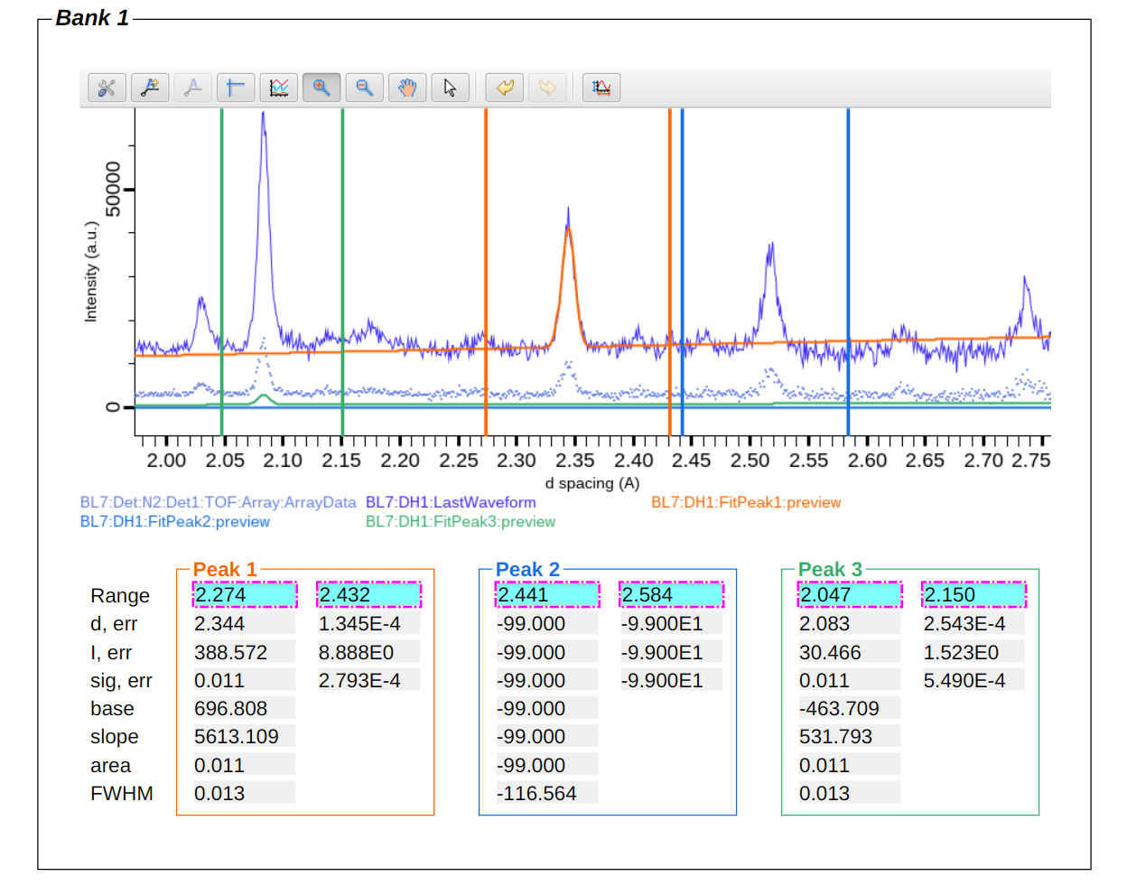
Live data visualization and analysis at VULCAN
Real-time neutron event histogram in EPICS ADnED2
- In situ continuous neutron diffraction
On-the-fly peak analysis in EPICS
Simultaneously fitting 18 peaks = 3 (peaks/bank) x 6 (banks)
Lattice evolution by contour plot
Instant diffraction pattern
(sec – min)
Credit: Alex Sobhani @ NTD

Slide 6
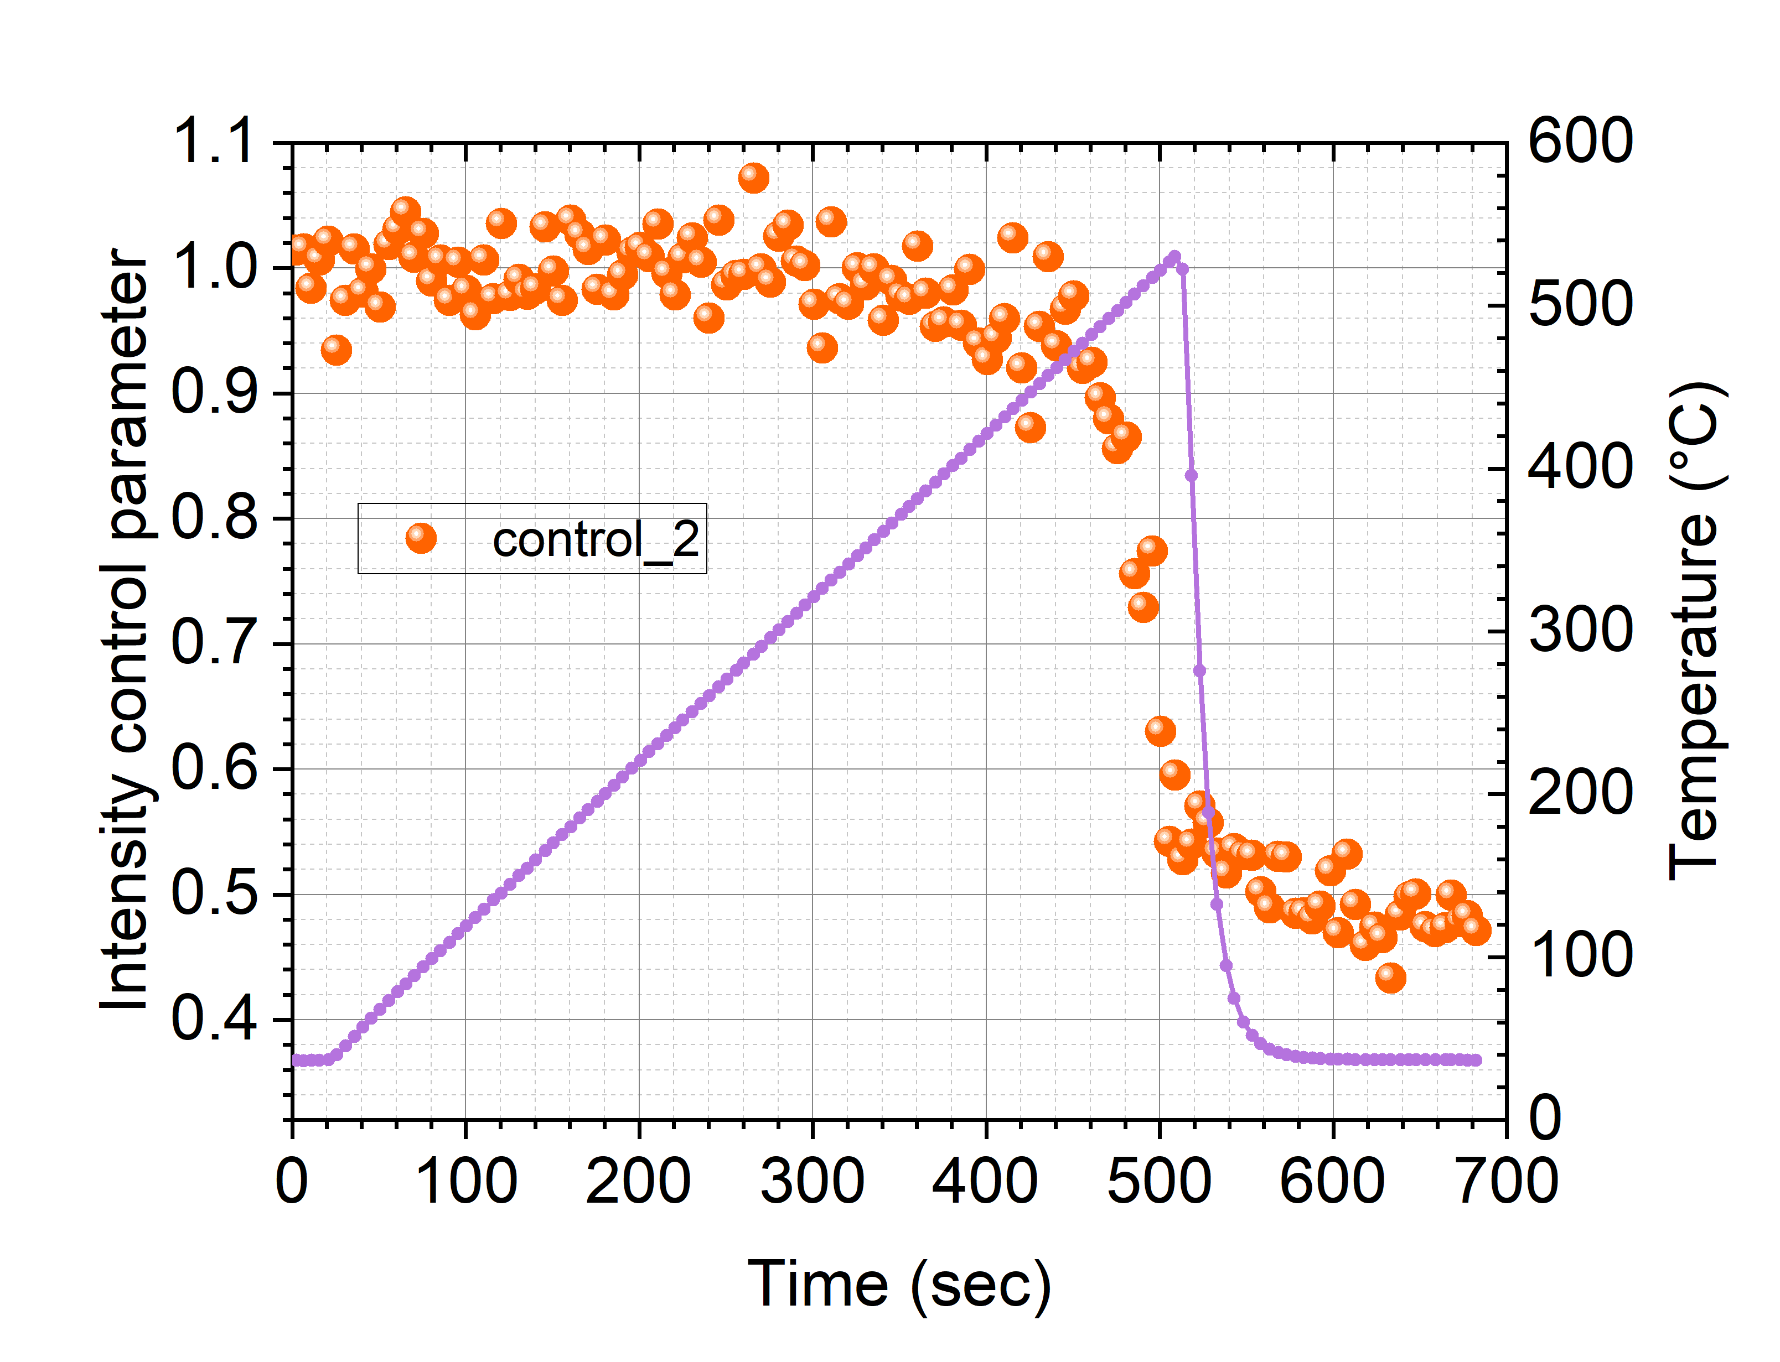
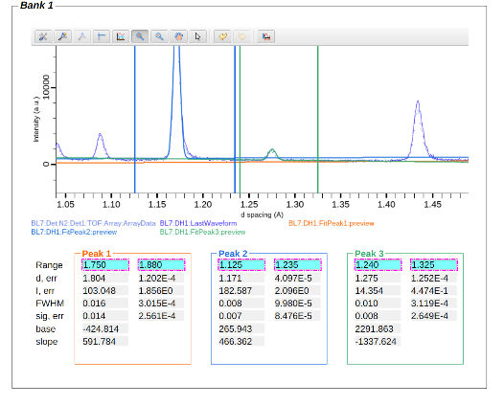
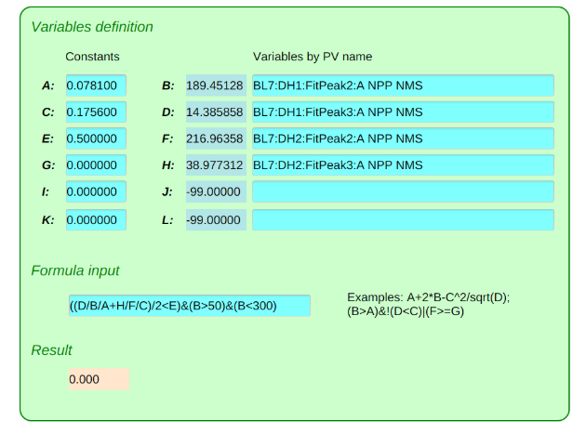
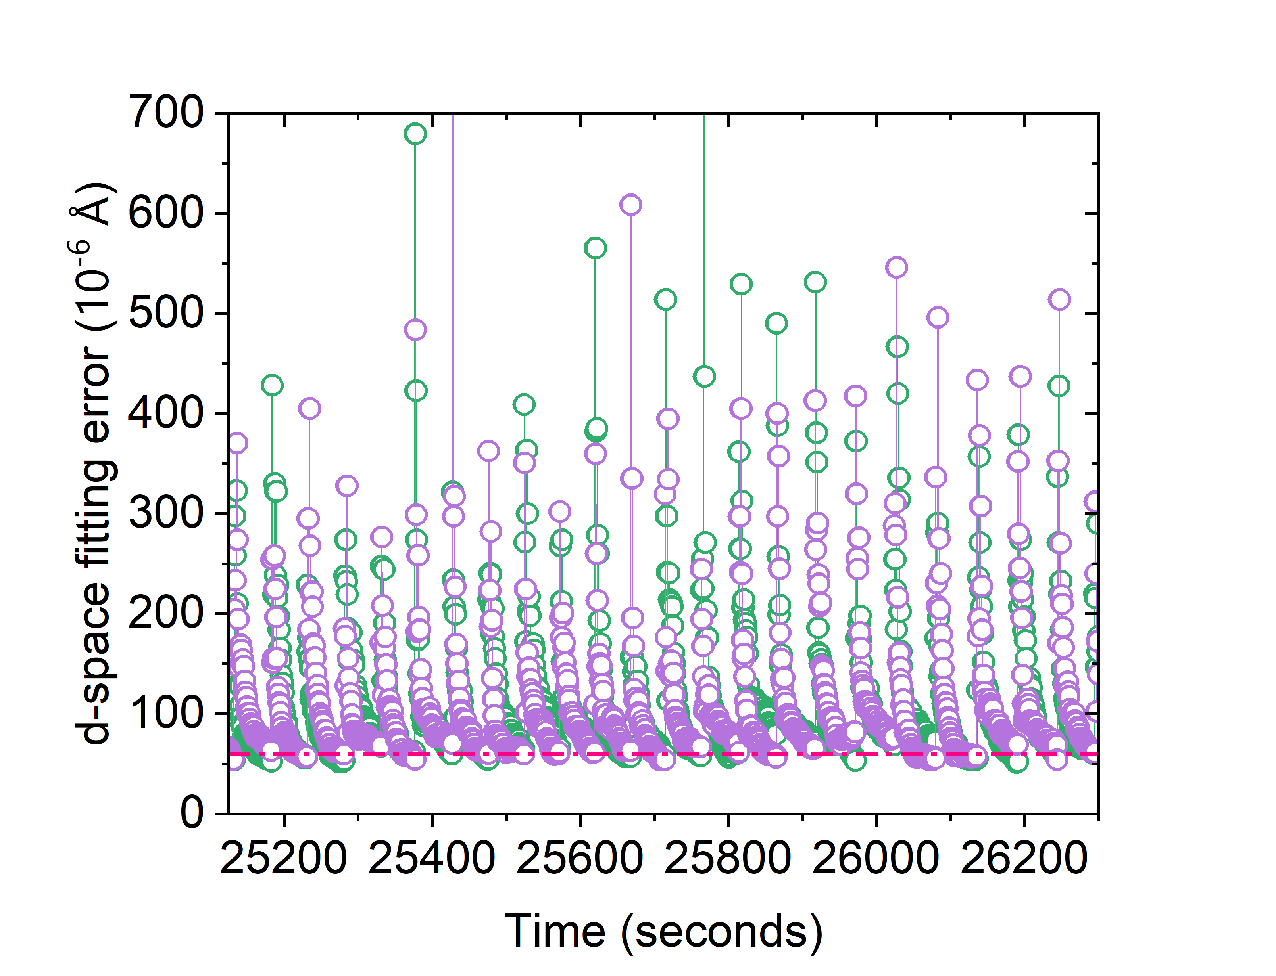
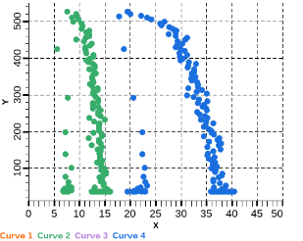

Live analysis and adaptive control
Live fitting and analysis
Versatile logical operations
Adaptive controls
Detect phase transition
Live multipeak fitting
T. vs. Intensity
Lattice strains
Taking account for customized variables and complex logical conditions
Easy to understand and use by users
Low latency to control experiments
Improve experiments efficiency and data quality
Distributable to various beamlines
Live results
Improve data quality

Slide 7
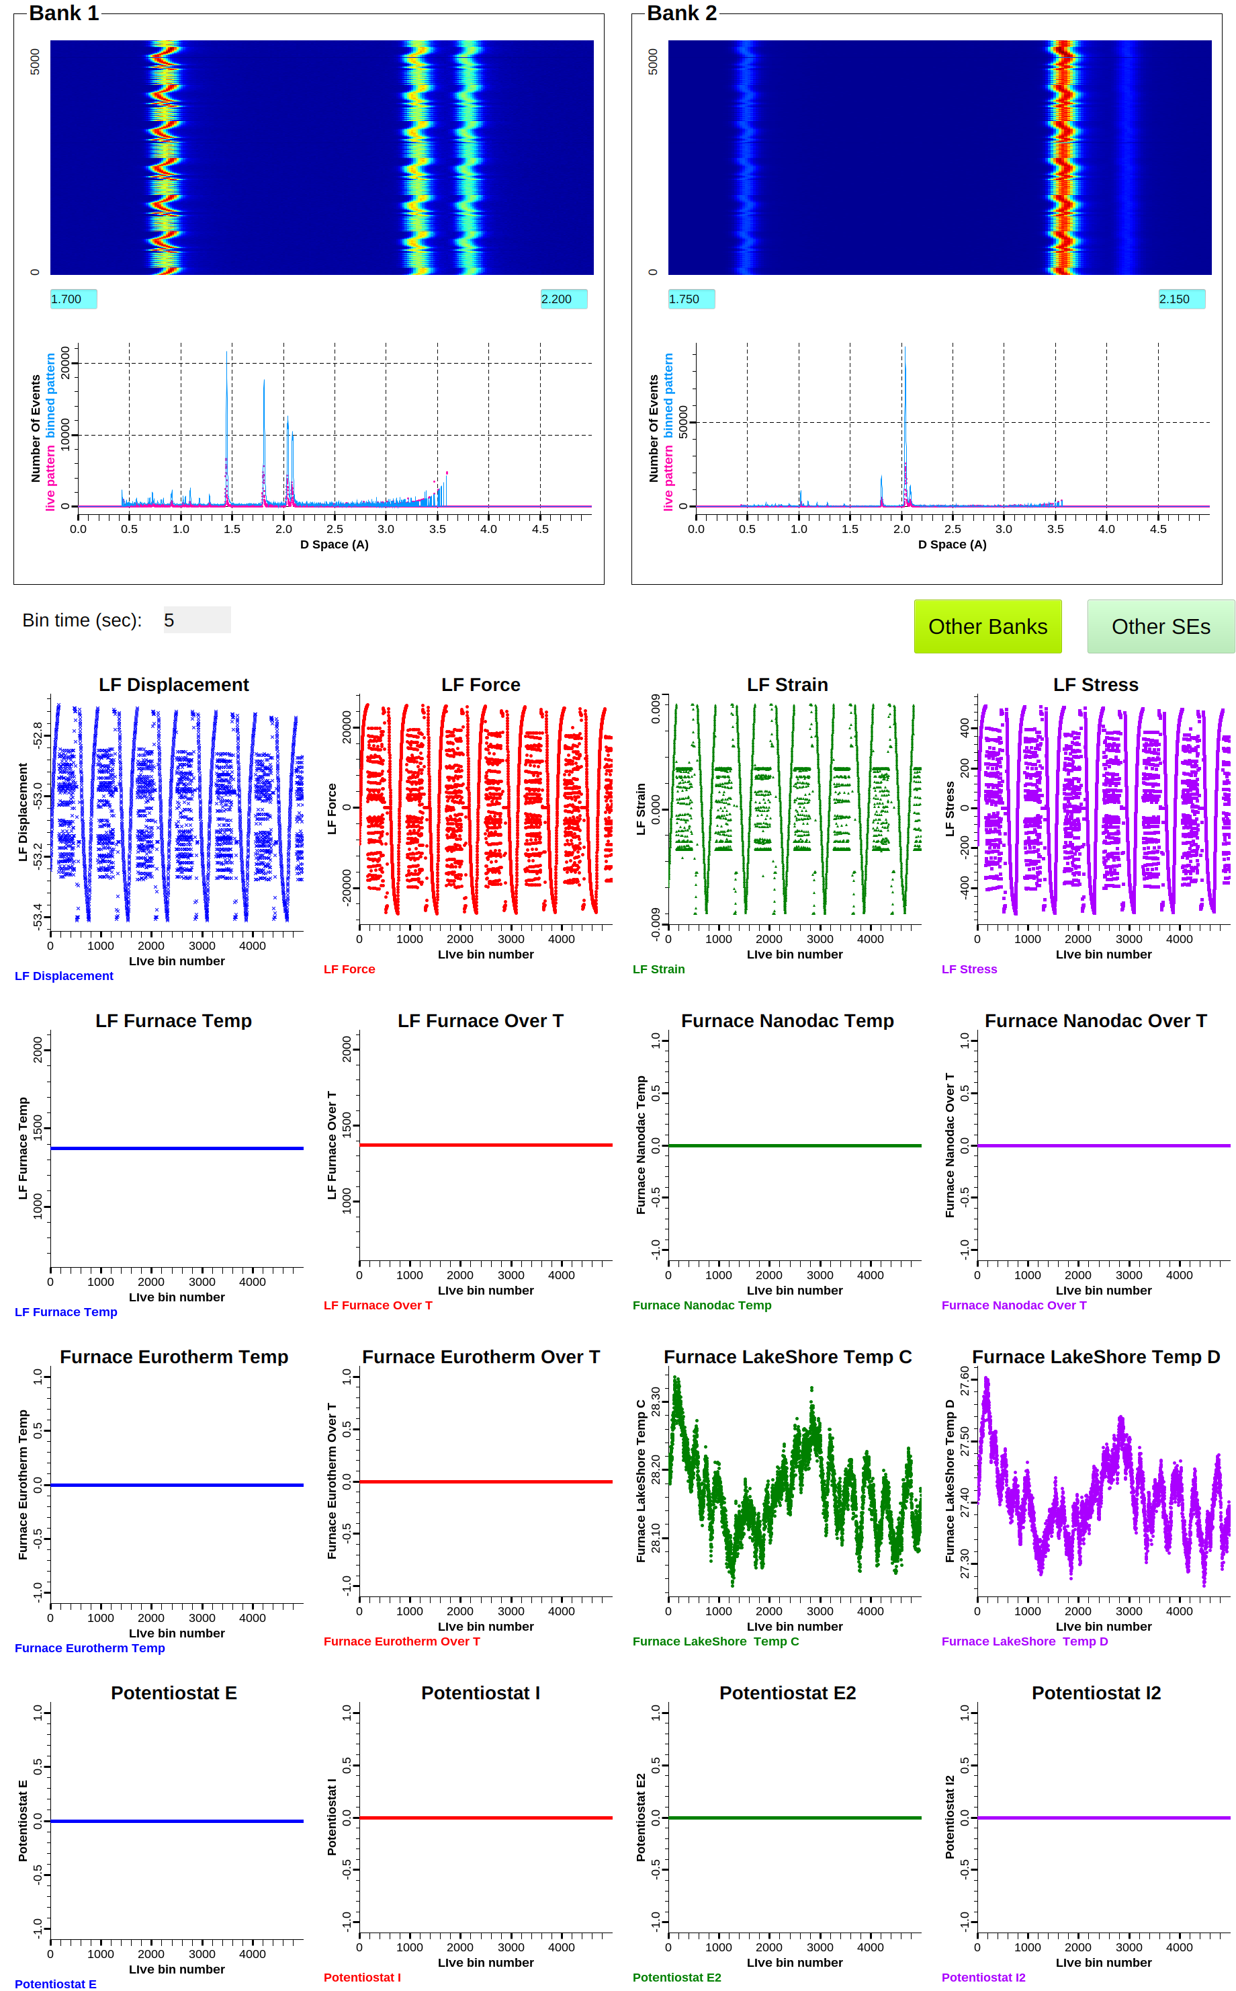
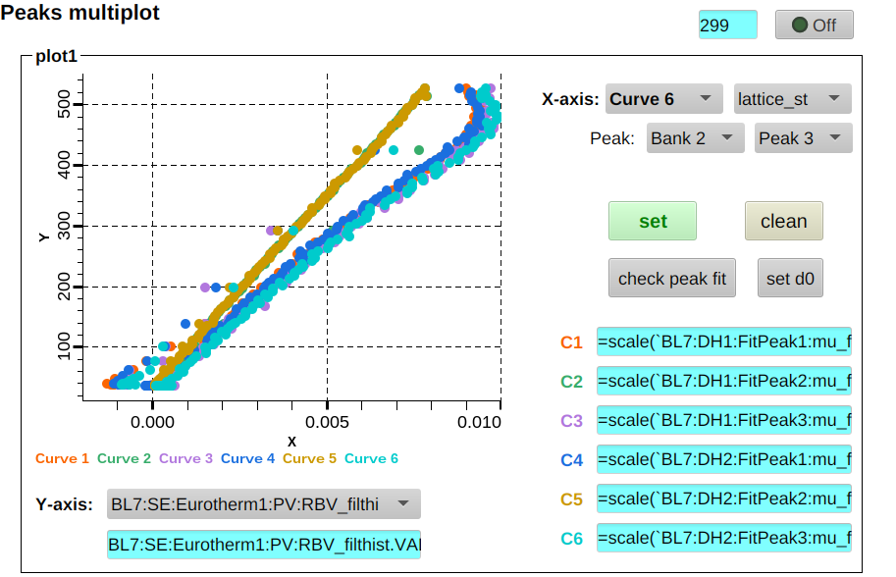
All the available PVs can be pulled out lively.
Live fit results synchronized to SE meta data to show phases’ lattice evolution behaviors instantly
(hkl)s of BCC
Temperature
(hkl)s of FCC
Lattice strain
Monitor and visualization of multiple SE meta data
(available in webopi, accessible in mobile device)

Slide 8
Massive datasets at VULCAN
Notes:
Having shown how users translate live peak‑fit metrics into automated, in situ control, we now turn to the companion challenge: reducing the massive datasets these experiments generate

Slide 9
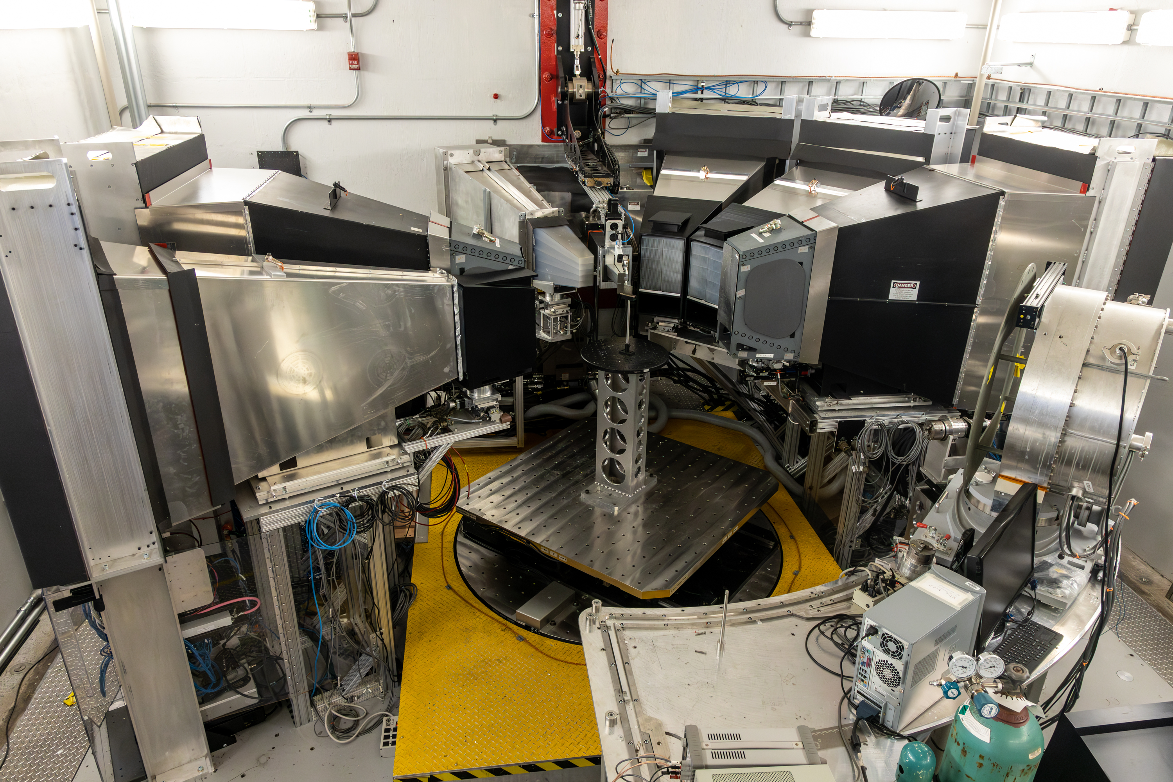
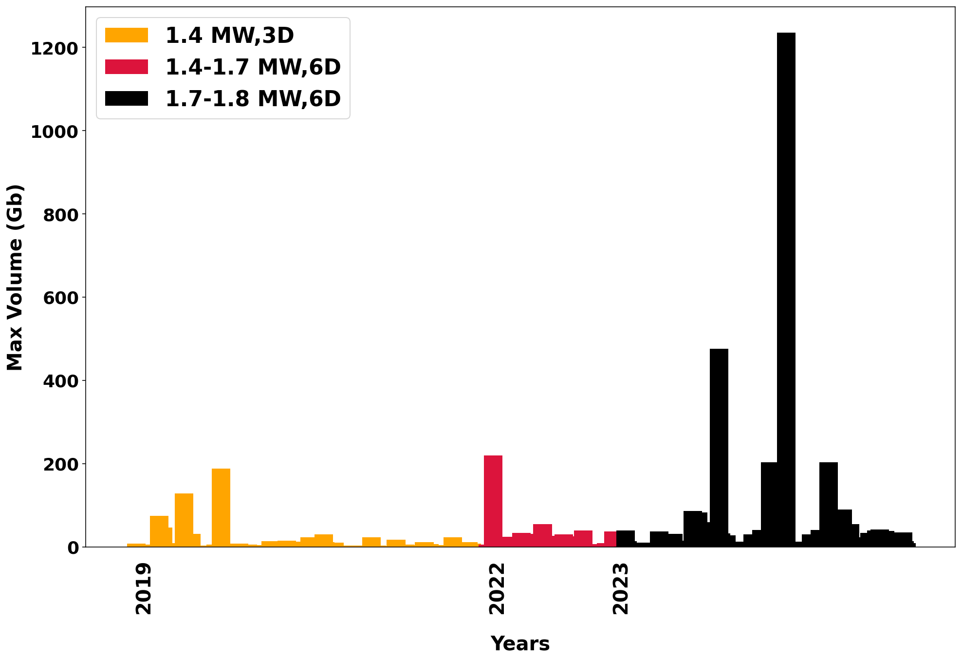
Challenges in data reduction analysis at VULCAN
???
Data reduction with VDRIVE (no support )
Massive data set
  -Reduction takes tens of minutes to hours
  -Massive dataset that can not be reduce
Replacement need to reproduce all of VDRIVE functionality
40 mins

Slide 10
VNEXT: A software replacement in development that addresses issues compromising future user needs
Reduction
Performance
File Size
Advance Filtering
Code being leverage for community use(NOMAD and POWGEN)
FY2026

Slide 11
VNEXT: A software replacement in development that addresses issues compromising future user needs
Reduction
Analysis
Visualization
Calibration
Performance
File Size
Advance Filtering
Code being leverage for community use(NOMAD and POWGEN)
Multi/Single peak fitting subroutines
Scripting Rietveld refinement
Texture analysis
Implement VDRIVE like Visualization using pyvista
Use python Matplotlib library
Time Focus Calibration
Instrument Calibration
FY2026
FY2027

Slide 12
VULCAN neutron data reduction challenges
VNEXT is an interim solution, because it is still a CPU based program and dealing with data at detector bank level.
New software and hardware must be scalable to VULCAN’s evolving geometry and capability
Ability to reduce live data for operando measurement by adaptive ROI and at a pixel level ( yes, each pixel provides an analyzable diffraction pattern)
Enable AI-assisted loop control for real time in situ decision by adaptive ROI and at pixel level during experiments

Slide 13
VULCAN neutron data reduction challenges
VNEXT is an interim solution, because it is still a CPU based program and dealing with data at detector bank level.
New software and hardware must be scalable to VULCAN’s evolving geometry and capability
Ability to reduce live data for operando measurement by adaptive ROI and at a pixel level ( yes, each pixel provides an analyzable diffraction pattern)
Enable AI-assisted loop control for real time in situ decision by adaptive ROI and at pixel level during experiments
We need a new paradigm!!!

Slide 14
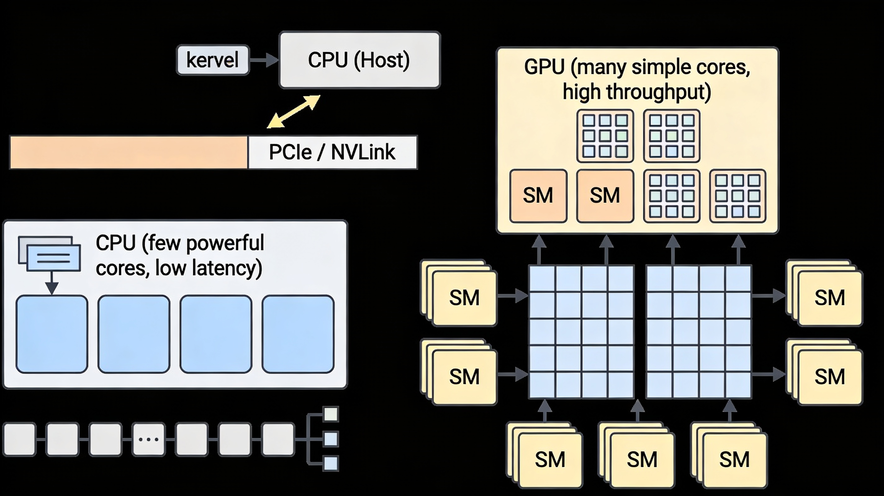

Blueprint for the next era of data reduction at VULCAN
New hardware
Local AI assisted agent
Unified CPU/GPU architecture delivering high performance and efficiency
Take Advantage of both CPU and GPU Parallelization
Closed‑loop optimization
Faster experimentation- shortened feed back loop
Open-access LLM to be installed locally

Slide 15
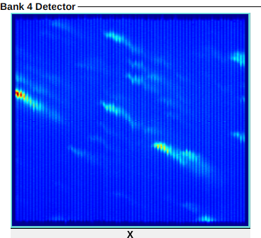
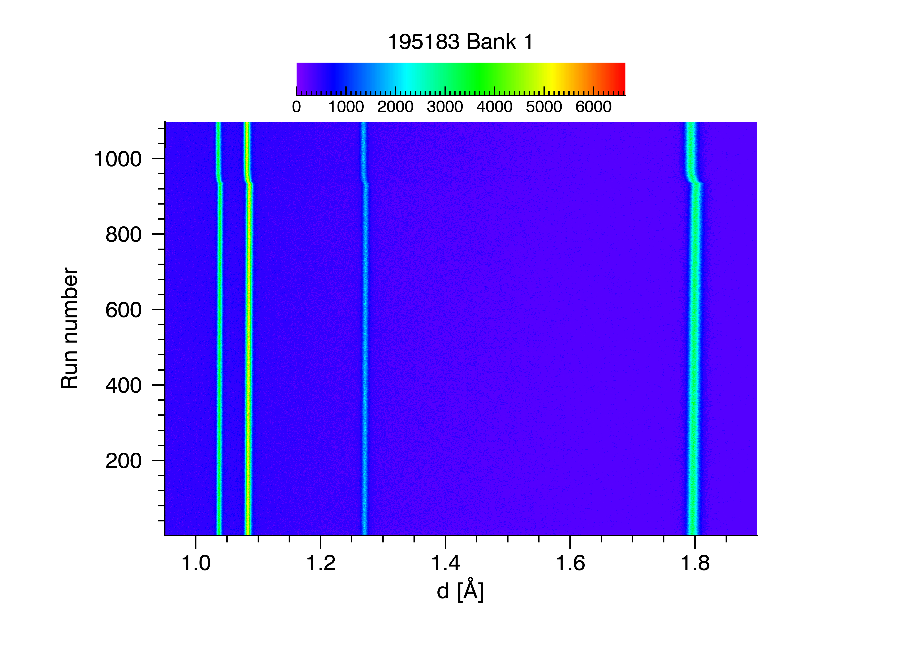
1st: Interactive data reduction and analysis
AI assisted, real time coarse view: peak positions, strain, etc
ROI selection, automatic peak finding , quality check during acquisition
Suggest binning and scanning
Synchronized with sample environments logs for instantaneous interpretation
Reduce feedback loops from hours to seconds/minutes while user is kept in the loop.
Time/PV
Hey, VULCAN….
d

Slide 16
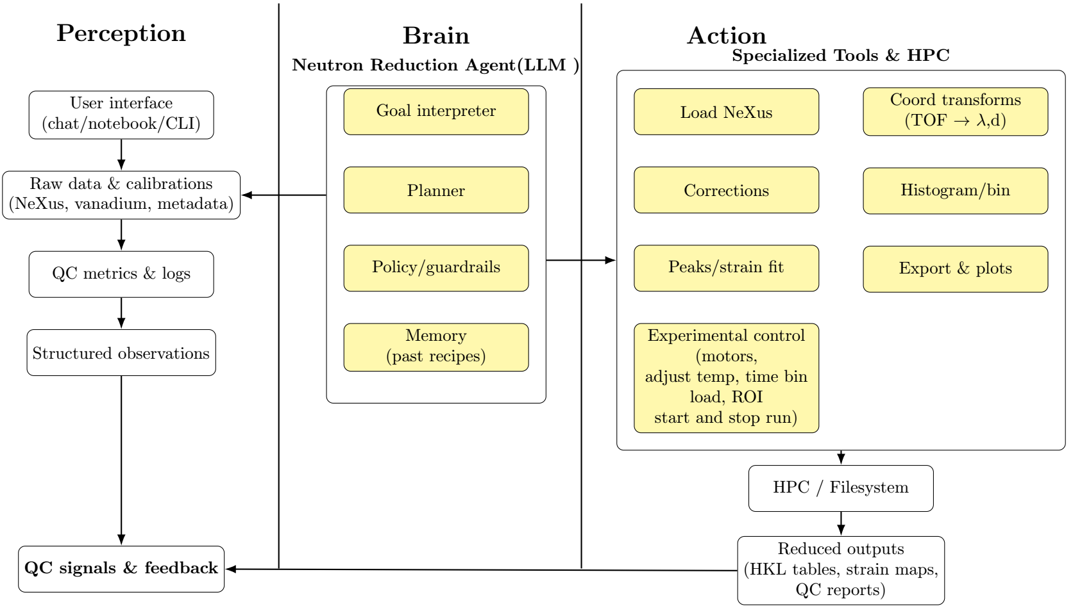
2nd: AI agent assisted interactive data reduction & analysis to transform VULCAN into a self- optimizing discovery platform

Slide 17
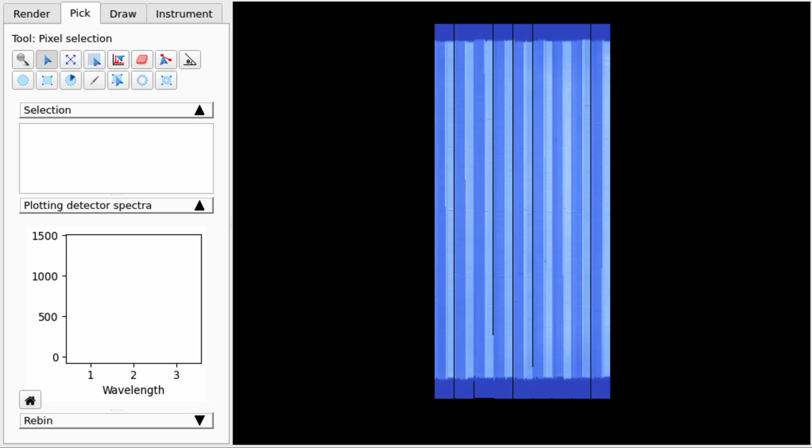
3rd: Pixel by pixel reduction
Pixel by pixel reduction why?
Exploit detector pixelation instead of averaging spatial information
  -Map short range strain, texture, phase
AI models cluster pixel into regions and denoise low count signals in real time
Key Advantages:
More Accurate calibration and time focus
Flexible rebinning
Flexible regrouping
Better use for ML automation
Notes:
Final phase: enable user‑driven, pixel‑by‑pixel data reduction. Each detector pixel is treated as its own diffractometer, with per‑pixel (or small‑group) calibration, normalization, and peak integration.
This preserves spatial heterogeneity and reveals local variations in strain, texture, and phase that are masked by early bank/ROI averaging
critical for additively manufactured materials and other heterogeneous operando systems.

Slide 18
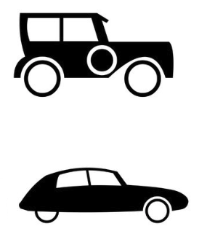

Summary
VDRIVE
  Hardware
    CPU & GPU machine
  Software
    -Conventional reduction and analysis
      VDRIVE
      VNEXT
    - AI assisted reduction and analysis
      Interactive ,
      AI agent assisted
      Pixel by pixel reduction
VNEXT
AI assisted reduction and analysis
New instrument needs new software and high computation power

