Slide 1
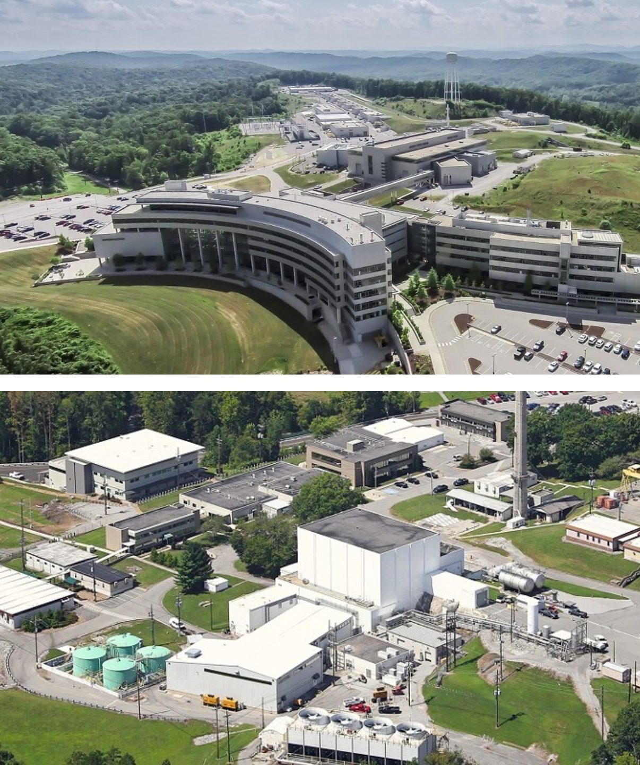
Review of the Materials Engineering Diffraction Instrument Suite
February 12, 2026
Volker Urban
Section Head, Large Scale Structures

Slide 2
Outline
Introduction of Review
Large Scale Structures Section Context
Materials Engineering Diffraction at ORNL
Review Charge Questions
Agenda & ‘Nuts & Bolts’

Slide 3


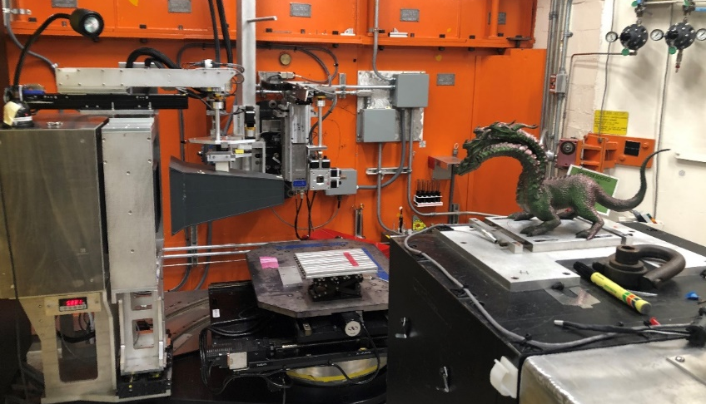
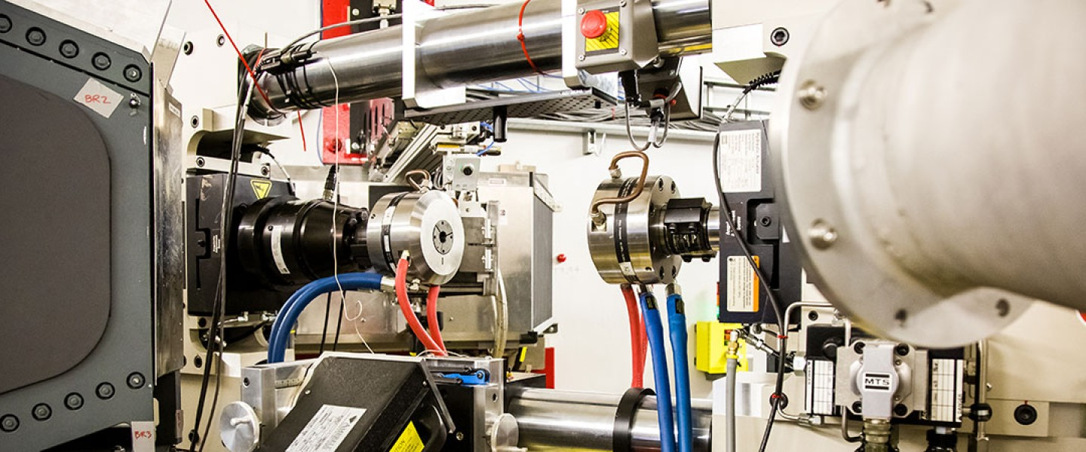
ORNL Materials Engineering Diffraction Suite Review
Welcome!
Review date: Feb 12-13, 2026
Reviewers
Sean Agnew, University of Virginia
Darren Pagan, PennState
Instruments
HIDRA, HB-2B, HFIR
VULCAN, BL-7, SNS

Slide 4
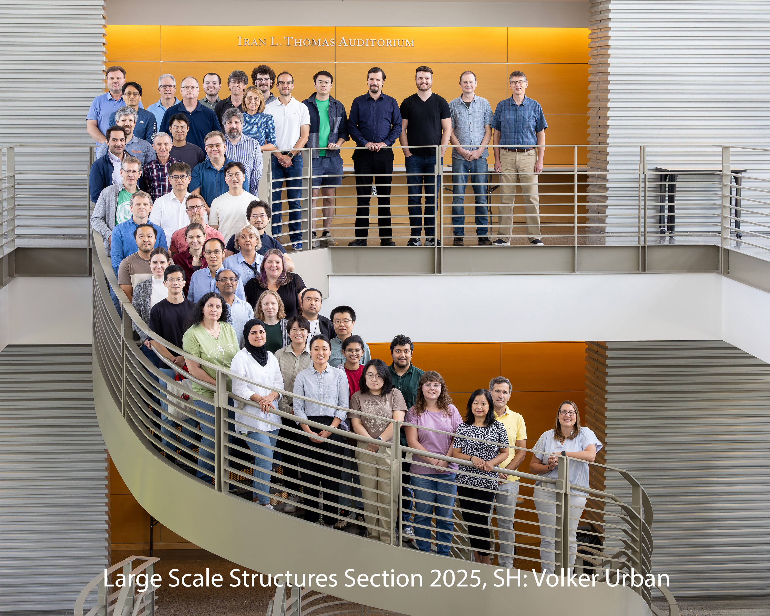
Large Scale Structures Section
Large Scale Structures Section
Four Groups
Materials Engineering Andrew Payzant
Neutron Reflectometry Jim Browning
SANS & Spin Echo William Heller
Biological Labeling and Scattering Hugh O’Neill

Slide 5
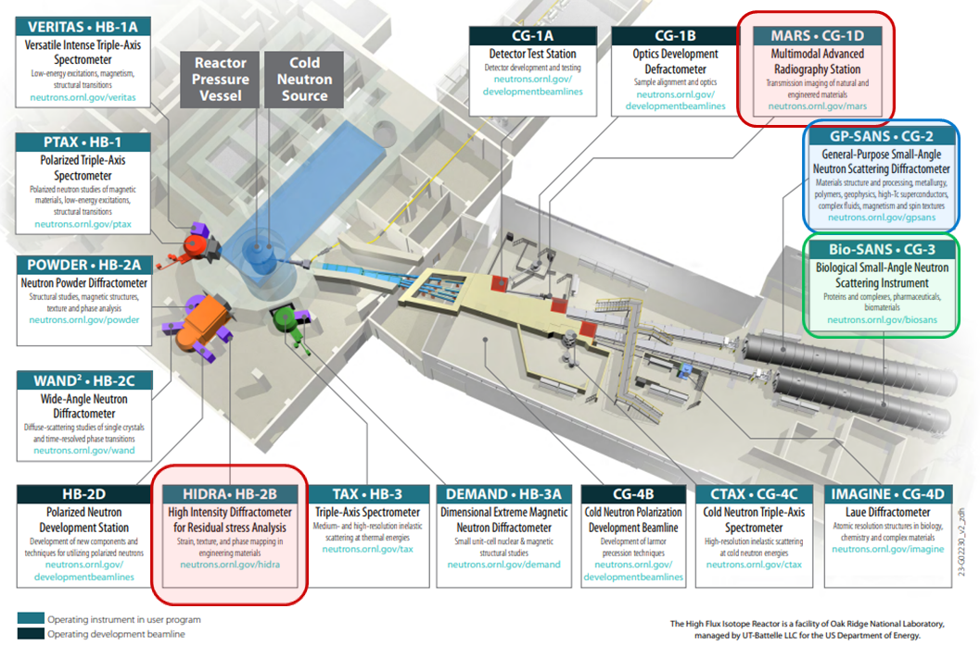
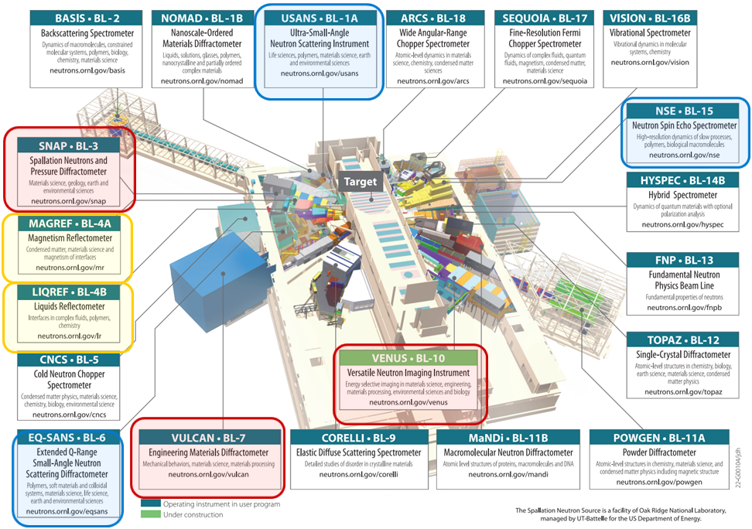
Large Scale Structures Section
High Flux Isotope Reactor
12 Instruments
4 at the HFIR
8 at the SNS
Spallation Neutron Source
4 Groups
Materials Engineering, A. Payzant
Neutron Reflectometry, J. Browning
SANS & Spin Echo, W. Heller
Biological Labeling and Scattering, H. O’Neill

Slide 6
Materials Engineering Diffraction at ORNL
HFIR HB-2B HIDRA
1992 LDRD project for dedicated residual stress mapping at ORNL.
1994–2001: 1st generation instrument NRSF operated under the High Temperature Materials Laboratory (HTML) user program at former HB-2 triple-axis spectrometer.
2004 Following HBRR reactor upgrades, dedicated NRSF2.
2019:Instrument renamed to HIDRA (High Intensity Diffractometer for Residual stress Analysis) to better reflect its upgraded capabilities.
SNS BL-7 VULCAN
2003 Conceptual Design, 2005 Beamline 7 project start, 2006 SNS First Beam
2008 Instrument Completion, 2009 Commissioning & First Neutrons, 2010 VULCAN in General User Program
2018–2022 Upgrade Phase: Significant upgrades to detector coverage

Slide 7
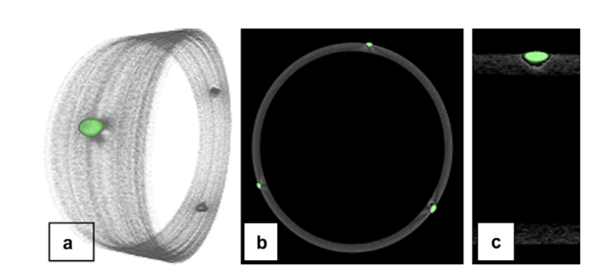
Examples of Mat Eng Diffraction “Cross-Section” Synergy
Brianne Heisinger PhD Dissertation, UTK 2021: Non-Destructive Characterization of Zircaloy-4 Nuclear Fuel cladding Using Neutron Scattering Techniques BL-7 (VULCAN), CG-2 (GP-SANS), CG-1D (MARS)
Nandhini Raju (now SE) Ph.D. Dissertation, U of Central Florida, 2024: Improving Structural Integrity of Additively Manufactured High-Temperature Gas Turbine Component HB-2B (HIDRA), CG-1D (MARS)

Slide 8
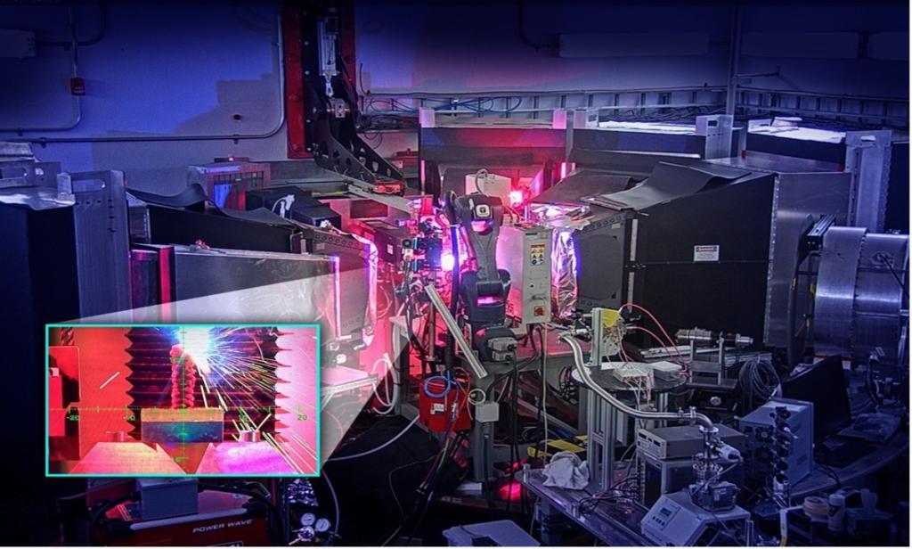
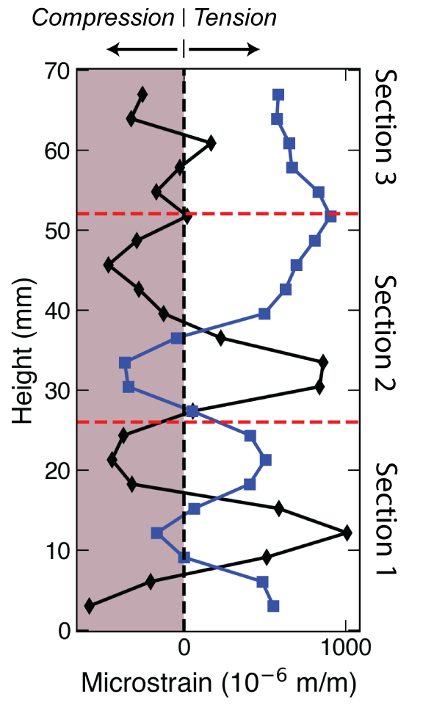
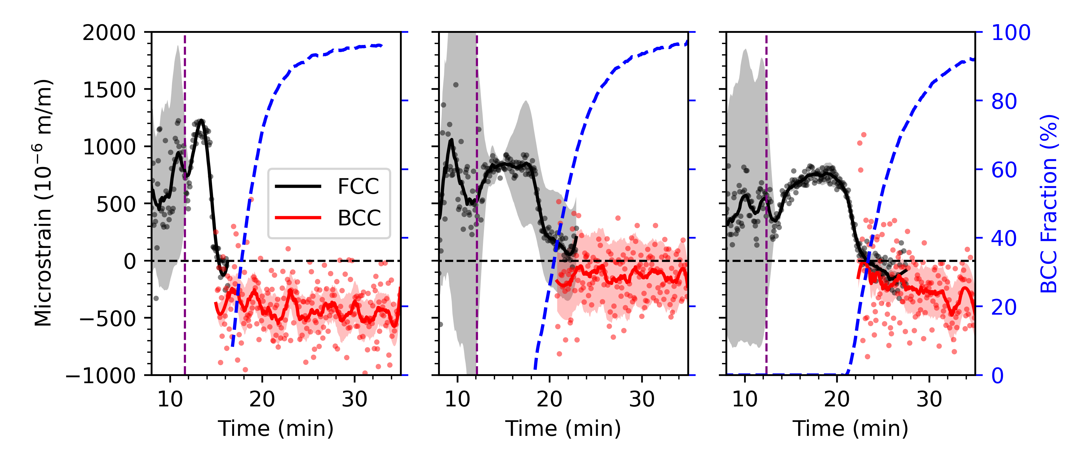
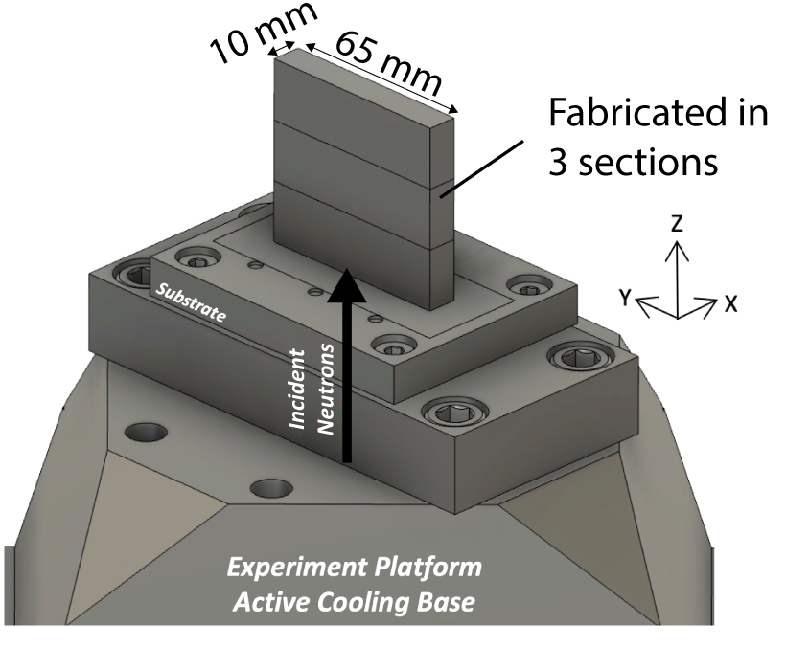
Correlating Elastic Strain and Phase Evolution to Understand Developed Residual Strains
Longitudinal Elastic strain evolution
Cooling
Tensile strain due to FCC/BCC CTE mismatch
Compressive strain from phase trans.
Plotkowski et al., Nature Communications 14, 4950 (2023)
HIDRA (HFIR) & VULCAN (SNS)
Notes:
An LTT sample was fabricated in 3 segments to study the effects of start stops that can occur during large scale additive manufacturing processes. Lattice strains measured by strain mapping at the HFIR HIDRA identified undulations near section interfaces.
Operando system at the SNS probided direct insights into the material evolution and how phase transitions underpins the appearance of strain localization.
Figure only shows the evolution in the longitudinal elastic strains. Data were measured near a section boundary where the thermal load of the subsequent deposition was sufficient to induce A reversion.
The strain evolution in this region is initially tensile, with a gradual increase in the magnitude of the tensile strain before the strain is reduced at the onset of the martensite fraction. Cooling through Ms nucleates M throughout the microstructure with a volume change that relieves build in lattice strain. Further cooling increases the fraction of M which further reduces the magnitude of the built in elastic strains. Formation of ~35 M fraction reduces the ~750 microstrain to zero. Continued cooling and increase in M drives the formation of a compressive elastic strain.

Slide 9
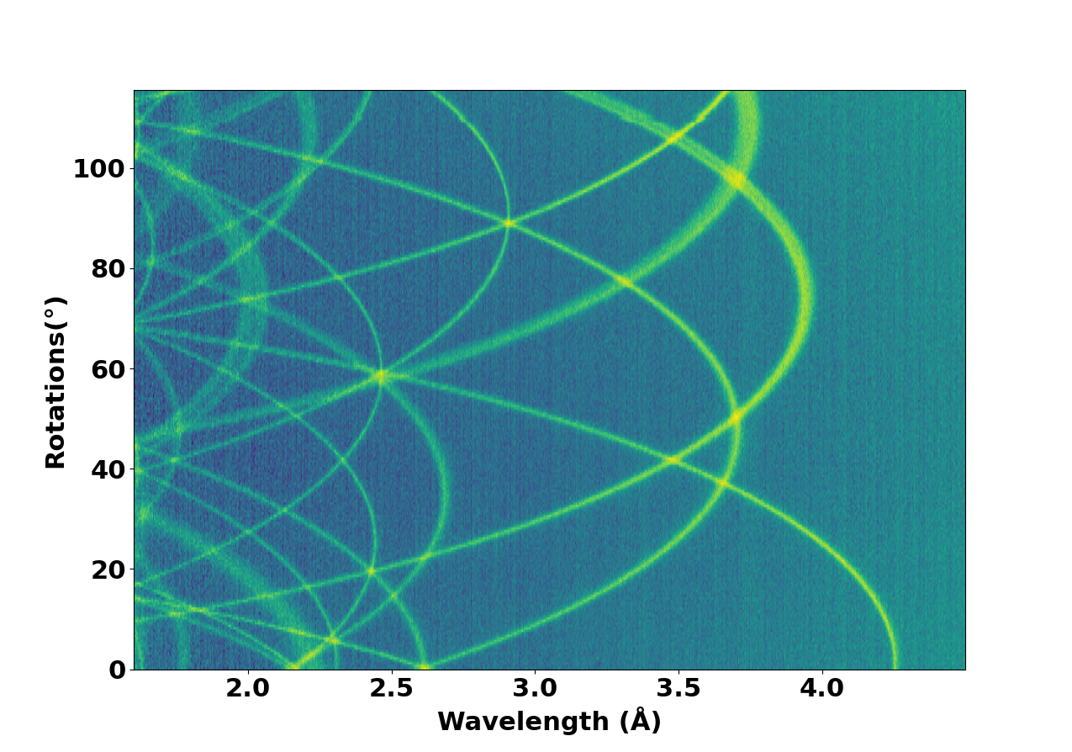
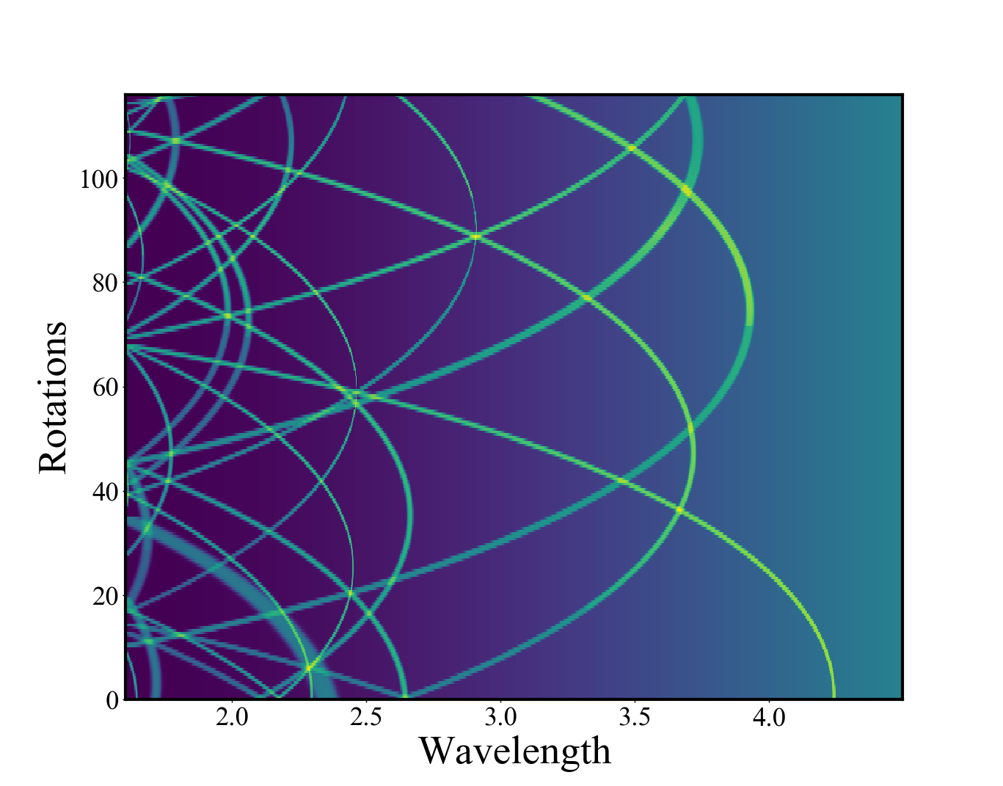
Crystallographic mapping by neutron transmission
ToF transmission scan while rotating sample around an axis allows retrieval of crystallographic information, such as crystal orientation as diffracted intensities rotate in and out of reflection condition. Work is demonstrating potential of the technique for applications such as fast texture scanning in engineering materials. Demonstrated for orthogonal rotation axis, arbitrary axis orientation in progress.
Single crystal measurement, SNAP, SNS BL-3
Simulation of recovered orientation
Dessieux et al, J Appl Cryst 2023

Slide 10
Review Charge Questions
Do the technical capabilities and performance of the individual instruments and instrument suites compare favorably with peer instruments at leading national and international neutron facilities?
Does the scientific productivity and impact of the instrument programs compare favorably with comparable programs at peer facilities?
Do the beamlines meet users’ day-to-day needs for data collection, reduction, and analysis? Are planned software developments sufficient to meet anticipated future user needs?
Is the current scientific portfolio and business case for each instrument competitive nationally and internationally (e.g., user demand, breadth of scientific applications, scientific impact, mission relevance, agency support, and/or industrial engagement)?
Are there a strong and sustainable user community and a clear case for future scientific demand for these instruments? Is the number of beamlines in a suite proportionate to user community demand?
Are the plans for development appropriate and well justified to meet current and future user requirements? Please consider aspects of instrument techniques, sample environments, sample preparation and characterization infrastructure, data analysis and modeling capabilities.
Are there well-defined and credible plans for future automation and integration of artificial intelligence or machine-learning approaches?
Have the strengths, weaknesses, opportunities, and threats for each instrument or suite been clearly identified, and are there realistic plans to address them where feasible?
Are there additional developments, capabilities, or provisions that could enhance the capacity, effectiveness, or scientific impact of diffraction science at SNS and HFIR that were not presented by the instrument teams?
Any other comments or recommendations the panel wishes to provide to the NScD Associate Laboratory Director?

Slide 11
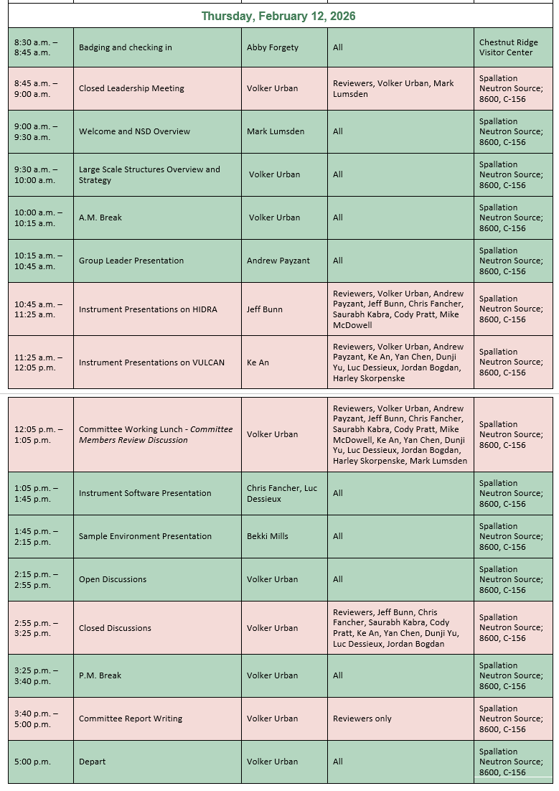
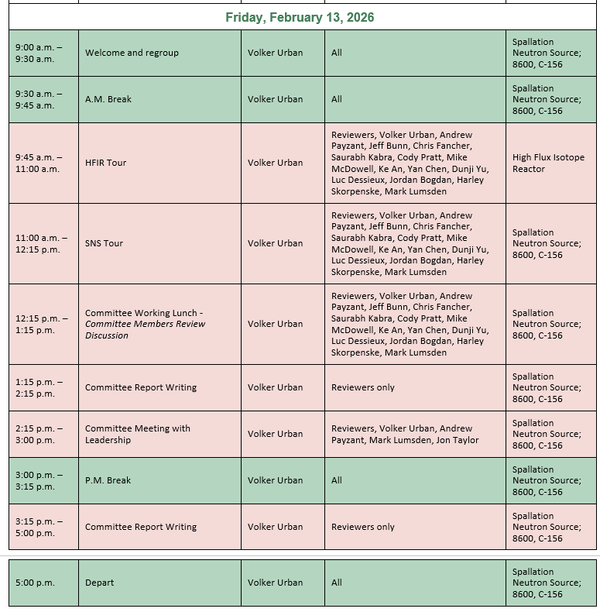
Review Agenda

Slide 12
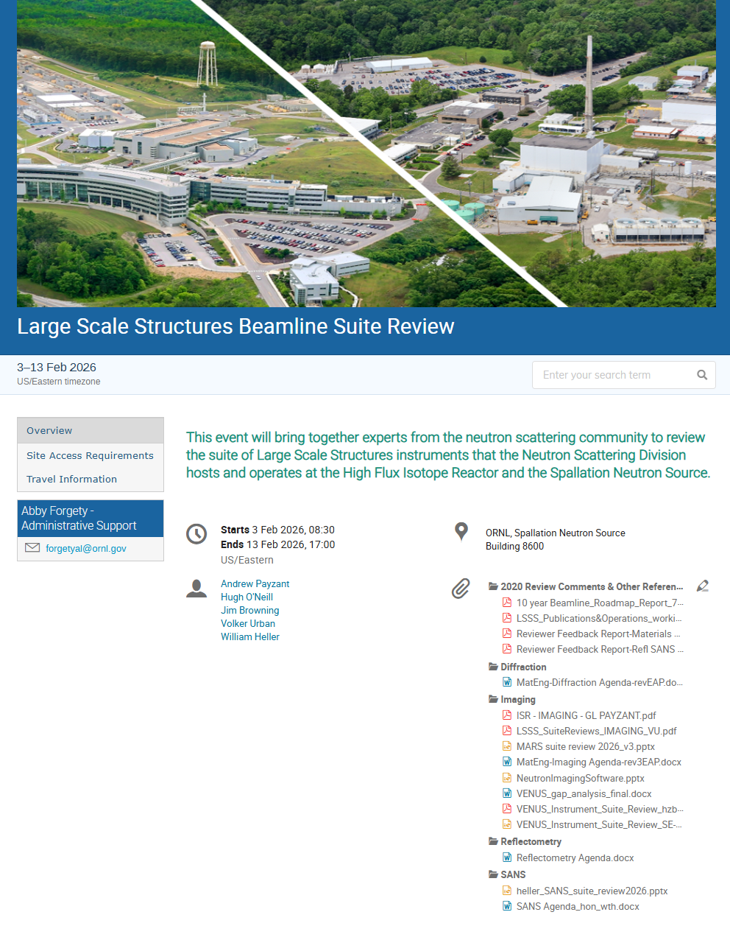
LSS Beamline Suites Review – nuts & bolts
Review Material: Agenda, Presentations, Additional Documentation: https://conference.sns.gov/event/529/
Some context
Previous suite reviews 2017, 2020
DOE reviews: …, 2018, 2023, 2027
Reviewers:
We can arrange additional discussions as needed.
We request report in 2 weeks.

Slide 13
A few recurring abbreviations…
CIS: Computational Instrument Scientist
SA: Scientific Associate (assigned to a beamline, staff in instrument support section)
SE: sample environment (generally and specifically SE Section)
HBRR: HFIR Beryllium Reflector Replacement
LSS(S): Large Scale Structures (Section)

Slide 14
Questions?
Next up: Group Leader Presentation, Andrew Payzant

Slide 15
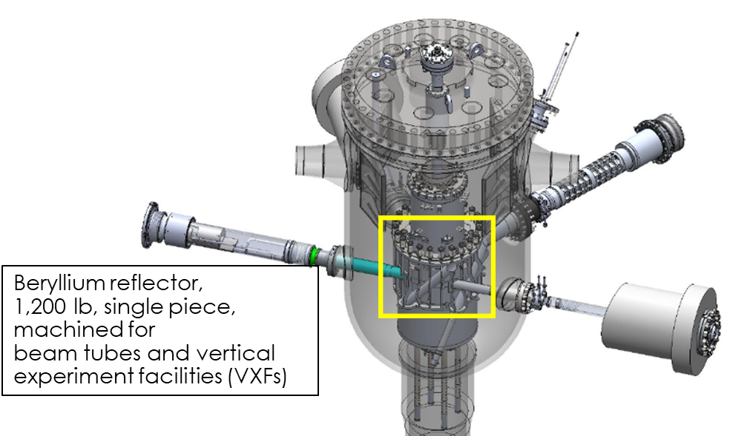
HBRR is critical to HFIR’s continued operations
Be embrittles and swells from fast neutron flux
Replace permanent Be reflector, core components, beam tubes, and cold neutron source
Replace cold neutron guide network
Instrument upgrades

