Slide 1
The Suite of SANS Instruments at ORNL
William T. Heller, Ph.D.
SANS & Spin Echo Group Leader
February 9, 2026

Slide 2
The SANS Suite of Instruments
The SANS & Spin Echo Group is home to three SANS instruments
GP-SANS at HFIR
Lisa Debeer-Schmitt, Lilin He, Karin Bichler (joined 2024) and Arina Rostopchina (joined 2025)
EQ-SANS at SNS
Changwoo Do, Gergely Nagy (joined 2020), Carrie Gao and William Heller (GL)
USANS at SNS
Wei-Ren Chen, Gernot Rother (joined 2024) and Carrie Gao
Yingrui Shang is the computational instrument scientist for SANS (joined 2021)

Slide 3
Scientific Productivity
ILL is the often considered to be the gold standard
ANSTO is a 20 MW LEU-fueled reactor
NCNR did not run significantly during this review period
Their fuel issue took place on February 3, 2021, which is about 1 year into the COVID-19 pandemic.
Considered D11, D22, D33, Bilby and Quokka
Considered Kookaburra
The NCNR BT5 USANS will no longer be available

Slide 4
Scientific Productivity
 | EQ-SANS | GP-SANS | D11 | D22 | D33 | Bilby | Quokka |  |  | TOF-USANS | Kookaburra
2020 | 30 | 24 | 49 | 23 | 26 | 21 | 29 |  | 2020 | 5 | 6
2021 | 24 | 17 | 46 | 37 | 18 | 18 | 39 |  | 2021 | 4 | 11
2022 | 26 | 14 | 36 | 34 | 19 | 8 | 25 |  | 2022 | 4 | 12
2023 | 32 | 19 | 37 | 33 | 17 | 21 | 31 |  | 2023 | 6 | 23
2024 | 23 | 23 | 21 | 39 | 13 | 20 | 34 |  | 2024 | 4 | 12
2025 | 22 | 26 | 11 | 31 | 19 | 20 | 24 |  | 2025 | 2 | 11
Peer-reviewed publications only
The D11 web page has a note that the primary guide and collimation system were upgraded, which may explain the lower publication numbers

Slide 5
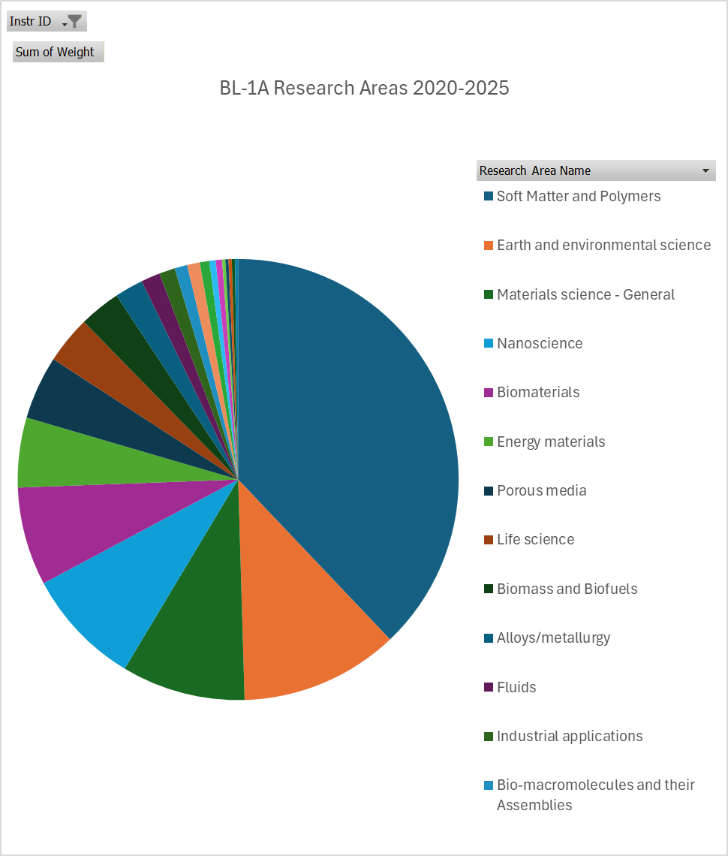
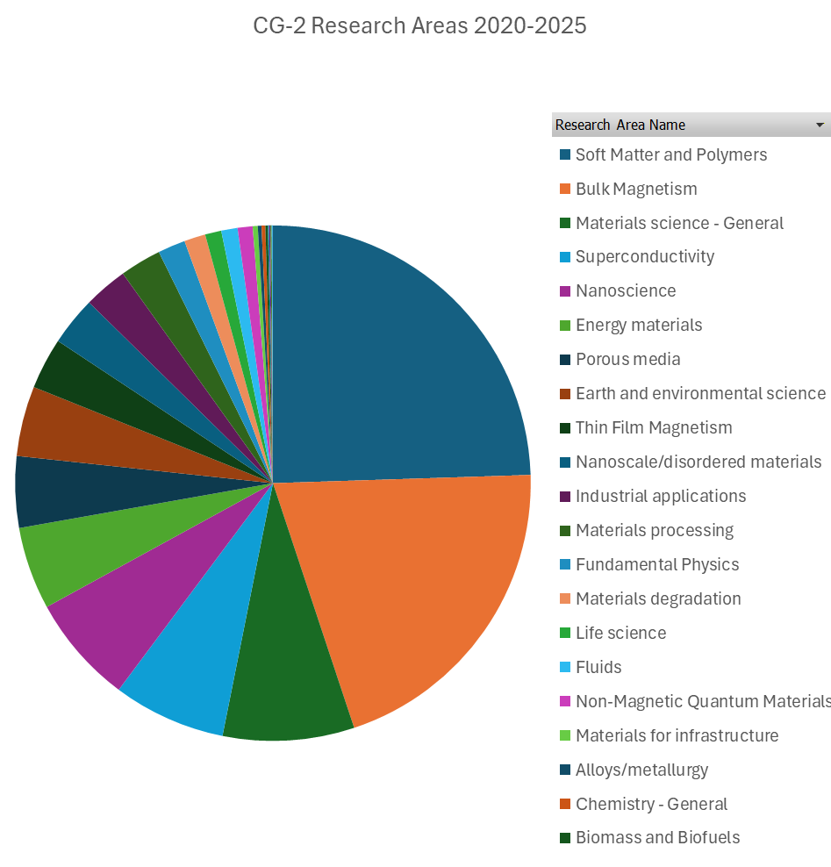
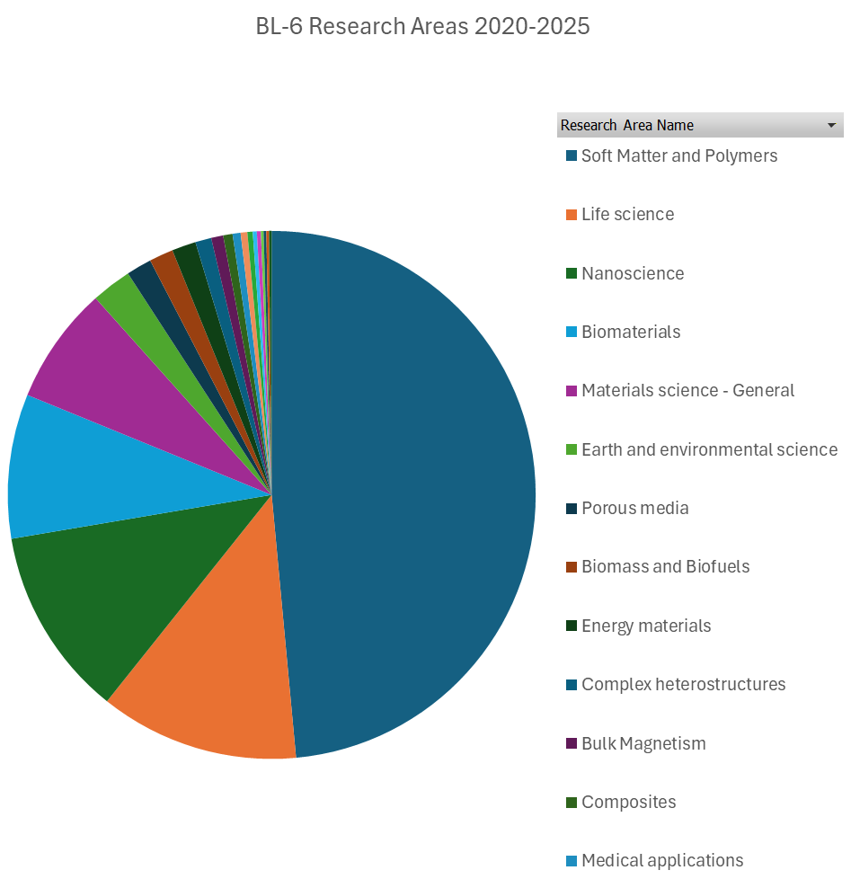
Strength of the User Community
The user communities of the SANS are diverse
Research areas overlap, but is it competition?
Perhaps, but GP-SANS and EQ-SANS have their own user base
USANS is strictly complementary

Slide 6
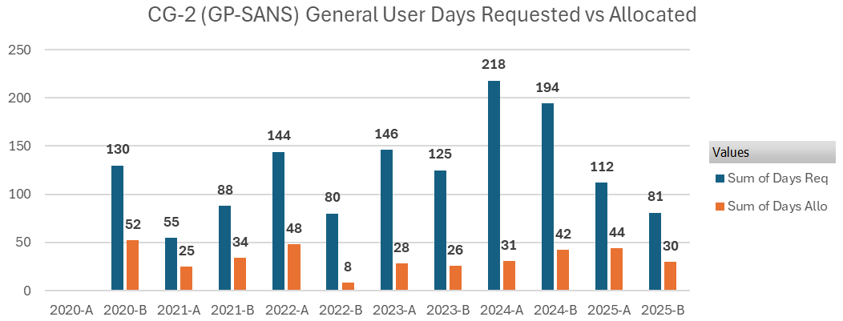
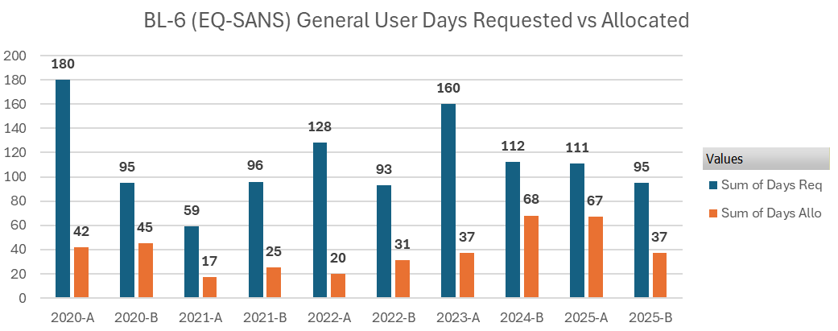
Strength of the User Community
The SANS instruments are over-subscribed

Slide 7
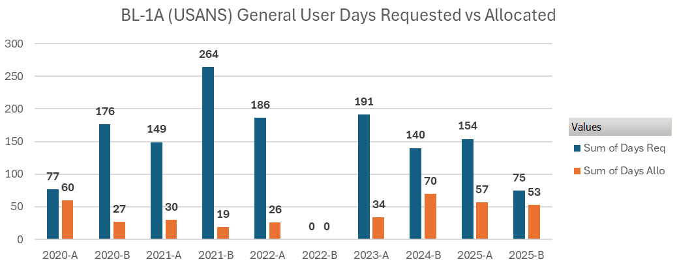
Strength of the User Community
The USANS instrument is over-subscribed

Slide 8
Expectations for Future Demand
SANS is a widely-applicable technique that can be applied to problems in many fields of research
Chemistry, Physics, Materials Science, Structural Biology, etc.
Neutrons still provide unique information
Contrast variation methods and isotopic labeling
No radiation damage
Excellent penetration power through robust sample environments that can recreate real world conditions

Slide 9
Expectations for Future Demand
There has always been some variability in the oversubscription rate for SANS instruments, but demand remains strong
There is more interest in in situ studies
The ORNL facilities provide the high flux needed for such work
More investment is required
Improvements in automation and remote experiments can make SANS more accessible to more researchers
Make things easier for novices
Reduce costs of experiments
More investment is required

Slide 10
Expectations for Future Demand
USANS is a niche technique
The data is complementary to SANS data and generally requires it
ORNL has addressed this issue by allowing USANS users to request “complementary” SANS time when submitting a USANS proposal
The sample requirements are more stringent than for SANS
USANS is very flux-limited
There are some communities that benefit from access to USANS
Geology and metallurgy are two examples
Outreach is required to grow the user community

Slide 11
The Case for Future SANS Instruments
When SANS instruments are unavailable to users for extended periods of time, the community suffers from insufficient access
The oversubscription rates of the SANS at ORNL are healthy
One could argue that they are too high at times
HBRR and PVR will make the HFIR SANS unavailable for extended periods of time
NIST is not running yet
Expected to return to operations for science later this year

Slide 12
The Case for Future SANS Instruments
Of course we could use more SANS instruments at ORNL
It seems very likely that one or two more SANS could be built and all would remain busy
The user community remains hampered by lack of access to beamtime
If NIST does not come back to full user operations, the user community will have had such limited access for so long that many researchers will move on
A new instrument should provide capacity, but it is important to explore new capabilities

Slide 13
The Case for Future SANS Instruments
Add a 3rd traditional SANS at HFIR
There is no space for an additional guide to provide the flux needed for a world-class SANS instrument
For long wavelengths (≥ 8 Å), the guide currently being considered for an NSE would have a higher flux than EQ-SANS
The uses for a “long wavelength” SANS may be a little limited
There may be limited impact on demand for GP-SANS and Bio-SANS
EQ-SANS would likely have a lower subscription rate
It is a TOF-SANS instrument
The chopper upgrade will address this issue, but the flux will always be lower than GP-SANS, Bio-SANS and a 3rd HFIR long wavelength SANS.

Slide 14
The Case for Future SANS Instruments
Building SANS instruments at STS
There may be limited impact on demand for GP-SANS and Bio-SANS
The flux provided by STS will be lower than that provided by HFIR but better than FTS
If the design must use broad bandwidth TOF methods, many users will still prefer to use GP-SANS and Bio-SANS
This is based on experience at EQ-SANS, which still has a healthy community thanks to Changwoo’s and Gergely’s efforts
EQ-SANS would likely have a lower subscription rate
It could still have a role as a mail-in instrument that is also available for rapid access if there is one STS SANS
If there are two STS SANS instruments, it may be more cost-effective to shut down EQ-SANS and move staff to the STS or HFIR

Slide 15
The Case for Future SANS Instruments
What about another SANS at FTS?
Another SANS at FTS could be built before SANS at STS
BL-14A, which does place some constraints on the design
It could be finished about the time of HBRR
If you start, almost literally, today
A simpler, less expensive, but still highly versatile, design could be considered
Design with automation in mind

Slide 16
The Future of USANS
It is not easy to justify construction of a second USANS
Not a large user community because it is a very niche technique
Moving the existing instrument to a new location has been considered
HFIR’s Cold Guide Hall
The performance of the instrument would improve

Slide 17
SWOT Analysis - SANS
Threats
Opportunities
All: Limited SANS beamtime in US; more users with less expertise: rely on IS for publications; travel restrictions, reduced science funding limits user community & future staff training
GP: HFIR outages → loss of users; resource competition (HBRR, STS)
EQ: High-flux competitors (ESS, ISIS, J-PARC, ILL) for time-resolved and complex experiments;
STS-SANS may question EQ-SANS future
Strengths
Weaknesses
GP: high flux wide Q-range, broad science portfolio; emerging polarization, magnetic tomograpjy; automation; SEs; adequate staffing
EQ: Best dQ/Q and high flux in mid to high Q; t-resolved; SE growth in soft matter; Early AI for experiment, data collection
GP: limited detector coverage; need more SE & DAQ support; data analysis & modeling & live I vs Q; Materials Engineering expertise of instrument scientists
EQ: Low-Q performance; limited detector coverage; TOF hampered by inelastic scattering; no polarization; limited SE space and accessibility
All: AI for DAQ, reduction, analysis;
GP: increase detector coverage; full polarization; magnetic tomography; integrate GrASP (ILL software) visualization in SASView; enhance robot;
EQ: increase detector coverage; more flux (PPU); grow mail-in; improve robotic sample changer; new choppers for monochromatic beam definition

Slide 18
SWOT Analysis - USANS
Strengths
Weaknesses
Opportunities
Threats
Only operational USANS in America/Europe; Ultra-high Q resolution (low Q); excellent sample environments; strong community impact; complementary to HFIR/SNS SANS
Low neutron flux on sample: long measurements and few experiments/cycle; limited space for bulky SE (magnets etc); need samples that strongly scatter
Growing demand for multiscale characterization; more routinely run SANS first to increase experiment success rate; more routinely use larger samples to increase counts
Replacement options for monochromator & analyzer crystals unclear; emerging alternative characterization methods (microscopies, USAXS, etc) could take some business away

