Slide 1
Biological Labeling and Scattering Group
Hugh O’Neill
BLS Group leader, Center for Structural Molecular Biology Director
Notes:
Accessing Title Slide Options The standard ORNL presentation template includes five branded title slide layouts:
Title | Standard. The preferred layout for lab-wide and general presentations. Features a default aerial photograph of the lab.
Title | Custom Image. Allows replacement of the default background with a custom full-slide image (16:9 or 4:3 landscape format).
Title | Custom Portrait Image. Supports inclusion of a custom 4:3 portrait image positioned next to the introductory text.
Title | Custom Landscape Image. Supports inclusion of a custom 16:9 landscape image positioned next to the introductory text.
Title | Text Only. Offers additional space for longer titles and multiple presenters.
Additional Lab-approved title slides specific to directorates and user facilities are available in PowerPoint under the following folders: Custom Title Slides and User Facility Templates, located in Presentation Templates.
Custom Title Slide Guidelines
Image Rights. Any custom images, graphics, or photography must be owned by ORNL or used with documented permission from the original creator or source.
Appropriate Image Use. Select images that work well with the layout. Ensure the focal point of the image is not obscured by the title text and white overlay box.
Relevance and Impact. Visuals are a key element of effective communication. Whenever possible, use imagery that enhances the message of your presentation and reflects ORNL’s mission and values.
Quality and Clarity. Use high-resolution images for clarity on large screens. Avoid overly complex or dark images that may conflict with the title text.
Text-Only Option. If no appropriate or approved imagery is available, or if imagery is not permitted for the subject matter, the Title | Text Only layout provides a clean, professional alternative.
Learn more about ORNL presentations
https://ornl.sharepoint.com/sites/branding/SitePages/presentations.aspx

Slide 2
Biological Labeling and Scattering Group
Bio-SANS
Science and User Program
Bio-labs
Supports biological sample preparation for SNS/HFIR
Supported by
DOE Biological and Environmental Research
Center for Structural Molecular Biology
Biofuels SFA
LAMBDA project (SEED)
Multimodal SANS instrument for the STS
BES-SUF (NSD FWP)
BES- BRaVE (Taskforce 5, LBNL lead)
ORNL LDRD
Second Target Station
SANS instrument concept and science program
Small molecule deuteration
Collaboration with the CNMS

Slide 3
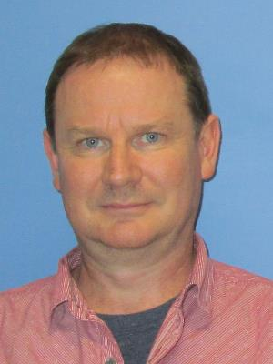
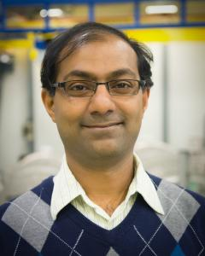
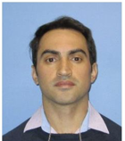
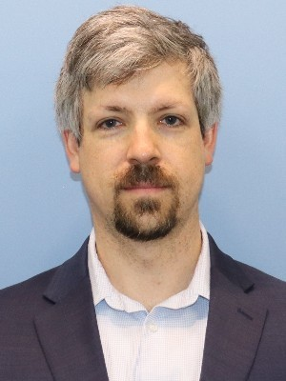
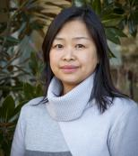
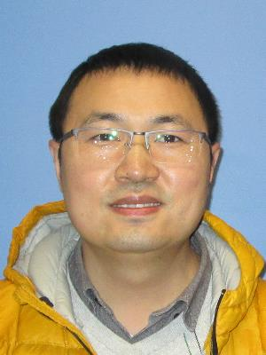
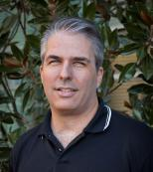
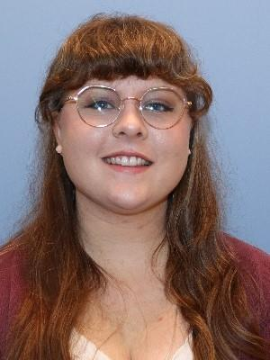
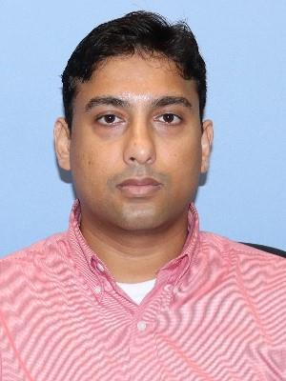
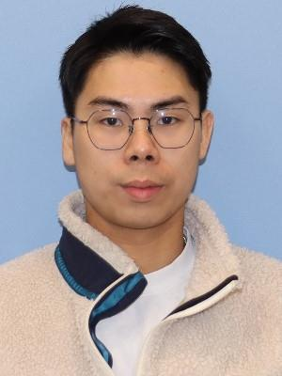
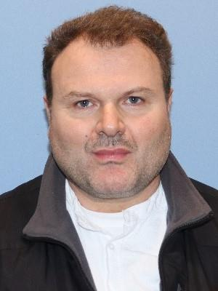
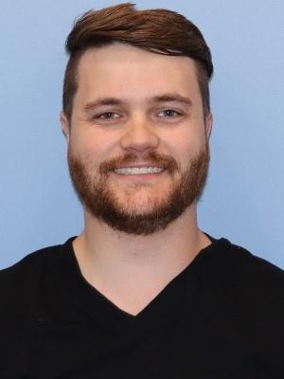
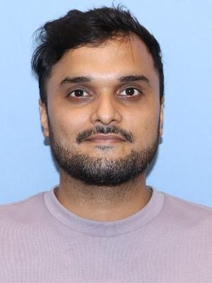
BLS group members
Staff
Hugh O’Neill | Sai-Venkatesh Pingali | Wellington Leite | Alan Hicks | Qiu Zhang¹ | HongHai Zhang² | Kevin Weiss
Bio-SANS
Bio-deuteration
Post-docs and students
Jenny Warnock | Sharique Khan | Luoxi Tan | Anton Astner | Brandon Nusser² | Shivam Pandit³
Matrixed staff : ¹Lab Support Group, ²Macromolecular Structures Group CNMS,
³Center for Structural Biophysics, BESSD

Slide 4

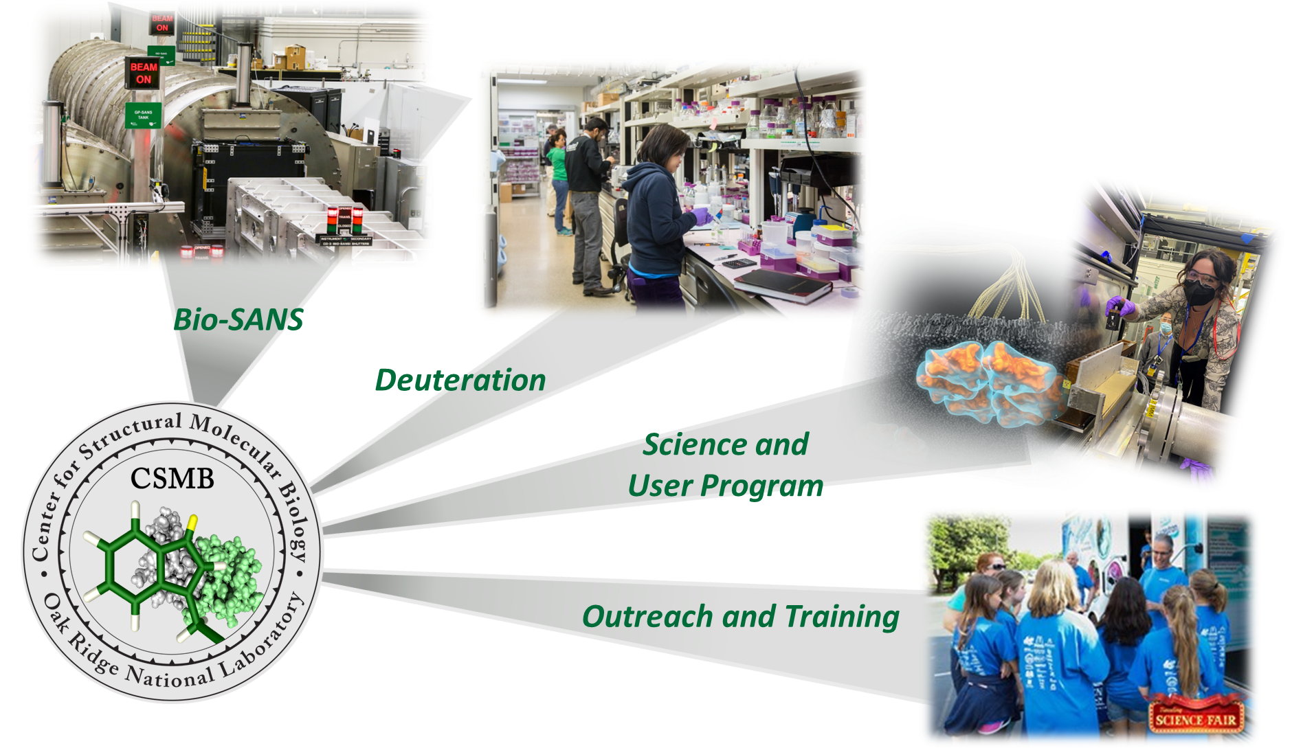
Center for Structural Molecular Biology A DOE – BER supported Structural Biology Resource

Slide 5
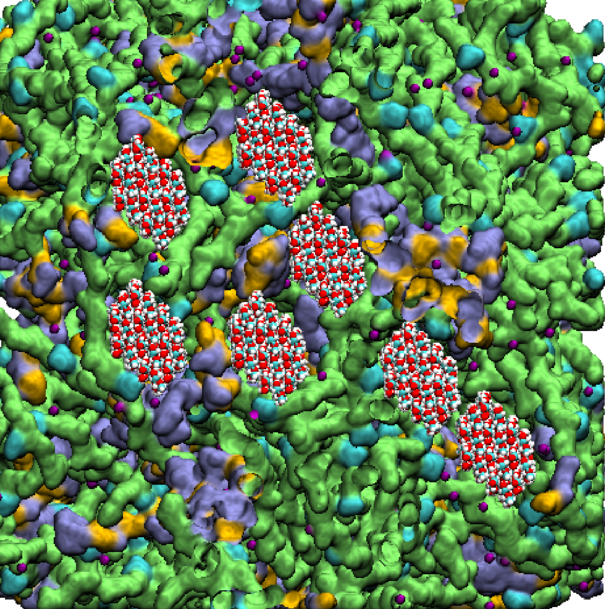
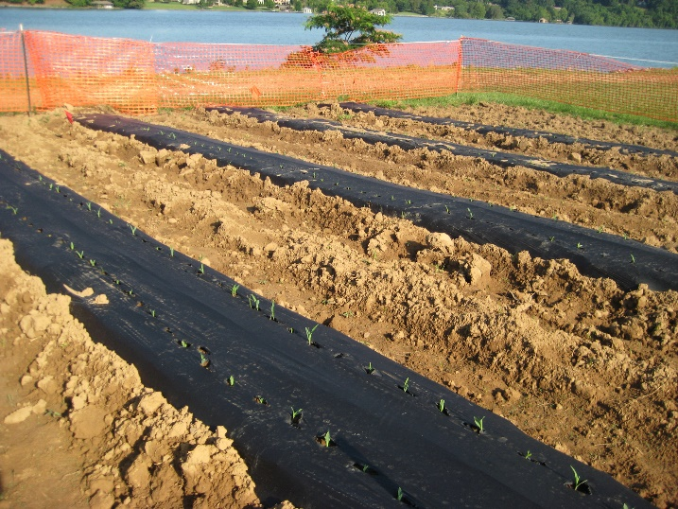

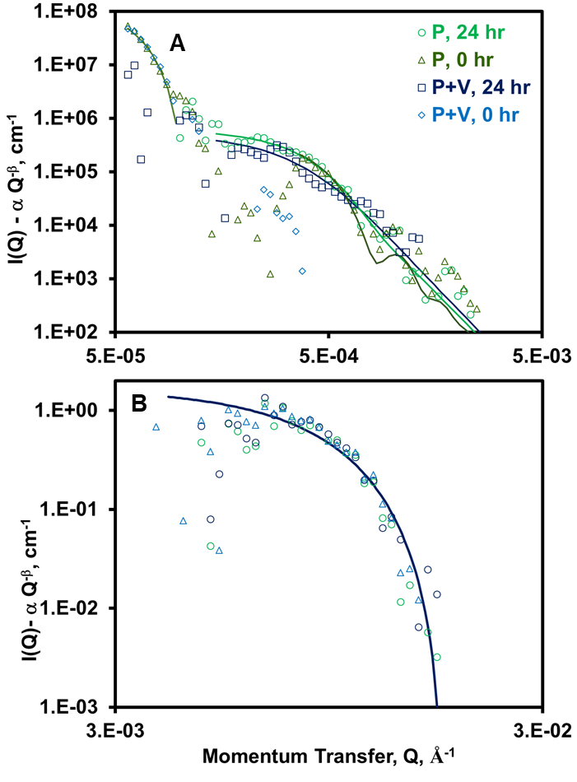
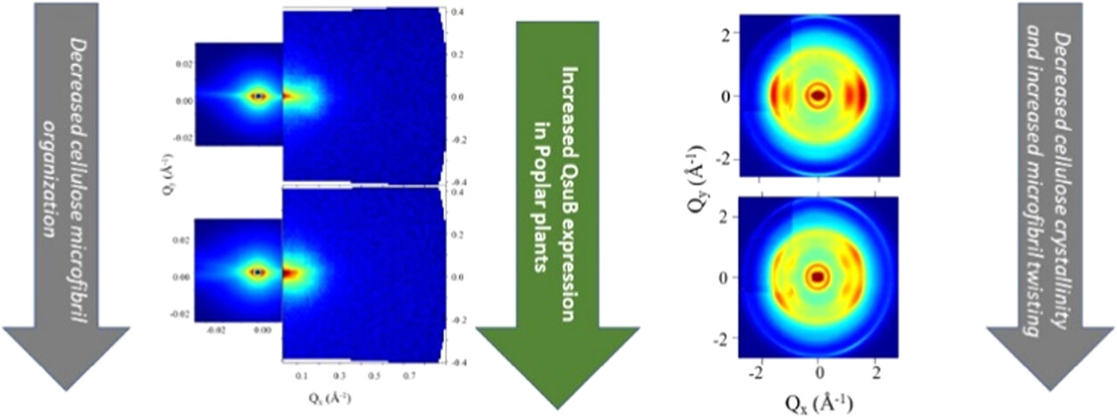
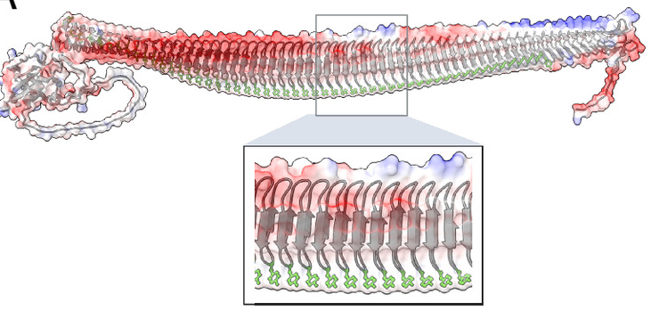
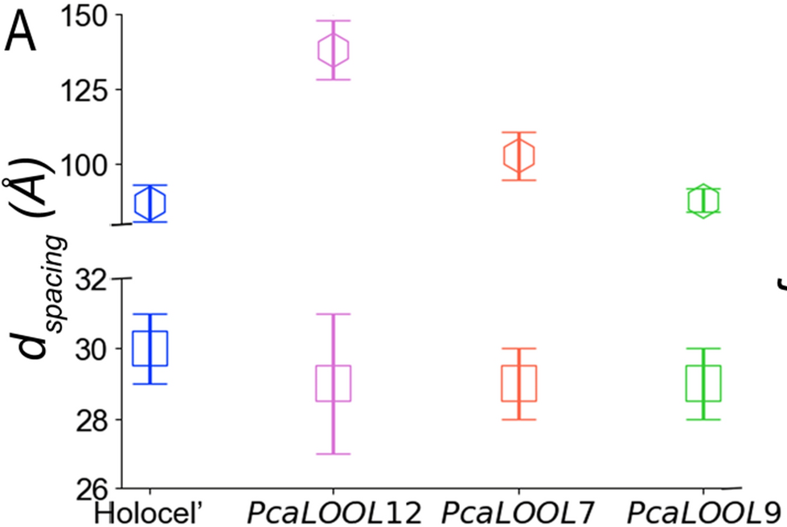
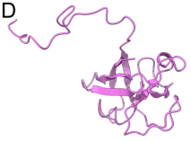
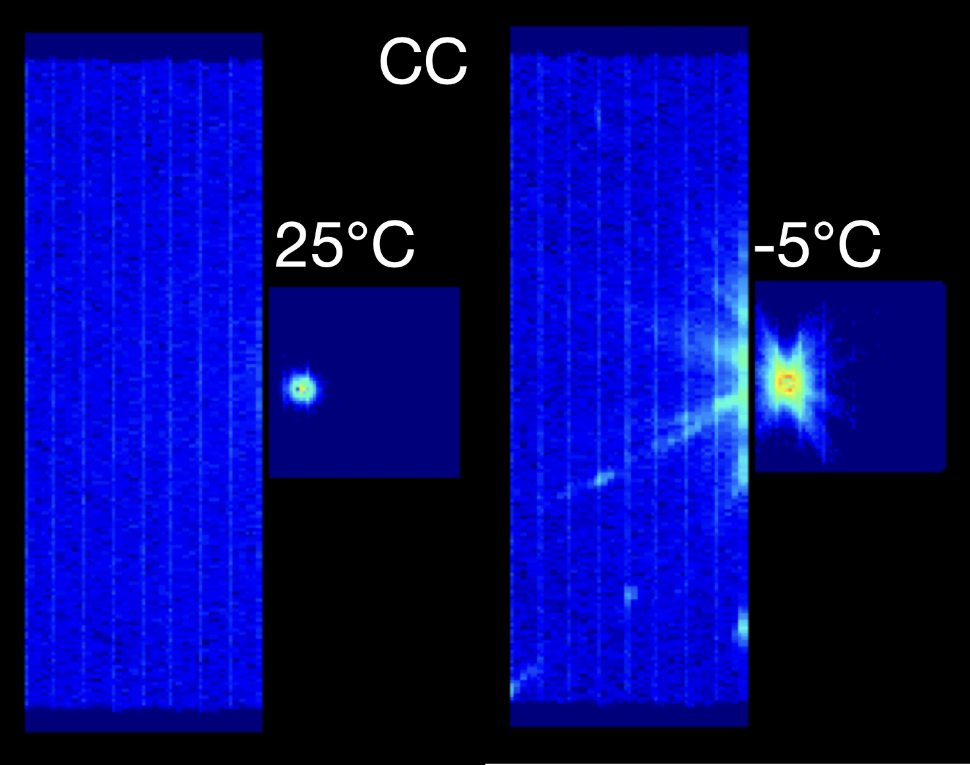
SANS provides unique insights into biological systems science
Biofuels and Bioproducts
Microbial Conversion
Environmental Processes
Cell wall structure of
transgenic plants
Anaerobic respiration
Senanayake et al. ACS Sus Chem Eng 2023
Khan et al. Chem. Sci 2024
Nanoplastics
in soil
Astner et al. PLOS ONE 2020
Solvent mediated membrane disruption
Tan et al. Langmuir 2025
Biological ice nucleation
Cell wall disruption by loosenins
Meister, Boise State
Dahiya et al. Biotech Biofuels 2025

Slide 6
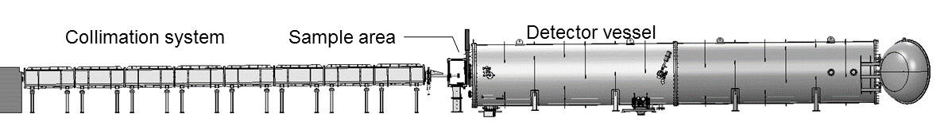
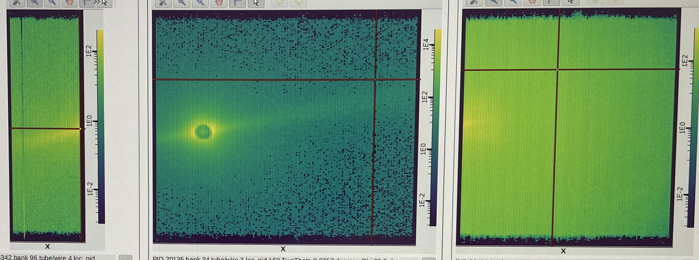
Bio-SANS Instrument
Instrument innovations enable new science and efficient use of neutrons
Instrument features
Bio-SANS three-detector array
Three-detector array
Wide dynamic range from 0.003 – 0.85 Å
Simultaneous scattering/transmission measurements
Semi-transparent beam stop
User-friendly data acquisition
Auto data reduction
Versatile space for sample environments
Future: Extending Bio-SANS low-Q coverage
Bio-SANS Talk (Venky Pingali)

Slide 7
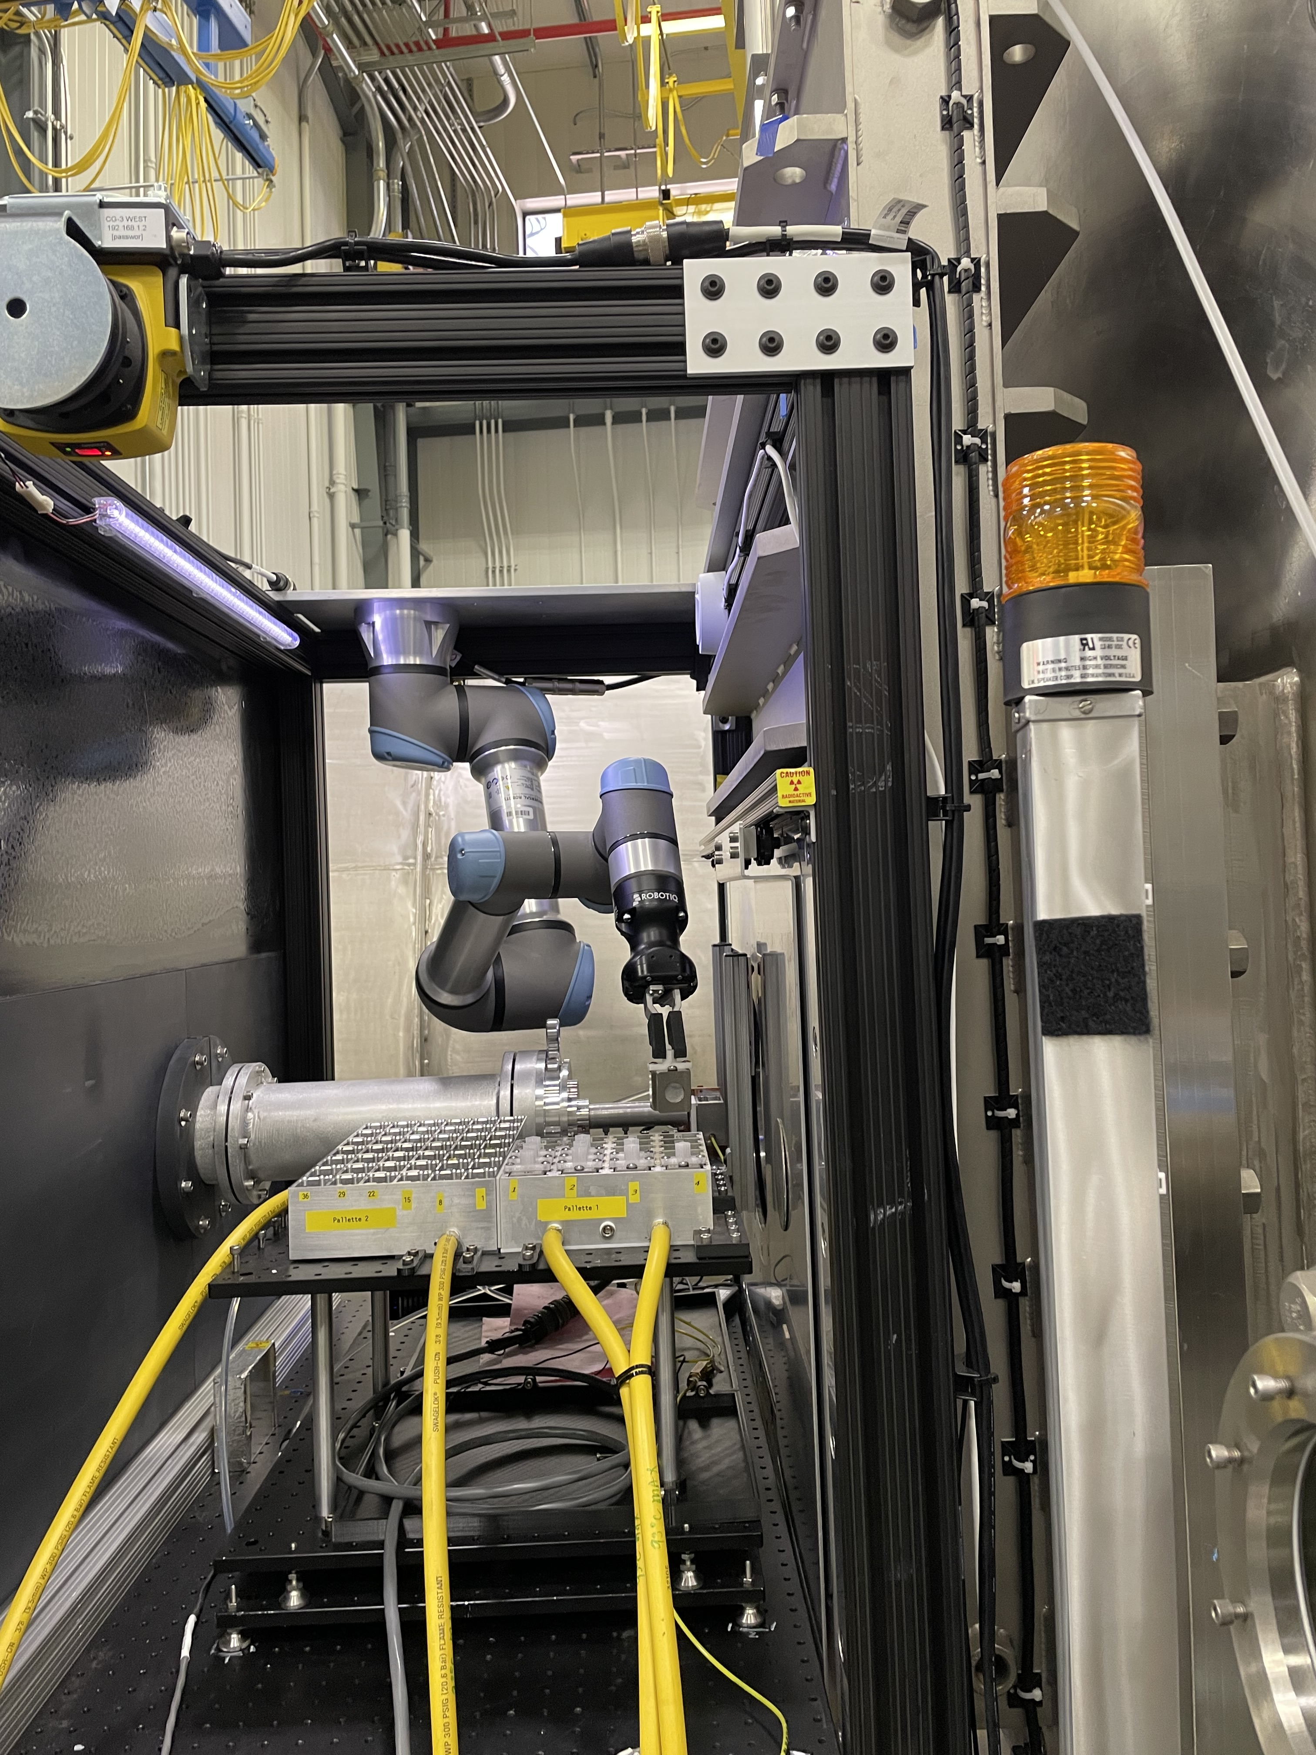
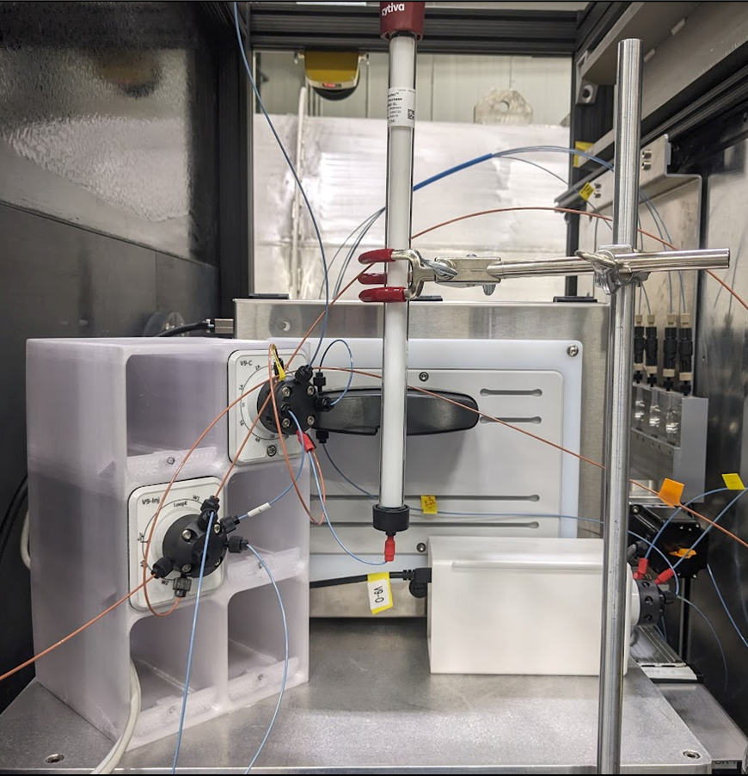
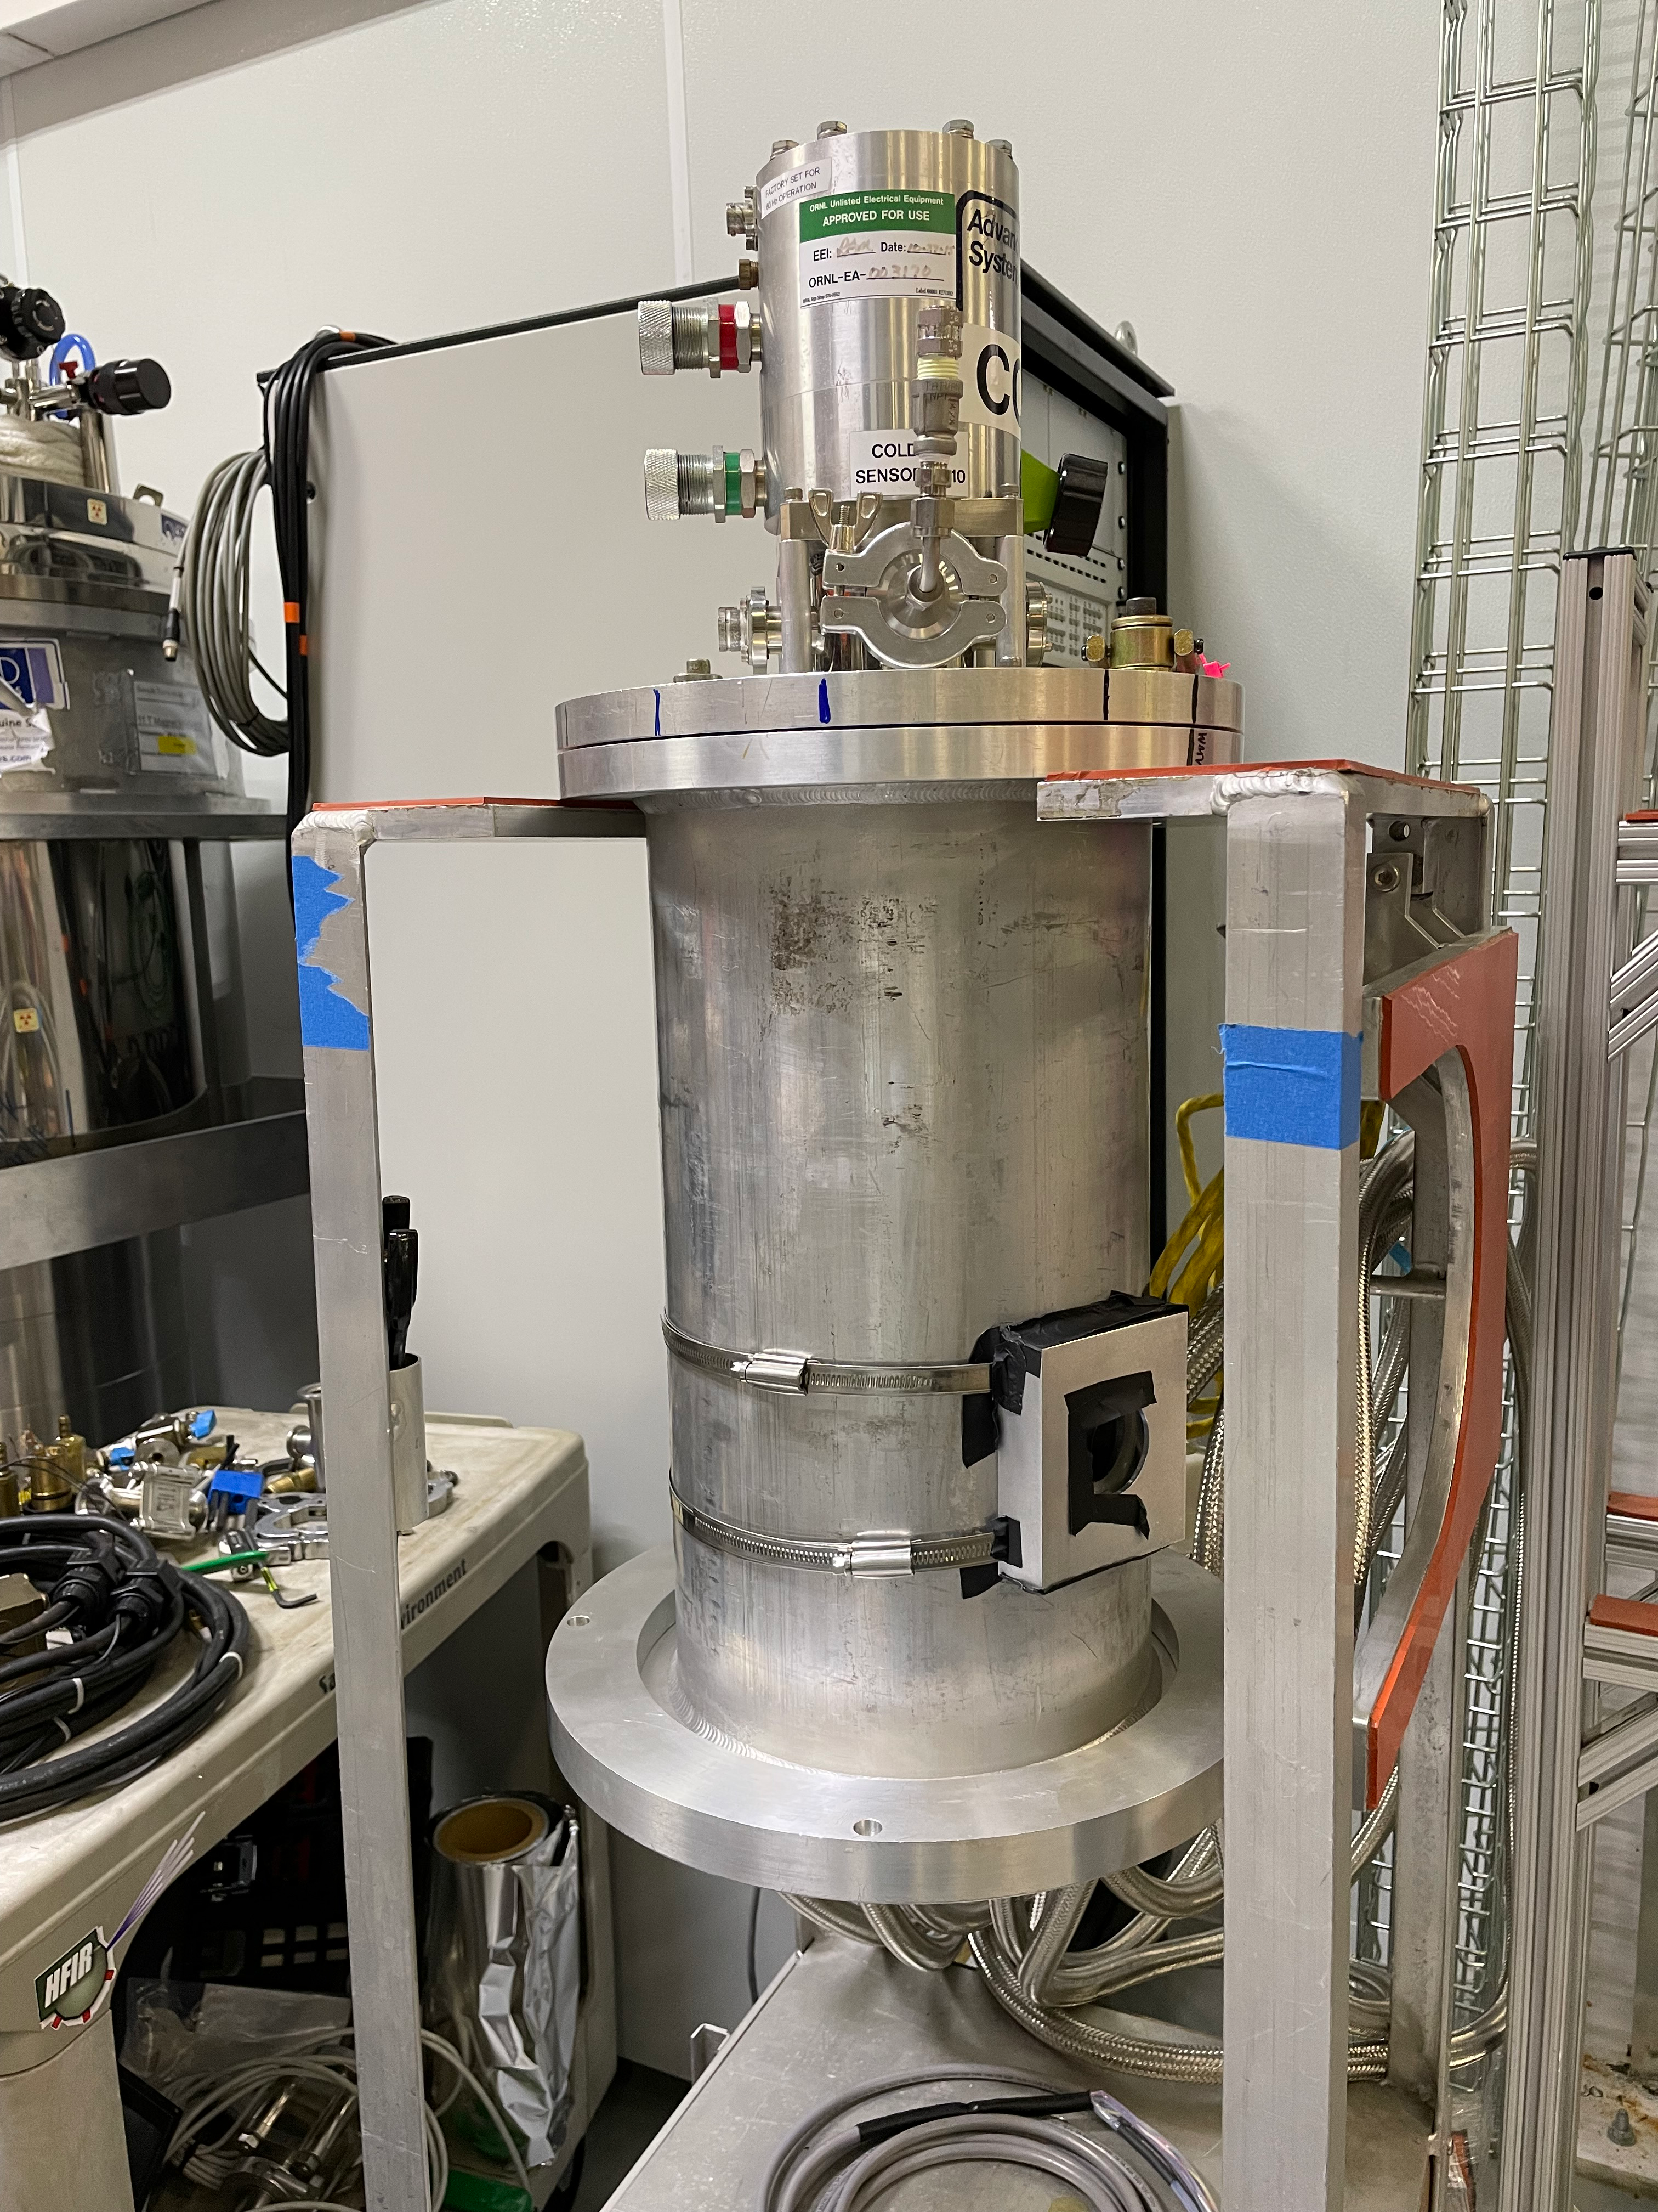
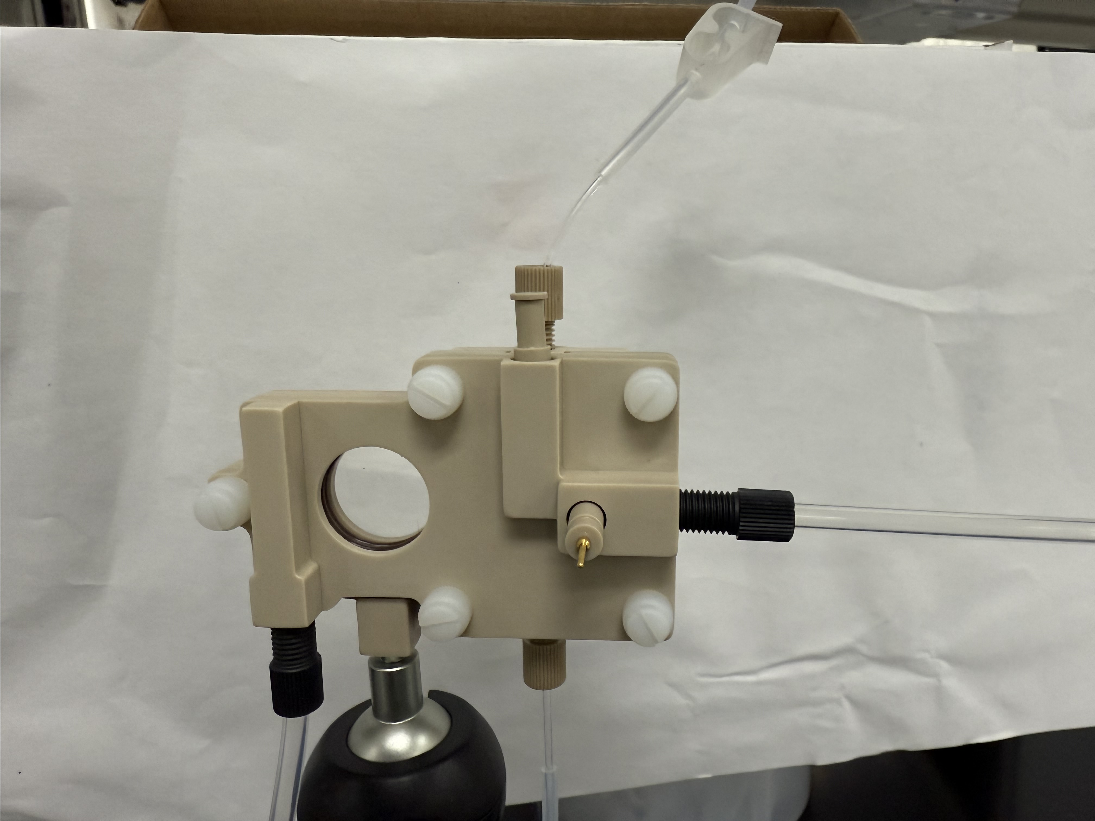
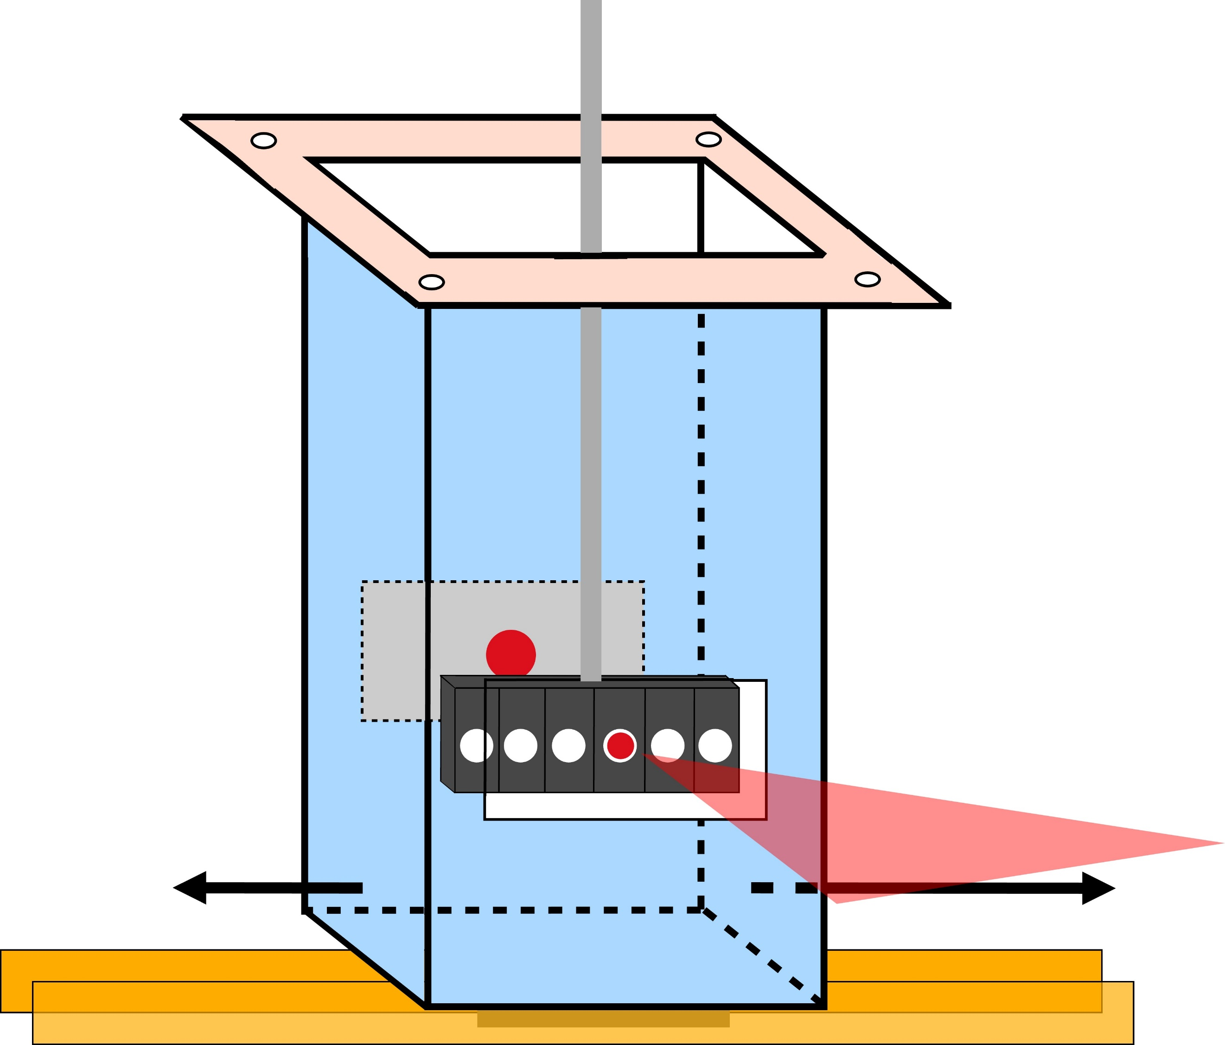



Bio-SANS – Sample environments
Automation
Lab-to-beam
Low-temperature
SEC -SANS
Robot
E-cell
(Redox Me)
Multi-position cryostat
Single-position cryostat
Current / Ongoing
Current / Ongoing
Current / Ongoing
84 position sample changer
Automated Liquid-handling system (collab. – NIST NCNR)
Chromatography SANS
Electrochemistry
Commissioning Rapid mixing (Collab. – NIST NCNR)
Commissioned single-position cryostat (T_{max} ~ –100 °C)
Commissioning of high-throughput cryo-cell (T_{max} ~ –30 °C)
Future
Future
Future
High temperature (~300ºC)
Dynamic light scattering (ORNL LDRD)
Multi-position cryostat (6 pos)
Bio-SANS Talk (Venky Pingali)

Slide 8
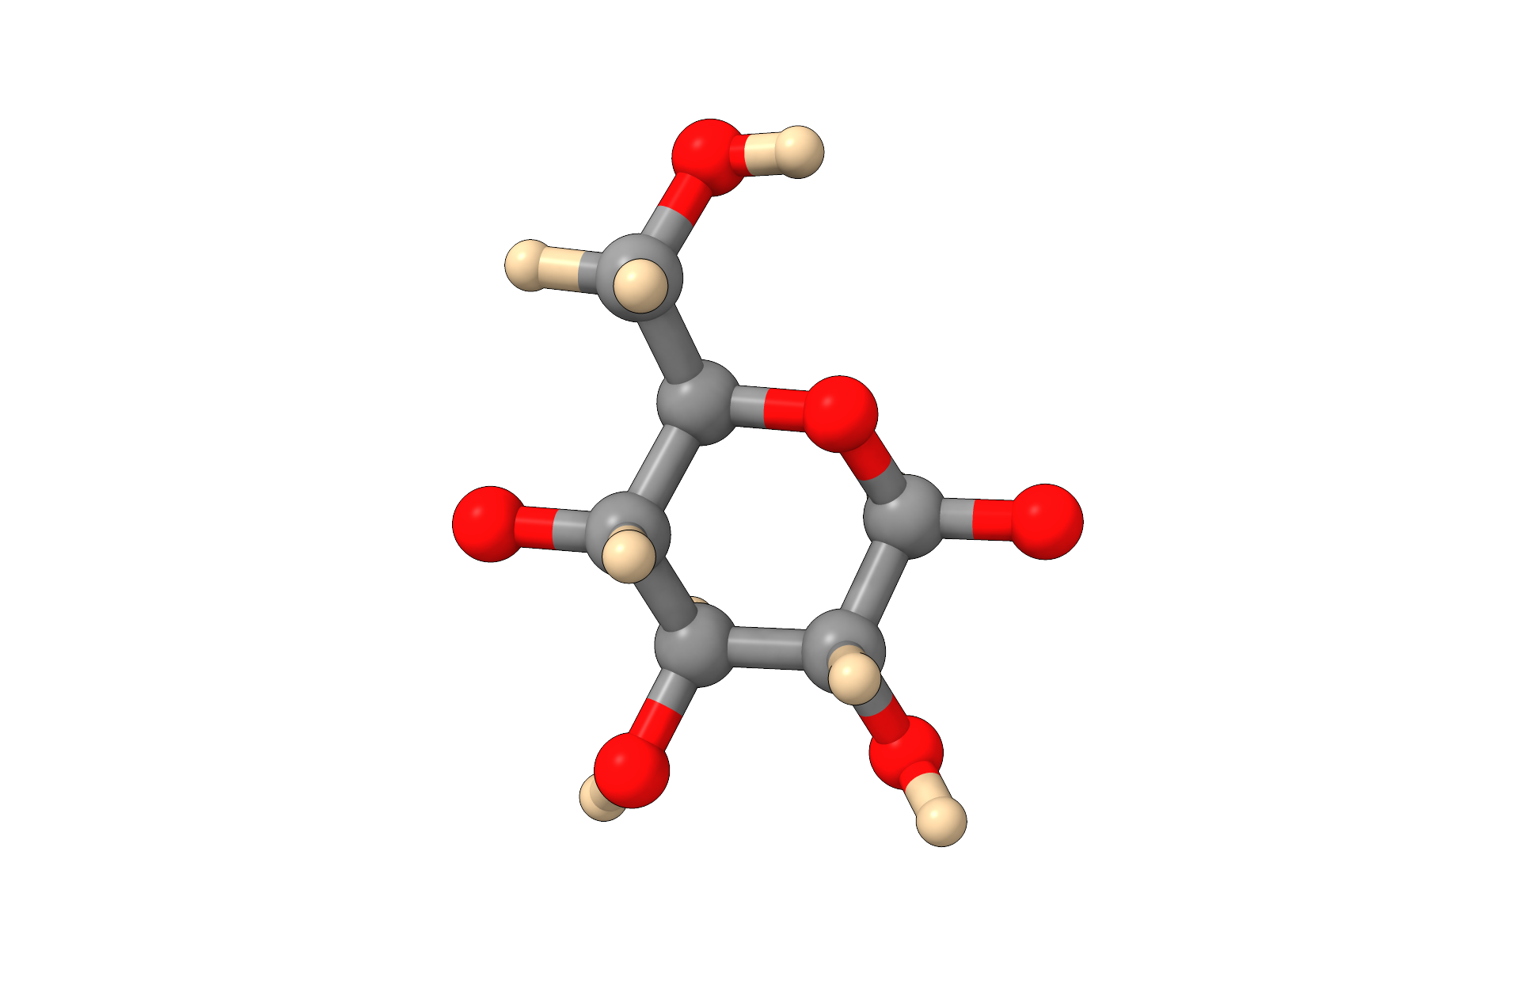
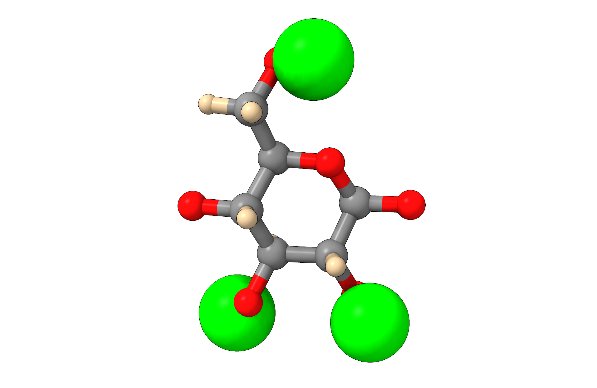
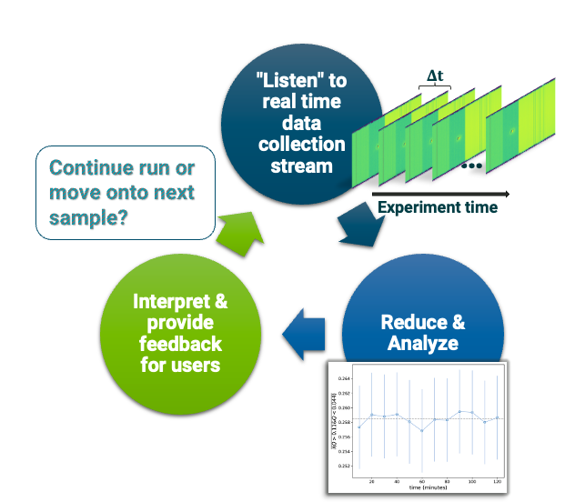
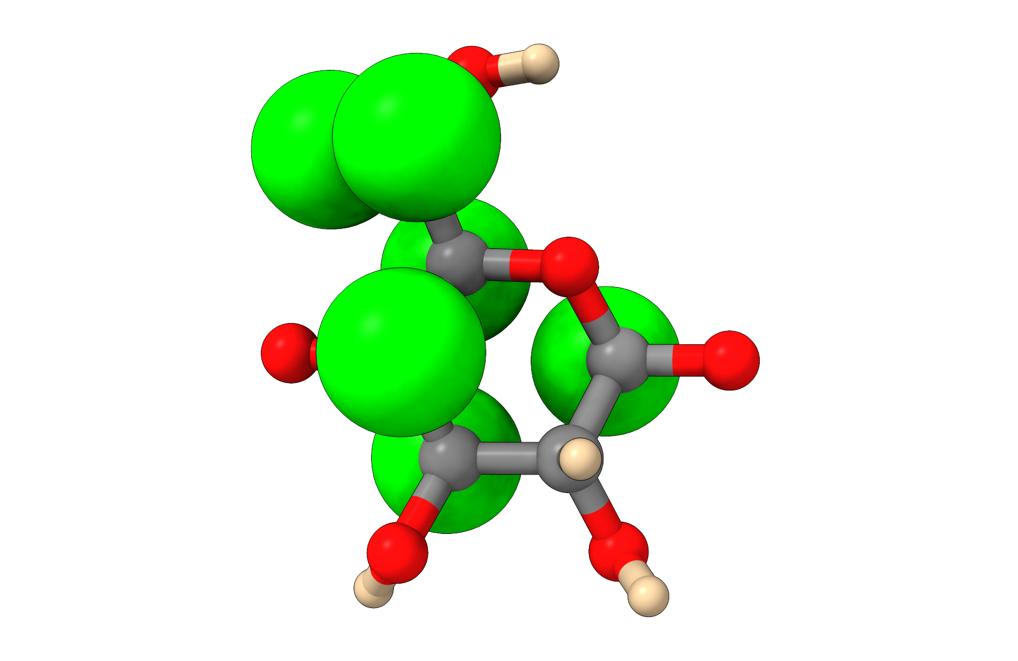
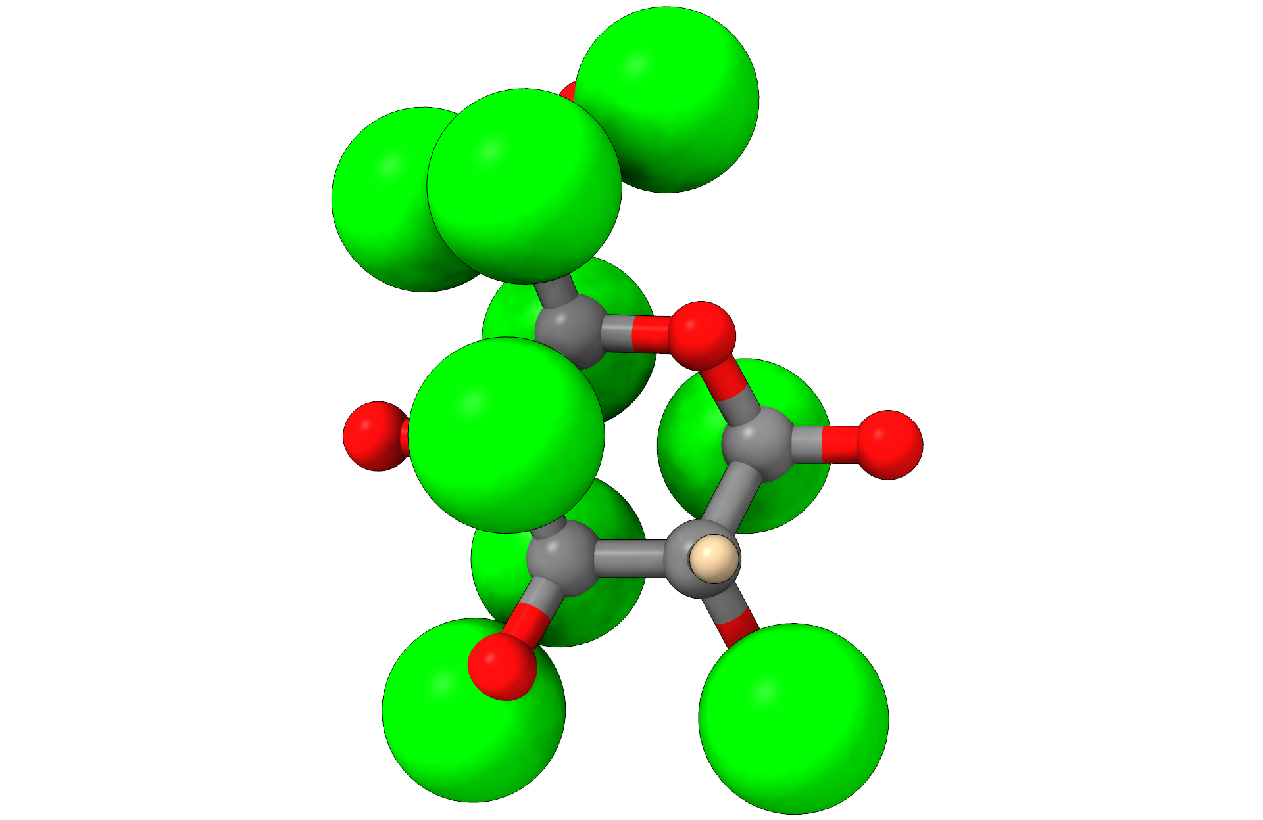
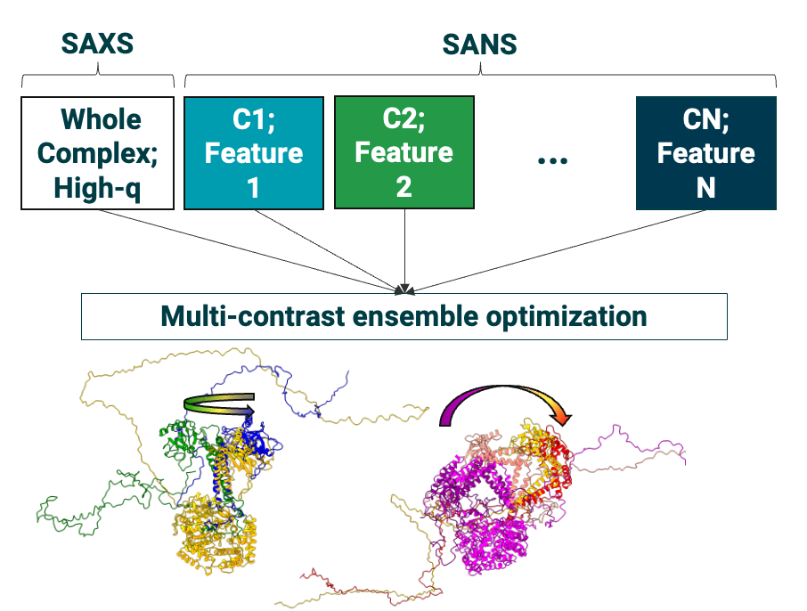
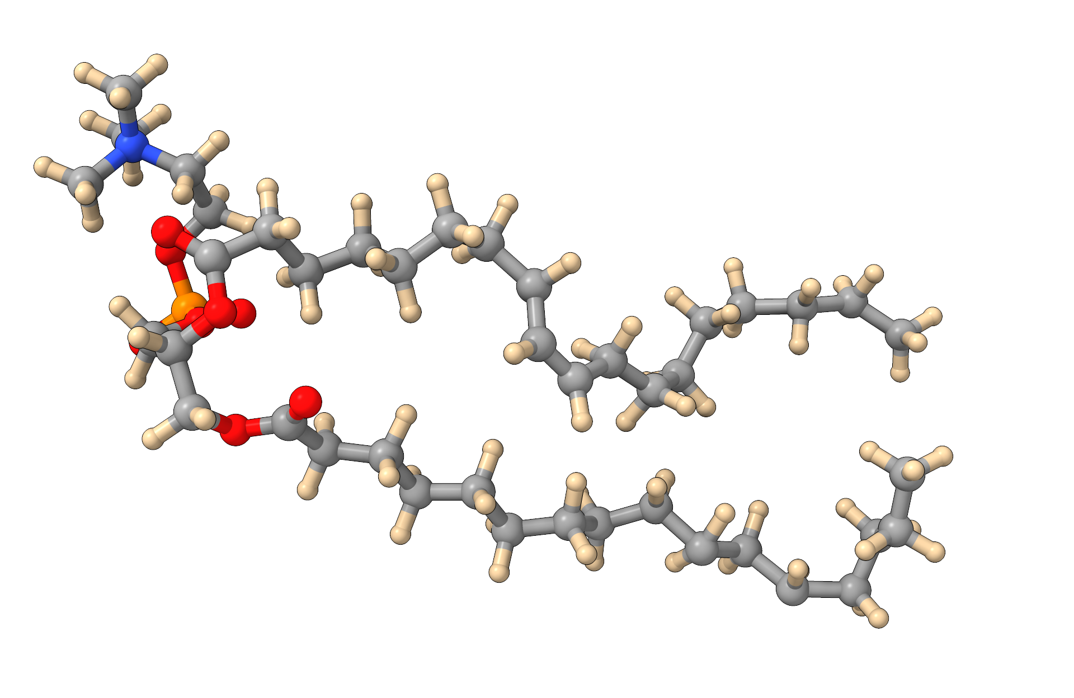
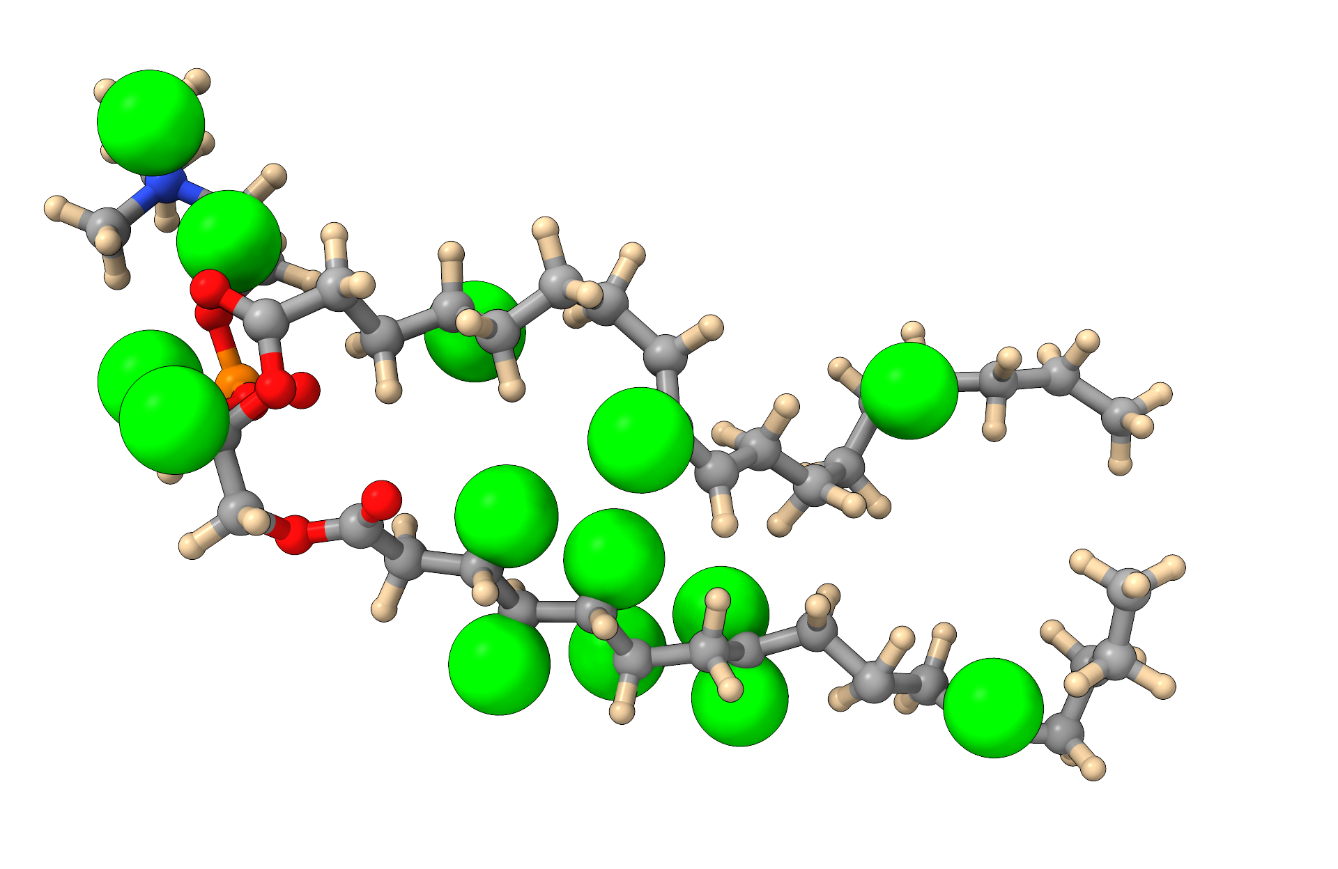
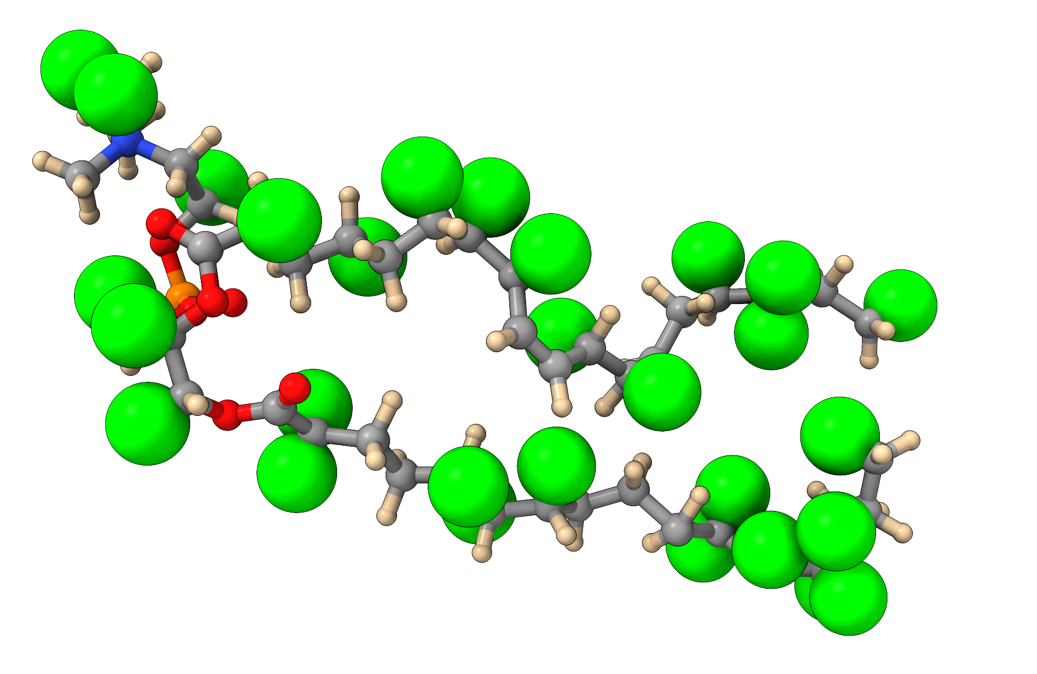
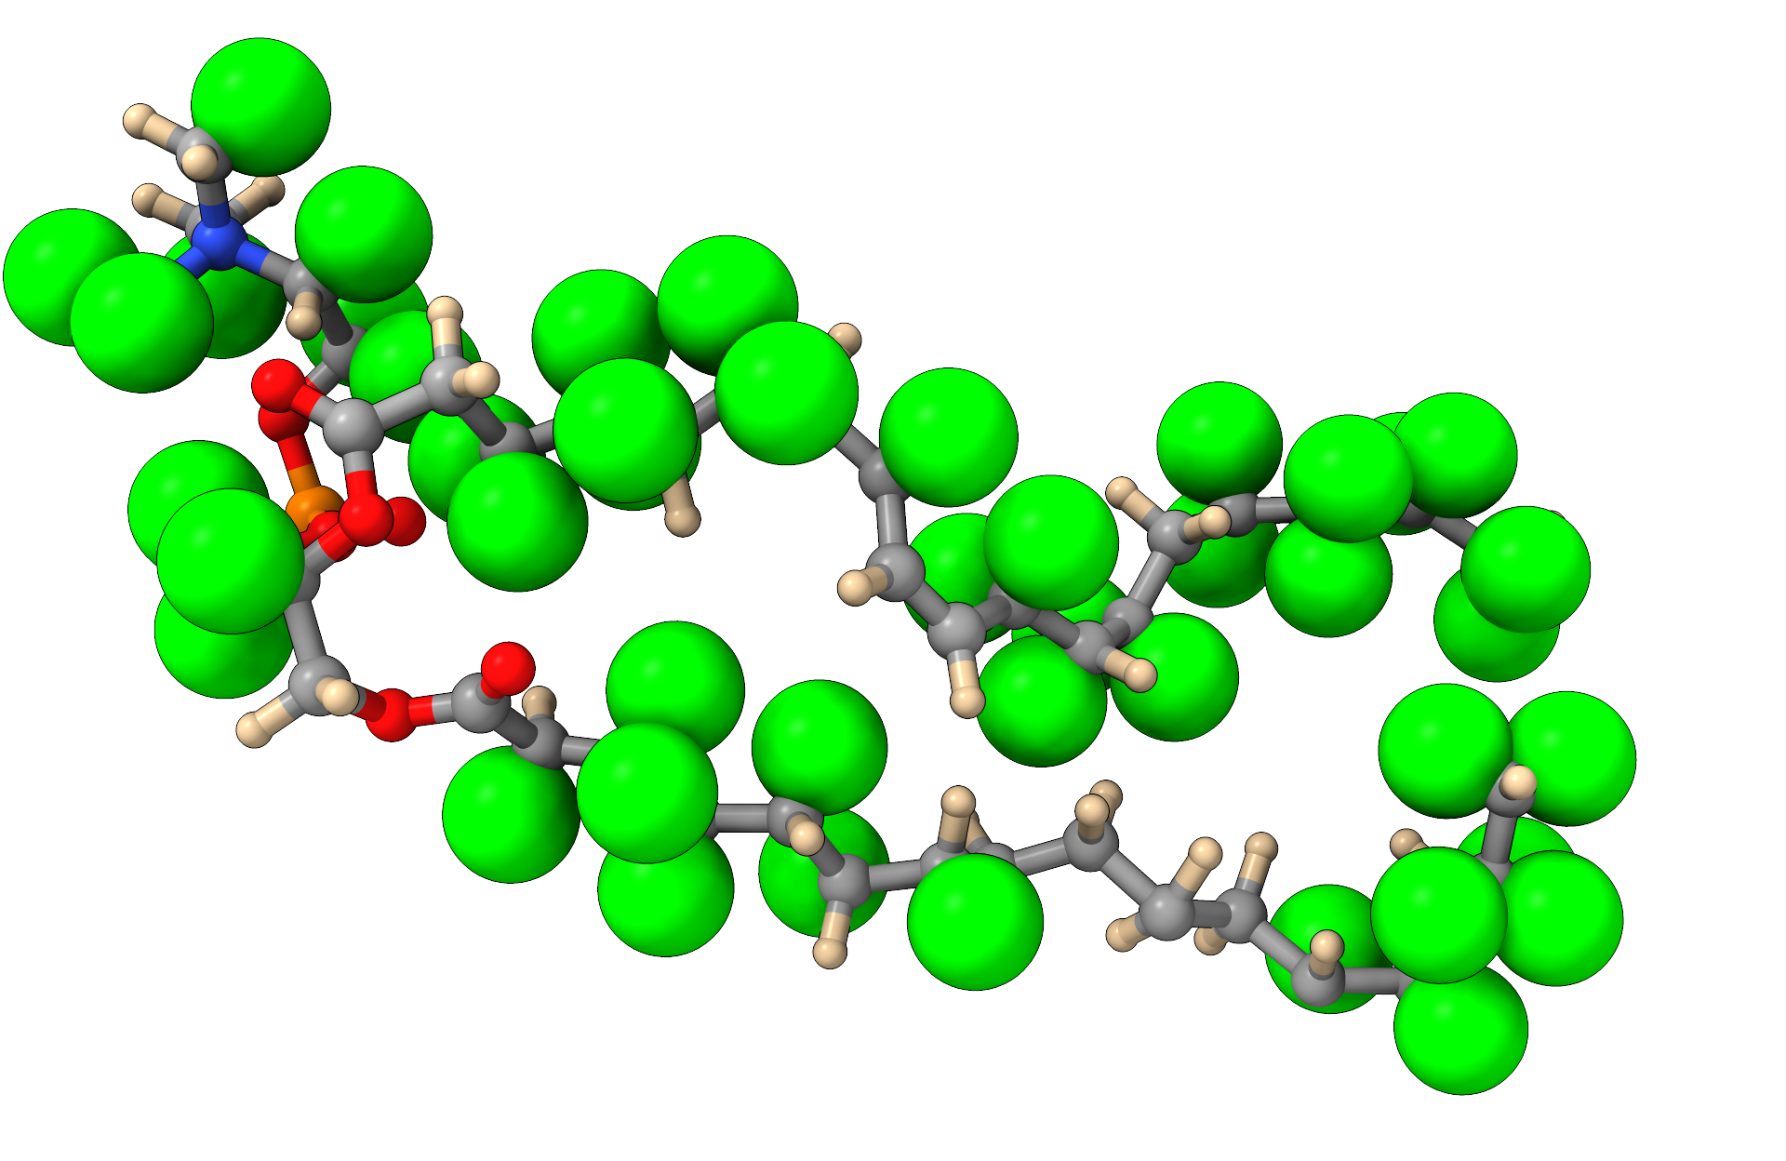
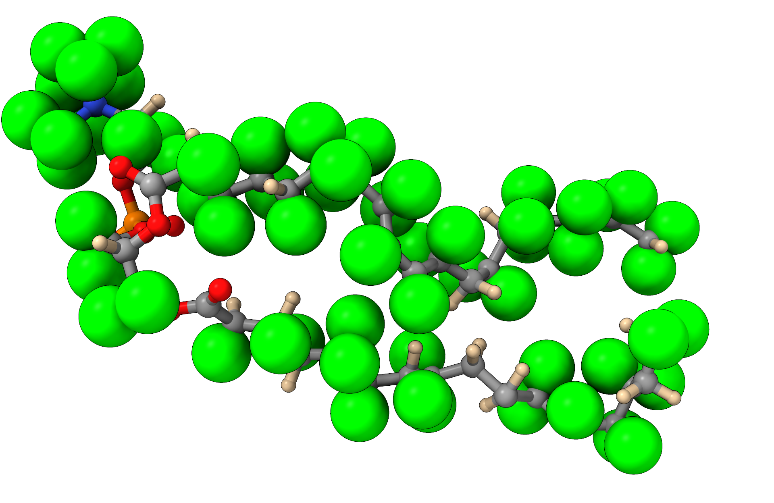
Data processing and analysis
Goal: To develop a robust data pipeline for the Bio-SANS user program
Experiment planning
Data collection and reduction
Data analysis
SCOMAD-XP – A deuteration prediction tool
Real-time data reduction
Multi-contrast fitting of biomolecular assemblies
Glucose
C₆H₁₀O₅
C₆H₇D₃O₅
C₆H₄D₆O₅
C₆H₁D₉O₅
POPC
Increasing deuterium in media
Expand capabilities to:
Complex carbohydrates
Lipids
Deploy in Neutrons Data Interpretation Platform (NDIP)
On-the-fly data analysis
Chromatography SANS
Rapid mixing studies
Future AI-driven experiments
Increase accuracy and performance of BilboMD-SANS
Accurately refine biomolecular complexes with larger degrees of freedom
Data Analysis Talk (Wellington Leite)

Slide 9
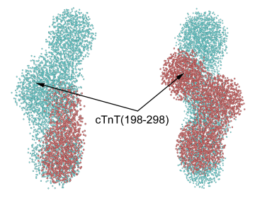
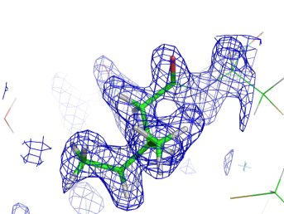
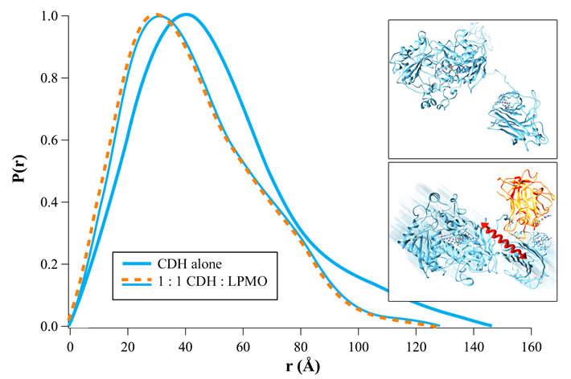
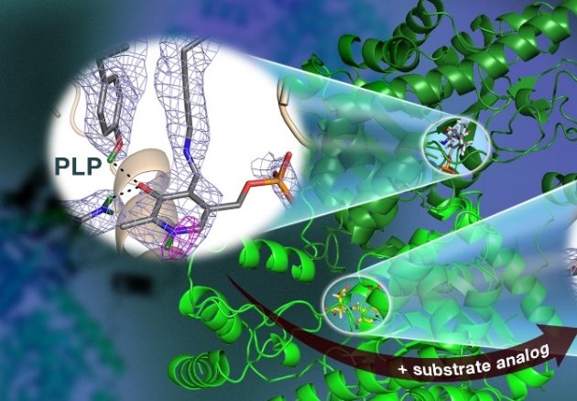
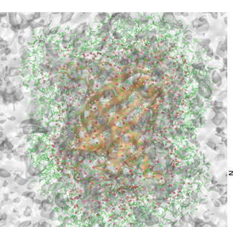
Deuteration program
Neutrons are excellent non-destructive structural probes that can discriminate between hydrogen and deuterium.
Characterizing higher-order macromolecular complexes
Pinpointing positions of individual hydrogen atoms
Probing the structure and dynamics of biomacromolecules
SANS
Crystallography
Dynamics
A. Bodenheimer, et al. (2018) Biochem Biophys Acta., 1862:1031-1039
S. Dajnowicz, et al. (2017) Nat Commun., 8: 955 - 964
Perticaroli, et al. (2016) JACS, 139: 1098 - 1105

Slide 10
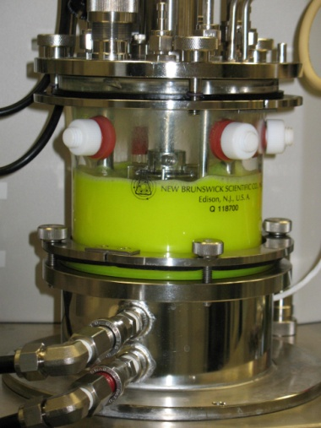
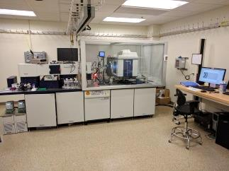
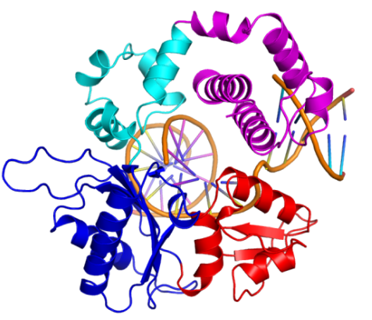
Deuteration program
We offer a variety of capabilities for training and support of users
Biomacromolecules
Small molecules
Biophysical techniques
Escherichia coli / Yeast
Insect and mammalian cells
Soluble/membrane proteins
Lipids
Cholesterol
Precursors (amines/amides)
Monolignols
SAXS
Light scattering
Spectroscopy
Mass spectrometry (CNMS)

Slide 11
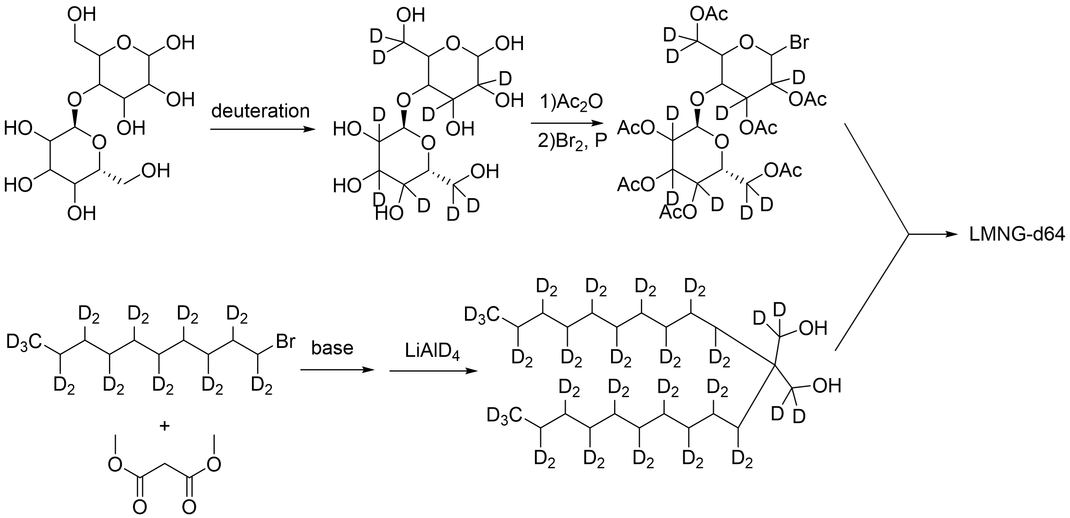
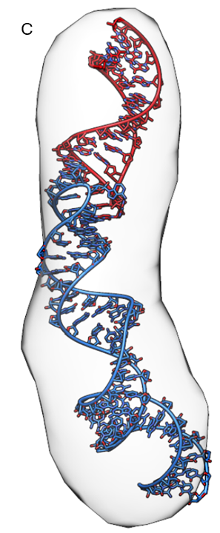


Deuteration – future directions
Lauryl maltose neopentyl glycol synthetic pathway
Deuterated ribonucleic acids (RNA)
Automation of D₂O adaptation for protein production
Carbohydrate deuteration
Biocompatible detergents
Expansion of lipid deuteration
Bacteria and yeast (bio)
Ionizable lipids (chem)
Selective deuteration of RNA
B. subtilis cardiolipin
https://doi.org/10.1016/j.str.2025.01.017

Slide 12





Bio-SANS user program productivity
Bio-SANS General User Proposals
Bio-SANS User Numbers
Bio-SANS Publication Metrics
Publications
HFIR cycles
*Only 1 proposal call
Major science areas supported
Collaborative access mechanisms

Slide 13
Bio-SANS comparison with other facilities
Number of HFIR cycles per year (FY)
2025 | 2024 | 2023 | 2022 | 2021 | 2020
2.4 | 6.1¹ | 5.1 | 4.0 | 5.7 | 6.6²
The scientific output of Bio-SANS is lower in comparison to other SANS instruments. Possible reasons-
Restricted science mission
Lower staffing level compared to other instruments (2 instrument scientists vs. 3 at other instruments/facilities)
Non-expert user community means that the team is very involved in turning data to publications
¹4.1 user program cycles
² remote
SANS beamline publications comparison (CY)
Beamline publications | 2025 | 2024 | 2023 | 2022 | 2021 | 2020
Bio-SANS | 21 | 19 | 16 | 16 | 13 | 21
GP-SANS | 35 | 26 | 22 | 20 | 21 | 31
EQ-SANS | 25 | 25 | 40 | 30 | 30 | 38
D11 | 15 | 22 | 50 | 42 | 54 | 55
D22 | 50 | 41 | 36 | 40 | 39 | 30
Bilby | 21 | 20 | 22 | 8 | 18 | 21
Quokka | 24 | 34 | 30 | 25 | 39 | 29

Slide 14


Outreach, dissemination and training
Biological SANS Workshop
Educate users on practical aspects of SANS experiments and data analysis
Two-day virtual event held annually
Workshops
National meetings (e.g., ACA)
Neutron schools at ORNL
Other outreach activities
Engage BER community in collaboration with Structural Biology Resources, FICUS (JGI, EMSL)
CSMB website development
CSMB website; Bio-deuteration, SANS experiment set-up and execution
BER Structural Biology Portal
Bio-SANS workshop statistics

Slide 15
SWOT Analysis – Bio-SANS
Strengths
Weaknesses
A dedicated program for biological systems science
Large dynamic Q-range
Automation in data collection & Auto–reduction
Diverse sample environments for Bio- community
3-panel detectors enable time resolved studies
GUI for Interactive data analysis of biomolecules in solution
Live data reduction is not available
Current velocity selector has limited functionality for varying wavelength and resolution
Experiment to Publication time
Data from Bio-SANS is not AI ready
Lack of AI expertise for instrument and data analysis
Irregular HFIR reactor operation’s impact to user program
Lack of space for offline SE testing/development
Opportunities
Threats
Use of AI in data pipeline (Design, execution, analysis)
Expand for low-Q for hierarchical systems
Integration of real time MD with data collection for studying flexible proteins
Improve signal-to-noise using polarization
Incorporation of multi-modal techniques for data collection
Develop a robust time resolved studies program
Engagement with other User facilities (SANS/SAXS) during HBRR
Develop higher resolution detectors for SANS instruments
Non-expert community for biological scattering
General lack of user-friendly data analysis tools
Users heavily rely on IS to turn data into publication
Specialized engineering support on automation
Lack of AI expertise
Limited access to high-power computational resources to facilitate ‘Opportunities’
Potential issues with moving Bio-SANS during HBRR – limited SE storage space at Bio-SANS

Slide 16


Summary – key outcomes
Continued development of CSMB science and user program in key areas
Enabling technology developments in
Instrument upgrades
Sample environments
Data analysis
Bio-deuteration
Leveraging neutron scattering expertise and capabilities at the SNS/HFIR
Developing strategic collaborative partnerships supporting BER-relevant science
Engagement with the structural biology community through outreach, training and dissemination
To address future challenges in understanding complex biological systems

