Slide 1
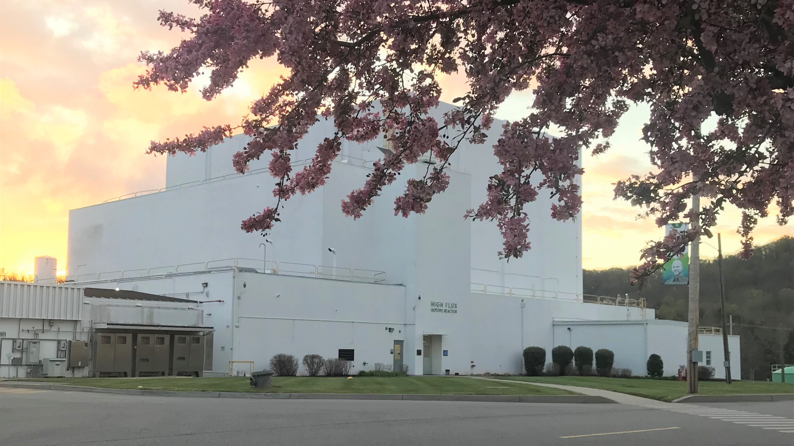

GP-SANS Instrument: Capabilities and Research Highlights
Lisa DeBeer-Schmitt, Lilin He, Karin Bichler
SANS Suite Review 2026

Slide 2
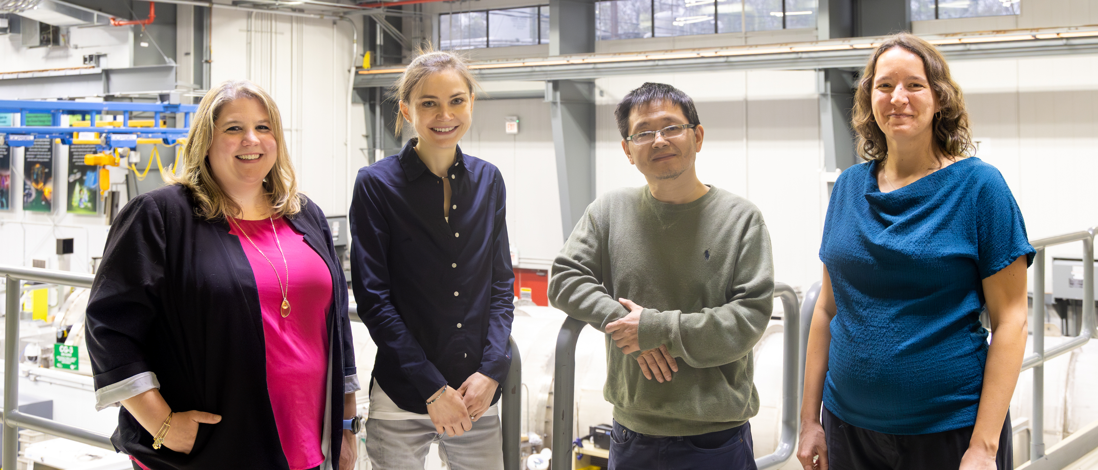
Instrument Team
Lisa DeBeer-Schmitt | Karin Bichler | Lilin He | Arina Rostopchina
Instrument Scientist | Instrument Scientist | Instrument Scientist | Scientific Associate
Hard Matter/ Instrumentation | Rheometery/ Polymers | Soft matter/ Porous Materials | Operation and Safety
Notes:
Our team provides comprehensive support for a diverse user base, organized by the following expertise:
Lisa DeBeer-Schmitt (Instrument Scientist): 8 years on the beamline, specializing in Hard Matter and Instrumentation development.
Karin Bichler (Instrument Scientist): 1.5 years on the beamline, focusing on Rheometry and Polymers.
Lilin He (Instrument Scientist): 13 years on the beamline, providing expertise in Soft Matter and Porous Materials.
Arina Rostopchina (Scientific Associate): 1 year on the beamline, managing Operation and Safety.

Slide 3
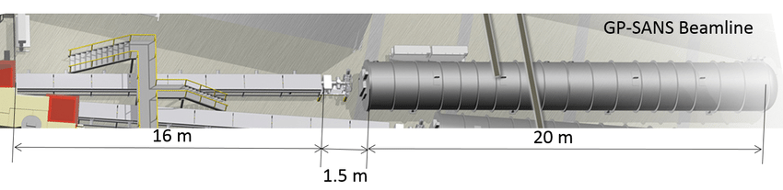
GP-SANS at Present
World leading reactor-based SANS instrument
  Designed to probe length scales of 0.5-700 nm
  Highest time averaged flux on sample
  Maximal flexibility of sample environments
  Wide dynamic Q-range (multiple settings) with lowest minimum Q available at ORNL
  Mail-in
Neutrons
Courtesy of W.B. Bailey and L. DeBeer-Schmitt
Notes:
While our standard design probes up to 700 nm, utilizing our MgF lenses allows us to push that resolution toward 800 nm.

Slide 4
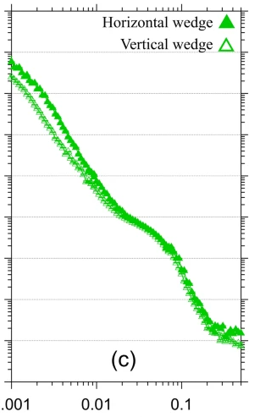
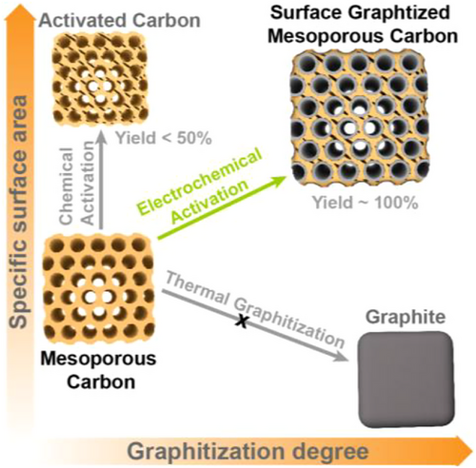
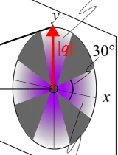
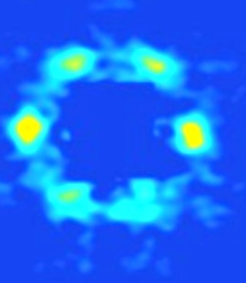
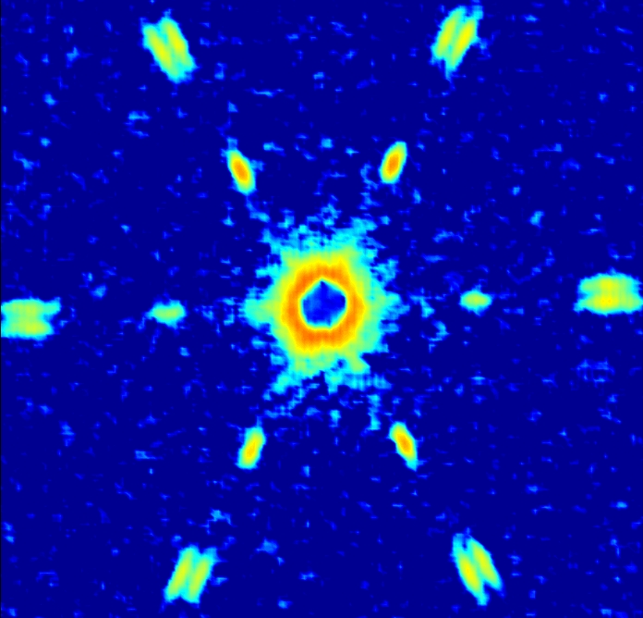
GP-SANS: Probing Hierarchal Structures Across Material Science
Precipitates in Al-Zn-Mg-Mn alloys
100 nm
10 nm
Length scales
1 nm
0.1 nm
Fe/Gd thin film skyrmions
Nd skyrmions
Notes:
References:
Desautels R.D., Debeer-Schmitt L.M., Montoya S., Borchers J.A., Je S.G., Tang N., Im M.Y., Fitzsimmons M.R., Fullerton E.E., Gilbert D., "Realization of ordered magnetic skyrmions in thin films at ambient conditions", Physical Review Materials , 3, 104406 (2019).
Fan J., Yuan Y., Wang T., Luo H., Wang F., Wang Q., Mahurin S.M., Thapaliya B.P., He L., Liu J., Samartzis N., Yang Z., Dai S., "Surface Graphitized Mesoporous Carbon Surpasses the Conductivity-Porosity Trade-Off", Advanced Science, (2026).
Freiberg D.S., Ghaffari B., Littrell K.C., Sanders P.G., "Characterization of n′ Precipitates and Mn Dispersoids in Al-Zn-Mg-(Mn) Alloys Using Small-Angle Neutron Scattering and Electron Microscopy", Metallurgical and Materials Transactions A, 56, 670–685 (2024).
Joanna M. White, Taehyoung Kim, Frank S. Bates,* and Timothy P. Lodge., “How Does the Rate of Chain Exchange Relate to Stress Relaxation in Triblock Copolymer Networks?”, ACS Central Science, Vol. 11 Issue 3 Pages 422-430, (2025)
H. K. Beech, J. A. Johnson and B. D. Olsen., “Conformation of Network Strands in Polymer Gels”, ACS Macro Letters, Vol. 12 Issue 3 Pages 325-330, (2023)
Arachchige H.S., Debeer-Schmitt L.M., Kish L., Rai B., May A.F., Parker D.S., Pokharel G., Tian W., Stone M.B., Frontzek M., Mandrus D., Bleuel M., Islam Z., Fabbris G., Li H., Gao S., Miao H., Thomas S.M., Rosa P.F., Thompson J.D., Lin S.Z., Christianson, "Nanometric modulations of the magnetic structure of the element Nd", Materials Today Quantum, 4, 100016 (2024).

Slide 5
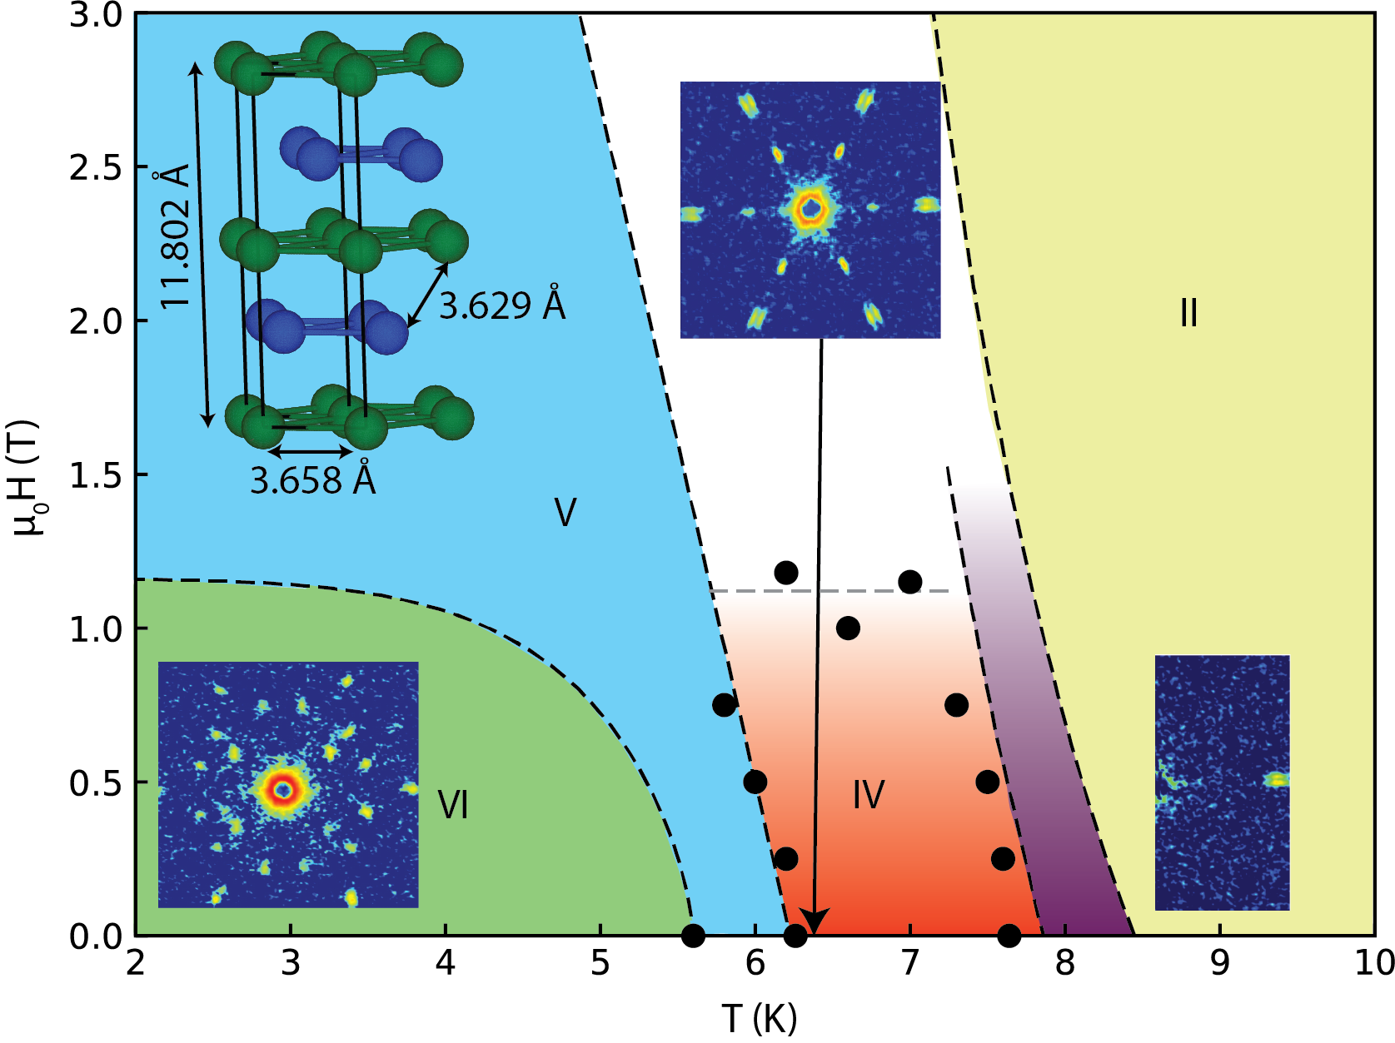
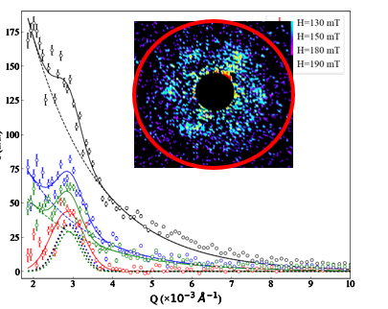
Dynamics and Dimension: New Frontiers in Quantum Magnetism
Quantum Complexity & Topological Phases
Chiral Dynamics & Fractal Networks
Emerging Frontiers: 3D Tomography
H. Suriya Arachchige, et al., Materials Today Quantum, Volume 4, 2024, 100016
Tang et al., Advanced Materials 2300416 (2023)
Henderson et al., In submission (2026)
Notes:
1. Quantum Complexity & Topological Phases: Elemental Neodymium
The "First" in Elemental Physics: While topological textures are common in complex alloys, discovering them in an elemental single crystal like Neodymium is a paradigm shift for the field.
The 6.5 K Skyrmion Phase: High-resolution SANS at GP-SANS revealed unexpected Bragg peaks signaling the formation of skyrmion-like modulations, a state never before captured in an elemental metal.
The 2 K "Mystery" Phase: Below 2 K, a second set of entirely new peaks emerges; we are currently utilizing our polarization upgrade to disentangle the spin-state cross-sections and define this unknown magnetic symmetry.
The Objective: We expect the precise spin-state separation and flux gain from the new V-cavity polarizer to finally reveal the complex 3D magnetic structure driven by frustrated RKKY interactions at these lowest temperatures.
2. Chiral Dynamics & Fractal Networks: Thin-Film Multilayers
Collaborative Hardware Integration: This project highlights our transition toward a "Lab-on-a-Beamline" model; the user supplied the RF coil, and we worked closely to integrate its control and metadata directly into our data acquisition system.
Mapping High-Frequency Behavior: With this integrated setup, we studied Fe/Gd multilayers to observe how topological defects behave under GHz-frequency excitation in real-time.
Spin Wave Propagation: By exciting these skyrmion lattices, we visualized spin waves propagating through the material, manifesting as a measurable change in the overall background scattering.
The Strategic Theme: Our goal is to establish GP-SANS as the premiere facility for probing magnetic long-range structures, offering the unique combination of high-flux polarized neutrons and custom-integrated user environments.
3. Emerging Frontiers: 3D SANS Tomography
Solving the Projection Problem: Standard SANS provides a 2D reciprocal space projection (a bulk average); our new goal is to "invert" this data into real-space 3D volumes.
The Reconstruction Algorithm: Developed by post-doc Melissa Henderson, this method uses reciprocal space images and micromagnetics simulations to seed an algorithm that extracts the most likely 3D real-space tomographs.
Visualizing Topological Tubes: This enables the first true 3D volumetric reconstructions of skyrmion tubes and their connectivity within bulk samples.
Community Expansion: We are actively expanding this code to include flux line lattices, chiral solitons, and frustrated modulations (like those in Nd) to provide a standardized 3D mapping tool for the GP-SANS user community.

Slide 6
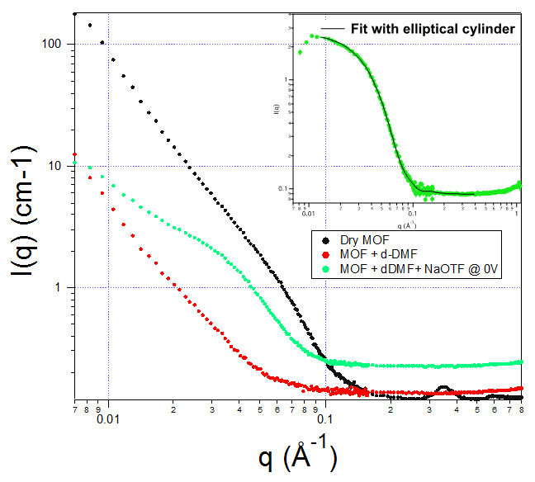
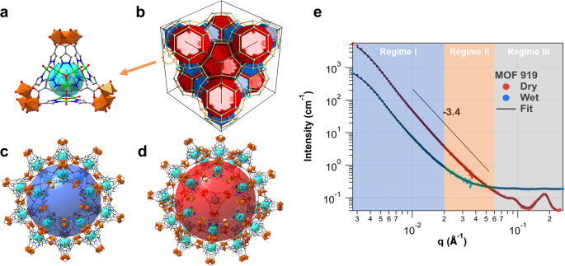
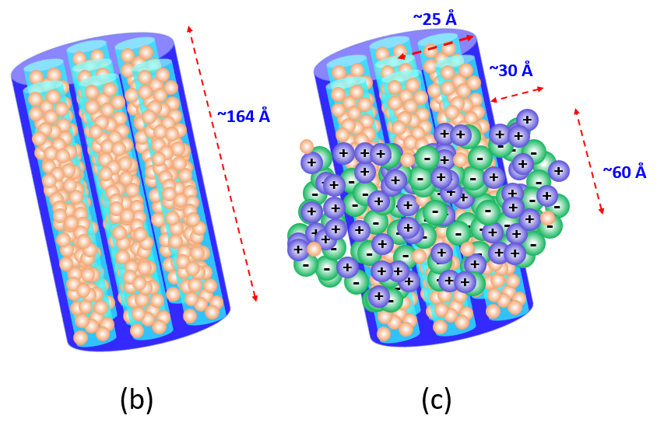
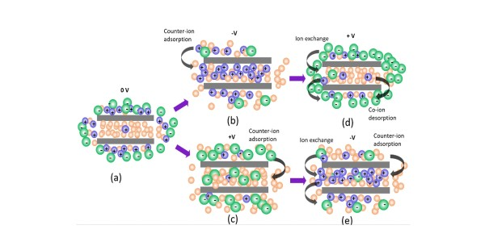
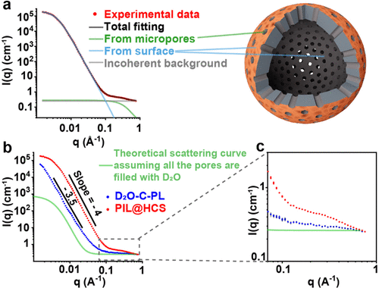
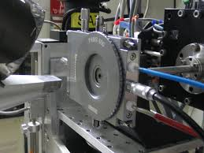
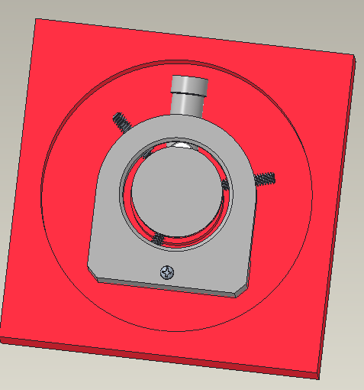
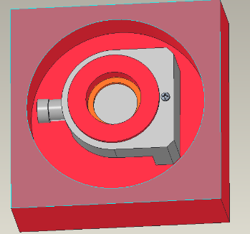
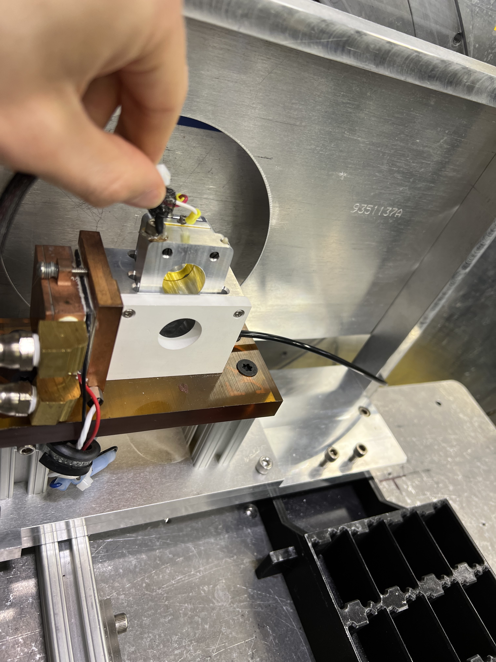
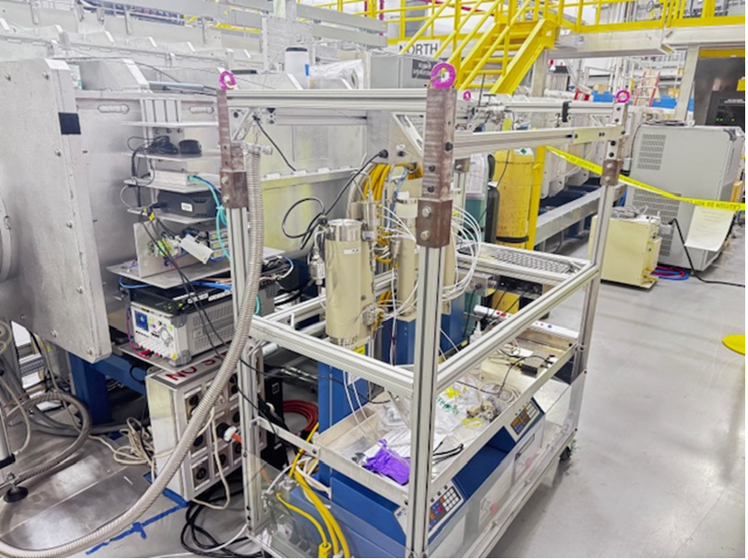
Probing Nanomaterials with Operando & in situ SANS
1. Batteries and supercapaitors
2. Protein encapsulation
Separator
Neutron beam
Carbon
MOF
Detector
Wang X., et al. Nature Communications, 14, 973 (2023).
Wang X., et al. Nature Communications, 14, 973 (2023).
He L., et al. Angew. Chem.Int. Ed., 59, 24, 9773-9779 (2020).
Jafta C.J., et al. Energy Storage Materials, 40, 219-228 (2021).
3. Porous liquids
4. Other activities
Development of new sample environments
Data reduction and analysis
Participated in LDRD (Led by T. Saito)
Outreach activities: Co-organized southeast polymer forum
Moitra D., et al. JACS, 147, 3421–3427 (2025).
Li E., et al. Chemie International Edition, 64, e202421615 (2025).
Mokhtari-Nori N. et al. Materials Today Energy, 45, 101693 (2024).
Linkham Thermal Stage -19.8 to 350 °C
Gas Loading and BDS-SANS

Slide 7
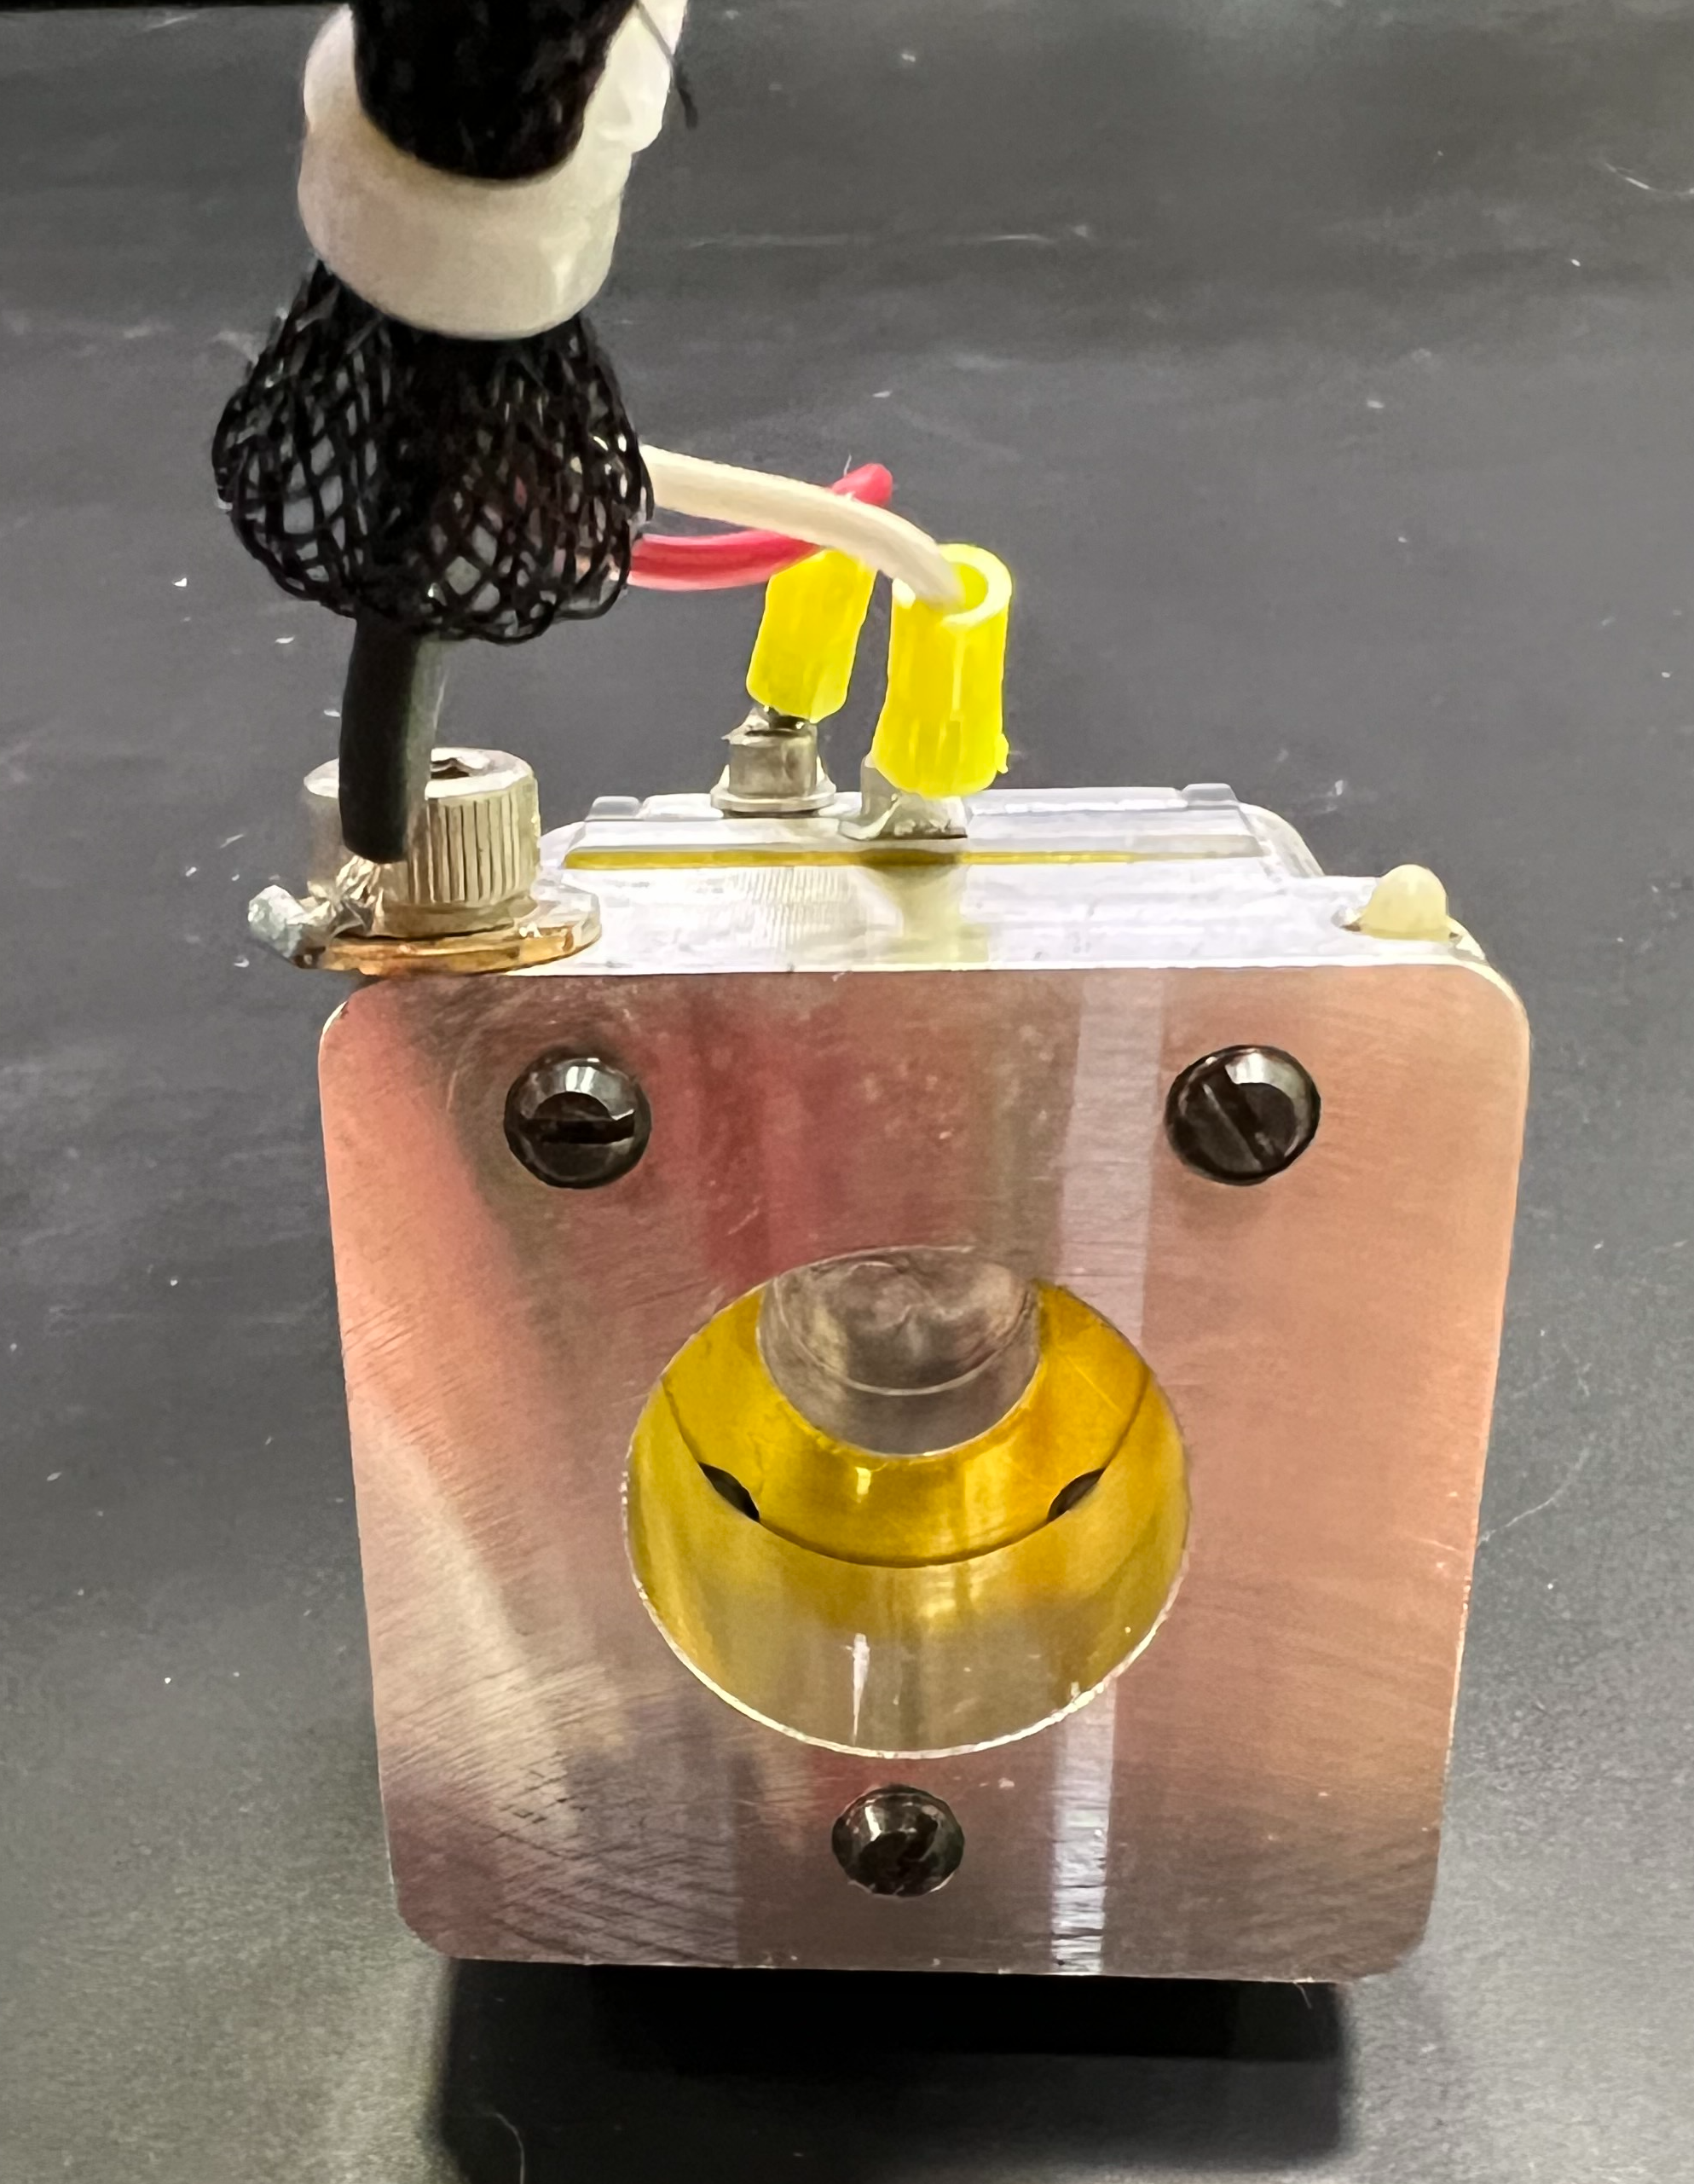
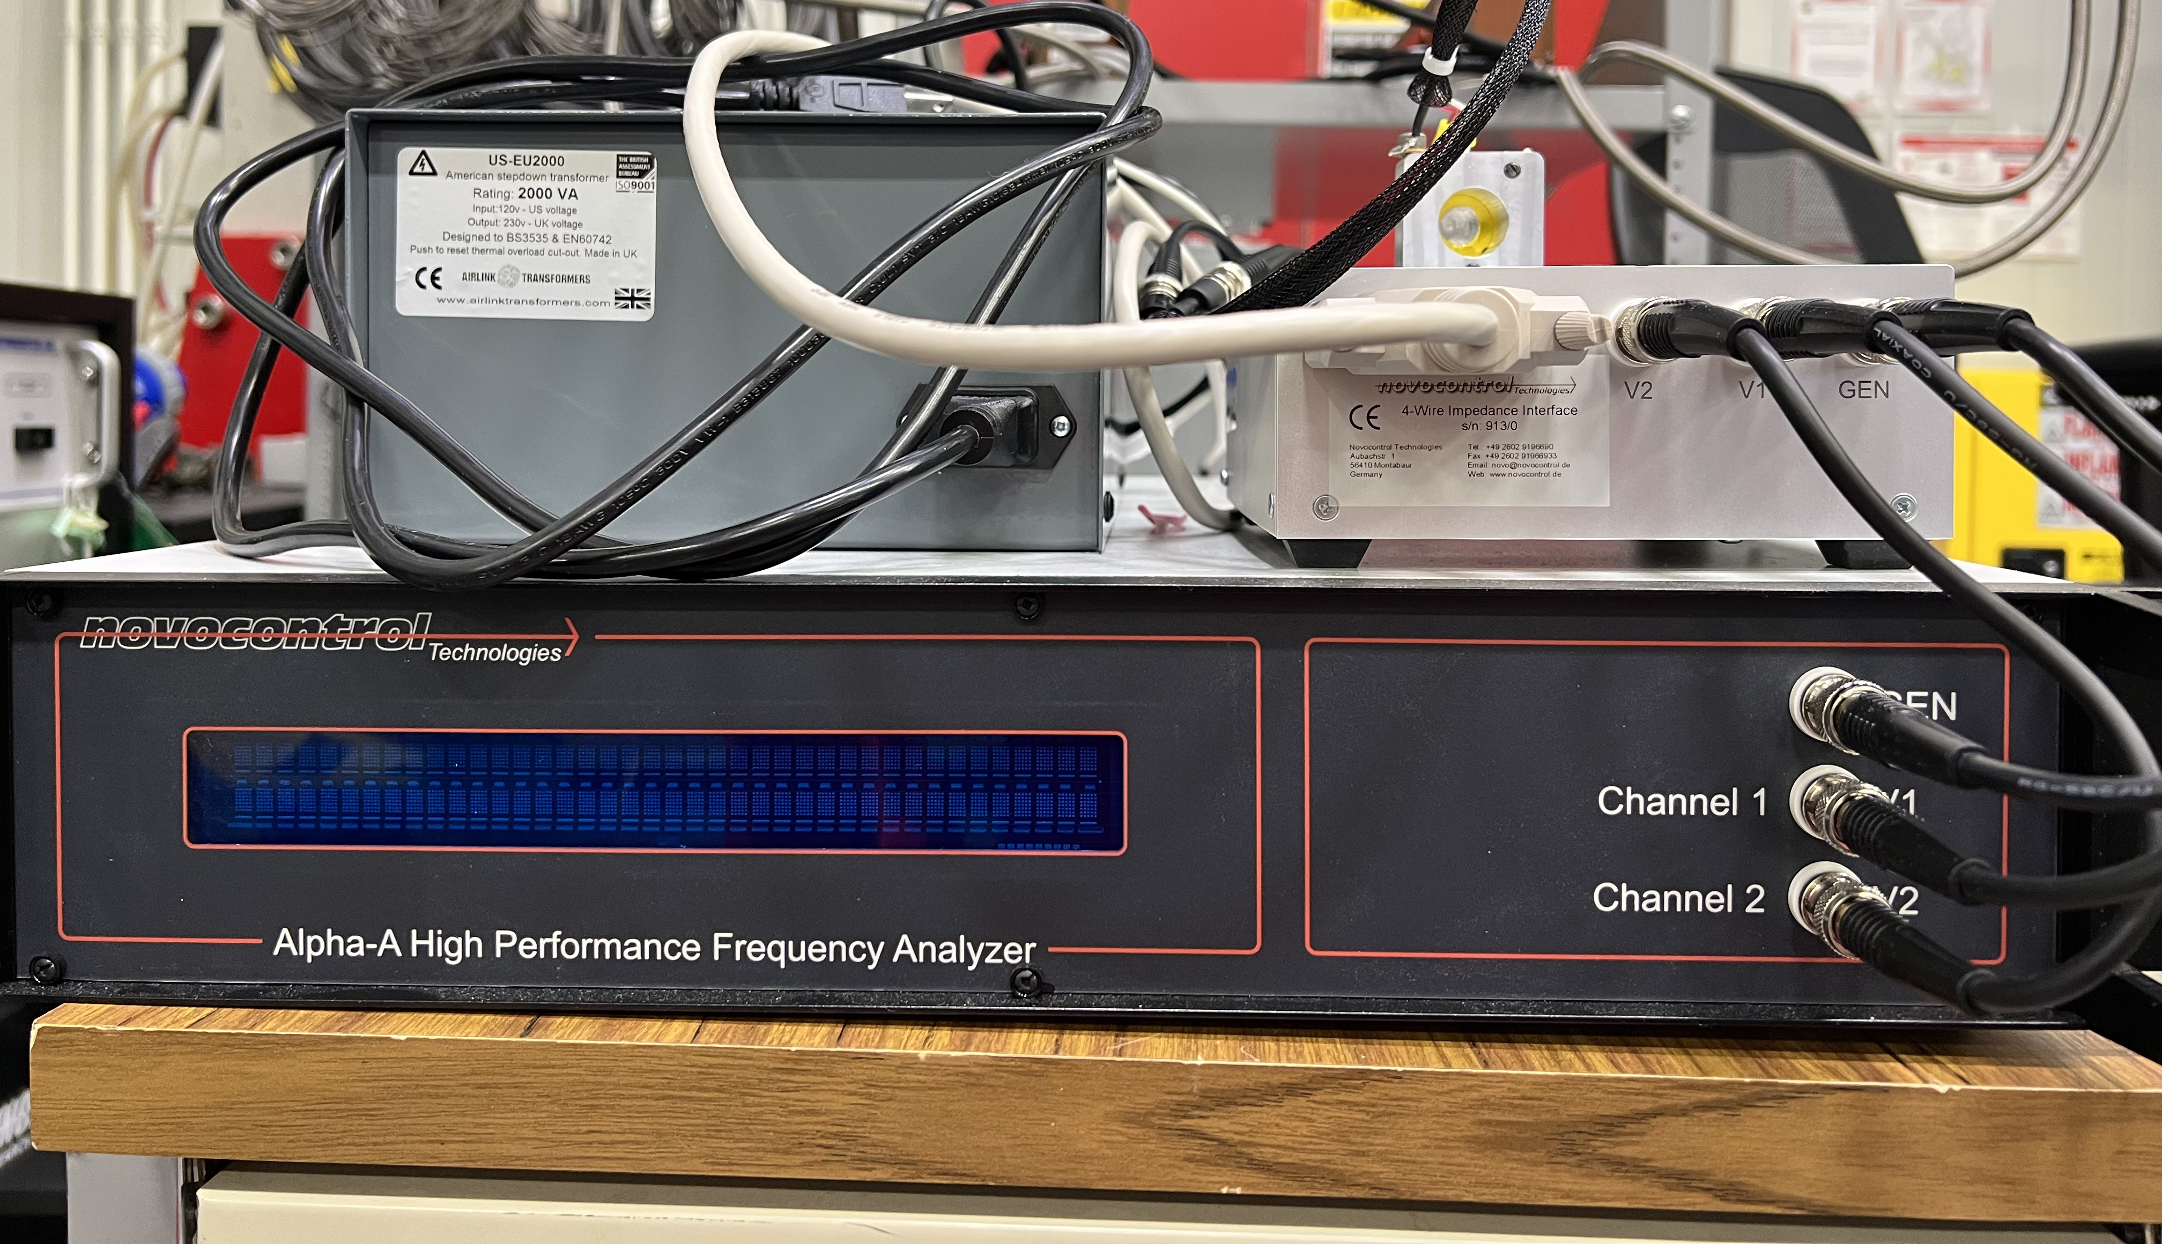
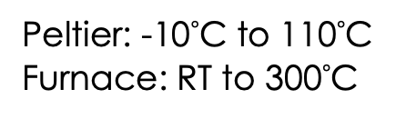
Broadband Dielectric Spectroscopy (BDS) - SANS
Measuring broadband dielectric spectroscopy (BDS) and small-angle neutron scattering (SANS) simultaneously
Connecting dynamical changes with structural changes
Dynamics
BDS
Temperature control using Robot Peltier setup at GP-SANS
Different
Temperatures
Different temperatures shift the dynamics through the frequency window. Higher temperature; Faster relaxation
Peltier: -10$°$C to 110$°$C
Furnace: RT to 300$°$C

Slide 8
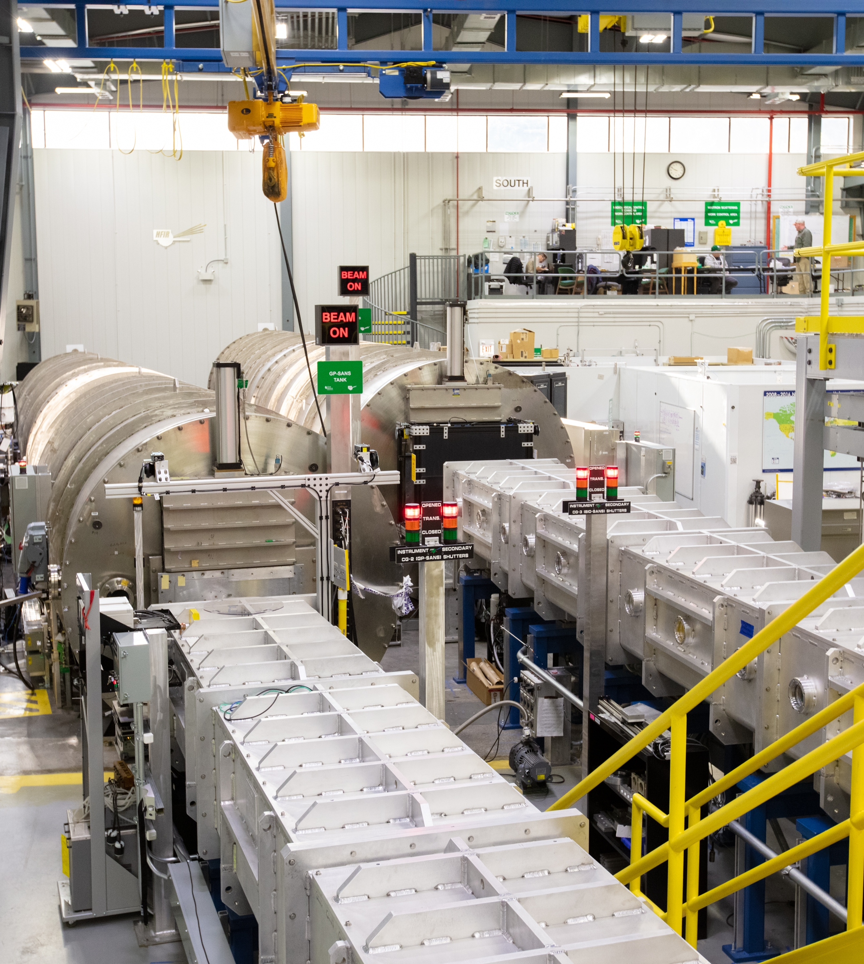
Upgrades

Slide 9
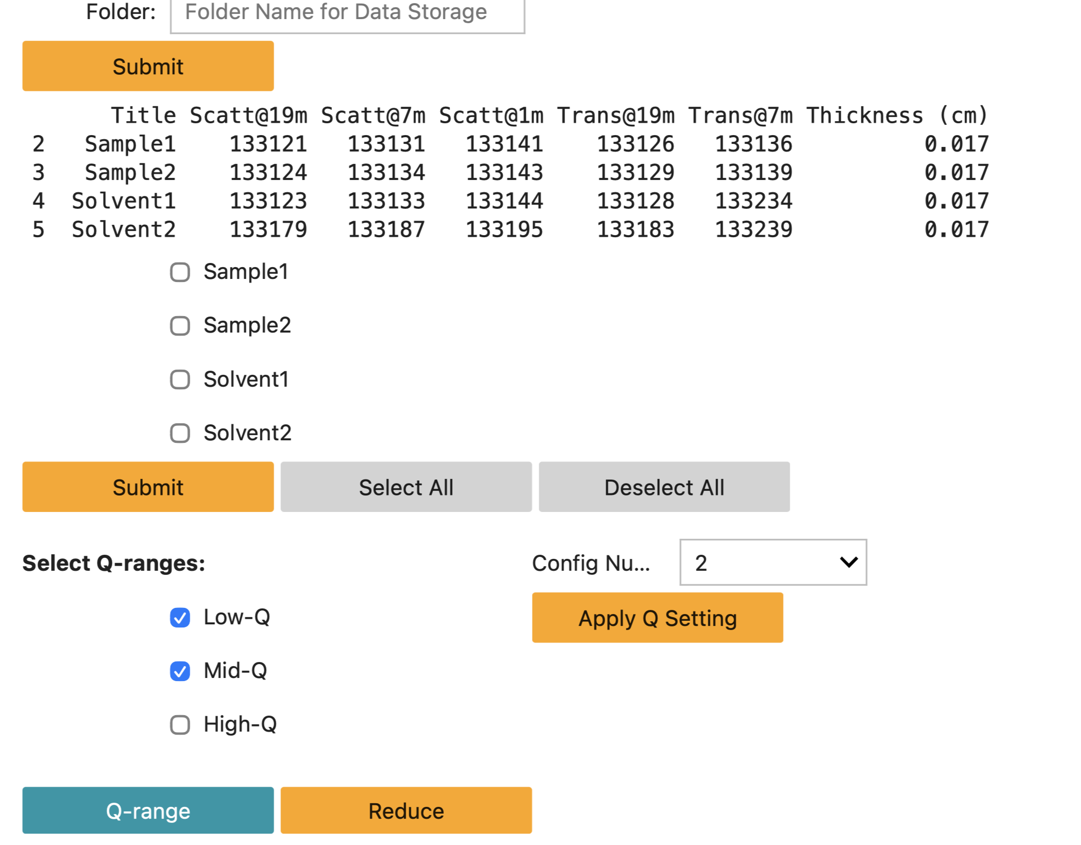
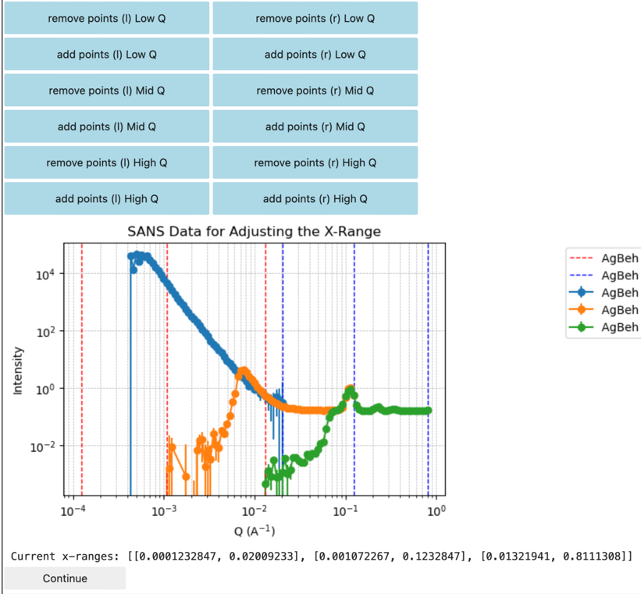
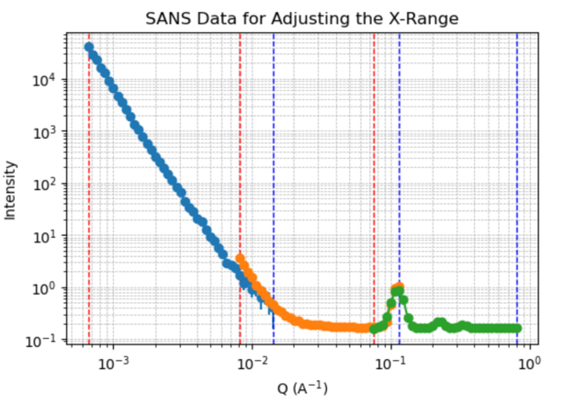
Data Reduction at GP-SANS
User Choices:
Specify folder for data storage
Selecting the samples by ticking them
Selecting the Q-range
Instantaneous user based Q-range adjustment for data reduction and stitching

Slide 10
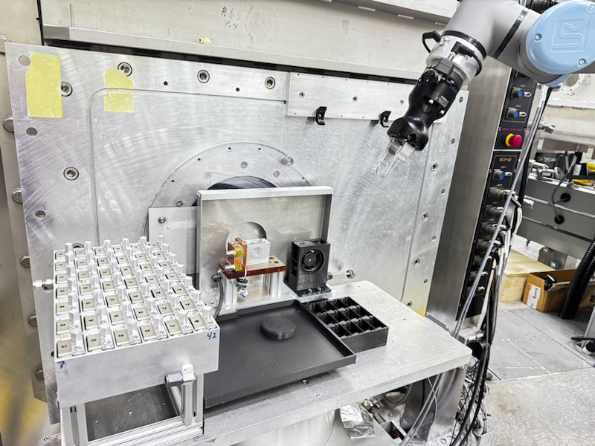
Automation & Precision: The Multi-Axis Robotic Platform
New multipurpose Robotic changer
  Replaces 9 different sample changers
  Better changer for use in magnetic fields
  ALARA for highly irradiated samples (also in magnetic fields)
  Optimize shielding for background reduction
  High throughput, reducing manual sample changes
  Better optimization of sample environment stimuli (humidity, temperature, lab on table)
  Decrease in beam line footprint (post-HBRR)
Future developments:
  Automation of sample aperture changes for optimizing beam time
  In beam positioning of samples (Raster scans across welds or corrosion points)
Notes:
1. Evolution of Automation at GP-SANS
From Fragmented to Unified: Historically, we managed nine different sample changers—four for room temperature and five for specific environments—each requiring manual intervention and distinct setups.
The Multipurpose Solution: The new robotic platform replaces this fragmented approach with a single, high-capacity system designed for high-throughput and "lab-on-a-table" flexibility.
ALARA & Safety Priority: By automating sample handling, we significantly reduce staff radiation exposure, particularly when managing highly irradiated samples in lead piglets from HFIR.
2. Current Operational Capabilities
The 42-Position Peltier System: We currently offer an active cooling/heating block (10°C to 100°C) with a 42-position "waiting area," allowing samples to equilibrate at temperature before the beam to maximize efficiency.
High-Temperature Furnace: Our furnace insert currently supports room temperature up to 300°C, providing automated transitions for in situ studies of polymer and alloy phase changes.
Precision and Background Control: The robot's integrated shielding is optimized for background reduction, ensuring that the high-throughput doesn't come at the cost of signal-to-noise ratio.
3. Strategic Research & Future Directions
Metallurgy & The "Magnetic Kill": The platform is specifically engineered for use within our 5 T open bore magnet, enabling the automation of metallurgical studies where we saturate the matrix to resolve hidden precipitates in advanced steels.
Spatial Mapping (Raster Scanning): We are developing the robot to act as a precision motor for automated raster scans, allowing users to map microstructural variations across additive manufactured parts, welds, and geological slices.
Dynamic Sample Conditioning: Future developments include humidity-controlled interfaces and vibration/tumbling systems to prevent sample settling in complex fluids.

Slide 11
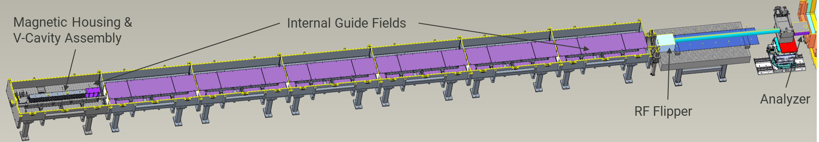
GP-SANS Polarization Project
Core Hardware Capabilities
V-Cavity Polarizer: Maximized incident neutron flux.
Full Analysis: Resolve all four spin states (++, +-, -+, --).
Modular Optics: Magnetic lenses, pinholes, and curved mirrors.
Advanced Modes: Support for SNP, MIEZE, and SESANS.
Ease of Use
"Push-Button" Switching: Automated EPICS/Phoebus integration.
Live Analysis: Real-time spin-state separation and data reduction.
Scripted Deployment: Rapid, on-the-fly polarized measurements.
Science Impact
Quantum: Skyrmion lattices and topological pockets in Kagome metals.
Magnetism: Hidden nanometric modulations in elemental magnets.
Superconductivity: Vortex lattice symmetry and flux line dynamics.
Soft Matter: Dynamics in ferrofluids and nanoparticle brushes.
Metallurgy: 5 T "magnetic kill" to resolve precipitates in steels.

Slide 12
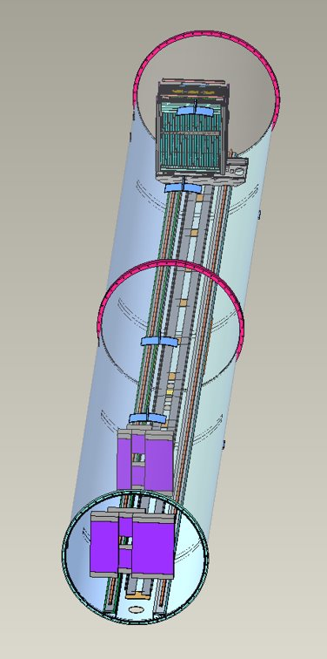
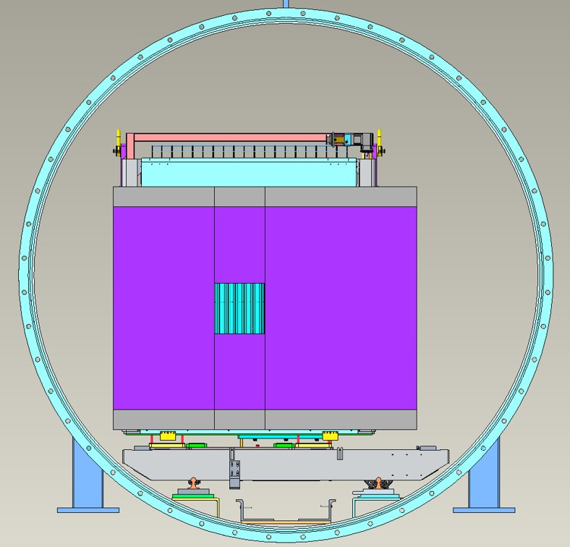
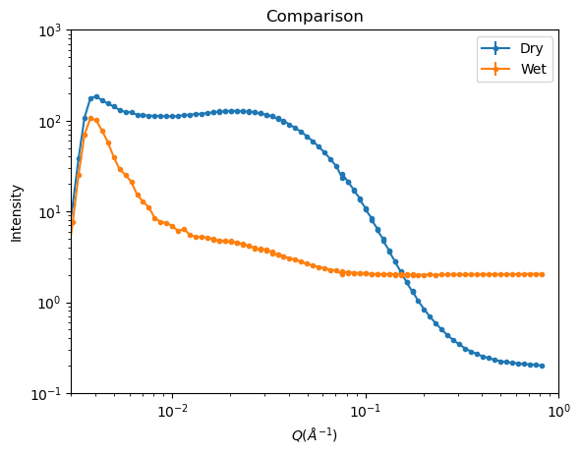
GP-SANS detector build out
The upgrade will enable largest dynamic q-range (Q_{max}/Q_{min}~300) at ORNL.
  High Flux setting (0.003 – 1 Å⁻¹)
  High Resolution (0.0007 – 0.2 Å⁻¹)
  Full-Q-range studies involving anisotropic scattering
Science Cases:
  Kinetic studies of annealing precipitates in steels, rheometry on polymers, self-assembly of soft matter materials
  Multiscale magnetic transitions
  Hierarchical structures and composites
  In-situ processing, sintering, fluid intrusion and exchange in pores
Entire curve in one measurement

Slide 13
Vision for GP-SANS
Immediate / Operational Focus (Pre-HBRR & During)
Mid-Term / Strategic Upgrades (Post-HBRR)
Long-Term / The 3-Source Ecosystem
Polarization Launch: Commissioning high-flux V-cavity polarizer and RF flippers with "push-button" software integration.
AI-Integrated Analysis: Implementing Physics-informed ML for autonomous data stitching and automated model selection.
Autonomous Operations: Expanding the Robot Sample Changer to handle diverse, complex sample environments for high-throughput science.
Multi-Frame Detector Array: Picture-frame arrays at 1m and 4m for large simultaneous Q-range.
Technical Readiness: Training users during HBRR on polarization and AI-driven analysis tools.
User Program Revitalization: Focused recruitment to restore community vitality post-restart.
Structural Leadership: Preeminent venue for large-scale structures in the 200–700 nm regime.
Developmental Hub: Open sample area designed to foster next-generation sample environment development.
Diverse Science Enabled: High-flux reactor anchor supporting the broadest array of scientific disciplines at GP-SANS.
Notes:
Immediate:
Expanding collaborations to grow the user base and enhance scientific productivity;
Developing full auto-reduction tool and automate the experimental settings;
Developing AI tools to identify hidden features and optimal experimental conditions on the fly.

Slide 14
Extra Slides

Slide 15
Sample Environments:
Current Sample environment options:
  New Robot sample changer
    Peltier system that goes from -10 to 110 °C with 0.01 degree control and holds 42 samples at temperature
    Atmosphere Furnace from room temperature up to 300 °C
  Rheometer with temperature control -10 to 80 °C
  Vacuum furnace > 1200 °C
  Horizontal 11 T recondensing magnet allowing users to utilize 11 T at 30 mK, 5 T horizontal open bore magnet and 8 T vertical magnet with temps 30 mK to 300 K
    Electric field and current can also be applied to the samples
  Pressure cells (McHugh 2kBar and 1kBar changer)
  Tumbler
Future upgrades:
  Linkham thermal stage -197 °C to 350 °C
  Robot humidity chamber
  BDS cell
  In-situ reaction vessel
  Load frame for metallurgical specimens

