Slide 1
Bio-SANS:
Current Status–Future Goals
FEBRUARY 09,2026 | OAK RIDGE, TENNESSEE
PRESENTED BY
Venky (Sai Venkatesh) Pingali
Center for Structural Molecular Biology

Slide 2
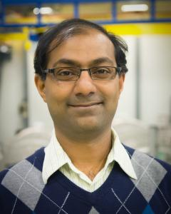
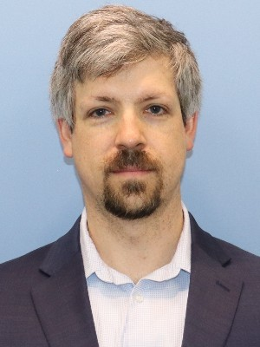
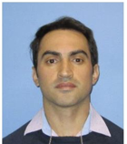
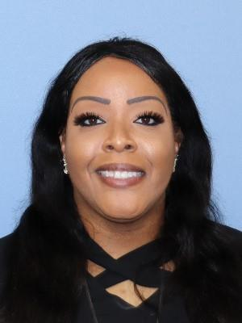
Bio-SANS Team
Venky Pingali
Instrument Scientist
Instrument Development
Plant cell wall (Assemb. & Deconst.)
Bio-Environmental
Biomembranes
Biomaterials
Biomacromolecular Complexes
Computational Instrument Scientist
Real-time Data Reduction (Live)
AI-driven Automation Capability
Flexible Proteins (MD)
Protein/Nucleic Acid Complexes
Deuterium Incorporation
Alan Hicks
Instrument Scientist
Sample Environment Development
Data Analysis
Biomacromolecular Complexes
Lipid Nanoparticles
Nucleic Acid Complexes
Biomembranes
Biomaterials
Scientific Associate
Instrument Operations
User Training
Testing Sample Environments
Coordinate maintenance jobs
Maintain Safe Procedures
Wellington Leite
Felicia Gilliland

Slide 3
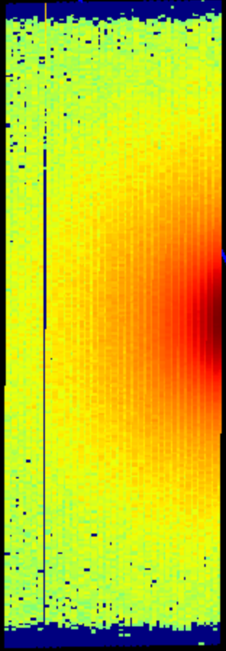
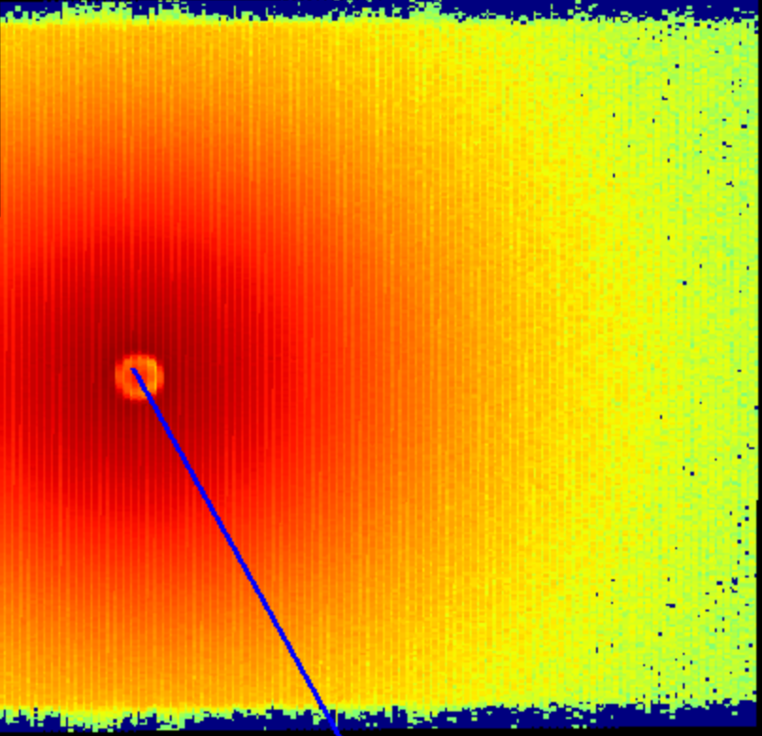



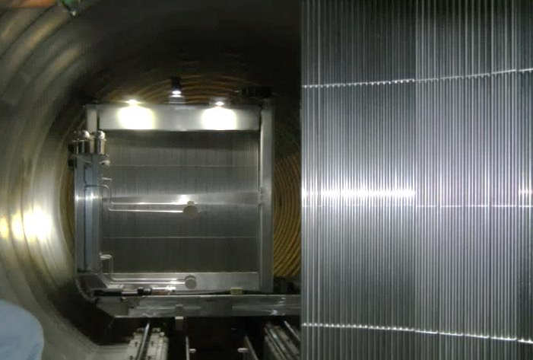
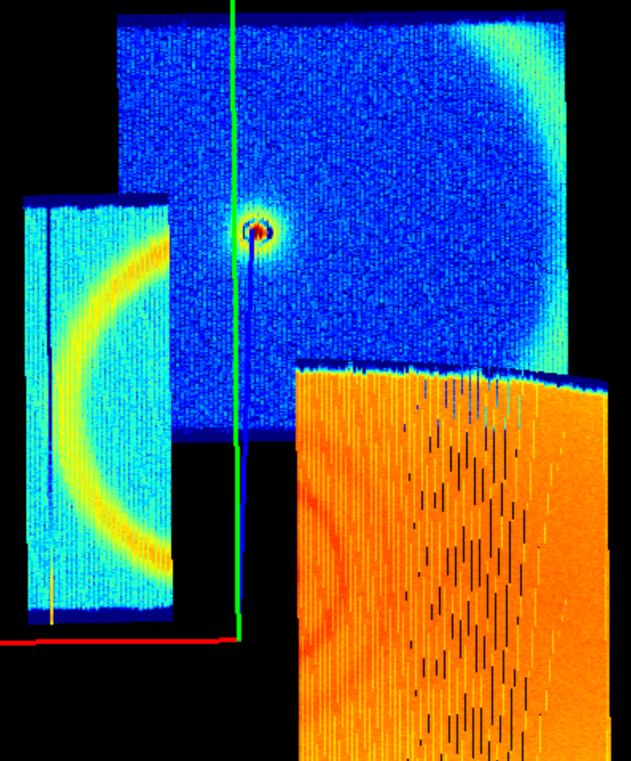
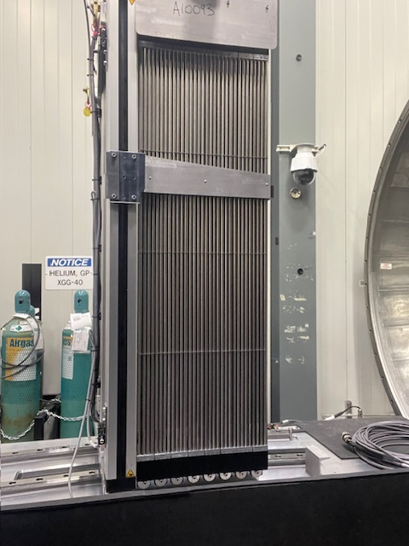
Bio-SANS Instrument (Charge Q1)
Semi-Transparent Beam Trap
Monochromator, λ
Sample
Wing
Mid-Range
Neutron Beam Direction
Ө
Guides (Passive Collimation)
Main
Vacuum Tank
³He Tube Detectors
Main
Monochromation:
6–25 Å
Collimation System:
8 M1 Guides (2 m each)
Detection System:
³He Linear Position Sensitive Detectors (LPSD) – 256 Pixels
Staggered arrangement of tubes – (H x V: 5.5mm x 4.5mm)
Main ~ 1m x 1.0m (192 tubes) – (2012)
Mid-range ~ 1m x 0.4m (64 tubes) – (2024)
Wing ~ 1m x 0.9m (160 tubes) – (2016)
Main
Midrange
Wing
Wing
Midrange

Slide 4
Unique capabilities of Bio-SANS (Charge Q1)
Semi-transparent beam trap:
  simultaneous ‘Scattering’ & ‘Transmission’ measurements
Multi-array detector system:
  provides a dynamic q-range factor of 280
Specialized for biological community:
  Size Exclusion Chromatography (SEC) SANS of biomolecules
  Freeze-thaw protein solutions for pharma & biology
  Data analysis for intrinsically disordered protein (ALS collab.)
  Live reaction cell for thermochemical deconstruction of plants
  In-vivo whole cell studies for biofuels

Slide 5
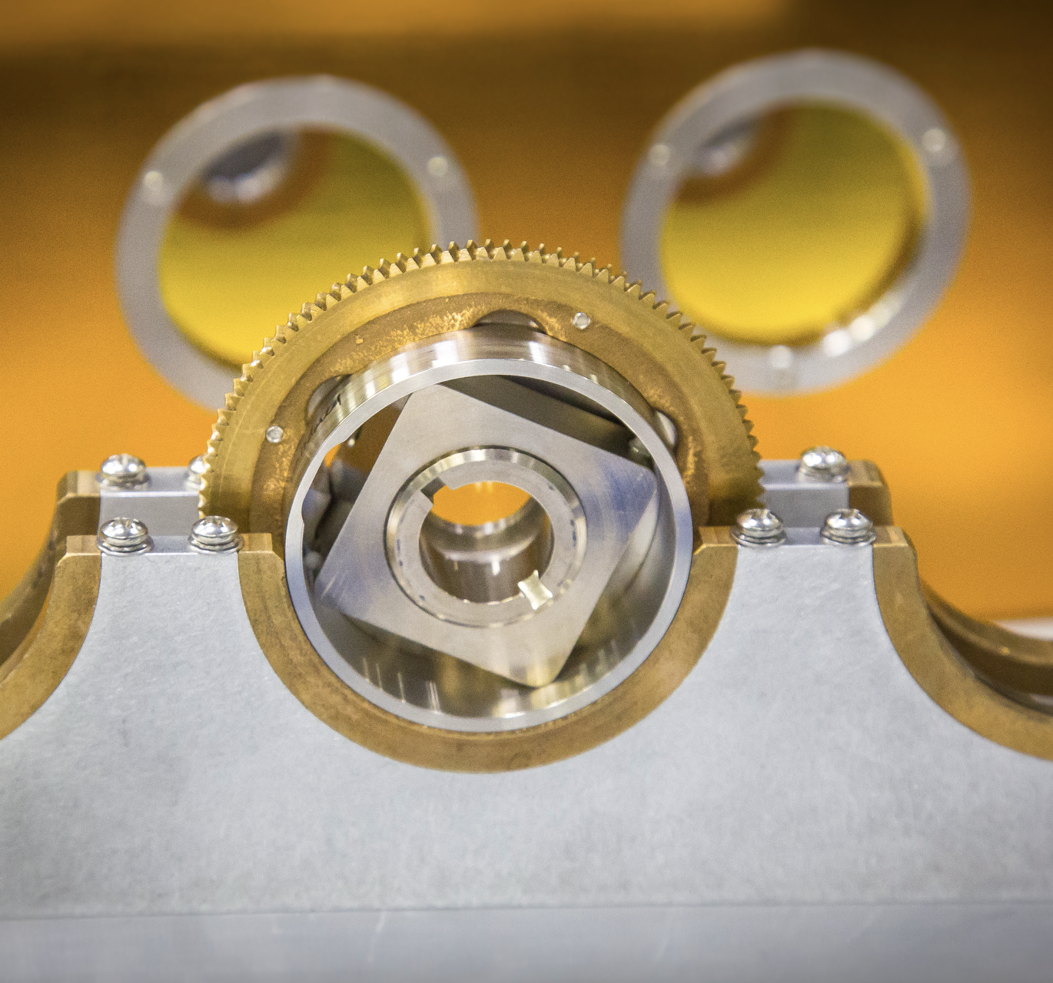
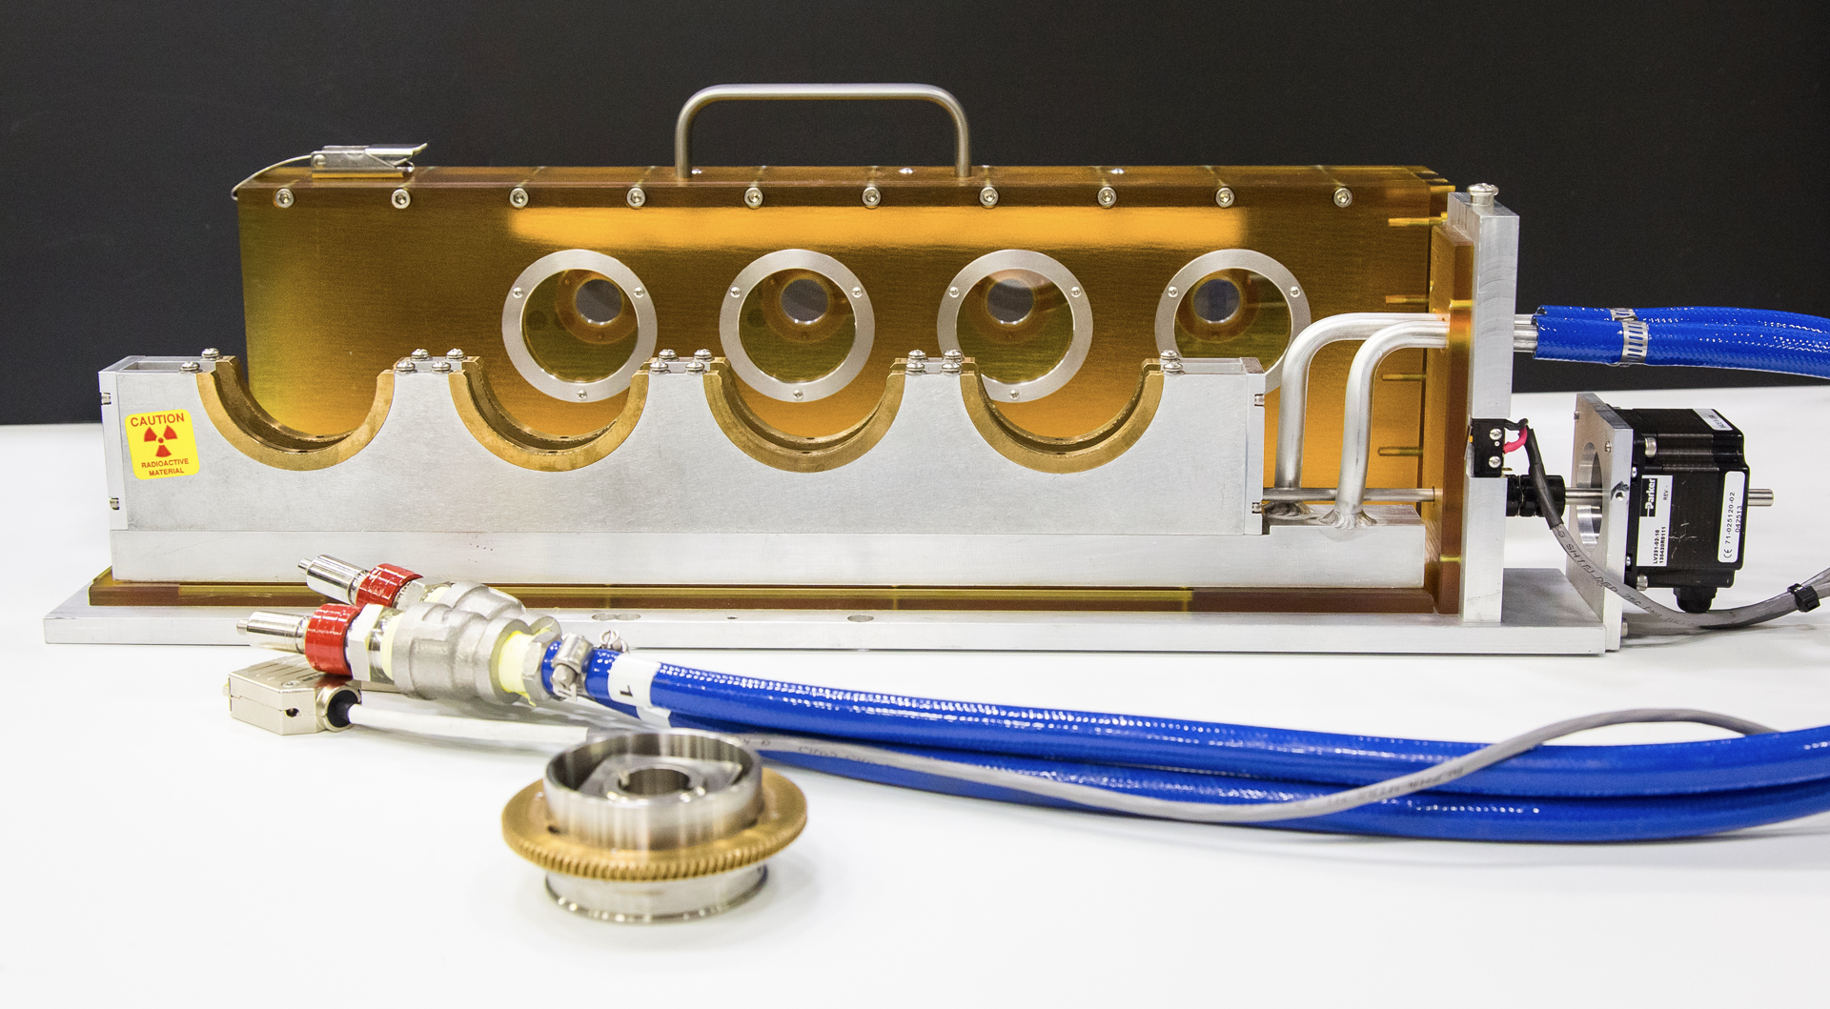
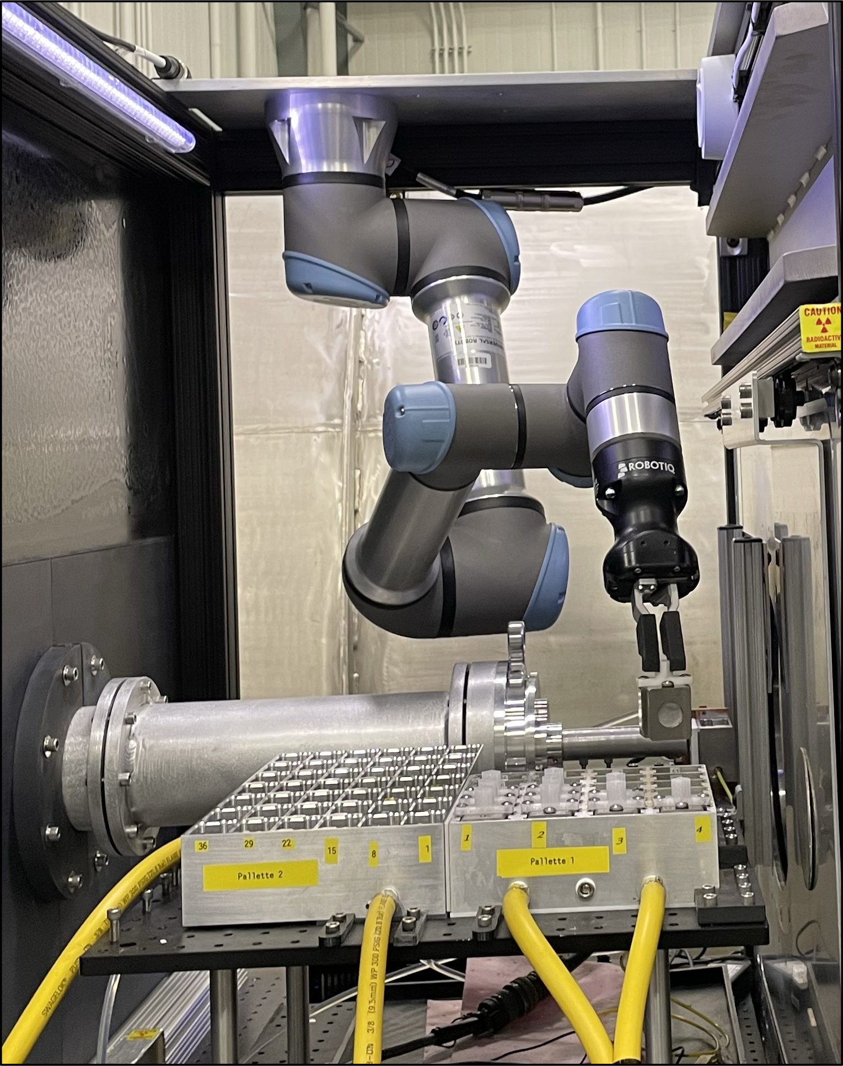
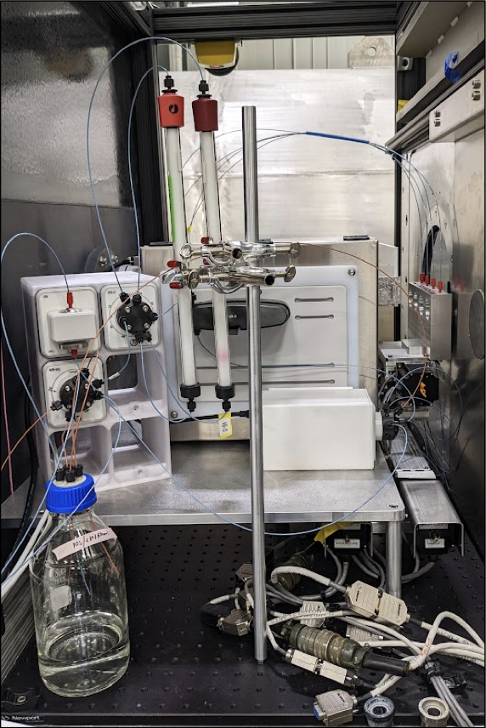
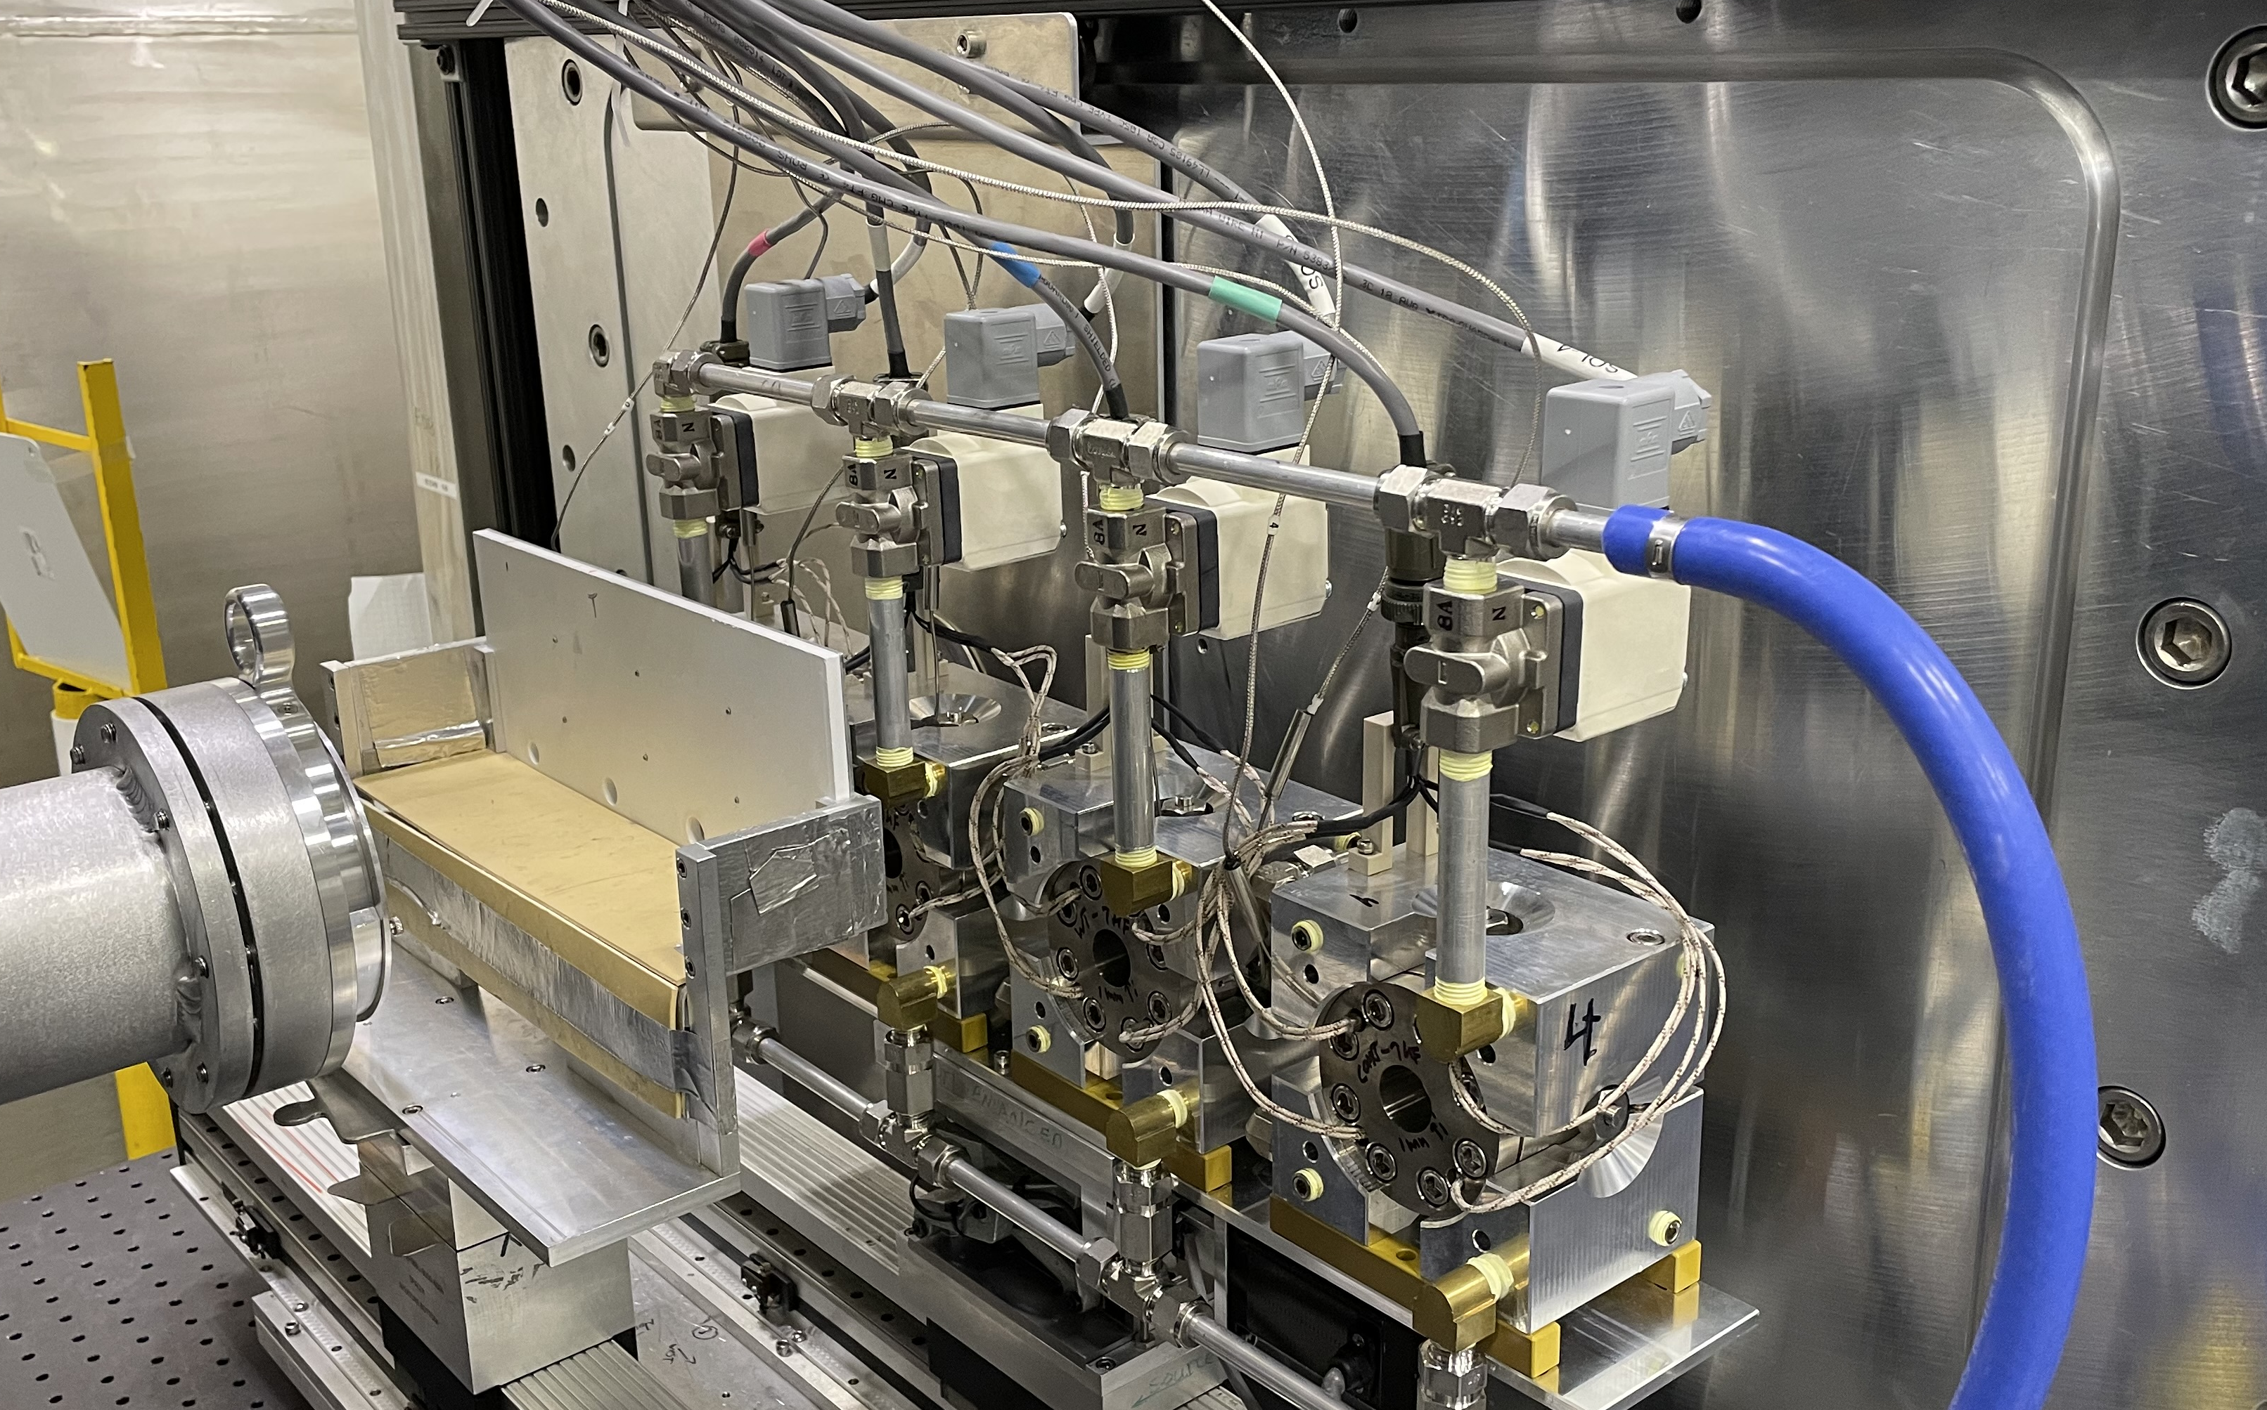
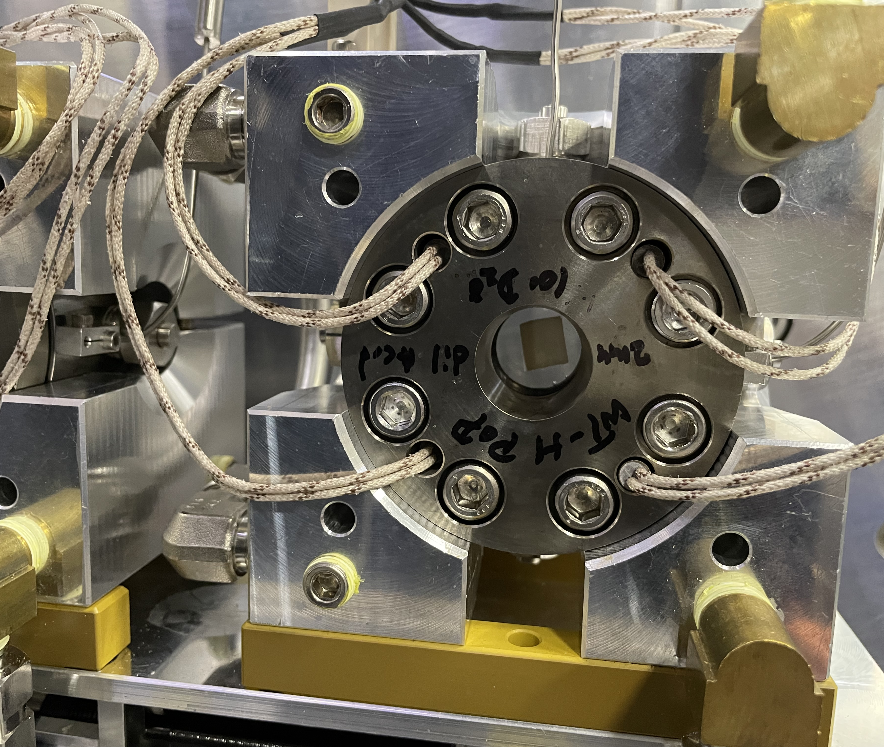
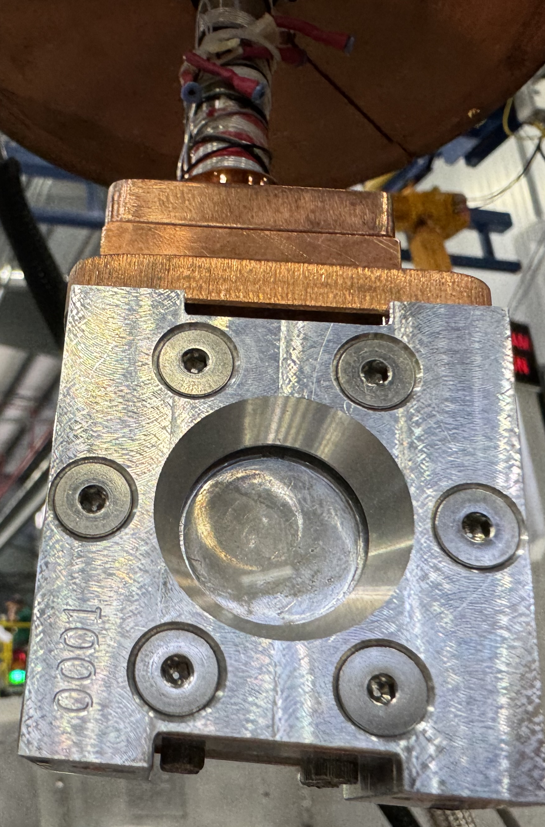
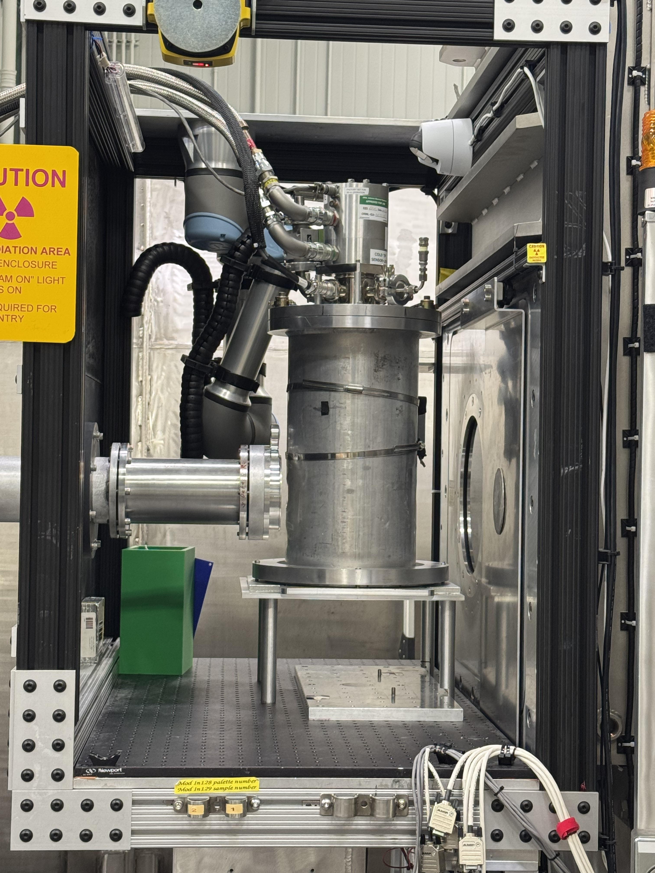
Bio-SANS sample environment suite developed for the biological community (Charge Q1)
4-Position Tumbler
Robot w/84 Positions
Chromatography SANS
4-Position Reaction Cell Holder
CryoTemp Solutions

Slide 6
Suite Review 2020
REVIEW COMMENTS/SUGGESTIONS | RESOLUTION
Publication areas - 50% Soft Matter/40% Biology The number of "bio-users" is low, but focusing on team expertise suggests to concentration on biosciences | Dr. Wellington Leite was hired in 2021 Distribution: 9% Soft Matter/81% Biology (Biomacromolecular Complexes + Biomembranes + Biomass/Biofuels + Biomaterials )
Output lower than GP-SANS and EQ-SANS. The team should consider why? | Contributing factors: Lower staffing level 2 vs. 3 Instrument scientists for Bio-SANS vs. GP-& EQ-SANS Inexperienced user community, need IS collaboration for success
Beamline staff are over-stretched as the beamline becomes high throughput | Developed interactive SANS solution sample data analysis to relieve some burden on IS
Data analysis is a bottleneck | Dr. Alan Hicks was hired in 2024 as computational instrument scientist for biology
It is ideal to focus beam at detector to improve low-Q capabilities, which would be beneficial to RNA and bio complex studies and complement EQ-SANS | Instrument development: Increase low-Q access to Q ~ 5 x 10^{–4} Å^{–1}
Low demand for SEC-SAXS at synchrotrons; Discuss with counterparts at other facilities to determine SEC-SANS demand and invest instead for auto-samplers (robotics) | The team discussed with neutron facility: D22 (ILL), and synchrotron facilities: Bio-CAT (APS), LiX (NSLS-II), BL4-2 (SSRL) before committing to develop SEC-SANS capability. In addition, the team was the trend-setter in developing robotic auto-samplers.

Slide 7
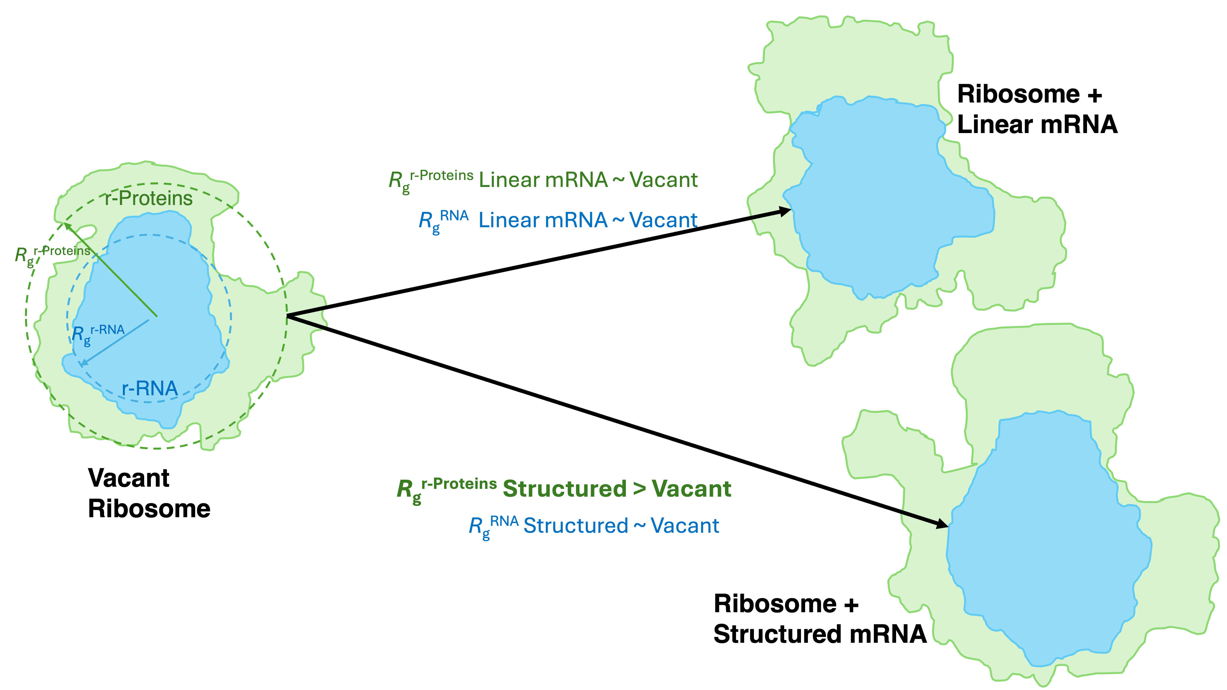
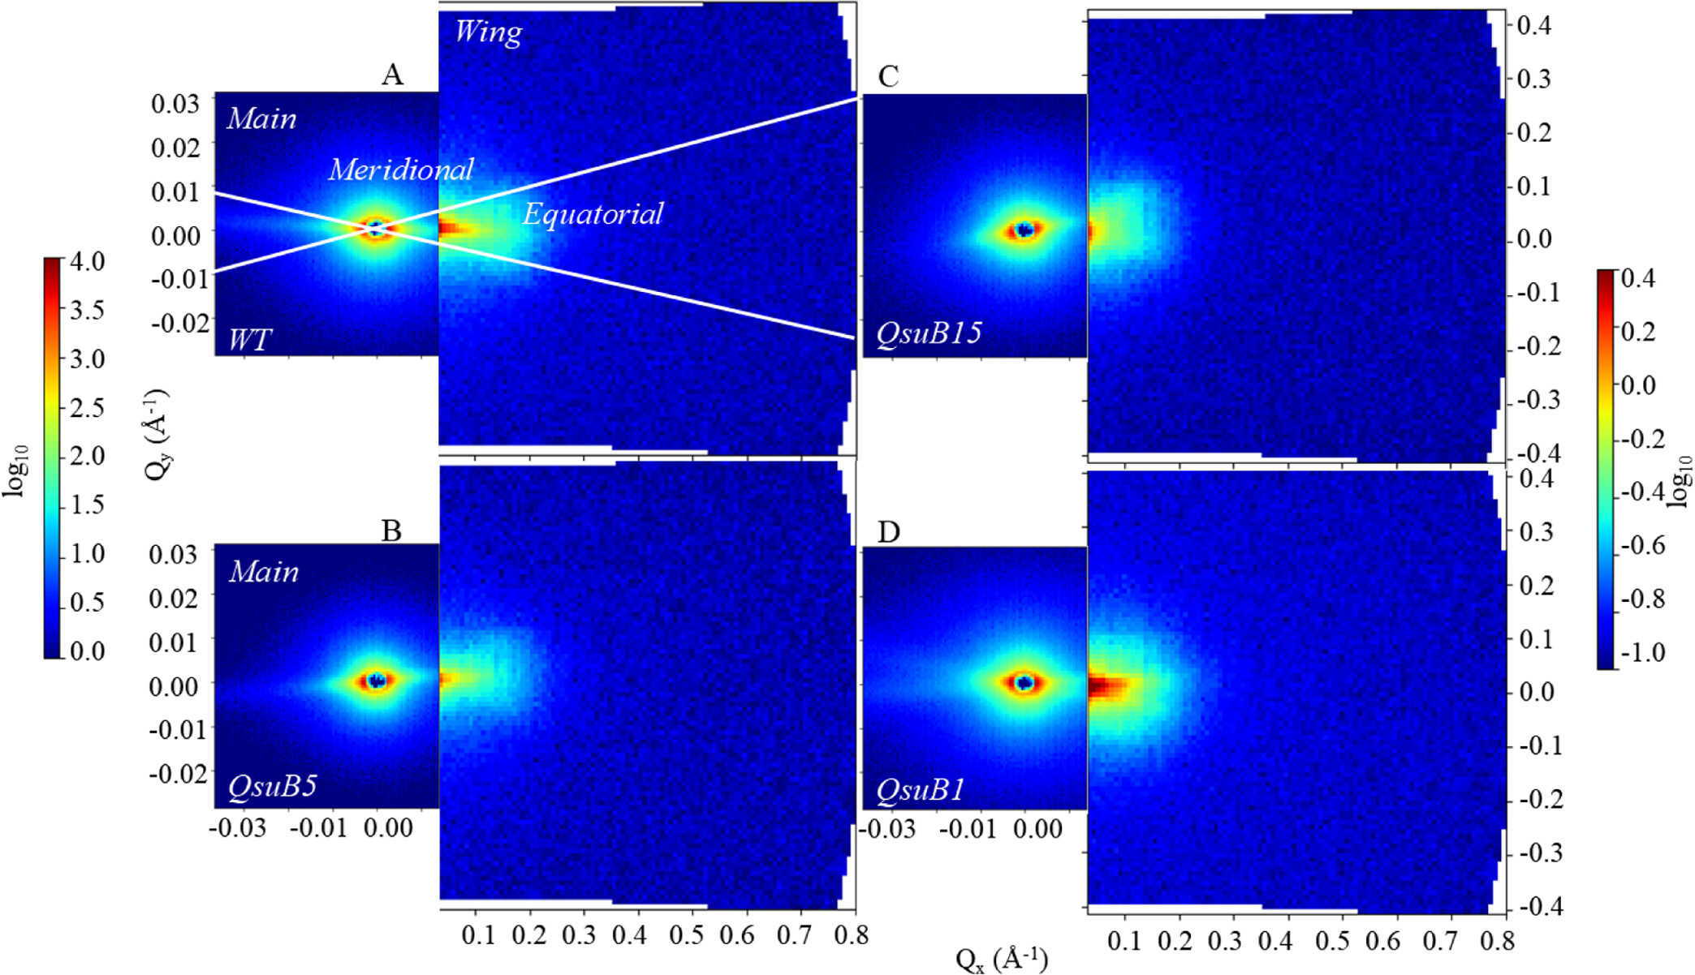
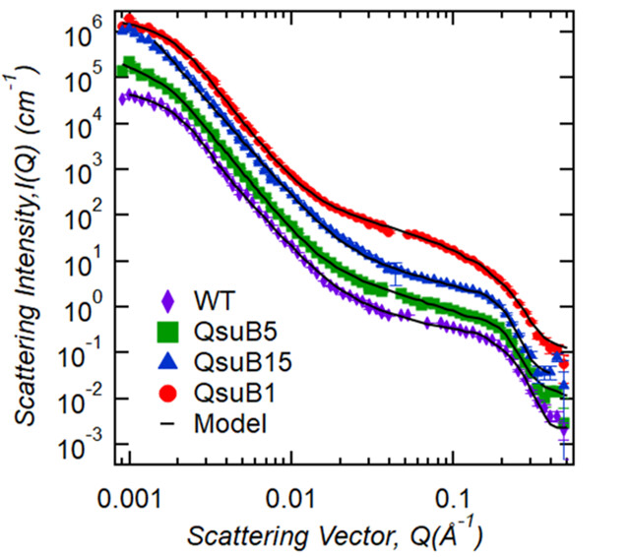



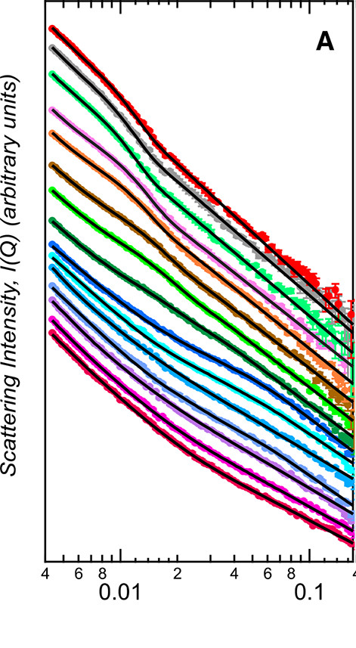
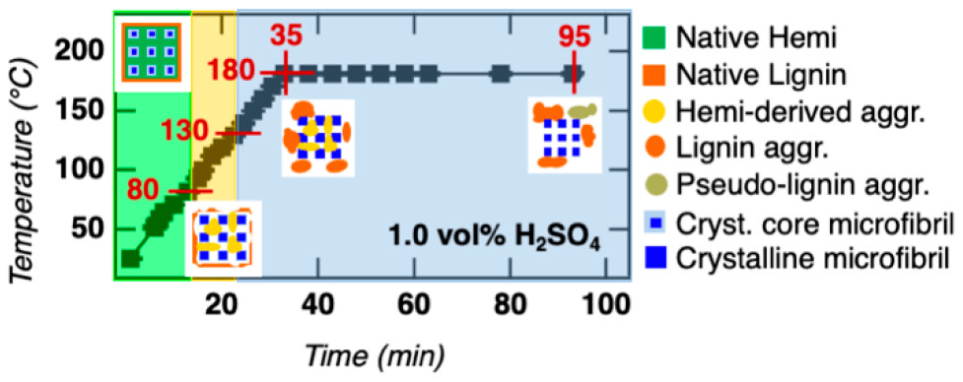
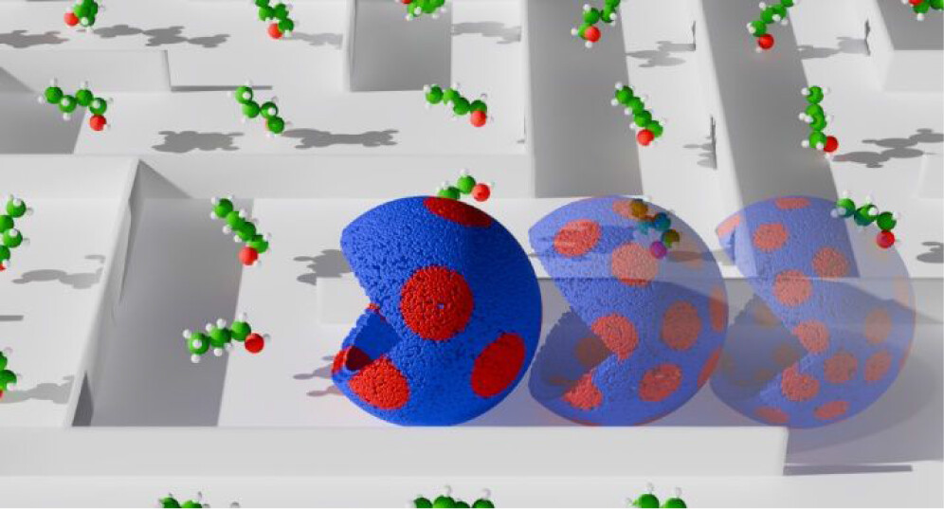


Complex Hierarchical Biosystems – Venky Pingali
Plant Cell Wall
Environmental Process
Biomacromolecular Complexes
Plant cell wall Assembly
NSD Go! Student
Ribosome Structure during Transcription
Senanayake et al. Biomac. (2024)
DOI: 10.1021/acs.biomac.4c00187
Armbruster et al. Biomac. (2024) DOI: 10.1021/acs.biomac.4c01829
DOE BER funded Biofuels SFA (ORNL)
Biomembranes
Plant cell wall Deconstruction
Biomembrane Disruption
Yang et al. ACS Sus. Chem. Eng. (2022) DOI: 10.1021/acssuschemeng.1c06276
Astner et al. Environ. Sci.: Nano (2025) DOI: 10.1039/D4EN01199F
4
Tan et al. Langmuir (2025)
DOI: 10.1021/acs.langmuir.4c03677
DOE BER funded Biofuels SFA (ORNL)

Slide 8
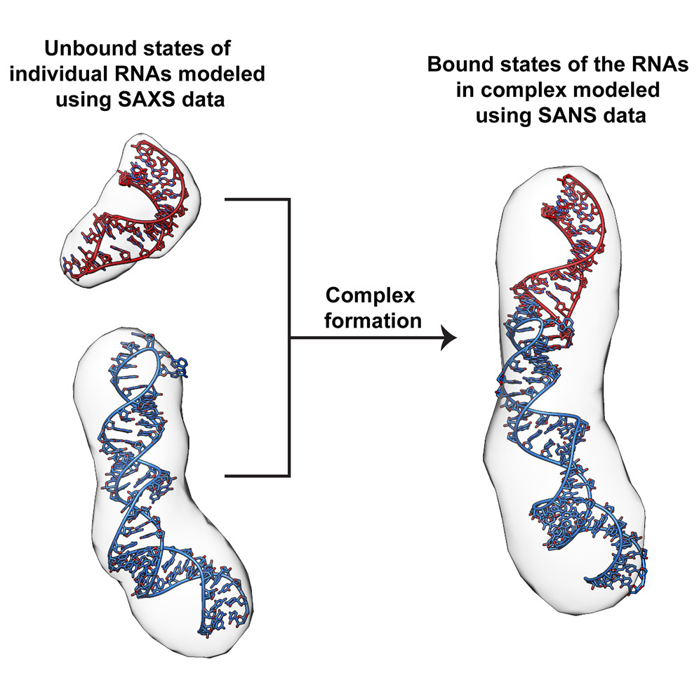
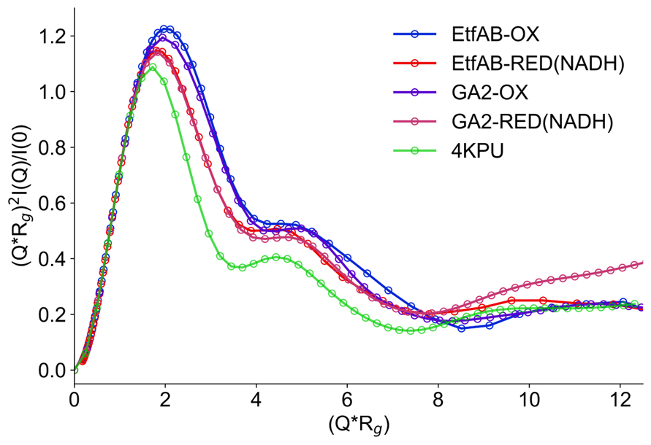
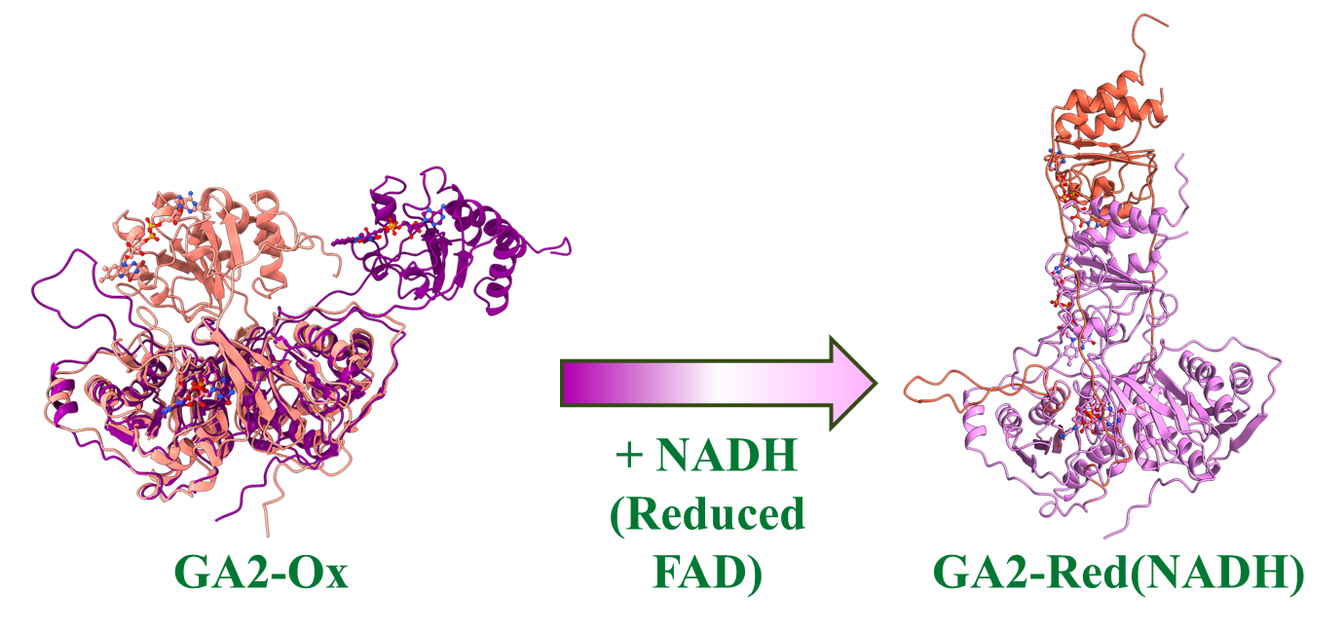
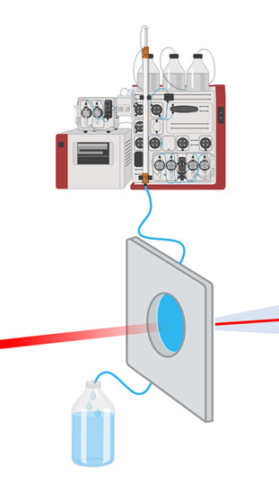

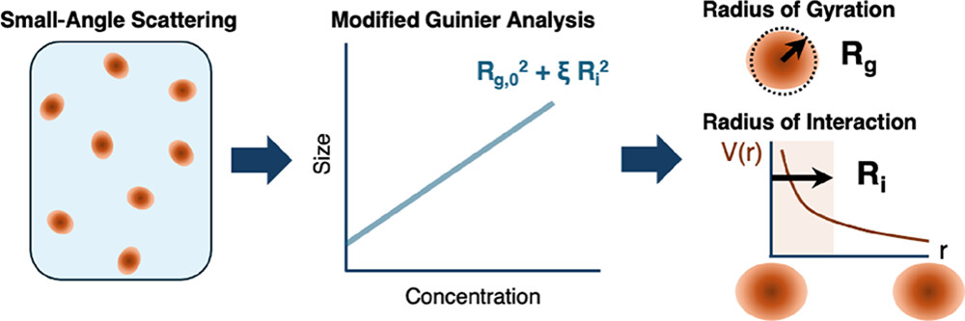
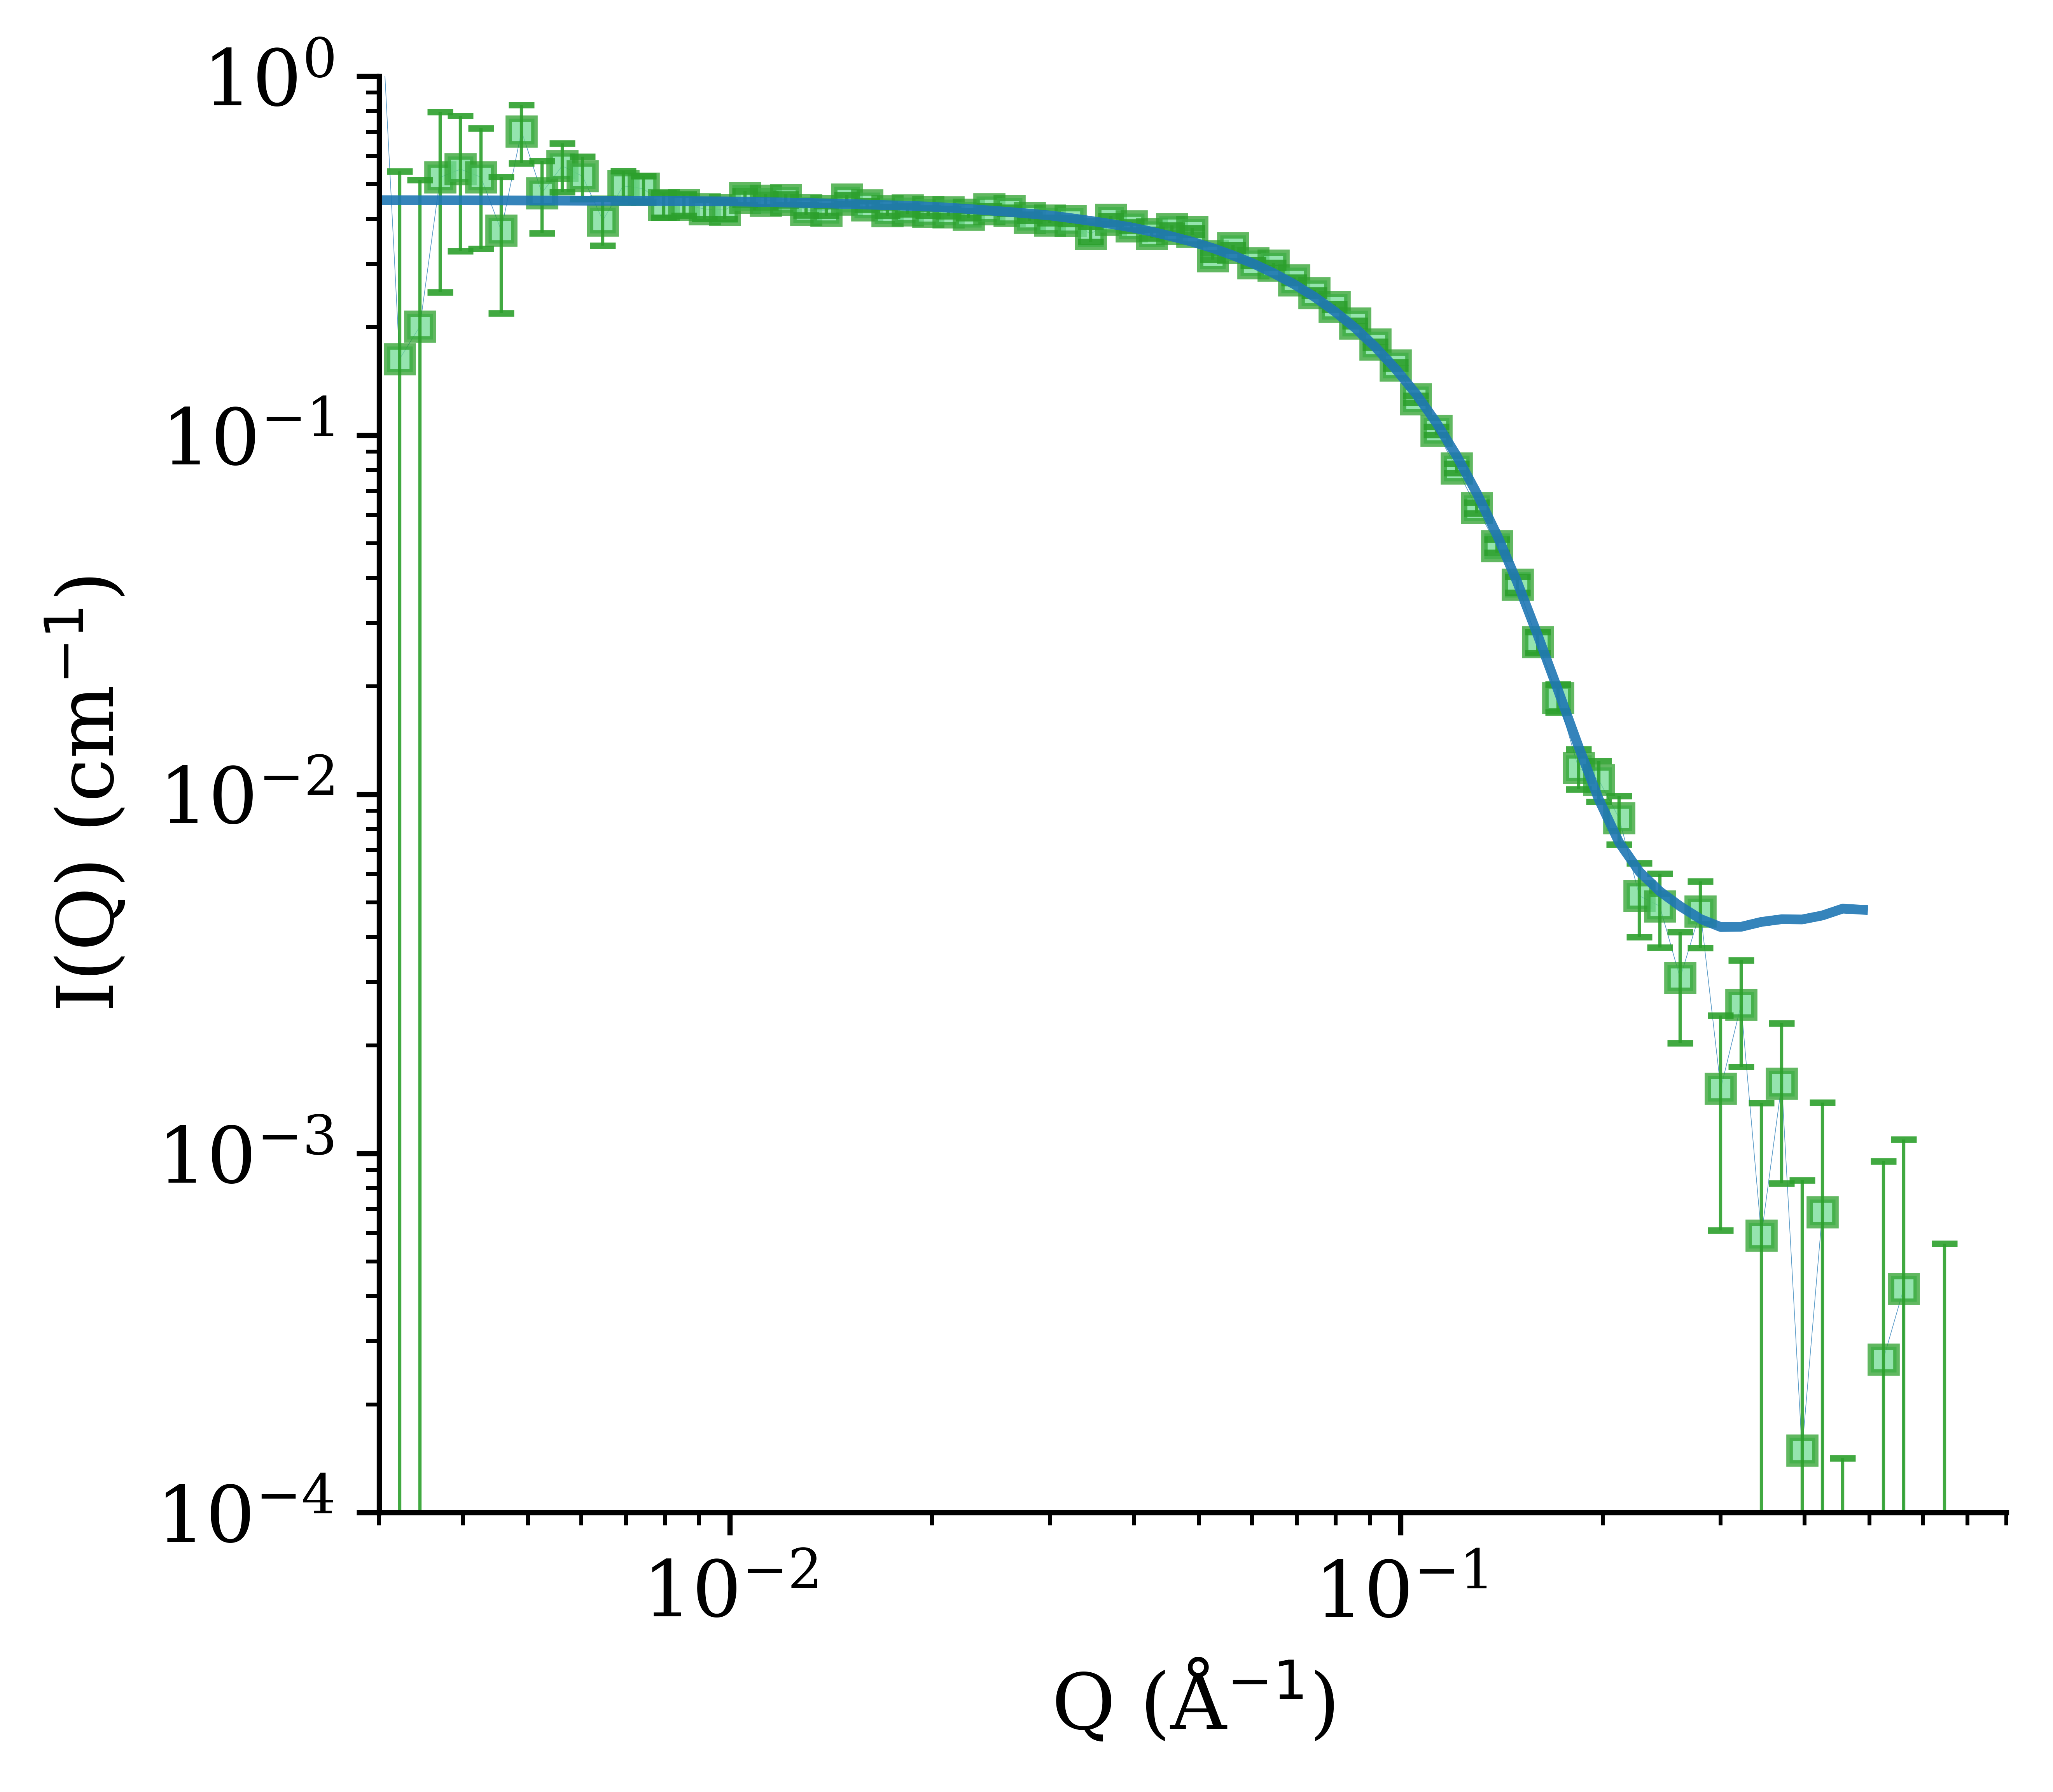

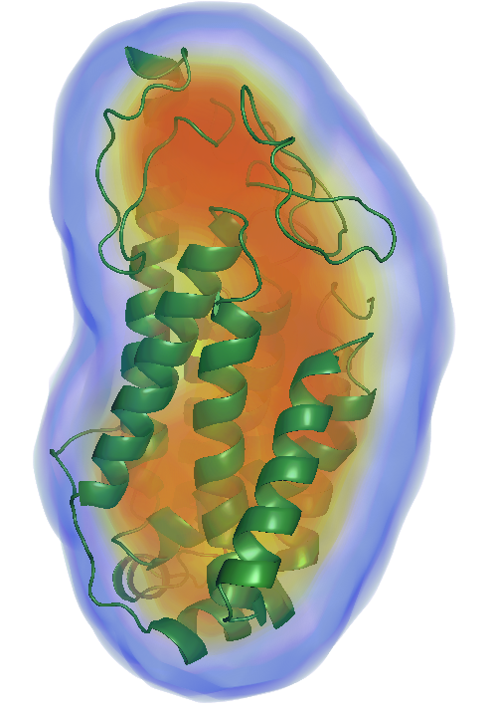


Biomacromolecules – Wellington Leite
Proteins
RNA:RNA Complex
Membrane Proteins
SEC-SANS
NSD Go! Student
Electron Transfer Flavoproteins
Khan et al. Chem. Sci. (2024) DOI: 10.1039/D4SC04544K
Thomas et al. Biophys. J. (2024)
DOI: 10.1016/j.bpj.2024.05.029
Edwards et al. ACS Measurement Science Au (2025) DOI: 10.1021/acsmeasuresciau.5c00099
Munsayac et al. Structure (2025) DOI: 10.1016/j.str.2025.01.017

Slide 9
Future Goals (Charge Q6)
INSTRUMENT DEVELOPMENT
Develop Focusing Optics System to access Lower-Q (d~1.6 μm)
Establish Laser Alignment Capability
SAMPLE ENVIRONMENT DEVELOPMENT
Develop Multi-Position Cryo-Temp Solution Sample Capability
Collaborative Development Projects with NCNR (NIST)
  Automated Liquid Handling System for Autonomous Experiments
  High-throughput High-pressure/Freezing-temperature Capability
  Rapid-Mixing for Studying Fast Transient States
Automated Liquid Handling System for Autonomous Experiments
In Sample Environment Talk (Luke Heroux)

Slide 10
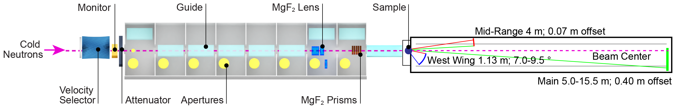
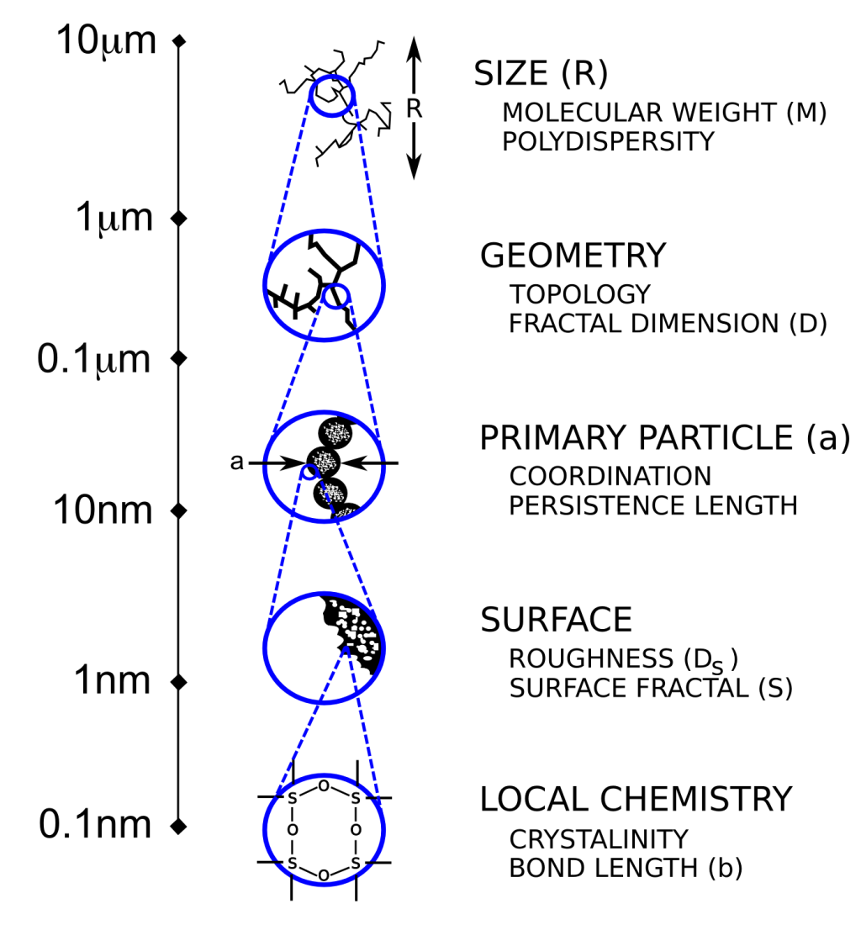
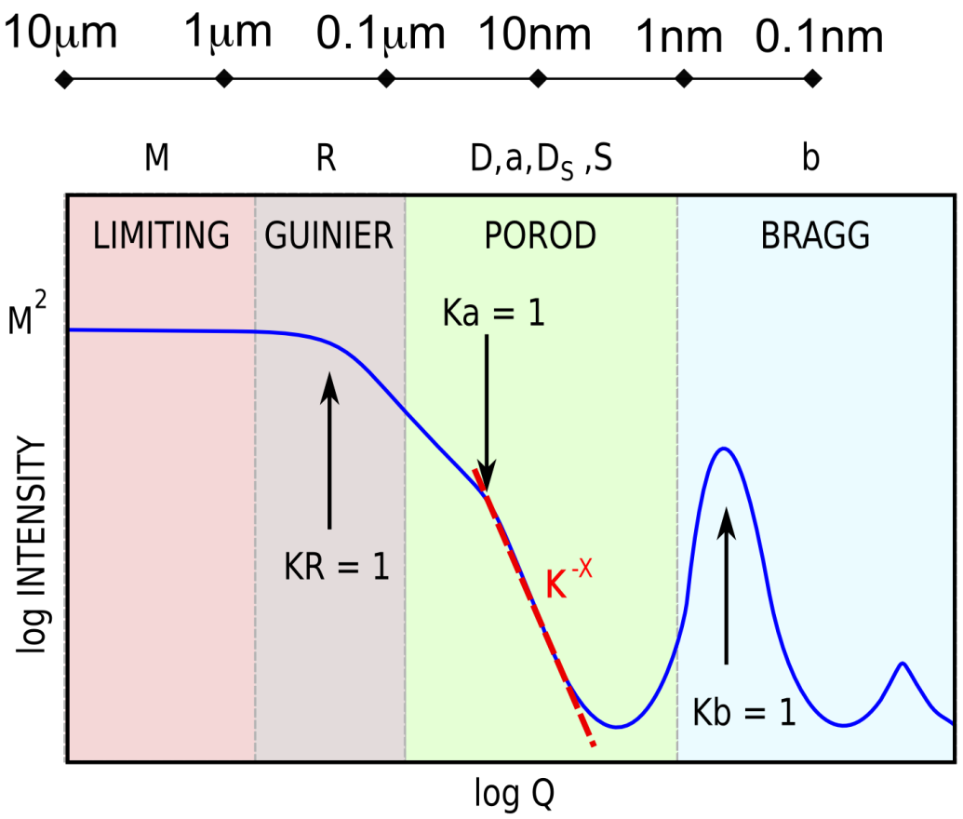
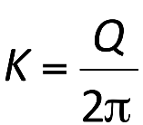
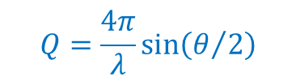
McStas Model of Q_{min} Extension by Insertion of Lenses, Prisms, and High-Resolution Detector (Charge Q6)
High Resolution
Detector
$$Q=\frac{4π}{λ}sin\left(θ/2\right)$$
1.6 μm
Three main components to Model in McStas:
Lens to focus beam at the detector
Prisms to eliminate beam elongation
High Resolution Detector to resolve small-angles finely
(~1 mm pixels)
Q_{min} = 4 x 10^{–4} Å^{–1} (Improvement of ~2.5x )
max. length scale ~ 1.6 μm
0.6 μm
In technical support by John Barker, NIST
Adapted from Schaefer, D.W, Material Research. Society Symposium Proceeding,(1987)

Slide 11
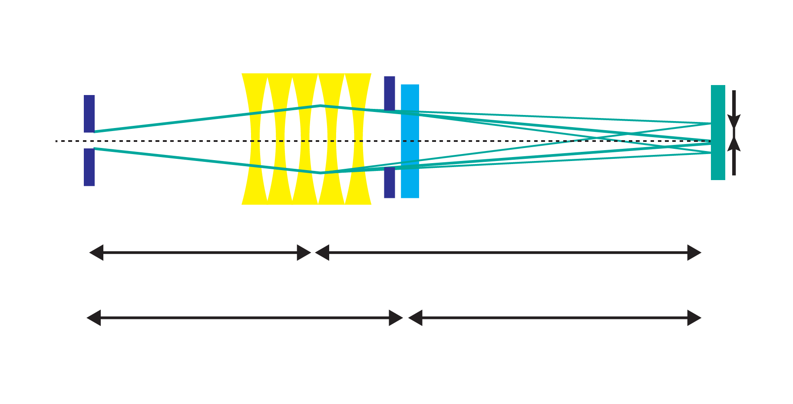
Determine Number of Lenses to Optimize Beam Size and Intensity of Focused Beam (Charge Q6)
We will measure beam size and beam intensity at the detector position by varying
Number of lenses
Neutron wavelength
Lens diameters (12.7mm, 25.4 mm) or sample aperture
Q_{min} ~ 4 x 10^{–4} Å^{–1}
A_{s}=𝛟10mm
A_{d}=𝛟14mm
A₀=𝛟6mm
λ
=10 Å
~10^{–4} Å^{–1}
Source
Lens
Sample
HiRes-DET
D₁=15 m
D₂=17.5 m
L₁=18m
L₂=14.5m
Adapted from Iwase et al. J. Appl. Cryst. (2011)
DOI: 10.1107/S0021889811007527

Slide 12
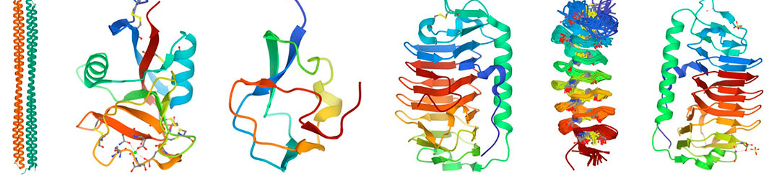

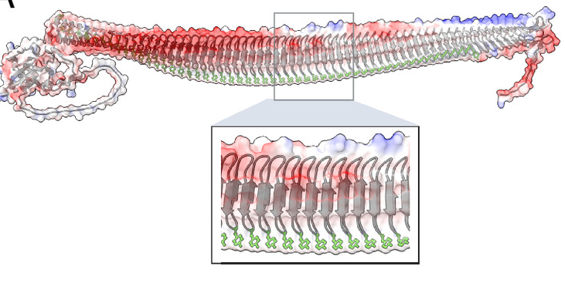
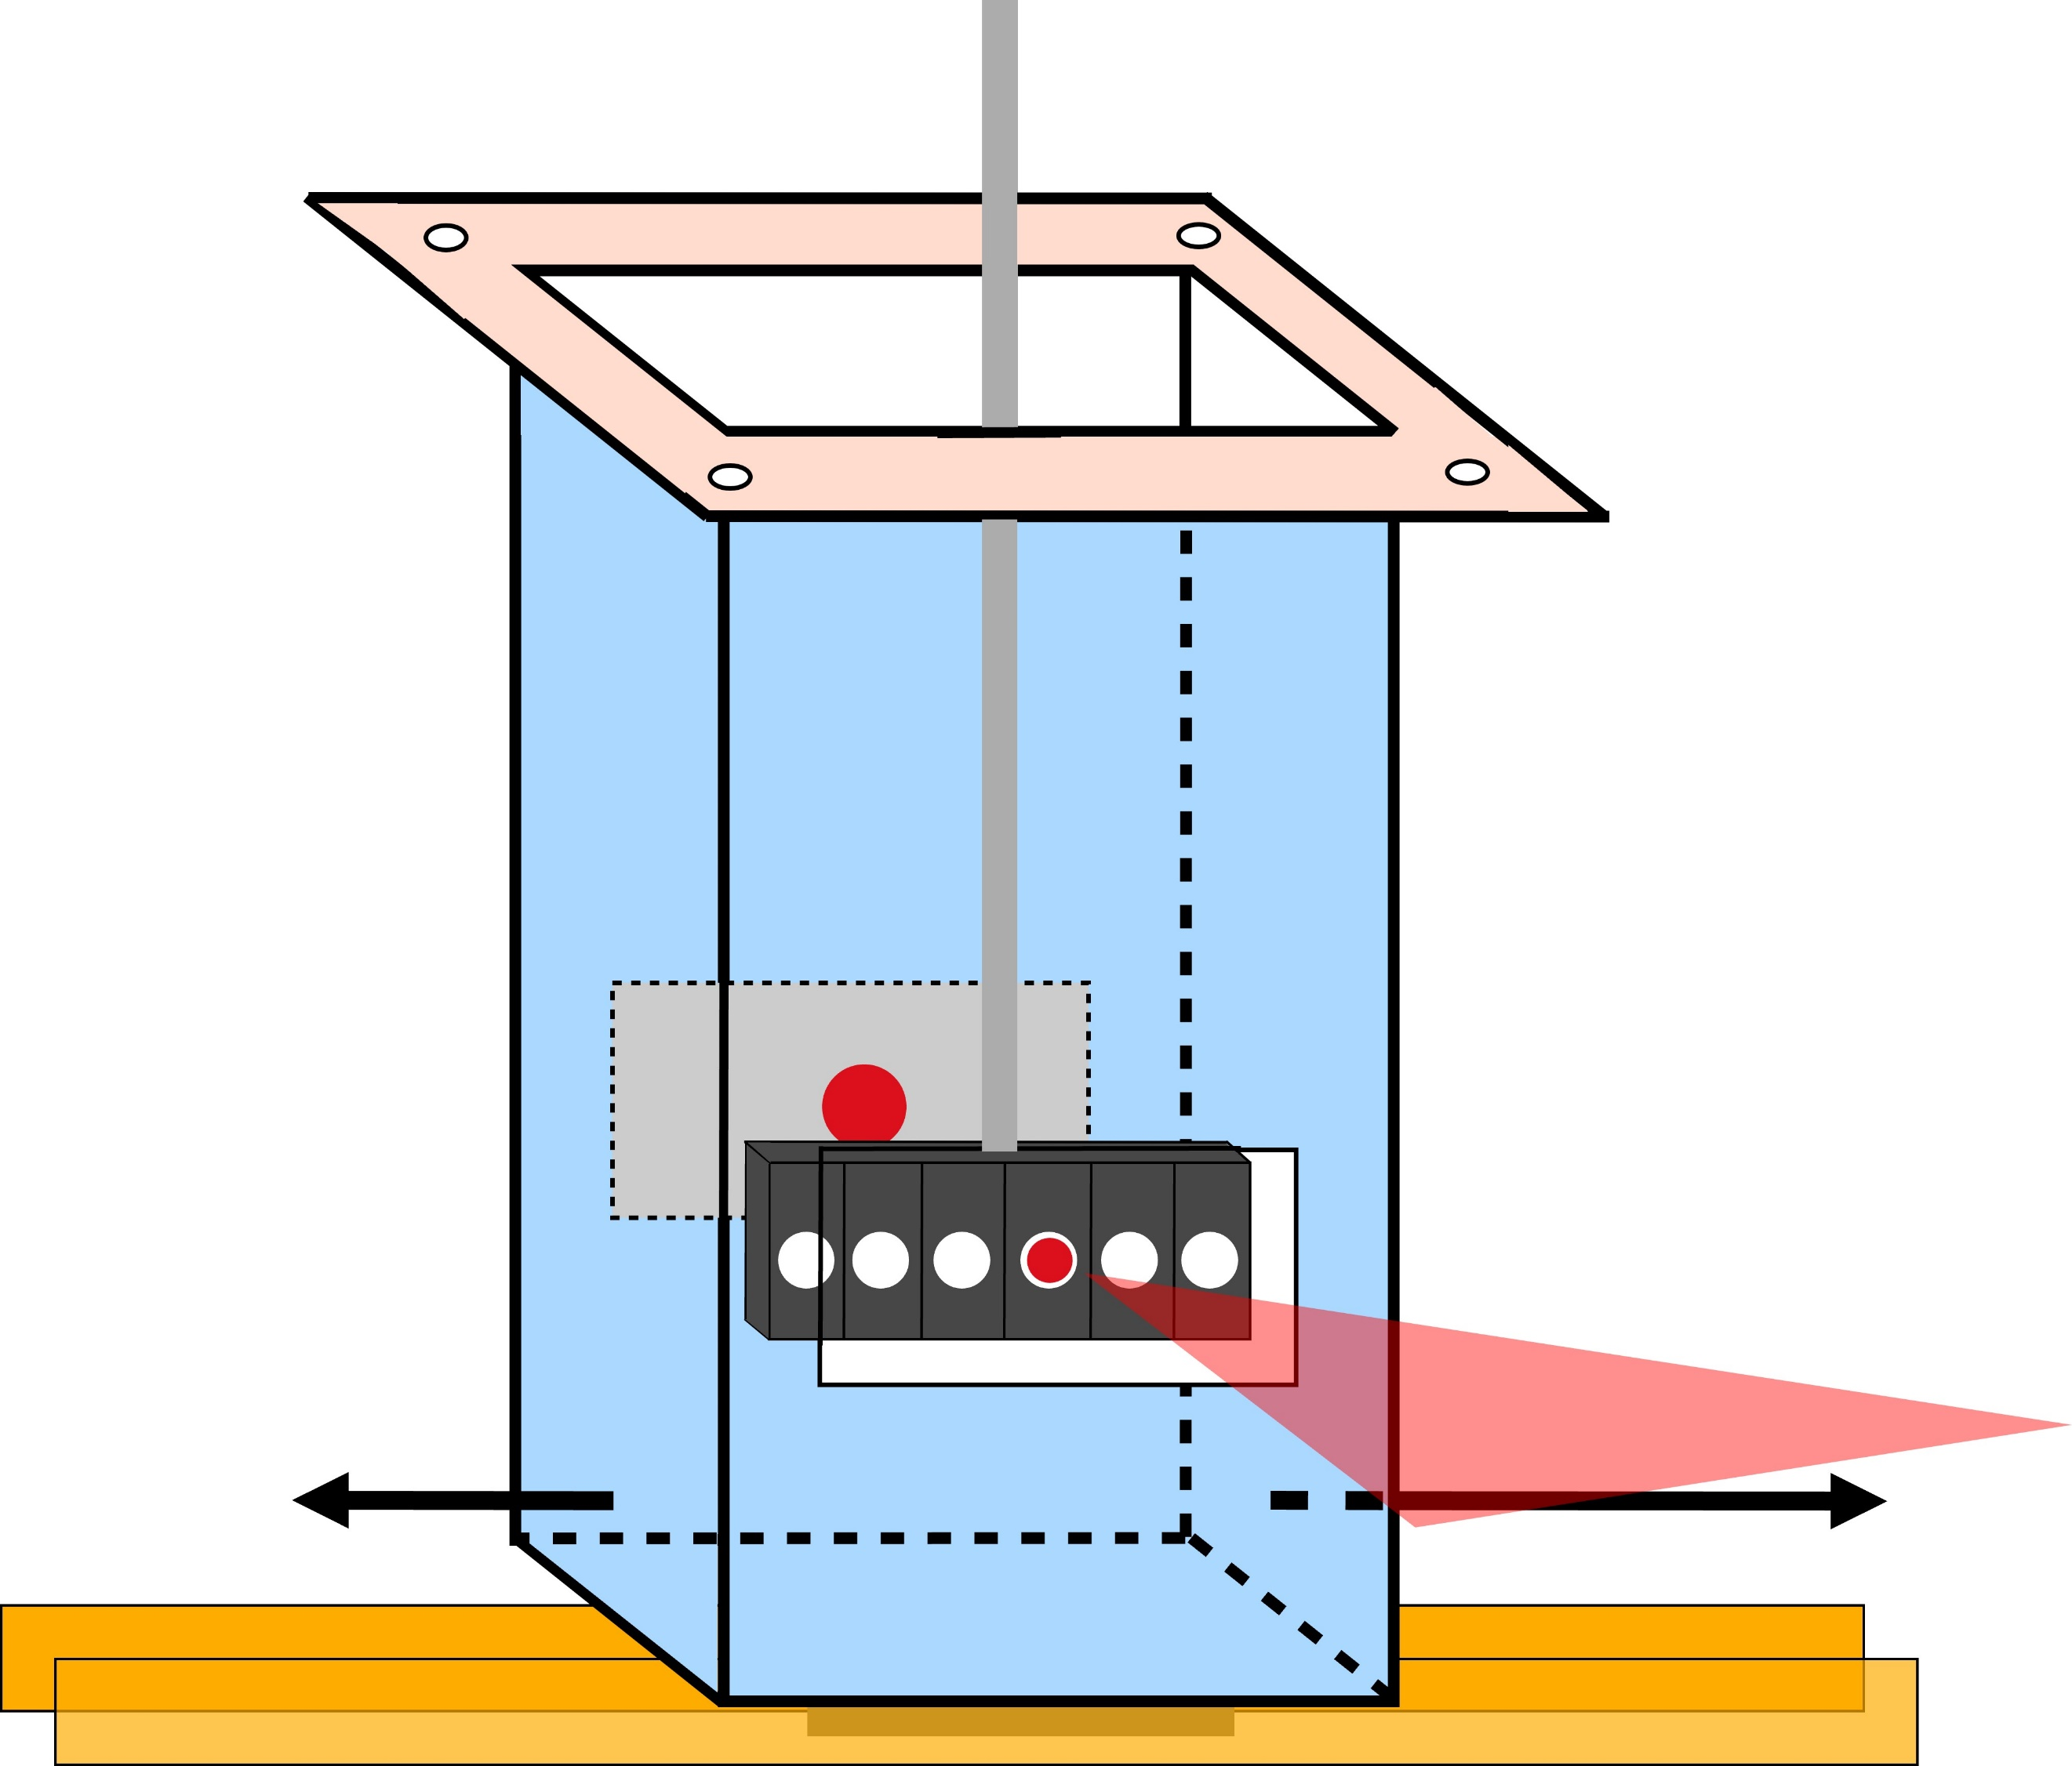




Expanding Capability for Studying Solution Samples at Freezing/Cryo Temperatures (Charge Q6)
25
Biological ice Nucleation
Biological ice Antifreeze
Gharib et al. (2021)
DOI: 10.3389/fbioe.2021.770588
–20
Meister, Boise State
–30
T(°C)
ORNL (in-house)
Quantum NorthWest
–80
–100

Slide 13
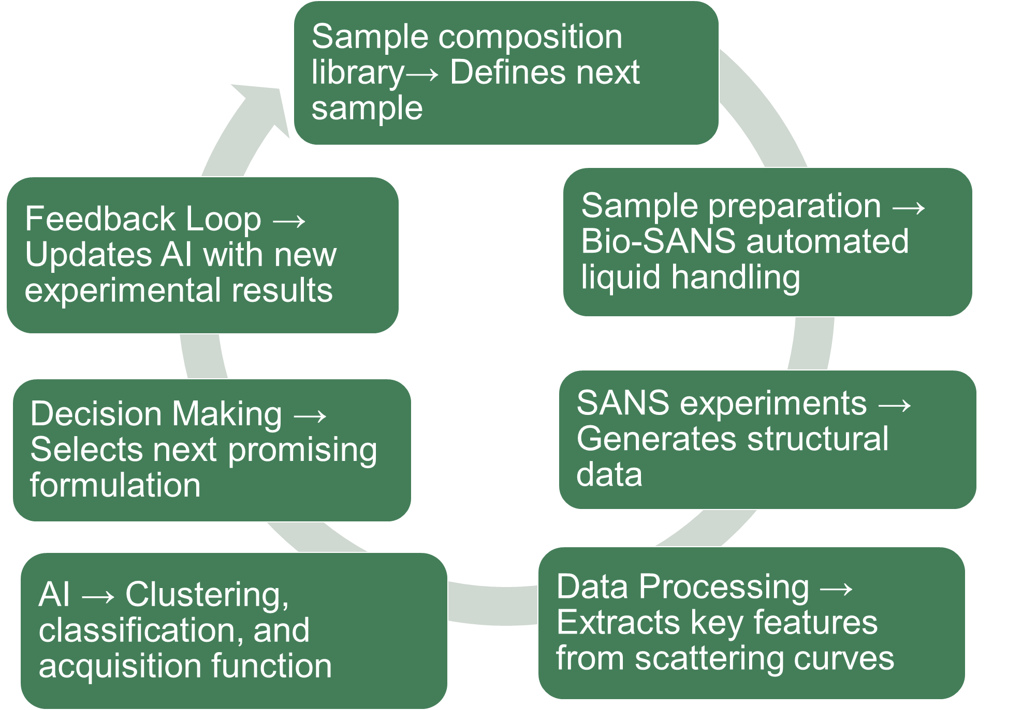
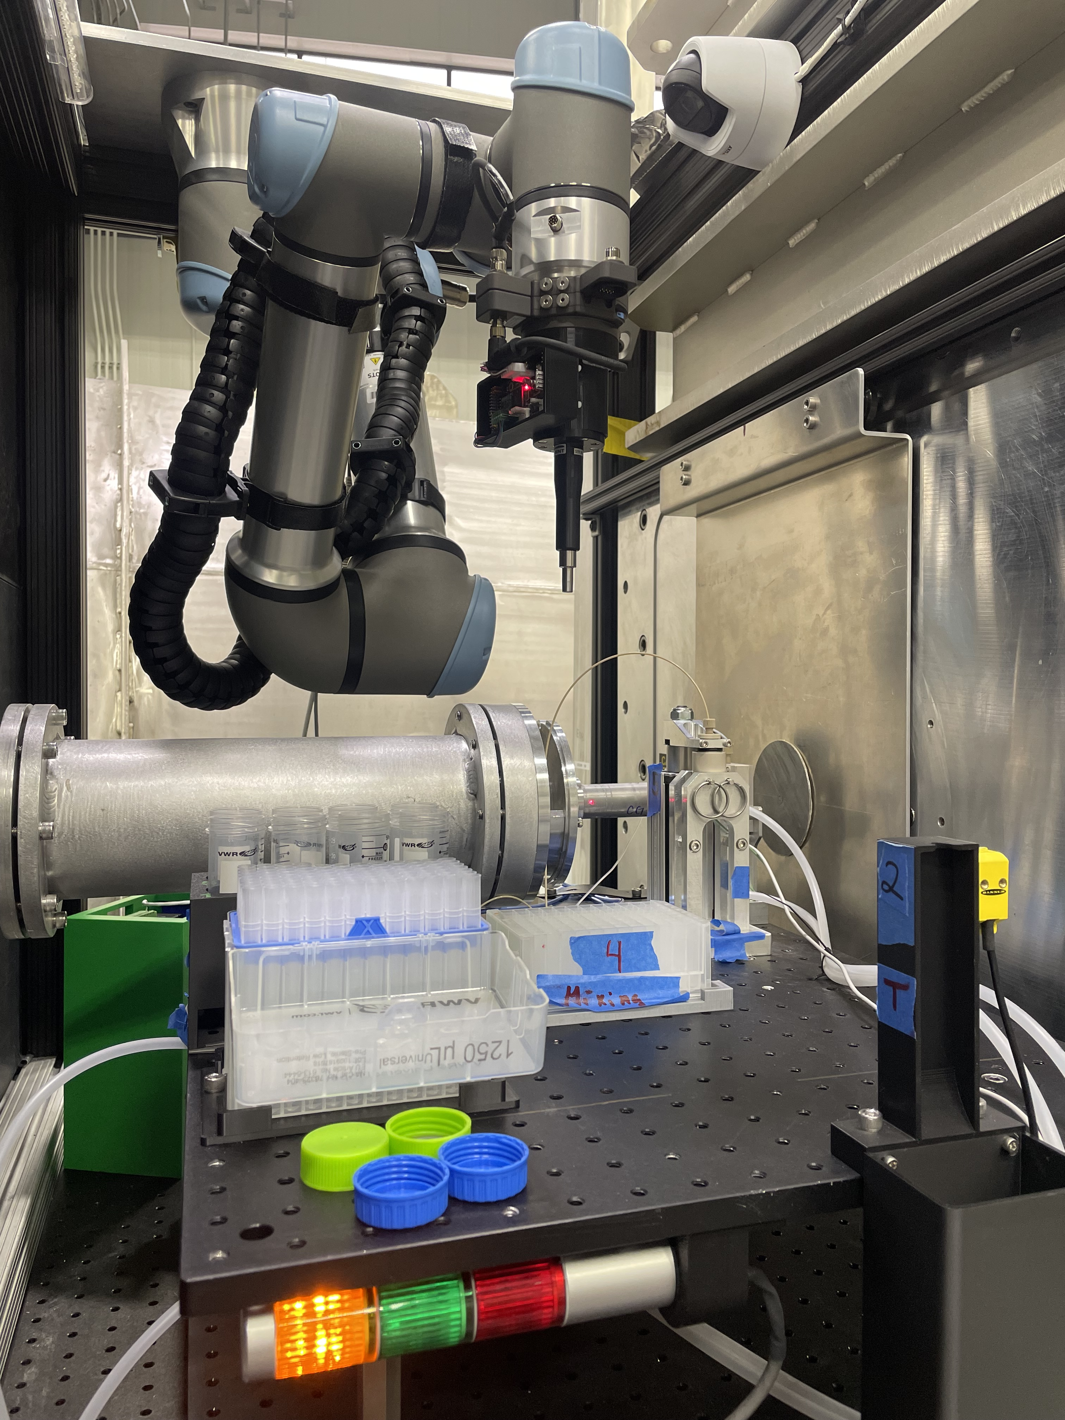
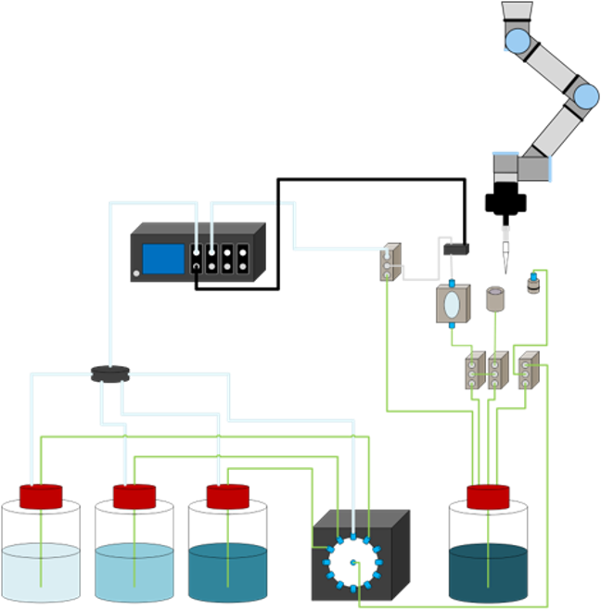
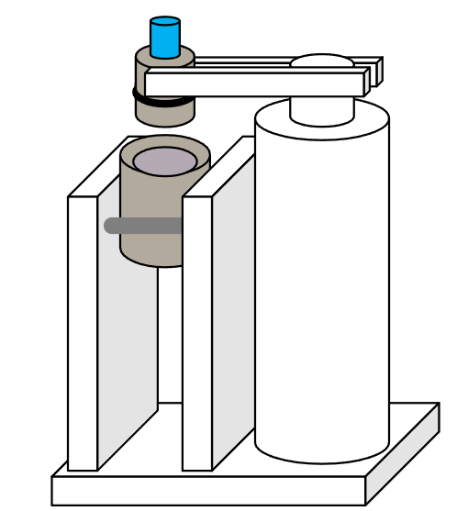


Automated Liquid Handling System (Charge Q6/Q7)
DOE BRaVE Initiative funded project
Details in Sample Environment Talk by Luke Heroux
Robot arm (UR 5)
Pressure controller
Electronic pipettor
Air flow distribution valve
Nozzle and funnel
Flow-
cell
Enable
AI-driven Experiments
Actuator arm
Path control valves
Load samples from 96-well plates
For the next experiment, the cell is emptied and cleaned by sequential washes with water, detergent, ethanol, and dry air
Mix (1-8) stock solutions to prepare next sample
waste container
Wash solutions
containers
Main distribution valve

Slide 14
AI-Driven Experiment Capability Status (Charge Q7)
Detector Upgrade-3:
Midrange
Data Processing/Analysis:
– Interactive Solvent Background Subtraction
– Automated Basic Data Analysis for Solutions
Large dynamic q-range
Simultaneous ‘Trans.’ & ‘Scatt.’
Basic auto-reduction of data
Basic data analysis (solutions)
Metadata storage (improve)
Auto-empty cell subtraction
1st Beam through Bio-SANS
DAS Upgrade:
EPICS
Data Reduction:
DRTSANS
Detector Upgrade-1: Modular Design
Automation-2:
2nd Gen. Robot SE
Sample Environment: Commission of
Automated Liquid Handling
Detector Upgrade-2: West Wing
Automation-1:
1st Gen. Robot SE
13
15
25
AI-Driven
Experiments
2007
12
16
19
20
22
24
26
Data AI-Ready?:
Metadata Storage Robustness (LAMBDA)
Data Reduction/Processing:
– 1st Gen. Auto-reduced Data
– ML-driven Prediction of Empty Cell Data
Beam trap Upgrade:
Semi-transparent
Collimator Vessel Upgrade:
Spacious/Flexibility
Sample Area Upgrade:
– Open Scaffolding
– Sample flushed to Tank Window

Slide 15
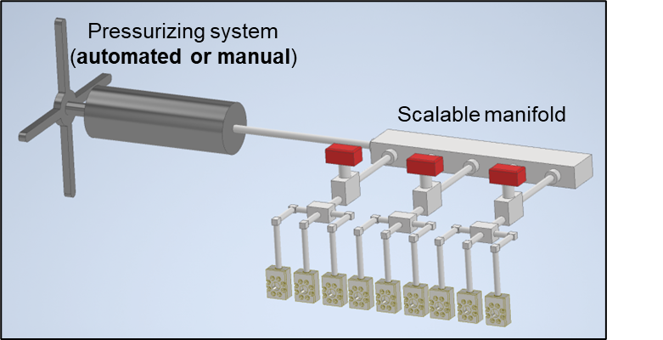
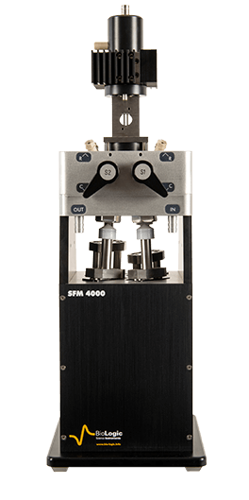
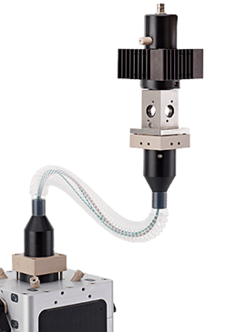
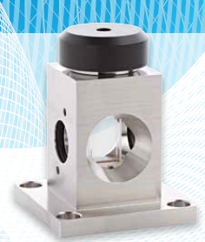
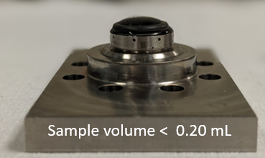


Synergistic Collaborative Efforts (Q6)
Sample environment development and commissioning by NIST-NCNR scientists that will be useful for the broader Bio-SANS user community
Time: 10 – 300s
Beam on sample
Umbilical Link
Pressure: 0 – 2.2 kbar
Temperature: –20 – +65 °C
NIST SBIR 70NANB21H130 (Patent Pending)
Rectangular Cell
1.5 cm
High-Throughput High-Pressure/Freezing-Temperature
Rapid-Mixing System
https://www.biologic.net/products/sfm2000-3000-4000-stopped-flow/

Slide 16
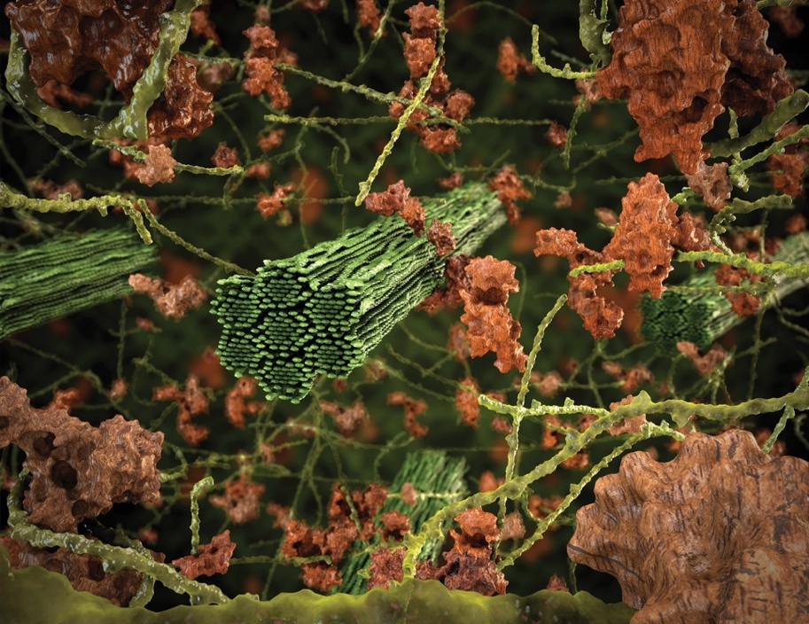
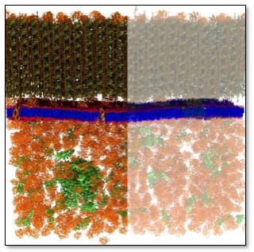





Conclusion
Assembly & Deconstruction of Plant Cell Wall
Cellular Components in Living Cells
Pave the path to access length scales > 1 μm
Optimize Lens Configuration
Enable freezing & cryo-temperature capabilities
Develop Automation and AI-driven experimental capability
Leverage collaborations for development of complex sample environments
Flexible Protein Domains
Nanoplastics/Soil Systems
Lipid Nanoparticles
Membrane Protein
mRNA + Lipid Nanoparticles

Slide 17
Questions
Thank you for taking the time to review and provide your valuable suggestions

Slide 18

Laser System will Streamline Alignment of Sample Environments
Laser spot on sample will provide a quick visual check without the need for neutrons

Slide 19



HFIR will Undergo Major Maintenance in FY29 Q3
HFIR Beryllium Reflector Replacement (HBRR)
Cold Guide Hall Instruments Layout
CSMB FY 26–28 funding cycle

Slide 20








Bio-SANS Instrument will Maintain Capability Post-HBRR
Post-HBRR (2030 Q3)
New Beam Delivery Guide System
Beam bending by an additional 3°
Airbus Velocity Selector (higher transmission)
Access to 4.5 Å
Q_{max} = 1.2 Å^{–1} (from 1.0 Å^{–1})
Neutron
Reactor
Beam Centerline
Instrument Centerline
7.22°
9°
Microbial Nanoparticles
NB3 Beamline Centerline
Current Instrument Planned Upgrade
4.5 Å
Soliman et al. Environmental Science: Nano (2022)
DOI: 10.1039/D2EN00263A

Slide 21



Protein Complex/RNA/RNA-LNP – Wellington Leite
Method Development
RNA–Lipid Nanoparticle
Molecular Condensates
Edwards et al. ACS Measurement Science Au (2025) DOI: 10.1021/acsmeasuresciau.5c00099
Thelen et al. ACS Nano (2024) DOI: 10.1021/acsnano.3c08014
Gibbs, E.,et al. Nat Commun 15, 9531 (2024) DOI: 10.1038/s41467-024-53904-z

