Slide 1
Data Reduction and Analysis at SANS
January 29th, 2026
Yingrui Shang, Wellington Leite, and Alan Hicks
Neutron Scattering Division
Notes:
Accessing Title Slide Options
The standard ORNL presentation template includes five branded title slide layouts:
Title | Standard. The preferred layout for lab-wide and general presentations. Features a default aerial photograph of the lab.
Title | Custom Image. Allows replacement of the default background with a custom full-slide image (16:9 or 4:3 landscape format).
Title | Custom Portrait Image. Supports inclusion of a custom 4:3 portrait image positioned next to the introductory text.
Title | Custom Landscape Image. Supports inclusion of a custom 16:9 landscape image positioned next to the introductory text.
Title | Text Only. Offers additional space for longer titles and multiple presenters.
Additional Lab-approved title slides specific to directorates and user facilities are available in PowerPoint under the following folders: Custom Title Slides and User Facility Templates, located in Presentation Templates.
Custom Title Slide Guidelines
Image Rights. Any custom images, graphics, or photography must be owned by ORNL or used with documented permission from the original creator or source.
Appropriate Image Use. Select images that work well with the layout. Ensure the focal point of the image is not obscured by the title text and white overlay box.
Relevance and Impact. Visuals are a key element of effective communication. Whenever possible, use imagery that enhances the message of your presentation and reflects ORNL’s mission and values.
Quality and Clarity. Use high-resolution images for clarity on large screens. Avoid overly complex or dark images that may conflict with the title text.
Text-Only Option. If no appropriate or approved imagery is available, or if imagery is not permitted for the subject matter, the Title | Text Only layout provides a clean, professional alternative.
Learn more about ORNL presentations
https://ornl.sharepoint.com/sites/branding/SitePages/presentations.aspx

Slide 2


Computational Instrument Scientist Role at ORNL –
”Owning the data pipeline”
Experimental data pipeline
Data acquisition modes
Static; Stopped-flow; Continuous-flow; Reactions
Data reduction
drtSANS
Data analysis
User
Scientific Software Development Team
Computational Instrument Scientist
Instrument Scientists
Discuss and transfer scattering knowledge for software design and development to the NScD/CSMD Scientific Software Development Team
Every instrument suite has at least one CIS
Design and select new data acquisition modes, reduction and analysis techniques for the instrument and users
Yingrui Shang Alan C. Hicks
IS since 2021 2023
Aims for CIS:
Develop and deploy new techniques for data analysis and interpretation of SANS
User support for data reduction and analysis
Notes:
Mention that NScD SSDT are professional software engineers

Slide 3
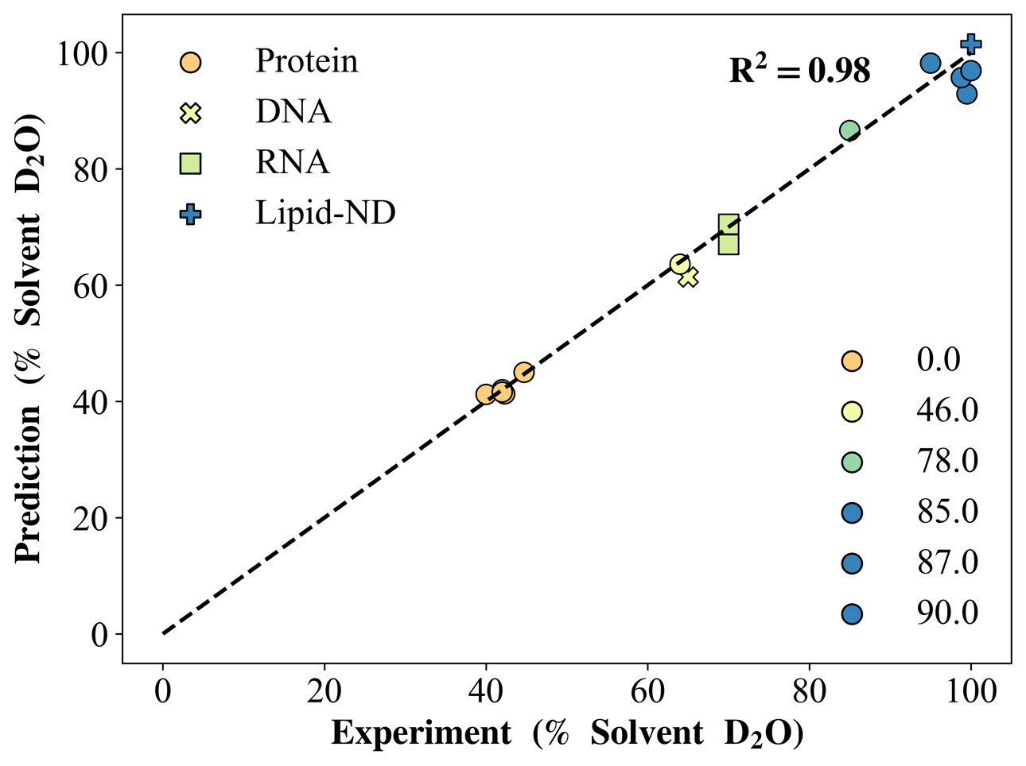
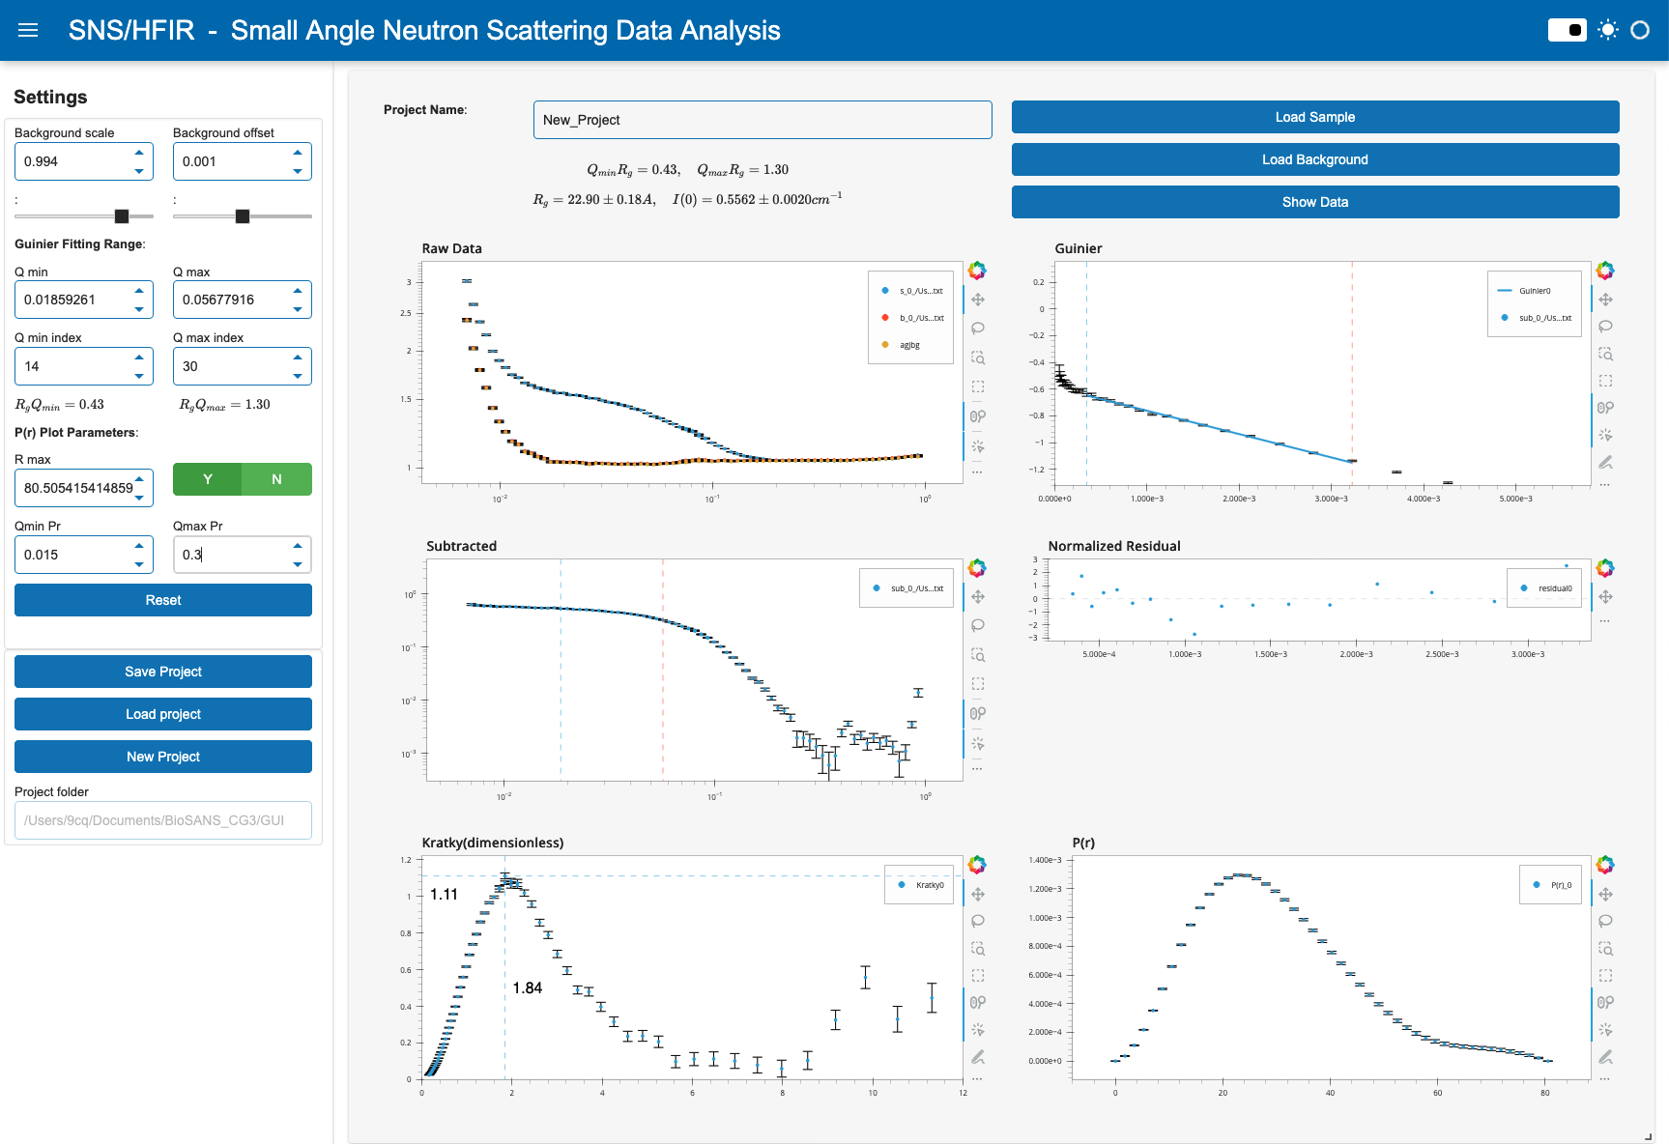
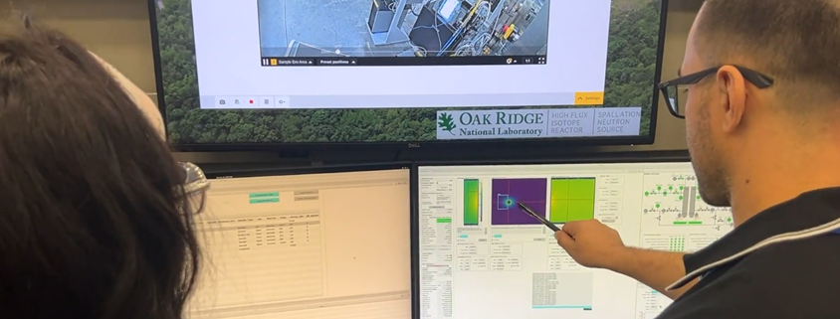
Integrative data platform for experiment planning, execution and analysis
Overarching aim is to develop and implement methodologies for streamlining experiments at SANS beamlines
Execution & Reduction
Improve user accessibility to interpretable information for their experiments
Planning Experiments
ab initio structure-based contrast match point prediction
Data Analysis
Advanced analysis techniques to understand complex and flexible biosystems

Slide 4
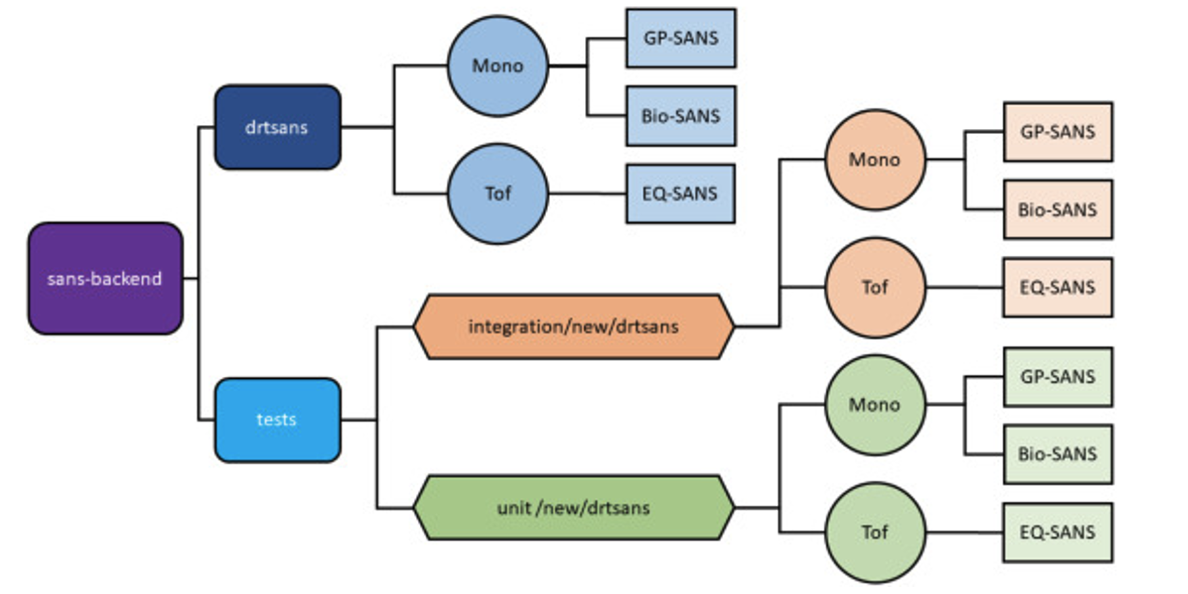
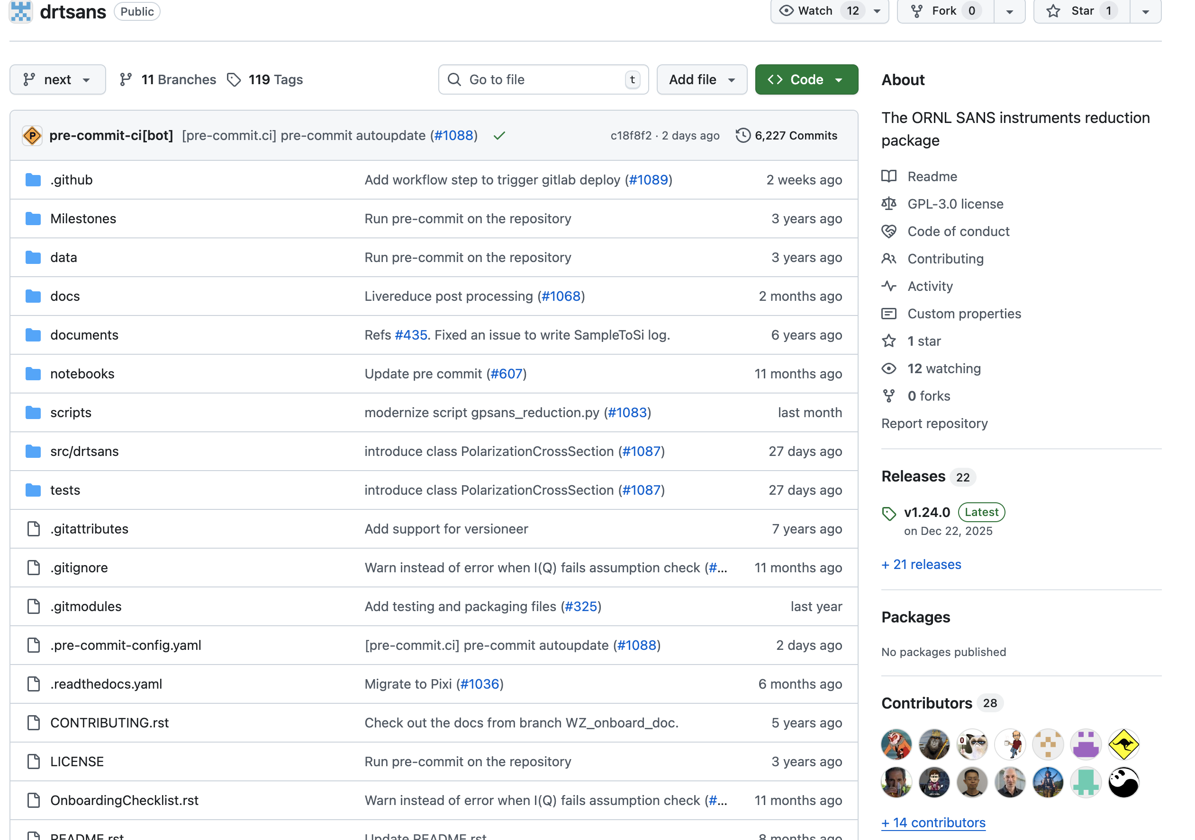
Data Reduction for SANS
Data reduction key highlights
Unified framework
Spanning multiple SANS instruments (HFIR & SNS)
Reproducible
Universal API interface
Production-grade corrections
Designed for both routine users and advanced experiments
1D/2D data export standardized for interoperability with the broader SANS analysis ecosystem
Auto-reduction is implemented for beamlines
Architect of drtSANS data reduction software
Uses Mantid APIs for low-level data access and NeXus-based algorithms
Heller, William T., et al. "drtsans: The data reduction toolkit for small-angle neutron scattering at Oak Ridge National Laboratory." SoftwareX 19 (2022): 101101.
Active repository with collaborative development and community involvement

Slide 5
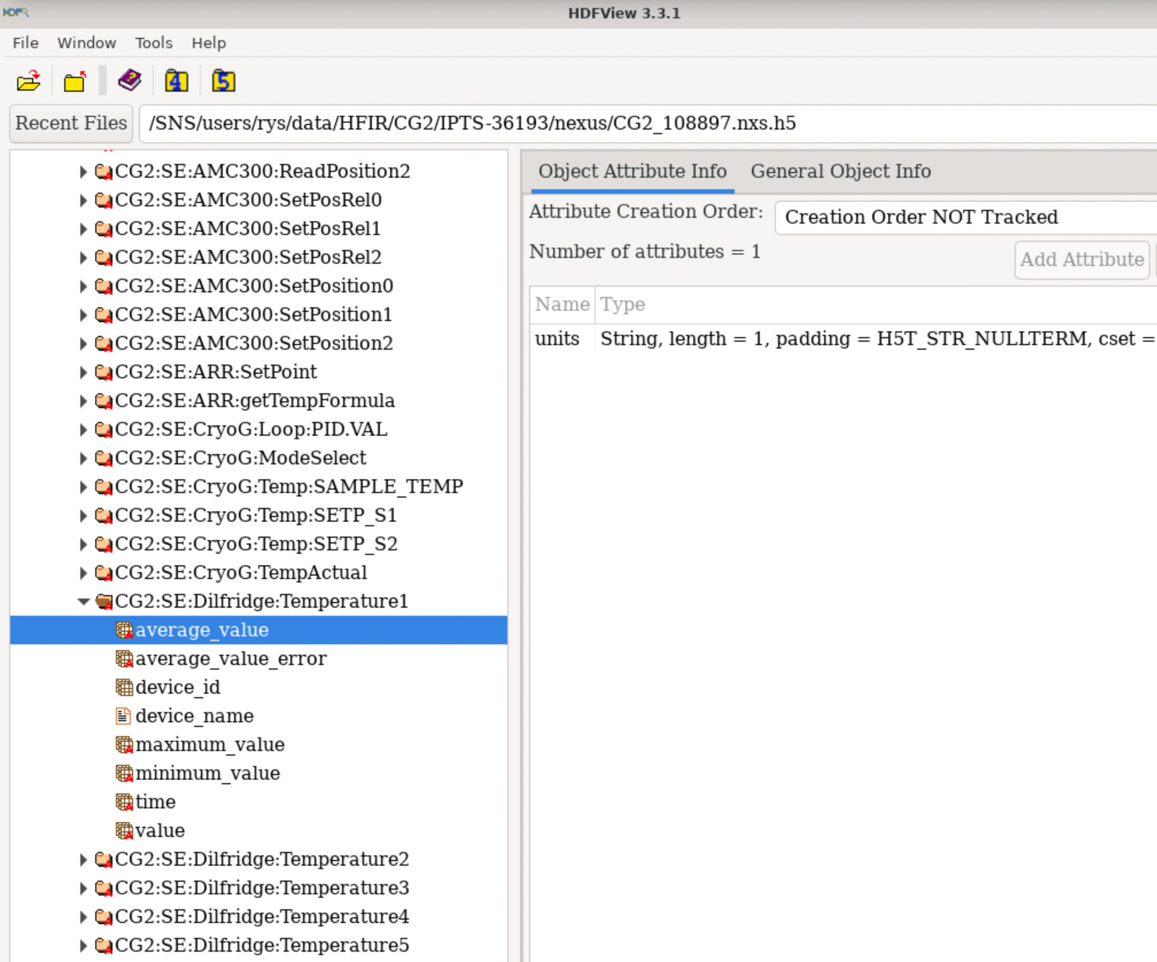
Advanced Features
Advanced capabilities
  Anisotropic scattering reduction with wedging
  Time-resolved filtering and summation
  Incoherent and inelastic background correction
  Supports complex sample environments and multi-configuration experiments
Active Development Efforts in SANS Data Reduction
  Development of a graphical user interface for SANS data reduction
  Implementation of magnetic scattering corrections at the GP-SANS beamline
  Support for the new monochromatic chopper configuration at EQ-SANS
  Refactoring and modernization of the USANS data reduction workflow with GUI
Anisotropic features in SANS measurement
Anisotropic features in SANS measurement
Time-resolved metadata supporting complex sample environments and multi-configuration experiments
Notes:
Because TOF-SANS uses a broad wavelength band, inelastically scattered neutrons appear at incorrect wavelengths and introduce a Q-dependent background. The correction uses wavelength-resolved TOF data to identify and remove that excess incoherent contribution without discarding data.

Slide 6
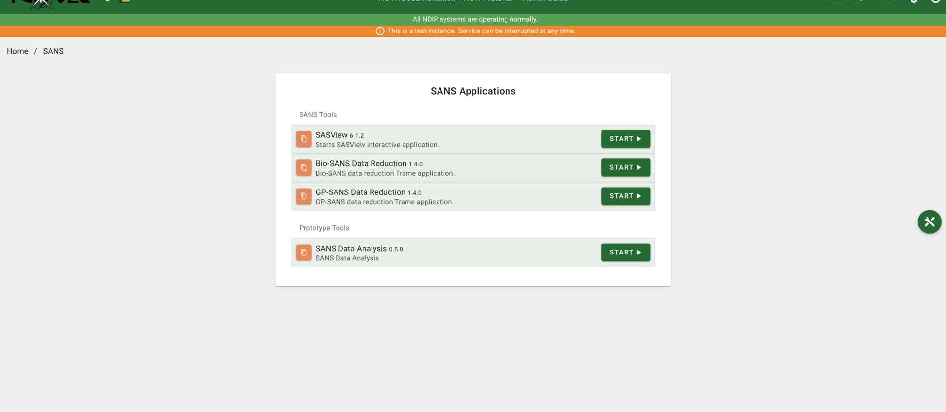
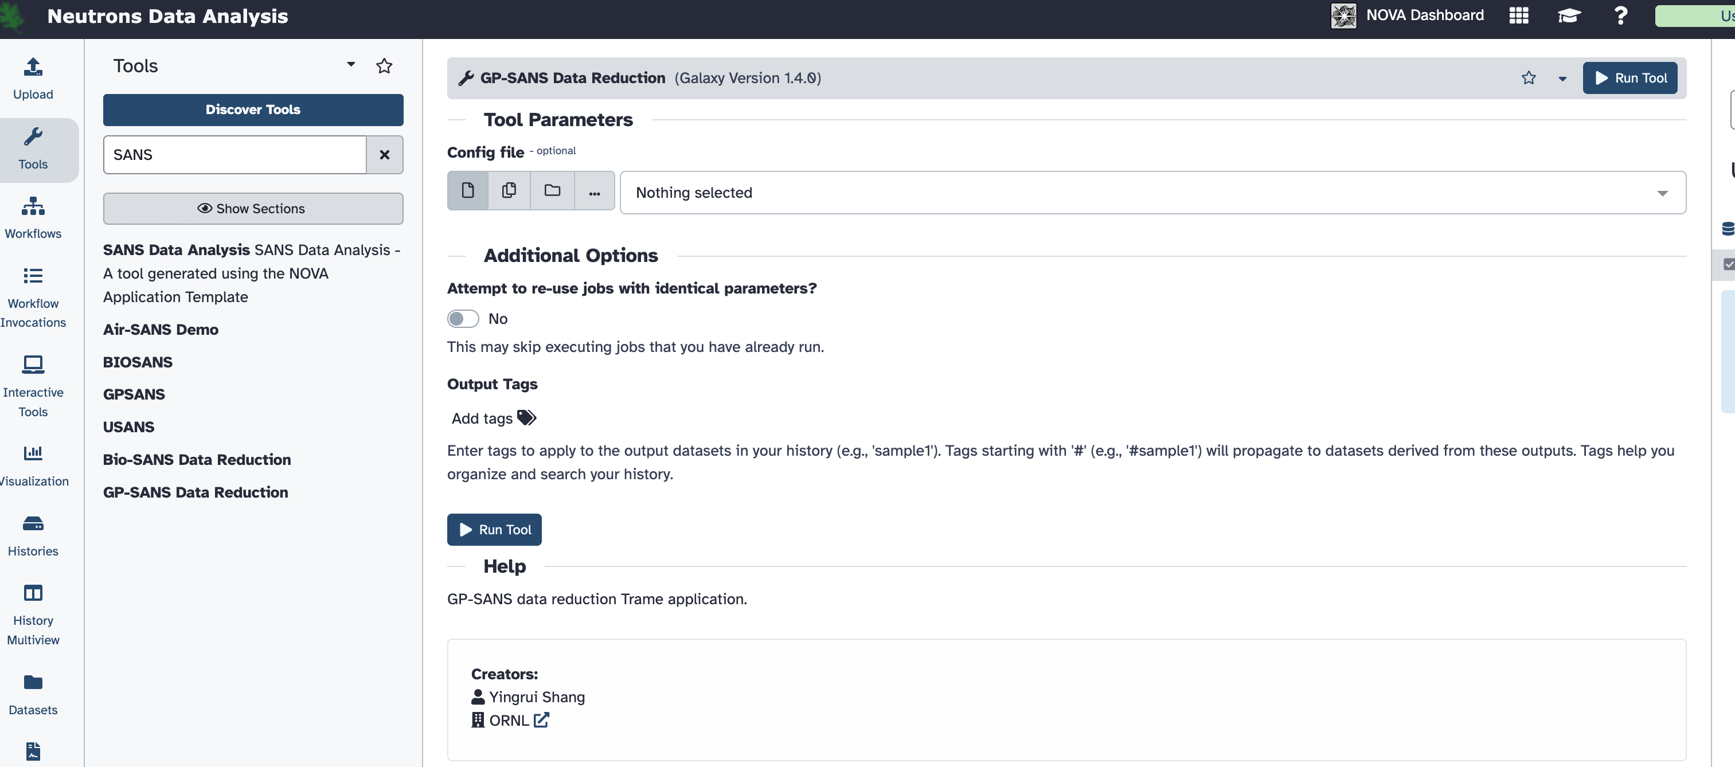
Graphical User Interface for
SANS Data Reduction
A graphical user interface (GUI) is under active development
Designed to support both routine users and advanced experimental workflows
Data reduction configurations can be saved, shared, and reloaded
Reduction results can be visualized, reviewed, and shared within the GUI
Beamline-specific interfaces tailored to individual SANS instruments
GUI deployment and testing on the NDIP platform
NDIP provides a centralized ORNL environment for neutron data management, reduction, and analysis.

Slide 7
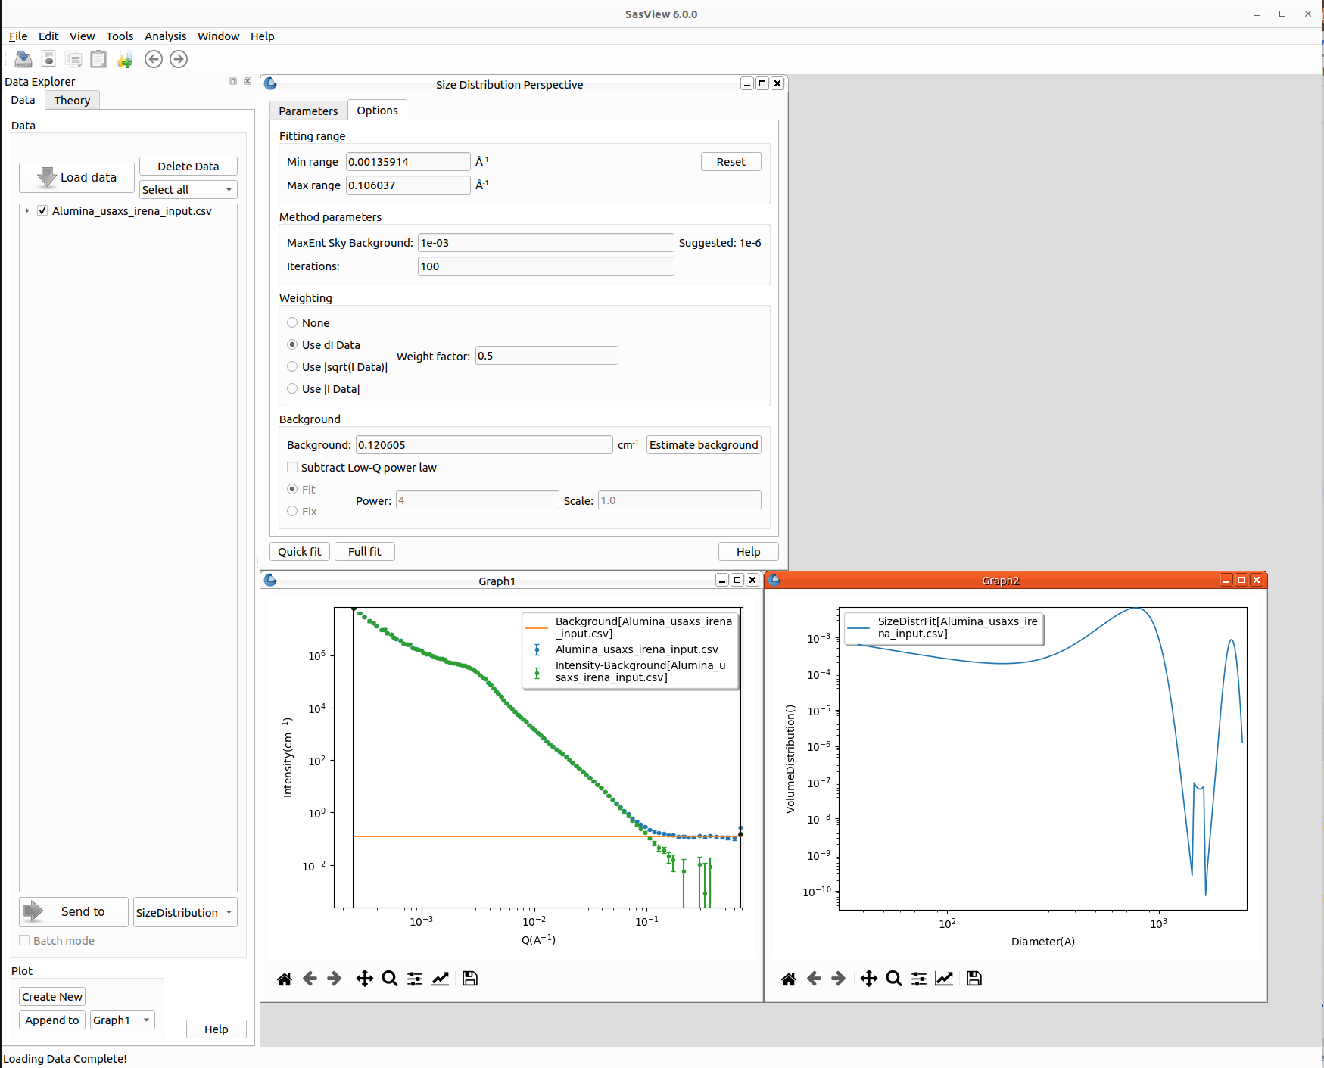
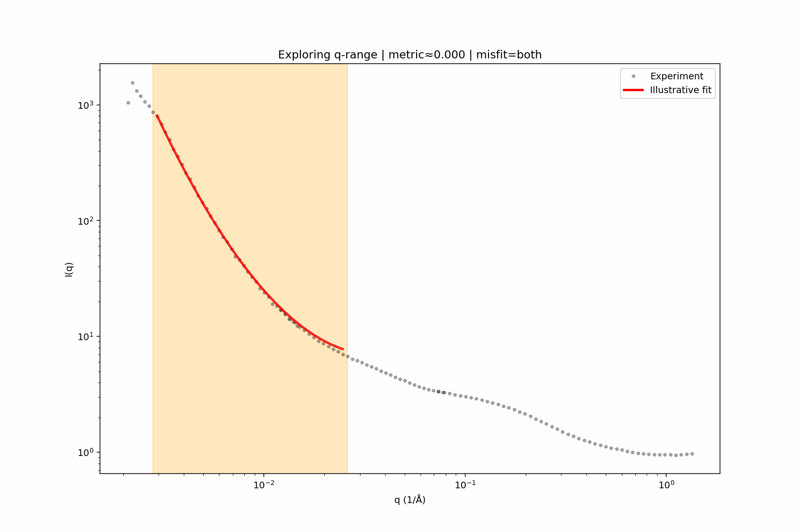
Advanced Data Analysis in SANS
SASView Development & Community Contributions
Participation in SASView development activities
Engagement in SASView developer meetings
Contributions to community documentation and user support
Development and evaluation of polydispersity models
Automated and Model-Driven Data Analysis
Systematic exploration of candidate models for specific data sets
Automatic determination of appropriate Q-ranges for model fitting
Efficient identification of feasible models and parameter ranges in terms of hours
User-Driven Scientific Data Analysis & Simulation
Extensive involvement in user scientific data analysis cases
Numerical simulations of aliphatic polymer chain systems
PDF analysis based on SANS data to study distributions of Rg
Micelle simulations directly comparable to experimental SANS data
Utilization of ORNL high-performance computing (HPC) resources (CADES, NERSC, and Frontier)

Slide 8
Highlights on planning, execution, data analysis, and ML/AI capabilities

Slide 9
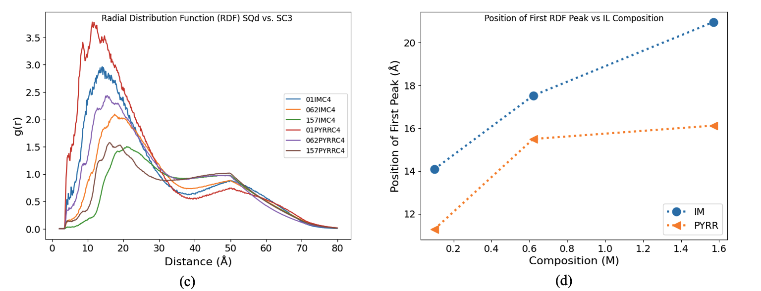
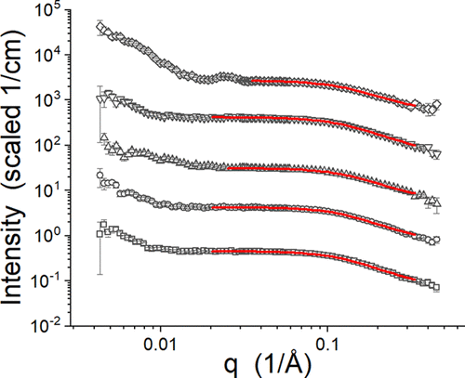
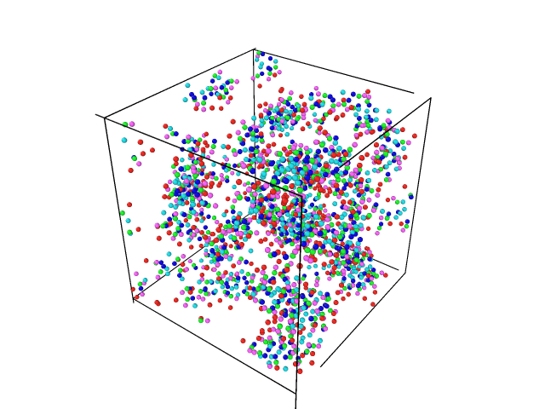
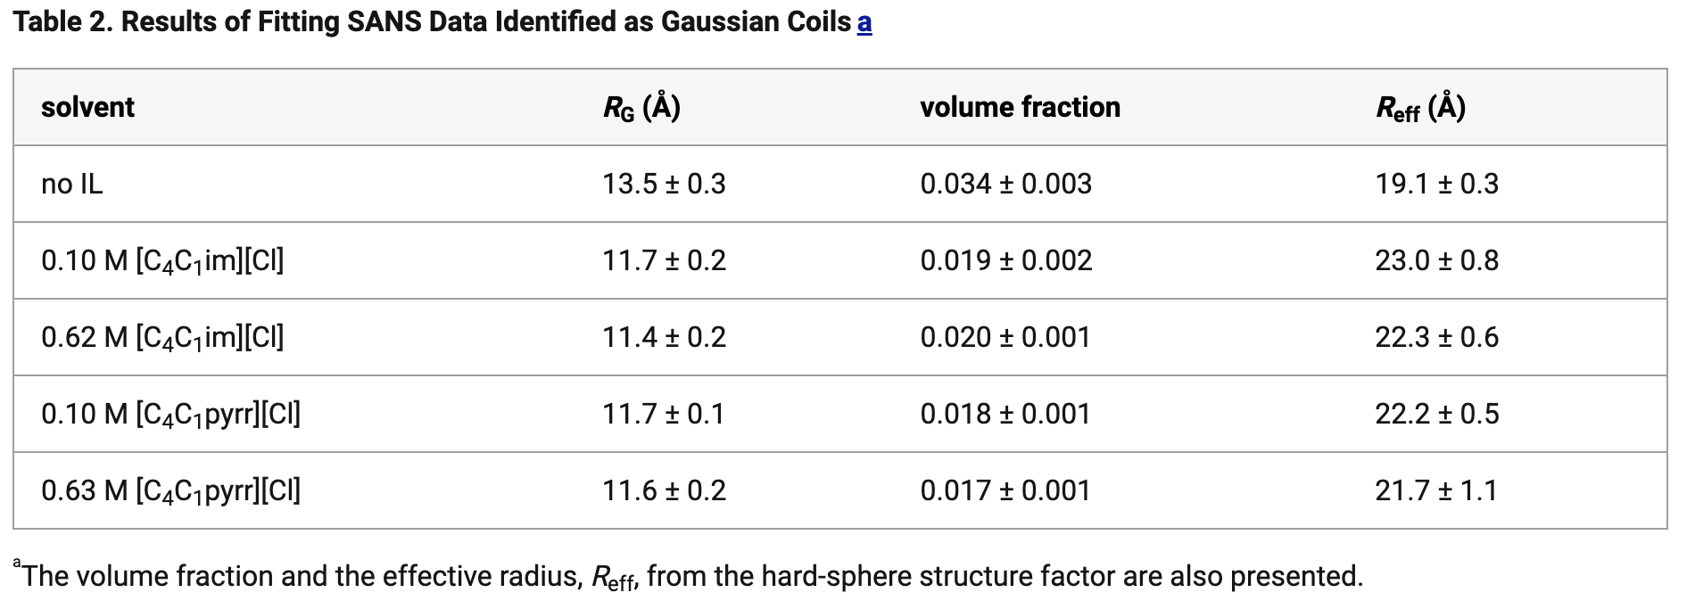
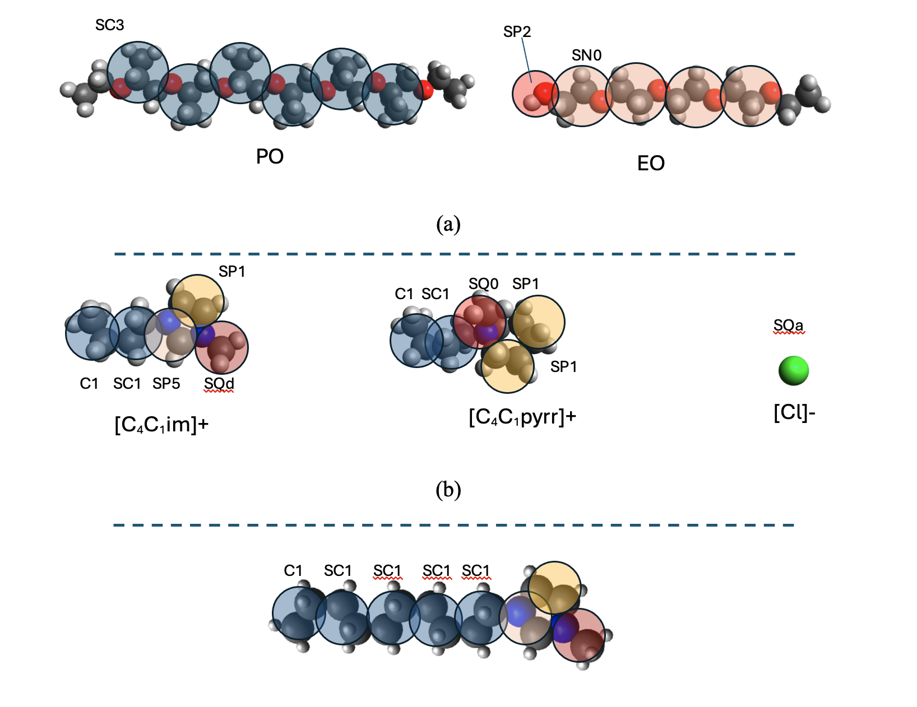
Scientific Studies Enabled by Advanced Data Analysis
Structure and Morphology Evolution
Fast simulations of amphiphilic polymer micelles in solution
Temperature-resolved SANS data analysis and model fitting to identify morphology evolution
Development of molecular dynamics force fields matched to SANS length and time scales
Improved mechanistic understanding of morphology evolution processes
SANS data analysis example: fitting Gaussian coils
Heller, William T., and Changwoo Do. ACS omega 7, no. 23 (2022): 19474-19483.
Shang, Yingrui, Changwoo Do, and William T. Heller. "Minimal implicit-solvent coarse-grained simulation of Pluronic block copolymers with ionic liquids." The Journal of Chemical Physics 163.16 (2025).
Large-scale MD simulation mimicking SANS experiments
with coarse graining and assumptions for acceleration

Slide 10
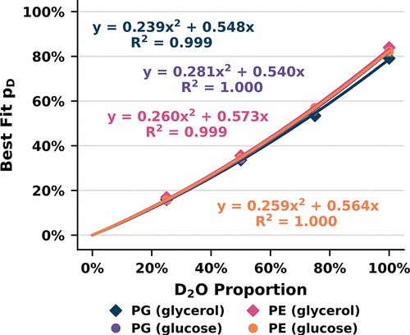
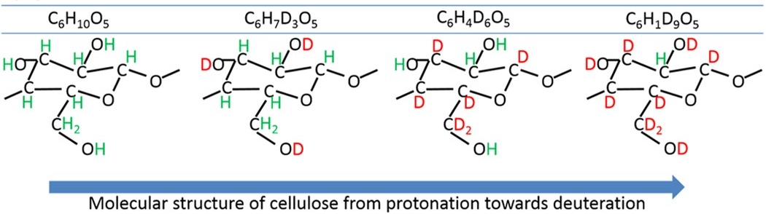
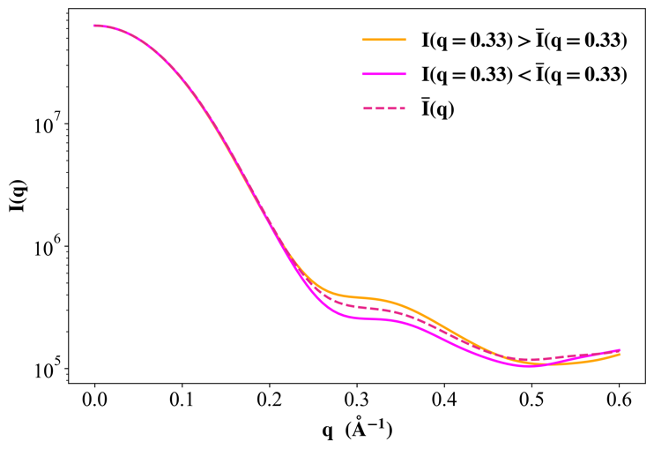
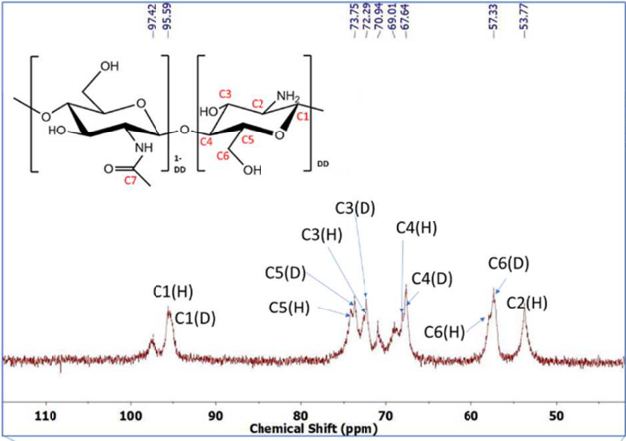
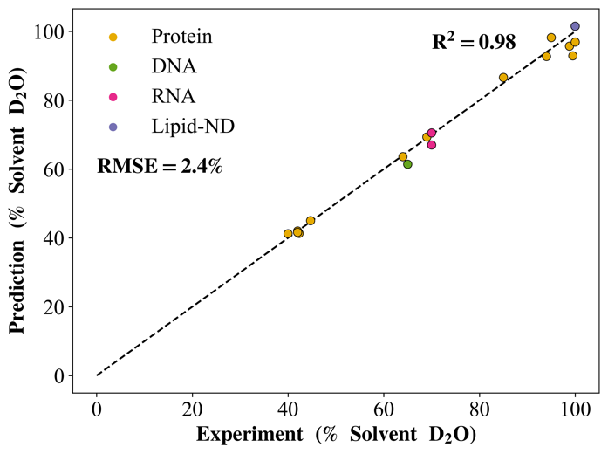
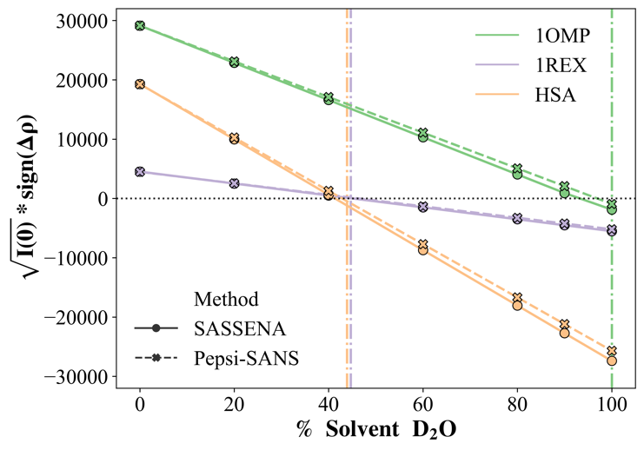
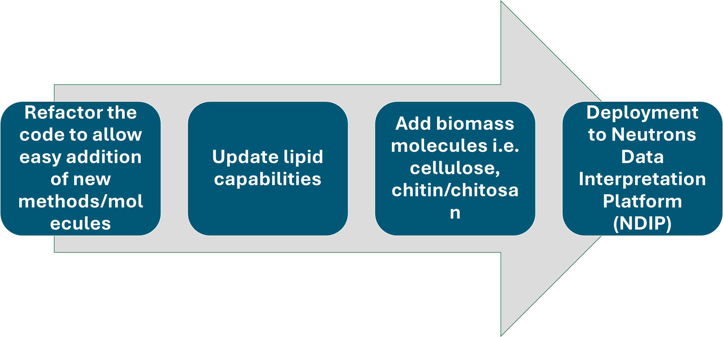
Planning: Expanding and deploying SCOMAP-XD
Developed a tool to predict the contrast-matching point of proteins, lipids, and nucleic acids
New development: Expansion to a broader range of molecular systems
In vivo deuteration of native phospholipids
Deuterated bacterial cellulose
Scattering Constrast Match Points with eXplicit atom Deuteration
Overlapping Atoms
10.1038/srep36119
Non-
Exchangeable
Deuterated chitosan
Exchangeable
10.1021/acs.analchem.3c03750
10.1016/j.carbpol.2021.117637
10.1107/S2059798323002899; https://github.com/achicks15/SCOMAP-XD

Slide 11
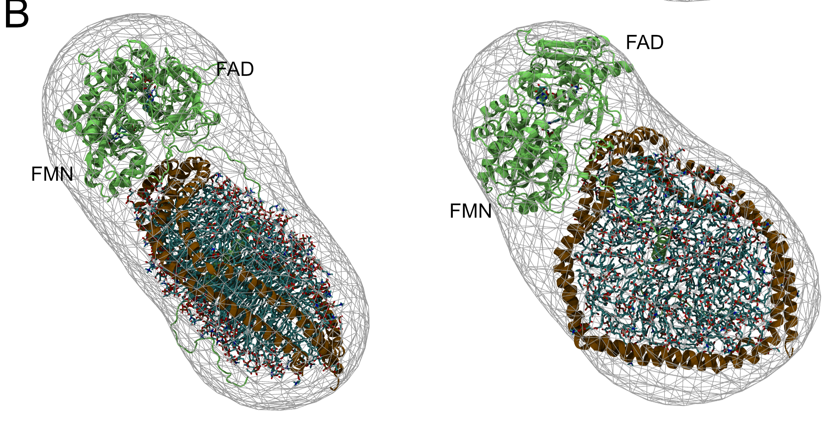
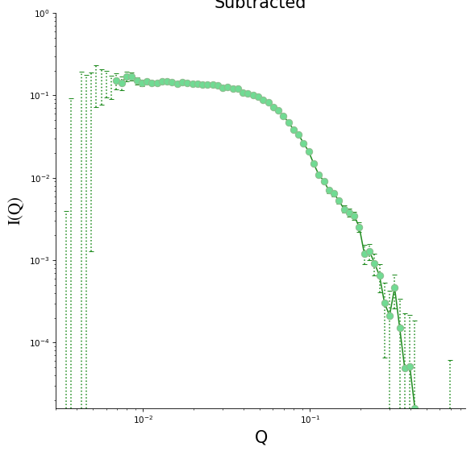
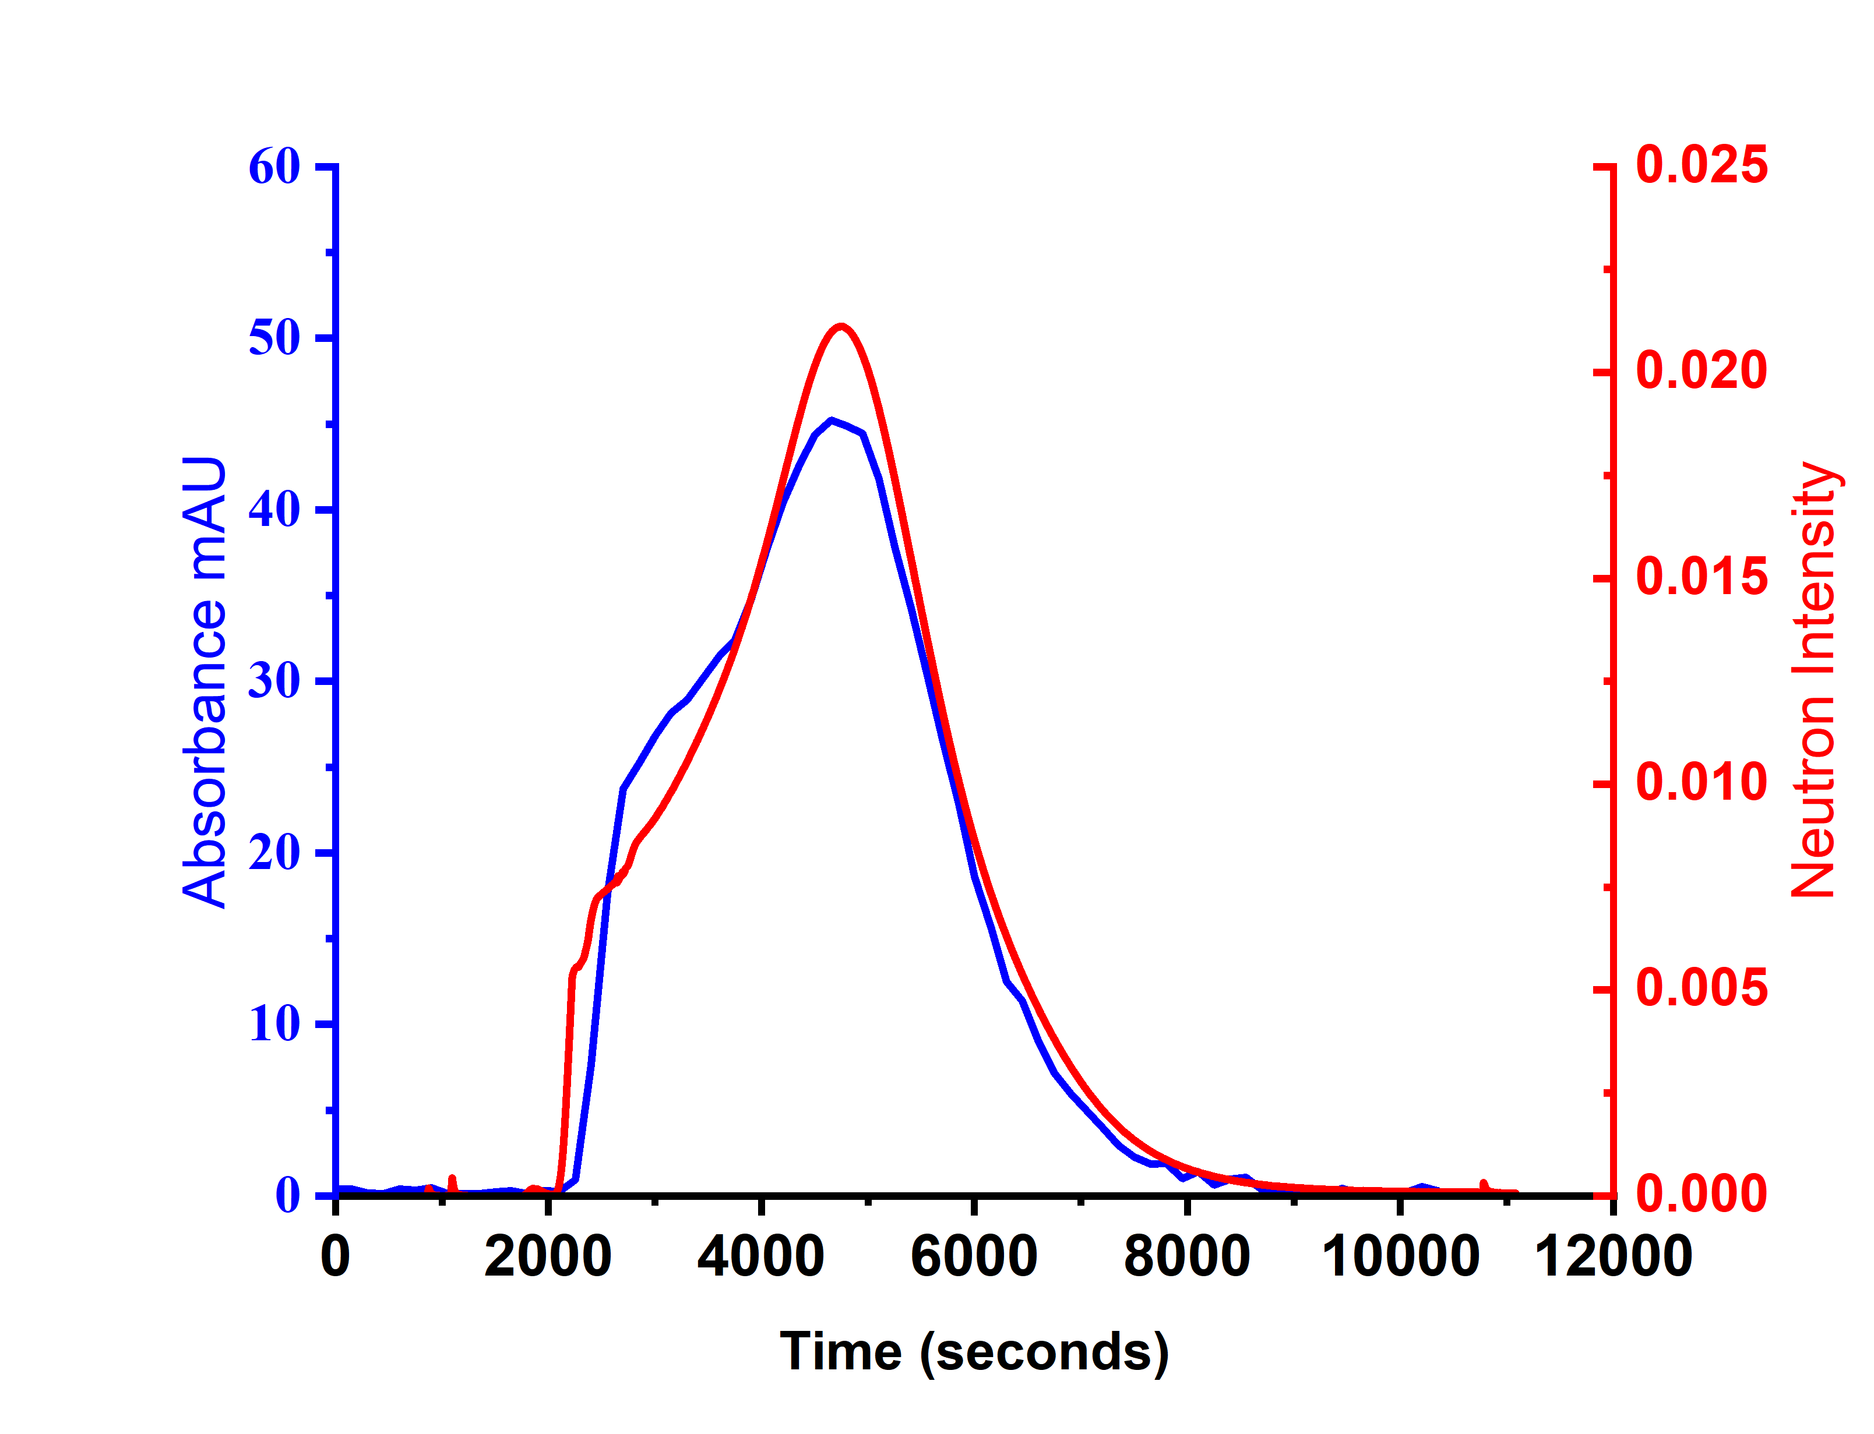
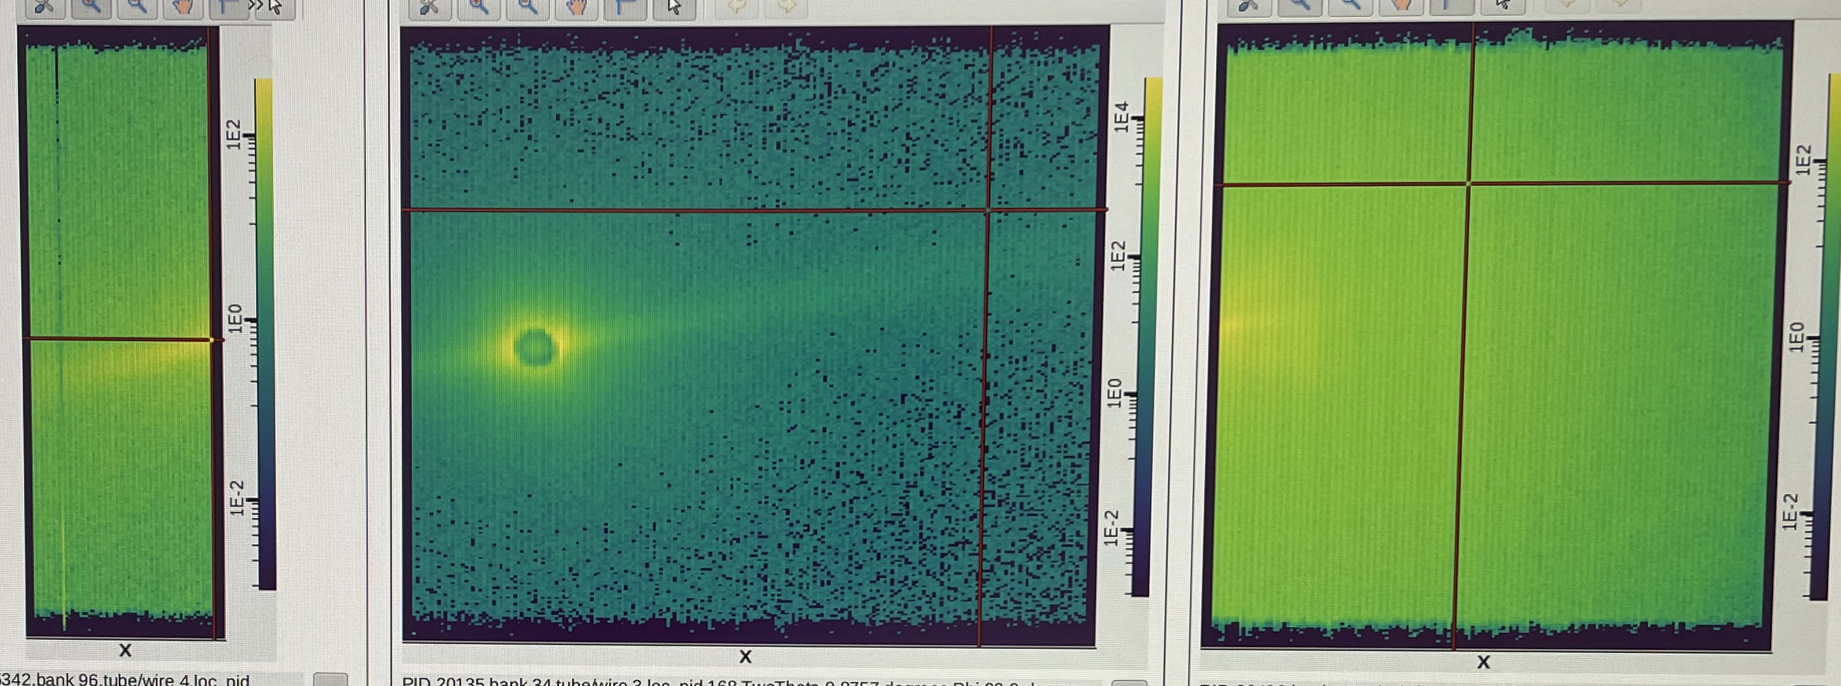
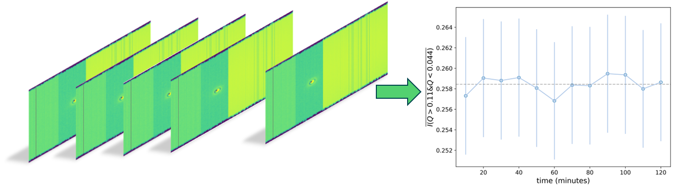

Execution: Advancing to real-time analysis for time-resolved SANS experiments and autonomous experiments
Under development: Real-time data reduction capabilities
Application : Real time integration of neutron scattering experiments with multimodal capabilities (e.g SEC-SANS, UV-VIS, DLS, etc)
Event Mode Data Collection
Each neutron is tagged with an event time
Exp. time ~ minutes to hours
2D images of Bio-SANS three-detector array
1D SANS profile
”Listen” to data stream at a specific time interval
Collaboration with John Hackett

Slide 12
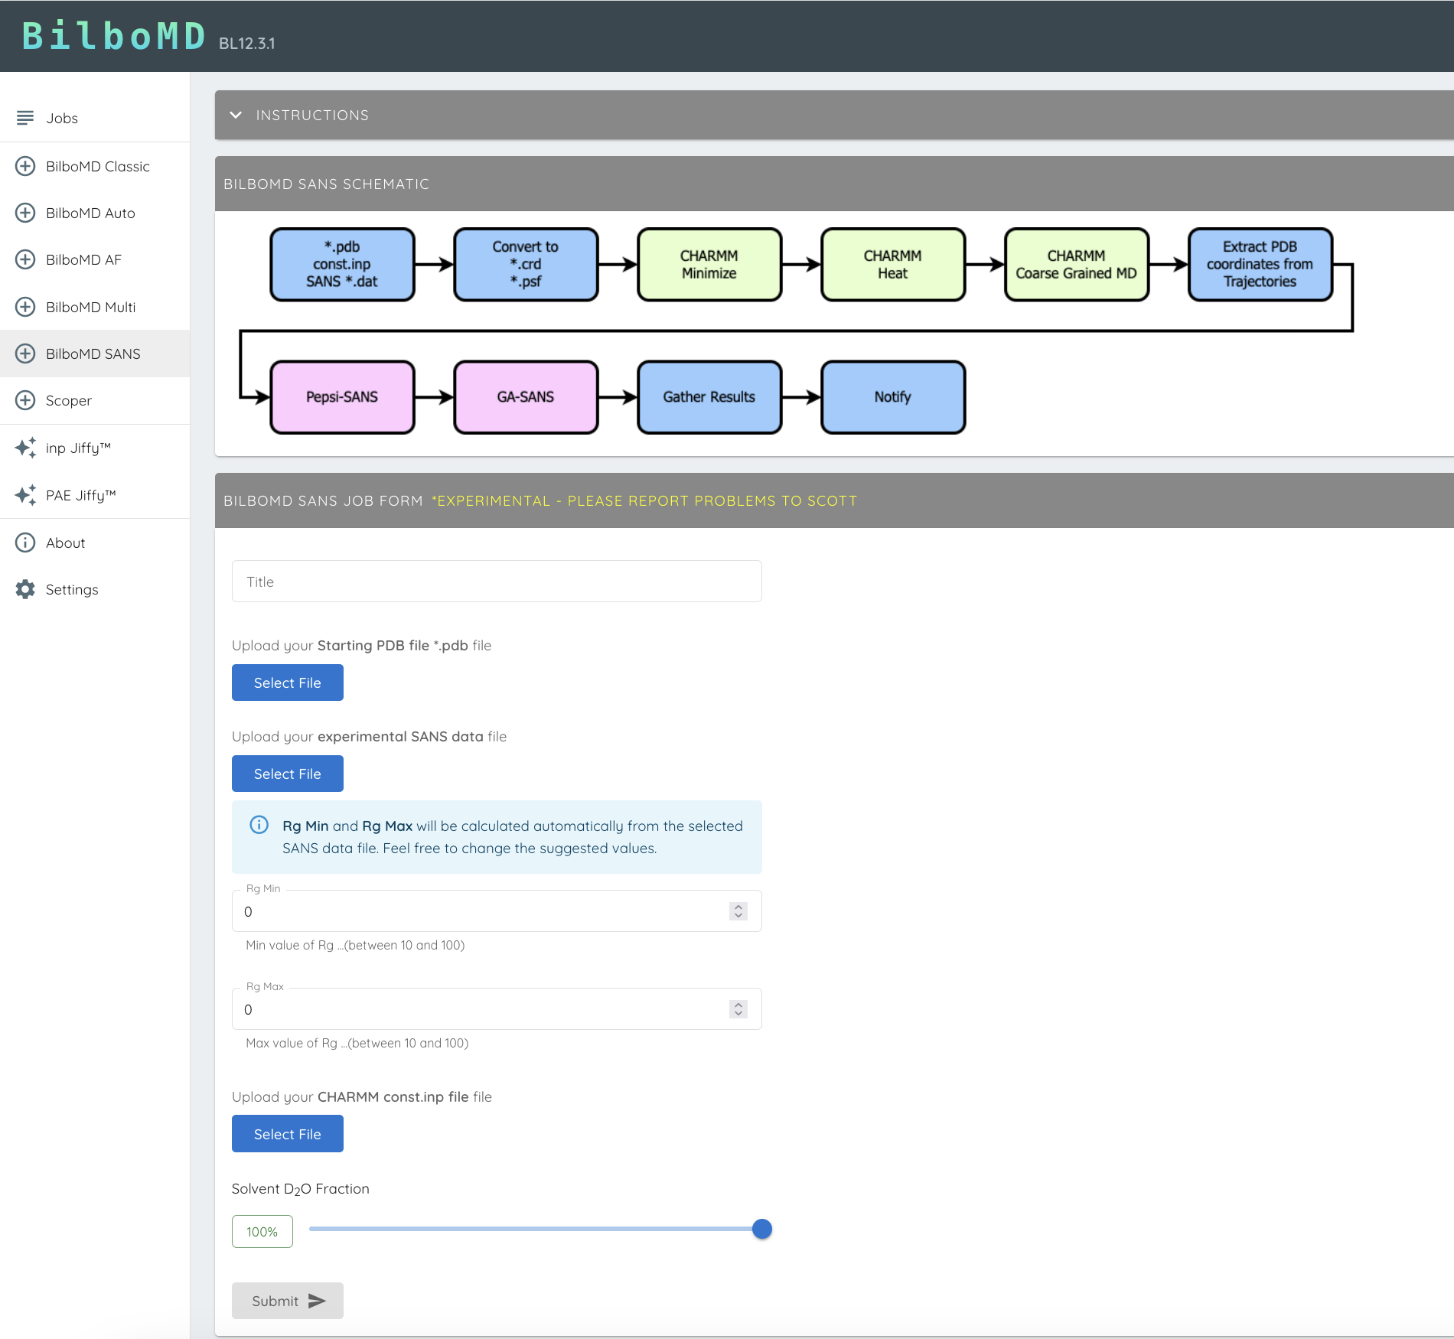
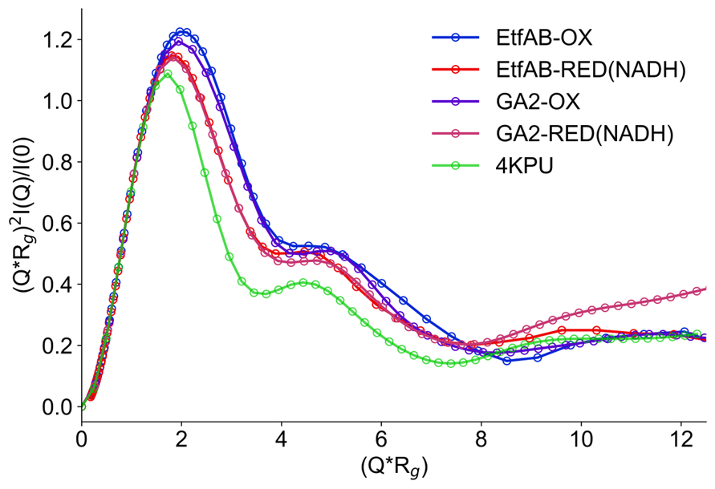
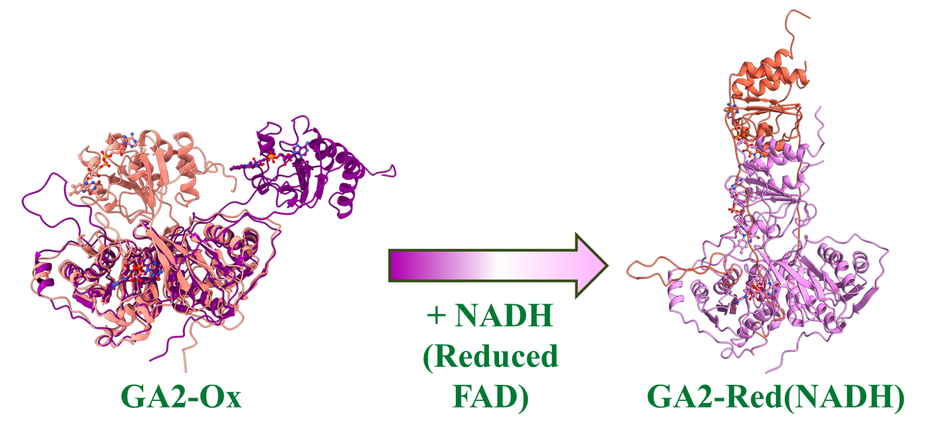

Analysis: Multi-contrast fitting for ensemble refinement of complex, flexible biomolecular assemblies
Developed: Bilbo-MD SANS
New development: Bilbo-MD multi-contrast ensemble optimization
SAXS
SANS
Whole Complex; High-q
C1; Feature 1
C2; Feature 2
CN;
Feature N
...
Higher information content refinement for more accurate ensembles
Access larger conformational entropy complexes
In collaboration with SIBYLS Beamline at the ALS, LBL
SAXS and SANS contain complementary information and are often used serially in analysis pipeline

Slide 13
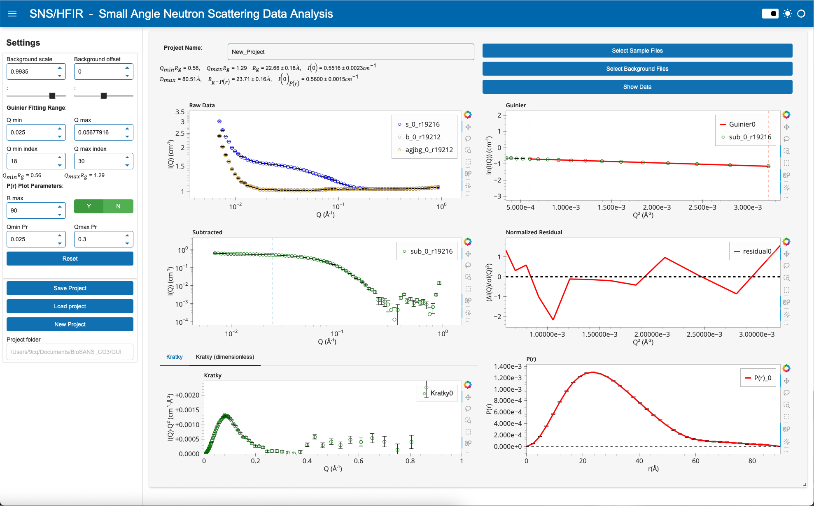
Analysis: Data analysis GUI for solution scattering of biomolecules
Developed: User-friendly data analysis tool for solution scattering
Features:
  Interactive background subtraction
  Guinier Analysis
  Kratky Representation
  P(r) distribution
Incorporate into NDIP (Under development)
Developed by
Yingrui Shang, Alan Hicks, and Wellington Leite

Slide 14
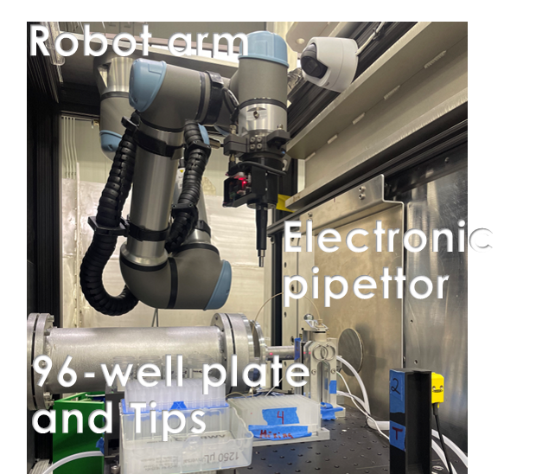
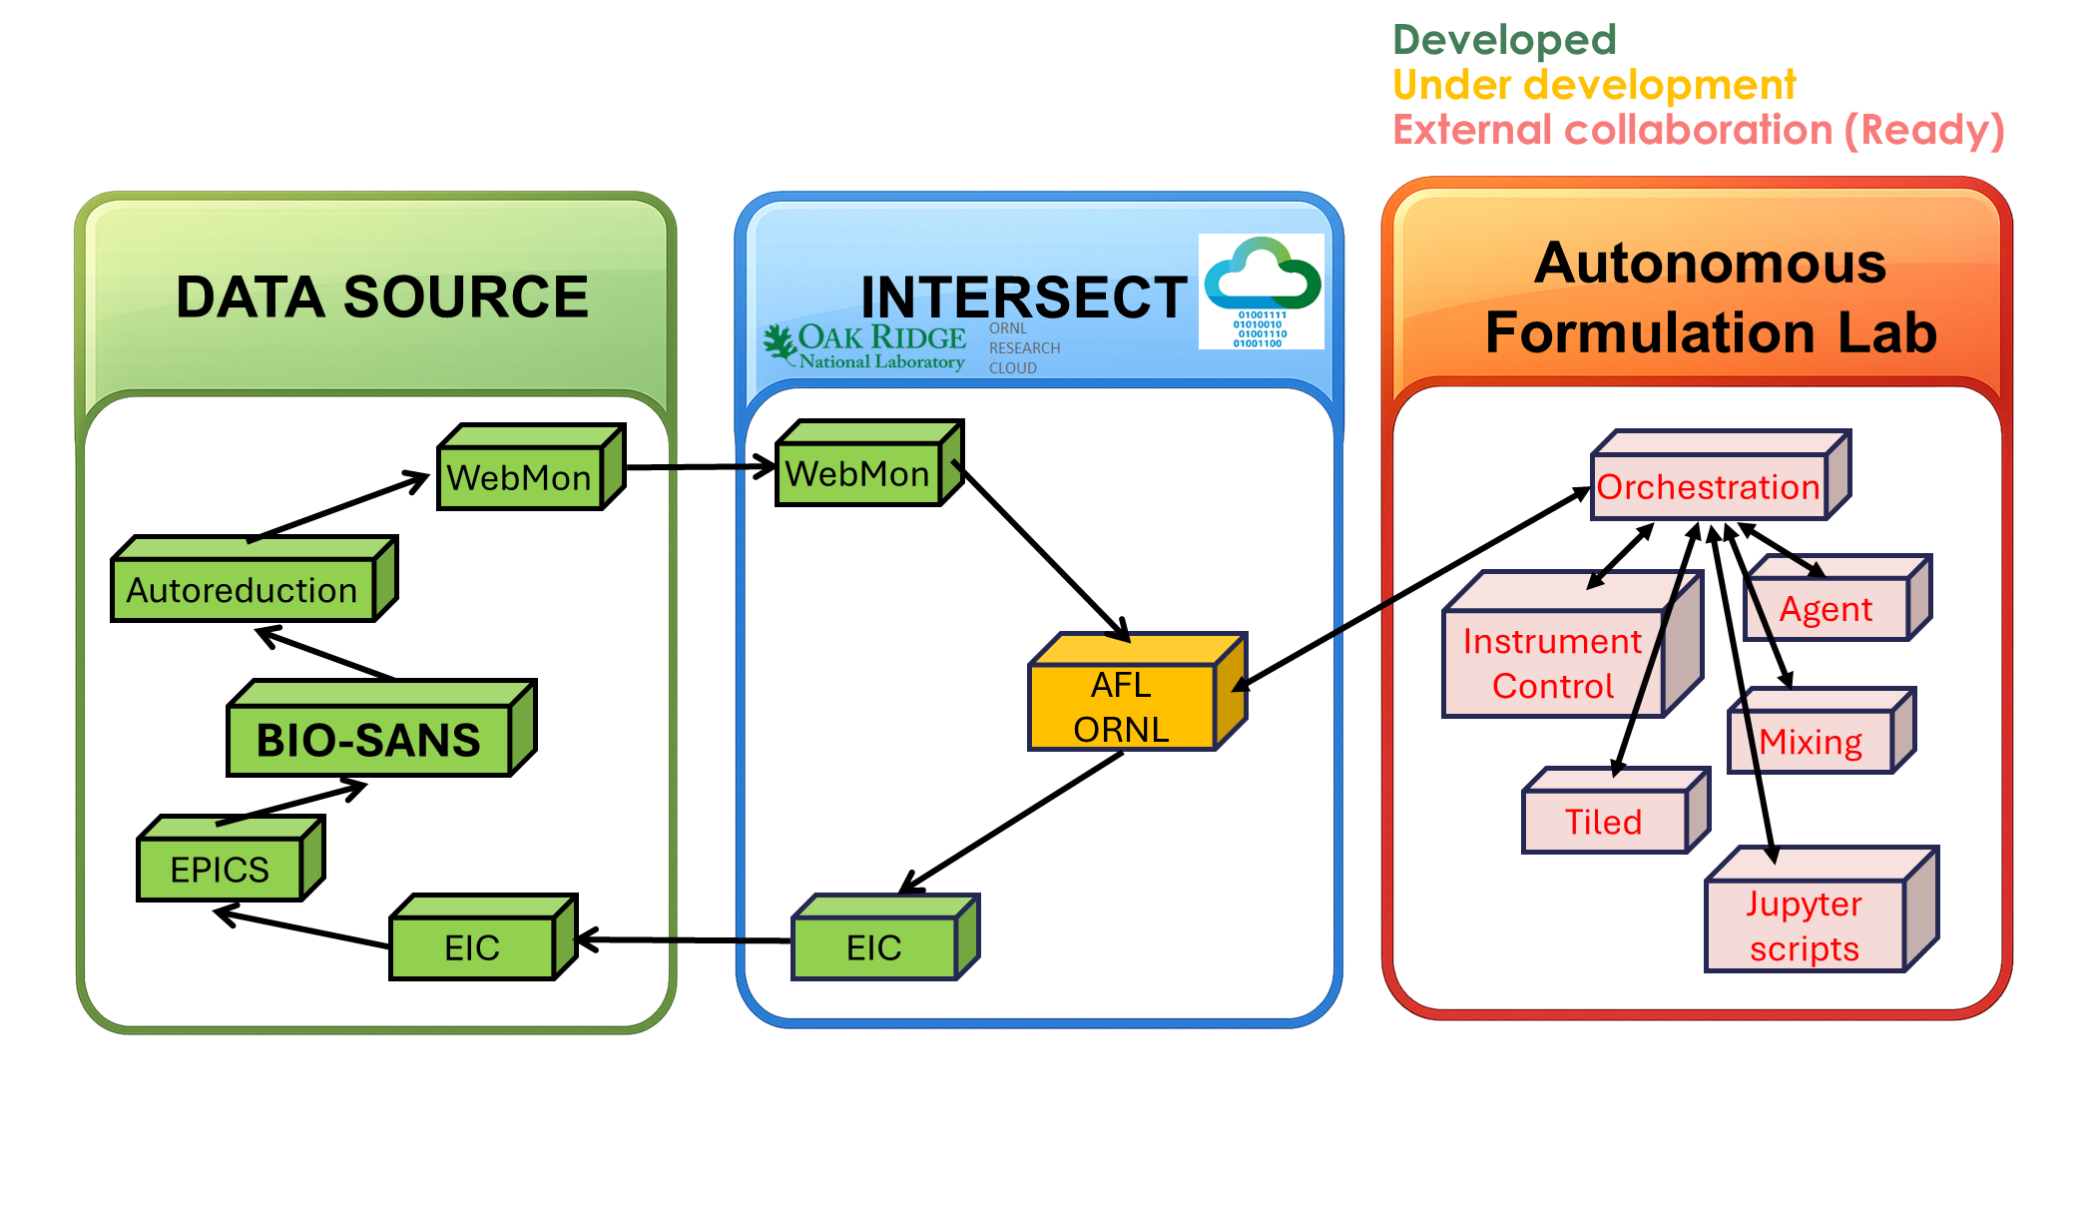
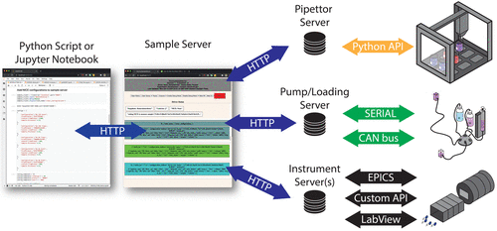

AI developments: Integration of ML/AI into experimental platforms
Milestone: First AI-guided experiment scheduling at Bio-SANS (Feb 2026)
Sample environment: Commissioned and fully tested
Computational capabilities: Near completion, with adaptation of existing ORNL platforms
Bio-SANS liquid handling robot
AFL@NIST-NCNR

Slide 15
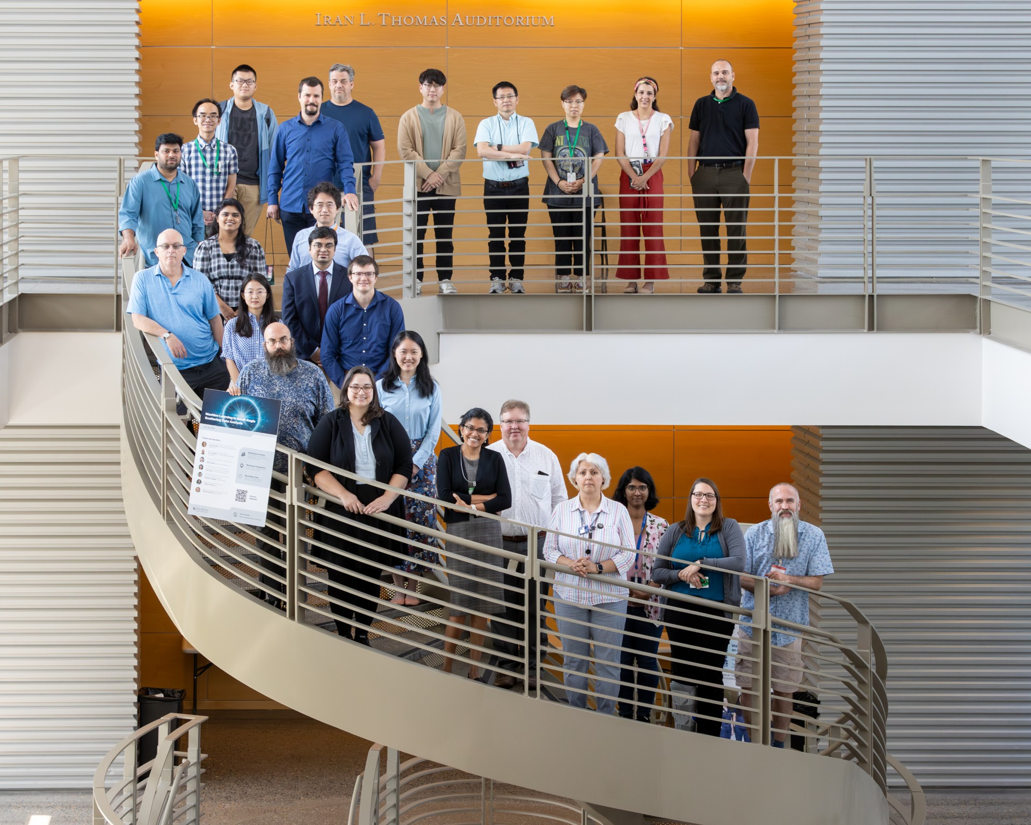
Summary
Unified and reliable framework for SANS data reduction
– Single workflow across HFIR & SNS instruments, reproducible and standardized outputs
Advanced capabilities for complex experiments
– Supports anisotropic data reduction, magnetic corrections, time-resolved experiments, and background corrections
Graphical user interface for SANS data reduction
– GUI designed for both experienced and new users to enable user-friendly data reduction
Active development and community engagement
– SASView contributions, held workshops for data analysis and AI in SANS
New data analysis tools for neutron scattering
– NDIP, high performance simulations, SCOMAP-XD, BILBO-MD, SANS data analysis GUI
Integration of ML/AI capabilities into experimental workflows
– Building upon existing ORNL computational capabilities infrastructure for ML/AI-guided experiments
Development of 2D data analysis tools for asymmetric and anisotropic structural features
(GRASP-like analysis capabilities)
Large-scale numerical simulations for direct comparison with SANS experiments
Automated SANS data analysis and model fitting enhanced by machine-learning methods
AI-assisted data analysis and knowledge-based expert systems for SANS data interpretation

Slide 16
Questions, and thank you for taking the time to review our facility

Slide 17
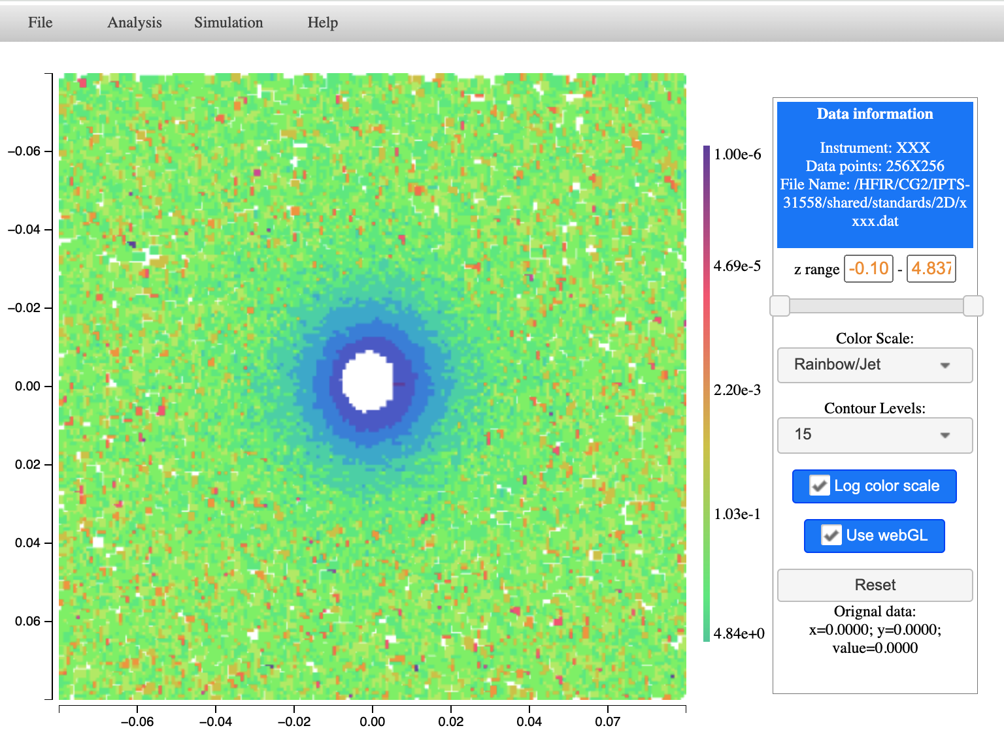
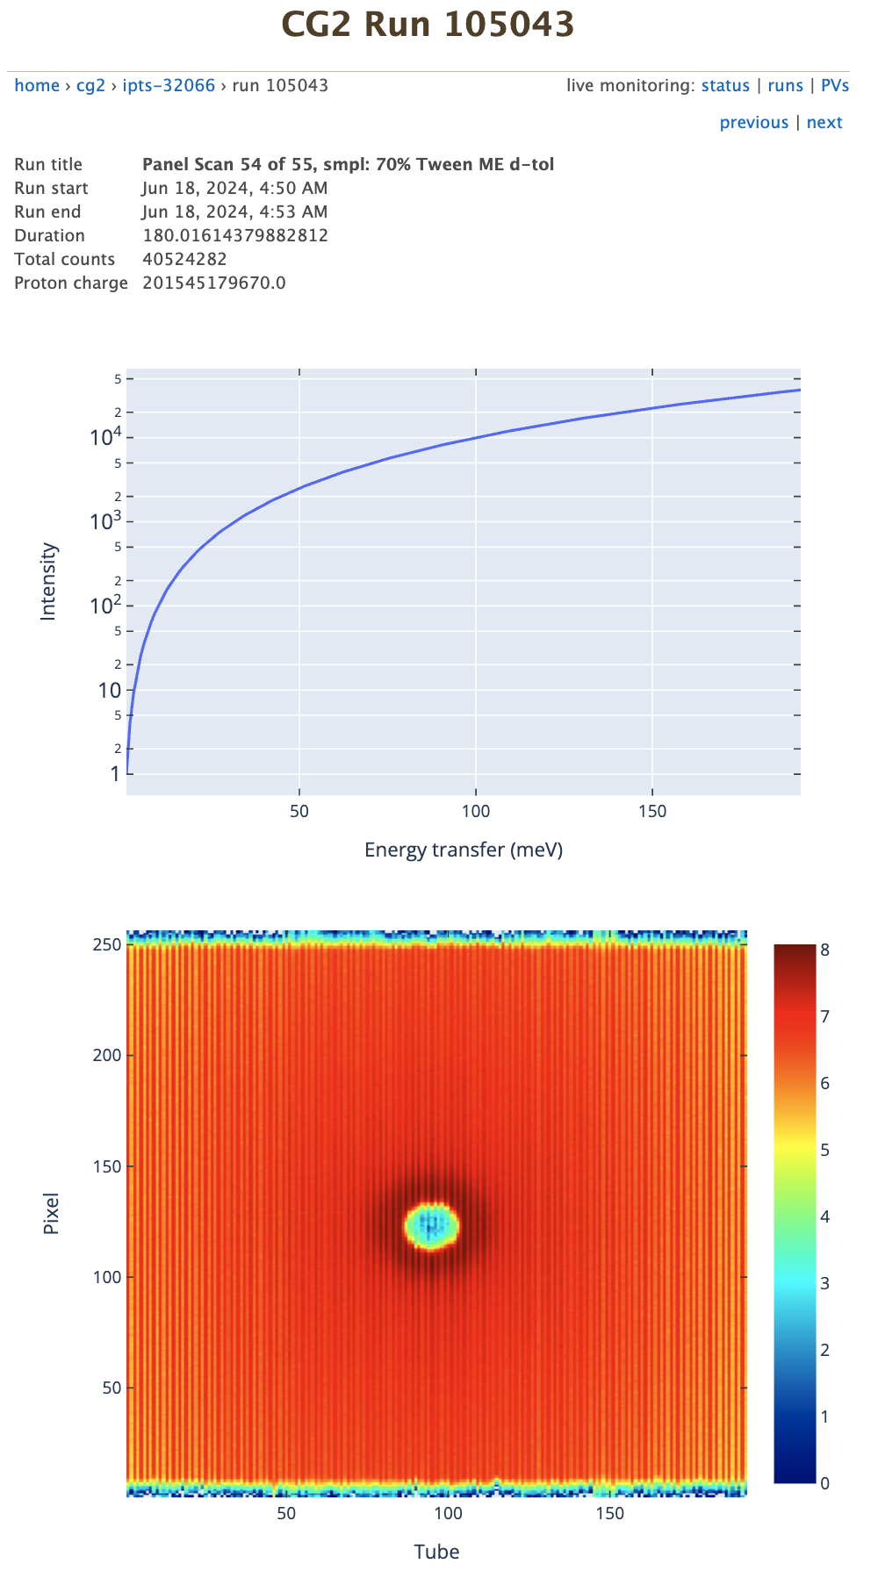
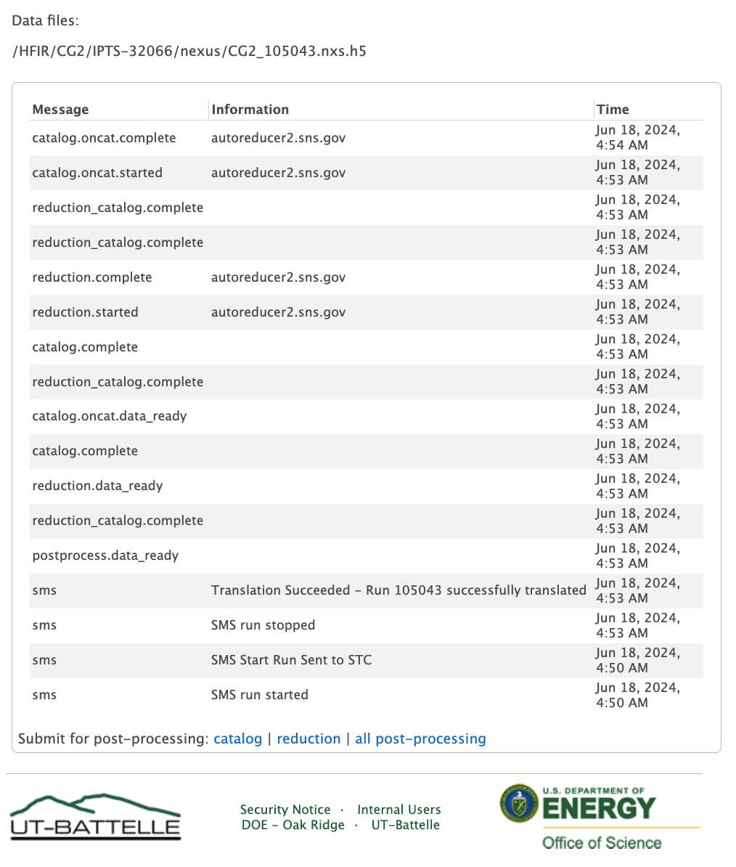
The Perspectives in Advanced Data Analysis
Development of 2D data analysis tools for asymmetric and anisotropic structural features
(GRASP-like analysis capabilities)
Large-scale numerical simulations for direct comparison with SANS experiments
Automated SANS data analysis and model fitting enhanced by machine-learning methods
AI-assisted data analysis and knowledge-based expert systems for SANS data interpretation
2D SANS data analysis
Autoreduction platform for SANS/HFIR

Slide 18
Summary and Perspectives in Advanced Data Analysis
Perspectives in Advanced Data Analysis
Unified framework for SANS data reduction
– Single workflow at HFIR & SNS instruments, reproducible and standardized outputs
Advanced capabilities for complex experiments
– Supports anisotropic, time-resolved, background corrections
Graphical user interface for SANS data reduction
– GUI designed for both experienced and new users to enable user-friendly data reduction
Active development and community contributions
– SASView contributions
Integration of ML/AI into experimental platforms
– Building upon existing ORNL computational capabilities infrastructure for ML/AI-guided experiments
2D SANS data analysis
Autoreduction platform for SANS/HFIR
Development of 2D data analysis tools for asymmetric and anisotropic structural features
(GRASP-like analysis capabilities)
Large-scale numerical simulations for direct comparison with SANS experiments
Automated SANS data analysis and model fitting enhanced by machine-learning methods
AI-assisted data analysis and knowledge-based expert systems for SANS data interpretation

Slide 19
Create impactful presentations by applying
ORNL brand elements and best practices
Aa
T
Fonts
Colors
Text
Visuals
Notes:
Tips and Tricks
Keep text on the slide to a minimum. Use the notes section for additional details.
Any photography or videography included must be owned by ORNL, or permission to use the images or videos must be obtained from the owner/source.
Charts, diagrams, and infographics should be created by the presenter or the Creative Services department. If any visual assets are not owned by the Lab, the presenter should receive permission to use the materials and credit the original author.
Do not use ‘global compress’ to decrease the size of images in your presentations, it will degrade the ORNL logos embedded in the slides. Instead, compress one image at a time, if file size is a concern.
Ensure images of sufficient size and quality to communicate necessary details and information. This may mean reducing accompanying text or moving images to a new slide.
Presentation Development Process
Consider your audience. When making choices on presentation content, slide design, and delivery, ask, "What is the most effective way to communicate with this audience?”
Determine the primary take away. What is the most important message of the presentation? Write down that message as a single sentence. What information does the audience need to know to fully digest the primary take away message?
Develop 2–4 supporting messages. Write out in complete sentences the key points that lead your audience to understanding your primary take away.
Build your presentation. Take the full sentence messages you have created and put one sentence at the top of each slide. Next, find or create a visual image to support the message such as a picture, graph, diagram, or timeline. Any text on the body of the slide should be a call out describing a key feature of the visual.
Pro Tips
Ensure that your title, questions, and conclusion slides are visually appealing and that the visual elements used directly support your primary take-away message on each slide.
Consider creating an informational sheet with extended notes and additional information to hand out before your presentation.
Details about ORNL fonts
https://ornl.sharepoint.com/sites/branding/SitePages/typography.aspx
Details about ORNL color palette
https://ornl.sharepoint.com/sites/branding/SitePages/color_palette.aspx
Learn more about ORNL electronic presentations
https://ornl.sharepoint.com/sites/branding/SitePages/electronic-presentations.aspx

Slide 20
Aptos is the brand font for all ORNL presentations
Aptos
32pt Headline text
24pt Sub-headline text
16pt Body text
14pt Captions and labels
Light
Regular
Semibold
Bold
ExtraBold
Light Italic
Italic
SemiBold Italic
Bold Italic
ExtraBold Italic
AaBbCcDdEe
FfGgHhIiJjKk
LlMmNnOoPp
QqRrSsTtUu
VvWwXxYyZz
0123456789
Notes:
Guidelines for Font Use
Aptos is ORNL’s presentation typeface and is embedded as the default font in PowerPoint.
The default sizes built into the slide master were selected to ensure readability.
Use only the fonts and recommended sizes provided in the template.
Headline text should be no larger than 32pt and body copy no smaller than 16pt.
Sub-headline text should be no larger than 24pt and no smaller than 16pt.
Body text should not be as large as the Headline or Sub-headline text but should be no smaller than 16pt.
Captions and labels should be no smaller than 14pt.
Learn more about ORNL fonts
https://ornl.sharepoint.com/sites/branding/SitePages/typography.aspx

Slide 21
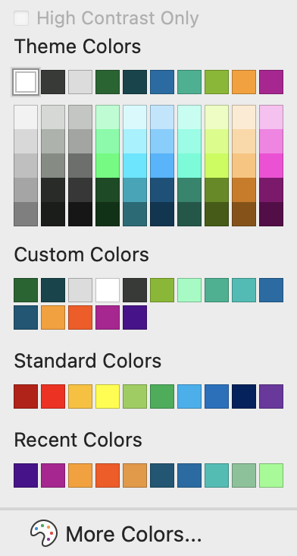
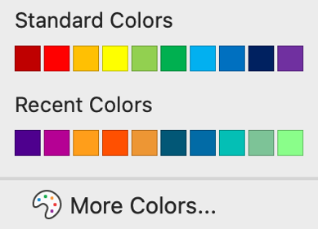

Consistent use of ORNL colors plays a significant role in brand recognition
PRIMARY
ORNL
Green
Hale
Navy
PRIMARY
COLORS
Standard
Text Color
Dark Matter
Graphite
Polar
SECONDARY
Energy
Mist
Biome
SECONDARY
COLORS
ACCENT
COLORS
Aqua
Infinity
Hydro
ACCENT
Forge
Spark
Plasma
Pulsar
Notes:
Guidelines for Color Use
ORNL’s color palette is embedded in the presentation template.
Primary and Secondary colors may be used in all slides to help complement and highlight content.
Accent colors are not required for use. They may be used in materials when applicable and needed to provide contrast.
Accent colors should never appear as the dominant color in any slide.
Learn more about ORNL color palette
https://ornl.sharepoint.com/sites/branding/SitePages/color_palette.aspx

Slide 22
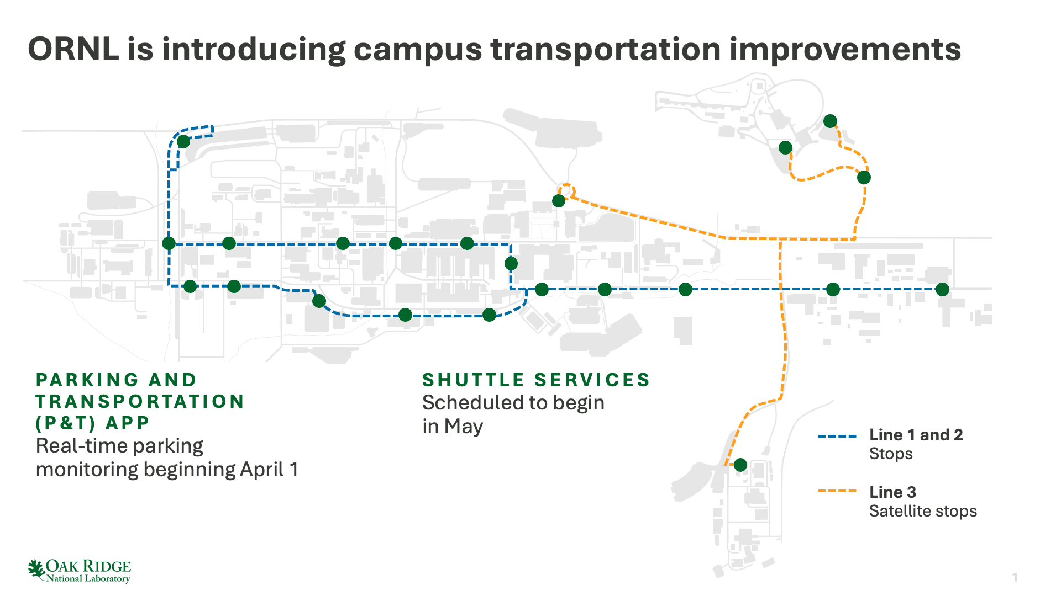
Use a full-sentence headline to assert the main idea of each slide
Notes:
Best Practices for Slide Headlines
Use a full-sentence headline to assert the main idea of each slide.
Keep additional text to a minimum. Use the notes section for additional details.
Presentation Development Process
Consider your audience. When making choices on presentation content, slide design, and delivery, ask, "What is the most effective way to communicate with this audience?”
Determine the primary take away. What is the most important message of the presentation? Write down that message as a single sentence. What information does the audience need to know to fully digest the primary take away message?
Develop 2–4 supporting messages. Write out in complete sentences the key points that lead your audience to understanding your primary take away.
Build your presentation. Take the full sentence messages you have created and put one sentence at the top of each slide. Next, find or create a visual image to support the message such as a picture, graph, diagram, or timeline. Any text on the body of the slide should be a call out describing a key feature of the visual.
Pro Tips
Ensure that your title, questions, and conclusion slides are visually appealing and that the visual elements used directly support your primary take-away message on each slide.
Consider creating an informational sheet with extended notes and additional information to hand out before your presentation.

Slide 23
Compelling visuals support the main idea of each slide and support audience retention
Check out the
Example Templates
to see how to use
various types of slides
Notes:
Best Practices for Visuals
Minimize text in images, graphs, and infographics — use it selectively for increased clarity or emphasis.
Add labels and annotations. Make sure your visuals are self-explanatory. Add annotations or short explanations directly on the image.
Color use can help differentiate key data or highlight changes. Avoid applying too many varied colors in one image, which can confuse the audience.
Ensure all images are sized to be clear and legible for large screen presentations.
Select only ORNL-owned images or obtain written permission from the source.
Types of Visual Elements
Data visualizations: Graphs (bar charts, line graphs, scatter plots), tables, and heatmaps are often used to support quantitative assertions. Choose the type that best conveys the data you are presenting.
Infographics and diagrams: Combine images and text to tell a story visually. This can include annotated diagrams or step-by-step sequences. Use simple and clean diagrams to explain mechanisms or processes.
Photography and videography: Photographic and videographic evidence can be extraordinarily powerful when relevant to the subject being presented.
Learn more about ORNL electronic presentations
https://ornl.sharepoint.com/sites/branding/SitePages/electronic-presentations.aspx

