Slide 1
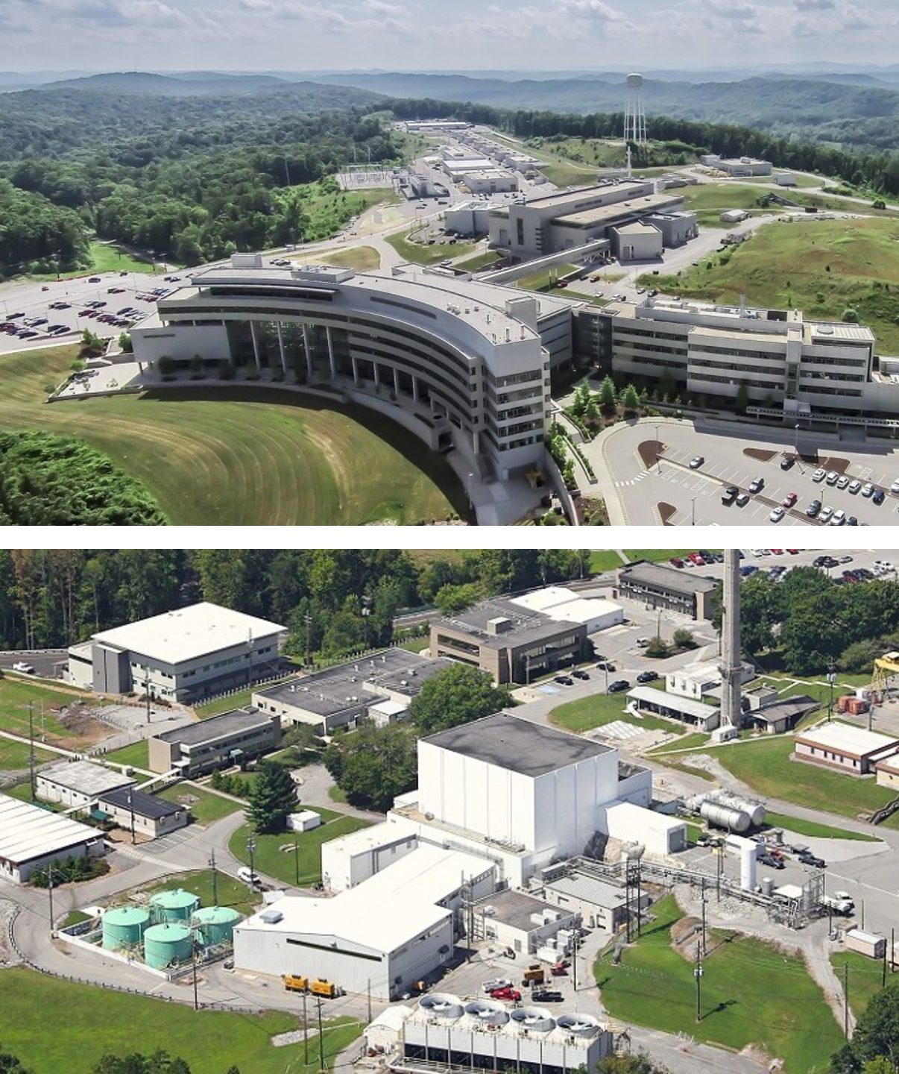
Review of the (U)SANS Instrument Suite
February 9, 2026
Volker Urban
Section Head, Large Scale Structures

Slide 2
Outline
Introduction of Review
Large Scale Structures Section Context
SANS & USANS at ORNL
Review Charge Questions
Agenda & ‘Nuts & Bolts’

Slide 3



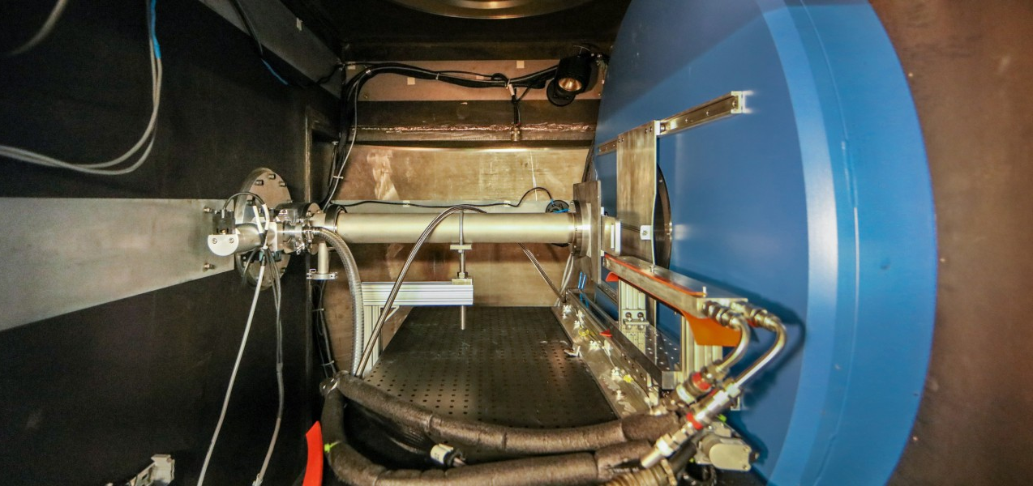
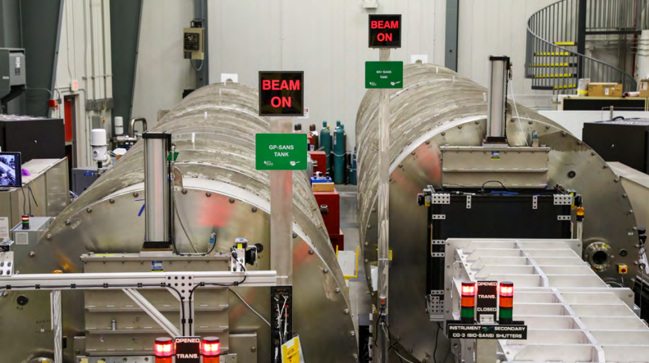
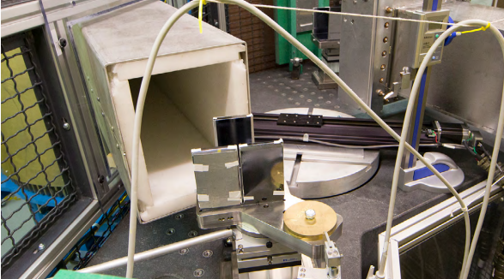
ORNL SANS Suite Review
Welcome!
Review date: Feb 9-10, 2026
Reviewers
Byeongdu Lee, APS, Argonne National Lab
Xiaodan Gu, University of Southern Mississippi
Thomas Weiss, SSRL, SLAC National Accelerator Lab
Instruments
Bio-SANS, CG-3, HFIR
GP-SANS, CG-2, HFIR
EQ-SANS, BL-6, SNS
USANS, BL-1A, SNS

Slide 4
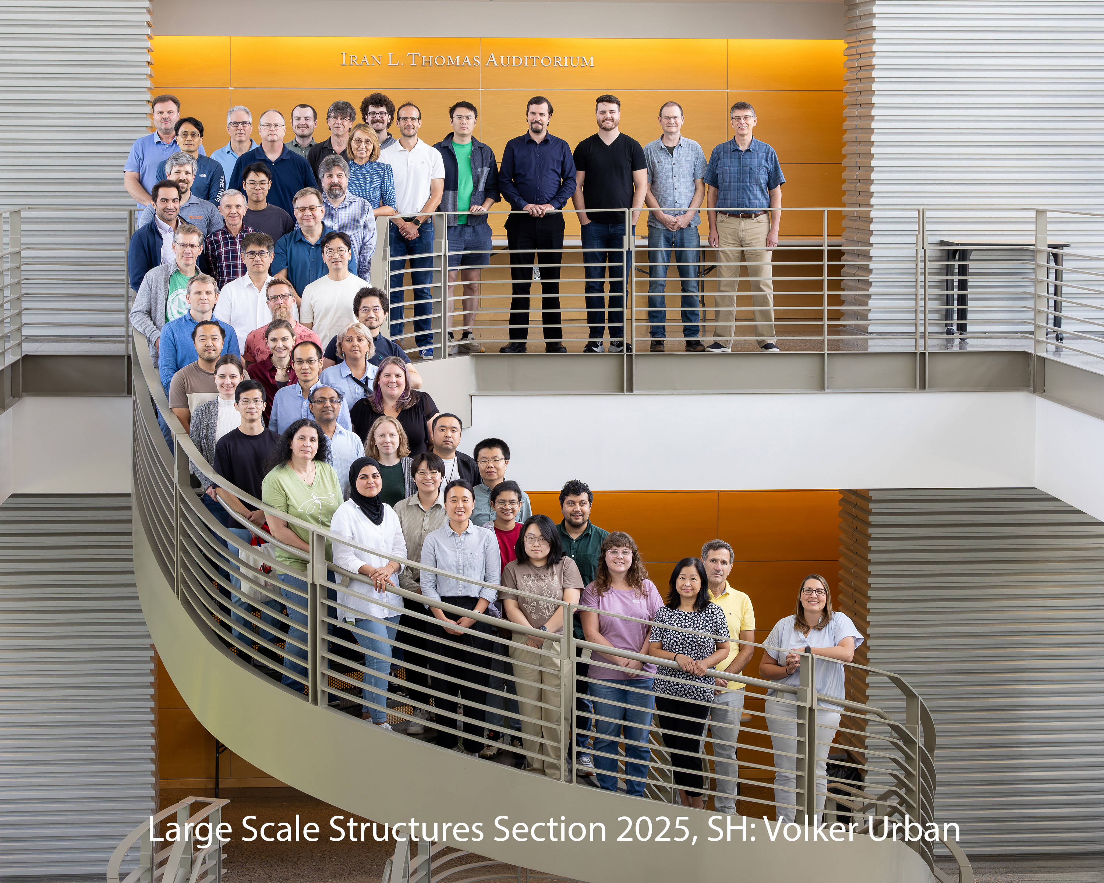
Large Scale Structures Section
Large Scale Structures Section
Four Groups
Materials Engineering Andrew Payzant
Neutron Reflectometry Jim Browning
SANS & Spin Echo William Heller
Biological Labeling and Scattering Hugh O’Neill

Slide 5
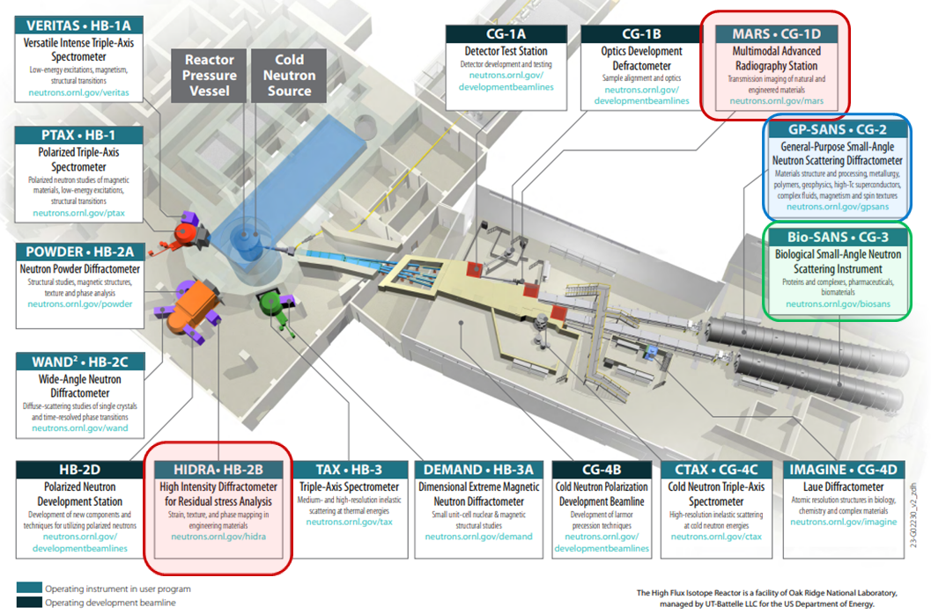
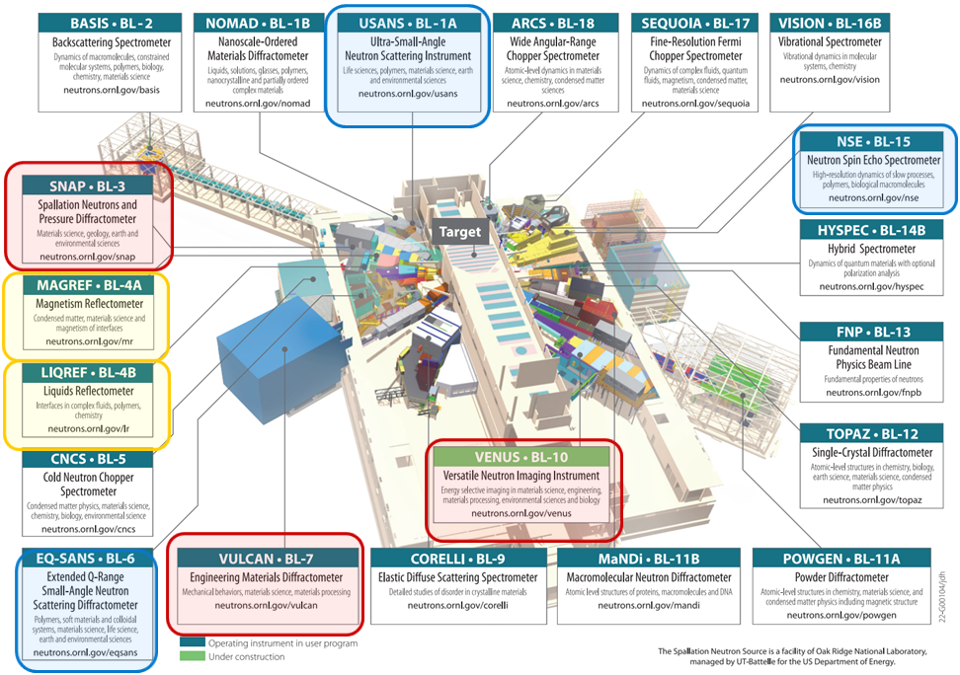
Large Scale Structures Section
High Flux Isotope Reactor
12 Instruments
4 at the HFIR
8 at the SNS
Spallation Neutron Source
4 Groups
Materials Engineering, A. Payzant
Neutron Reflectometry, J. Browning
SANS & Spin Echo, W. Heller
Biological Labeling and Scattering, H. O’Neill

Slide 6
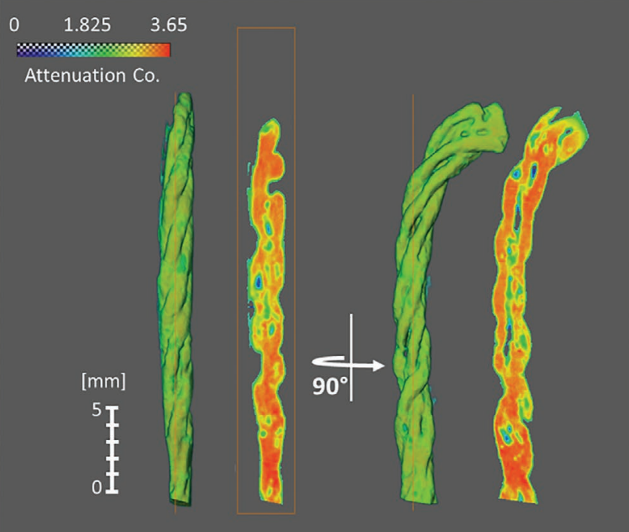
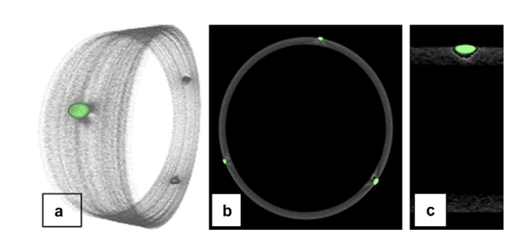
Examples of SANS “Cross-Section” Synergy
Yue Yuan (now CNMS) PhD Dissertation, NC State U, 2021: Enzyme Immobilization in Biobased Polymeric Fibrous Matrices for Biocatalytic Textiles: Material Innovation, Mechanistic Studies and Applications CG1D (MARS), CG3 (Bio-SANS)
Brianne Heisinger PhD Dissertation, UTK 2021: Non-Destructive Characterization of Zircaloy-4 Nuclear Fuel cladding Using Neutron Scattering Techniques BL-7 (VULCAN), CG-2 (GP-SANS), CG-1D (MARS)

Slide 7
SANS at ORNL
Long history (some say it started here in Oak Ridge.)
SANS at HFIR 1970s to ~2000: monochromator & no cold source
HFIR cold source and SNS ToF-SANS brought a major boost ~2007.
The suite:
GP-SANS: highest flux, broad applications
Bio-SANS: Bio-mission (BER), broadest simultaneous angular range
EQ-SANS: ToF enables excellent dQ/Q resolution at mid-to high Q
USANS: unique complementary capability for lowest Q

Slide 8
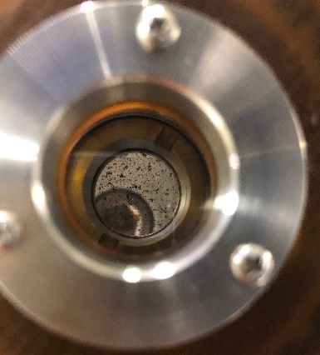
Particle dynamics of nanoplastics suspended in water with soil microparticles (SANS/USANS Study)
Scientific Achievement
The study elucidated the interactions that govern formation of nanoplastics (NPs) from biodegradable agricultural plastics in soil. Results suggest convective transport limit NP agglomeration in soil, while favoring formation of small NPs, well dispersed into its monomeric form
Significance and Impact
NPs are an important environmental issue affecting all domains of our ecosystem. The abundant use of plastics in agriculture contribute to the high concentration of NPs in agricultural fields, where they can potentially enter the food web or groundwater.
Research Details
Contrast variation SANS and USANS were employed to selectively highlight NPs into two distributions: Large NPs (LNPs) and small NPs (SNPs)
Soil particulates contrast matched in 67% D₂O solvent
SNPs (<50 nm) remained dispersed in water without further size reduction, while soil limits agglomeration of LNPs (350-1100 nm).
Convection increased SNPs by size reducing LNPs through interaction between soil microparticles-LNPs.
Top: Tumbling cell during SANS/USANS measurement Bottom: Formation of small NPs due to collision between soil microparticles and Large NPs. This was measured by contrast matching soil particles to selectively highlight NP distributions
Astner et al. PLOS ONE (2020) 15, e0235893. DOI: 10.1371/journal.pone.0235893 (Special Issue on “Plastics in the Environment”)
Astner et al. Environ. Sci.: Nano (2025) 12, 3539-3552 DOI: 10.1039/D4EN01199F
Notes:
The results demonstrate that LNPs are more fragile than SNPs and are more likely to undergo size reduction (thereby forming SNPs) when exposed to soil microparticles under convection. In contrast, SNPs undergo size reduction to a minor extent during convection, although they form homoaggregates as their concentration is increased in the absence of V, and they interact with V microparticles with increased convection. Therefore, the behavior of NPs near water-soil interfaces is complex, with NP size and the presence of convective forces being critical factors controlling the dynamics.

Slide 9
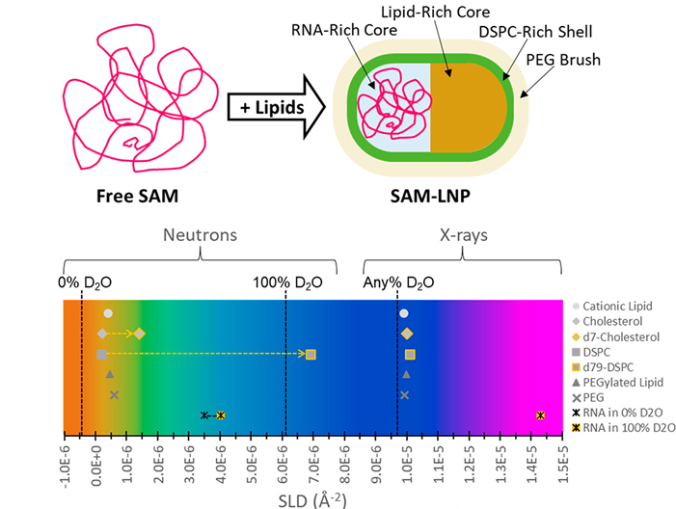

How large mRNA shapes lipid nanoparticle structure
Scientific Achievement
This work shows how large mRNA drives the formation of distinct two-compartment lipid nanoparticle (LNP) structures, providing structural insight for the rational design of next-generation mRNA delivery systems
Significance and Impact
Lipid nanoparticles protect mRNA and enable cellular uptake, understanding new morphologies enables the development of new LNP systems for vaccines and genetic based therapies
Top: Cartoon of RNA encapsulation forming a two-compartment lipid nanoparticle (LNP). Bottom: Scattering length density contrast of LNP components for neutrons and X-rays.
Research Details
Lipid nanoparticles were prepared at GSK
Experiments were performed remotely in collaboration with NIST
A two-compartment core–shell model was developed at ORNL
Jacob L. Thelen, Wellington Leite, Volker S. Urban, Hugh M. O’Neill, Alexander V. Grishaev, Joseph E. Curtis, Susan Krueger, and Maria Monica Castellanos. ACS Nano 2024 18 (2), 1464-1476 DOI: 10.1021/acsnano.3c08014Work
Work was performed at Bio-SANS, HFIR CG-3

Slide 10
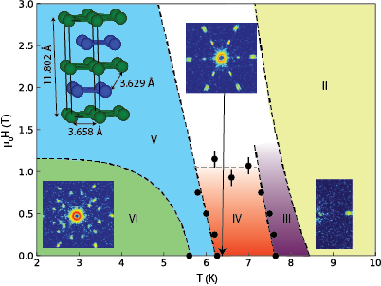






Nanometric modulations of the magnetic structure of the element Nd
Scientific Achievement
The discovery of new magnetic Bragg peaks in elemental Nd, revealing spin textures with nanoscale modulations and highlighting the emergence of large-scale spin structures from localized moment-conduction electron interactions.
Significance and Impact
Advancing the understanding of the interactions between localized magnetic moments and conduction electrons giving insights to relevant to fields like spintronics.
Research Details
SANS done at GP-SANS at HFIR and at NG3 at NCNR revealed new magnetic Bragg peaks that correspond to spin textures.
Field-temperature phase diagram (𝜇₀𝐻 ∥ 𝑐) for Nd, with phase boundaries determined from this study (filled circles) and (dashed lines), showing individual phases (I-VI) and SANS diffraction patterns for phases VI, IV, and II, alongside the Nd double hexagonal closed packed structure (inset).
H. Suriya Arachchigea, L.M. DeBeer-Schmitt, L.L. Kish, Binod K. Rai, A.F. May, D.S. Parker, G. Pokharel, Wei Tian, Matthew B. Stone, Matthias Frontzek, D.G. Mandrus, M. Bleuel, Z. Islam, G. Fabbris, H.X. Li, S. Gao, H. Miao, S.M. Thomas, P.F.S. Rosa, J.D. Thompson, Shi-Zeng Lin, A.D. Christianson Materials Today Quantum 4, 100016 (2024), doi:10.1016/j.mtquan.2024.100016.
Work was performed at ORNL.
Notes:
Neodymium (Nd), a rare-earth element, has some of the most intricate magnetic behavior among all elements. Using small-angle neutron scattering (SANS), along with other techniques like neutron diffraction and x-ray analysis, we studied how its magnetic structure changes with temperature and magnetic field. The results reveal nanoscale spin patterns that shift in size and direction across different phases, highlighting a new modulation between 5.9 and 7.6 K. These spin structures, likely caused by competing magnetic interactions, are influenced by the arrangement of Nd layers and external magnetic fields, offering insight into how complex magnetic orders emerge.
Researchers: H. Suriya Arachchige, G. Pokharel, D.G. Mandrus, (University of Tennessee: Knoxville), L.M. DeBeer-Schmitt, A. F. May, Wei Tian, Mathew B. Stone, Matthias Frontzek, H. X. Li, S. Gao, H. Miao, A.D. Christianson (ORNL), L. L. Kish (University of Illnois: Urbana Champaign), Binod K. Rai (Savannah River National Laboratory), M. Bleuel (NCNR, University of Maryland: College Park), Z. Islam, G. Fabbris,(APS Argonne National Laboratory), S.M. Thomas, P.F.S Rosa, J. D. Thompson, Shi-Zeng Lin (LANL)
Acknowledgement from paper: We thank C. Batista for useful discussions and D. Schlagel for providing details of the sample synthesis and purity. This work was supported by the U.S. Department of Energy, Office of Science, Basic Energy Sciences, Materials Sciences and Engineering Division. This research used resources at the High Flux Isotope Reactor, a Department of Energy (DOE) Office of Science User Facility operated by Oak Ridge National Laboratory (ORNL). H. S. A. was supported by the Gordon and Betty Moore Foundation’s EPiQS Initiative, USA through Grant GBMF9069 and the Shull Wollan Center Graduate Research Fellowship. G. P. was supported by the Gordon and Betty Moore Foundation’s EPiQS Initiative, USA through Grant GBMF4416. The work at LANL was carried out under the auspices of the US DOE NNSA under Contract No. 89233218CNA000001 through the LDRD Program. This research used resources of the Advanced Photon Source, a U.S. Department of Energy (DOE) Office of Science user facility at Argonne National Laboratory and is based on research supported by the U.S. DOE Office of Science Basic Energy Sciences, under Contract No. DE-AC02-06CH11357. The single crystal of Nd was synthesized at the Materials Preparation Center, Ames National Laboratory, USDOE. See www.mpc.ameslab.gov The work done by SZL was performed, in part, at the Center for Integrated Nanotechnologies, an Office of Science User Facility operated for the DOE Office of Science, under user Proposals No. 2018BU0010 and No. 2018BU0083. We acknowledge the support of the National Institute of Standards and Technology, U.S. Department of Commerce, in providing the neutron research facilities (NG-7 SANS) used in this work. This manuscript has been authored by UT-Battelle, LLC under Contract No. DE-AC05-00OR22725 with the U.S. Department of Energy. The United States Government retains and the publisher, by accepting the article for publication, acknowledges that the United States Government retains a non-exclusive, paid-up, irrevocable, world-wide license to publish or reproduce the published form of this manuscript, or allow others to do so, for United States Government purposes. The Department of Energy will provide public access to these results of federally sponsored research in accordance with the DOE Public Access Plan (http://energy.gov/downloads/doe-public-access-plan).
Publication/ press releases/ related links:
“Nanometric modulations of the magnetic structure of the element Nd,“ Materials Today Quantum 4 (2024)
100016
https://doi.org/10.1016/j.mtquan.2024.100016

Slide 11
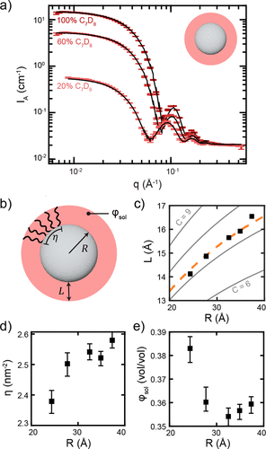


Probing the Invisible: Neutrons Illuminate Ligand Structures in Colloidal Nanocrystals
Scientific Achievement
Precise ligand shell thickness and structures of colloidal nanocrystals were revealed by small-angle neutron scattering (SANS), providing essential information unattainable by other conventional techniques.
Significance and Impact
Deepened the understanding of ligand shell structures in colloidal nanocrystals, enabled improved control of their self-assembly and functionality, which is critical for applications in optoelectronics, sensing, and photocatalysis.
Research Details
Organic ligand shells on colloidal nanocrystals were characterized by SANS and data fitting;
Ligand shell thickness was influenced by both the nanocrystal core size and the surrounding solvent's identity.
(a) SANS data (colored data points with error bars) and core–shell model (black lines) for the nominally 7.4 nm diameter PbS NC batch, where the data are shown only at 100%, 60%, and 20% toluene deuteration for clarity. (b) Schematic of core–shell model, including fit parameters of core size (R), shell thickness (L), and volume fraction of solvent in
shell (φsol) as well as the calculated parameter of areal ligand coverage (η). (c–e) Variation of physical parameters with fitted core radius, including (c) fitted L, (d) calculated η, and (e) fitted φsol.
Eliza Price, Guilherme Bejar, Jimin Kwag, Niamh Brown, Lilin He, William Tisdale J. Am. Chem. Soc. 2025, 147, 13859-13870(2025), doi:10.1021/jacs.5c02070
Work was performed at GP-SANS/ORNL.
Notes:
The ligand shell plays a critical role in imparting colloidal stability, tuning functional properties, and mediating self-assembly of NCs, but is notoriously difficult to characterize structurally due to its low electron density relative to the inorganic core. In this work, we employed three different scattering techniques—Small-Angle Neutron Scattering (SANS), Small-Angle X-ray Scattering (SAXS), and Grazing-Incidence SAXS (GISAXS)—to probe and contrast the ligand shell structure of oleyl-capped PbS nanocrystals of varying core size and in different solvents. SANS stands out because of its unique sensitivity to organic molecules (using isotopic contrast variation), allowing direct measurement of the ligand shell’s thickness and composition. SAXS and GISAXS, by contrast, can only infer the shell indirectly: SAXS via particle–particle interactions in concentrated dispersions, and GISAXS via analysis of superlattice spacings in self-assembled films.
The paper demonstrates that SANS directly reveals that ligands extend up to 15% farther from the NC surface as the core size increases (attributed to curvature effects), and that the shell thickness is sensitive to solvent identity (due to differences in how solvent penetrates the shell). SAXS and GISAXS provide complementary, but sometimes contrasting, information: the inferred ligand shell thickness from these techniques may not match the physical thickness determined by SANS, reflecting the difference between true structure and effective interparticle repulsion. Importantly, the authors also highlight that the various ligand populations—bound, physisorbed, and free—play distinct roles in how each technique “sees” the ligand shell.
Overall, this work provides a comprehensive, unified view of how different scattering methods probe the organic shell of nanocrystals, emphasizing the need to combine multiple techniques to build a holistic structural picture. This enables more rational design and functionalization of nanocrystal-based materials for optoelectronics, catalysis, and beyond.
.
Researchers: K. Khedekar, P. Atanassov, and I.V. Zenyuk (University of California, Irvine); A. Zaffora (UC Irvine and University of Palermo, Italy); M. Santamaria (University of Palermo, Italy); M. Coats and S. Pylypenko (Colorado School of Mines); J. Braaten, L. Cheng, and C. Johnston (Bosch Research and Technology Center North America); and N. Tamura (ALS).
Acknowledgement from paper: Bosch Research and Technology Center North America. Operation of the ALS is supported by the US Department of Energy, Office of Science, Basic Energy Sciences program.
Full highlight: https://als.lbl.gov/tracking-platinum-movement-on-fuel-cell-electrodes/

Slide 12
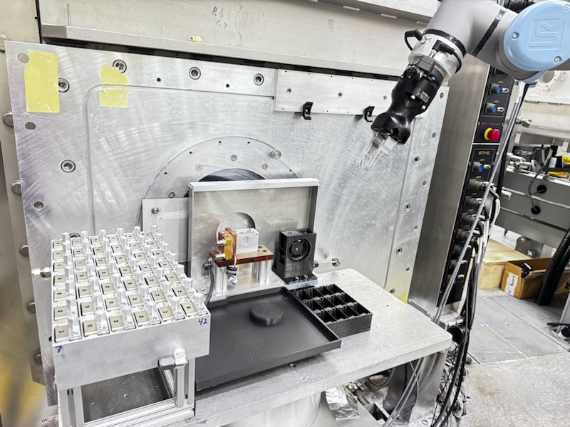
Automation & Precision: The Multi-Axis Robotic Platform at GP-SANS
New multipurpose Robotic changer
Replaces 9 different sample changers
Better changer for use in magnetic fields
ALARA for highly irradiated samples (also in magnetic fields)
Optimize shielding for background reduction
High throughput, reducing manual sample changes
Better optimization of sample environment stimuli (humidity, temperature, lab on table)
Decrease in beam line footprint (post-HBRR)
Future developments:
Automation of sample aperture changes for optimizing beam time
In beam positioning of samples (Raster scans across welds or corrosion points)

Slide 13
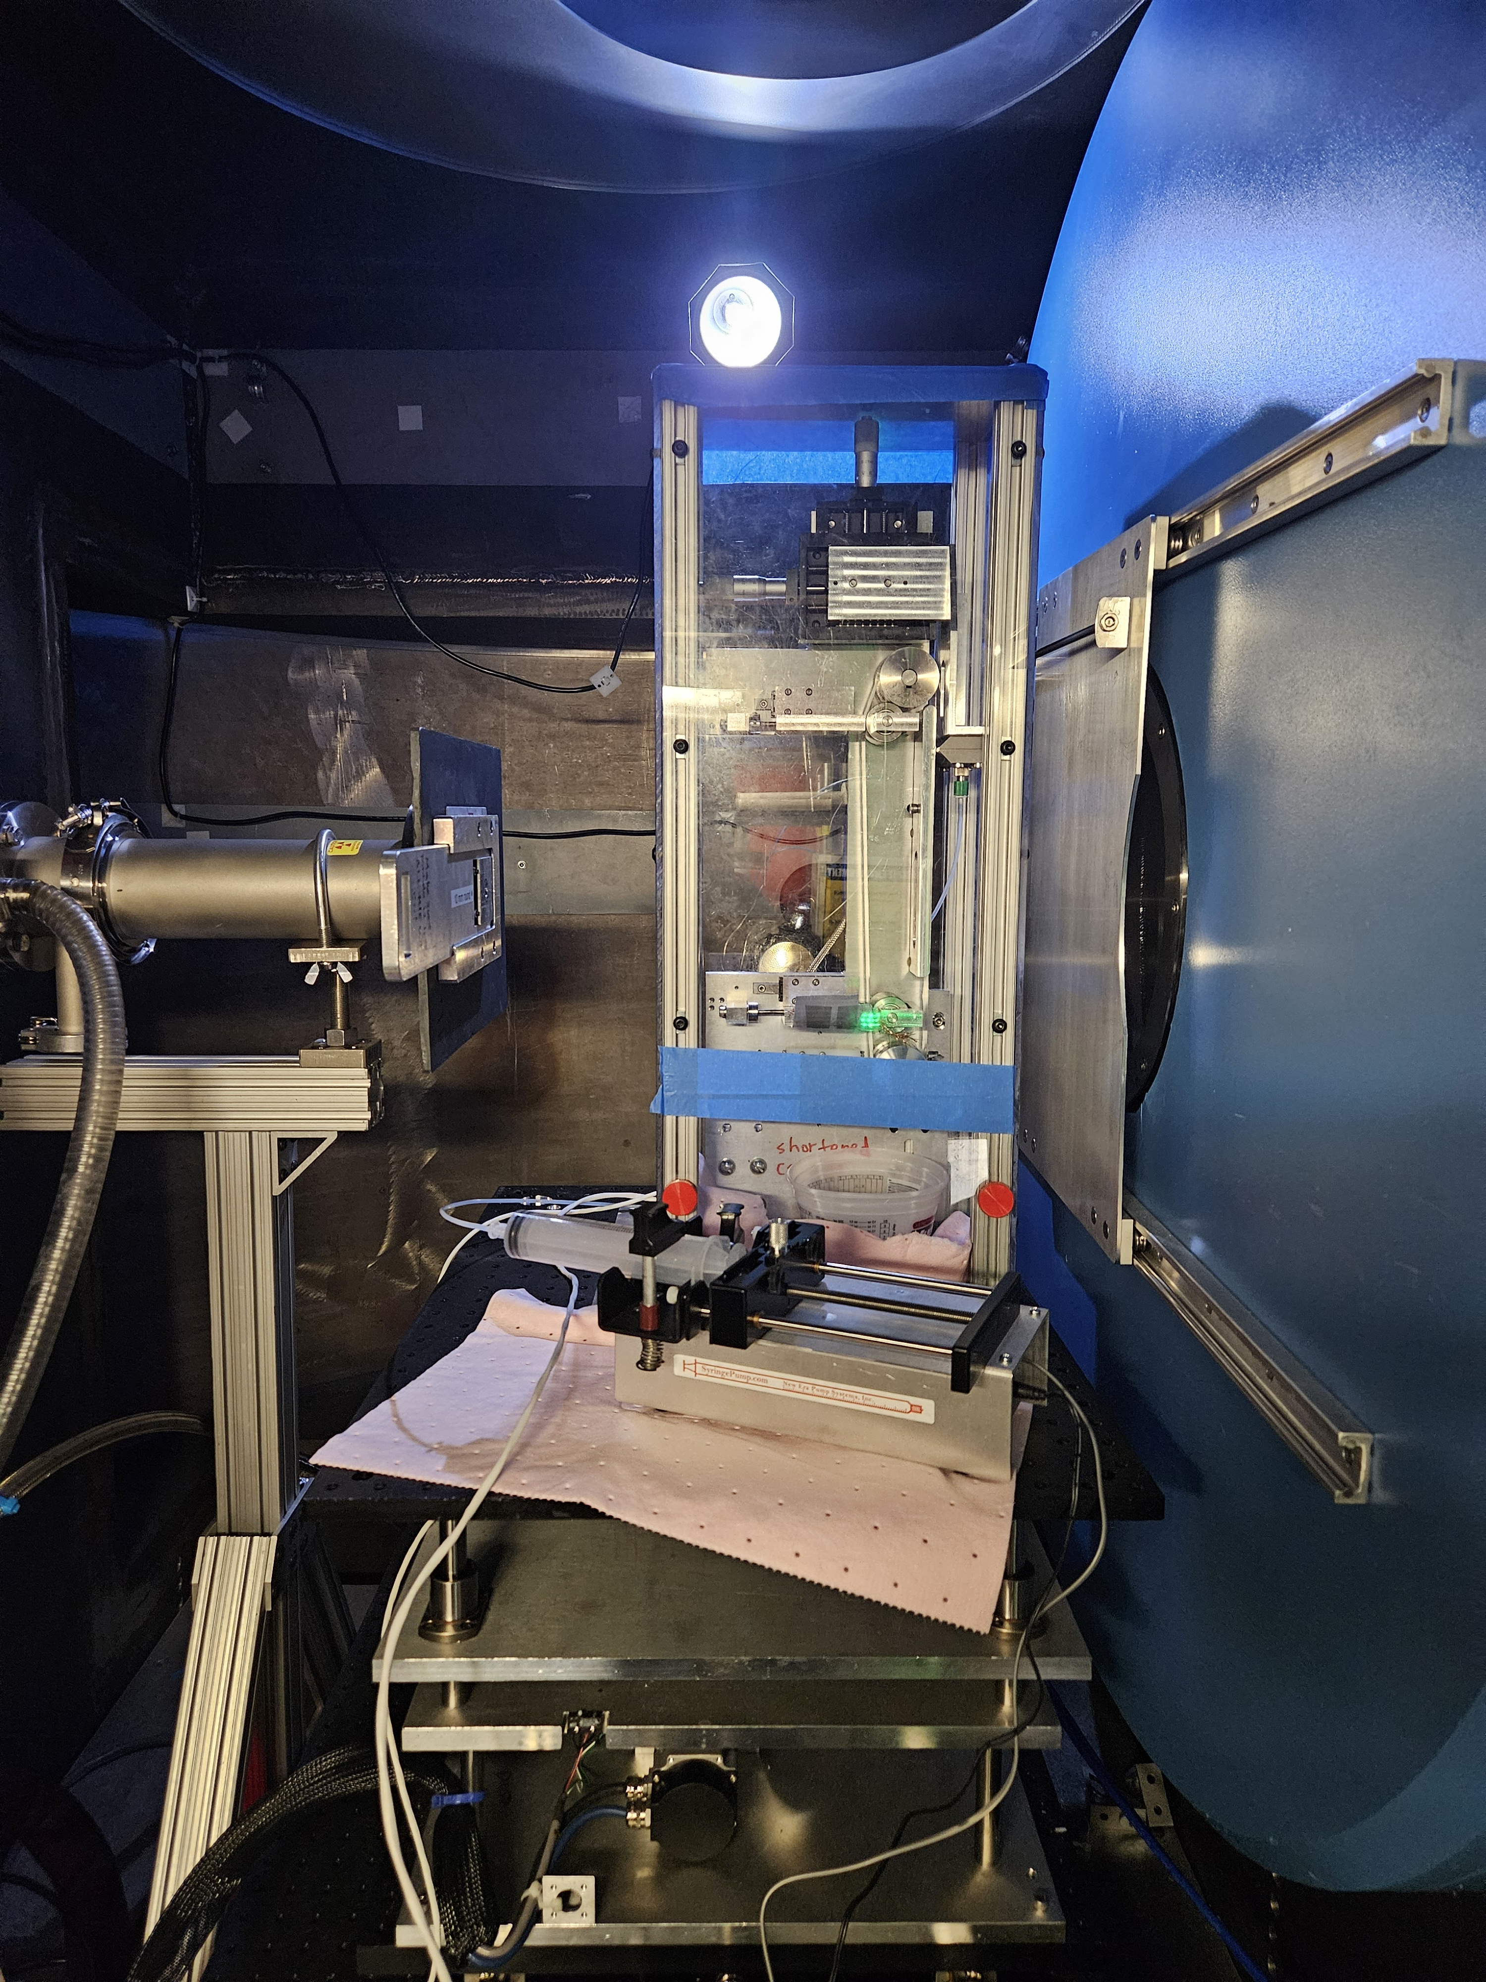
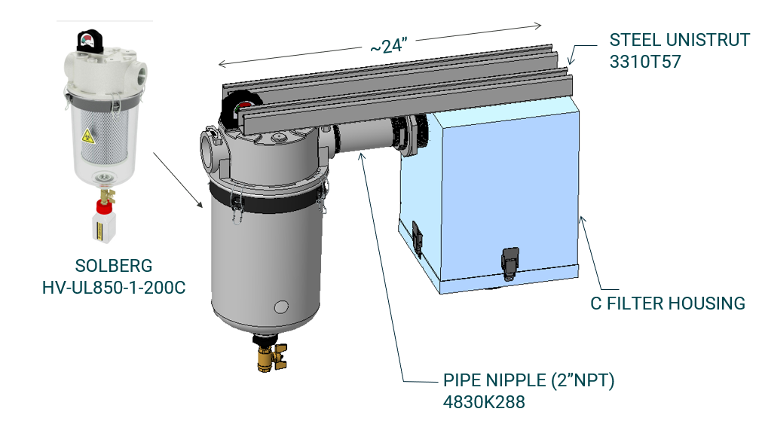
User Inspired SEs
In-situ battery electrode casting
Collaborative development proposal
Safety developments allowing:
Unbound nanomaterial
Flammable solvent
Notes:
Some of our sample environment development is based on unique user requests. For example we have an ongoing Collaborative development proposal with the Northwestern University. This sample environment aims for allowing in situ structural characterization of a battery electrode casting process.
We needed to implement some safety developments too to enable this experiment, such as installation of a removable ventilation system allowing for combined use of unbound nanomaterials and flammable solvents.
You can also see here our first results on the system showing scattering from different concentrations of cellulose nanocrystal solution after subtraction of belts scattering

Slide 14
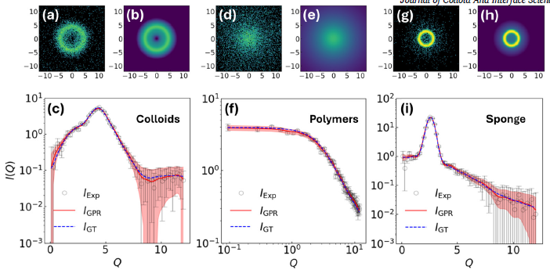
Integration/Application of ML & AI Approaches (Q7)
Augmenting Sparse SANS Measurements with Bayesian Inference
Result of a completed LDRD project “ML-Assisted SANS Data Analysis”
1D High-Fidelity Reconstruction: A "one-shot" GPR approach that reconstructs smooth 1D profiles from sparse data
2D anisotropic Recovery: Extends Bayesian inference to 2D patterns using symmetry-aware basis functions to recover complex features from noisy or occluded detector data
Real-Time Convergence Metric: A dimensionless forecasting tool that predicts optimal measurement duration from early-time data by identifying universal power-law scaling in profile evolution.
(1) Tung, C. H.; Yip, S.; Huang, G. R.; Porcar, L.; Shinohara, Y.; Sumpter, B. G.; Ding, L.; Do, C.; Chen, W. R. Unlocking Hidden Information in Sparse Small-Angle Neutron Scattering Measurements. Journal of Colloid and Interface Science 2025, 692, 137554–137554. https://doi.org/10.1016/J.JCIS.2025.137554.
(2) Tung, C.-H.; Ding, L.; Shinohara, Y.; Huang, G.-R.; Carrillo, J.-M.; Chen, W.-R.; Do, C. A Convergence Metric for Counting Statistics in Time-Resolved Small Angle Neutron Scattering. The Journal of Chemical Physics 2025, 163 (7), 074107. https://doi.org/10.1063/5.0281134.
(3) Tung, C.-H.; Wang, Y.; Carrillo, J.-M.; Shinohara, Y.; Chen, C.-Y.; Lin, J.-M.; Porcar, L.; Murphy, R. P.; Huang, G.-R.; Ding, L.; Do, C.; Chen, W.-R. Bayesian Inference of Anisotropic 2D Small-Angle Scattering from Sparse Measurement. The Journal of Chemical Physics 2025, 163 (15), 154103. https://doi.org/10.1063/5.0291081.

Slide 15

Integration/Application of ML & AI Approaches
User describes experiment intent
ESAC proposes script
User reviews/ modifies
Answer questions about instrument
Search past script
Notes:
Remove this slide

Slide 16
Review Charge Questions
Do the technical capabilities and performance of the individual instruments and instrument suites compare favorably with peer instruments at leading national and international neutron facilities?
Does the scientific productivity and impact of the instrument programs compare favorably with comparable programs at peer facilities?
Do the beamlines meet users’ day-to-day needs for data collection, reduction, and analysis? Are planned software developments sufficient to meet anticipated future user needs?
Is the current scientific portfolio and business case for each instrument competitive nationally and internationally (e.g., user demand, breadth of scientific applications, scientific impact, mission relevance, agency support, and/or industrial engagement)?
Are there a strong and sustainable user community and a clear case for future scientific demand for these instruments? Is the number of beamlines in a suite proportionate to user community demand?
Are the plans for development appropriate and well justified to meet current and future user requirements? Please consider aspects of instrument techniques, sample environments, sample preparation and characterization infrastructure, data analysis and modeling capabilities.
Are there well-defined and credible plans for future automation and integration of artificial intelligence or machine-learning approaches?
Have the strengths, weaknesses, opportunities, and threats for each instrument or suite been clearly identified, and are there realistic plans to address them where feasible?
Are there additional developments, capabilities, or provisions that could enhance the capacity, effectiveness, or scientific impact of diffraction science at SNS and HFIR that were not presented by the instrument teams?
Any other comments or recommendations the panel wishes to provide to the NScD Associate Laboratory Director?

Slide 17


Review Agenda

Slide 18

LSS Beamline Suites Review – nuts & bolts
Review Material: Agenda, Presentations, Additional Documentation: https://conference.sns.gov/event/529/
Some context
Previous suite reviews 2017, 2020
DOE reviews: …, 2018, 2023, 2027
Reviewers:
We can arrange additional discussions as needed.
We request report in 2 weeks.

Slide 19
A few recurring abbreviations…
CIS: Computational Instrument Scientist
SA: Scientific Associate (assigned to a beamline, staff in instrument support section)
SE: sample environment (generally and specifically SE Section)
HBRR: HFIR Beryllium Reflector Replacement
LSS(S): Large Scale Structures (Section)

Slide 20
Questions?
Next up: Group Leader Presentations, Hugh O’Neill, William Heller

Slide 21
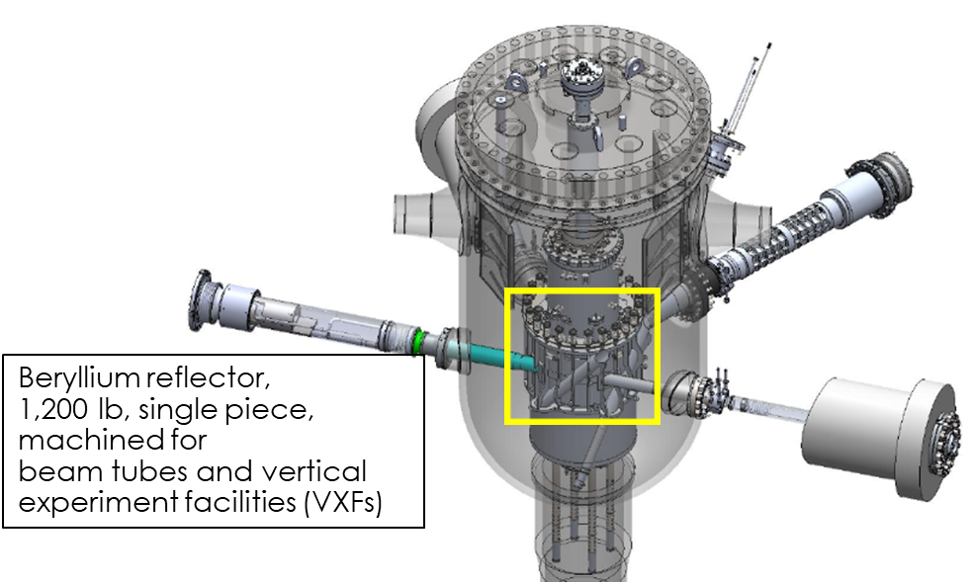
HBRR is critical to HFIR’s continued operations
Be embrittles and swells from fast neutron flux
Replace permanent Be reflector, core components, beam tubes, and cold neutron source
Replace cold neutron guide network
Instrument upgrades

Slide 22
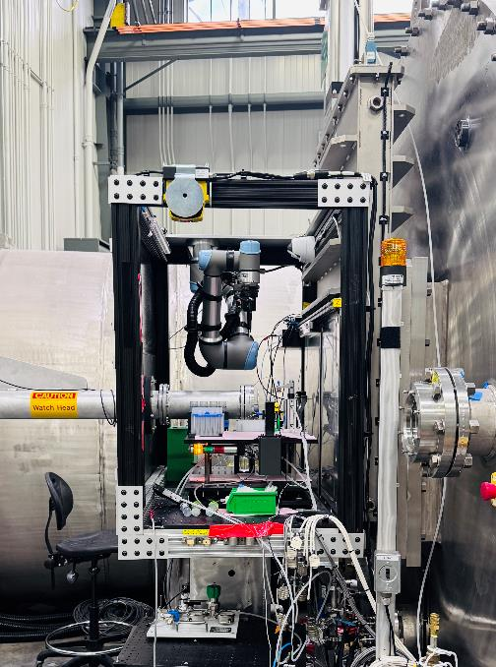
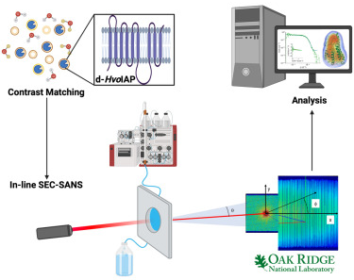
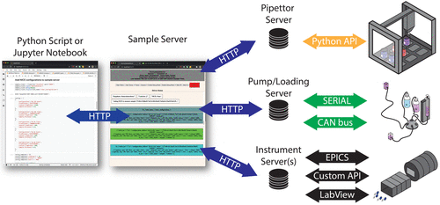
SEC-SANS & SANS AI Auto Sampler
DOE BRAVE funded collaboration with NIST-NCNR (T. Martin, P. Beaucage) and UConn: M-P. Nieh, Q. Yang
96 sample well capacity
AI/ML Model fitting (10 models currently loaded). Minimizes number of measurements to determine phase diagram.
Currently up to 4 components to form complex solution
Testing on CG-3 utilizing existing Universal Robot system
Integrated approach of neutron contrast matching, in-line Size-Exclusion Chromatography-Small Angle Neutron Scattering (SEC-SANS) with broad angular two-detector coverage, and advanced data analysis (DENSS). Example: Discovery of multiple oligomeric states and the monomer solution structure of an intramembrane aspartyl protease protein in detergent and in membrane-like lipid environment.
Installation on Bio-SANS HFIR CG-3
G.M. Thomas, et al., Biophys. J. 123(13), 1846-1856 (2024).
Bio-SANS, HFIR CG-3
Courtesy of NIST/UCONN

Slide 23
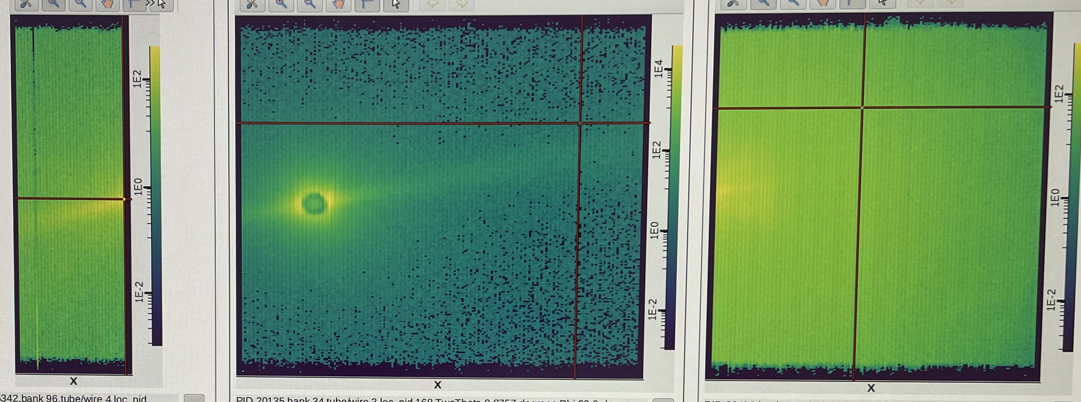
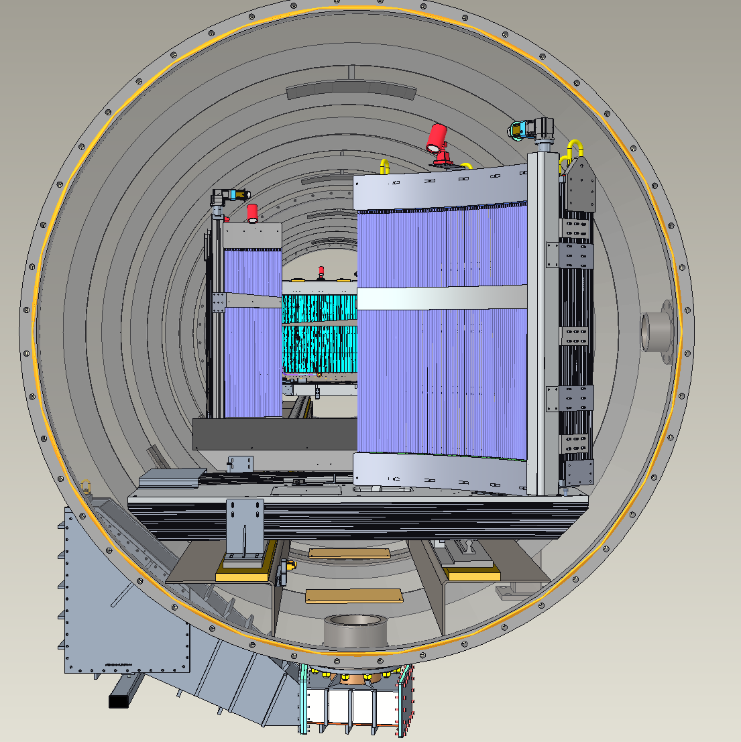
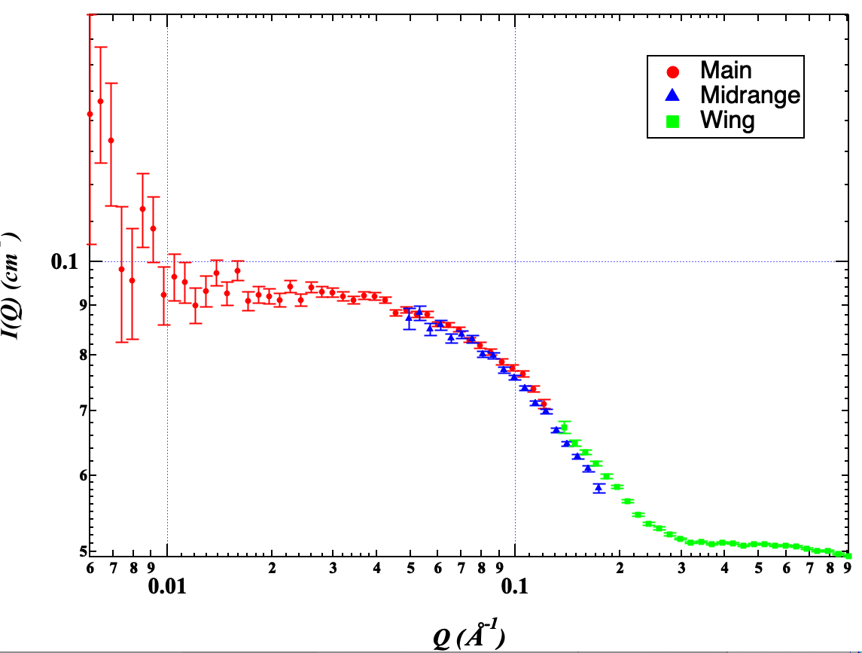
Three-array detector for up to 300 dynamic Q-range at Bio-SANS
Bio-SANS (HFIR CG-3) three detector array
Mid-range
Main
Wing
Mid-range detector installed 2024, completing detector expansion. Better q-resolution matching in data overlap, better data for hierarchical systems, increased angular coverage, sub-minute time resolution.

Slide 24
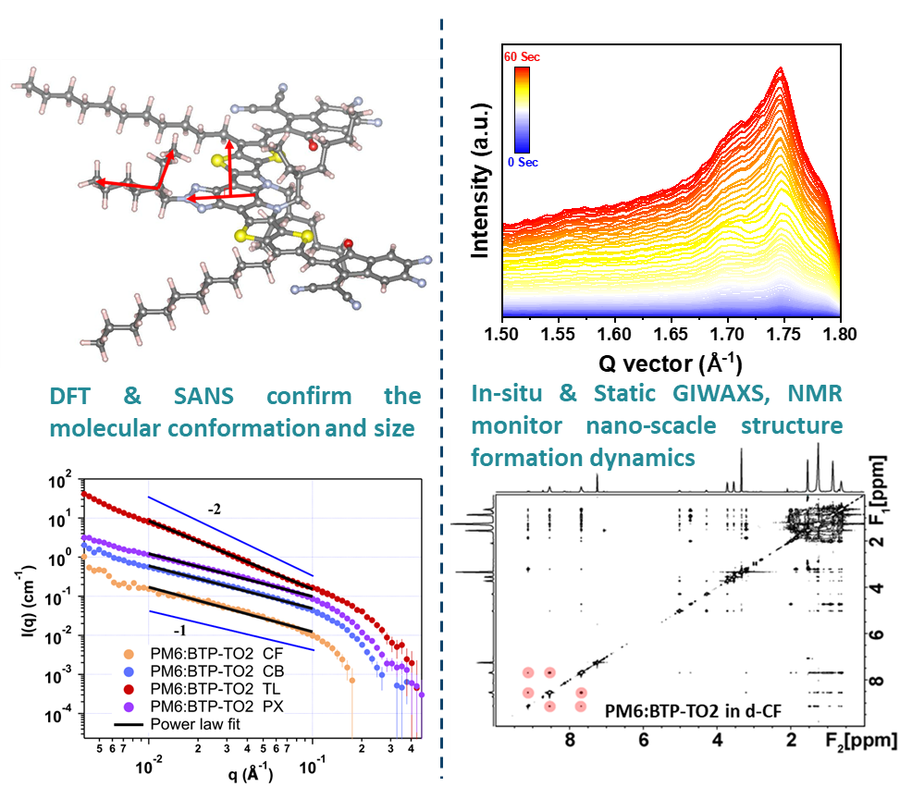




Molecular Strategies for Stable, High-Efficiency Organic Solar Cells
Scientific Achievement
Neutron scattering combined with other advanced characterization techniques reveal the molecular conformation and interactions between components and solvents in organic blends.
Significance and Impact
This work provides new understanding on the morphology control and guidelines to design materials towards practical organic solar cells, where green solvents are required.
Research Details
SANS accurately reveals molecular conformations and interactions across various solutions.
In-situ/static GIWAXS efficiently monitor the nano-scale structure formation dynamics during solvents evaporate.
Design rules related to molecular interaction and conformation are confirmed for effective control of morphological structures in organic solar cells.
Small-angle neutron scattering (SANS) and DFT calculation show molecular conformation and aggregation behaviors in both solution and film states. In-situ and static GIWAXS monitor the molecular packing behavior, and show the molecular interactions linked with NMR during film formation dynamics
R. Zhang, H. Chen, T. Wang, L. Kobera, L. He, Y. Huang, J. Ding, B. Zhang, A. Khasbaatar, S. Nanayakkara, J. Zheng, W. Chen, Y. Diao, S. Abbrent, J. Brus, A. H. Coffey, C. Zhu, H. Liu, X. Lu, Q. Jiang, V. Coropceanu, J. Brédas, Y. Li, Y. Li, F. Gao, Nature Energy 10, 124-134 (2025)
DOI: 10.1038/s41560-024-01678-5
Work was performed at GP-SANS CG-2 BL, ORNL and BL 7.3.3, ALS.
Notes:
In this work, we provide a comprehensive picture of the fundamental factors that determine the morphological structure of organic solar cells (OSC morphology). We develop a novel non-fullerene acceptor material (BO2, which incorporates an oligo (ethylene glycol) (OEG) side chain attached to the central nitrogen atom of its benzotriazole unit, see Fig. 1a) that leads to similar active-layer morphology when processed from a wide range of (halogenated and non-halogenated) solvents and consistently contributes to high PCEs around 19%. By examining both the intrinsic molecular conformations and the interactions in solution and film states at the nano-scale level, we are able to propose general morphological design rules for non-fullerene based OSC blends: (1) Enhance side chain-solvent interactions in small-molecule acceptors. (2) Weaken the intermolecular interactions between the polymer donor and the non-fullerene acceptor in solution. Building on insights from our successful case study, we further generalize our morphological design rules by developing an additional non-fullerene acceptor that also exhibits solvent-independent morphology and improved device performance.
Main Researchers: R. Zhang, F. Gao (Linkoping University, Sweden); L. He (Oak Ridge National Laboratory, Oak Ridge, Tennessee 37831, United States); A. Khasbaatar, Y. Diao (University of Illinois Urbana−Champaign, United States). S. Nanayakkara, V. Coropceanu, J. Bredas (The University of Arizona, United States); A. H. Coffey, C. Zhu (Advanced Light Source, Lawrence Berkeley National Laboratory, Berkeley, United States)
Acknowledgements – This work was supported by the Swedish Strategic Research Foundation through a Future Research Leader programme to F.G. (FFL 18-0322); the National Natural Science Foundation of China (52325307); the Swedish Government Strategic Research Area in Materials Science on Functional Materials at Linköping University (faculty grant number SFO-Mat-LiU #2009-00971); the Wallenberg Initiative Materials Science for Sustainability WISE; Olle Engkvists Stiftelse; the US Office of Naval Research and US Office of Naval Research Global under grant number N62909-23-1-2043; the Office of Naval Research under award numbers N00014-20-1-2110 and N00014-24-1-2114; and the University of Arizona Institute of Energy Solutions and Office for Research, Innovation, and Impact for support via the Arizona Technology and Research Initiative Fund. The 2D NMR measurement and analysis was supported by the Grant Agency of the Czech Republic (grant GA24-10199S). T.W. and Q.J. acknowledge supports by the National Natural Science Foundation of China (number 52130101) and the National Key R&D Program of China (grant number 2023YFB3003001), ‘Xiaomi Young Scholar’ project. H.C. acknowledges the National Natural Science Foundation of China (22309129). The static/in situ 2D GIWAXS data were acquired at beamlines 7.3.3 at the Advanced Light Source, which is supported by the Director, Office of Science, Office of Basic Energy Sciences, of the US Department of Energy (DE-AC02-05CH11231). Y.D. and A.K. acknowledge support by the Office of Naval Research under grant number N00014-22-1-2202. This research used resources at the High Flux Isotope Reactor, a DOE Office of Science User Facility operated by the Oak Ridge National Laboratory. The beam time was allocated to CG2 on proposal number IPTS-31199.1. F.G. is a Wallenberg Scholar. H.L. and X.L. would like to acknowledge the support from the Research Grants Council (RGC) of Hong Kong (number 14304723).
Publication/ press releases/ related links:
https://www.nature.com/articles/s41560-024-01678-5#Ack1
https://liu.se/en/news-item/sa-kan-giftfria-och-effektiva-solceller-tillverkas

Slide 25



Neutron Scattering Reveals the Structure of Networks for Clean Energy Generation and Storage Devices
Scientific Achievement
Neutron scattering studies and large scale atomistic molecular dynamics (MD) simulations reveals the multi-length scale heterogenous structure of polymeric networks driven by assembly of ionizable groups.
Significance and Impact
The fundamental understanding of formation of heterogenous ionizable polymeric networks elucidates the conditions required for the formation of stable polymeric membranes for targeted light-weight energy generation and storage.
a- SANS profiles of polystyrene sulfonate ionomers in toluene, marked by blue and red symbols, together with the calculated static structure factor S(q) from atomistic molecular dynamics computed networks, marked by squares and triangles, at the indicated sulfonation fraction. Solid line corresponds to a fit of the data to a unified model of exponential functions, each capturing features on a given length scale. b- Visualization of the computed networks, where S is yellow, oxygen-red, Na⁺-black and all carbons are blue. Toluene not shown for clarity.
Research Details
SANS studies were carried out on polystyrene sulfonate in toluene. A unified model was used to fit the data determining the hierarchical structure of the networks.
A feedback loop between the exascale MD simulation and SANS analysis was established.
Kosgallana C., Senanayake M., Mohottalalage S. S., Wijesinghe S., He L., Grest G. S., Perahia D., "Clustering Effects on the Structure of Ionomer Solutions: A Combined SANS and Simulations Study", Macromolecules 57, 1688 (2024).
Work performed on HFIR GP-SANS (CG2)
Notes:
The structure of a model ionomer, sulfonated polystyrene in toluene solutions, was investigated as the cluster cohesion was tweaked by the addition of ethanol using a combination of SANS and MD simulations. The static structure factor was correlated with the size of the ionic clusters as the polymer concentration was varied. The method enabled the determination of the structure in these inhomogeneous networks on multiple length scales. We find that across the entire concentration range studied, a network driven by the formation of ionic clusters was formed, where the size of the clusters drives the inhomogeneity of these systems. Tweaking the ionic clusters through the addition of ethanol impacts the packing of the sulfonated groups, their shape, and their size distribution, which in turn, affects the structure of these networks.
Researchers: Kosgallana C, (Clemson University) Senanayake M. (Clemson University ) Mohottalalage SS (Clemson University), Wijesinghe S, (Clemson University) He L, (ORNL) Grest GS, (Sandia National Laboratories) Perahia D. (Clemson University,)
1. Department of Chemistry, Department of Physics, Clemson University, Clemson SC 29634-0973 2. Center of Integrated Nanotechnologies, Sandia National Laboratories, NM, 87185
3. Neutron Scattering Division, Oak Ridge National Laboratory, Oak Ridge, Tennessee 37831, USA
Acknowledgements: DP gratefully acknowledges DOE grant DE-SC0019284 for support. This research used resources at the High Flux Isotope Reactor, a DOE Office of Science User Facility operated by the Oak Ridge National Laboratory. This work benefited from the use of the SasView application, originally developed under NSF award DMR-0520547. SasView contains code developed with funding from the European Union’s Horizon 2020 research and innovation program under the SINE2020 project, grant agreement No 654000. The authors kindly acknowledge the use of computational resources provided by NSF MRI-1725573. This work was made possible in part by advanced computational resources deployed and maintained by Clemson Computing and Information Technology. This research used resources at the National Energy Research Scientific Computing Center (NERSC), a U.S. Department of Energy Office of Science User Facility operated under contract no. DE-AC02-05CH11231. This work was performed, in part, at the Center for Integrated Nanotechnologies, an Office of Science User Facility operated for the U.S. Department of Energy (DOE) Office of Science. Sandia National Laboratories is a multi-mission laboratory managed and operated by National Technology & Engineering Solutions of Sandia, LLC, a wholly owned subsidiary of Honeywell International, Inc., for the U.S. DOEs National Nuclear Security Administration under contract no. DENA-0003525. The views expressed in this article do not necessarily represent the views of the U.S. DOE or the United States Government. This research used resources at the High Flux Isotope Reactor, a DOE Office of Science User Facility operated by the Oak Ridge National Laboratory. The beam time was allocated to CG2 on proposal number IPTS-31694.1 and IPTS-28754.1.
Publication/ press releases/ related links:
“Clustering Effects on the Structure of Ionomer Solutions: A Combined SANS and Simulations Study.” Macromolecules 57 (4), 1688–1698 (2024)
https://doi.org/10.1021/acs.macromol.3c01646

Slide 26
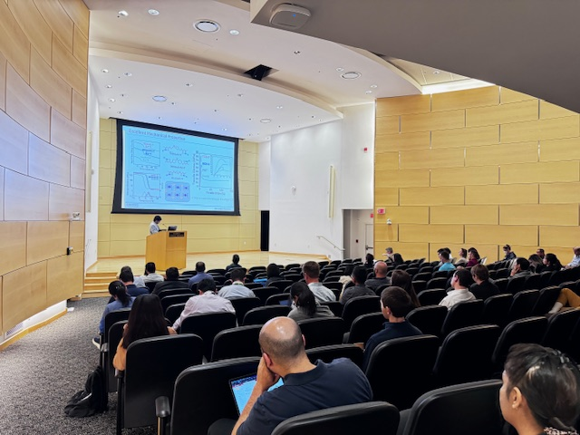
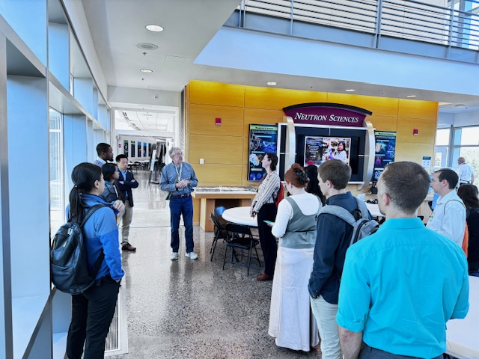
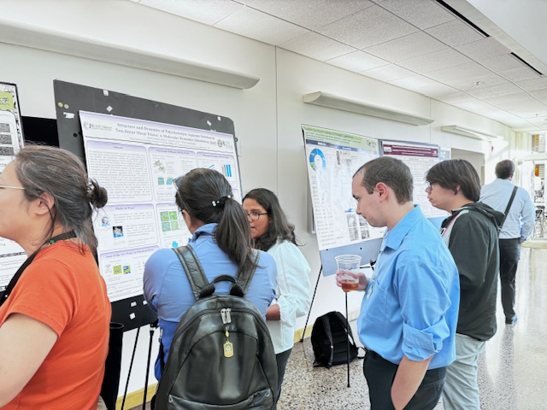
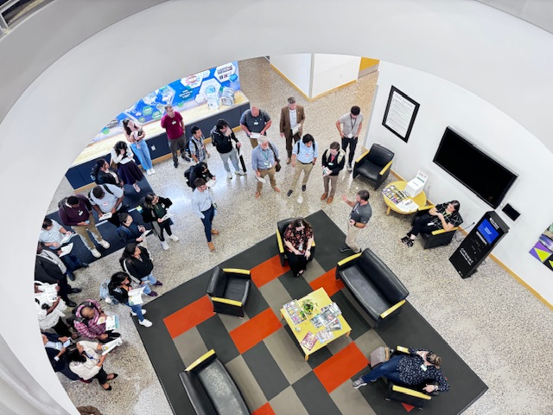
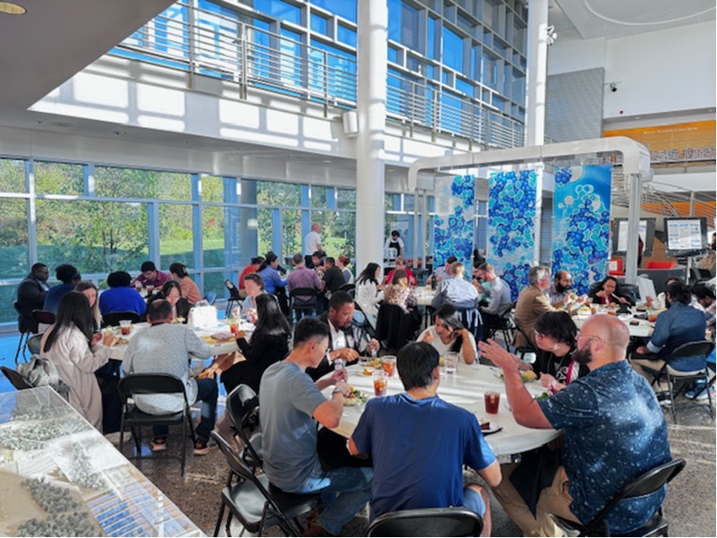
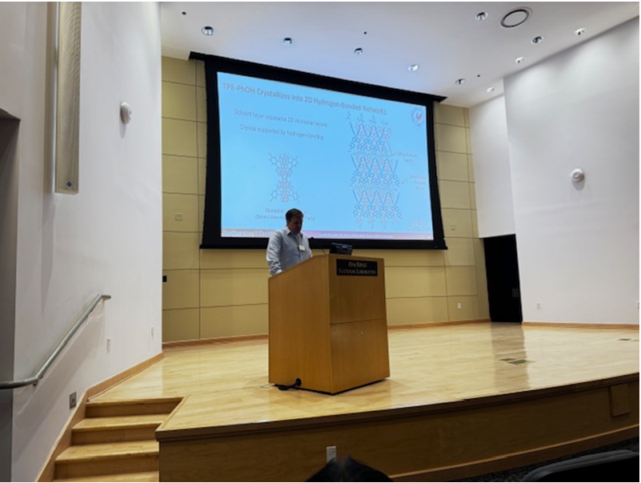
Southeast Polymer Forum 2024
Workshop held Oct. 7-9, 2024, at ORNL
To learn the progress of cutting-edge polymer science and to establish stronger collaboration in the southeast region and beyond. ;
~100 participants registered from universities in the Southeast and ORNL;
2 keynote speakers from Northwest Univ. and MIT, 28 contributed talks, and 36 posters;
Covered the topics associated with the societal challenges, i.e. polymer synthesis, energy storage, material and environmental sustainability, and additive manufacturing;
The participants had roundtable discussions on a few key questions (see later slide).
Next forum will be held at the University of Georgia, 2025?
Group Photo

Slide 27
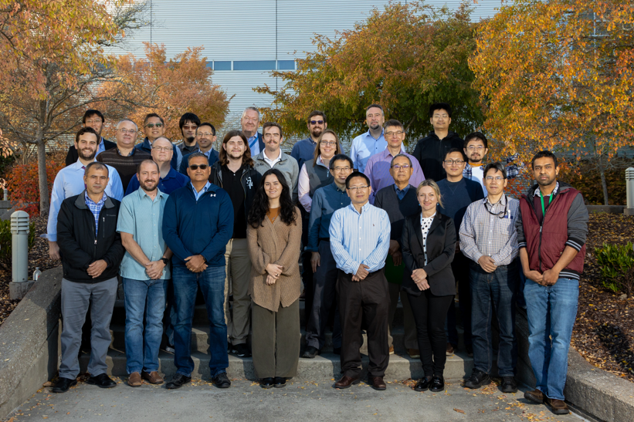
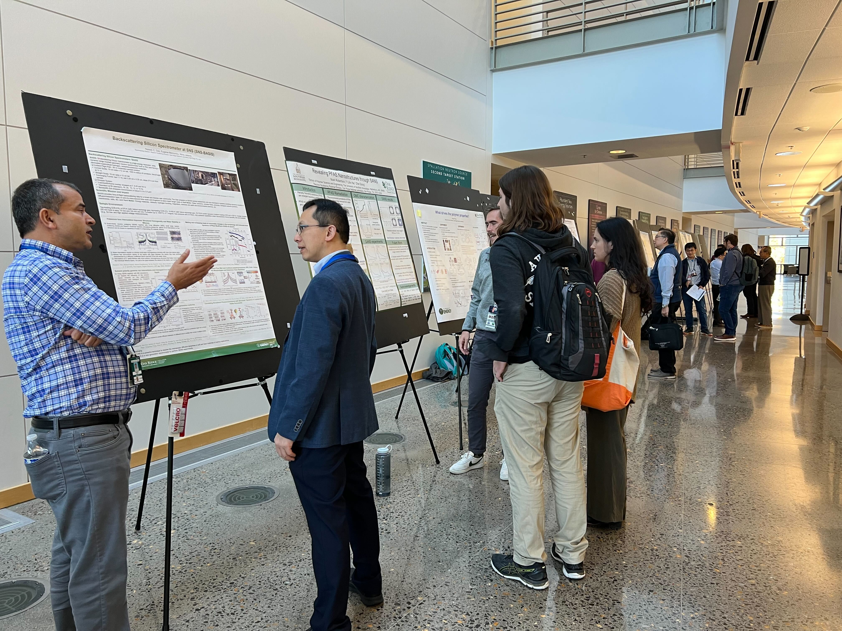
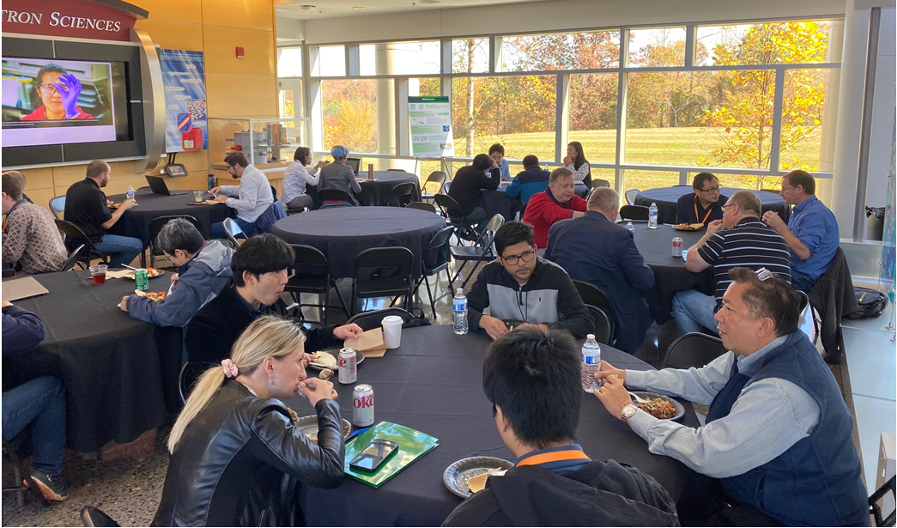
ORNL Soft Matter Symposium 2022
Workshop held Oct. 27-28, 2022, at SNS
Aims to facilitate an exchange of ideas between diverse teams help produce ideas that lead to discoveries and innovations;
Organizing Committee: Lilin He, Alexei Sokolov, Rigoberto Advincula, Bobby Sumpter, Volker Urban, Wim Bras, William Heller, Yangyang Wang, Vera Bocharova, Jihua Chen, Yunqiao (Joseph), Pu, Catalin Gainaru;
~50 registered participants, mostly from ORNL/UTK, three external speakers;
13 invited talks and 11 posters;
Covered the topics associated with the societal challenges, i.e. energy storage, material sustainability, water purification and additive manufacturing;
Formed a soft matter characterization consultant team;
The participants suggested to continue the symposium every 2 years. Tomonori Saito agreed to take the lead for the next one in 2024.

Slide 28
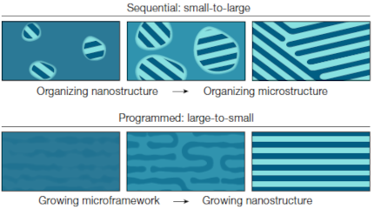




Controlled Large-Scale Growth of Nanosheets
Scientific Achievement
Highly ordered nanosheets can be grown from blends of nanoparticles, small molecules and block copolymer supermolecules by controlling the self-assembly process. The resulting materials have very few defects, making them excellent candidates for high-performance barriers.
Significance and Impact
The newly-developed self-assembly pathway enabled simultaneous self-assembly of nanoscale structures into materials at scale, paving the way for manufacturing these materials for wide-spread use.
Comparison of the assembly pathway of typical sequential growth of nanosheets that produces less well-ordered structures (top) with the developed programmed nanosheet growth mechanism that gives rise to much more ordered structures with fewer defects.
Research Details
Developed a blend of block copolymers, small molecules and nanoparticles and a process that allows for programmed self-assembly
Performed a wide variety of materials characterizations to understand the resulting structure and dielectric performance
Small-angle neutron scattering revealed solution-state structures that were the foundation of the self-assembly
Emma Vargo, L Ma, H. Li, Q. Zhang, J. Kwon, K. M. Evans, X. Tang, V. L. Tovmasyan, J. Jan, A. C. Arias, H. Destaillats, I. Kuzmenko, J. Ilavsky, W.-R. Chen, W. Heller, R. O. Ritchie, Y. Liu and Ting Xu, “Functional Composites by Programming Entropy-Driven Nanosheet Growth,” Nature (2023)
Work performed on SNS BL-1A, BL-6; Advanced Photon Source, Advanced Light Source, Molecular Foundry
Notes:
Summary
In traditional self-assembly of nanomaterials into large scale structures, nanoscale structures first form locally and grow before assembling into larger-scale structures. Ting Xu’s group (LBNL and UC-Berkeley) has developed a way to reverse the order of the self-assembly process. The framework for the large-scale structure forms first, before the nanostructure assembles within it. Such a “programmable” self-assembly process made it possible to form highly regular nanoscale structures in thin films. The programmable approach to self-assembly of nanomaterials has great potential for creating advanced materials.
The materials presented in the published work are composed of zirconium oxide nanoparticles, 3-pentadecylphenol (a small molecule and abbreviated PDP) and supermolecules based on polystyrene-block-poly(vinyl pyridine) block copolymers hydrogen bonded with PDP. The materials start co-dissolved in chloroform, which small-angle X-ray and neutron scattering revealed to be molecular aggregates at low concentration (10 vol%) and well-defined lamellar structures at high concentration (30 vol%). X-ray photocorrelation spectroscopy confirmed that the nanoparticle diffusion changes with the concentration. The drying of the solutions into thin films results in a highly ordered structure, as revealed by transmission electron microscopy and grazing transmission small-angle X-ray scattering. The resulting arrays of nanosheets have very few defects that disrupt the stack of nanosheets, and the kind of defect formed can be controlled via the programmable self-assembly process. The films perform quite well as barrier materials for volatile organic compounds when placed over porous Teflon membranes. The films also exhibit excellent dielectric breakdown strengths, which makes them excellent materials for capacitors. Interestingly, the films are highly recyclable. They can be dissolved in an organic solvent and recast into a new nanosheet film.
Work was performed at
XXX at Oak Ridge National Laboratory’s Spallation Neutron Source, Argonne National Laboratory’s Advanced Photon Source, and Lawrence Berkeley National Laboratory’s Advanced Light Source and Molecular Foundry, DOE Office of Science User Facilities.
Collaborating Institutions
¹Department of Materials Science and Engineering, University of California, Berkeley, Berkeley, CA, USA.
²Materials Sciences Division, Lawrence Berkeley National Laboratory, Berkeley, CA, USA.
³The Molecular Foundry, Lawrence Berkeley National Laboratory, Berkeley, CA, USA.
⁴Advanced Photon Source, Argonne National Laboratory, Lemont, IL, USA.
⁵Department of Mechanical Engineering, University of California, Berkeley, Berkeley, CA, USA.
⁶Department of Chemistry, University of California, Berkeley, Berkeley, CA, USA.
⁷Energy Technologies Area, Lawrence Berkeley National Laboratory, Berkeley, CA, USA.
⁸Department of Electrical Engineering and Computer Sciences, University of California, Berkeley, Berkeley, CA, USA.
⁹Spallation Neutron Source, Oak Ridge National Laboratory, Oak Ridge, TN, USA.
Acknowledgements – This work was funded by the U.S. Department of Energy, Office of Science, Office of Basic Energy Sciences, Materials Sciences and Engineering Division, under Contract DE-AC02-05-CH11231 (Organic–Inorganic Nanocomposites KC3104). EV was supported by the Department of Defense through the National Defense Science & Engineering Graduate (NDSEG) Fellowship Program. JJ was supported by a National Science Foundation Graduate Research Fellowship under Grant No. DGE 1752814. HD and XT acknowledge support from the Laboratory Directed Research and Development (LDRD) program under the Contract No. DE-AC02-05CH11231. Membrane fabrication for VOC and water permeability testing was supported by the Defense Threat Reduction Agency under Contract No. HDTRA1-22-1-0005. A portion of this research used resources at the Spallation Neutron Source, a DOE Office of Science User Facility operated by the Oak Ridge National Laboratory, the Advanced Photon Source operated by the Argonne National Laboratory, under Contract No. DE-AC02-06CH11357, the Advanced Light Source and the Molecular Foundry operated by the Lawrence Berkeley National Laboratory under Contract No. DE-AC02-05CH11231. We thank Prof. Andrew Minor for providing access to the nanoindentation measurements.
Publication/ press releases/ related links:
“Functional Composites by Programming Entropy-Driven Nanosheet Growth”
Emma Vargo^{1,2}, Le Ma^{1,2}, He Li^{2,3}, Qingteng Zhang⁴, Junpyo Kwon^{2,5}, Katherine M. Evans⁶, Xiaochen Tang⁷, Victoria L. Tovmasyan¹, Jasmine Jan⁸, Ana C. Arias⁸, Hugo Destaillats⁷, Ivan Kuzmenko⁴, Jan Ilavsky⁴, Wei-Ren Chen⁹, William Heller⁹, Robert O. Ritchie^{1,2,5}, Yi Liu^{2,3} and Ting Xu^{1,2,6}
Nature (in press) DOI: https://doi.org/10.1038/s41586-023-06660-x

Slide 29
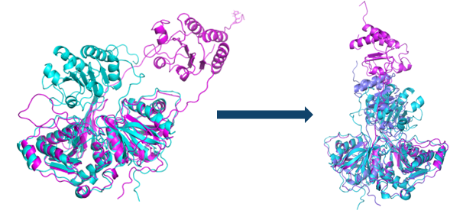
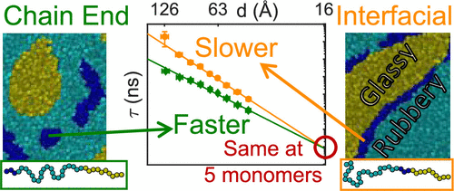

Interfaces impact polymer dynamics
Dynamic structure in redox proteins
Monomers near the interface between flexible and rigid portions of a block copolymer have slower dynamics than those away from the interface. The origin of this complex behavior was explained by combining neutron scattering and coarse-grained molecular dynamics simulations.
M. Goswami, et al., Macromolecules 56, 762-771 (2023)
SANS identified new bf-ETF conformations that facilitate rapid interconversion between functional states, enabling efficient electron bifurcation.
S. A. Khan, et al., Chem. Sci. 15, 18796-18817 (2024)
Bio-SANS (HFIR CG-3)
Bio-Deuteration Lab
EQ-SANS & NSE (SNS BL-6 & 15)
Notes:
Could expand columns upwards – no need for a top headline or so, then can fit pub info for the third item.

Slide 30
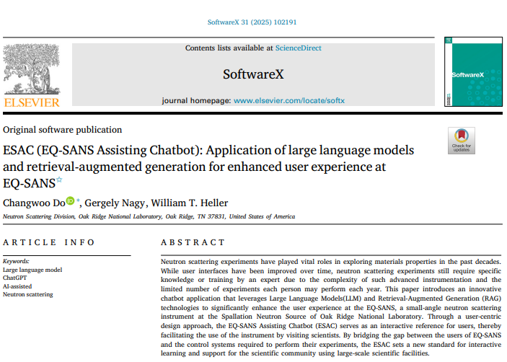
Integration/Application of ML & AI Approaches (Q7)
ESAC: AI-Assisted Chatbot for EQ-SANS Users
Domain-specific AI chatbot
Help users:
Write experiment scripts
Understand instrument functions
Produces transparent, editable scripts
User Workflow
User describes experiment intent
ESAC proposes script
User reviews/ modifies
Script executed normally
Data collected as usual

Slide 31
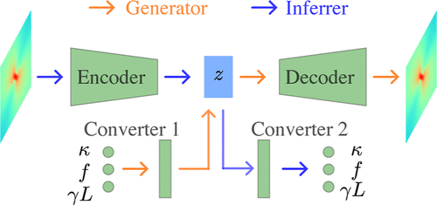
Integration/Application of ML & AI Approaches (Q7)
Machine Learning-Assisted SANS Analysis
Result of a completed LDRD project “ML-Assisted SANS Data Analysis”
ML models developed for:
Interacting polydisperse hard spheres
Charged polymers
Interacting charged spheres
Lamellar phases
Ladder polymers
Mechanically driven polymers
Interacting hard rods (in progress)
[1] Tung, C. H. et al. Inferring effective electrostatic interaction of charge-stabilized colloids from scattering using deep learning. Journal of Applied Crystallography 57, 1047–1058 (2024).
[2] Tung, C.-H. et al. Insights into distorted lamellar phases with small-angle scattering and machine learning. J Appl Crystallogr 58, 523–534 (2025).
[3] Ding, L., Tung, C.-H., Sumpter, B. G., Chen, W.-R. & Do, C. Machine learning inversion from scattering for mechanically driven polymers. J Appl Crystallogr 58, 1526–1532 (2025).
[4] Ding, L., Tung, C.-H., Sumpter, B. G., Chen, W.-R. & Do, C. Deciphering the Scattering of Mechanically Driven Polymers Using Deep Learning. J. Chem. Theory Comput. 21, 4176–4182 (2025).
[5] Ding, L., Tung, C.-H., Carrillo, J.-M. Y., Chen, W.-R. & Do, C. Machine learning inversion from small-angle scattering for charged polymers. Digital Discovery 10.1039.D5DD00038F (2025) doi:10.1039/D5DD00038F.
[6] Ding, L. et al. Machine learning-assisted profiling of a kinked ladder polymer structure using scattering. Digital Discovery 4, 1570–1577 (2025).
[7] Ding, L. & Do, C. Deciphering the small-angle scattering of polydisperse hard spheres using deep learning. APL Machine Learning 3, 036112 (2025).

