Slide 1
USANS Suite Review
Wei-Ren Chen
Gernot Rother
Yingrui Shang
Carrie Gao
February 9th 2026

Slide 2
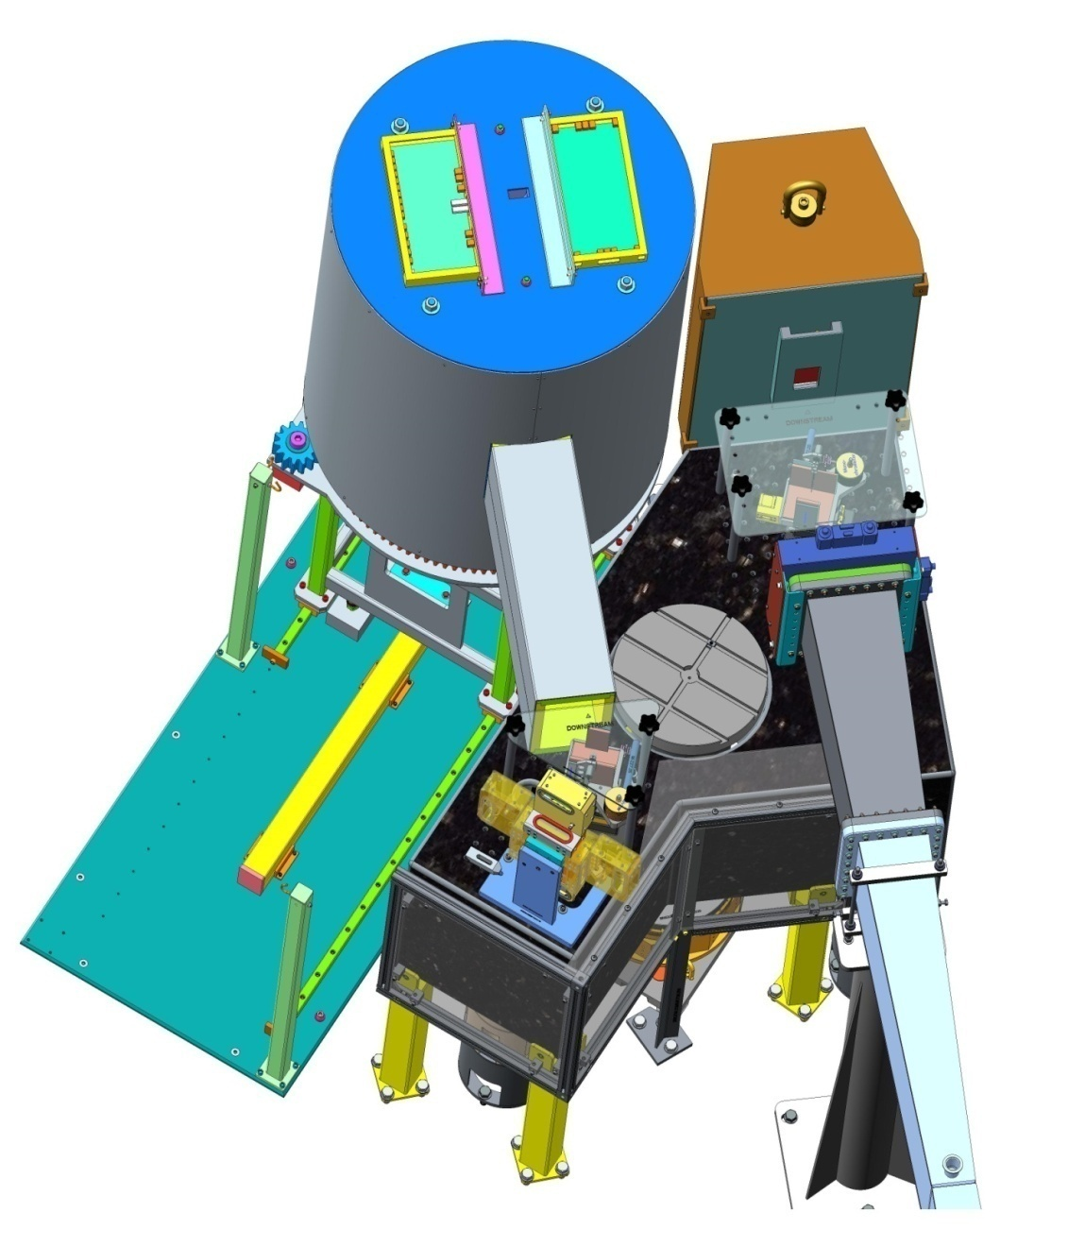
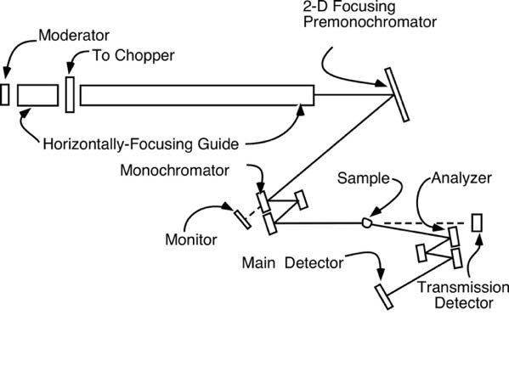
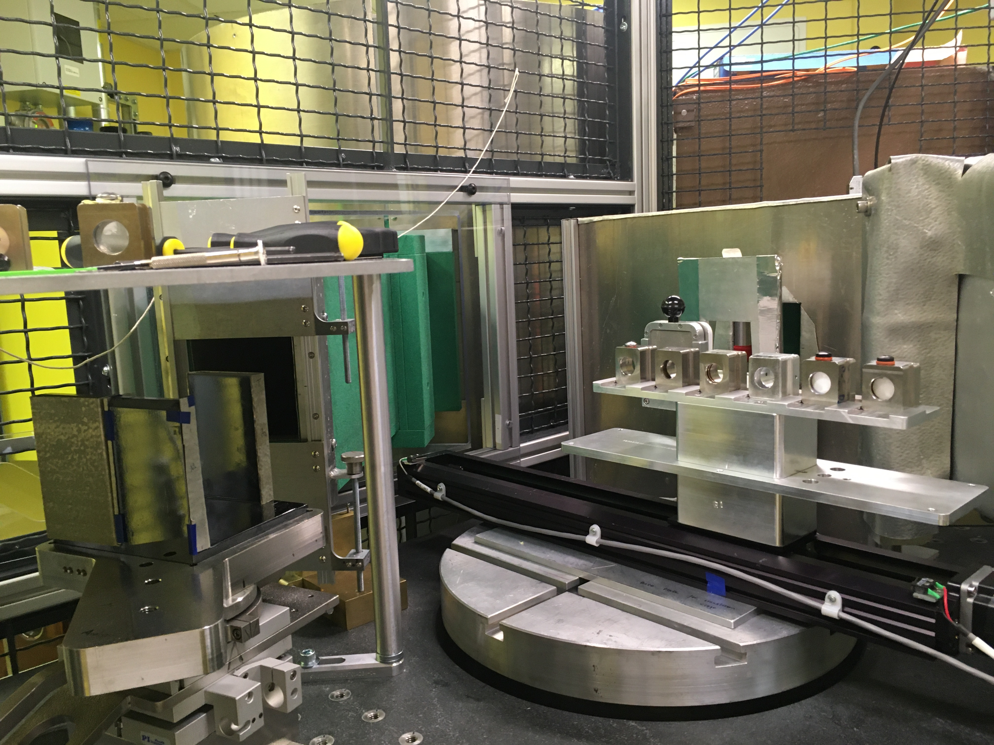
The USANS Instrument at BL-1A: Time of Flight Double Crystal Diffractometer on Si(220) Triple-Bounce Crystals
Beam
stop
Main
detector
Beam
monitor
Si(220)
channel-cut
crystals
Sample
position
Transmission
detector
Vibration
isolation
table
Flight
tube

Slide 3
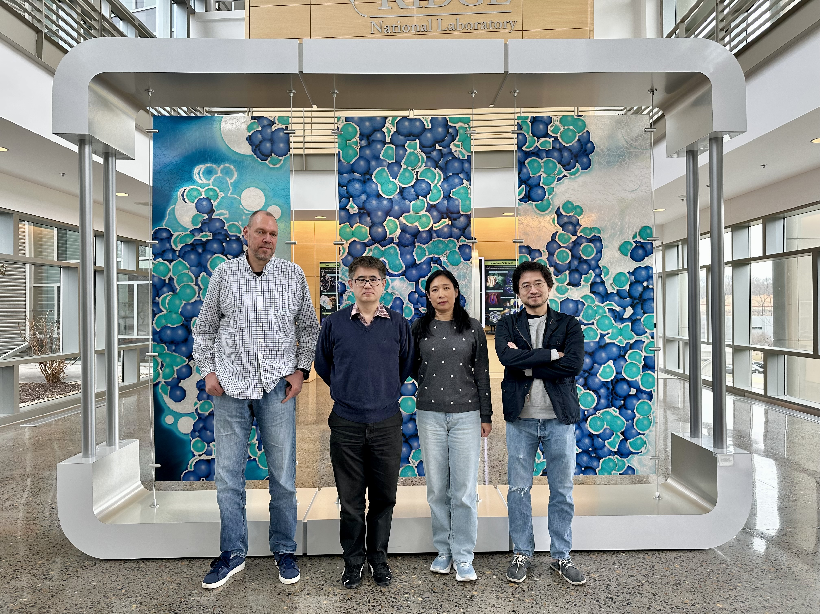
USANS Instrument Team
Gernot Rother Wei-Ren Chen Carrie Gao Yingrui Shang

Slide 4
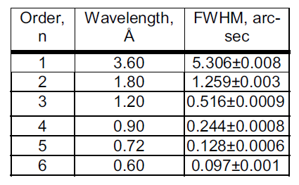


Q Range Accessed by USANS at SNS
$3×{10}^{−5}≤Q≤3×{10}^{−3}$ Å⁻¹
$$Q \left(Å^{−1}\right)$$

Slide 5
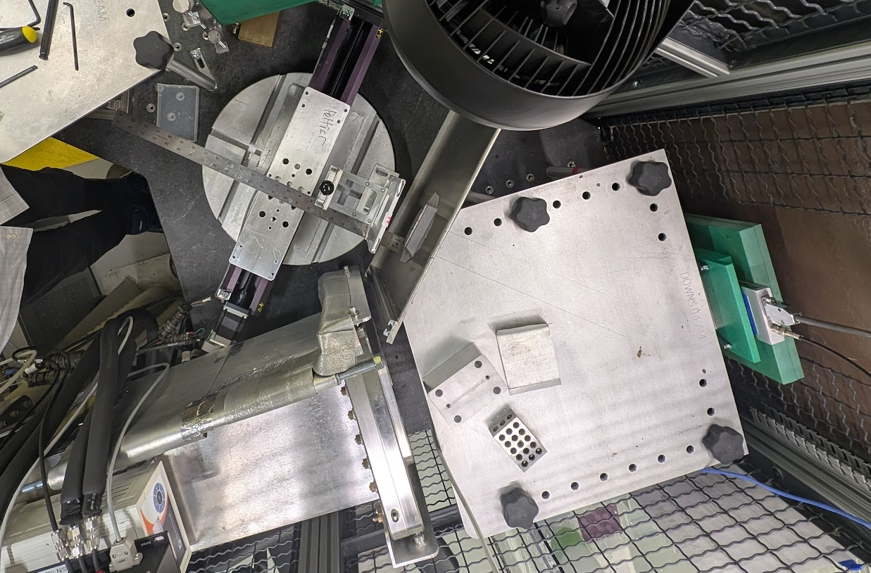
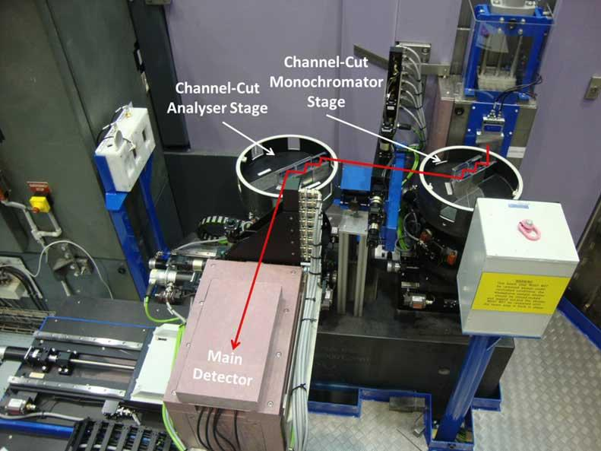
Technical Capabilities: Comparison BL1A USANS to KOOKABURRA
 | Kookaburra | BL1A USANS
Wavelength (Å) | 4.74 2.37 | 3.6, 1.8, 0.9,…
TOF harmonics selection/resolution | No | Yes
Peak neutron flux at sample position | 190 k n/s (4.74 Å) 23 k n/s (2.37 Å) | Ca. 100 k n/s (3.6 Å)
Minimum Q | 3E-5 | 3E-5
TOF Background reduction | No | Yes
Filters | Yes | No
Crystals | Quintuple bounce | Triple bounce
SNS BL-1A accommodates a wide range of sample environments while Kookaburra is quite compact and limited to translation stage

Slide 6
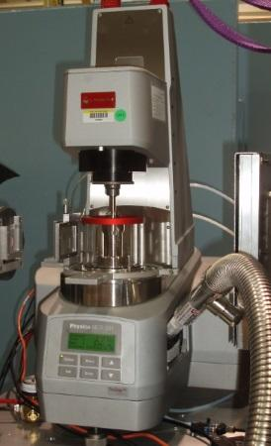
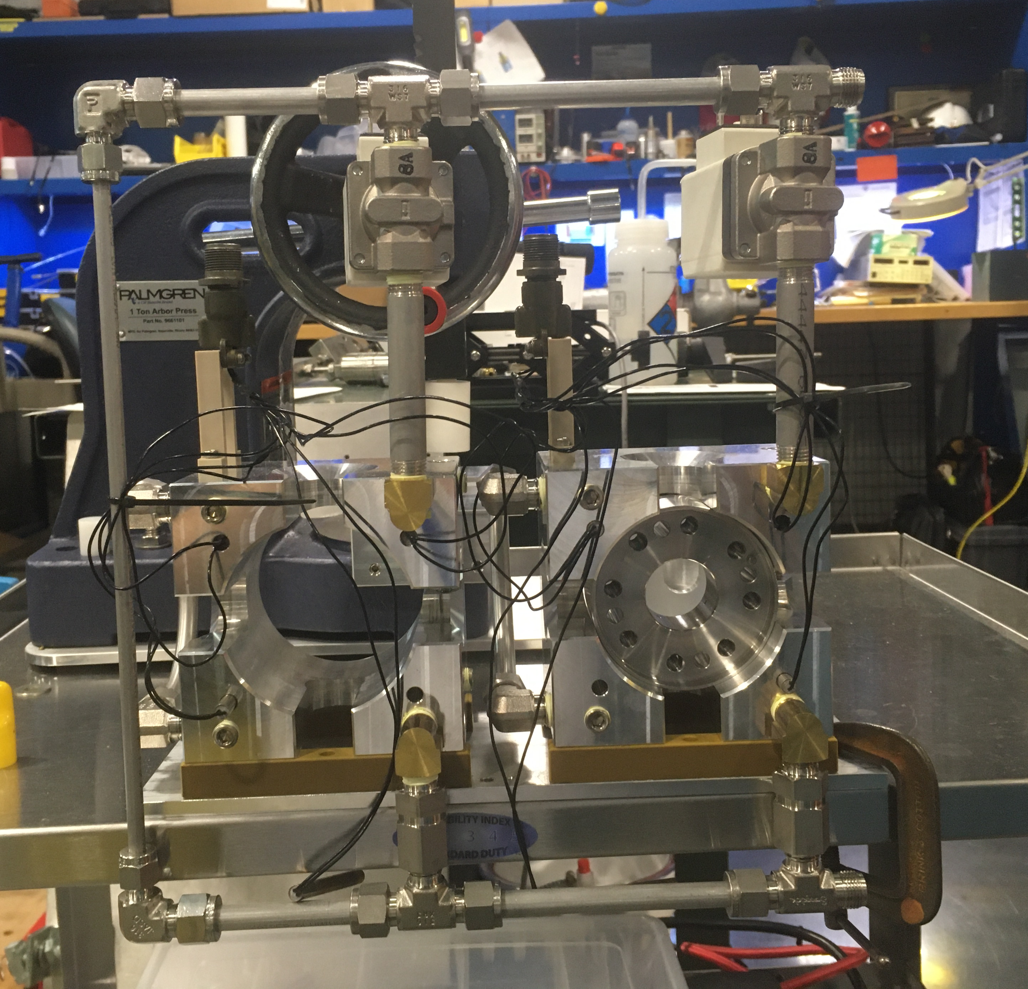
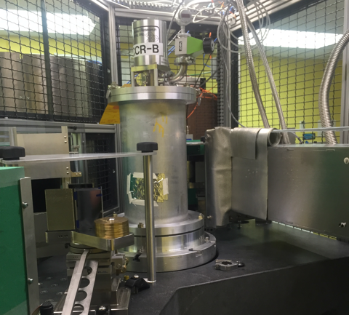
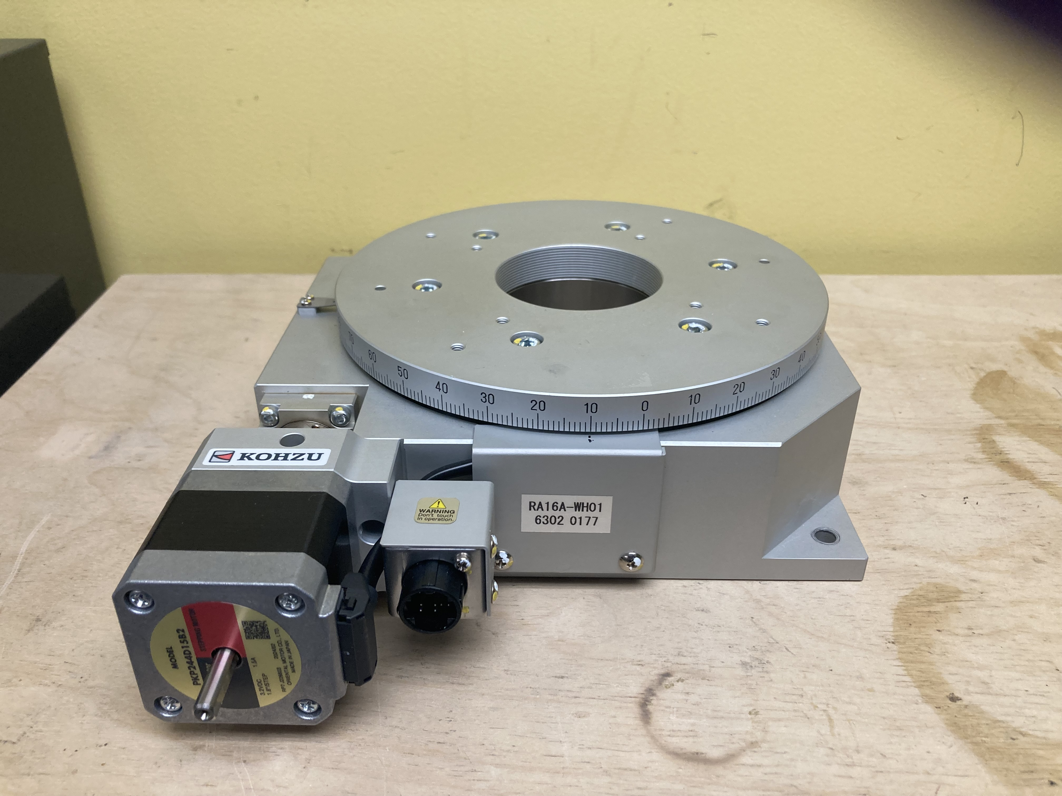
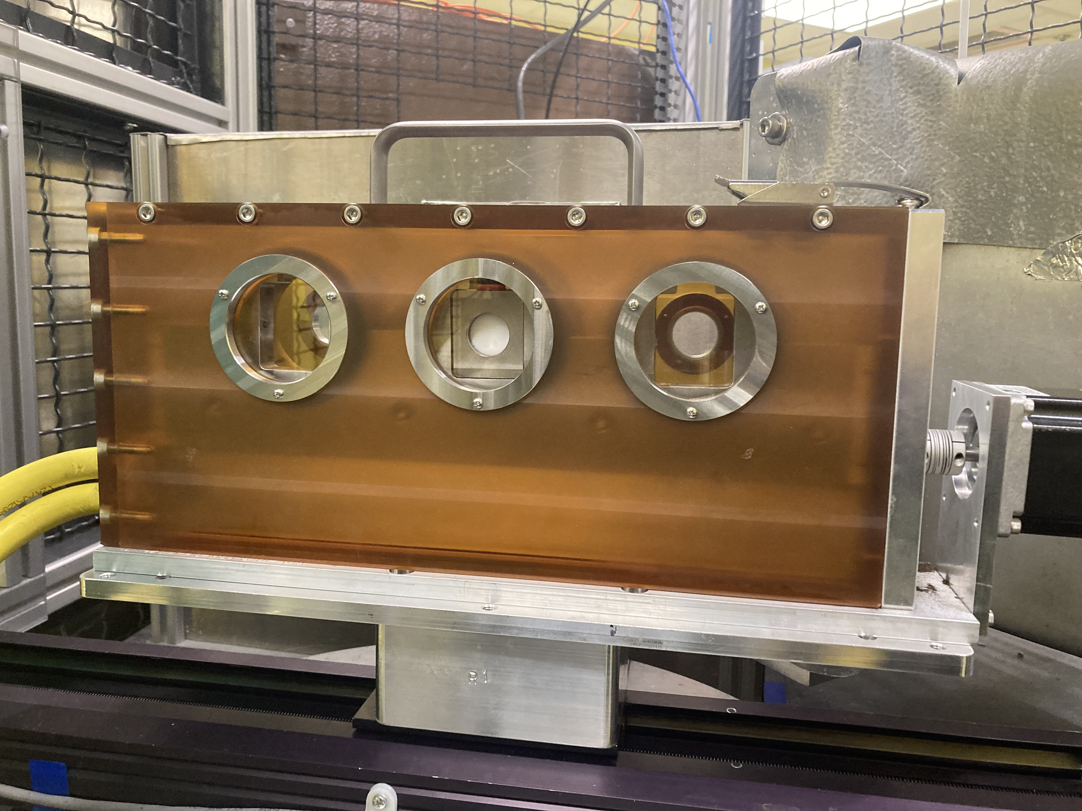
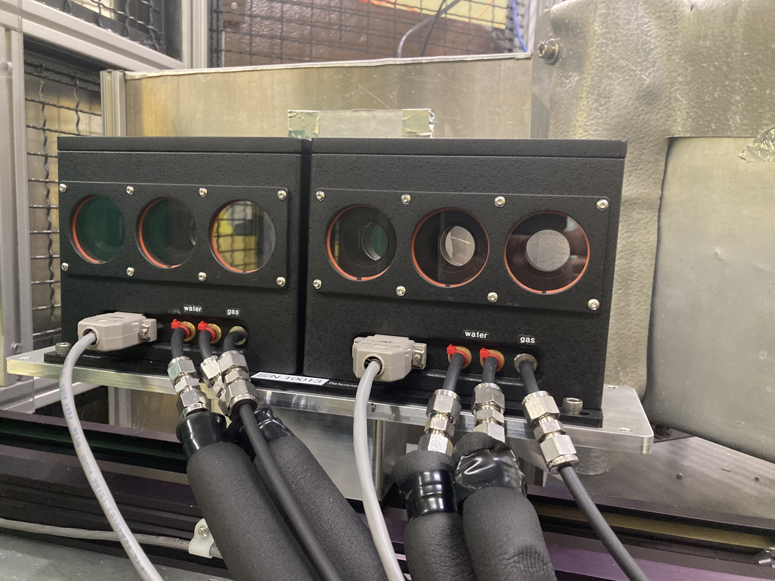




Sample environments (Q6)
Rheometer
Shear rate ${10}^{−3}<\dot{γ}<{10}^{3} s^{−1}; τ=0.2 N∙m$
Pressure Cell
$$P=4 kbar$$
Closed Cycle Refrigerator
Down to 6K
Rotation stage
$$0<θ<{60}^{o}$$
3 Position Tumbler
6 Position Peltier
$$5<T<{80}^{ o}C$$

Slide 7
Typical Science at USANS
Characterization of porosity and Pore-confined Matter
Multi-scale characterization of rock porosities
Characterization of porosity in corrosion systems
Fluid accumulation / phase separation in large pores
Colloidal Chemistry / Polymers
Suspensions and dispersions (carbons in mineral oil under shear)
Long-range interactions in colloidal systems, lyotropic systems
Structure of battery electrolytes / electrodes / SEI
Particle Characterization

Slide 8
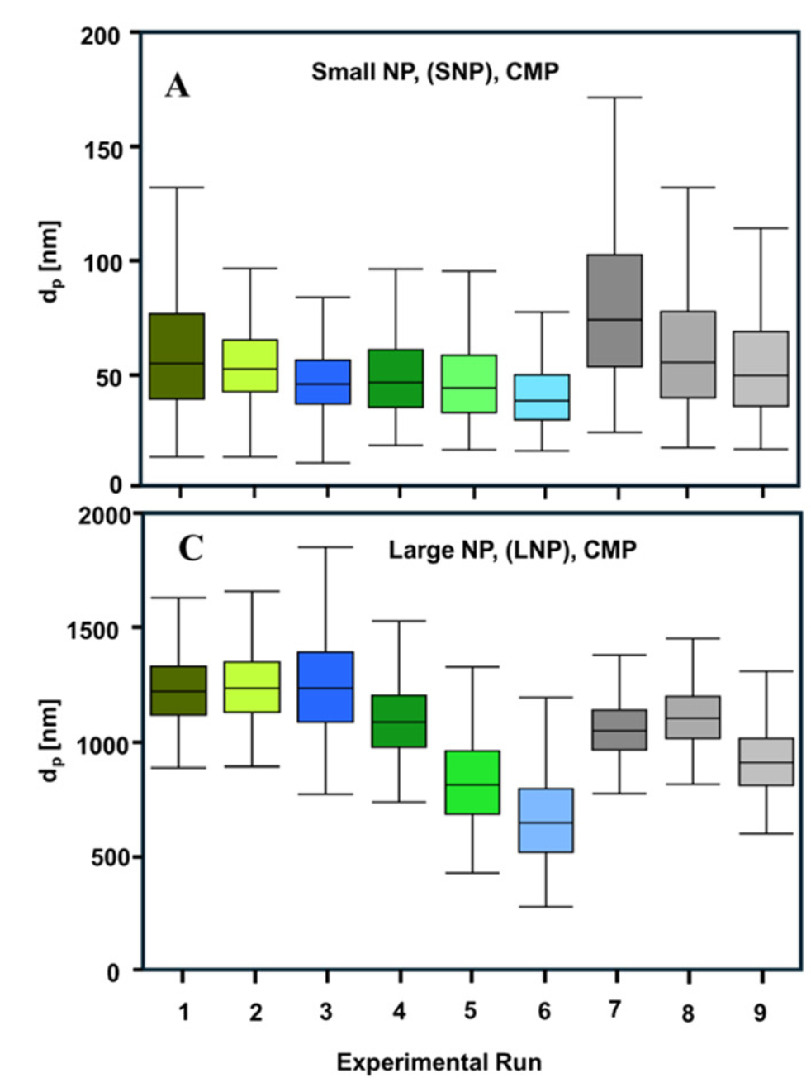


(U)SANS elucidates the fate of nanoplastics in soil
Scientific Achievement
Weathering of small and large plastics nanoparticles (NP) was studied under agitation in clay soil. While small NP were stable, large NP broke up – indicating potential for increased mobility of even large NP in vadose zones.
Significance and Impact
Transport of NP in the environment controls pesticide and other toxicants migration but is still poorly understood.
Research Details
  Size distributions of nanoplastics in soil slurries were measured using H/D contrast matching techniques unique to neutron scattering, enabling NP size measurements unimpeded by soil presence.
(U)SANS-derived size distributions for NP in soil (experiments 4-6). The sizes of large NP shrink with increased agitation time while small NP remain unaffected.
A. Astner, et al, Environ. Sci. Nano (2025), doi:10.1039/d4en01199f.
Work was performed at USANS BL-1A, Bio-SANS
Notes:
1-2 paragraph description of highlight – NOT the abstract of the paper… more like talking points for a non-expert speaker using the slide that summarize the most important aspects .
The paper by Astner et al simulates the fate of nanoplastics in the environment. Neutron scattering is uniquely suited for this study as the use of H/D contrast variation allows detailed measurements of NP size distributions in the slurry with simulated soil. Large and small plastics nanoparticles were studied
for their mechanical stability in stirred soil slurries, simulating convective transport near soil-water interfaces in vadose zones. 1% NP slurries were prepared in water (experiments 1-3) and 0.05% vermiculite (experiments 4-6, and 5% NP were mixed with 0.05% vermiculite (experiments 7-9). SANS and USANS data were taken after 0, 24, and 168 h of stirring, and analyzed for the sizes of NP. Contrast matching was applied to mask out the scattering from vermiculite soil, which was critical for the analysis and a unique capability of neutron scattering.
The results are summarized in the Figure. For small NP, the size distributions showed little change with stirring in all 3 experiments, indicating that small NP are mechanically stable in environmental settings. However, large NP – which are expected to have low mobility – were shown to break upinto smaller, more mobile particles. Understanding the mobility of NP in the environment is of great importance for their role in contaminant transport. Environments similar to those simulated in this study are found near watersheds, and more generally, in vadose zones.
Researchers: Anton Astner, Douglas Hayes (University of Tennessee, Knoxville); Sai Venkatesh Pingali, Hugh O’Neill, Barbara Evans, Volker Urban, Kenneth Littrell (Oak Ridge National Laboratory)
Acknowledgements: Grant 2020-67019-31167), UTIA SPRINT Program, the Herbert College of Agriculture, the Biosystems Engineering and Soil Department, and the Science Alliance at the University of Tennessee, Knoxville, TN. Measurements on Bio-SANS were supported by the
Center for Structural Molecular Biology, funded by the DOE Office of Biological and Environmental Research through Field Work Proposal (FWP) ERKP291. This research used resources at the High Flux Isotope Reactor and Spallation Neutron Source,
DOE Office of Science User Facilities operated by the Oak Ridge National Laboratory. The beam time was allocated to Bio-SANS on proposal number IPTS-22148.1 and USANS on proposal number IPTS-28744.1. The initial feedstocks for preparing M/NPs of PBAT-based biodegradable mulch film were kindly
provided by BioBag Americas, Inc. (Dunevin, FL, USA)
Publication/ press releases/ related links:
“Particle dynamics of nanoplastics suspended in water with soil microparticles: insights from small angle neutron scattering (SANS) and ultra-SANS“, Environmental Science Nano (2025)
https://pubs.rsc.org/en/content/articlelanding/2025/en/d4en01199f

Slide 9
Recommendations for the USANS from the 2020 Suite Review
Instrument Recommendations
Explore a mail-in program - implemented
Collaborate widely across the SANS suite and ORNL to build the scientific program – implemented, in progress
Data Reduction and Analysis
The committee was quite pleased with the state of things in the SANS suite. No specific recommendations were made.
Suite Recommendations
Develop a plan to optimize the beamlines – implemented, in progress
Better couple EQ-SANS and USANS - implemented
Engage in collaborations with staff on other SANS and with external researchers to build the science program of the instrument – implemented
Instrument scientists should work closely with other SANS instrument scientists to find potential users who would benefit from USANS – referral system implemented
Allocate SANS beamtime to all USANS users – implemented

Slide 10
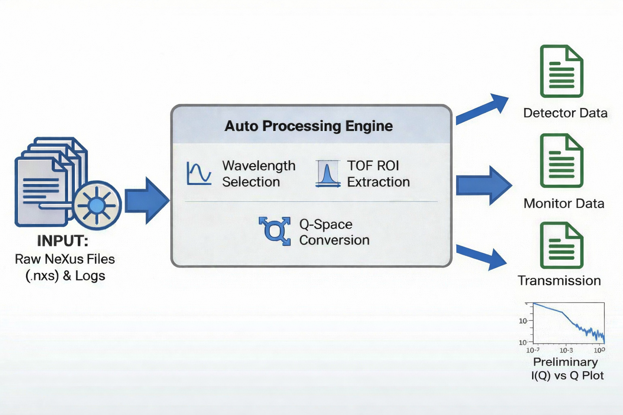
Data Acquisition and Auto Conversion (Q3)
From acquisition to reduction-ready data
  Raw USANS data acquired in NeXus (HDF5) format
  Instrument metadata, monitor counts, and transmission recorded automatically
  NeXus files are automatically converted into reduction-ready text formats:
    Detector intensity
    Monitor normalization
    Transmission information
Auto-reduction support
  Automated preprocessing triggered during or after data acquisition
  Standardized file structure enables:
    Consistent downstream reduction
    Reduced manual intervention
  Provides immediate feedback on data quality and completeness

Slide 11
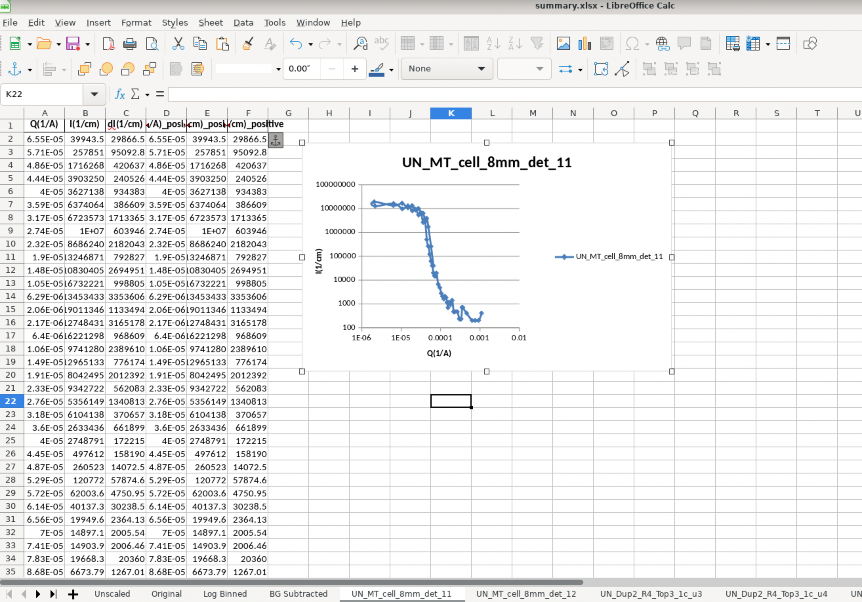
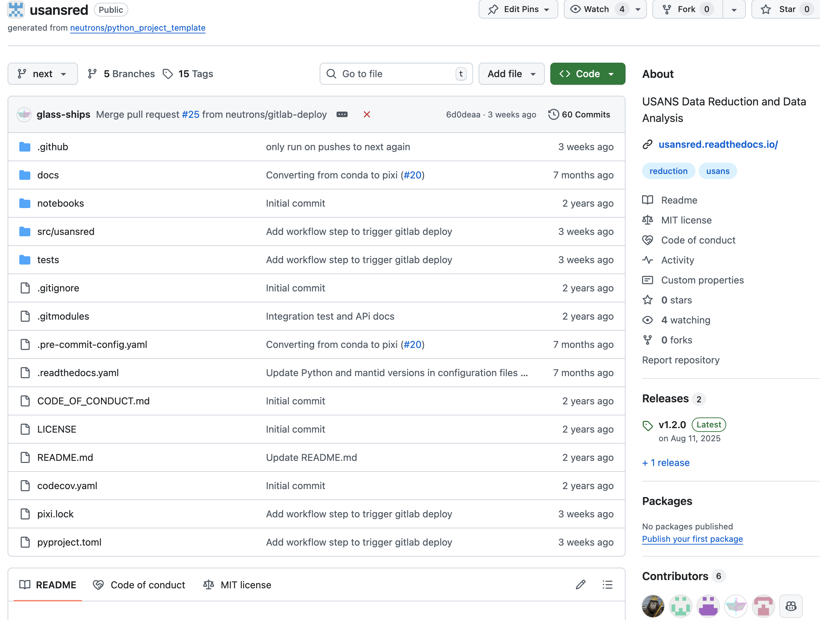
USANS Data Reduction package (Q3)
Designed around the experiment hierarchy:
  Scan → Sample → Experiment
Core reduction process:
  Monitor normalization
  Stitching of multiple analyzer-angle and wavelength scans
  Q conversion and intensity rescaling
  Background subtraction on matched Q grids
  Customization with user request
User interfaces
  Script-based interface for advanced and batch users
  Generates:
    Reduced I(Q) in ASCII format
    Spreadsheet-based summaries and plots for quick inspection
Future development
  Graphical User Interface
  Desmearing and multiple scattering
  Long-term alignment with broader SANS data analysis ecosystem

Slide 12
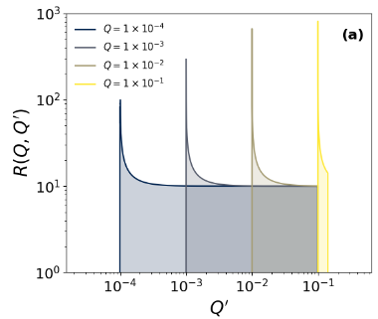
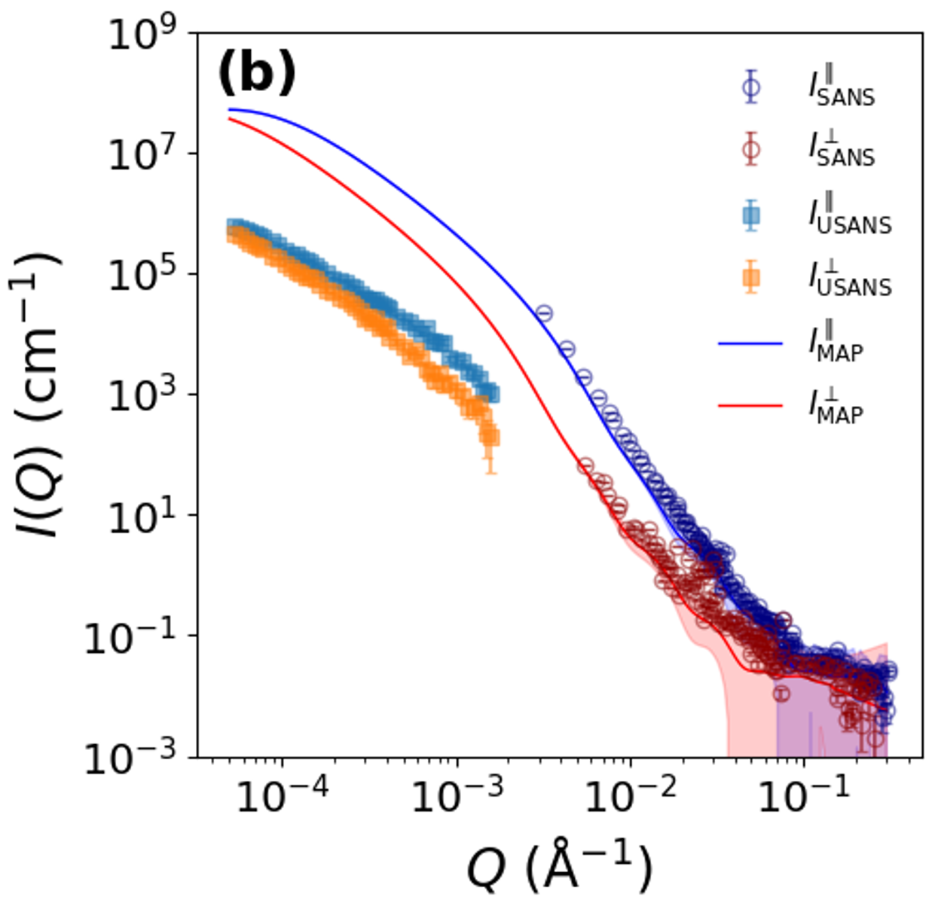

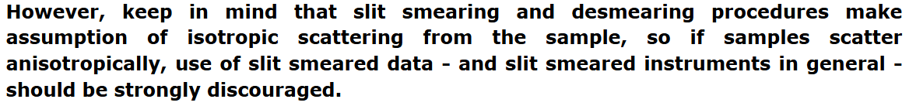
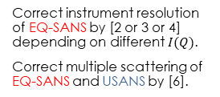
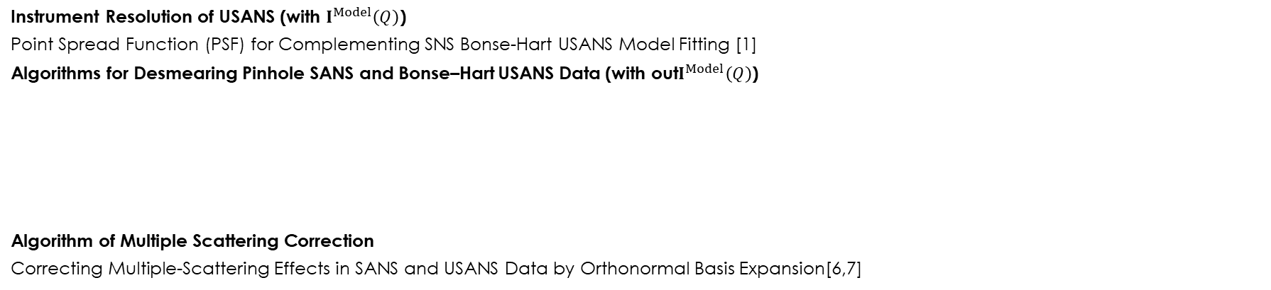
characterization infrastructure (Q6)
Instrument Resolution of USANS (with $I^{Model}\left(Q\right)$)
Point Spread Function (PSF) for Complementing SNS Bonse-Hart USANS Model Fitting [1]
Algorithms for Desmearing Pinhole SANS and Bonse–Hart USANS Data (with out$I^{Model}\left(Q\right)$)
Algorithm of Multiple Scattering Correction
Correcting Multiple-Scattering Effects in SANS and USANS Data by Orthonormal Basis Expansion[6,7]
 | SANS | USANS
Isotropic scattering | Central moment expansion[2,3] | ML-GPR[1]; Truncated Abel transform [5]
Anisotropic scattering | Central moment expansion [4] | ML-GPR[6]
[1] Tung et al. REsolution 250885;
[2] Huang et al. JAC 56 1537 (2023);
[3] Huang et al. JAC 58 1355 (2025);
[4] Huang et al. JAC 58 1342 (2025);
[5] Huang et al. REsolution 250884;
[6] Tung et al. REsolution 252148;
[7] Tung et al. REsolution TBD.
Correct instrument resolution of EQ-SANS by [2 or 3 or 4] depending on different $I(Q)$.
Correct multiple scattering of EQ-SANS and USANS by [6].
Smear the corrected EQ-SANS by PSF of SNS USANS by [1] to join with the corrected USANS.
Desmear the joint corrected EQ-SANS and USANS by [1 or 5].
Revamp of the data reduction GUI with options for desmearing and multiple scattering correction
Notes:
Revamp of the data reduction GUI with options for desmearing and multiple scattering correction

Slide 13
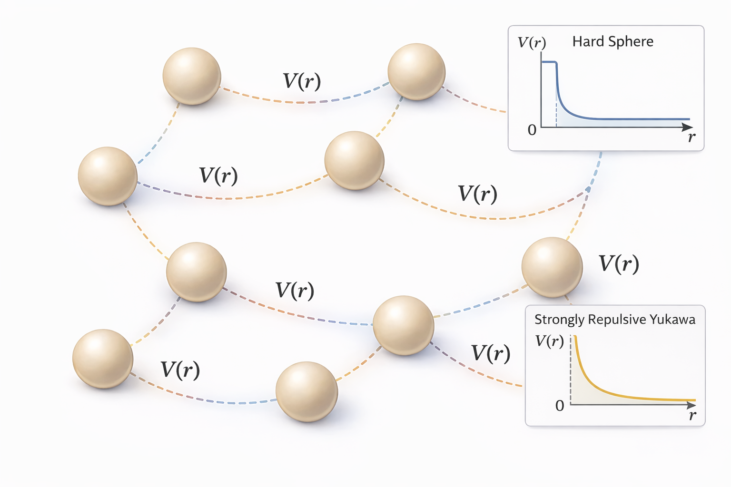
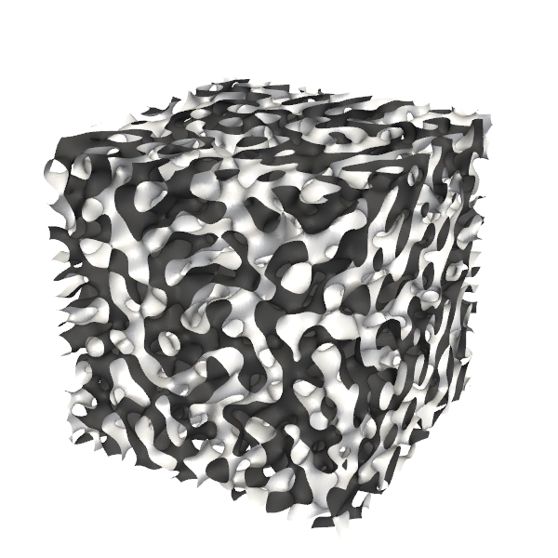
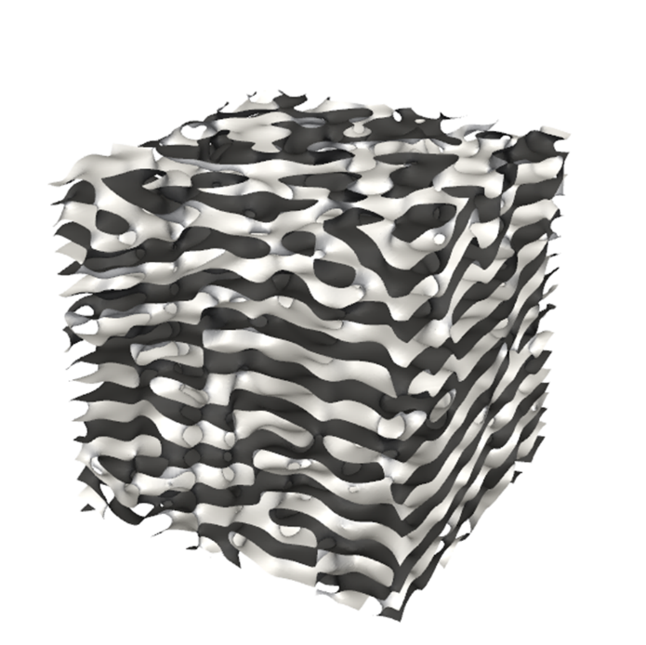
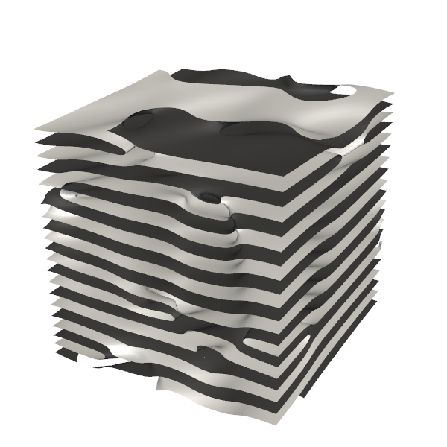
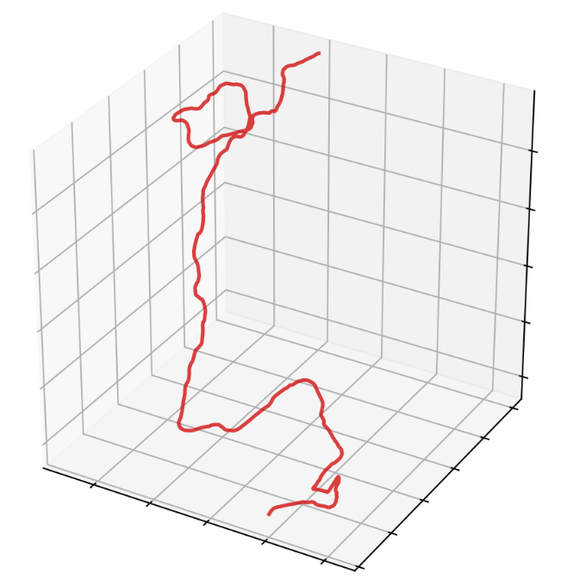
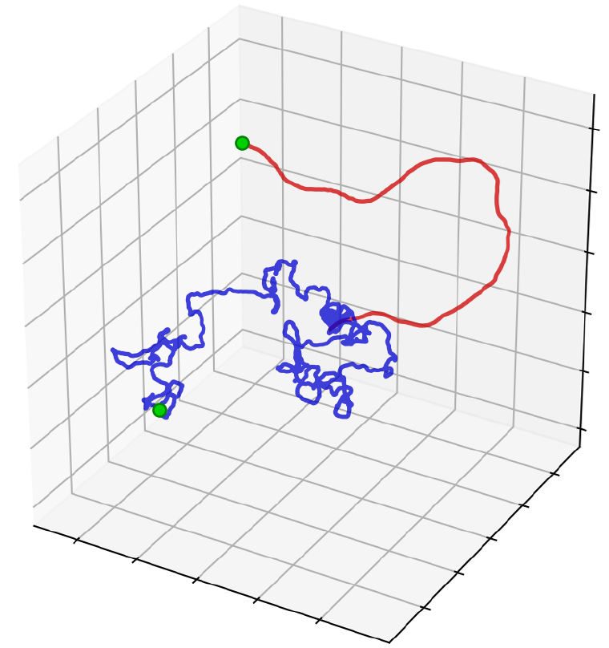
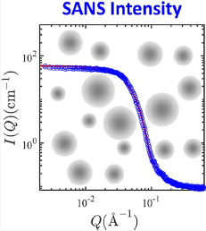
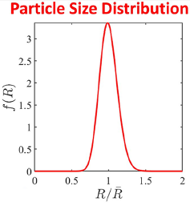





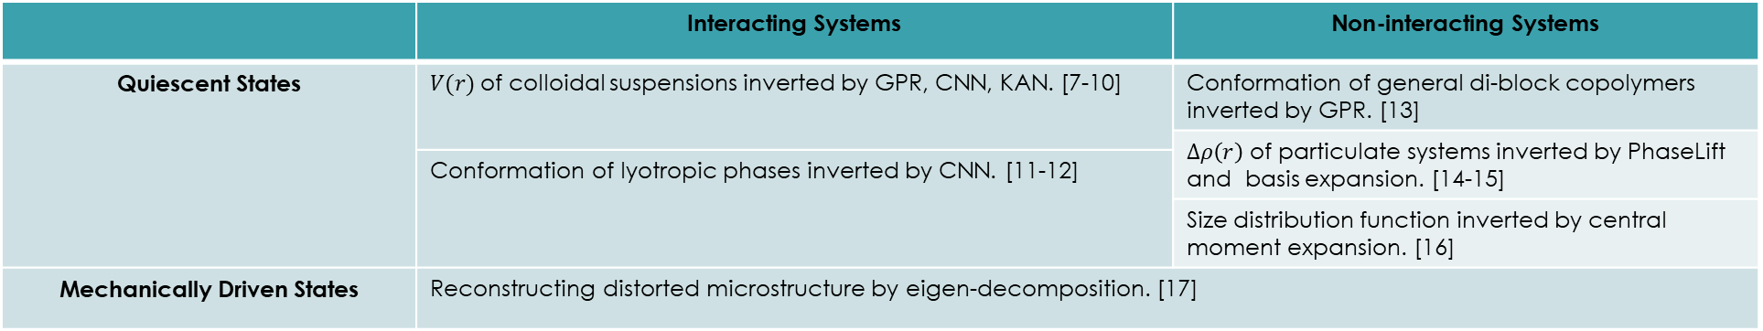
data analysis and modeling capabilities (Q6)
$$𝓛\left(I\right)={\left(I^{Exp}−I^{Model}\right)}^{T}Σ^{−1}\left(I^{Exp}−I^{Model}\right)+ℛ$$
 | Interacting Systems | Non-interacting Systems
Quiescent States | $V(r)$of colloidal suspensions inverted by GPR, CNN, KAN. [7-10] | Conformation of general di-block copolymers inverted by GPR. [13]
 |  | $∆ρ\left(r\right)$ of particulate systems inverted by PhaseLift and basis expansion. [14-15]
 | Conformation of lyotropic phases inverted by CNN. [11-12]
 |  | Size distribution function inverted by central moment expansion. [16]
Mechanically Driven States | Reconstructing distorted microstructure by eigen-decomposition. [17]
$$MD$$
Sponge
$$Anisotropic Wave Field$$
Lamellar
$$MC$$
[7] Chang et al. Commun. Phys. 5 46 (2022).
[8] Tung et al. CT 10 100252 (2023).
[9] Tung et al. JAC 57 1027 (2024).
[10] Tung et al. JCP 162 074106 (2026).
[11] Tung et al. JCIS 659 739 (2024).
[12] Tung et al. JAC 58 523 (2025).
[13] Tung et al. JCP 156 131101 (2022).
[14] Huang et al. JCP 162 174102 (2025).
[15] Huang et al. JAC 57 140 (2024).
[16] Huang et al. Macromolecules 56 6436 (2023).
[17] Huang et al. JAC 58 637 (2025).

Slide 14
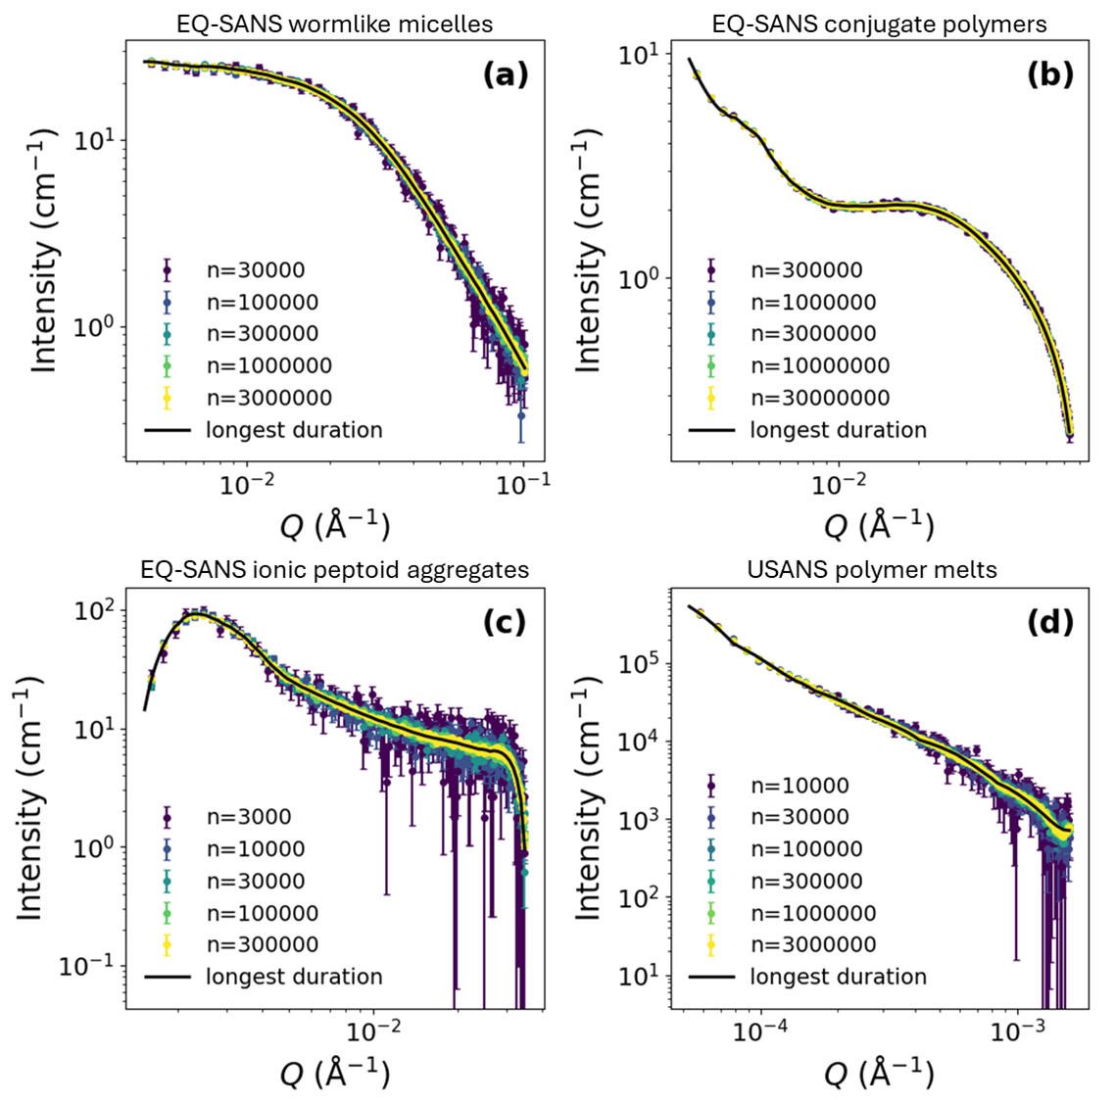
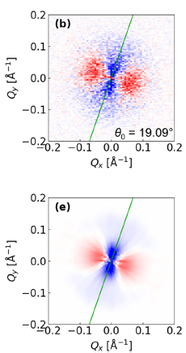
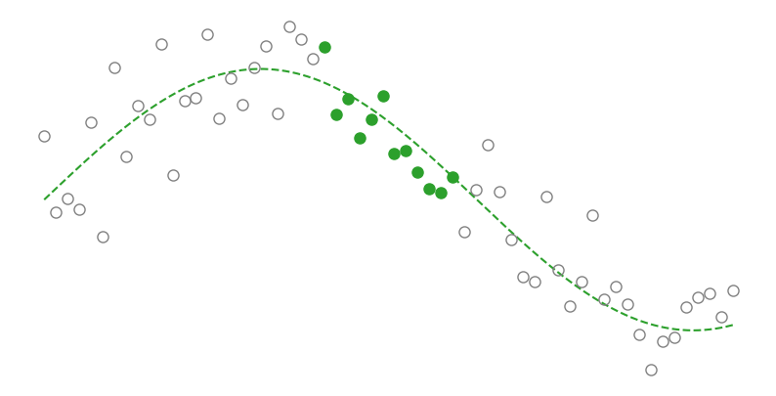
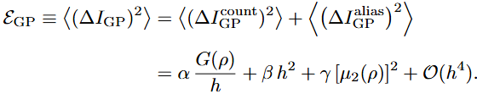
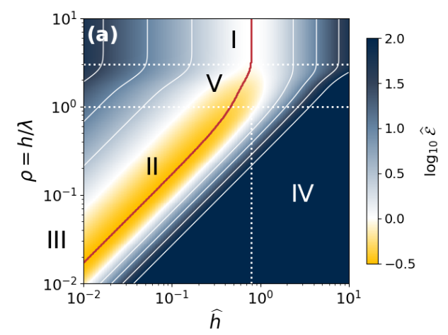












credible plans for future AI/ML automation (Q7)
Feasibility of Robust Inference of 1D and 2D Scattering from Sparse Measurements [18-20]
$$𝓛\left(I\right)={\left(I^{Exp}−I^{GT}\right)}^{T}Σ^{−1}\left(I^{Exp}−I^{GT}\right)+ℛ$$
$$regression→inference$$
1D
2D
$$Posterior$$
$$Likelihood$$
$$Prior$$
$$Bayes′ theorem$$
$$𝓛\left(I\right)={\left(I^{Exp}−I^{GT}\right)}^{T}Σ^{−1}\left(I^{Exp}−I^{GT}\right)+I^{T}K^{−1}I$$
$$K\left(Q_{i}−Q_{j}\right)\sim exp\left[−\frac{{\left(Q_{i}−Q_{j}\right)}^{2}}{2λ^{2}}\right]$$
$$\frac{∂𝓛\left(I\right)}{∂I}=0⇒I^{MAP}=K{\left(Σ+K\right)}^{−1} I^{Exp}$$
$$some tens to\sim 1000x?$$
A Universal Criterion for Sample-Adaptive Enhancement of Counting Efficiency [21-22]
[18] Tung et al. JCIS 692 137554 (2025).
[19] Tung et al. JCP 163 034107 (2025).
[20] Tung et al. JCP 163 154103 (2025).
[21] Tung et al. REsolution 247236.
[22] Tung et al. REsolution 248419.

Slide 15
Thank you for your attention

