Slide 1
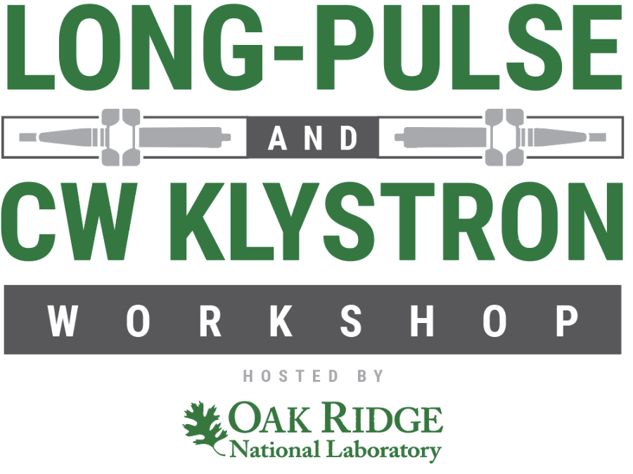
Operational Experience
Doug Horan
Argonne National Laboratory

Slide 2
Operational Experience
Open discussion – What is everyone’s single biggest challenge in operating klystrons reliably?
Melted collectors
Gun arcing
Optimizing interlocks to protect the klystrons
Water leaks into oil tanks
Obsolete parts
Operator abuse
Klystron aging
Vacuum issues
Consistent performance klystron-to-klystron

Slide 3
Operational Experience
Have new klystrons typically met operating specifications both at the manufacturer test stand and in the final operating socket?
Customer typically cannot match performance demonstrated during factory acceptance test
New klystrons are not tested after delivery due to technician availability
Has operation been modified to match the available performance?
Yes
Are the specifications realistic or could they be relaxed?
Harmonic level and x-ray emission are often quite variable

Slide 4
Operational Experience
Open discussion – Klystron lifetime……….longest and shortest lifetime, and typical failure modes causing end-of-life.
Longest lifetime ~ 200k hours, 75-100k hours more typical
Some klystrons have failed almost right out of the box (~ 2,300 hr)
Cathode depletion
Sideband instability
DC leakage in gun
Gun arcing
Cracked output window
Pinhole leaks in ceramics
Loss of vacuum
Heater failure, shorted/open

Slide 5
Operational Experience
Open discussion – What has been the most common failure mode?
Cathode depletion
Sideband instability
DC leakage in gun
Gun arcing
Cracked output window
Pinhole leaks in ceramics
Loss of vacuum
Heater failure, shorted/open

Slide 6
Operational Experience
Open discussion – How do you maintain your operating klystrons and klystrons in storage?
Full-power test each klystron
Utilize conservative heater warm-up time
Keep ion pumps energized for klystrons in storage
Check for oil and water leaks
Breakdown-test oil
Clean and inspect high voltage connectors
Do you have a full-power test stand to evaluate klystrons?
Yes, but testing klystrons is a tedious process
New klystron conditioning in test stand
Do you perform cathode emission tests to maintain correct heater operating point?
Yes
No, just run lowest heater power necessary to maintain required beam current

Slide 7
Operational Experience
Open discussion – Have you had klystron operational problems directly related to quality/workmanship defects?
Yes -- oil leaks, water leaks, vacuum leaks
Loose or missing hardware
Concerning refurbished/rebuilt klystrons, have you found them to be less reliable and/or have a shorter lifetime?
No
Little difference in lifetime to that of new klystrons
Rebuilds don’t last as long as new klystrons
Quicker turn-around on rebuilds
Have refurbished/rebuilt klystrons “paid off”?
Yes
Cost is typically 70-75% less than new klystrons

