Slide 1
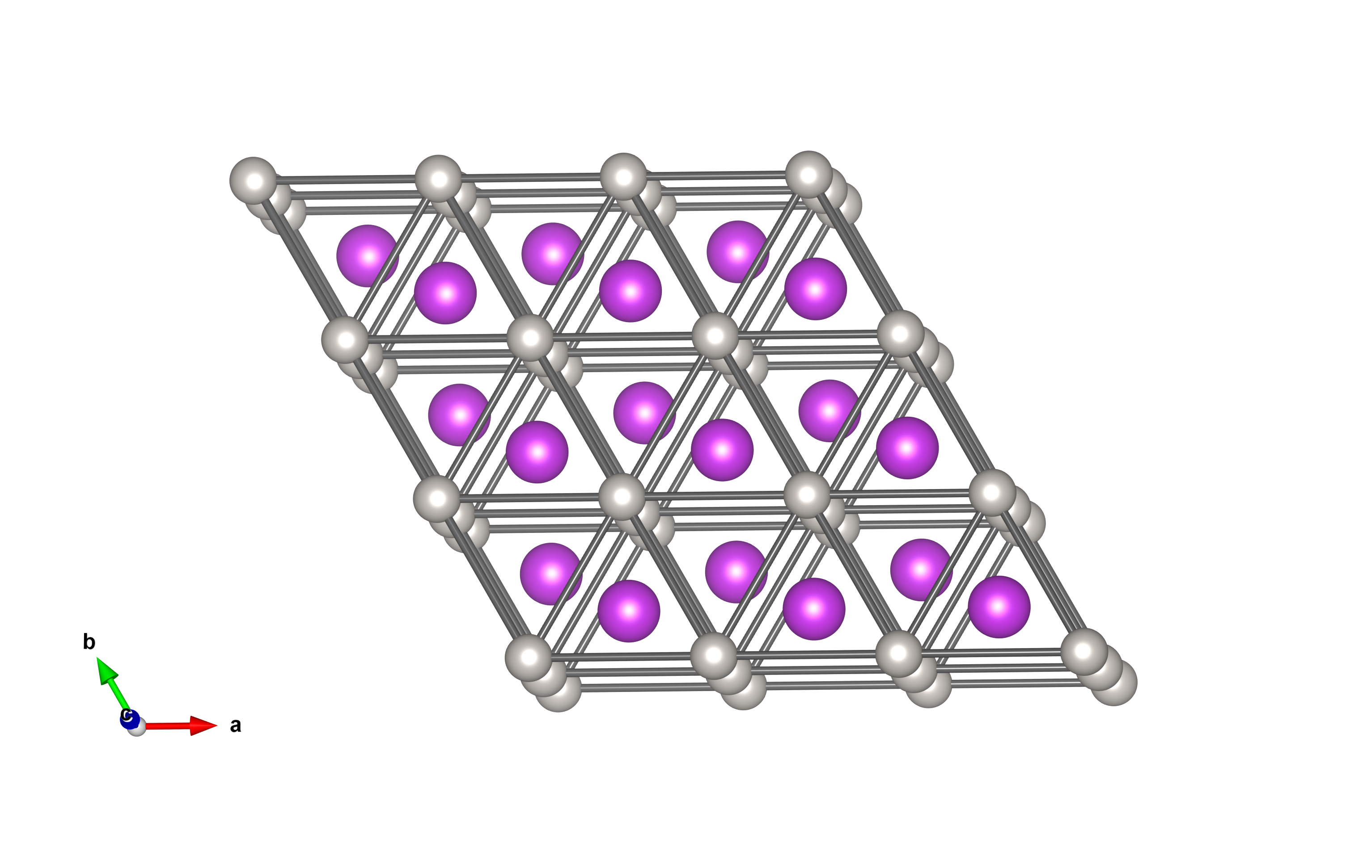





  Searching for Broken Symmetries in Superconductors with Muons
Graeme Luke
Dept. of Physics & Astronomy
McMaster University

Slide 2
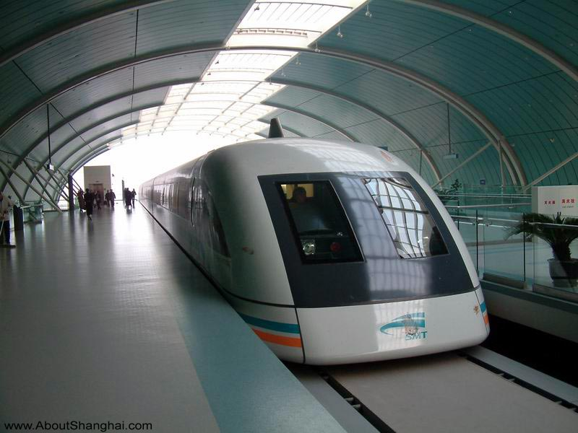
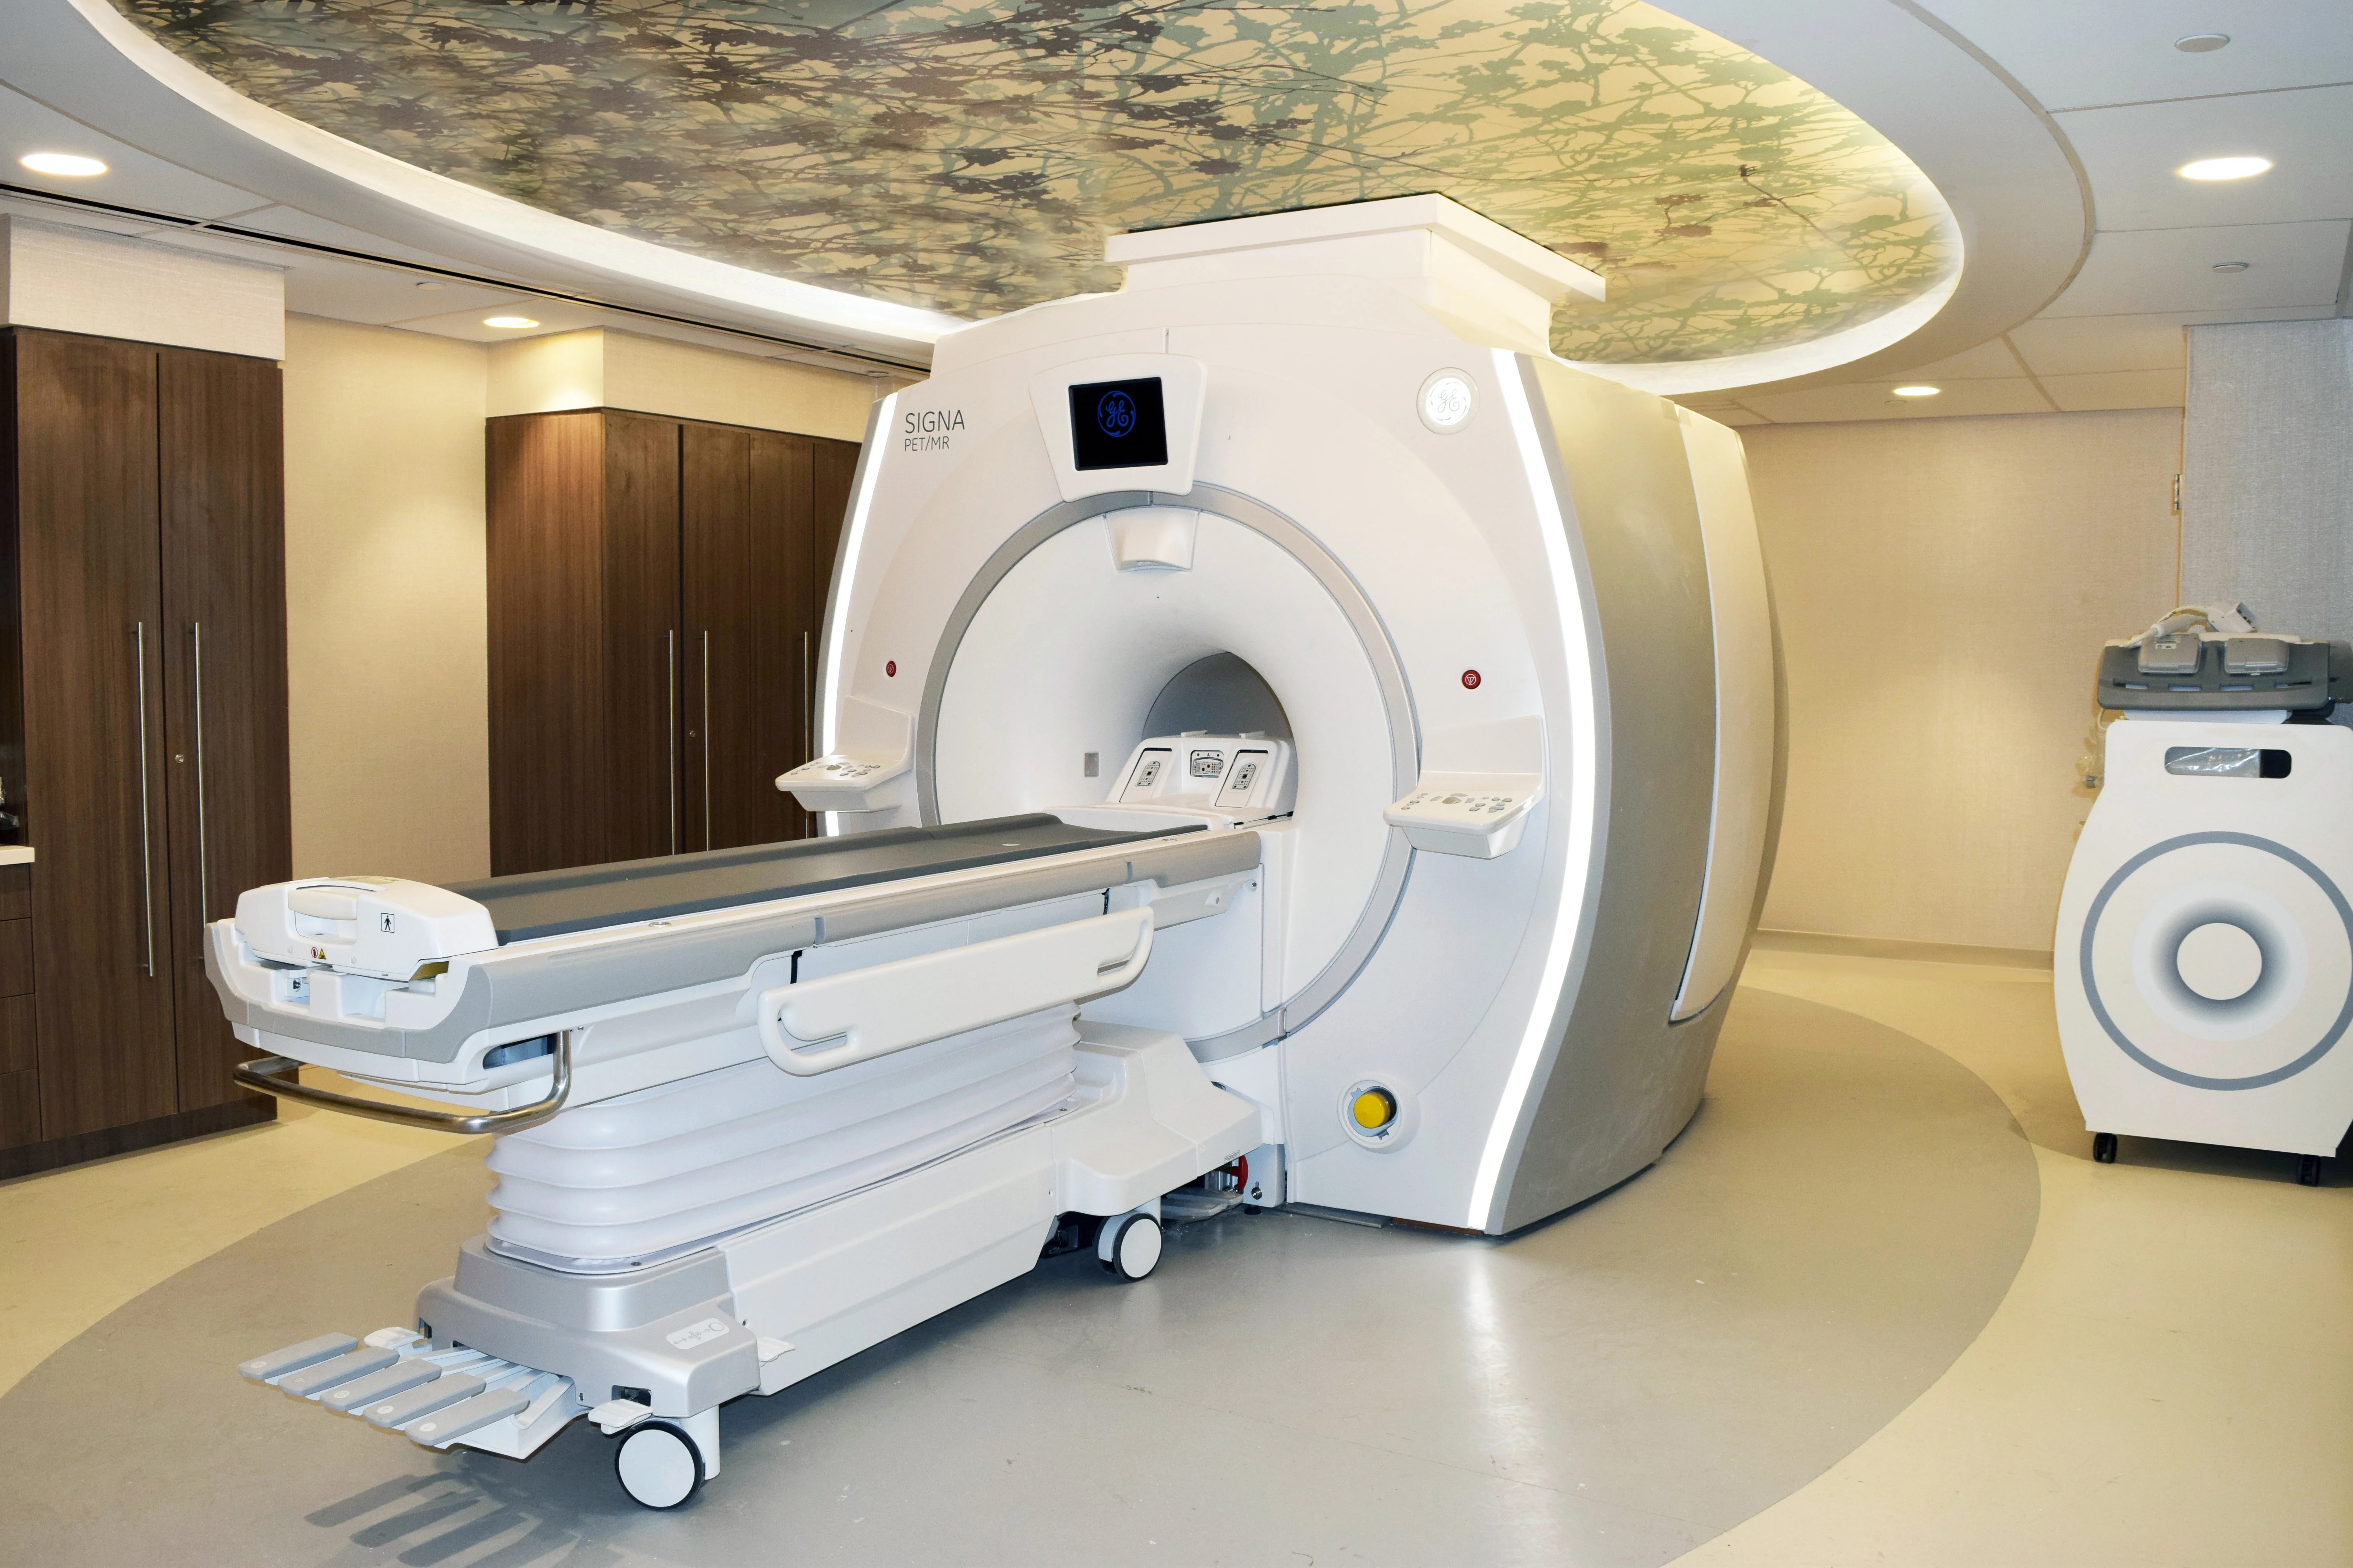
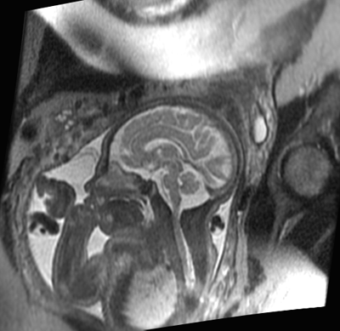
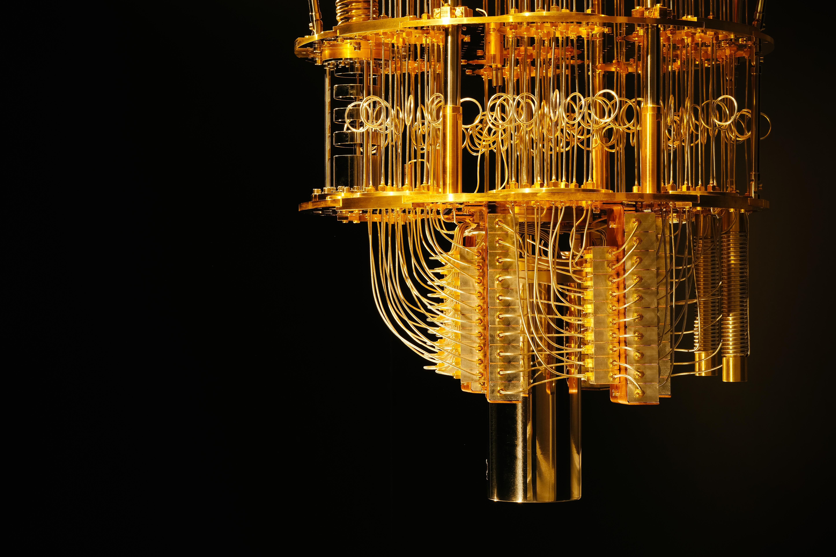
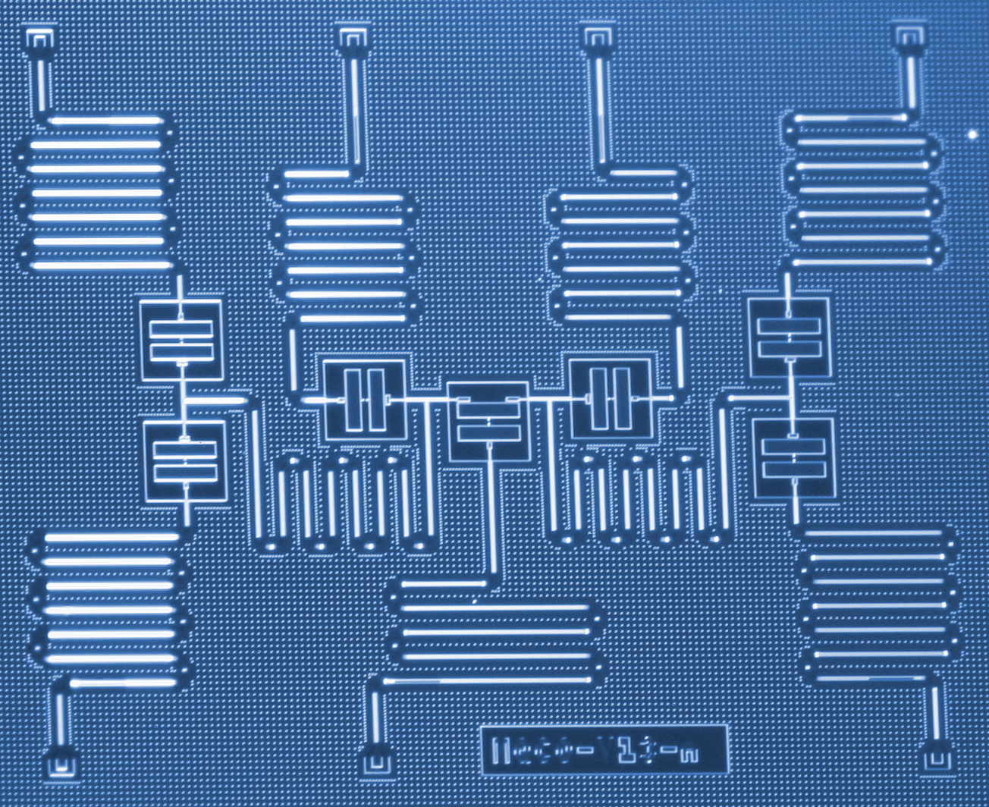

Superconductivity

Slide 3
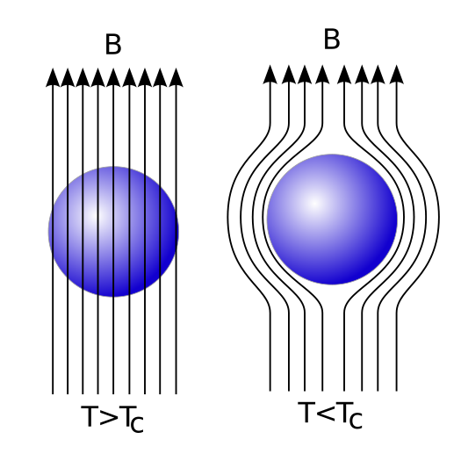
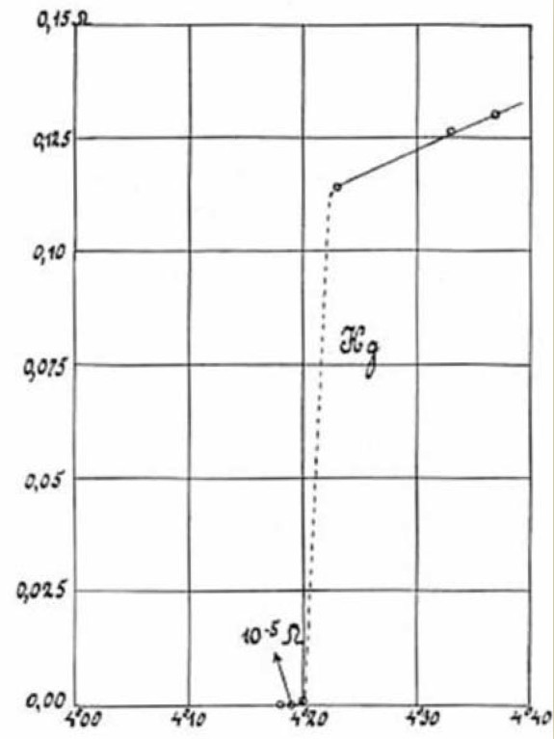
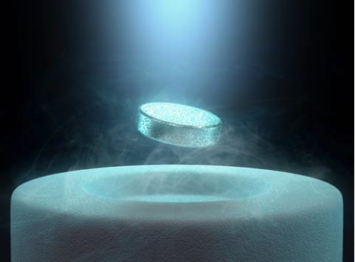
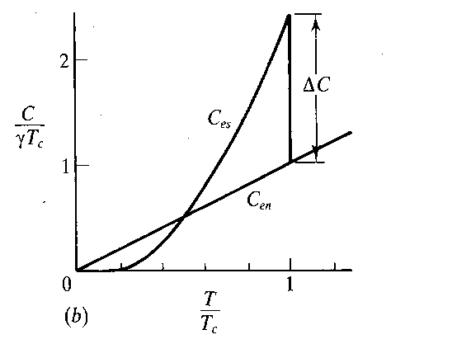
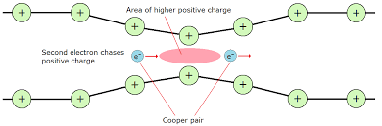
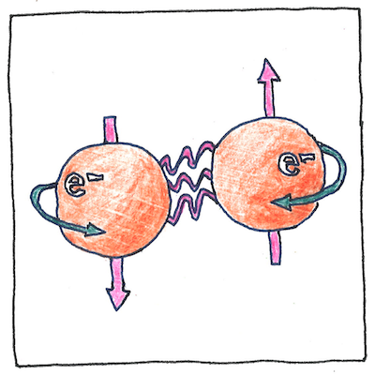
Superconductivity

Slide 4
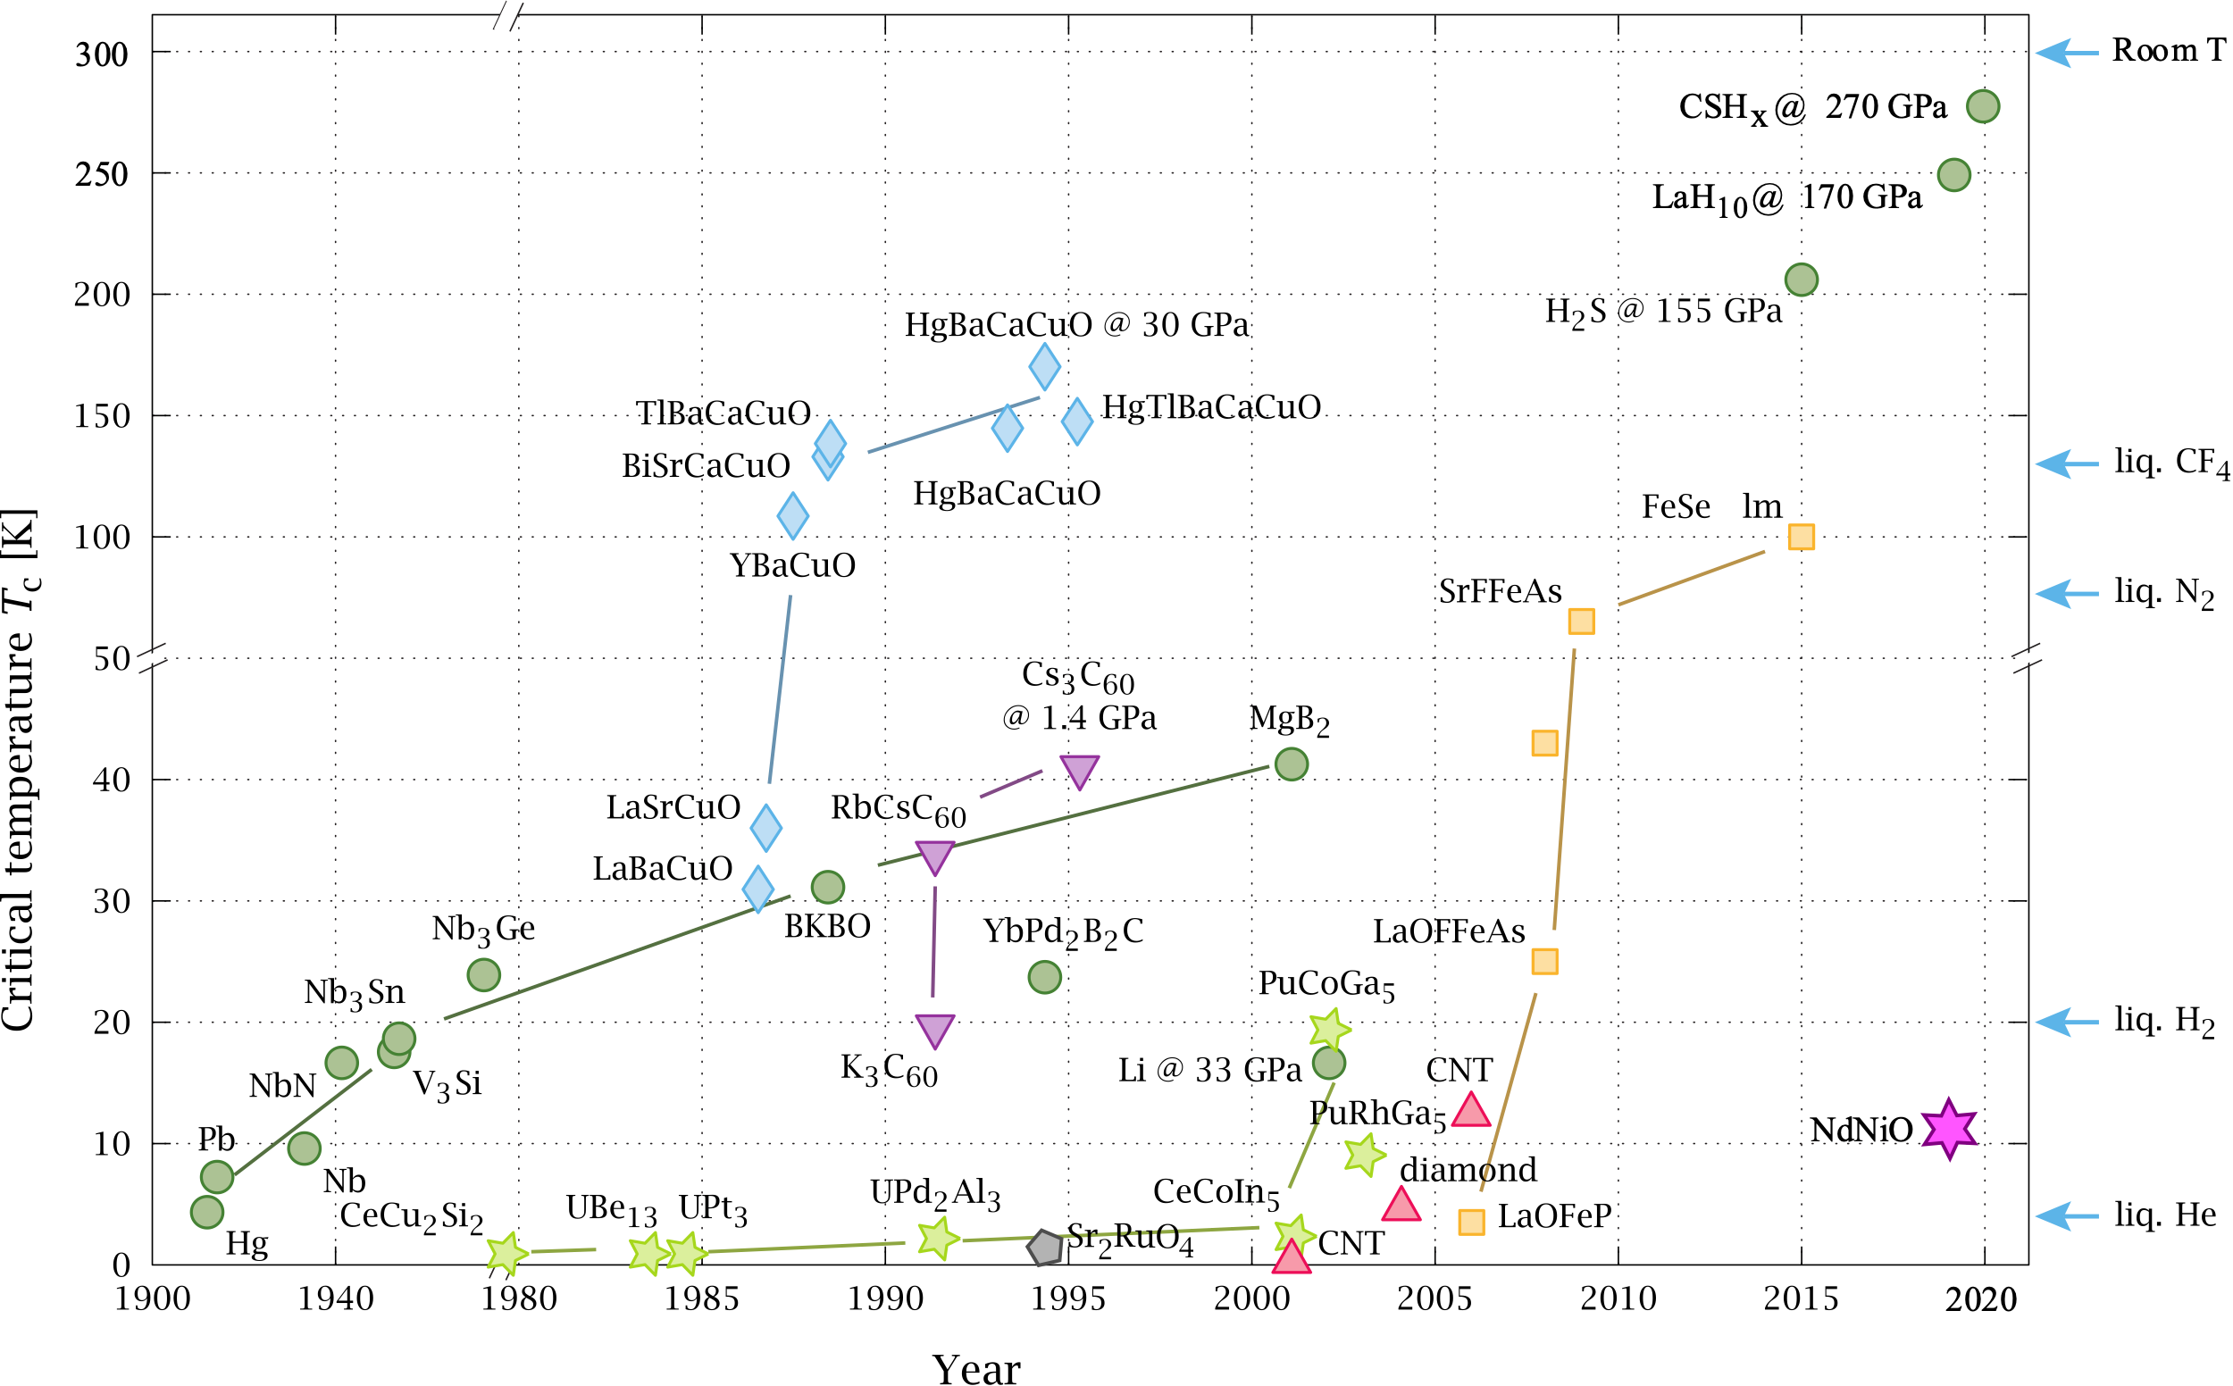
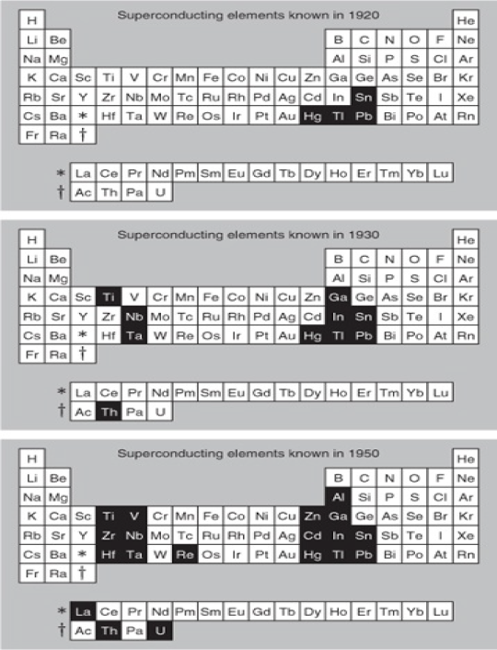
Superconductivity in Elements and Compounds
Blundell
Wikipedia

Slide 5
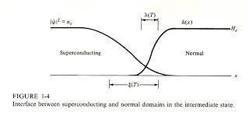
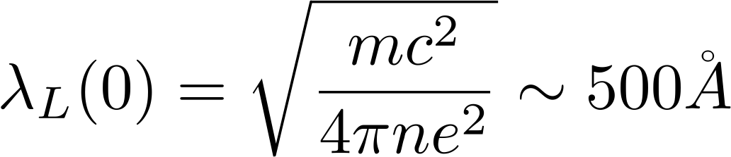
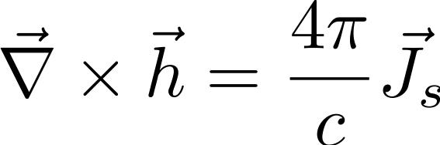
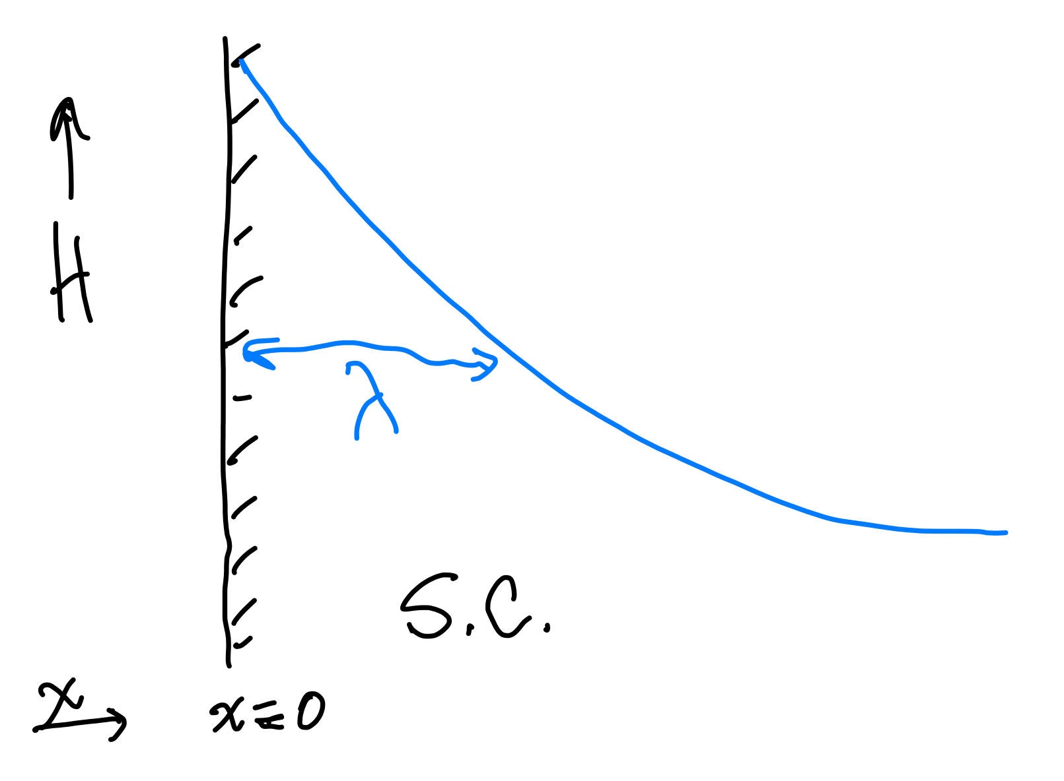
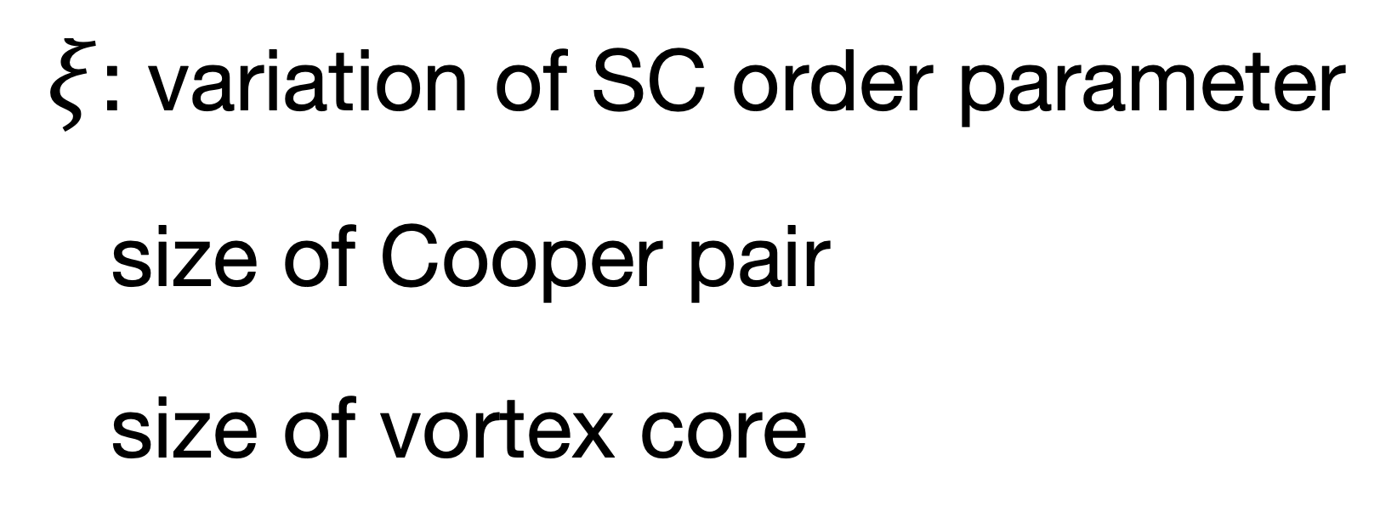
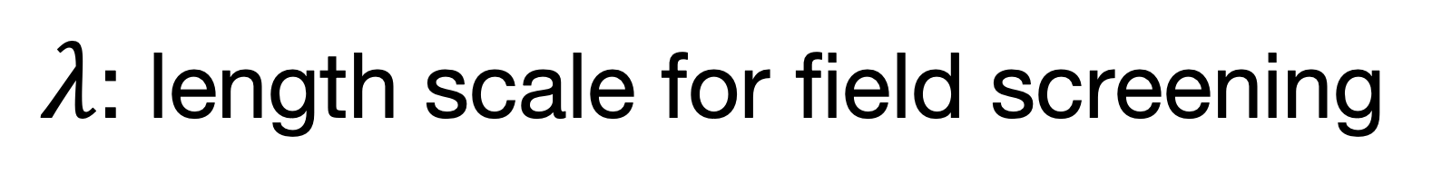
Length Scales in Superconductivity
Penetration Depth & Coherence Length
$ξ$: variation of SC order parameter
  size of Cooper pair
  size of vortex core
$λ$: length scale for field screening

Slide 6
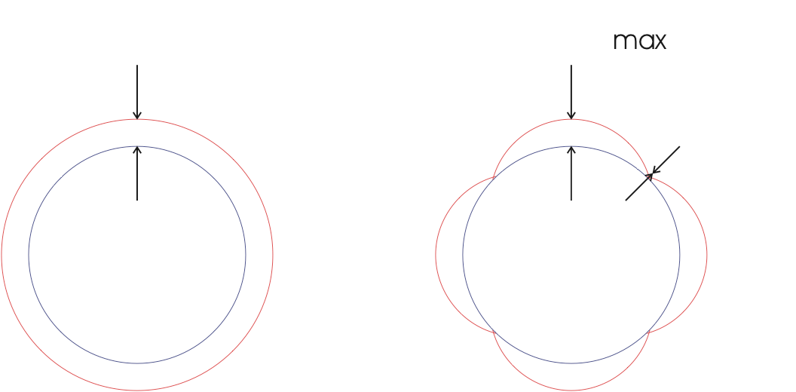
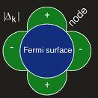
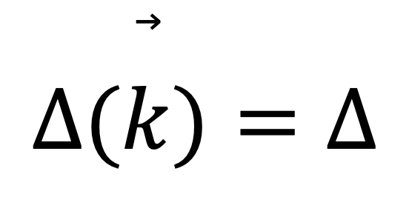
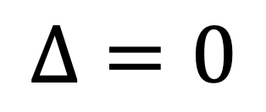
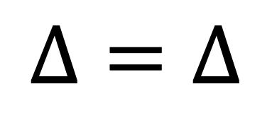
Unconventional Superconductivity
Bi-2212
$$Δ=Δ$$
$$Δ(\overset{⃗}{k})=Δ$$
$$Δ=0$$
Ding et al., PRB 54, 9678 (1996)
Conventional
Δ(k) has symmetry of crystal
Usually Δ(k)=Δ (s-wave)
Unconventional
Δ(k) has lower symmetry
Possible nodes in gap.
Other broken symmetries

Slide 7
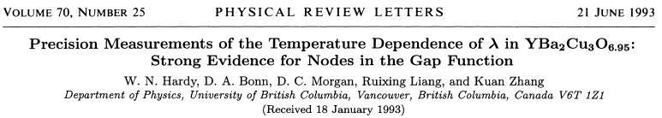
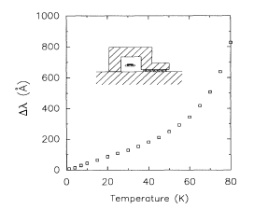
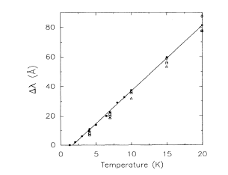
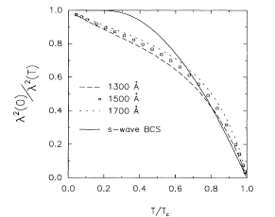
Pairing Symmetry – Penetration Depth
𝜆(0) from 𝜇SR measurements

Slide 8
Unconventional Superconductivity
Adenwalla et al., (1990)
ultrasound
Trappmann, Lohneysen, and Taillefer, (1992)
Trappmann, Lohneysen, and Taillefer, (1991)
Multiple SC phases vs. B, P
Luke et al., PRL 72, 1466 (1993).

Slide 9
Routes to Unconventional Superconductivity
Conventional SC (BCS): electron phonon interaction overcomes Coulomb repulsion via retardation.
Strongly correlated metals, electrons retain more localized character (Coulomb > electron-phonon): retardation less effective.
  Other interactions (eg. spin fluctuations)
  Superconductivity near magnetic quantum critical point.
Role of crystal structure, such as presence/absence of inversion symmetry.
  ASOC gives mixture of spin-singlet/spin-triplet pairs, with possibility of broken TRS, gap nodes, multiple gaps.
Topologically non-trivial bands hosting SC.

Slide 10
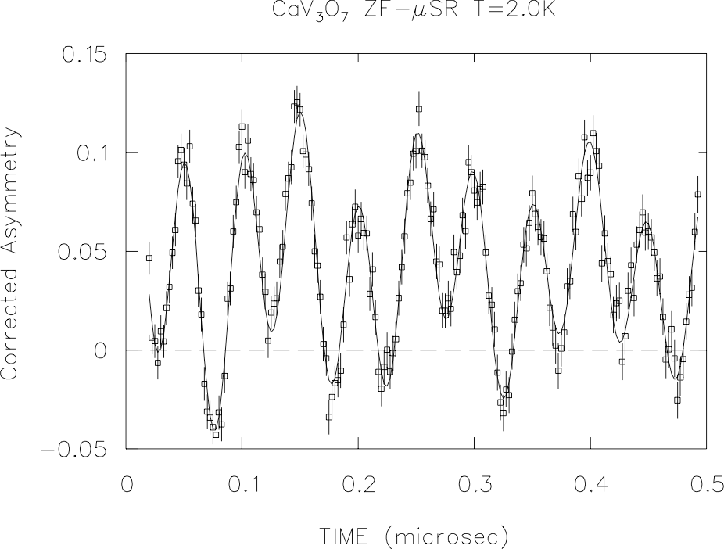
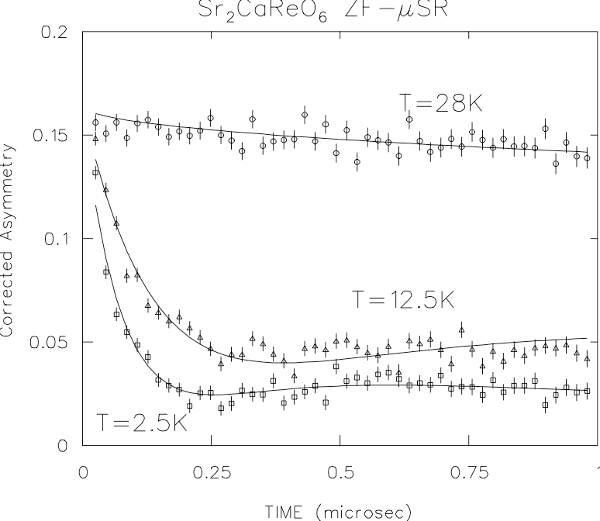
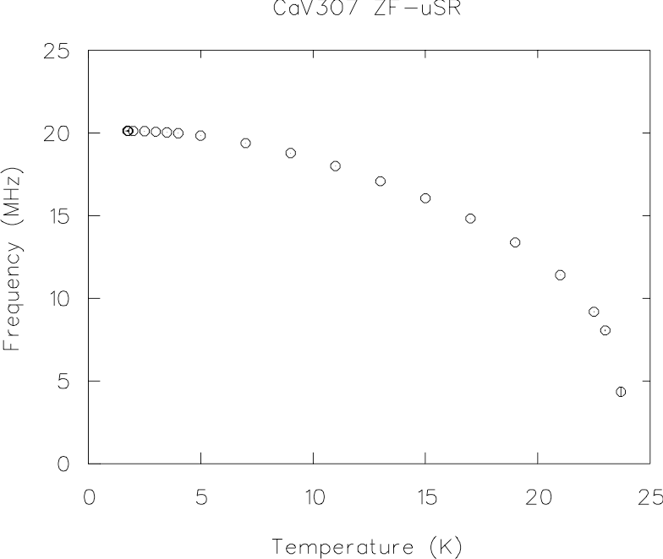
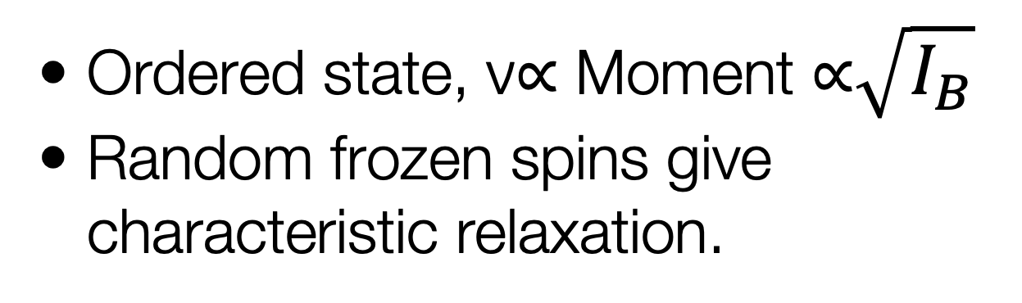
Zero Field ZF-μSR
Ordered state, ν∝ Moment ∝$\sqrt{I_{B}}$
Random frozen spins give characteristic relaxation.

Slide 11
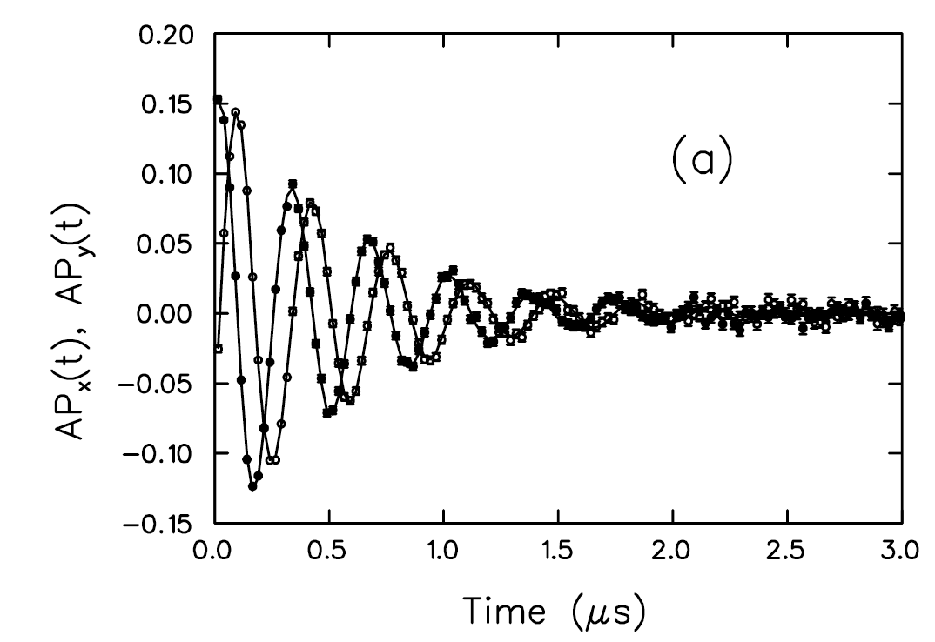
Transverse Field µSR
Amplitude: volume fraction of signal.
Frequency: local field at muon site(s): Knight shift
  Field of 8T gives 1GHz precession
  Max field of ~0.2T at pulsed facility due to pulse width, pion lifetime.
Damping: Field inhomogeneity: line shape gives field distribution.

Slide 12
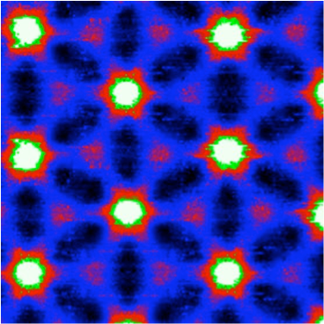
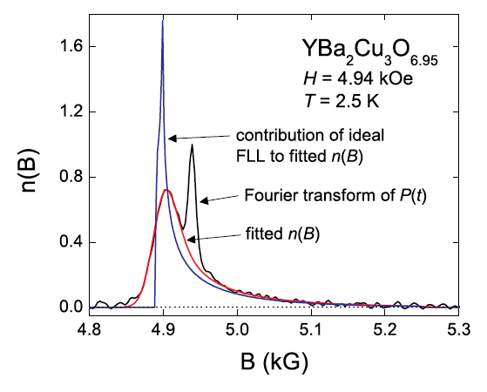
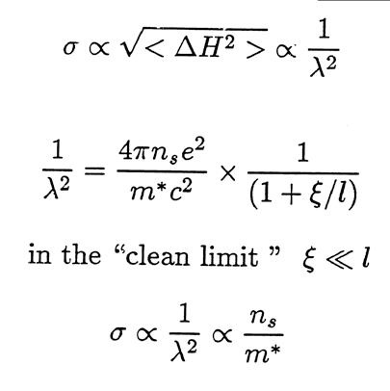
Type-II Superconductors: Vortex State
2 lengthscales: λ, ξ
Disorder: broadening of line shape features (convolute with Gaussian).
J.C. Davis website
Ceramics - Gaussian
Sonier, Rep. Prog. Phys. 70, 1717 (2007).

Slide 13
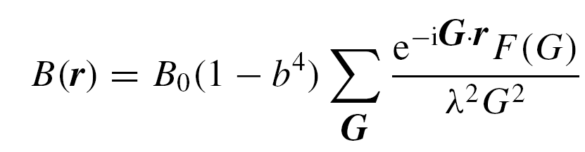
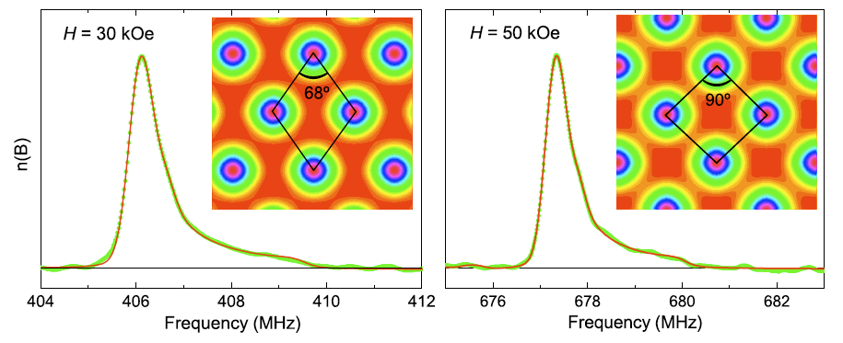

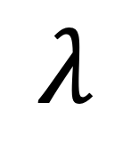
Vortex Lattice Field Distribution
Yaouanc et al., Phys. Rev. B 55, 11107 (1997).
V3Si
$$λ$$
$$ξ$$

Slide 14
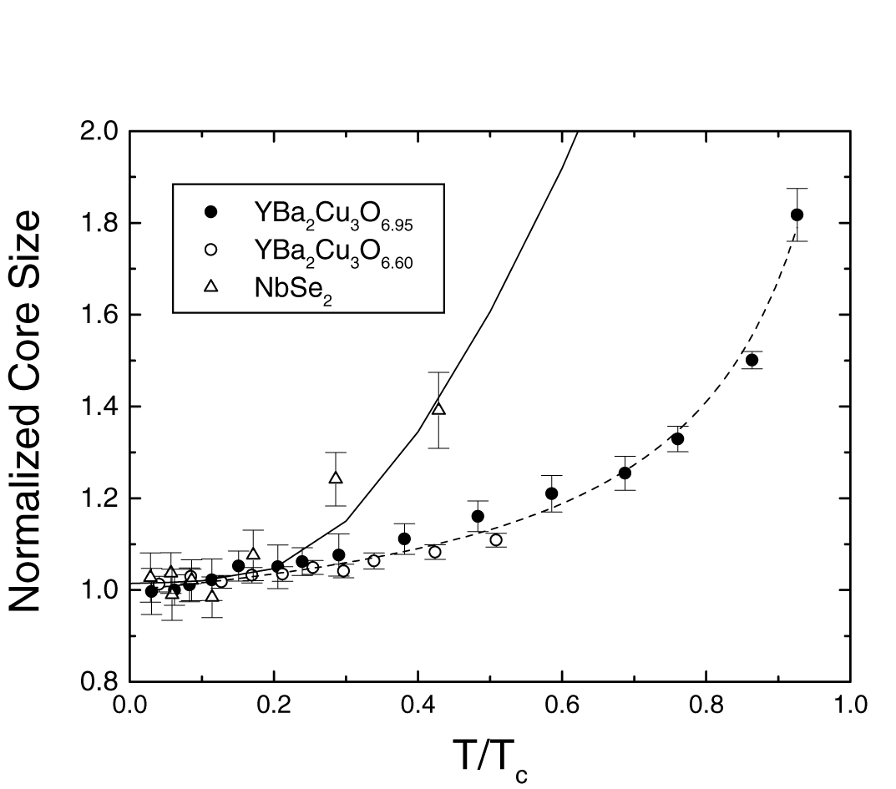
Superfluid density & Vortex Core Size
Sonier et al.
Curve is ZF μ-wave result. (Hardy et al.)
Linear T-dependence due to d-wave pairing (gap nodes)
High field flattening due to q.p.’s at gap nodes.
Weak dependence of 𝝃 on T indicates absence of bound states in vortex cores.

Slide 15
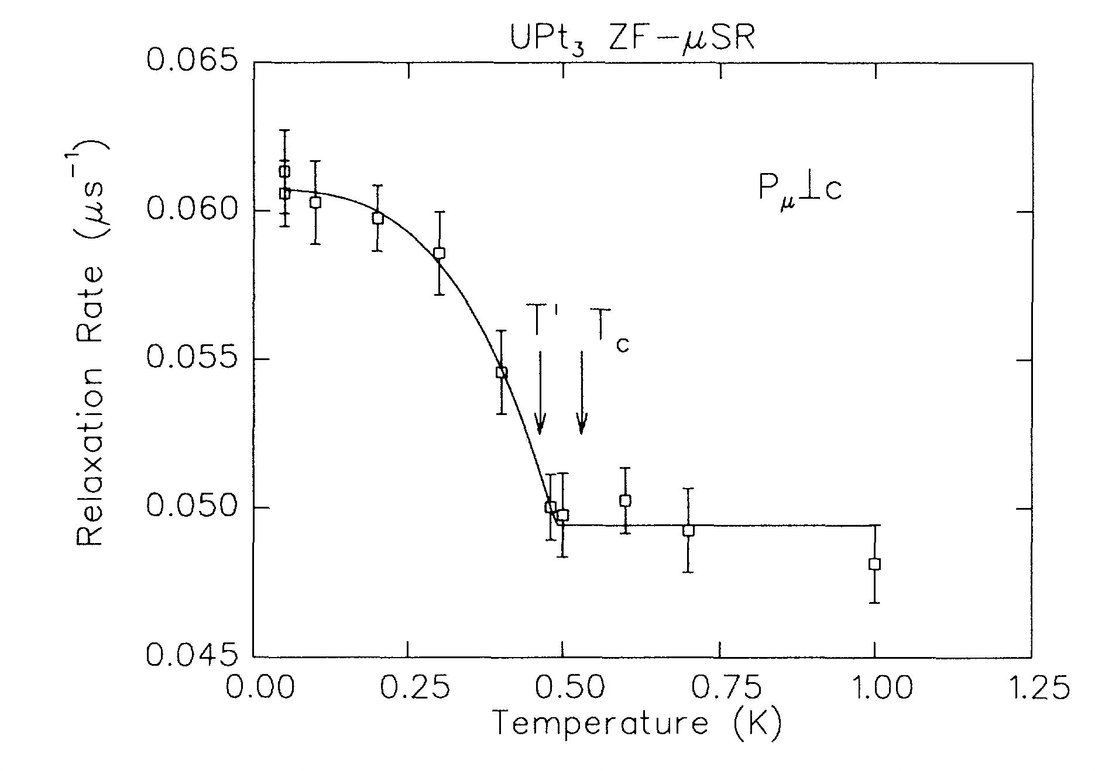
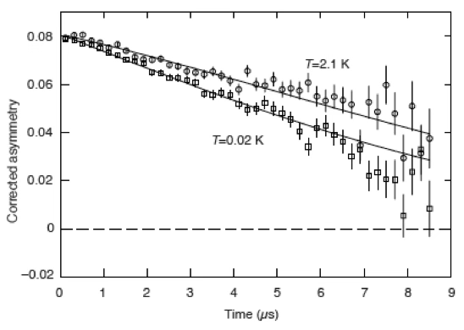
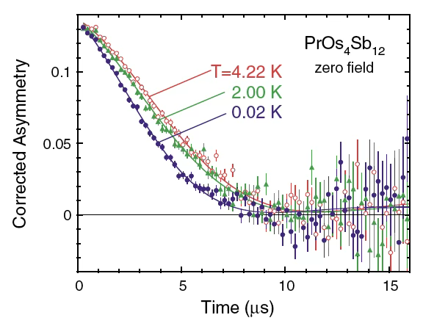
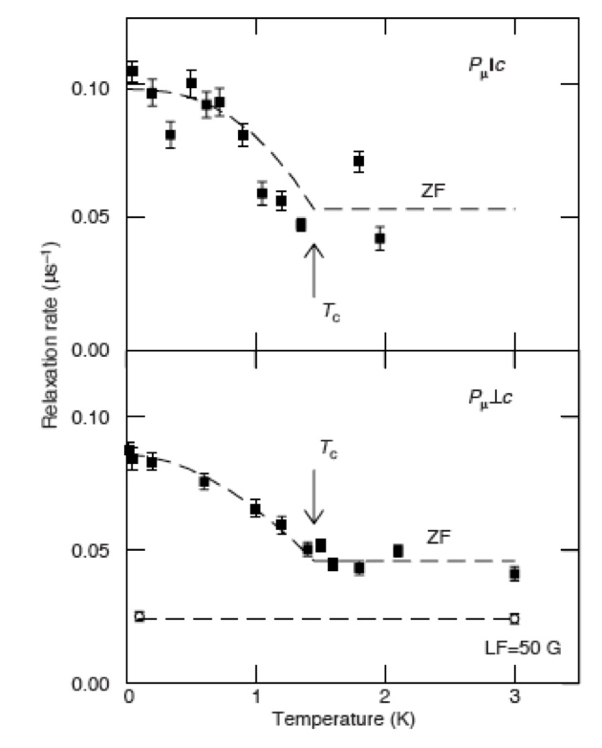
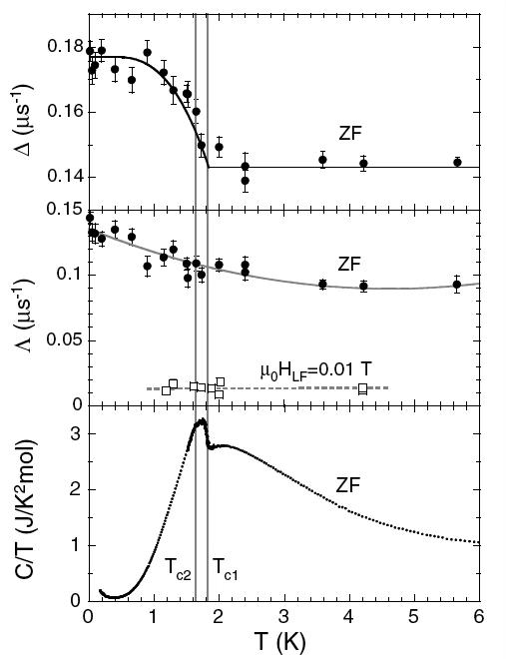
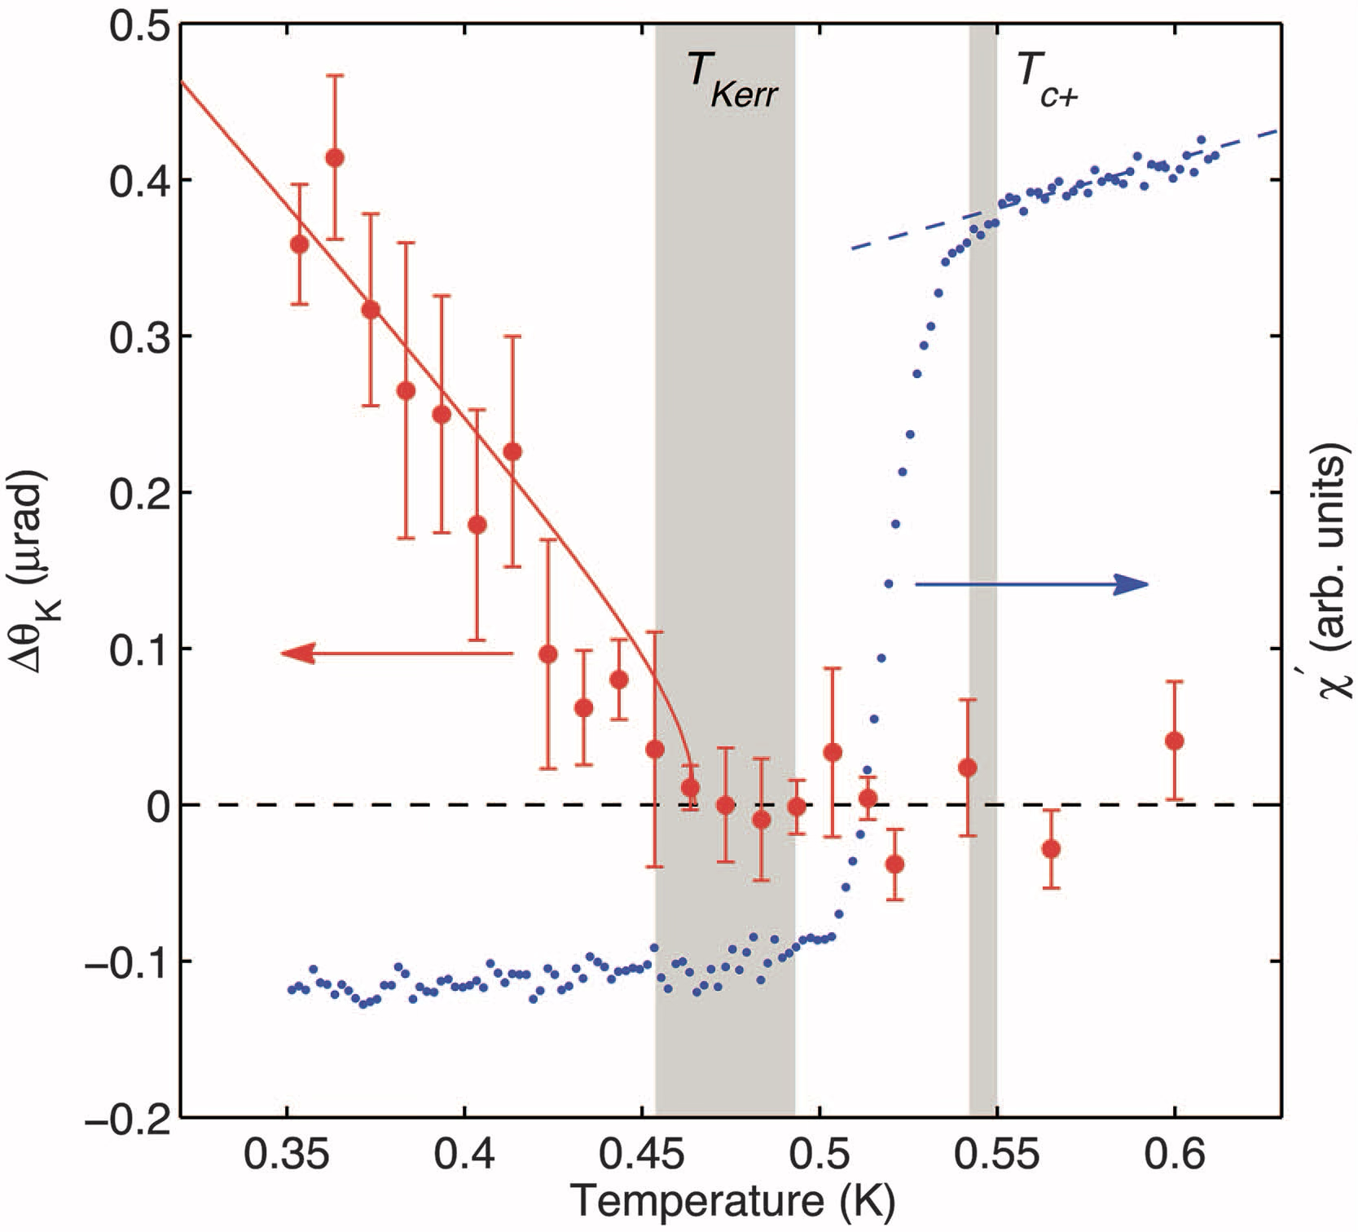
Broken Time Reversal Symmetry
Luke et al., Phys. Rev. Lett. 71, 1466 (1993).
Luke et al., Nature 394, 156 (1998).
Aoki et al., Phys. Rev. Lett. 91, 1067003 (2003).
Schemm et al., Science 345, 190 (2014).

Slide 16
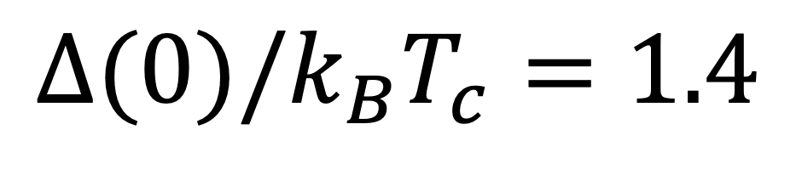
Spin Orbit Coupling w/o Inversion Symmetry
TaReSi & TaRuSi
Re/Ru
Si
Ta
$$Δ(0)/k_{B}T_{c}=1.4$$
Sajilesh K P and R.P. Singh, Supercond. Sci. Technol. 34, 055003 (2021).

Slide 17
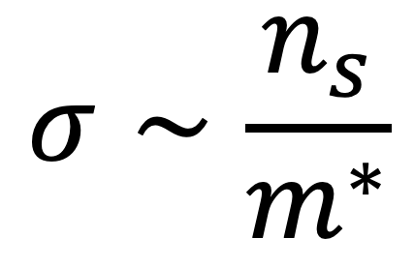
Transverse Field $μ$SR
$$σ∼\frac{n_{s}}{m^{∗}}$$
SOC
Sharma et al., PRB 108, 144510 (2023).

Slide 18
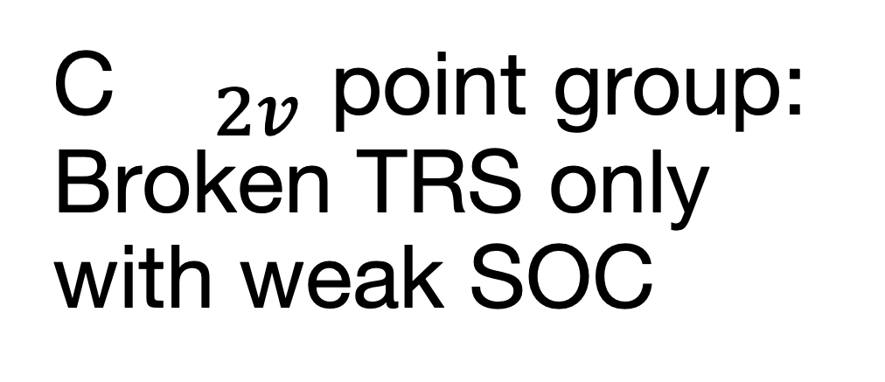
Zero Field $μ$SR
Broken TRS in TaRuSi
Conserved TRS in TaReSi
C${}_{2v}$ point group: Broken TRS only with weak SOC
Sharma et al., PRB 108, 144510 (2023).
SOC
Quintanilla et al., Phys. Rev. B 82, 174511 (2010)

Slide 19
Role of Spin Orbit Coupling
DFT (Addison Richards & Erik Sorensen)
TaReSi
TaRuSi
SOC

Slide 20

Broken TRS in $C_{2v}$
[ unitary: $Δ(\overset{⃗}{k})Δ^{†}(\overset{⃗}{k})∝I$ ]
Hillier, Quintanilla and Cywinski, PRL 102, 117007 (2009).

Slide 21

Non-Unitary Triplet Pairing in TaRuSi with weak SOC
Isostructural SC’s w/o inversion symmetry
ZF-$μ$SR shows broken TRS in TaRuSi, conserved TRS in TaReSi
TF-$μ$SR shows isotropic s-wave (conventional) SC in TaReSi
TF-$μ$SR shows multi-gap SC in TaRuSi
DFT indicates weak SOC in TaRuSi, strong SOC in TaReSi
Symmetry analysis attributes SC state in TaRuSi to non-unitary triplet pairing state.

Slide 22



Topological Superconductivity
Majorana Fermions
Normal fermions can be represented as composed of two Majorana fermions (which are their own anti-particles).
Interest comes if Majoranas can be spatially separated, independently probed.
  immune to decoherence
  Possible application to quantum computation.
Exist in vortex cores of chiral superconductors (eg. $k_{x}±ik_{y}$): Sr2RuO4?
predicted in vortex cores of topological surface state coupled to bulk s-wave superconductor (Fu & Kane, PRL 100, 096407).
M. Franz, Nature Nanotech. 8, 149 (2013)
Luke et al., Nature 394, 156 (1998).
Mourik et al., Science 336, 1003 (2012).

Slide 23
Topological Superconductivity?
Hexagonal crystal structure
Hexagonal structure: Dirac cones, flat bands.
BiPt : Superconductivity reported in 1952 (Alekseevskii), 1953 (Matthias).
  only Tc reported (around 1.2K-1.3K)
Cao et al., Nature 595, 526 (2021)
Twisted tri-layer Graphene

Slide 24



BiPt
Sharma et al., Phys. Rev. B 113, 094522 (2026)

Slide 25

BiPt
Sharma et al., Phys. Rev. B 113, 094522 (2026)
Anisotropic (Abrikosov) Lineshape
Anisotropic superfluid density

Slide 26


BiPt1-xPdx DFT
BiPt1-xPdx changes from topologically trivial to non-trivial around x=0.75.
hexagonal BiPd not stabilized in bulk, but predict Dirac crossing at Fermi level for surface state.
Sharma et al., Phys. Rev. B 109, 224509 (2024)

Slide 27



BiPt1-xPdx
Hexagonal crystal structure
  predicted to exhibit Dirac band crossings, flat bands which potentially support topologically non-trivial behaviour.

Slide 28


BiPt0.5Pd0.5 Muon Spin Rotation/Relaxation
BiPt0.5Pd0.5 fully gapped with preserved time reversal symmetry.
Next steps, proceed to higher Pd substitution levels.
Sharma et al., Phys. Rev. B 109, 224509 (2024)

Slide 29








Unconventional Superconductivity
Synthesis, Characterization & Identification
Multiple routes to unconventional superconductivity
Strong correlations, cooperative crystal structure critical.
Muons provide a real space/volume sensitive probe.
Thanks for your attention!

Slide 30



Now with muons! TRIUMF M9H
4T 6 port magnet with DR,SiPM spectrometer
First muon decay channel explicitly designed for delivery of transversely spin polarized beams.
High energy decay muons (µ⁺/µ⁻), suitable for pressure cells, muonic x-rays for elemental analysis.

