Slide 1
The SNS Power Ramp-Up
June 10, 2026
Workshop on New Science and Applications at SNS
Sang-ho Kim
Research Accelerator Division
Notes:
Accessing Title Slide Options
The standard ORNL presentation template includes five branded title slide layouts:
Title | Standard. The preferred layout for lab-wide and general presentations. Features a default aerial photograph of the lab.
Title | Custom Image. Allows replacement of the default background with a custom full-slide image (16:9 or 4:3 landscape format).
Title | Custom Portrait Image. Supports inclusion of a custom 4:3 portrait image positioned next to the introductory text.
Title | Custom Landscape Image. Supports inclusion of a custom 16:9 landscape image positioned next to the introductory text.
Title | Text Only. Offers additional space for longer titles and multiple presenters.
Additional Lab-approved title slides specific to directorates and user facilities are available in PowerPoint under the following folders: Custom Title Slides and User Facility Templates, located in Presentation Templates.
Custom Title Slide Guidelines
Image Rights. Any custom images, graphics, or photography must be owned by ORNL or used with documented permission from the original creator or source.
Appropriate Image Use. Select images that work well with the layout. Ensure the focal point of the image is not obscured by the title text and white overlay box.
Relevance and Impact. Visuals are a key element of effective communication. Whenever possible, use imagery that enhances the message of your presentation and reflects ORNL’s mission and values.
Quality and Clarity. Use high-resolution images for clarity on large screens. Avoid overly complex or dark images that may conflict with the title text.
Text-Only Option. If no appropriate or approved imagery is available, or if imagery is not permitted for the subject matter, the Title | Text Only layout provides a clean, professional alternative.
Learn more about ORNL presentations
https://ornl.sharepoint.com/sites/branding/SitePages/presentations.aspx

Slide 2
Introduction

Slide 3
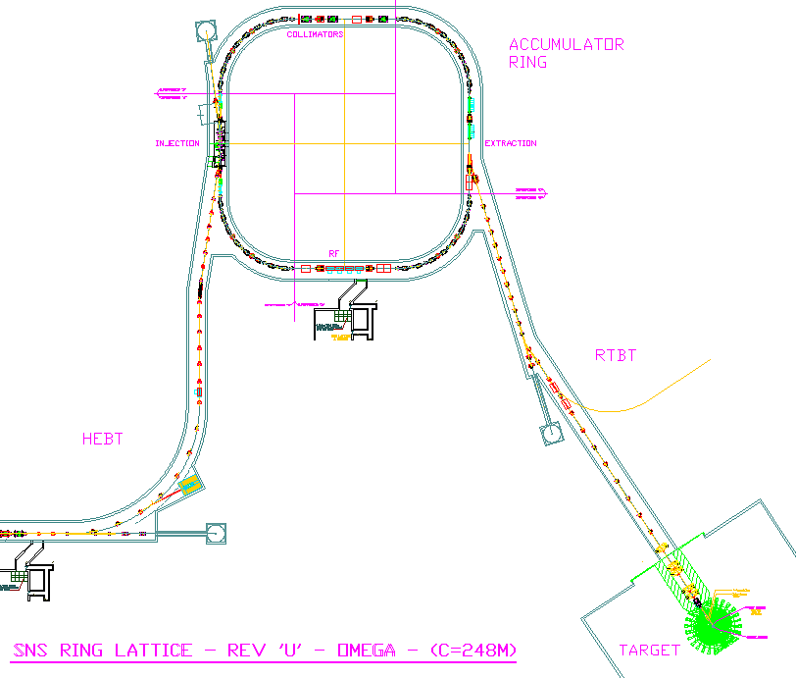
SNS Layout
Accumulator Ring: Compress 1-ms long pulse to 700 ns
Front-End: Produce
a 1-msec long, chopped, H-beam at 60 pps
H- stripped to p
LINAC; 1 GeV
402.5 MHz
805 MHz
DTL
CCL
SRF, β=0.61
SRF, β=0.81
upgrade
Liquid Hg Target
2.5
86.8
186
387
1000
1300 MeV
259 m
157 m
71 m
SNS was originally designed for 1.4 MW with built-in upgrade provision

Slide 4
SNS beam time-structure in linac and knobs for beam power
No. of macro pulses in one second: up to 60 (1 ~ 60 pps)
16.7 ms
Macro pulse
(60 Hz spacing)
Up to1 ms
No. of mini-pulses in one macro pulse: up to 1100 (1 ~ 1100)
Up to 1 ms
Mini-pulse
(Beam chopping
at LEBT)
Up to 0.8 T
One revolution in ring
T~910 ns at 1.3 GeV
No. of micro bunches in one mini-pulse: up to 300 (100 ~ 300)
Micro bunch
~2.5 ns
Bunch intensity: number of protons per micro bunch,
Controllable from Ion source

Slide 5
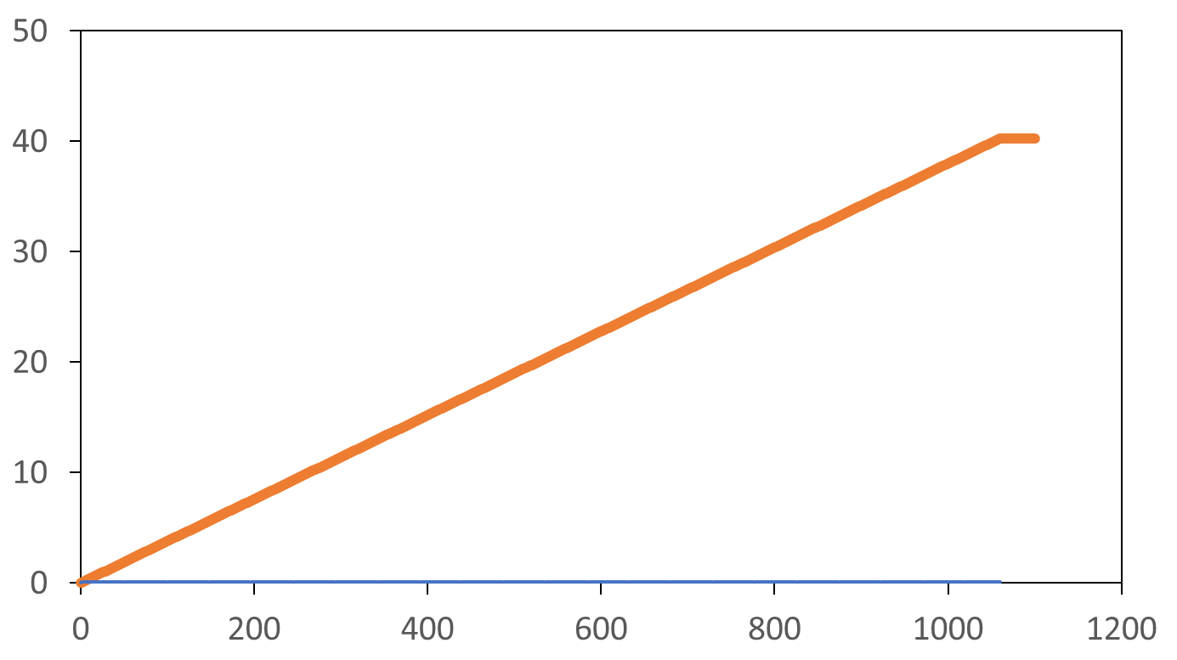
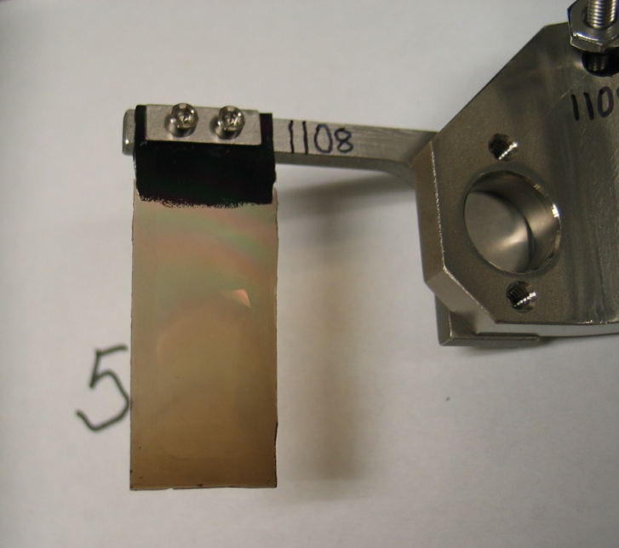
Acceleration, accumulation, and extraction of beam pulse
Carbon foil
e⁻
From linear accelerator
H⁻
proton beam
1.4-MW
In Ring
circulating proton beam
e⁻
thin carbon foil
Beam current (A)
accumulator ring
In Linac
38 mA
Accumulator Ring
Turns
This happens in 1 ms, and repeats
60 times a second or 5.2 million times a day
Each line corresponds to one mini-pulse, ~700 ns
Linear Accelerator
Liquid Hg Target

Slide 6
Proton Power Upgrade Project

Slide 7
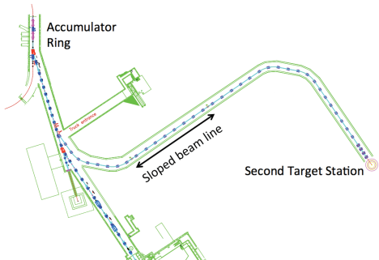
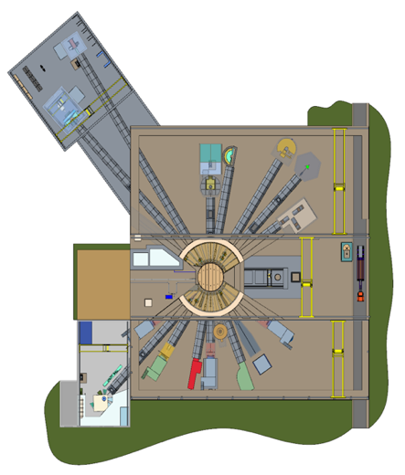
Proton Power Upgrade Project Goals
Accelerator: upgrade or replace components to enable 2.8 MW beam operation
First Target Station: upgrade for 2-MW beam at 1.3 GeV, 60 pps
Second target station (STS) is a separate project (received CD-1, CD-3a and CD-3b)
Beam distribution after STS
  45 pps to First Target Station (2.0 MW)
  15 pps to Second Target Station (0.7 MW)
  Beam energy per pulse ~ 46.7 kJ
0.7 MW
2 MW
Second Target Station
First Target Station

Slide 8
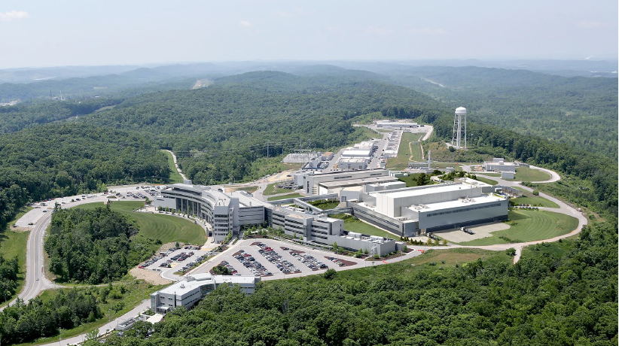
Baseline Beam Pulse distribution (all 60 Hz spacing)
FTS: 2 MW at 60 pps
(33.3 kJ/pulse)
FTS: 2 MW at 45 pps
(44.5 kJ/pulse)
STS: 0.7 MW at 15 pps
(46.7 kJ/pulse)
FTS
STS
Second Target Station
First Target Station

Slide 9
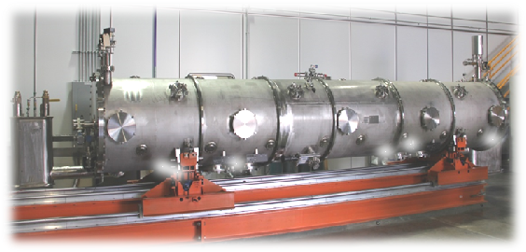
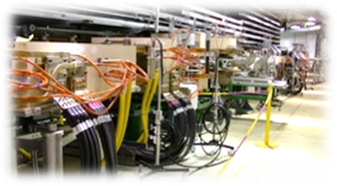
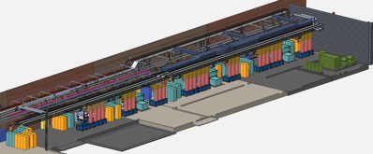
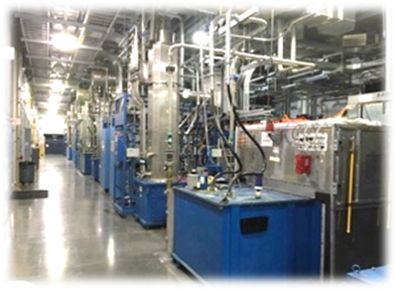
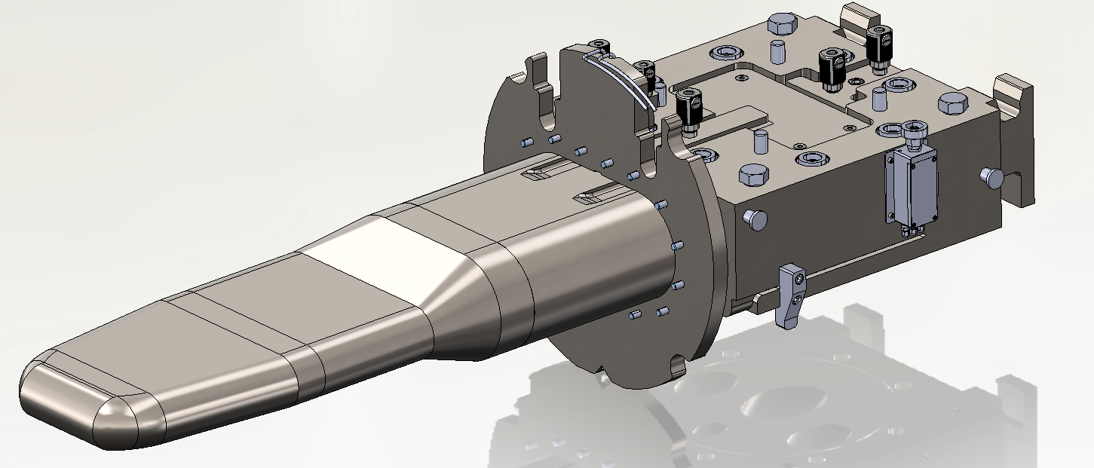
PPU project scope
Ring system upgrades
Primarily injection and extraction
Collimators
Extraction
Superconducting Linac upgrades
Add 7 new cryomodules
FE
DTL
CCL
SRF, β=0.61
SRF, β=0.81
upgrade
Liquid Hg Target
Radio Frequency (RF) system upgrades
Additions for new cryomodules
Upgrades for existing systems
First Target Station upgrades
2 MW, at 1.3 GeV, 60 pps
Conventional facility upgrades
Klystron gallery extension
RTBT stub

Slide 10
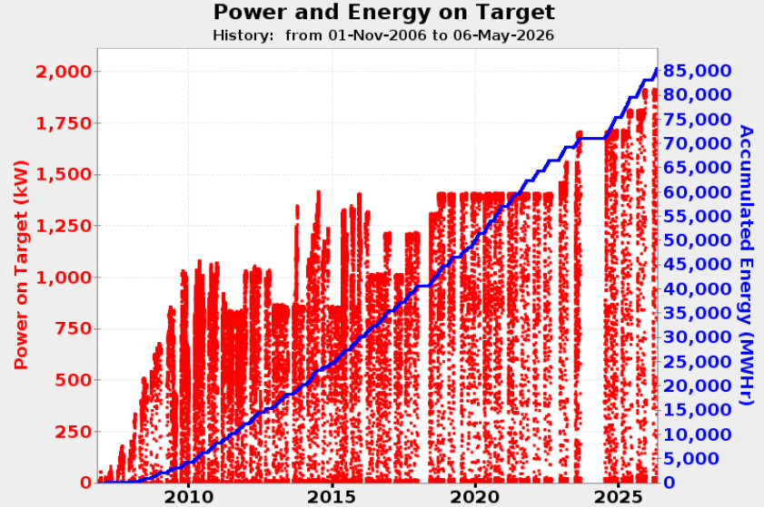
SNS beam power history
Toward > 2.8 MW
Target improvement
Reliable operations
Ion source, HVCM, SRF, Foil challenges
Power ramp-up
PPU
Initial learning
Target, RFQ challenges
Currently running at 2.0 MW

Slide 11
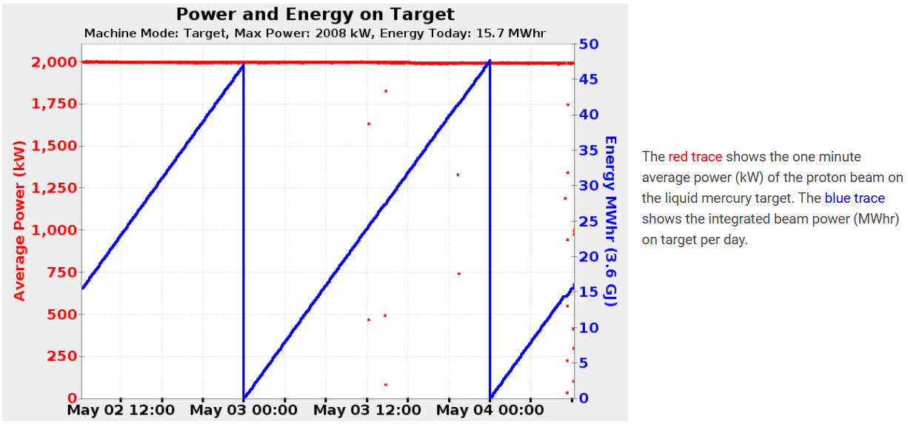
Neutron production at 2.0 MW beam
Reliable 2-MW neutron production during routine user operations

Slide 12
Toward > 2.8 MW

Slide 13
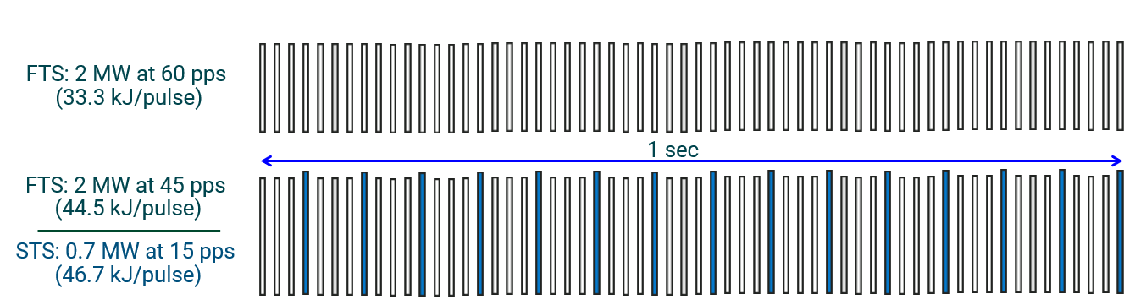
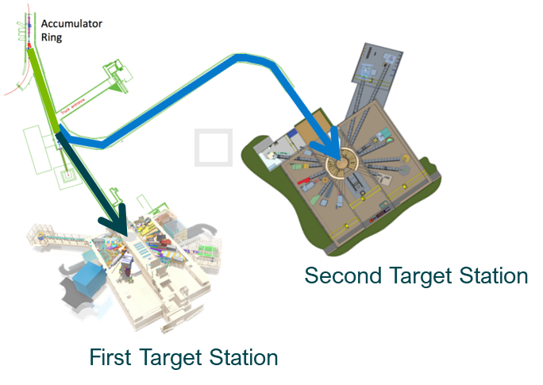
How we get > 2.8 MW
Launched 2.8 MW initiative in September 2024 with goal
  Demonstrate 2.8-MW equivalent beam intensity and 2.0-MW beam operation at 45 pps on the first target station
Objectives
  Identify weak links and ‘unknown unknowns’ earlier
  Stress test in advance wherever possible
  Ensure margin (capacity, beam energy, beam current, beam loss, etc.), reliability and long-term sustainability, including some topics for operational improvements
  Staff training for future
Eight teams primarily accelerator performance and operational limits including team effort for proof-of-principle test at the end of every run cycle

Slide 14
2.8-MW demonstration status and plan
2.0 MW on FTS
at 45 pps (June 2027)
2.8 MW-equivalent pulse-intensity
at 30 pps (Dec. 2026)
2.8 MW-equivalent pulse-intensity
at 10 pps (June 2026)
2.6 MW equivalent intensity
at 10 pps (Nov. 2025)
2.3 MW equivalent intensity
at 10 pps (May 2025)

Slide 15
Beam distribution with Third Target Station (TTS)
Beam split system (magnets)
Controls and diagnostics for three flavor beams
Third beam line
Third target station

Slide 16
Examples of Beam Pulse distributions with TTS
(all 46.7 kJ/pulse): 46.7 x 60 = 2.8 MW
FTS: 1.87 MW
at 40 pps
STS: 0.7 MW
at 15 pps
TTS: 0.23 MW
at 5 pps
FTS: 1.96 MW
at 42 pps
STS: 0.7 MW
at 15 pps
TTS: 0.14 MW
at 3 pps

Slide 17
3 MW beam (50 kJ/pulse) with TTS
FTS: 2.0 MW
at 40 pps (50 kJ/pulse)
STS: 0.7 MW
at 15 pps (46.7 kJ/pulse)
TTS: 0.25 MW
at 5 pps (50 kJ/pulse)

Slide 18
Expanded accelerator capability opens new opportunities for science, applications, and national needs
FTS
STS
TTS

