Slide 1
ORNL New Science and Applications at SNS Workshop
2026 June 10-12
Energy scales of unconventional superconductors
measured by muons and neutrons
Yasutomo J. Uemura, Columbia University, USA

Slide 2
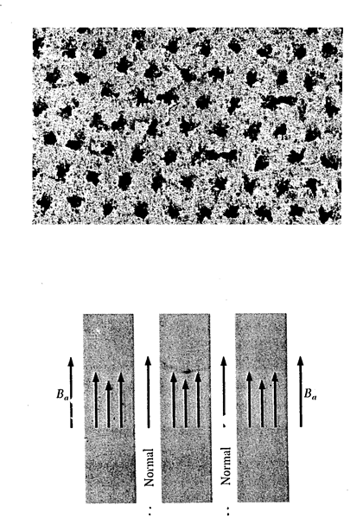
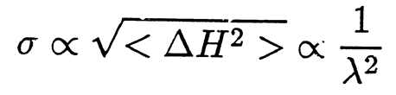
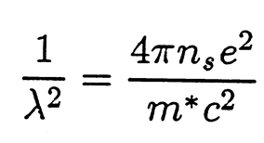
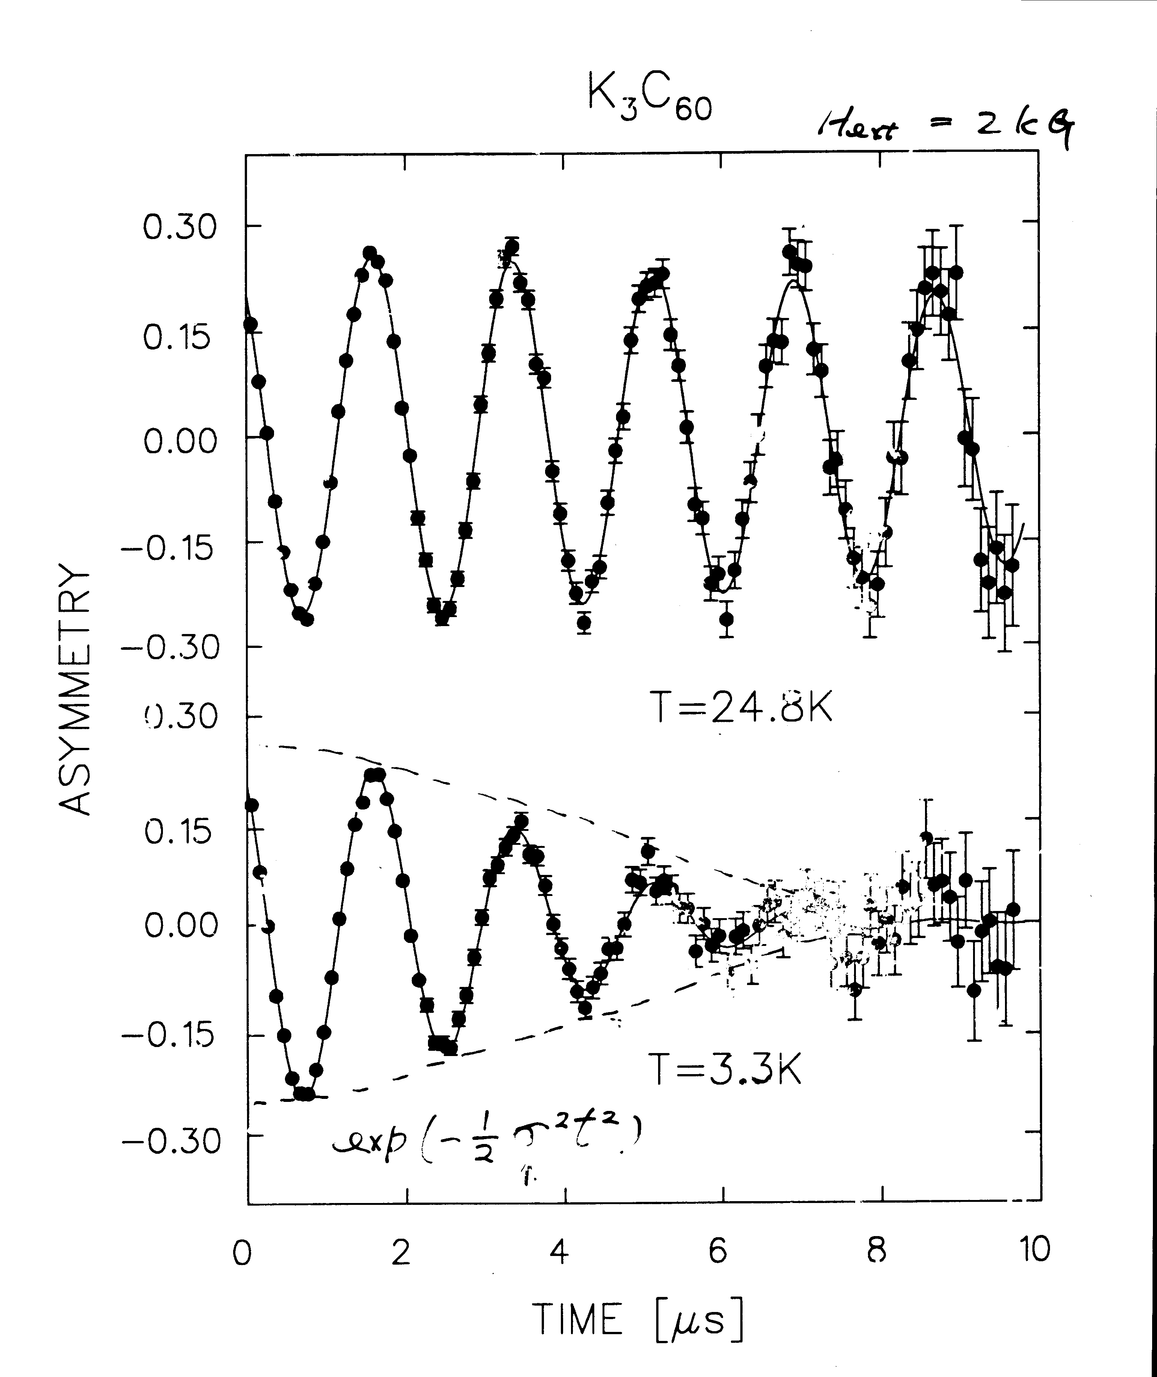
TF 2kG
exp(-σ²t²/2)
relaxation rate σ
~ 1000 A for 1 kG

Slide 3
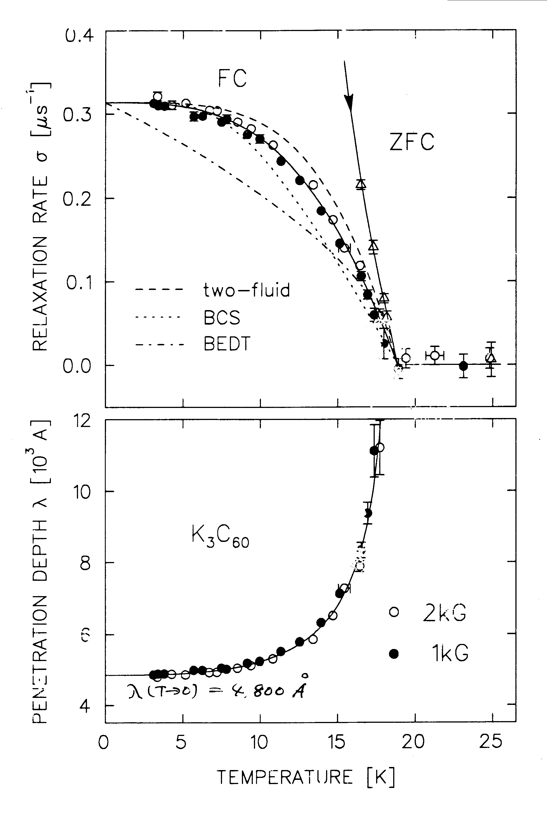
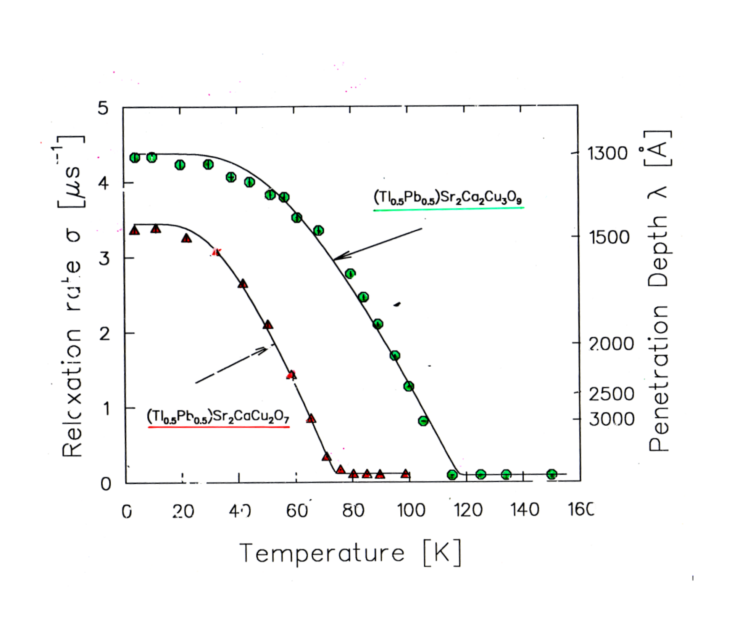
Relaxation rate
λ(T=0) = 4800 A

Slide 4
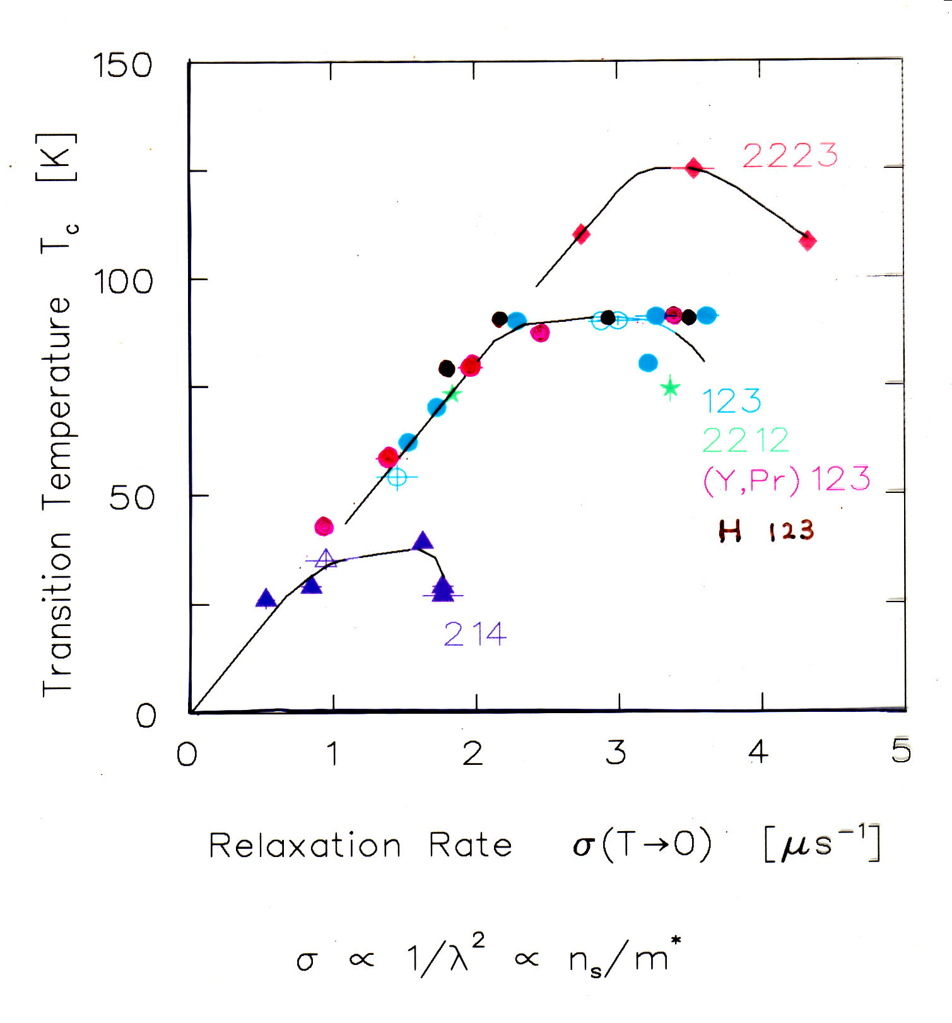
Uemura et al. PRL 1989
UBC x-tal

Slide 5
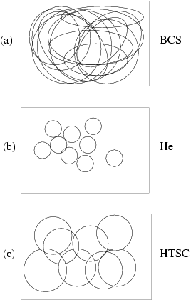


~ n_{s} /m*

Slide 6
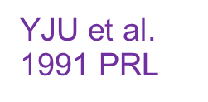
BEC BCS Crossover
Phase Coherence

Slide 7
BE-BCS
crossover
Uemura
1994
Fermions (e)
Fermions (e) + Bosons (2e)
Retardation: charge energy (kT_{F}) vs. mediator energy (hω_{B})

Slide 8
Why is Tc reduced from T_{BEC} ?
⁴He: T_{BEC} = 3.2 K
T_{C} = 2.2 K
Cuprates:
T_{BEC} / T_{C} ~ 5

Slide 9
Neutron magnetic resonance mode
Analogy with rotons in superfluid ⁴He
Role of competing order

Slide 10
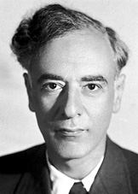
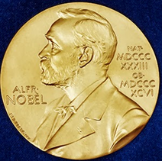
Rotons in bulk He
1962
solid He (66 atm)
T_{BE} = 3.2 K T_{λ} = 2.2 K due to rotons
Rotons: Soft phonons for solidification of He --- competing state

Slide 11
Tc of the bosonic superfluid 3-d ⁴He
determined by the soft mode energy
towards competing state.
2
1
0
0.0
1.0

Slide 13
2
1
spin gap energy
0
0.0
1.0

Slide 14
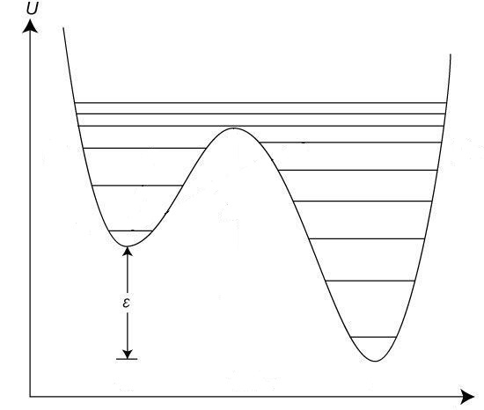
Thermal effect of competing order
Magnetic resonance mode; rotons
F
AF / HCP
SC / SF

Slide 15
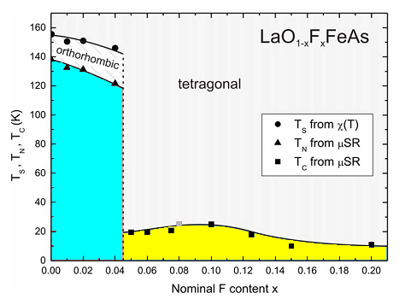
La(O,F)FeAs
AF
SC
(b)
F
AF / HCP
SC / SF

Slide 16
Nernst Effect and Photo-excited transient SC
-- Overcoming competing order --

Slide 17
Vortex-like Nernst onset
N.P. Ong et al. 2000
Nernst Effect
Diamagnetic Susceptibility

Slide 18
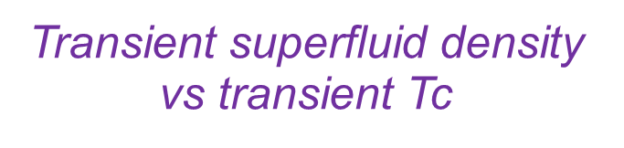
Andrea Cavalleri
Photo
excited

Slide 19
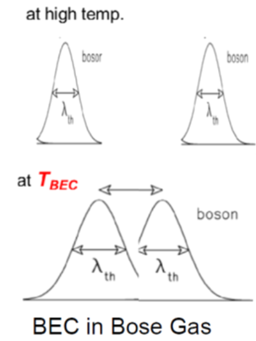
boson
boson

Slide 20
Effect of Photo Excitation
LBCO. LESCO: Melting Charge and Spin Stripe Order
Inducing transient Superconductivity
YBCO: Melting Resonance Mode (inelastic mode)
Inducing transient Superconductivity
Eliminating
Competing
State

Slide 21
Anomalous disappearances of superfluid responses
in the overdoped region

Slide 22
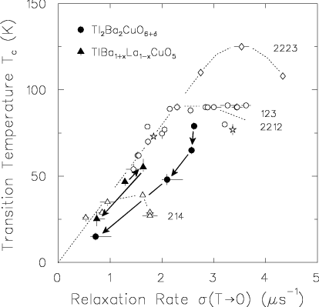
Overdoped Tl2201
Uemura Nature 1993
Niedermayer PRL 1993
n_{s}
n_{n}
n_{hole}
n_{s}/m*

Slide 23
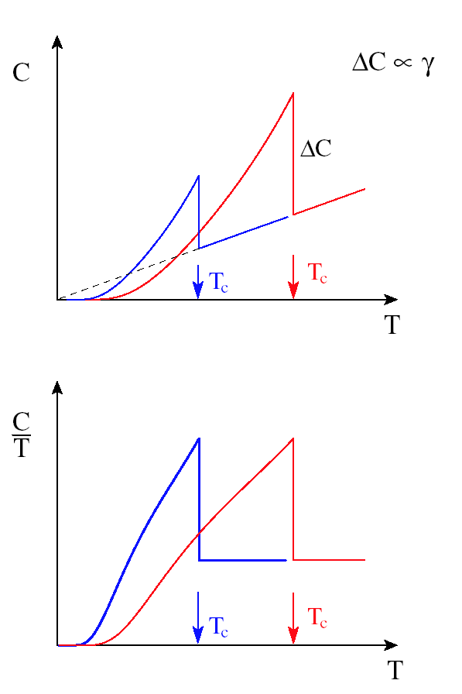
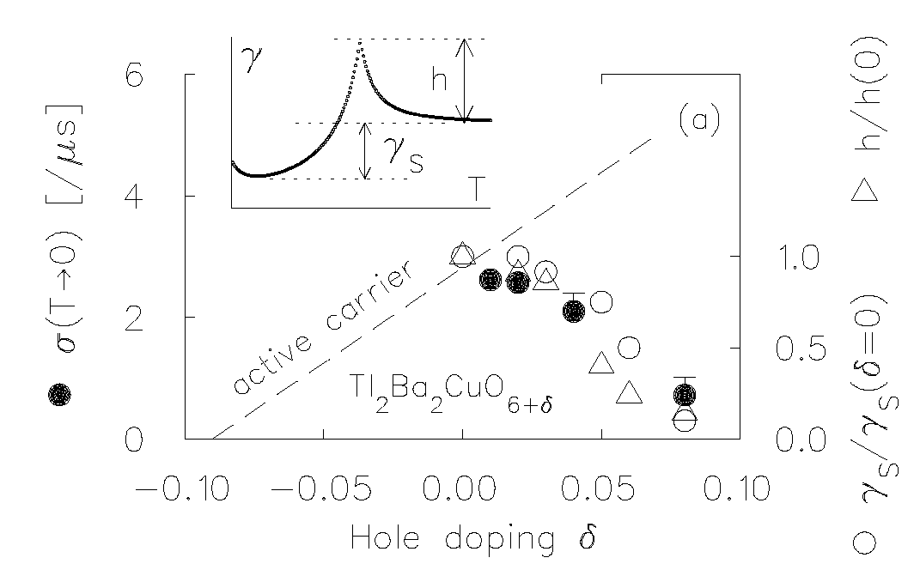
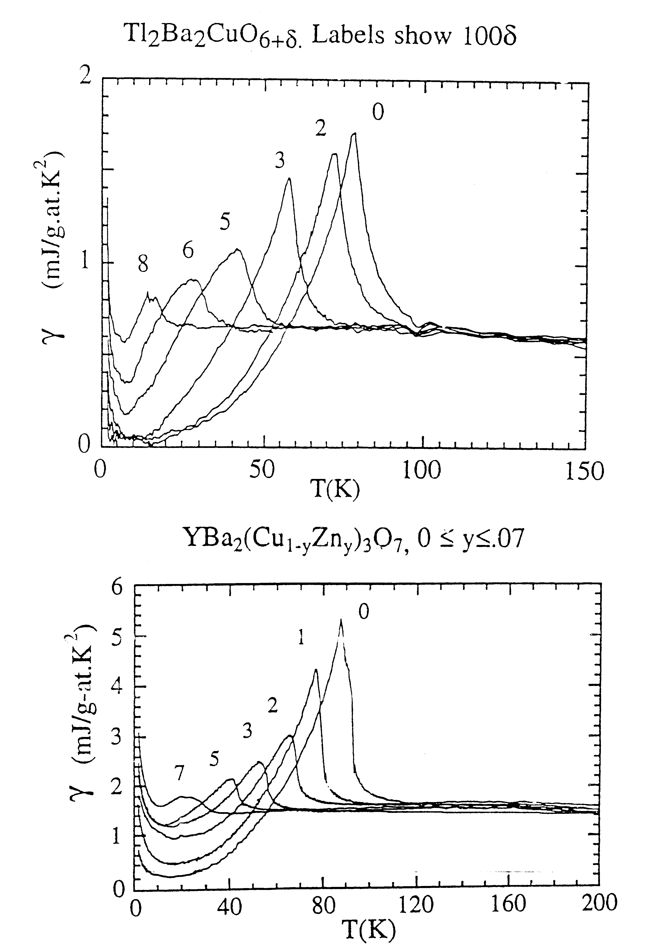
(a)
(c)
CT
BCS
(b)
(d)
Fig. 7

Slide 24
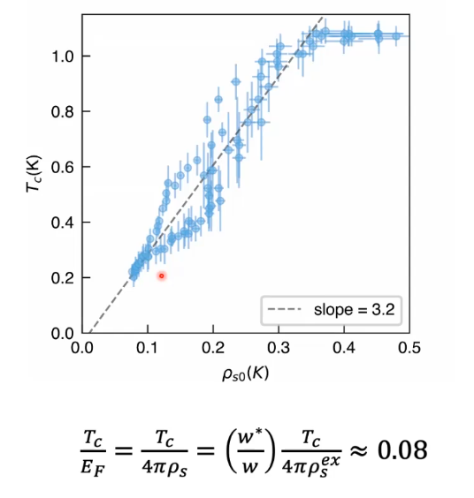
Superfluid Density of Tri-layer Twisted Graphene
Philip Kim et al. Nature (2025)

Slide 25
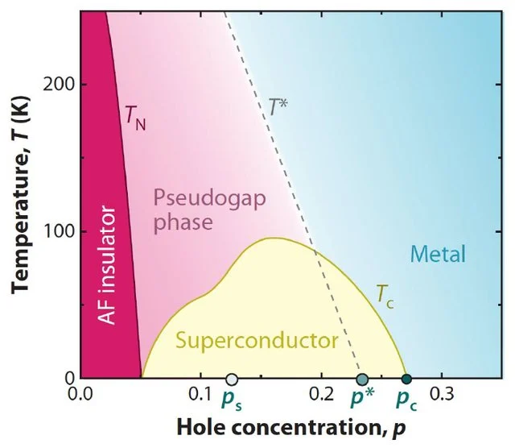
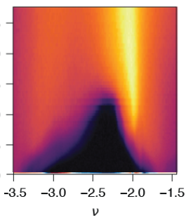

YBa₂Cu₃O_{x}
La(O,F)FeAs
Twisted Tri-layer Graphene

Slide 26
Comparable spin and charge energies
Model of synchronizing spin and charge time scales
“ Traffic Light Resonance ”

Slide 27
Moriya-Ueda
Spin Fluctuation Energy
T_{c} ~ ε_{F}
T_{c} ~ max (hω_{SF})
ε_{F} ~ J

Slide 28
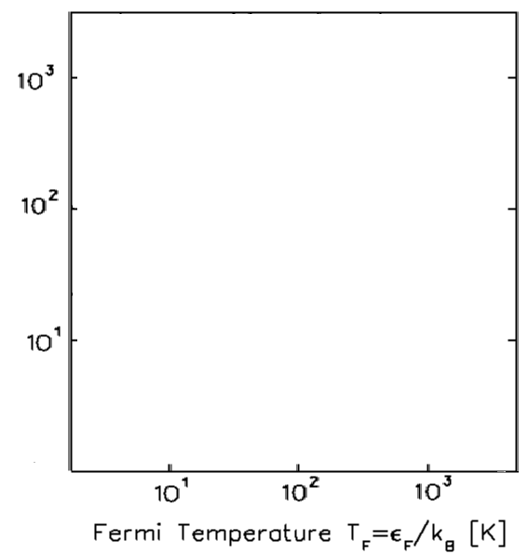
Tl 2223
YBCO123
CuO
Ba122FeAs
FeAs
Spin Fluctuation Temperature T_{SF} [K]
URu2Si2
UPd2Al3
Spin energy scale J
UPt3
Heavy Fermions
ε_{F} = J
Charge energy scale ε_{F}

Slide 29
x
x
x
hω_{AF} ~ kT_{F}
Dynamically avoiding frustration

Slide 30
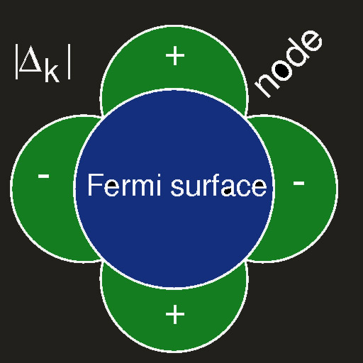
Nodal Charge
No frustration for Nodal Charge Motion
Antinodal Charge Needs Cooperation of AF fluctuations
Nodal Charge Does NOT Need that
➔ Coherent nodal charge

Slide 31
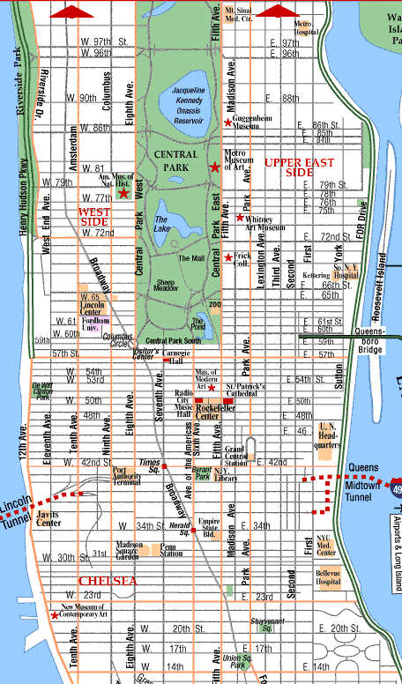
Traffic-light resonance
How a charge (= car)
can avoid
spin selection rules, frustration and Hubbard U (= red traffic light)
J ~ hω_{AF} ~ kT_{F}
Static order prevents charge motion

Slide 32
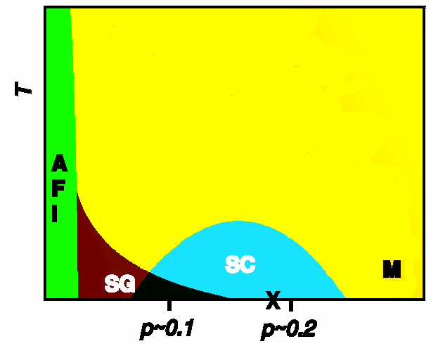
Charge energy ε_{F}
Spin energy J
Pairable charges

Slide 33
Unconventional Superconductors
MuSR: superfluid charge energy scales
Neutron scattering: spin energy scales
➔ Combination reveals novel spin-charge quantum interplays

