Slide 1
Overview of target technology for SNS applications
June 10, 2026 | New Science and Applications at the SNS Workshop
Yongjoong Lee
Target R&D SNS/STS
Notes:
Accessing Title Slide Options
The standard ORNL presentation template includes five branded title slide layouts:
Title | Standard. The preferred layout for lab-wide and general presentations. Features a default aerial photograph of the lab.
Title | Custom Image. Allows replacement of the default background with a custom full-slide image (16:9 or 4:3 landscape format).
Title | Custom Portrait Image. Supports inclusion of a custom 4:3 portrait image positioned next to the introductory text.
Title | Custom Landscape Image. Supports inclusion of a custom 16:9 landscape image positioned next to the introductory text.
Title | Text Only. Offers additional space for longer titles and multiple presenters.
Additional Lab-approved title slides specific to directorates and user facilities are available in PowerPoint under the following folders: Custom Title Slides and User Facility Templates, located in Presentation Templates.
Custom Title Slide Guidelines
Image Rights. Any custom images, graphics, or photography must be owned by ORNL or used with documented permission from the original creator or source.
Appropriate Image Use. Select images that work well with the layout. Ensure the focal point of the image is not obscured by the title text and white overlay box.
Relevance and Impact. Visuals are a key element of effective communication. Whenever possible, use imagery that enhances the message of your presentation and reflects ORNL’s mission and values.
Quality and Clarity. Use high-resolution images for clarity on large screens. Avoid overly complex or dark images that may conflict with the title text.
Text-Only Option. If no appropriate or approved imagery is available, or if imagery is not permitted for the subject matter, the Title | Text Only layout provides a clean, professional alternative.
Learn more about ORNL presentations
https://ornl.sharepoint.com/sites/branding/SitePages/presentations.aspx

Slide 2
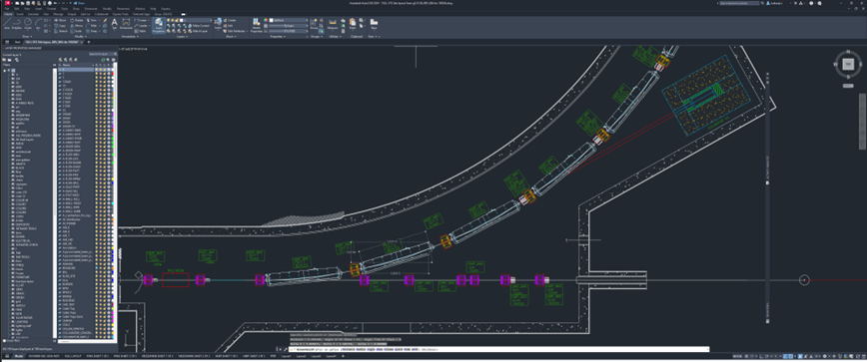
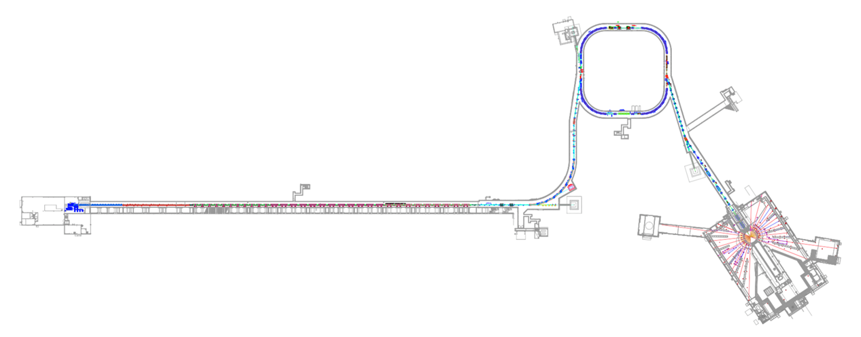
Potential Target Station Options Considered
Multipurpose Target Station:
  Medical isotope production target
  Muon target: MuSR, muCF, particle physics
  Neutron target: Particle physics, ADS, Chip irradiation, fusion materials irradiation
Linac Dump Irradiation Station:
  Medical isotope production demo station
  Pion production target demo station
  Beam diagnostics device test station
  Moderator test station
  Materials irradiation station
Multipurpose Target Station
Third Target Station
Linac Dump Irradiation Station

Slide 3
Target technologies for Multipurpose Target Station

Slide 4
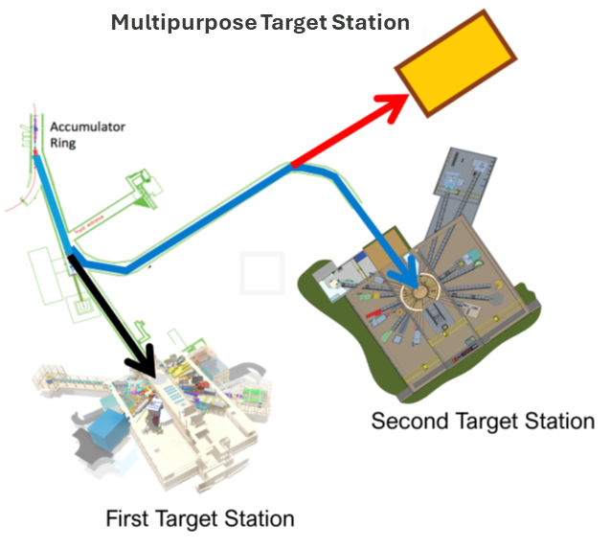
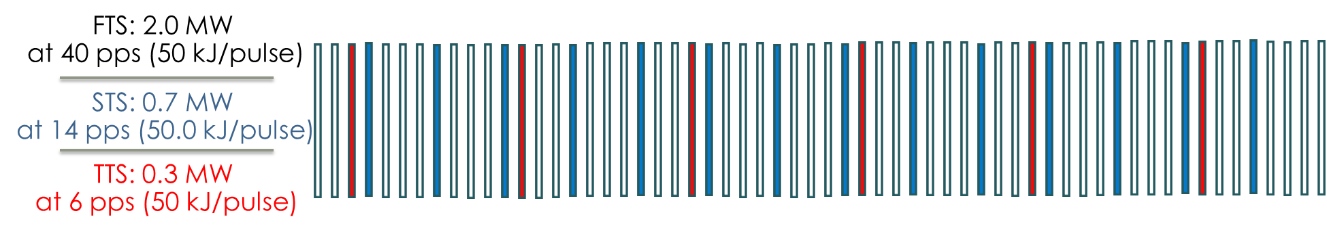
Multipurpose Target Station
This Talk:
  General shielding requirements
  Design concept of Isotope production target
  Predicted capabilities of muon production target
  Spallation targets for non-neutron scattering applications
Beam Parameters:
  Beam energy: 1.3 GeV
  Beam power: 300 kW
  Pulse energy: 50 kJ/s
  Repetition rate: 6 Hz
  Pulse length: 700 ns (short pulse)
  Time averaged proton current: < 1.44e15 p/s

Slide 5
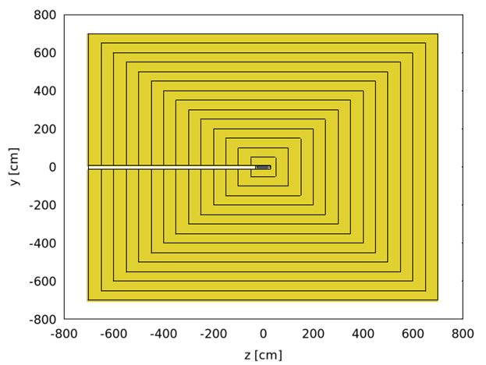
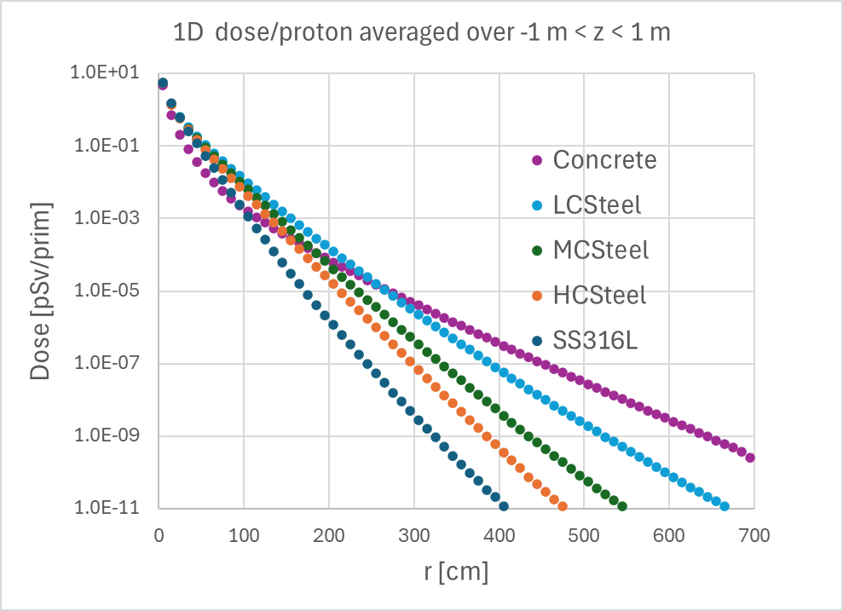
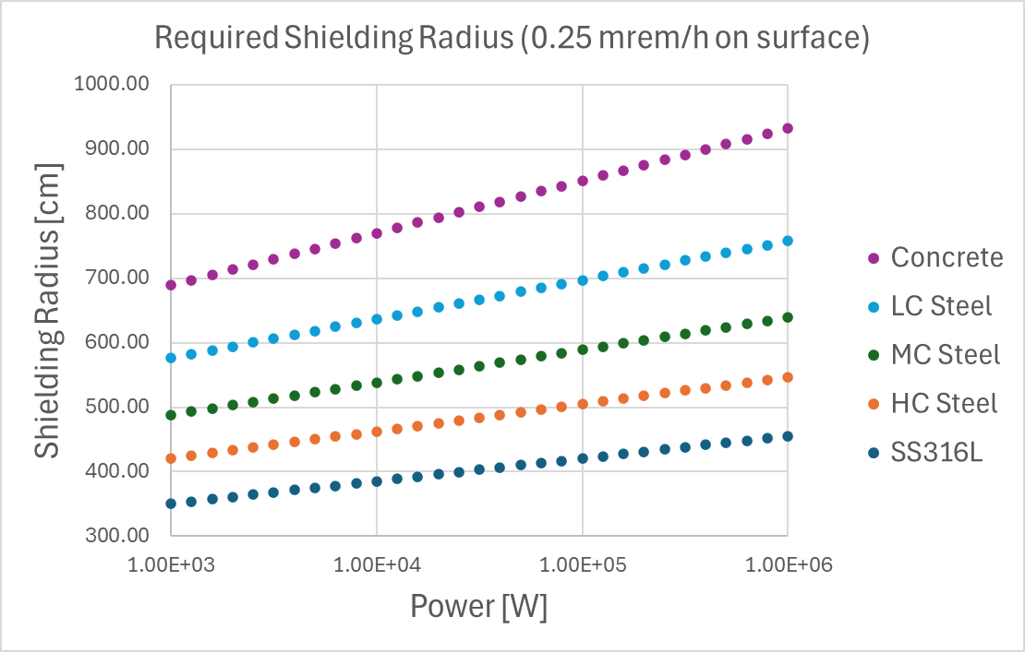
General Shielding Requirements – 300 kW Beam Power
Prompt dose attenuates by exp(-1) for 15 cm (SS) – 35 cm (Concrete) additional shielding thickness
  Total required shielding thickness ranges from 4.6 m (SS) to 9.3 m (concrete) for 1 MW source (contact dose < 0.25 mrem/h)
  Reducing power from 1 MW to 1 kW reduces the required shielding thickness by 1 m (SS) and 2.4 m (concrete), which are a quarter of total thickness
300 kW target station needs shielding that is not much less than the STS (700 kW)
STS target station shielding:
  6 m diameter (ca. $30M is budgeted)
  Complementary concrete shielding is CF scope

Slide 6
Medical Isotope Production Target

Slide 7
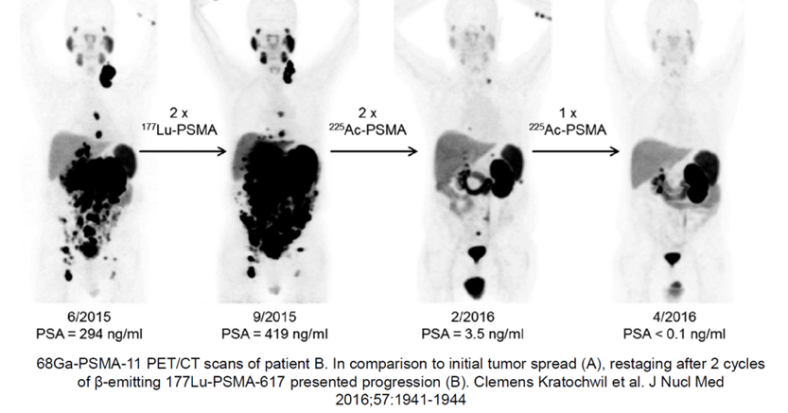
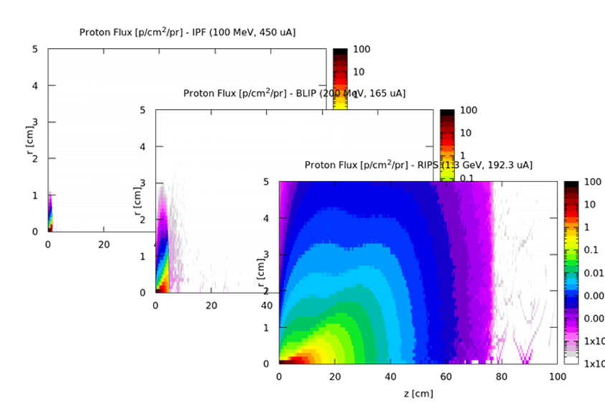
Study Case: Ac-225/Ra-225
Promising preclinical and clinical results for targeted alpha therapy with Ac-225
Tri-Lab effort targets at up to 1000 mCi (37 GBq) Ac-225 production per batch (approximately a batch per month)
  Mainly source: Th-229 decay, a waste from U-233
  Accelerator driven production could reduce the batch cycle (BLIP/BNL)
LDRD on “Radioisotope Production at SNS” has been performed in FY24-25
  More details: Justin Griswold’s talk on “Results of the LDRD radioisotope production at SNS”
RIPS focused on the capability of high energy (1.3 GeV@231uA) compared to BLIP/BNL (0.2 GeV@165 uA) and IPF/LANL (0.1 GeV@450 uA) at equivalent current
  Stopping range of 1.3 GeV proton in Th-target is an order of magnitude deeper than 200 MeV

Slide 8
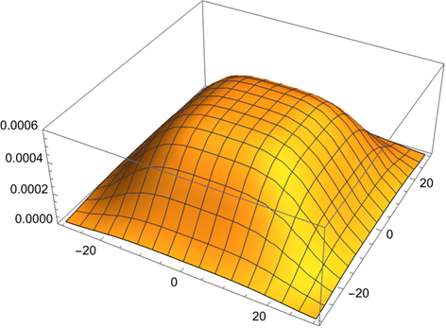
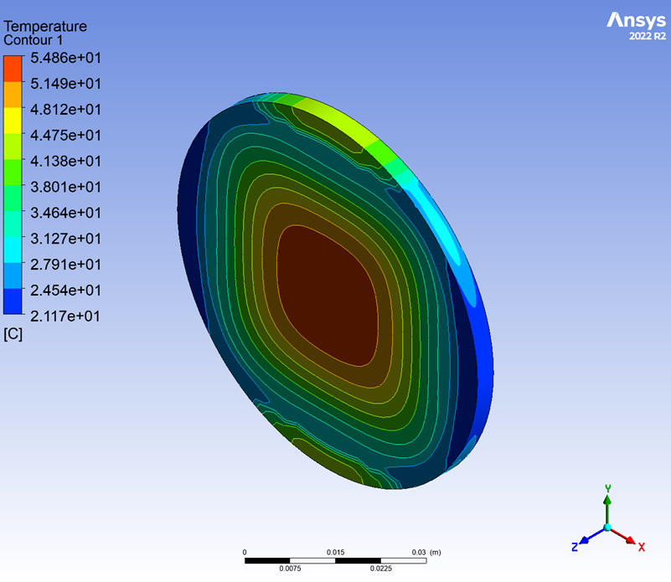
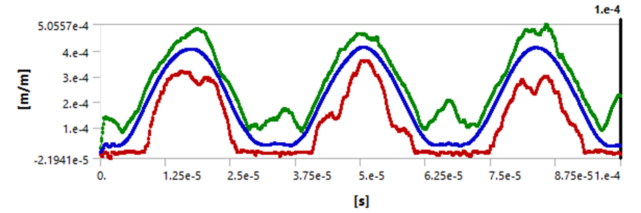
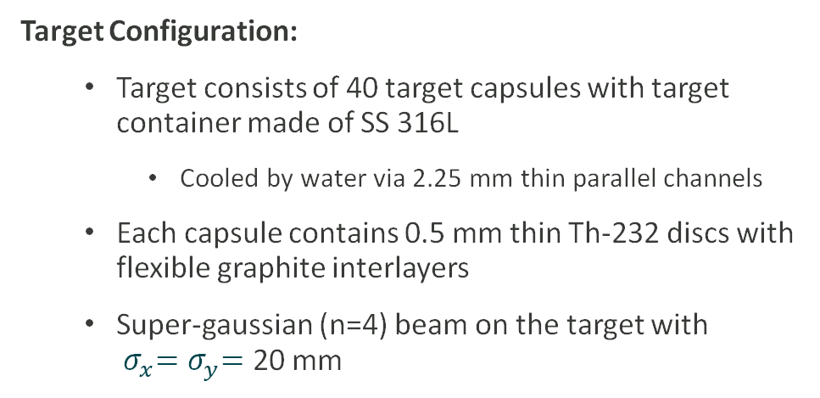
Conceptual Isotope Production Target
Target Configuration:
  Target consists of 40 target capsules with target container made of SS 316L
    Cooled by water via 2.25 mm thin parallel channels
  Each capsule contains 0.5 mm thin Th-232 discs with flexible graphite interlayers
  Super-gaussian (n=4) beam on the target with ${ σ}_{x}{=σ}_{y}=$ 20 mm
Target Survivability:
Steady and structural analyses showed that the maximum stress in the structural vessel lower than YS (235 MPa) and UTS (560 MPa) with a good margin.
  Further optimization is needed to keep the maximum stress below YS/2 and UTS/3
Fatigue analyses showed that the maximum strain amplitude in the vessel is lower than the fatigue endurance limit for 10-day operation (5 million cycles)

Slide 9
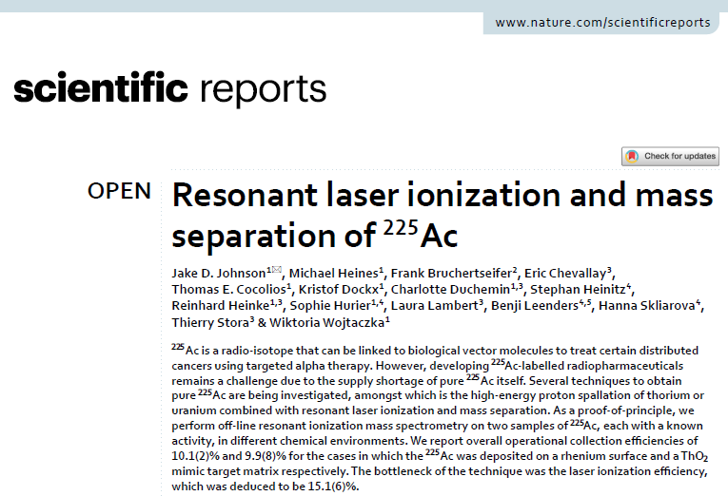
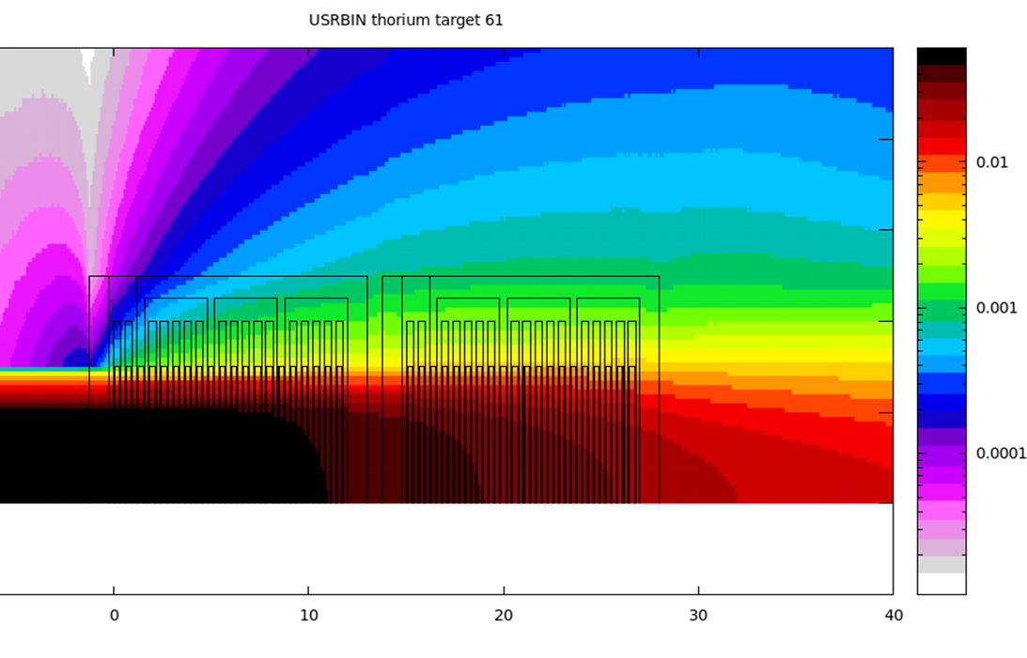
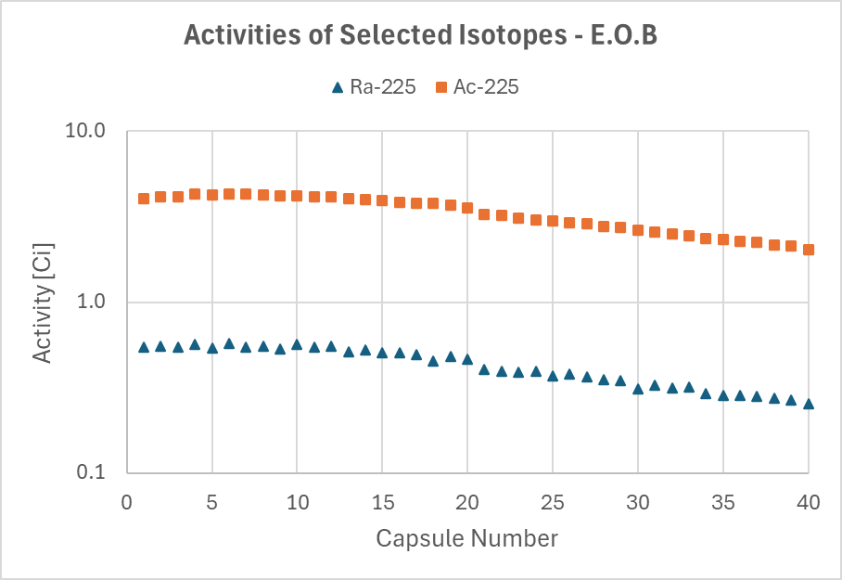

Ra-225 and Ac-225 Yields
Beam on target: 10 days.
Isotopes yields at E.O.B.:
  Ra-225 (Ac-225 generator): 17 Ci
    About 10 x Tri-Lab capacity/run cycle
  Ac-225: 133 Ci (with 0.3 Ci Ac-227 contamination)
    About 100 x Tri-Lab/run cycle
    However, practical yield efficiency will be much lower than Ra-225 due to Ac-227 contamination
Theoretically, the 300kW class isotope production target could provide more than million patient dose Ac-225 for 20-run cycles per year (10 days beam time per each run cycle)
  While chemical separation of Ra-225 from the Th-232 target is well established, direct separation of Ac-225 is challenging
    Mass separation technology to be explored (Next LDRD?)

Slide 10
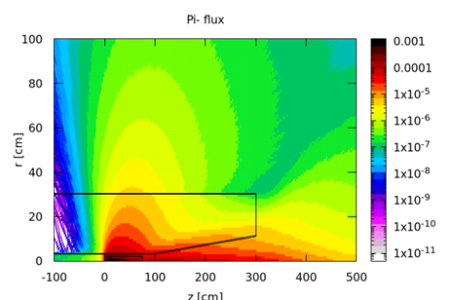
Muon Production Target

Slide 11
Muon Targets
G. Dal Maso et. al., EPJ Web of Conferences 282, 01012 (2023)
Applications: MuSR, MuCF, Particle Physics
Target station types
  Beam passing: Thin targets that intercept a small fraction of beam energy
    Graphite muon targets at PSI, ISIS, JPARC
    Majority of the protons travel further downstream towards a beam stopping target for other physics applications
  Beam stopping: Thick targets that intercept a large fraction of beam energy
    Solid and liquid targets studied for muon collider
    Mu2e target at Fermilab and COMET target at JPARC
    Neutrino targets at Fermilab and JPARC
  Muons are either captured by solenoid or magnetic horn
R. J. Weggel et. al., Proc. Particle Accel. Conf., New York, 1999

Slide 12
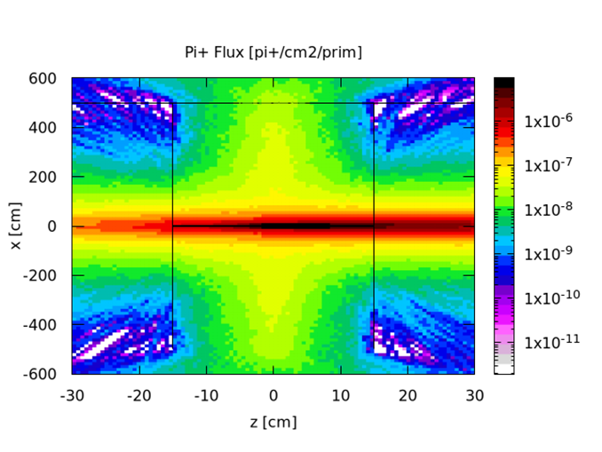
Muon Target – Beam Passing Type
Benchmark case: High-Intensity Muon Beams (HIMB) project at PSI – Graphite target
  Beam energy: 0.6 GeV
  Beam current: 2.4 mA (1.50e16 p/s)
  Muon yield: 1.22e10 mu+/s
  Proton travel length in target: 20 mm
  Pi+ yield at target: 6.20e-3/p
  Solenoid field: 0.45 T
The TTS/SNS could provide HIMB/PSI equivalent mu+ current of > 1e10 mu+/s by double the proton travel length and increasing solenoid field:
  Beam energy: 1.3 GeV
  Beam current: 0.23 mA (1.44e15 p/s)
  Proton travel length in target: 40 mm
  Pi+ yield at target: 3.12e-2/p
  Solenoid field: 1.0 T
Pulsed muon source
  Pulsed power supply with a small duty factor for normal conducting solenoid could make higher magnetic field possible with limited ohmic heating in the coils
  Can be optimized for specific experiments – to be defined
G. Dal Maso et. al.,
EPJ Web of Conf. 282, 01012 (2023)

Slide 13
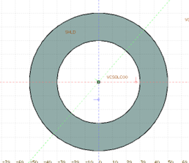
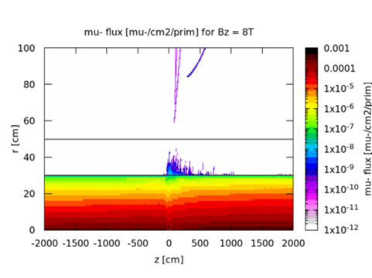
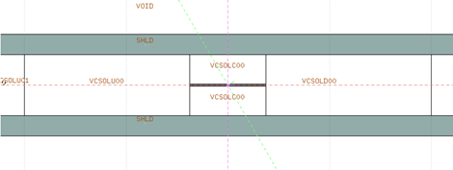

Muon Target – Beam Stopping Type w/ Solenoid Muon Capture
Target material chosen for the study: Graphite
  Longer interaction length than high Z material is compensated with reduced self absorption of produced pions at low proton energies (1.3 GeV)
  Reduced volumetric heat deposition and high surface emissivity make the “passive” target cooling possible, while High Z target require active cooling
Toy Model: Cylindrical target (D20 mm x L750 mm) in parallel solenoid field.
Ideal muon production yield for solenoid field Bz = 8 T
  Yield from the target: 9.95e13 pi-/s
  Yield at 20 m downstream: 5.36e13 pi-/s (54% eff.)
  Yield at 20 m upstream: 1.58e13 pi-/s (16% eff.)
Downstream muon beam transport needs more study
  Downstream beam optics and required muon beam emittance

Slide 14
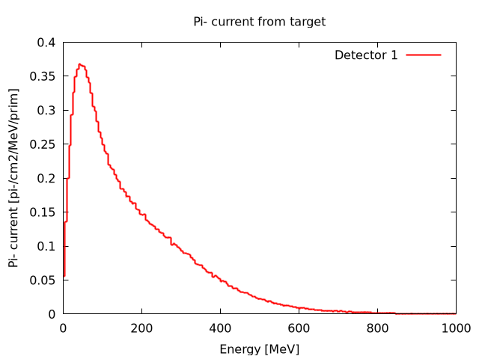
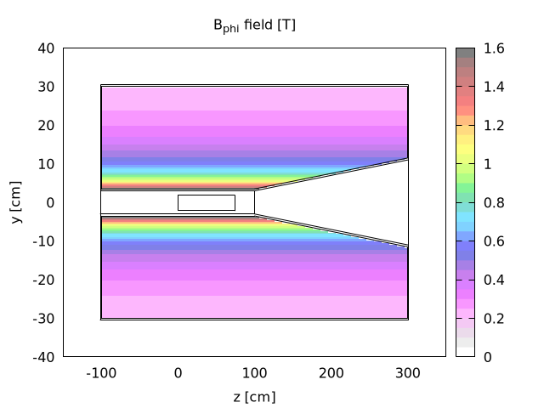

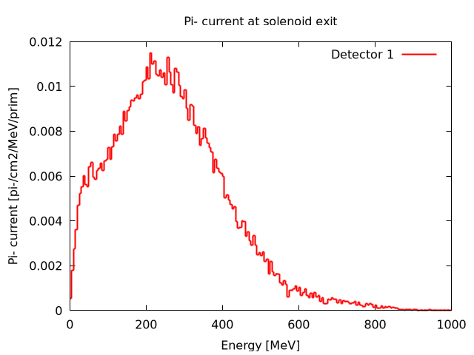
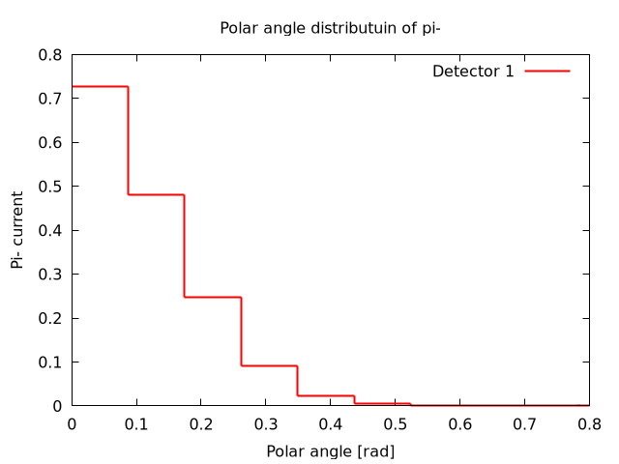
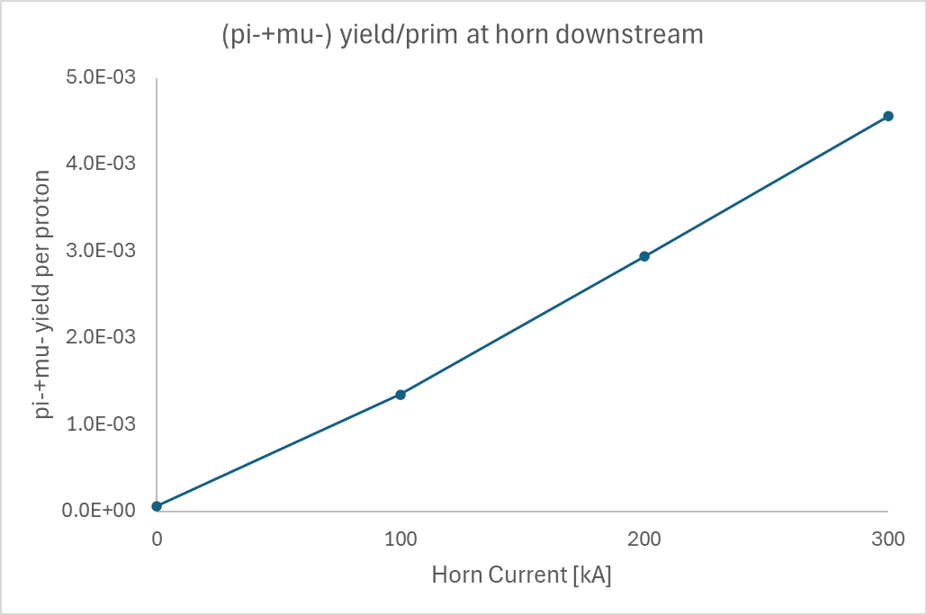
Muon Target – Beam Stopping Type w/ Magnetic Horn Capture
Toy model: Ad hoc magnetic horn made of Al surrounding graphite target with D40 mm x L750 mm
  For 300 kA horn current, 6.57e12 (pi-+mu-)/s are focused on the monitoring plane at the horn downstream.
Compared to capture solenoid
  Cons:
    Reduced muon capture
  Pros:
    More focused angular distribution of pion/muon
    More affordable engineering
    Horn can be optimized for particular muon beam phase space making the downstream beam transport design more straightforward.
Pi- current monitoring

Slide 15
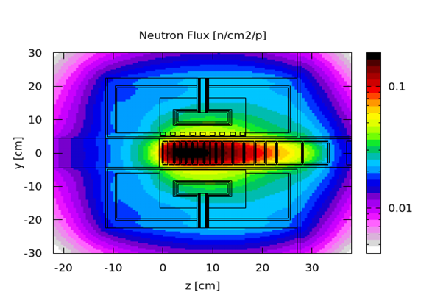
Neutron Target for Particle Physics, ADS, Chip Irradiation and Fusion Materials Research Applications

Slide 16
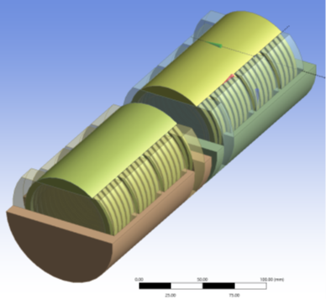
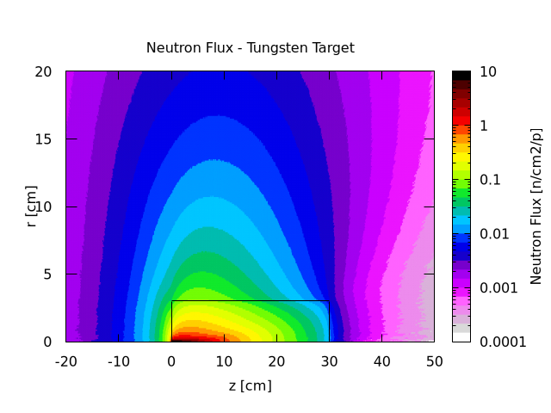
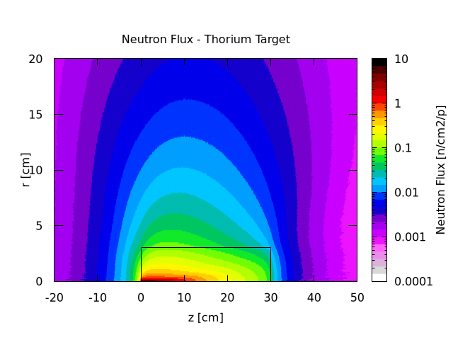
Stationary Neutron Production Target for 300 kW Beam Power
Stationary targets for short pulsed beam:
  Stationary tungsten target can take beam power up to 800 kW – Y. Lee, Proc. IPAC’24, pp. 3841-3844
  Thorium target for Ac-225 production can simultaneously used for neutron production
    Neutron Yield Comparison: (D60 mm x L300 mm)
      Tungsten (35.65 n/p) ~ Thorium (36.81 n/p)
Application of 300 kW Neutron Production Target
  Particle Physics: Hamiltonian beyond SM
    UCN – Neutron magnetic dipole moment
    NNbar – Baryon number violation
  300 kW class ADS demo station
  Chips irradiation station
  Fusion material irradiation station

Slide 17
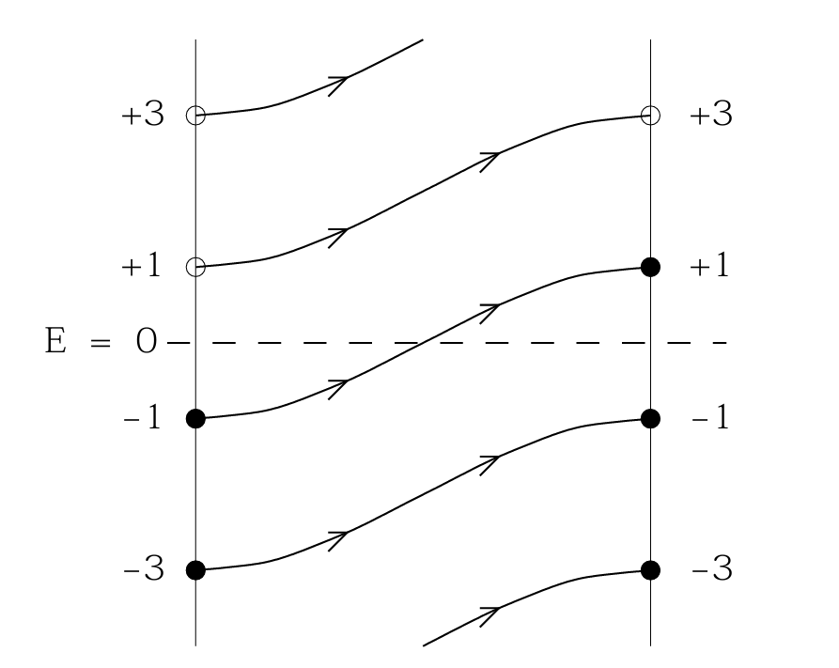
Hamiltonian Search Beyond SM
Ultra Cold Neutron (UCN)
  UCN: E < 300 neV (v < 8 m/s)
  Precision measurement of permanent neutron electric dipole moment (nEDM)
  Benchmark: PSI
    UCN Target: 0.6 GeV; 2.4 mA (1.4 MW)
      Beam on target duration: 8s
      Beam repetition rate: every 300s (0.9 MWh/d)
  SNS UCN Target: 1.3 GeV; 0.23 mA (7.2 MWh/d)
N-Nbar
  Searching Hamiltonian causing Baryon Number Violation: N => Nbar
    On perturbative level, the SM does not provide Hamiltonian for N-Nbar vertex
    On non-perturbative level, the probability of a baryon tunnelling through sphaleron energy barrier is quite low
  High flux (not high brightness) low energy neutron beam is beneficial
    Moderator should be researched extensively
G. Bison et. al., Eur. Phys. J. A (2022) 58:103
A. Addazi et al 2021 J. Phys. G 48 070501

Slide 18
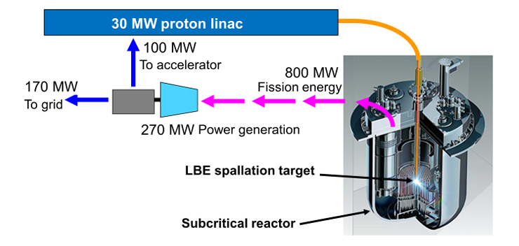
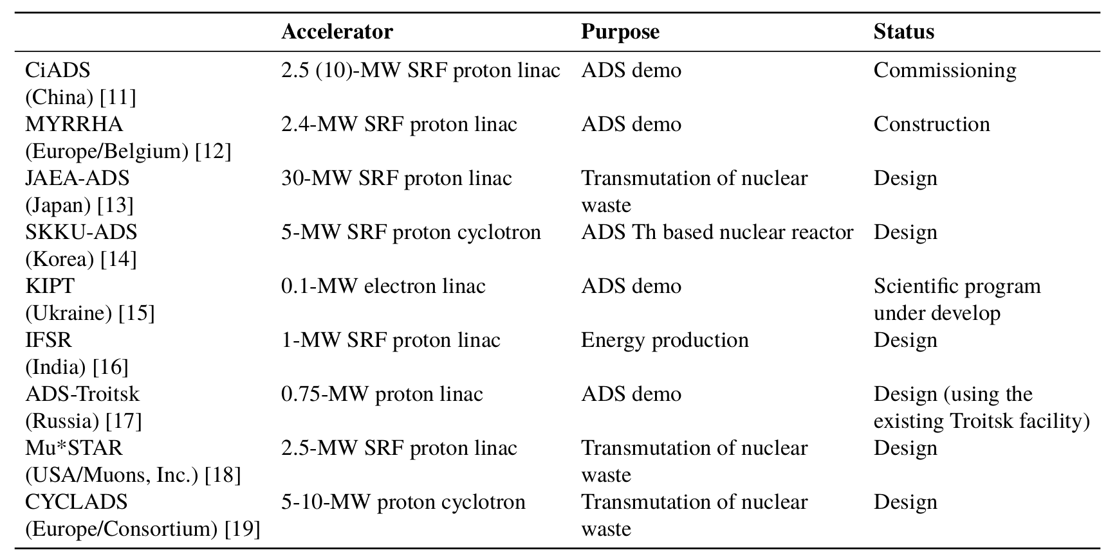
Accelerator Driven System Demo Station
Accelerator Driven System
  Spallation neutrons are used to transmute the nuclear waste to reduce the radiotoxicity level.
  Spallation neutrons are used to generate power by inducing unsustainable nuclear chain reactions in a subcritical reactor core
The ADS demo station at SNS can provide:
  Proof of ADS concept with a dedicated subcritical reactor core design
  ADS target technologies for optimized neutron production and system validation
JAEA-ADS design: B. Yee-Rendon, Proc. 31st Int. Linear Accel. Conf.
pp. 310-313 (2022)
Summary of the Worldwide ADS Activities: B. Yee-Rendon,
Proc. 31st Int. Linear Accel. Conf. pp. 310-313 (2022)

Slide 19
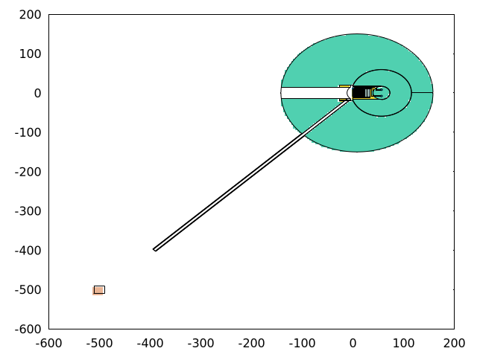
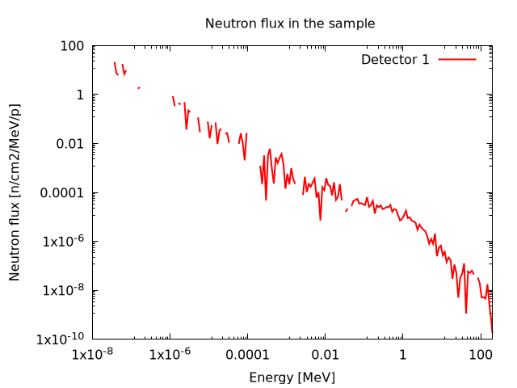
Chips Irradiation Station
Radiation damage in semiconductor chips
  Reference Criteria: R2E Requirements on “Standard Electronics” used at CERN, which does not require radiation hardness assurance (RHA)
  Beyond R2E applications, radiation hardness of the electronics shall be tested and confirmed
    Electronics in high radiation environment like accelerators and reactors
    Electronics in avionic and space applications
Model: Si sample (20 cm x 20 cm x 20 cm) placed at the end of 5.5 m long neutron guide (7 m from the source)
  Sample receives near atmospheric neutron spectrum
  Enough dose for failure simulation: Perhaps, the flux needs to be attenuated
    TID 1 Gy/h; SI1MEVNE > 1e8 SiNeq/cm2/s
    HEHAD-EQ > 1e7 HEHeq/cm2/s; THNEU-EQ > 1e6 ThNeq/cm2/s
 | R2E Quantity | R2E Limit
Cumulative Effects | Total Ionizing Dose (TID) | 10 Gy
 | Si 1 MeV Neutron Equivalent Fluence (Si1MeVNE) | 1e11 SiNeq/cm2
Single Event Effects | High Energy Hadron Equivalent Fluence (HEHeq) | 3e6 HEHeq/cm2
 | Thermal Neutron Equivalent Fluence (ThNeq) | 3e7 ThNeq/cm2

Slide 20
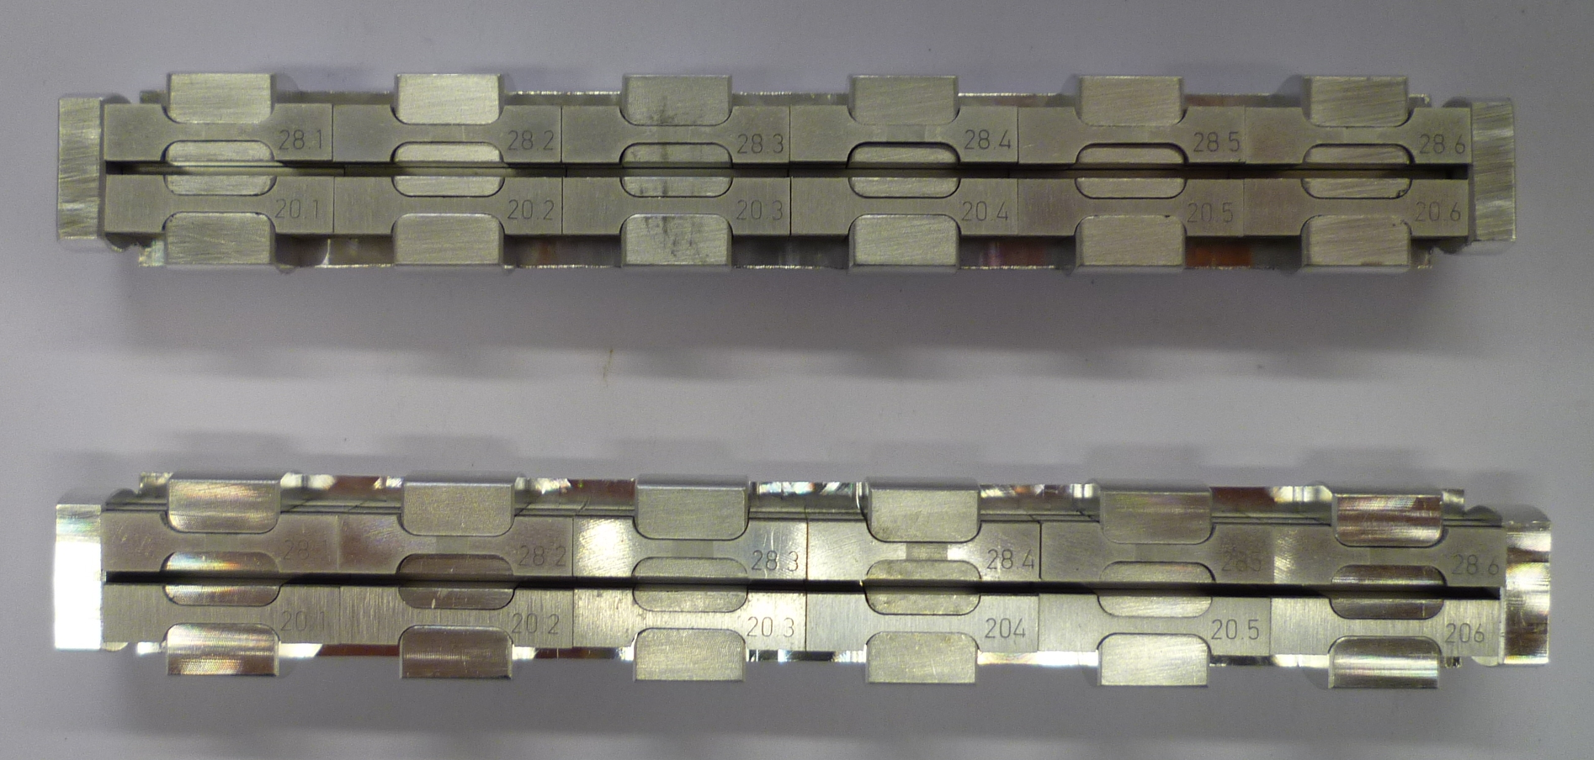
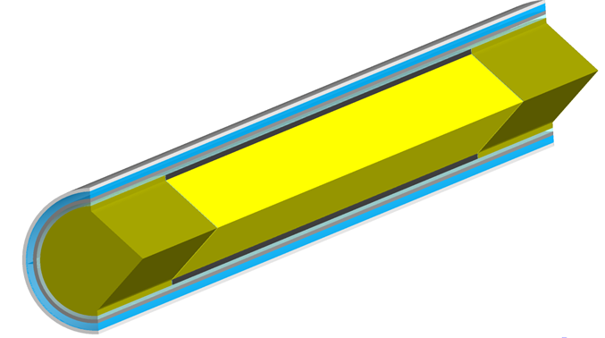
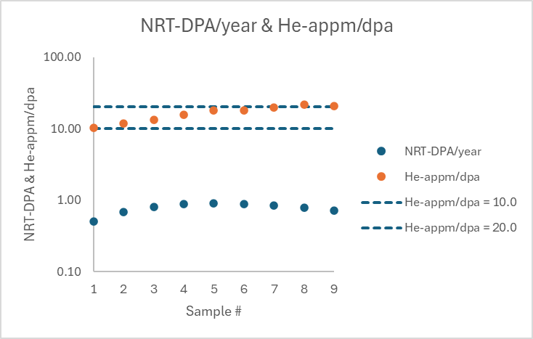

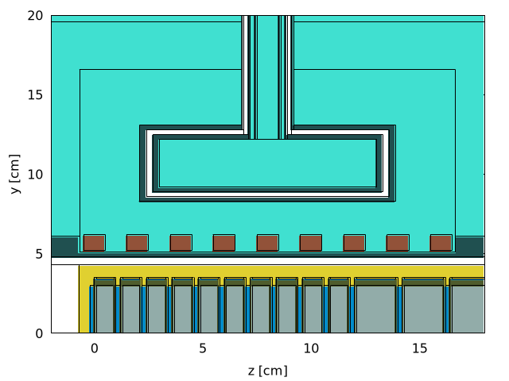
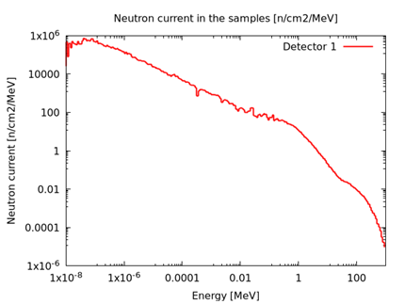
Fusion Materials Irradiation Module
Parasitic installation of fusion materials irradiation module next to the neutron production target
  Irradiation temperature control: Water cooling with helium–argon insulation layer for heat conductance controlling or helium cooling with varying mass flux
With 300 kW proton beam, the iron samples in the irradiation module show:
  Up to 1 dpa/year dislocation damage rate
  Between 10 and 20 He-appm/dpa: Similar to fusion neutron irradiation condition
Irradiation modules

Slide 21
Target Technologies for Linac Dump Area

Slide 22
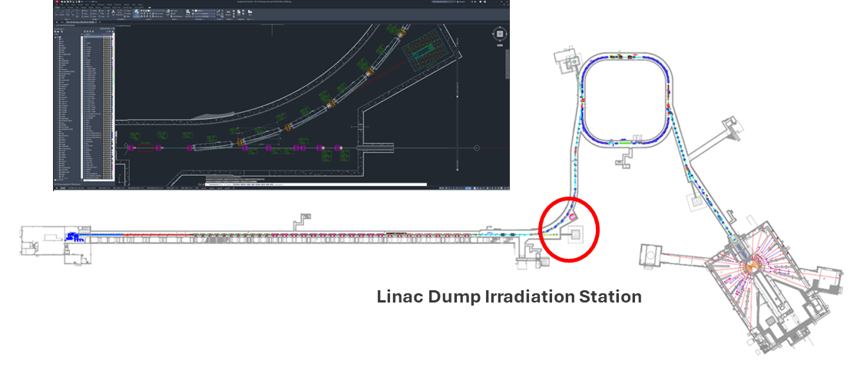
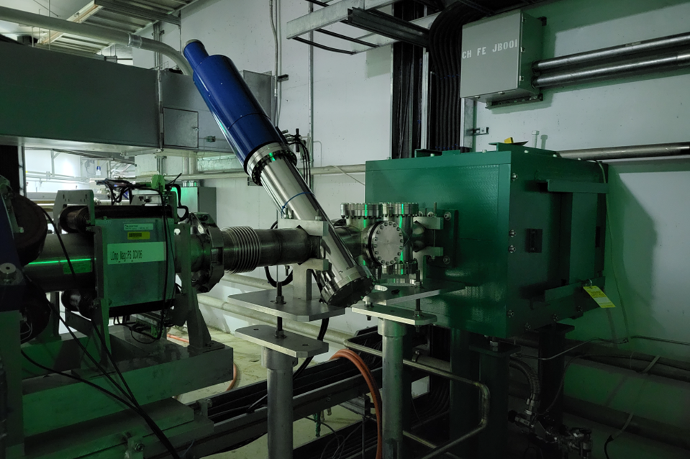
Linac Dump Irradiation Station:
This Talk:
  Operations envelop in the linac dump area
  Radiation damage in polymers and electronics
  Medical isotope production demo station
  SNS project support – luminescent coating
  Other applications
Beam Parameters: Beam parameters are constrained by operational envelope (OE) limit
  Beam energy: < 1.3 GeV
  Beam power: < 7.0 kW
  Beam pulse length: < 1 ms (long pulse)
  Pulse energy: < 33 kJ/pulse
  Time averaged proton current: < 3.36e13 p/s

Slide 23
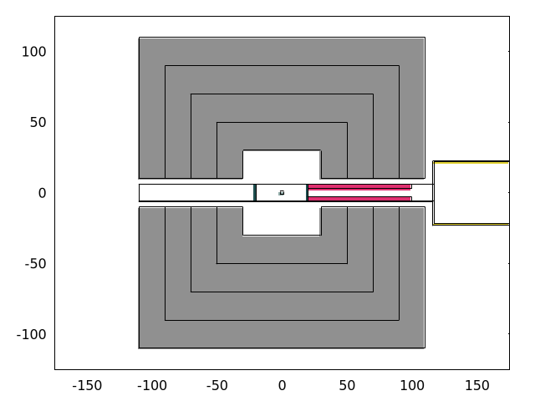
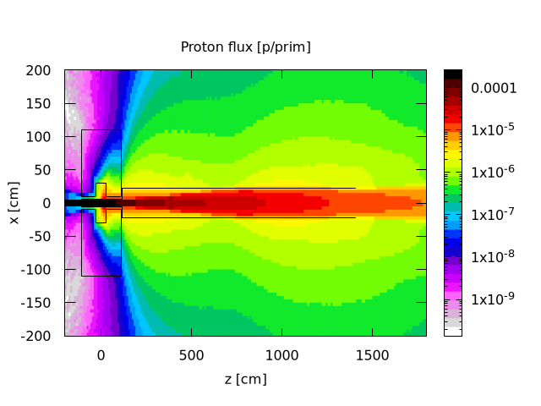
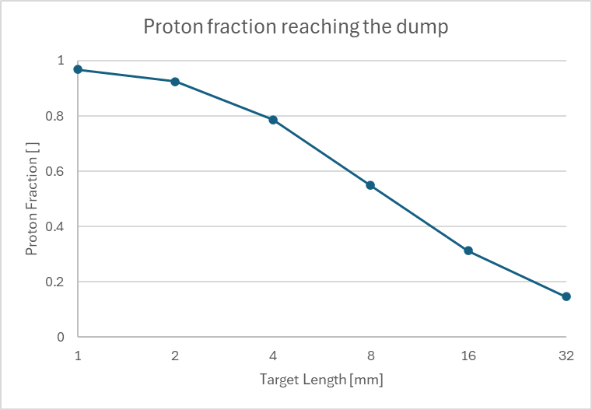
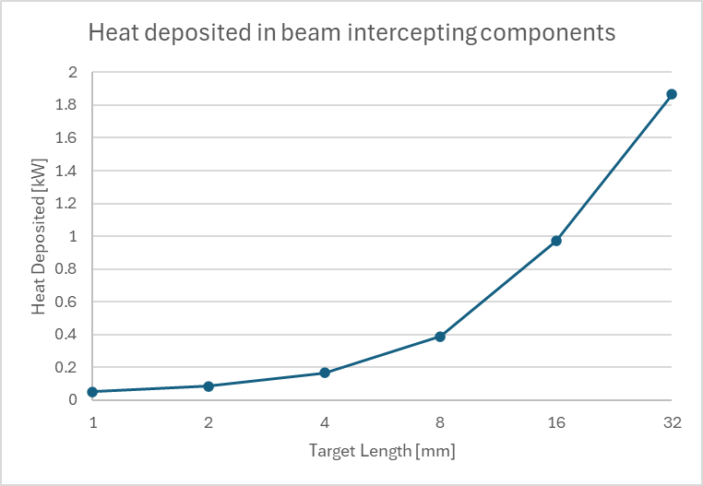
Operations Envelop – Proton Loss
Model:
  Cylindrical W target with diameter 20 mm
    Nuclear collision length: 51.5 mm
    CSDA range: 438.6 mm
  Beam condition: 1.3 GeV, 7.5 kW, sigma = 2 mm
  2 Beam windows made of Al6061-T6
  Downstream collimator
  Target station is surrounded by shielding
Multiple scattering at beam interception parts:
  PBW1 and PBW2: 1 mm thick each
  Target with L > 4 mm, beam loses > 20% of protons until it reaches the linac dump.
  Target with L > 4 mm, heat deposited in the beam intercepting parts is > 0.2 kW
As a rule of thumb, the target length in the linac dump area is chosen to be less than 10% of nuclear collision length of the target material.

Slide 24
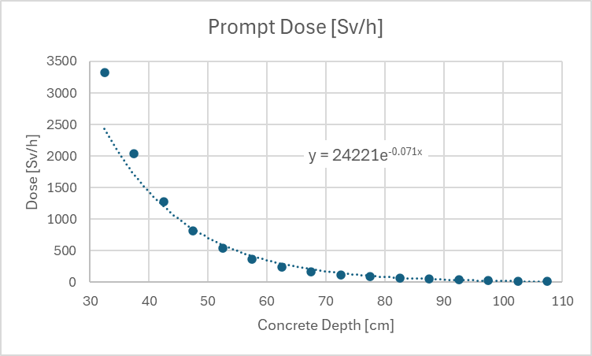
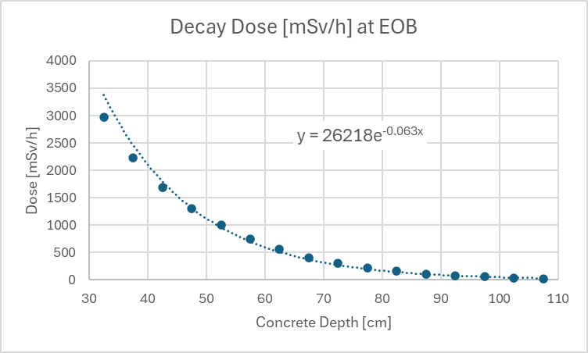
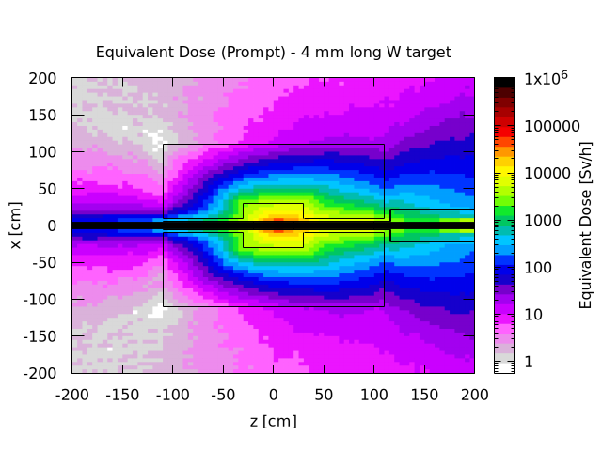
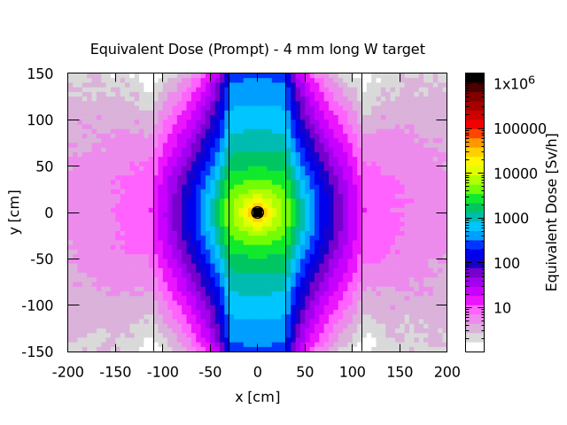


Operations Envelop - Dose
Irradiation: 7.5 kW proton beam on the target for 7 days
Maximum contact dose on the shielding surface:
  Prompt dose: 24 Sv/h
  Decay dose at E.O.B: 30 mSv/h
Concrete Shielding
  Dose decays by exp(-1) for every 15 cm additional shielding (35 cm if far away from the source)
    About 50 cm additional shielding (130 cm shielding thickness) will be needed for 7 kW beam:
      Decay dose at E.O.B on the shielding surface below 1 mSv/h (100 mrem/h)
      Prompt dose on the shielding surface below 1 Sv/h (100 rem/h)
  Shielding should be tailored to each experiment

Slide 25




Radiation Damage in Cables and Electronics
Polymer irradiation – Cables and O-rings
  Prompt dose in polymers outside the shielding is < 10 Gy/h
    Most of the cable insulators and elastomers show radiation resistance of > 100 kGy => Negligeable damage in the cables
  Upstream magnet coils could be exposed to 100 Gy/h => Negligeable damage in the coil insulators
  Prompt dose inside the shielding can be used for studying radiation damage of polymers
Commercial Off-the-Shelf (COTS) Electronics irradiation – Any measurement devices
  For 1 week-long experiments, the electronic devices should be placed where
    TID < 60 mGy/h (6 rad/h)
    HEHAD-EQ < 5 HEHeq/cm2/s
    THNEU-EQ < 50 ThNeq/cm2/s
    SI1MEVNE < 1.65e5 Si1MeVeq/cm2/s
  High dose area can be used for chip irradiation.

Slide 26


Medical Isotopes Production Demo Station (RIPS SpA4)
Objectives of LDRD radioisotope production at SNS
  Obtain benchmarking data to validate concepts and computational results
  Acquire basic demonstration for the isotope production, handling, and separation processes
Target: 0.25 mm thin Th-disc is canned in SS capsule which is installed in one of the existing port
Beam: 48 hours radiation of 1 kW beam (48 kWh)
  Dose on the shielding surface after 1 day decay time is < 10 mrem/h
  Isotopes Yields at EOB:
    Ra-225 (0.8 MBq); Ac-225 (5.7 MBq)
Potential yields for 7 kW beam on 10 mm thick Th-disc (10% of nuclear collision length = 99 mm) for 8 hours (56 kWh)
  Ra-225 (37 MBq=1mCi); Ac-225 (266 MBq=7 mCi)

Slide 27





SNS Project Support – Luminescent Coating
Luminescent material coating is used for beam profile monitoring on the target surface
  It monitors whether beam is centered on the rotating target segment
  It monitors whether the beam profile is within the target design envelop
Optical response of candidate coating materials needs to be characterized with full 1.3 GeV beam
  The BTF experiment (2.5 MeV; 0.5 uC/pulse) demonstrates full applicability in linac dump area
Measurement devices:
  Photodiode, optical camera, IR camera, spectrometer, mirrors for light transmission

Slide 28
Other Potential Applications
Pion Production Target Demo Station
  Measurement and simulation validation of pion production cross section
  Pion production characterization of different target materials
Moderator Test Station
  Test stand for moderator material characterization
  Test stand for reflector material characterization
  Neutron collision driven para-to-ortho-hydrogen conversion kinetics and catalyst study
Materials Irradiation
  Characterization of radiation damage in polymers and electronics
  Measurement and validation of radioisotopes production and proton scattering cross sections
Beam Diagnostic Devices Test Station
  Harp: Characterization of signal disturbance from delta rays
  Effect of gas discharge on backgrounds of SE signal and optical signal
More Ideas are Welcome!!!

Slide 29
Post PPU reserve beam power opens opportunities for new applications
Production of medical isotope covering millions of patient doses
Muon production targets for particle physics, materials science and muon catalyzed fusion applications
Fast neutron production targets for particle physics, chip irradiation, fusion materials research and ADS demo station applications
Linac dump area can be utilized as proof-of-concept test stand for the full 300-kW reserve beam power applications

