Slide 1
Options for “3rd Target Station” at SNS
June 10-12, 2026
Workshop on New Science and Applications at SNS
Vasiliy Morozov
Research Accelerator Division
Notes:
Accessing Title Slide Options
The standard ORNL presentation template includes five branded title slide layouts:
Title | Standard. The preferred layout for lab-wide and general presentations. Features a default aerial photograph of the lab.
Title | Custom Image. Allows replacement of the default background with a custom full-slide image (16:9 or 4:3 landscape format).
Title | Custom Portrait Image. Supports inclusion of a custom 4:3 portrait image positioned next to the introductory text.
Title | Custom Landscape Image. Supports inclusion of a custom 16:9 landscape image positioned next to the introductory text.
Title | Text Only. Offers additional space for longer titles and multiple presenters.
Additional Lab-approved title slides specific to directorates and user facilities are available in PowerPoint under the following folders: Custom Title Slides and User Facility Templates, located in Presentation Templates.
Custom Title Slide Guidelines
Image Rights. Any custom images, graphics, or photography must be owned by ORNL or used with documented permission from the original creator or source.
Appropriate Image Use. Select images that work well with the layout. Ensure the focal point of the image is not obscured by the title text and white overlay box.
Relevance and Impact. Visuals are a key element of effective communication. Whenever possible, use imagery that enhances the message of your presentation and reflects ORNL’s mission and values.
Quality and Clarity. Use high-resolution images for clarity on large screens. Avoid overly complex or dark images that may conflict with the title text.
Text-Only Option. If no appropriate or approved imagery is available, or if imagery is not permitted for the subject matter, the Title | Text Only layout provides a clean, professional alternative.
Learn more about ORNL presentations
https://ornl.sharepoint.com/sites/branding/SitePages/presentations.aspx

Slide 2
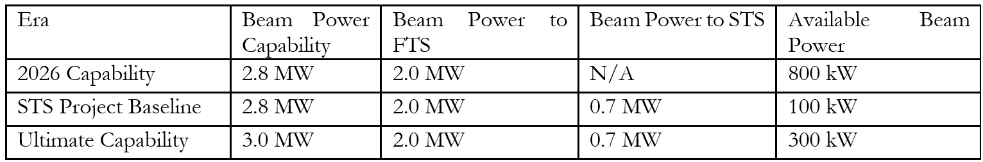
Application of SNS Excess Power
Substantial additional power available even when First Target Station (FTS) and Second Target Station (STS) operate simultaneously
Oak Ridge Accelerator Institute established
  Gauge user needs
  Conceptual design of a high-power ~300 kW dedicated facility
  Design, install, and commission a prototype low-power target in the existing tunnel

Slide 3
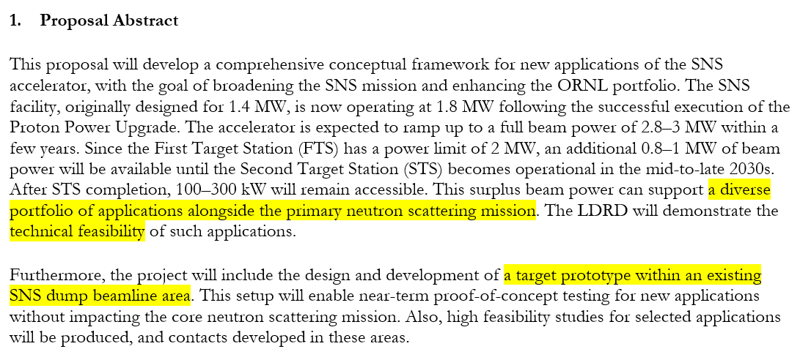
Ongoing Activities at SNS
FY 2025-26 LDRD DEPUTY DISCRETIONARY PROPOSAL:
Investigation of new applications of the Spallation Neutron Source facility
PI: Fulvia Pilat, Co-PI: Vasiliy Morozov

Slide 4
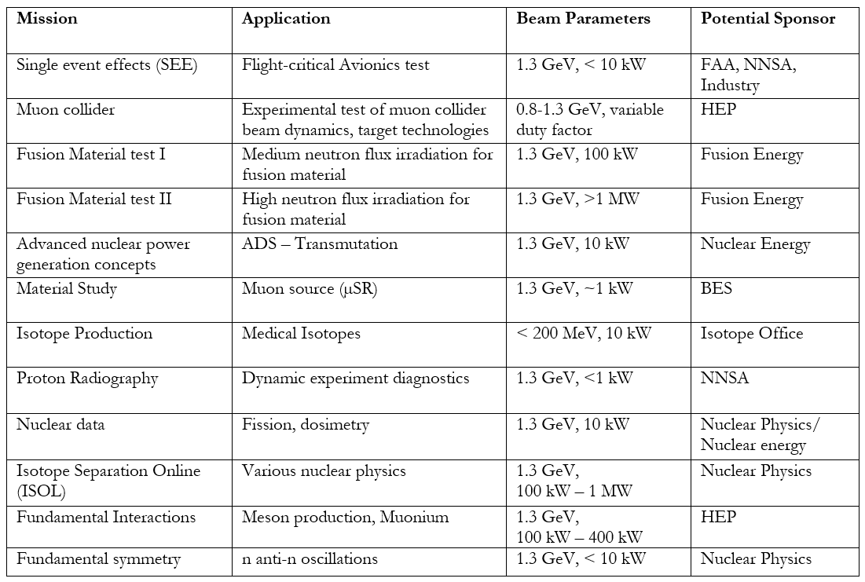
Potential Application of SNS Excess Power
Preliminary compilation of
potential applications
This workshop aims to collect,
refine and prioritize potential
applications as well as identify
their requirements

Slide 5
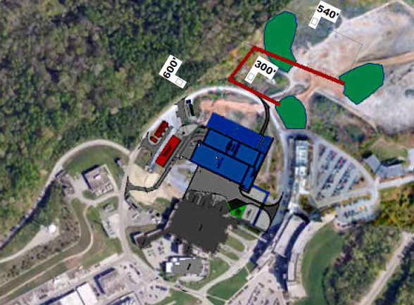
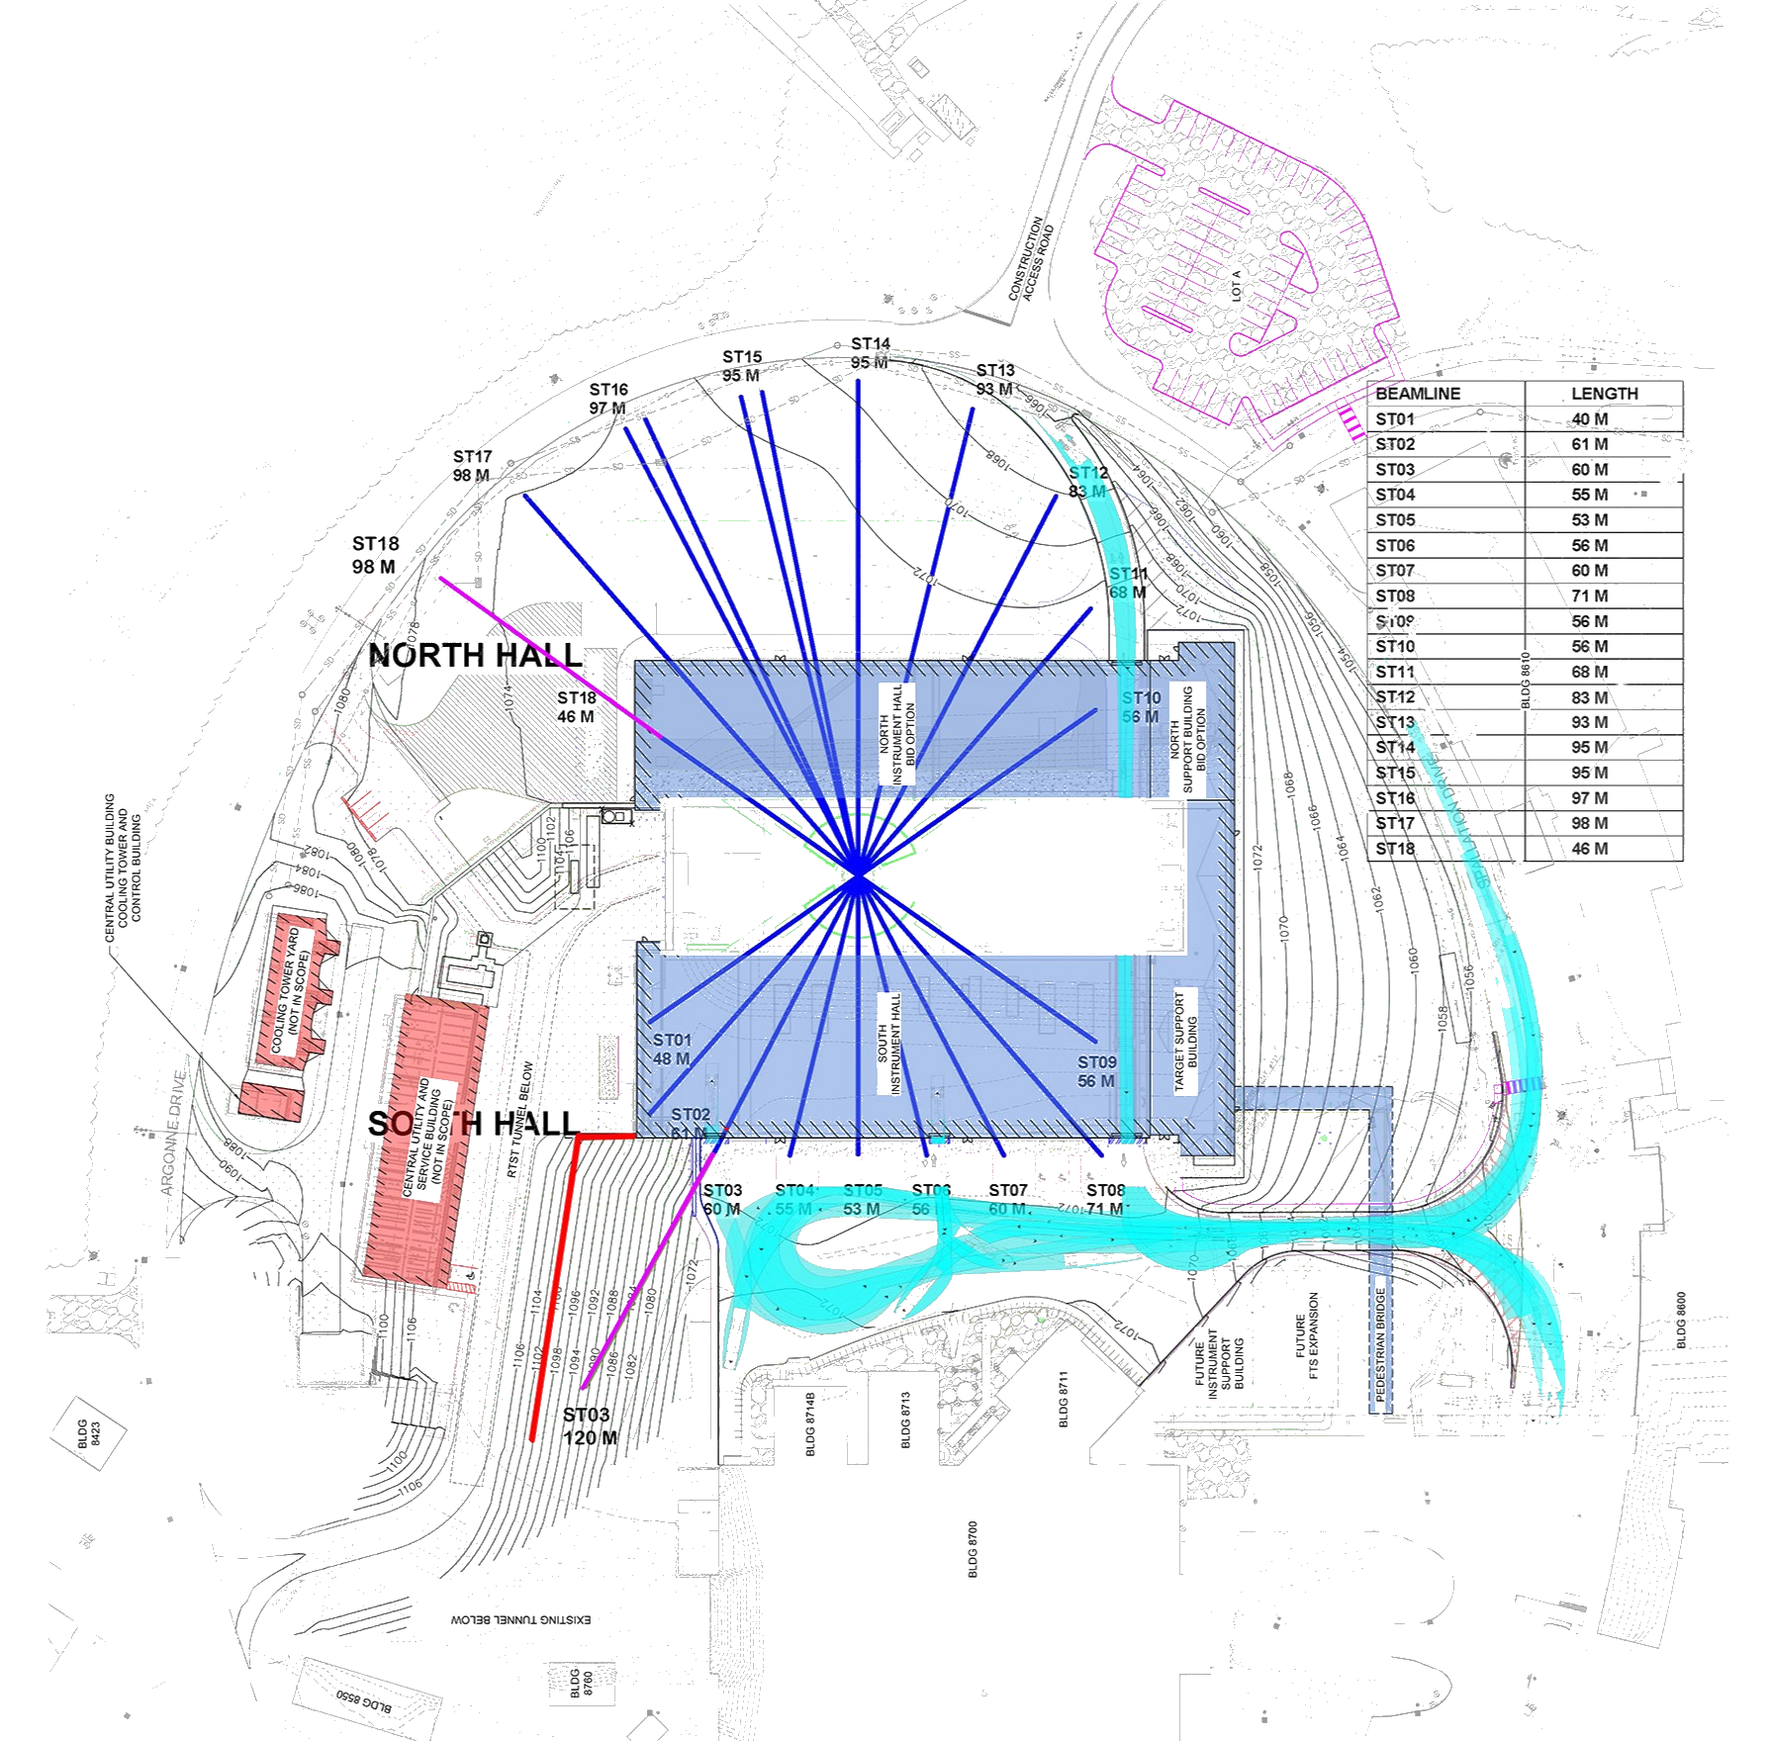
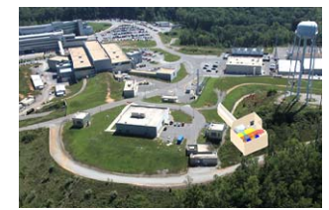
Potential Siting of 3rd Target Station
Area near injection into the accumulator ring
Area beyond STS
Location 1 was studied earlier for a lower-power
target station
Shielding thickness grows logarithmically with power
Green areas are leveled by the STS and
available for 3rd TS
Reference for beam line cost
  STS tunnel construction: $40M
  Total STS tunnel cost including beamline design,
  element procurement and installation: $75M
100 m
2
Accumulator Ring
STS
1
1
FTS
SNS Linac

Slide 6
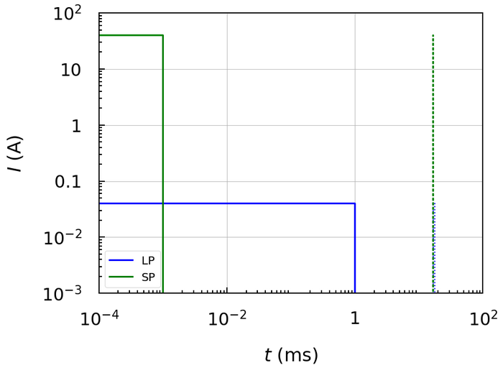


Beam Time Structure
Station after the linac
  Low-power high-rep-rate laser-assisted extraction
  Low-power 1 ms pulses at 60 Hz (up to100 kW)
  High-power low-rep-rate conventional kicker
  extraction
  Full-power 1 ms pulses at ~6 Hz (up to 300 kW)
Station after the accumulator ring
High-power low-rep-rate conventional kicker
extraction only
  1 ms full-power pulses without accumulation in
  the ring at ~6 Hz (up to 300 kW)
  1 $μ$s full-power pulses with accumulation in
  the ring at ~6 Hz (up to 300 kW)
<47 kW
$<1/60$ ms
<1 ms

Slide 7
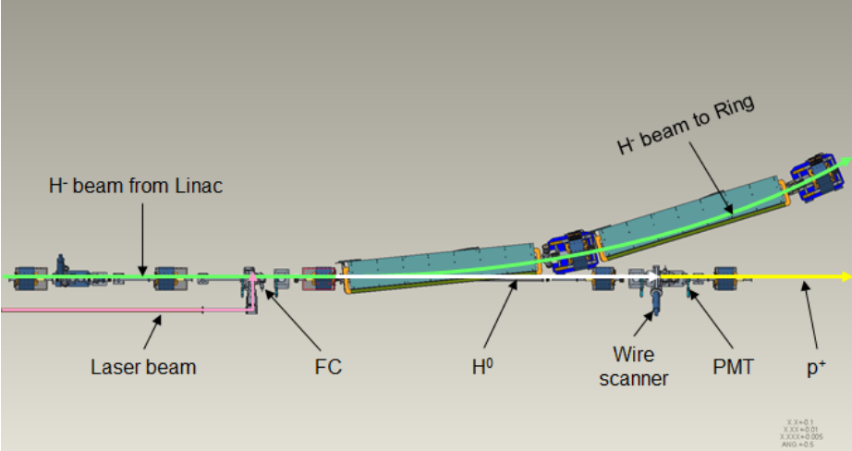
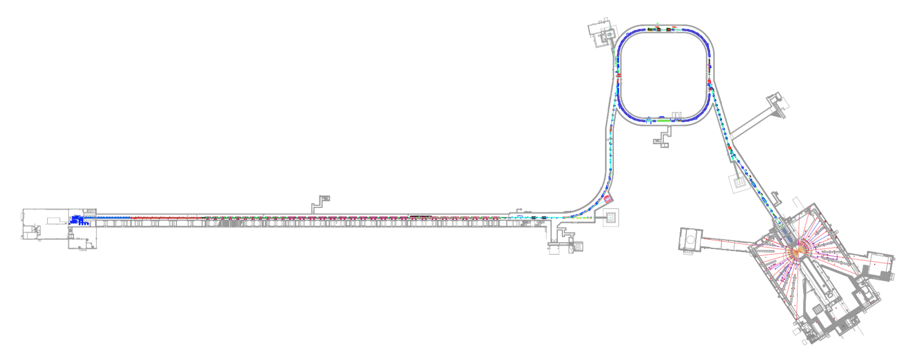
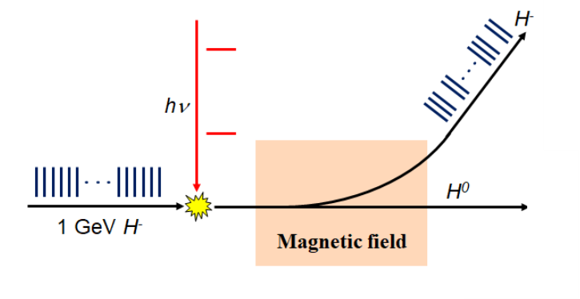
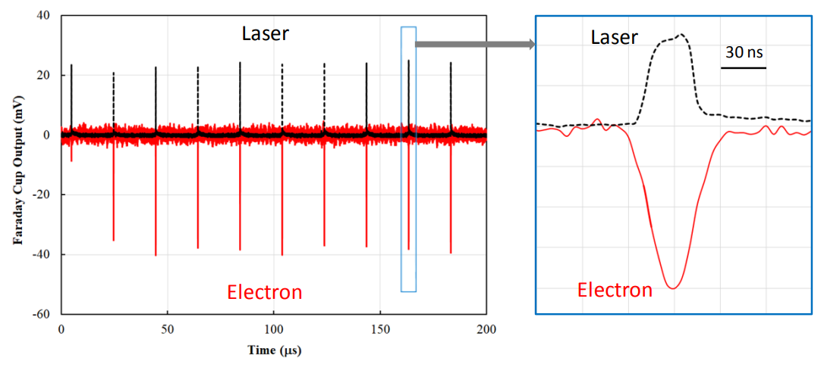

Laser-Assisted Extraction
After extensive development over many years, the laser-assisted extraction technique is now well established and routinely used for diagnostic measurements at the SNS*.
Relatively small fraction of $H^{−}$ ions is
neutralized by laser photons and
separated from the rest of the beam by
a dipole
*Illustration of laser-assisted extraction setup in the linac dump area (can be adopted for prototype target, see the next talk by N. Evans)

Slide 8
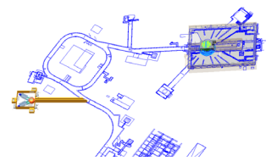
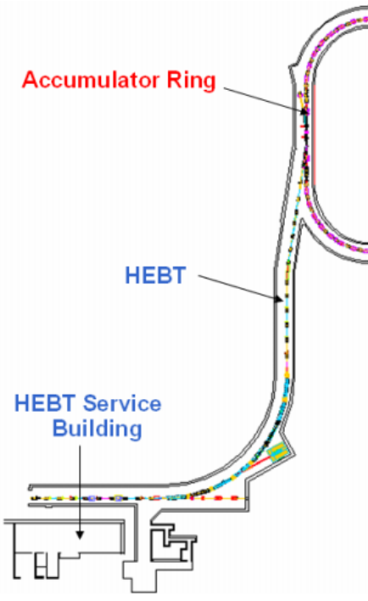
Laser-Assisted Extraction
Only available for Option 1
Can be setup in the ring injection line
(similar to extraction in the linac dump line)
Extracted power
limited by laser power
and stripping efficiency
to 100 kW
Same concept as an earlier SEEMS project
Can capitalize on some of the earlier results
Proton pulse
Laser light

Slide 9
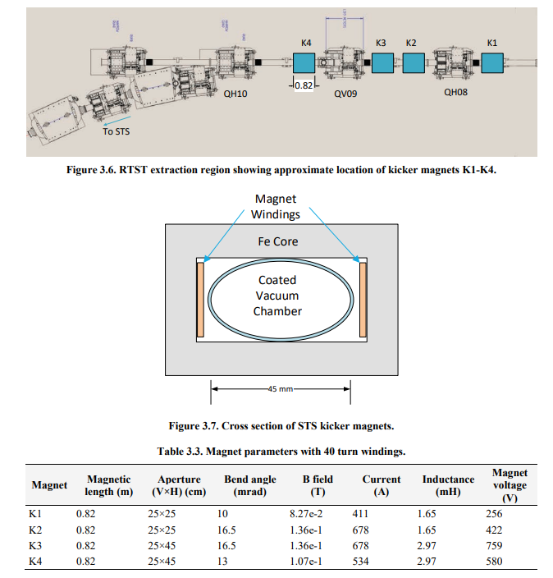
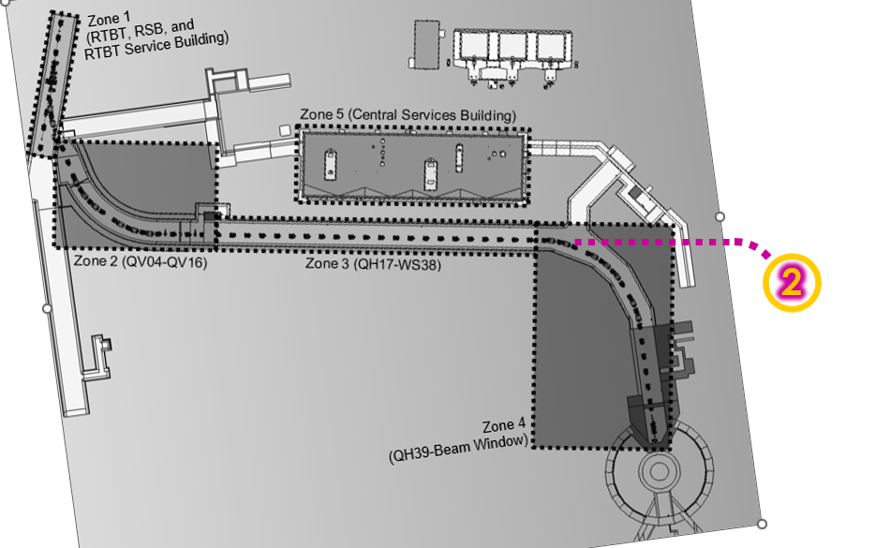

Kicker Extraction
Available for both potential locations
Entire 1 ms macro pulse extracted without or with (1 ms → 1 $μ$s) accumulation
Same extraction setup as from RTBT to RTST
Extraction to STS with 4 kickers

Slide 10

Kicker Extraction after Accumulator Ring
Depending on experimental requirements both 1 $μ$s and 1 ms pulses are available after the ring
In production, 1 ms linac pulse is accumulated for about 1000 turns in the ring resulting in 1 $μ$s at extraction
1 ms pulse can also go around a half of the ring and be immediately extracted without accumulation by shifting the ring’s orbit
x1000

Slide 11
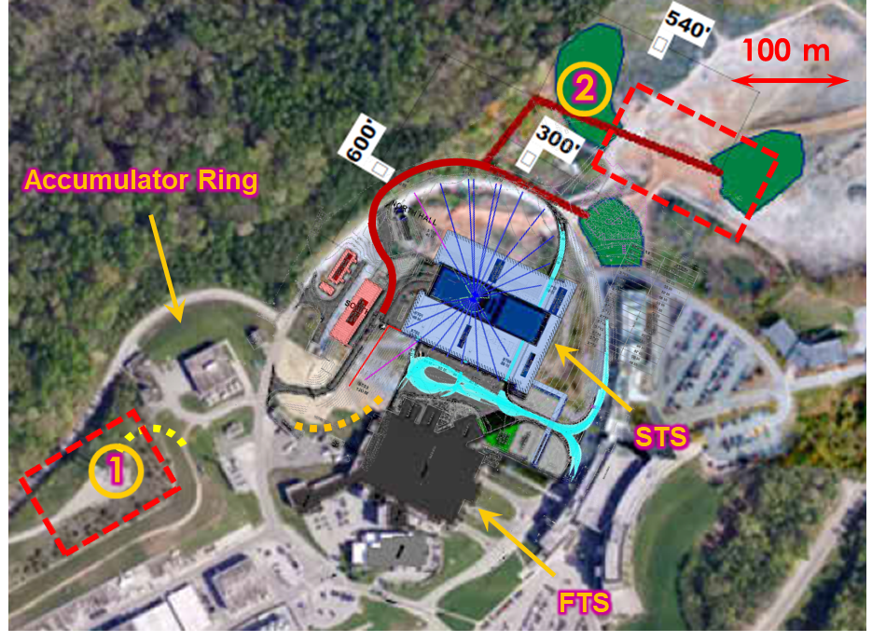
Compatibility with Other Target Stations
3rd target station must be compatible with operation
of the first two stations
Laser-assisted extraction available for Option 1 makes
the 3rd target station invisible to the first two stations
Kicker extraction for both Options 1 and 2 require
modification of the time structure and charge per
pulse to maintain constant power
All target stations must be operable independently
of each other
 | Baseline with two targets |  |  | Laser-assisted extraction |  |  | Kicker extraction
 | Rep. Rate (Hz) | Q/pulse (kJ) | P (kW) | Rep. Rate (Hz) | Q/pulse (kJ) | P (kW) | Rep. Rate (Hz) | Q/pulse (kJ) | P (kW)
1st TS | 45 | 44.4 | 2,000 | 45 | 44.4 | 2,000 | 40 | 50 | 2,000
2nd TS | 15 | 46.7 | 700 | 15 | 46.7 | 700 | 14 | 50 | 700
3rd TS |  |  |  | 60 | 5 | 300 | 6 | 50 | 300

Slide 12
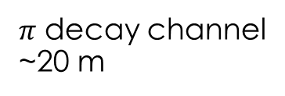




Current Collaboration on $μ$-Catalyzed Fusion
Example application: Volumetric Neutron Source in collaboration with ORNL FFESD, PSD, NScD and industry (Acceleron)
  1.3 GeV proton beam hits a target
  generating $π^{−}$
  $π^{−}$ are captured and decay into $μ^{−}$
  $μ^{−}$ are cooled and sent to
  a fusion target
  $μ^{−}$ binds $D$ and $T$ into a molecule
  $D$ and $T$ fuse due to small separation
  generating a high flux of
  14 MeV neutrons
Another experiment, such as isotope production
$$π→μ$$
Capture Solenoid
Muon ionization cooling
Fusion target
$μ$ Target
$$π$$
~300 kW
$π$ decay channel
~20 m

Slide 13
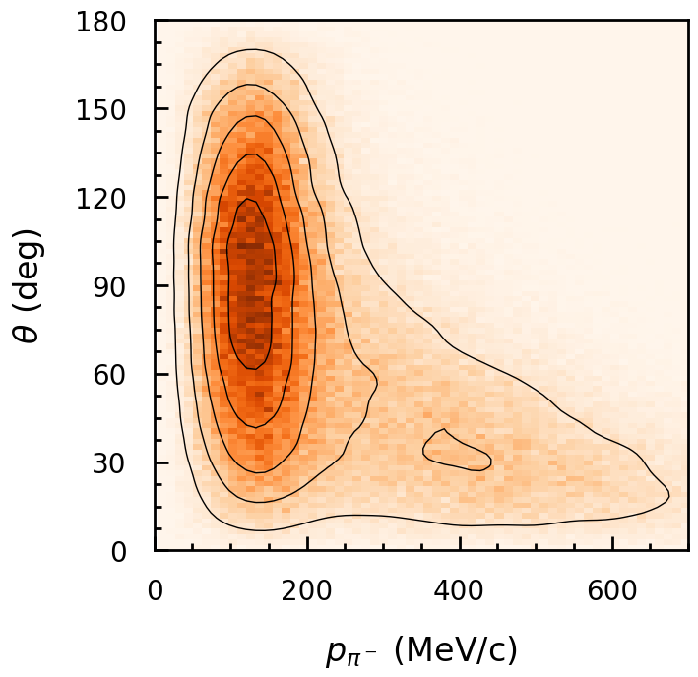
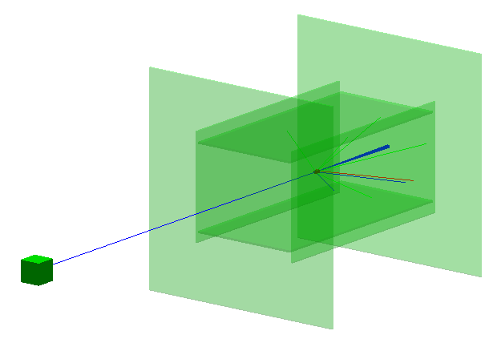

Pion Spectrum
QGSP_BERT GEANT4 Physics list
1 mm radius, 2 mm long cylindrical W target
Produced $π^{−}$ momentum centered at ~150 MeV/c
$π^{−}$ average angle is ~${90}^{∘}$ with respect to the beam direction
${10}^{8}$ incoming 1.3 GeV protons generate a total of
$1.8⋅{10}^{5}$ $π^{−}$ total ($1.8⋅{10}^{−3}$ $π^{−}$/$p$)

Slide 14

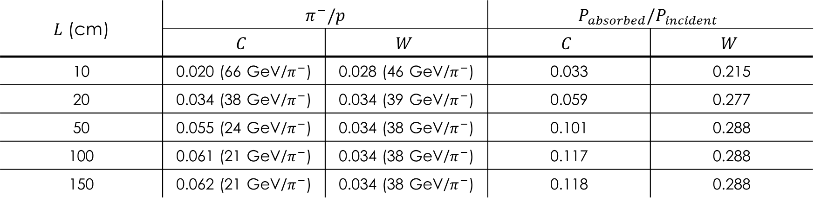
Pion Production in Thick Target
QGSP_BERT GEANT4 Physics list
${10}^{8}$ incoming 1.3 GeV protons
Cylindrical target of 1 cm radius and variable length
Total number of $π^{−}$, decays disabled, no capture efficiency factored in
Carbon and tungsten are good prospective pion target materials from the point of view of target cooling
Carbon has nominally higher production efficiency for thicker targets, but capture becomes harder
$L$ (cm) | $$π^{−}/p$$ |  | $$P_{absorbed}/P_{incident}$$
 | $$C$$ | $$W$$ | $$C$$ | $$W$$
10 | 0.020 (66 GeV/$π^{−}$) | 0.028 (46 GeV/$π^{−}$) | 0.033 | 0.215
20 | 0.034 (38 GeV/$π^{−}$) | 0.034 (39 GeV/$π^{−}$) | 0.059 | 0.277
50 | 0.055 (24 GeV/$π^{−}$) | 0.034 (38 GeV/$π^{−}$) | 0.101 | 0.288
100 | 0.061 (21 GeV/$π^{−}$) | 0.034 (38 GeV/$π^{−}$) | 0.117 | 0.288
150 | 0.062 (21 GeV/$π^{−}$) | 0.034 (38 GeV/$π^{−}$) | 0.118 | 0.288

Slide 15
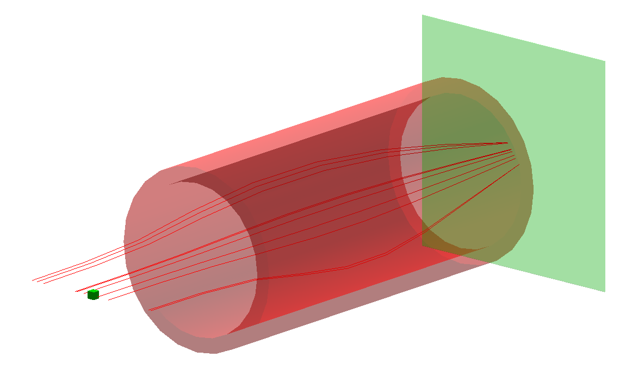
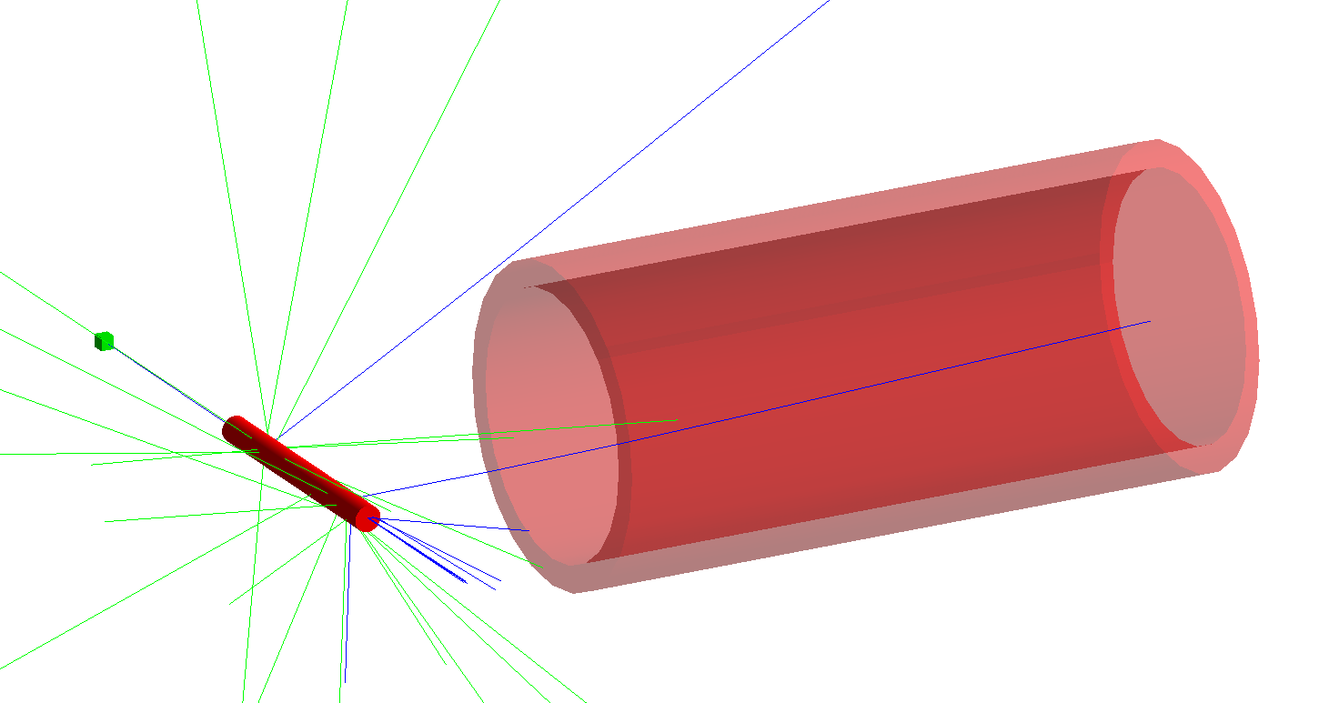




Pion Capture
Target outside of 0.5 m solenoid
Target at the focal point of the solenoid for 150 MeV/c $π^{−}$ ($B_{sol}\sim 2.5$ T)
Cylindrical target of 1 cm radius
Total number of $π^{−}$ after the solenoid, decays disabled
$$D$$
$$R_{S}$$
$$L_{T}$$

Slide 16
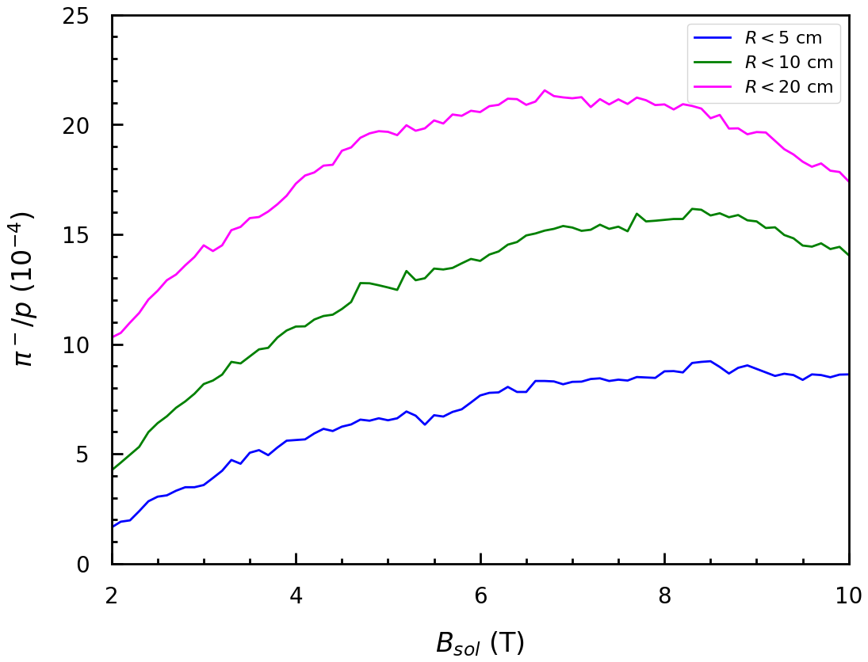
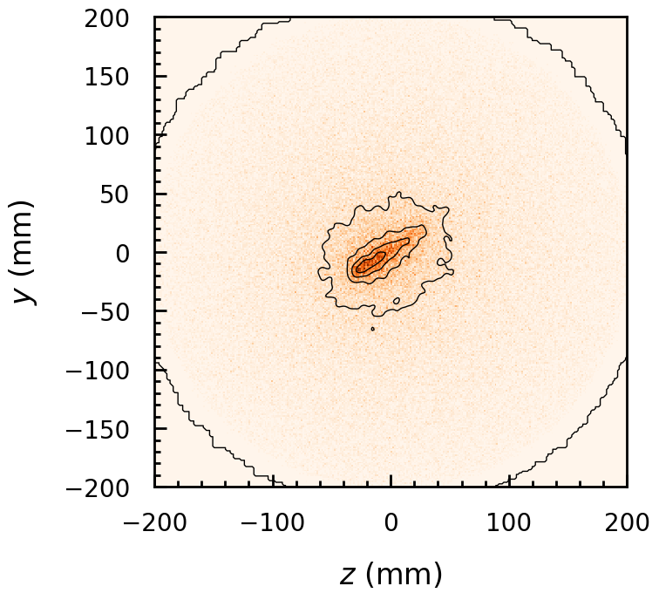
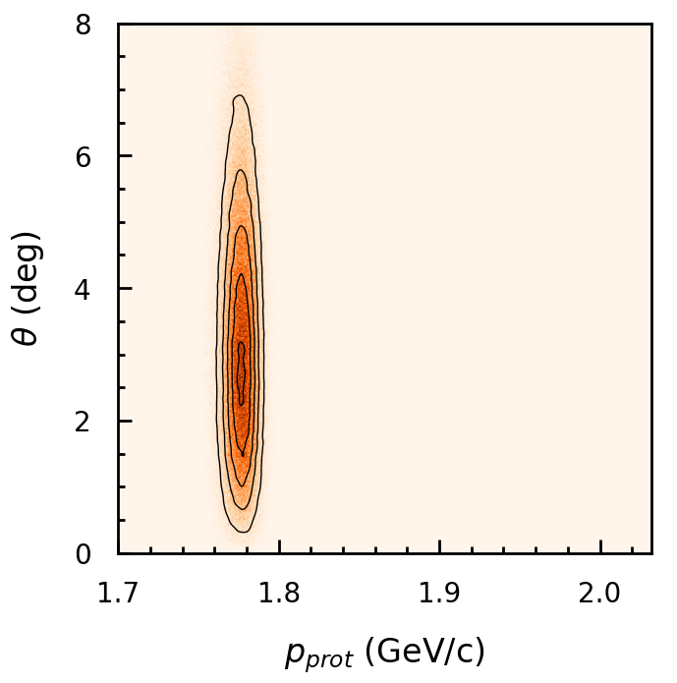
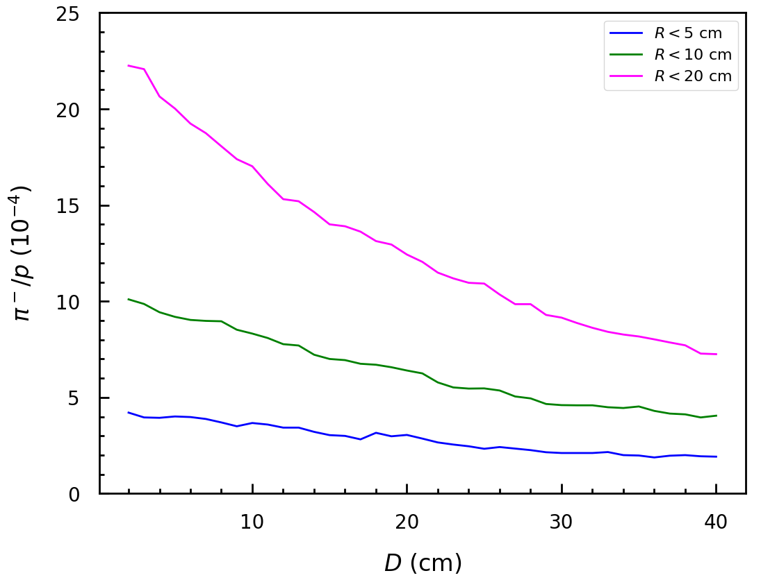








Captured Pion Distribution
$D=20$ cm
10 cm long cylindrical W target
Assuming 7 kW on the LDmp target:
$N_{p}=3.4⋅{10}^{13}$ s⁻¹, ${π^{−}}/p=1⋅{10}^{−4}$ ⇒ $N_{π^{−}}=3⋅{10}^{9}$ s⁻¹
Proton distribution after
passing through target
$π^{−}$ spot side at solenoid exit
$D=20$ cm
$$B_{sol}=2.5 T$$
$L_{T}=10$ cm
$$B_{sol}=2.5 T$$
$T_{prot}=1.07$ GeV
$T_{prot}=1.3$ GeV

Slide 17
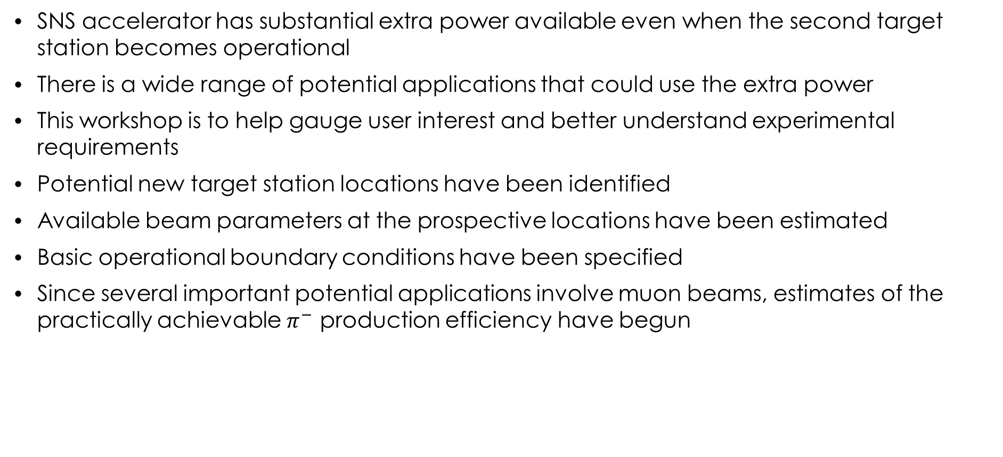
Summary
SNS accelerator has substantial extra power available even when the second target station becomes operational
There is a wide range of potential applications that could use the extra power
This workshop is to help gauge user interest and better understand experimental requirements
Potential new target station locations have been identified
Available beam parameters at the prospective locations have been estimated
Basic operational boundary conditions have been specified
Since several important potential applications involve muon beams, estimates of the practically achievable $π^{−}$ production efficiency have begun

Slide 18
Backup

Slide 19
Summary of Applications and Requirements
Application | Lead time for technical maturity | Funding source | Sponsor’s priority (high, medium, low) | Most suitable option (Prototype, 1, 2) | Beam Power (kW) | Time structure |  | Typical irradiation time | Access requirements | Space requirements
 |  |  |  |  |  | Rep. Rate (Hz) | Pulse length
Material irradiation for risk mitigation of STS | 1 year | BES | Med | Prot | 1 | 60 | 1 ms | 1 day | Daily | 1x1 m

Slide 20
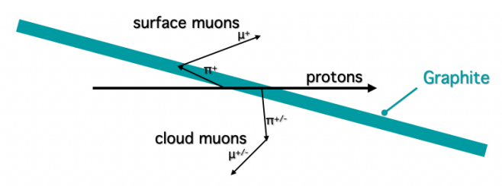
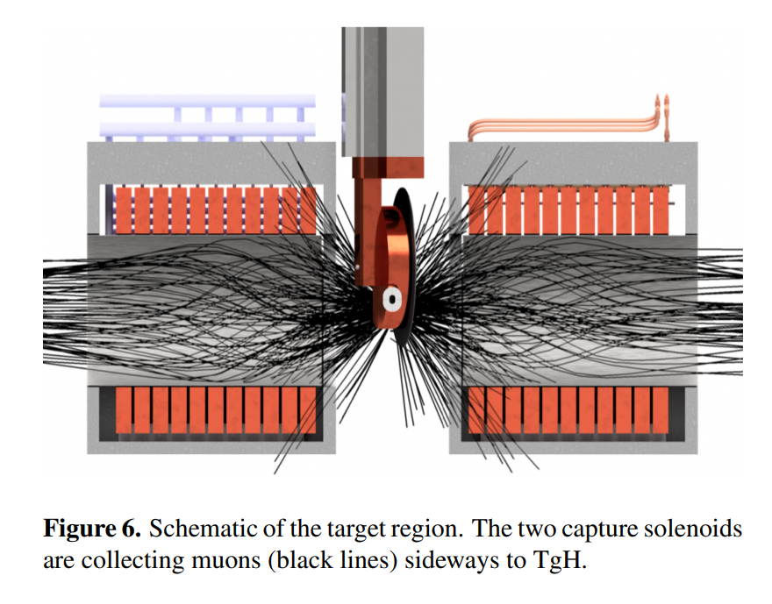
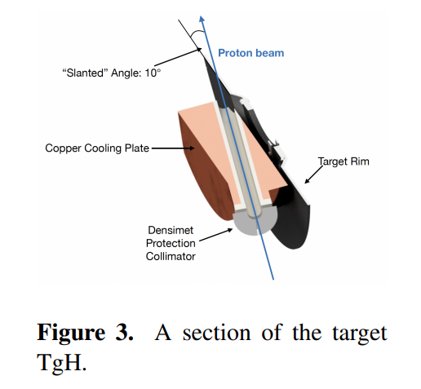
High-Intensity Muon Target at PSI
20 mm thick carbon target, ~20 kW of 2.4 mA 1.4 GeV proton beam

Slide 21
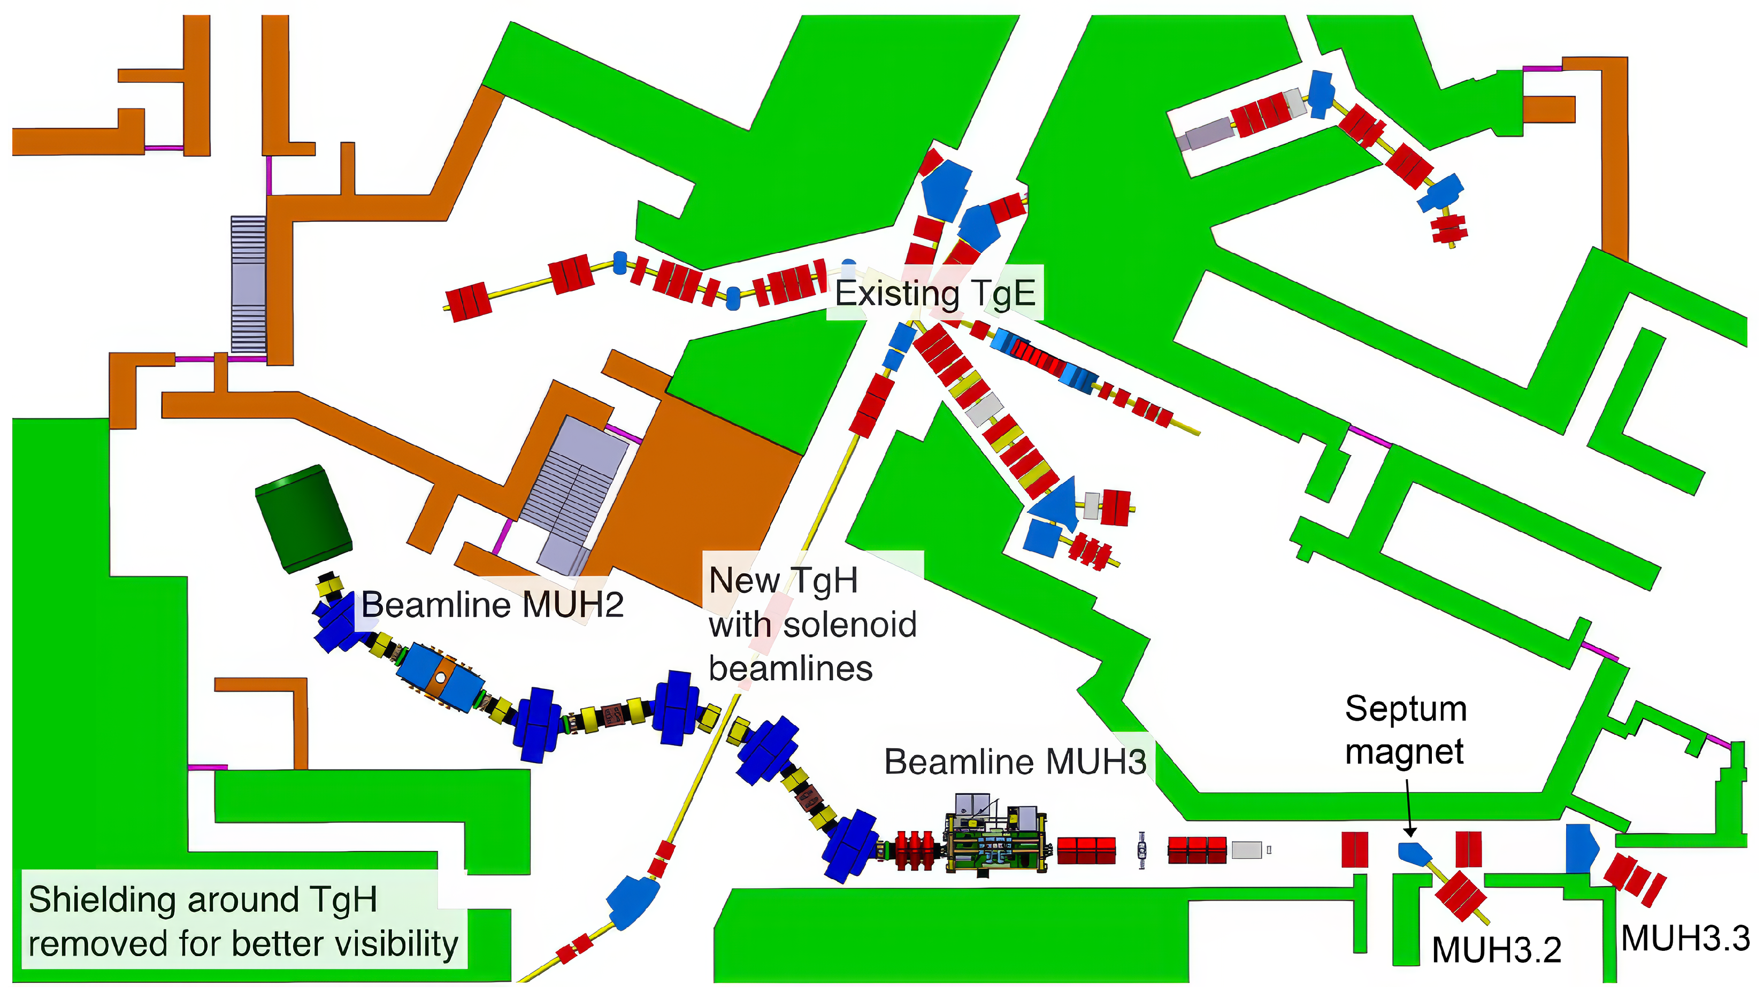
Experimental Beamline Scenarios
Can be optimized for surface (MUH3) and non-surface muons (MUH2)

Slide 22
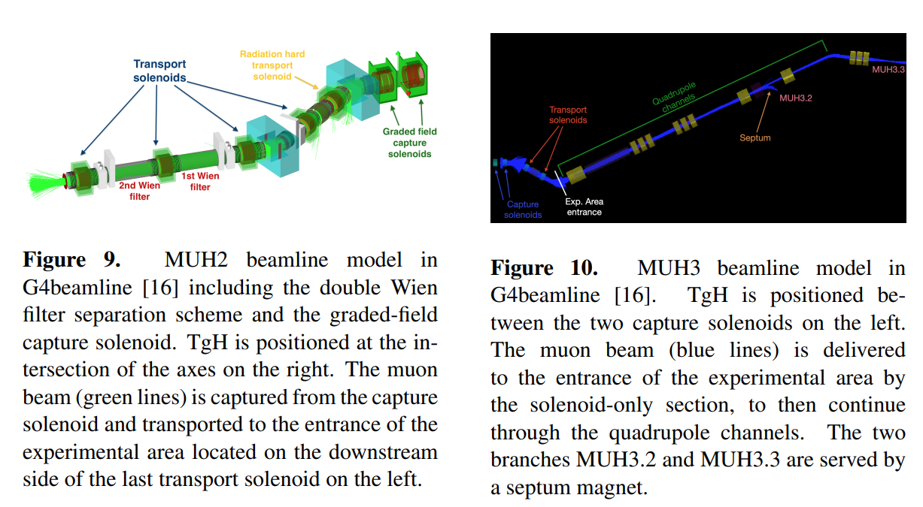
PSI Examples
8 m

Slide 23
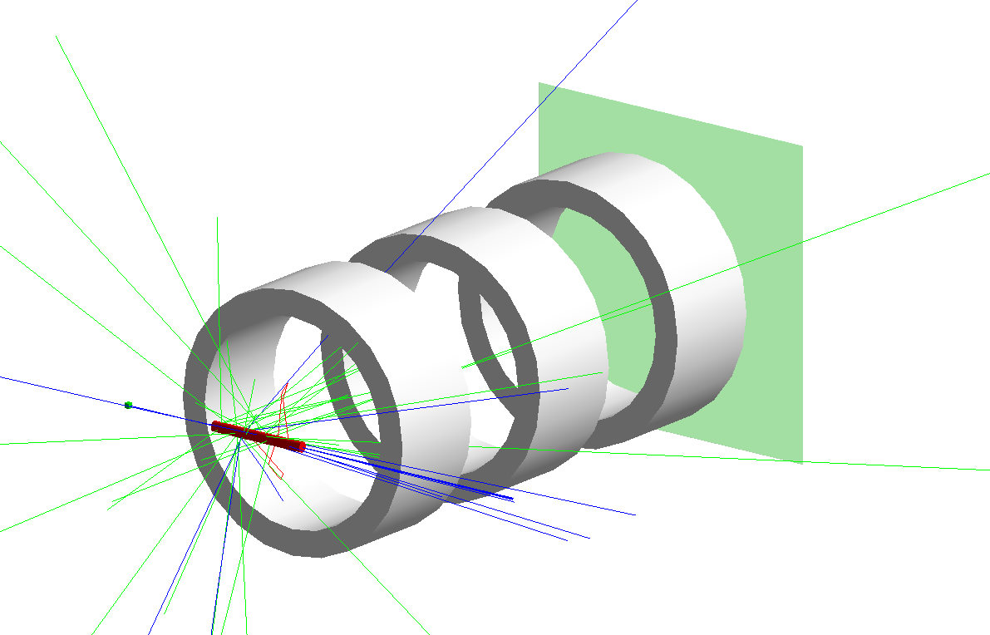
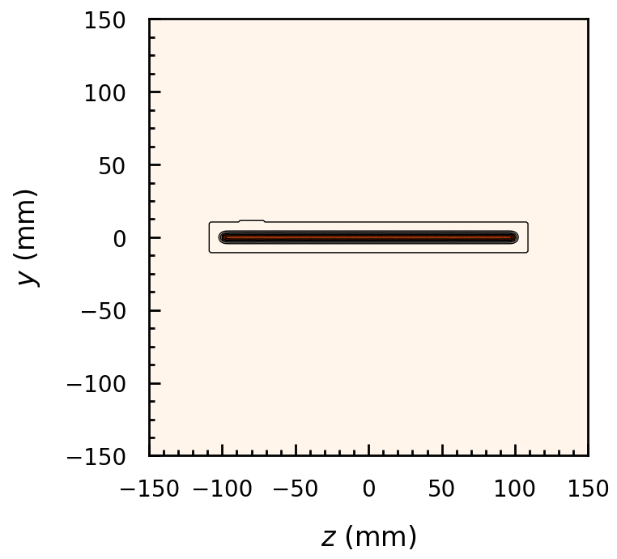
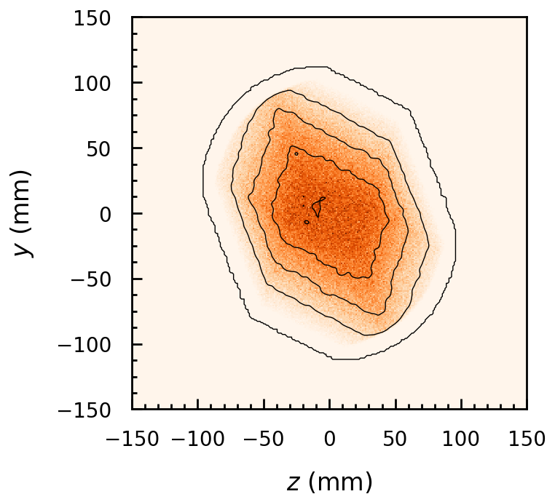

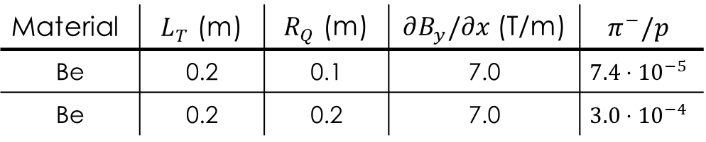
Pion Capture with F2R Triplet
Pion distribution at a long target is somewhat flat
Try capturing $π^{−}$ with a flat-to-round triplet
Three 0.2 m long quads separated by 0.2 m at 0.1 m
from the target
${10}^{8}$ incoming 1.3 GeV protons
Cylindrical target of 1 cm radius
Total number of $π^{−}$ after the triplet, decays disabled
Material | $L_{T}$ (m) | $R_{Q}$ (m) | $∂B_{y}/∂x$ (T/m) | $$π^{−}/p$$
Be | 0.2 | 0.1 | 7.0 | $$7.4⋅{10}^{−5}$$
Be | 0.2 | 0.2 | 7.0 | $$3.0⋅{10}^{−4}$$

