Slide 1
Opportunities for Fundamental Physics at the SNS
June 10, 2026 | Oak Ridge
Marcel Demarteau (demarteau@ornl.gov)
Oak Ridge National Laboratory

Slide 2
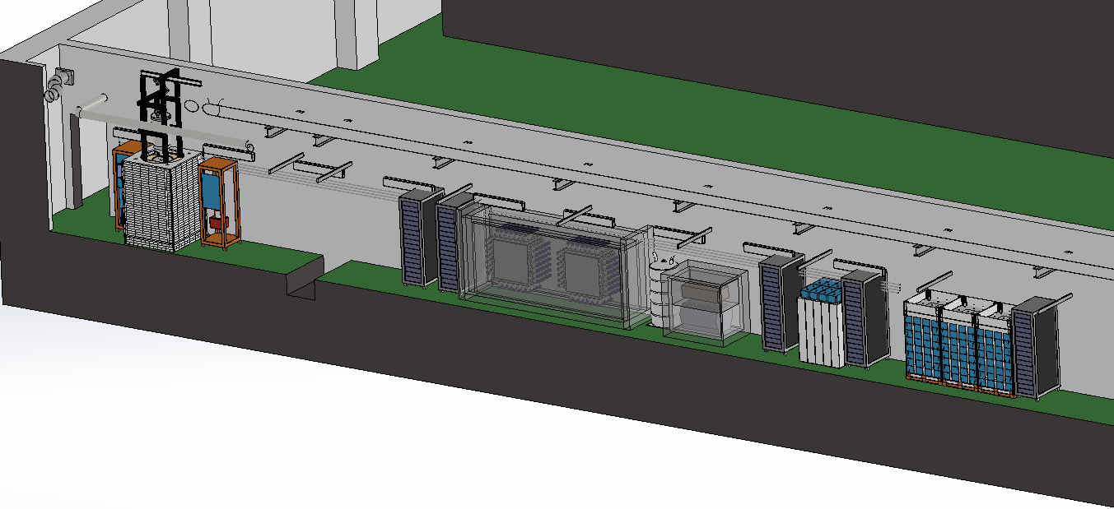
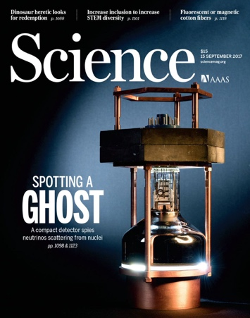
Neutrino Program at the SNS
World-unique neutron user facilities are also world unique neutrino facilities
High Energy and Nuclear Physics
”Neutrino alley”:
Service corridor at the SNS
Ongoing CEvNS in Neutrino Alley
COHERENT experiment:
First measurement ever of a process that had eluded discovery for 40 years: Coherent Elastic Neutrino Nucleus Scattering (CEvNS)
Since then, continue world-leading CEvNS measurements on multiple isotopes, including argon
2017
Akimov et al. Science Vol 357, 6356

Slide 3
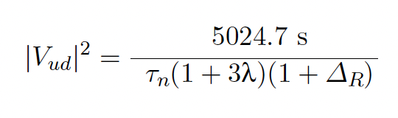
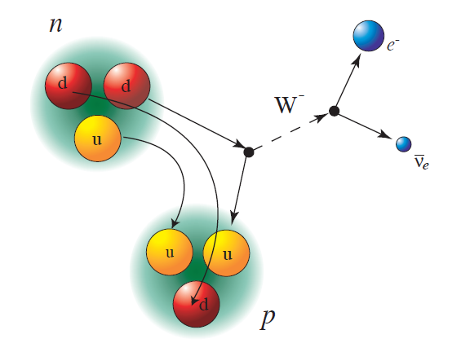
Complementary Probe: CKM Unitarity
The tension in the Unitarity of the CKM matrix is most prominent
in the first row:
$$0.977$$
(data up to 2025)
$$V_{ud}$$
$$0.976$$
that is mainly probed by neutron, pion; kaon, hyperon, tau decays.
$$0.975$$
$V_{us}$, CKM unitarity
$$0.974$$
Neutron Lifetime (τ_{n}) discrepancy Bottle vs Beam experiment
Ratio axial-vector coupling constants through precision neutron angular correlation measurements
$$0.973$$
Nuclear decay
https://doi.org/10.1051/epjconf/202430305001
V_{ud}
$$0.972$$
$$τ_{n, bottle}$$
$$τ_{n, beam}$$
$$λ_{A}$$
$$λ_{a}$$
$$0.971$$
$$−1.280$$
$$−1.270$$
$$−1.260$$
$$λ=g_{A}/g_{V}$$
The most precise measurement of V_{ud} will come from neutron decays. (Nab, PERKEO, PERC, BRAND, PIONEER, …)

Slide 4
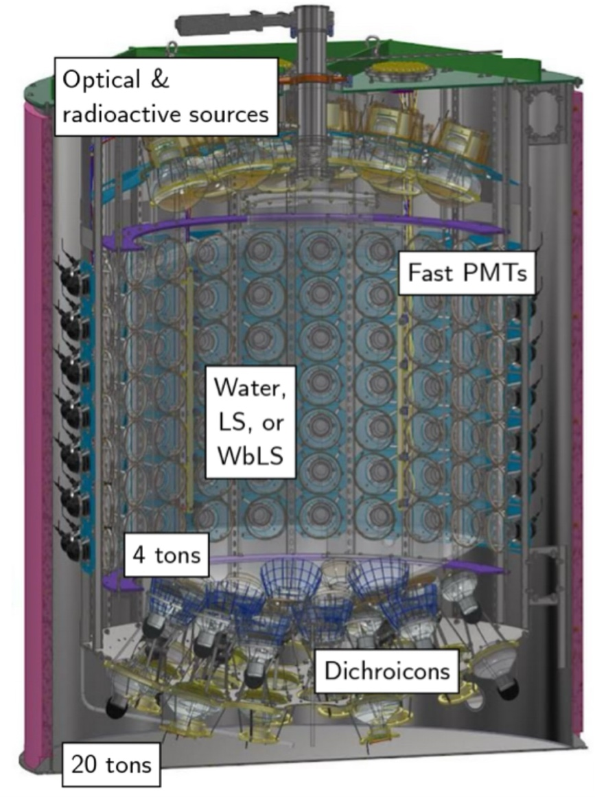
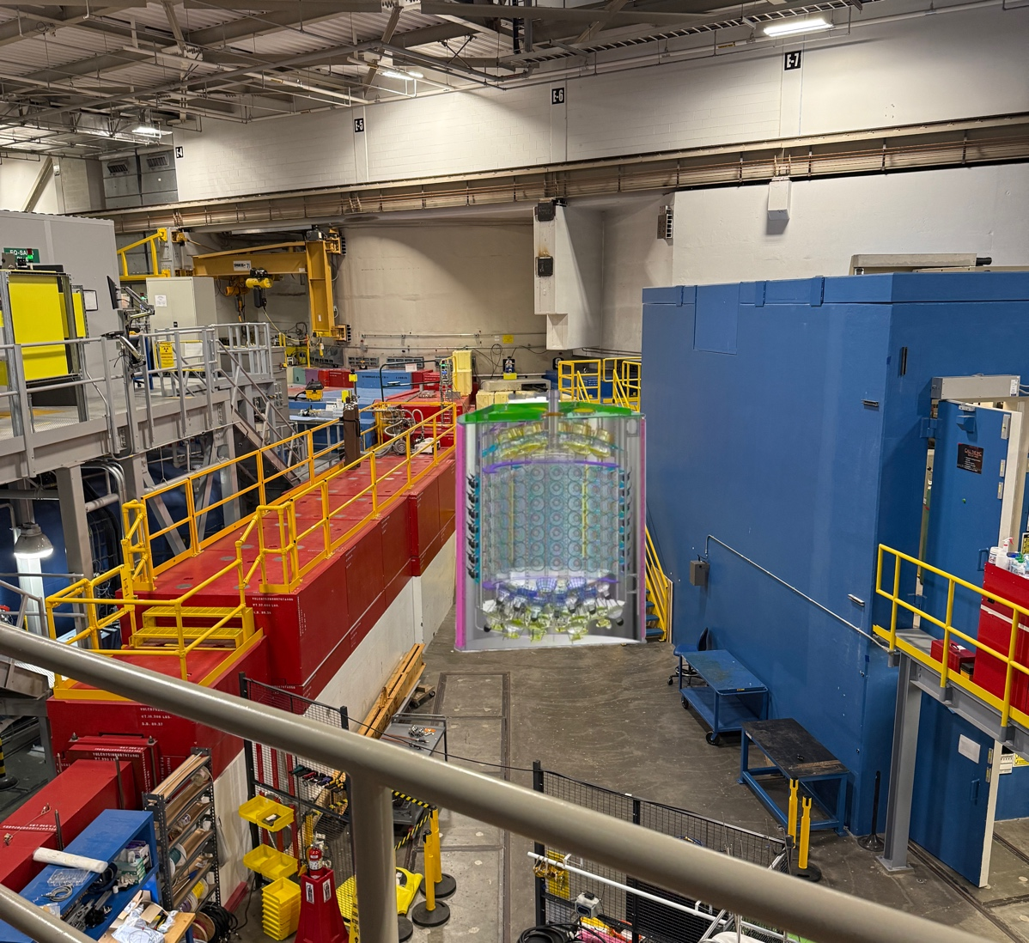
SNS for Neutrino Physics
Development of novel technology: water-based liquid scintillator detectors (Eos)
Eos Detector
Proposal to deploy the Eos detector on Beam Line 8 on the
instrument floor of the SNS
Project is supported by DNN, NP and HEP (proposal pending
with Japan)
Science program:
Measure CC ν_{e}¹⁶O cross section
Measure (ν_{e,}¹³⁰Te) cross section
Cherenkov-Scintillation light separation
Scalable near-surface neutrino detection
Pathway to beyond ton-scale neutrinoless double beta decay

Slide 5
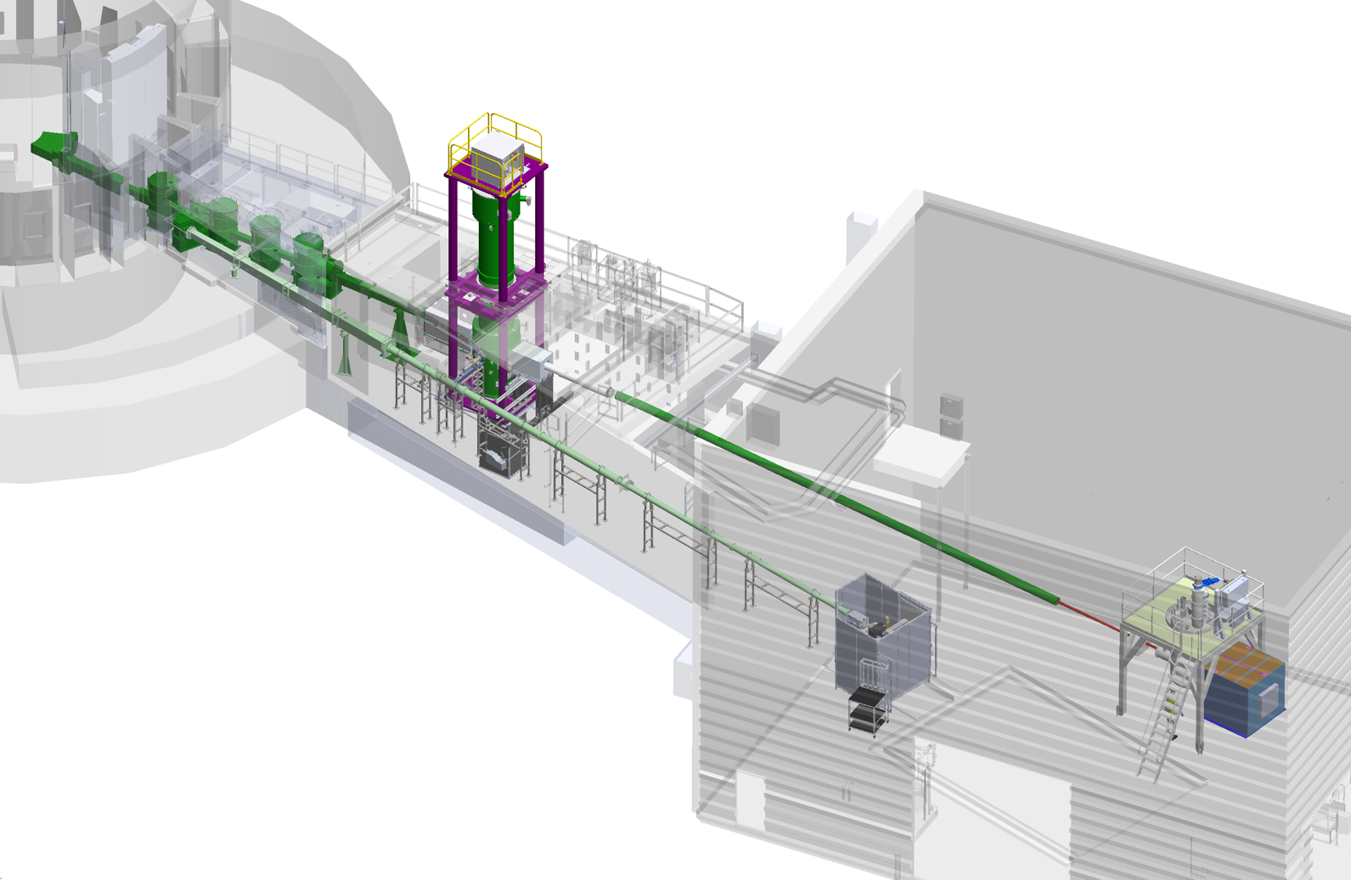
Maximizing Research Opportunities at the FnPB
BL13 at the SNS, the Fundamental neutron Physics Beamline, is a unique, high flux, cold neutron source with two beamlines.
Currently only hosting one experiment.
Solicited proposals for new experiments. Multiple proposals were received and reviewed that could be implemented with minimal investment.
With the termination of the nEDM experiment, it is proposed to make the
FnPB a user-facing facility accommodating multiple experiments.
Experiment 1
Experiment 3
Experiment 2

Slide 6
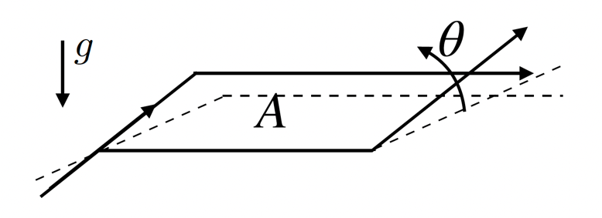
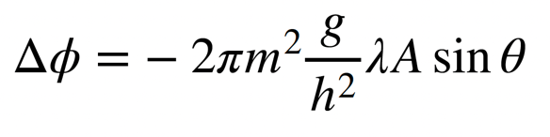

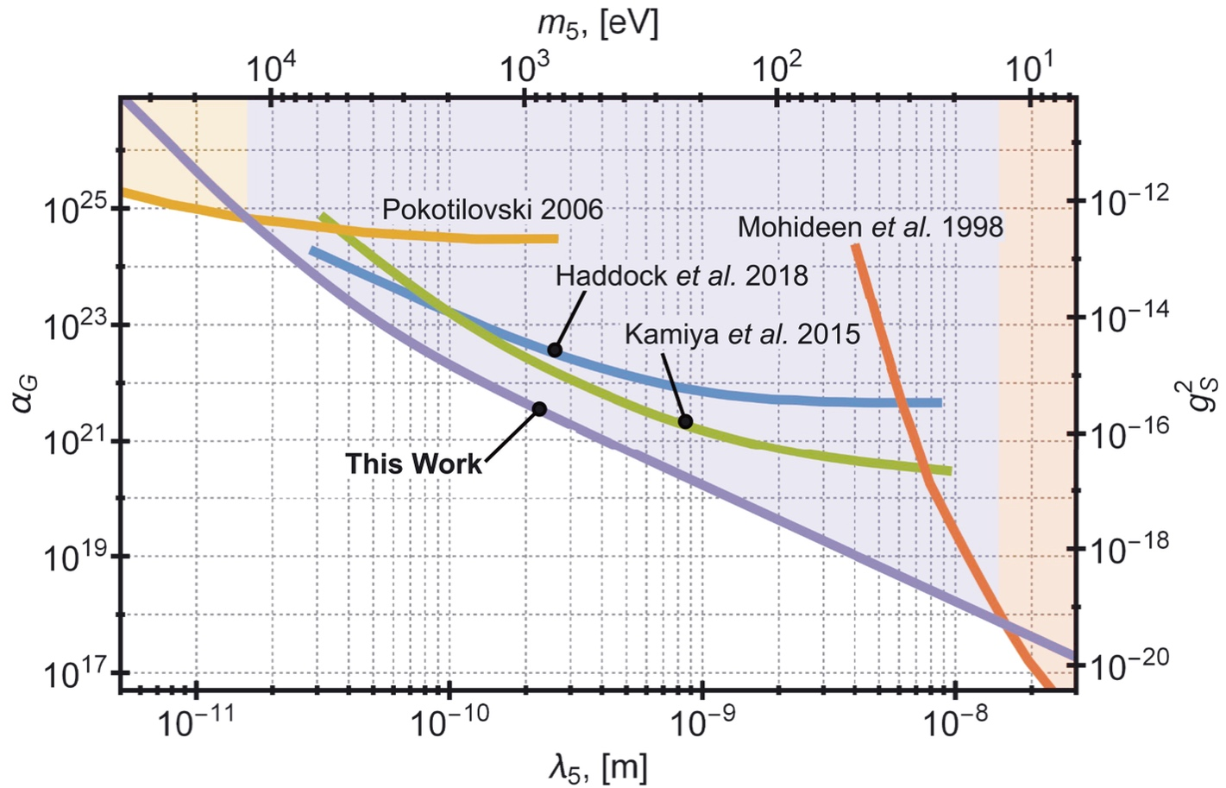
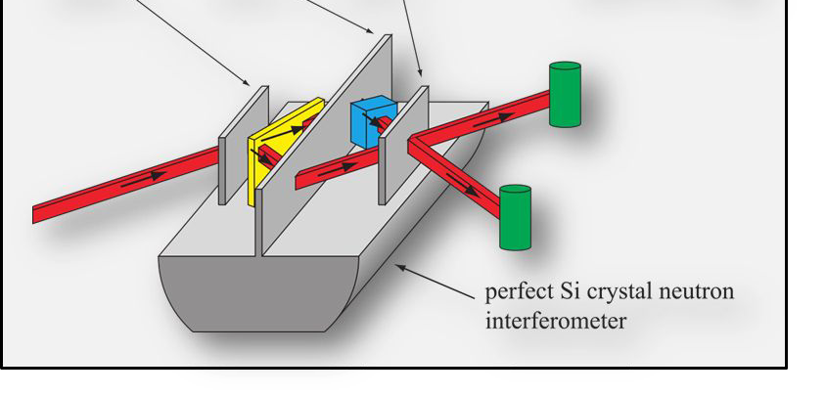
Interferometry With Neutrons
Neutron Interferometry provides a powerful probe to look for BSM Physics
Probe for:
Gravitationally-induced interactions
Nuclear interactions at low energy
CPT and Lorentz invariance, ….
Strength of Yukawa modification to gravity
Credit: M. Huber
Pendellösung Interferometry
Doi: 10.1126/science.abc2794
See: https://www.nature.com/articles/s42254-021-00298-2
https://journals.aps.org/rmp/pdf/10.1103/RevModPhys.90.025008
Penetration Depth

Slide 7
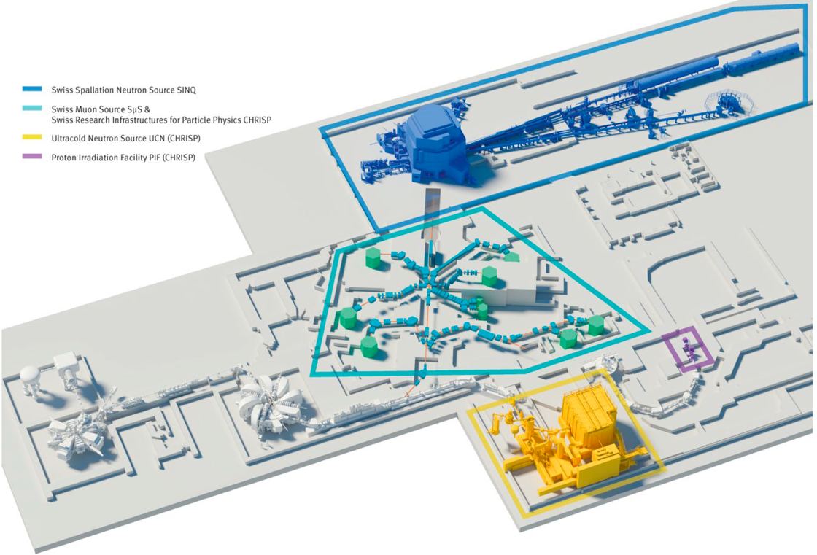
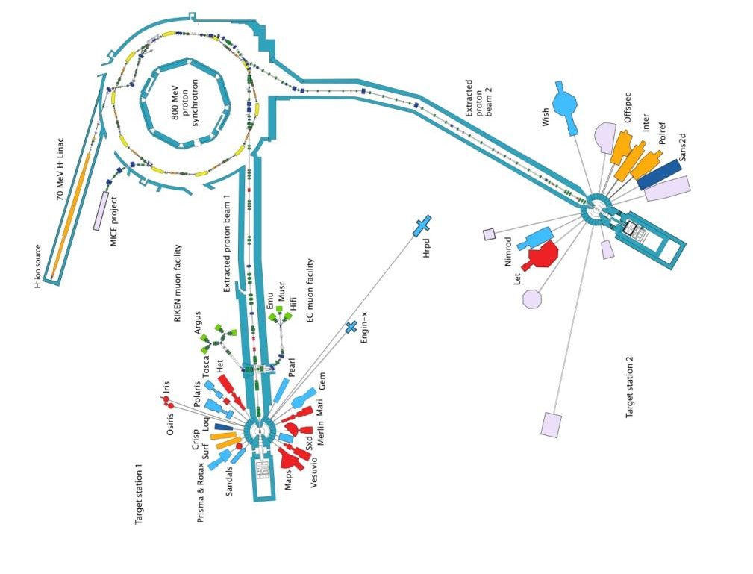
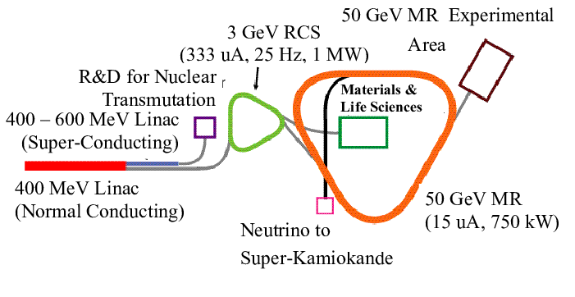
Broad Programs At Other Facilities
PSI
PSI – Switzerland:
590 MeV proton cyclotron (CW):
SμS, SINQ, UCN, Irradiation
ISIS – UK:
800 MeV synchrotron:
Two neutron targets, muons
JPARC – Japan
400 MeV Linac,
50 GeV PS:
muSR, neutrinos,
particle physics,
transmutation
JPARC
ISIS

Slide 8
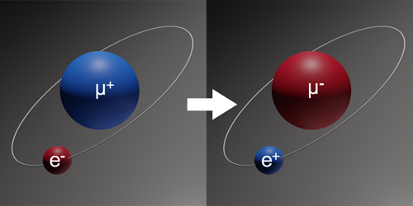
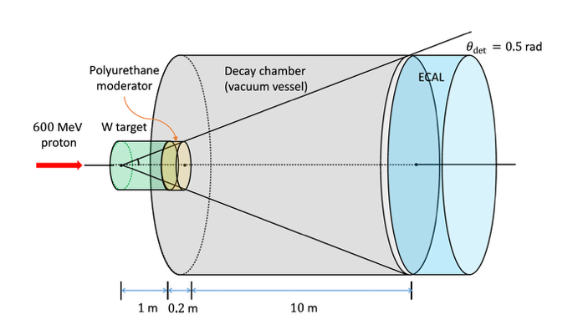
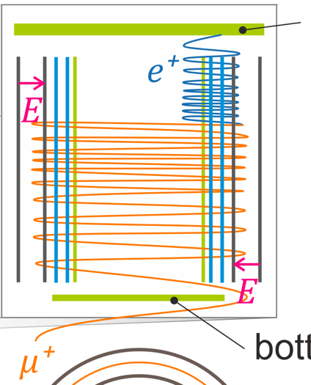
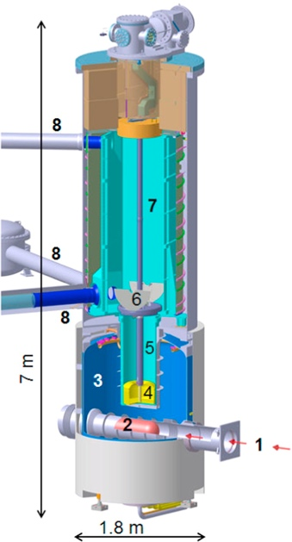
New Opportunities for Fundamental Physics at the SNS
Muonium
Dark Matter Search
Muon Properties
UCN
  Bound state of μ⁺ - e⁻.
  Muon spectroscopy for tests of QED and new physics
  Measurement of equivalence principle with anti-matter
  Muonium oscillations for Lepton Flavor Violation
  Muon anomalous magnetic moment
  Beam dump experiment to search for dark matter candidates
  Axion like particles interact through the Primakoff effect and create photons, detected in high-grained EM calorimeter
  Dedicated experiments to search for lepton flavor violation (LFV):
    μ → 3 e
    μ → e γ
    μ Ν → e Ν
  Measure muon EDM
  Search for Beyond the Standard Model physics:
    Neutron EDM
    Lifetime
    Quantum gravity
Scint.
Scint.
Riv. Nuovo Cim. 41.2 (2018)
Phys. Rev. Lett. 82 (1999)
Phys Rev. D 107, L031901 (2023)
arXiv: 2102.08838
10.1016/j.nima.2014.12.091

Slide 9
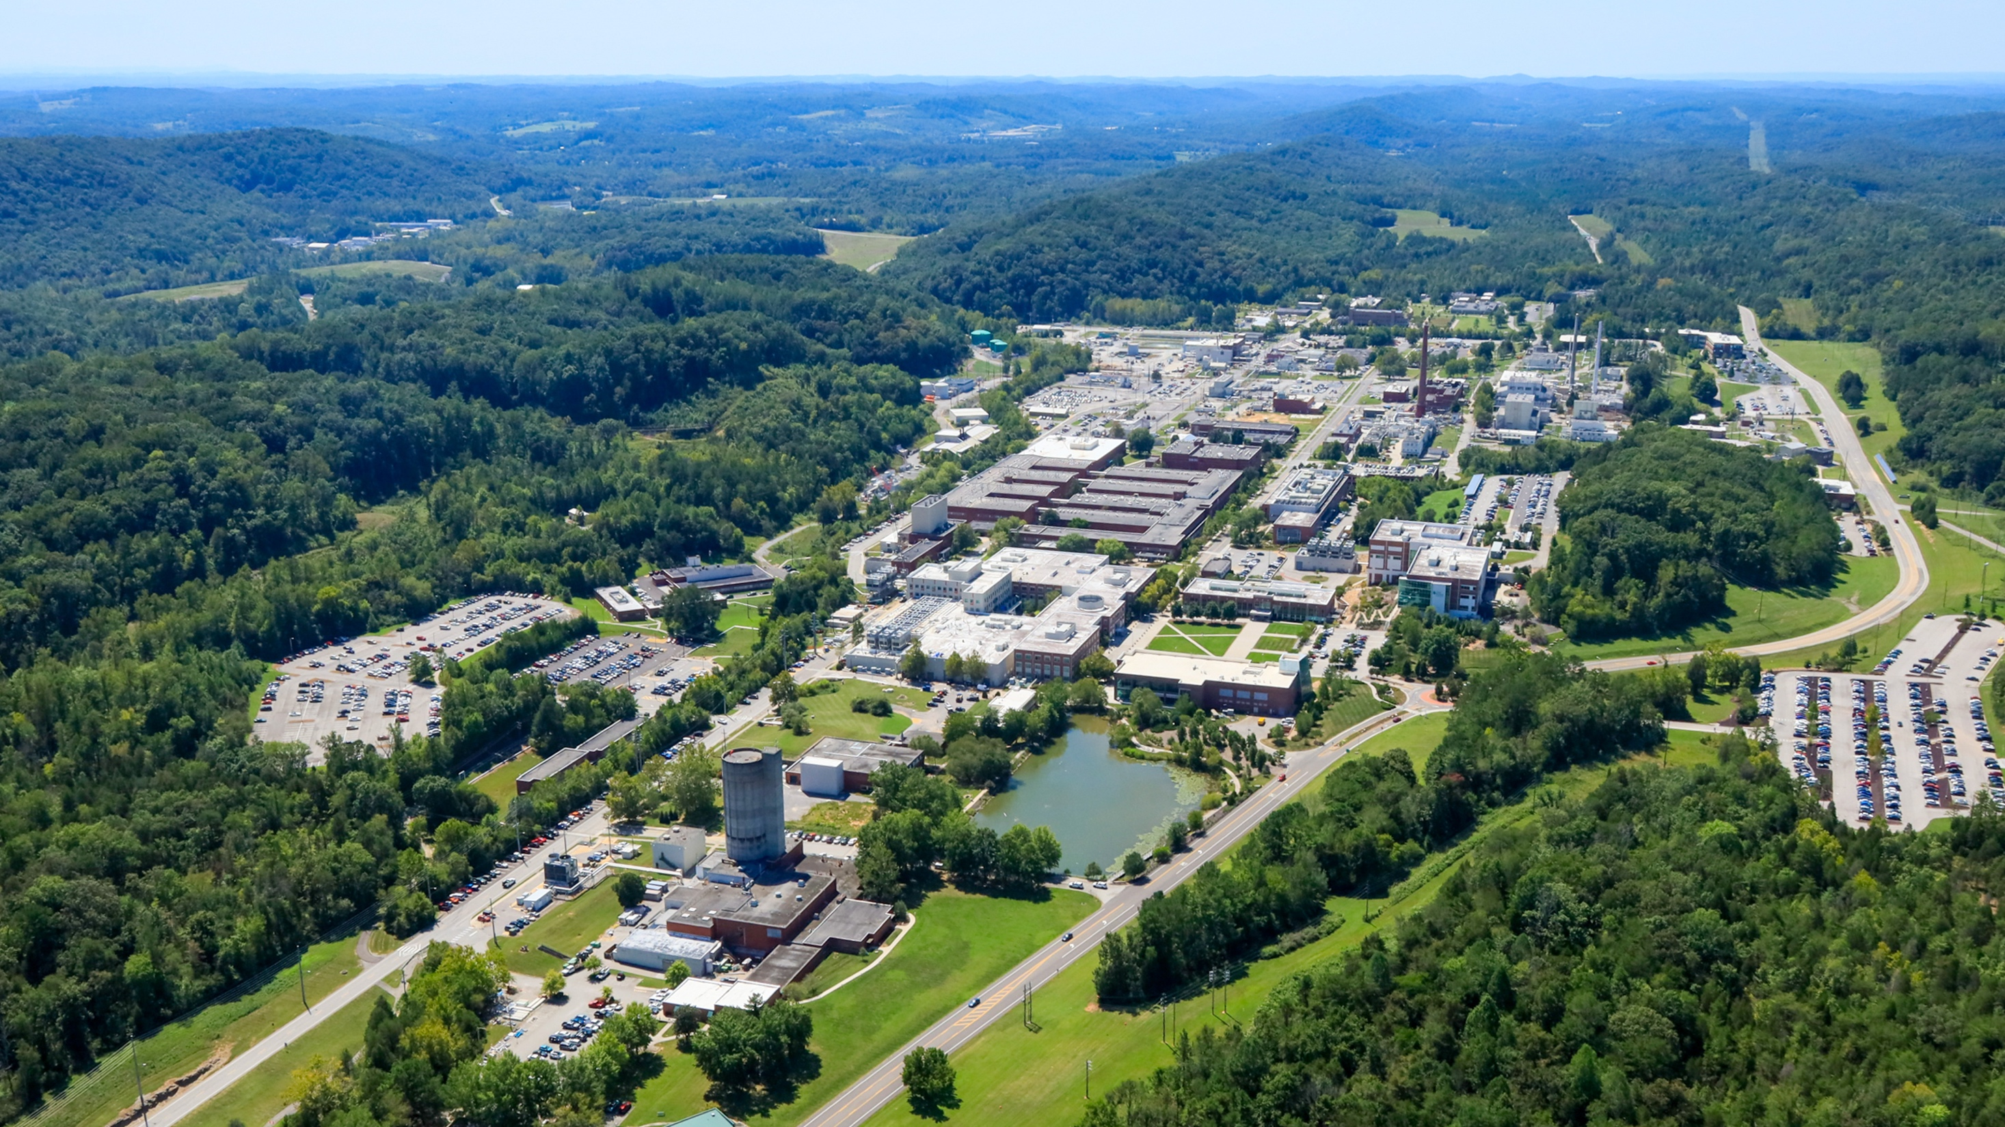

Discussion

Slide 10
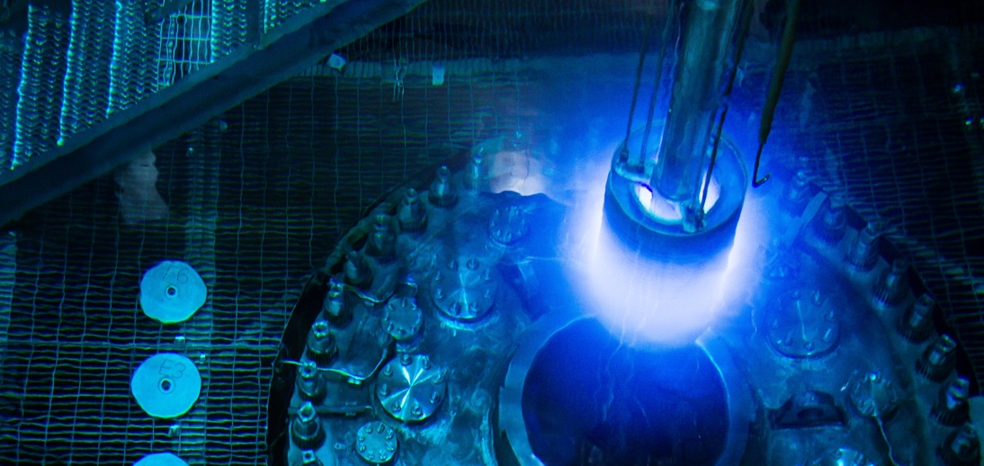
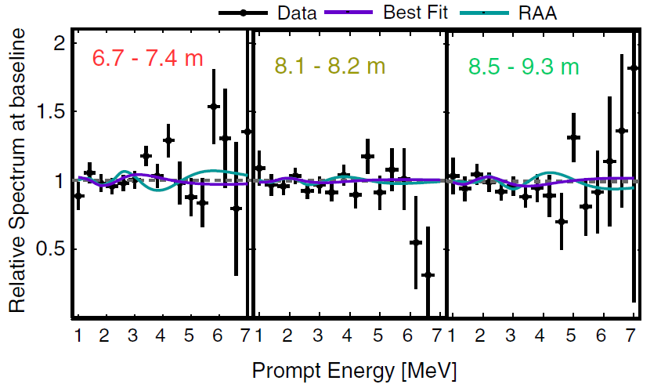
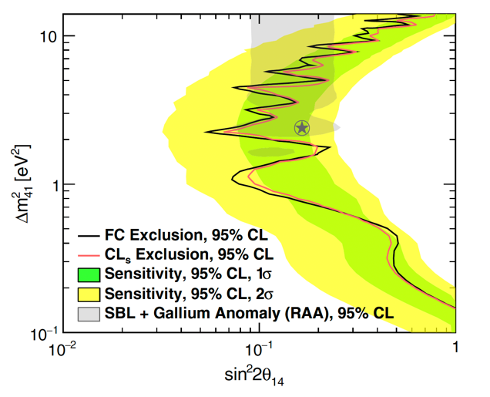
Neutrino Program at HFIR
The PROSPECT experiment demonstrated how precision detector design and segmentation can enable high-quality reactor antineutrino measurements in a challenging environment, helping establish ORNL as a leading site for low-energy neutrino detector development
High Energy and Nuclear Physics
First above-ground reactor neutrino experiment
Measurement of the absolute neutrino flux and neutrino energy spectrum
Search for sterile neutrinos
Non-proliferation applications
Also a testbed for fundamental neutron physics (e.g., the search for neutron–mirror neutron oscillations)
Powerful features of the PROSPECT detector enable sensitive searches

Slide 11
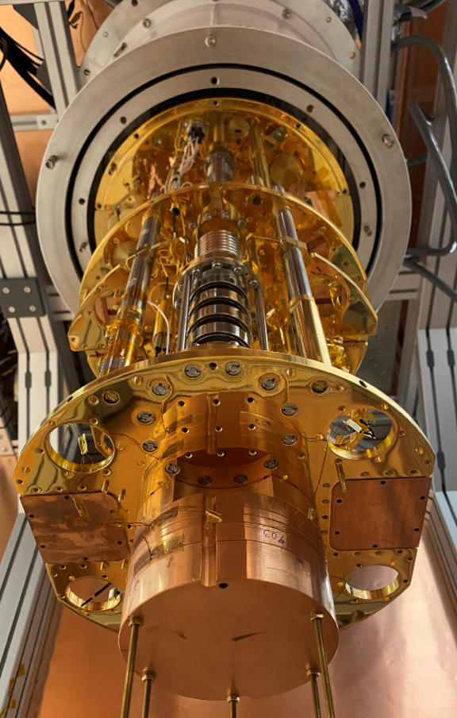
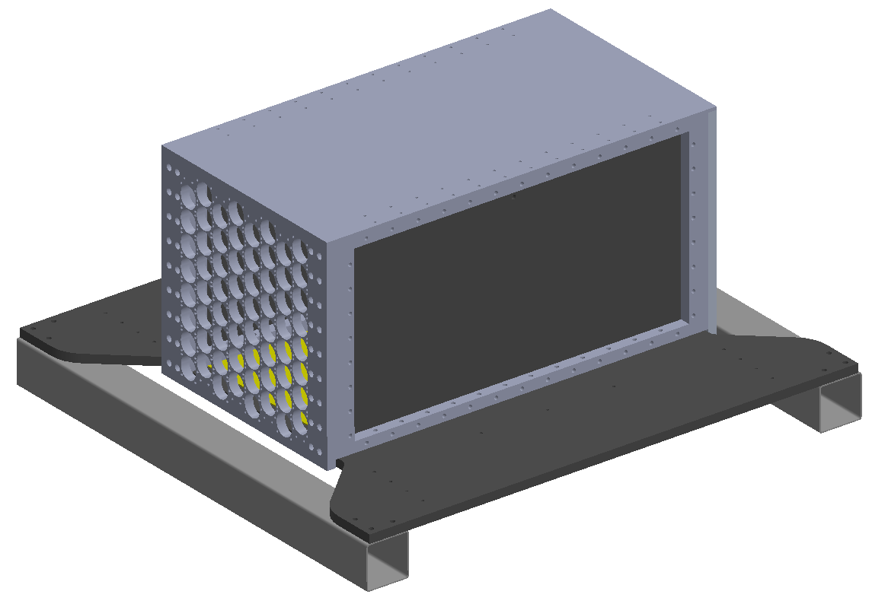
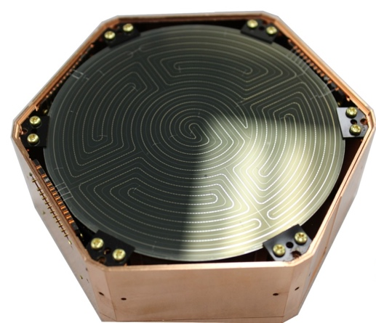
HFIR for Neutrino Physics
Development of a testbed for quantum sensors for reactor neutrino detection
Mobile Antineutrino Demonstrator:
Bolometer
Sub - 100eV ER/NR recoils from CEνNS and ALPs
Event rate ~300/kg/day
3-kg detector payload with 7-kg cryo shielding
Lead, borated rubber, water shielding
Dilution refrigerator
8x8 bars of Li-6 doped PSD plastic
~250kg active mass
Instrumented with 128 x 2” PMTs
Assembly at LLNL

Slide 12

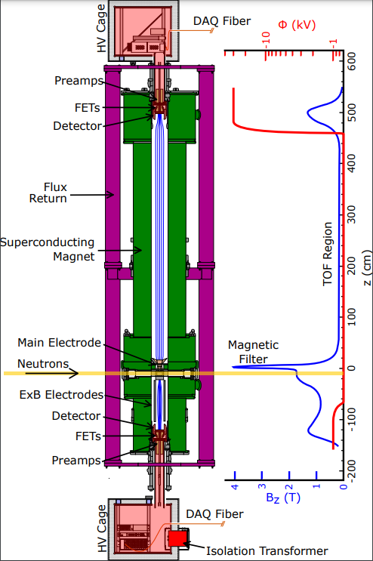

Neutron Program at SNS: Maximizing Research Opportunities at the Fundamental neutron Physics Beamline (FnPB)
BL13 at the SNS is a unique, high flux, cold neutron source with two beamlines
High Energy and Nuclear Physics
World-leading measurements on hadronic parity violation
World-leading measurement on weak decay of neutron
Search for physics beyond the Standard Model
The Nab (neutron ‘a’ and ‘b’) experiment is a high-precision free neutron beta decay experiment
‘a’ – CKM unitarity test
‘b’ – scalar/tensor coupling in weak interaction

