Slide 1
SNS Capabilities, Test station at the Linac dump
June 10, 2026 | Oak Ridge National Lab
Nicholas Evans
Accelerator Science & Technology Section Head
Notes:
Accessing Title Slide Options
The standard ORNL presentation template includes five branded title slide layouts:
Title | Standard. The preferred layout for lab-wide and general presentations. Features a default aerial photograph of the lab.
Title | Custom Image. Allows replacement of the default background with a custom full-slide image (16:9 or 4:3 landscape format).
Title | Custom Portrait Image. Supports inclusion of a custom 4:3 portrait image positioned next to the introductory text.
Title | Custom Landscape Image. Supports inclusion of a custom 16:9 landscape image positioned next to the introductory text.
Title | Text Only. Offers additional space for longer titles and multiple presenters.
Additional Lab-approved title slides specific to directorates and user facilities are available in PowerPoint under the following folders: Custom Title Slides and User Facility Templates, located in Presentation Templates.
Custom Title Slide Guidelines
Image Rights. Any custom images, graphics, or photography must be owned by ORNL or used with documented permission from the original creator or source.
Appropriate Image Use. Select images that work well with the layout. Ensure the focal point of the image is not obscured by the title text and white overlay box.
Relevance and Impact. Visuals are a key element of effective communication. Whenever possible, use imagery that enhances the message of your presentation and reflects ORNL’s mission and values.
Quality and Clarity. Use high-resolution images for clarity on large screens. Avoid overly complex or dark images that may conflict with the title text.
Text-Only Option. If no appropriate or approved imagery is available, or if imagery is not permitted for the subject matter, the Title | Text Only layout provides a clean, professional alternative.
Learn more about ORNL presentations
https://ornl.sharepoint.com/sites/Branding/SitePages/Presentations.aspx

Slide 2
The Oak Ridge Accelerator Institute – Foundational LDRD
At its inception ORAI was awarded an LDRD with two aims:
Aim 1
  Year 1: Bottom-up analysis of available options for installation of a beam test facility at the SNS.
    Q1: Exploration of potential locations for facility installation and evaluation of required modifications.
    Q2: Shielding and beam dump analysis and estimation of the beam parameter range available at each location: average and peak powers, time structure, energy, etc.
    Q3: Layout of the beam line and component count for each potential location.
    Q4: Outline the beam delivery scheme, evaluate potential impact on operations, and identify key questions to be addressed during the conceptual design phase.
Aim 2
  Year 1:
    Q2: Preliminary beamline parameters established – beamline PDR
    Q3: Optics design including diagnostics placement – beamline FDR
    Q4: Detailed magnet specifications complete, vacuum chamber designs complete – hardware FDRs, PRRs

Slide 3
The Oak Ridge Accelerator Institute – Test Station Goals
Aim 2
  Year 1:
    Q2: Preliminary beamline parameters established – beamline PDR
    Q3: Optics design including diagnostics placement – beamline FDR
    Q4: Detailed magnet specifications complete, vacuum chamber designs complete – hardware FDRs, PRRs
The high-level goals of the test station are:
Build working relationships outside of neutron science applications
  Isotope production, chip irradiation, materials testing, etc.
Provide a test-bed for proof-of-principle experiments
Bring some R&D in-house that would require travel to other facilities
Slowly introduce additional capability to figure out issues

Slide 4
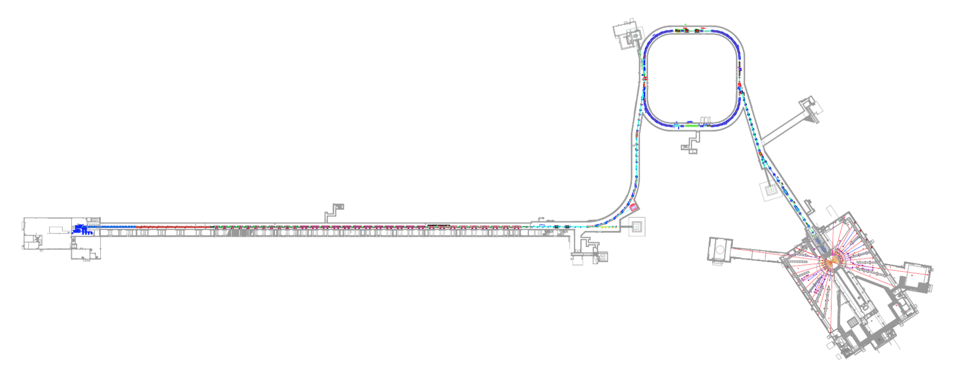
The Spallation Neutron Source Accelerator Overview
SNS was designed for 1.4 MW with future upgrades planned into the design to allow up to 2.8 MW of beam power
RFQ 2.5 MeV
CCL 186 MeV
SCL 387 MeV
SCL1000 MeV
1300 MeV
Upgrade
DTL 87 MeV
H- Ion
Source
Warm linac
Superconducting (cold) linac
Ion source produces 1 ms long pulse of H- beam at 60 pulses per second
Beam is chopped before RFQ to provide beam structure for ring
1000 mini-pulses of H⁻ beam
accelerated to 1.3 GeV or 0.91c in the linac

Slide 5
The Spallation Neutron Source Accelerator Overview
SNS was designed for 1.4 MW with future upgrades planned into the design to allow up to 2.8 MW of beam power
Protons accumulated via charge exchange injection to compress long linac pulse
Ring
High Energy Beam Transport
(HEBT)
Ring-Target
Beam Transport
(RTBT)
Target
H- Ion
Source
Warm linac
Superconducting (cold) linac
Ion source produces 1 ms long pulse of H- beam at 60 pulses per second
Beam is chopped before RFQ to provide beam structure for ring
1000 mini-pulses of H⁻ beam
accelerated to 1.3 GeV or 0.91c in the linac
700 ns pulse of 1.44 E14 protons is extracted to target 60 times a second – 33 kJ per pulse

Slide 6
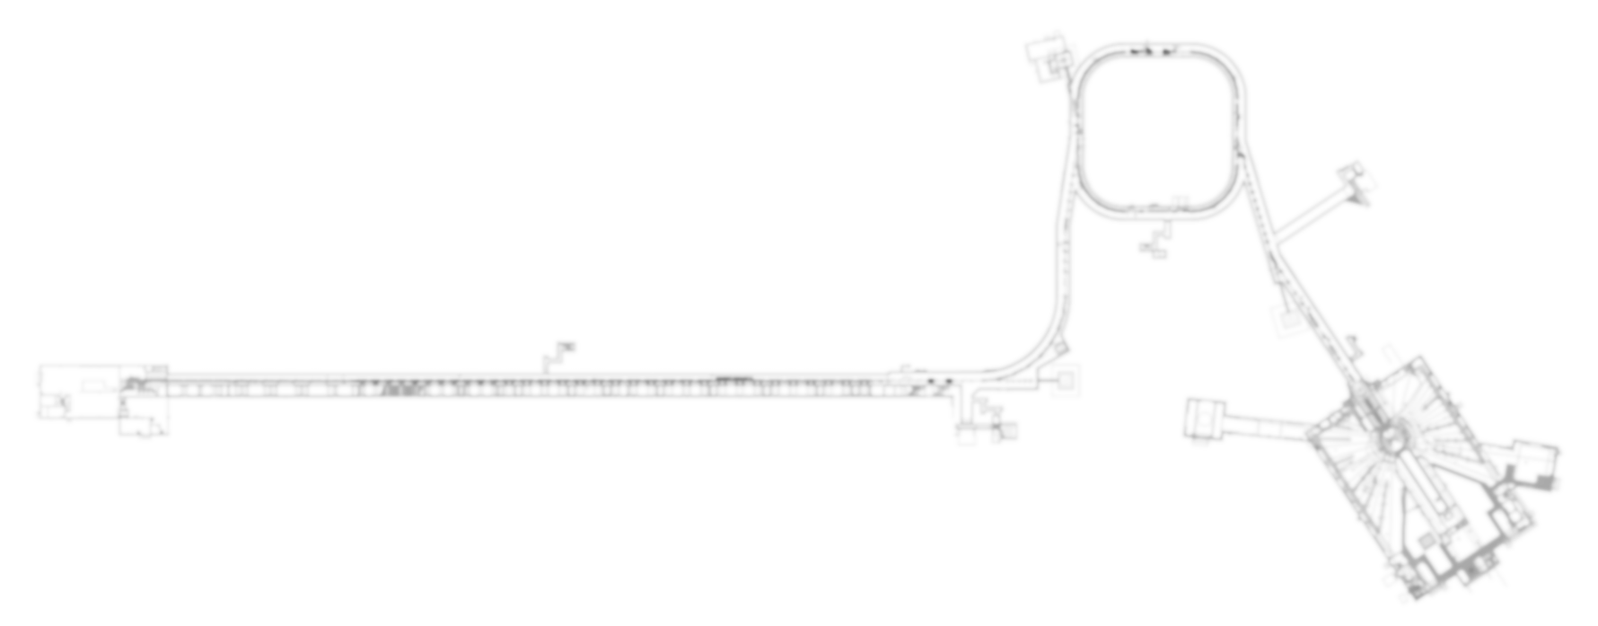
The Spallation Neutron Source Accelerator Overview
SNS was designed for 1.4 MW with future upgrades planned into the design to allow up to 2.8 MW of beam power
RFQ 2.5 MeV
CCL 186 MeV
SCL 387 MeV
SCL1000 MeV
1300 MeV
Upgrade
DTL 87 MeV
7.5 kW
Linac Dump
H- Ion
Source
Warm linac
Superconducting (cold) linac
Po

Slide 7
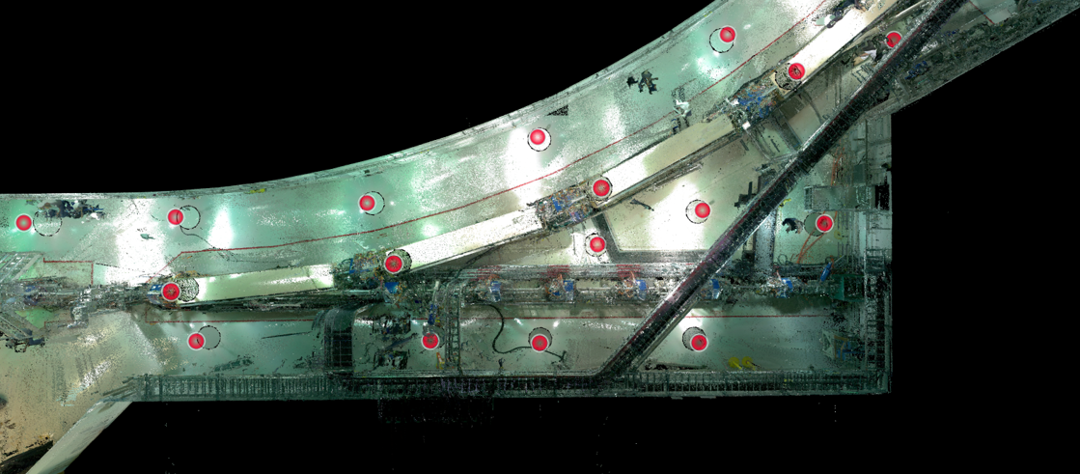
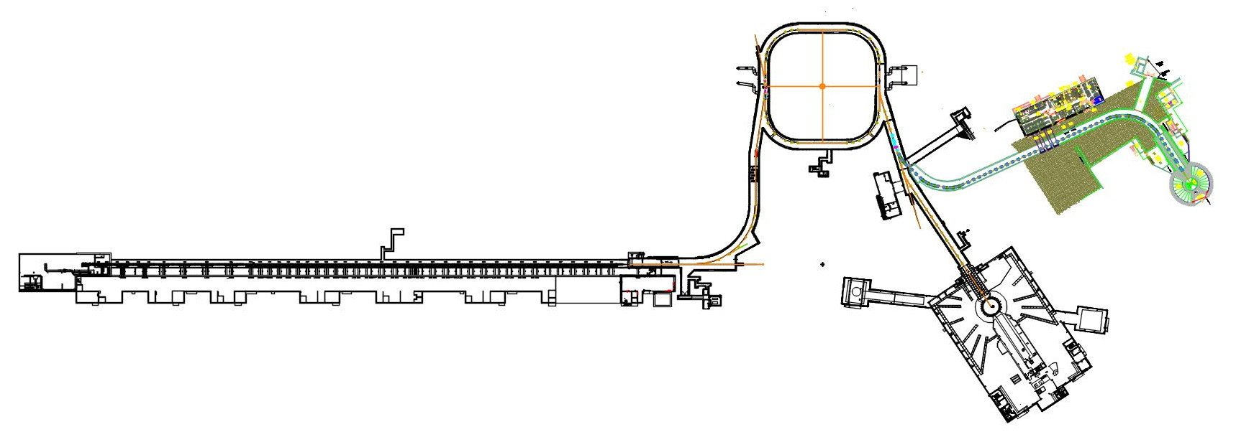
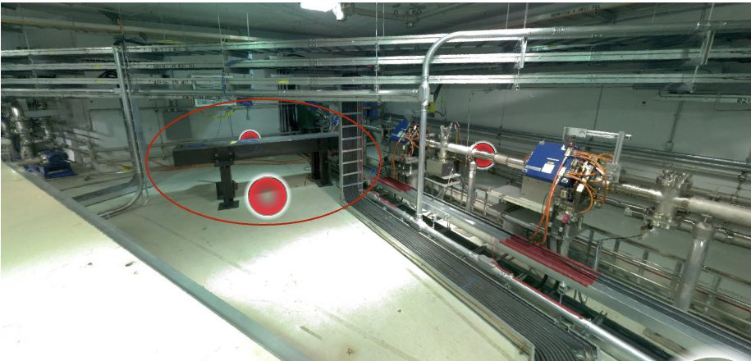
Linac Dump – Available Space
Some space available downstream of the laser for beam intercepting devices
A small-scale isotope production pilot study has been designed for this location
Potential for additional studies, but must fit footprint, including shielding
5m

Slide 8
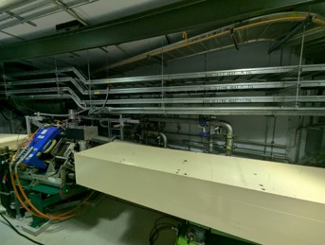
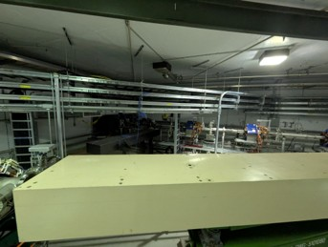
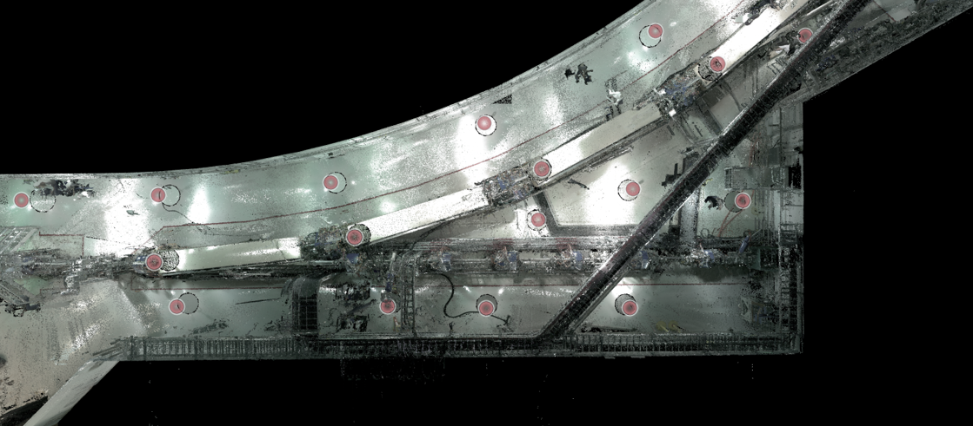
Linac Dump – Available Space
5m

Slide 9
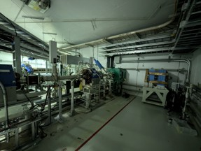
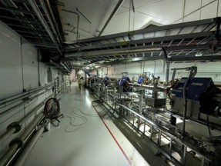
Linac Dump – Available Space
5m

Slide 10
Test Station Considerations
Beamline modifications
  Cannot impact on normal function of the dump for operations tune-up, including:
  optics, cooling, power, vacuum
Operational Impact
  No impact on operations schedule – no exceptions
  Can make use of already allocated study time, maintenance days
  Above considerations generally limit tunnel access to weekly – potentially in/out on study day ~8hrs
Power to experiments
  Limit at 7.0 kW for dump (3.36E15 protons/sec) from Operations Envelope
  Dose to experiment during study periods, with potential for bleeding small amounts of beam with laser
Cost and Schedule
  We estimate <$1M (we have shielding on hand), potentially operational in 1 year based on operations cycle

Slide 11
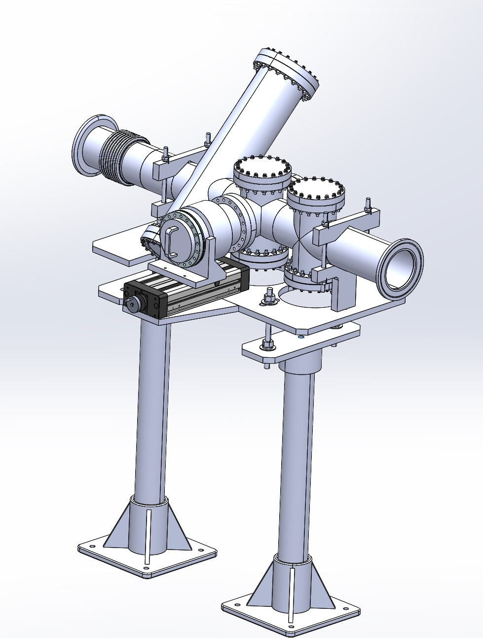
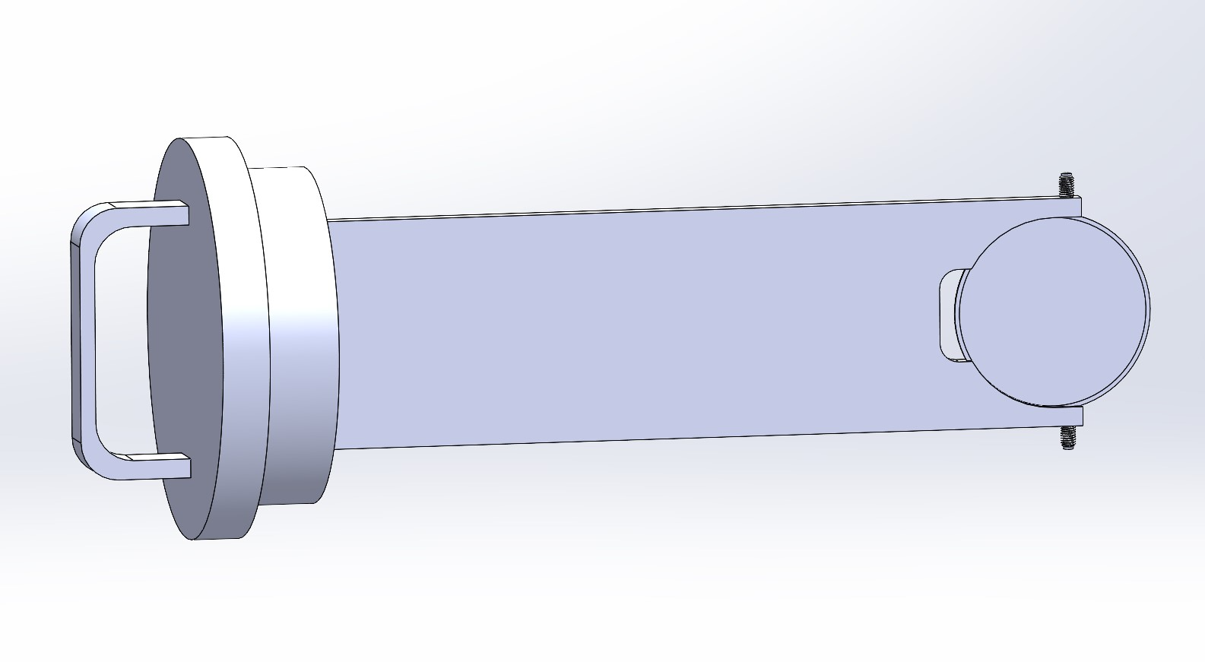
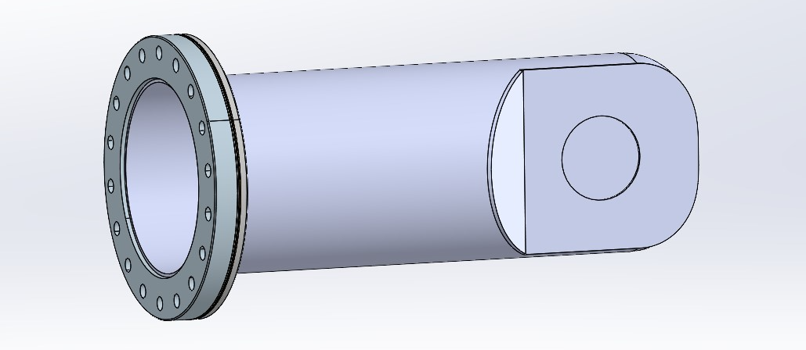
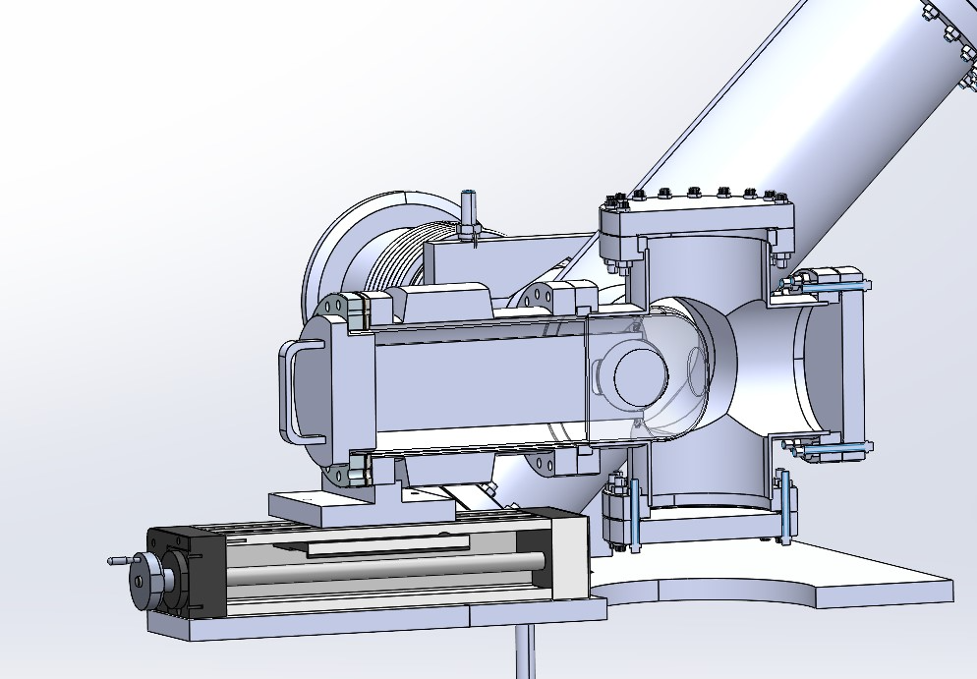
Radio Isotope Production at SNS (RIPS*) Design
Aluminum Insert
(vacuum isolation)
Sample holder
66 mm
Fit into existing beamline with minimal modification
Sample removal without breaking vacuum minimizes disruption to ops
Currently designed for manual changeout, which limits operation – we will discuss
Designed specifically for RIPS – would love to hear feedback, requests from other potential users
*See: J. Griswold Tomorrow 1:20pm

Slide 12
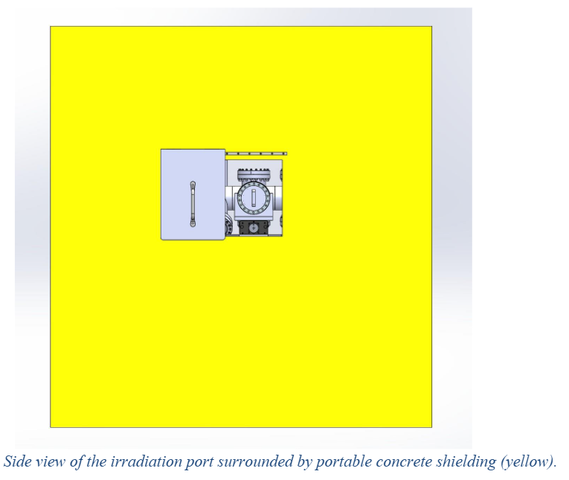
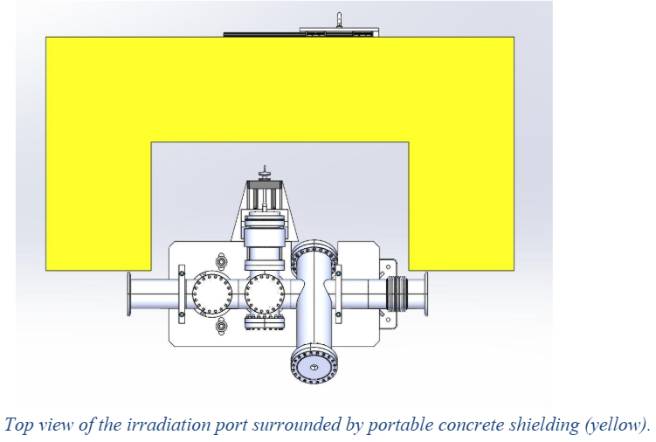
Shielding and Power
Shielding requirements depend on application – (residual rate below 10 mrem < hr at 30 cm)
In RIPS case, 46 cm concrete required for 1 kW beam on 0.25 mm target
More detailed modeling shows 7 kW* on target is possible with 130 cm shielding, reasonable assumptions on target interaction
Space is limited – more beam = more shielding = less space for test station
Top view of RIPS shielding
Aisle view of RIPS shielding
*See Yong-Joong Lee’s talk today

Slide 13
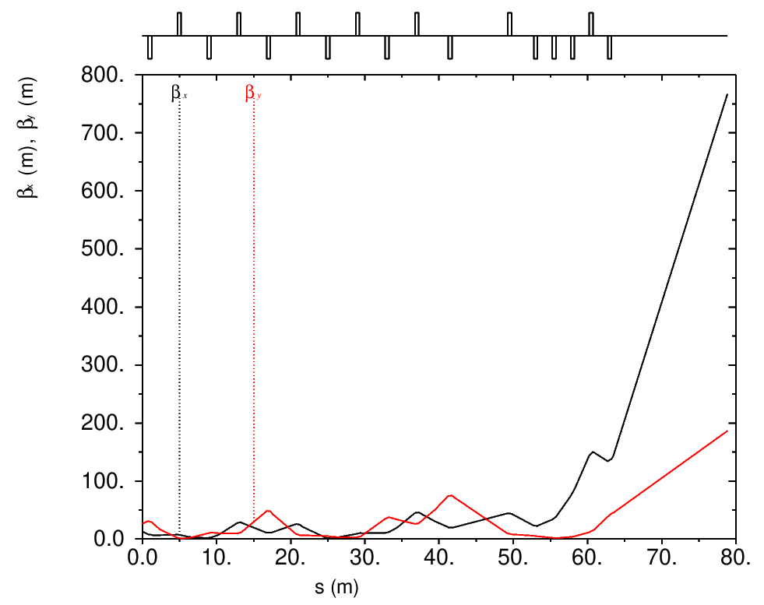
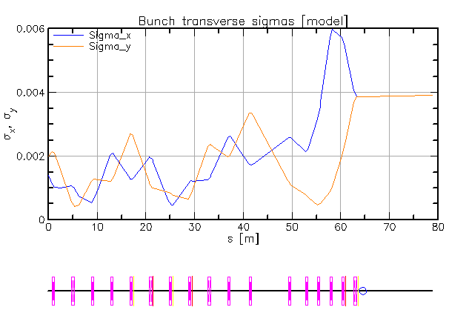
HEBT1 and LDmp Optics
Preliminary optics have been developed that require no modification to existing magnets and meet requirements for beam size at the test station
Beam size is tunable – solution shown here is 4 mm x 4 mm (aperture ~12 cm diameter in dump line)
HEBT1
LDmp
Design Optics
HEBT1
LDmp
Test Station Optics

Slide 14
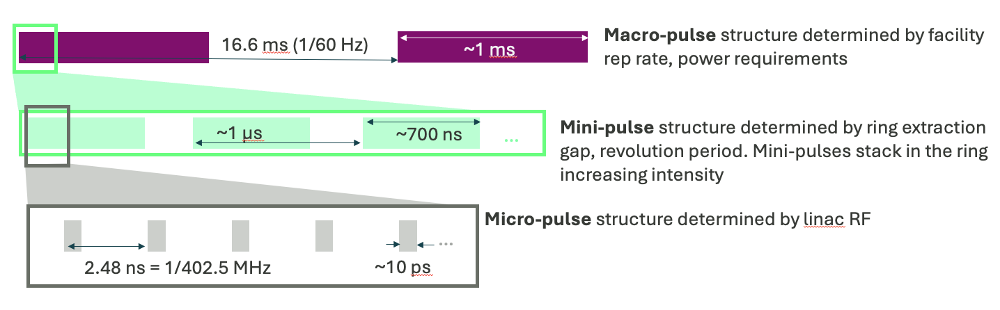
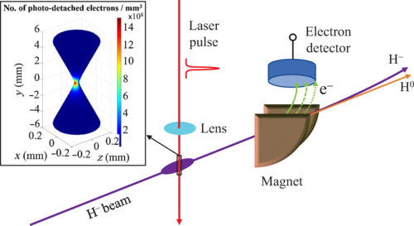
H- Neutralization – Existing Capability
Existing laser system can be used to bleed off beam from long linac pulse by neutralizing H- beam – would require additional stripping to ensure control of beam at test station
Any time structure consistent with SNS time structure would be possible during operation

Slide 15
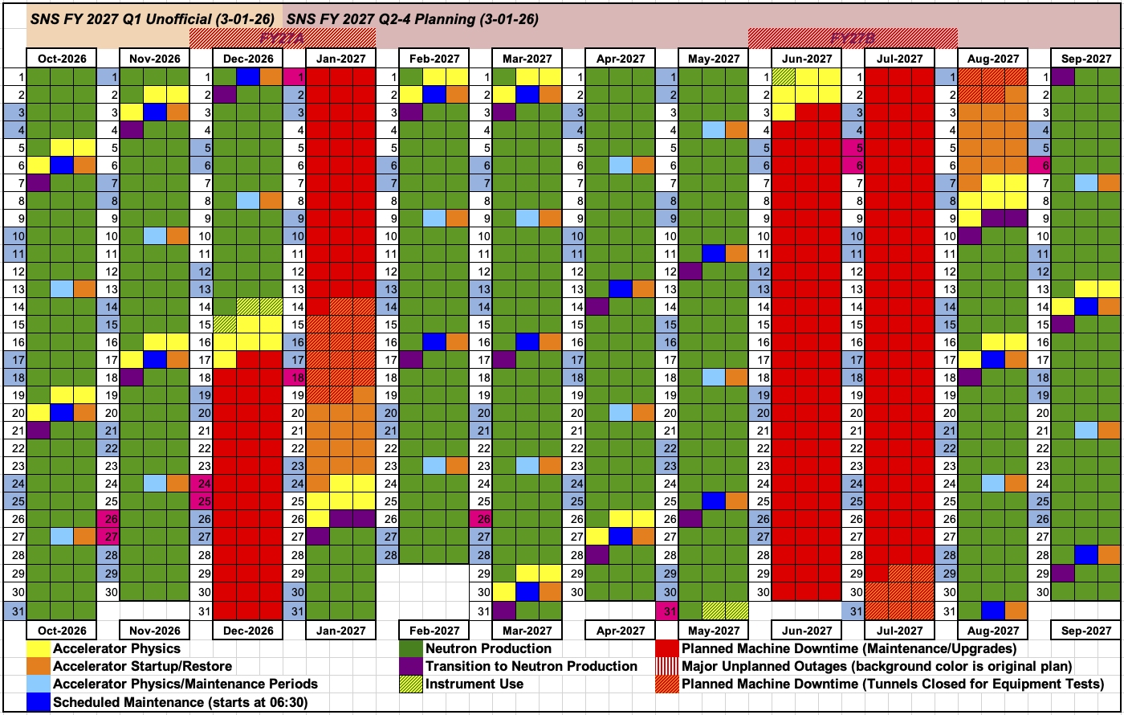
Spallation Neutron Source – Operating Schedule
SNS is working toward 5000 hrs/year of neutron production - test station cannot interfere!
Green days are for neutron production – NO ACCESS
Red days are extended outages for maintenance – Access, No beam
Blue days are bi-weekly maintenance days – Access, No beam
Yellow reserved for R&D, and machine development – Access, beam
A future upgrade to allow remote handling could change the situation

Slide 16
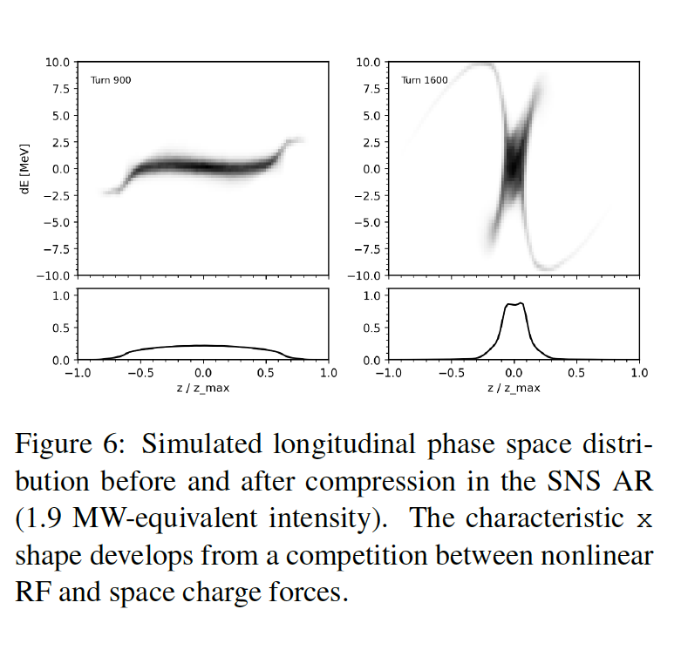
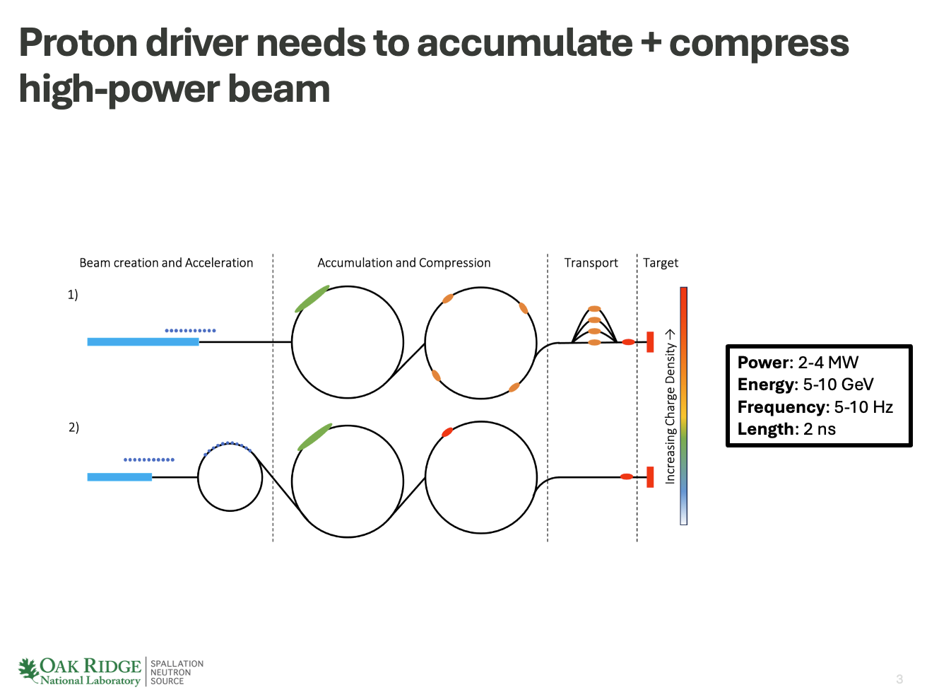
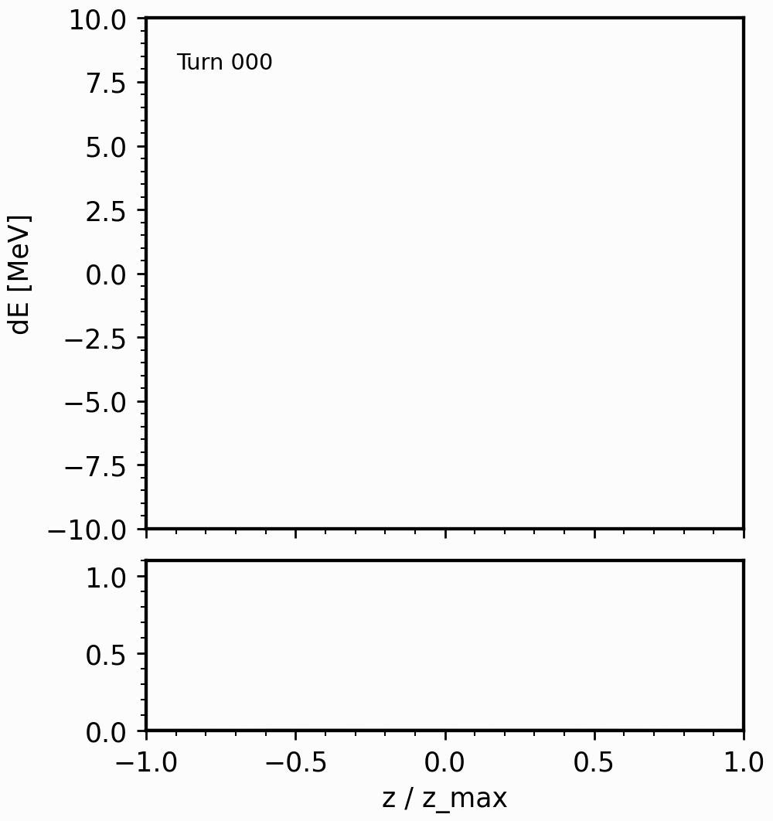

Bunch Compression for Space Charge
Physics (and Muon Collider)
Energy
Austin Hoover is investigating longitudinal bunch compression to explore space charge physics in the SNS ring
Bunch compression by a factor of 5-10 is possible with existing RF
Flexibility of energy in the SNS ring gives a wide range of space charge
Addresses a major challenge of most well-developed muon collider designs which require a SNS intensity, but 100 times shorter bunch
Time
1.3 GeV
0.8 GeV
Energy
Time

Slide 17
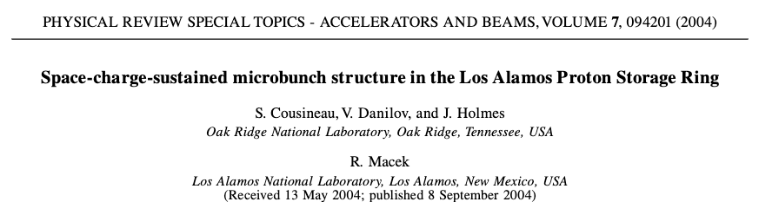
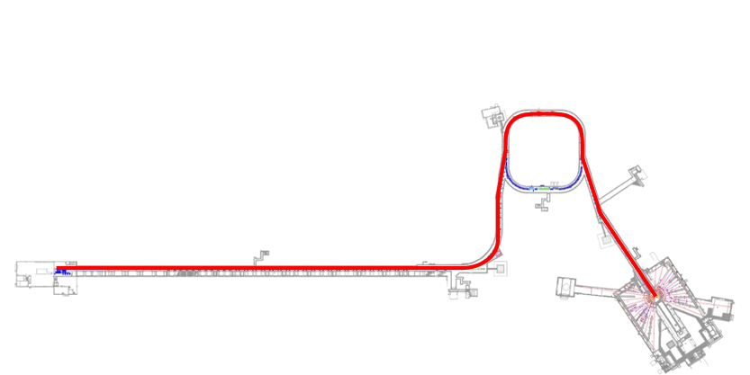
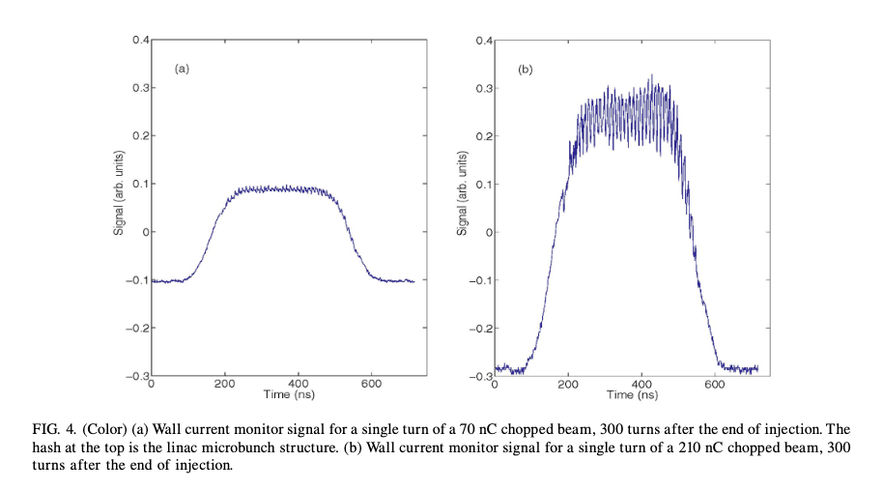
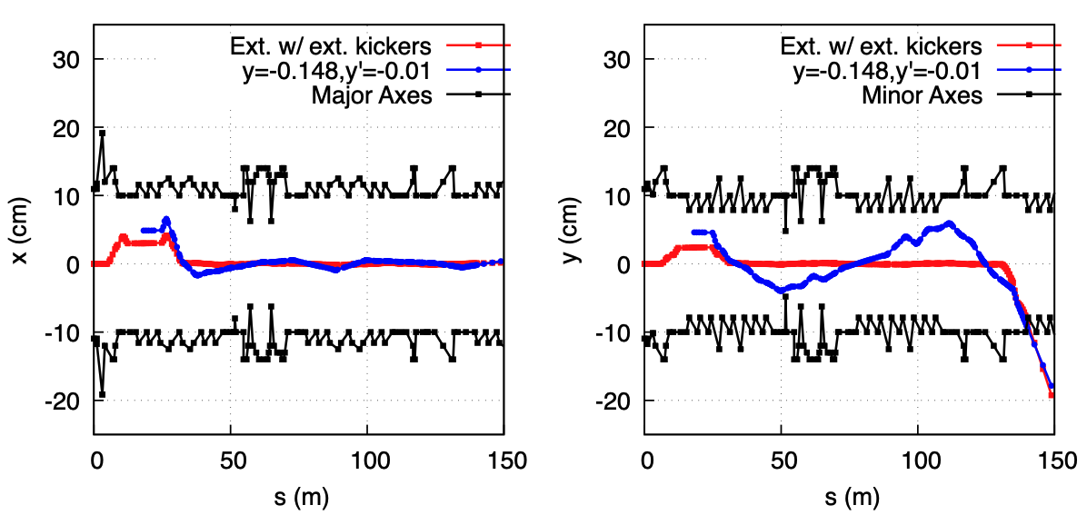
Potential for New Beam Structure
Beam trajectory for a ‘long pulse’ ring optics using existing capability
* Analysis courtesy of Fanglei Lin
Can potentially achieve 30% modulation in beam current at 402.5 MHz
This effect only requires synchronization of timing in ring and linac
First observed at PSR, but also observed at SNS
Extraction kickers can only turn on for a limited time
Can pass linac beam through ½ of the ring and extract without kickers allowing a full 1 ms long pulse – requires a special ring setup
Some minor modifications to the ring could make this a normal operating mode
Long Pulse After Ring
Microstructure beyond ring
We’ve suggested what we think could be useful – but user feedback is critical. If it could be helpful, maybe we can figure out how to do it!

Slide 18
Summary
We are planning a linac test station to explore applications beyond neutron scattering, build relationships, and provide some local R&D capability which could be operational as soon as one year from now
Up to 7 kW of beam (3.36E15 protons/sec) will be available with a tunable beam spot size (nominal 4 mm x 4 mm)
Some operational constraints may make the first iteration
Beyond ‘beam on target’ there are applications for which SNS provides an ideal test-bed
Feedback from the community is critical to getting all that we can out of the linac test station and future high-power applications

Slide 19
END

Slide 20

Isotope LDRD Shielding Concept
The dose to workers to be limited to 10 $mrem⋅{hr}^{−1}$ at 30 cm distance from the outside shielding surfaces after a day of cool down time.
1 kW 1.3 GeV proton beam (16.7 J/pulse at 60 Hz) limited by mechanical stresses in the target.
46-cm thick portable concrete shielding with a slide door made of 316L stainless steel.

Slide 21
Beam Dumps and Limits
 | Avg. Power
Linac | 7.5 kW
Momentum | 2.5 kW
Injection | 150 kW
Extraction | 7.5 kW
First Target | 2.1 MW
Inj.
RTST Stub
Mom.
Ext
Linac
First Target
*Design values, OE is slightly lower

